Slide 1
MODIS Atmosphere Product Collection 7 (C7):
Summary of Plans/Status
Cloud Mask, Cloud Top, Optical/Microphysical Properties: S. Platnick¹, K. Meyer¹, G. Wind^{2,1}, N. Amarasinghe^{2,1}, C. Wang^{3,1}, C. Peterson⁴, E. Borbas⁵, R. Holz⁵, P. Veglio⁵, et al.
Aerosol DT: R. Levy¹, V. Sawyer^{2,1}, S. Mattoo^{2,1}, et al.
Aerosol DB: C. Hsu¹, V. Kim⁶, J. Lee⁶, et al.
Clear Sky: E. Borbas⁵
Atmosphere Team Level-3: P. Hubanks^{7,1}, S. Platnick¹, K. Meyer¹
¹NASA GSFC, ²SSAI, ³GESTAR/UMBC, ⁴ORAU, ⁵U. Wisconsin/SSEC/CIMMS, ⁶ESSIC/UMCP, ⁷ADNET
Atmo. C7, MODIS/VIIRS STM, May. 2023

Slide 2
C7 Atmosphere Team L3: MOD/MYD08
New algorithm based on A-SIPS Yori software package to improve flexibility/maintenance.
Provides scalar/multi-dimensional statistics consistent with current MOD/MYD08
Change from C6.1: separate L3 daily and monthly product files for each L2 Atmosphere science product (e.g., cloud, aerosol, etc.). Discontinue 8-day aggregation?
NetCDF-4 with same internal variable formatting as CLDPROP_L3
Initial work started in spring 2020. In testing in MODAPS for C7 cloud products, recently were able to scale up for more efficient processing. Code for aerosol and clear sky products in development.
See Paul Hubanks et al. poster
Atmo. C7, MODIS/VIIRS STM, May. 2023
Notes:
Yori: Python

Slide 3
C7 Clouds: MOD/MYD06 Optical and 1km Cloud Top
Major algorithm updates
Approach: Leverage common science modules with CLDMSK/CLDPROP v2 products to improve maintainability, science.
New algorithms (ROSES 2017) with some science testing started in MODAPS
IR Optimal Estimation (IROE) for 1km cloud-top height and ice cloud optical thickness/particle effective size retrievals [Wang et al., 2016a,b], old version. Parallel/updated testing at A-SIPS.
Pixel-level radiative fluxes (RRTMG code). Parallel testing at A-SIPS.
1.38µm cirrus cloud optical thickness retrievals [Meyer & Platnick, 2010]
New algorithm to be integrated by MODAPS
Random Forest cloud phase [Wang et al., 2020]. Latest version of code sent to SDST (STIG) a couple of months ago. Parallel testing at A-SIPS for eventual integration into CLDPROP.
Experimental efforts to be evaluated
Improved retrieval failure metric (RFM): extended liquid CER valid range (4-50µm)
High-resolution 500m optical property retrievals
Cloud forward radiative model: updated liquid refractive index datasets for consistency with CLDPROP [Platnick et al., 2020] currently under testing.
Atmo. C7, MODIS/VIIRS STM, May. 2023

Slide 4
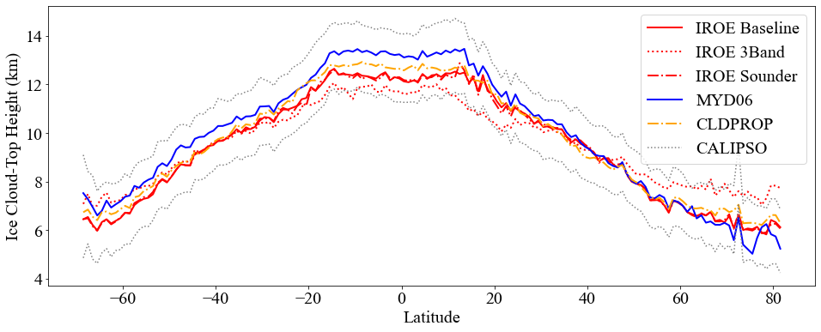
C7 Clouds: MOD/MYD06 Optical and 1km Cloud Top
See Chenxi Wang et al. poster
Cloud-top 1km properties algorithm (IROE) that also provides day/night ice cloud optical properties and enables leveraging AIRS and CrIS sounder absorption channels.
See Colten Peterson et al.
surface flux evaluation poster
New pixel-level SW and LW broadband radiative flux calculations (TOA, sfc) using cloud property retrievals as input and GEOS-IT (incl. aerosol information needed to characterize optical properties for clear sky calculations).
Atmo. C7, MODIS/VIIRS STM, May. 2023
Notes:
Advertisement

Slide 5
C7 Clouds: MOD/MYD06 Optical and 1km Cloud Top
Other algorithm updates
Transition to GEOS-IT atmospheric profile and snow cover ancillary dataset. Available for testing.
NetCDF-4 file format (all Atmosphere products)
Improved pixel-level uncertainties
Updated atmospheric corrections
Various QA updates under consideration:
Clear sky restoral and multilayer flag algorithm updates
Improved metadata descriptions and status flags
Atmo. C7, MODIS/VIIRS STM, May. 2023

Slide 6
C7 Clouds: MOD/MYD06 5km Cloud Top
Transition to GEOS-IT atmospheric profile and snow cover ancillary dataset
Eliminate the need for NSIDC NISE and NOAA Optimum Interpolation SST.
Reduce blockiness due to the low spatial resolution of ancillary data (atmospheric profiles)
QA updates:
Lower confidence level for high (> 900 hPa) CTP (CTH) values when Cloud Mask indicates cloudy or probably cloudy.
C7 Clouds: MOD/MYD35 Cloud Mask
MOD35 will be replaced with continuity algorithm (MVCM), including updated reflectance tests.
Transition to GEOS-IT atmospheric profile and snow cover ancillary dataset
Update of night ocean and snow fraction thresholds for GEOS-IT
Updates related to Terra Printed Wire Assembly (PWA) failures
Atmo. C7, MODIS/VIIRS STM, May. 2023

Slide 7
C7 Aerosol Deep Blue (DB): MOD/MYD04
C7 algorithm based on VIIRS DB v2 algorithm for consistency between sensors
C7 algorithm will no longer be dependent on PGE toolkits. (Same for Dark Target)
MOD/MYD04 L2 will have different SDS structure compared to C6.1
Initial draft of the C7 DB science codes will be ready before the end of 2023
A long-term record of C7 L1b data is necessary for algorithm development and any potential additional calibration adjustment. (Same for Dark Target)
Atmo. C7, MODIS/VIIRS STM, May. 2023

Slide 8
C7 Aerosol Dark Target (DT): MOD/MYD04
MODIS C7 algorithm is based on team’s MEaSUREs “DT-Package” that allows for consistency between sensors.
MODAPS has shown they can run the DT-Package code, with outputs
10 km product: will have different SDS structure (separate geolocation and geophysical) compared to C6.1, although DT variable names will be identical. Note: case conventions are consistent with VIIRS (e.g., “Solar_Zenith” versus “solar_zenith”).
Discussing with DB whether to keep the same (e.g., NDVI-based) merge of DT/DB in the MOD04_L2 product or make updates.
3 km product (MxD04_3K): also use the DT-Package, with major update that scan lines will be re-ordered monotonically by latitude to mitigates bow-tie.
Anticipate a few science updates that have been tested, but not implemented in the current algorithm. Recently concentrating on MEaSUREs (GEO) and VIIRS (v2) processing but need to circle back to C7 science.
Atmo. C7, MODIS/VIIRS STM, May. 2023

Slide 9
C7 Clear Sky: MOD/MYD07 and 05
MOD/MYD07 – Atmosphere Profiles
Transition to GEOS-IT form GDAS
Update SRF shifts and detector config files after the C7 L1B data processing*
Update regcoefs (format from bin to NetCDF4) after the C7 L1B data processing*
Update training data with the latest Emissivity Atlas (CAMEL V3)
Small bug fixes with units, top layers of moisture profile, the inversion over ice etc.
QA updates for inversions over ice, Terra/TOZ (due to the B30 issue)
MOD/MYDDS – Destriping Algorithm
Update configuration files after the C7 L1B data processing*
MOD/MYD85 – Clear Sky Bias Algorithm
Transition to GEOS-IT.
*involves the delivery of two text/NetCDF4 files
Atmo. C7, MODIS/VIIRS STM, May. 2023

Slide 10
C7 Atmosphere Team – Looking Forward
C7 (cloud team) science testing turnaround has slowed over past couple of years. Do we have sufficient SDST personnel to engage both the Atmosphere and Land algorithm teams? If not, how are priorities determined?
Capability of MODAPS to support C7 reprocessing once C7 L2+ code is finalized?
C7 L1B testing/evaluation in process.
With SDST help, successfully created alternative to OISST (for C6.1 forward processing, C7 will use GEOS-IT); NSIDC NISE likely to be continued through MODIS lifetime!
Change to Ubuntu and GitLab over last couple of years has been a challenge.
Code delivery/testing in GitLab environment, creation of unit tests, remains problematic.
Was the move to GitLab worth the effort (e.g., improve algorithm delivery productivity/tracking) given that this is the last major Collection update for Atmospheres?
Specific team tech. issues:
Usability of Windhoek (team machine), CEPH buckets (open-source storage solution), etc.
U. Wisconsin: Local machine no longer viable to support PGEs. User account on MODAPS or Windhoek would be very beneficial to help solve technical issues with being outside the firewall. Request from Nov. 2021.
Atmo. C7, MODIS/VIIRS STM, May. 2023

