Slide 1
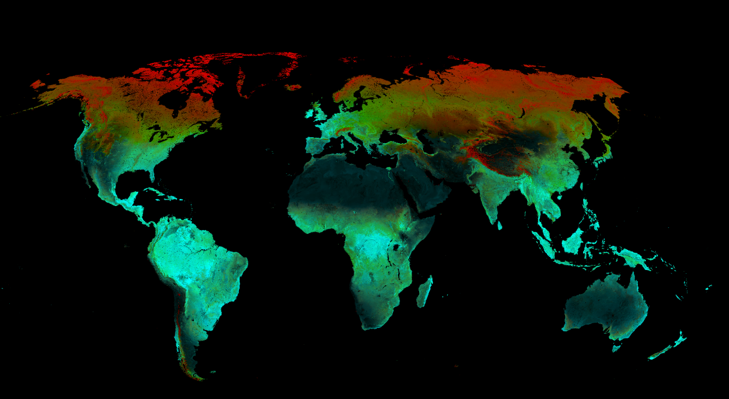
The Dynamic Habitat Indices from Terra, Aqua, Suomi NPP and JPSS data for biodiversity science and conservation
Volker C. Radeloff, Duanyang Liu, University of Wisconsin-Madison
E. Silveira, E. Razenkova, A. M. Pidgeon, N. Coops, D. Gudex-Cross, M. Hobi, and A. Ives

Slide 2
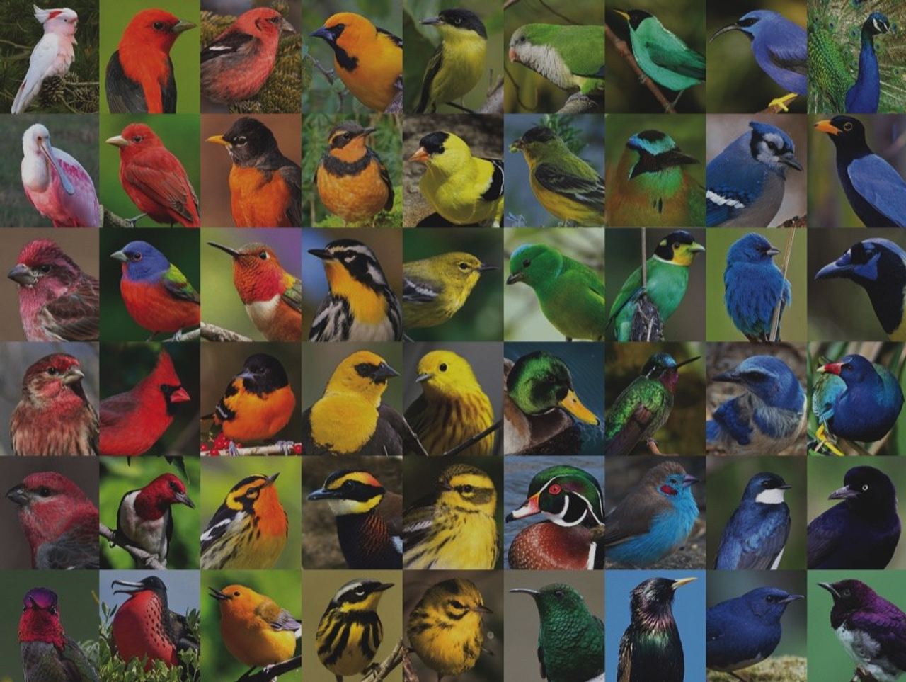
Introduction

Slide 3
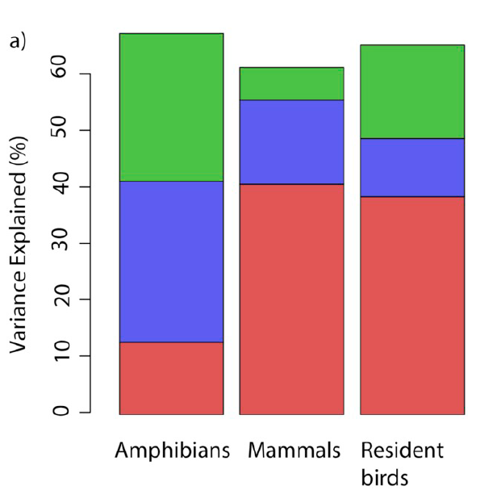
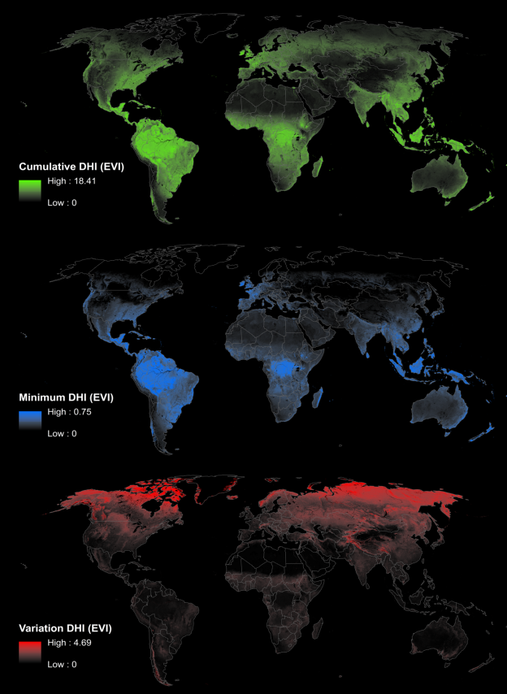
Introduction
Ecology |  | DHIs
Available energy hypothesis
Environmental stress hypothesis
Environmental variability hypothesis
Radeloff, et al., 2019, RSE

Slide 4
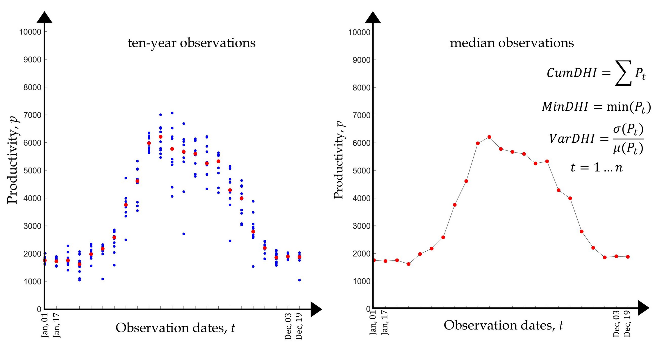
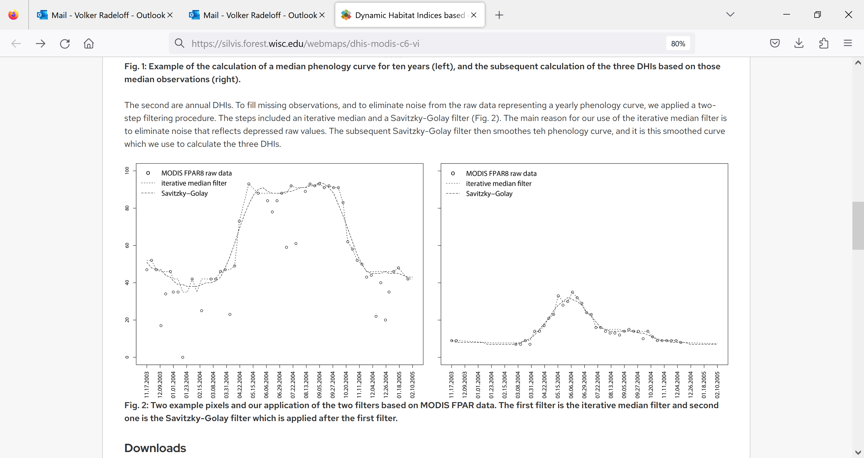
Introduction
Composite & annual DHIs from MODIS and VIIRS
Radeloff, et al., 2019, RSE

Slide 5
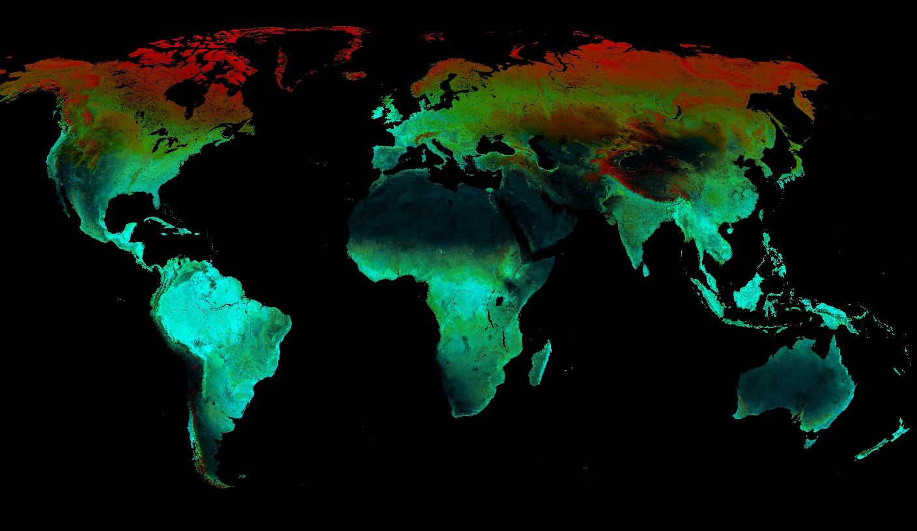

Introduction
Var
Min
Cum
VIIRS 2013-22 EVI DHIs
Notes:
500 m EVI 2013-2022

Slide 6
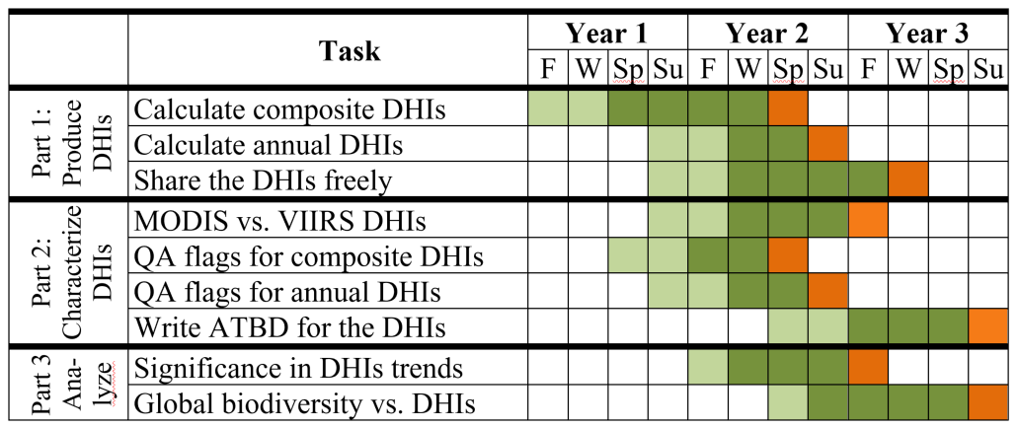
Product status
100% Done
66% Done
75% Done
75% Done
75% Done
50% Done
10% Done
10% Done
75% Done

Slide 7
Product status
Composite & annual DHIs from MODIS and VIIRS
 | Vegetation index | Resolutions | Time span
MODIS Collection 6.1 Aqua & MODIS Collection 6.1 Terra | NDVI | 250/500/100m, 16-day | 2003-2017
 |  |  | 2018-2022
 |  |  | 2013-2022
 |  |  | 2003-2022
 | EVI | 250/500/100m, 16-day | 2003-2017
 |  |  | 2018-2022
 |  |  | 2013-2022
 |  |  | 2003-2022
 | LAI | 500m, 8-day | 2003-2017
 |  |  | 2018-2022
 |  |  | 2013-2022
 |  |  | 2003-2022
 | fPAR | 500m, 8-day | 2003-2017
 |  |  | 2018-2022
 |  |  | 2013-2022
 |  |  | 2003-2022
 | GPP | 500m, 8-day | 2003-2017
 |  |  | 2018-2022
 |  |  | 2013-2022
 |  |  | 2003-2022
 | Vegetation index | Resolutions | Time span
VIIRS | NDVI | 500m, 16-day | 2018-2022
 |  |  | 2013-2022
 | EVI | 500m, 16-day | 2018-2022
 |  |  | 2013-2022
 | EVI2 | 500m, 16-day | 2018-2022
 |  |  | 2013-2022
 | LAI | 500m, 16-day | 2018-2022
 |  |  | 2013-2022
 | fPAR | 500m, 16-day | 2018-2022
 |  |  | 2013-2022

Slide 8
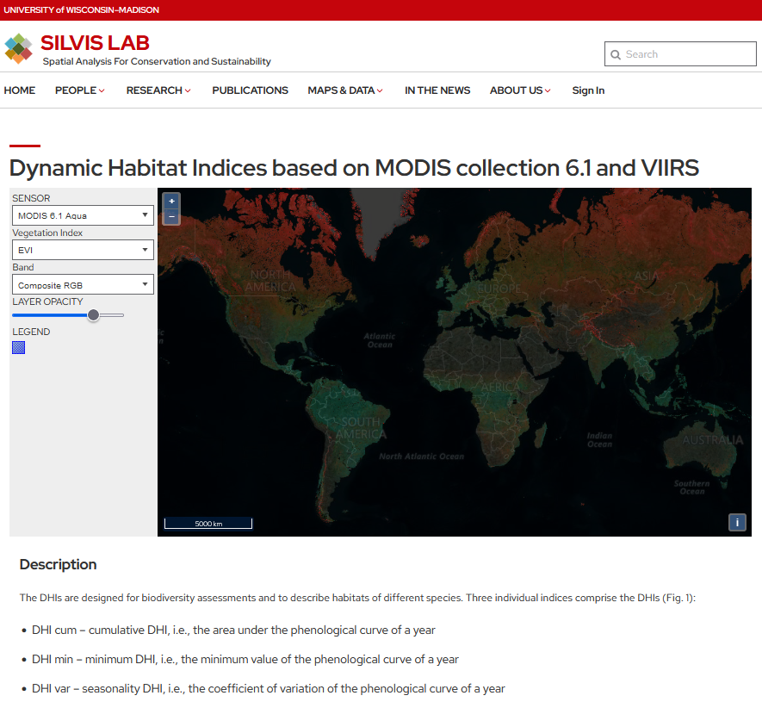
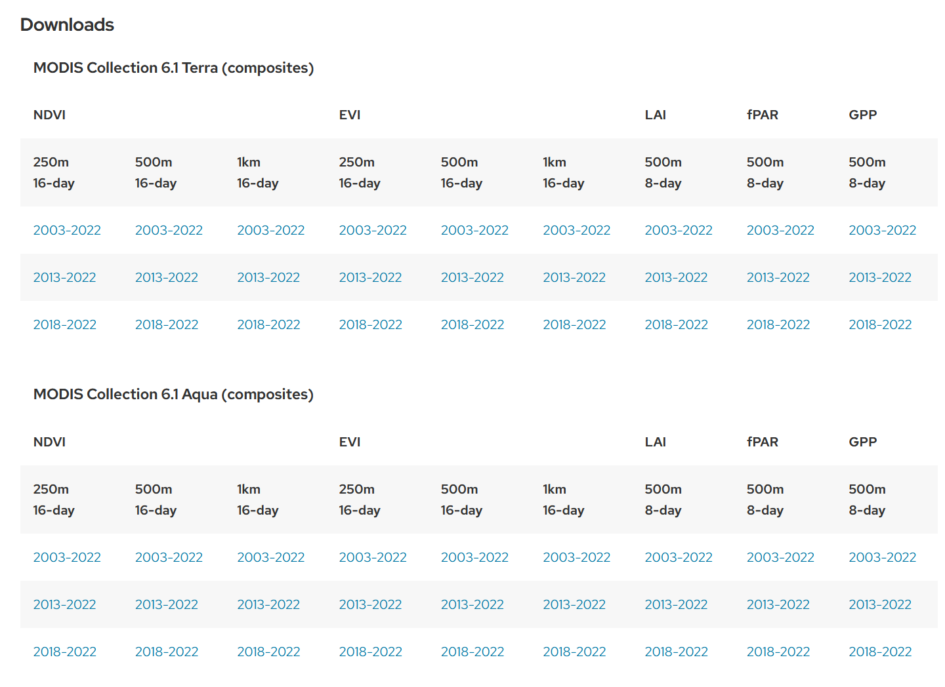
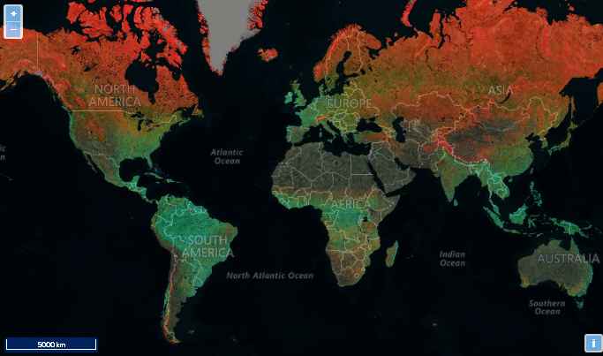
Product status

Slide 9
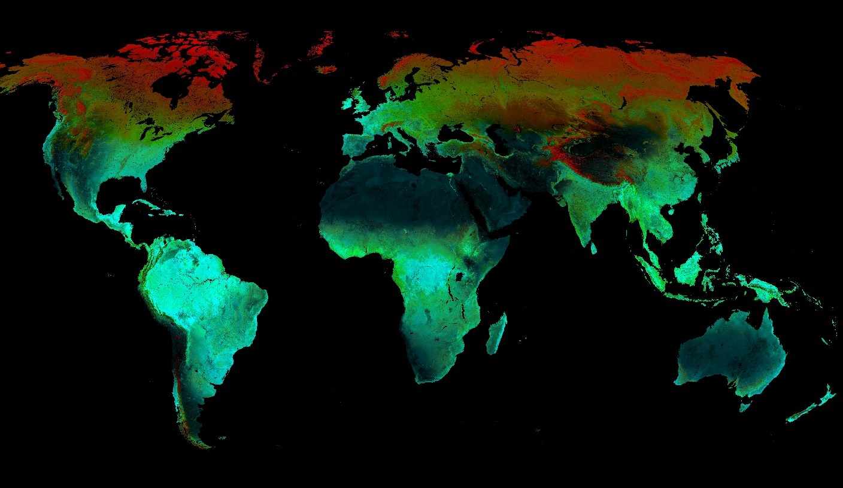
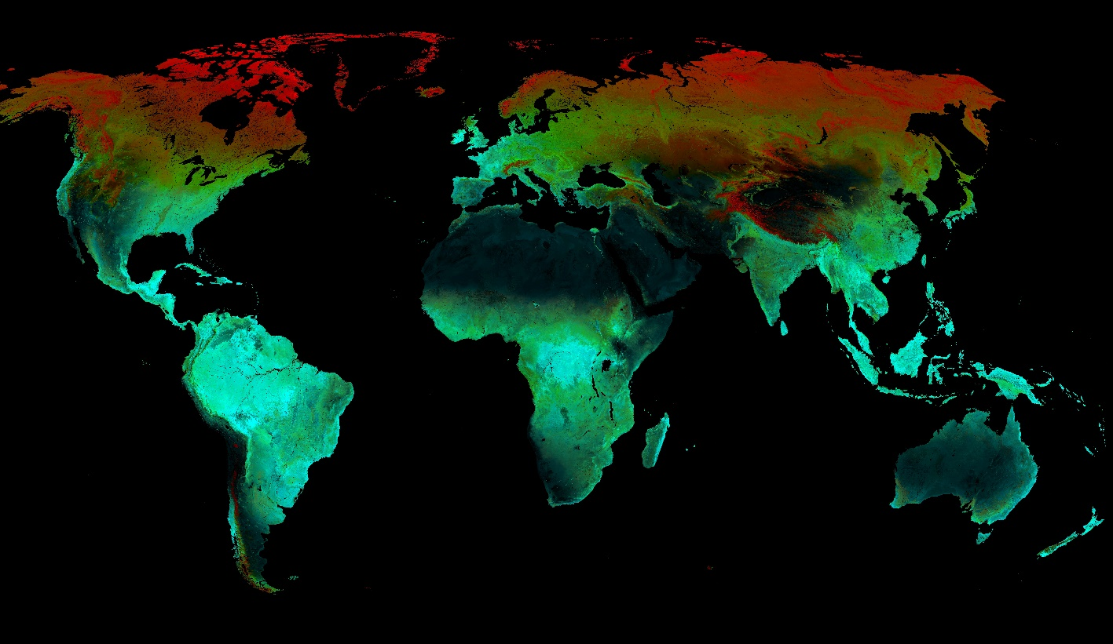

MODIS – VIIRS comparison
MODIS C6.1 Aqua
VIIRS
Var
Min
Cum
Notes:
500 m EVI 2013-2022

Slide 10
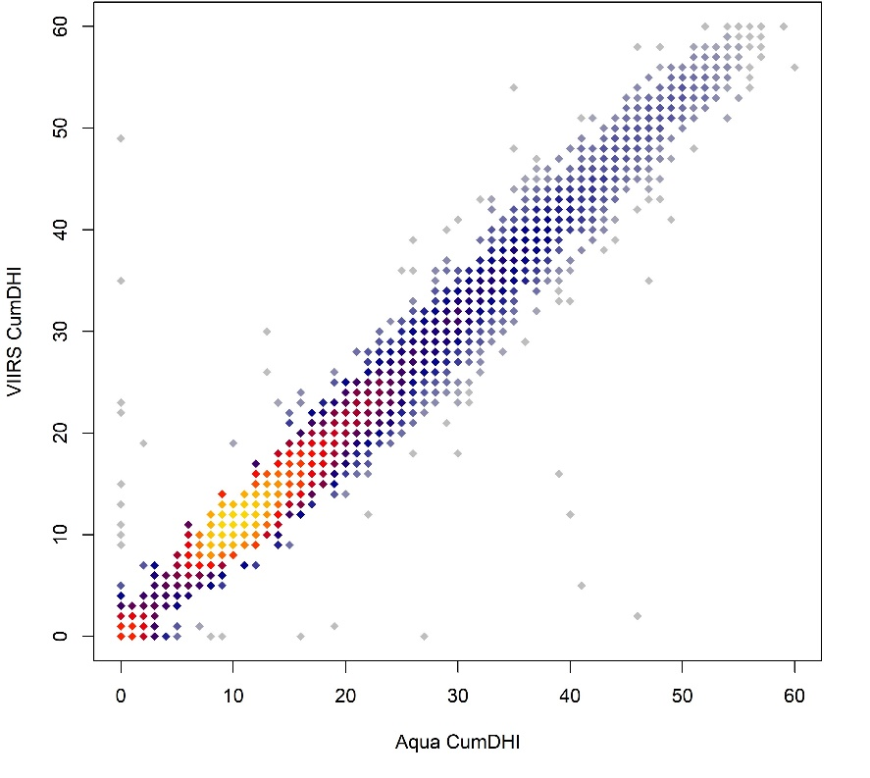
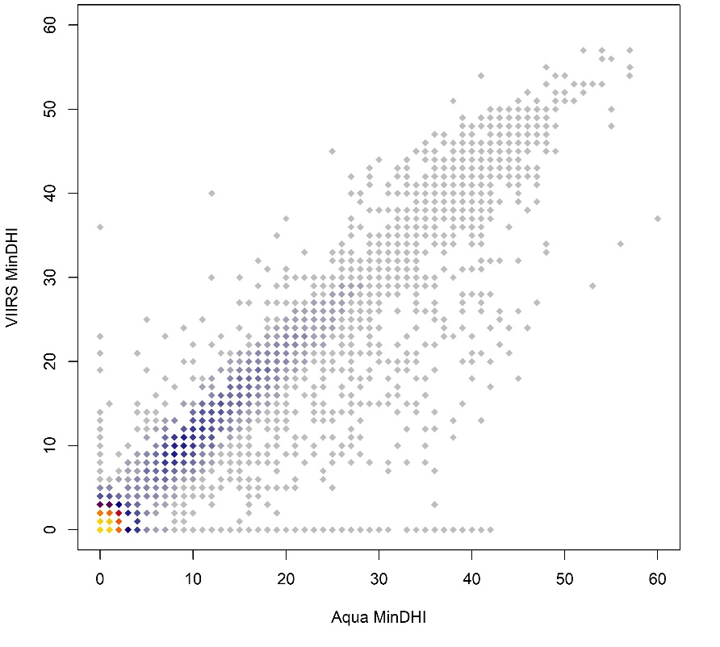
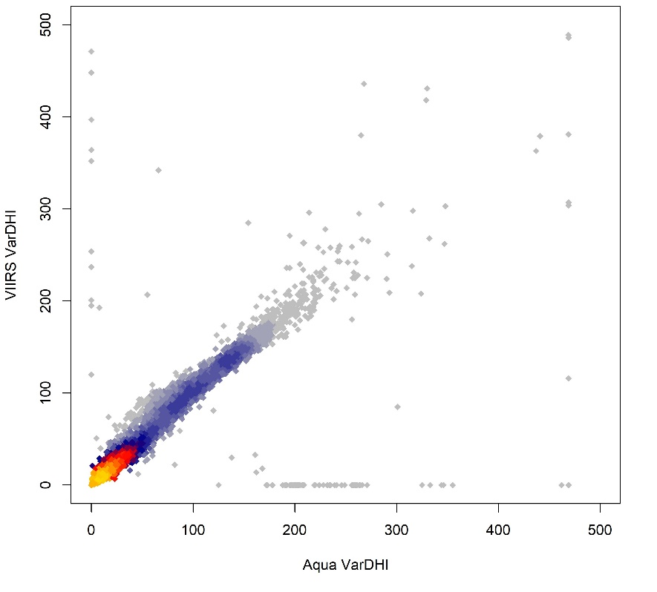
MODIS – VIIRS comparison
CumDHI
MinDHI
VarDHI
R² = 0.98
R² = 0.88
R² = 0.79

Slide 11
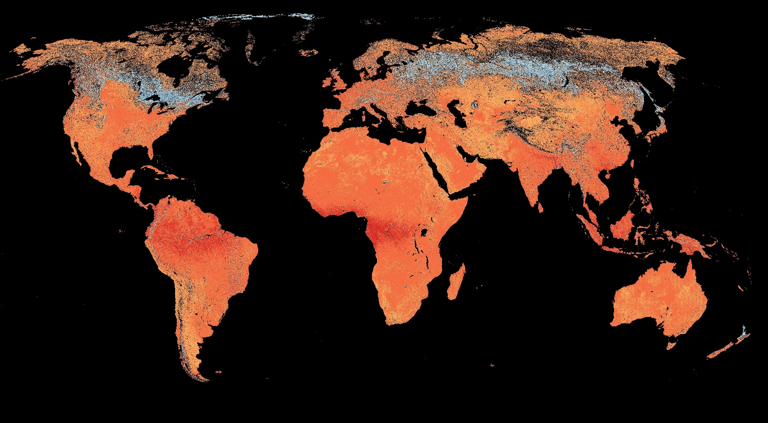
MODIS – VIIRS comparison
Cum-DHI
Cum-DHI EVI 2013-22: MODIS Aqua minus VIIRS

Slide 12
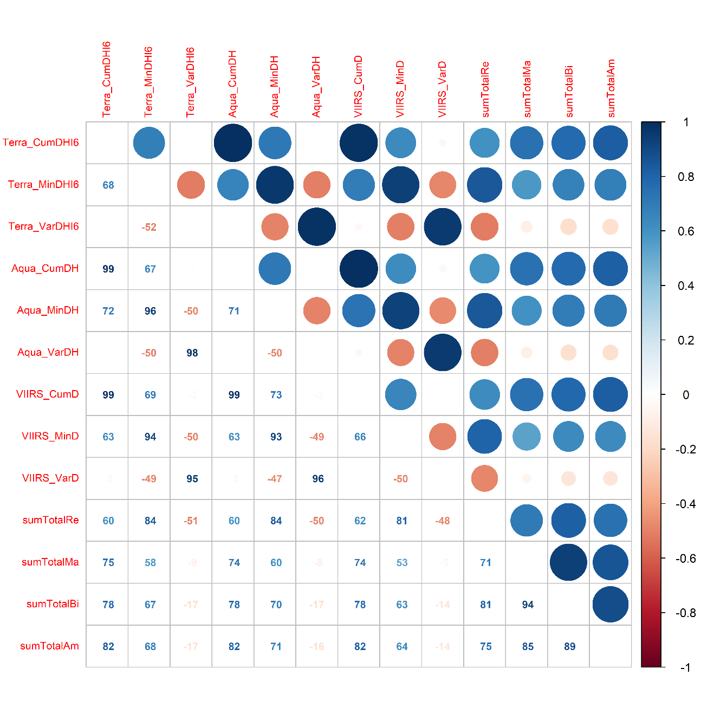

DHIs versus global species richness
Amphibians
Birds
Mammals
Reptiles
Amphibians
Mammals
Terra Cum-DHI
Terra Min-DHI
Terra Var-DHI
Aqua Cum-DHI
Aqua Min-DHI
Aqua Var-DHI
VIIRS Cum-DHI
VIIRS Min-DHI
VIIRS Var-DHI
1
0
-1
Birds
Reptiles
Cox, Young, Bowles, et al. Nature (2022)

Slide 13
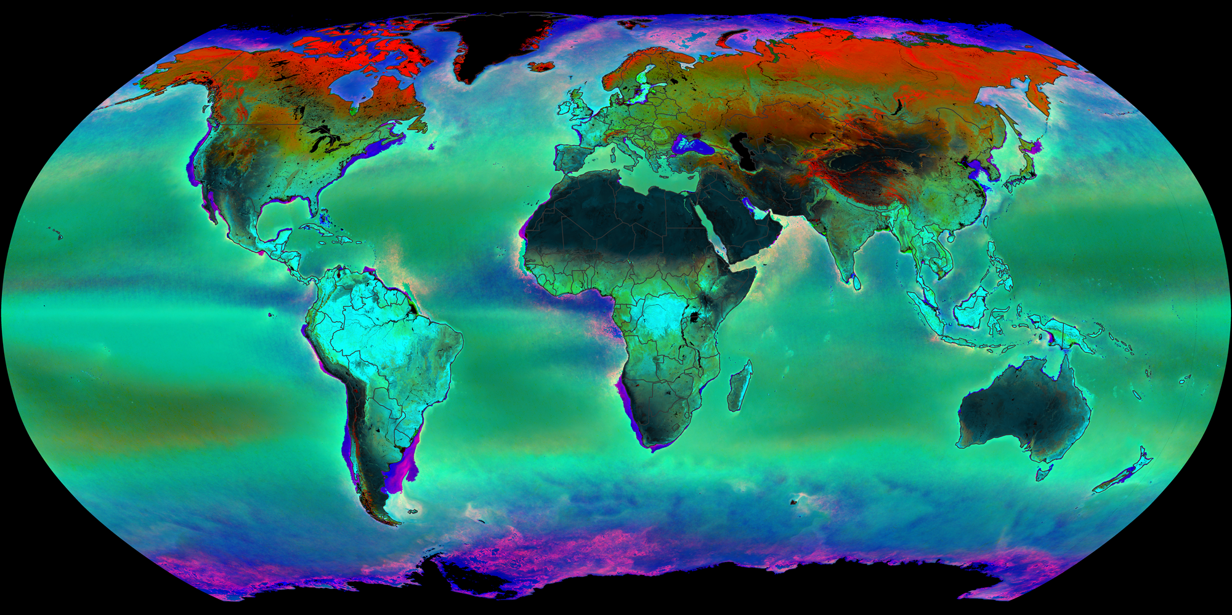
DHIs versus global species richness

Slide 14
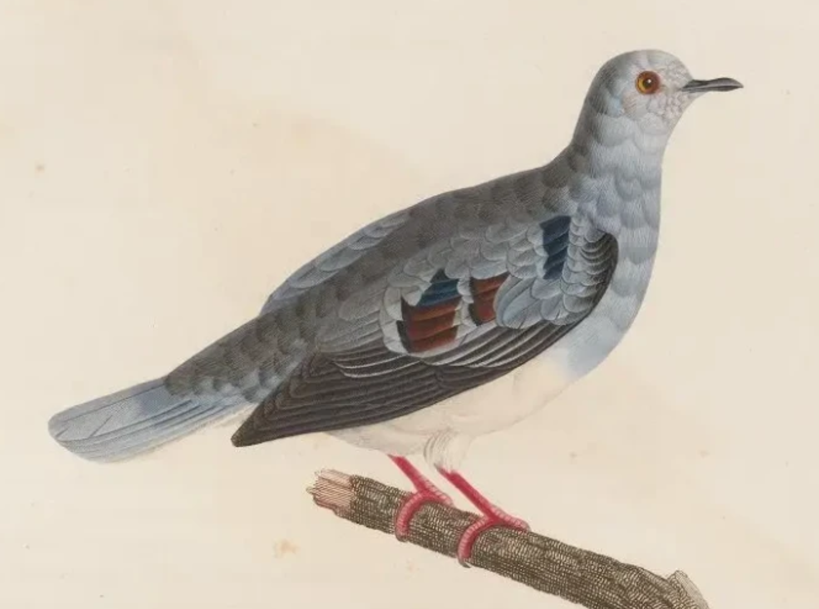
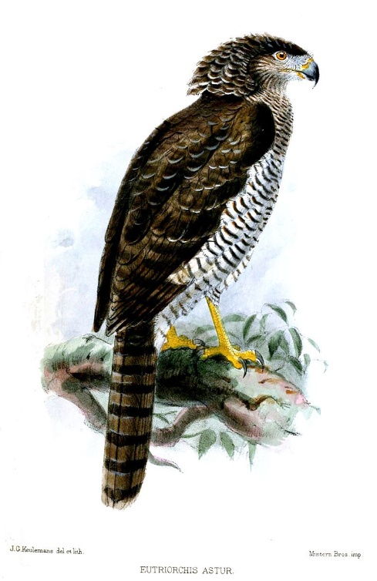
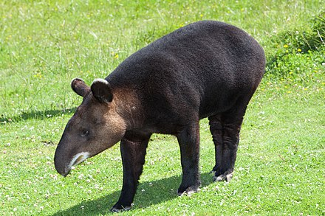
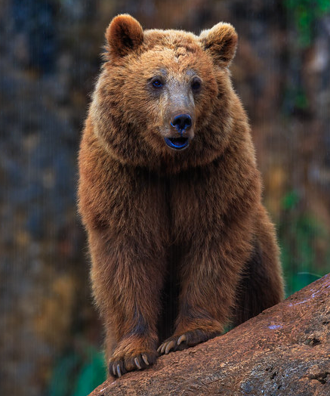
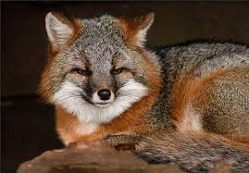
DHIs versus global species richness
SILVIS Lab
Other Users
Hobi, 2017, RSE
Radeloff, 2019, RSE
Hobi, 2021, Ecol Ind
Rapacciuolo, 2017, GEB
Coops, 2018, Sci Rep
Marin, 2018, Proc R Soc B
Coops, 2019, Ecol Ind
Rapacciulo, 2019, Nature E&E
Suttidate, 2019, RSE
Razenkova, 2020, Sci Rep
Silveira, 2021, RSE
Silveira, 2022, EcoApps
Suttidate, 2021, GECCO
Carroll, 2022, EcoApps
Razenkova, 2023, J. BioG
Suttidate, 2023 Bio Cons
Richness
Mammal richness / Xinjang
Bird diversity / France
Raptor richness / Americas
…
Species distributions
Brown Bears / Cantabria
Andean Condor / Argentina
Grey Foxes / US
Philippine Eagle / Philippines
Purple-winged Ground Dove
Mountain Tapir / Peru
Serpent Eagle / Madagascar
…

Slide 15
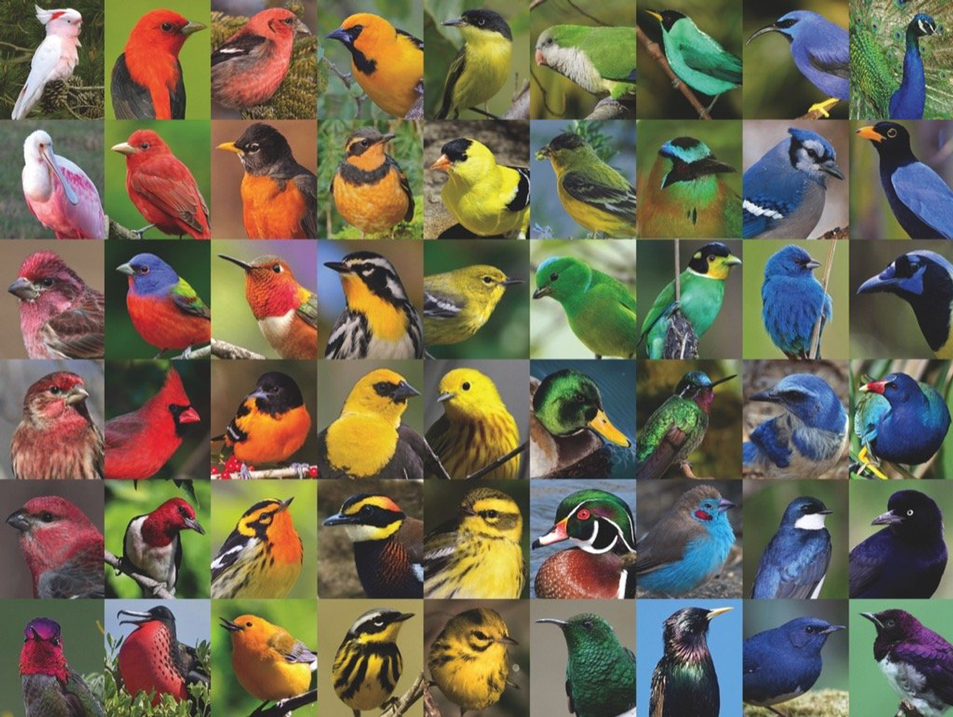
Thank you!!!

