Slide 1
Status of Terra Mission
Kurt Thome, Si-Chee Tsay, Robert Wolfe
MODIS/VIIRS Science Team Meeting
May, 2023

Slide 4
Terra is a healthy platform
No known life-limiting hardware on Terra at this time
Last inclination burns took place in March 2020 and crossing time changing to earlier times reaching 10:15 am in Sept. 2022
Terra exited 705-km constellation in Oct. 2022
Terra continues to drift in crossing time with altitude slowly decaying and end of science in Feb. 2027
Perigee lowering and spacecraft passivation in Sept. 2027

Slide 5
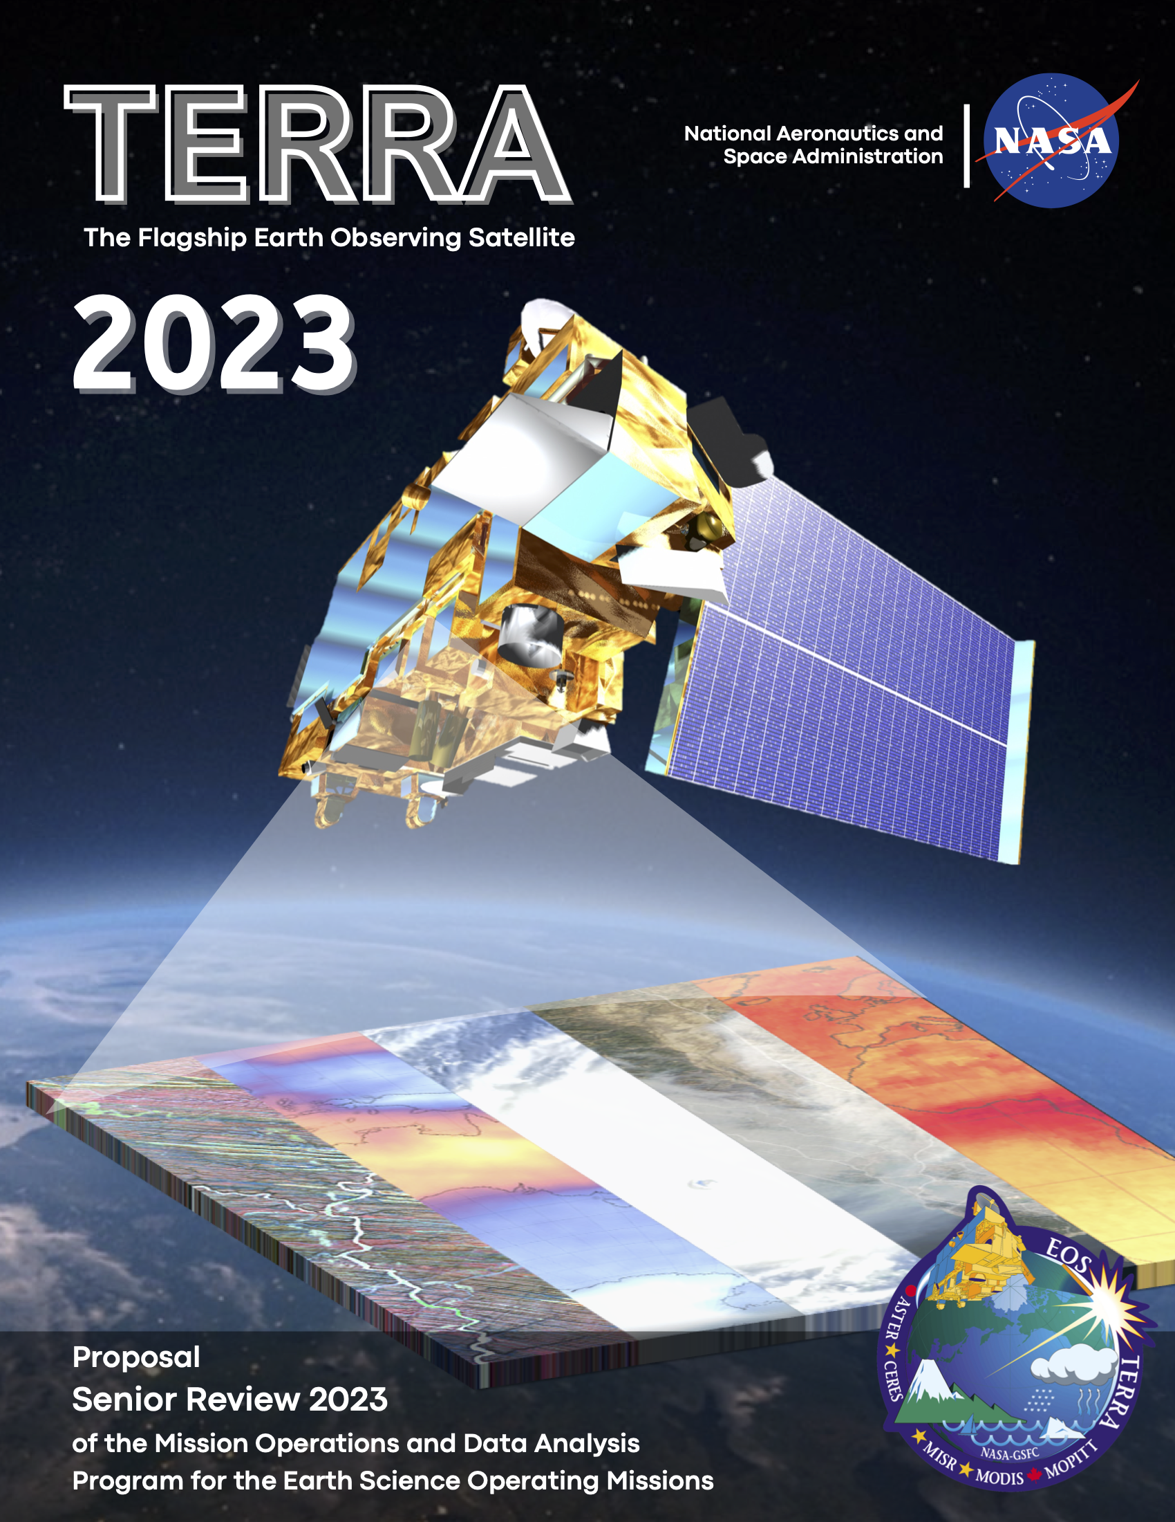
2023 Senior Review
Senior Review requested a proposal with Terra operations through 2026
Extended budget is 50% of what has been used in the past to operate mission
Budgets assume Terra science collection ends in February 2027
Operations budget leads to lights out periods overnight
Science budget leads to reduced response to sensor changes
Algorithm maintenance support is again integrated into the project proposals

Slide 6
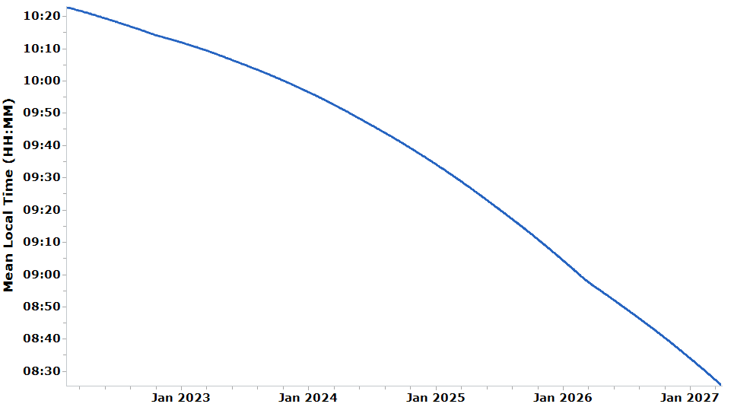
Terra Operations and crossing time
Phase E Science Operations
Phase F
Terra conducts Instrument Shutdown & Spacecraft Passivation.
Oct 2022, Terra orbit lowered from 705 km Earth Science Constellation
Feb-Mar 2026, Terra reaches 9 am MLT
Project management and ASTER, CERES, MISR, MODIS, and MOPITT science team activities to produce final science-quality datasets and documentation
9:00
Reprocessing of final Terra datasets
at the end of Phase F, final delivery of Terra science-quality datasets to data archive:
MLT drift
Jan 2028
Jan 2029
Risk mitigation maneuvers for orbital debris avoidance continue until passivation
Inclination adjust maneuvers ended in Spring 2020 (crossing time not maintained)
Drag makeup maneuvers no longer occur to maintain Terra’s altitude
WRS-2 (worldwide reference system) and 16-day repeat ground track not maintained

Slide 7
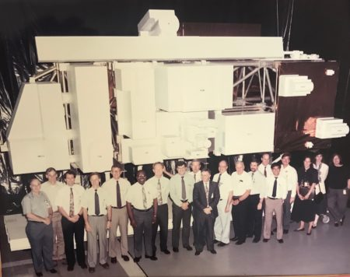
Terra continues to add to its 23-year legacy
Met the 18-year, planned data record for three EOS AM platforms
Terra continues to play a role as baseline for comparisons for recent and future missions such as S-NPP, NOAA-20, Earth Venture, ESO
Successful Senior Review Proposal provides the opportunity for >3 years of additional data
Quality of Terra data will be maintained
Lights out operations and reduced science budgets may lead to delays in when that quality is achieved
“A well-built spacecraft, talented people running it and making great science products, with lots of people using the data, that’s what has kept it running all these years.”
Dimitrios Mantziaras, Terra Mission Director marking Terra’s 100,000 orbits
NASA scientists, engineers and designers pose in front of a full-sized model of Terra

Slide 8
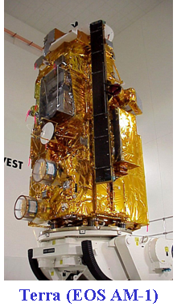
Terra team/sensors
ASTER
Hi-resolution, multi-spectral images from 15 m to 90 m resolution, plus stereo
CERES
Earth’s shortwave, longwave, and net radiant energy budget
MISR
Global multiangle images for aerosol, cloud, and surface characteristics
MODIS
1-2 day global coverage in 36 wavelengths from 250 m to 1 km resolution
MOPITT
Global measures of CO
GSFC
Project Scientist (PS) Kurt Thome
Deputy PS Si-Chee Tsay
Deputy PS for Data Robert Wolfe
ESMO Project Manager Wynn Watson
Instrument PIs and Team Leads (TL)
ASTER Japan TL Yasushi Yamaguchi
US TL Michael Abrams UJPL)
CERES PI Norman Loeb (LaRC)
MISR PI David Diner (JPL)
MODIS TL Miguel Román (Leidos)
MOPITT Canada PI James Drummond
(Dalhousie Univ.)
US PI Helen Worden (NCAR)

