Slide 1
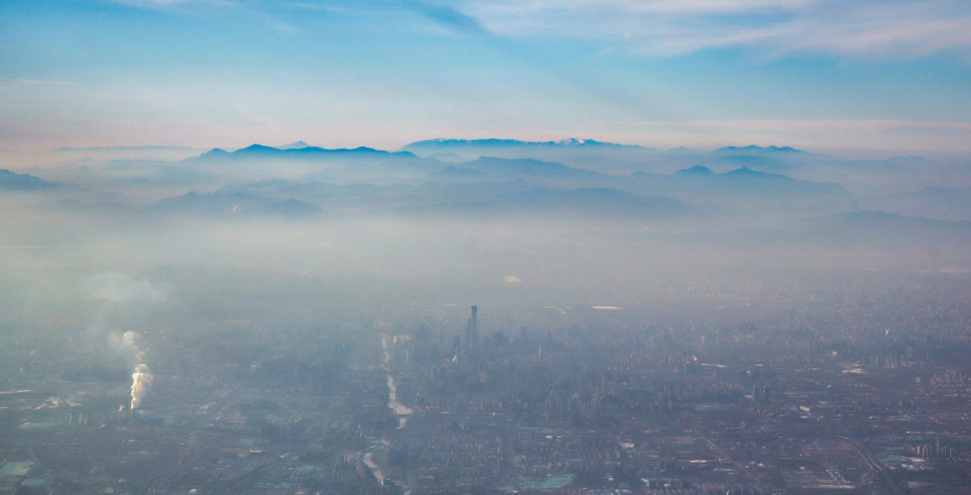
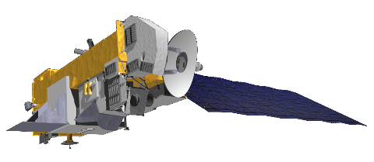
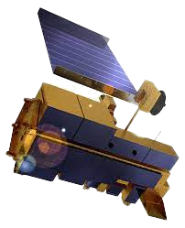
Tracking Ambient Particulate Matter and Chemical Composition from Space using AI
Jing Wei & Zhanqing Li
ESSIC & Department of Atmospheric and Oceanic Science, University of Maryland, College Park, MD, USA

Slide 2
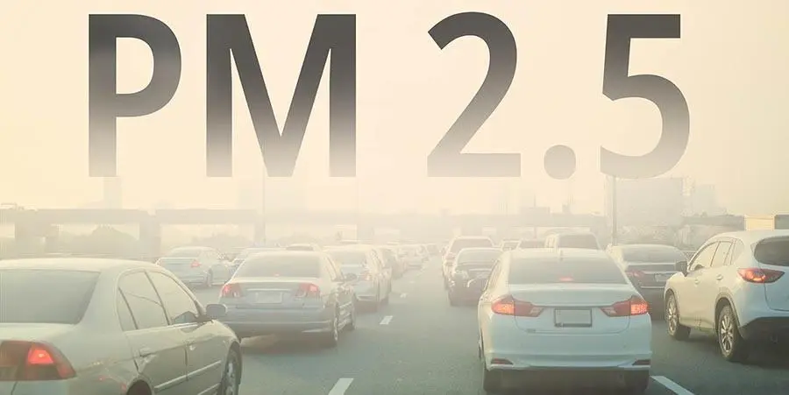
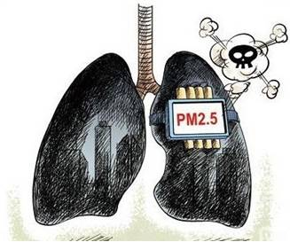
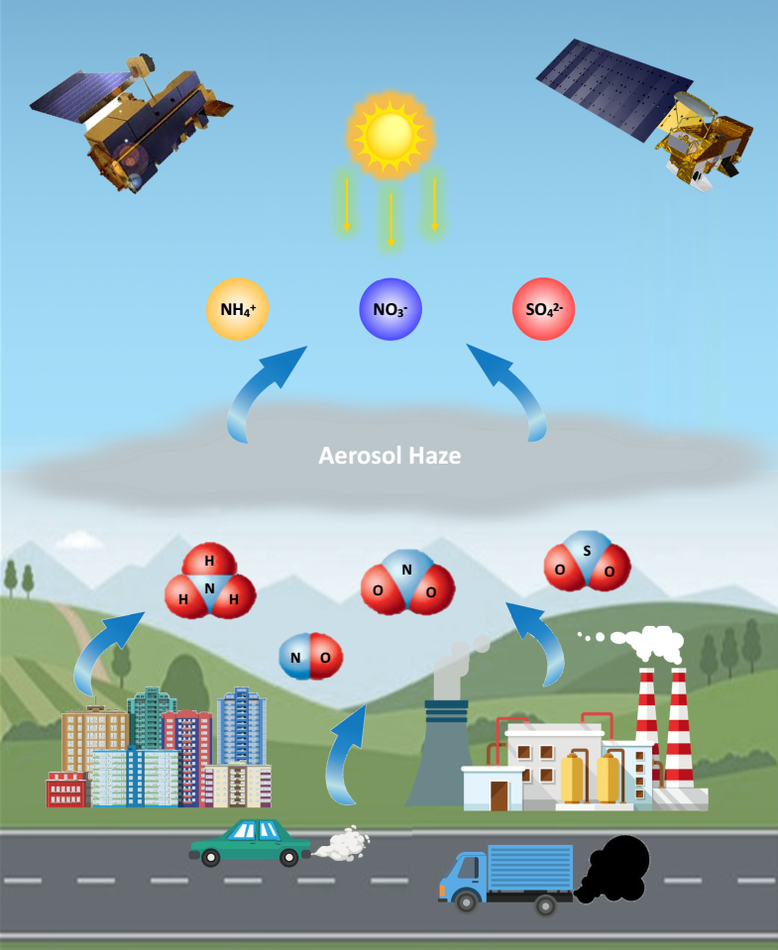
Ambient Air Pollution
Particulate Matter
PM_{2.5} has become an urgent environmental health threat and ranked the 4th risk factor, especially in developing countries like China.
PM_{2.5} contains primary and secondary aerosols, and different species impact the public health in different ways.
Black carbon from wildfires or ultrafine particles from automobile exhaust may have strong toxicities
The formation of SIA components (sulfate (SO₄^{2–}), nitrate (NO₃–), ammonium (NH₄⁺)) is a main cause of severe haze pollution.
Their sources are complex, whose estimation is highly challenging.

Slide 3
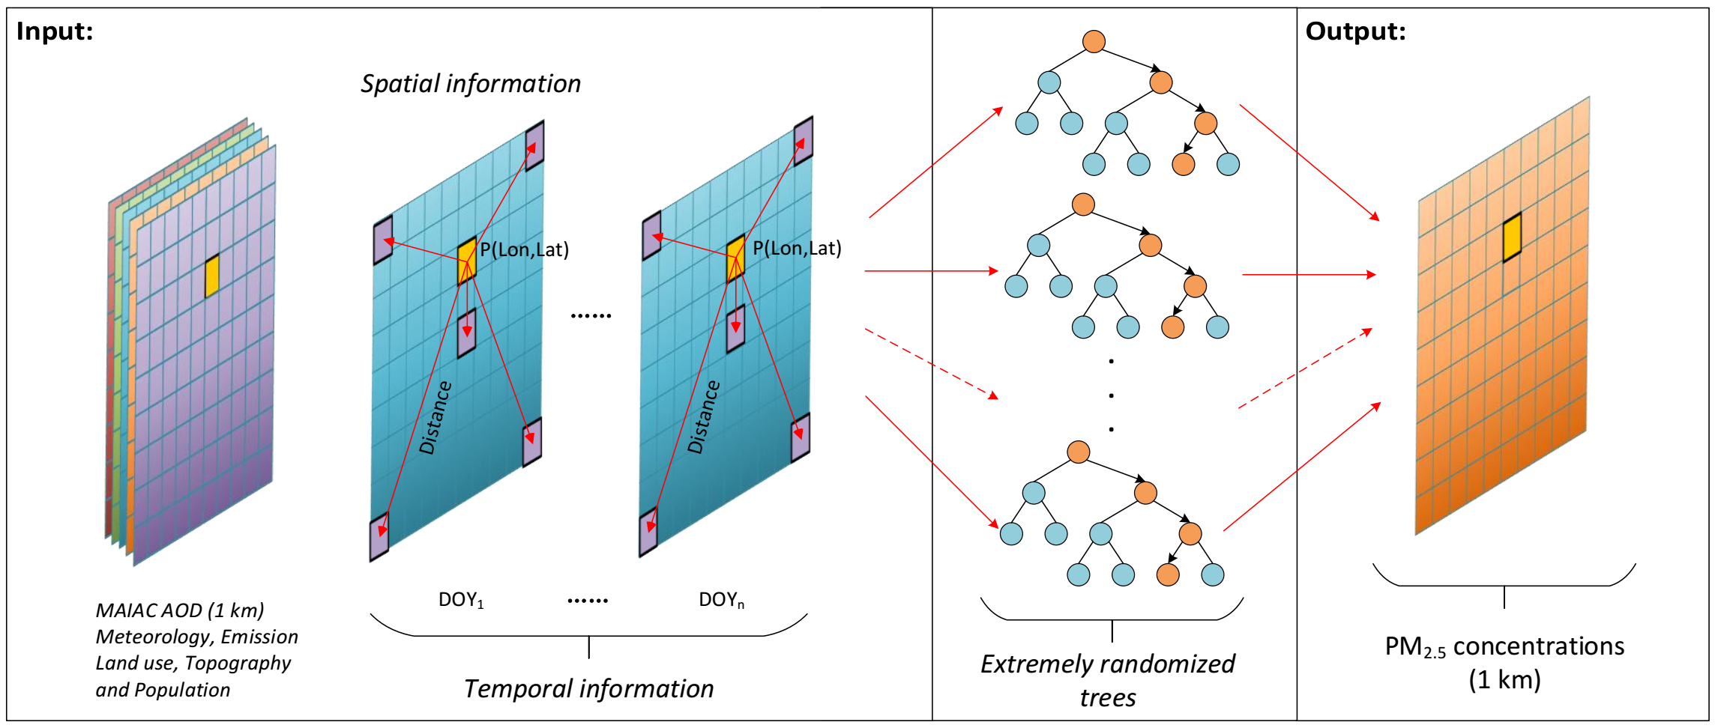
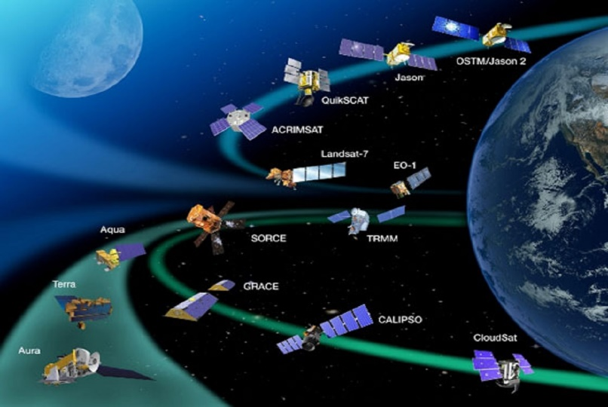
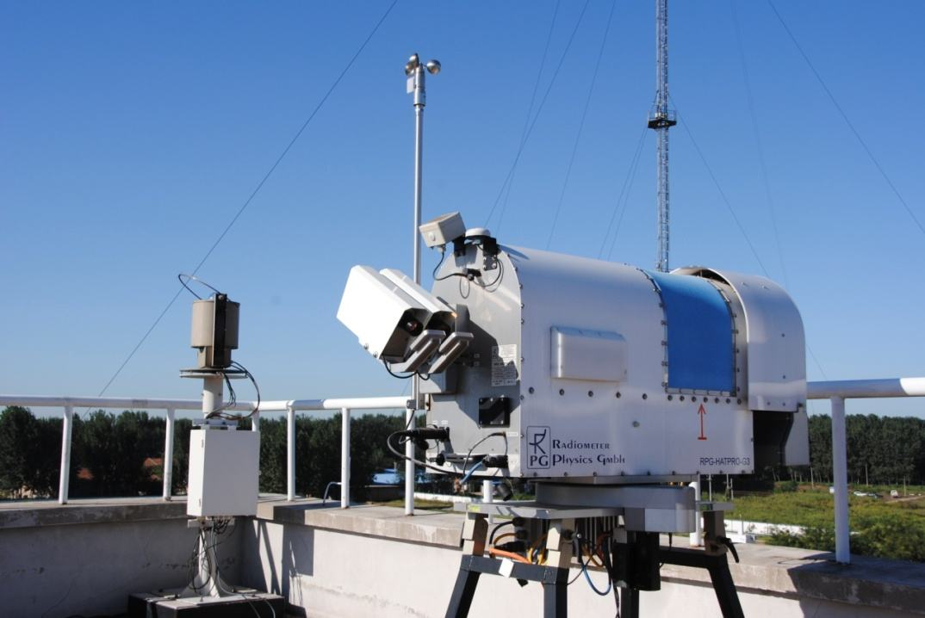
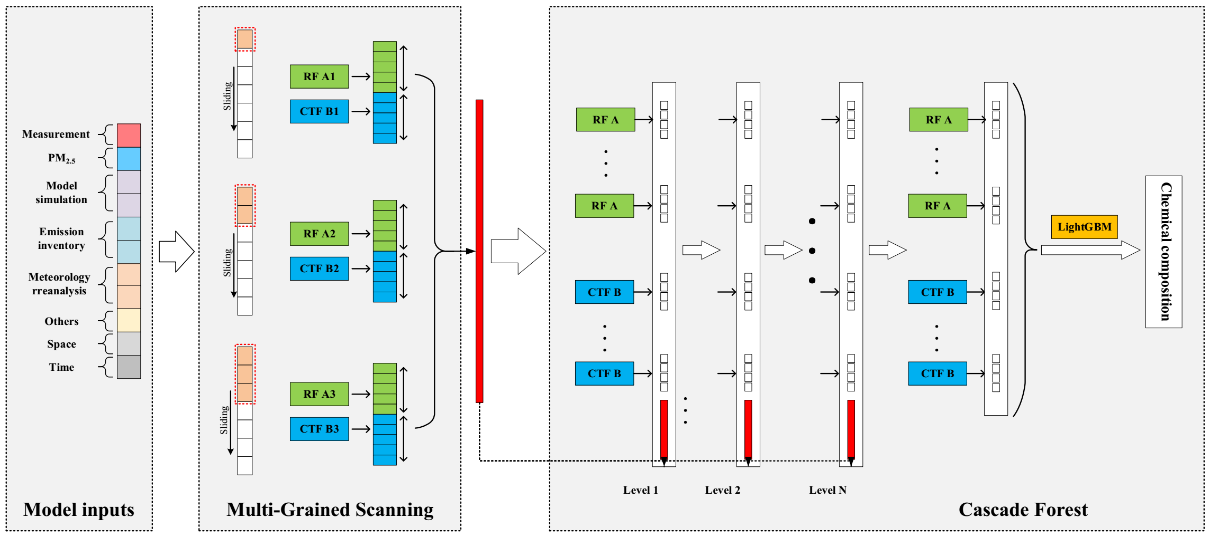
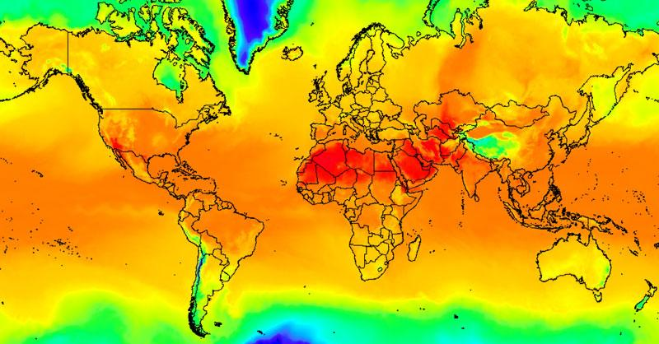
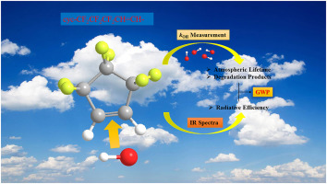
The era of Big-Data-driven AI has arrived and thrived!
We have developed several state-of-the-art AI (machine and deep learning) tools by considering the spatiotemporal information of air pollution to improve estimation accuracies and efficiencies.
Satellite remote sensing
Ground Measurements
STET
4D-STDF
Atmospheric Reanalysis
Model Simulations

Slide 4
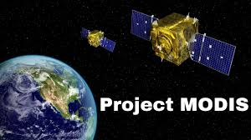
As the #1 source of emissions whose influences spread across the Asia-Pacific rim, China have experienced most dramatic changes in the last a few decades, but country-wide PM_{2.5} records only dated back to 2013.
Question I?
How did PM_{2.5} and its composition change across China during the last two decades?
Thanks to more than 20 years of long-term earth observations by NASA MODIS, and its operational high-resolution AOD products, we have re-constructed daily 1-km PM_{2.5} data records from 2000 in China. The long-term, continuous and seamless product allow objective evaluation of air quality change in time and space.

Slide 5
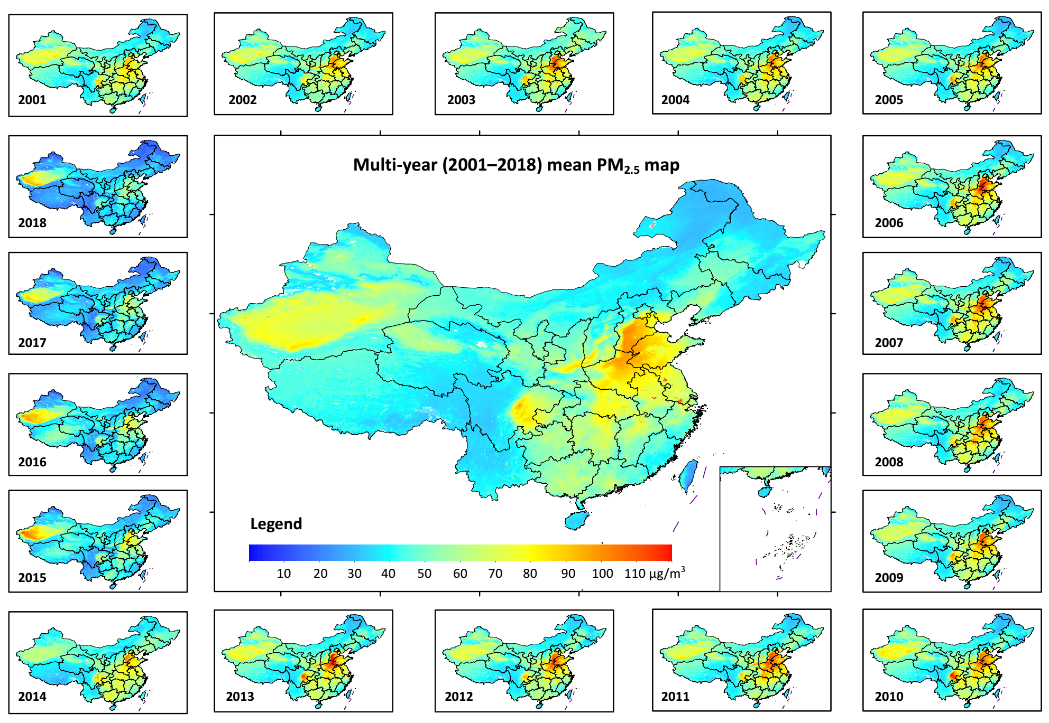
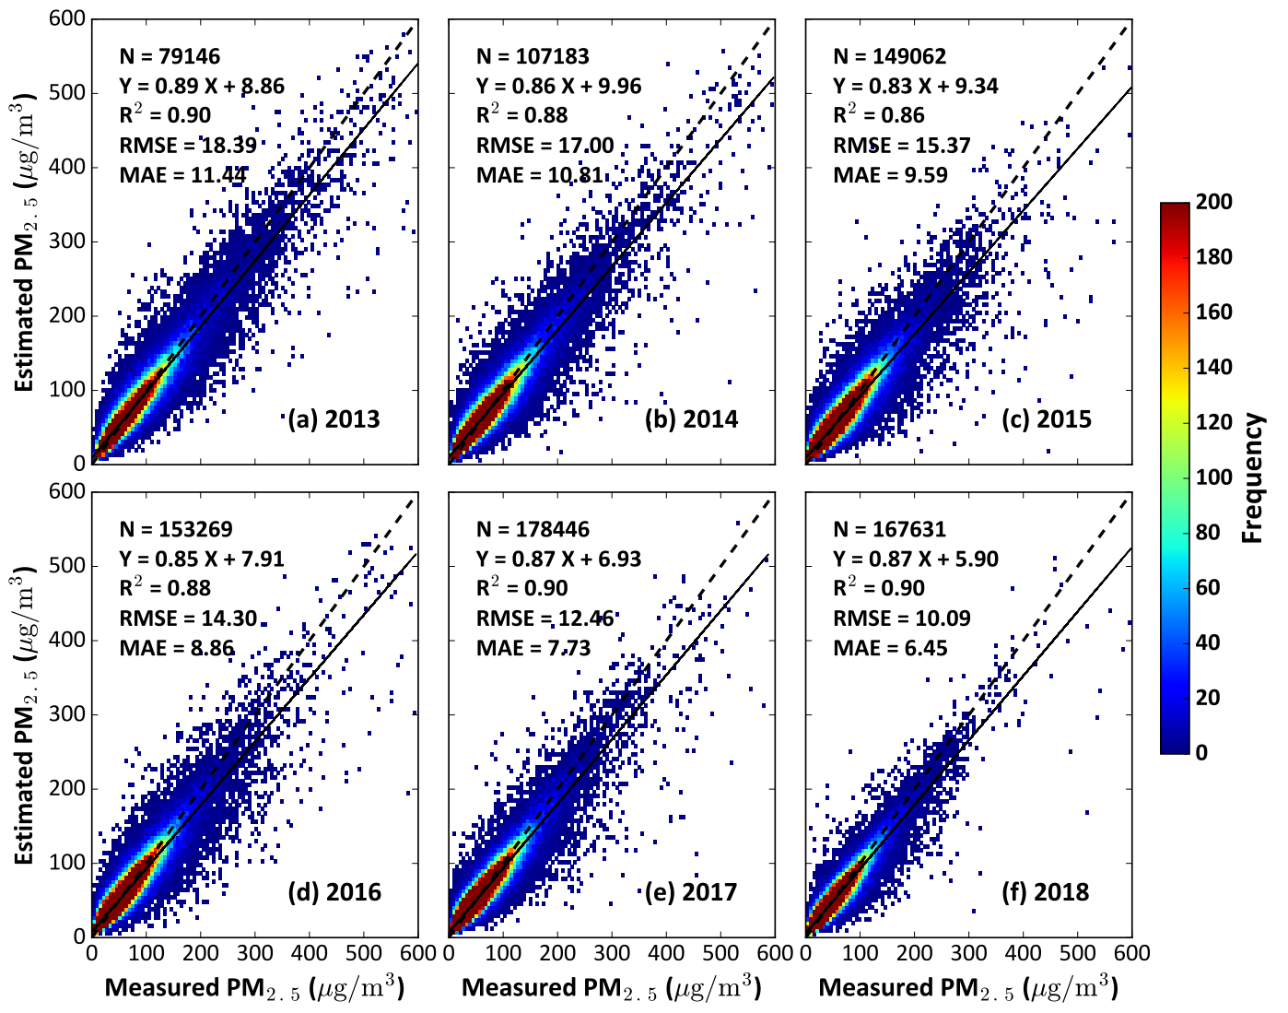
MODIS-derived 20-years PM_{2.5} records and validation
Using MODIS MAIAC AOD products, we reconstructed 1 km PM_{2.5} data records since 2000 in China, making up for the gap in studies on long-term PM_{2.5} variations since surface observations only date back to 2013.
10-fold cross-validation
Daily PM_{2.5} retrievals agree well with ground measurements among different years.
Wei, Li, et al., RSE, 2021

Slide 6
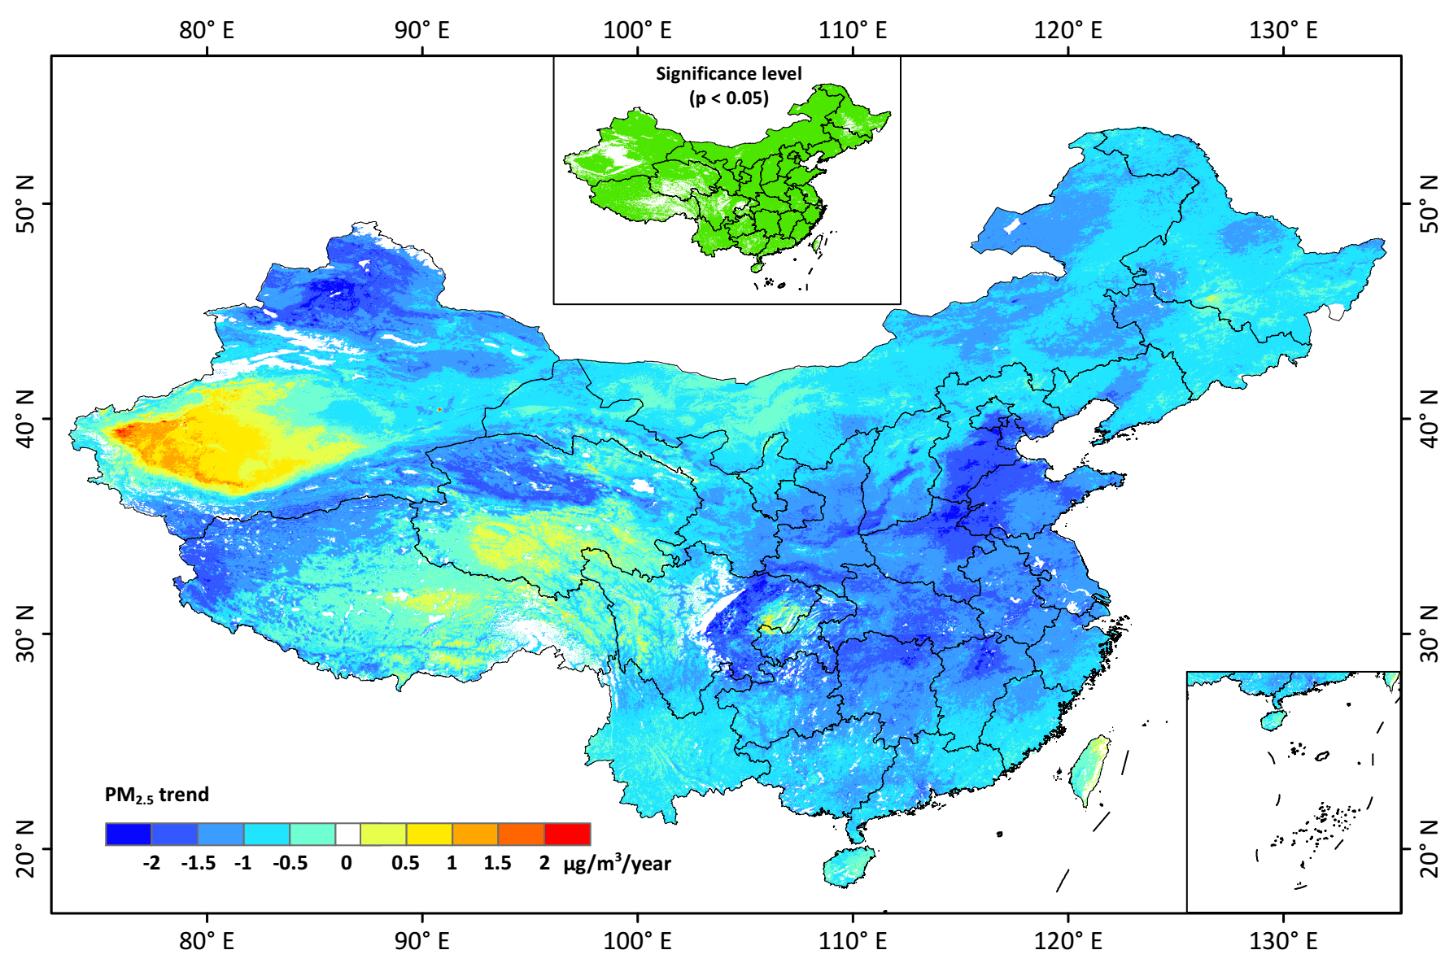
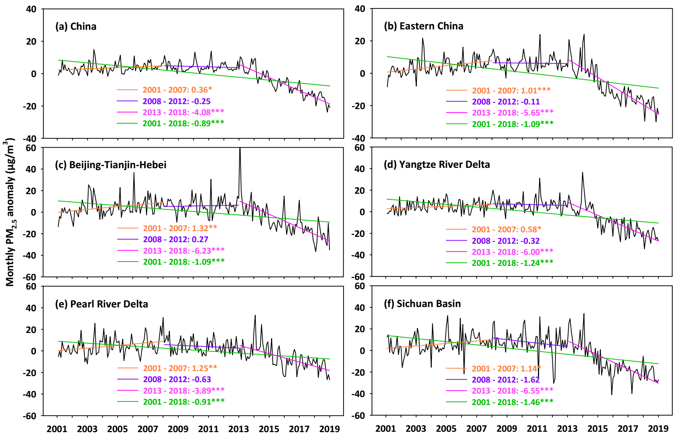
Long-term temporal variations in PM_{2.5} pollution
Annual PM_{2.5} trend during 2001-2018
Monthly variations of PM_{2.5} anomaly
PM_{2.5} pollution has experienced dramatic changes: increasing until around 2007, remaining high until 2013, and decreased significantly since then in most areas especially in eastern China, in response to policy shift and economy-structure changes.
Wei, Li, et al., RSE, 2021

Slide 7
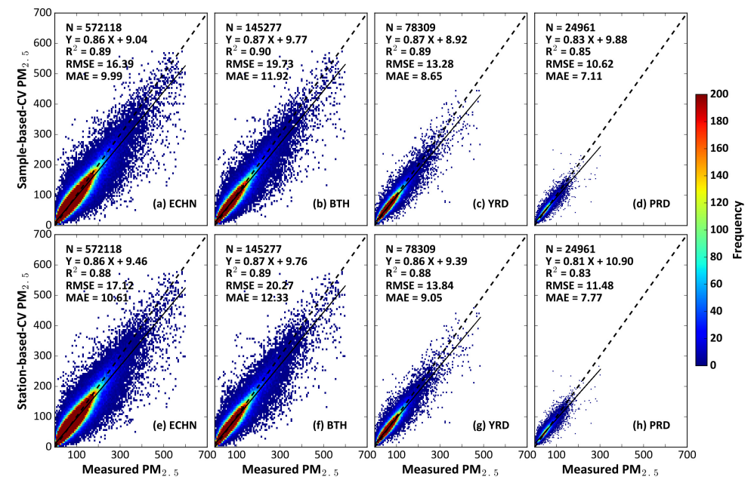
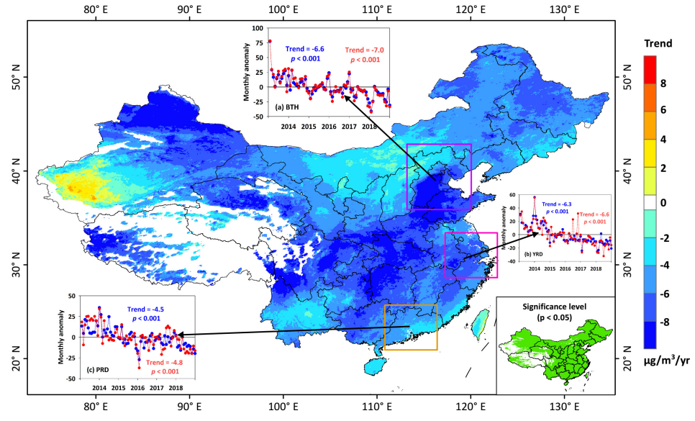
Extending the EOS long-term PM_{2.5} records with VIIRS AOD
Validation of daily PM_{2.5} estimates and predictions
Temporal PM_{2.5} trend since 2013
Our PM_{2.5} product has the unique advantages of the longest records, highest resolution, daily and seamless that can thus well capture the temporal trends and spatial inhomogeneity.
VIIRS satellite aerosol products can be adopted to extend the Earth Observing System (EOS) long-term PM_{2.5} data records using ML to the next few decades in the post MODIS/MISR era.
Wei, Li, et al., TGRS, 2022

Slide 8
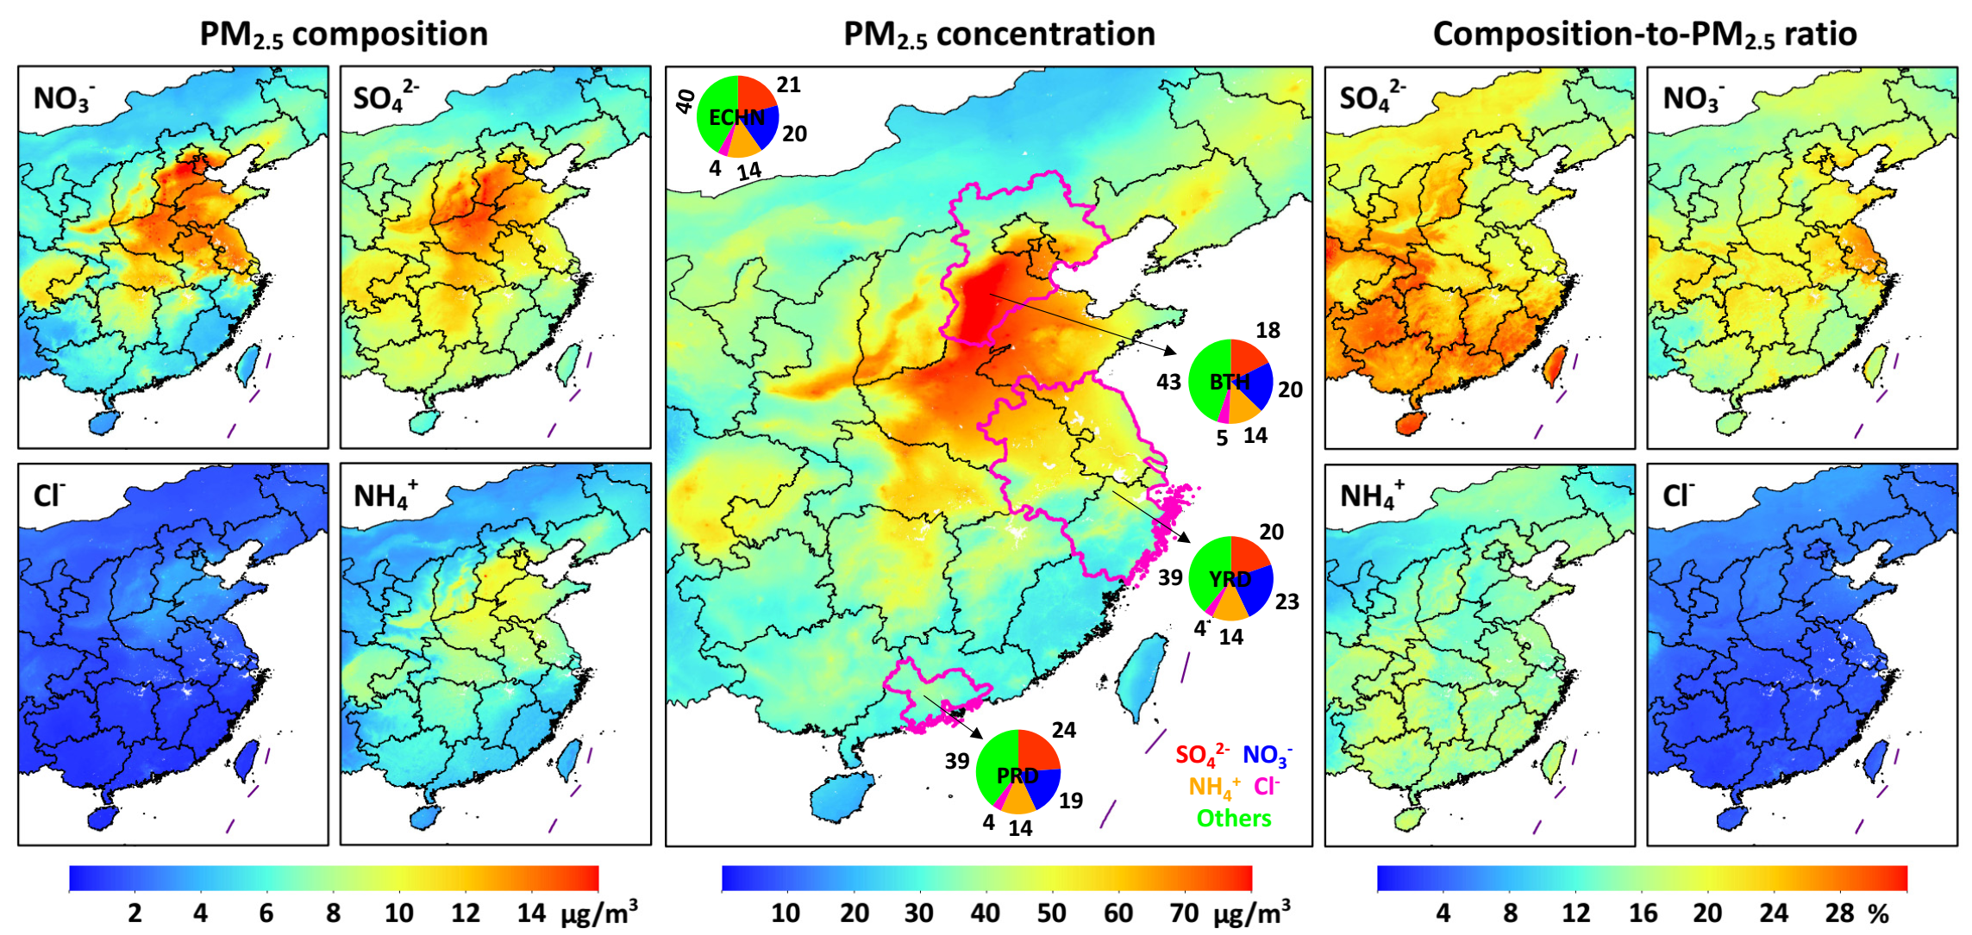
Separating PM_{2.5} Chemical Composition via Deep Learning
We developed a four-dimensional spatiotemporal deep forest (4D-STDF) model to estimate daily 1 km PM_{2.5} chemical composition since 2000 from a high-density observation network and satellite PM_{2.5} retrievals
Cross-validation illustrates the reliability of sulfate (SO₄^{2–}), nitrate (NO₃–), ammonium (NH₄⁺), and chloride (Cl–) estimates, with high CV-R² of 0.74, 0.75, 0.71, and 0.66, respectively, with reference to ground observations.
Four main inorganic aerosols account for 58% of PM_{2.5} in eastern China, and three SIA components account for 21% (SO₄^{2–}), 20% (NO₃–), and 14% (NH₄⁺) of the total PM_{2.5} mass in eastern China.
Wei, Li, et al., EST, 2023

Slide 9
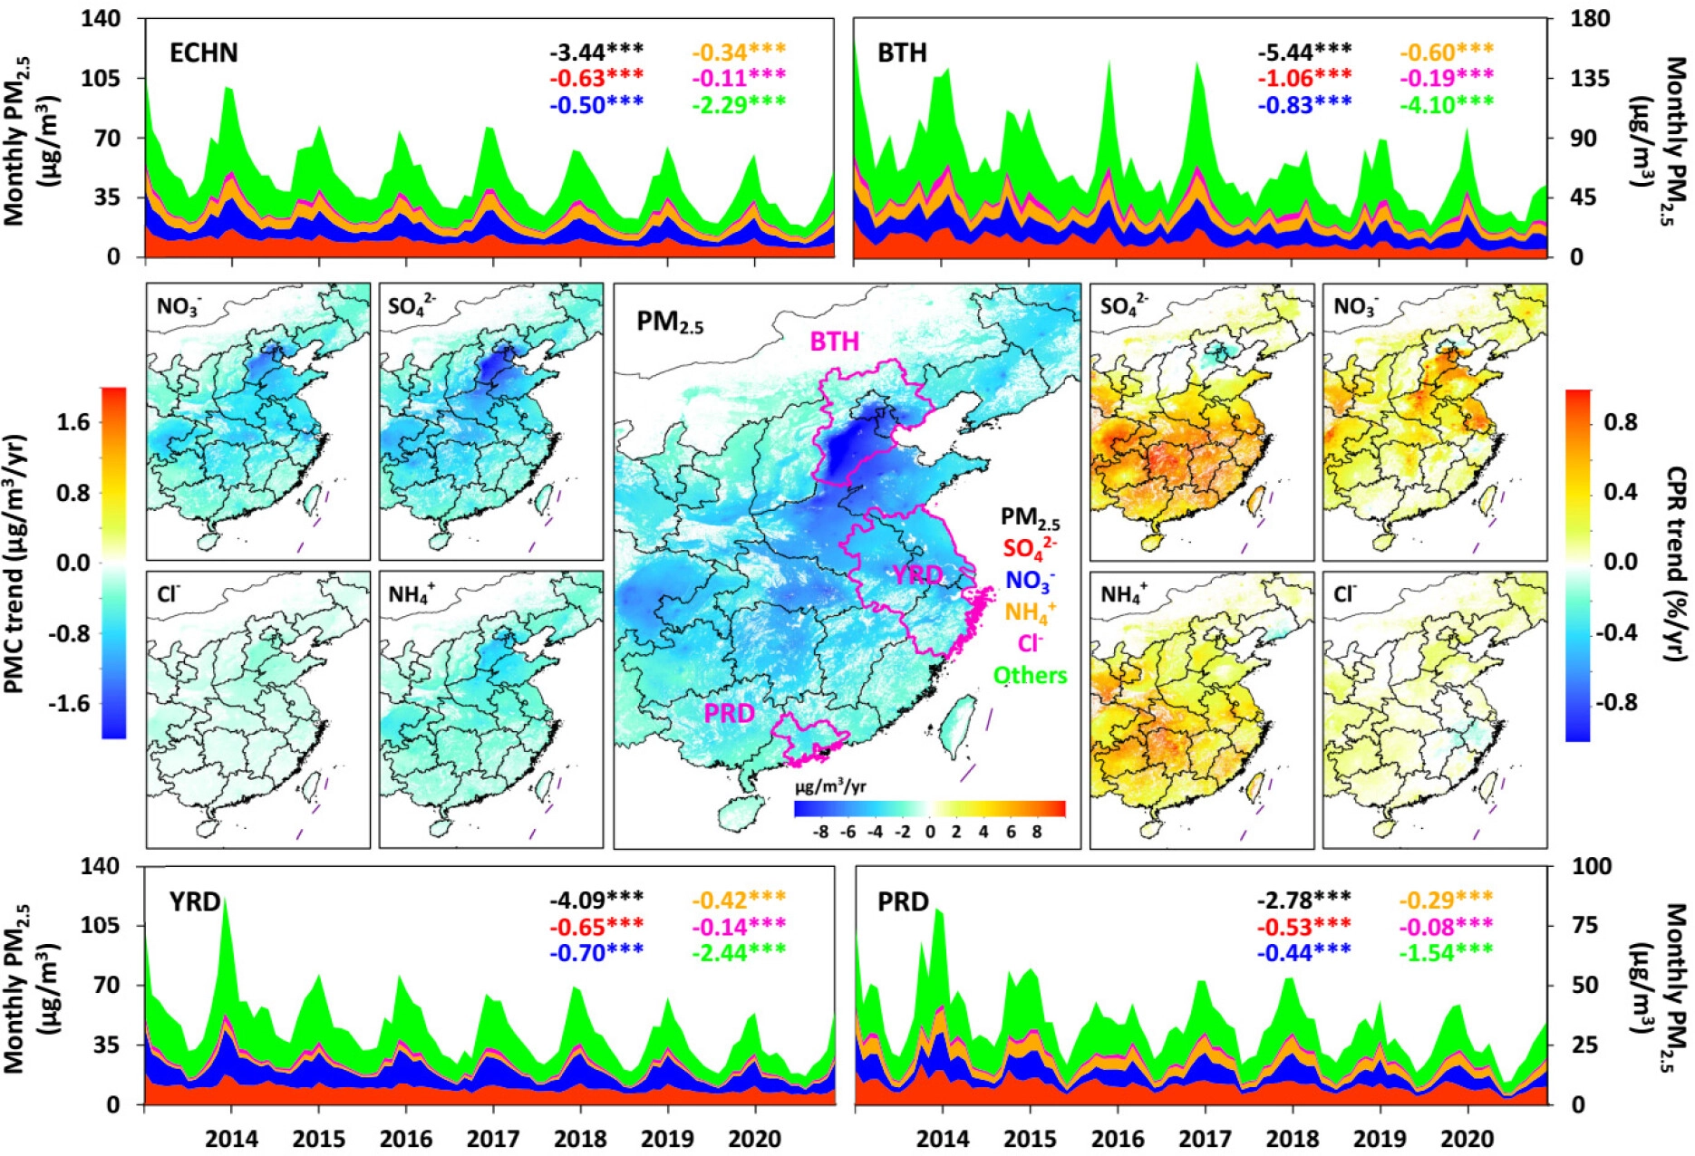
Temporal Variation of Chemical Composition
We observed significant reductions in the mass of inorganic components by 40–43% between 2013 and 2020, slowing down since 2018.
Comparatively, the ratio of SIA to PM_{2.5} increased by 7% across eastern China except in Beijing and nearby areas, accelerating in recent years.
SO₄^{2–} has been the dominant SIA component in eastern China, although it was surpassed by NO₃– in some areas, e.g., Beijing–Tianjin–Hebei region since 2016.
Trends of total PM_{2.5} and components (PMC) and composition-to-PM_{2.5} ratios (CPR) in eastern China from 2013 to 2020
Wei, Li, et al., EST, 2023

Slide 10
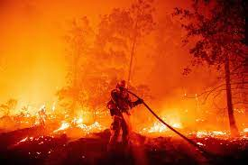
The long-term improvement trends in air quality and public health in the continental United States (US) were obscured in the past decade by the increase of fire emissions that potentially counterbalanced the decline in anthropogenic emissions.
Question II?
How did the wildfires affect the long-term air quality and public health in the US?
We tackle both questions by building upon the advances enabled by deriving surface 1 km PM_{2.5} and BC since 2000 in the US with full spatial coverage via the deep learning approach and estimated the mortality burden.

Slide 11
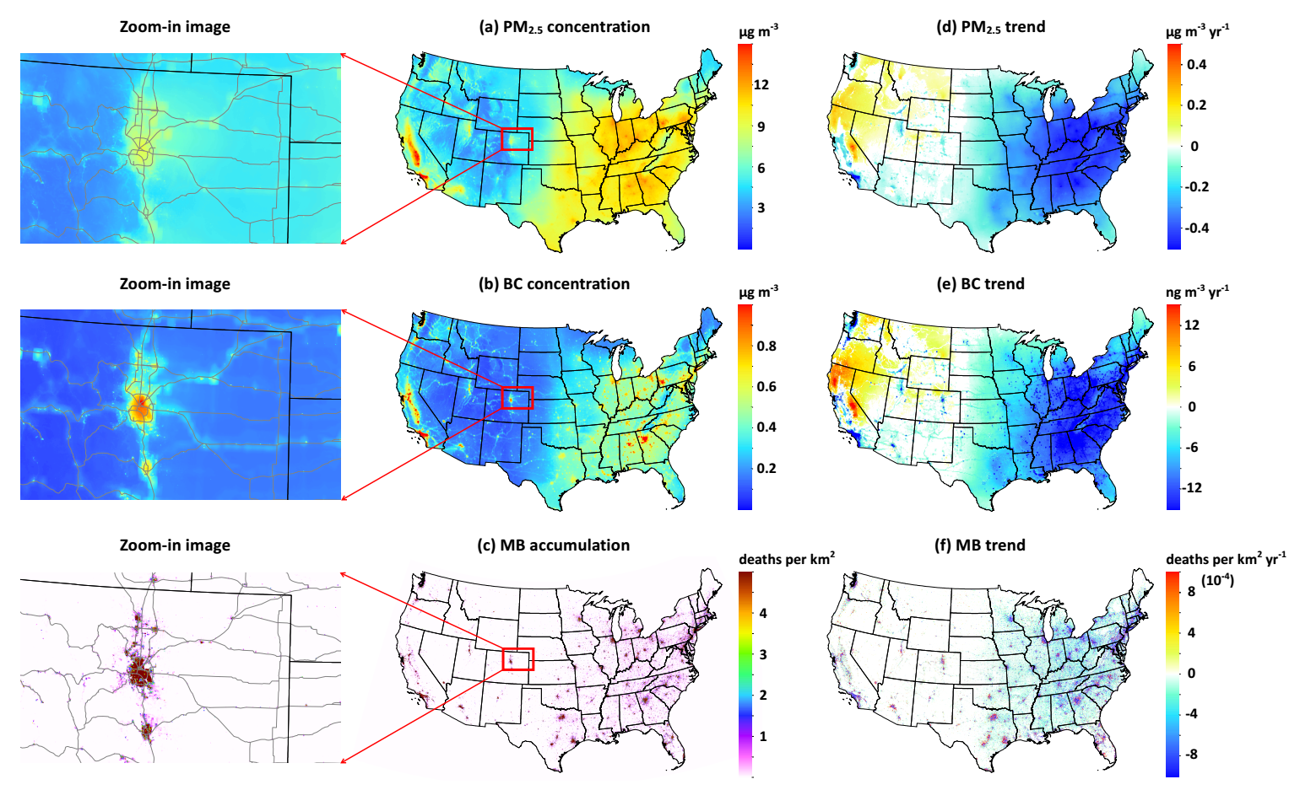
Spatiotemporal variations
2000 – 2020 Trends in PM_{2.5}, BC, and Mortality Burden
Annual PM_{2.5} and BC have similar spatial distributions: US EAST are ～2 times higher than US WEST.
Strong contrast in the air quality between urban and rural regions.
Annual PM_{2.5} and BC has declined steadily in the EAST, vs big increases in the WEST
The opposite trends are seen in air quality related premature deaths: increasing/decreasing in the WEST and EAST.
Wei et al., Lancet – Planet Health, under revision
High BC concentrations along highways due to traffic-related emissions (from diesel trucks) are well captured.

Slide 12
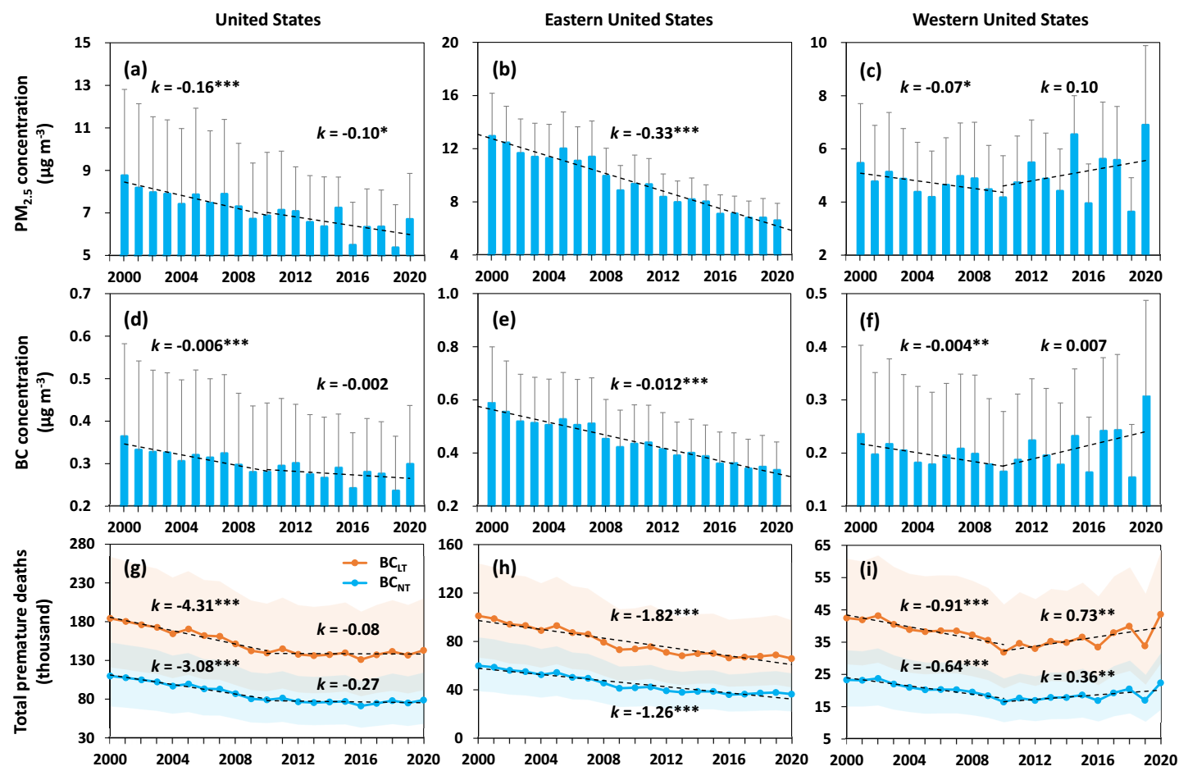
Major findings and conclusions
Nationally, the PM_{2.5} and BC decreasing trends were larger in the first decade and slowed down after.
Air quality has improved continuously in the EAST, whereas the same downward trend was reversed in the WEST due to increased fire emissions in the recent decade.
And so are the trends in air quality-related mortality rate, e.g., an increase of ~730 (360) deaths per year in the WEST due to total and BC emissions.
Following the launch of the Himawari-8 Advanced Himawari Imager (Himawari-8/AHI) in October 2014, surface PM_{2.5} concentrations in the Eastern Hemisphere can now be estimated and used to examine their diurnal cycle.
Wei et al., Lancet – Planet Health, under revision
Time series of variations in PM_{2.5}, BC, and Mortality Burden

Slide 13
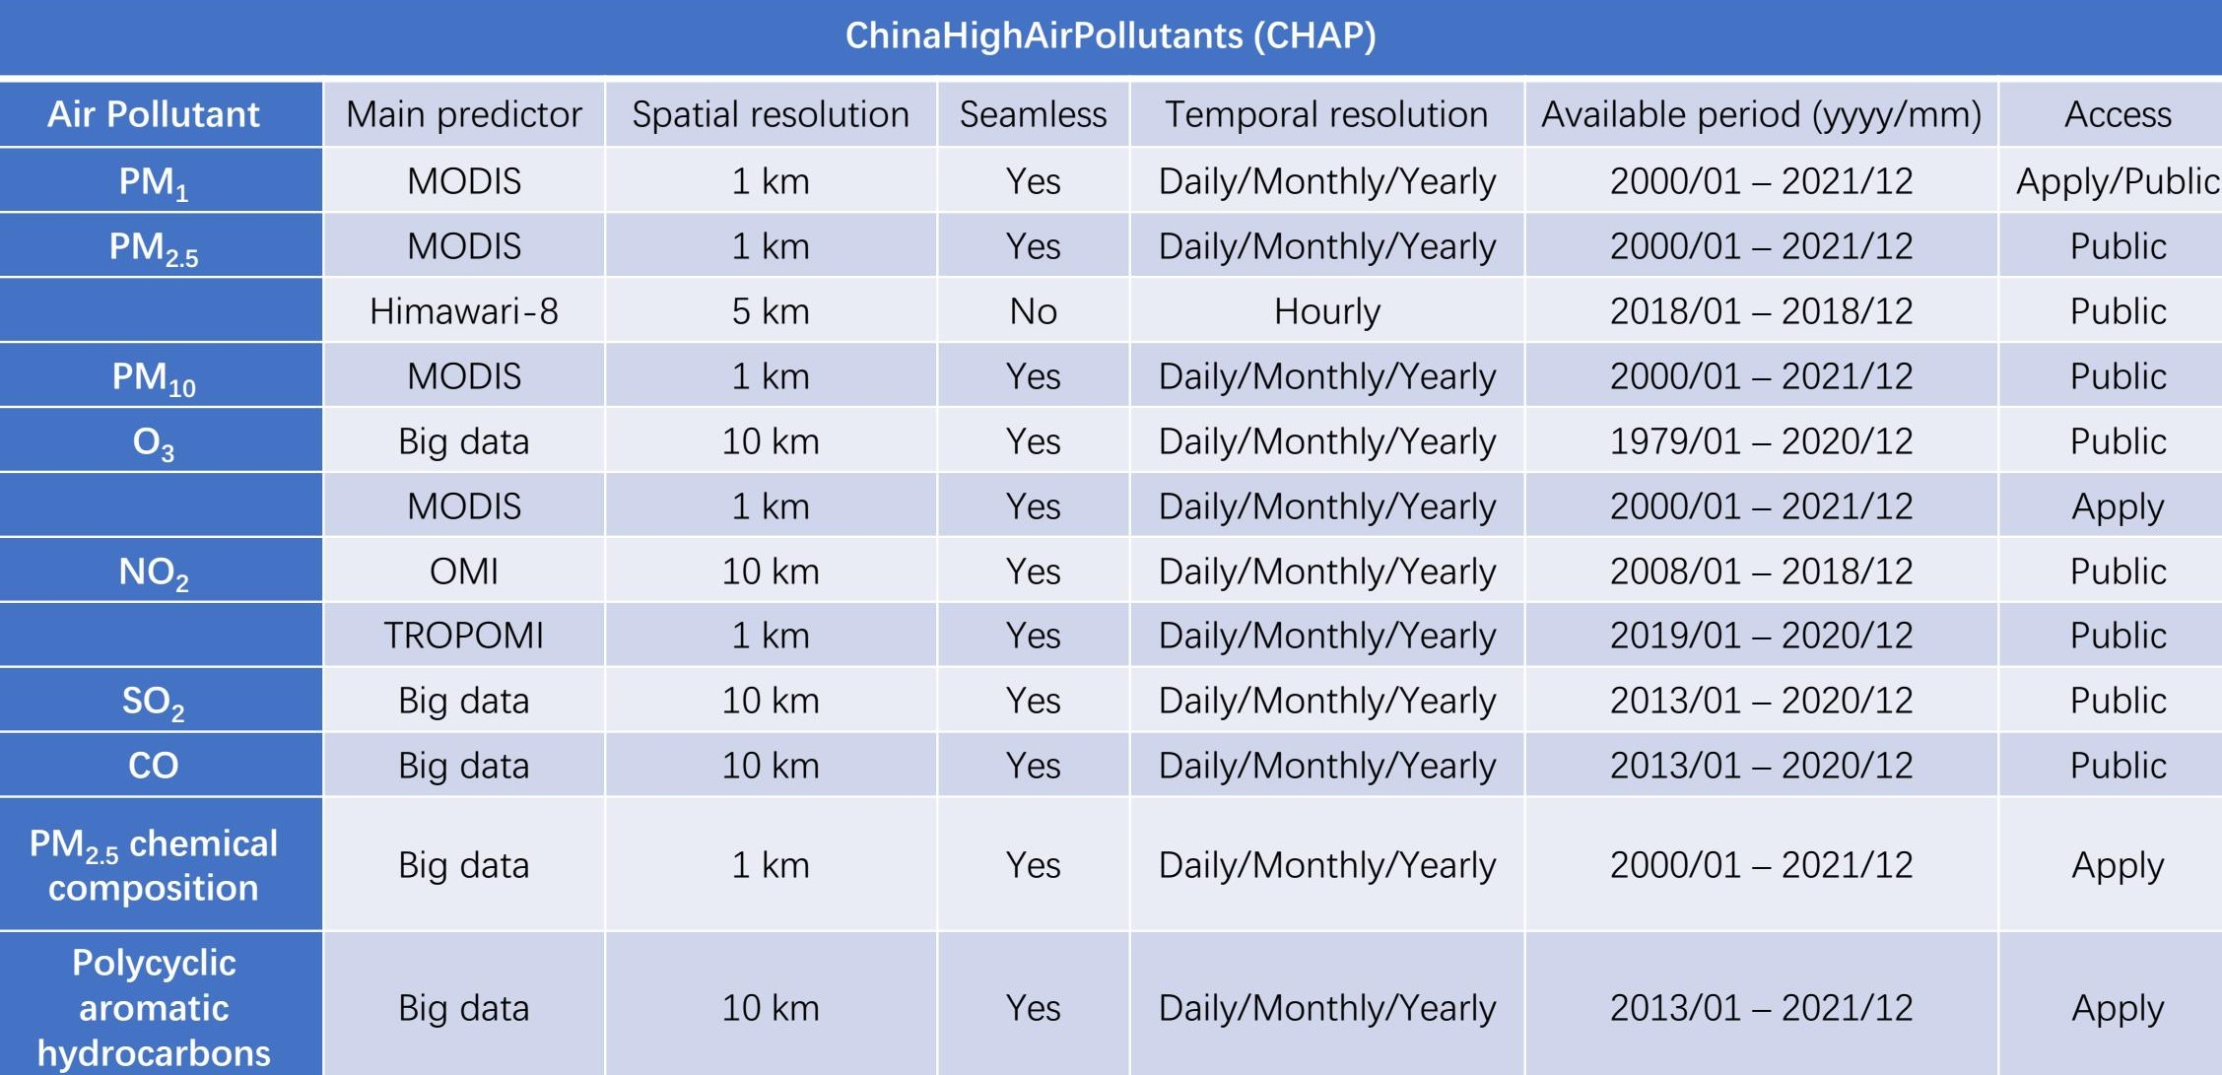
Summary of the Air Quality Products

Slide 14
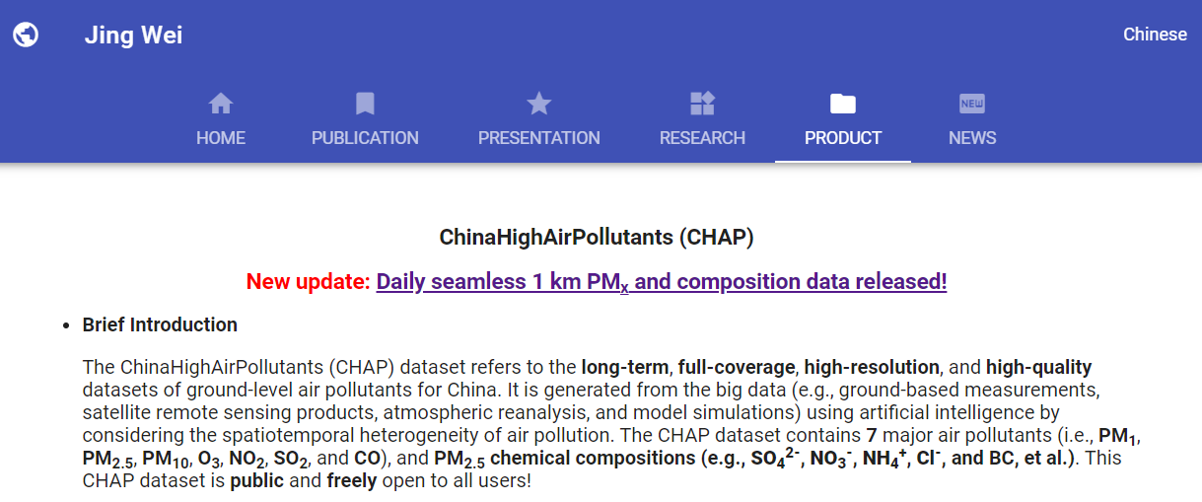
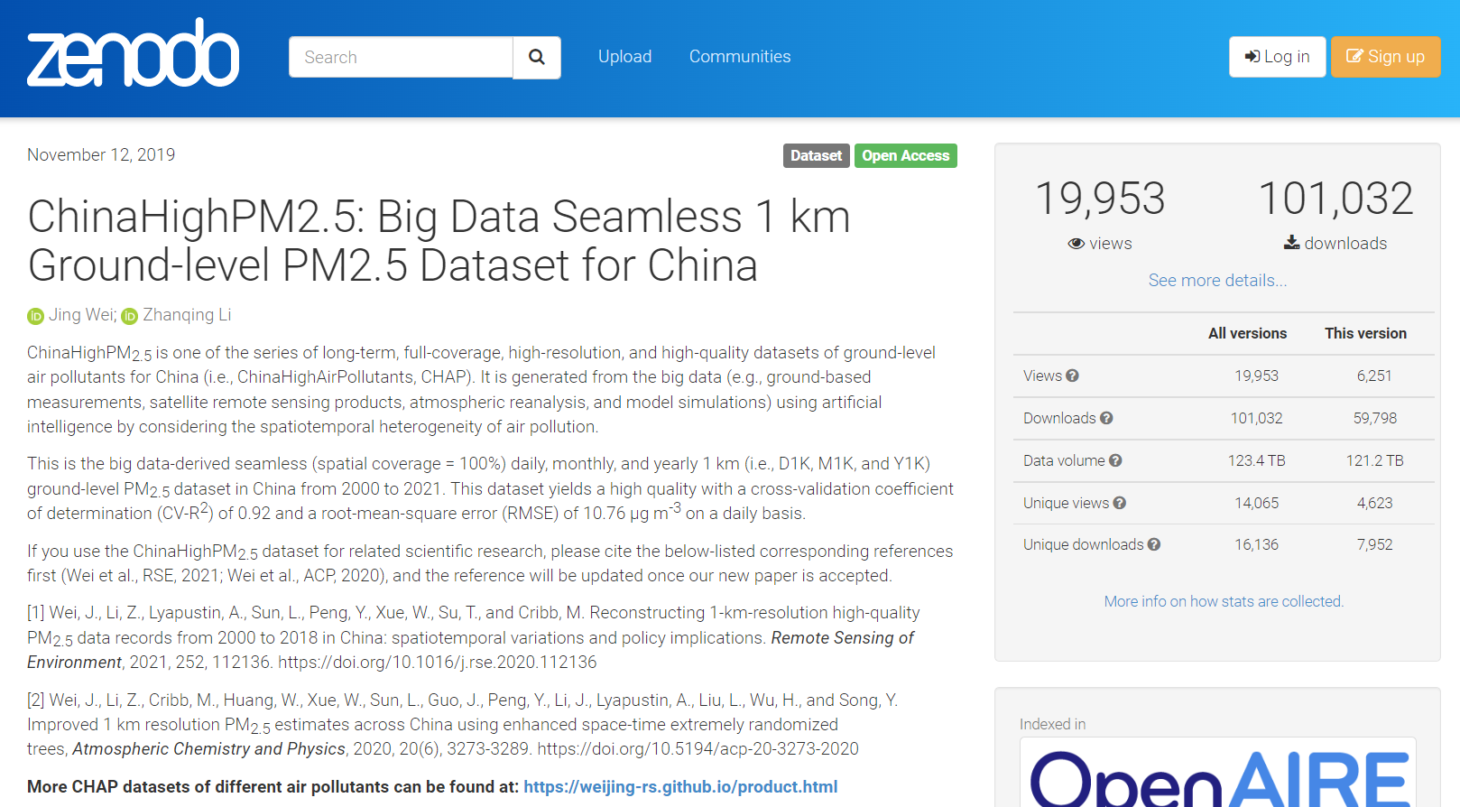
Online Products Distribution and Usage
The air quality datasets have been widely used in environmental health studies, among others, leading to hundreds of publications
GitHub
https://weijing-rs.github.io/product.html
Published > 160 applied papers in leading journals like Thorax, Hypertension, ES&T, GRL, et al.!
https://doi.org/10.5281/zenodo.3539349

Slide 15
Related Publications and Citations
Wei, J., Li, Z.*, et al. Reconstructing 1-km-resolution high-quality PM_{2.5} data records from 2000 to 2018 in China: spatiotemporal variations and policy implications. Remote Sensing of Environment, 2021, 252, 112136. (ESI Hot and Highly Cited Paper, Journal Most Cited Articles since 2019 and 2020) [281]
Wei, J., Li, Z.*, et al. Improved 1 km resolution PM_{2.5} estimates across China using enhanced space-time extremely randomized trees. Atmospheric Chemistry and Physics, 2020, 20, 3273–3289. (ESI Hot and Highly Cited Paper) [236]
Wei, J., Li, Z.*, et al. Satellite-derived 1-km-resolution PM₁ concentrations from 2014 to 2018 across China. Environmental Science & Technology, 2019, 53(22), 13265-13274. (ESI Hot and Highly Cited Paper) [154]
Wei, J.*, Li, Z.*, et al. Separating daily 1 km PM_{2.5} inorganic chemical composition in China since 2000 via deep learning integrating ground, satellite, and model data. Environmental Science & Technology, 2023, in press.
Wei, J.*, Li, Z.*, et al. Extending the EOS long-term PM_{2.5} data records since 2013 in China: application to the VIIRS Deep Blue aerosol products. IEEE Transactions on Geoscience and Remote Sensing, 2022, 60, 4100412.
Wei, J.*, Wang, J., Li, Z., et al. Wildfire emissions disrupt black carbon and PM_{2.5} mortality burden trends across the continental US. The Lancet – Planetary Health, 2022, under revision.
THANKS

