Slide 1
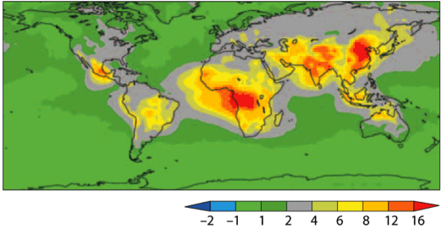
Quantifying impacts of light-absorbing aerosols on atmospheric temperature and circulation
Eric Wilcox, Marco Giordano and Farnaz Hosseinpour, Division of Atmospheric Sciences,
Desert Research Institute, Reno, NV
Jun Wang and Lakhima Chutia, Department of Chemical and Biochemical Engineering, University of Iowa
Kristina Pistone, NASA Ames Research Center and BAERI
All-sky solar heating of the atmosphere by light-absorbing aerosols
W m⁻²
from: Chung et al. (2005) via Ramanathan and Carmichael (2008)
Solar heating of the atmosphere by aerosol absorption of sunlight is widespread in the tropics, subtropics and Asia. But global observations do not yet discriminate the distribution of light-absorbing aerosols from all aerosols.
Chung, C., Ramanathan, V., Kim, D., & Podgorny, I. A. J. Geophys. Res. 110 (2005)
Ramanathan, V., and G. Carmichael Nature Geosci., 1, 221-227 (2008)

Slide 2
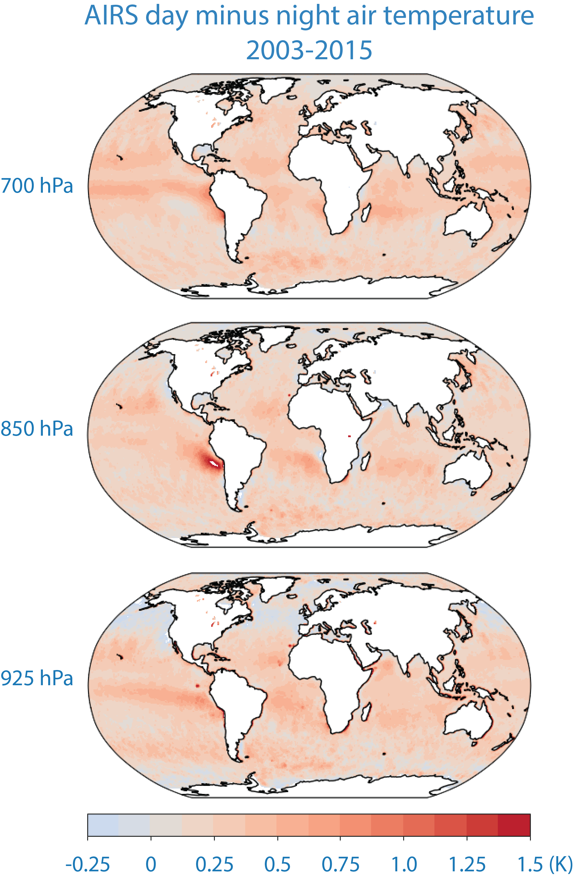
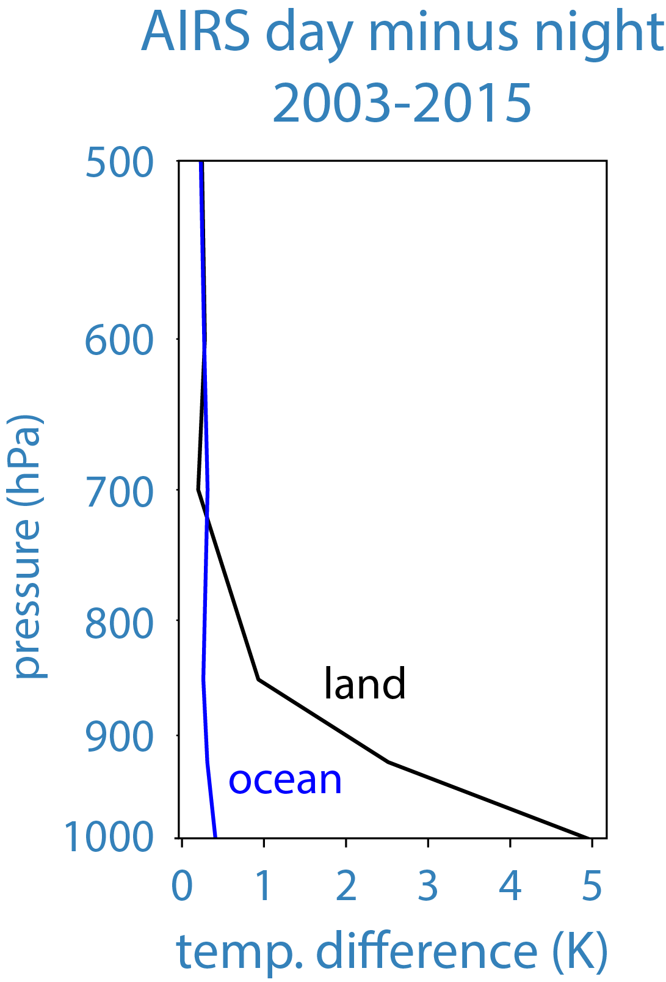
Daytime air temperature is generally greater than night time air temperature nearly everywhere.
Daytime heating of the lower troposphere is strongest over land.
Variability is evident in the lower troposphere over oceans.
See also: Wallace, J.M. and D.B. Patton, MWR, 98, 7, 548-552, 1970.

Slide 3
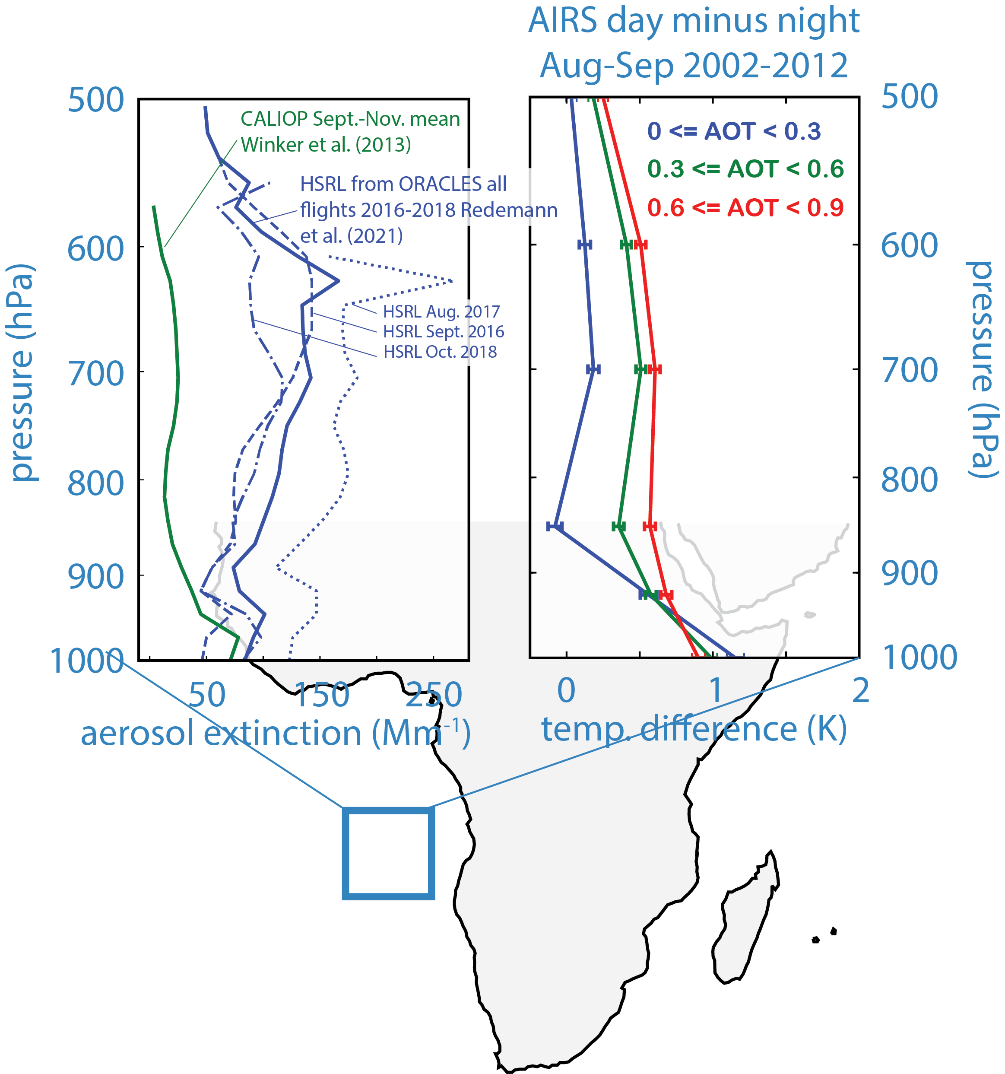
Over the southeast Atlantic Ocean smoke overlays stratocumulus clouds.
Day minus night temperature retrievals from the AIRS sounder systematically increase with aerosol optical depth from MODIS.
Winker D. M., J. L. Tackett, B. J. Getzewich, et al. Atmos. Chem. Phys., 13, 3345–3361, 2013.
Redemann, J., R. Wood, P. Zuidema, et al. Atmos. Chem. Phys., 21, 1507–1563, 2021.

Slide 4
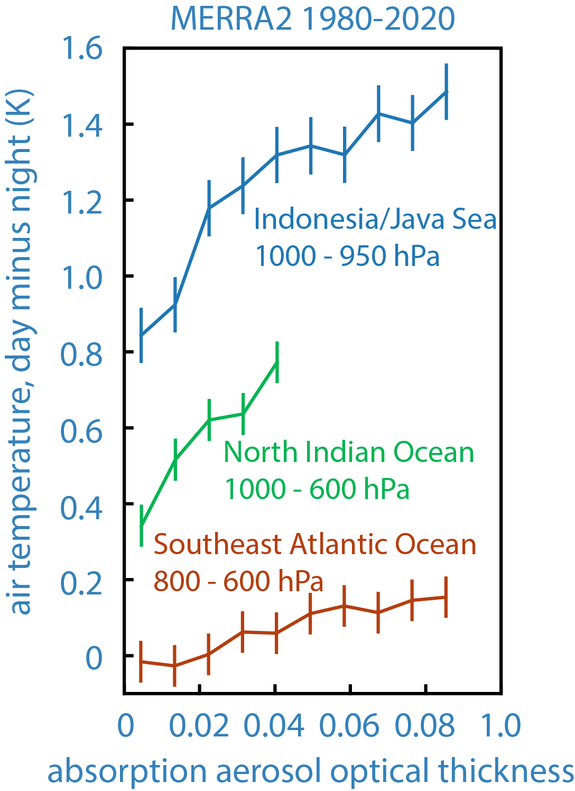
In MERRA2 reanalysis with aerosol assimilation, the day minus night temperature contrasts increases systematically with the absorption aerosol optical thickness.

Slide 5
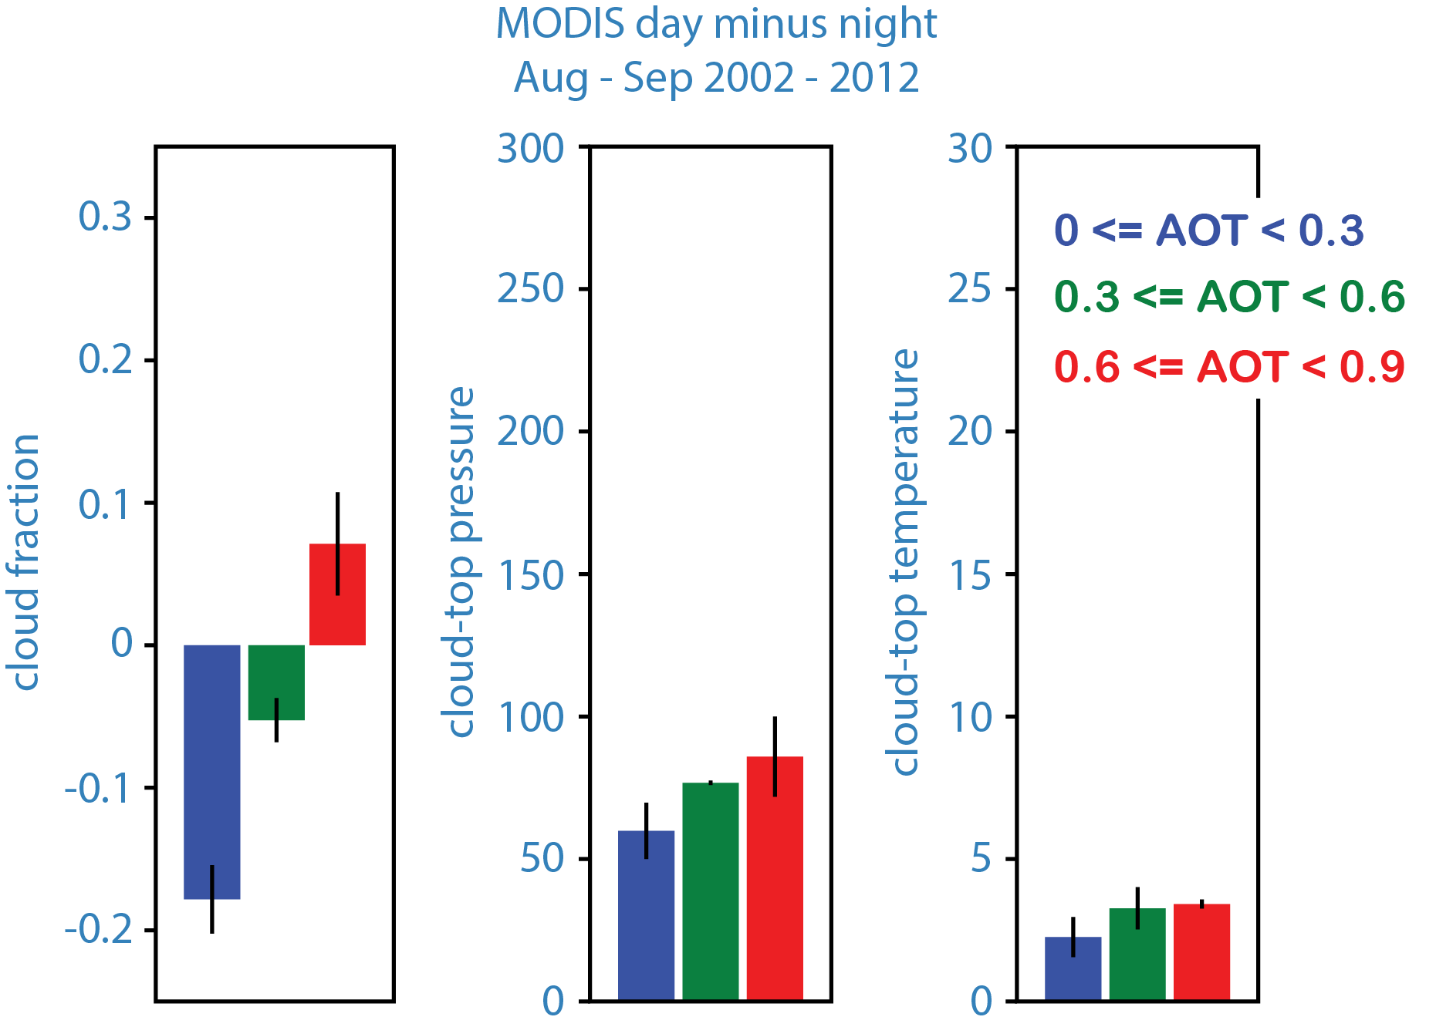
Over the southeast Atlantic Ocean smoke overlays stratocumulus clouds.
Day minus night temperature retrievals from the AIRS sounder systematically increase with aerosol optical depth from MODIS.
Day minus night clouds also depend systematically on AOD with greater coverage and lower cloud tops favored more during day relative to night during high AOD conditions.
Winker D. M., J. L. Tackett, B. J. Getzewich, et al. Atmos. Chem. Phys., 13, 3345–3361, 2013.
Redemann, J., R. Wood, P. Zuidema, et al. Atmos. Chem. Phys., 21, 1507–1563, 2021.
As in: Johnson, B.T., K.P. Shine, and P.M. Forster, Q. J. R. Meteorol. Soc., 130, 1407-1422, 2004.
Wilcox E.M., Atmos. Chem. Phys., 10, 11769–11777, 2010.

Slide 6
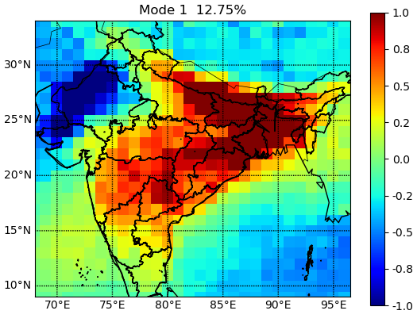
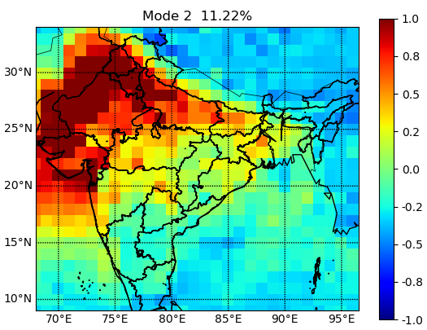
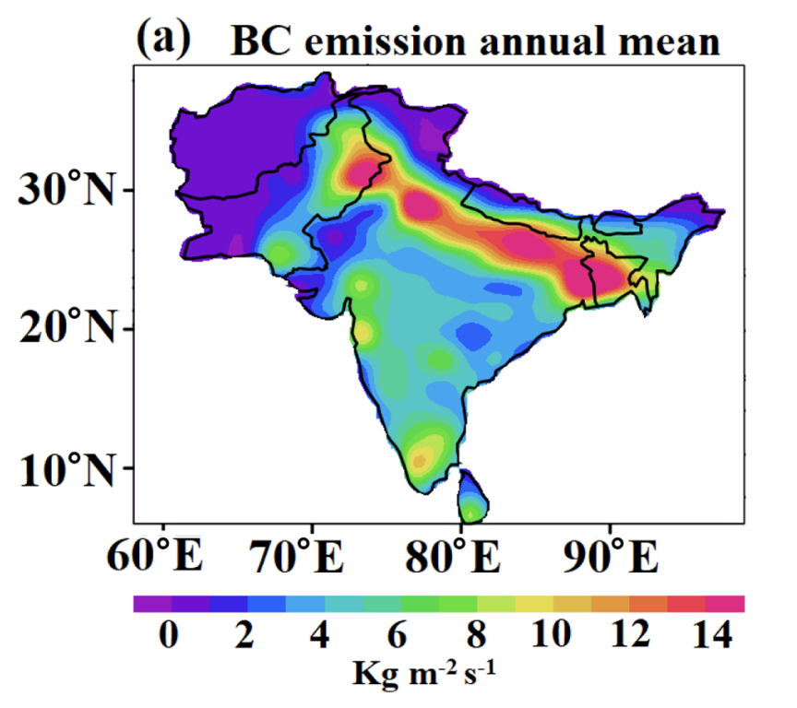
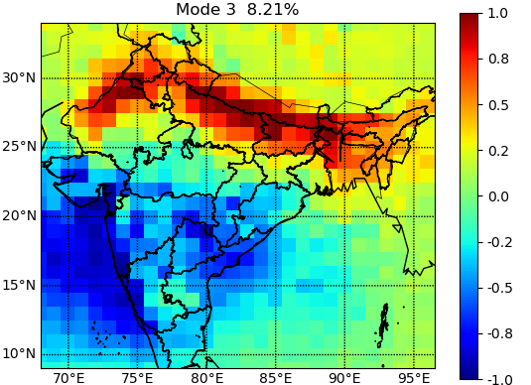
Exploring spatio-temporal variability of light-absorbing aerosols and lower-tropospheric air temperature
via Principal component analysis - Lakhima Chutia (U. Iowa)
Mode 1, 12.8%
Mode 2, 11.2%
BC aerosol emissions (annual)
CO emissions (spring)
Mode 3, 8.2%
MODIS-Aqua aerosol optical thickness, 2003-2022 de-seasonalized.
Spatial patterns of modes 1-3 of the principal components.
Modes 1 and 3 appear to coincide with anthropogenic emissions.
Mode 2 appears to coincide with seasonal dust transport from Middle East.

Slide 7
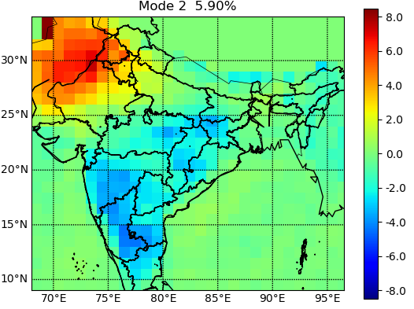
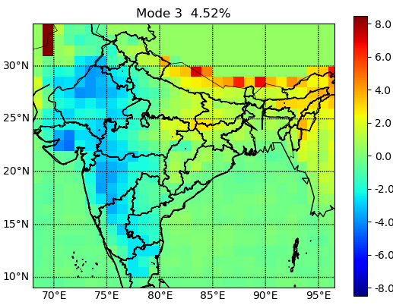
Exploring spatio-temporal variability of light-absorbing aerosols and lower-tropospheric air temperature
Mode 2, 5.9%
Mode 1, 12.8%
Mode 2, 11.2%
AIRS 925 hPa day minus night air temperature, 2003-2022 de-seasonalized.
Spatial patterns of modes 2 and 3 of the principal components appear to potentially coincide with the dust and anthropogenic aerosol signatures.
Mode 3, 4.5%
Mode 3, 8.2%
MODIS-Aqua aerosol optical thickness, 2003-2022 de-seasonalized.
Spatial patterns of modes 1-3 of the principal components.
Modes 1 and 3 appear to coincide with anthropogenic emissions.
Mode 2 appears to coincide with seasonal dust transport from Middle East.

Slide 8
Exploring spatio-temporal variability of light-absorbing aerosols and lower-tropospheric air temperature
925 hPa day minus night temperature contrast correlates roughly with the principal components of CO variations.
Mode 3 of the day minus night temperature variability roughly correlates with mode 1 of MODIS aerosol optical thickness.

Slide 9
Exploring the consequences for atmospheric waves of spatio-temporal variability of light-absorbing aerosols – Farnaz Hosseinpour
African easterly waves occur as oscillations about the mean flow of the African easterly jet.
Short period waves are in the 2-6 day range.
Long period waves in the 6-11 day range.
The waves coincide with radiative forcing of the atmosphere by dust outflow from the Sahara Desert.
Hosseinpour and Wilcox (2023) preprint in AMTD
https://doi.org/10.5194/egusphere-2022-1210

Slide 10
Exploring the consequences for atmospheric waves of spatio-temporal variability of light-absorbing aerosols – Farnaz Hosseinpour
Difference in eddy kinetic energy of short period African easterly waves between dust outbreak events and low-dust conditions.
Hosseinpour and Wilcox (2023) preprint in AMTD
https://doi.org/10.5194/egusphere-2022-1210

Slide 11
Summary
In several oceanic regions, the day minus night temperature contrast appears to be a reliable indicator of the atmospheric heating from light-absorbing aerosols.
Day minus night contrasts in cloud cover and cloud-top pressure/temperature from multi-year satellite records indicate greater low cloud cover and lower cloud tops with greater light-absorbing aerosol in the lower troposphere.
So far, we have explored these relationships in places where we know there is an effect and there are related in-situ and/or modelling studies on the effects of light-absorbing aerosols. We are now exploring principal component analysis (PCA) and combined-PCA to better characterize the spatio-temporal variability of atmospheric temperature related to aerosol variations.
In addition to cloud responses, there may be dynamical responses to light-absorbing aerosols, such as adjustments to the Atlantic ITCZ and African Easterly Wave activity to atmospheric heating.
Also, a MODIS poster:
“Deep convective cloud systems across the global tropics and subtropics”, Eric Wilcox, Tianle Yuan, and Hua Song. A MEaSUREs-funded project to develop cloud object datasets from MODIS (T. Yuan, PI).
This work has been supported by NASA Science of Terra, Aqua and SNPP program grants: 80NSSC18K0846 and 80NSSC21K1981.

