Slide 1





MODIS and VIIRS Instrument Status
Jack Xiong
Code 618.0, NASA Goddard Space Flight Center, Greenbelt, MD 20771
MODIS and VIIRS Science Team Meeting, The Hotel at the University of Maryland, College Park, MD, May 2, 2023

Slide 2
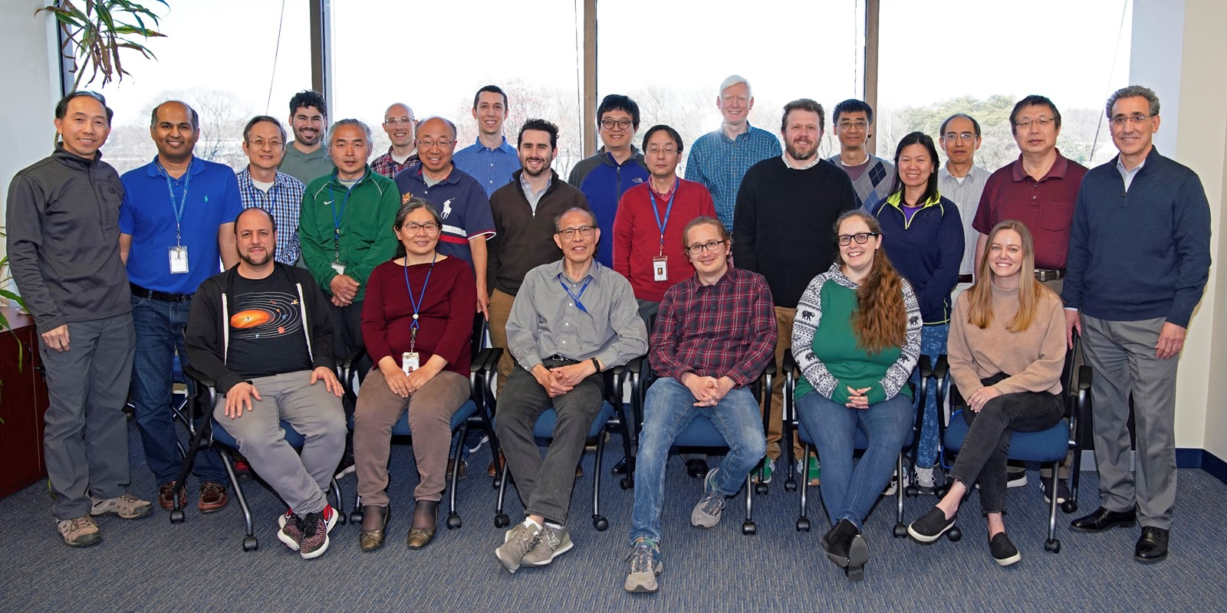
Acknowledgements
Contributions:
MODIS Characterization Support Team (MCST)
VIIRS Characterization Support Team (VCST)
Support:
Terra, Aqua, S-NPP, and JPSS Projects
Mission/Flight Operation Teams (MOT/FOT)
MODIS and VIIRS Science Teams
Instrument Vendor (Raytheon)
NOAA JPSS Program and VIIRS SDR Team
March 30, 2023

Slide 3
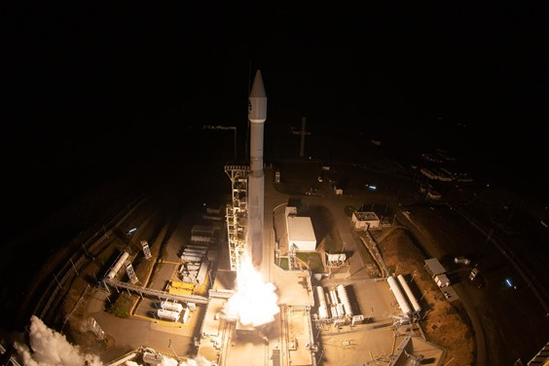
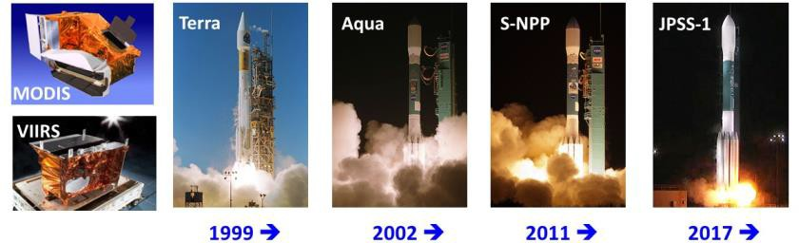
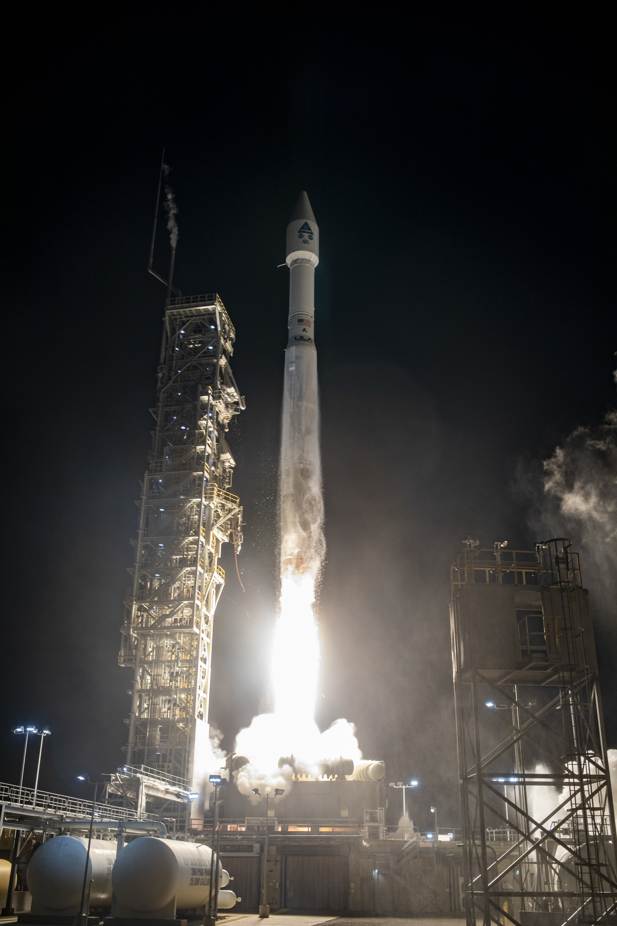
Outline
Instrument Status
  Terra and Aqua MODIS
  S-NPP, N-20, and N-21 VIIRS
MODIS and VIIRS On-orbit Performance
Current and Future Activities
Summary
JPSS-2 launch on Nov 10, 2022
JPSS-2
JPSS-3/4 VIIRS
(2028/2032)
2022

Slide 4
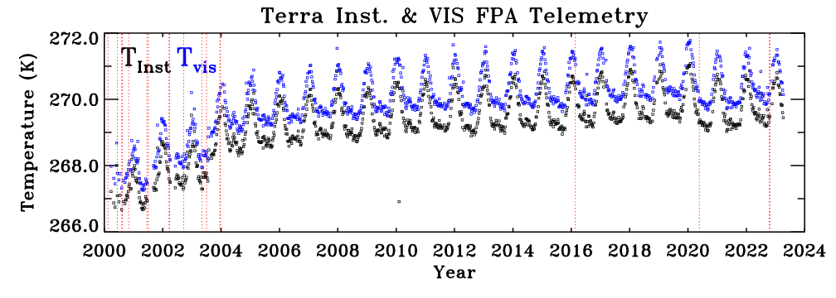
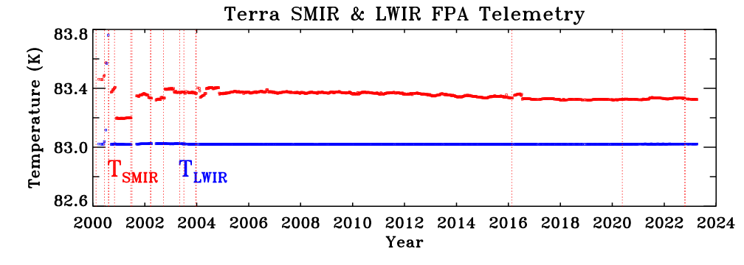
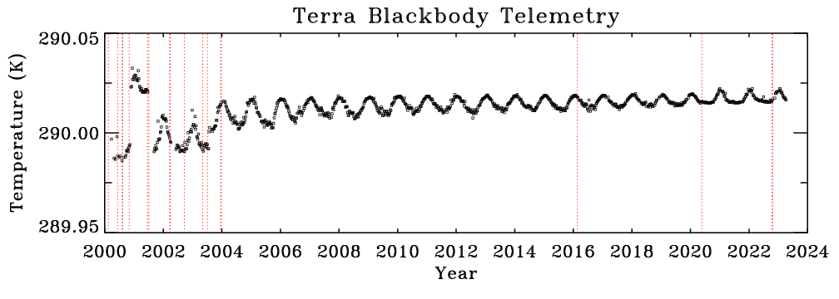
Instrument Status: Terra MODIS
Instrument Operations and OBC Functions – Normal
  Same configuration (A-side electronics with B-side formatter) since 2003
    CFPA at 83 K; BB at 290 K (285 K since 04/25/2020)
  Orbit Maneuvers
    Constellation Exit Maneuvers (CEM) on 10/12/2022 and 10/19/2022
    Final drag makeup maneuver (DMU) on 07/28/2022
    Final inclination adjustment maneuver (IAM) on 02/27/2020
  Successful SSR Reset on 09/22/2021
  Standby Mode due to Terra CP/FP Reset on 03/15/2022 (recovered back to Science Normal on 03/16/2022)
  1 new noisy detector (B6 d13) since last STM in Feb 2021
    Currently 40 noisy detectors (30 from prelaunch; 35 at-launch) and 2 inoperable detector (B36 d7 and B5 d4)
< 3.5 K increase
< 35 mK increase
5 K added to T_BB after setting at 285 K (04/25/20)

Slide 5
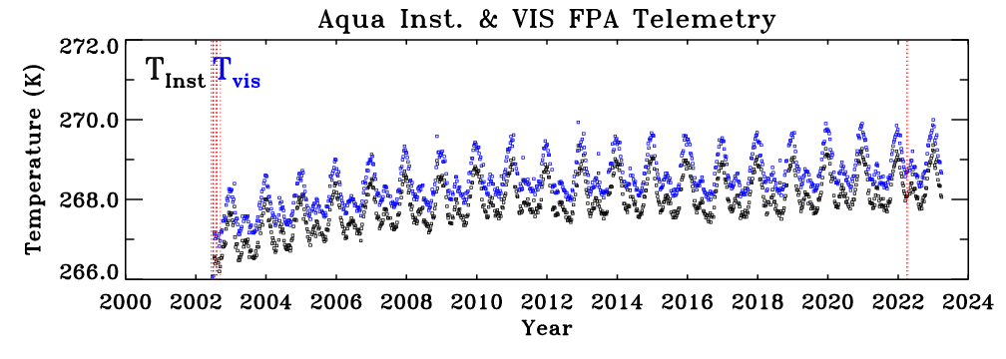
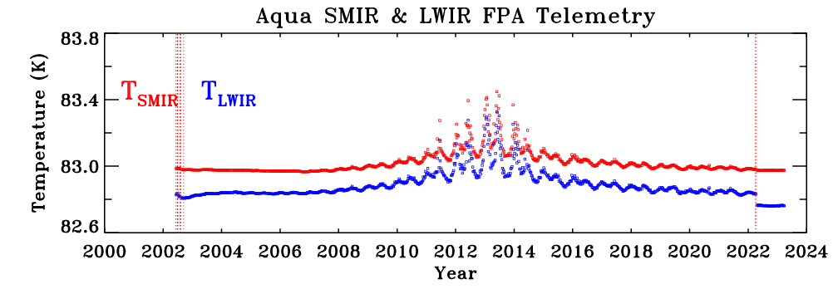
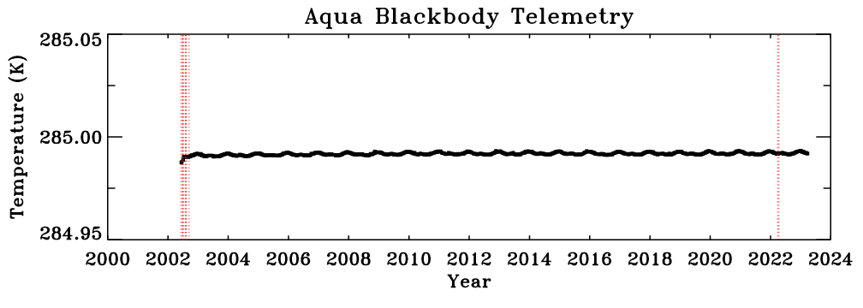
Instrument Status: Aqua MODIS
Instrument Operations and OBC Functions – Normal
  Same configuration (B-side electronics and formatter) since launch
    CFPA at 83 K; BB at 285 K
  Orbit Maneuvers
    Final DMU: 12/01/2021
    Final IAM: 03/18/2021
  Aqua pitch maneuver on 09/23/2021
  Aqua FMU (Formatter-Multiplexer Unit) anomaly on 02/22/2022; back to nominal operation on 03/23/2022
  Aqua Safe Mode on 03/31/2022; back to nominal operation on 04/13/2022 (with fully controlled CFPA temperatures)
  3 new noisy detectors (B27 d1 and d3, B30 d1) and 1 new inoperable detector (B6 d4) since last STM
    Currently 9 noisy detectors (2 from pre-launch; 3 at launch) and 15 inoperable detectors (13 in Band 6)
< 2.0 K increase
well-controlled after safe mode (outgassing)
extremely stable

Slide 6
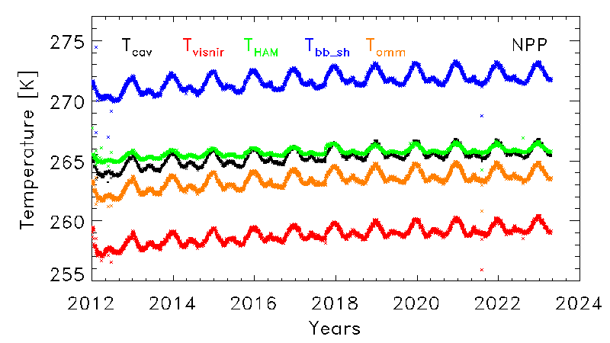
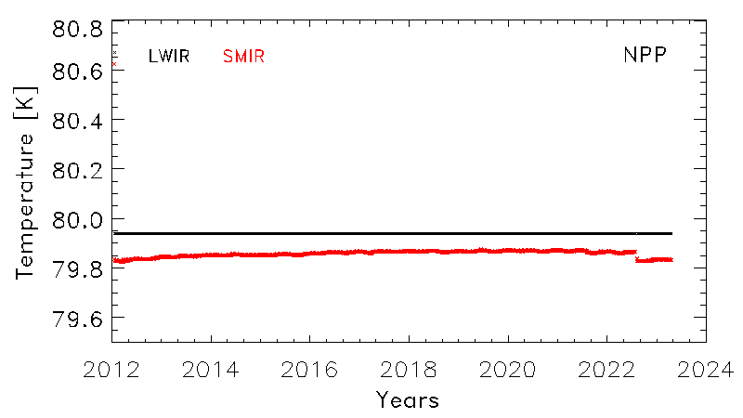
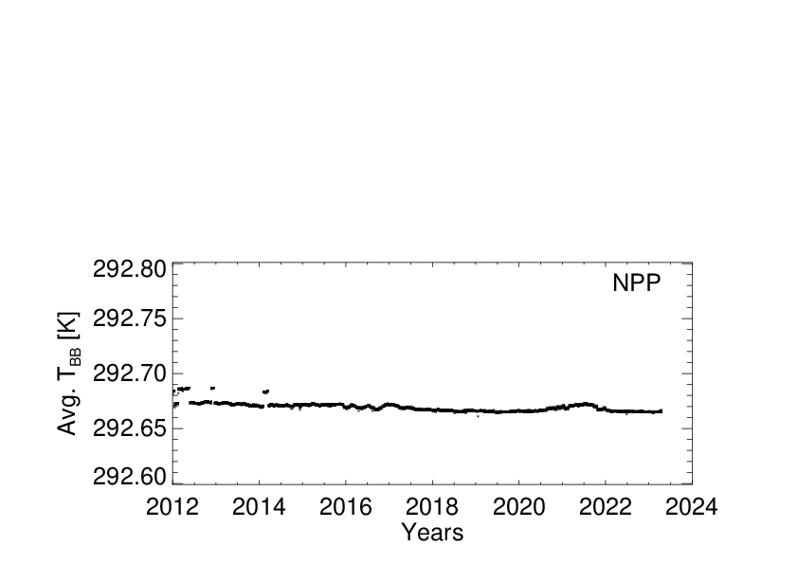
Instrument Status: S-NPP VIIRS
Instrument Operations and OBC Functions – Normal
  Same configuration (B-side) since launch
    CFPA at 80 K; BB at 292.5 K
  Single Board Computer (SBC) Lock-up (petulant mode): 16 since launch (most recent on 6/28/2022)
  Scan Sync Loss between RTA and HAM: 136 since launch (most recent on 9/17/2022)
  S-NPP Safe Mode on 8/3/2021 (after Star Catalog V1.09 upload)
  S-NPP Safe Mode from 7/26 to 8/10/2022
  No new noisy or inoperable detectors since launch
    All detectors continue to function well

Slide 7
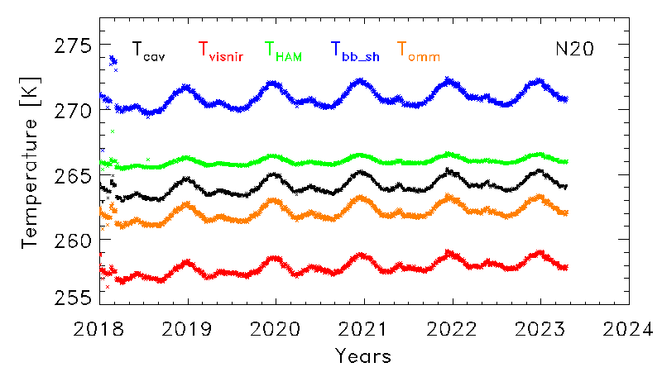
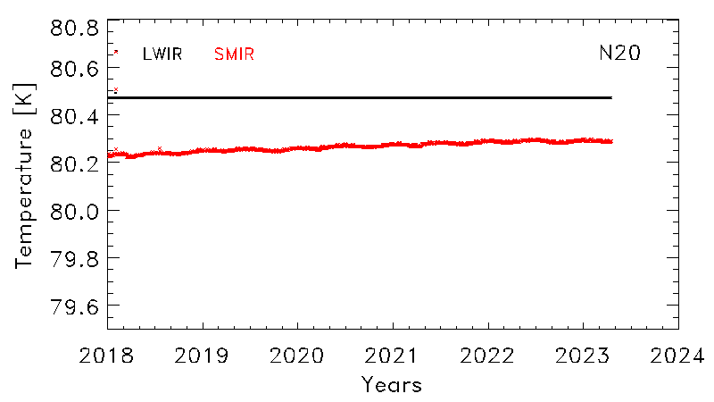
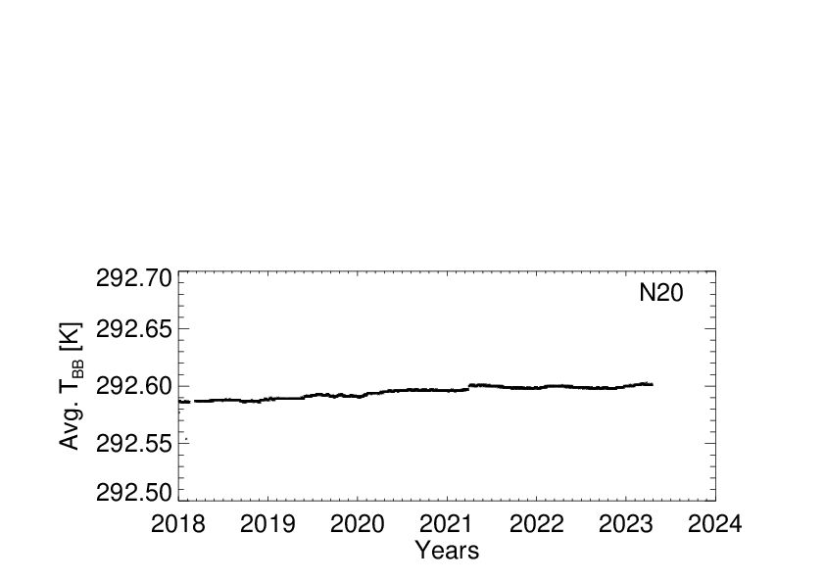
Instrument Status: N-20 VIIRS
Instrument Operations and OBC Functions – Normal
  Same configuration (A-side) since launch
    CFPA at 80 K; BB at 292.5 K
  SBC Lock-up: none
  Scan Sync Loss between RTA and HAM: 87 since launch (most recent on 1/23/2023)
  VIIRS RTA (rotating telescope assembly) anomaly due to SEU (single event upset) on 2/14/2021; data outage for ~ 6 hours
  No new noisy or inoperable detectors since launch
    1 noisy detector at launch (I3 D29)

Slide 8
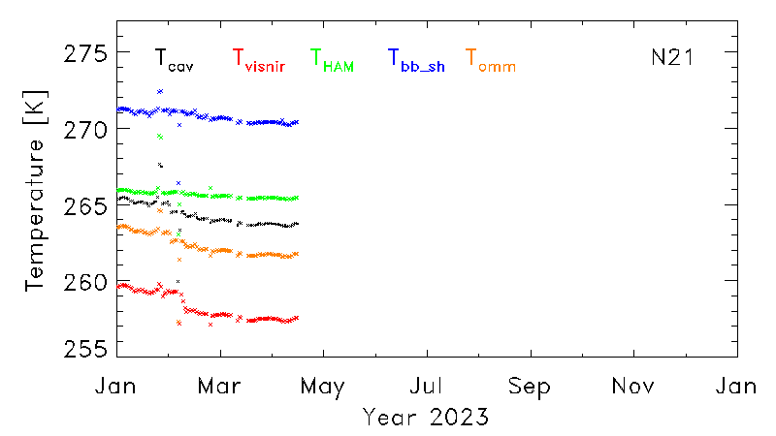
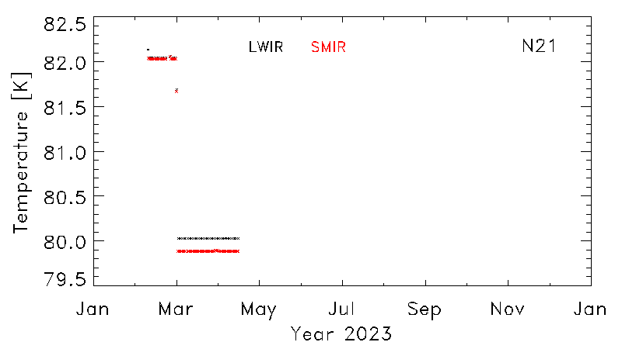
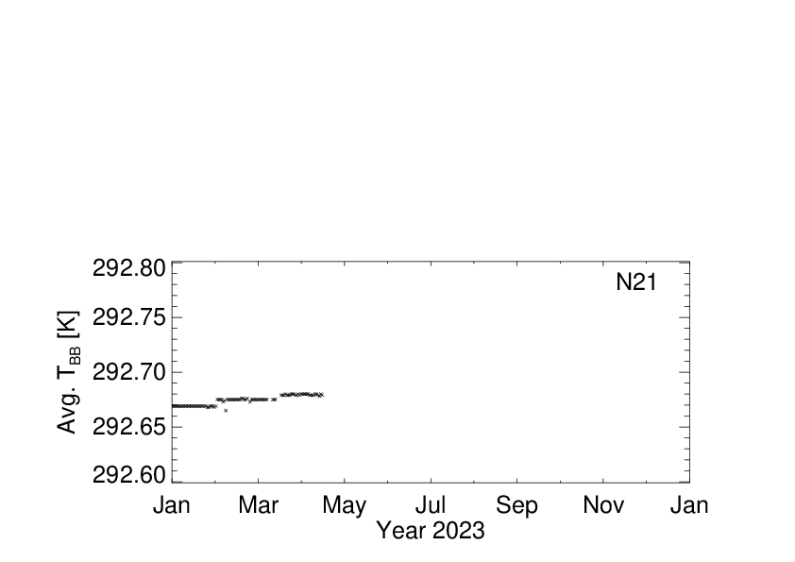
Instrument Status: N-21 VIIRS
Instrument Operations and OBC Functions – Normal
  Same configuration (A-side) since launch
    CFPA at 80 K (82 K prior to 03/03/2023); BB at 292.5 K
  SBC Lock-up: none
  Scan Sync Loss between RTA and HAM: 7 since launch (most recent on 4/23/2023)
  N-21 primary Ka-Transmitter (KATX-1) anomaly on 12/16/2022; the secondary Ka-Transmitter (KATX-2) activation on 2/2/2023 (48 days of data gap).
  MMOG (mid-mission outgassing) on 02/23/2023
  All PLT activities, including initial calibration maneuvers, completed
  No new noisy or inoperable detectors since launch
    All detectors continue to function well
CFPA setting changed from 82 K to 80 K on 03/03/23
NOAA-21 Satellite Acceptance Review/Post Launch Acceptance Review/Handover Readiness Review (March 29-30, 2023)

Slide 9
MODIS and VIIRS Spectral bands and On-orbit Calibration
1 DNB
(0.5-0.9 μm)
14 RSB
(0.4-2.3 μm)
7 TEB
(3.7-12 μm)
Dual Gain: M1-M5, M7, M13
MODIS: bands 33-36

Slide 10
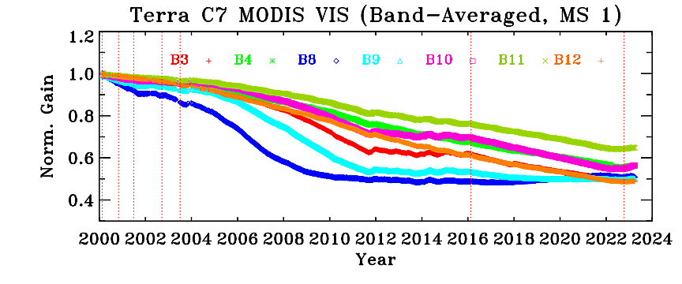
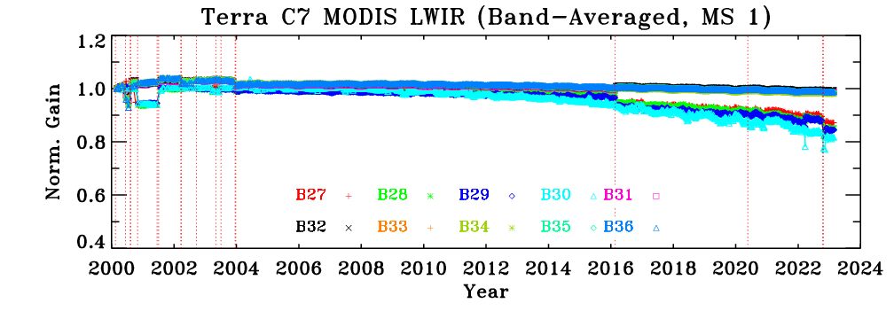
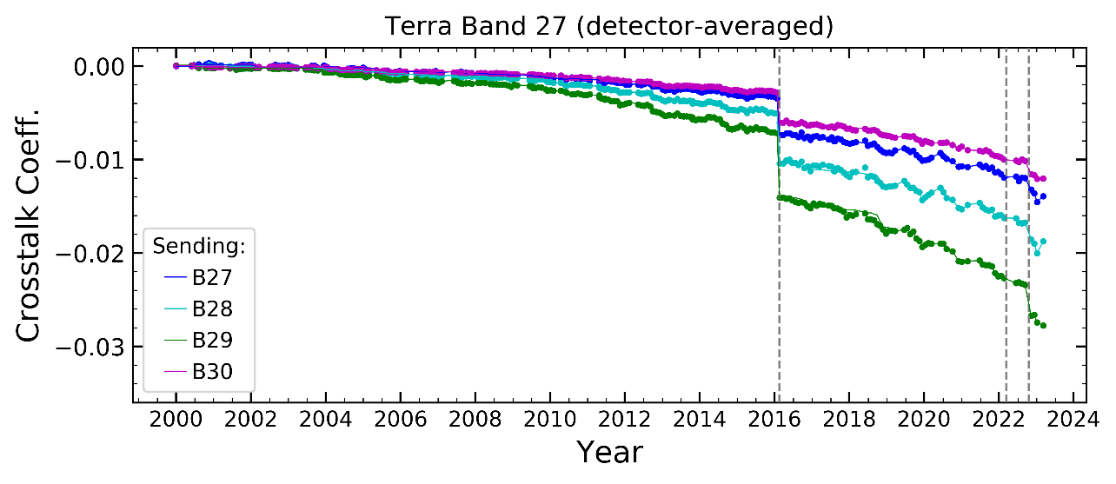
Terra MODIS Performance
Radiometric
  Large changes in sensor response and RVS at short wavelengths (VIS/NIR bands)
  Discontinuities in sensor performance parameters (e.g. TEB gains and crosstalk coefficients) due to sensor Safe Mode
  Large SD degradation at short wavelengths
  Terra LWIR PV crosstalk correction in C6.1 remains effective
Spatial and Spectral
  Band-to-band registration (BBR): stable since launch
  VIS/NIR center wavelengths and bandwidths: changes are within 0.5 nm and 1.0 nm, respectively, except for bands (1, 2, 17) with broad bandwidths
Geolocation
  C6.1 RMSE Track: 43 m; Scan: 45 m, nadir equivalent
crosstalk correction coefficient
Spatial, Spectral, and Geolocation Performance Examples Provided in Backup Slides

Slide 11
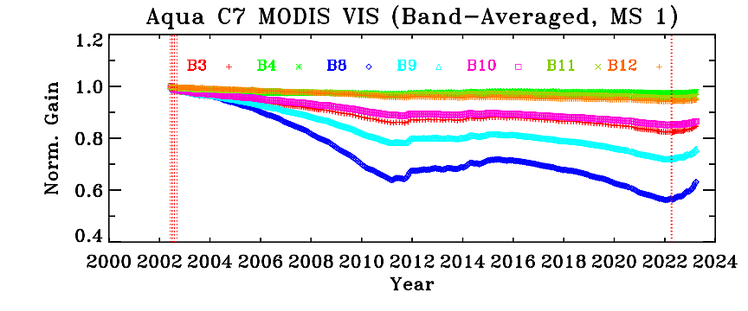
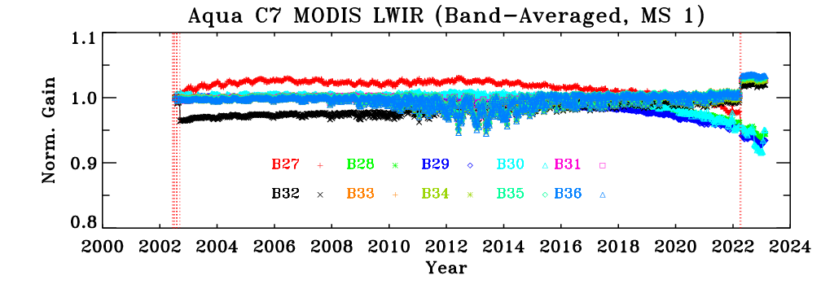
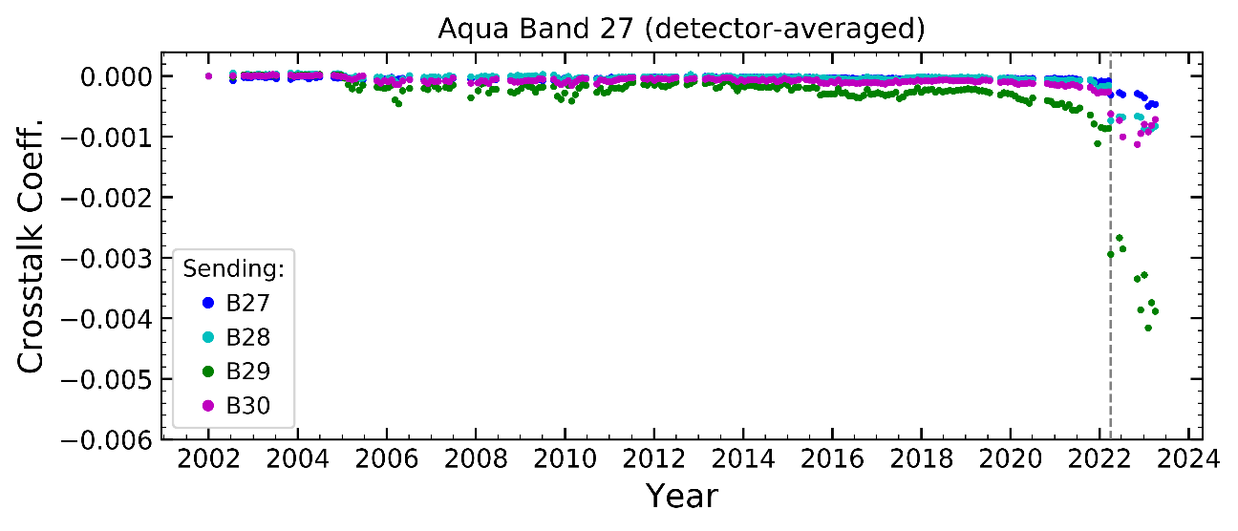
Aqua MODIS Performance
Radiometric
  Large changes in sensor response and RVS at short wavelengths (VIS/NIR bands)
  Discontinuities in sensor performance parameters (e.g. TEB gains and crosstalk coefficients) due to sensor Safe Mode
  Large SD degradation at short wavelengths
  Aqua LWIR PV crosstalk correction is applied to C7 (entire mission) and C6.1 (forward only) to address more recent increase of the crosstalk effects
Spatial and Spectral
  Band-to-band registration (BBR): stable since launch
  VIS/NIR center wavelengths and bandwidths: changes are within 0.5 nm and 1.0 nm, respectively.
Geolocation
  C6.1 RMSE Track: 46 m; Scan: 54 m, nadir equivalent
crosstalk correction coefficient
Spatial, Spectral, and Geolocation Performance Examples Provided in Backup Slides

Slide 12
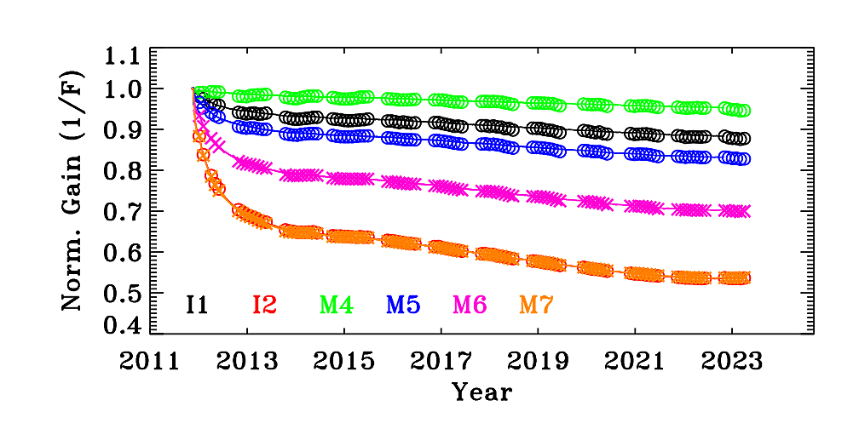
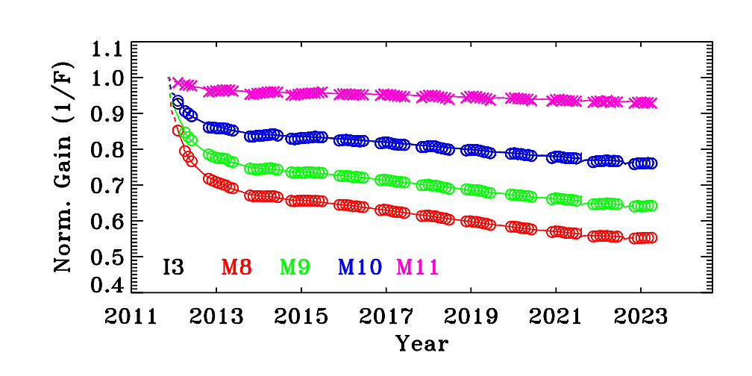
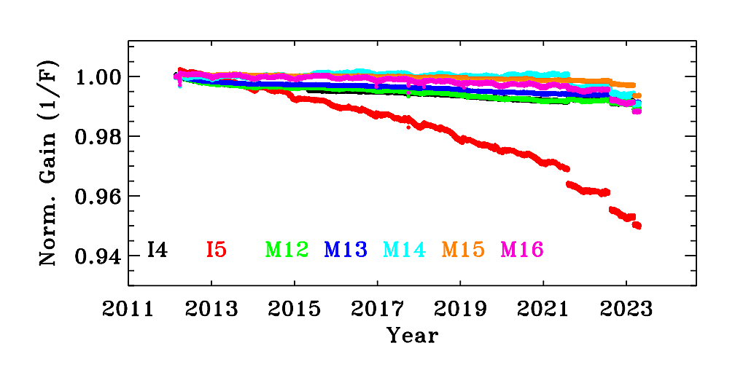
S-NPP VIIRS Performance
Radiometric
  Large degradation in several NIR and SWIR bands, especially at mission beginning (a known issue due to RTA mirror coating contamination)
  Large SD degradation at short wavelengths
  A gradual gain decrease for I5 (5% over 11 years)
  DNB stray light correction remains effective
Spatial and Spectral
  Band-to-band registration (BBR): stable since launch
  Relative spectral response (RSR): on-orbit modulated RSR (large impact on DNB calibration)
Geolocation
  C2 RMSE Track: 59 m; Scan: 48 m
Spatial and Geolocation Performance Examples Provided in Backup Slides

Slide 13
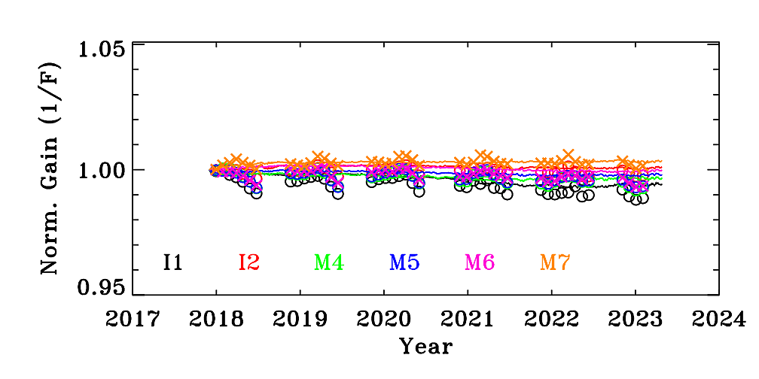
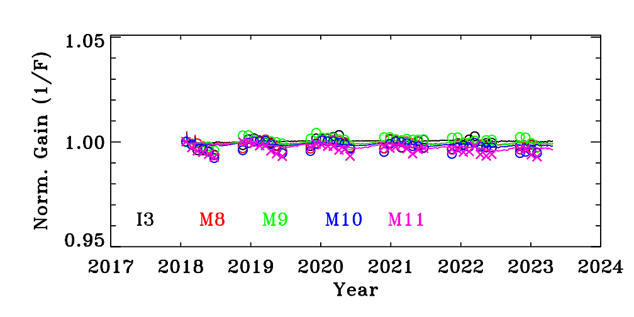
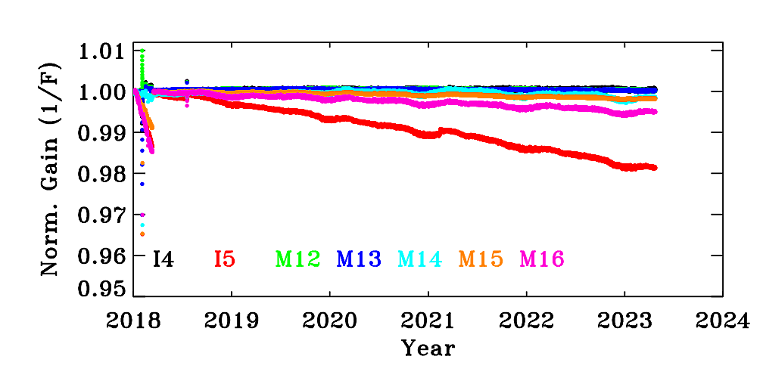
N-20 VIIRS Performance
Radiometric
  RSB responses (detector gains) have been extremely stable over the entire mission
  Large SD degradation at short wavelengths
  TEB gains have remained stable since MMOG (mid-mission outgassing), a gain decrease for I5 (similar to SNPP; 1.8% over 5 years)
  DNB stray light correction remains effective
Spatial and Spectral
  Band-to-band registration (BBR): stable since launch
  Relative spectral response (RSR): pre-launch characterization
Geolocation
  C2.1 RMSE Track: 57 m; Scan: 47 m
MMOG
Spatial and Geolocation Performance Examples Provided in Backup Slides

Slide 14
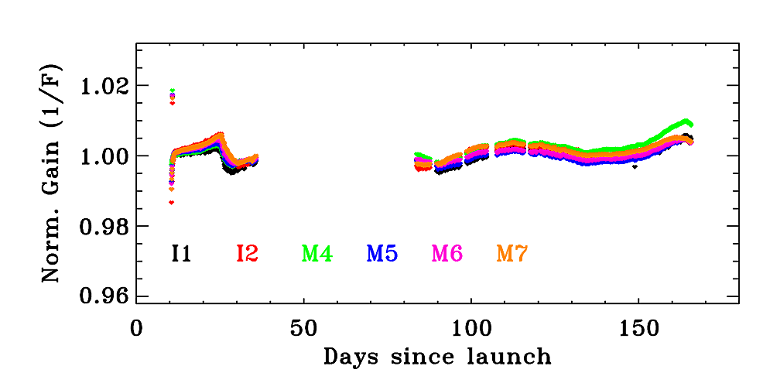
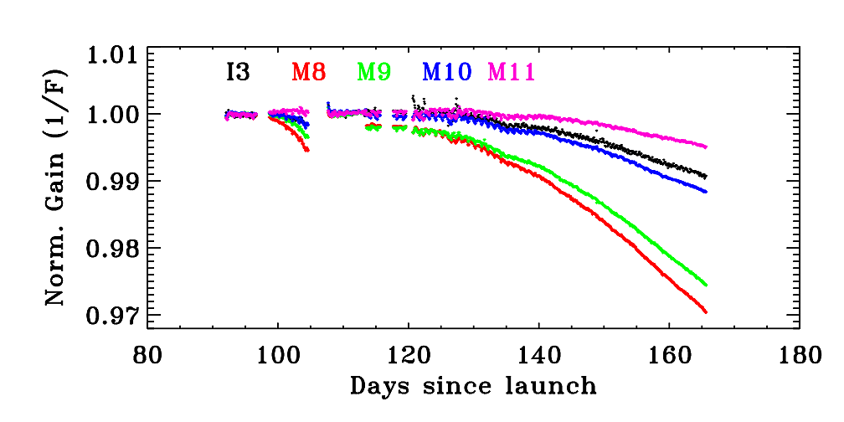
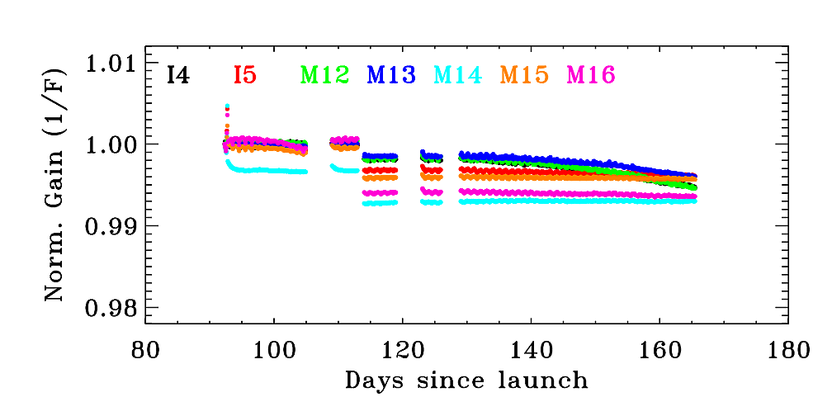
N-21 VIIRS Performance
Radiometric
  Stable responses (detector gains) for most spectral bands (VIS/NIR/LWIR) under the same operating condition
  Relatively large decrease in SWIR (M8, M9) responses
  Small decrease in MWIR (I4, M12, M13) responses
  Large SD degradation at short wavelengths
  DNB stray light: smaller than S-NPP and N-20
Spatial and Spectral
  Band-to-band registration (BBR): stable since launch (preliminary with limited measurements)
  Relative spectral response (RSR): pre-launch characterization
Geolocation
  “C2” RMSE Track: 61 m; Scan: 48 m
Spatial and Geolocation Performance Examples Provided in Backup Slides

Slide 15
Current and Future Activities: Terra and Aqua MODIS
  Continue to monitor sensor performance and to derive and update calibration LUTs in support of C6.1 data production (C6 data production ended in April 2023)
  Update C7 calibration LUTs regularly when forward production begins (C7 mission-long LUTs were initially delivered for science testing in March 2021 and later updated through Dec 2022, including several RSB and TEB algorithm enhancements and L1B code changes).
  Continue to monitor and address crosstalk impact on Terra and Aqua PV LWIR bands 27-30. As Aqua crosstalk contamination continues to increase after recent safe mode, further adjustments may be needed to improve calibration accuracy, long-term stability, and image striping.
  Monitor and update crosstalk correction for select MWIR detectors (included in C7)
  Implement C7 RSB algorithm changes into C6.1 forward production (started March 2023 with gradual phase-in over several months)
  Enhance and expand post-CEM calibration strategies in support of extended Terra and Aqua MODIS missions (use of OBC and lunar observations, vicarious calibration targets, and alternative approaches) – to address impact due to drifting orbits
  Support Terra and Aqua FOT for planning and preparation of special end-of-mission maneuvers and decommissioning activities

Slide 16
Current and Future Activities: S-NPP, N-20, and N-21 VIIRS
Continue to monitor sensor performance and to derive and update calibration LUTs in support of SIPS for VIIRS data production (S-NPP, N-20, and N-21) with special effort on changes in N-21 SWIR response
Continue to monitor detector-to-detector calibration differences and implement corrections as necessary (already applied in S-NPP C2 for a few VIS bands; likely to extend to N-20 SWIR bands)
Continue to track VIIRS calibration stability, including potential changes in the RVS, using different EV targets and DCC
Complete and implement the saturation rollover pixel flagging and uncertainty index for all three instruments, including L1B code changes.
Further improve N-21 VIIRS RSB calibration (SDSM Sun view screen transmittance, use of both SD and lunar measurements for LUT updates, …)
Further improve DNB calibration accuracy and stray light characterization and correction
Develop strategies to assess and address S-NPP, N-20, and N-21 RSB calibration differences (a major challenge for producing consistent long-term data records)

Slide 17
MODIS and VIIRS Publications
Citation: 31/article
Citation: 15.4/article
Citation: 26/article
Citation: 10.7/article

Slide 18
Summary
Both Terra and Aqua MODIS and their OBC continue to operate and function normally
S-NPP, N-20, and N-21 VIIRS and their OBC continue to operate and function normally
On-orbit changes in sensor responses and key performance parameters are well characterized using OBC measurements, lunar observations, and select earth view targets (e.g. PICS and DCC); further improvements for N-21 is expected as more calibration data sets become available
Overall performance of VIIRS is more stable than MODIS
Strategies have been developed and implemented to address calibration challenges due to recent drifting orbits (Terra and Aqua )
Continuing efforts by the MCST and VCST to
  Characterize and monitor sensor performance
  Address issues identified, including changes of sensor characteristics resulting from spacecraft and instrument anomalies and calibration differences among sensors
  Derive and deliver calibration parameters in support of sensor L1B and science data processing and reprocessing (MODIS C6.1/C7 and VIIRS C2.0/C2.1)
More Details in Presentations at MODIS and VIIRS Calibration Workshop (May 1, 2023)

Slide 19
Backup Slides

Slide 20
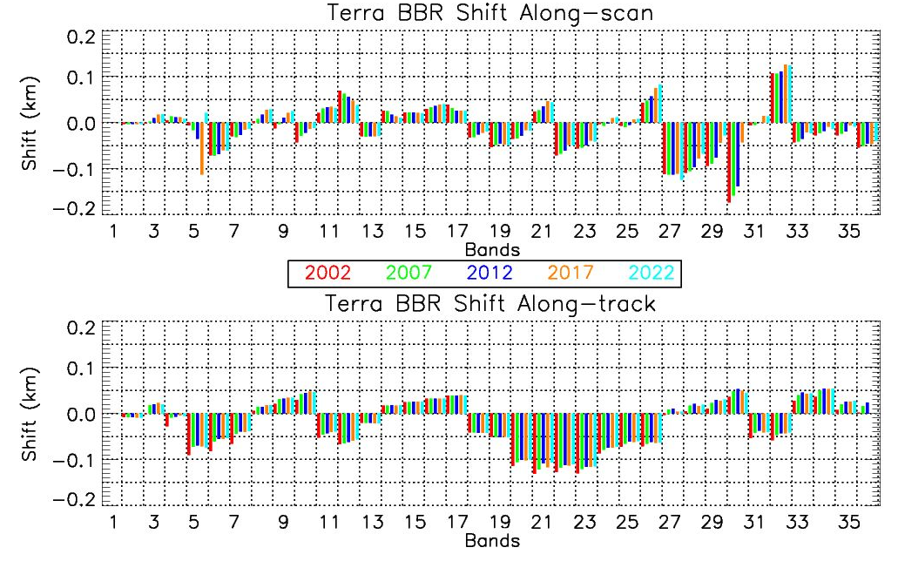
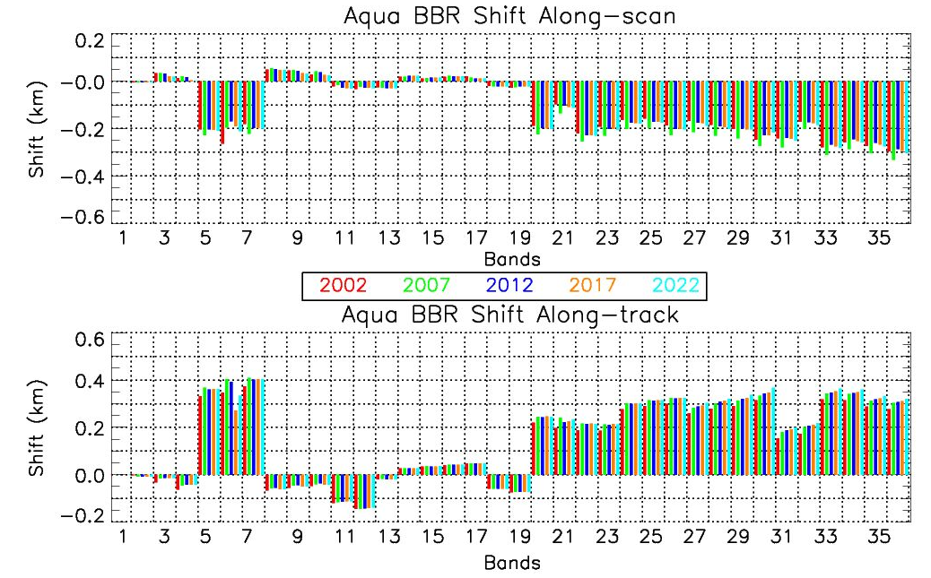
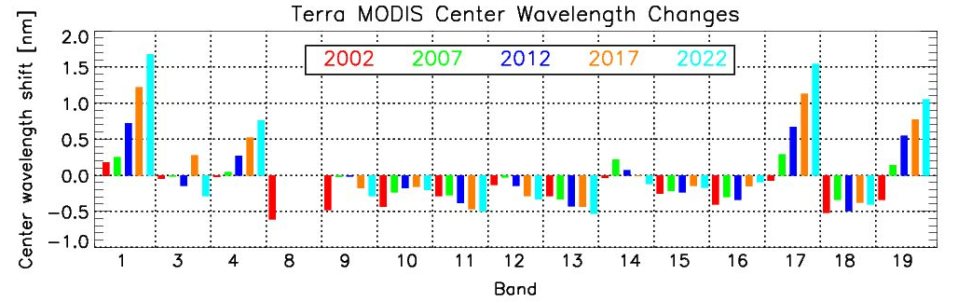
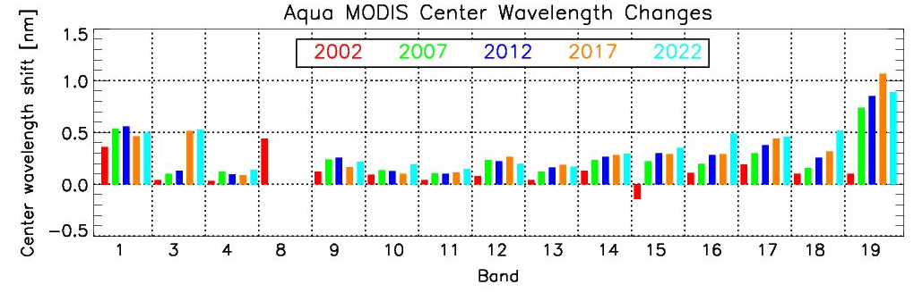
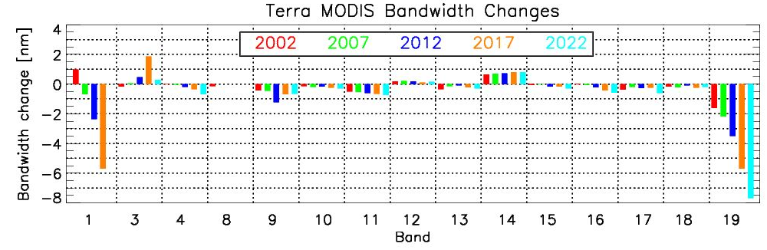
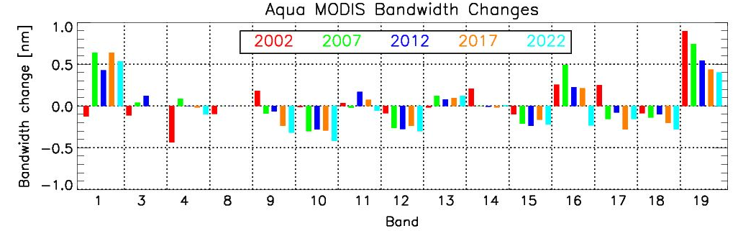
MODIS Spatial and Spectral Characterization
Terra MODIS
Aqua MODIS
Along-scan BBR
Along-track BBR
Changes in CW
Changes in BW

Slide 21
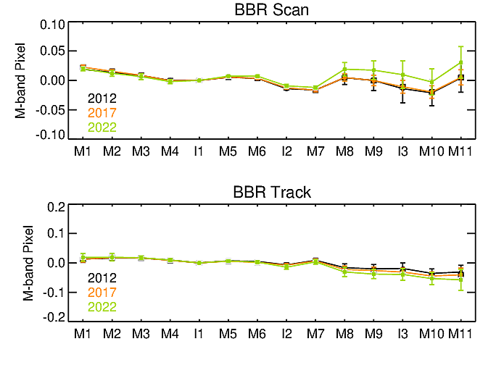
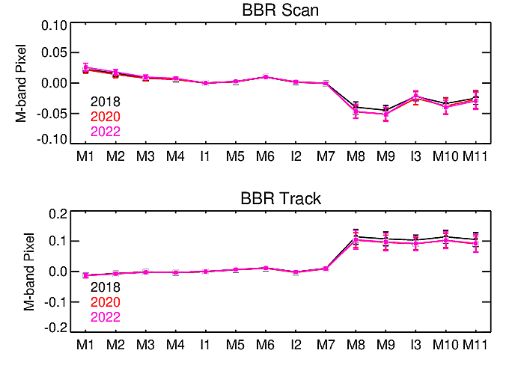
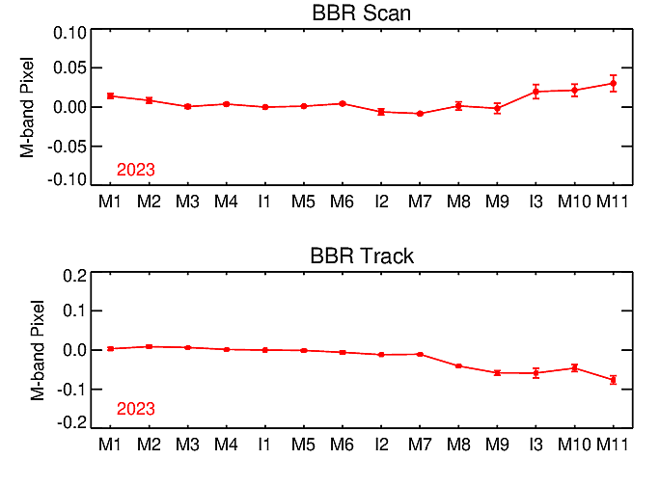
VIIRS Spatial Characterization
S-NPP VIIRS
N-20 VIIRS
N-21 VIIRS
N-21 results are based on the average from the first two lunar observations

Slide 22
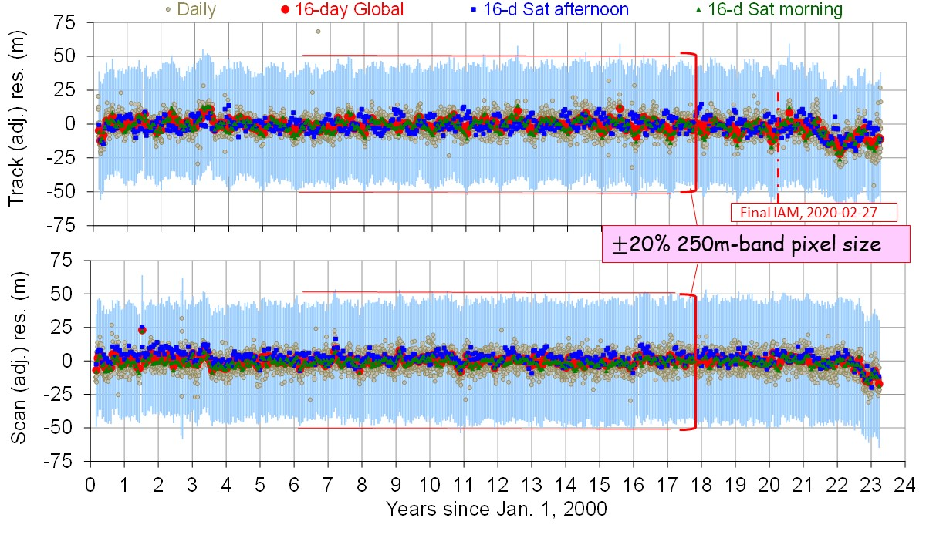
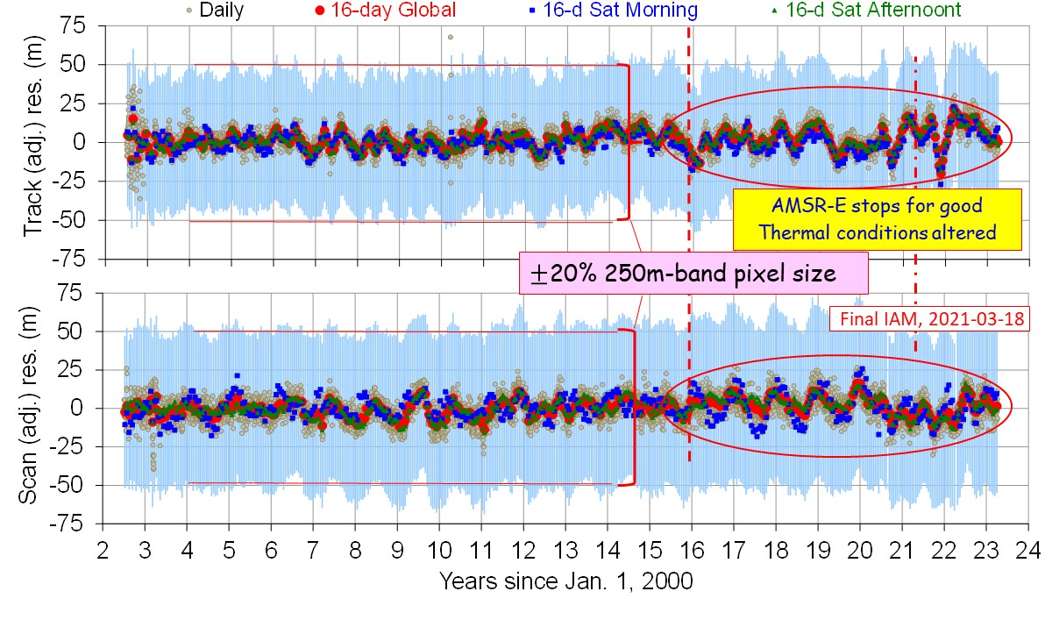
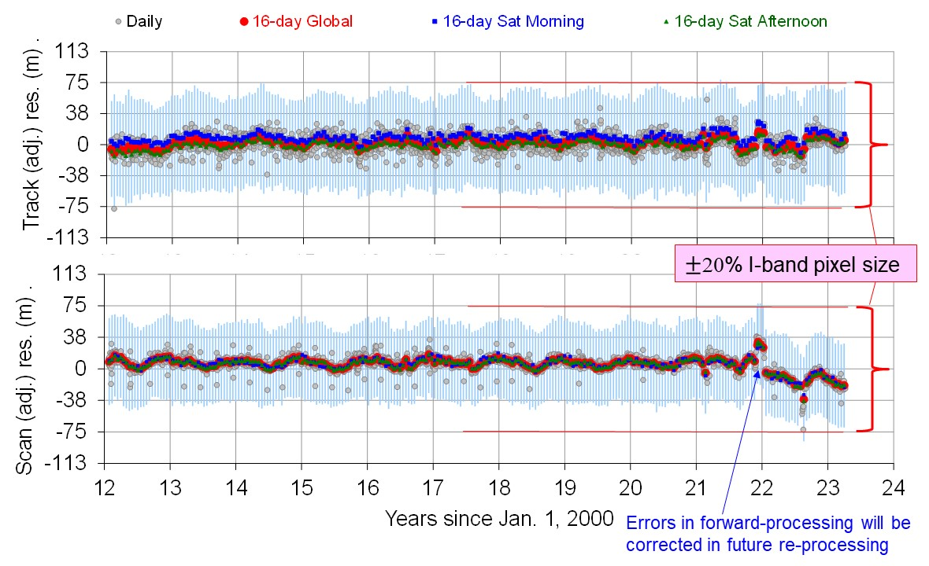
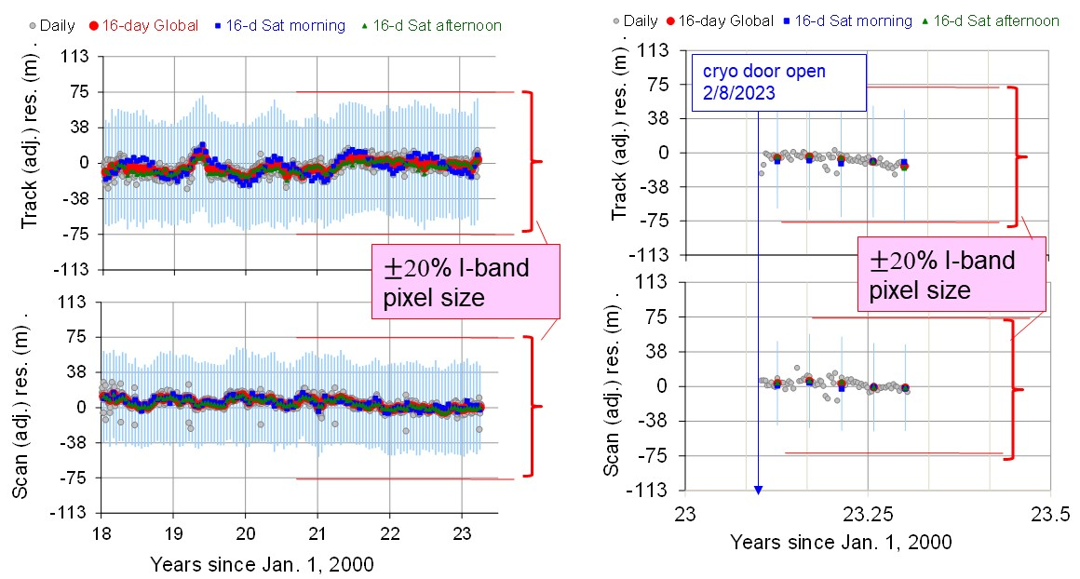
MODIS and VIIRS Geolocation
Track: 43 m; Scan: 45 m (Terra C6.1)
Track: 46 m; Scan: 54 m (Aqua C6.1)
Track: 59 m; Scan: 48 m (S-NPP C2)
Track: 57 m; Scan: 47 m (N-20 C2.1)
Track: 61 m; Scan: 48 m (N-21 C2)

