Slide 1
Recent Studies in Ice Cloud Models
Bryan Baum¹, Ping Yang², Andy Heymsfield³,
Carl Schmitt³, Aaron Bansemer³, Yu Xie², Yong-Xiang Hu⁴, Zhibo Zhang⁵
Bob Holz¹, Andy Heidinger⁶
Space Science and Engineering Center, Univ. Wisconsin-Madison
Texas A&M University, College Station, TX
National Center for Atmospheric Research, Boulder, CO
NASA Langley Research Center
UMBC/NASA Godard Space Flight Center
NOAA/NESDIS/STAR
MODIS Science Team Meeting
May 18, 2011

Slide 2
Recent Studies in Ice Cloud Models
Bryan Baum¹, Ping Yang², Andy Heymsfield³,
Carl Schmitt³, Aaron Bansemer³, Yu Xie², Yong-Xiang Hu⁴, Zhibo Zhang⁵
Bob Holz¹, Andy Heidinger⁶, Steve Platnick⁷
Space Science and Engineering Center, Univ. Wisconsin-Madison
Texas A&M University, College Station, TX
National Center for Atmospheric Research, Boulder, CO
NASA Langley Research Center
UMBC/NASA Godard Space Flight Center
NOAA/NESDIS/STAR
NASA GSFC
MODIS Science Team Meeting
May 18, 2011

Slide 3
Outstanding Issues
C5 models: assumed smooth particles and were based on limited set of microphysical data and pristine ice particle shapes (habits)
Significant issues (not a complete list):
Differences found between MODIS C5 cirrus optical thicknesses and those from CALIOP V3 products and also with IR retrievals based on IR window bands
Spectral gaps in the ice models that need to be filled for sensors such as the SSFR
Discontinuities in transition in absorption/extinction efficiencies obtained from one scattering model to another (e.g., FDTD/DDA to IGOM)
Updated ice index of refraction published (Warren and Brandt, JGR, 2008)
Seasonal differences found between POLDER and MODIS (Zhang et al 2009)

Slide 4
Expanded Set of Microphysical Data Available
IWC range: 1.E-6 to 1 g m ⁻³
Field Campaign | Location | Instruments | # PSDs
ARM-IOP (UND Citation) | Oklahoma, USA 2000 | 2D-C, 2D-P, CPI, CVI, FSSP | 1420
TRMM-KWAJEX (UND Citation) | Kwajalein, Marshall Islands, 1999 | 2D-C, HVPS, FSSP | 201
CRYSTAL-FACE (NSA WB-57F) | SE Florida/Caribbean 2002 | CAPS (CIP, CAS), VIPS | 62
SCOUT (Geophysica) | Darwin, Australia 2005 | FSSP, CIP | 553
ACTIVE - Monsoons (Egrett) | Darwin, Australia 2005 | CAPS (CIP, CAS) | 4268
ACTIVE- Squall Lines (Egrett) | Darwin, Australia 2005 | CAPS (CIP, CAS) | 740
ACTIVE- Hectors (Egrett) | Darwin, Australia 2005 | CAPS (CIP, CAS) | 2583
MidCiX (NASA WB-57F) | Oklahoma, USA 2004 | CAPS (CIP, CAS), VIPS, FSSP | 2968
Pre-AVE (NASA WB-57F) | Houston,Texas, USA 2004 | VIPS, CAPS | 20
TC-4 | Costa Rica 2007 | CAPS, CPI | 7663
Number of particle size distributions for each field campaign. The total sample set has been filtered by the requirement that the cloud temperature be colder than –40ºC, providing > 20,000 PSDs.

Slide 5
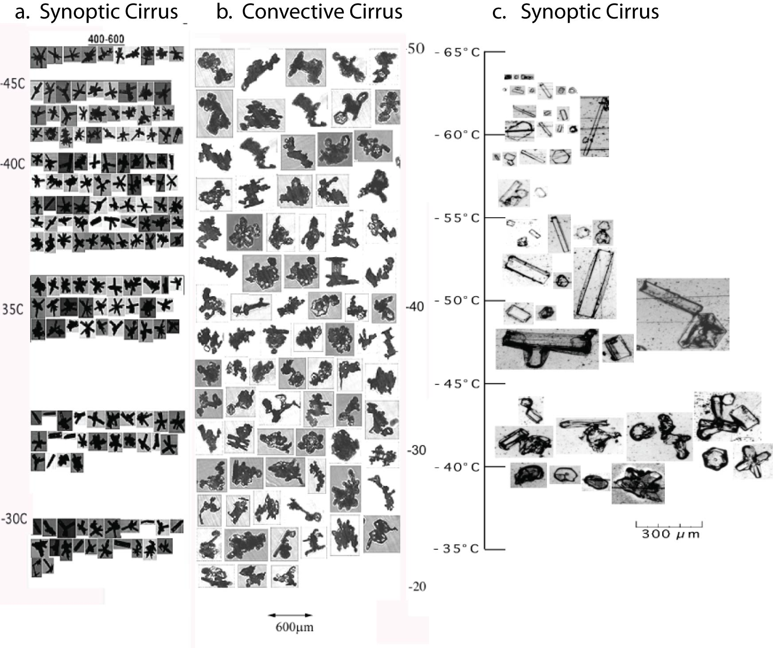
Different Formation Mechanisms for Ice Particles
Homogeneous Develop in updrafts Cold-topped synoptic cirrus
Nucleation of deep convection

Slide 6
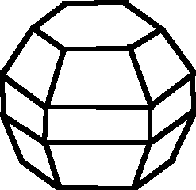
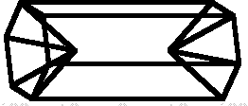
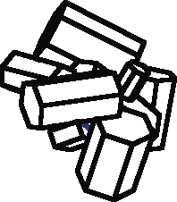
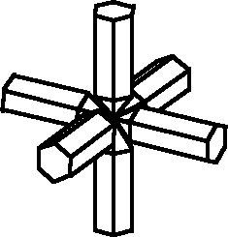
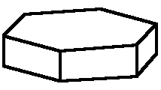
Set of Ice Habits Used to Develop
Version 2 Single-Scattering Properties
Droxtal Solid Column Hollow Column
Plate Aggregate of Solid Columns 3D Bullet Rosette

Slide 7
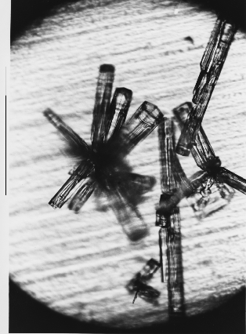
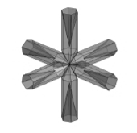
New Habits
Photomicrograph of snow particles falling at the South
Pole Station, 18 August, 1992, at ambient temperature
-54ºC. Photograph by Stephen Warren.
New 3D Hollow Bullet Rosette
Yang et al., 2008: Effect of cavities on the optical properties of bullet rosettes: Implications for active and passive remove sensing of ice cloud properties. J. Appl. Meteor. Climatol. 47, 2311-2330.

Slide 8
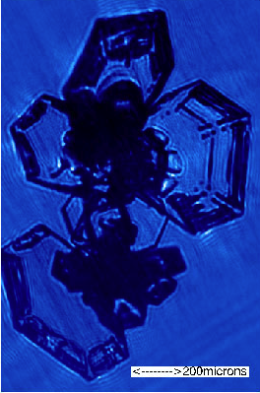
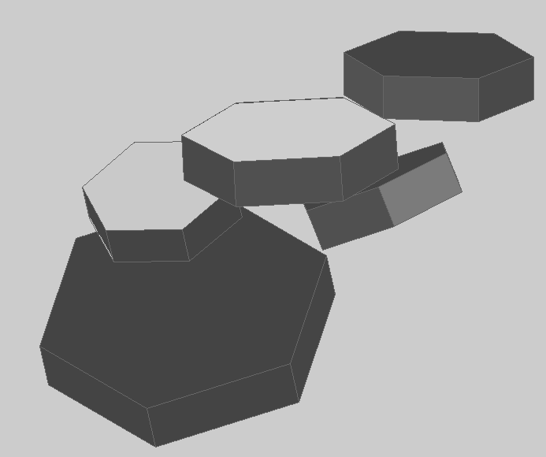
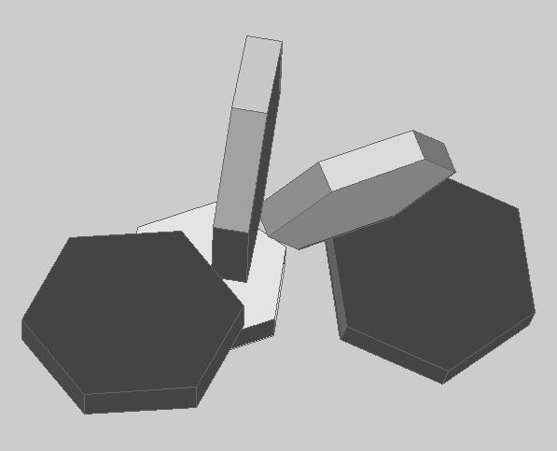
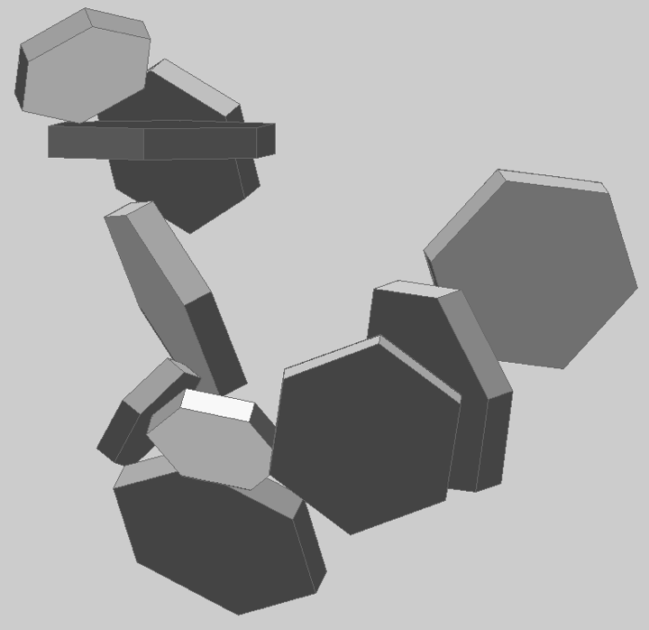
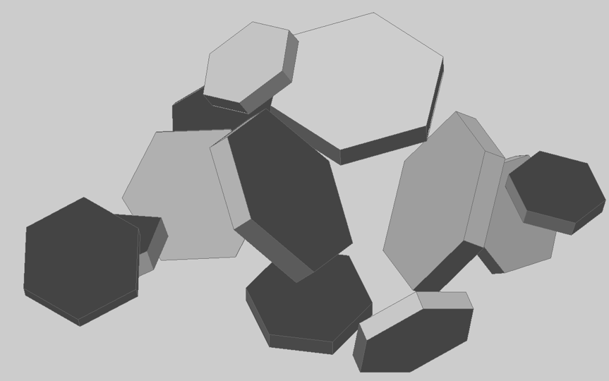
Different Realizations for the Aggregate of Plates
Small Aggregate of Plates
Small Aggregate of Plates
Large Aggregate of Plates
Large Aggregate of Plates

Slide 9
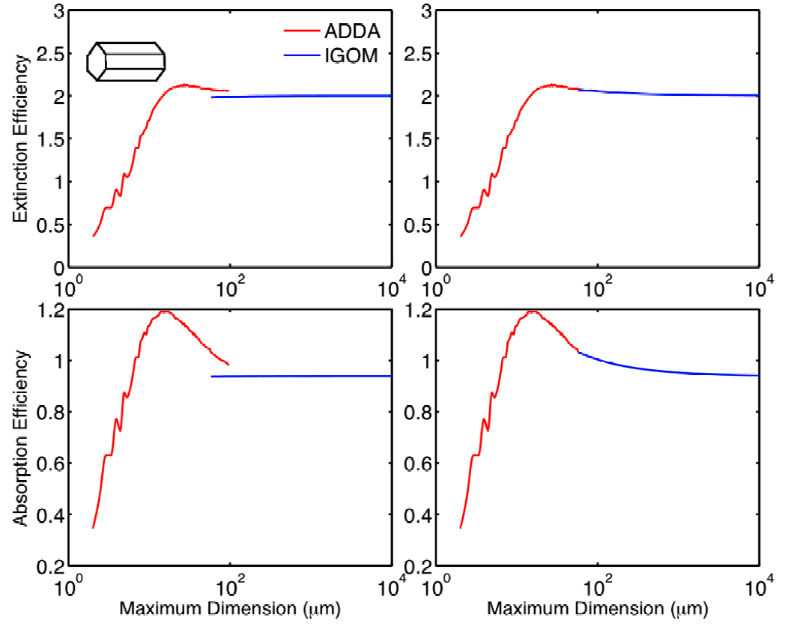
Improvements to Light Scattering Models
New treatment of ray-spreading results in the removal of the term relating to delta-transmission energy at the forward scattering angle.
Improved the mapping algorithm: the single-scattering properties from the new algorithm smoothly transition to those from the conventional geometric optics method at large size parameters.
Semi-analytical method developed to improve the accuracy of the first-order scattering (diffraction and external reflection).
Semi-empirical method is developed to incorporate the edge effect on the extinction efficiency and the above/below-edge effects on the absorption efficiency.
12 mm
Bi et al, 2009: Simulation of the color ratio associated with the backscattering of radiation by ice crystals at 0.532 and 1.064-mm wavelengths. J. Geophys. Res., Vol. 114, D00H08, doi:10.1029/2009JD011759.
Not considering edge effects Considering edge effects

Slide 10
New Library of Single–Scattering Properties
Long-term plan: New database of single-scattering properties that will encompass spectrum from UV through Far-IR with no spectral gaps
Short term: A preliminary set of single-scattering properties provides what is needed for building and testing models for upcoming MODIS Collection 6 effort
Current library includes:
189 particle sizes between 2 – 10,000 mm
396 wavelengths between 0.2 and 15.25 mm
new habits, e.g., hollow bullet rosette and small/large aggregate of plates
properties for smooth, moderately roughened, and severely roughened particles
host of improvements to light scattering calculations (e.g., no delta-transmission term)
use of updated ice index of refraction (Warren and Brandt, JGR, 2008)

Slide 11
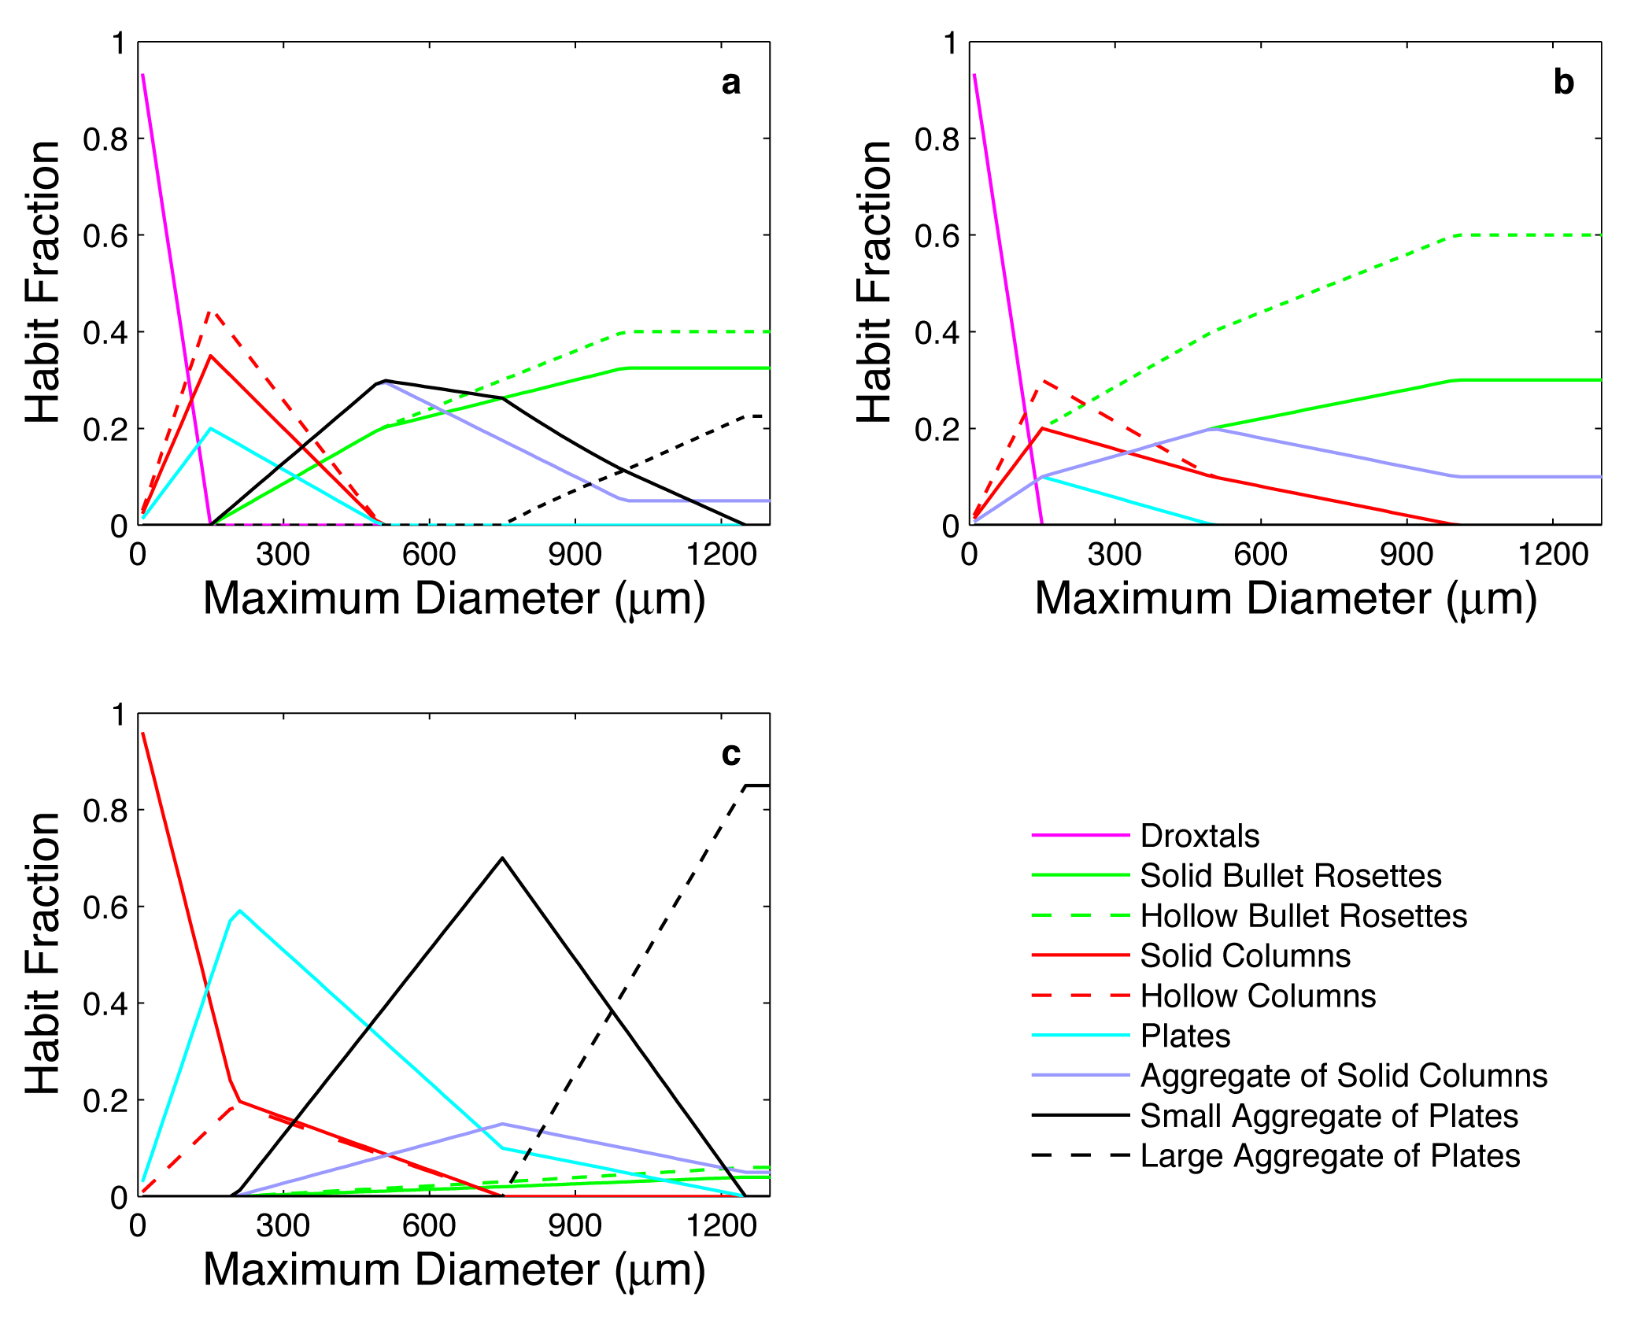
Development of three new habit recipes
General
Mixture
Midlatitude/
Polar
Tropical Deep Convection

Slide 12
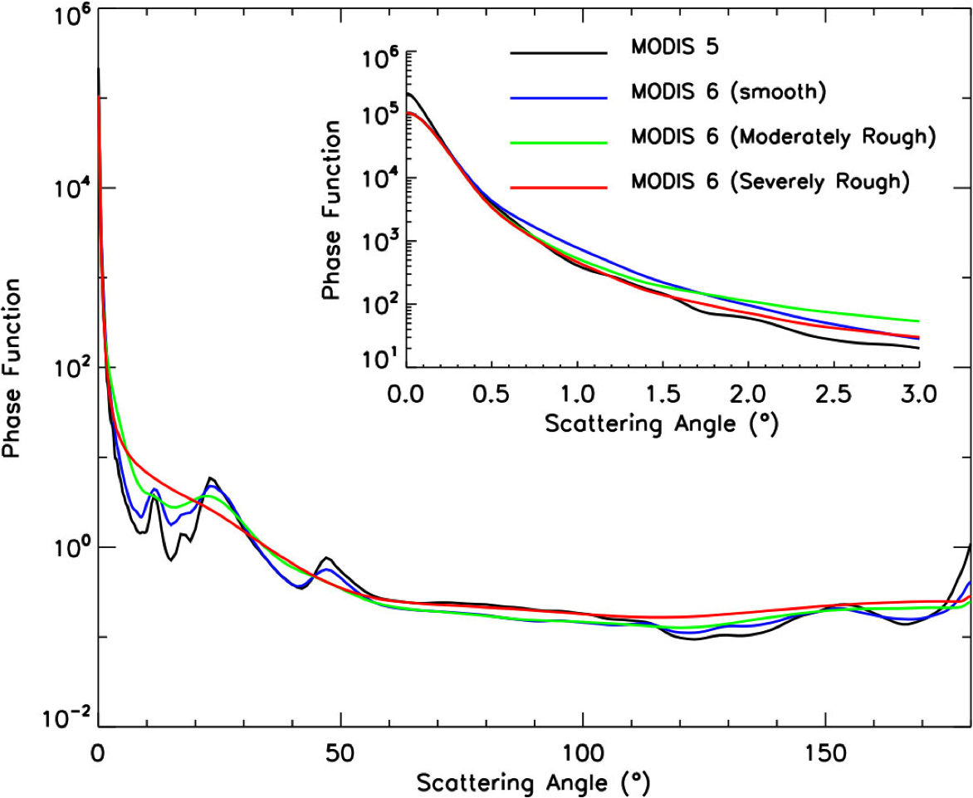
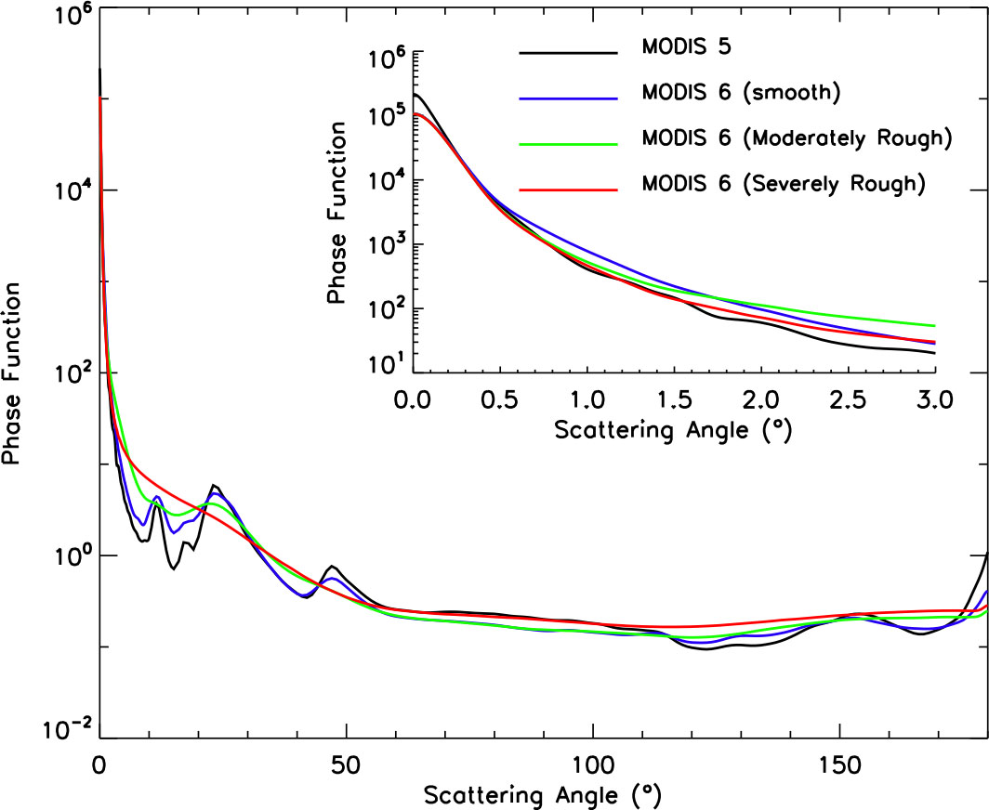
Comparison of MODIS C5 to Potential C6 Phase Functions
MODIS Band 1 (l = 0.65 mm)

Slide 13
Single–scattering albedo and asymmetry factor
MODIS C5
Gen. mixture
Mod. rough
Gen. habit mixture
Severely rough

Slide 14
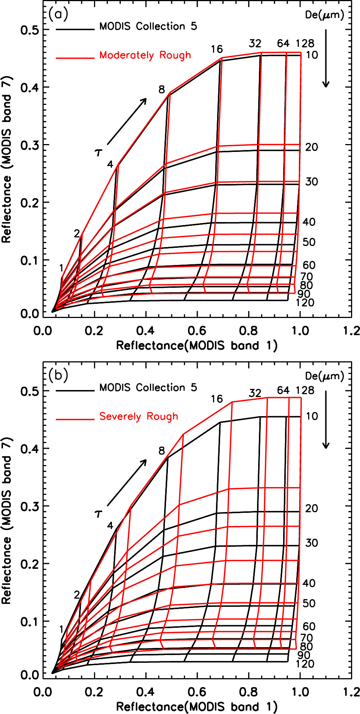
Sample LUT showing difference between MODIS Collection 5 and moderately-roughened or severely roughened models
Use of models with particle roughening will result in lower t and higher D_{eff}

Slide 15
In summary…
We are incorporating a wealth of improvements in microphysical data and single-scattering computations
In the solar: use of severely roughened particles has the most impact compared to other changes (new PSDs, habits, etc.)
In the IR: particle roughening will have little impact, but there are two changes that have an influence:
a. use of new Warren-Brandt index of refraction
b. use of realistic PSDs for D_{eff} ≤ 40 microns
Currently performing some closure studies to study impact of these changes on both solar and IR optical thickness/particle size retrievals

