Slide 1
Collection 6 Cloud Mask (MOD35)
Status and Recent Analysis
Richard Frey, Brent Maddux, and Steve Ackerman
MODIS Science Team Meeting
May 18, 2011

Slide 2
Status:
Collection 6 cloud mask has been delivered
Original delivery August 2010 (Low Earth Orbiter Cloud Algorithm Testbed)
LEOCAT installed
Problems found with 1.38 µm land test thresholds and 7.2-11 µm polar
day test; TPW info from ancillary data too coarse spatially
2nd delivery October 2010
Problem discovered when false sea ice in ancillary data led to undetected
clouds
3rd delivery November 2010
Ok so far … may need threshold tweaks for use with Collection 6 L1b

Slide 3
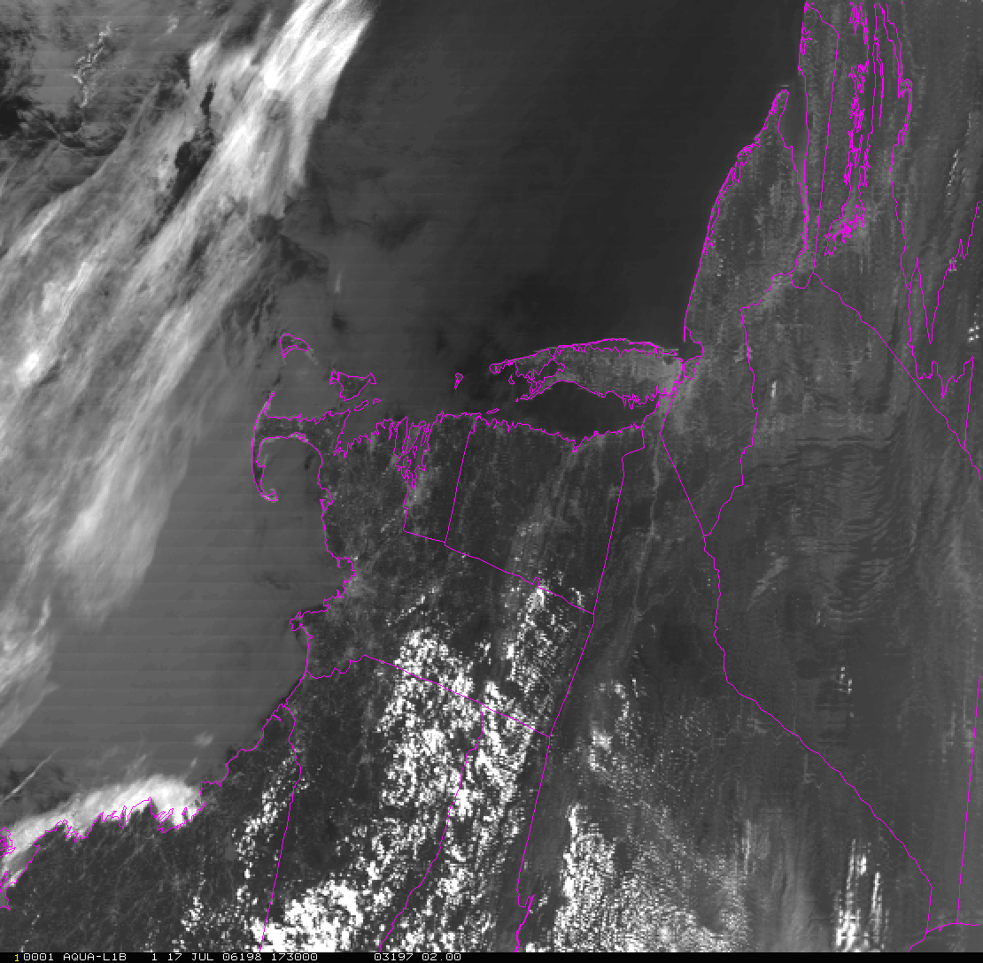
MODIS Band 1 Reflectance
Washington
Baltimore
Philadelphia
New York
Boston
July 17, 2006

Slide 4
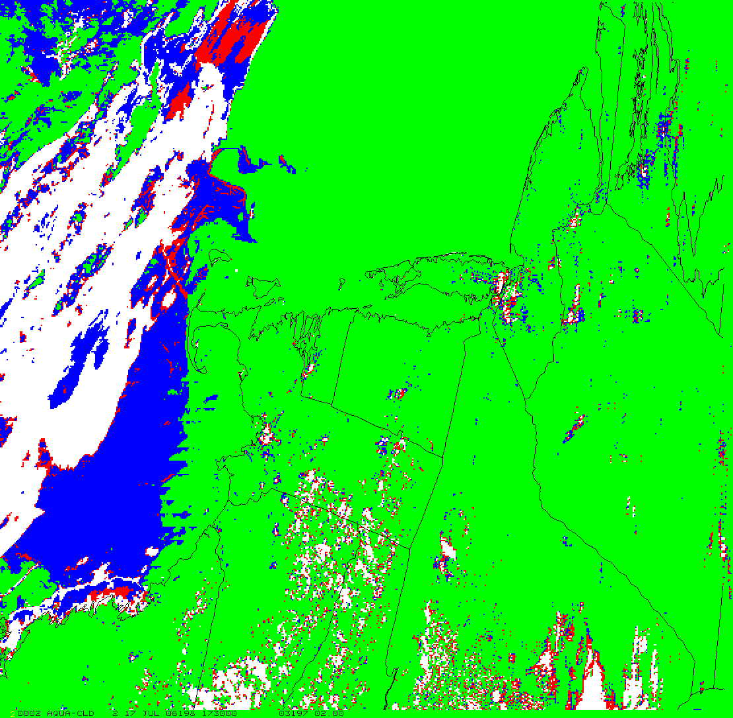
Collection 5 MODIS Cloud Mask (MOD35)

Slide 5
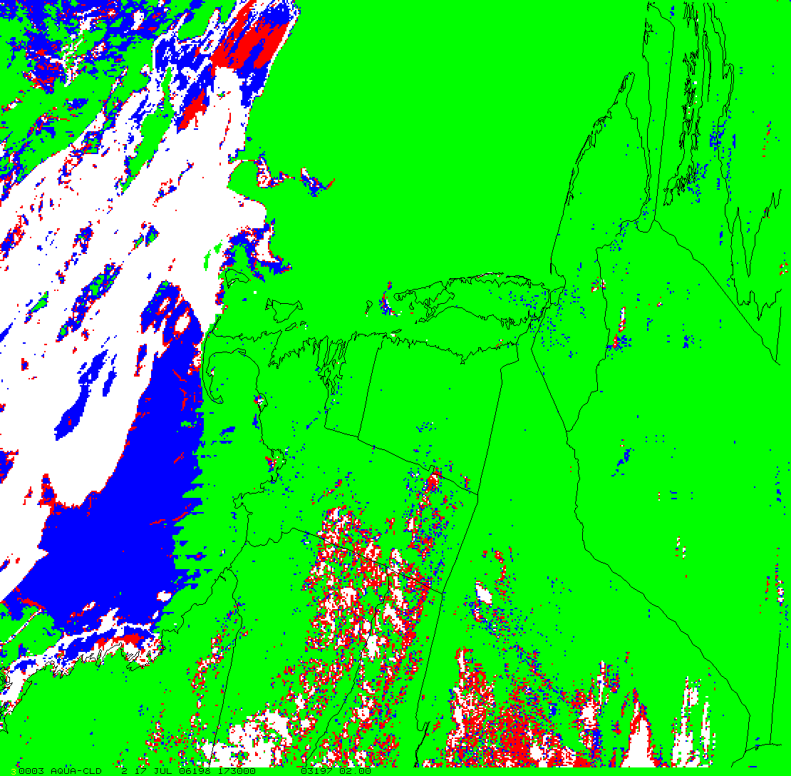
Collection 6 MODIS Cloud Mask (MOD35)

Slide 6
Month/Scene Type | Hit Rate / HK SS
Aug 2006 60S-60N day land (non-arid) | 88.46 / 78.15
Aug 2006 60S-60N day desert | 89.14 / 65.40
Aug 2006 60S-60N night land (non-arid) | 91.12 / 81.78
Aug 2006 60S-60N night desert | 88.36 / 69.76
Nov 2006 60S-60N day land (non-arid) | 87.51 / 73.26
Nov 2006 60S-60N day desert | 86.29 / 69.09
Nov 2006 60S-60N night land (non-arid) | 88.48 / 72.38
Nov 2006 60S-60N night desert | 83.74 / 66.26
Feb 2007 60S-60N day land (non-arid) | 86.14 / 69.40
Feb 2007 60S-60N day desert | 85.20 / 69.59
Feb 2007 60S-60N night land (non-arid) | 87.35 / 72.36
Feb 2007 60S-60N night desert | 81.72 / 62.90
May 2007 60S-60N day land (non-arid) | 87.57 / 76.89
May 2007 60S-60N day desert | 87.53 / 66.70
May 2007 60S-60N night land (non-arid) | 89.67 / 77.89
May 2007 60S-60N night desert | 86.45 / 67.50

Slide 7
Global to Large Region Cloud Amount Analysis
- uses Collection 5 MODIS Level 3 Data
monthly/daily means at 1-degree resolution
ten years of Terra, eight years of Aqua
do cloud amount data show expected seasonal variations on a year-by-year
basis (show temporal consistency)?
are spatial patterns consistent with known atmospheric processes?
how close are we to a cloud amount climatology baseline?
in which regions can we establish “climate quality” credibility?

Slide 8
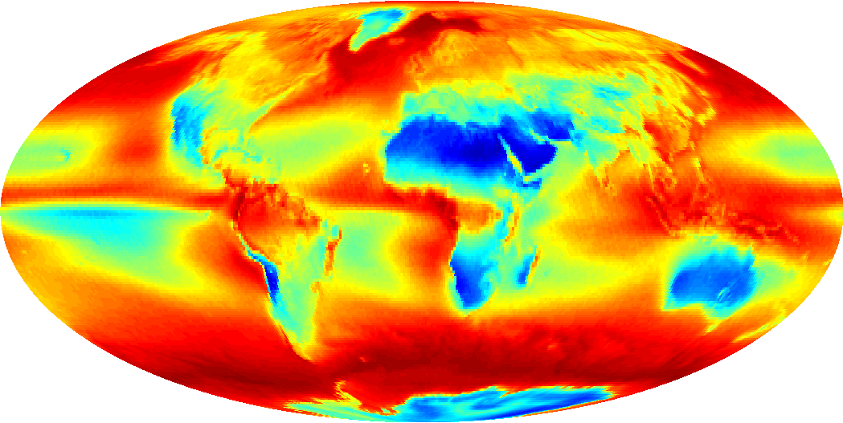
Ten Year Terra Daytime Cloud Fraction
10:30 AM ECT
0.0 0.5 1.0

Slide 9
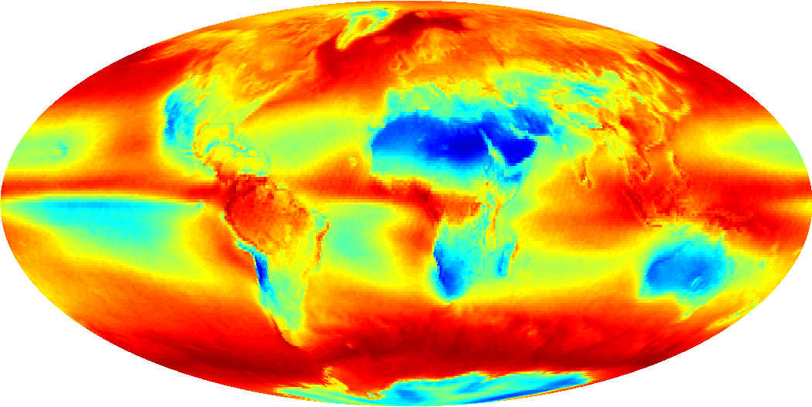
Eight Year Aqua Daytime Cloud Fraction
01:30 PM ECT
0.0 0.5 1.0

Slide 10
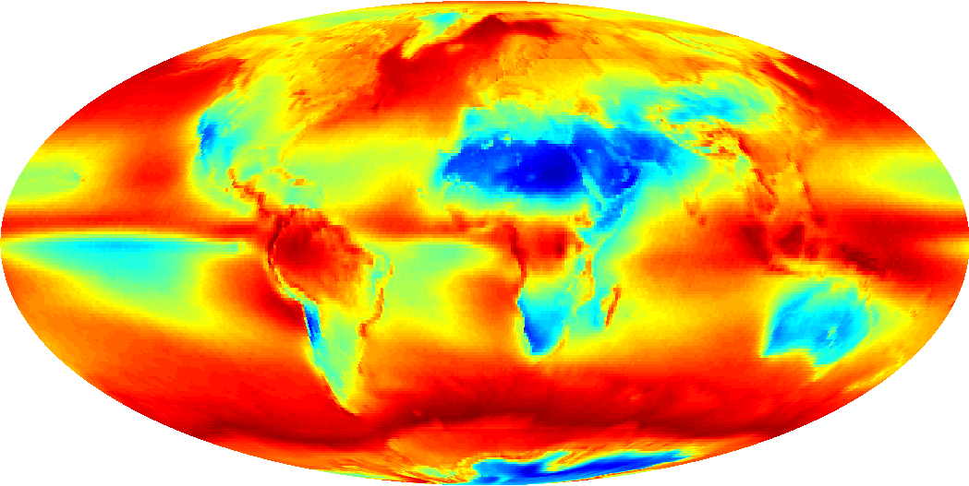
Ten Year Terra Nighttime Cloud Fraction
10:30 PM ECT
0.0 0.5 1.0

Slide 11
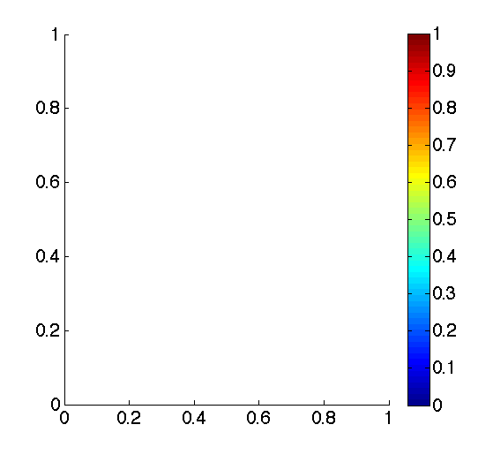
Daily Zonal Hovmoller: Terra Daytime Cloud Fraction
Latitude
-90 0 90
2000 2001 2002 2003 2004 2005 2006 2007 2008 2009 2010
Year

Slide 12
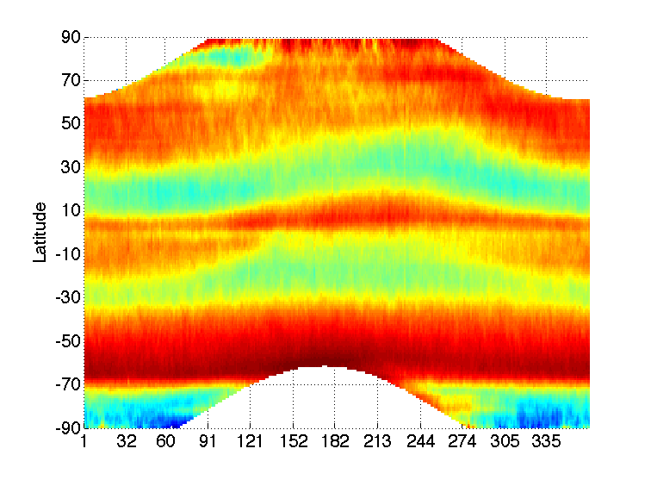
Terra Daytime Mean Cloud Fraction
Day of Year

Slide 13
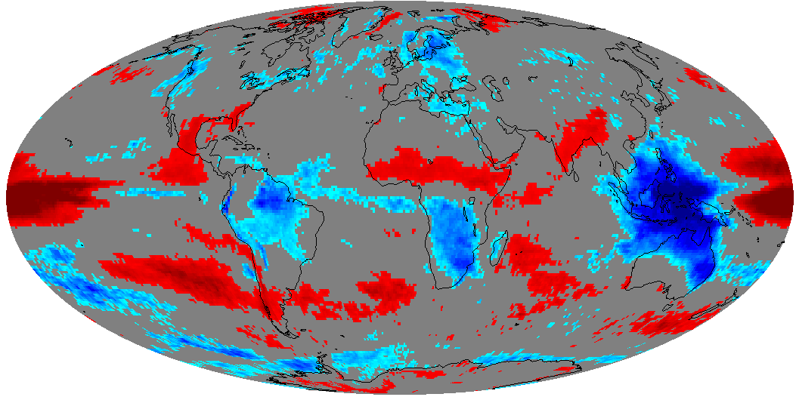
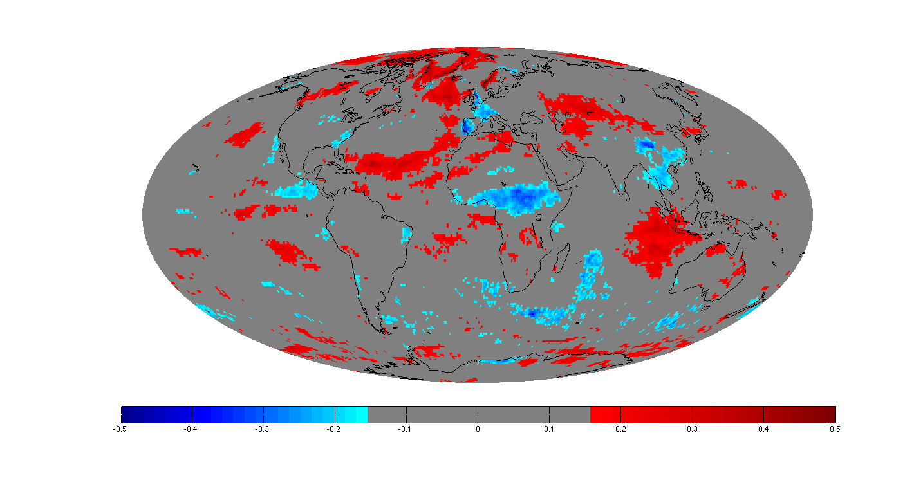
Correlation of ENSO and Terra Cloud Fraction
-0.5 -0.4 -0.3 -0.2 0 0.2 0.3 0.4 0.5
Correlation is significant >± .15 for a p-value of .05

Slide 14
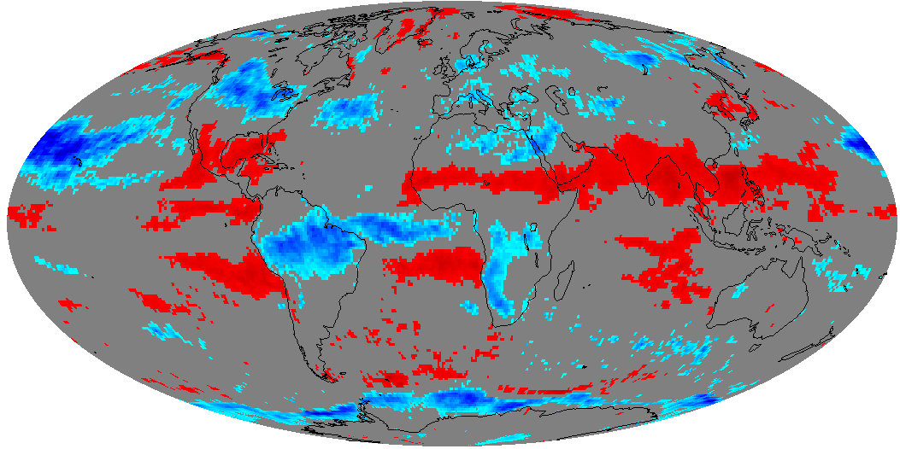
Correlation of PNA and Terra Cloud Fraction
-0.5 -0.4 -0.3 -0.2 0 0.2 0.3 0.4 0.5
Correlation is significant >± .15 for a p-value of .05

Slide 15
Small Region to Local Cloud Amount Analysis – a Wisconsin Example
- demonstrate the value of high resolution gridding
-**create previously unavailable local cloud amount climatologies?
- study cloud processes and interactions with atmospheric phenomena
at local scale, e.g. lake breeze, urban heat island, etc.
-**analyze systematic biases due to surface type, ancillary data, etc.
-----------------
For each granule that overlaps Wisconsin:
- place each 1-km pixel (C5 L2) to a fixed grid with resolution of about 1.2 km
preserves the pixel level data at nearly the original full resolution
results in minimal horizontal movement of pixels between grids
- gridding and averaging for Aqua and Terra independently
this creates four “looks” at Wisconsin daily

Slide 16
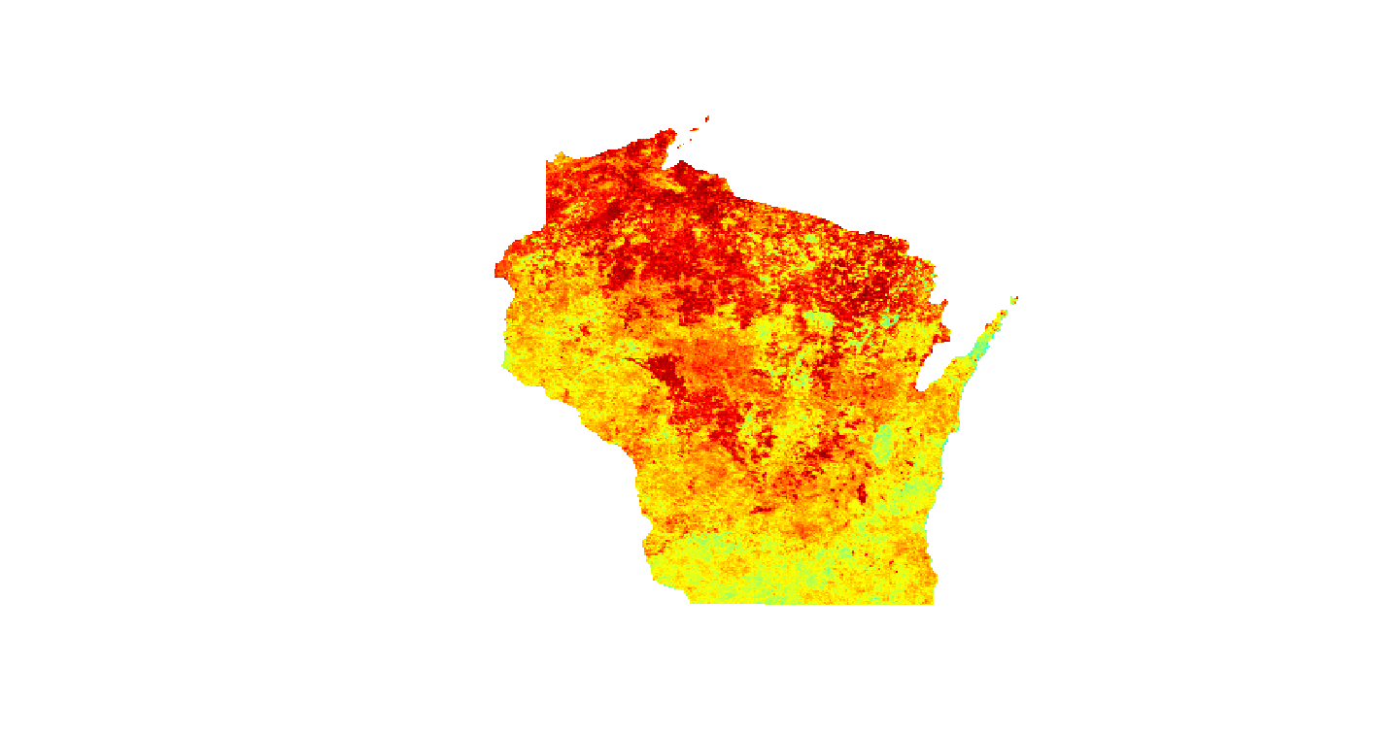
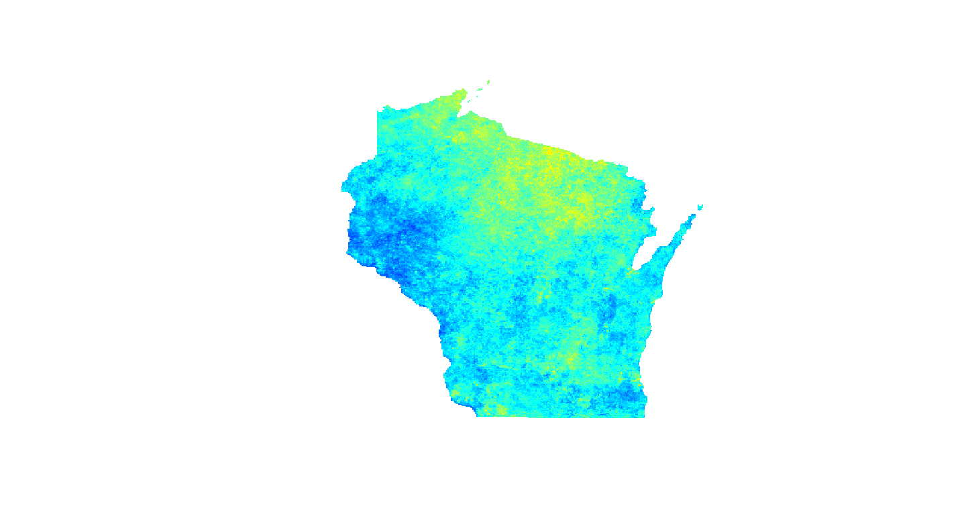
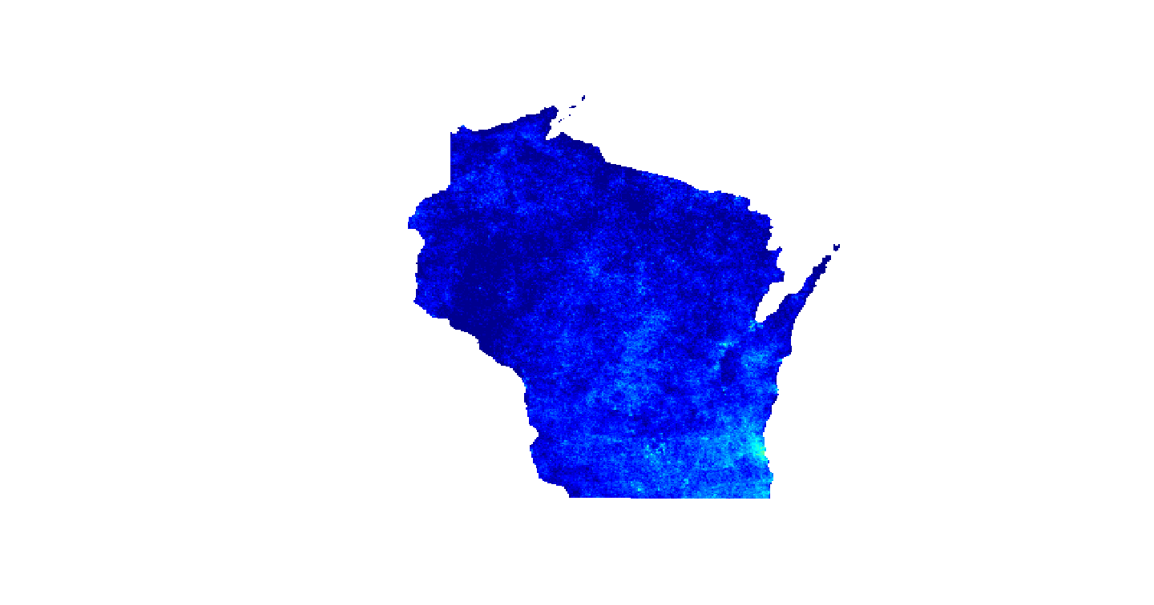
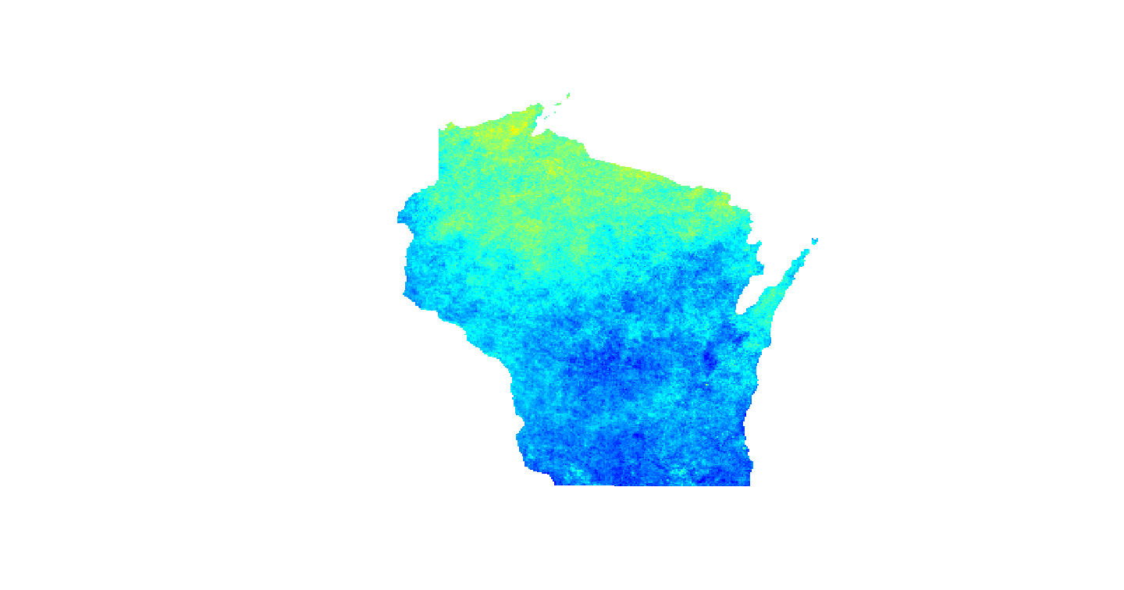
DJF
MAM
JJA
SON
0.4 0.5 0.6 0.7 0.8 0.9 1.0
Wisconsin Seasonal Cloud Amounts
from Ten Years of Terra Data

Slide 17
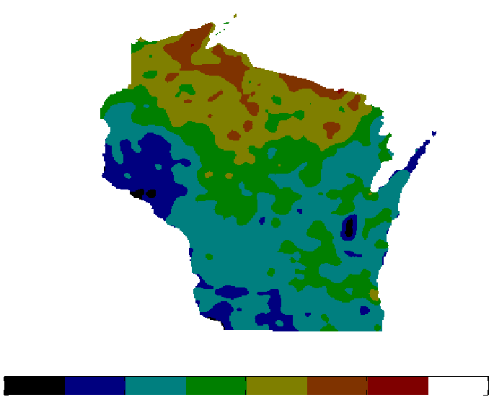
From 10-year
Terra Data Set
55.0 57.5 60.0 62.5 65.0 67.5 70.0 72.5
Wisconsin Annual Mean Cloud Amount

Slide 18
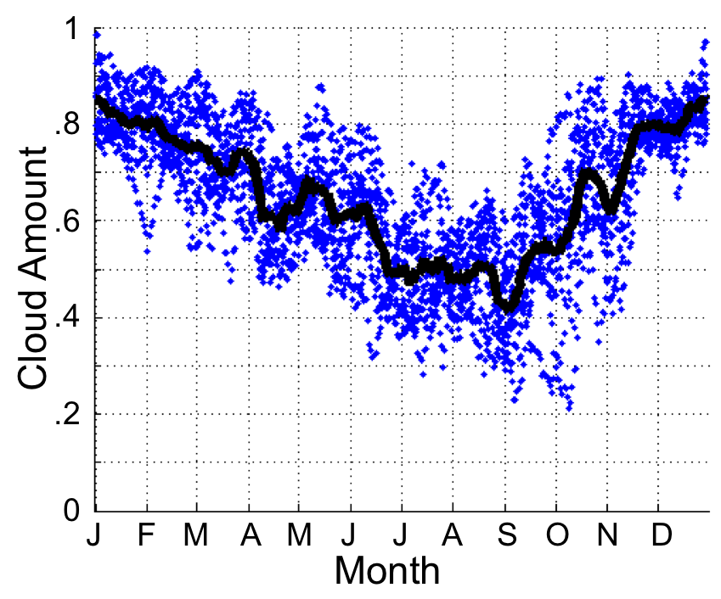
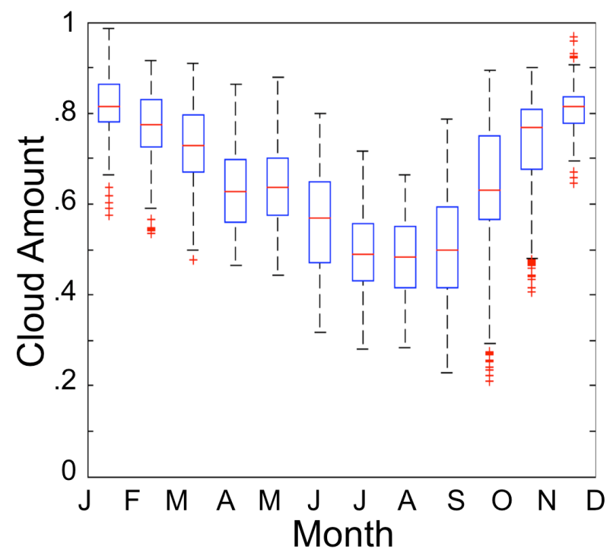
Wisconsin 10-Year Cloud Amount Variability
Terra daily mean cloud amounts plotted in blue dots for each day between 2001-2010

Slide 19
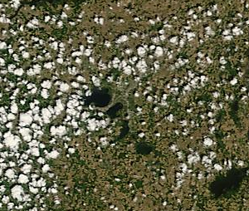
Fair weather cumulus over southern Wisconsin
June 4, 2008 250 m Resolution
Mean Summer Cloud Amount over Madison
Mendota
0.4 0.5 0.6 0.7
Cloud Amount

Slide 20
Conclusions:
1) Collection 6 Cloud Mask (MOD35) is ready as far as we know.
2) Work by Brent Maddux shows that aggregated Collection 5
cloud mask data records atmospheric phenomena as
reflected in cloud amounts at large, regional, and local scales.

