Slide 1
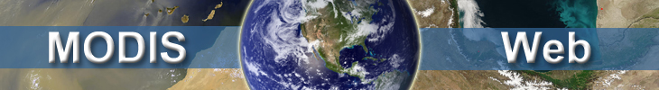
The dark-target aerosol remote sensing from MODIS, circa 2011
Robert Levy (SSAI and NASA/GSFC)
Shana Mattoo (SSAI and NASA/GSFC)
Lorraine Remer (GSFC)
Bill Ridgway (SSAI and NASA/GSFC)
Junqiang Sun (Sigma and NASA/GSFC)
Steve Platnick (GSFC)
Richard Kleidman (SSAI/GSFC)

Slide 2
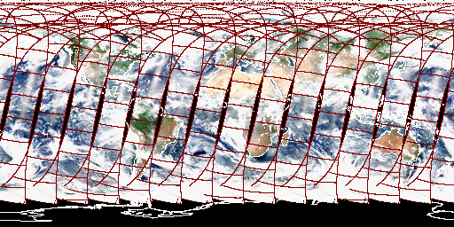
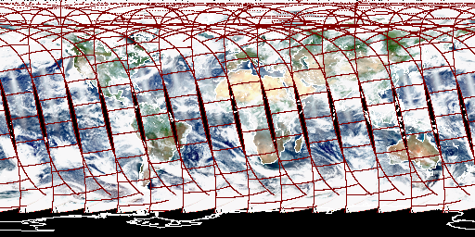
MODIS
Moderate resolution Imaging Spectroradiometer
Terra (10:30, Descending)
Aqua (13:30, Ascending)
“Identical Twins” – Have different personalities!!!

Slide 3
Outline
MODIS Dark target algorithms
Evaluation of Collection 5 (C005)
Trends and MODIS calibration
Transitioning to C006
Different approaches to C006 L1B calibration
Combined Deep Blue/Dark Target product
3-km product (New applications)
What is left to do before C006 operational.

Slide 4
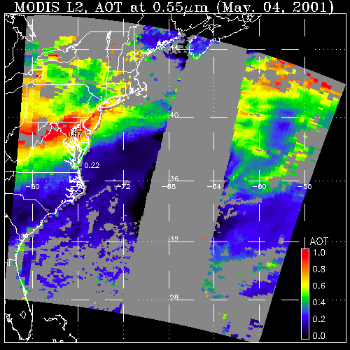
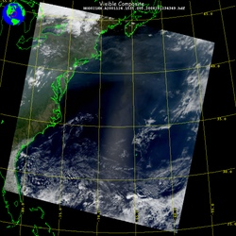
Evaluation of C005/C051 Dark Target Products
May 4, 2001; 13:25 UTC
Level 1 “reflectance”
May 4, 2001; 13:25 UTC
Level 2 “product”
LAND
OCEAN
40° GLINT MASK
AOD
1.0
0.0
History: Separate algorithms over
LAND (dark targets, vegetation and dark soil, Kaufman et al., 1997)
OCEAN (dark, far from glint, Tanré et al., 1997).
Now: algorithms are identical for Collection 5 (C005) and Collection 51 (C051).
LAND (Levy et al., 2007)
OCEAN (Remer et al., 2005, 2008).

Slide 5
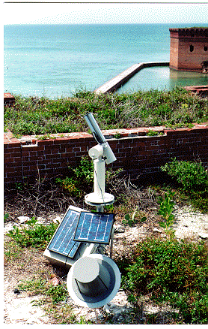
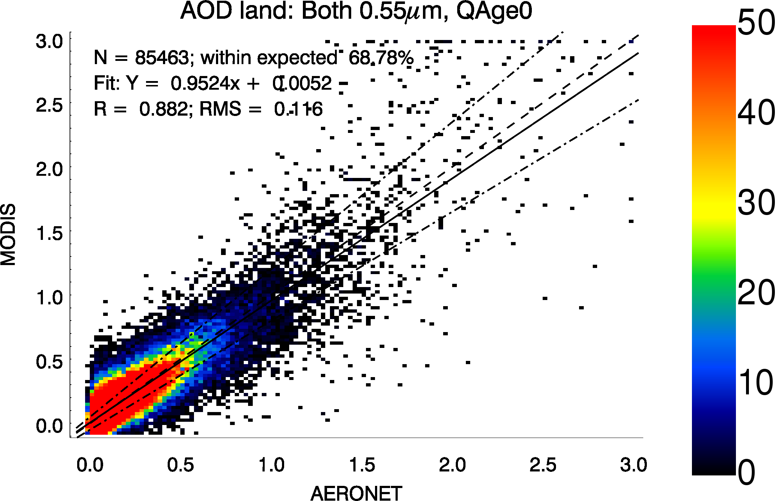
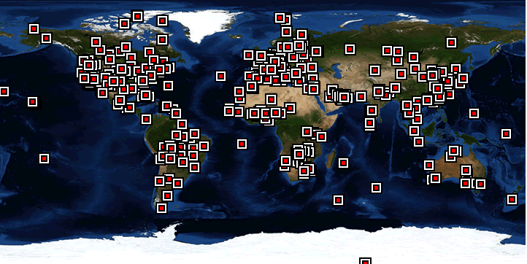
Validation: quantifying the expected error
May 4, 2001; 13:25 UTC
Level 2 “Granule”
First steps:
Pictures look good
Compare both land and ocean products to AERONET, separately
Validation: 66% are within “Expected Error” (EE) defined as
  Land: ±(0.15τ + 0.05)
  Ocean: ±(0.05τ + 0.04)
0.67
LAND
0.22
AOT
1.0
0.0
OCEAN GLINT MASK
LAND
AERONET: Level 2 (Quality Assured)
Levy et al., ACP 2010

Slide 6
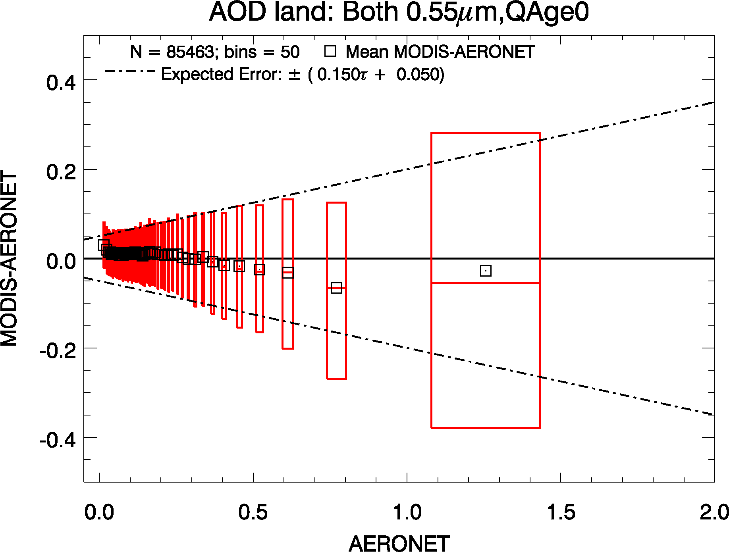
… Plotted a different way
AOD @ 553 nm; Land; N = 85468
Mean error of bin
66% interval
MODIS-AERONET AOD (MODIS Error)
Expected Error
Bins are of equal number
AERONET AOD
By “binning”, we can visualize systematic biases

Slide 7
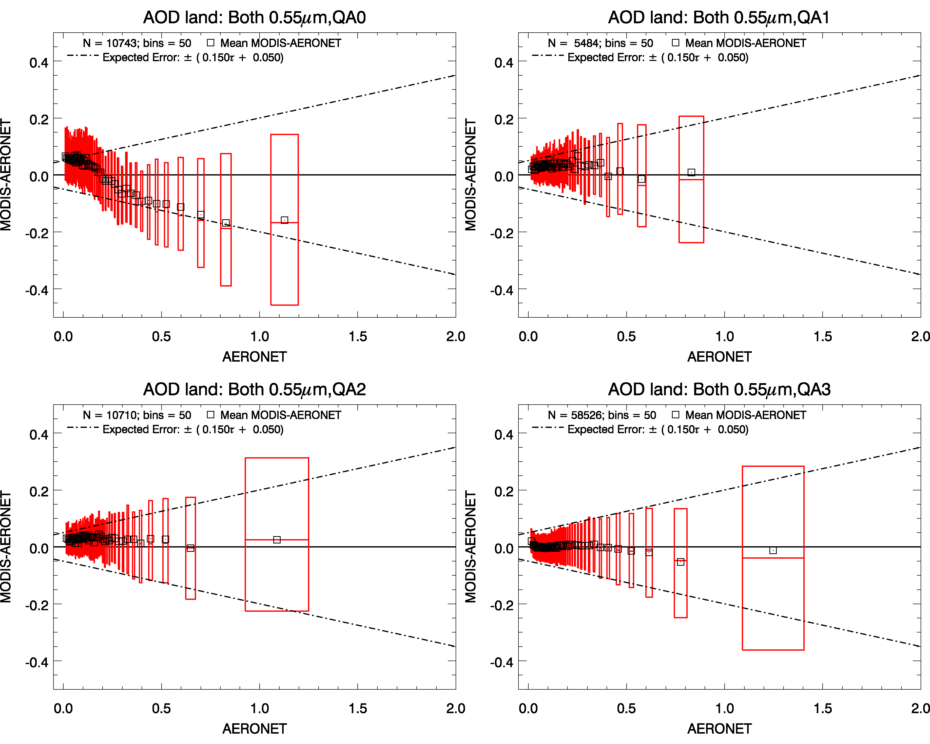
“Quality Flags” are VERY important
QAC=0: N=10743
QAC=1: N=5484
QAC=2: N=10710
QAC=3: N=58526
Systematic biases decrease with QAC: Recommend QAC=3 over land
Levy et al., ACP 2010

Slide 8
C005 Validation Summary
MODIS C005 dark-target AOD (Land and Ocean) is “validated”, generally as we expected it to be.
  66% within defined error envelope, globally
  Generally, more tightly constrained than C004
  Quality Flags are important!
  Biases are location/scene/condition dependent!
  No major difference between Terra and Aqua
  Residual biases in AOD are continually being quantified
In other words, no major surprises!
Therefore, we analyzed C005 data to answer some basic questions about global aerosol…

Slide 9
Q: Is global aerosol increasing or decreasing?

Slide 10
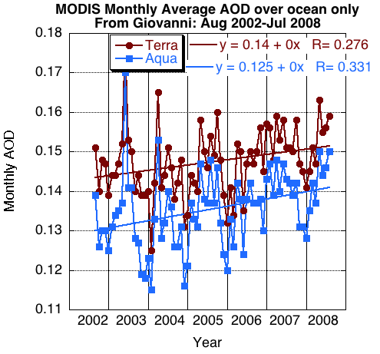
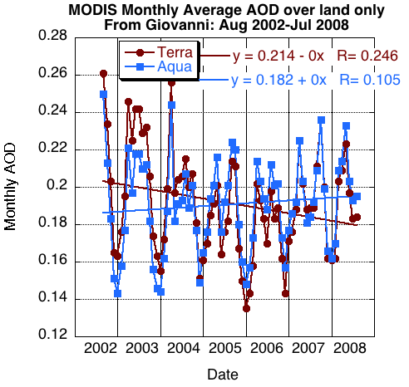
A: A Definite Maybe
Ocean
Land
Over ocean,
  Terra and Aqua are increasing (+0.001/yr), and are both significant at 95%
  Terra > Aqua by +0.01 (10%).
Over land,
  Terra decreases (-0.004/yr), and is significant at 95% level
  Aqua increases (+0.0007/yr), and is not significant at 95% level

Slide 11
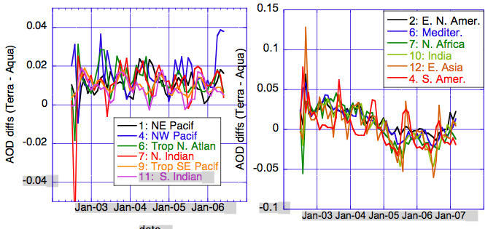
Terra ≠ Aqua
Ocean
Land
Terra – Aqua is the same everywhere on the globe!
  Ocean: Terra-Aqua = 0.01;
  Land: Terra-Aqua changes from +0.02 to -0.01.
Details of aggregation and sampling are NOT primary driver
All-regional behavior suggests not local diurnal cycle

Slide 12
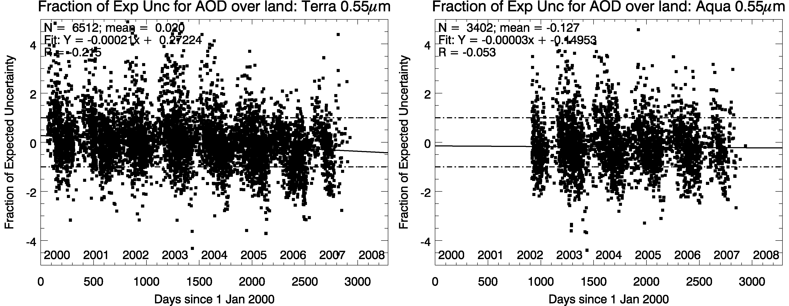
A: Trends may be related to instrument changes
Trends of MODIS-AERONET “agreement” over time (land)
4
2
0
-2
-4
N = 6516; R = -0.275
Terra
4
2
0
-2
-4
N = 3402; R = -0.053
Aqua
Difference Metric
Over land: 14 AERONET sites with >7 years of data (plotted)
Metric decreases for Terra (R = -0.275, significant), which means that in <2004, MODIS overestimates AOD, but >2004 MODIS underestimates! No trend for Aqua.
AOD Trends over land may be actually changes of instrument’s “personality”.
Same games played over ocean, show negligible increase of both instruments versus AERONET, with Terra biased high and Aqua biased low.

Slide 13

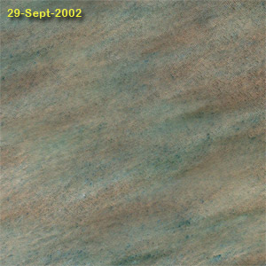
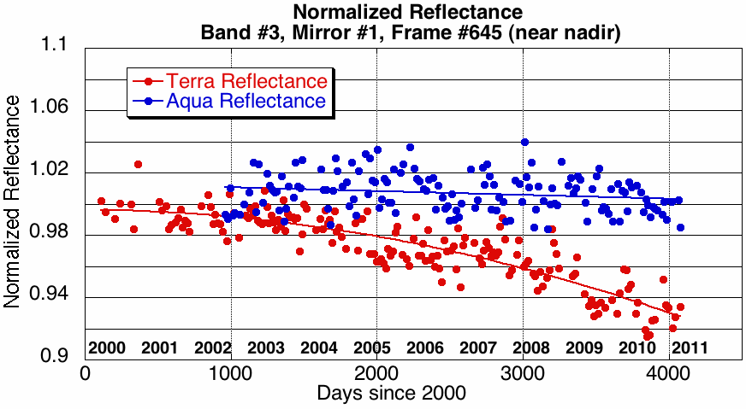
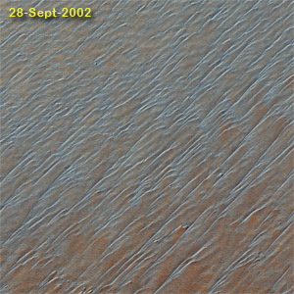
Tracking MODIS RSB radiometric stability from reflectance trends over CEOS desert sites
Collect clear-sky MODIS data over desert sites
Develop site-specific BRDF from first 3 years of mission
Over time, compare “observed” reflectance with BRDF modeled reflectance, for different view angles
Trends in Band #3 (0.47 μm) are consistent with Terra’s AOD trends over LAND!
CEOS desert test sites
Observed Reflectance / BRDF Reflectance
MCST (Sun, Xiong et al)
Notes:
13

Slide 14
Means and Trends
Surprises in C005
Means greatly depend on the methodology for aggregation, weighting and averaging
The C005 data record shows trends for Terra over land that do not agree with Aqua.
Calibration differences and drifts are sufficient to explain a portion of the apparent MODIS trends and Terra/Aqua discrepancies.

Slide 15
Looking ahead to Collection 6

Slide 16
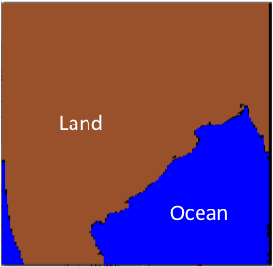
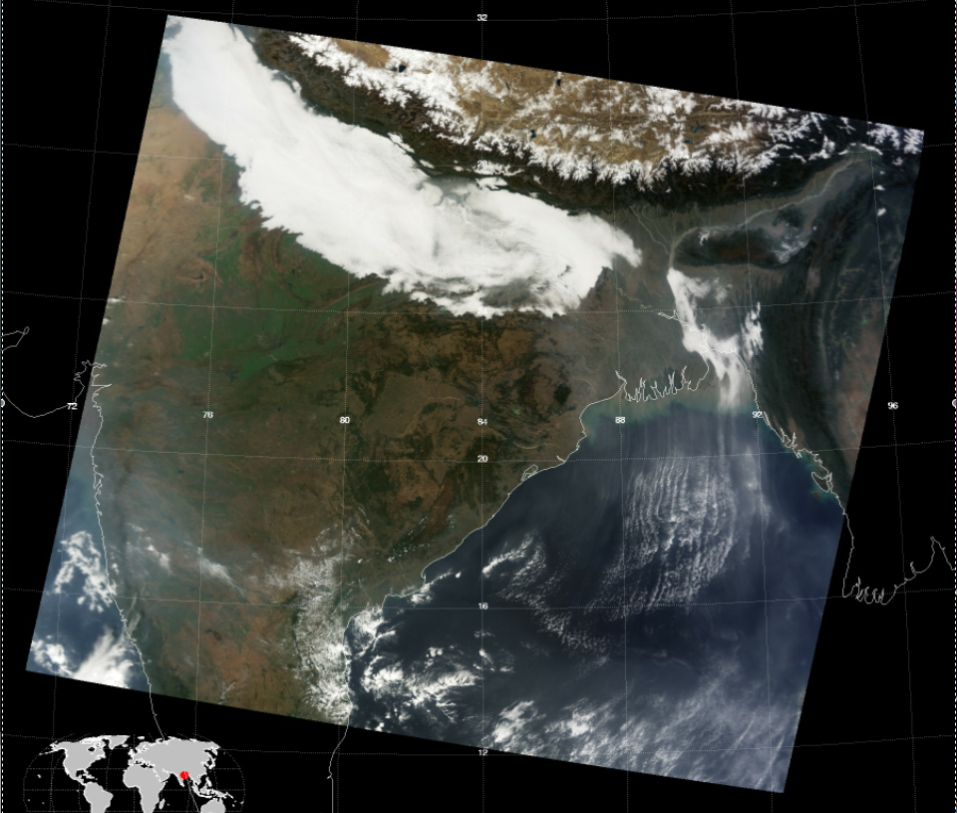
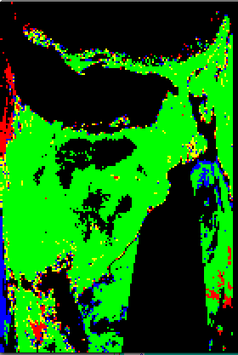
Users complained. We have listened.
“Land_Sea_Flag”
“Land_Sea_Quality_Flag”
Jan 2, 2010: 0500 UTC
0: Poor
1: Marginal
2: Good
3: Very Good
C006: “integer” SDS instead of bit-byte decoding

Slide 17
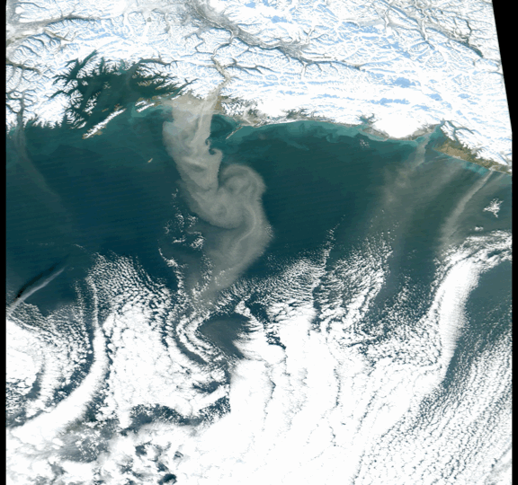
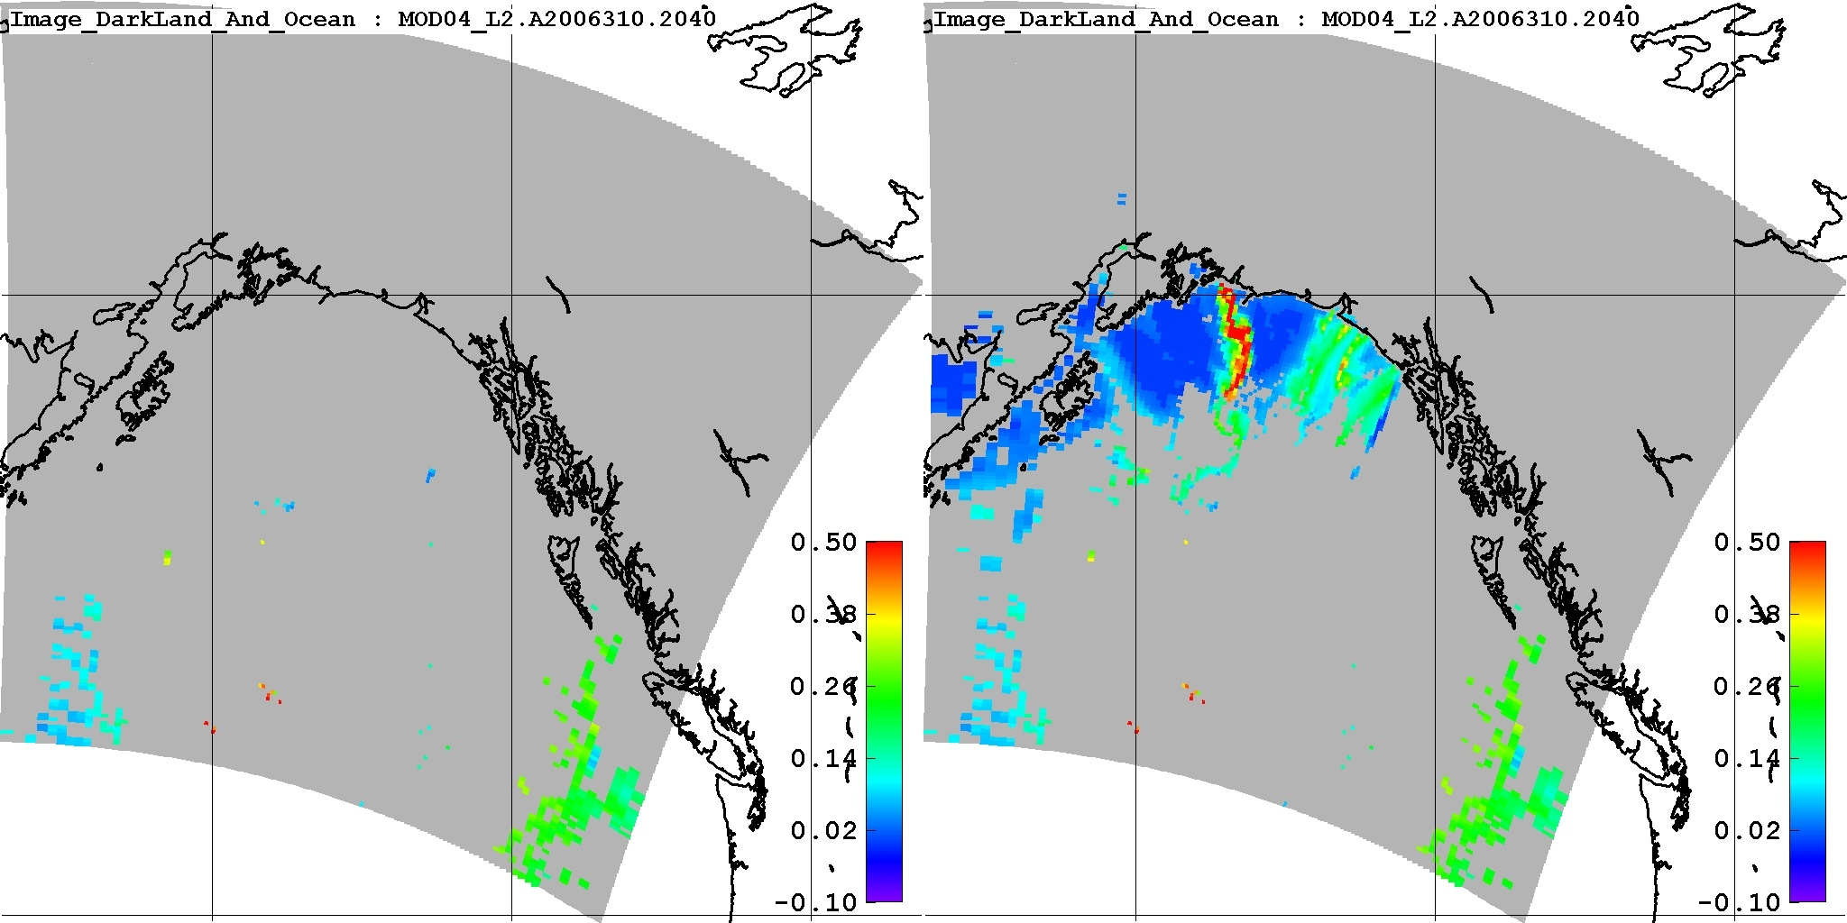
C006 will increase coverage in high latitudes
Dust event
Copper River
Gulf of Alaska
Nov 6, 2006
Relaxing threshold for valid solar zenith angle increases coverage and “discovers” NEW DUST SOURCE!
AOD
AOD
0.50
0.38
0.26
0.14
0.02
-0.1
0.50
0.38
0.26
0.14
0.02
-0.1
Old (θ₀ ≤ 72°)
New(θ₀ ≤ 82°)
Crusius et al., GRL , 2011

Slide 18
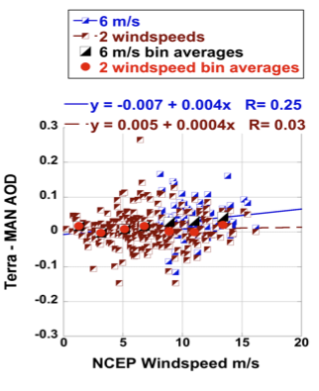
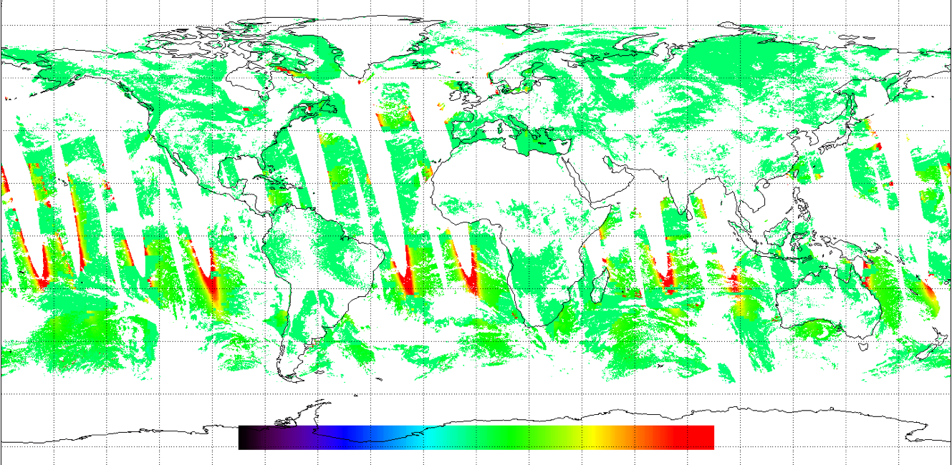
C006 will be more accurate near ocean glint
C005 bias related to windspeed
C006 calculates ocean surface as function of windspeed.
Biggest change near glint edges
Algorithm test: C006 – C005
Algorithm with 2 bins reduces bias
-0.1 0.0 0.1
“MAN vs MODIS”: Kleidman et al., TGRS, 2011
AOD difference

Slide 19
Changes for C006 product
Major changes to Level 2 algorithm
  Over land, aerosol model map is updated (new boundaries).
  Over ocean, sediment mask logic is updated.
  LUT consistency (adjustments in wavelengths, Rayleigh optical depth).
  QA consistency: Make sure QA is assigned correctly
Other changes to Level 2 algorithm and products
  Useful “integer” values and diagnostics for QA, land/sea flag
  Diagnostic SDS parameters: elevation, glint angle, wind speed
“New” products (contained within standard 10 km file)
  Combined Deep Blue/Dark Target retrieval
  500 m resolution “aerosol” cloud mask and “distance” to nearest cloud.
  “dark target” reflectance computed in additional wavelengths, such as 0.412 μm (band #8), 0.443 μm (band #9), 3.75 μm (band #15)

Slide 20
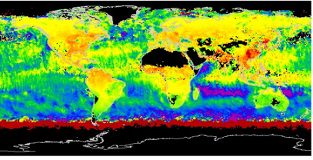

C6 – C5: AOD differences
Expected changes due to Algorithm changes
0.01 increase over land due to Rayleigh adjustments
0.02 to 0.05
decrease over ocean due to:
Rayleigh adjustments
Wind speed Adjustments
QA definition changes
Aqua, July 2003
Aqua July 2003
Extend coverage
towards the polar regions
0.03 to 0.05 increase over land due to changes in aerosol model map borders
Central US and East Asia

Slide 21
TEST, TEST, and TEST some more!
C005 development paradigm was:
The proposed C005 algorithm was tested on a small “test-bed” of C004 radiance inputs
We did not consider that the C005 radiance inputs might also be different
The C005 aerosol product was characterized after becoming operational, and we found:
  Artificial differences between Terra and Aqua
  Artificial trends in global AOD

Slide 22

TEST, TEST, and TEST some more!
C006 development paradigm is:
We know that C006 Radiance product will be different than C005.
Produce test versions of C006 radiances over many days, months, and seasons throughout both Terra and Aqua lifetimes.
Test different combinations of C005 and C006 algorithms/radiances
Characterize C006 aerosol
product before becoming operational

Slide 23
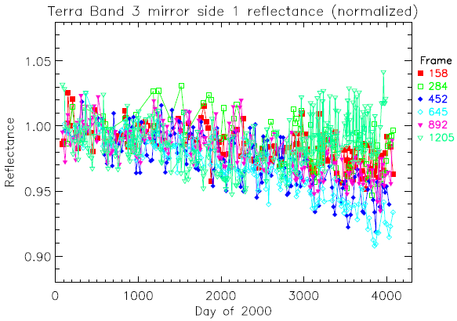
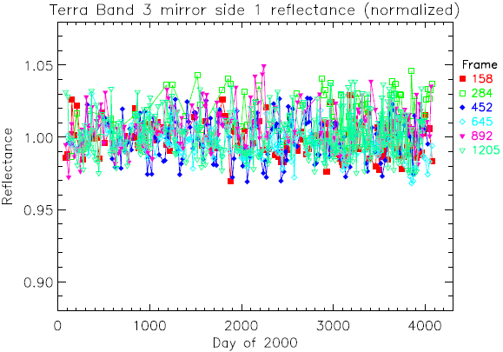
C6 Calibration: Testing Two approaches
Approach 1: Calibration coefficients are based on traditional methods of using moon and solar diffuser information only. Cannot account for unexpected changes in solar diffuser and mirrors.
Approach 2: Calibration coefficients modified by accounting for desert-based Earth View data trends. Terra only
Normalized Reflectance Terra Band # 3, Mirror Side #1 Normalized Reflectance
1.05
1.00
0.95
0.90
1.05
1.00
0.95
0.90
Approach I
Approach II
2000 2002 2004 2006 2008 2010
2000 2002 2004 2006 2008 2010
VERY PRELIMINARY ANALYSIS FOLLOWS!
J. Sun

Slide 24
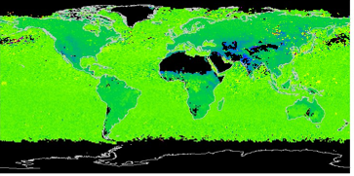
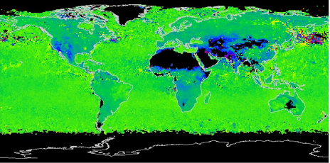
Differences in L1B only: C6#1 – C5
Changes to C6 L1B cause:
up to 0.03 decrease in
Terra AOD
Intensifies over time
Will intensify trend of
differences with AERONET
Aerosol Retrieval Algorithms are identical
Terra July 2003
Terra
Terra July 2008

Slide 25
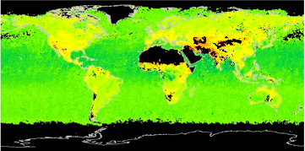
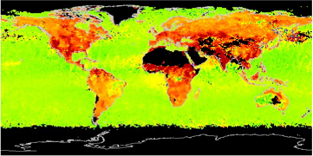
Now introduce Alternative calibration (Approach #2)
Terra July 2003 #1
Terra July 2003 #2
Terra July 2008 #1
Terra July 2008 #2

Slide 26
Differences in L1B only: C6#2 – C5
Alt calib changes to C6 L1B cause:
up to 0.05 increase in Terra AOD
Intensifies over time
Will mitigate trend of
differences with AERONET
Will need to investigate whether
this overshoots ideal?
Terra July 2003 #2
Terra
Terra July 2008 #2

Slide 27
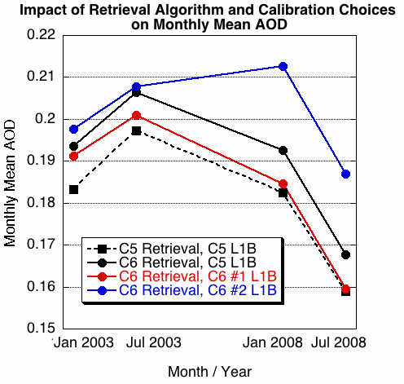
C6 Calibration: Approach #1 vs #2 (Land)
Terra
Impacts to monthly mean
Terra
Retrieval: C5->C6
Increase of 0.01
L1B: C5 -> C6 #1
Decrease of 0.005
L1B: C6 #1 -> C6 #2
Increase of 0.01 in 2003
Increase of 0.03 in 2008

Slide 28
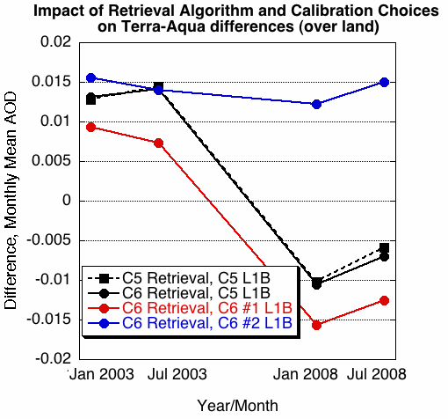
C6 Calibration: Approach #1 vs #2 (Land)
Impacts to Terra-Aqua difference
Retrieval: C5->C6
Same trend, same offset
L1B: C5 -> C6 #1
Same trend, reduced offset
L1B: C6 #1 -> C6 #2
Trend removed
Constant offset of 0.015

Slide 29
Summary of calibration studies
C5 Terra AOD trend over land consistent with recently found trends in Band #3
If standard calibration (e.g. Approach #1) is used for C6 calibration, then trend will remain for C6.
If alternative calibration (e.g. Approach #2) is used for C6 calibration, then Terra trend might be removed.
Even with Approach #2, Terra seems to be biased high compared to Aqua
Size parameters are sensitive to multi-band calibration changes, and may sometimes be a compensating response.
More testing is necessary.

Slide 30
Dark Target/Deep Blue combined product

Slide 31
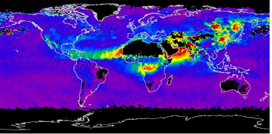
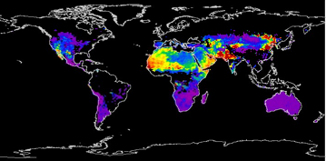
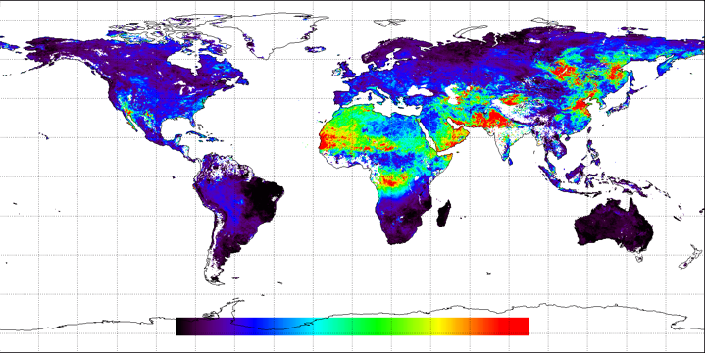
Terra July 2003
New combined DB/DT AOD
Combining “Algorithm”
If DB is good quality AND
DT is not, THEN DB
If DT is good quality AND
DB is not, THEN DT
If both good quality, THEN
0.5*DB + 0.5*DT
Dark Target
Deep Blue
combined

Slide 32
Terra July 2003
New combined DB/DT AOD
Dark Target
Coverage over Deserts, Rain forests and northern forests!
Deep Blue
Some “suspicious” extremes are mitigated
combined

Slide 33
New applications:
MODIS 3 km product (operational for C006)
S. Mattoo, M. Martins, L. Remer, B. Holben, et al

Slide 34
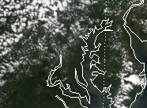
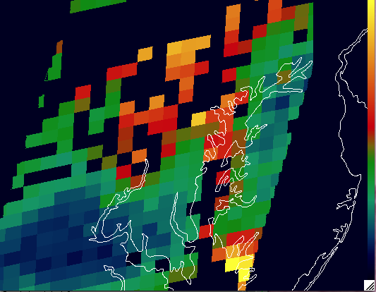
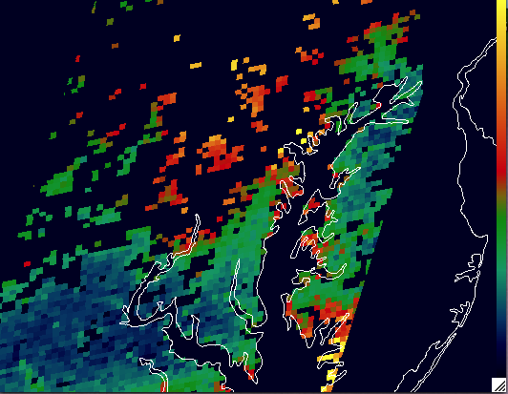
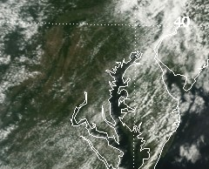
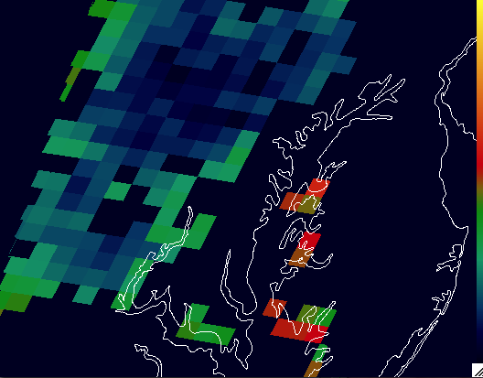
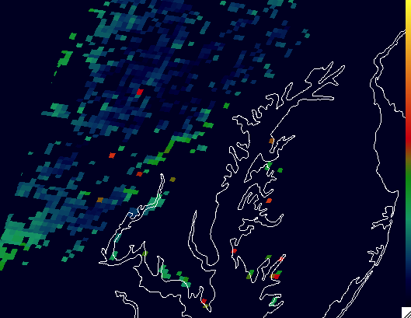
MODIS 3 km product over suburban (MD) landscape (DRAGON, summer 2010)
Aqua: Day 209 2010
10 km
3 km
Terra: Day 219 2010
10 km
3 km
3 km mirrors 10 km product (pattern and magnitude)
3 km introduces noise, but also can reduce spatial impact of outliers

Slide 35
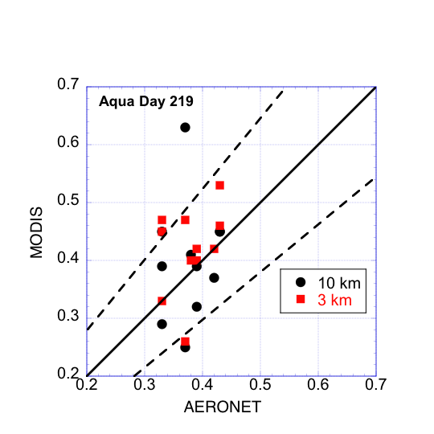
MODIS 3 km product over Maryland, Summer 2010
Compare with AERONET (DRAGON)
11 AERONET stations from Baltimore to College Park; Olney to Bowie.
station | AERONET | MODIS 3 km | MODIS 10km
BLTIM | 0.29 | 0.28 | 0.17
LAUMD | 0.26 | 0.24 | 0.20
OLNES | 0.23 | 0.22 | 0.09
RCKMD | 0.25 | 0.33 | 0.19
Overall, 3 km mirrors 10 km “validation”.
3 km validation sometimes improves with higher resolution matching

Slide 36
Before we “sign” off on Collection 6
Evaluate changes made to “Level 3” aerosol protocol and products
Consult with Christina about the DB/DT Combination product
Evaluate 3 km product output in MODAPS tests
See if most recent L1B/algorithm combo draws us nearer to or further from AERONET, both standard and alternative calibration
Once L1B calibration is FROZEN, make one more iteration.

Slide 37
Thank you
Collection 5 dark target AOD has been validated over land and ocean. QA flags are very important!
Over land, Terra and Aqua have are contradictory AOD trends.
C005 Trend inconsistencies are “consistent” with recently found trends in band #3 reflectance.
We are making improvements to aerosol retrieval algorithm and adding products for C006.
To combat the Terra “trending” we are testing different approaches for creating C006 L1B data.
  Approach #1 (no Earth View inputs): Terra’s AOD Trend remains
  Approach #2 (includes Earth View): Terra’s AOD Trend is removed, Terra-Aqua offset remains.
C006 will include a Combined Deep Blue/Dark Target product
C006 will have a separately produced 3km product (in addition to 10km)
We have much testing before C006 becomes “operational”
Impacts to aerosol size parameters are being evaluated (backup slides)

Slide 38
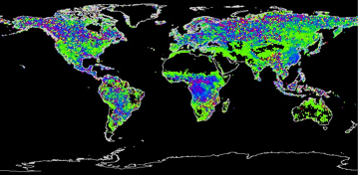
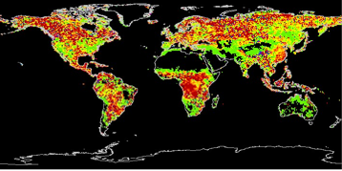

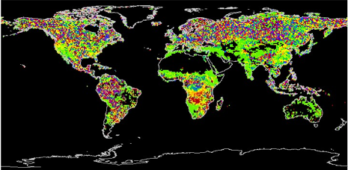
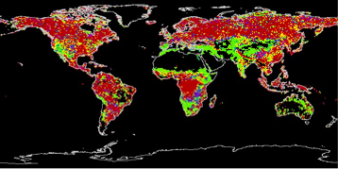
Fine fractions C6-C5: L1B differences only
Terra July 2003
(movement towards more dust)
Terra July 2003 Alternative calib
(movement towards less dust)
Terra July 2008
(strong changes but spatially random)
Terra July 2008 Alternative calib
(intensifies)

Slide 39
C6-C5: L1B differences only
Areas with most AOD change,
have least fine fraction change
Algorithm is compensating
Terra July 2003 fine fraction
Terra July 2003 AOD
Terra July 2008 fine fraction
Terra July 2008 AOD

Slide 40
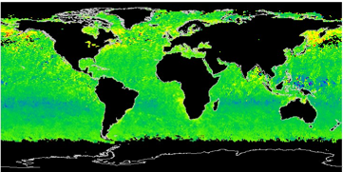
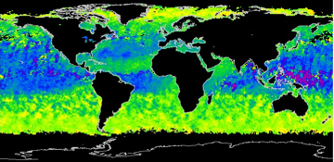

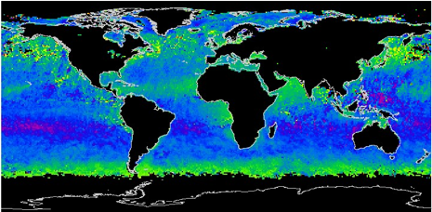

C6 – C5 Angstrom exponent: L1B changes only
Calibration changes show up over ocean
only in size parameters, and these
are very sensitive to calibration
Terra July 2003
Terra July 2003 Alternative calib
Terra July 2008
Terra July 2008 Alternative calib

Slide 41





Angstrom Exponent 1 Difference
Aqua size parameters affected more than Terra
Terra July 2003
Aqua July 2003
Terra July 2008
Aqua July 2008

