Slide 1
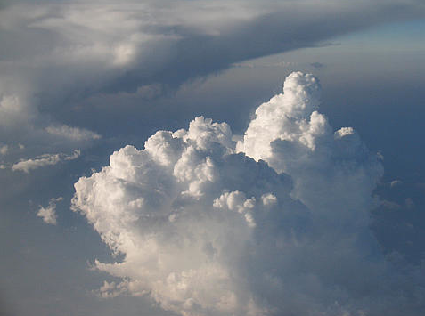


Aerosol properties near clouds
Alexander Marshak and Tamás Várnai
NASA GSFC and UMBC JCET
R. Cahalan, F. Evans, G. Wen, W. Yang

Slide 2
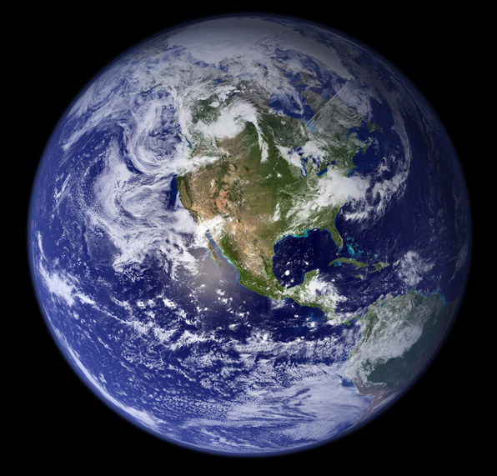
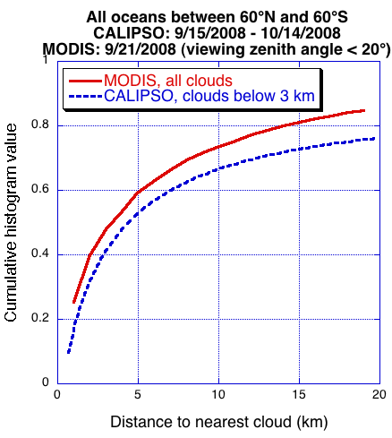
Aerosol measurements near clouds are important
Motivation:
Help satellite studies of aerosol-cloud interactions
Aerosol remote sensing near clouds is challenging
Excluding areas near-cloud risks biases in aerosol data
Notes:
Can we stay away from clouds? Are aerosols similar near and far from clouds?

Slide 3
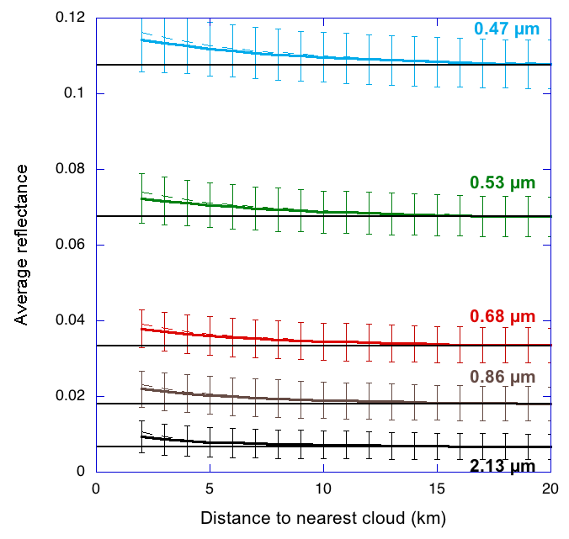
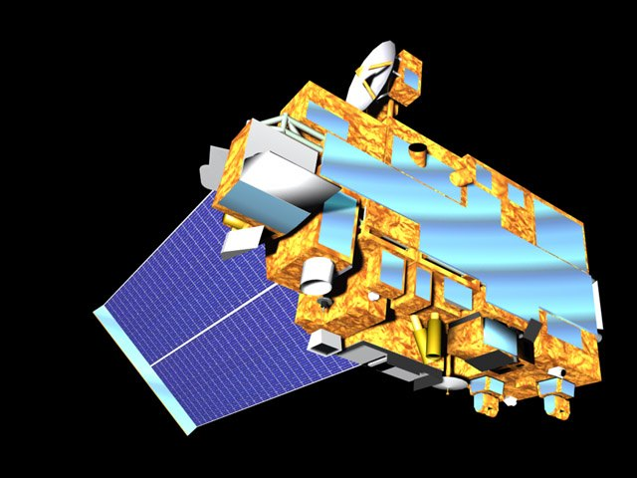

MODIS reflectances increase near clouds
NE Atlantic Ocean, MODIS Terra
2000-2007, September 14-29
Reflectance increase may come from:
Aerosol changes (e.g., swelling in humid air)
Undetected cloud particles
Instrument imperfections
3D radiative effects
Várnai and Marshak (2009)

Slide 4
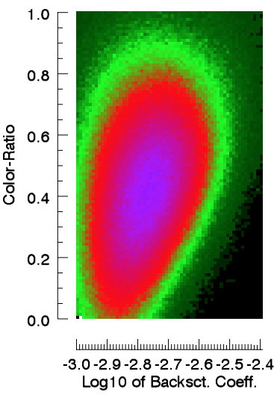
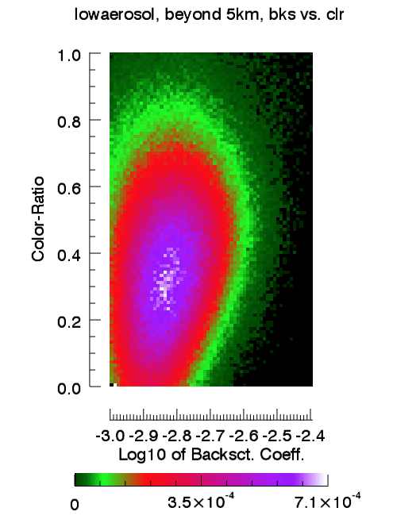
CALIOP backscatter and particle size
Far from clouds (> 5km)
Fraction of cloud-free vertical profiles
global night data over ocean
July 8 – Aug 7, 2007

Slide 5
CALIOP backscatter and particle size
Close to clouds (< 5km)
Fraction of cloud-free vertical profiles
global night data over ocean
July 8 – Aug 7, 2007

Slide 6
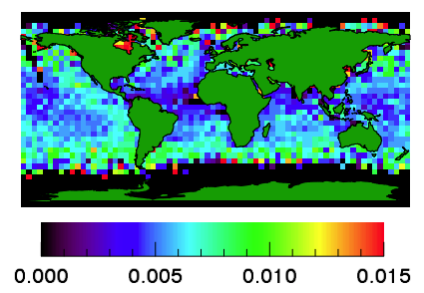
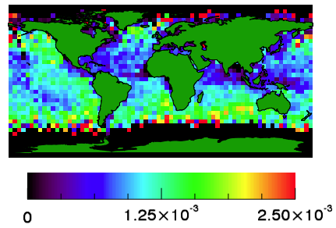
Enhancements occur over all oceans
MODIS 0.47 µm reflectance (R) enhancement
CALIOP 532 nm backscatter (β) enhancement
R_{d<5km} – R_{d>5km}
β_{d<5km} – β_{d>5km}
Median reflectance enhancement
Enhancement of median backscatter integrated up to 3 km (sr⁻¹)
One year, 11/06 – 10/07

Slide 7
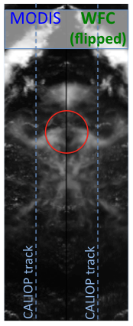
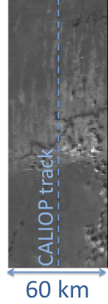
MODIS can add cloud information

Slide 8
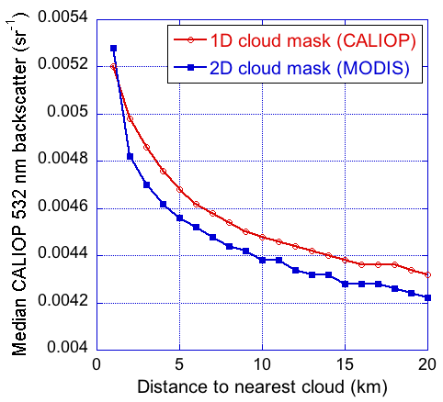
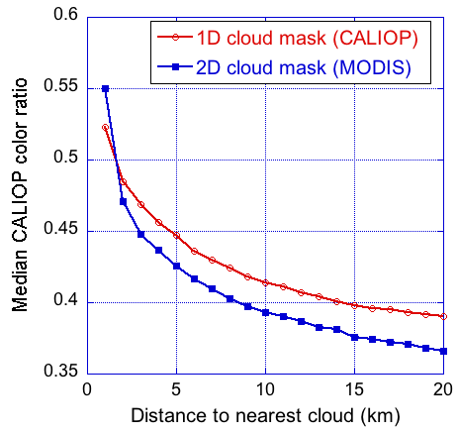
1D & 2D cloud masks yield similar enhancements
CALIOP 532 nm backscatter (β₅₃₂)
integrated up to 3 km altitude
CALIOP color ratio (β₁₀₆₄ / β₅₃₂)
(closely related to particle size)

Slide 9
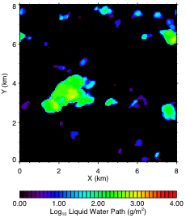
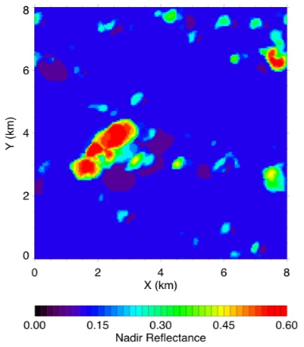
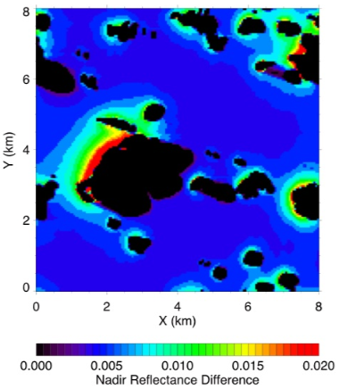
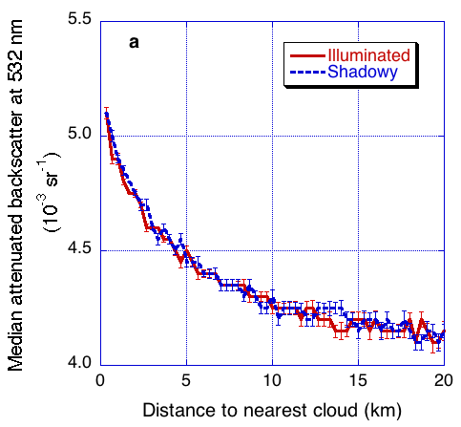
3D-related increases should be asymmetric
LES liquid water path
R_{3D} (0.47 µm)
Orbit
R_{3D}-R_{1D} (0.47 µm)
3D effect:
enhancement
everywhere
(outside shadows)
CALIOP 532 nm backscatter
Distance to cloud (km)

Slide 10
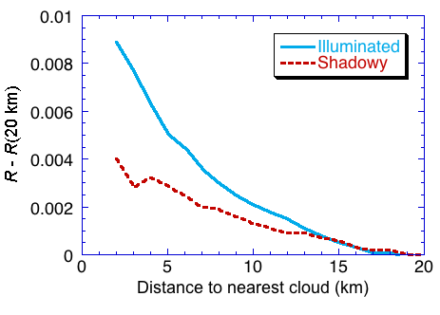
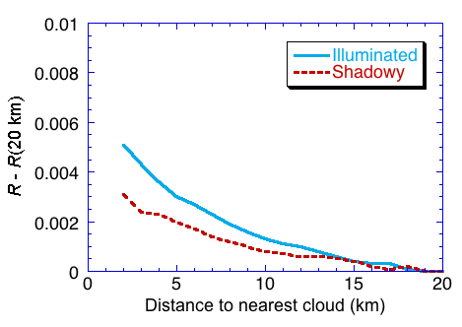
Asymmetry stronger at shorter λ: 3D is important
MODIS, 0.47 µm MODIS, 0.86 µm
Várnai and Marshak (2009)

Slide 11
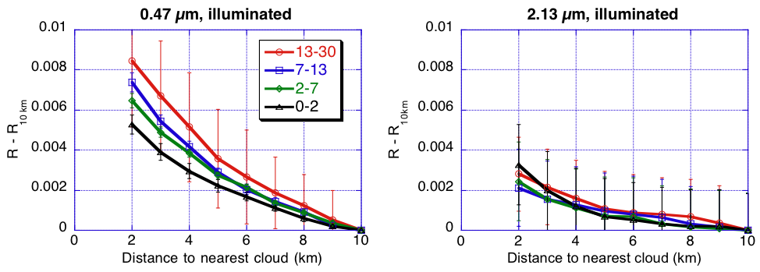
Strong increase near thick clouds agrees with 3D
MODIS reflectances near clouds of various optical thicknesses
Orbit
Várnai and Marshak (2009)

Slide 12
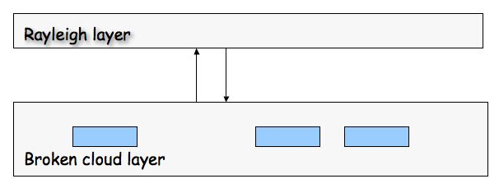
Simple model to correct for 3D enhancement
R_{corrected} = R_{MODIS} - ΔR(τ_{Rayleigh},F_{reflected})
Need this
RT model (τ, CF, r_{e})
Input from CERES and MODIS
Ocean BRDF
Correlated-k for BB
CERES
Marshak et al. (2008)

Slide 13
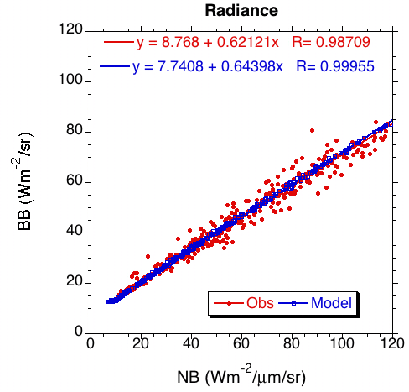
Test shows assumption works for radiances

Slide 14
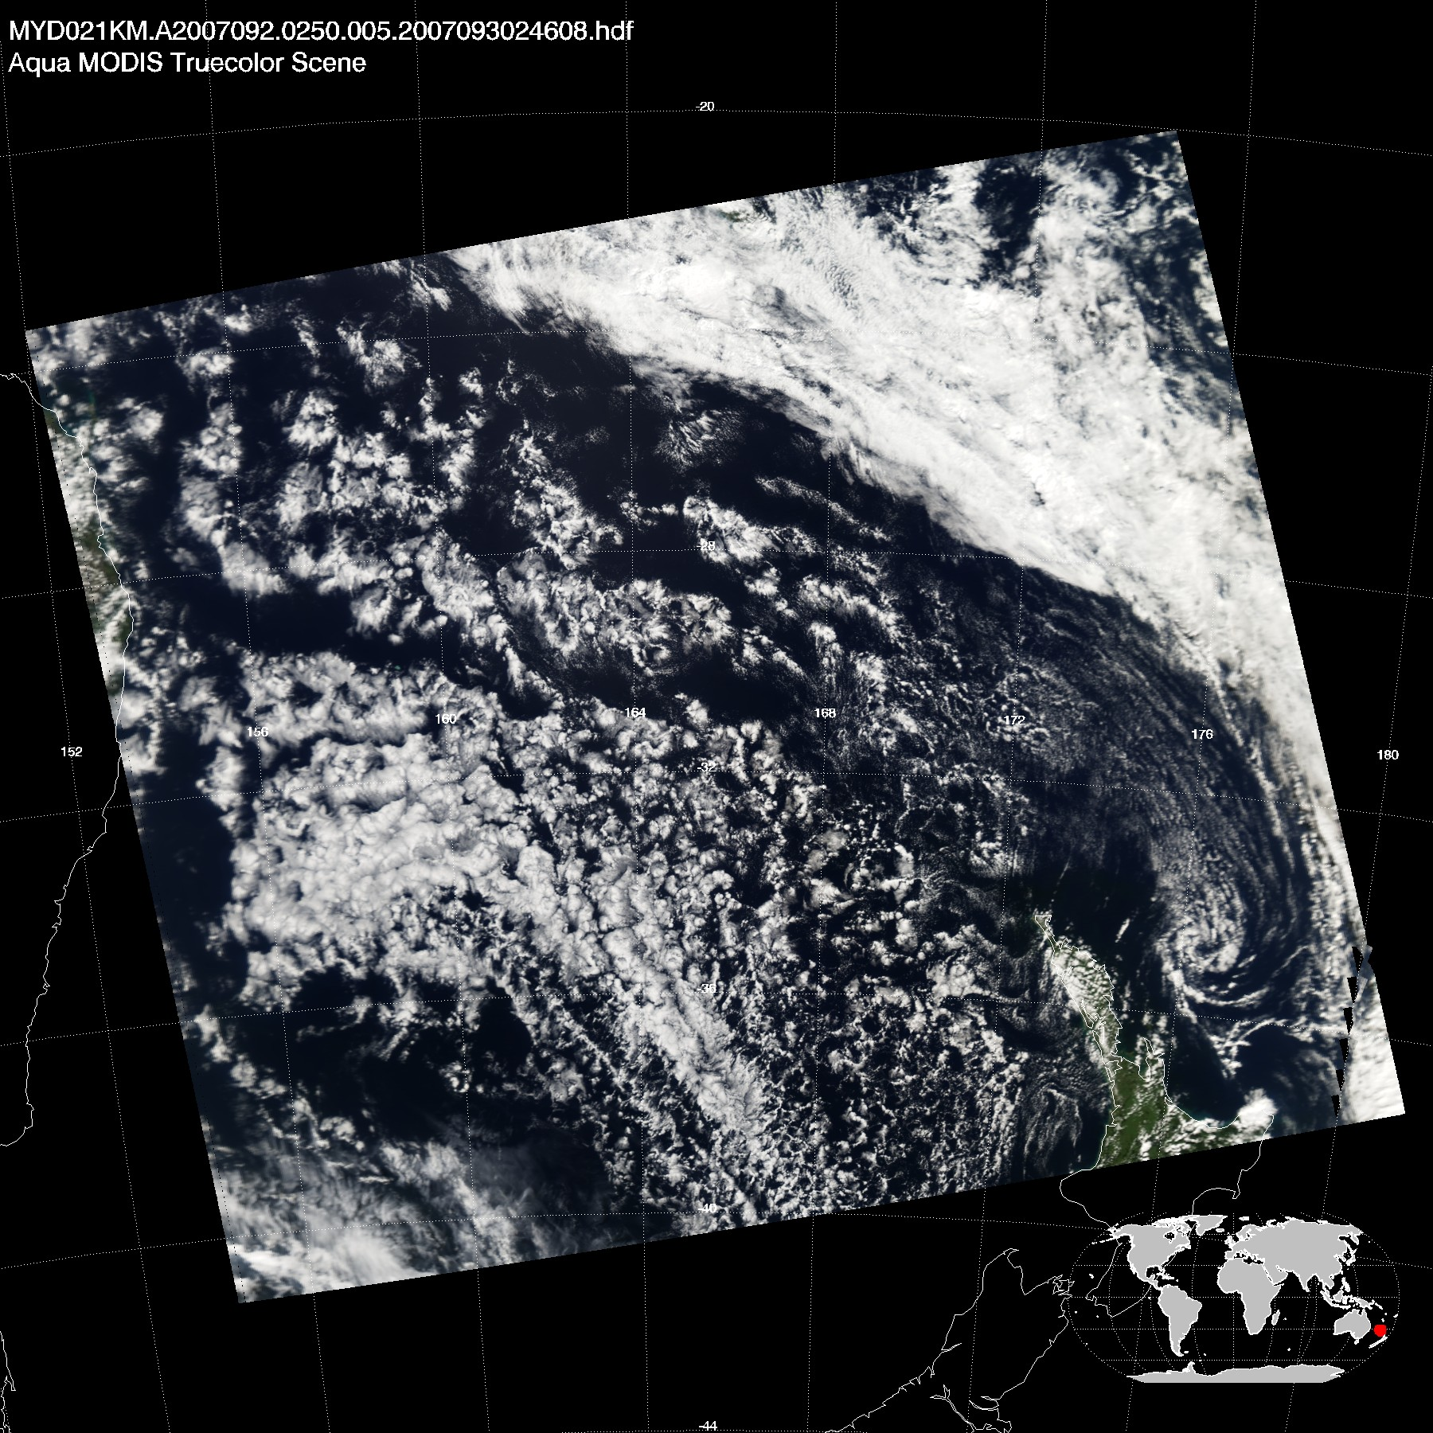
Test scene near New Zealand

Slide 15
MODIS cloud products
300 km
300 km
Average(τ)=9
Stddev(τ)=9
Average(R_{e})=18 μm
Stddev(R_{e}) =5 μm

Slide 16
Albedo and AOT
300 km
300 km
Low level water clouds
Average AOT ~0.13

Slide 17
Correction reduces some AOT values
Small change
Original 0.47 µm AOT
Corrected 0.47 µm AOT
Big change

Slide 18
Correction reduces fraction of small aerosols
Small fraction, corrected
cloud
Scattering
large aerosol
small aerosol
air molecules
Small fraction, original
Wavelength

Slide 19
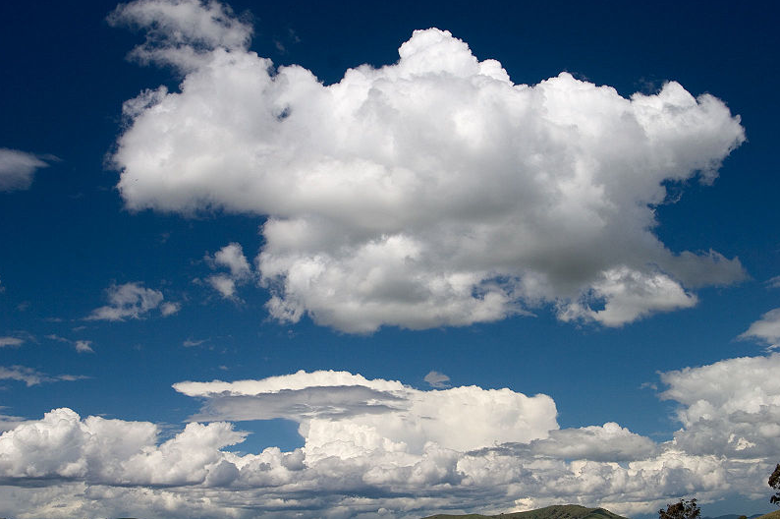
Summary
Clouds are surrounded by a wide (>10 km) transition zone of enhanced particle size and light scattering. This transition zone needs to be considered in studies of aerosol radiative effects and aerosol-cloud interactions.
3D radiative processes play an important role in enhancing clear sky solar reflectance near clouds. A simple two-layer model shows promise for considering these processes in passive satellite remote sensing.
A synergy of passive (MODIS, CERES and WFC) and active remote sensing (CALIOP) can help better understand and measure aerosol properties near clouds.

Slide 20
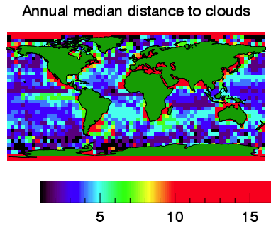
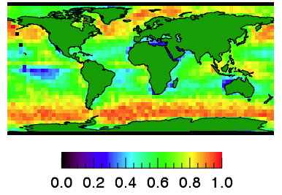

Cloud fraction affects typical distance to clouds
Annual median distance to clouds below 3 km
Annual mean cloud fraction
Median distance to clouds (km)
Mean cloud fraction

Slide 21
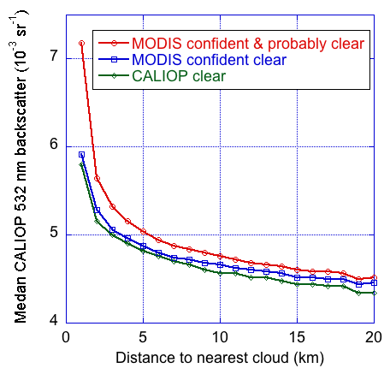
Cloud mask affects increase mainly near clouds

Slide 22
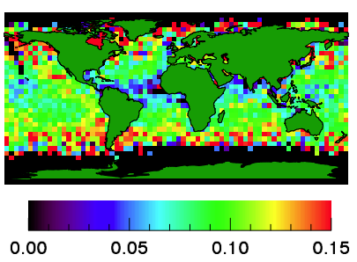
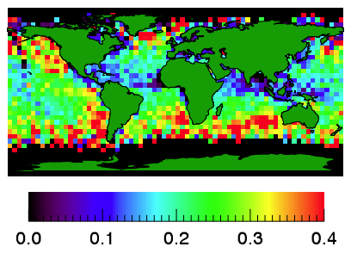
Median relative near-cloud enhancements
MODIS
CALIOP

Slide 23
CALIOP: increases occur below cloud top

Slide 24
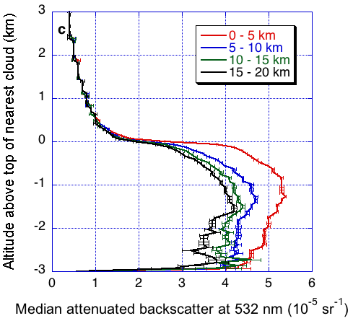
CALIOP: increases occur below cloud top
Várnai and Marshak (2010)

Slide 25
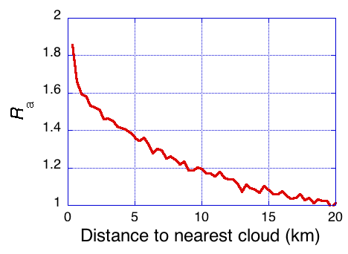
Increases suggest large changes in AOT

