Slide 1
MODIS Cloud Optical and Microphysical Properties Product Collection 6 Update
Steven Platnick, Michael D. King, Gala Wind, et al
MODIS Science Team Meeting
Adelphi, MD 18 May 2011
Notes:
Will talk about the updates and status of collection 6 product development

Slide 2
MOD06 Optical/Microphysical Product
Collection 6 plans and schedule
MOD_PR06OD
Thermodynamic phase, τ, r_{e}, WP
1 km retrievals, global (land, ocean, ice), daytime
C5 highlights
As before, primary r_{e} from band combination w/2.1 µm; 1.6 and 3.7 µm retrievals given as differences. L3 aggregations for 2.1 µm retrieval only.
Ice cloud radiative models from Baum, Yang, et al. (2005)
Various QA including:
“Clear Sky Restoral” (CSR): spatial (edge removal, 250m cloud mask over water surfaces) and spectral tests, used to help eliminate cloudy pixels not suitable for retrievals or incorrectly identified cloudy pixels. MOD35 pixels eliminated via CSR are not processed.
multilayer/phase cloud detection (separate aggregation in L3)
Land and snow/ice spectral surface albedo: gap-filled BU C4 product, Moody et al. (2005)
Pixel-level baseline uncertainties
Notes:
C5 highlights:
Ice cloud:

Slide 3
MOD06 Optical/Microphysical Product
Collection 6 plans and schedule
C6 Plan Highlights
Includes 1.6 and 3.7 µm retrievals as absolutes, allowing for L3 aggregations.
Ice cloud radiative models: TBD, but understood to be an important issue. Have included arrays of g_{λ} and ϖ_{0,λ} so users can compare/scale retrievals to their own radiative models.
Thermodynamic Phase: replace SWIR to VIS/NIR ratio tests with separate ice and liquid water retrievals; continue validation vs. CALIOP. (Benjamin Marchant)
Various QA including:
“Clear Sky Restoral” (CSR): Considering processing likely partly cloudy pixels identified by CSR; add appropriate flag to allow for separate L3 aggregation (which L3 statistics are TBD).
multilayer/phase detection: included Pavolonis & Heidinger algorithm.
Land spectral surface albedo: new combined Aqua/Terra gap-filled C5 product from BU team.
Pixel-level baseline uncertainties: link to retrieval QA assignments.
New LUTs: Full LUT (no asymptotic parameters) using DISORT w/wind-speed-interpolated Cox-Munk BRDF. (Nandana Amarasinghe)
Improved ancillary data product handling
Notes:
C6 highlights:
Phase: along w/CSR processing, requires major change in code logic (retrievals for only one phase will be kept and phase QA assignments need to precede CSR in code logic structure).
Will show examples of :
LUT: get away from combination of discrete ordinate and asymptotic theory – greatly complicated code vs. small LUT advantage.
5km vs 1km CT
Edge pixels retrieved

Slide 4
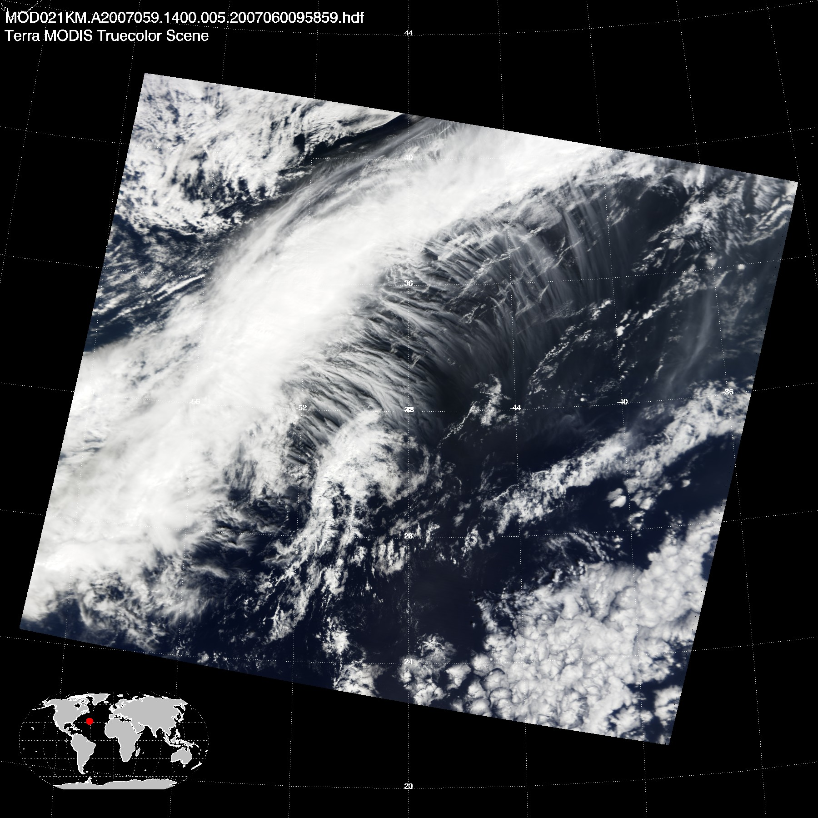
Cox-Munk Surface Reflectance Example
Terra 2007 day 059 14:00 UTC
Study area
(40N,52W – 32N,40W)

Slide 5
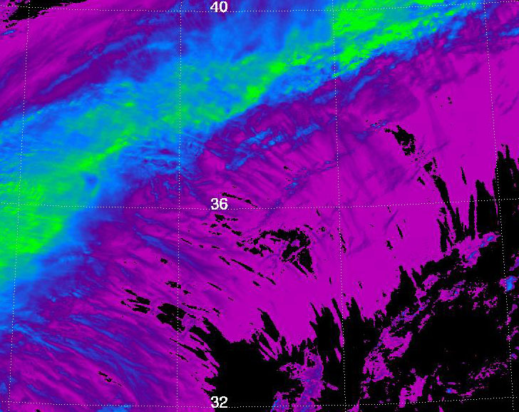
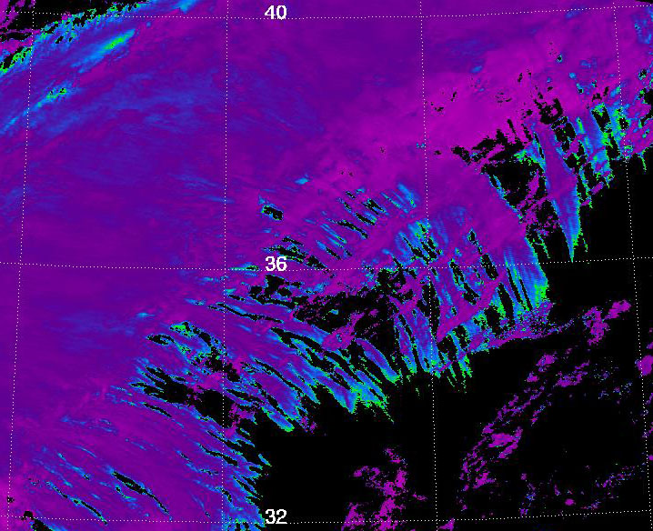
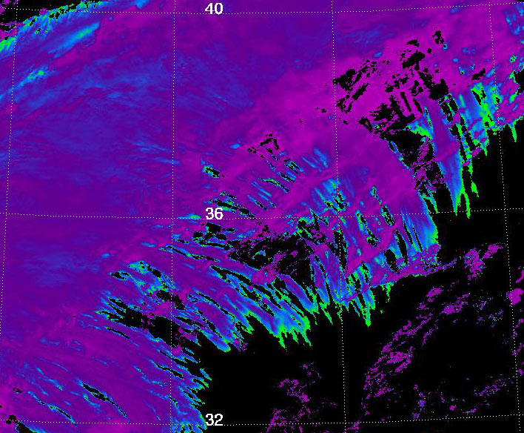
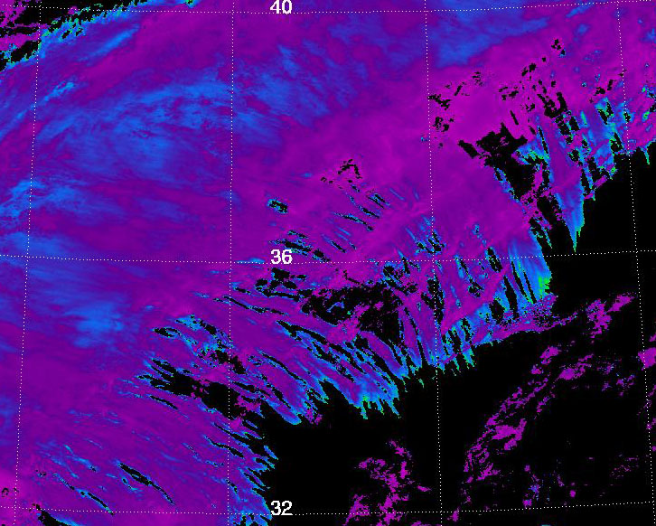
Cox-Munk Surface Reflectance Example
Lambertian ocean surface reflectance A_{s} = 0.05. Science Test (ST) 5A
Cloud Optical Thickness
Cloud Effective Radius 2.1µm
τ
Cloud Effective Radius 1.6µm
r_{e} (µm)
Cloud Effective Radius 3.7µm
Thermodynamic
phase
forced to ice

Slide 6
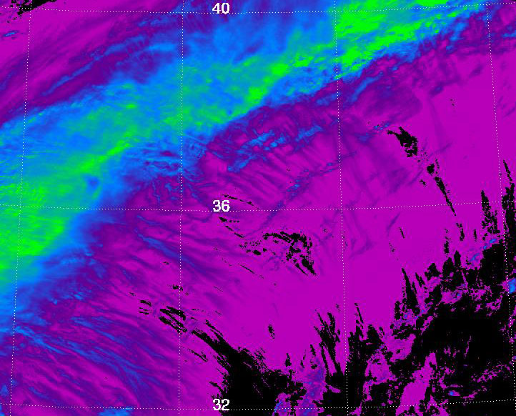
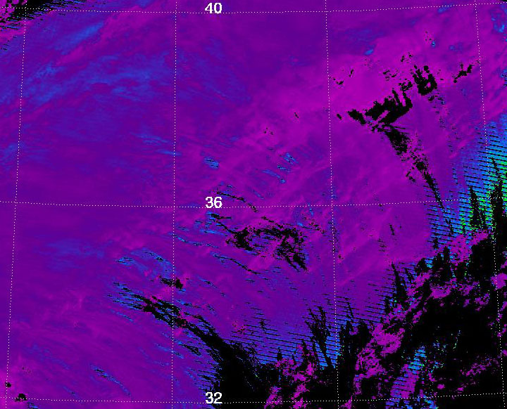
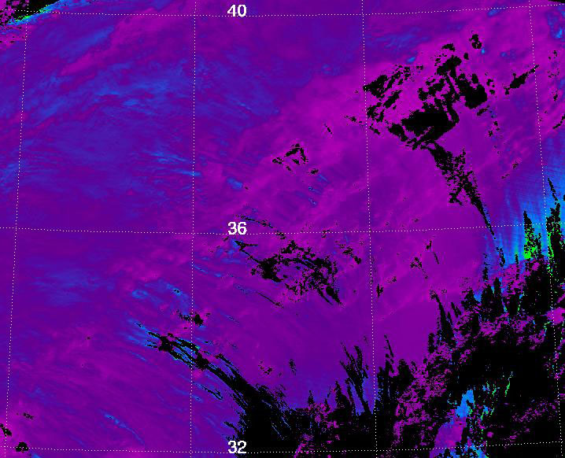
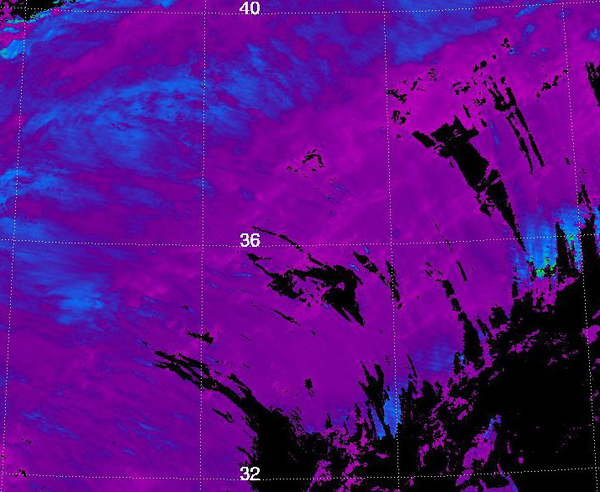
Cox-Munk Surface Reflectance Example
Cox-Munk ocean surface reflectance, averaged wind direction. ST 5
Cloud Optical Thickness
Cloud Effective Radius 2.1µm
τ
Cloud Effective Radius 1.6µm
r_{e} (µm)
Cloud Effective Radius 3.7µm
Thermodynamic
phase
forced to ice

Slide 7
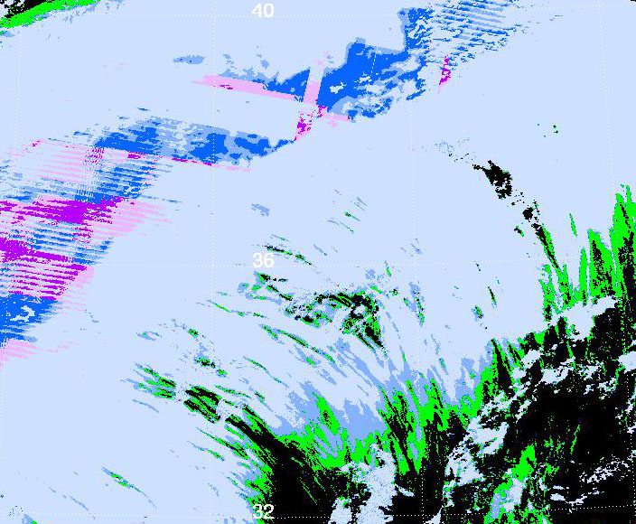
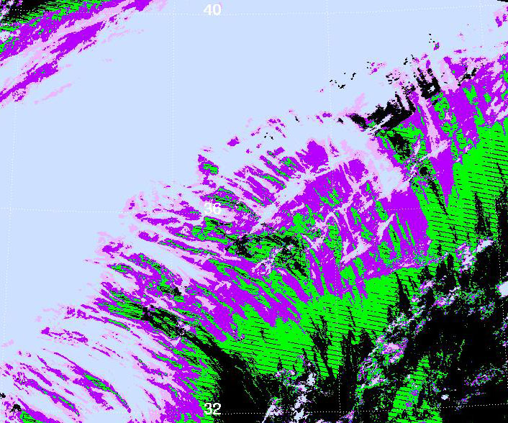
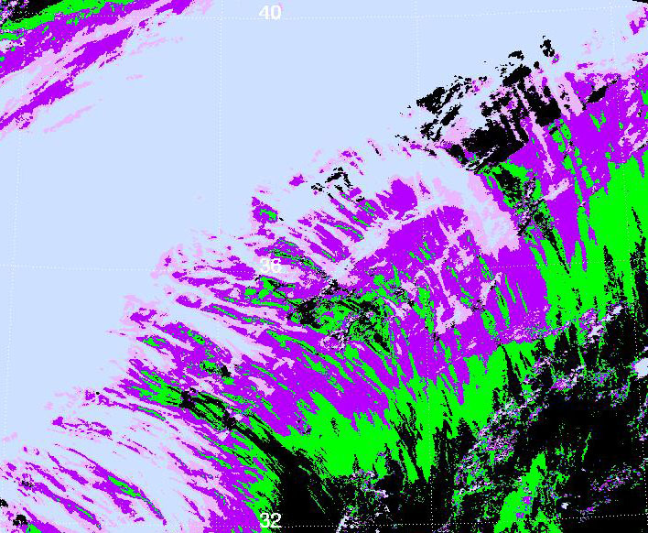
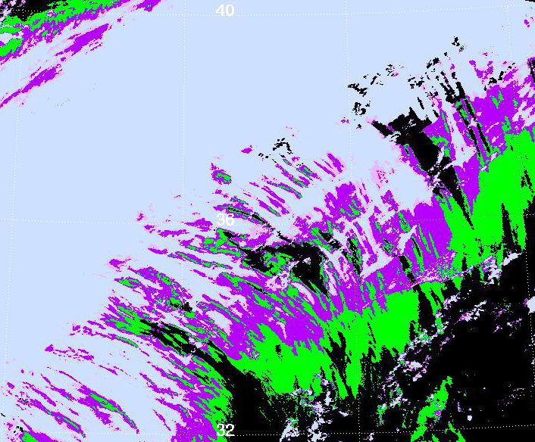
Cox-Munk Surface Reflectance Example
Difference between Cox-Munk and Lambertian surface models. ST 5 – ST 5A
Cloud Optical Thickness
Cloud Effective Radius 2.1µm
-1
1
τ
Cloud Effective Radius 1.6µm
-5
5
r_{e}
Cloud Effective Radius 3.7µm
Newly successful retrieval

Slide 8
Cox-Munk Surface Reflectance Example
Retrieval histograms, all successful retrievals
Cloud Optical Thickness
Cloud Effective Radius 2.1µm
Mean
C5: 11.43
C6: 10.86
Mean
C5: 24.97
C6: 22.30
Cloud Effective Radius 1.6µm
Cloud Effective Radius 3.7µm
Mean
C5: 25.52
C6: 21.95
Mean
C5: 24.25
C6: 21.47
Notes:
C6 is the science test 5
C5 is the science test 5A

Slide 9
Cox-Munk Surface Reflectance Example
Retrieval histograms, new successful retrievals only
Cloud Optical Thickness
Cloud Effective Radius 2.1µm
Mean: 0.301
Mean: 28.04
Cloud Effective Radius 1.6µm
Cloud Effective Radius 3.7µm
Mean: 26.19
Mean: 21.70

Slide 10
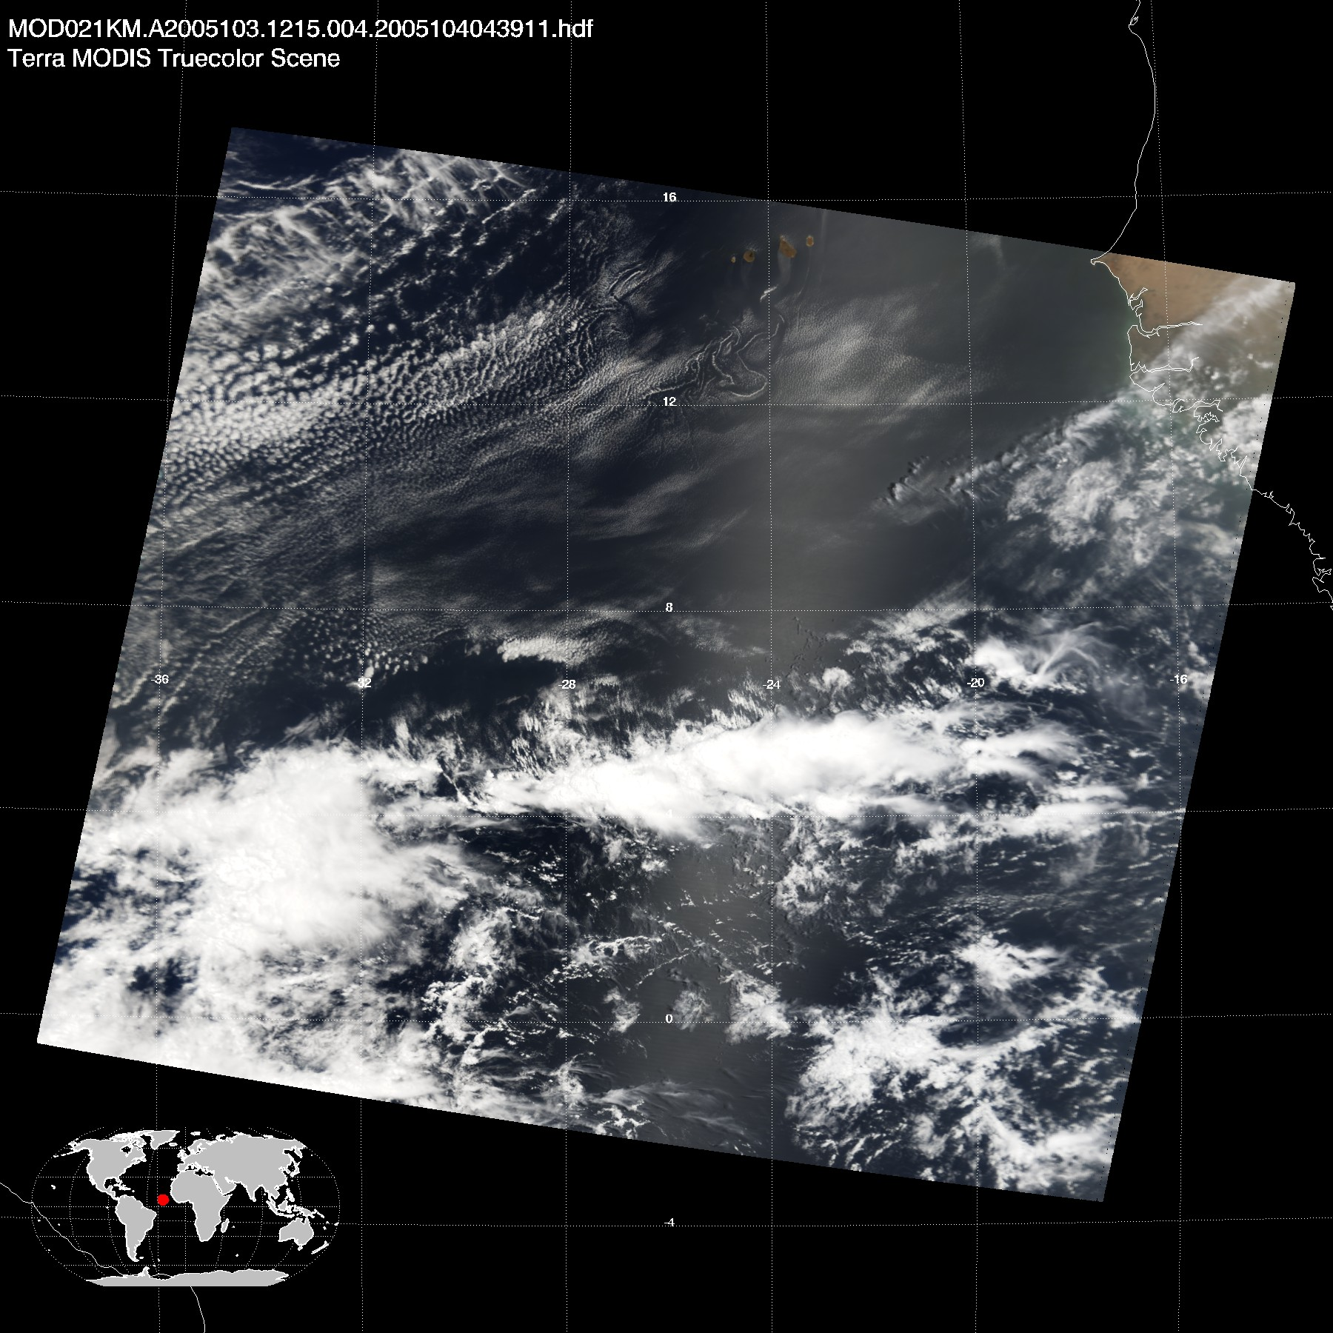
Cloud Edge and 250m Partly Cloudy Pixels
Terra 2005 day 103 12:15 UTC
Study area
(16N,32W – 8N,20W)

Slide 11
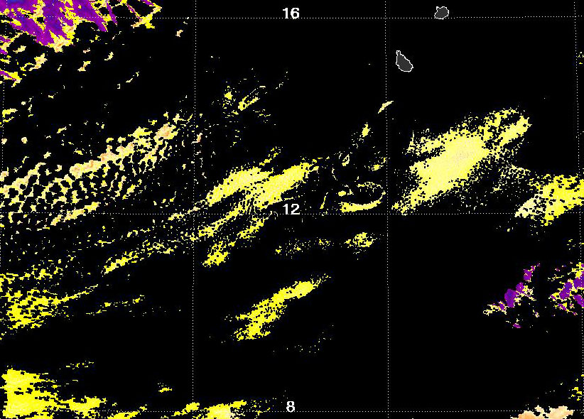
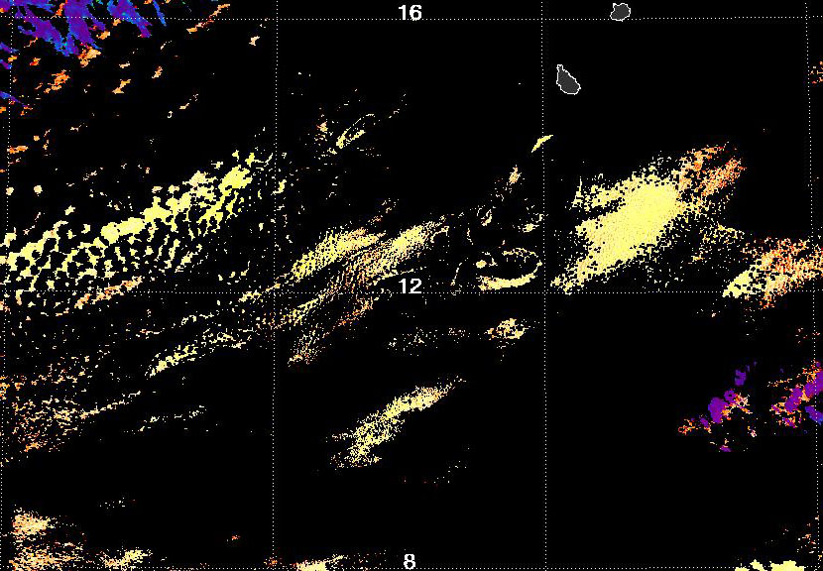
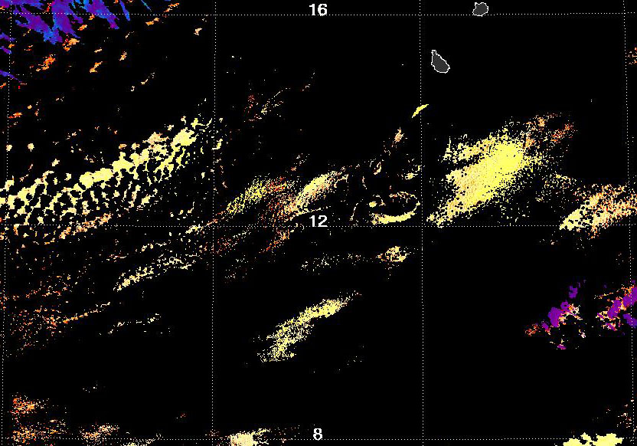
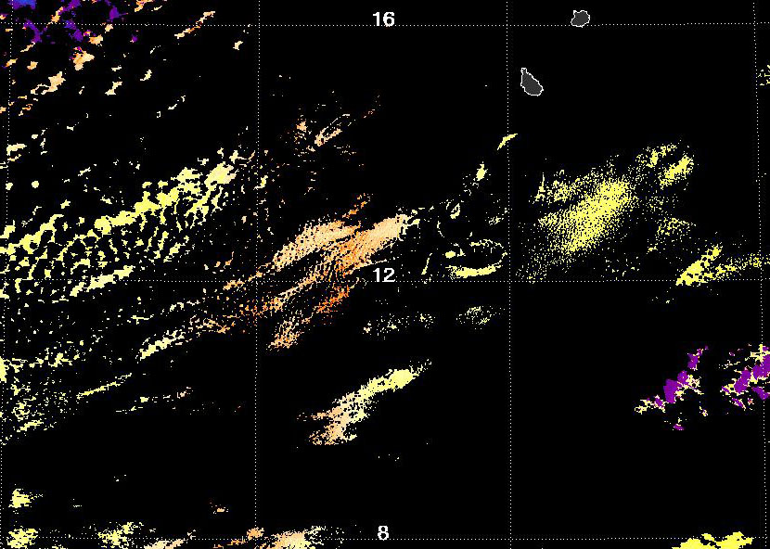
Cloud Edge and 250m Partly Cloudy Pixels
Example retrieval without the cloud edge and 250m partly cloudy pixels
Cloud Optical Thickness
Cloud Effective Radius 2.1µm
τ
Cloud Effective Radius 1.6µm
Cloud Effective Radius 3.7µm

Slide 12
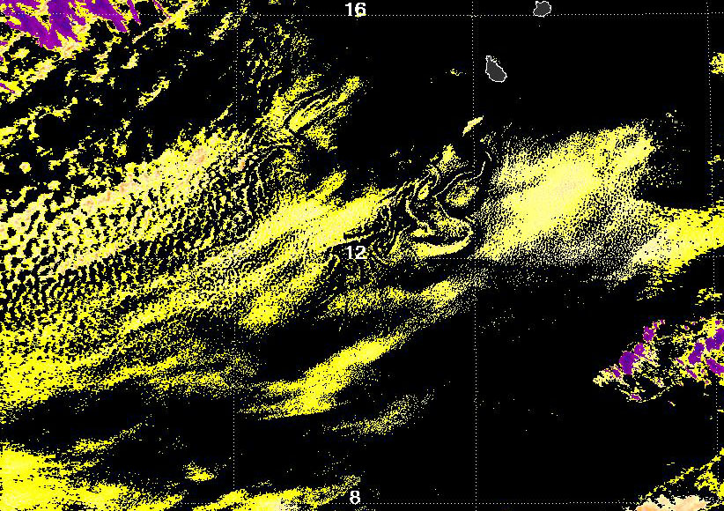
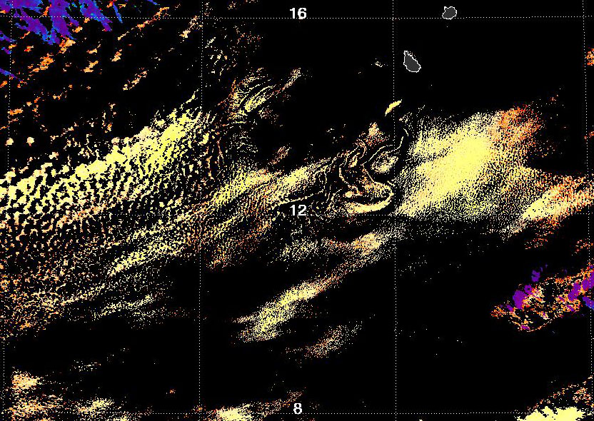
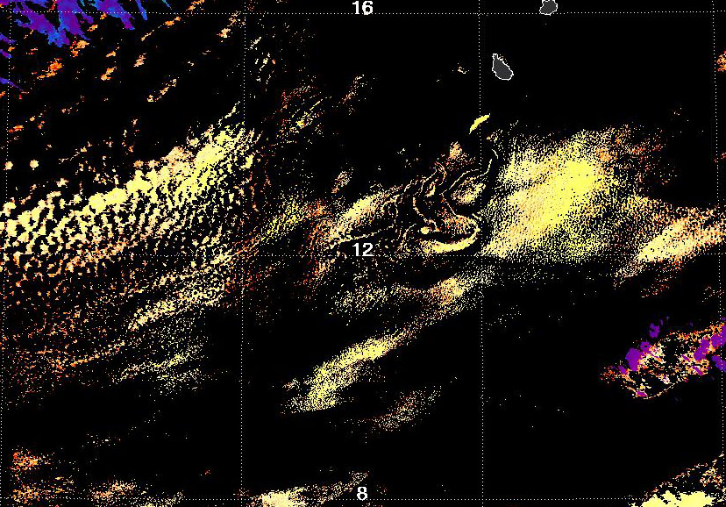
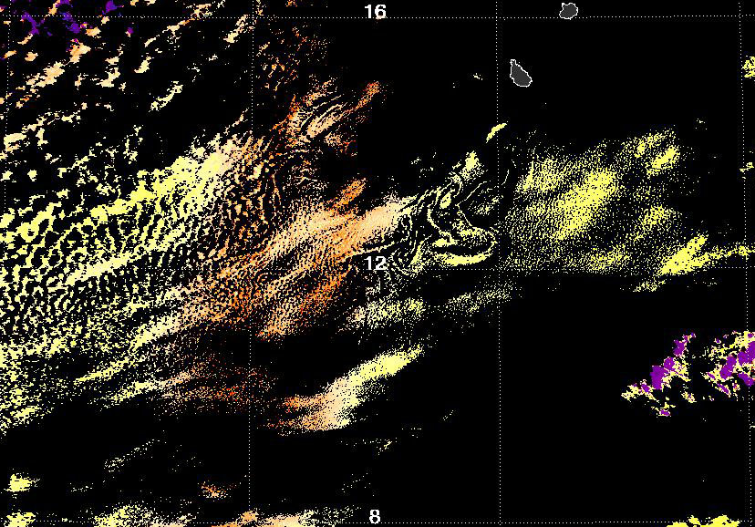
Cloud Edge and 250m Partly Cloudy Pixels
Example retrieval with the cloud edge and 250m partly cloudy pixels present
Cloud Optical Thickness
Cloud Effective Radius 2.1µm
τ
Cloud Effective Radius 1.6µm
Cloud Effective Radius 3.7µm

Slide 13
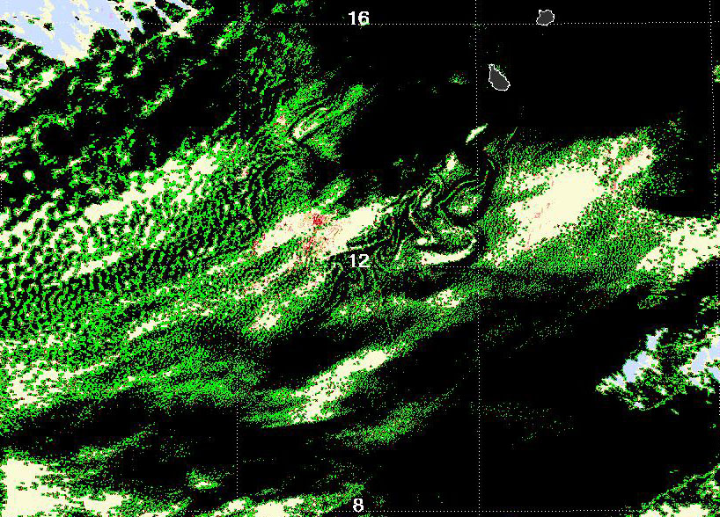
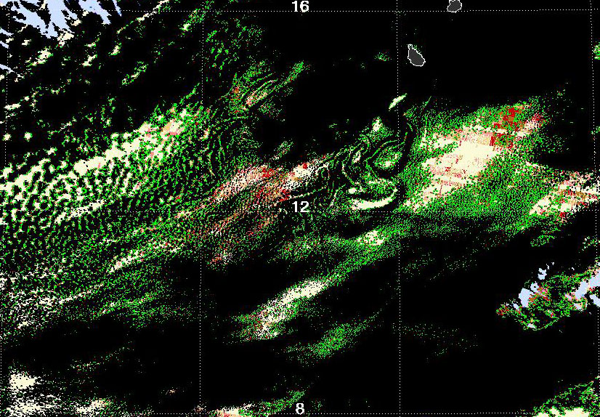
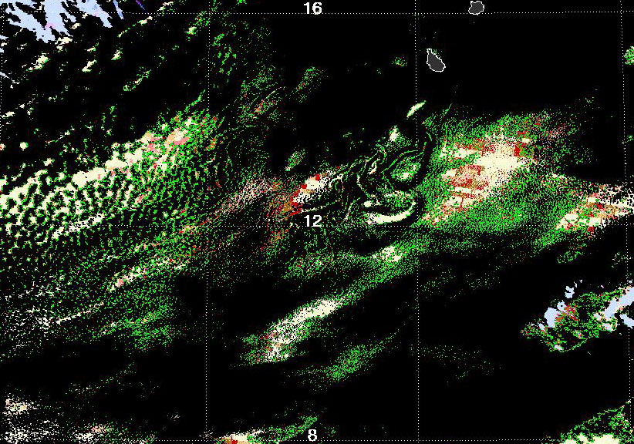
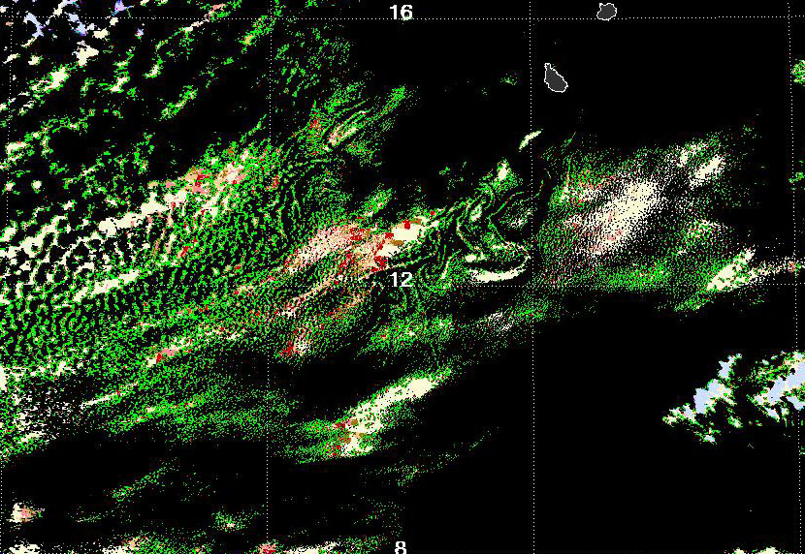
Cloud Edge and 250m Partly Cloudy Pixels
Retrieval differences with edge – without edge
Cloud Optical Thickness
Cloud Effective Radius 2.1µm
-2
2
-2
2
Cloud Effective Radius 1.6µm
Newly successful retrieval
Cloud Effective Radius 3.7µm

Slide 14
Cloud Edge and 250m Partly Cloudy Pixels
Retrieval histograms before and after
Cloud Optical Thickness (with partial)
Cloud Effective Radius 2.1µm
Means:
EL: 1.773
NL: 2.594
NI: 2.517
EI: 2.499
Means:
EL: 14.757
NL: 13.323
NI: 25.989
EI: 18.076
Cloud Effective Radius 1.6µm
Cloud Effective Radius 3.7µm
Means:
EL: 14.634
NL: 13.568
NI: 24.327
EI: 24.348
Means:
EL: 12.211
NL: 11.169
NI: 18.107
EI: 18.075
Notes:
Including partial retrievals for tau

Slide 15
Cloud Edge and 250m Partly Cloudy Pixels
Retrieval histograms for edge and 250m pixels only
Cloud Optical Thickness (with partial)
Cloud Effective Radius 2.1µm
Means:
Liq: 1.247
Ice: 1.292
Fraction:
Liq: 0.686
Ice: 1.000
Means:
Liq: 16.084
Ice: 30.679
Fraction:
Liq: 0.428
Ice: 0.897
Cloud Effective Radius 1.6µm
Cloud Effective Radius 3.7µm
Means:
Liq: 15.745
Ice: 26.406
Fraction:
Liq: 0.371
Ice: 0.989
Means:
Liq: 13.045
Ice: 21.827
Fraction:
Liq: 0.439
Ice: 0.529
Notes:
Fraction is the successful retrieval fraction for edge and 250-m pixels.
Ice is a whole lot more successful than water. However, we only have 87 ice pixels within the box of interest here.
We also have a C5 phase here. Generally in C5 edges of ice clouds over ocean come up as non-ice, therefore water retrieval fractions would come out as too low, because one can not separate the true edge effect from failure due to incorrect thermodynamic phase and ice fractions would be biased unnaturally high as it would take some doing to actually hit an edge pixel and for it to be identified as ice
When the full granule is concerned, we have: tau_frac: 0.938, re16 = 0.765, re21 = 0.625, re37 = 0.362
Also interesting the failure patterns. For liquid 1.6 fails more often than 2.1 and 2.1 more often than 3.7.
For ice the effect is the opposite, 1.6 fails the least and 3.7 fails the most.

Slide 16
MOD_PR06OD Through the Ages
Product execution time for an average granule (70% cloudy)

Slide 17
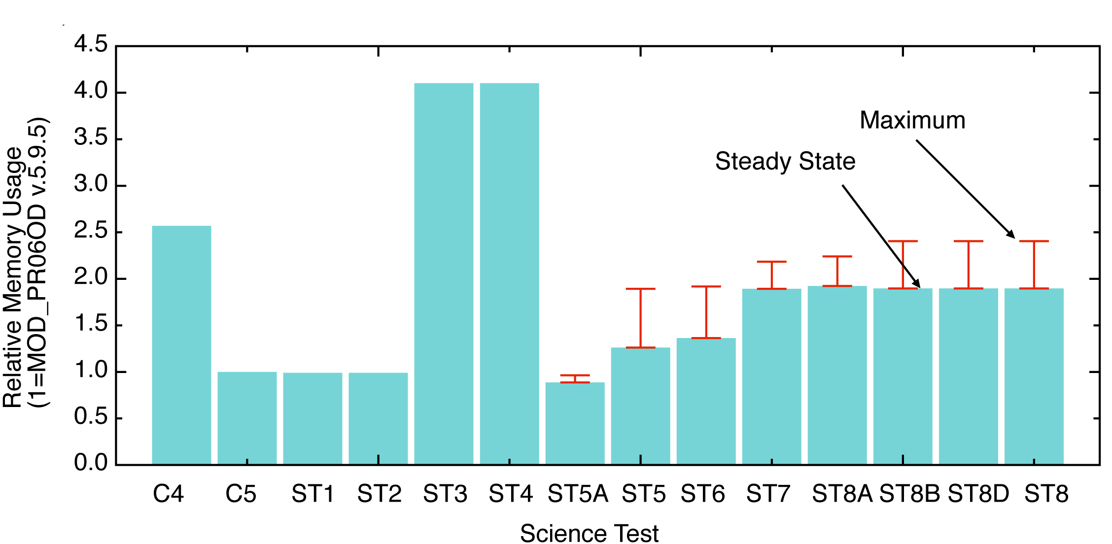
MOD_PR06OD Through the Ages
Product RAM usage for an average granule (70% cloudy)

Slide 18
Conclusion
Current Status: PGE06 v.6.0.24 in science test
8 out of planned 14 tests completed
Science changes left to implement:
3.7µm atmospheric emission
New solution logic to retrieve pixels just outside library space (with appropriate QA)
New thermodynamic phase
New surface albedo
New ice crystal models
RGB color tests for clear sky restoral
Uncertainty for ice cloud model error source (approximate method, but TBD)
Finalize L3 aggregation additions and changes (possible impact on L2 QA)
Take a look at our L2 poster for complete development status and timeline

