Slide 1

Global characteristics of marine stratocumulus clouds and drizzle
Sandra Yuter
Department of Marine, Earth, and Atmospheric Sciences
North Carolina State University
May 2011

Slide 2
Stratocumulus formation
← Equator
Poleward →
Stevens 2005, from Arakawa 1975

Slide 3
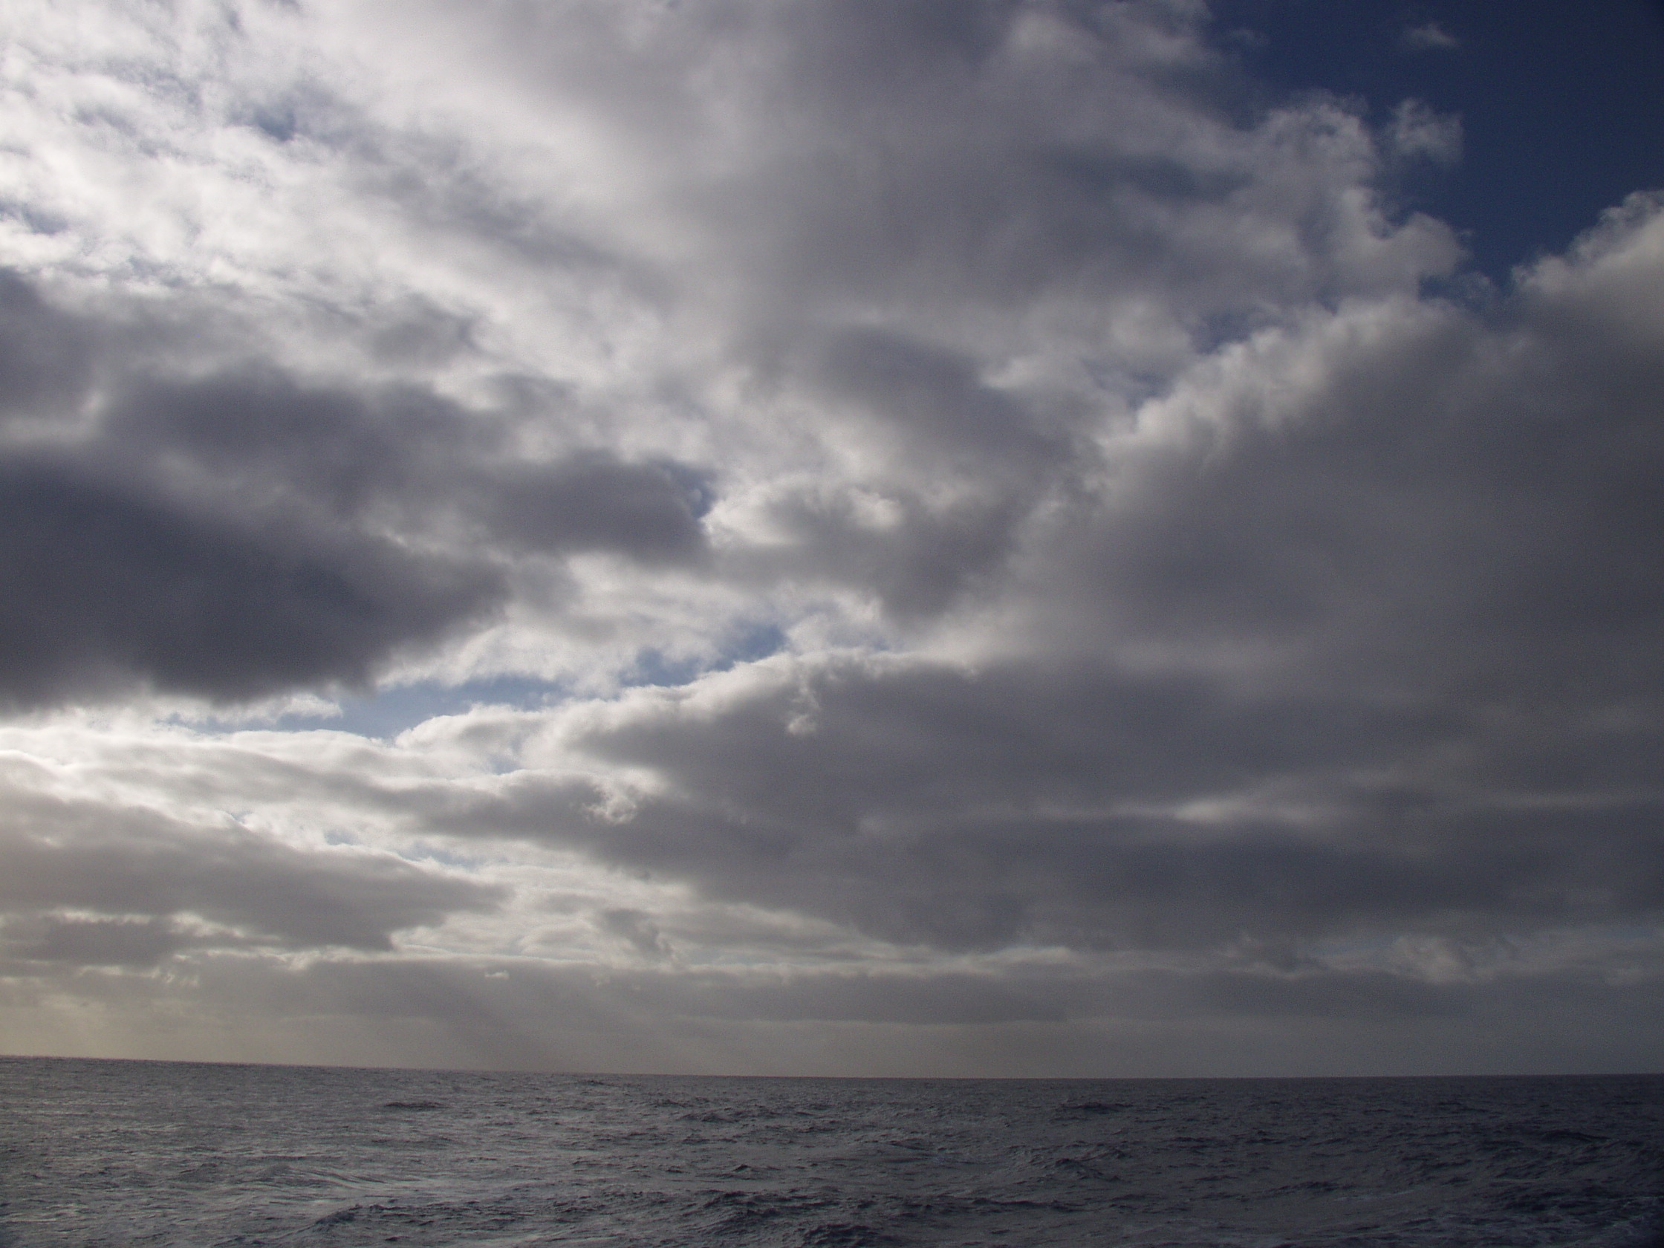

Slide 4
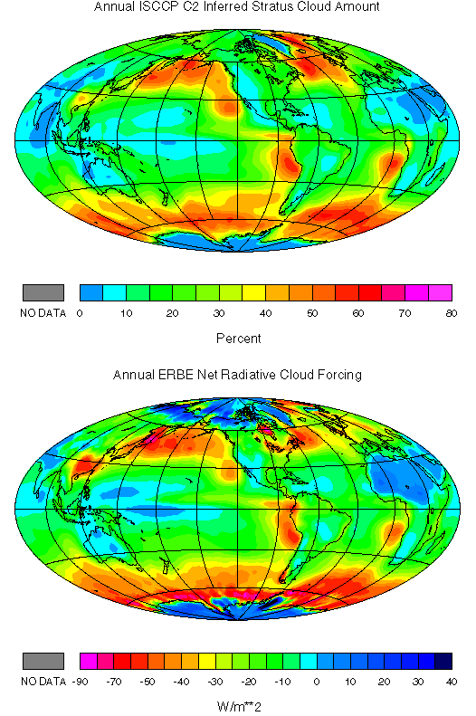
Why study marine stratocumulus?
Annual ISCCP Stratus Cloud Amount
No data
0 10 20 30 40 50 60 70 80
Percent
Courtesy of Dennis Hartmann
Notes:
Subtropical sc regions

Slide 5
Why study stratocumulus?- radiative forcing
Annual ERBE Net Cloud Radiative Forcing
cloud forcing
=
cloudy TOA rad. flux
–
clear sky TOA rad. flux
No data
-90 -70 -50 -40 -30 -20 -10 0 10 20 30 40
W/m²
Courtesy of Dennis Hartmann
Notes:
“A mere 4% increase in the area of the globe covered by low level stratus clouds would be sufficient to offset the 2-3K predicted rise in global temperature due to a doubling of CO2.” Randall et al 1984
(cloud forcing=observed TOA rad. flux – clear sky TOA rad. flux)
Sc popular destinations for field campaigns

Slide 6
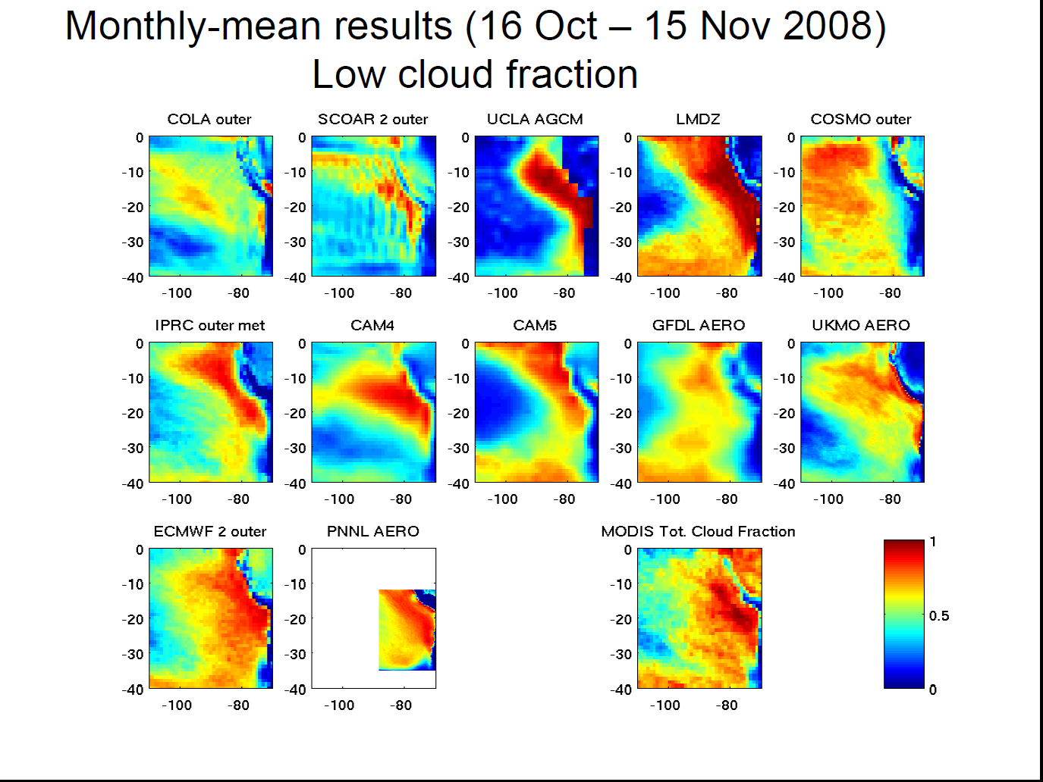
Modeled low cloud fraction for SE Pacific
M. Wyant, U. Washington

Slide 7
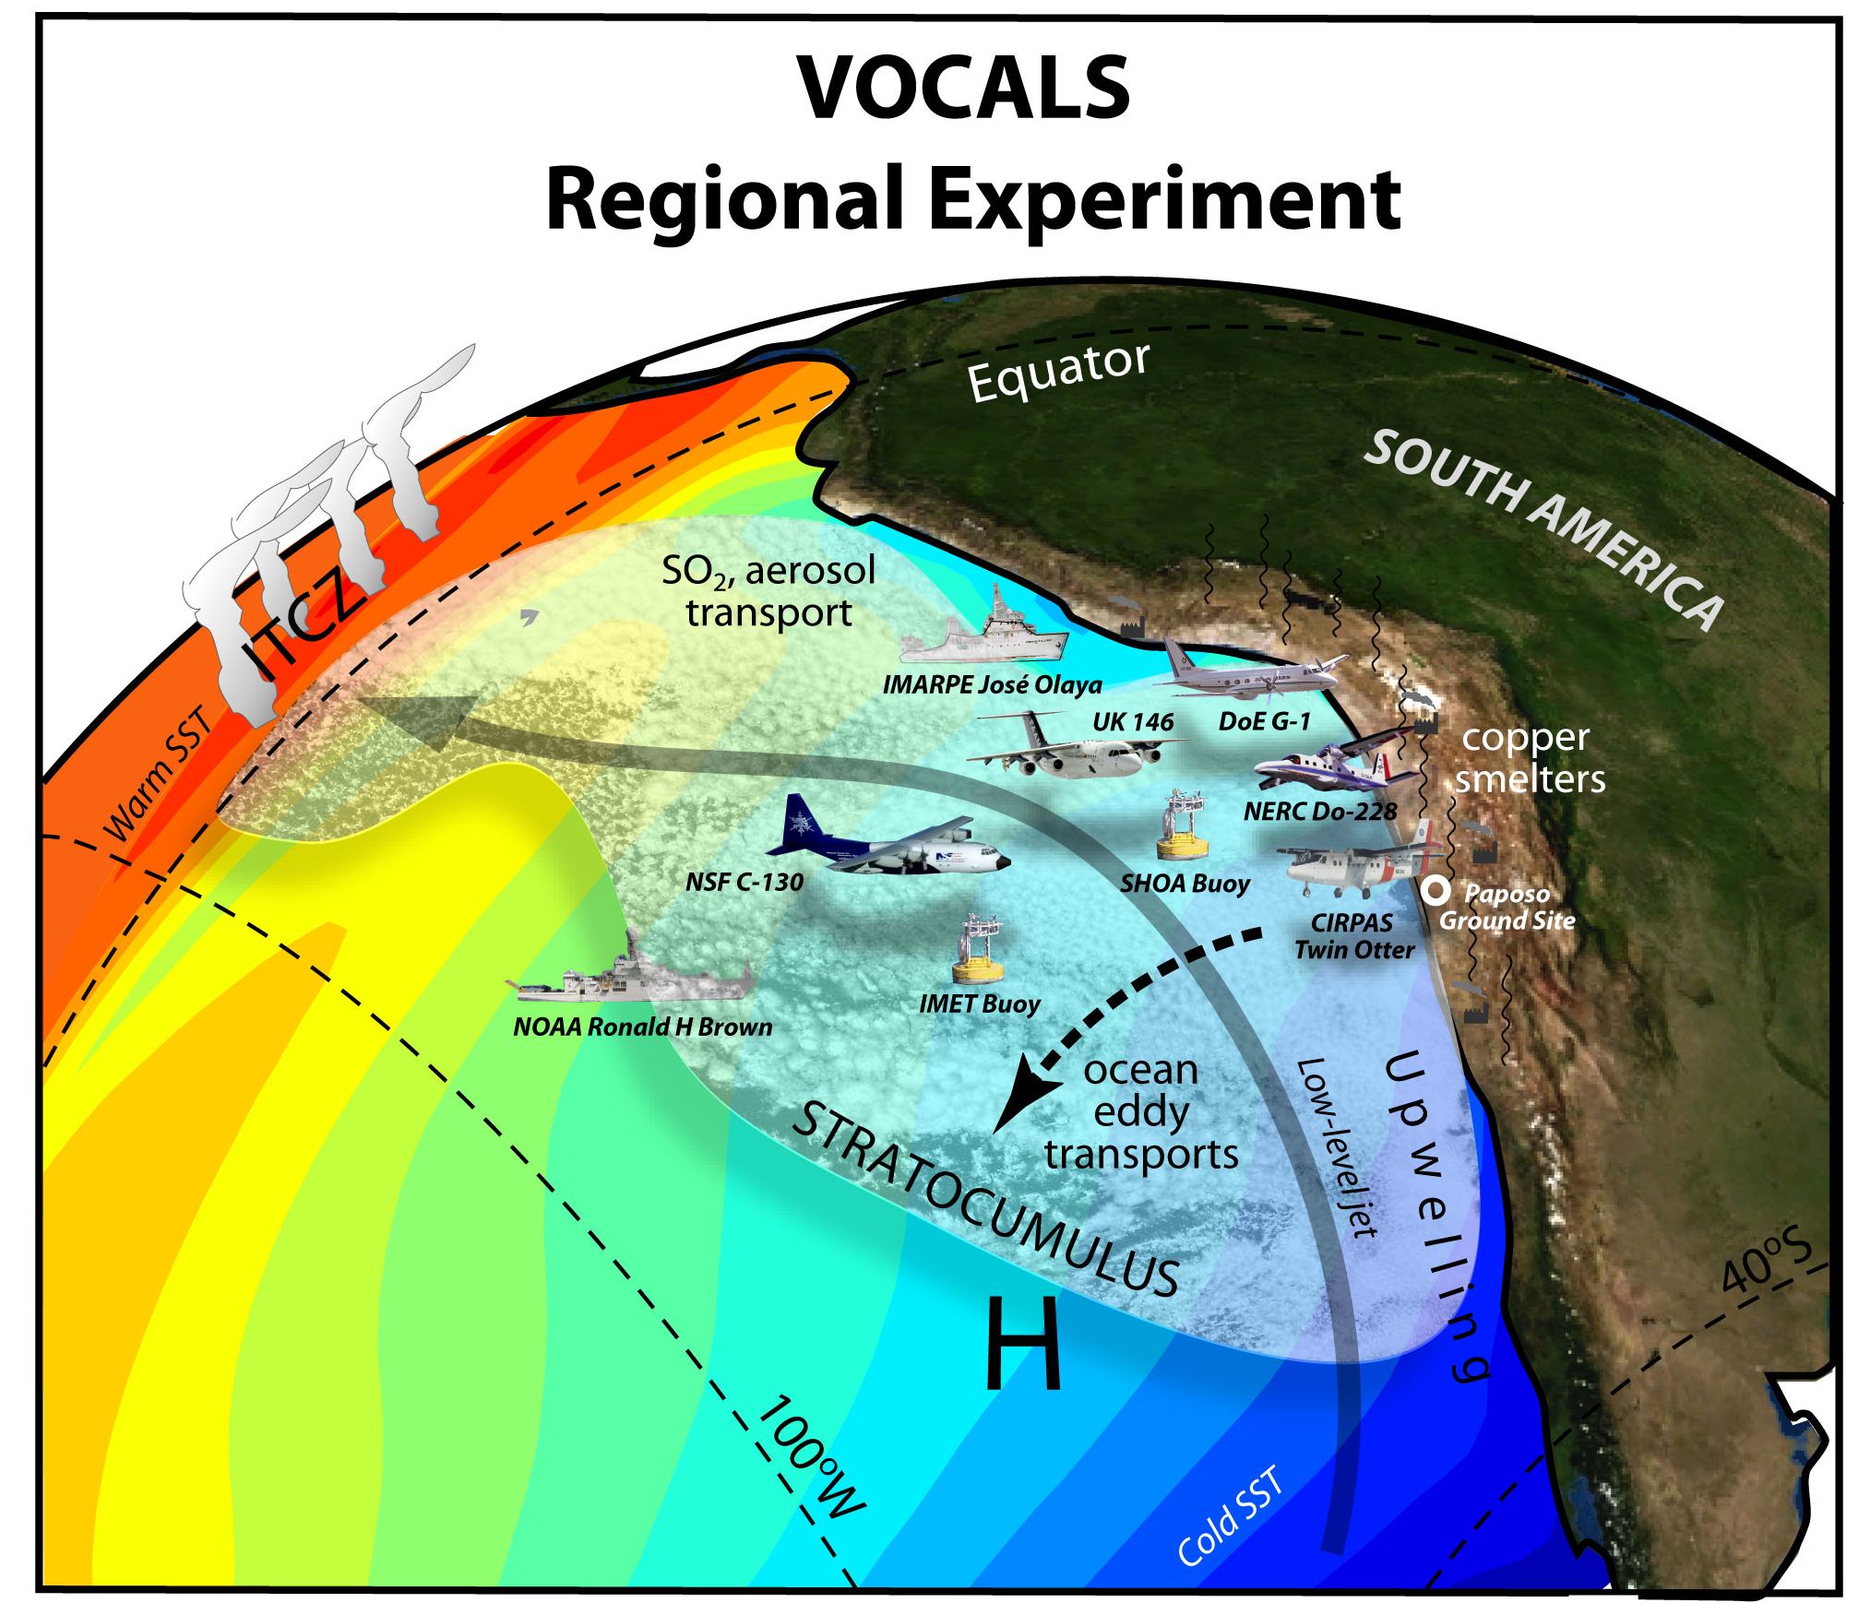
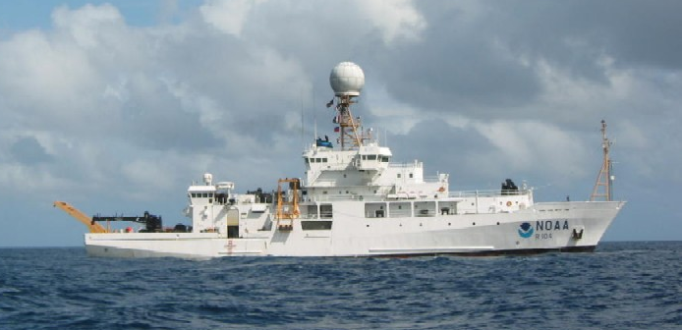
1 Oct – 1 Dec 2008
Doppler cloud radar Doppler lidar
C-band radar
NOAA Ronald H Brown

Slide 8
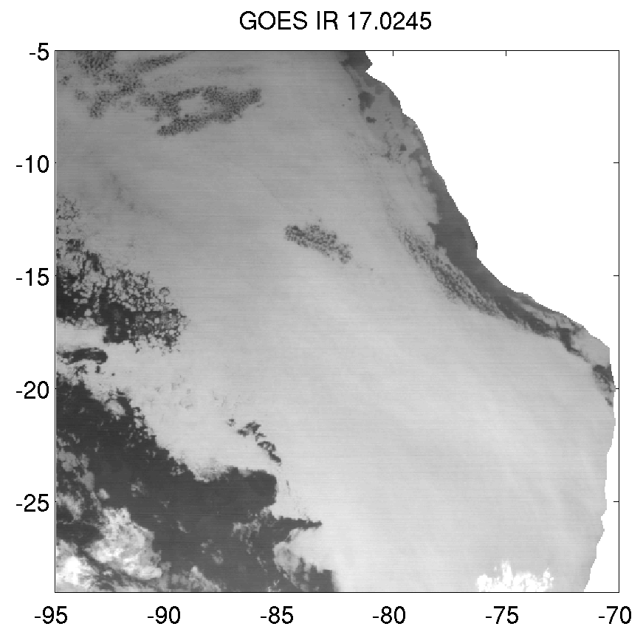
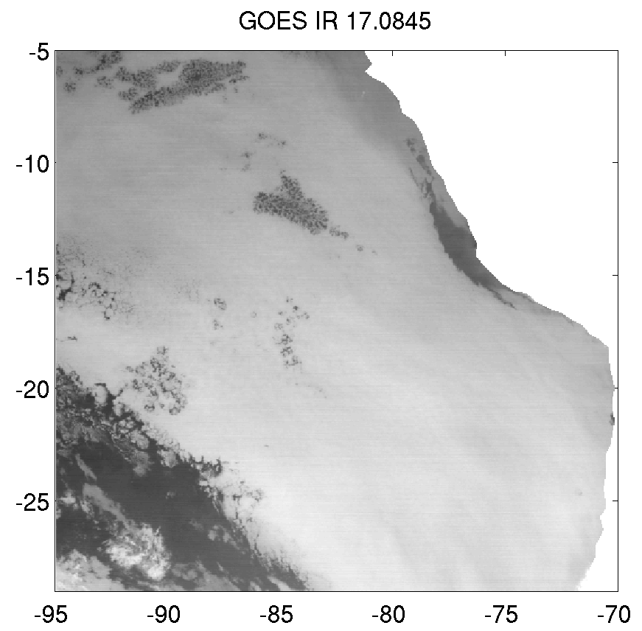
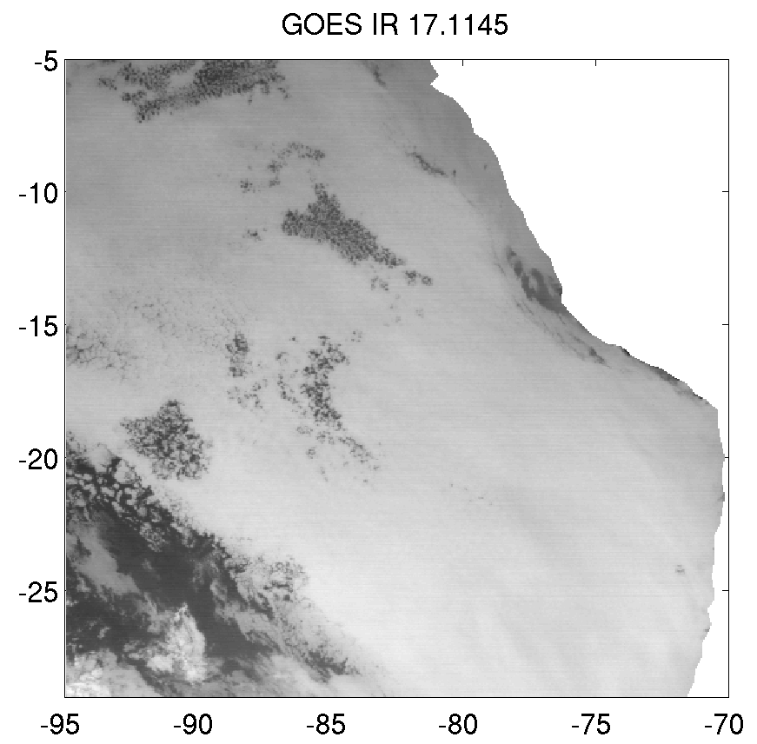

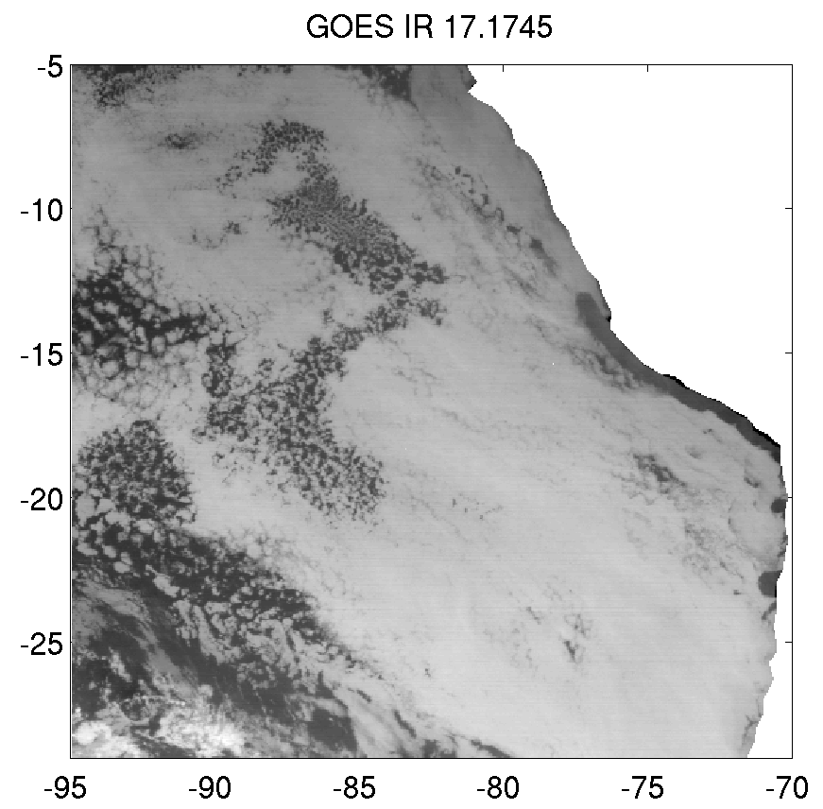
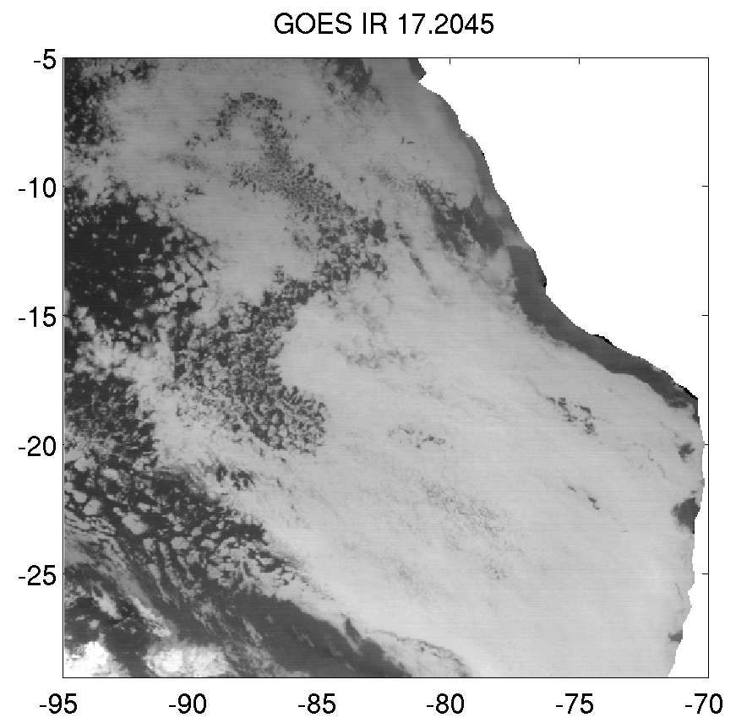
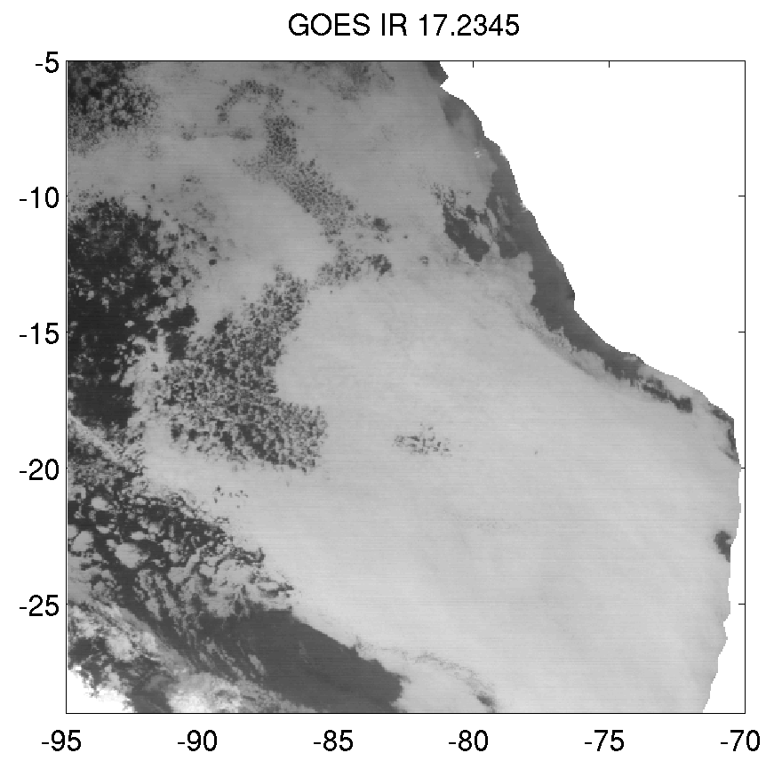
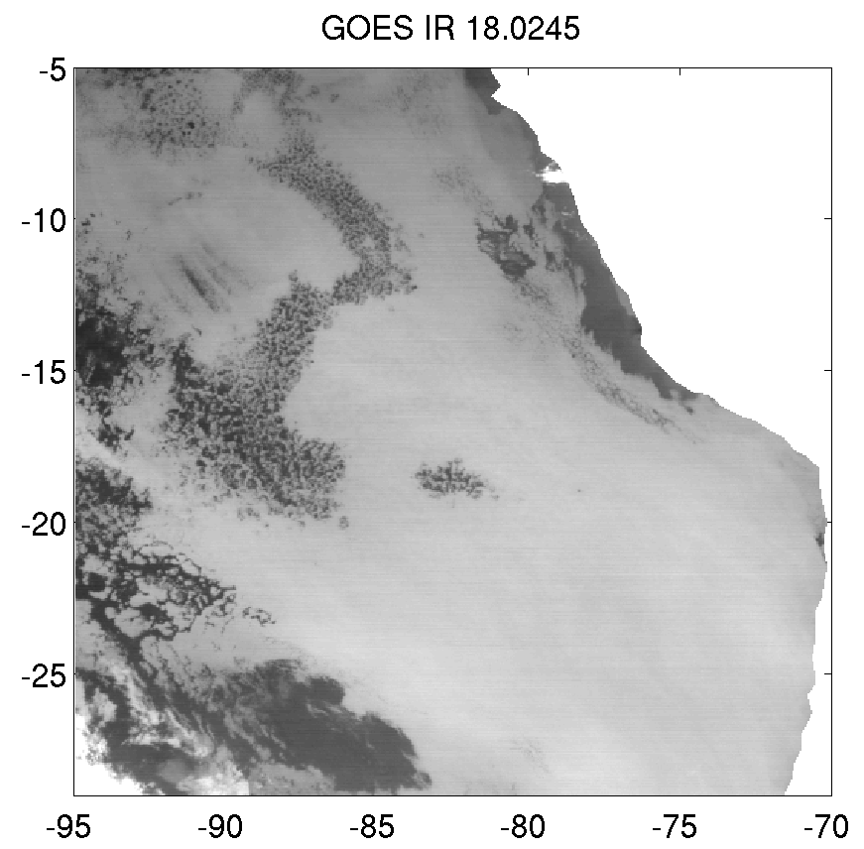
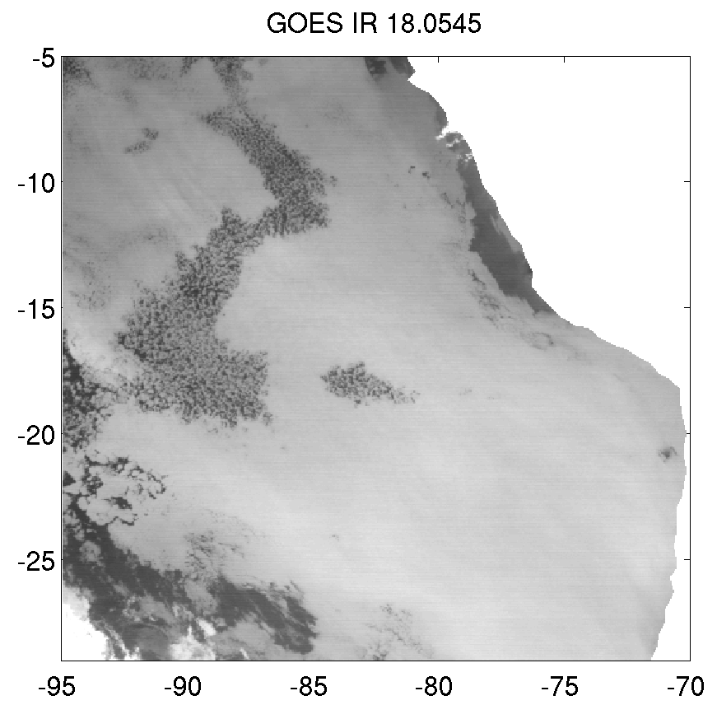

Focus on stratocumulus mesoscale organization and albedo variations
Pockets of
open cells
Notes:
IN SE PACIFIC, POCS ARE LARGER (THAN NE PACIFIC) & BETTER DOCUMENTED (in terms of rain rate…)

Slide 9
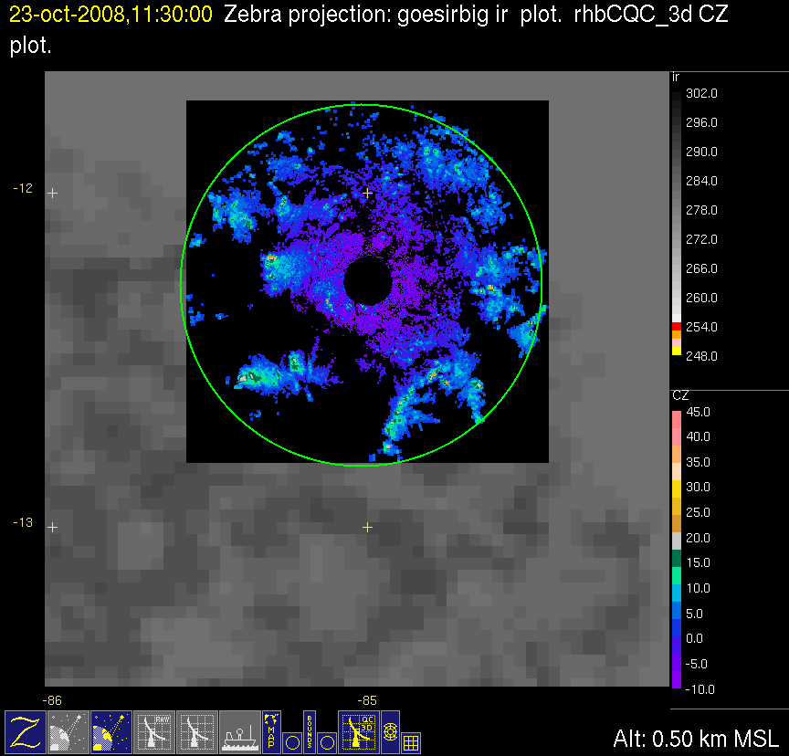
1130-1430 UTC
23 Oct 2008
Put movie here

Slide 10
Field project data sets (and modeling studies) show that drizzle is implicated in the transition from closed to open-cellular
Closed
Transition
Open
03 LT
06 LT
09 LT
GOES IR
C-band radar
03 LT
06 LT
0715 LT
08 LT
09 LT
EPIC Sc cruise Oct 2001
Comstock et al. 2007

Slide 11
Field project data sets contain detailed data from multiple sensors but are limited in time and spatial coverage….
…In order to understand these clouds globally and over multiple years, we need to use satellite data sets

Slide 12
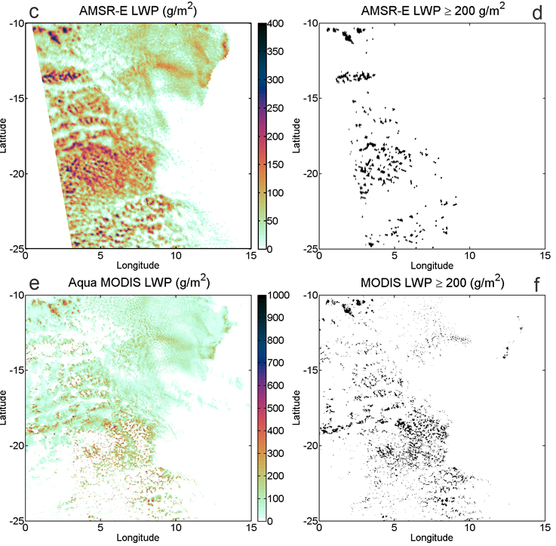
Current satellite methods to identify drizzling stratocumulus are either lacking in resolution (AMSR-E LWP; 12 km x 12 km) or diurnal coverage (MODIS LWP daylight only; 1 km²).

Slide 13
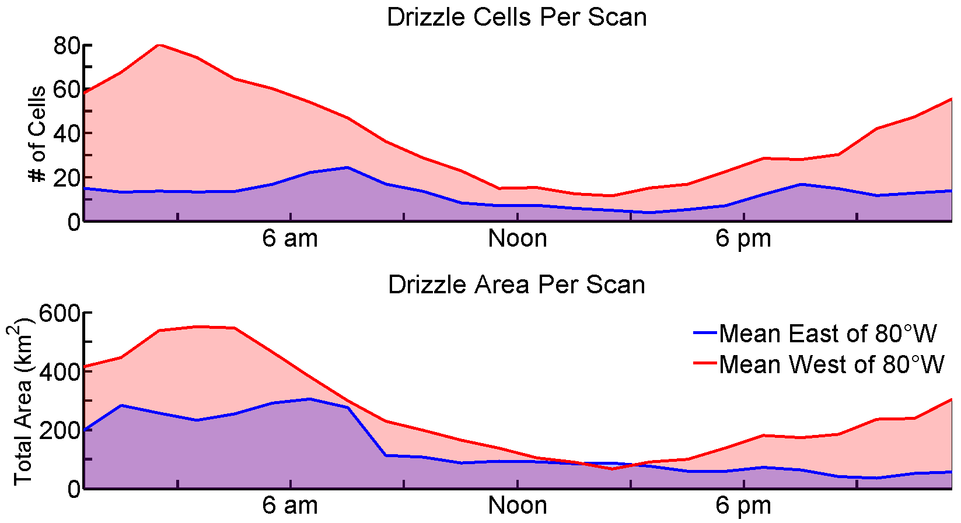
Most drizzle occurs at night
C-Band Radar Observed Drizzle: SE Pacific
Only AMSR-E LWP
MODIS LWP
& AMSR-E LWP

Slide 14
Level II AMSR-E Cloud LWP
Level II MODIS Cloud LWP
In the absence of ice, AMSR-E 89 GHz Tbs (6 km x 4 km)
contain liquid water emission information
AMSR-E 89 GHz Tb
C-band radar & IR
Notes:
Figure 8. Detailed comparison among a) AMSR-E Level 2 Liquid Water Path, b) MODIS Level 2 Cloud Water Path, c) AMSR-E Level 2 89 GHz brightness temperature and d) C-band ship-borne radar data obtained at 1936 UTC on 27 October 2008 in the SE Pacific during VOCALS experiment. The 60 km radius range ring from the radar is overlaid on each image. In order to highlight gradients in LWP, the dynamic range of the color scales differ between a) and b).

Slide 15
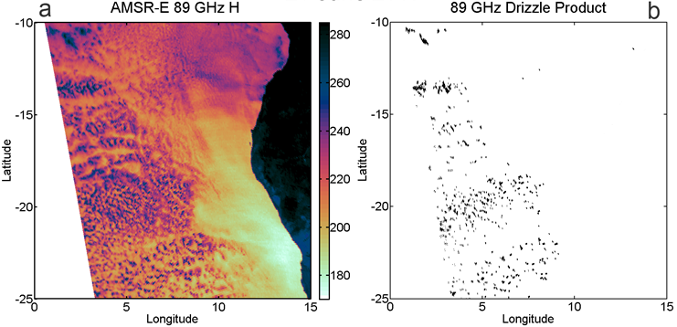
We can improve upon AMSR-E LWP in regions where clouds contain no ice

Slide 16
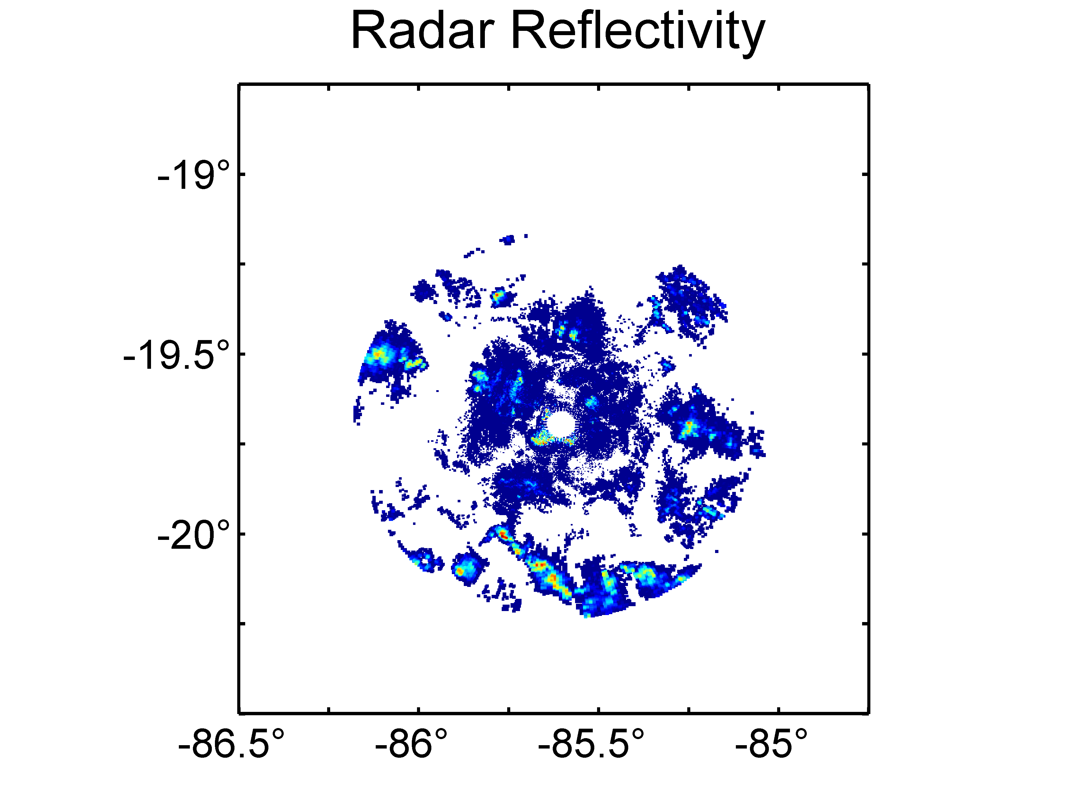
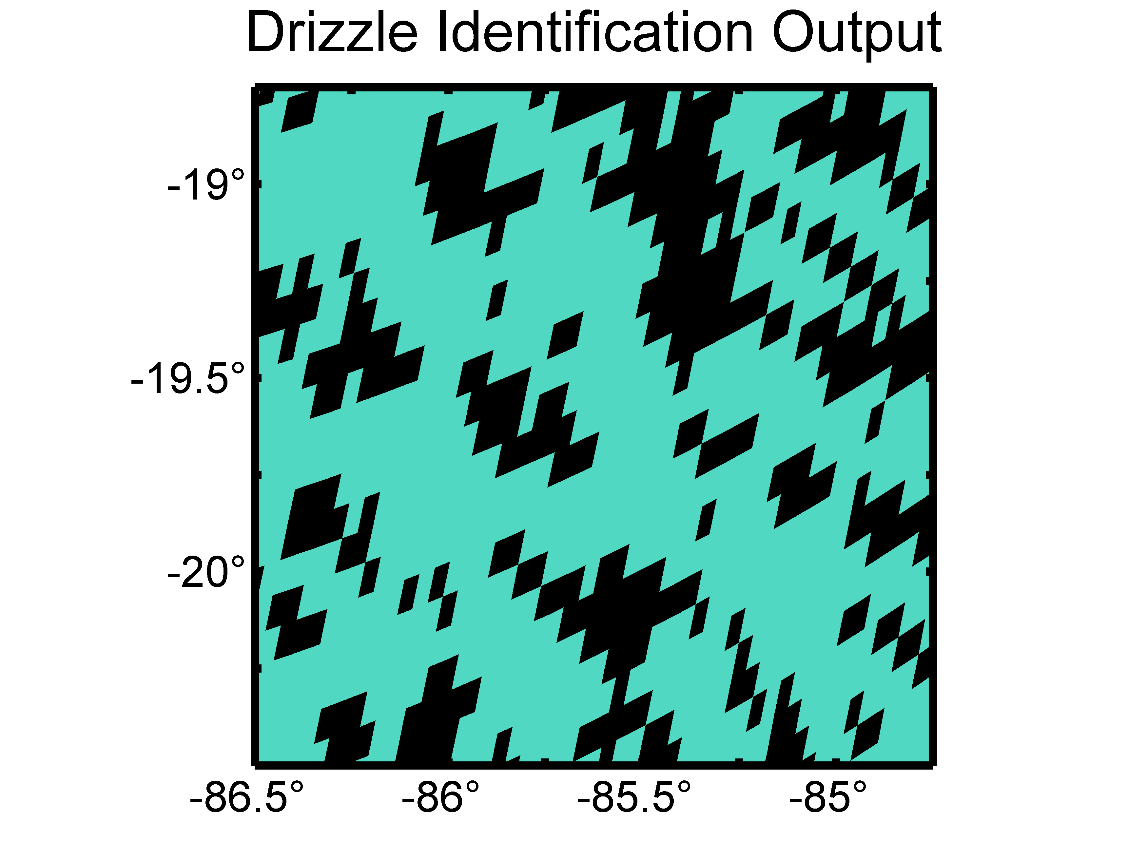
Oct 27 2008 06:55 UTC (Night)
C-Band Radar Reflectivity (left), 89 GHz Drizzle Cell ID (right)

Slide 17
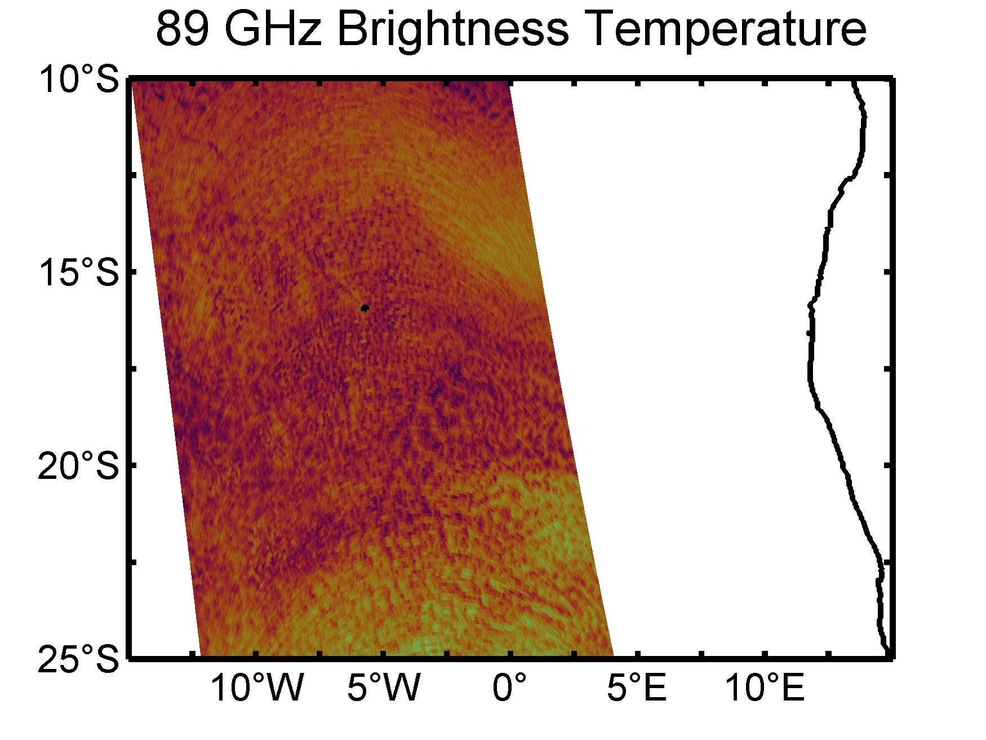
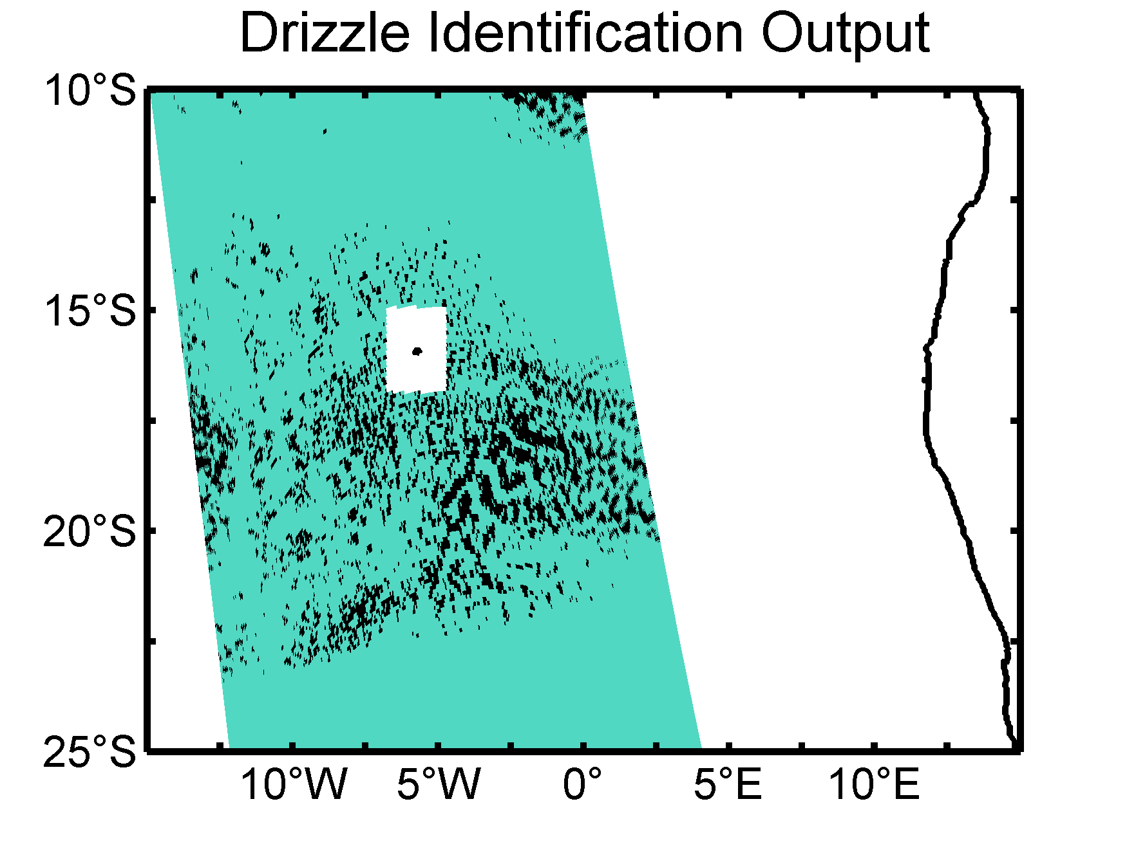
SE Atlantic Oct 8 2008 13:49 UTC (Day)
Africa

Slide 18
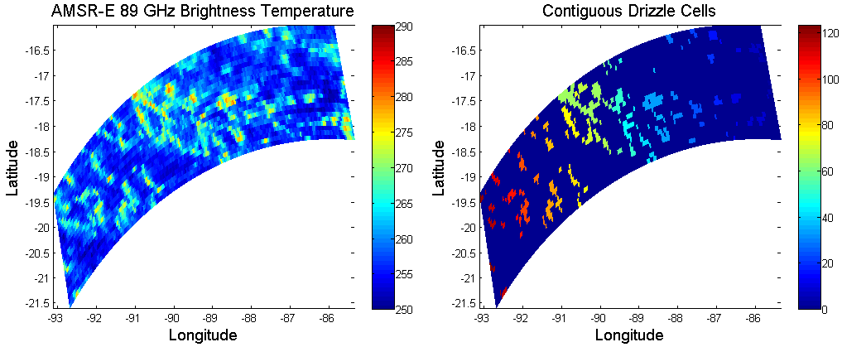
Feature analysis tools
Identified drizzle cell features are color-coded by feature number

Slide 19
Goals
Refine drizzle proxy product based on combination of AQUA MODIS and AMSR-E data using ship-based VOCALS Rex data sets
Extend drizzle proxy product to work based on TRMM TMI 85 GHz data
Use drizzle proxy product to address:
  How do the characteristics of drizzle cells and their mesoscale organization compare among the different marine stratocumulus cloud decks?
  Variability in regional drizzle occurrence since 2002

Slide 20
