Slide 1


Evaluating MODIS marine water cloud products with LES models
MODIS Science Team Meeting
May 19, 2011
Zhibo Zhang (UMBC JCET)
Steven Platnick (NASA GSFC)
Andrew Ackerman (NASA GISS)
Graham Feingold (NOAA ESRL)
Toshihisa Matsui (NASA GSFC)
Thanks to: Robert Pincus (NOAA ESRL), Alexander Marshak (NASA GSFC),
Tamás Várnai (UMBC JCET) and Tianle Yuan (UMBC JCET)

Slide 2
Outline
Background
Observational study of the difference between MODIS r_{e}(1.6µm), r_{e}(2.1µm) and r_{e}(3.7µm) for MBL clouds
Pathway toward the future

Slide 3
Background
Spectral locations of MODIS cloud bands
MODIS has three water absorbing SWIR/NIR bands, with band center located at 1.6µm, 2.1µm and 3.7µm.
Each of these absorbing bands can be coupled with a conservative band (e.g., 0.86µm) for simultaneous retrieval of τ and r_{e}
Water Absorption Index
In Collection 05, r_{e} retrievals from these bands are reported in MOD06 product as
r_{e}(2.1µm)
r_{e}(1.6µm) - r_{e}(2.1µm)
r_{e}(3.7µm) - r_{e}(2.1µm)
0.8µm
1.6µm
2.1µm
3.7µm

Slide 4
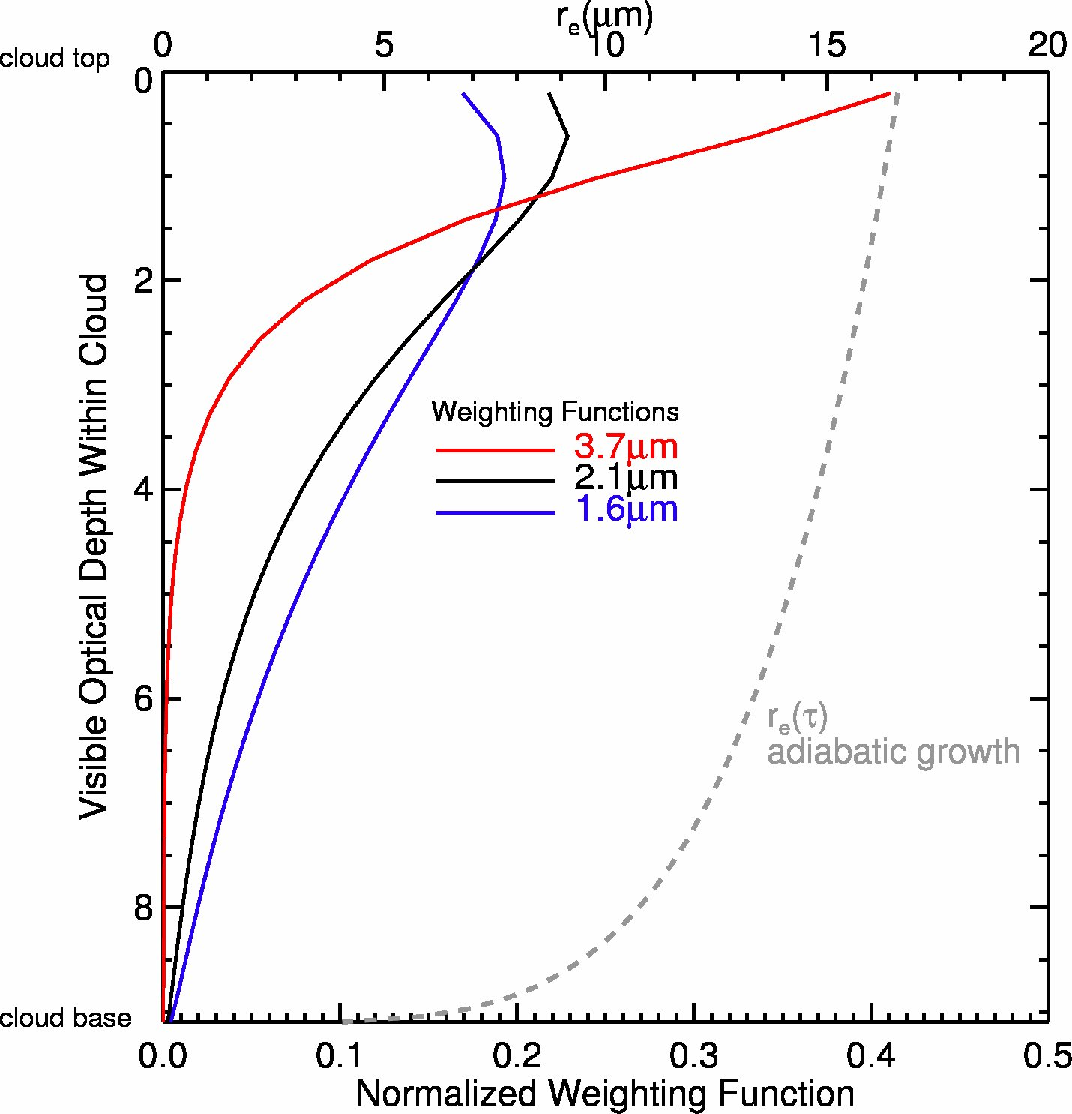
Background
MODIS r_{e} retrieval weighting Function
3.7µm
2.1µm
1.6µm
Penetration depth:
1.6µm > 2.1µm > 3.7µm
top
adiab
C.-C.
r_{e}(3.7µm)
r_{e}(3.7µm)
r_{e}(2.1µm)
r_{e}(2.1µm)
After Platnick JGR 2000
r_{e}(1.6µm)
r_{e}(1.6µm)
base
Particle size

Slide 5
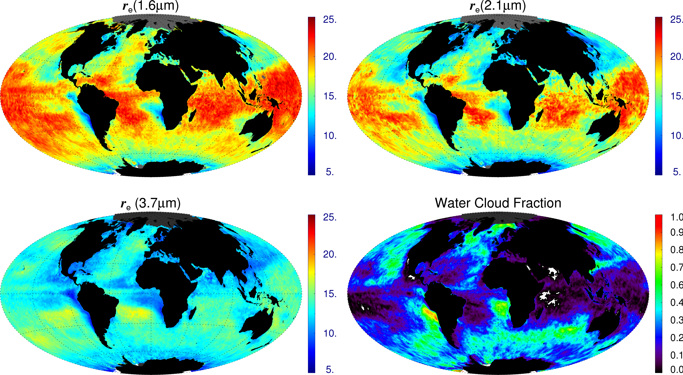
Monthly Mean Global MODIS r_{e}
Data from MODIS/Terra April 2005 used. Only water cloud pixels with Tc>273K selected

Slide 6
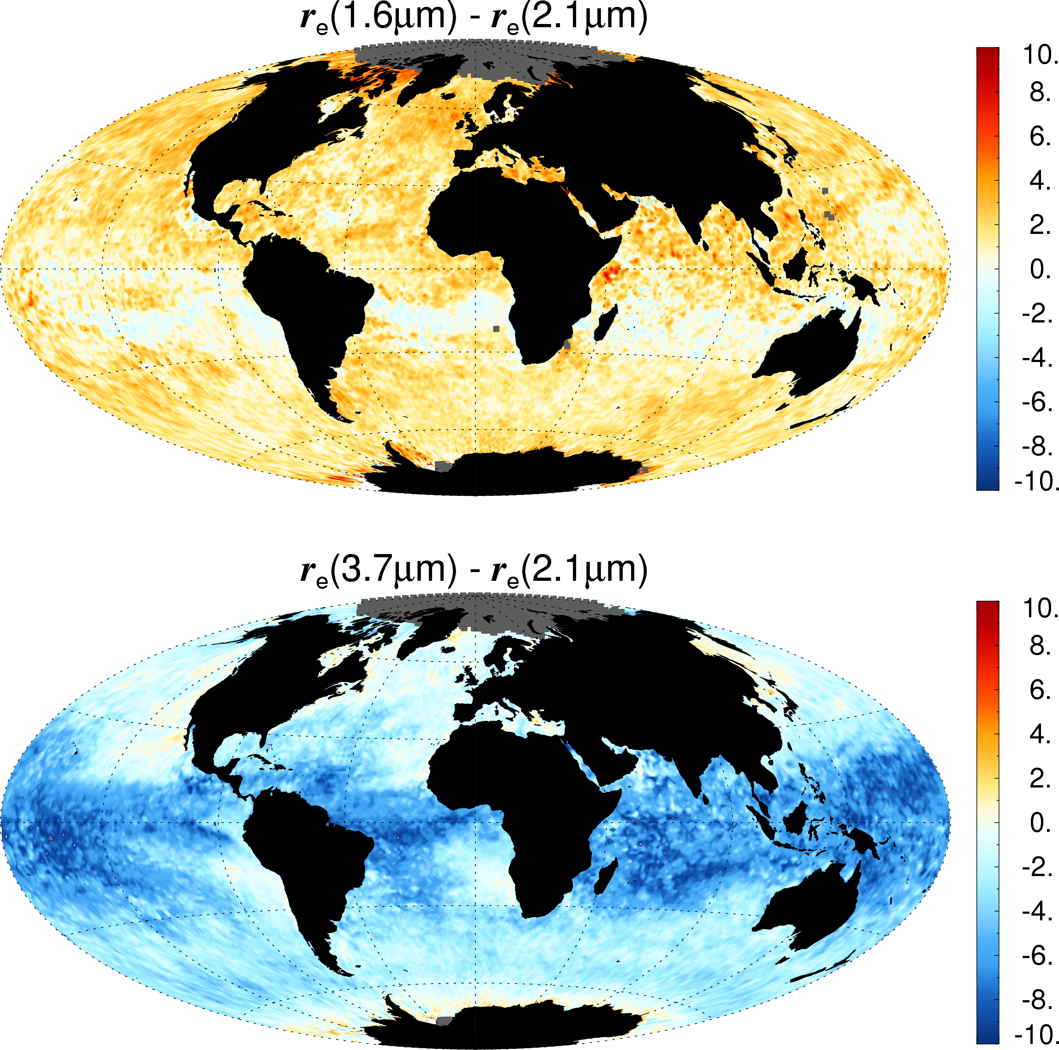
Monthly Mean Global Δr_{e}
Δr_{e} (1.6µm-2.1µm) is generally within ±3µm and has no obvious pattern
Δr_{e} (3.7µm-2.1µm) shows strong dependence on cloud regimes.
Over the coastal StCu regions, Δr_{e} (3.7µm-2.1µm) is close to zero or even slightly positive.
Over broken cloud regimes, Δr_{e} (3.7µm-2.1µm) < -5µm, sometimes ~-10µm
Similar to previous studies (Seethala and Horváth JGR 2010; Nakajima et al. JGR 2010)

Slide 7
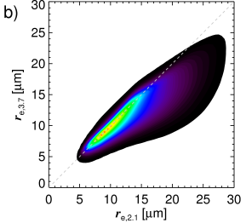
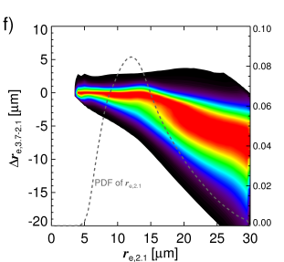
Correlation studies: Δr_{e} vs. r_{e}
Correlation studies based more than 1.5billion pixels
Threshold-like behavior of Δr_{e}(3.7µm-2.1µm) around r_{e} ~15µm
Coincidence or drizzle effect ?

Slide 8
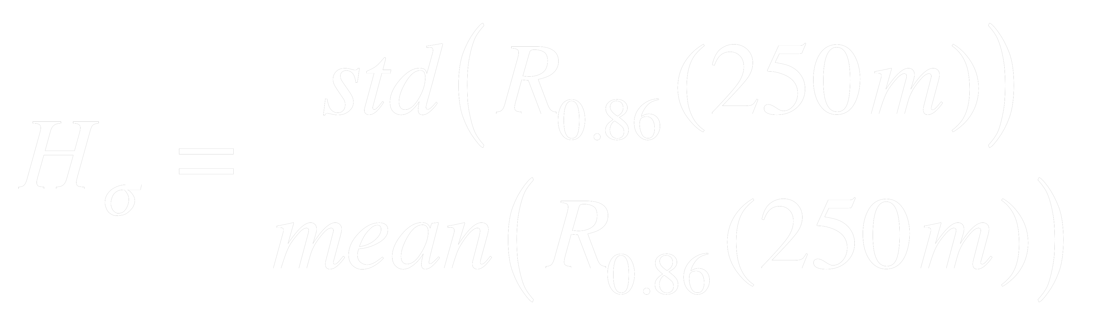
Correlation studies: Δr_{e} vs. H_{σ}
Sub-pixel cloud inhomogeneity index
Defined as the standard deviation of sixteen 250m resolution
0.86µm band cloud reflection / the mean cloud reflection (Liang, Di Girolamo and Platnick 2009 GRL)
250m
Sub-pixels
H_{σ} ~ 0 homogenous
H_{σ} >> 0 inhomogeneous
1km

Slide 9
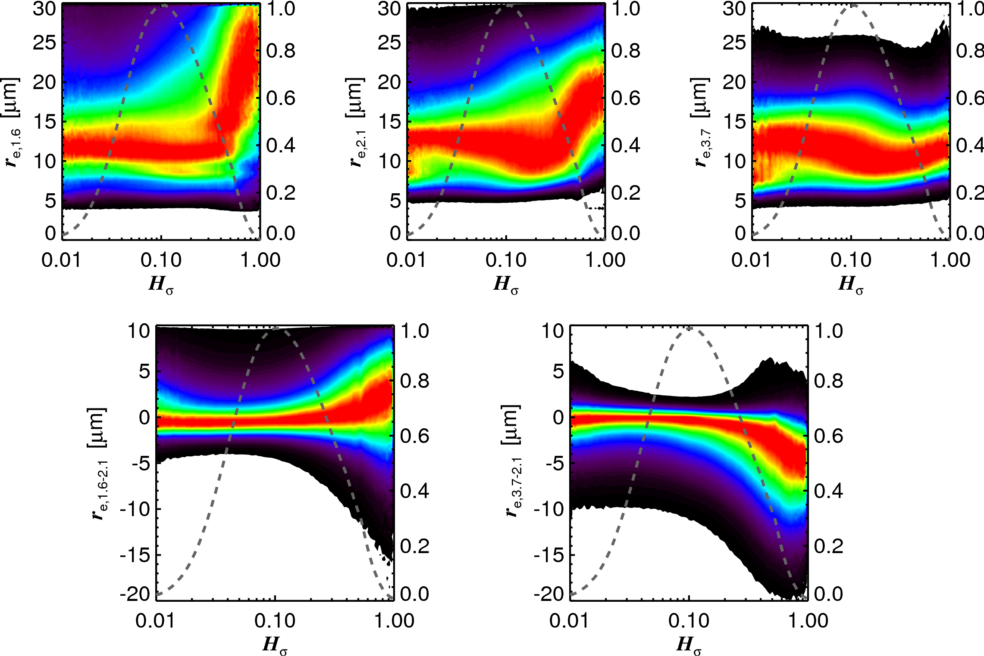
Correlation studies: r_{e ,} Δr_{e} vs. H_{σ}
Joint histogram
r_{e} vs. H_{σ}
Joint histogram
Δr_{e} vs. H_{σ}
Red color corresponds to the most frequent r_{e} or Δr_{e} for a given value of H_{σ}

Slide 10
Lessons learned
Zhang and Platnick 2011 JGR submitted
Significant differences are often found between r_{e,2.1} and r_{e,3.7}, and the differences are a strong function of cloud regime.
Correlation studies reveal that the difference between r_{e,2.1} and r_{e,3.7} are relatively small for clouds with r_{e,2.1} smaller than about 15µm, but the difference increases quickly after r_{e,2.1} exceeds 15µm.
The correlation studies also reveal that both r_{e,1.6} and r_{e,2.1} have a clear dependence on cloud heterogeneity index H,. The different sensitivities of r_{e,3.7} and r_{e,2.1} to H_{s} aligns with the increasing difference between the two with increasing H_{s}.

Slide 11
What could cause Δr_{e}
Microphysical processes
3D effects
Algorithm issues
Adiabatic growth
Observation uncertainty
τ(visible)
Info
Coalescence
(drizzling)
Algorithm
uncertainty
r_{e}(1.6µm)
r_{e}(3.7µm)
Entrainment
r_{e}(2.1µm)
Nonlinearity
Unknown

Slide 12
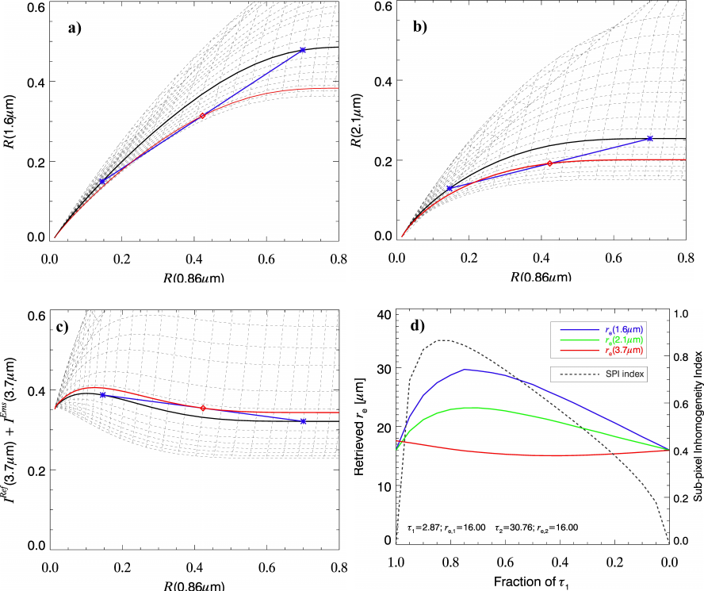
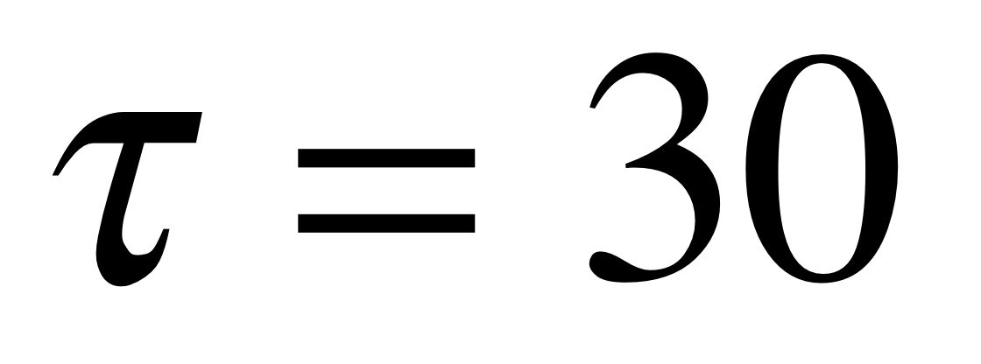
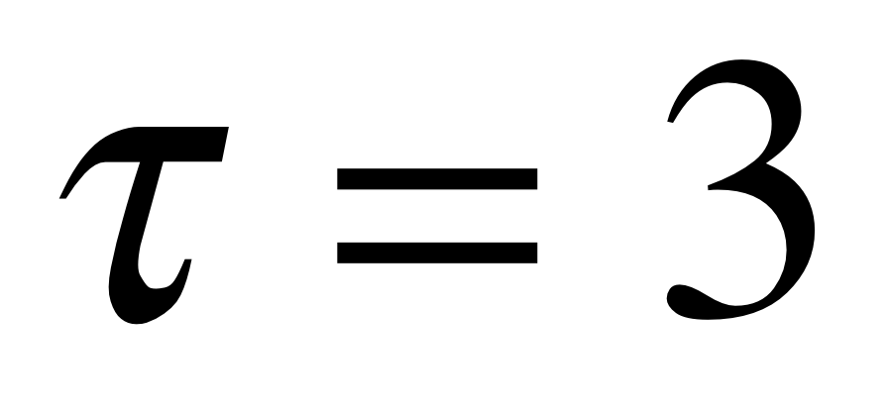
Impact of sub-pixel cloud inhomogeneity on r_{e} retrieval
r_{e} retrieval ~25µm
Same r_{e}=16µm

Slide 13
What could cause Δr_{e}
Microphysical processes
3D effects
Algorithm issues
Adiabatic growth
Observation uncertainty
τ(visible)
Info
Coalescence
(drizzling)
Algorithm
uncertainty
r_{e}(1.6µm)
r_{e}(3.7µm)
Entrainment
r_{e}(2.1µm)
Nonlinearity
Unknown

Slide 14
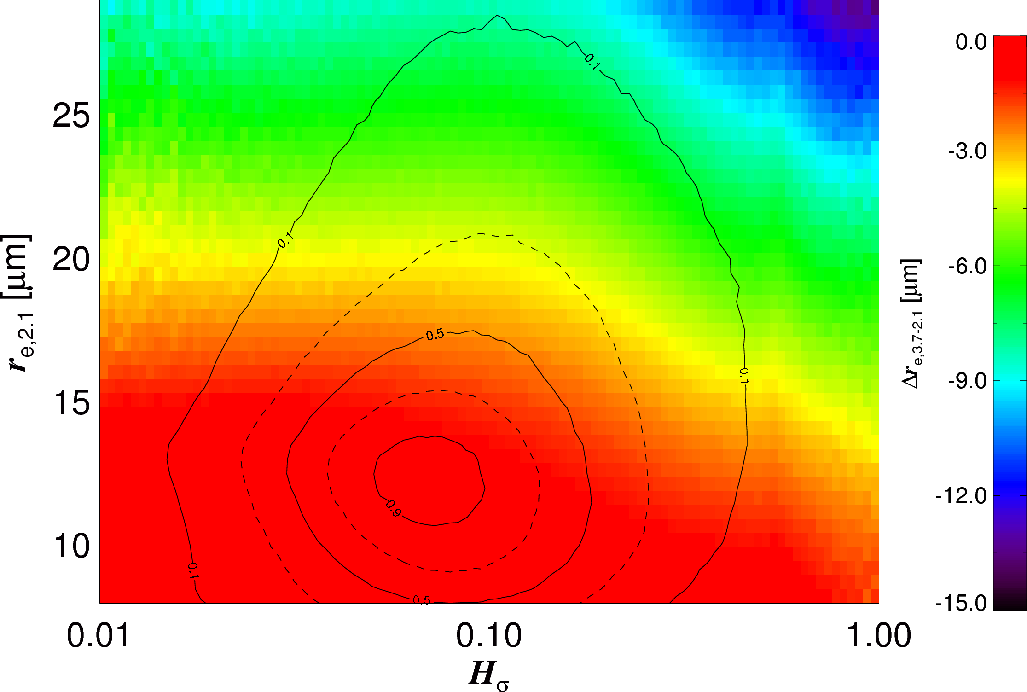
Separation of cloud regime
constructed using pixels with τ>5
3-D effect coupled with drizzle effect?
Effect of drizzle?
Broken cloud regions?
Close cell; Coastal StCu regions?
Very Homogeneous
Very Inomogeneous
Zhang and Platnick JGR 2011 submitted

Slide 15
Entangled Problem
Microphysical processes
3D effects
Algorithm issues
Adiabatic growth
Observation uncertainty
τ(visible)
Info
Coalescence
(drizzling)
Algorithm
uncertainty
r_{e}(1.6µm)
r_{e}(3.7µm)
Entrainment
r_{e}(2.1µm)
Nonlinearity
Unknown

Slide 16

Pathway toward the future

Slide 17
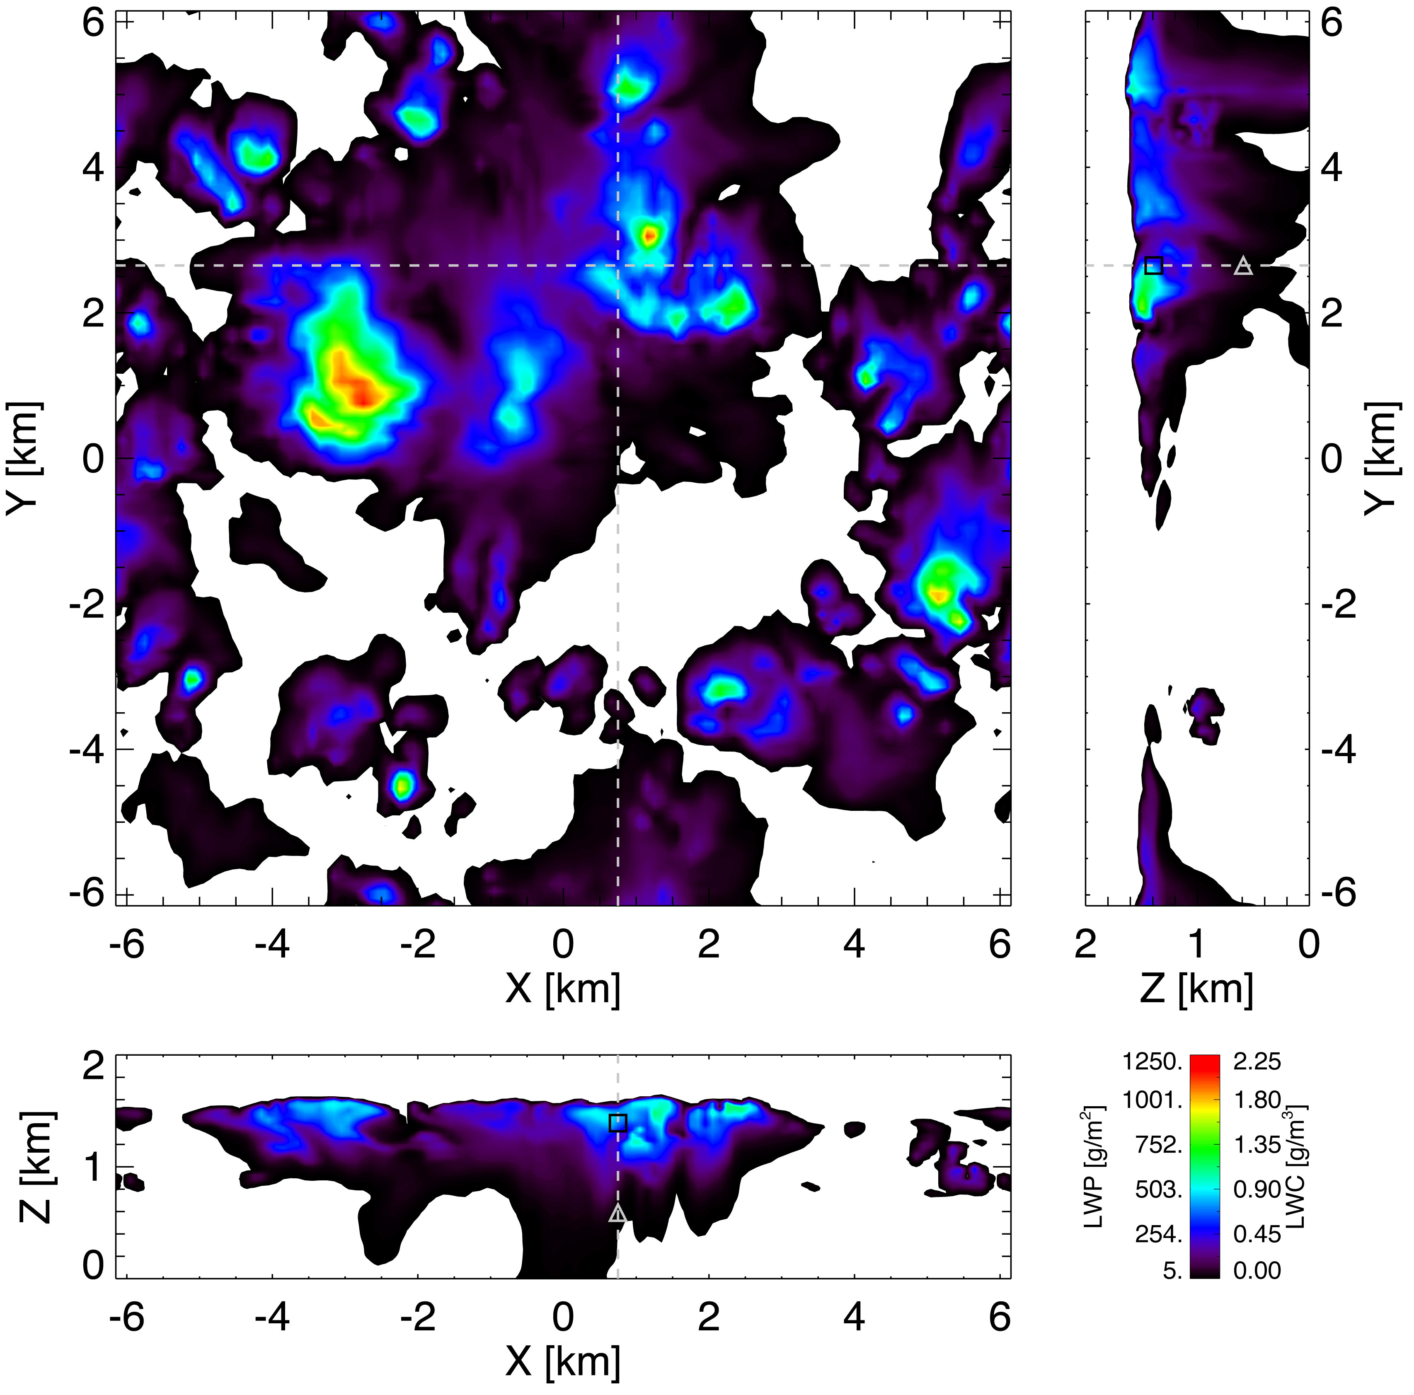
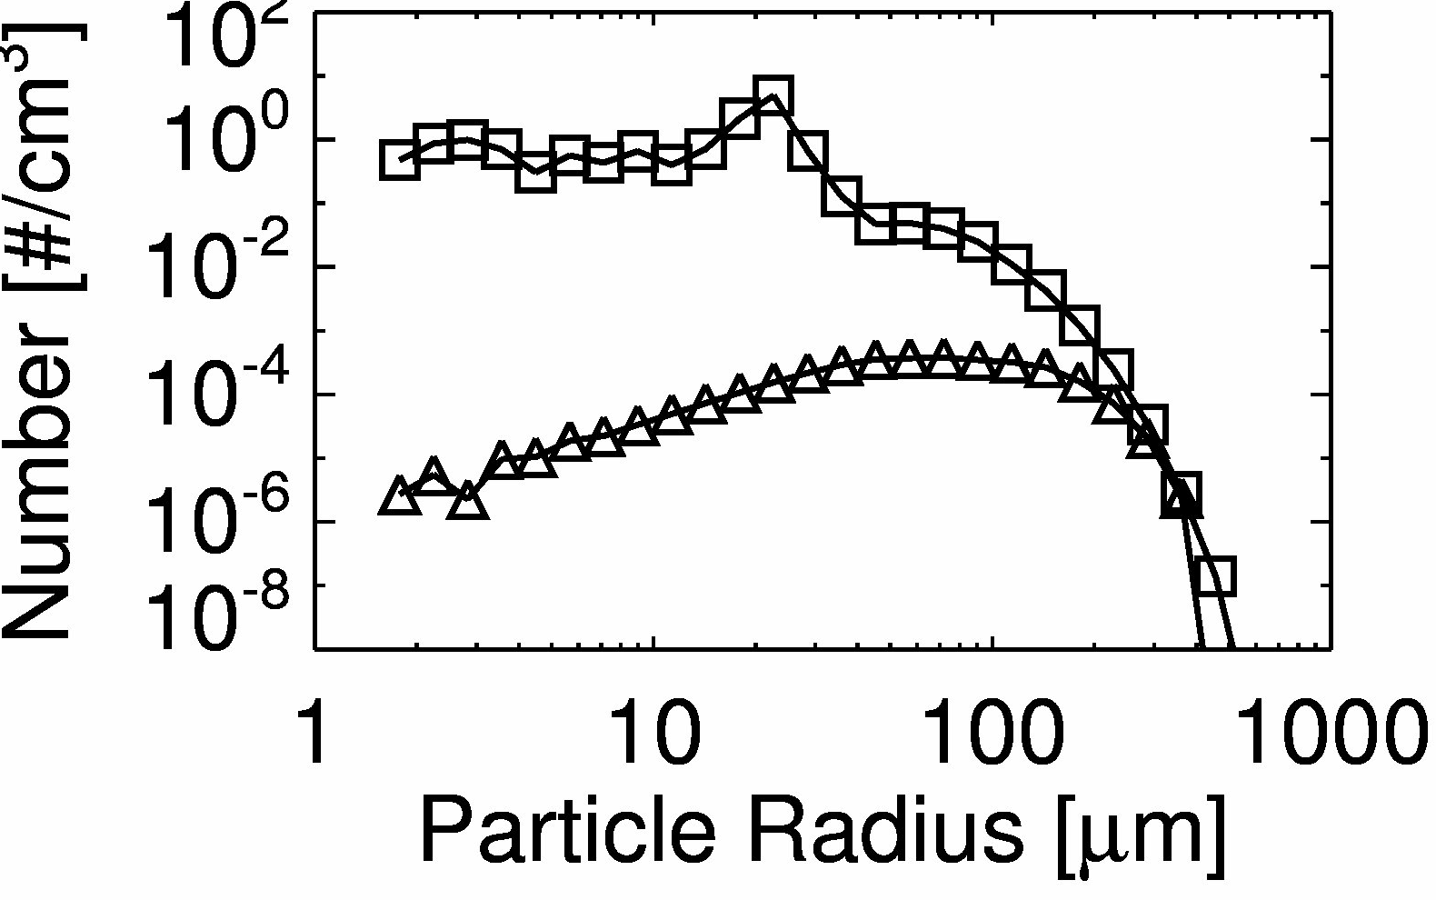
A seamless interface between bin-microphysics LES and I3RC
Every details of cloud microphysical structure from the LES simulation are dynamically re-constructed in 3D RT simulation (I3RC; Pincus and Evans 2010) based on the relative extinction distribution (F_{i})
Cloud field simulated using LES model with bin-microphysics (Xue, Feingold and Stevens 2008 JAS)

Slide 18
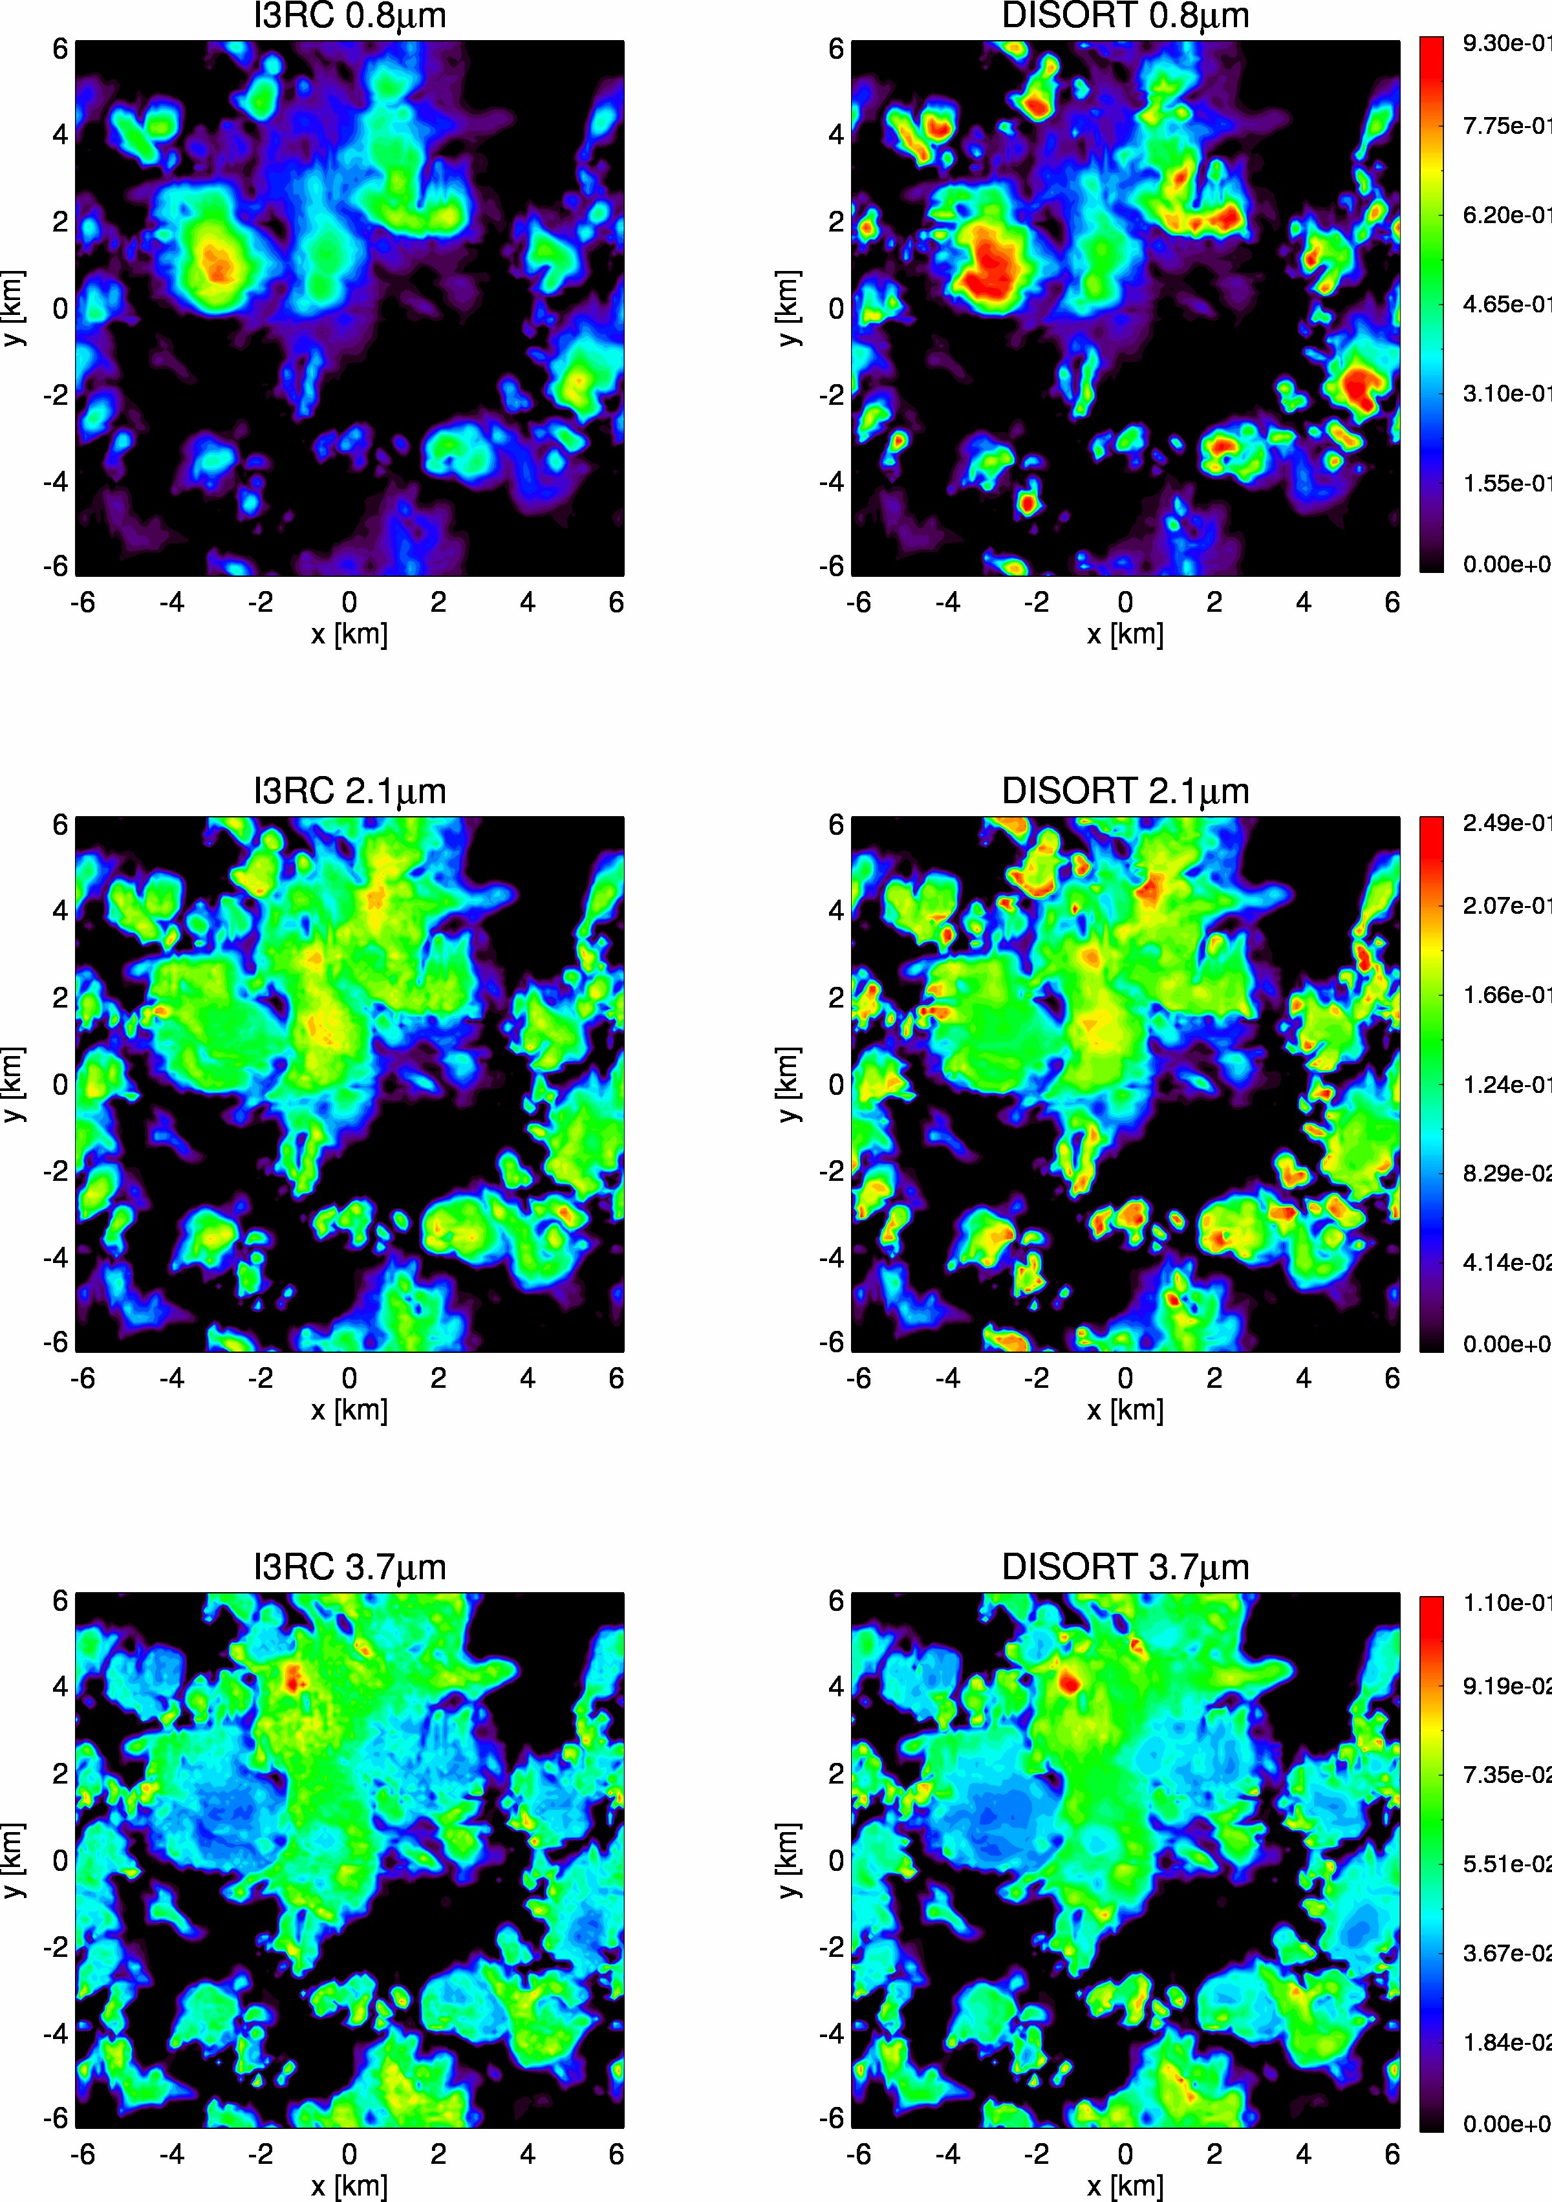
Preliminary results: reflection
Solar zenith 20⁰ Nadir viewing; black surface

Slide 19
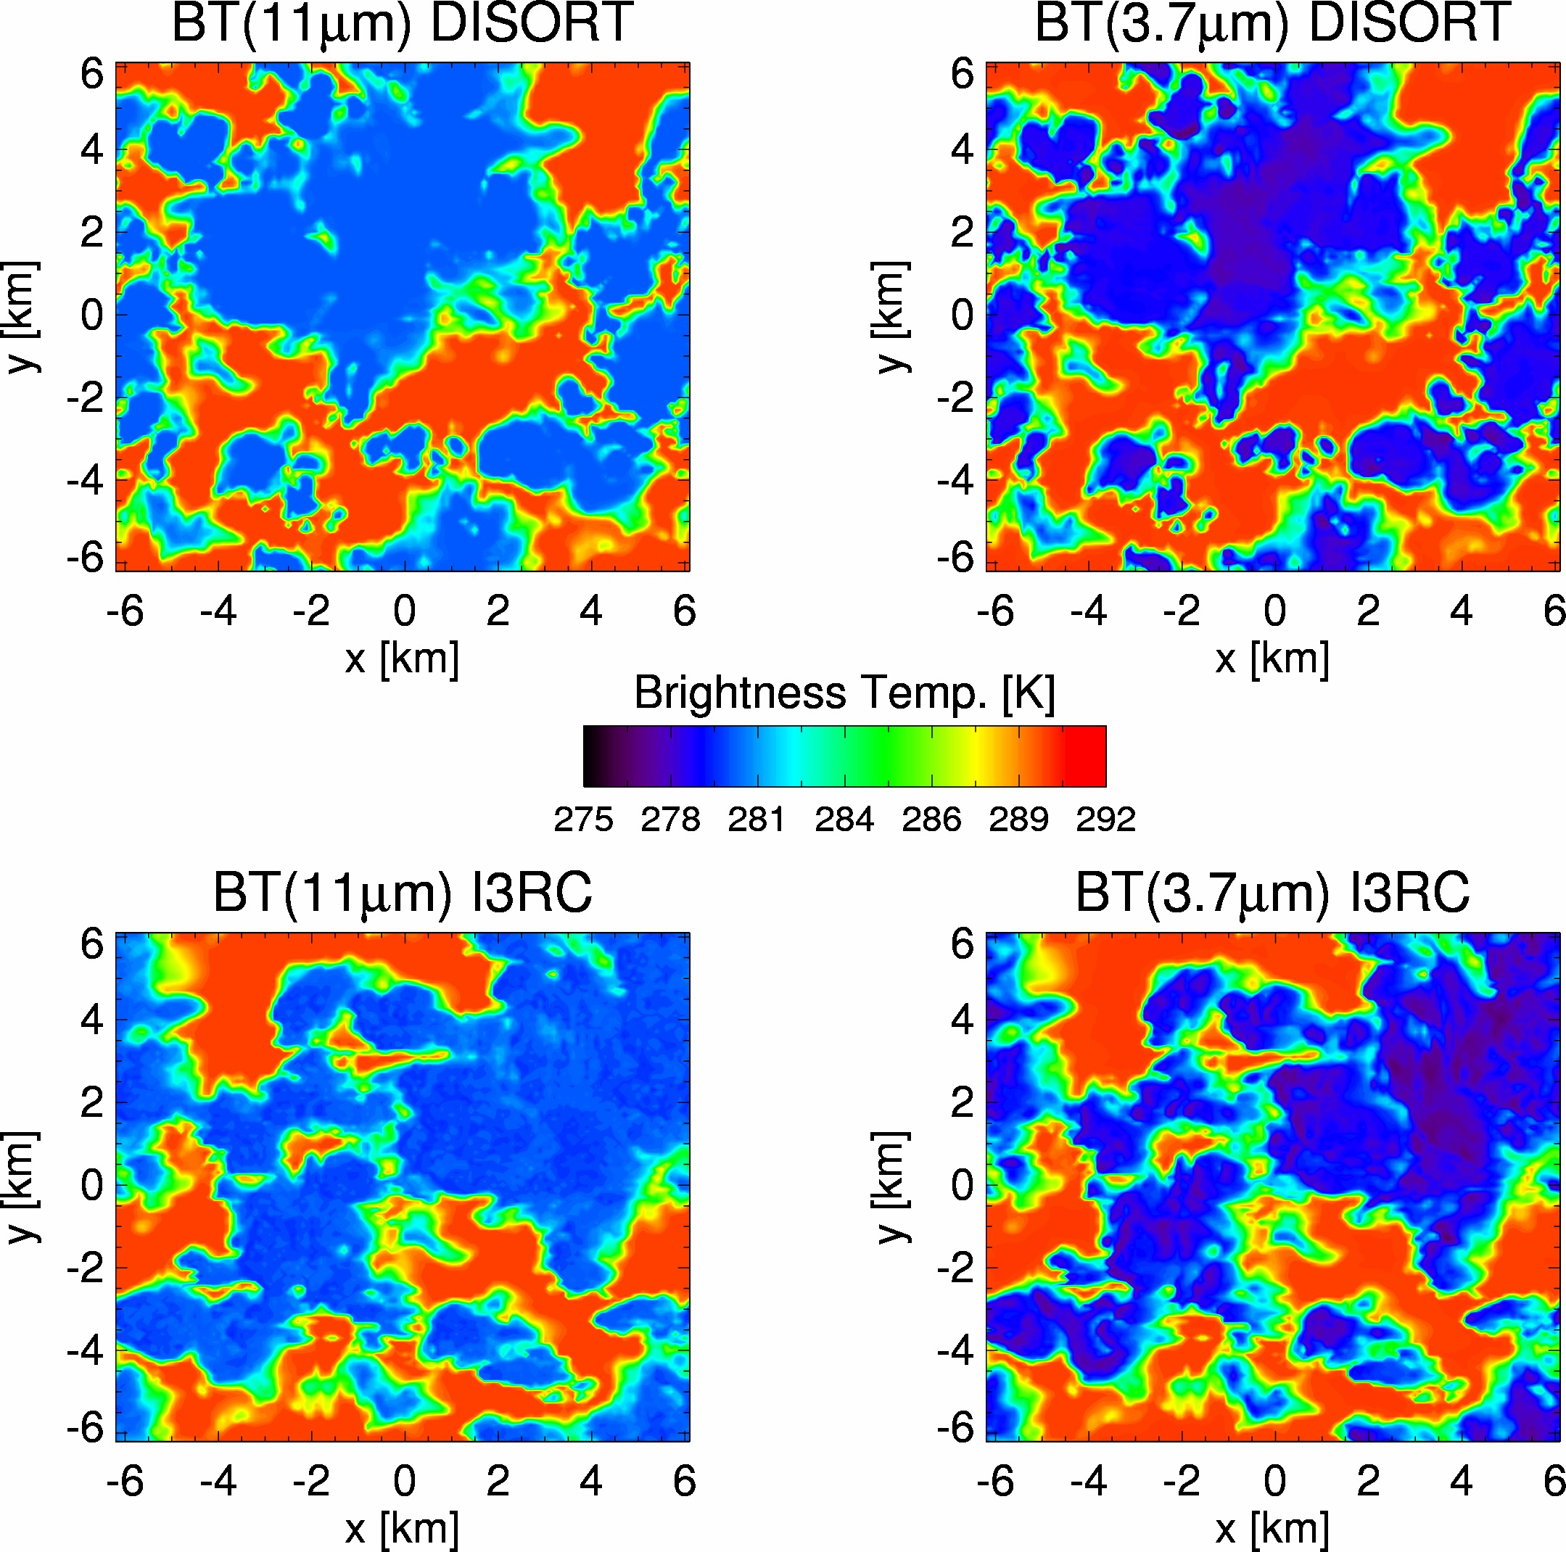
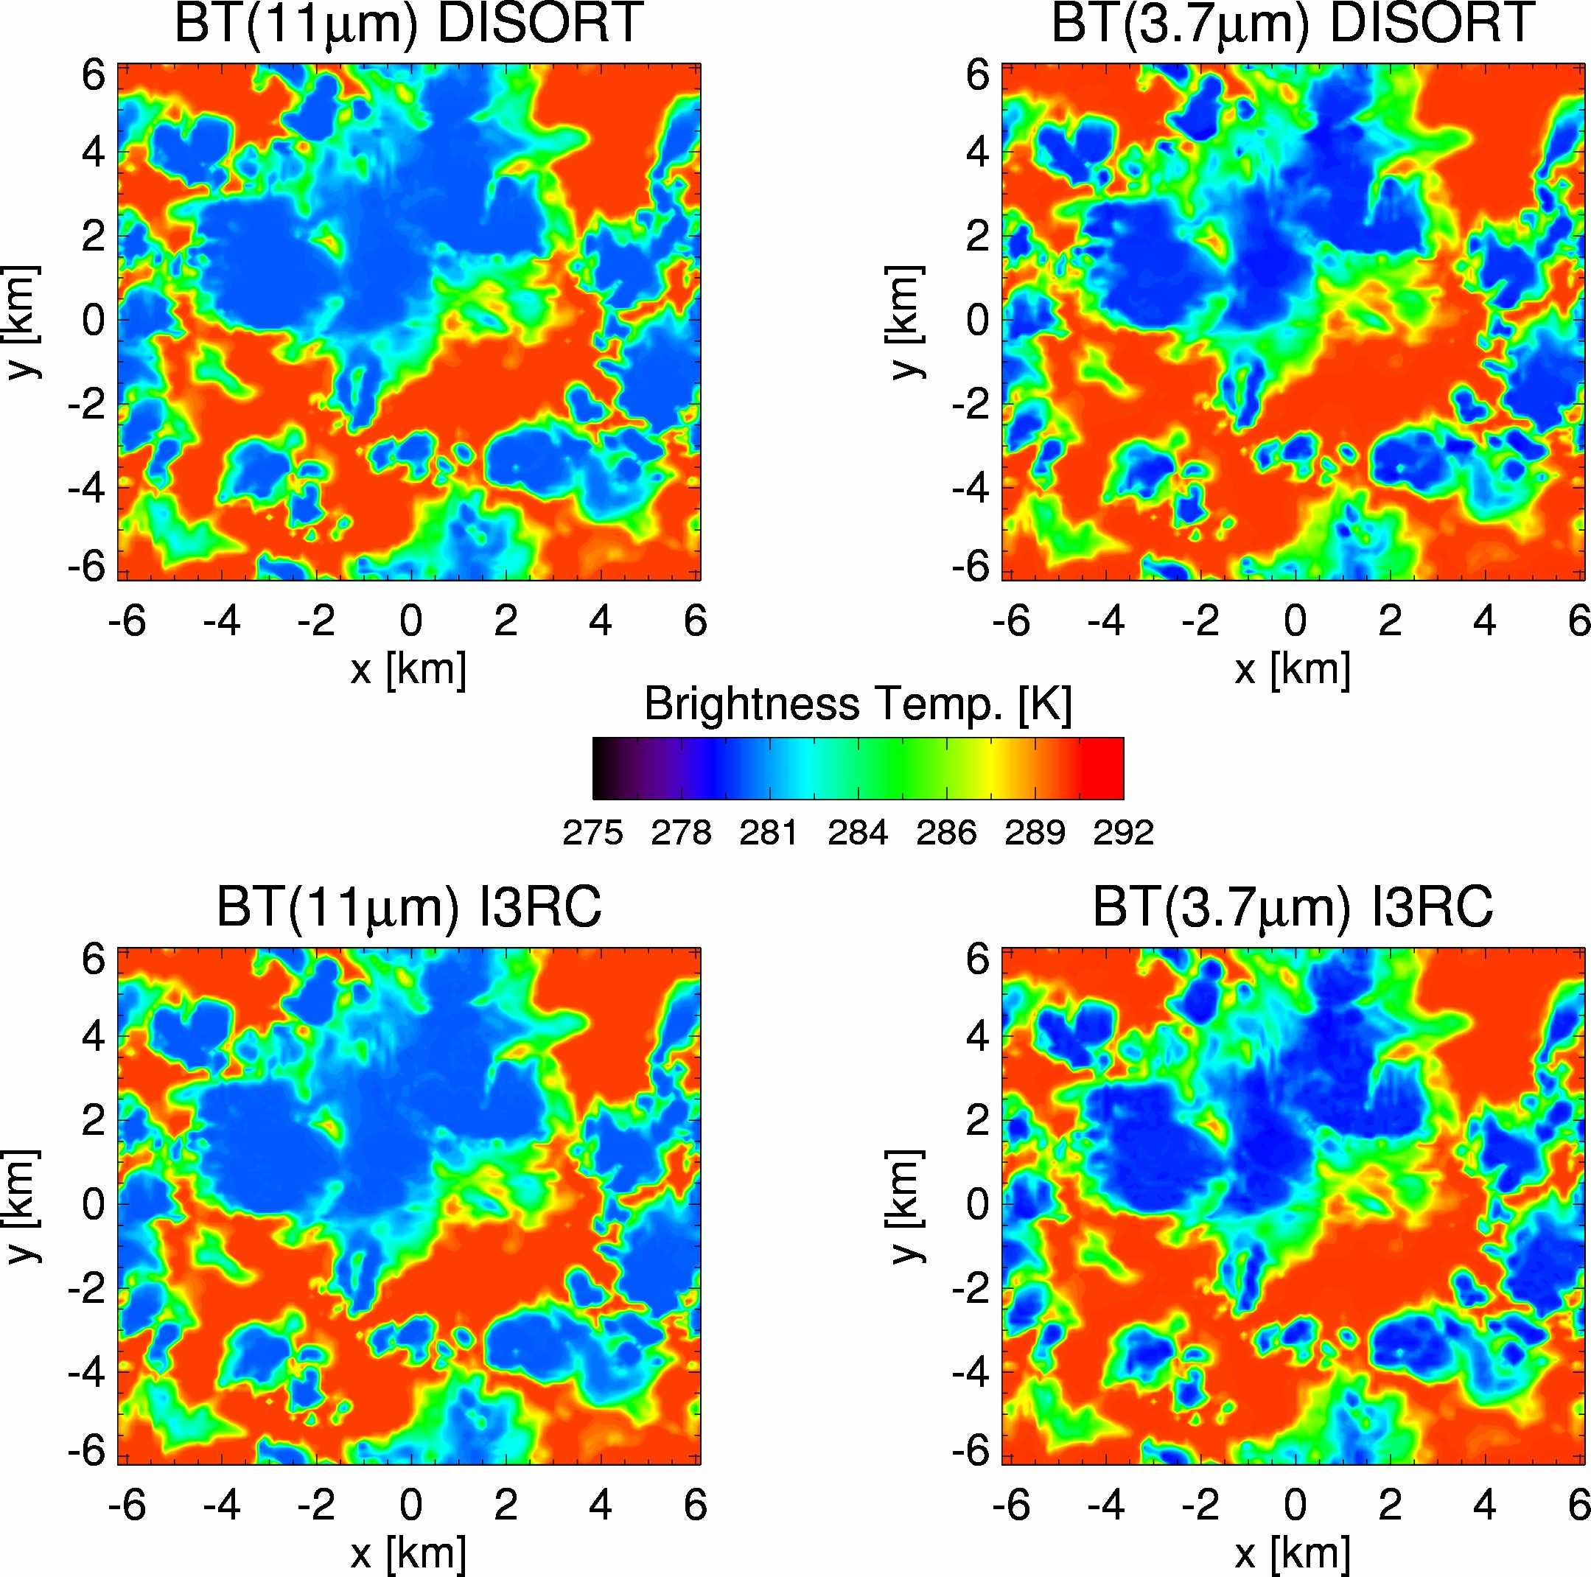
Preliminary results: emission
3-D emission simulation is implemented in I3RC based on the adjoint Monte-Carlo method
is the “escape function” corresponding to the contribution of a unit source in cloud at the location (x,y,z)
is the “escape function” corresponding to the contribution of a unit source at surface (x,y)
Cloud temp. 280K; surface temp. 290K

Slide 20
Summary & Conclusions
Significant differences are often found between r_{e,2.1} and r_{e,3.7}, and the differences have a strong dependence on cloud regime.
Potential reasons are discussed
Furthur studies based on the combination of LES and 3-D radiative transfer models are underway.

Slide 21
Backup

Slide 22
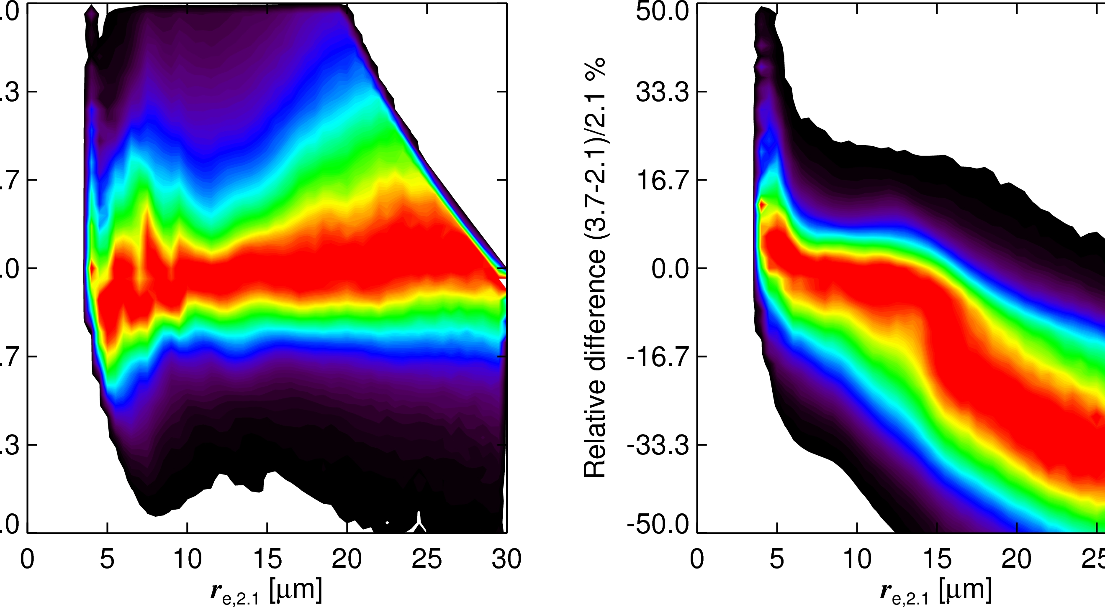
Relative difference

Slide 23
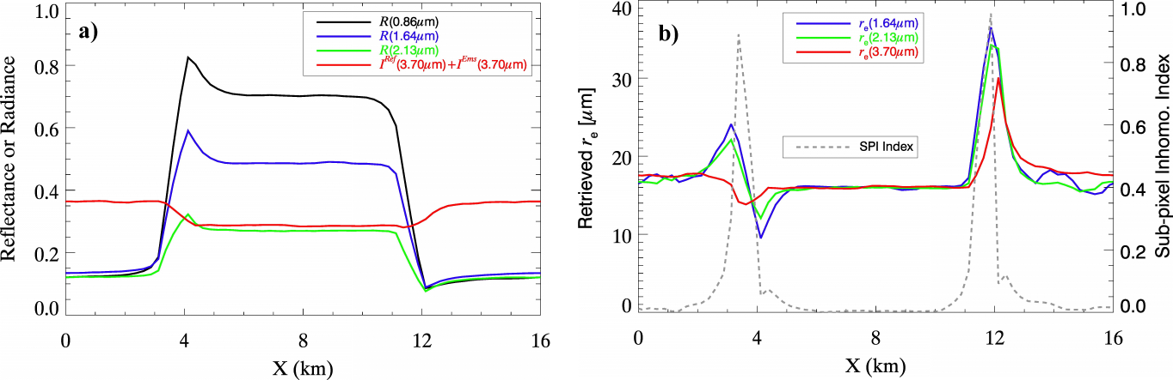
Impact of 3-D effect:
A simple step cloud case
Solar zenith 50º
τ=3
τ=30
τ=3
r_{e}=16µm

