Slide 1

MODIS Atmosphere Solar Reflectance Issues
1. Aqua VNIR focal plane empirical re-registration status
Ralf Bennartz, Bob Holz, Steve Platnick²
¹ U. Wisconsin, Madison, ² NASA GSFC
2. Terra trend anomalies in cloud and aerosol data records
Steve Platnick¹, Rob Levy²
¹ NASA GSFC, ² SSAI
MODIS Cal-Val Mtg., 17 May 2011

Slide 2
MODIS Atmosphere Solar Reflectance Issues
1. Aqua VNIR focal plane empirical re-registration status
Ralf Bennartz, Bob Holz, Steve Platnick²
¹ U. Wisconsin, Madison, ² NASA GSFC
2. Terra trend anomalies in cloud and aerosol data records
Steve Platnick¹, Rob Levy²
¹ NASA GSFC, ² SSAI
MODIS Cal-Val Mtg., 17 May 2011
Notes:
Original title: “An empirical correction for the Aqua MODIS VNIR focal plane spatial misregistration”

Slide 3
Overview
AQUA MODIS VNIR focal plane arrays are misregistered by about 200m (cross-track) to 500m (along-track) relative to the SWIR/MWIR/TIR focal plane arrays.
Misregistration expected to be important for algorithms that use both VNIR and other bands and observe strong spatially inhomogeneous scenes (e.g., cloud properties for trade Cu clouds).
A revised VNIR 250 m → 1 km empirical aggregation approached had already been developed to minimize the misregistration.
  Empirically-derived weights minimize focal plane mismatch from 250m resolution channels by minimizing the cross-correlation between aggregated VNIR vs. SWIR bands for selected scenes (Levenberg-Marquardt minimization).
  Empirical weights used to aggregate 250m data to a 1 km file.
New method has been tested in the UW-Madison Atmosphere PEATE for two months of Aqua MODIS data.
Results for Level-1 results are reported here.
Study on impact of new/old aggregation on Level-2 cloud products is ongoing.
Notes:
“Move” 250m pixel location by 2 (along-track) and 1 (cross-track) positions.
VNIR: 0.41-0.56 µm; 0.85-0.94 µm

Slide 4
Results for new Level-1 1km aggregation
New aggregation method provides significantly better co-registration results VNIR with SWIR/MWIR bands than standard method. Results with new method are similar to Terra-MODIS (Terra-MODIS does not suffer from this issue and can be used as a reference).
As expected, inhomogeneous cloud scenes are significantly affected. In those scenes the correlation between VNIR and SWIR/SMIR channels is significantly improved (see example).
For homogeneous scenes the new method does not affect results.
  About 10 % of the MODIS aggregated VNIR pixels show a difference larger than 0.01 in reflectances between the new and old aggregation scheme. About 1% of the pixels show a difference larger than 0.05 in reflectance.
Initial results for Level-2 cloud products show small but potentially systematic differences in cloud mask and optical properties retrievals in certain cloud regions. Testing impact on C6 cloud product test code is ongoing.

Slide 5
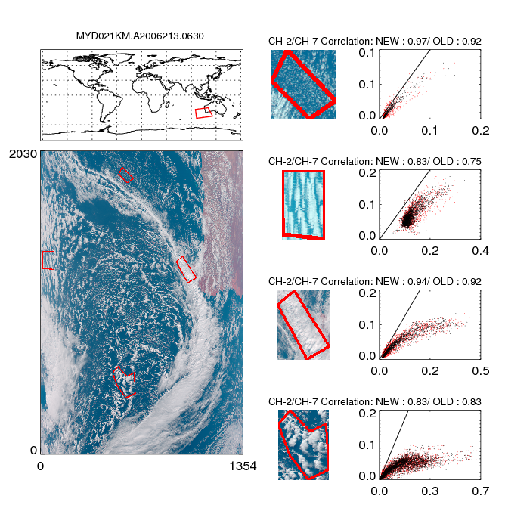
Example: L1b correlation between b2 and b7

Slide 6
Example: L1b correlation between b2 and b7
Red dots: MODIS operational aggregation

Slide 7
Example: L1b correlation between b2 and b7
Red dots: MODIS operational aggregation
Black dots: MODIS new empirical aggregation

Slide 8
Example: L1b correlation between b2 and b7
Red dots: MODIS operational aggregation
Black dots: MODIS new empirical aggregation
Significantly improved b2 vs. b7 correlation w/new aggregation in broken cloud regimes.

Slide 9
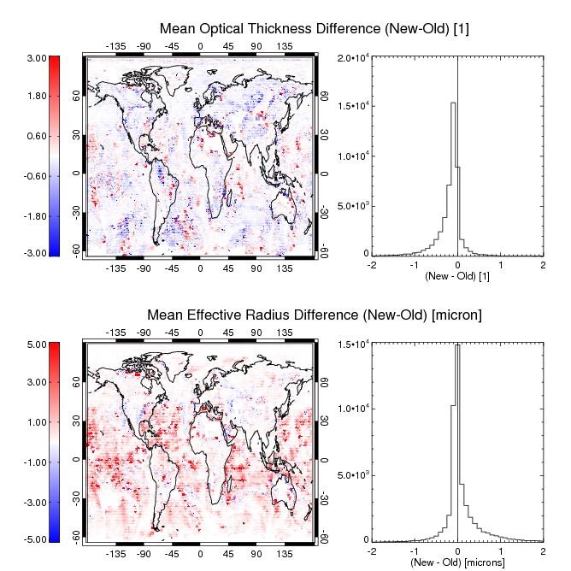
Example L2 Results- single day evaluation

Slide 10
MODIS Atmosphere Solar Reflectance Issues
1. Aqua VNIR focal plane empirical re-registration status
Ralf Bennartz, Bob Holz, Steve Platnick²
¹ U. Wisconsin, Madison, ² NASA GSFC
2. Terra trend anomalies in cloud and aerosol data records
Steve Platnick¹, Rob Levy²
¹ NASA GSFC, ² SSAI
MODIS Cal-Val Mtg., 17 May 2011
Notes:
Original title: “An empirical correction for the Aqua MODIS VNIR focal plane spatial misregistration”

Slide 11
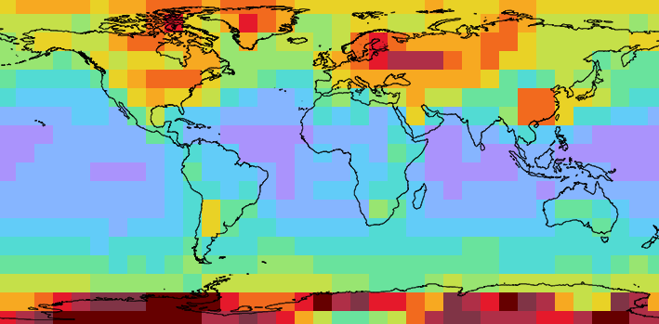
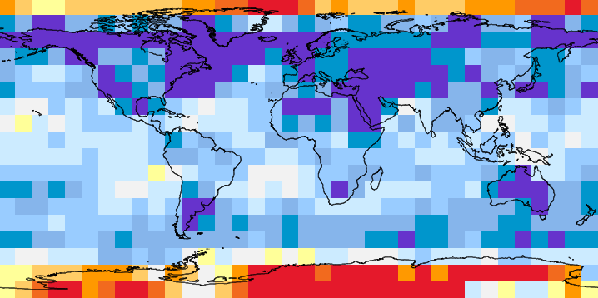
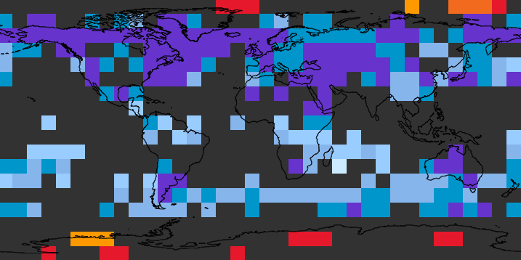
Annual Mean (July 2000 – June 2001)
Cloud Optical Thickness, water clouds, Terra
(10° binning, daytime observations only)
0
15
30
Optical Thickness Trends
(July 2000 – June 2010)
Trends Masked by Significance Level <0.05
%/decade
≤20
0
≥20
Platnick and Levy, MODIS Cal-Val, 17 May 2011

Slide 12
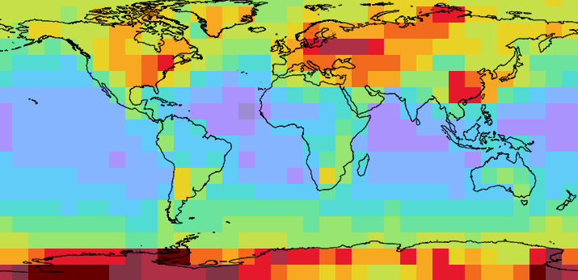
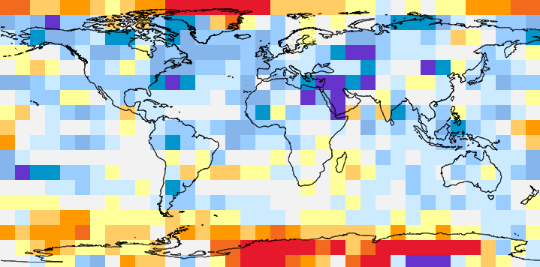
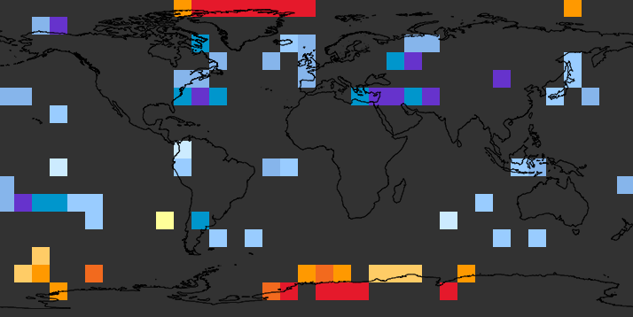
Annual Mean (July 2002 – June 2001)
Cloud Optical Thickness, water clouds, Aqua
(10° binning, daytime observations only)
0
15
30
Optical Thickness Trends
(July 2002 – June 2010)
Trends Masked by Significance Level <0.05
%/decade
≤20
0
≥20
Platnick and Levy, MODIS Cal-Val, 17 May 2011

Slide 13
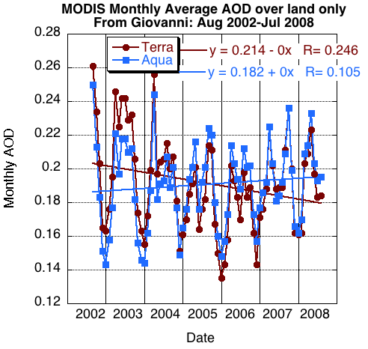
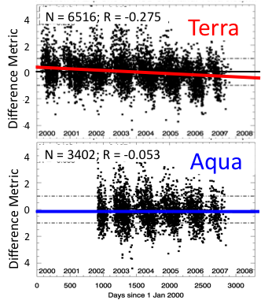
Trends in C5 Terra AOD over land: Artificial?
A
B
} Δτ≈-0.03
Difference metric =
(τ_{MODIS}-τ_{AERO}) / EE
EE = “Expected Error”
EE = 0.05 + 0.15τ_{AERO}
Terra and Aqua show different AOD trends over land (Terra’s is statistically “significant”)
Difference with AERONET shows trend for Terra but not Aqua
Consistent with trend in “Earth View” calibration of Band #3 (0.47μm) used for AOD retrieval
1.2
1.1
1.0
0.9
0.8
Refl/BRDF
Desert Sites
Band #3, Mirror Side #1, Frame=675
Aqua
} Δρ≈-0.0040
From Junqiang Sun, MCST
Terra
C
2000
2001
2002
2003
2004
2005
2006
2007
2008
2009
2010
2011
Platnick and Levy, MODIS Cal-Val, 17 May 2011

Slide 14
Instrument Artifacts?
Trends (%/decade), ±60° latitude, areal averaging
Cloud Optical Thickness, Land (~ band 1)
 | Aqua (8 yrs) | Terra (8 yrs) | Terra (10 yrs)
τ_{liquid} | -3.44 | -15.62 | -14.56
τ_{ice} | -0.98 | -11.20 | -10.71
Cloud Optical Thickness, Ocean (~ band 2)
 | Aqua (8 yrs) | Terra (8 yrs) | Terra (10 yrs)
τ_{liquid} | -2.6 | -12.6 | -10.0
τ_{ice} | -1.4 | -13.1 | -10.5
Aerosol AOD, Land (~ band 3)
 | Aqua (8 yrs) | Terra (8 yrs) | Terra (10 yrs)
τ_{a} (pixel-weighing of grids) | -1.0 | -24.0 | -12.4
τ_{a} (no weighting) | -0.9 | -25.9 | -15.3
Platnick and Levy, MODIS Cal-Val, 17 May 2011
Notes:
Band 1 looks similar, and band 3 (used by aerosol dark target over land)
Will be corrected in C6.

Slide 15
Instrument Artifacts? C5 Aqua & Terra Band 2 Trends vs. AOI (frame #)
MCST evaluation via desert ground targets (from S. Junqiang)
Aqua b2, ms1
Terra b2, ms1
5%
Terra b3, ms1
Terra b1, ms1
5%
5%
Notes:
Band 1 looks similar, and band 3 (used by aerosol dark target over land)
Flattened out in C6 Approach 2 (not shown).

