Slide 1
MODIS Calibration Workshop
Jack Xiong (NASA GSFC)
and
MODIS Characterization Support Team
MODIS Science Discipline Representatives
University of Maryland University College, Adelphi, MD 20783 (May 17, 2011)

Slide 2
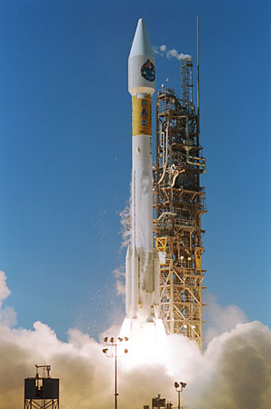
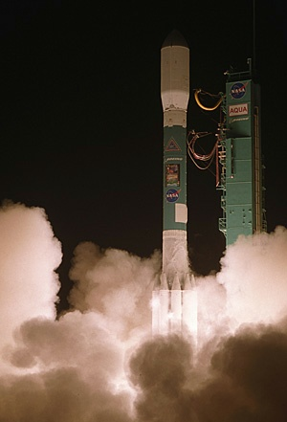
Terra MODIS: over 11 years of successful operation
Aqua MODIS: over 9 years of successful operation
Terra
An unprecedented amount of data products with significant contributions to the broad user and science community
Successful Senior Review for both Terra and Aqua missions
Aqua
Page 2

Slide 3
Acknowledgements
MODIS Characterization Support Team (MCST)
  Instrument Operation Team (IOT)
  Level 1B Group
  Calibration Group (RSB, TEB, LUT delivery)
MODIS Sensor Working Group (MsWG)
  Discipline Representatives (ocean, land, and atmosphere)
NASA HQ and MODIS Science Team
  Continuous Funding Support for both Terra and Aqua Missions
  Leadership and Science Contributions
User and Science Community
  Input and Feedback
Page 3

Slide 4
Agenda
MODIS Operation, Calibration, and Performance
Introduction (Jack Xiong) 1:30 pm
Instrument Operation Status (Gavin Westenburger) 1:40 pm
Recent L1B Algorithm and LUT Updates (James Kuyper) 1:50 pm
RSB Calibration, Performance, and C6 (Amit Angal, Junqiang Sun) 2:00 pm
TEB Calibration, Performance, and C6 (Sri Madhavan, Aisheng Wu) 2:40 pm
Geo-location Characterization and Performance (Robert Wolfe) 3:05 pm
Coffee Break 3:20 pm
Science Discipline Presentations
CAL/VAL Presentations (Simon Hook, Chris Moeller) 3:40 pm
Land Presentations (Eric Vermote, Alex Lyapustin) 4:05 pm
Ocean Presentations (Peter Minnett, Gerhard Meister) 4:30 pm
Atmosphere Presentations (Steve Platnick, Rob Levy) 4:55 pm
Summary (Jack Xiong, Brian Wenny) 5:20 pm
Adjourn 5:30 pm
Page 4

Slide 5
Summary
Part 1: Instrument operation, calibration, performance, and C6 issues
Part 2: Vicarious calibration and science applications
  Spectral and spatial performance is provided in the backup slides
  Recent updates to the L1B Uncertainty Index (UI) is available on the MCST webpage (materials discussed and reviewed at MsWG)
Both instruments and their on-board calibrators continue to operate normally (no new changes to the instrument operational configurations)
  Terra MODIS SD door fixed at the “open” position (July 2, 2003), which led to the increase of SD degradation rates
  Gradual decrease of Aqua MODIS cooler margin has led to small increase of cold FPA temperatures (up to 0.3 K) and orbital/seasonal variations
  Aqua SD door movements will soon reach the vendor limit (mid 2012), further decrease of Aqua SD calibration frequency is planned
Page 5

Slide 6
Challenges and Concerns
Large changes in VIS spectral band/detector response
  Mirror side, wavelength, and AOI dependent
  Changes in response versus scan-angle (RVS)
  Changes in scan mirror polarization sensitivity
  Noticeable impact in bands 8, 9, and 3, and likely in other bands (more in Terra than Aqua MODIS)
Large SD degradation at short wavelengths
  More degradation in Terra than Aqua MODIS
TEB calibration quality over cold targets
  Improvements made in C6, noticeable effect may still exist
Calibration consistency between Terra and Aqua MODIS
  Scene dependent differences (offsets and trends)
Lessons for NPP VIIRS Operation and Calibration
Page 6

Slide 7
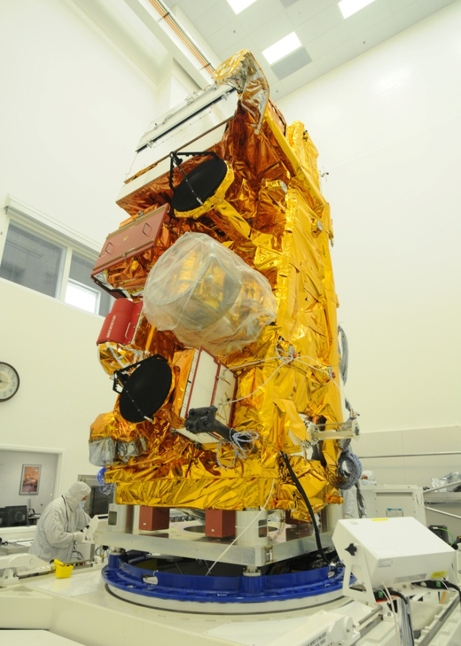

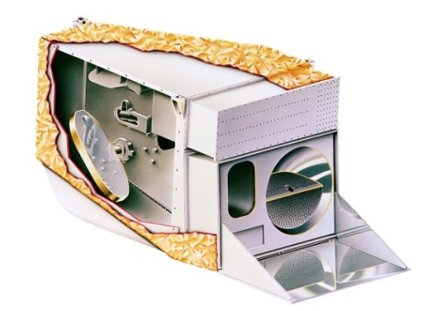
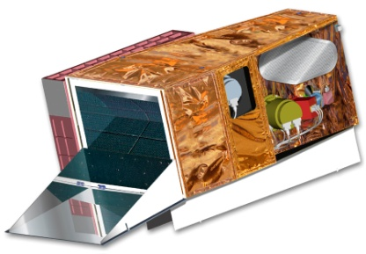
EOS/MODIS to NPP/VIIRS and Beyond
Page 7

Slide 8
Instrument Operation
No New Changes to Instrument Operational Configurations
Terra MODIS
  A-side: launch to Oct 30, 2000
  B-side: Oct 30, 2000 to June 15, 2001
  A-side: July 02, 2001 to Sept 17, 2002
  A-side electronics and B-side formatter: Sept 17, 2002 to present
  BB temperatures set at 290K
  Cold FPA (SMIR and LWIR) controlled at 83K
  SD door fixed at “open” since July, 2003
Aqua MODIS
  Same B-side configuration since launch
  BB temperatures set at 285K
  Cold FPA (SMIR and LWIR) controlled at 83K
Details of MODIS operational activities available on MCST Webpage
Page 8

Slide 9
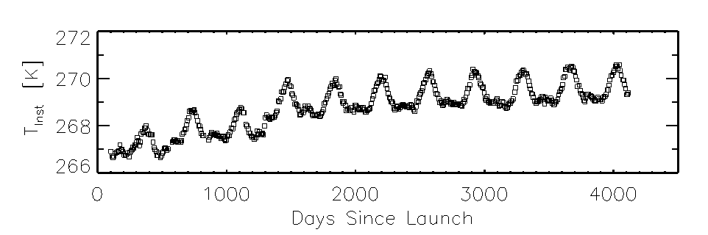
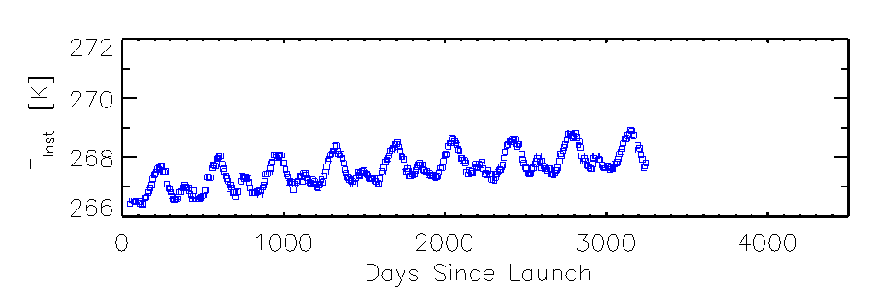
Instrument Temperatures
Terra MODIS: less than 3.5 K increase over 11 years
Aqua MODIS: less than 2.0 K increase over 9 years
Similar trends for the VIS and NIR FPA temperatures
Page 9

Slide 10
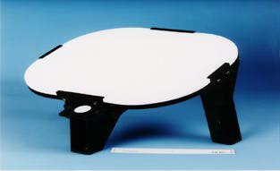
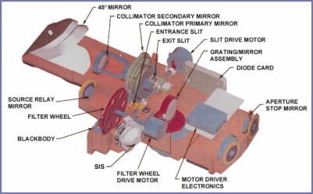
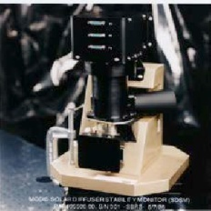
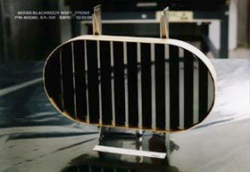



On-board Calibrator On-orbit Calibration
SRCA:
Radiometric: monthly
Spatial: bi-monthly
Spectral: quarterly
SD/SDSM:
Weekly to tri-weekly
Solar
Diffuser
SRCA
SDSM
Blackbody
Scan
Mirror
Space
View
BB: quarterly
Spacecraft maneuvers:
Yaw (SD BRF, VF)
Roll (Moon)
Pitch (only applied to Terra)
Moon: monthly (nighttime orbits)
0-20º spacecraft roll maneuvers
55º phase angle
Page 10

Slide 11

MODIS Instrument Operations
MODIS IOT
MCST Workshop at MST Meeting (May 17, 2011)

Slide 12
MODIS Operational Activities

Slide 13
Recent Events (Terra)
Spacecraft Events
  SFE-A (2010/065,107,177) – All Anomalies resulted in a data loss of several hours, but there was no detrimental impact to MODIS.
  Battery Anomaly (2009/286) - possible MMOD (Micro-Meteoroid Orbital Debris)
  On DOY 2010/181, the FOT erroneously commanded an additional second to the Command and Telemetry Interface Unit (CTIU). Terra Lunar Roll #98 on DOY 2010/182 was waived as a result of the anomaly. This error was corrected on DOY 182 (7/01/10) and there have been no further impacts to the spacecraft or MODIS.
Orbit Adjust Maneuvers
  Drag Make-Up #58-61
  Inclination Adjustment #25-28
MODIS Events
  A few telemetry points slightly exceeded configuration monitor limits, following the SRCA Spectral Calibration on DOY 2011/012. There was no impact to MODIS.

Slide 14
Recent Events (Aqua)
Spacecraft Events
  No new events
Orbit Adjust Maneuvers
  Drag Make-Up #40-48
  Inclination Adjustments #25-30
  Debris Avoidance Maneuver (2010/362, 2011/002, 039, 060)
MODIS Events
  Aqua SRCA Spectral Calibration scheduled for DOY 2011/013 was waived due to a miscommunication between the IOT and the new Aqua Flight Software Engineer. The SRCA Spectral activities were successfully completed on DOY 2011/048. There was no impact to MODIS.

Slide 15
Terra/Aqua MODIS OBC Operations
Activity | PL to 01/10 | 01/10 - present | Total
SD/SDSM# | 597 | 24 | 621
BB WUCD | 70 | 5 | 75
SRCA* | 299 | 29 | 328
Electronic Cal | 63 | 5 | 68
Lunar Roll | 95 | 9 | 104
T
E
R
R
A
Activity | PL to 01/10 | 01/10 - present | Total
SD/SDSM# | 408 | 35 | 443
BB WUCD | 31 | 5 | 36
SRCA* | 174 | 29 | 203
Electronic Cal | 44 | 5 | 49
Lunar Roll | 69 | 15 | 84
A
Q
U
A
# Open & Screened Activities counted independently
* Includes Spatial, Spectral and Radiometric
01/10 = last Science Team Meeting

Slide 16
SRCA Calibrations
Terra – 328 SRCA Calibrations
Aqua – 203 SRCA Calibrations
Lamp Power
10W
1W
Lamp #
1
2
3
4
1
2
Terra
Usage (hr)
298.0
172.1
190.3
99.7
581.2
282.0
Life (hr)
500
500
500
500
4000
4000
percent
59.6%
Failed on
11-20-2004
Failed on
2-18-2006
19.9%
14.5%
7.1%
Aqua
Usage (hr)
291.6
188.0
205.7
104.0
522.9
274.9
Life (hr)
500
500
500
500
5000
5000
percent
58.3%
Failed on
4-14-2003
Failed on
6-28-2005
20.8%
10.5%
5.5%

Slide 17
Future Operational Considerations
Aqua MODIS CFPA temperature control
  Currently set at 83K – two options for mitigation
    Change set point to 85K
    Perform outgas (given the opportunity)
      Preliminary Standard Operating Procedure (SOP) has been produced for an outgas.
Aqua SD/SDSM door movements
  Adjust calibration frequency to preserve door movements
 | PL to 01/10 | 01/10 to present | Total | Design Lifetime | % Used
Terra* | 2146 | 0 | 2146 | 3022 | 71.01
Aqua⁺ | 2849 | 95 | 2944 | 3022 | 97.42
* As of 07/02/2003, SD Door in fixed ‘open’ position with screen in place
⁺ At the current usage rate Aqua will reach designed lifetime of door movement on DOY 2012/191 (July 2012). Plans to reduce SD/SDSM frequency in the future are being considered.

Slide 18
MODIS Level 1B and LUT Status
MCST Workshop at MST Meeting (May 17, 2011)
Page 18
Notes:
18

Slide 19
Recent Code and L1B Updates
    Near-monthly LUT update for each MODIS forward processing
  96 for Terra MODIS and 60 for Aqua MODIS in Collection 5 since 2005
  Additional LUTs generated, tested, and delivered to OBPG (Ocean Biology Processing Group ) for special investigations
  Most LUT updates were driven by response changes of VIS bands
Page 19
Notes:
19
19

Slide 20
Production Changes to Collection 5
MOD_PR02 TERRA L1B Code
Page 20
Notes:
20
20

Slide 21
Number of MCST L1B Code and LUT Versions
(as of 2011-05-11)
Year | Terra Code Versions | Terra LUTs C2 | Terra LUTs C3 | Terra LUTs C4 | Terra LUTs C5 | Aqua Code Versions | Aqua LUTs C3 | Aqua LUTs C4 | Aqua LUTs C5 | Total
2000 | 5 | 2 | 0 | 0 | 0 | 0 | 0 | 0 | 0 | 7
2001 | 2 | 1 | 5 | 0 | 0 | 0 | 0 | 0 | 0 | 8
2002 | 3 | 0 | 1 | 0 | 0 | 2 | 3 | 1 | 0 | 10
2003 | 3 | 0 | 0 | 19 | 0 | 3 | 0 | 17 | 0 | 42
2004 | 1 | 0 | 0 | 17 | 0 | 1 | 0 | 11 | 0 | 30
2005 | 2 | 0 | 0 | 18 | 10 | 2 | 0 | 11 | 6 | 49
2006 | 0 | 0 | 0 | 20 | 14 | 0 | 0 | 12 | 9 | 55
2007 | 1 | 0 | 0 | 1 | 13 | 0 | 0 | 0 | 11 | 26
2008 | 1 | 0 | 0 | 0 | 16 | 1 | 0 | 0 | 8 | 26
2009 | 2 | 0 | 0 | 0 | 18 | 1 | 0 | 0 | 8 | 29
2010 | 1 | 0 | 0 | 0 | 18 | 1 | 0 | 0 | 14 | 34
2011 | 0 | 0 | 0 | 0 | 7 | 0 | 0 | 0 | 4 | 11
Total | 21 | 3 | 6 | 75 | 96 | 11 | 3 | 52 | 60 | 327
Does not include internal deliveries(18), nor special deliveries to Ocean Color Group (31) or Miami & Wisconsin (7)
Page 21
Notes:
21
21

Slide 22
MODIS MOD_PR02 L1B Code/LUTs
Major Production Changes Timeline
Terra Forward Processing
5.0.46 (2010136)
5.0.44 (2009235)
5.0.40 (2008024)
5.0.42 (2009191)
Production Start
5.0.6 (2005066)
5.0.38 (2007260)
4.2.0 (2003234)
2.4.4 (2000287)
3.0.1 (2002056)
4.1.2 (2003030)
4.3.0 (2003356)
2.3.2 (2000077)
2.4.2 (2000171)
3.0.0 (2001144)
2.5.5 (2001044)
2.5.4 (2000328)
2.4.3 (2000231)
Code Versions
1-34
1- 25
1
1- 4
1- 13
1- 19
LUT Versions
3
0
0-2
2-7
0,1
1-11
3-9
1-9, 11-58
1
1,2
0
Aqua Forward Processing
Production Start
Collection 2:
5.0.35 (2008023)
5.0.39 (2010132)
5.0.7 (2005185)
5.0.37 (2009191)
Collection 3:
4.1.1 (2002304)
4.1.3 (2003022)
3.1.0 (2002158)
4.2.1 (2003233)
4.3.1 (2004018)
Code Versions
Collection 4:
Collection 5:
LUT Versions
2-27
1- 12
1- 8
1- 13
0-3
0,1
0-11
4-8
1-36
Year
2000
2001
2002
2003
2004
2005
2006
2007
2008
2009
2010
2011
Page 22
Notes:
22
22

Slide 23
Production Changes to Collection 5
MOD_PR02 AQUA L1B Code
Page 23
Notes:
23
23

Slide 24
Collection 6 Code Changes for L1B-1
Change to no longer interpolate the values of inoperable detectors from nearby good detectors.
  The scaled integer value are now set to a flag value of 65531
Noisy/inoperable detector (sub-sample) flagging
  If sub-sample is inoperable, the scaled integer value will be set to the flag value 65525
The sector rotation timing fix
      The anomaly is caused by the mismatch of the timing of the instrument command to perform the sector rotation and the recording of the telemetry point that reports the angle of sector rotation.
      The same fix was also made to C5 PGE02 on 2010-02-25 in versions 5.0.46 (Terra) and 5.0.39 (Aqua).
Change in how ReprocessingActual ECS metadata is set and used.
  Previously, value was fixed as “processed once”
  Now the value is controlled by MODAPS operations:
    “Near Real Time” – causes file name to end with “.NRT.hdf”
    “processed once”
    “reprocessed once”
  Also implemented in Collection 5 code.
Page 24
Notes:
24
24

Slide 25
Collection 6 Code Changes for L1B-2
PCLW Electronics Side A and Side B on at same time
  Is one of three systems on spacecraft that can be commanded to have both sides on. (however, that command is incompatible with current hardware configuration)
  Previously treated as a fatal error, causing loss of entire granule.
  Corrupted data packets have made it appear to have happened.
  No longer fatal; only the affected scan is marked as bad.
New algorithms for calculating the uncertainties for RSB bands
  The uncertainty in C5 L1B includes 9 terms derived from prelaunch analysis. In C6 L1B, contributions to the uncertainty due to prelaunch measurements as well as on-orbit calibrations are included. They are grouped into 5 terms (u1, u2, u3, u4, and u5). Among the five terms, three are provided by input look up tables which are updated routinely. The other two terms are calculated since they are scene dependent. The parameters used in the calculation are also provided by input look up tables and may need to be updated.
New algorithms for calculating the uncertainties for TEB bands
  The perturbation method used to derive UI terms in the C5 L1B is replaced with an analytical expression approach. A few UI terms from prelaunch are replaced with on-orbit values. There are 11 new emissive LUTs added and 5 LUTs rendered obsolete.
Changed to model RVS for the RSB bands using a quartic polynomial, rather than a quadratic one.
Page 25
Notes:
25
25

Slide 26
Status of EOS Terra and Aqua MODIS RSB Calibration
MODIS Characterization Support Team (MCST)
MCST Workshop at MST Meeting (May 17, 2011)

Slide 27
Outline
Overview of the RSB calibration algorithm
Noisy & Inoperable RSB detectors
Solar Diffuser Degradation
RSB response trending
Summary of RSB overall performance
Page 27

Slide 28


MODIS RSB Calibration Using SD/SDSM
Reflectance Factor
Sun
1.44% Screen
Optional 7.8% Screen
SDSM
Scan Mirror (MODIS)
Δ_{SD}: SD degradation factor;
Γ_{SD}: SD screen vignetting function
d: Earth-Sun distance
dn*: Corrected digital number; dc: Digital count of SDSM
SD
Page 28
Notes:
The SD and SDSM operate together as a system for calibration of the reflective solar bands. The SDSM is used to track the changes in the SD reflectance.
Two illumination levels of SD calibration are provided using deployable 7.8% transmission screen. The diffuser is constructed from space-grade Spectron (manufactured by Labsphere, North Sutton, NH), which is a proprietary thermoplastic formulation of polytetrafluoroethylene (PTFE). A 1.6% transmission screen is fixed in front of the sun-view port of the SDSM.
The SDSM was designed to track change in the reflectance properties of the SD for wavelengths below 1 um. SDSM consists of a miniature integrating sphere with a single input aperture and nine filtered diodes embedded in its inner wall. Each filter has a narrow spectral band pass of approximately the same width as a corresponding MODIS spectral band.
It is important to point out that the MODIS observed sunlight is forward scattered from the SD and the SDSM observed sunlight is backward scattered from the SD. This situation is the primary source of uncertainty in the use of the SDSM for trending changes in the diffuser BRF.

Slide 29
MODIS RSB Noisy & Inoperable Detectors
Terra
Aqua
e
No new inoperable/noisy detectors since
the last MST (Jan, 2010)
Detectors in SBRS order
Page 29
Notes:
Terra Noisy detector: band 5 detector 17 in SBRS order
Aqua noisy detector: band 6 detector 4 in SBRS order,
Aqua dead detector: band 5 detector 1, band 6 detector 1,2,3,5,6,7,9,11,15,16,17,19
Currently most RSB detectors in both instruments continue to meet their design spec as expressed by the SNR.

Slide 30
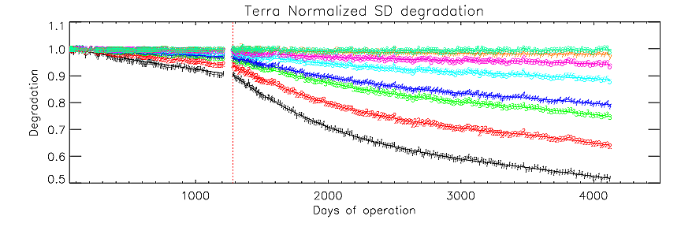
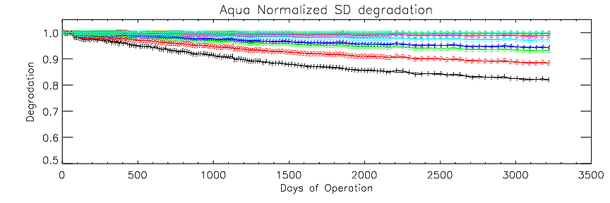
MODIS SD Degradation Trending
SD door anomaly on July 2nd, 2003
The results are derived from a normalization approach to SDSM D9 (936 nm).
An additional correction for the degradation at SDSM D9 wavelength is applied
Page 30
Notes:
SDSM for both terra and aqua operates tri-weekly. The degradation is plotted against the days of operation for both instruments.
After the SD door always kept open, the degradation of Terra SD is getting much fast.
But if we look at the day of 1200, which is the time before terra SD door continues open, the degradation of SD for both Aqua and Terra are same

Slide 31
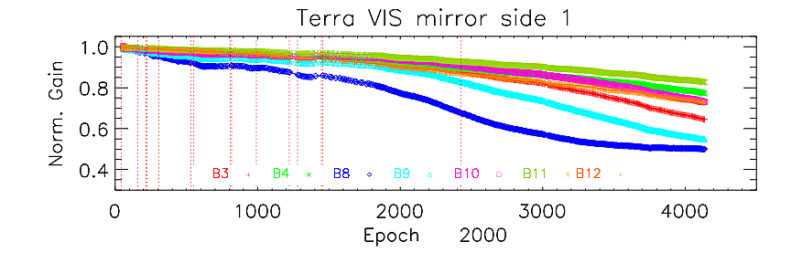
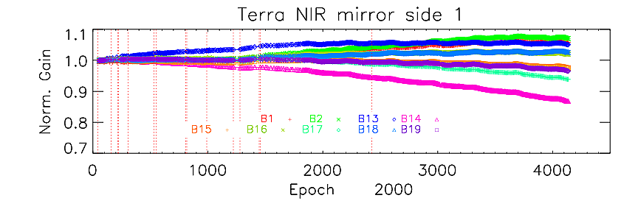
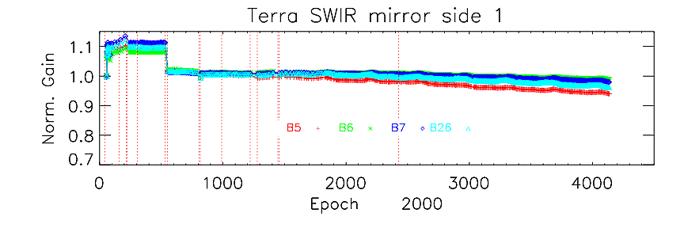
MODIS RSB Response Trending
Page 31
Notes:
2000160 CFPA lost control (160, 06/08/2000)
2000218 Standby mode, Lower Power Mode (218, 08/05/2000)
2000224 Transition to A-Side Science Mode (224, 08/11/2000)
2000304 Transition to B-Side Science mode (304,10/30/2000)
2001166 Power off in Survive mode (day 532, 06/15/2001)
2001183 Transition to A-Side science mode (549, 07/02/2001)
2002078 atuonomously enter safe mode, science data production stopped (809, 03/19/2002)
2002086 Nadir door was commanded open (817, 03/27/2002)
2002260 Formatter from A-side to B-side (991, 09/17/2002)
2003126 SD door failure, (1222, 05/06/2003)
2003183, Screen left close, SD door opened. (1279, 07/02/2003)
2003350, ACE-B Anomaly, Safe mode (1446, 12/16/2003)
2005358, Nadir Door reopen. (1454, 12/24/2003)
New event at 2006234, NADIR & SVD closed accidently
Band 8 shows the largest gain drop about 34%, and band9 is about 20%. Since this gain is composed of electronic gain & optical gain, you can see for band 13 and band 14 shows totally different trending direction. Band 13 is going upwards about 5%, However, band 14 drop like 5%.
Side change, and SD door failure, screen closed.

Slide 32
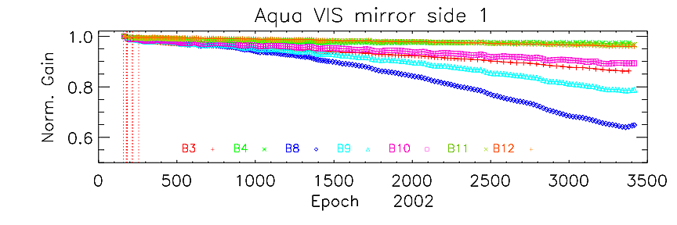
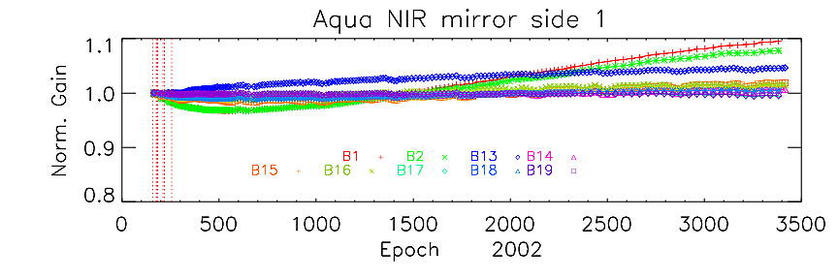
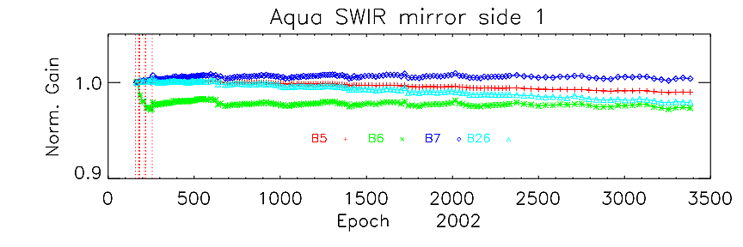
MODIS RSB Response Trending
Page 32
Notes:
06/07/2002, day 158, in Science mode
06/24/2002, day 175, Nadir door open
06/27/2002, day 178, enter safe mode due to spacecraft CTC swap
07/01/2002, day 182, Nadir door open
07/02/2002, day 183, Transition to B-side science mode
07/29/2002, day 210, autonomously enter safe mode
08/05/2002, day 217, Nadir door open
08/06/2002, day 218, Transition to B-side science mode
09/12/2002, day 255, autonomously enter safe mode, Nadir door open, to B-side safe mode
Band 8 drop 10% and band 9 is about 7%.
We also see band 13 has 2% increase in gain and band 2 first drop then increase.

Slide 33
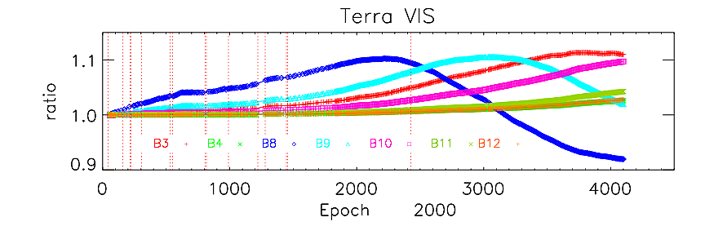
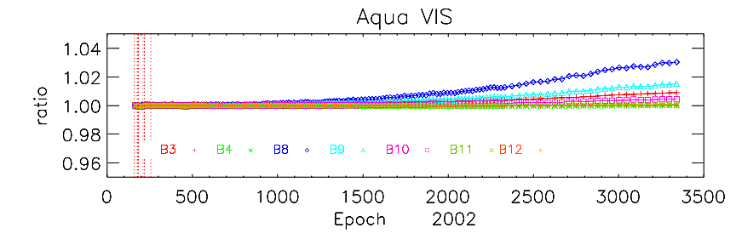
MODIS RSB Response Trending
Smaller mirror side differences
observed in Aqua MODIS
Page 33
Notes:
06/07/2002, day 158, in Science mode
06/24/2002, day 175, Nadir door open
06/27/2002, day 178, enter safe mode due to spacecraft CTC swap
07/01/2002, day 182, Nadir door open
07/02/2002, day 183, Transition to B-side science mode
07/29/2002, day 210, autonomously enter safe mode
08/05/2002, day 217, Nadir door open
08/06/2002, day 218, Transition to B-side science mode
09/12/2002, day 255, autonomously enter safe mode, Nadir door open, to B-side safe mode
Band 8 drop 10% and band 9 is about 7%.
We also see band 13 has 2% increase in gain and band 2 first drop then increase.

Slide 34
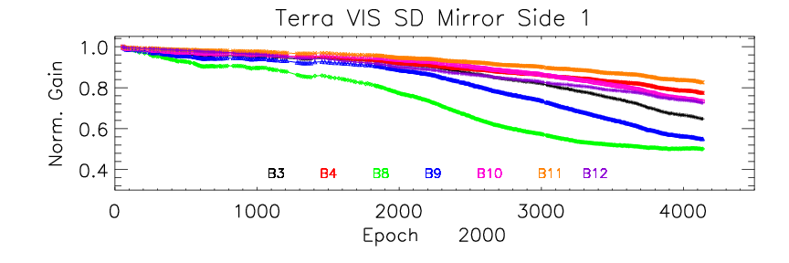
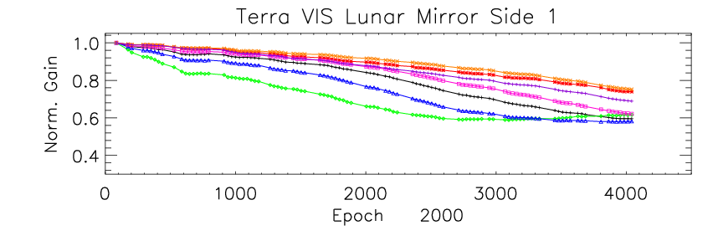
MODIS RSB Response Trending
SD/SDSM and lunar observations used to track the on-orbit RSB Response versus Scan Angle (RVS) change
Page 34
Notes:
The mirror side difference of Terra is constantly increasing. For band 8 is about 10% in total 6 years.
And this difference is wavelength dependent. we can see that band 3 difference is between band band 9 and band 10 as we already know that band 3 central wavelength is in the middle of band 9 and band 10.
For Aqua, the mirror side side difference is extremely small.

Slide 35
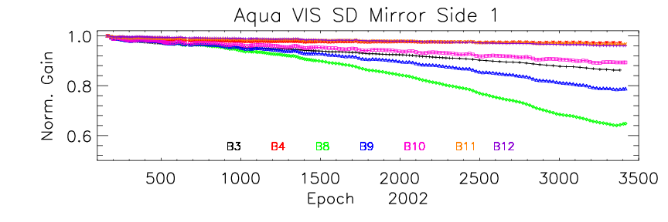
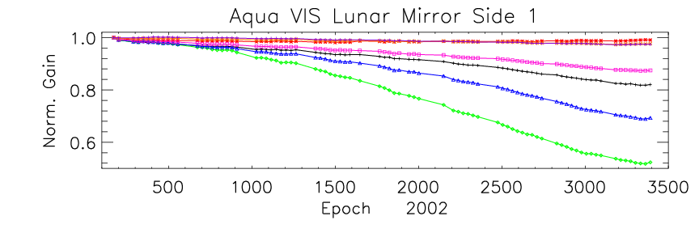
MODIS RSB Response Trending
SD/SDSM and lunar observations used to track the on-orbit RSB Response versus Scan Angle (RVS) change
Page 35
Notes:
The mirror side difference of Terra is constantly increasing. For band 8 is about 10% in total 6 years.
And this difference is wavelength dependent. we can see that band 3 difference is between band band 9 and band 10 as we already know that band 3 central wavelength is in the middle of band 9 and band 10.
For Aqua, the mirror side side difference is extremely small.

Slide 36
Summary of RSB overall Performance
RSB calibration has performed well according to design specifications
  Terra (11+ years) and Aqua (9+ years)
  No new noisy/inoperable detectors since last STM
  SD/SDSM and the Moon observations are used to track the on-orbit RSB gain change
  Noticeable optics degradation identified and corrected in both sensors’ response
    Most degradation seen in VIS bands with largest change seen for Band 8 (412 nm) at SD AOI: 50% for Terra and about 35% for Aqua
    Gain change for NIR and SWIR bands is generally within 10% for both instruments
    Mirror side differences are smaller in case of Aqua VIS bands (within 5%) as compared to the Terra VIS bands (± 10 %)
    Mirror side differences in NIR and SWIR bands for both instruments are within ±0.5%
Page 36

Slide 37
MODIS RSB Collection 6 LUTs
MODIS Characterization Support Team (MCST)

Slide 38
Outline
Introduction
  Look Up Tables (LUT)
    Calibration coefficients (m1)
    Response versus Scan angle (RVS)
    Uncertainty Index (UI)
  Approaches developed for m1 and RVS
Approach I for m1 and RVS
  Algorithms and results
  EV reflectance trending
Approach II for m1 and RVS
  Algorithms and results
  EV reflectance comparison
Summary and Challenges
Page 38

Slide 39
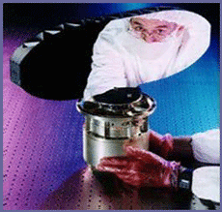
RSB m1 and RVS
EV Reflectance
LUTs need to be updated for RSB
  m1: Inversely proportion to gain at the AOI of SD
  RVS: Sensor Response versus Scan angle (normalized to SD view AOI to the scan mirror)
  Uncertainty Index (UI), not be discussed here
Calibration Source
  Lunar observation
  SD/SDSM calibration
  SRCA and EV mirror side (MS) ratios
  Selected EV targets
MODIS scan mirror
11.2
Angle of Incidence (AOI)
Page 39

Slide 40
Terra C6 m1 and RVS (Approach I)
m1 calibration coefficients are generated using SD observations
Mirror side 1 (MS1) RVS on-orbit variation is tracked using SD and lunar calibration coefficients with a linear approximation for its AOI dependence
Mirror side 2 (MS2) RVS on-orbit variation is derived from the mirror side ratio of sensor response at multiple AOI (SD, Moon, EV, and SRCA ) with a quadratic approximation for the AOI dependence and using MS1 RVS as reference
No time-dependent RVS applied to bands 5-7 and 26
Approach I is, in fact, the same as C5 approach with following improvements
  RVS detector dependence (8-12)
  Time-dependent RVS for bands 13-16
  SD degradation at wavelength 936 nm measured by SDSM D9
Page 40

Slide 41
Terra C6 m1 and RVS (Approach II)
m1 and RVS are generated using the lunar calibration, SD calibration (absolute calibration at beginning of the mission), and sensor EV response trending at multiple AOI
Detector differences in both m1 and RVS are identical to the Approach I LUTs, which are obtained using SD and lunar calibration coefficients
The lunar m1 is used to track the gain change at the AOI of the SV
A quartic approximation is applied for both MS1 and MS2 AOI dependence of the RVS on-orbit variation.
Page 41

Slide 42
MODIS RSB RVS Algorithms
Approach I
RVS is characterized by prelaunch measurement and on-orbit variation
  B, D, M, θ and t represent band, detector, mirror side, AOI and time
  pl: pre-launch; oo: on-orbit.
RVS on-orbit variation at AOI of the SV
Mirror side one RVS on-orbit variation – a linear function of AOI
Mirror side two RVS
  Instrument response mirror side ratio is obtained from SD, lunar, SRCA, and EV observations
The calculated RVS is fitted to a quadratic form of the frame, and the fitted coefficients form a time dependent LUT for MODIS RSB RVS
  F: Frame
Page 42

Slide 43
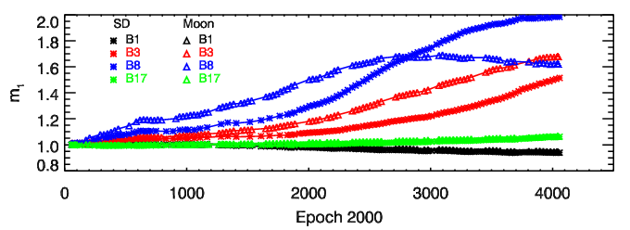
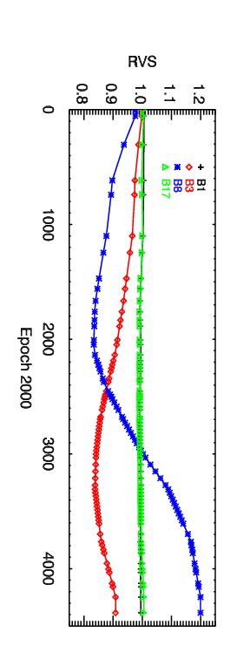
Terra MODIS RSB MS1 RVS
Detector-averaged SD and lunar calibration coefficients for Terra MODIS bands 1, 3, 8, and 17 MS1
Detector averaged RVS
at the SV AOI for Terra bands 1, 3, 8, and 17 MS1
Page 43

Slide 44
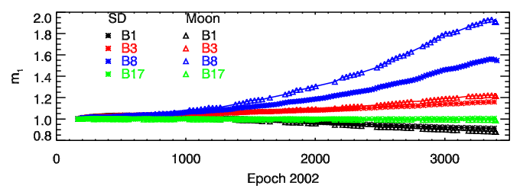
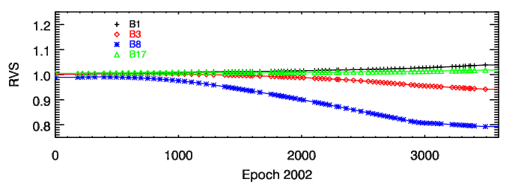
Aqua MODIS RSB MS1 RVS
Detector-averaged SD and lunar calibration coefficients for Aqua MODIS bands 1, 3, 8, and 17 MS1
Detector averaged RVS
at the SV AOI for Aqua bands 1, 3, 8, and 17 MS1
Page 44

Slide 45
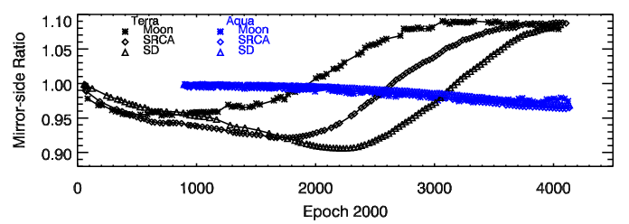
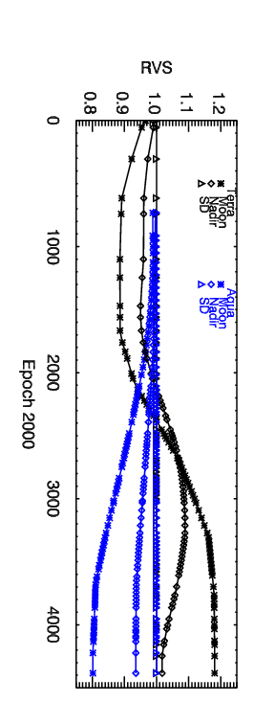
MODIS RSB MS2 RVS
Band 8 mirror side (MS)
ratios of the SD, SRCA,
and lunar response.
Detector averaged RVS
at the SV AOI for
Band 8 MS2.
Page 45

Slide 46
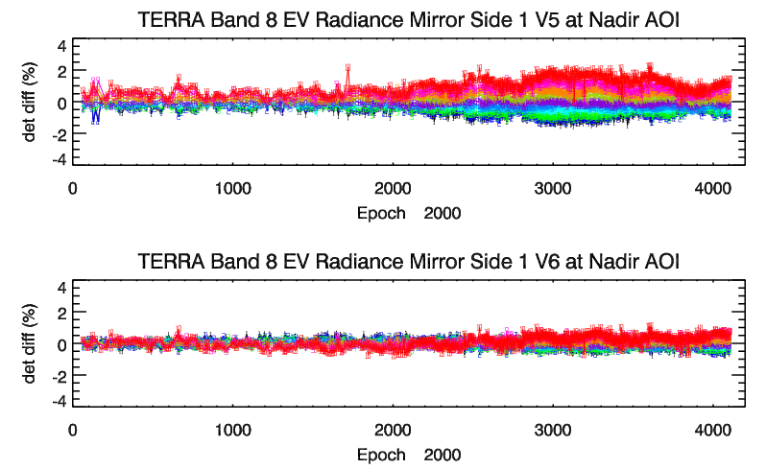
EV Radiance Detector Difference
C5
C6
Numbers denote detectors in product order
Page 46

Slide 47
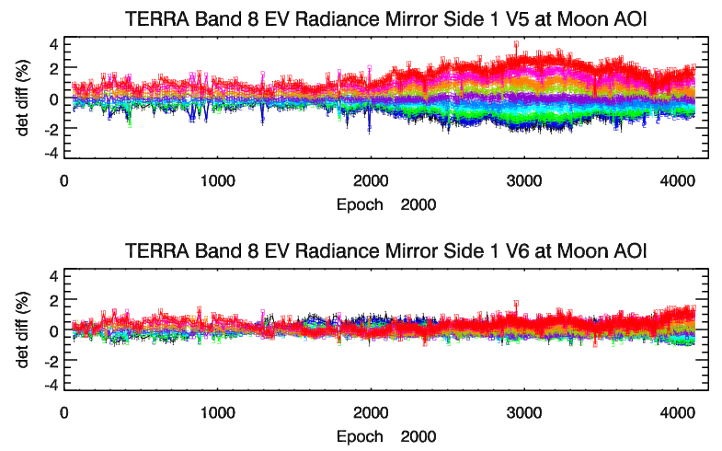
EV Radiance Detector Difference
C5
C6
Numbers denote detectors in product order
Page 47

Slide 48
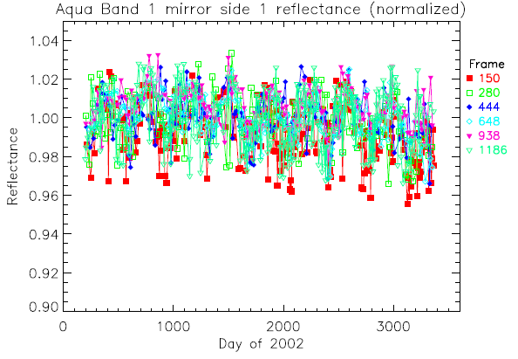
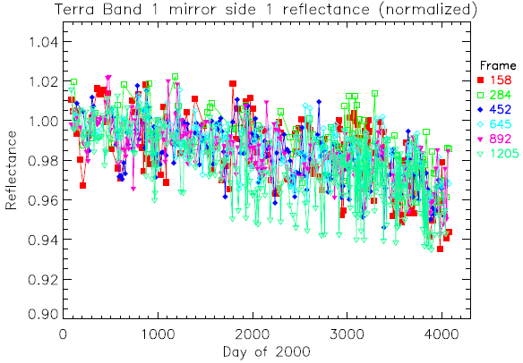
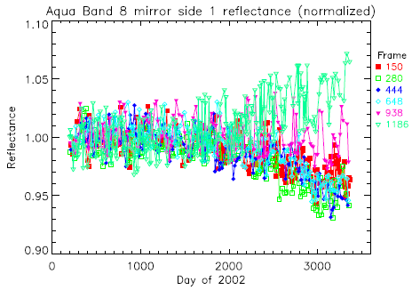
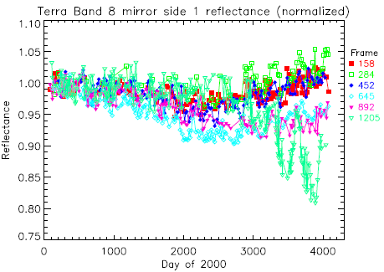
EV Reflectance
Aqua band 1 MS1
Terra band 1 MS1
Terra band 8 MS1
Oscillation at large AOI due to polarization effect
Aqua band 8 MS1
  ~3% drift in Terra bands 1, 2, and 4 and 2% in Aqua band 9
  Much larger drift seen in Terra bands 3 (~5%), 8 (10~15%), and 9 (~8%) and Aqua band 8 (~5%)
Page 48

Slide 49
MODIS RSB m1 and RVS Algorithms
Approach II
Summary for Approach I
  Works reasonably well for all RSB except Aqua bands 8-9 and Terra bands 1-4 and 8-9
    ~3% drift in Terra bands 1, 2, and 4 and 2% in Aqua band 9
    Much larger drift seen in Terra bands 3 (~5%), 8 (10~15%), and 9 (~8%) and Aqua band 8 (~5%)
  Possible Reasons
    Linear approximation for RVS AOI dependence
    Accuracy of SD/SDSM calibration
Pseudo-Invariant Desert Sites
  Sites: Mauritania 1, Mali 1, Algeria 1, Algeria 3, Niger 1, Libya 1, Libya 2, Libya 4, Egypt 1, Sudan 1, Yemen Desert 1, Arabia 2
  Detail information for these sites: http://calval.cr.usgs.gov/sites_catalog_map.php
Justification for the approximation
  Aqua and Terra MODIS should see similar long-term EV reflectance trending for a given wavelength
  Reports from various science groups that Aqua MODIS provide better L1B products
Page 49

Slide 50
MODIS RSB RVS Algorithms
Approach II
Lunar view response and Earth view responses at selected AOIs
  Terra AOIs (degree): 11.2 (lunar), 16.9, 22.0, 23.8, 28.9, 32.6, 36.7, 42.7, 46.7, 53.4, 59.4, 64.2
  Aqua Frames are slightly different from those of Terra
  For each AOI, the instrument response is fitted to smoothly connected analytical functions
Detector-averaged m1 and RVS on-orbit variation
  The fitted smooth functions are normalized at NADIR door open time for each instrument
  For any time t, the RVS on-orbit variation for a given band and mirror side is determined by fitting the values of the functions of the band and mirror side to a quartic polynomial of AOI with a constrain that the polynomial passes through the on-board lunar measurement
  The inverse of the fitted polynomial at AOI of the SD is the detector-averaged m1 on-orbit variation
  The polynomial normalized by the m1 above is the detector-averaged RVS on-orbit variation
Page 50

Slide 51
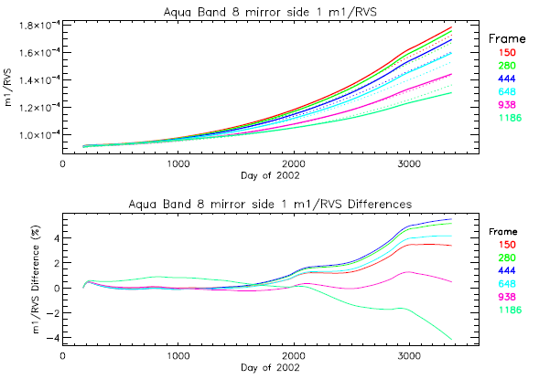
Aqua C6 Band 8 m1 and RVS LUTs
Dotted: Approach I
Solid: Approach II
Approach II / Approach I
Page 51

Slide 52
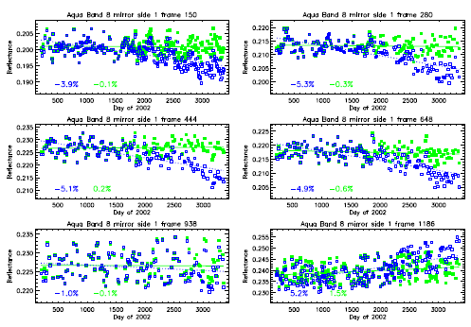
Aqua Band 8 EV Reflectance
Blue: Approach I; Green: Approach II
Page 52

Slide 53
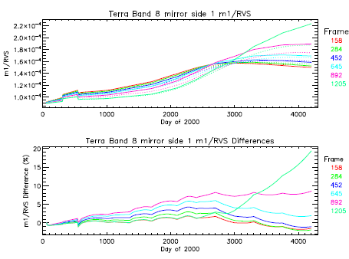
Terra C6 Band 8 m1 and RVS LUTs
Dotted: Approach I
Solid: Approach II
Approach II / Approach I
Page 53

Slide 54
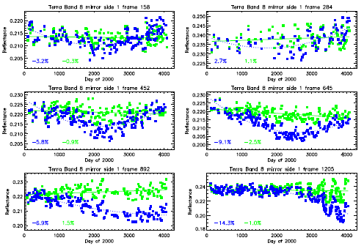
Terra Band 8 EV Reflectance
Blue: Approach I; Green: Approach II
Page 54

Slide 55

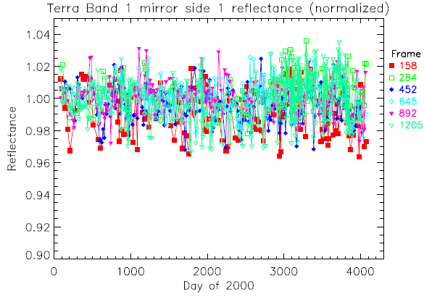
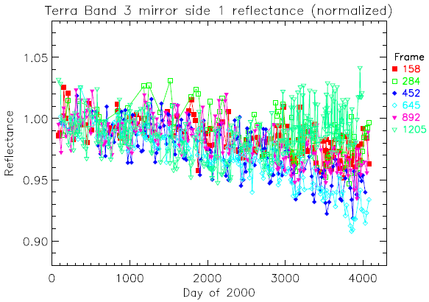
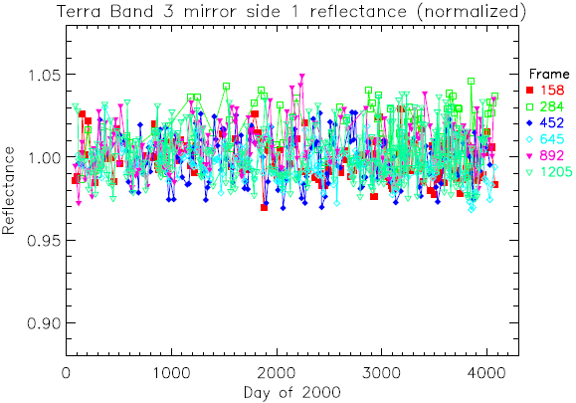
Terra EV Reflectance
Approach I Approach II
Band 1 MS1
Band 1 MS1
Band 3 MS1
Band 3 MS1
Page 55

Slide 56
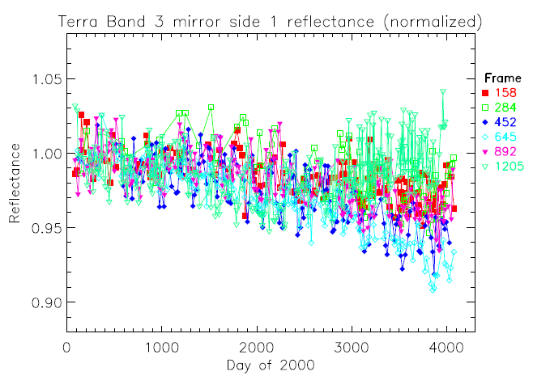
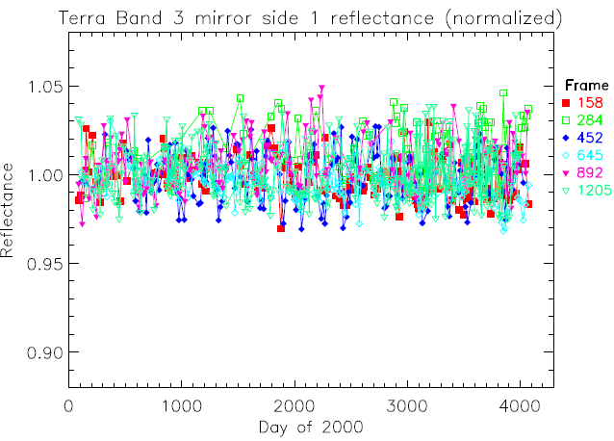
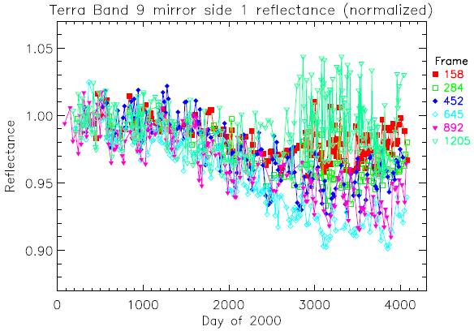
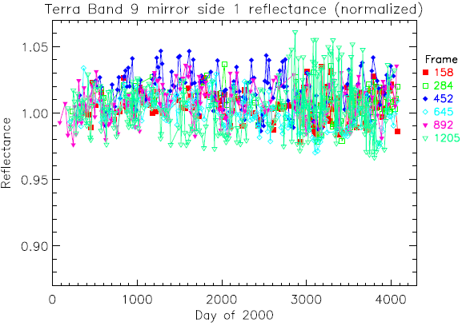
Terra EV Reflectance
Approach I Approach II
Band 3 MS1
Band 3 MS1
Band 9 MS1
Band 9 MS1
Page 56

Slide 57
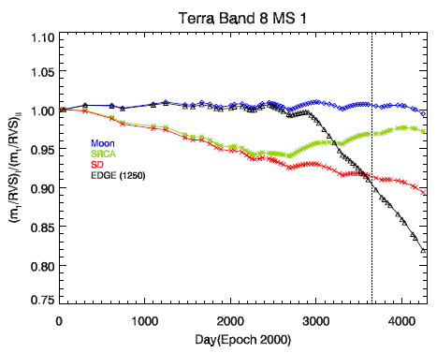



Approach II and OBPG Correction Comparison
Approach I and II difference
OBPG Correction to Approach I
Black: Frame 22 (Moon)
Green: Frame 675 (nadir)
Red: Frame 989 (solar diffuser)
Black: 1250 (end of scan)
Vertical dashed line denotes 01/01/2010
OBPG results provided by Gerhard Meister
Page 57

Slide 58
Summary and Challenges
Two approaches were developed to generate MODIS C6 RSB m1 and RVS LUTs
  Approach I is mainly based on SD calibration and lunar observation
    Aqua bands 1-7, 10-19, and 26 and Terra bands 5-7, 10-19, and 26
  Approach II is based on lunar observations and trending using the EV response from pseudo-invariant desert sites.
    Aqua bands 8-9 and Terra bands 1-4 and 8-9
Improvements compared to C5
  Detector differences reduced
  Time-dependent RVS applied to bands 13-16
  Long-term drifts observed in Aqua bands 8-9 and Terra bands 1-4 and 8-9 mitigated
Challenges
  Aging instruments
    Terra 11+ years
    Aqua 9+ years
  Polarization effect in Terra MODIS
  Accuracy of SD/SDSM calibration at short wavelengths
  Recent gain changes in Aqua MODIS short wavelength bands
Page 58

Slide 59
MODIS Thermal Emissive Bands
On-Orbit Performance
MODIS Characterization Support Team (MCST)
MODIS Science Team Meeting (May 17, 2011)

Slide 60
TEB Calibration Performance
TEB Calibration Algorithm
Terra and Aqua TEB On-orbit Performance
  Detector response & NEdT Trending
  Noisy Detector History
Page 60

Slide 61
On-orbit Calibration Methodologies and Performance
Quadratic Algorithm
  Linear calibration coefficients computed on a scan-by-scan basis; 40-scan running average used in the L1B
  Fixed coefficients used for B21 (a simple linear algorithm)
  Fixed coefficients also used for B33, 35, and 36 when T_bb are above T_sat during the warm-up/cool-down BB activities (AQUA ONLY !!!)
Quarterly BB Warm-up and Cool-down (WUCD) Activities
  Derive fixed linear coefficients
  Compute nonlinear coefficients (update if necessary)
Performance
  Dedicated short- and long-term monitoring effort (offline)
Page 61

Slide 62

TEB Radiometric Calibration
EV Radiance:
Calibration Coefficients:
RVS: Response Versus Scan-angle
ε: Emissivity
L: Spectral band averaged radiance
dn: Digital count with background corrected
WUCD T_{BB}: 270 to 315K
Page 62

Slide 63
Terra MODIS TEB Response Trend
Band | Percent Change
20 | -0.80
22 | -0.77
23 | -0.71
24 | -0.42
25 | -0.22
27 | -4.83
28 | -6.36
29 | -5.02
30 | -7.04
31 | -0.20
32 | -0.19
33 | -0.18
34 | -0.10
35 | 0.02
36 | 0.18
Page 63

Slide 64
Terra MODIS TEB NEdT Trend
Page 64

Slide 65
Aqua MODIS TEB Response Trend
Band | Percent Change
20 | 0.25
22 | 0.32
23 | 0.92
24 | 0.99
25 | 0.65
27 | 0.18
28 | -0.72
29 | -0.78
30 | -0.26
31 | -0.12
32 | 0.91
33 | -0.53
34 | -0.48
35 | -0.46
36 | -0.54
Page 65

Slide 66
Aqua MODIS TEB NEdT Trend
Page 66

Slide 67
MODIS Noisy Detector History
Detectors in Product Order
Terra
Aqua
Band | Detector | Status | Date Classified
27 | 1 | Noisy | Dec-03
 | 2 | Noisy | Nov-08
 | 3 | Noisy | Jul-07
 | 6 | Noisy | Jul-00
 | 8 | Noisy | Feb-06
28 | 1 | Noisy | Jun-04
 | 8 | Noisy | Dec-03
 | 9 | Noisy | Nov-05
 | 10 | Noisy | Apr-04
29 | 6 | Inoperable | Aug-06
30 | 1 | Noisy | Nov-08
 | 3 | Noisy | Jun-06
 | 5 | Noisy | Aug-00
 | 8 | Noisy | Jan-01
33 | 1 | Noisy | at launch
34 | 6 | Noisy | Jun-00
 | 7 | Noisy | at launch
 | 8 | Noisy | at launch
36 | 1-10 | Noisy | Pre- launch
Band | Detector | Status | Date Classified
27 | 3 | Noisy | Jan-05
29 | 2 | Noisy | Feb-08
 | 8 | Noisy | Dec-11
36 | 5 | Inoperable | Pre-Launch
Total TEB Detectors = 160
Noisy Detectors:
Terra = 27, Aqua = 3
Inoperable Detectors:
Terra = 1, Aqua = 1
No new noisy/inoperable detectors since 01/10
Page 67

Slide 68
TEB On-orbit Performance Summary
  Stable detector response for both Terra and Aqua (excluding sensor configuration changes and instrument reset events)
  Largest Gain Change (in terms of %)
    MWIR PV bands: Terra Band 20 – approx. 0.8% , Aqua Band 24 – approx. 1.0%
    LWIR PV bands: Terra Band 30 – approx. 7.0%, Aqua Band 29 – approx. 0.8%
    LWIR PC bands: Terra Band 31 – approx. 0.2%, Aqua Band 32 – approx. 0.9%
  No new noisy / inoperable detectors since last Science Team Meeting (Jan. 2010)
  Terra MODIS has 27 noisy detectors and 1 inoperable detector
    PV Detectors in LWIR Focal plane are getting noisier
  Aqua MODIS has 3 noisy detectors and 1 inoperable detector
Page 68

Slide 69
MODIS Thermal Emissive Bands
Collection 6
MODIS Characterization Support Team (MCST)
MODIS Science Team Meeting (May 17, 2011)

Slide 70
Outline of TEB C6 changes
a0/a2 update
L1B impact assessment due to a0/a2 change
Aqua B33, 35, & 36 default b1 update
Terra/Aqua uncertainty index for L1B*
*details will be documented on MCST webpage

Slide 71
TEB C6 LUT – a0/a2 update strategy
Aqua C5 Changes in C6
B20, 22-30 PL a0/a2 Adjust PL a2 based on cool-down*
B21 a0 = 0 and a2 = 0 no change
B31-32 Warm-up a0/a2 a0 = 0, cool-down a2
B33-36 a0 = 0, PL a2 Adjust PL a2 based on cool-down
Terra C5 Changes in C6
B20, 22-30 Warm-up a0/a2 Cool-down a0/a2
B21 a0 = 0 and a2 = 0 no change
B29, 31-32 Warm-up a0/a2 a0 = 0, cool-down a2
B33-36 a0 = 0, warm-up a2 a0 = 0, cool-down a2
Coefficients derived from quarterly BB Warm-up & Cool-down Activities
C6 improves TEB performance for low temperature scenes
C6 has additional early mission time steps to capture instrument configuration change impact

Slide 72
TEB C6 LUT – a0/a2 update strategy for Aqua*
*Bands: all TEB except for B21, 31 and 32 use prelaunch (PL) a0/a2.
Goal for update:
Maintain the initial differences in BT between PL and the first on-orbit a0/a2
Update method:
Adjustment of PL a2 to maintain nearly constant BT differences over time due to on-orbit drifts in a2 (set a0=PL and fit a2)
Update criteria:
Examine if BT differences exceed two times of NEdT from 0.3Ttyp to Ttyp for two consecutive BB warmup/cooldown events

Slide 73
TEB C6 LUT – a0/a2 update strategy for Aqua*
Algorithm details
Calculate initial post-launch BT differences at T_{typ}, ΔT⁰_{typ}
ΔT⁰_{typ} = BT [on-orbit a0/a2(0)] – BT [PL a0/a2]
2) At a given time t, calculate the difference, ΔT^{t}
  ΔT^{t} = ΔT^{t}_{typ} - ΔT⁰_{typ}
3) Make iterative adjustments of PL a2 with a factor δ
a2(i) = a2(i) + δa2, i = 0, 1, 2, 3 ….
4) After the iterative adjustment, a conversion is reached
at step i when
ΔT^{t} (i) ≤ 0.03*NEdT

Slide 74
TEB C6 LUT impact – Terra B20-23
ΔT = C6 – C5
Test Granule = Terra 2011128.1300
Colored lines denote individual detectors
Vertical lines: red = 0.3Ltyp, green = Ltyp, blue = 0.9Lmax
Horizontal lines : green = +/- NEdT at Ltyp, red = +/- NEdT at 0.3 Ltyp

Slide 75
TEB C6 LUT impact – Terra B24-28
ΔT = C6 – C5
Test Granule = Terra 2011128.1300
Colored lines denote individual detectors
Vertical lines: red = 0.3Ltyp, green = Ltyp, blue = 0.9Lmax
Horizontal lines : green = +/- NEdT at Ltyp, red = +/- NEdT at 0.3 Ltyp

Slide 76
TEB C6 LUT impact – Terra B29-32
ΔT = C6 – C5
Test Granule = Terra 2011128.1300
Colored lines denote individual detectors
Vertical lines: red = 0.3Ltyp, green = Ltyp, blue = 0.9Lmax
Horizontal lines : green = +/- NEdT at Ltyp, red = +/- NEdT at 0.3 Ltyp

Slide 77
TEB C6 LUT impact – Terra B33-36
ΔT = C6 – C5
Test Granule = Terra 2011128.1300
Colored lines denote individual detectors
Vertical lines: red = 0.3Ltyp, green = Ltyp, blue = 0.9Lmax
Horizontal lines : green = +/- NEdT at Ltyp, red = +/- NEdT at 0.3 Ltyp

Slide 78

TEB C6 LUT impact – Aqua TEB
∆a2->
∆a2->
a2
T(0.3L_{typ}) T(L_{typ}) T(0.9L_{max})
Trends of on-orbit BB WUCD a0/a2 show that there are noticeable drifts in Aqua band 29 and 30. An update of a2 (2009208) is made using an iterative adjustment of PL a2 based on ΔT^{t} (i)

Slide 79
Estimated L1B Impact
ΔΤ = BT(C6) – BT(C5) (K), actual differences are detector and time-dependent
Band | T_{typ} | Terra |  |  | Aqua
 |  | ΔT (0.3L_{typ}) | ΔT (L_{typ}) | ΔT (0.9L_{max}) | ΔT (0.3L_{typ}) | ΔT (L_{typ}) | ΔT (0.9L_{max})
20 | 274, 300, 335 | - 0.10 | + 0.02 | - 0.03 | 0.00 | 0.00 | -0.03
22 | 273, 300, 328 | - 0.05 | + 0.02 | + 0.01 | 0.00 | 0.00 | 0.00
23 | 273, 300, 328 | - 0.08 | + 0.02 | 0.00 | 0.00 | 0.00 | -0.01
24 | 229, 250, 264 | - 1.20 | - 0.30 | - 0.15 | 0.00 | 0.00 | 0.00
25 | 250, 275, 285 | - 0.40 | - 0.08 | - 0.04 | 0.00 | 0.00 | 0.00
27 | 212, 240, 271 | - 0.50 | - 0.20 | - 0.05 | -0.02 | -0.02 | -0.01
28 | 217, 250, 275 | - 0.70 | - 0.15 | - 0.02 | -0.01 | -0.01 | -0.01
29 | 247, 300, 324 | - 0.55 | - 0.03 | - 0.20 | -0.05 | 0.04 | 0.13
30 | 207, 250, 275 | + 0.40 | + 0.15 | + 0.10 | -0.13 | -0.11 | -0.05
31 | 235, 300, 324 | - 0.20 | - 0.04 | - 0.14 | - 0.40 | 0.00 | - 0.05
32 | 231, 300, 324 | - 0.20 | - 0.04 | - 0.14 | - 0.40 | 0.00 | - 0.05
33 | 202, 260, 285 | + 0.10 | + 0.08 | + 0.05 | 0.01 | 0.00 | 0.00
34 | 195, 250, 268 | + 0.10 | + 0.08 | + 0.07 | 0.00 | 0.00 | 0.00
35 | 187, 240, 261 | + 0.10 | + 0.08 | + 0.07 | -0.12 | -0.10 | -0.07
36 | 175, 220, 238 | + 0.08 | + 0.08 | + 0.07 | 0.02 | 0.02 | 0.02
Band 21 – Differences are generally within +/- 2K (detector & time dependent)

Slide 80
C6 procedure for default b1 update (b33, 35&36)
b1 variation with CFPA Temperature
At time for update, an average of b1 is used
Rate of Change in b1 due to CFPA temperature variations: ~7.8%/K, ~8.5%/K & ~9.0%/K for B33, 35 & 36
Default b1 update in C5 became arbitrary depending on CFPA temperature
Impacts are only limited to the WUCD periods when BB temp are larger than T_{SAT}
Notes:
80

Slide 81
C6 procedure for default b1 update (B33, 35&36)
b1 Trending from WUCD
B33
1.0%
CFPA temp fluctuation’s
impact on default b1 is 2-3%
B35
B36

Slide 82
Number of Terra/Aqua C5/C6 LUT time stamps
 | Terra |  | Aqua
 | C5 | C6 | C5 | C6
a0/a2 | 15 | 22 | 5 | 2
B21-b1 | 15 | 25 | 11 | 10
Default b1 | N/A | N/A | 5 | 2
More Terra C6 a0/a2 time stamps are added for different configurations during early post-launch period
C5 uses warmup and C6 uses cooldown data
C6 uses moving average when a0/a2 measurements are available
Requirements for C6 a0/a2 update are more stringent than those used in C5

