Slide 1
Using MODIS to Monitor Dynamics in Land Cover & Phenology at Seasonal to Decadal Time Scales
Land Cover Type, Land Cover Dynamics
Refinements & Science Data Analysis
Mark Friedl, Damien Sulla-Menashe, Koen Hufkens, Xiaoman Huang, Eli Melaas, Surajit Ray, Luis Carvalho, Bin Tan, Robert Wolfe, Curtis Woodcock, Jeff Morisette, Andrew Richardson
Boston University, NASA GSFC, USGS, Harvard University

Slide 2
Land Cover Type: Refinements
Prototype Hierarchical Classification

Slide 3
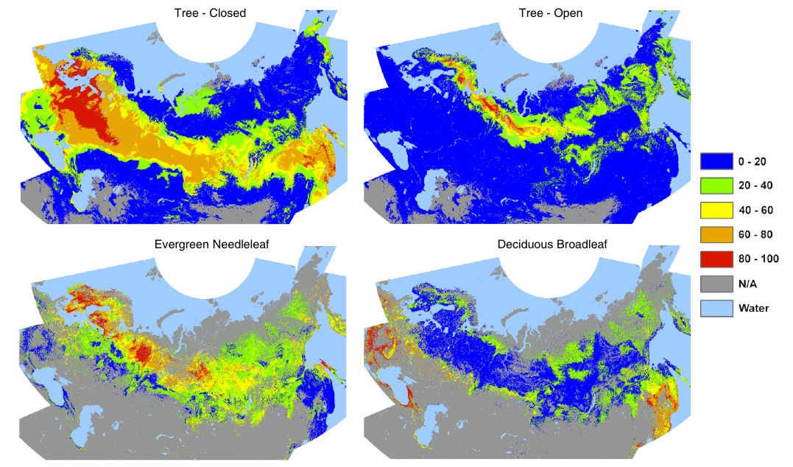
Land Cover Type: Refinements
Incorporating Potential Vegetation Prototype for Northern Eurasia

Slide 4
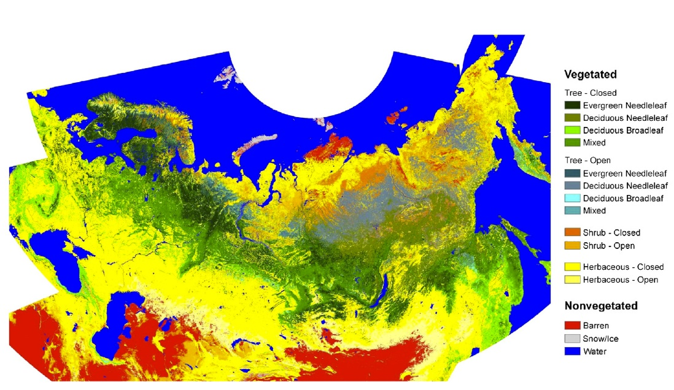
Land Cover Type: Refinements
C6 Prototype Classification (wetlands, land use not shown)

Slide 5
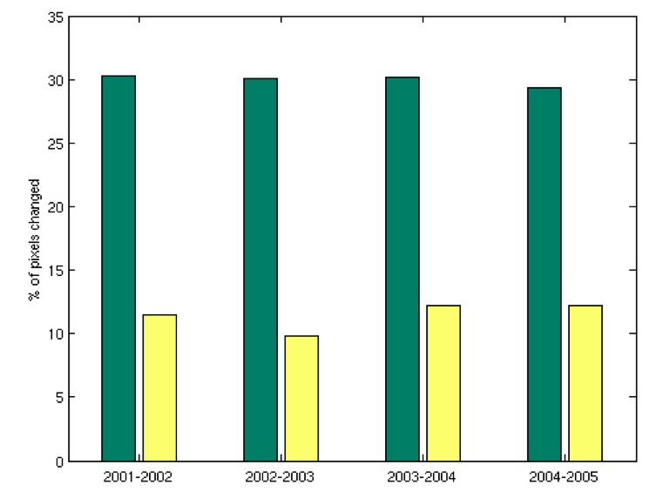
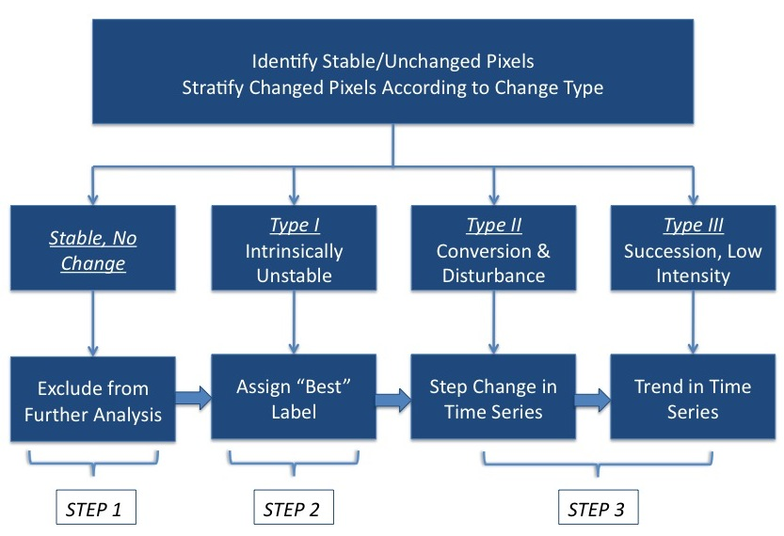
Land Cover Type: Science Data Analysis
Interannual rates of change in MCD12Q1
Conceptual stratification of change pixels
Identification and characterization of change

Slide 6
Land Cover Type: Science Data Analysis
Time Series & Functional Data Analysis
Basic idea is to explore and exploit time domain
Evaluating traditional time series and Bayesian models, and newer functional data models
Leveraging NSF Collaborations in Mathematical Geosciences, S. Ray, PI; L. Carvalho, collaborator

Slide 7
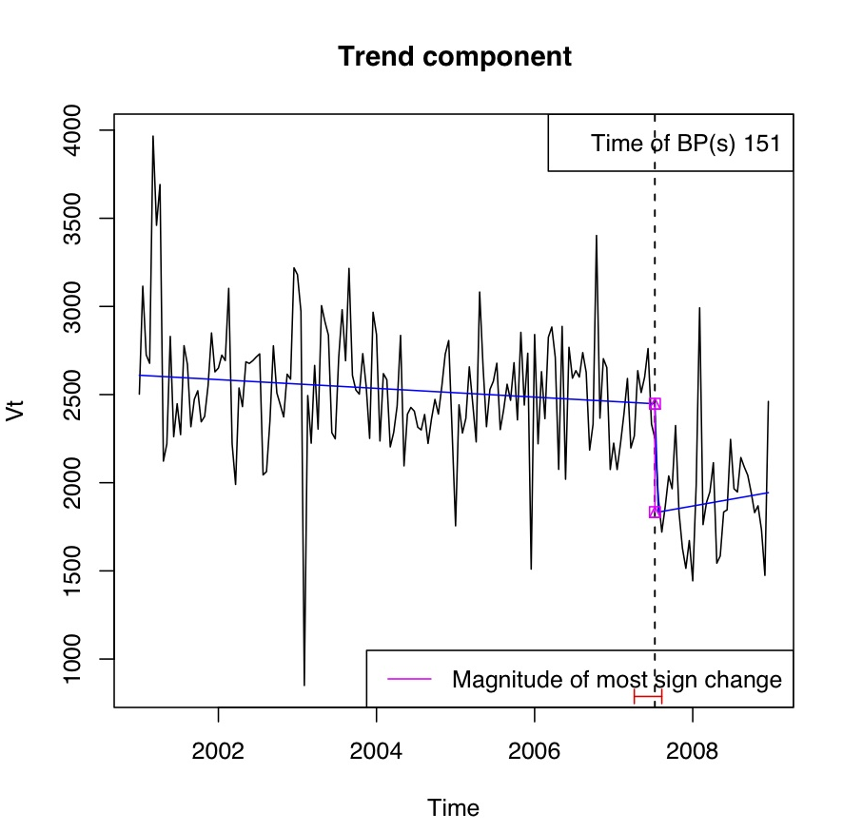
Land Cover Type: Science Data Analysis
Time Series & Functional Data Analysis
Time series analysis of Mountain Pine Beetle
infestation near Fraser, CO.
Above: Time series of Landsat-based maps of infestation (red = tree mortality); courtesy J. Hicke, U. Idaho.
At Left: Time series analysis using BFAST applied to MODIS EVI. The dashed vertical line indicates a detected break point in the time series.

Slide 8
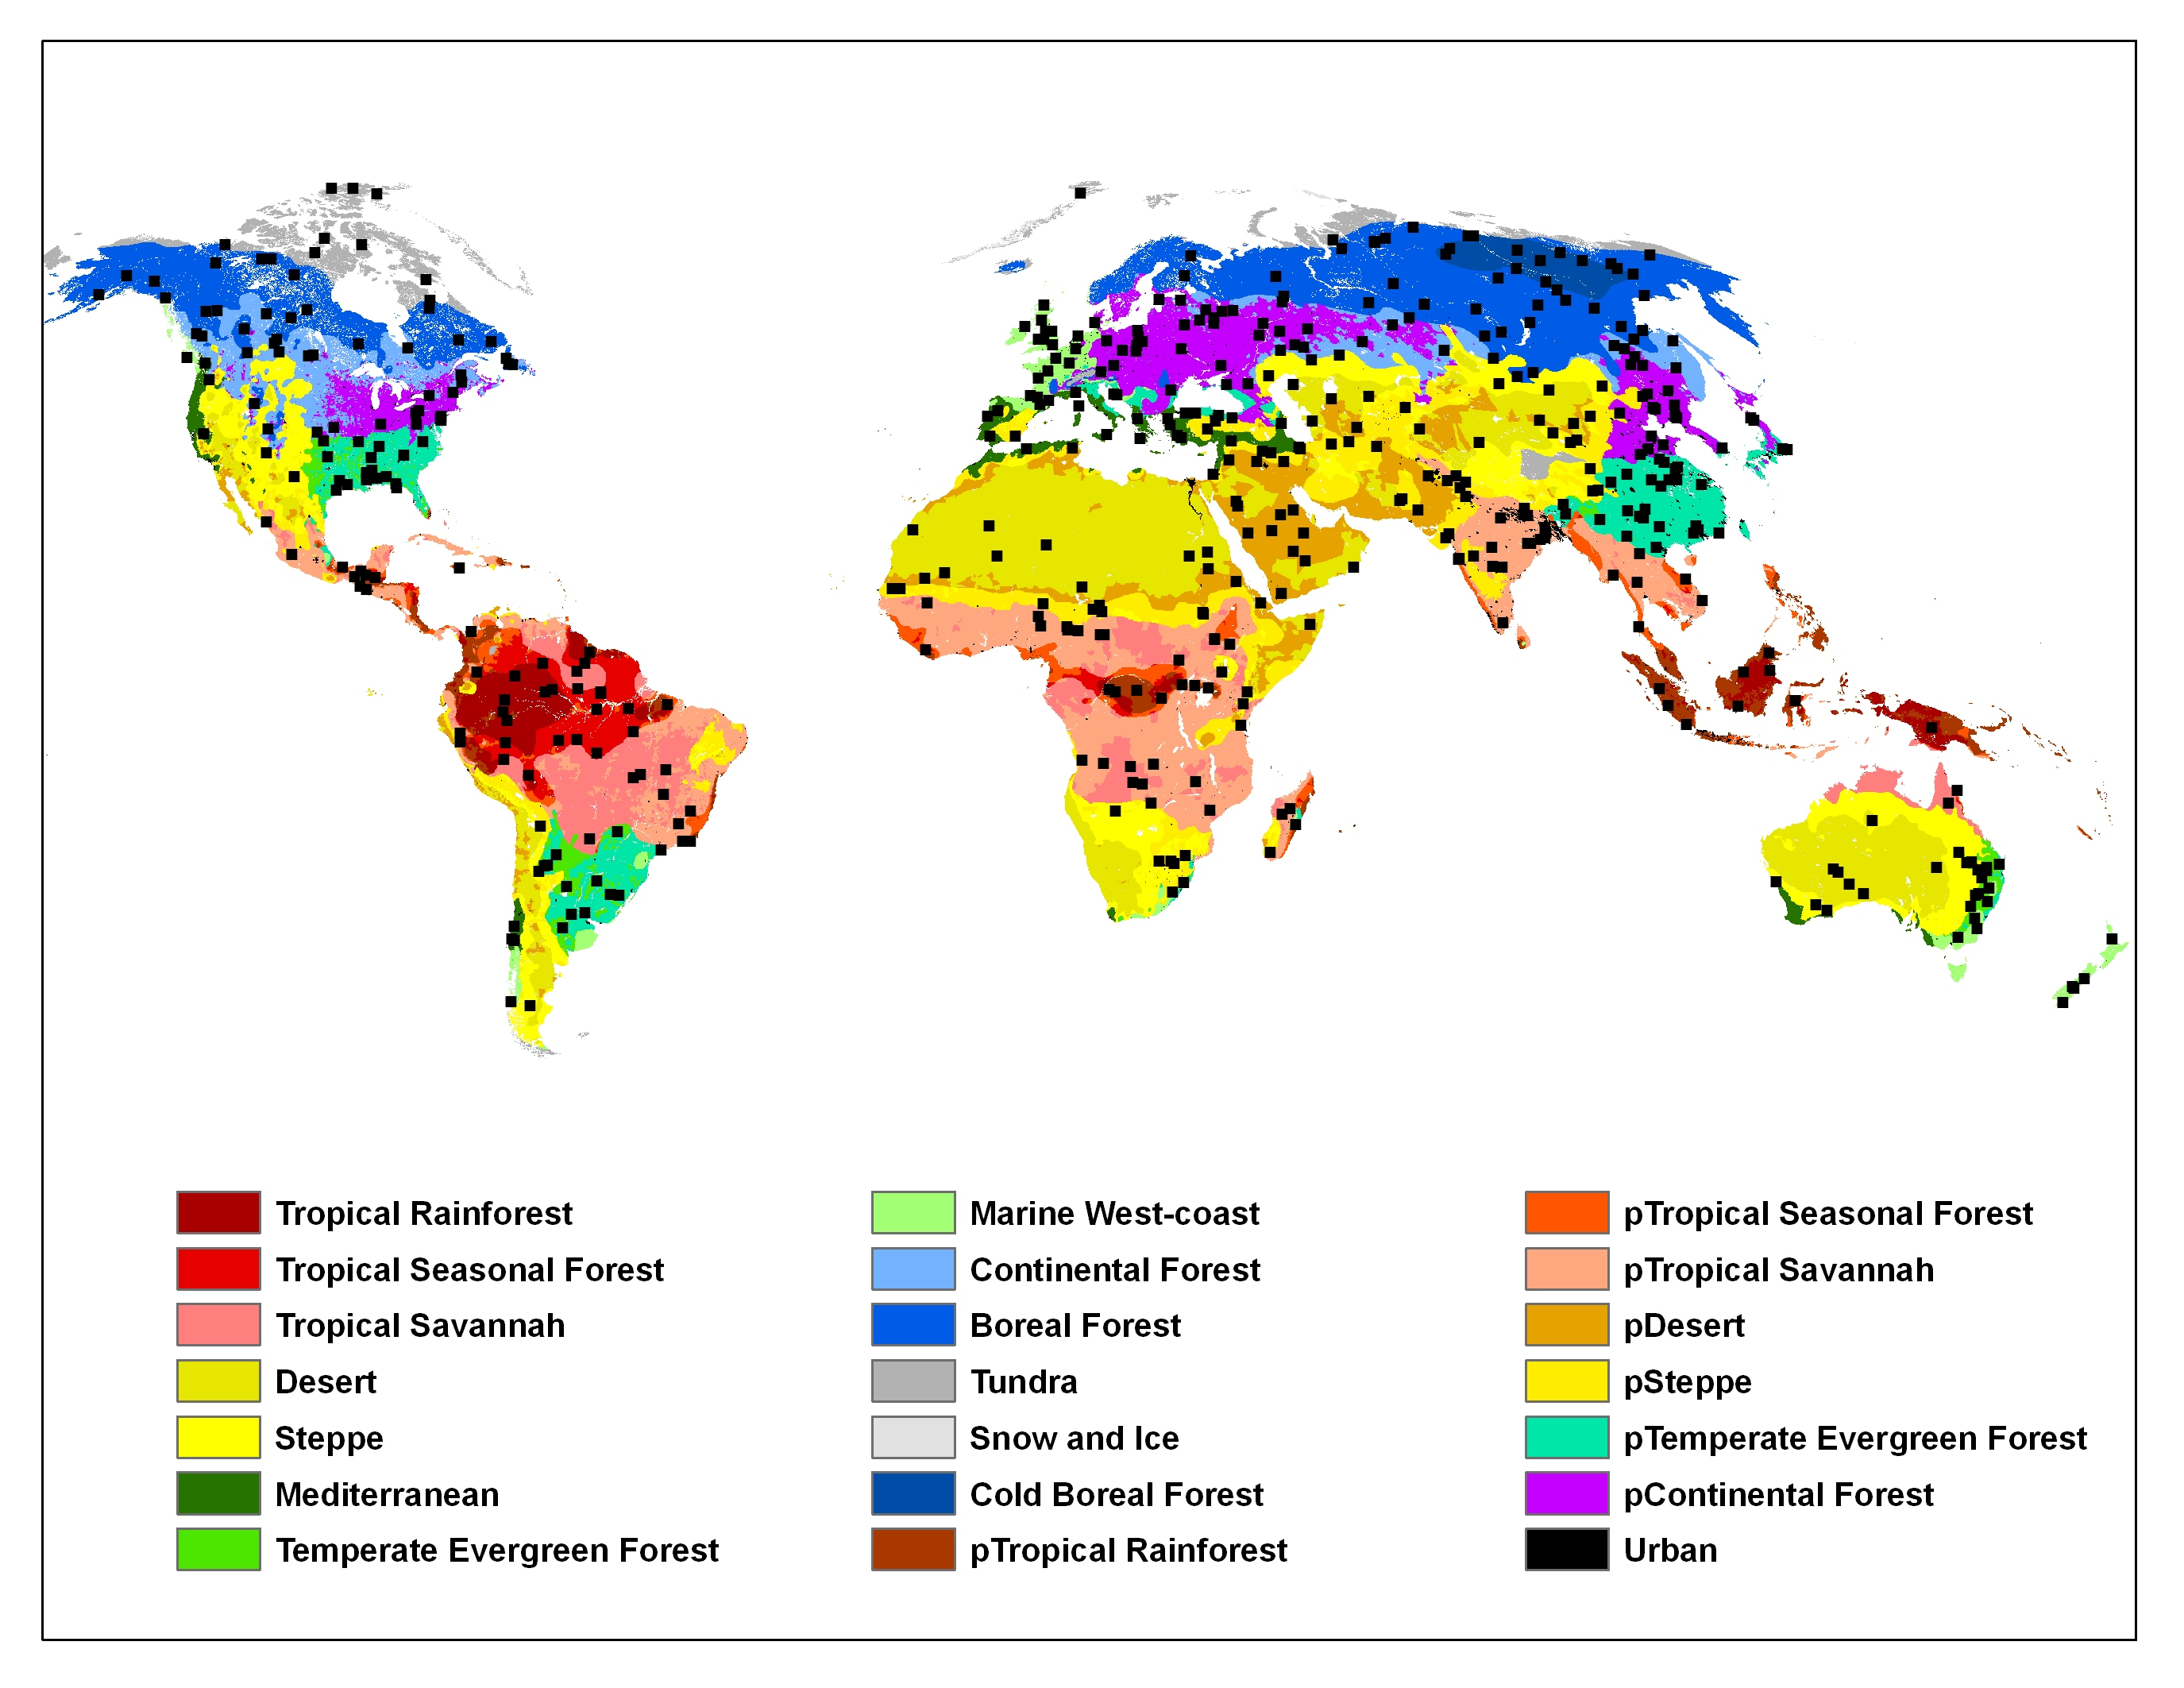
Land Cover Type: Validation
Developing Database of 500 validation sites in collaboration with Curtis Woodcock, Martin Herold (GOFC/GOLD) and partially supported by NPP Cal/Val Team)

Slide 9
Land Cover Dynamics:
Refinements
Model identification
  Assessment of VI dynamics
Input selection
  Testing different VI’s (Fall vs Spring)
Filtering snow
  Key source of variance in greenup dates

Slide 10
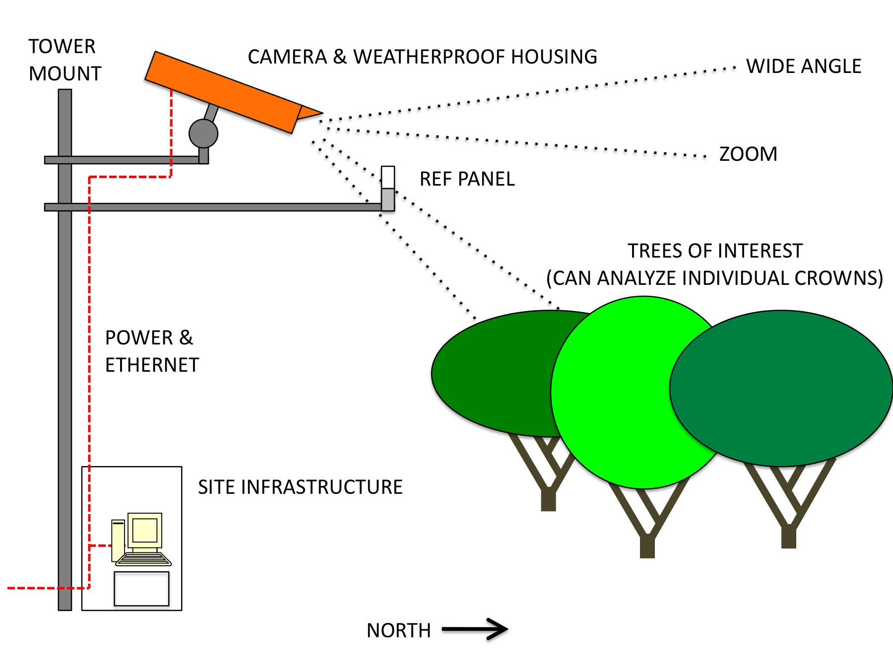
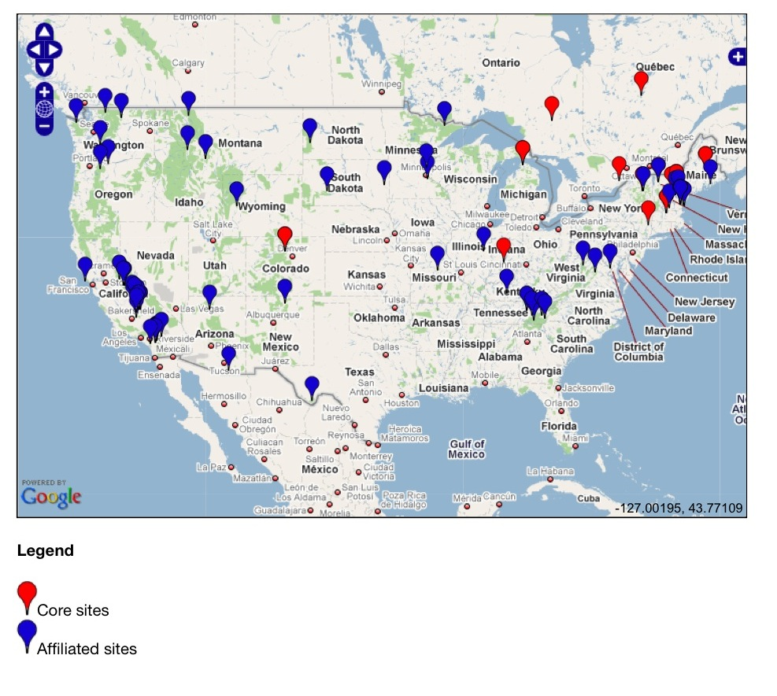
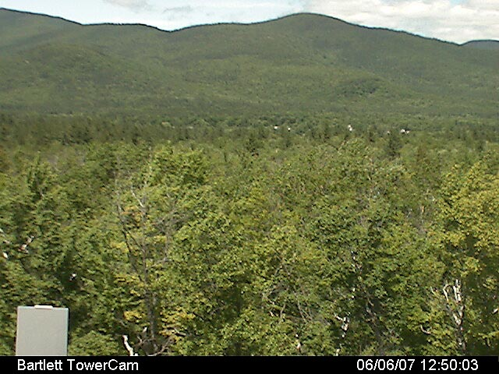
Land Cover Dynamics: Refinement & Validation
Webcam Monitoring of Phenology
Supports model development
Error characterization and validation
Leveraging NSF Macrosystems Biology Continental-Scale Monitoring, Modeling and Forecasting of Phenological Responses to Climate Change; Richardson, PI

Slide 11
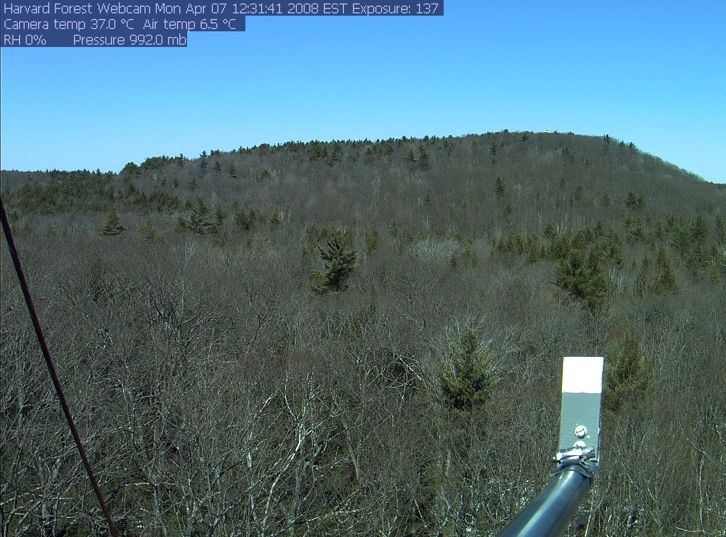

Slide 12
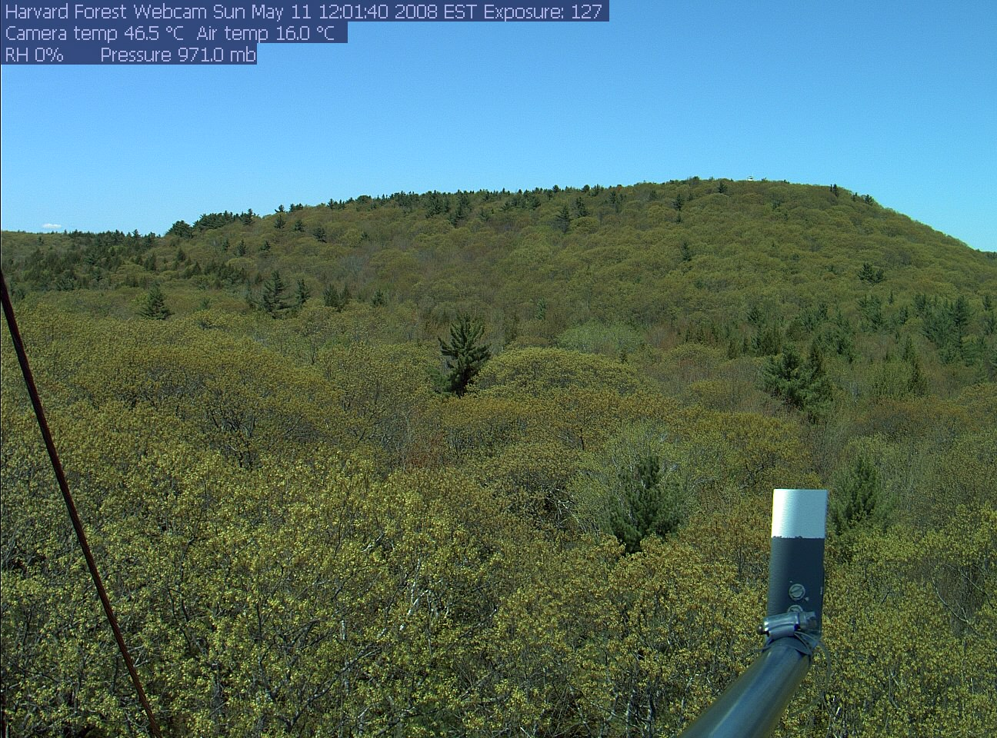

Slide 13
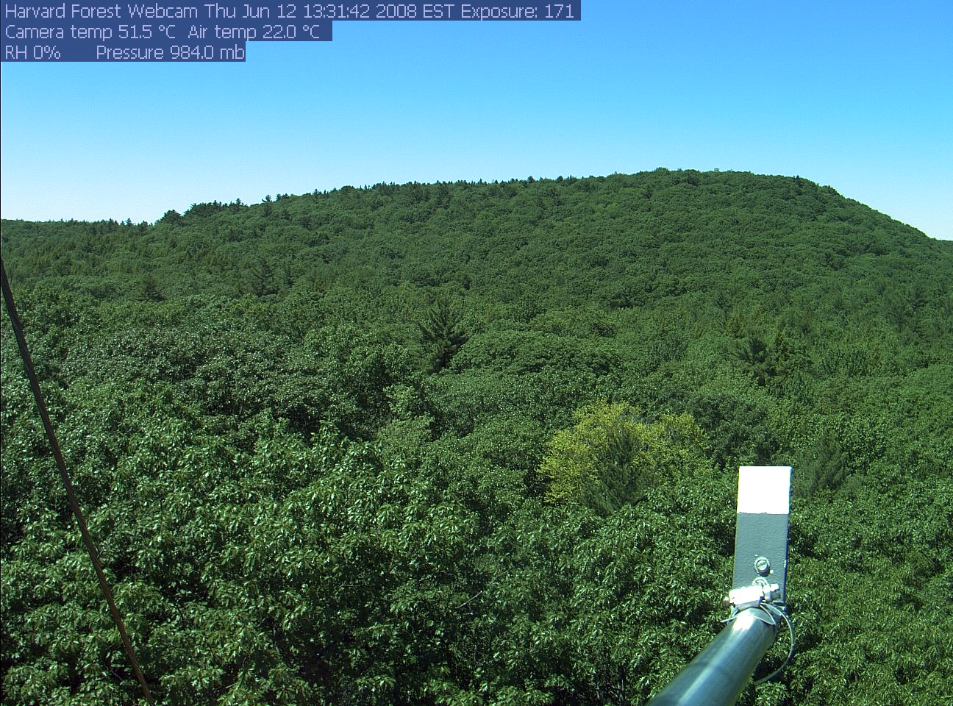

Slide 14
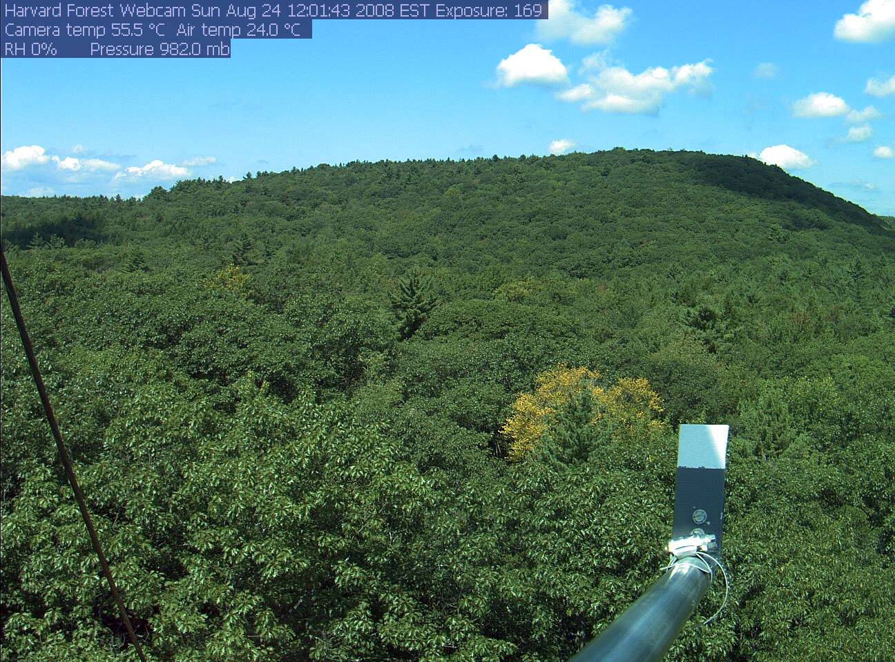

Slide 15
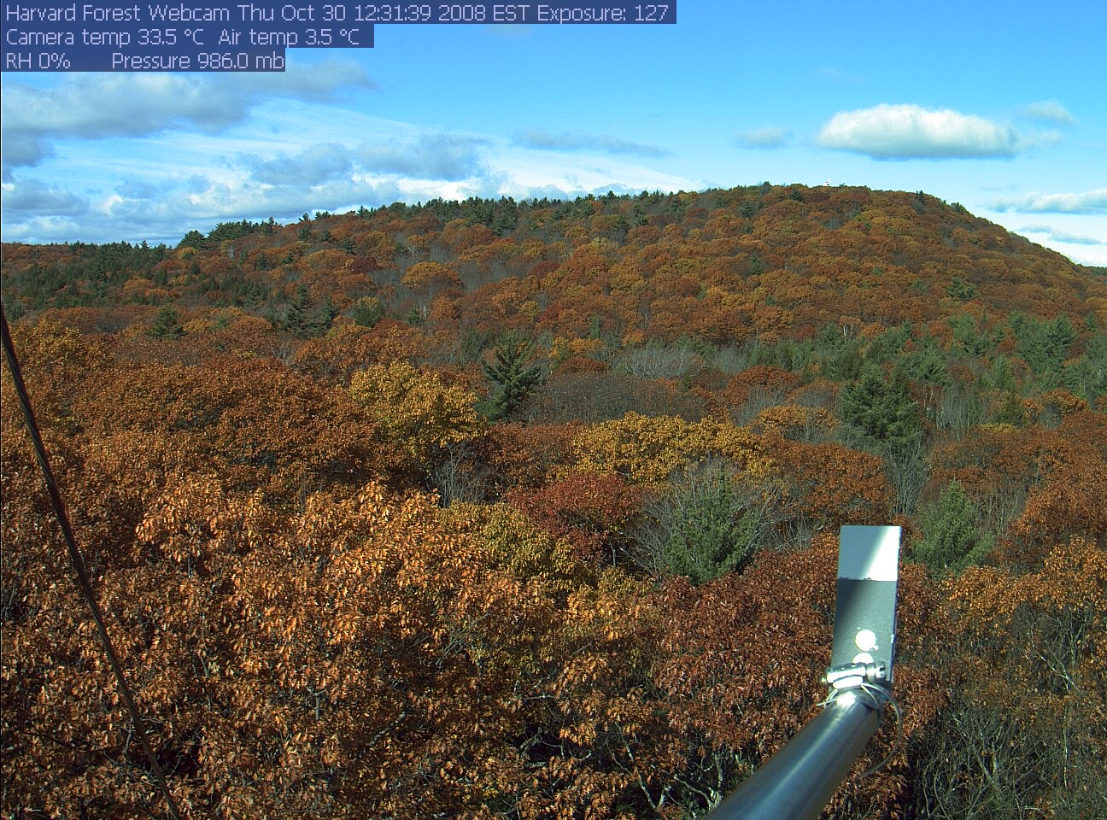

Slide 16
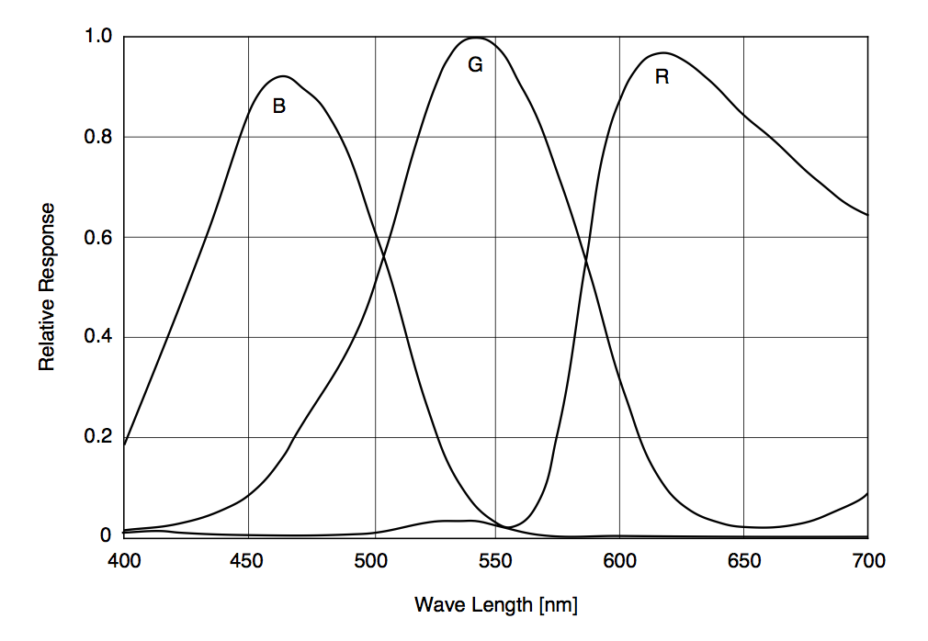
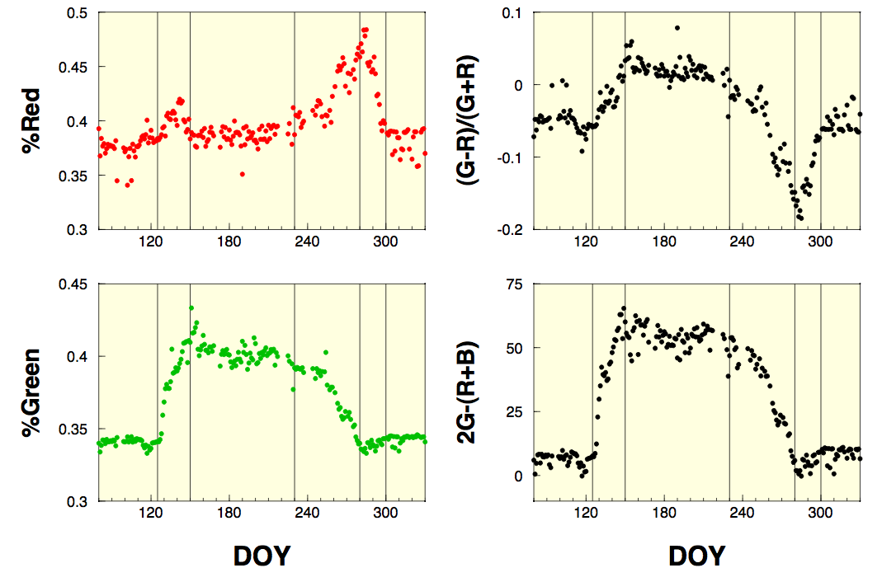
Land Cover Dynamics: Refinement & Validation
PhenoCam Vegetation Indices
Image analysis (RGB channel extraction) to quantify phenological dynamics
  Richardson et al., 2007, Oecologia; Richardson et al, 2009, Ecological Applications

Slide 17
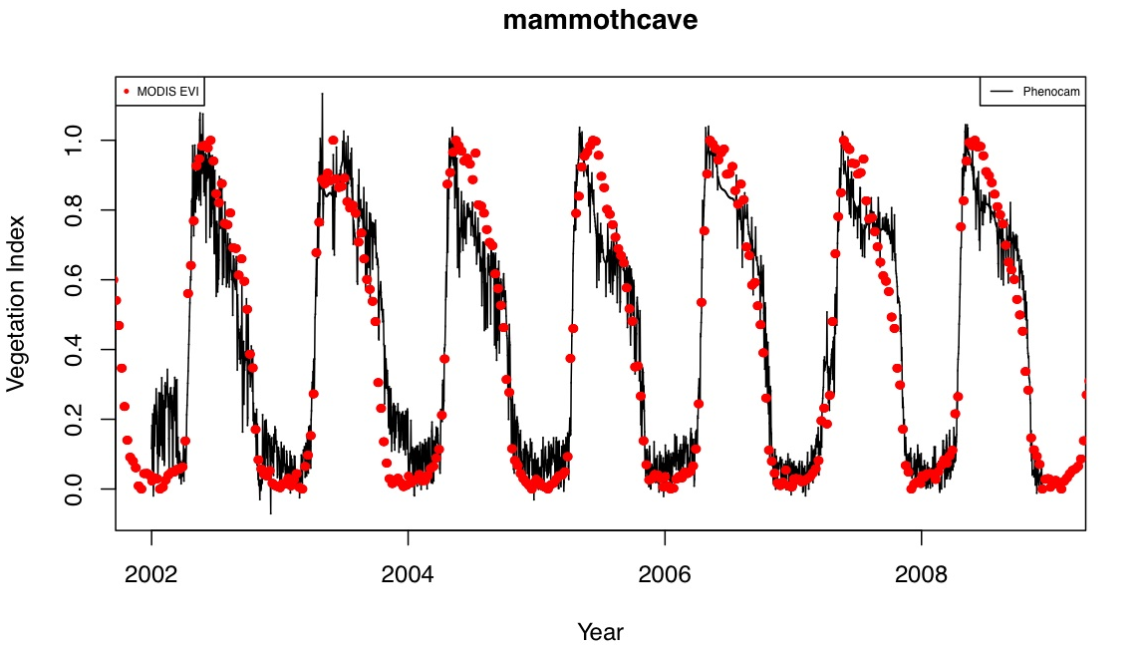
Land Cover Dynamics: Refinement & Validation
Phenocam vs MODIS (Mammoth Cave, Ky)
Clear phenology, modest noise level, strong covariance w/MODIS

Slide 18
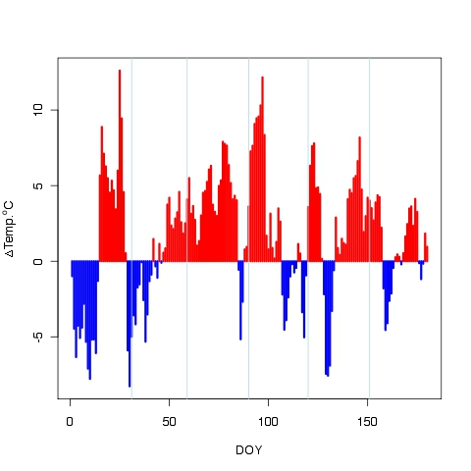
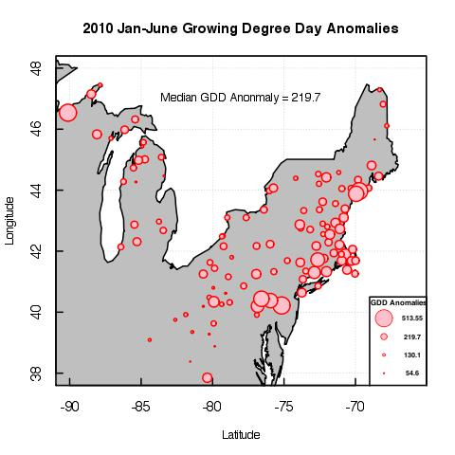
Land Cover Dynamics Science Data Analysis:
Signatures of Climate & Ecosystem Dynamics
2010 Jan-June Temperature Anomalies

Slide 19
Land Cover Dynamics Science Data Analysis:
Signatures of Climate & Ecosystem Dynamics

Slide 20
Land Cover Dynamics Science Data Analysis:
Signatures of Climate & Ecosystem Dynamics
Onset of “greenup”
Greenup anomaly vs GDD anomaly

Slide 21
Land Cover Dynamics Science Data Analysis:
Signatures of Climate & Ecosystem Dynamics
Old Jack Pine Site,
Saskatchewan, 2003
Estimate start of growing season from fluxes – compare with MCD12Q2

Slide 22
Land Cover Dynamics Science Data Analysis:
Signatures of Climate & Ecosystem Dynamics
Compare timing of flux phenology from FluxNet with timing of greenup from MODIS
Deciduous Broadleaf Forest Sites
11 sites, 43 site years, sites > 3 years
NA (5), Europe(5), Japan(1)
8 temperate, 1 boreal, 2 Mediterranean

Slide 23
Questions?

