Slide 1
Overview of the MODIS Snow - Ice Project Part 1
Dorothy K. Hall Cryospheric Sciences Branch NASA / Goddard Space Flight Center Greenbelt, Md. dorothy.k.hall@nasa.gov
George A. Riggs SSAI and Cryospheric Sciences Branch
Nicolo E. DiGirolamo SSAI and Cryospheric Sciences Branch
Jeffrey A. Miller Wyle & Cryospheric Sciences Branch
James L. Foster Sujay Kumar Soni Yatheendradas Hydrological Sciences Branch NASA / Goddard Space Flight Center
MODIS Science Team Meeting Land Team College Park, Md. 18 May 2011

Slide 2
Outline
Product Usage
Three New & Related Products
Re-Launched Website [modis-snow-ice.gsfc.nasa.gov]
Science Results
Collection 6 (C6) Changes – Part 2 - George Riggs

Slide 3
4,500,000 Terra & Aqua Snow-Sea Ice Granules Distributed in 2010
Number of Granules
Source: Doug Fowler / NSIDC
Also see Bibliography of MODIS Snow and Sea Ice Papers, updated 5-9-11 – see “Publications” on Website

Slide 4
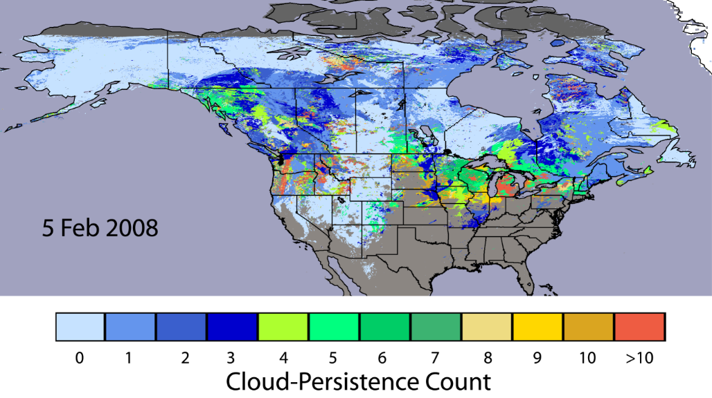
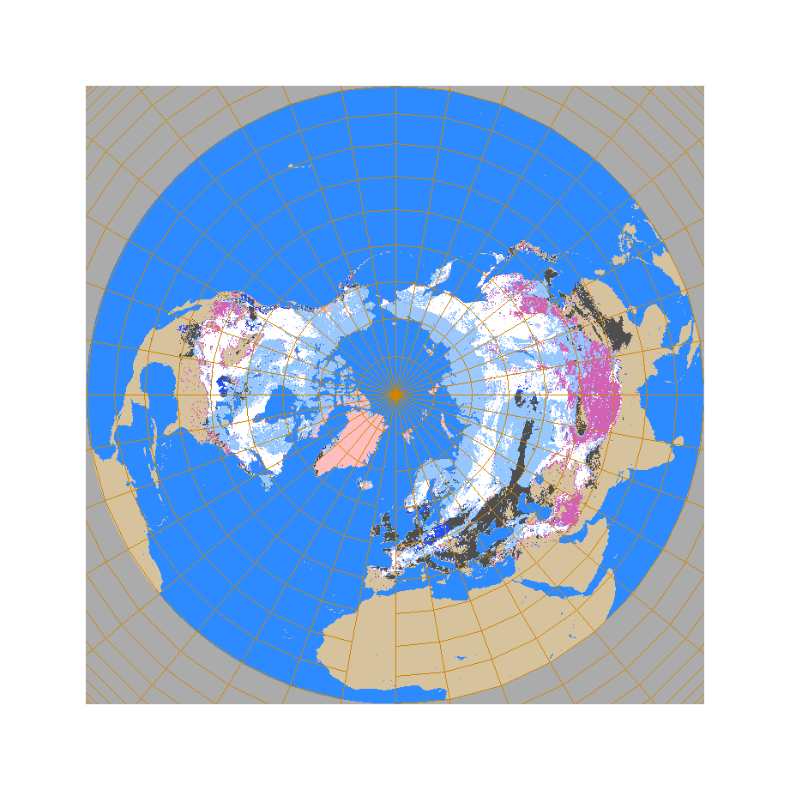
Three New Products Have Been Developed
Daily Cloud-Gap-Filled Snow Map
1
Daily Blended MODIS-AMSR-E Snow Map (funded mostly by the Air Force Weather Agency)
2
Hall et al., 2010
Snow by both sensors
Snow by AMSR-E, MODIS cloud or no data
Snow by MODIS, AMSR-E no snow
No snow by MODIS or AMSR-E but cloud obscured
No snow: no snow by MODIS in clear view, but AMSR-E detects snow
Snow free land by both MODIS and AMSR-E
Foster et al., 2011

Slide 5
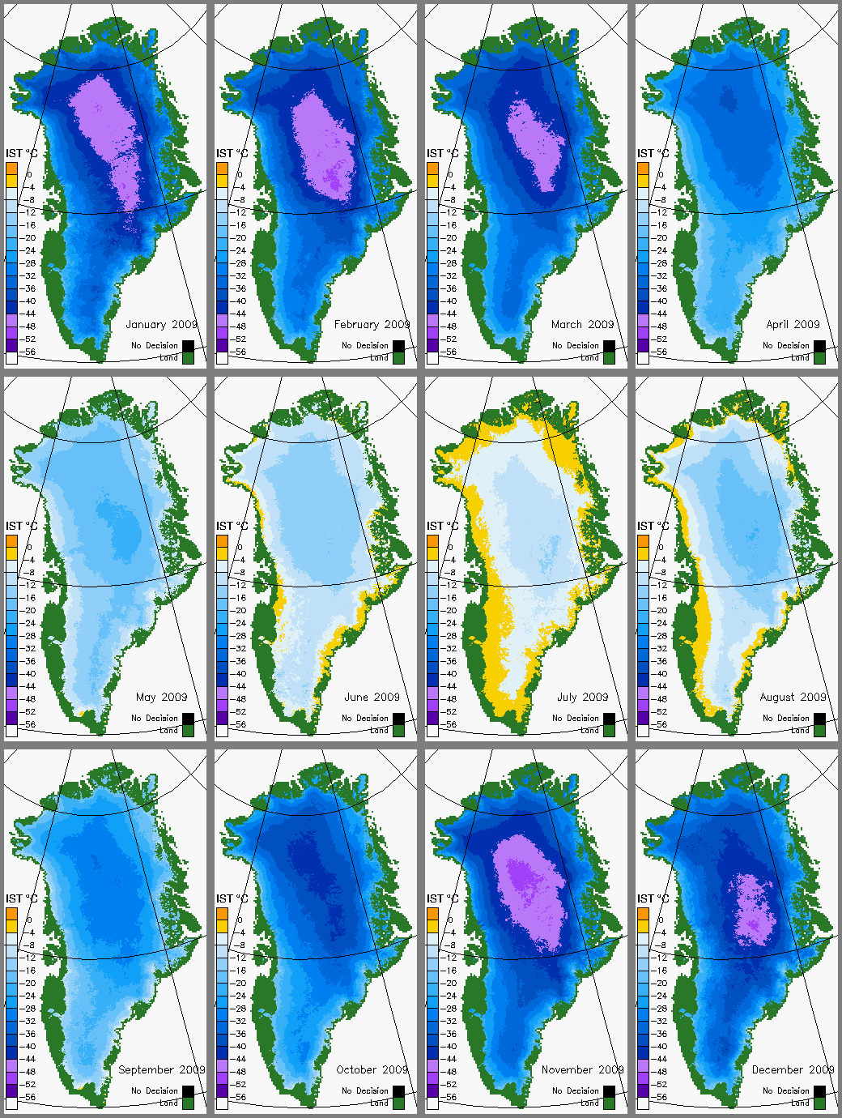
Mean-Monthly IST of the Greenland Ice Sheet for 2010
3
MODIS Climate-Data Record (CDR) of the Surface Temperature of the Greenland Ice Sheet , 2000 - 2010
Uses MODIS ice-surface temperature (IST) algorithm currently used for sea ice IST algorithm
CDR to be available for downloading in summer 2011
Related product developed with NASA Cryospheric Sciences Program funding

Slide 6
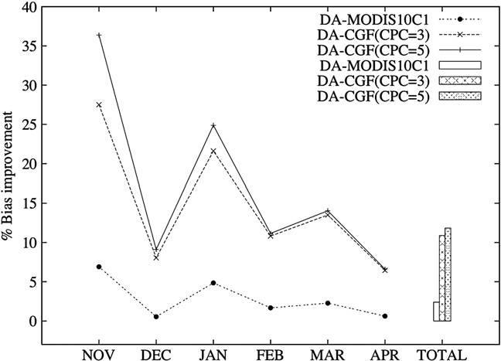
Science and Modeling Applications
Snow-cover depletion curves for the Wind River Range, Wyo., 2000 – 2010 from MODIS CGF snow-cover data
MOD10 and CGF snow-cover products used to correct modeled SWE and snow depth fields in data-assimilation modeling
Percent of Basin Snow Covered
Model runs by Sujay Kumar / GSFC Code 614.3
Day of Year
Hall et al., 2011

Slide 7
Overview of the MODIS Snow - Ice Project
Snow Algorithms and Products for C6
Part II
George Riggs
MODIS Science Team Meeting
18 – 20 May 2011
College Park, MD

Slide 8
Overview
C6 changes, are response to users’ feed back regarding accuracy
and errors reported for various applications of the MODIS snow products ,
and our evaluation of MODIS snow products.
Revised C6 snow algorithms
Adapt to the L2G lite storage format
New C6 snow products
Two groups affected by C6 changes
production -- down stream products that use MOD10* products,
new products, and NSIDC EOS-DAAC
users – applications using primarily MOD10A1 and higher levels

Slide 9
Learned from Users
Usage: [listing of papers that use MODIS snow products at modis-snow-ice.gsfc.nasa.gov/]
MOD10A1 is most often used in applications, MOD10CMG for global scale modeling, e.g. Noah land surface model
Though both the snow covered area (SCA) and fractional snow cover (FSC)maps available, the SCA is most often used
QA data used infrequently
Comparison:
MOD10A1 compared to other snow covered area algorithms/products and surface station data
Snow errors:
Snow/cloud confusion at snow cover edge
Snow/cloud confusion in other situations associated with cloud cover, producing snow commission or omission errors
Snow errors in less than ideal viewing conditions
Disappearance of snow cover during summer in mountains

Slide 10
Summary Major C6 Revisions
Sequence of snow products will continue in C6
MOD10_L2 snow algorithm C6 revised to improve snow cover detection
MOD10A1 algorithm revised to use L2G lite format
MOD10SR – new independent product to be made using MOD09GA input
Supersede the MOD10A1
MOD10 CGF – new L3 cloud gap filled (CGF) products added to sequence of products

Slide 11
Investigation & Evaluation relevant to users’ feedback
Investigated using more data/information from inputs to reduce snow errors of omission and commission in some situations
Evaluated using MOD09GA as input to the snow algorithm and running it at L3
Using MOD09GA, daily surface reflectance, resulted in similar SCA and FSC maps compared to MOD10A1 that originated from MOD02HKM TOA input.
Improvements gained with MOD09GA are;
decreased snow/cloud confusion in some situations, done by use of both MOD35 and MOD09 cloud flags (snow/cloud confusion might also be decreased at L2 by use of individual cloud spectral test results, previous investigation done)
decrease in snow commission errors associated with cloud fringes and/or shadows
slightly increased accuracy in low illumination and low surface reflectance situations.
Disappearance of summer snow in mountains is caused by low (10%) visible reflectance screen that prevented snow detection. Removing that screen allows detection of summer snow cover in mountains.

Slide 12
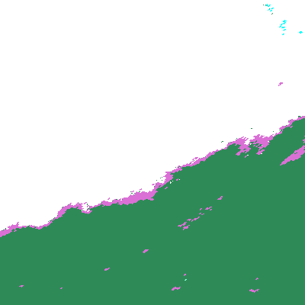
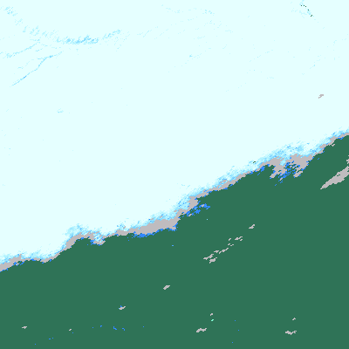
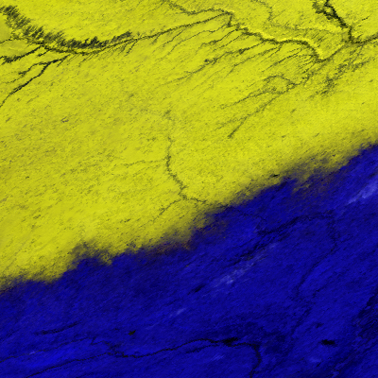
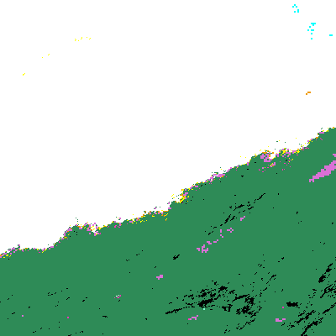
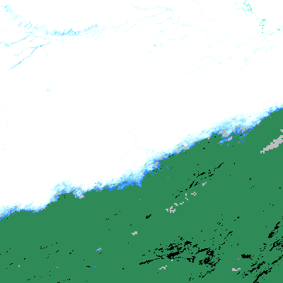
Great Plains snow edge mapping
1 December 2001
tile h10v04
MOD10A1 SCA
MOD10A1 FSC
MOD09GA bands 1,4,6
MOD10SR SCA
MOD10SR FSC
MOD10SR -- combined usage of MOD_35 and MOD09 flags to alleviate snow/cloud confusion at edge of snow cover in MOD10A1 snow maps

Slide 13
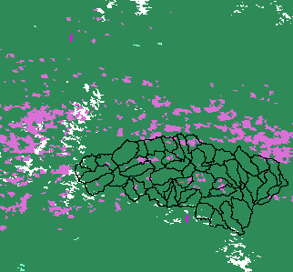
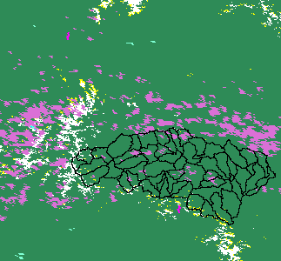
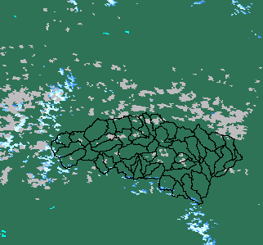
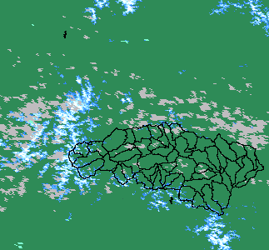
MOD10A1 C5
MOD10SR C6
Improved snow detection using MOD09GA input to MOD10SR
Snow cover underestimation using SCA (binary) has been reported, for example
Molotch, N.P. and Margulis S.A. 2010. Response to comment by… Advances in Water Resources 33:231-239, doi:10.1016/j.advwatres.2009.11.008
MOD10A1.A2002126.h09v05 (6 May)
Rio Grande headwaters
Improved snow detection with MOD10SR
SCA
SCA
FSC
FSC

Slide 14
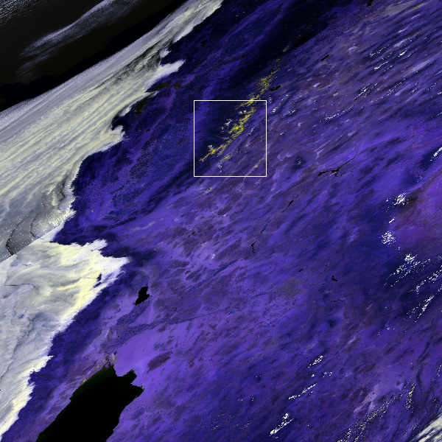
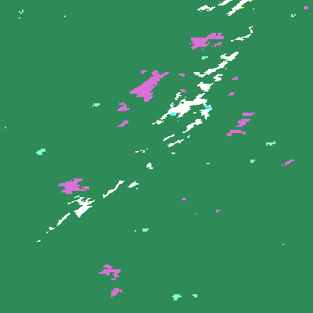
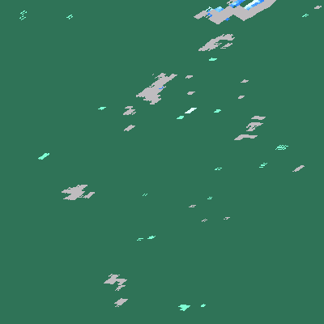
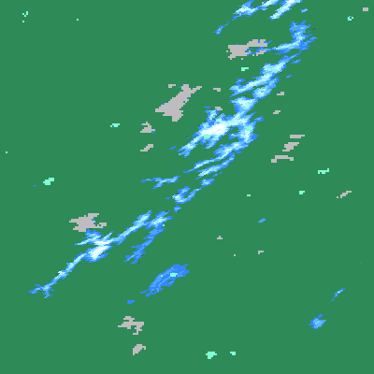
MOD09GA.2010187.h08v05
July 6, 2010
MOD10A1 C5
With low visible reflectance screen
MOD10SR C6
No low visible reflectance screen
SCA
FSC
LEGEND
SNOW
LAND
CLOUD
INLAND WATER
OCEAN
NO DATA
Disappearance of summer snow in mountains is caused by low (10%) visible reflectance screen that prevented snow detection. Removing that screen allows detection of summer snow cover in mountains. (Caveat, snow commission errors can be made on unmasked water bodies without that screen. Other screens for water bodies implemented; being tested.)

Slide 15
New Daily Snow Product MOD10SR C6
Revised implementation of the MODIS snow algorithm in response to user feedback on use of the MOD10A1 product
The snow algorithm will be run at L3 in processing sequence but will use MOD09GA input.
SCA algorithm and FSC regression equation are not changed. Low visible reflectance screen dropped, replaced by other screen(s)
Use MOD35 and MOD09 cloud flags for cloud/masking and apply more snow/cloud discrimination screens
FSC will be the first SDS in the product
Supersede M0D10A1 because of improved snow maps, SCA and FSC, for users.
Independent of any other MOD10* products in sequence
New ESDT, MOD10SR, is independent of other MOD10* PGEs and ESDTs Will require a new PGE in MODAPS and ESDT at NSIDC EOS-DAAC

Slide 16
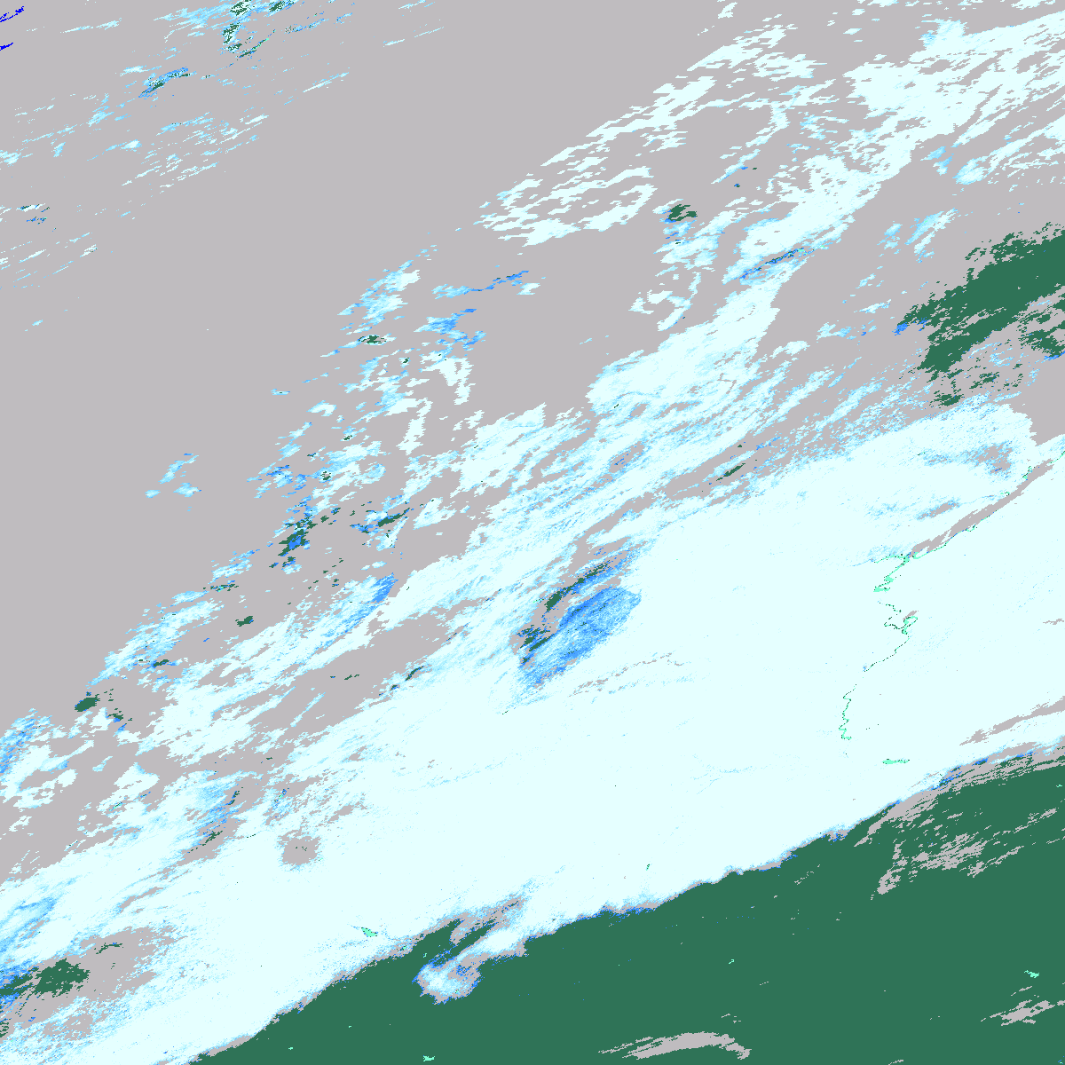
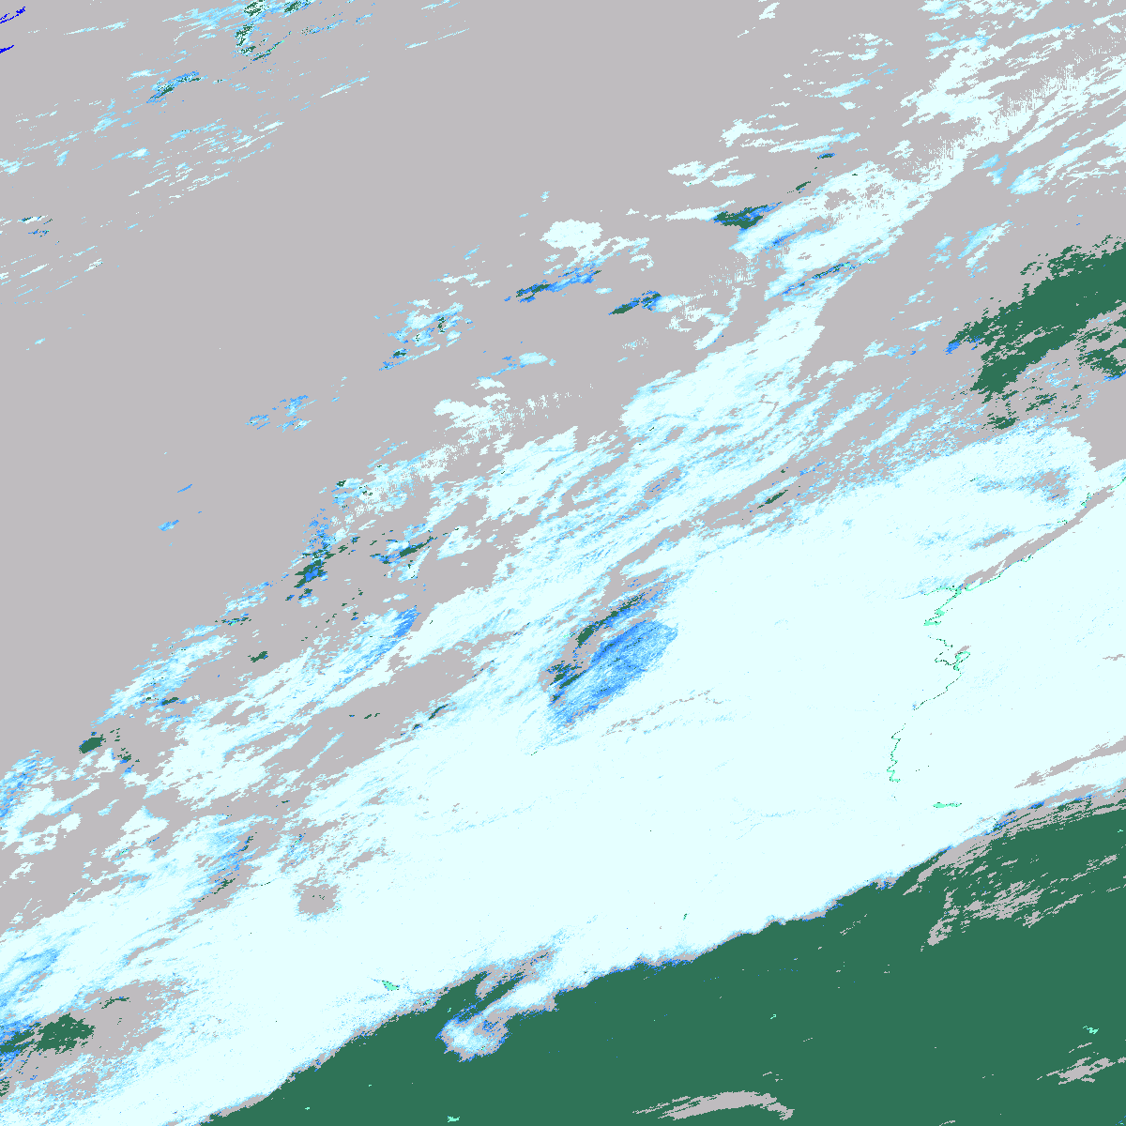
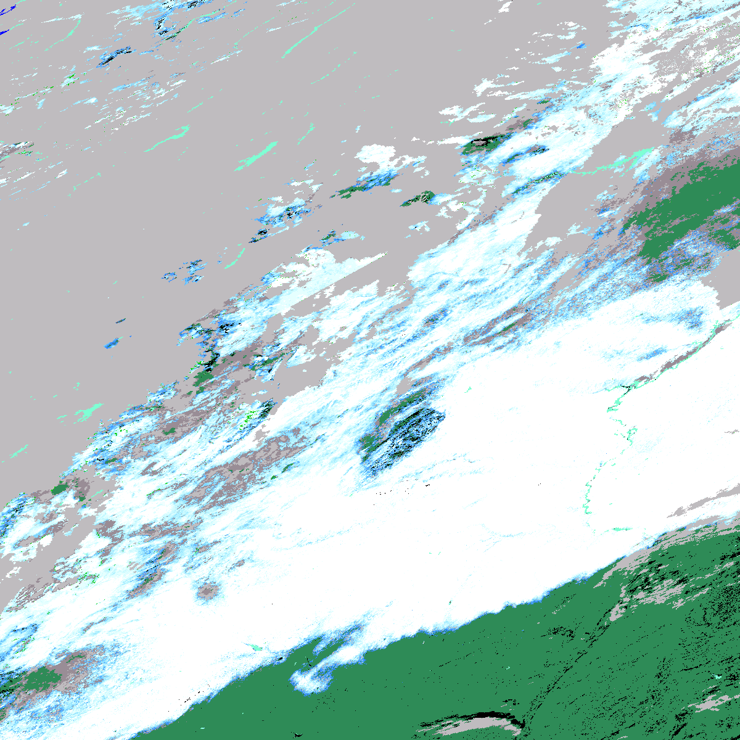
L2G LITE storage affect on MOD10A1
Change in observation selection technique
L2G lite selection algorithm essentially the same as MOD10A1 but with added criterion for clear over cloud observation. Differences can occur in orbit overlap region. MOD10L2G lite science test pending. Change MOD10A1 C6 to use only the first layer in MOD10L2G lite. Eliminates an algorithm step and may decrease cloud cover in regions of orbit overlap. MOD09GA lite storage used in this analysis; 1 Dec 2001, tile h10v04, covering Great Plains.
MOD10L2G C5 FSC
First layer
MOD10SR C6 FSC
First layer
MOD09GA ORBIT POINTER
First layer
MOD10A1 C5 FSC

Slide 17
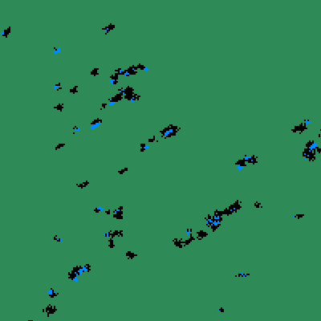
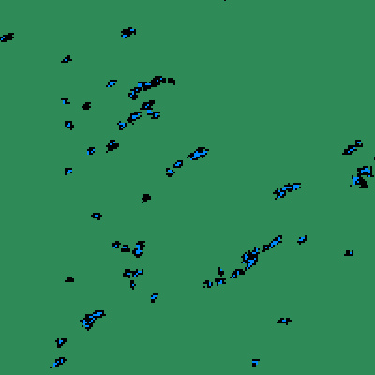
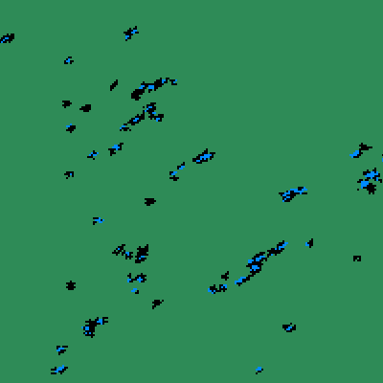
The land/water mask exhibits day to day changes in L3 products
Noted by users and NSIDC in MOD10A1
Land/water mask subset extracted from MOD09GA tile h09v05
2006 106
2006 107
2006 108
Land/water mask is static but mapping through product levels causes day to day changes in location of a lake (blue) or boundary (black) in a tile.
Pixel mapping error through product levels affects applications and analysis done by users.

Slide 18
Summary Major C6 Revisions
Sequence of snow products will continue in C6
MOD10_L2 snow algorithm C6 revised to improve snow cover detection
MOD10A1 algorithm revised to use L2G lite format
MOD10SR – new independent product to be made using MOD09GA input
Supersede the MOD10A1
MOD10 CGF – new L3 products added to sequence of products

