Slide 1




Routine Mapping of Land-surface Carbon, Water and Energy Fluxes at Field to Regional Scales by Fusing
Multi-scale and Multi-sensor Imagery
Rasmus Houborg
Earth System Science Interdisciplinary Center, University of Maryland, College Park
European Commision, JRC, Institute for Environment and Sustainability, Ispra, Italy
Martha C. Anderson & W.P. Kustas
USDA-ARS Hydrology and Remote Sensing Laboratory, Beltsville, MD
Feng Gao & Matthew Rodell
NASA Goddard Space Flight Center, Greenbelt, MD

Slide 2
Motivation
Routine carbon and water cycle predictions at fine spatial resolution (< 100 m) are of critical importance in applications such as drought monitoring, yield forecasting, agricultural management and crop growth monitoring
These applications require both high spatial resolution and frequent coverage in order to effectively resolve processes in heterogeneous landscapes at the scale of individual fields or patches
Multi-scale and multi-sensor fusing approaches have the ability to blend aspects of spatially coarse (e.g. MODIS) and spatially fine (e.g. Landsat) resolution sensors to extend the applicability of land surface modeling schemes to provide meaningful decision support at micrometeorological scales (< 100m)
One of the major challenges to applying a LSM over spatial and temporal domains lies in specifying reasonable inputs of key controls on vegetation dynamics and ecosystem functioning

Slide 3
Goals and Objectives
Fuse Landsat and MODIS data streams to facilitate high spatial resolution monitoring of carbon, water and heat fluxes at a temporal frequency not otherwise possible
Refine and implement a novel technique for using satellite estimates of leaf chlorophyll to delineate variability in photosynthetic efficiency in space and time
Develop and apply a scalable thermal-based flux modeling system and multi-scale data fusion approach to targeted regions that encompass a range of land cover types and environmental conditions
Validate blended vegetation biophysical products and flux simulations using a combination of in-situ datasets, multi-year flux tower observations and independent satellite datasets and LSM output
Work toward an automated approach to enable routine thermal-based flux mapping at fine spatial scales (<100 m) critically important to local water resource and agricultural management

Slide 4
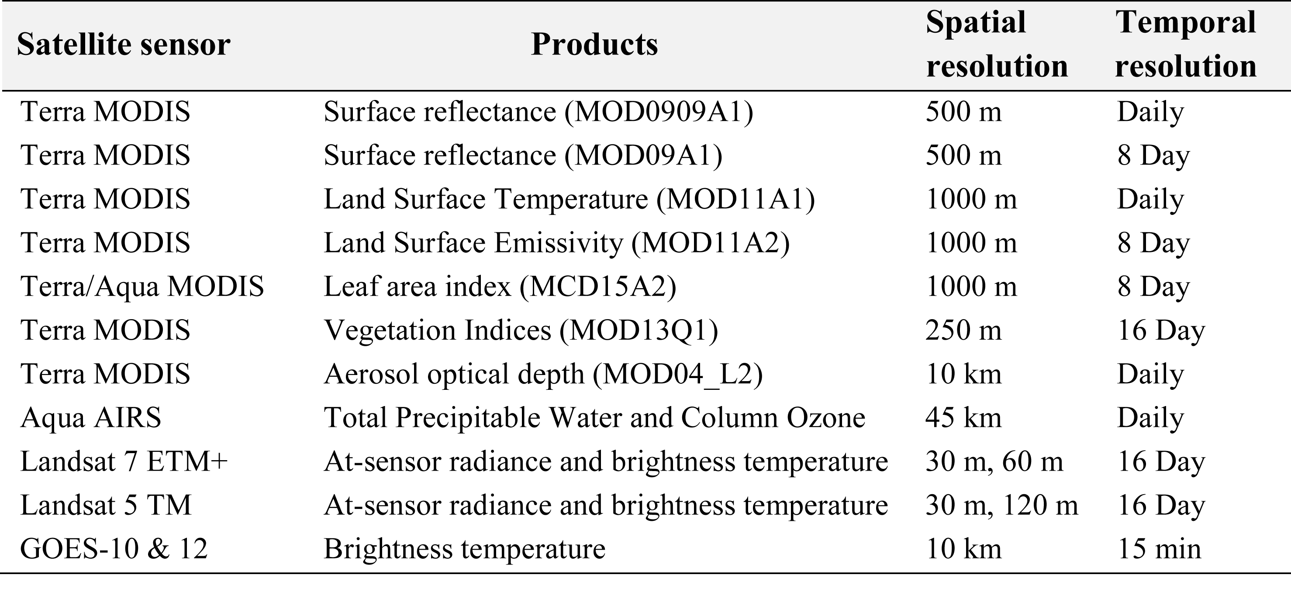
Satellite products
Notes:
The completion of these task will involve synergistic use of a suite of multi-scale and multi-sensor data products from MODIS, AIRS, GOES and Landsat, exploiting the unique temporal/spatial information content provided by the EOS instrument suite.

Slide 5
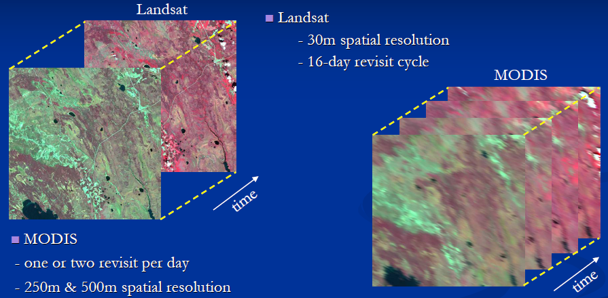
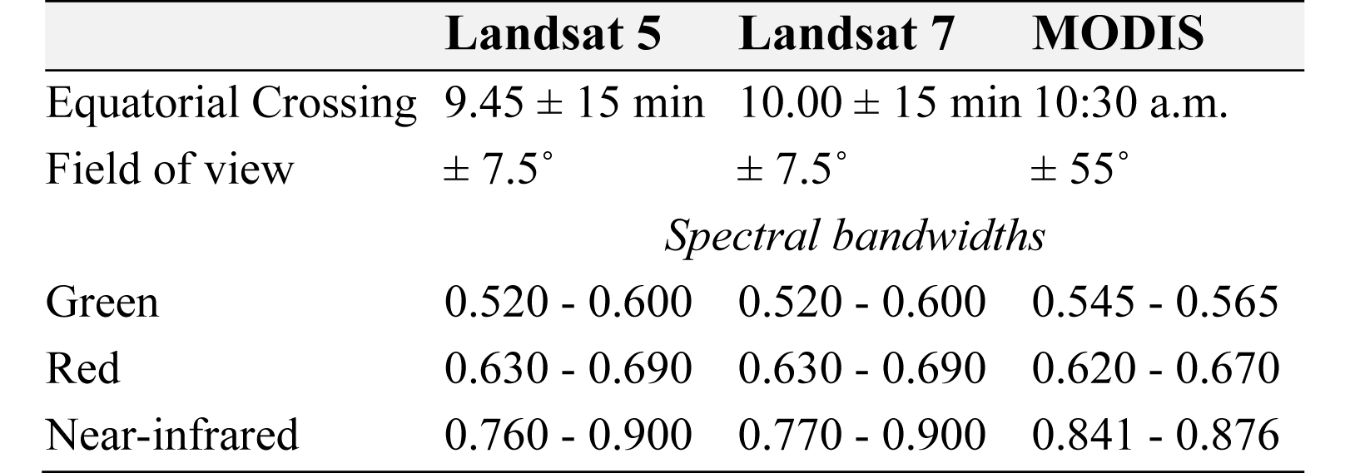
  Models
  Data fusion algorithm
STARFM = Spatial and Temporal Adaptive Reflectance Fusion Model
Notes:
We will employ STARFM, the Spatial and Temporal Adaptive Reflectance Fusion model, to blend Landsat and MODIS data streams. It was designed for generating maps of surface reflectance that preserve the high spatial resolution of Landsat and high temporal resolution of MODIS.
An important prerequisite for a successful implementation of STARFM is rigorous comparability between the MODIS and Landsat data streams. In this respect, MODIS and Landsat are characterized by similar spectral bandwidths and equatorial overpass times (Table..). However the viewing angle can be widely different due to wide field of view of the MODIS instrument. These directional effects will be minimized by normalizing the data streams to near-nadir viewing angles and a common solar angle.
As a first step STARFM will be used to blend MODIS and Landsat surface reflectance data streams to produce weekly reflectance products at Landsat spatial resolution.

Slide 6
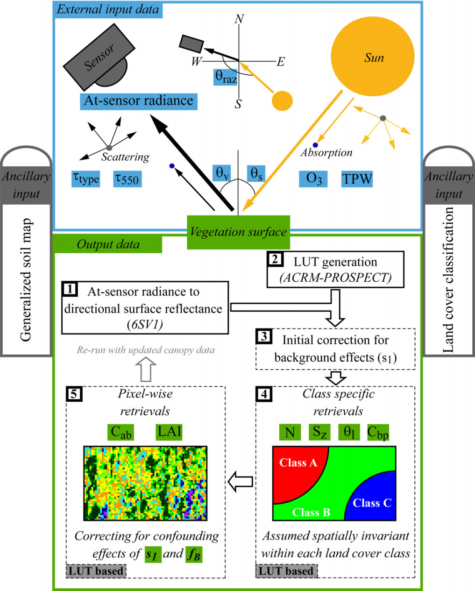
  Models
  Vegetation parameter retrieval tool
REGFLEC = REGularized canopy reFLECtance tool
Physically-based approach for estimating key descriptors (LAI and leaf chl) of vegetation dynamics
Combines leaf optics (PROSPECT), canopy reflectance (ACRM), and atmospheric radiative transfer (6SV1) modules
Requires at-sensor radiance observations in green, red and nir wavebands, standard atmospheric state data, land cover and soil map
The retrieval system is entirely image-based and does not rely on local ground-based data for model calibration
REGFLEC accommodates variations in sensor and atmospheric absorption and scattering conditions, soil background conditions, surface BRDF and species composition
Houborg & Anderson (2009)
Notes:
The blended reflectance dataset will be used as input to the Regularized canopy reflectance tool (REGFLEC) for retrieving LAI and leaf chl at 30 m resolution and weekly intervals.

Slide 7
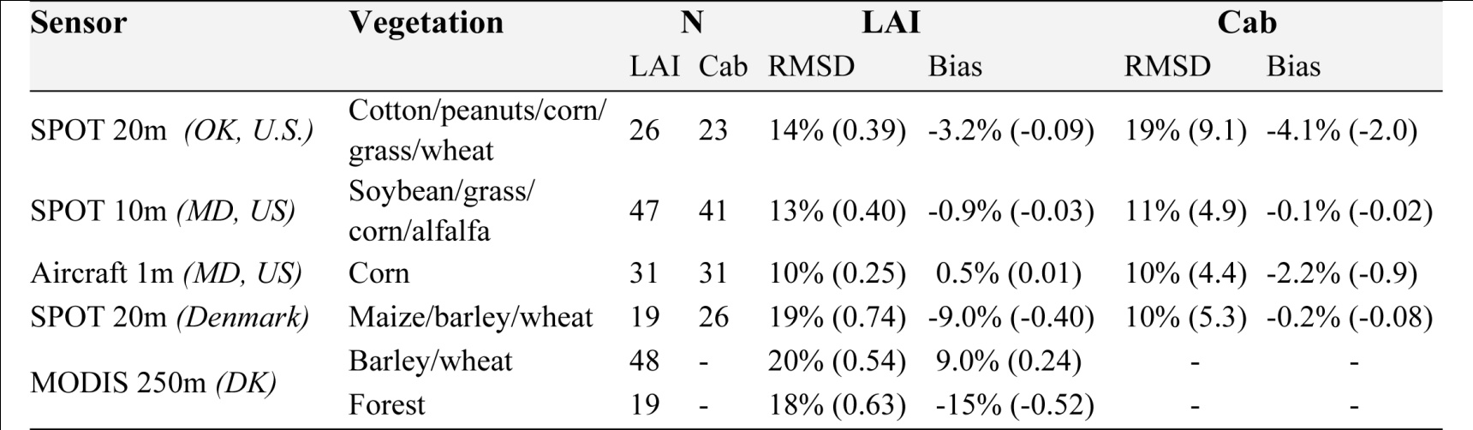
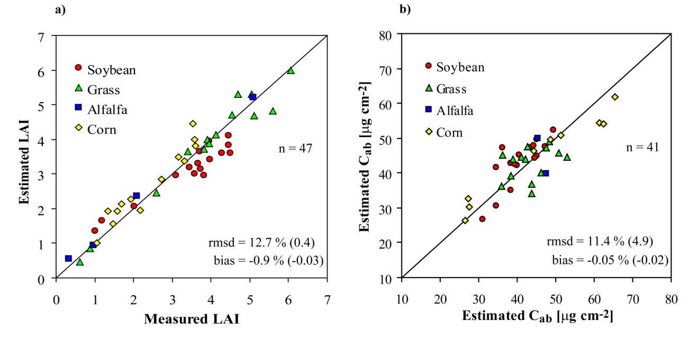
  Models
  Vegetation parameter retrieval tool
REGFLEC LAI and leaf chl retrieval accuracies
LAI (SPOT 10m - MD, US)
Leaf chl (SPOT 10m - MD, US)
Measured

Slide 8

  Models
  Land-surface model
Atmosphere-Land Exchange Inverse (ALEXI)
Regional scale
ΔT_{RAD} - GOES
T_{a} - ABL model
Landscape scale
T_{RAD} - Landsat, MODIS
T_{a} - ALEXI
Surface temp:
Air temp:

Slide 9
  Models
  Land-surface model
Notes:
As visualized in these maps, the ALEXI/DisALEXI modeling suite facilitates scalable flux mapping using thermal imagery from a combination of geostationary and polar orbiting satellites, zooming in from the national scale to sites of specific interest.
The robustness of the scalable modeling approach has been supported by several validation experiments typically yielding flux errors on the order of 15 % in comparison with tower flux observations.

Slide 10
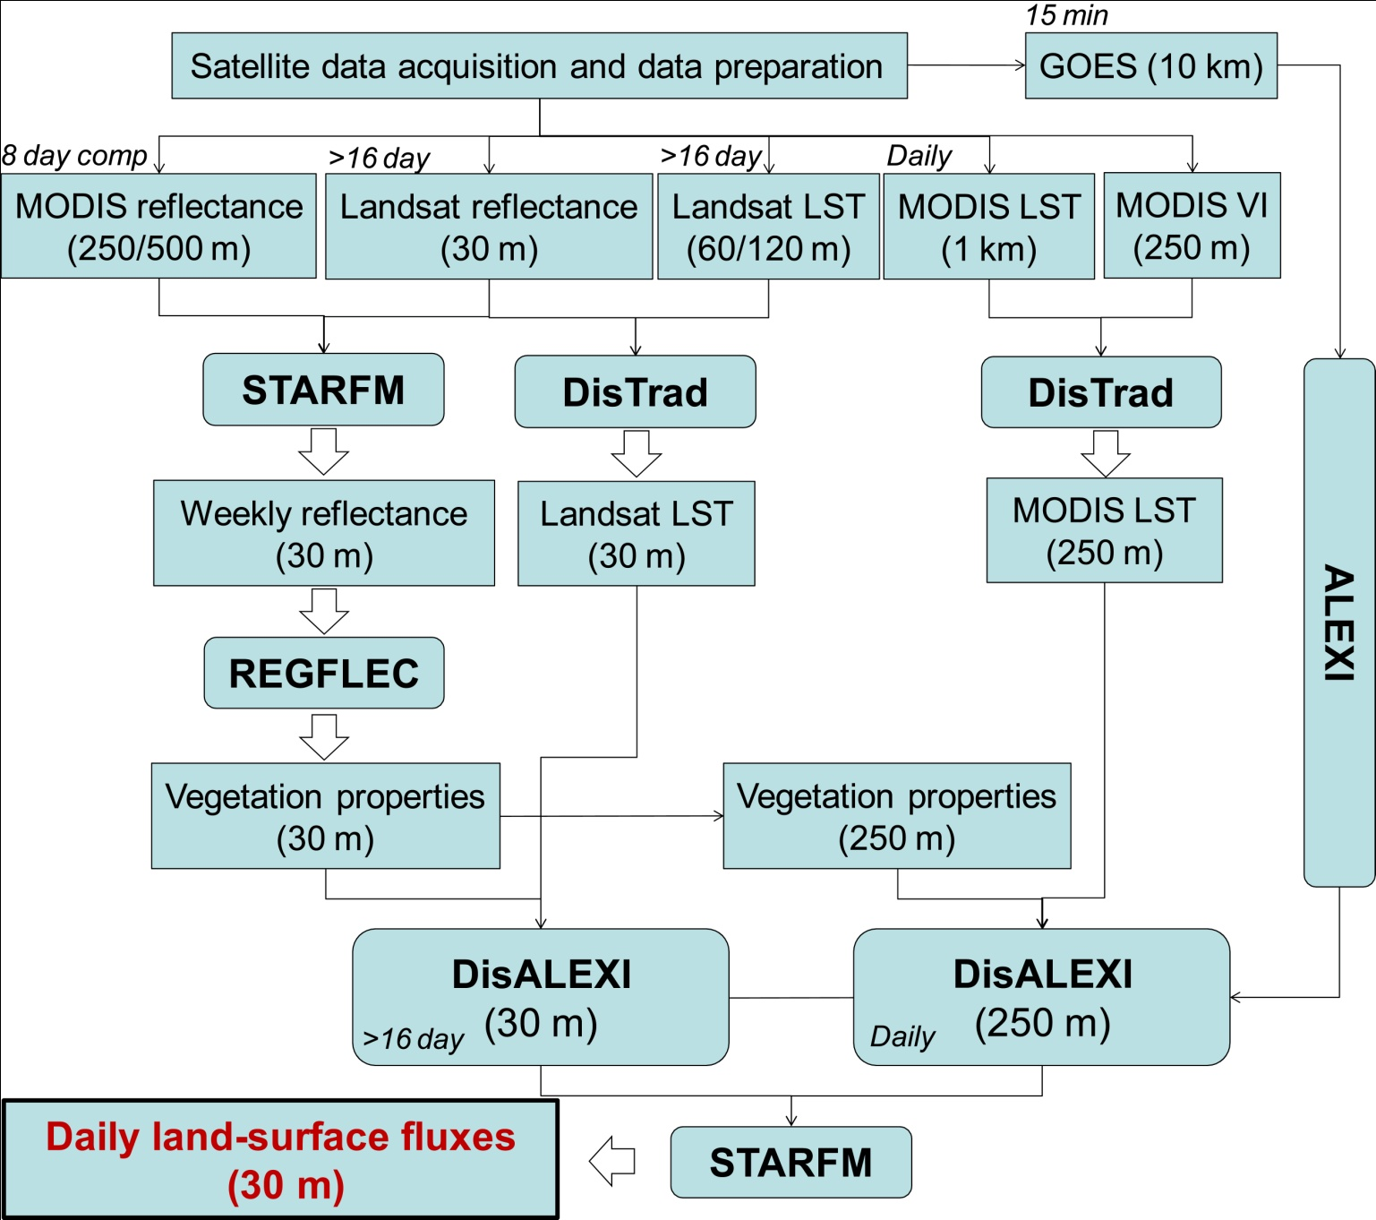
  Processing steps
Notes:
This is a flow diagram of the overall steps required for generating flux maps at Landsat spatial resolution and MODIS temporal frequency.
First STARFM will be used to blend MODIS and Landsat surface reflectance data streams to produce weekly reflectance products at Landsat spatial resolution. The fused reflectance dataset will then be used as input to REGFLEC for retrieving LAI and leaf chl at 30 m resolution.
The DisTrad thermal sharpening algorithm will be applied to Landsat and MODIS data to increase the spatial resolution of the Landsat thermal data from 60 m to 30m and the MODIS data from 1km to 250 m
We will then setup and run DisALEXI using the sharpened 30 m resolution LST and blended vegetation parameter sets during Landsat acquisitions.
At the same time DisALEXI will run on a daily timescale using sharpened MODIS LST and blended vegetation datasets appropriately resampled to the 250 m resolution
As the final step STARFM will be applied to the resulting carbon, water and heat flux fields to produce daily fluxes at Landsat spatial resolution.

Slide 11
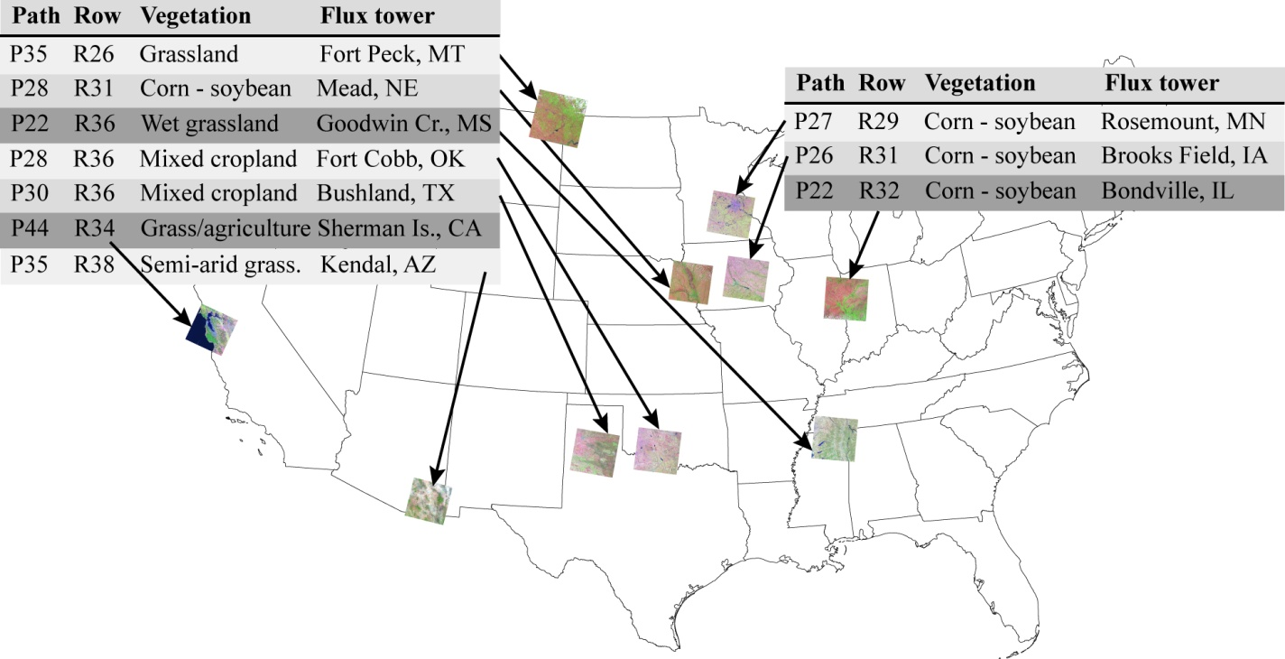
  Study regions
Notes:
These processing steps will be performed for a set of regions that were selected to capture a variety of cover types and climatic conditions. They will function as the testbed for evaluating vegetation biophysical retrievals and flux simulations. As the project matures we expect to populate this map with additional Landsat-defined regions. In this study, the primary focus will be on agricultural and short vegetation natural ecosystems. All regions provide validation data of CO2, water and energy flux observations from at least one flux tower.

Slide 12
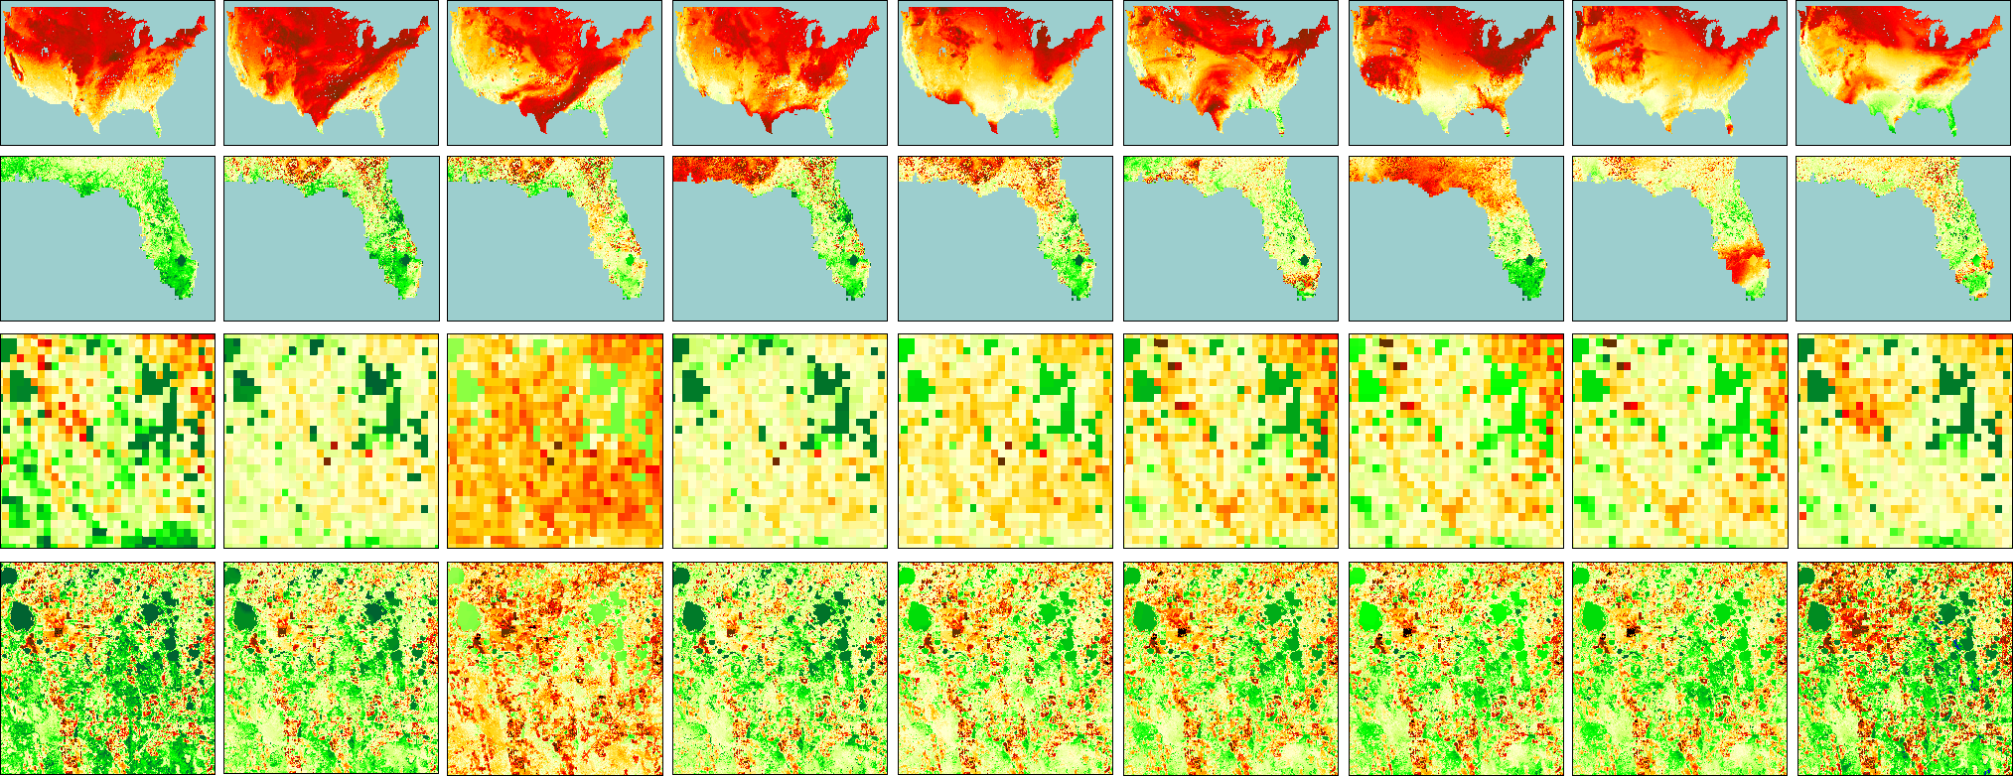
  Flux-based data fusion
Daily Evapotranspiration – Orlando, FL, 2002
DOY 328
329
330
331
332
333
334
335
336
GOES
(ALEXI)
MODIS
(DisALEXI)
LANDSAT
(DisALEXI)
Landsat 5
Landsat 7
Spatial Temporal Adaptive Reflectance Fusion Model
(STARFM)
(Gao et al, 2006)
Notes:
These plots are included to visualize the flux-based data fusion that we propose to use in this project. Here STARFM is used to fill the gaps in the fine spatial resolution Landsat time-series based on high frequency MODIS observations.

Slide 13
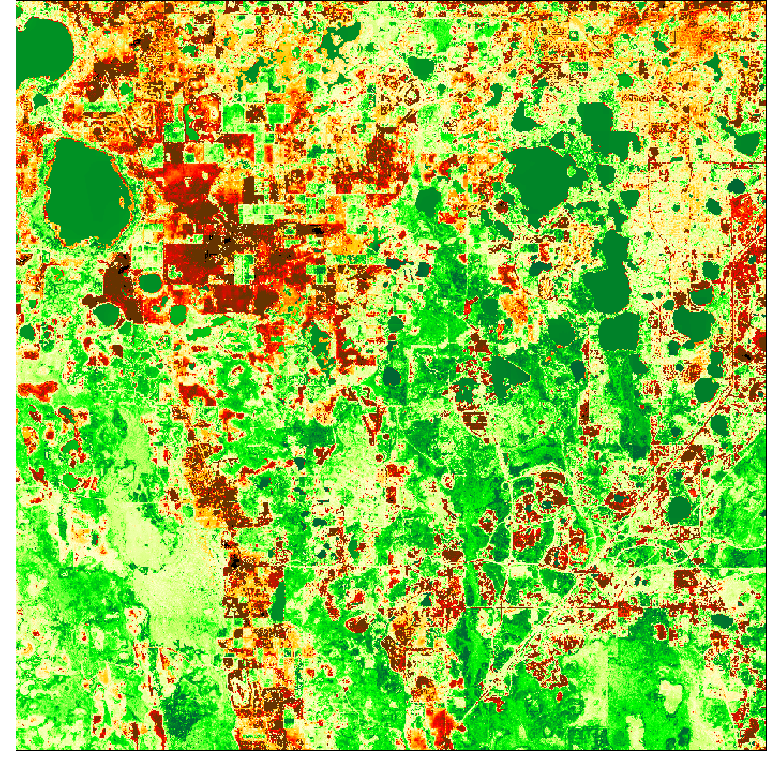
  Flux-based data fusion
Daily Evapotranspiration – Orlando, FL, 2002
DOY 328
329
330
331
332
333
334
335
336
GOES
(ALEXI)
MODIS
(DisALEXI)
LANDSAT
(DisALEXI)
Observed
Landsat 5
Predicted
Spatial Temporal Adaptive Reflectance Fusion Model
(STARFM)
(Gao et al, 2006)
R²: 0.83
(9% error)
Notes:
And in this case the error between STARFM predicted and actually observed ET is around 9%.

Slide 14
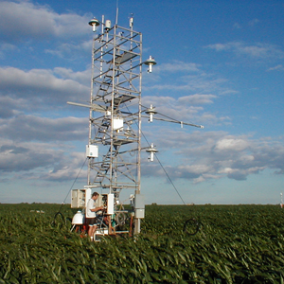
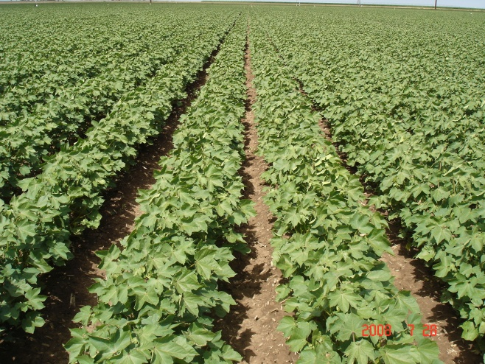

  Validation efforts
Retrieved vegetation biophysical products will be validated using a combination of in-situ datasets and independent satellite datasets
The quality of observed and blended flux maps will be evaluated at localized points using available flux tower observations
Generated flux maps will be compared to independent flux output from the suite of LSMs embedded within the Land Information System (LIS) Land Data Assimilation System (LDAS)

