Slide 1
MODIS Meeting
College Park, MD
19 May 2011
Using MODIS snow cover fraction
in the NASA GEOS-5 modeling and assimilation system
Rolf Reichle, Ally Toure, and Gabrielle De Lannoy
Global Modeling and Assimilation Office
NASA Goddard Space Flight Center
Phone: 301-614-5693
Email: Rolf.Reichle@nasa.gov

Slide 2
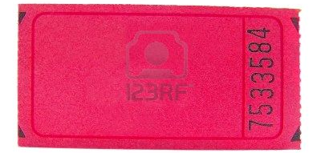
Outline
ROSES Terra/Aqua proposal:
“Enhancing NASA GEOS data products through multi-variate assimilation of land surface observations from Aqua and Terra”
Just getting started…
This presentation:
Evaluation of GEOS-5 products vs. MODIS SCF
Assimilation of MODIS SCF
The SMAP Level 4 Carbon product

Slide 3
NASA/GMAO GEOS-5 products
MERRA: Recently completed re-analysis
GEOS-5.2.0
1979-present, continued updates w/ ~1 month latency, global
Resolution: Lat=0.5º Lon=0.67º, 72 vertical levels
MERRA-Land: Enhanced land enhanced product for land surface hydrological applications (Reichle et al., J. Clim., 2011)
“Forward processing”
Near-real time, global
Currently using GEOS-5.2.0
From ~June 2011:
  GEOS-5.7.1 (incl. GCM revisions a.k.a. “Fortuna”)
  Resolution: Lat=0.25º Lon=0.3125º, 72 vertical levels

Slide 4
Land-only (“off-line”) replay
Precipitation |  | MERRA |  | MERRA + GPCPv2.1
Surface Tair, Qair, SW, LW, etc. |  | MERRA |  | MERRA
Land model version |  | MERRA |  | Fortuna
Data product |  | MERRA “replay” |  | MERRA-Land

Slide 5
Catchment land surface model parameter changes
Parameter | Description | Units | MERRA | Fortuna
SATCAP | Capacity of canopy interception reservoir | kg/m² | 1.0*LAI | 0.2*LAI
FWETL | Areal fraction of canopy leaves onto which large-scale precipitation falls | [-] | 1.0 | 0.02
FWETC | Same as FWETL but for convective precipitation | [-] | 0.2 | 0.02
WEMIN | Min. SWE in snow-covered area fraction | kg/m² | 13 | 26
DZ1MAX | Max. depth of uppermost snow layer | m | 0.05 | 0.08

Slide 6
MERRA-Land has improved estimates of soil moisture, runoff, canopy interception, and evapotranspiration (Reichle et al., J. Clim., 2011),
BUT
if we look at snow cover fraction and compare to MODIS…

Slide 7
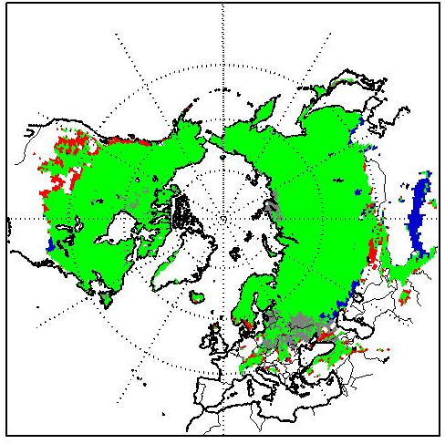
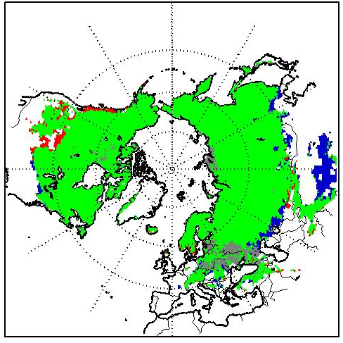
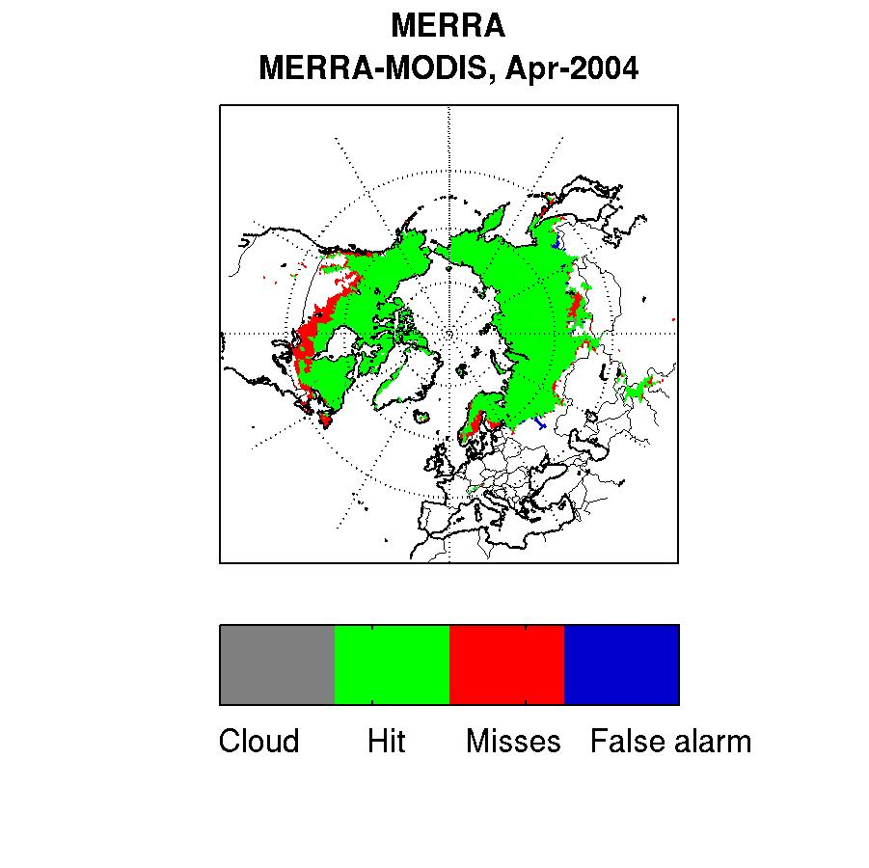
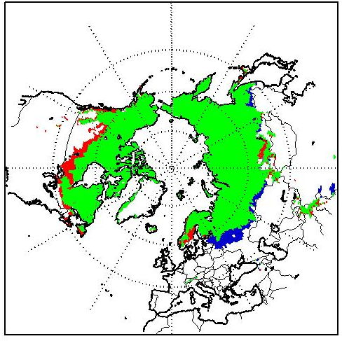
Categorical analysis of snow cover fraction vs. MODIS
MERRA
MERRA-Land
MOD10C2, aggregated to monthly avg. SCF
Feb 2004
MERRA SCF agrees well with MODIS SCF observations.
False alarm rate increases in MERRA-Land.
Apr 2004

Slide 8
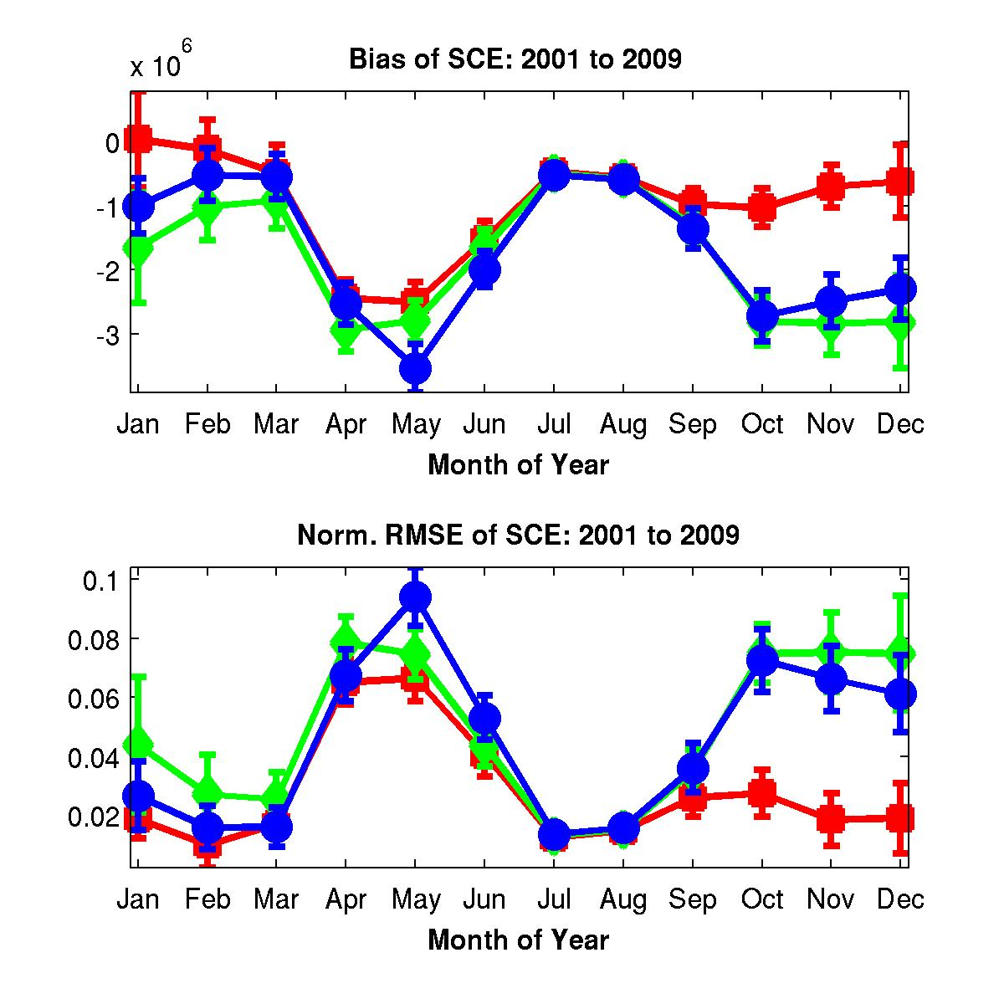
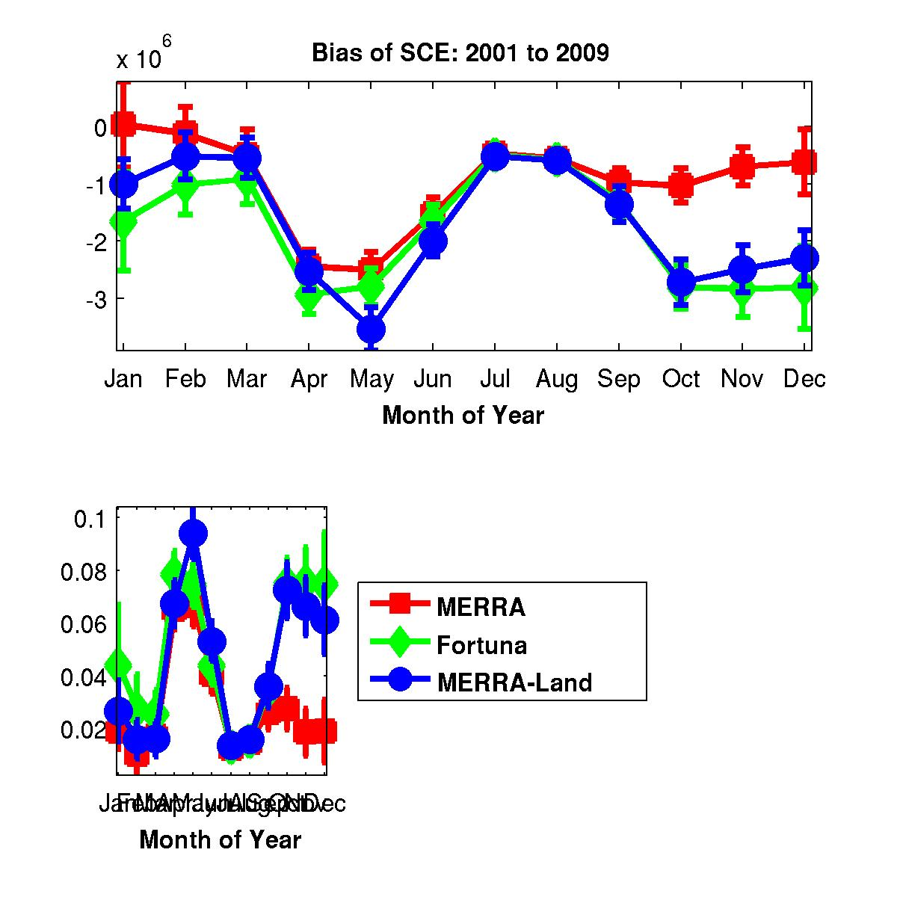
Snow cover extent (SCE) v. MODIS
km²
Change of WEMIN parameter in “Fortuna” unhelpful for estimation of snow cover fraction.
[Not sensitive to GPCP precipitation corrections.]
See poster by Toure and Reichle for details.
*RMSE normalization vs. max annual SCE.

Slide 9
Outline
Evaluation of GEOS-5 products vs. MODIS SCF
Assimilation of MODIS SCF
The SMAP Level 4 Carbon product

Slide 10
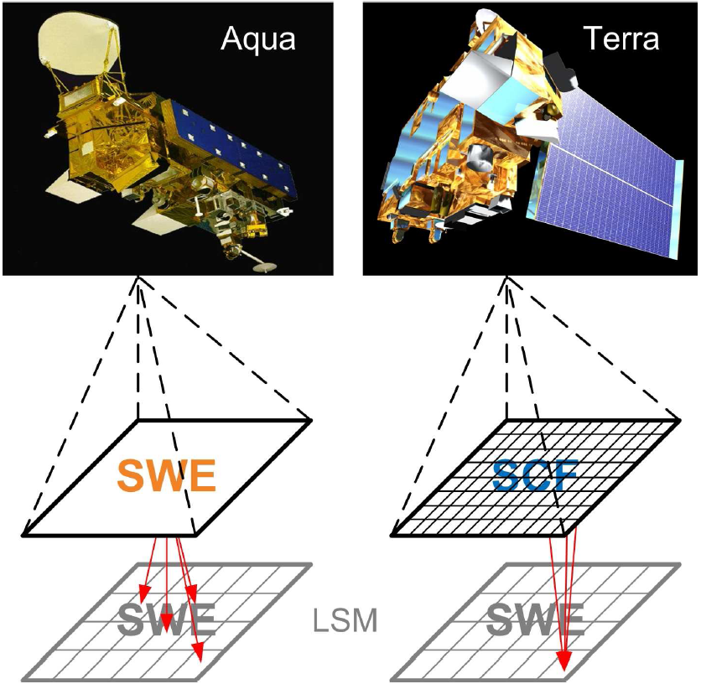
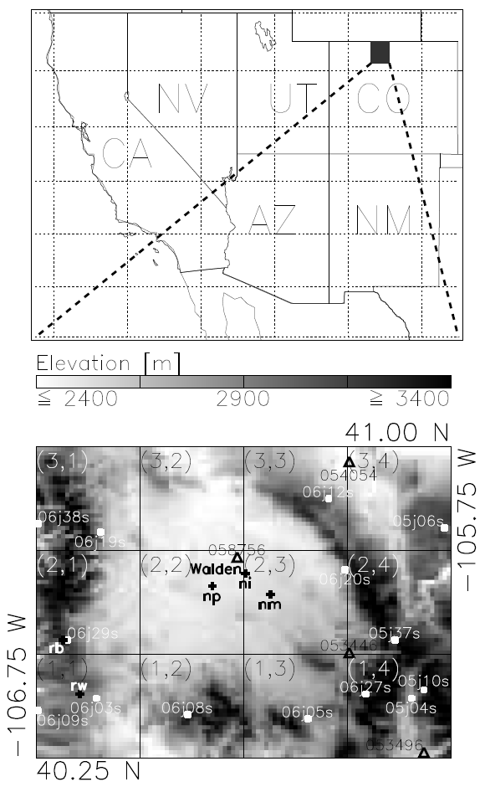
Assimilation of MODIS snow cover fraction (SCF)
Noah land surface model (1 km resolution)
100 km X 75 km domain in northern Colorado
Multi-scale assimilation of MODIS SCF and AMSR-E SWE observations.
Validation against in situ obs from COOP (Δ) and Snotel (▪) sites for 2002-2010.

Slide 11
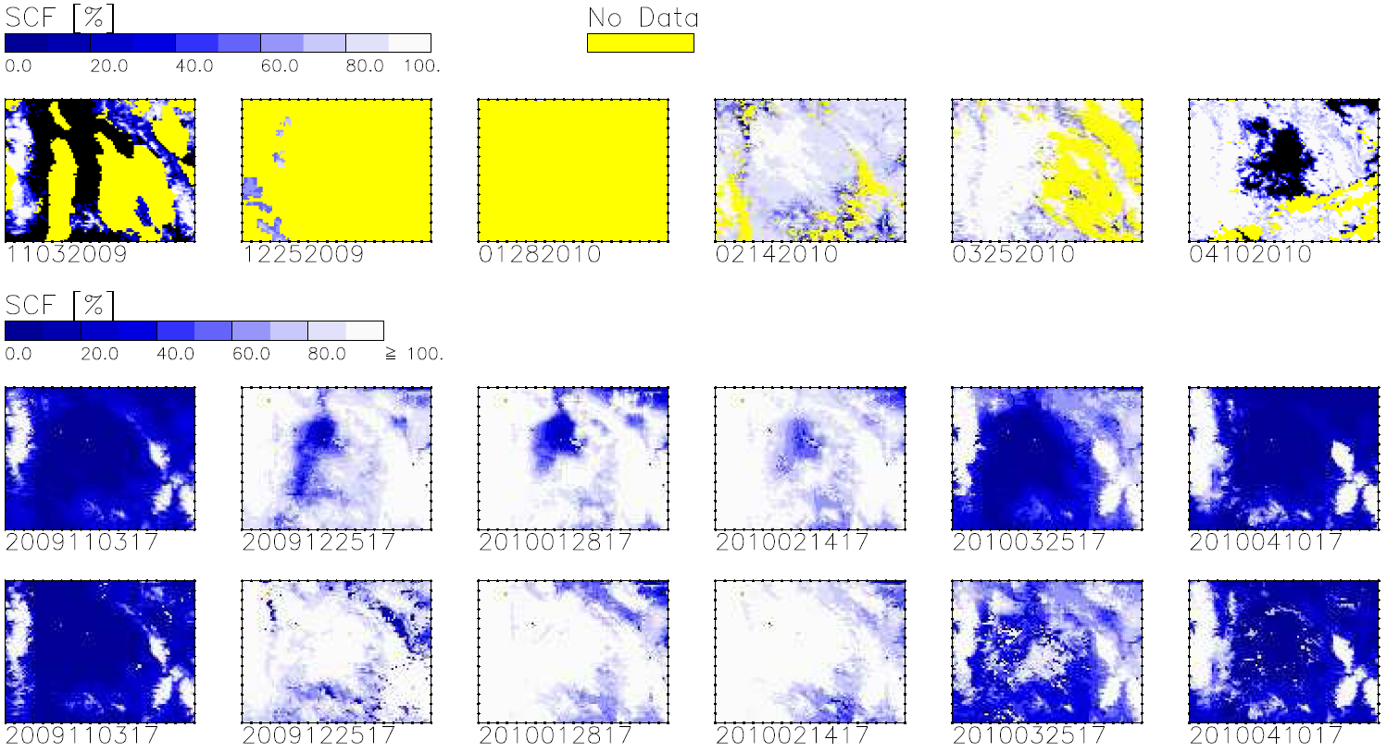
Assimilation of MODIS snow cover fraction (SCF)
MODIS
Noah
SCF assim.
3 Nov 09
25 Dec 09
28 Jan 10
14 Feb 10
25 Mar 10
10 Apr 10
MODIS SCF successfully adds missing snow,
… except during melt season.
MODIS SCF also improves timing of onset of snow season (not shown).
See poster by De Lannoy et al. for more information.

Slide 12
Outline
Evaluation of GEOS-5 products vs. MODIS SCF
Assimilation of MODIS SCF
The SMAP Level 4 Carbon product

Slide 13
SMAP Level 4 soil moisture and carbon products
Product/ algorithm based on MODIS heritage
L4_SM Product:
Lead: Rolf Reichle, NASA/GMAO
Assimilating SMAP data into a land model driven with observation-based forcings yields:
a root zone moisture product (reflecting SMAP data), and
a complete and consistent estimate of soil moisture & related fields.
Surface meteorology
SMAP observations
Land model
Gross Primary Productivity
Data Assimilation
L4_C Product:
Lead: John Kimball, U Montana
Combining L4_SM (SM & T), high-res L3_F/T_A & ancillary Gross Primary Productivity (GPP) inputs within a C-model framework yields:
- a Net Ecosystem Exchange (NEE) product, &
- estimates of surface soil organic carbon (SOC), component C fluxes (R) & underlying SM & T controls.
L4_SM Product:
Surface and root-zone soil moisture and temperature
Carbon model
L4_C Product:
Net Ecosystem Exchange

Slide 14
Summary
Used MODIS snow cover fraction (SCF) to assess GEOS-5.
SCF estimates from (old) MERRA system agree better with MODIS than those from (new) GEOS-5.7.1 system (but SWE estimates are comparable; not shown).
MODIS provides helpful information for model development.
MODIS SCF assimilation:
can improve model snow estimates, and
will be included in GEOS-5 land assimilation system.
MODIS GPP heritage contributes to SMAP Level 4 Carbon product.

Slide 15
Thanks for listening!
Questions?

Slide 16
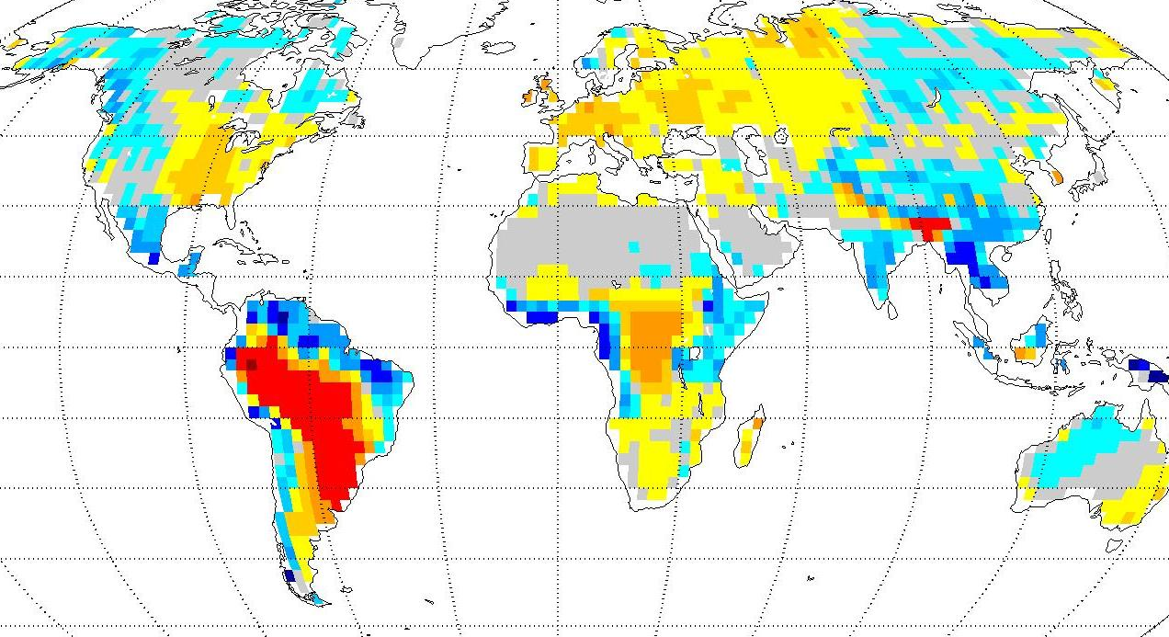
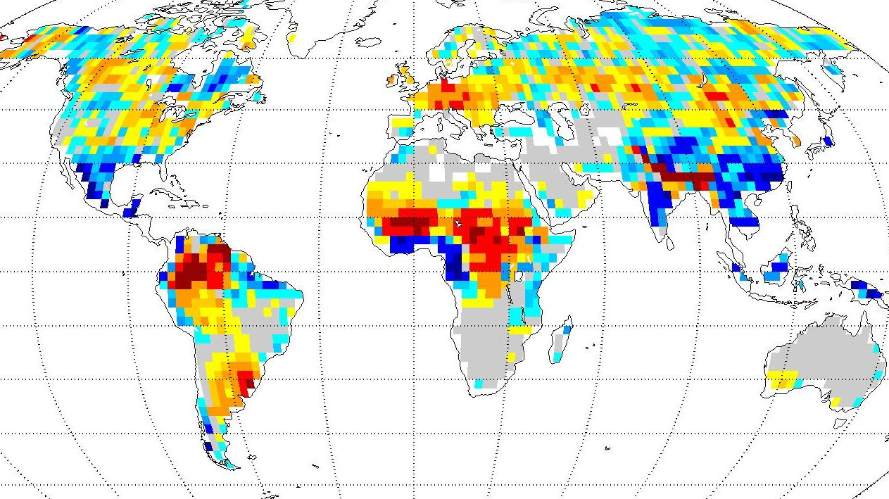

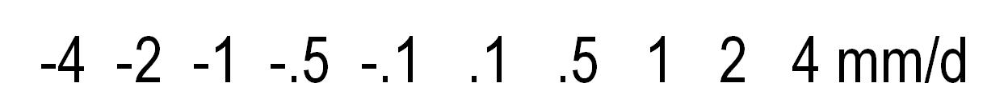
Precipitation
MERRA – GPCPv2.1
1981-2008 [mean=-0.03 mm/d]
Aug 1994 [mean=-0.04 mm/d]
Long-term bias
Synoptic-scale errors
→ Correct MERRA precipitation with global gauge- and satellite-based precipitation observations to the extent possible.
Reichle et al. J Clim (2011) submitted

Slide 17
Precipitation corrections
MERRA
  Reanalysis
  Hourly
  0.5 deg
GPCP v2.1
  Satellite + gauges
  Pentad
  2.5 deg
Rescale MERRA
separately for each pentad and 2.5 grid cell
For each pentad and each 2.5 deg grid cell, the corrected MERRA precipitation (almost) matches GPCP observations.
MERRA + GPCPv2.1
  (hourly, 0.5 deg)

Slide 18
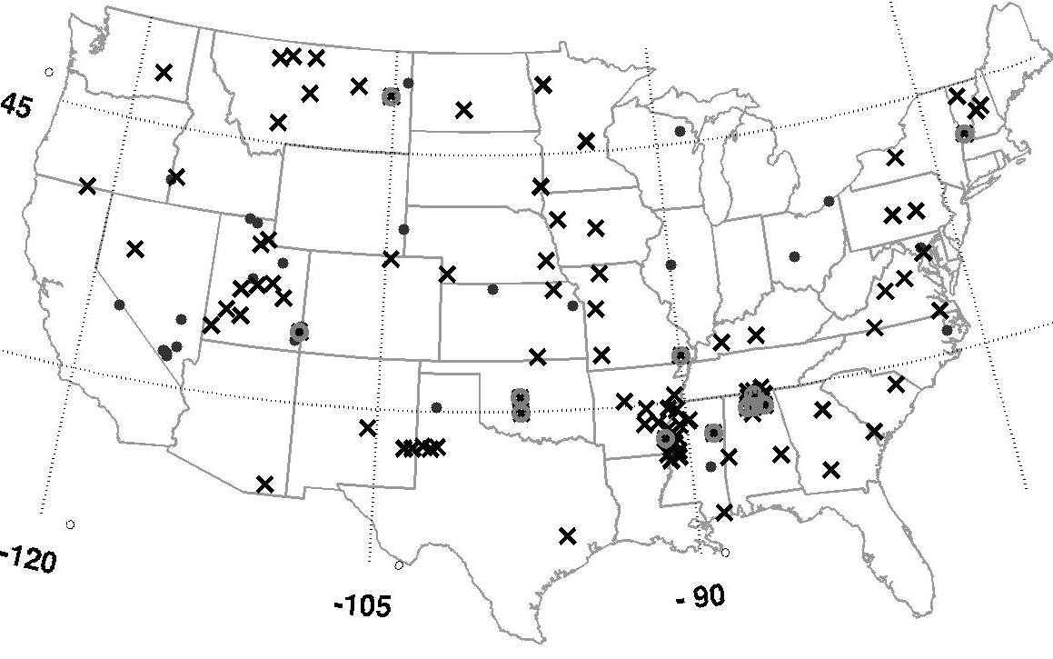
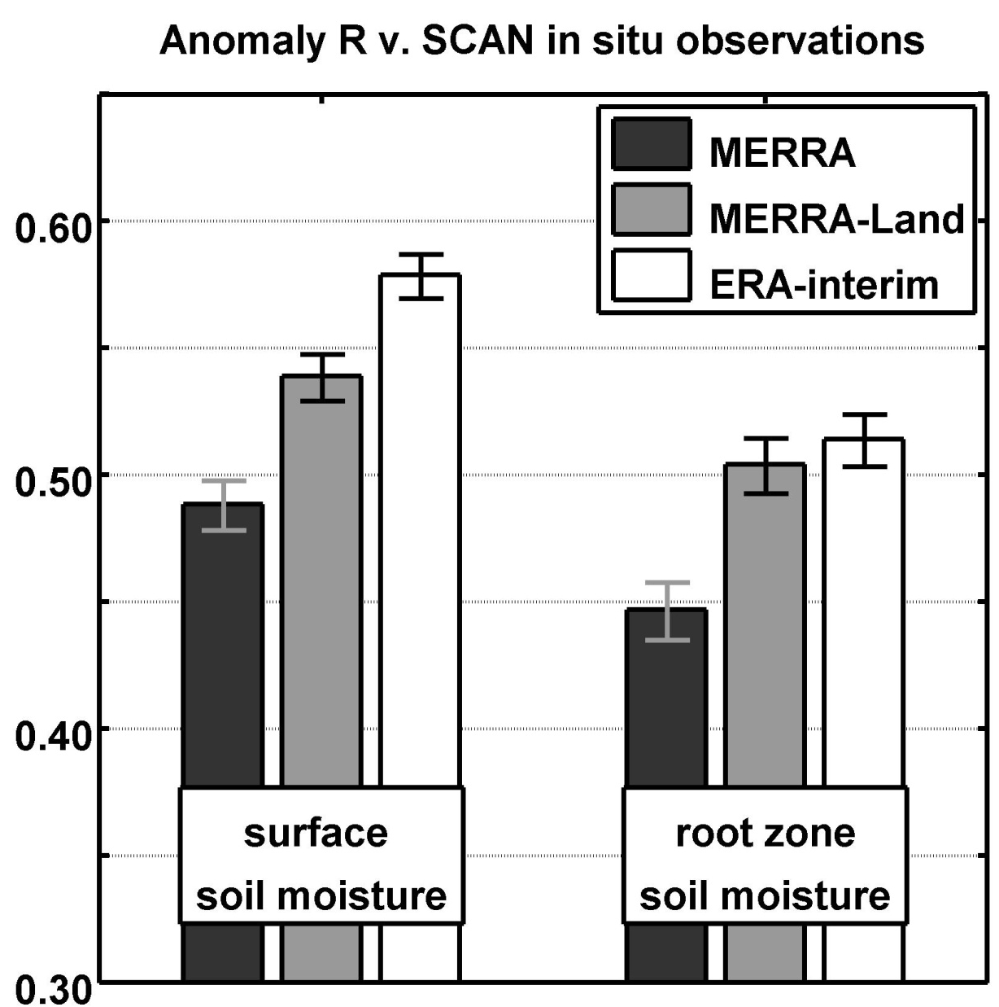
Soil moisture validation (2002-2009)
Pentad anomaly R
v. SCAN in situ observations
Better soil moisture anomalies (attributed to GPCP corrections).
Additional analysis (not shown):
MERRA skill comparable to ERA-Interim (if accounting for layer depth).
Use of 5 cm surface layer depth in Catchment model is better (currently: 2 cm).
Notes:
Figure 6. Soil moisture validation against SCAN in situ measurements (Appendix b). (a) Locations of SCAN sites that were (crosses) used for surface and root zone soil moisture validation (85 sites), (circles) used only for surface soil moisture validation (12 sites), and (dots) not used. (b) Skill (pentad anomaly R) versus SCAN in situ surface and root zone soil moisture anomalies for MERRA and MERRA-Land estimates (2002-2009). Error bars indicate approximate 95% confidence intervals.

Slide 19
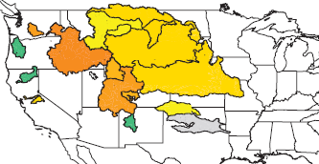
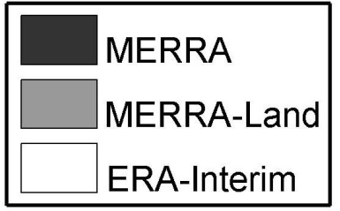

Runoff
Validation against naturalized streamflow observations from 7 “large” and 8 “small” basins (~1989-2009).
3-month-average anomaly R
GPCP corrections yield significantly better runoff for Arkansas-Red.
MERRA and MERRA-Land (0.5 deg) better than ERA-Interim (1.5 deg).
Not shown: In all cases the revised interception parameters yield improved runoff anomalies (albeit not significant).
Notes:
Figure 7. Seasonal anomaly time series correlation coefficients for runoff estimates from MERRA, MERRA-Land, and ERA-Interim for the basins and time periods listed in Table 2.

Slide 20
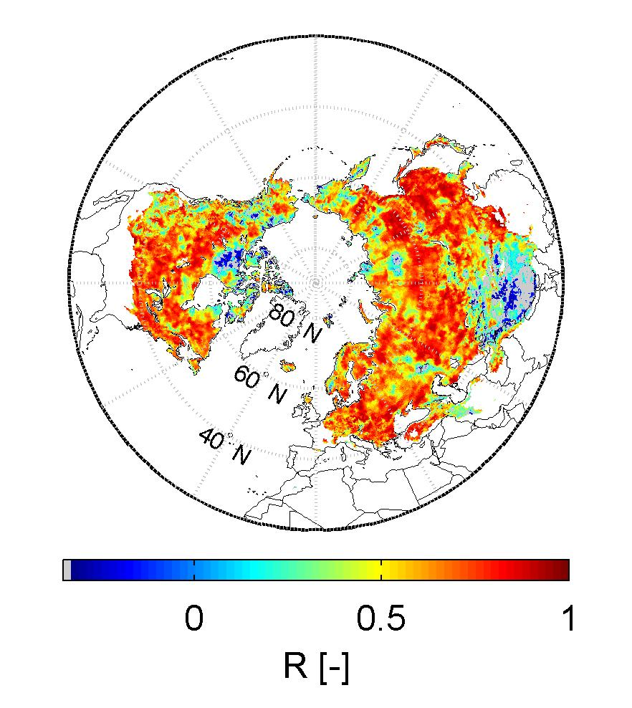
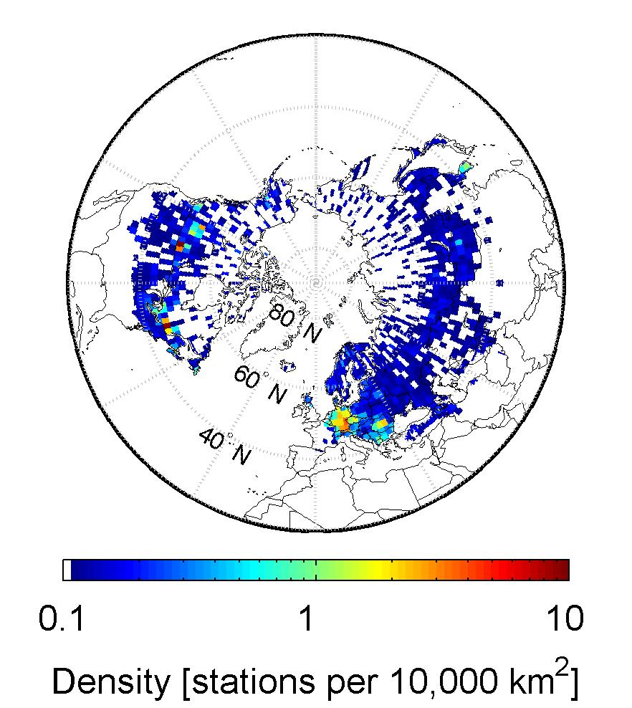
Snow water depth
MERRA-Land v. CMC snow analysis
Pentad anomaly R (2002-2009)
Note: No snow analysis in MERRA or MERRA-Land.
CMC snow analysis
Density [stations/10,000 km²]
MERRA and MERRA-Land have similar skill.
Low R values in areas without in situ observations.
Not shown: Similar result for comparison against in situ data (583 stations) and for snow water equivalent (SWE).
Notes:
Figure 8. (a) Skill (pentad anomaly R) of MERRA-Land snow depth versus CMC estimates (2002-2009). R values that are not statistically different from zero at the 5% significance level are shown in gray. (b) Maximum density of in situ snow depth measurements available for CMC snow analysis.

Slide 21
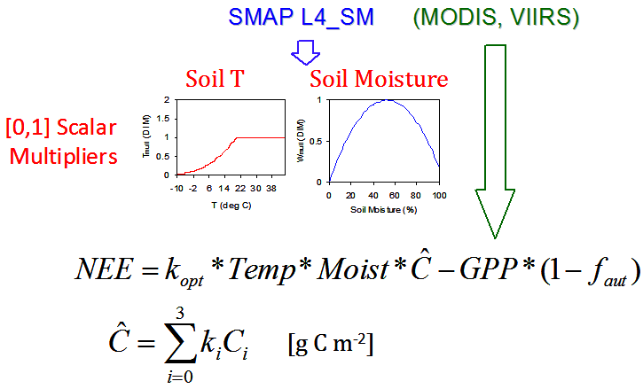
L4_C baseline algorithm
Product: Net Ecosystem CO₂ exchange (NEE = GPP – R_{eco})
Motivation/Objectives: Quantify net C flux in boreal landscapes; reduce uncertainty regarding missing C sink on land (NRC Decadal Survey);
Approach: Apply a soil decomposition model driven by SMAP L4_SM & ancillary (LC, GPP) inputs to compute NEE;
Inputs: Daily surface (<10cm) SM & T (L4_SM), LC & GPP (MODIS, VIIRS);
Outputs: NEE (primary/validated); R_{eco} & SOC (research);
Domain: Vegetated areas encompassing boreal/arctic latitudes (≥45 N);
Resolution: 9x9 km;
Temporal fidelity: Daily (g C m⁻² d⁻¹);
Latency: 14-day;
Accuracy: Commensurate with tower based CO₂ Obs. (RMSE ≤ 30 g C m⁻² yr⁻¹ and 1.6 g C m⁻² d⁻¹).

Slide 22
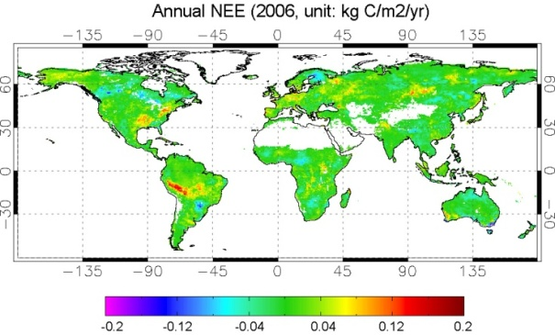
L4_C algorithm options
Several L4_C options are being evaluated based on recommendations from an earlier ATBD peer-review; options designed to enhance product accuracy & utility include:
Global domain encompassing all vegetated land areas;
Internal GPP calculations using SMAP L4_SM, L3_FT & ancillary land cover (LC) & VI (e.g. NDVI from MODIS, VIIRS) inputs;
Represent finer scale (<9km) spatial heterogeneity consistent with available LC inputs;
Explicit representation of LC disturbance (fire) and recovery impacts;
Algorithm calibration using available observation data (FLUXNET, soil inventories).

