Slide 1
Phytoplankton cell size from ocean color imagery: connection to variability in the ocean carbon sink
Colleen Mouw and Galen McKinley
University of Wisconsin-Madison
Photo David Doubilet

Slide 2
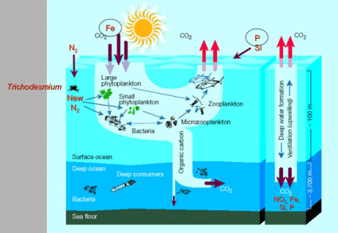
Ecological Importance of Cell Size
Small cells:
recycled within euphotic zone
utilizing regenerated nutrients
Prefer stratified high light conditions
Large cells:
sink out of the euphotic zone
utilize new nutrients efficiently
Prefer turbulent, low light conditions
Chisholm, 2000
Unifying principals that mechanistically explain global, annual mean patterns and seasonal to interannual variations in particulate flux to depth remain elusive.
Links between variation in export and air-sea CO₂ flux and its temporal variation have only begun to be explored.
Previous studies suggest [Chl] and PP are not enough to accurately predict flux.
Phytoplankton cell size is a critical determinant of flux.
Many biogeochemical processes are directly related to the distribution of phytoplankton size class (Longhurst 1998), and is a major biological factor that governs the functioning of pelagic food webs (Legendre and Lefevre 1991).

Slide 3
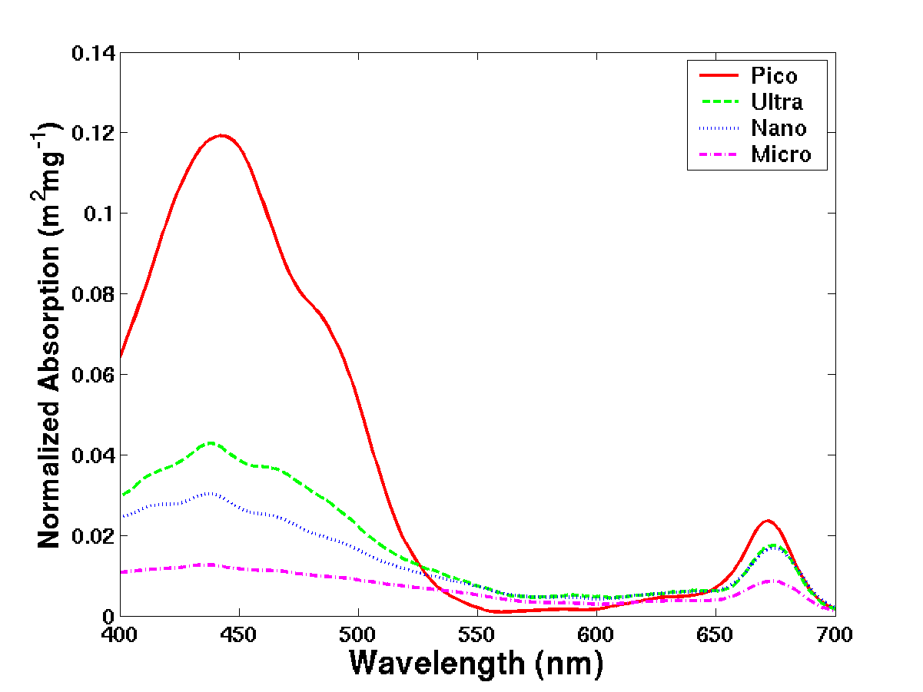
Optical Importance of Cell Size
Despite the physiological and taxonomic variability, variation in spectral shape can be defined by changes in the dominant size class.
Ciotti et al. 2002
a*_{ph}(λ)= [(1-S_{f}) × a*_{pico}(λ)] + [S_{f} × a*_{micro}(λ)]
Package effect

Slide 4
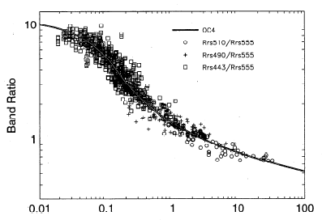
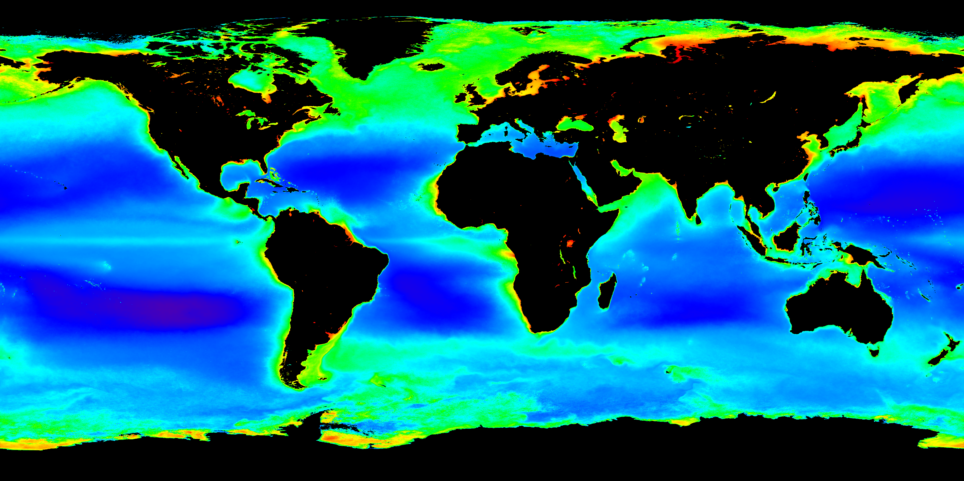
Motivation
R_{rs}(λ) data contains more information than just concentration.
R=log{(R_{rs}443 > R_{rs} 490 > R_{rs}510)/R_{rs}555}
Chl (mg m⁻³)
SeaWiFS standard chlorophyll algorithm (OC4).
O’Reilly et al. 1998

Slide 5
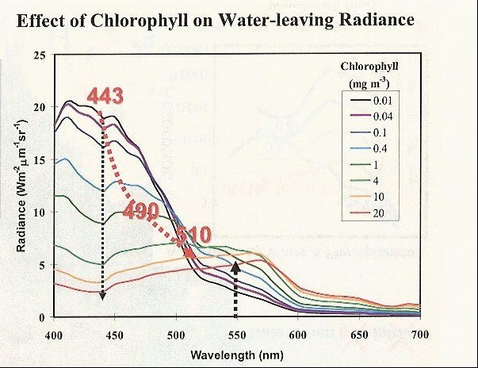
Effect of [Chl]on R_{rs}(λ)
Effect of [Chl] on water-leaving radiance
Maximum band shifts from 443 to 490 to 510 nm with increasing chlorophyll concentration
Spectral shift
O’Reilly et al. 1998

Slide 6
Effect of Cell Size on R_{rs}(λ)
S_{fm} varying
Constant [Chl] = 0.5 mg m⁻³
Constant a_{CDM}(443) = 0.002 m⁻¹
Magnitude shift!
R_{rs} (sr⁻¹)
Wavelength (nm)
Mouw & Yoder, 2010

Slide 7
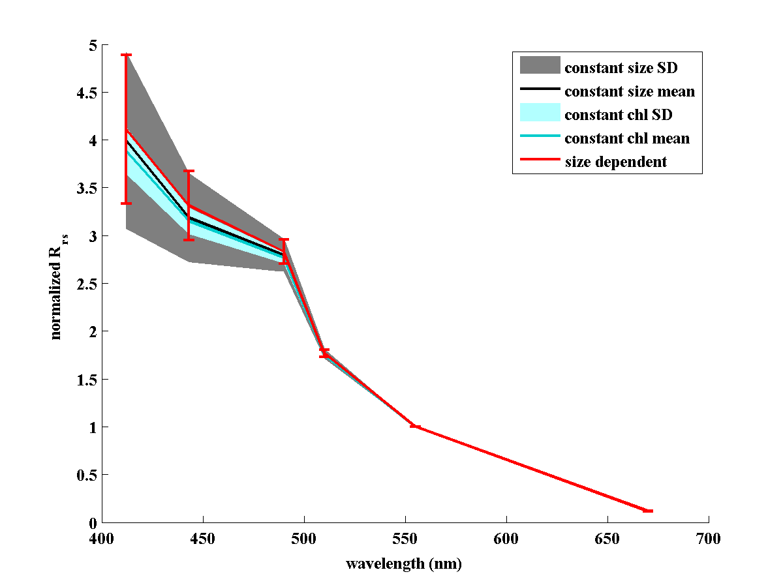
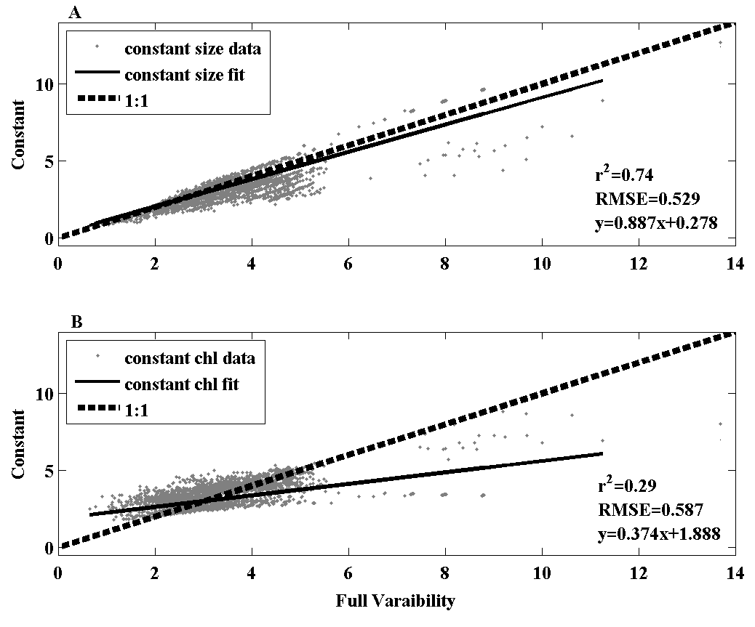
Contribution of S_{fm} & [Chl] to R_{rs}(λ)
Variations in [Chl] impact R_{rs}(443) more significantly than S_{fm} variations.
S_{fm}
Normalized R_{rs}
Constant
[Chl]
Wavelength (nm)
Constant
Mouw, Yoder & Doney, submitted
Full Variability

Slide 8
Size Impact on OC4 [Chl]
Percent Difference
22% Difference
Mouw, Yoder & Doney, submitted

Slide 9
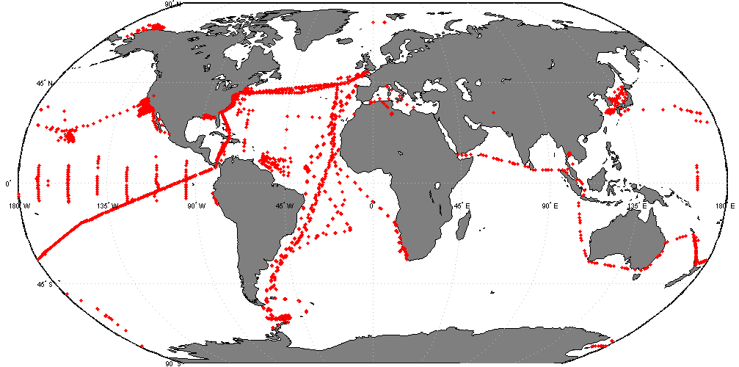
LUT Construction
n=4,564
Percent Microplankton
Optical model
Full Factorial Design:
Chl, S_{fm},
a_{CDM}(443)
Log₁₀ in situ [Chl] (mg m⁻³)
Hydrolight
GSM01 a_{CDM} (443) m⁻¹
R_{rs}(λ)
Log₁₀ GSM01 [Chl] (mg m⁻³)
n = 44,343
Mouw & Yoder, 2010

Slide 10
LUT Retrieval
If [Chl] above/below threshold < ⇒ Mask
If [Chl] within threshold ⇒ Continue
GSM01 Chl
0.05 - 1.75 mg m⁻³

GSM01 a_{CDM}(443)
If a_{CDM}(443) > threshold ⇒ Mask
If a_{CDM}(443) < threshold ⇒ Continue
< 0.17 m⁻¹

Hydrolight
Normalized R_{rs}(443)
(S_{fm} range)
S_{fm}
R_{rs}(λ) imagery
Normalized & Corrected R_{rs}(443)
⇒
Mouw & Yoder, 2010

Slide 11
Phytoplankton Size Retrieval
Estimated S_{fm} for May 2006
High CDM/Chl
Process the remainder of the SeaWiFS mission
Process MODIS-Aqua for the whole mission
Low Chl
Land/Cloud
No flag
Beyond NEΔR_{rs} thresholds
Mouw & Yoder, 2010

Slide 12
Validation
85% within 1 standard deviation
11%, 2 std. dev.
4%, 3 std. dev.
Mouw & Yoder, 2010

Slide 13
Export Processes
Boyd & Trull, 2007
Biological pump efficiency – biologically mediated export of carbon from the surface ocean and its remineralization with depth.

Slide 14
Flux Variation with Depth
Martin Curve
Guidi et al. 2009

Slide 15
Flux Variation with Depth
Martin Curve
Lutz et al. 2002
Martine curve - Underestimation of shallow remineralization.
Boyd & Trull, 2007

Slide 16
Previous Satellite Retrieval of Export
pr_{d}
rl_{d}
p(Δz): particulate flux : total production
pr_{d}: liable export fraction
rl_{d}: remineralization scale
pr_{r}: refractory export fraction
pr_{r}
SVI of production
SST (°C)
Relationships developed with selection of only data points that yielded a statistically significant fit – Does not add mechanistic understanding
Lutz et al. 2007

Slide 17
Previous Modeling of Export
Empirical
Captures site-to-site variations, but not variability at specific sites.
Mechanistic
Full model (87%)
Primary control – PP (59%)
Proximate control – size (28%)
Dunne et al., 2005

Slide 18
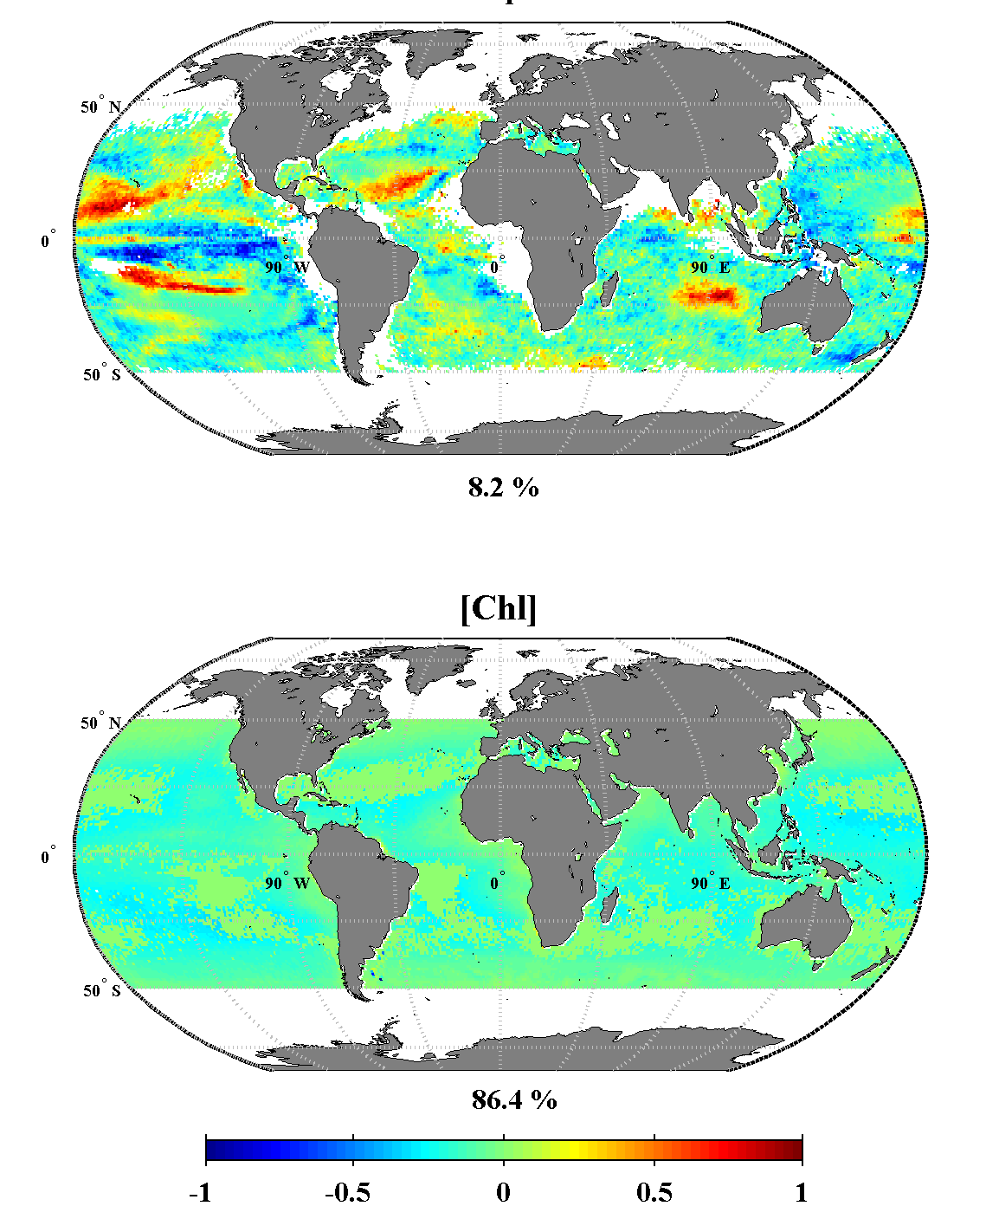
Individual EOF – Mode 1
S_{fm}
Global syntheses for particle export & remineralization have done a good job capturing differences between regions, but a poor job capturing seasonal & interannual variations at individual locations.
Phytoplankton cell size displays greater interannual variability than chlorophyll
[Chl] - adjustments to seasonal cycle
S_{fm} - ENSO relations
Mouw & Yoder, in prep.

Slide 19
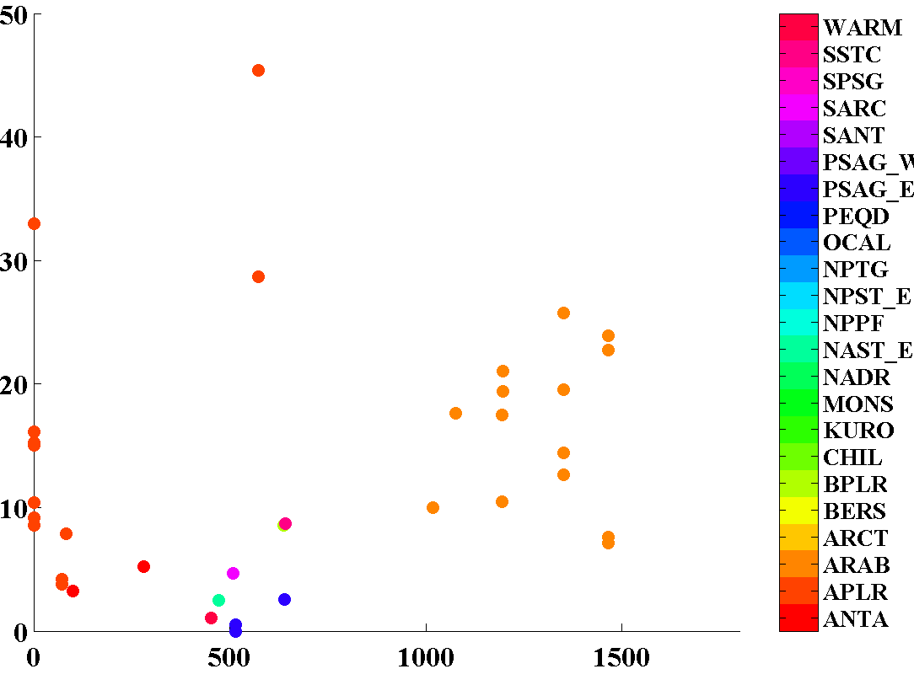
Cell Size, NPP & Flux
JGOFS
Upper 1 km
S_{fm}, % microplankton
VGPM NPP (mg C m⁻² d⁻¹)
Refine Dunne et al. (2005) & Lutz et al. (2007) using phytoplankton size as a key predictor.

Slide 20
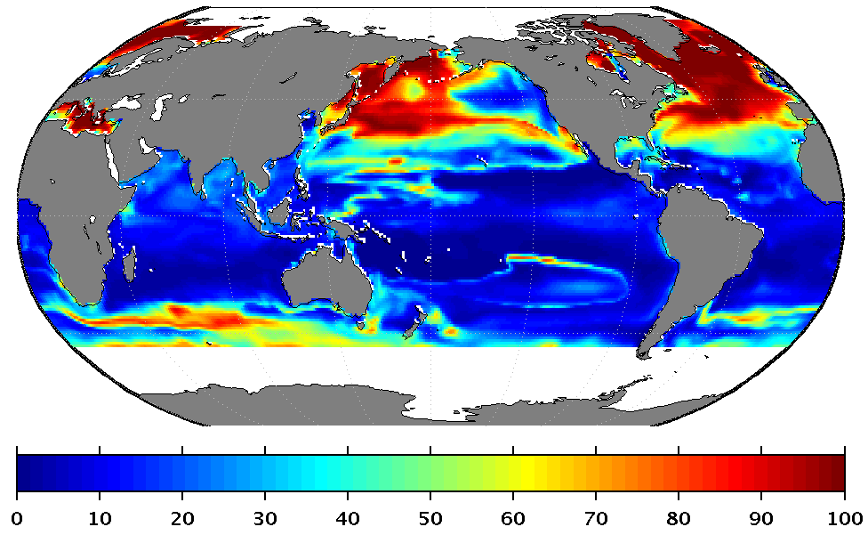
Emergent Functional Groups
http://darwinproject.mit.edu
Percentage of “r” Strategists
>10μm
Follows et al. 2007
Green: Prochlorococcus
Orange: small photo-autotrophs
Red: diatoms
Yellow: large phytoplankton
Figure, Dutkiewicz
Update export parameterization to include lithogenic & other mineral ballasting.
Incorporate improved understanding of how phytoplankton size structure controls particle export & remineralization.

Slide 21
Objectives & Questions
Objectives -
Use newly available satellite retrievals of phytoplankton community size structure to refine algorithms for sinking biogenic particles and their remineralization at depth.
Integrate into the Darwin model to improve export parameterization.
Use the improved Darwin model to understand connections to ocean carbon uptake and storage.
Questions –
Do satellite retrievals of phytoplankton size structure improve empirical algorithms for the export of biogenic particles from the surface ocean and their remineralization at depth?
How does the variability in the surface ocean phytoplankton size structure impact the biological pump of carbon to the deep ocean?

Slide 22
Acknowledgements
Jim Yoder (WHOI)
Jay O’Reilly and Kim Hyde (NOAA, NMFS)
Tatiana Rynearson and Maureen Kennelly (URI, GSO)
Benjamin Beckmann (GE Global Research)
Scott Doney and Ivan Lima (WHOI)
NASA OBPG & SeaBASS

Slide 24
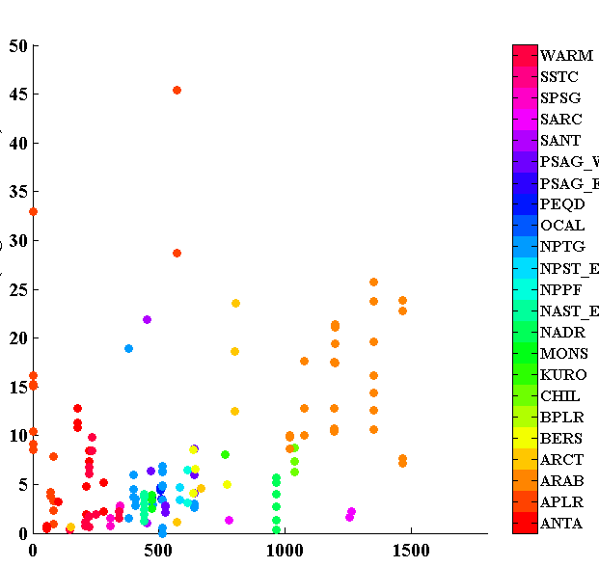
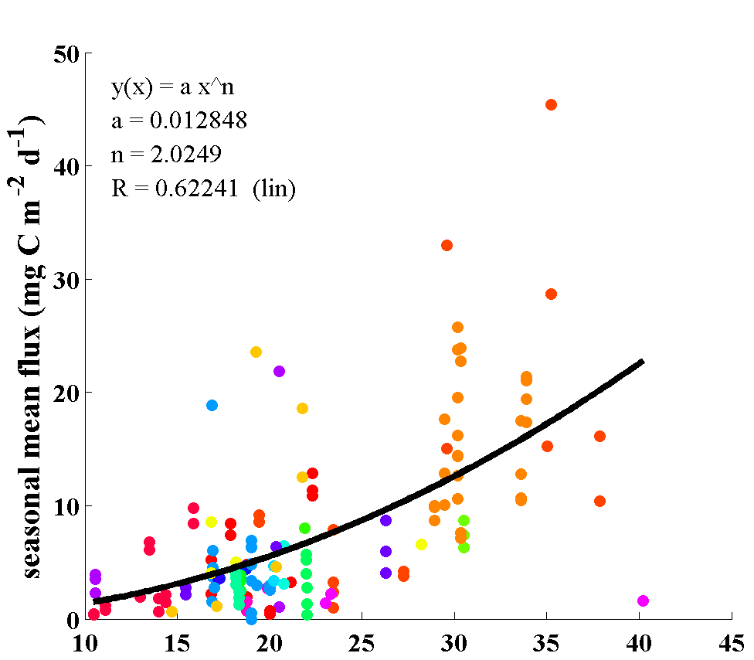
Cell Size, NPP & Flux
JGOFS
Depths < 4 km
S_{fm}, % microplankton
VGPM NPP (mg C m⁻² d⁻¹)

Slide 25
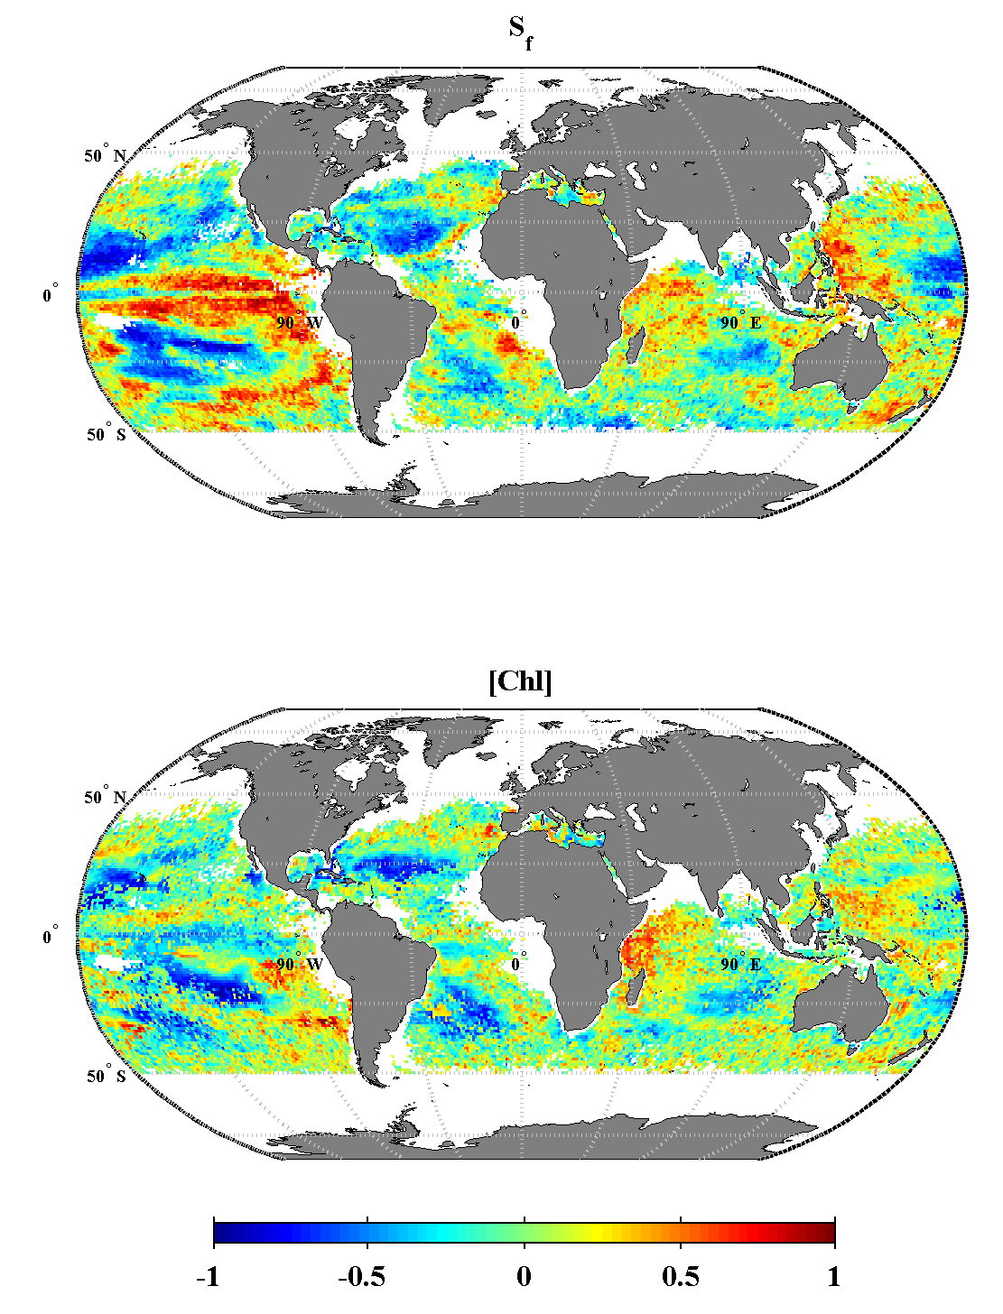
Joint EOF – Mode 1
Amplitude time series
– mirror over zero of individual S_{fm} mode 1
- Variance driven by S_{fm}

Slide 26
Effect of CDM/NAP on R_{rs}(λ)
a_{CDM/NAP}(443) varying
Constant Chl = 0.5 mg m⁻³
Constant S_{f} = 50%
Increasing a_{CDM/NAP}(443) lowers the blue region of the R_{rs} spectra
R_{rs} (sr⁻¹)
Wavelength (nm)
Mouw & Yoder, 2010

Slide 27
Detectable Ranges
If LUT ∆nRrs(443) > SeaWiFS NE∆nR_{rs}(443)
Beyond detection
R_{rs} (sr⁻¹)
a_{CDM/NAP} (443) (m⁻¹)
Wavelength (nm)
SeaWiFS has the sensitivity to retrieve S_{fm}
Chlorophyll 0.05 - 1.75 mg m⁻³
a_{CDM}(443) < 0.17 m⁻¹
Of decadal mean imagery,
84% of [Chl]
99.7% of a_{CDM}(443)
fall within thresholds
Chlorophyll (mg m⁻³)
Mouw & Yoder, 2010

Slide 28
Look-up-table Construction
Full factorial design
Independently varied [Chl], S_{f}, & a_{CDM/NAP} over expected ranges for the global ocean
For a given combination of IOPs, AOPs are calculated via radiative transfer
Mouw & Yoder, 2010

Slide 29
Correction
In situ HPLC observations matched to nearest pixel of LAC & GAC R_{rs}(443) imagery.
GSM01 inversion products calculated from R_{rs}(443) pixels
LUT nRrs(443) that varies only due to S_{f}
In situ HPLC estimated S_{f} & SeaWiFS nR_{rs}(443)
Correction factor = LUT nR_{rs}(443)/SeaWiFS nR_{rs}(443)
nR_{rs}(443) (sr⁻¹)
Corrected nR_{rs}(443) (sr⁻¹)
GSM [Chl] (mg m⁻³)
Mouw & Yoder, 2010

Slide 30
Correction
Regression
black > 3 std dev.
Extreme removed
initial
Evaluate how well the correction surface represents the point data & identify outliers
Surface correction
Point correction
Point correction
Outliers
Red = extreme
blue = > 3 std dev.
Remaining data points
Mouw & Yoder, 2010

Slide 31
Correction
Log₁₀ nR_{rs}(443) (sr⁻¹)
Linear relationship of high quality data points
Correction surface applied to imagery
Extrapolated to extremes of detectable ranges
SeaWiFS nR_{rs}(443) multiplied by correction factor for a [Chl] & nR_{rs}(443) pair
Log₁₀ nR_{rs}(443) (sr⁻¹)
Log₁₀ GSM [Chl] (mg m⁻³)
Mouw & Yoder, 2010

Slide 33
Comparison with other functional type retrievals
June 2000
Uitz et al. 2006

Slide 34
Comparison to other PFT retrievals
Uitz et al. 2006
June 2000

Slide 35
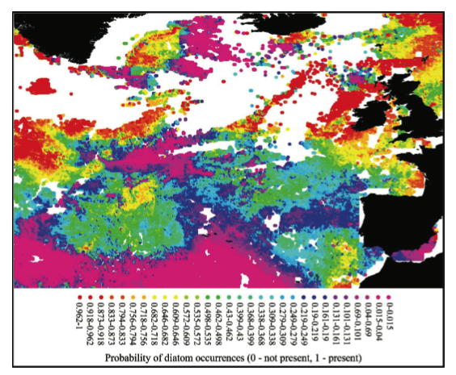
Comparison to other PFT retrievals
Raitsos et al. 2008
2nd week of May 1999

Slide 36
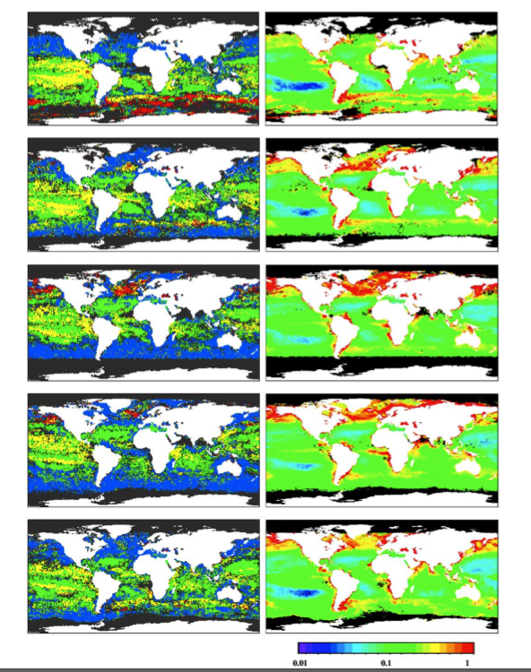
Comparison to other PFT retrievals
2001
PFT
Chl a
Jan
Alvain et al. 2005
Blue- hyptophyes
Green - Prochlorococcus
Yellow - Synechococcus-like cyanobacteria
Red - diatoms
Apr
Jun
Aug
Oct

Slide 37
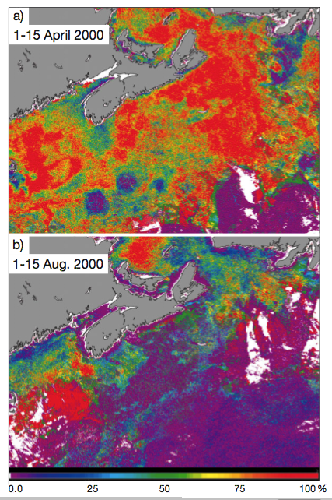
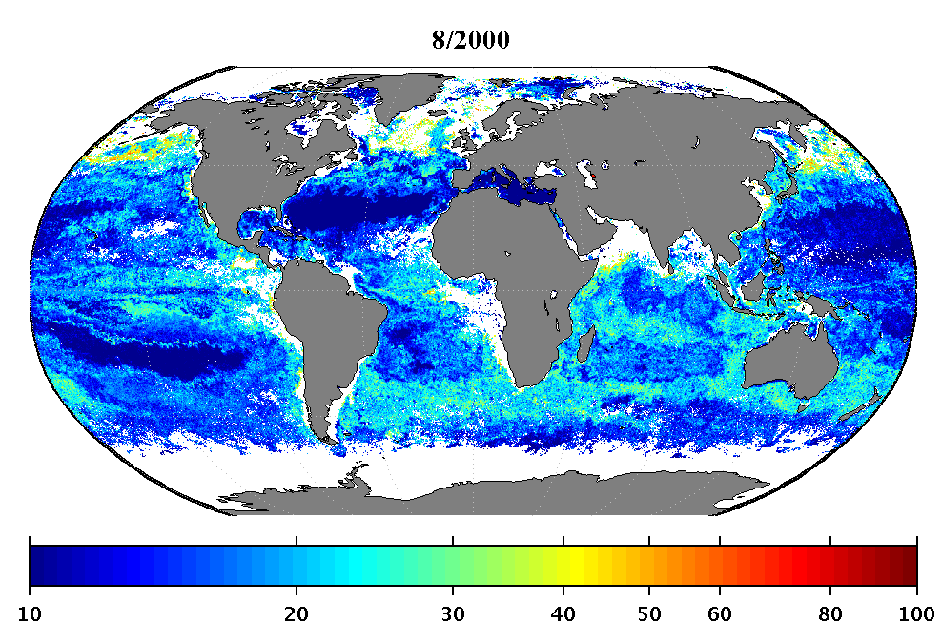
Comparison with other PFT retrievals
April 2000
August 2000
Sathyendranath et al. 2004

Slide 38
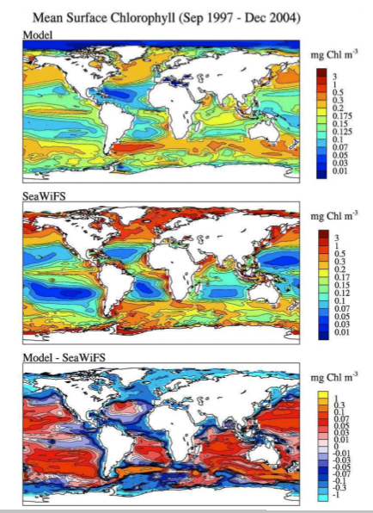
Model [Chl] vs. SeaWiFS [Chl]
Doney et al. 2009

Slide 39
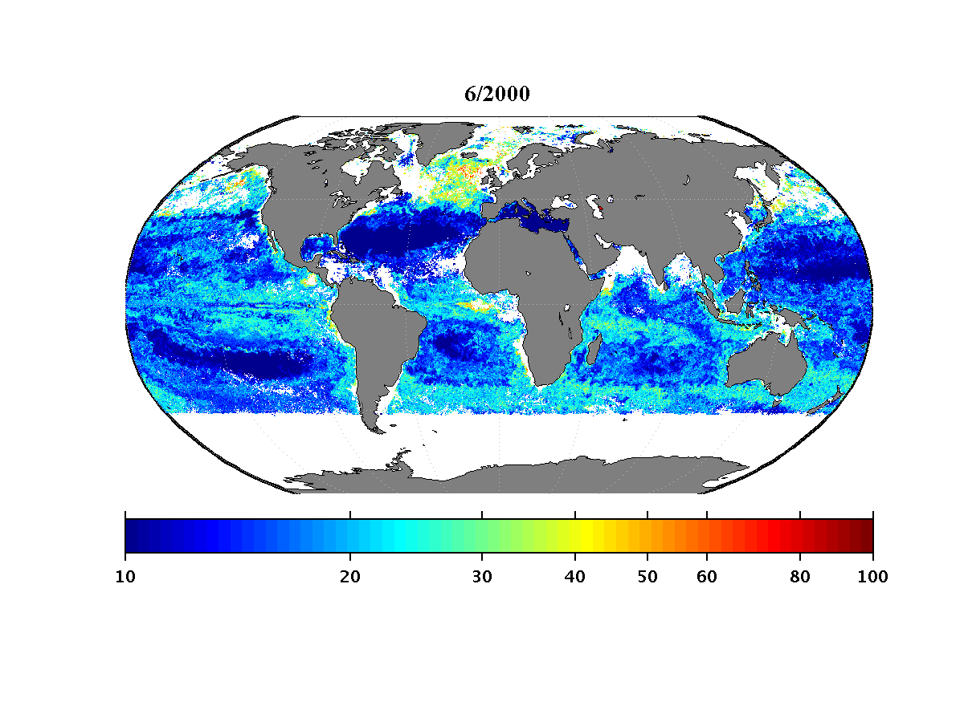
Comparison with other functional type retrievals
Uitz et al. 2006
Mouw & Yoder, in press
June 2000
 | Uitz et al. 2006 | Mouw & Yoder, in press
Median | 0.02 | 0.0058
mean | 0.012 | 0.0054
Std. dev. | 0.883 | 0.2315

Slide 40
Comparison with other Functional Type Retrievals
Mission mean (Sept. 1997 – Dec. 2007)
Mouw & Yoder, in press
Kostadinov et al. 2010
r²=0.60, RMSE =12.64
r²=0.415, RMSE =17.1

Slide 41
Correction Scheme
Mouw & Yoder, 2010

Slide 42
Correction
Mouw & Yoder, 2010

Slide 43
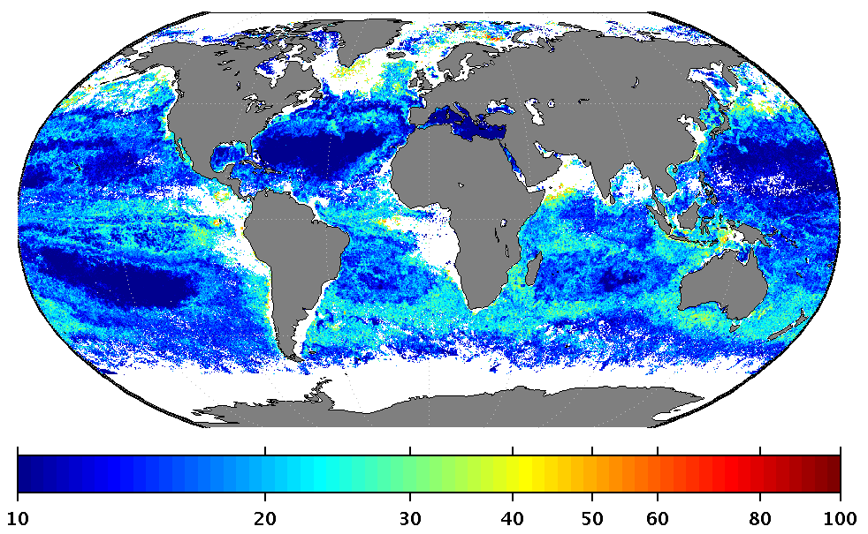
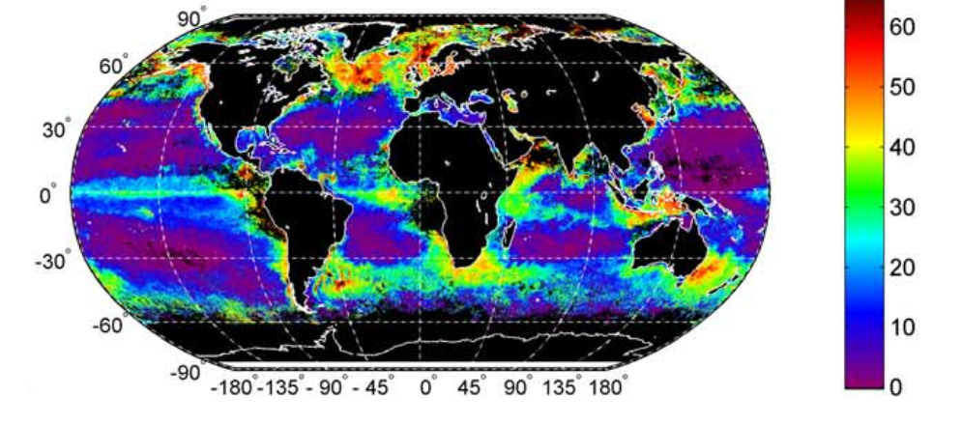
Comparison with other functional type retrievals
June 2000
August 2007
Uitz et al. 2006
Kostadinov et al. 2009

