Slide 1

Development Of A Globally Consistent Aqua MODIS Fluorescence Line Height (FLH) Record And Its Science Applications
Funded through The Science of Aqua and Terra (NNX11AE64G)
PI: Toby K. Westberry,
CoI’s: Michael J. Behrenfeld, Allen J.Milligan

Slide 2
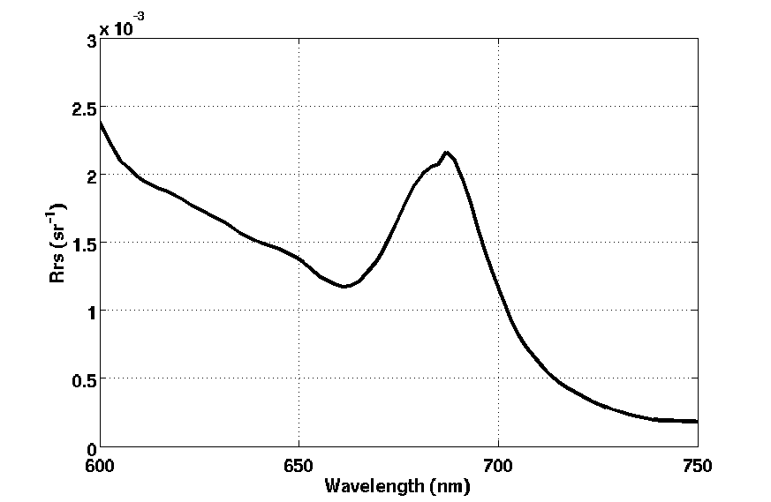
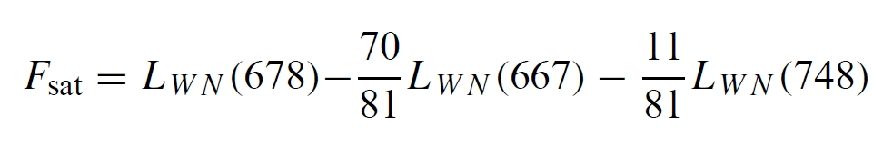
MODIS Fluorescence Line Height (FLH)
A geometric definition
Can be related to total fluoresced flux (e.g., Huot et al., 2005)
Band 13
Band 14
Band 15

Slide 3
Fluorescence Basics
Three primary factors regulate global phytoplankton fluorescence distributions:
pigment concentrations
(2) “pigment packaging”, a self-shading phenomenon influencing light absorption efficiencies (Duysens 1956; Bricaud et al., 1995, 1998).
(3) a photoprotective response aimed at preventing high-light damage (i.e., “nonphotochemical quenching”, NPQ)
Notes:
3

Slide 4
Relating FLH to
ϕ
FLH = Chl_{sat} x <a_{ph}*> x PAR x x S
satellite
chlorophyll
chlorophyll-
specific
absorption
fluorescence
quantum
yield
subtract small F_{sat} value of 0.001 mW cm⁻² um⁻¹ sr⁻¹ to
satisfy requirement that FLH = 0 when Chl = 0
Notes:
radiometric uncertainty of MODIS fluorescence band is +/- 0.003 mW cm-2 um-1 sr-1

Slide 5
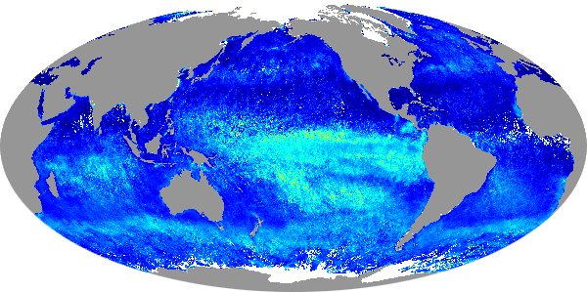
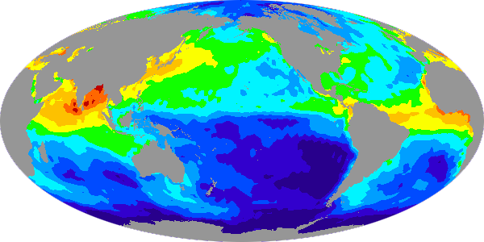
Fluorescence Quantum Yields (ϕ, or FQY)
Spring 2004
2.0%
1.5%
φ_{sat} (%)
1.0%
0.5%
0%
1
0.1
Soluble Fe deposition
( ng m⁻² s⁻¹ )
0.01
0.001

Slide 6
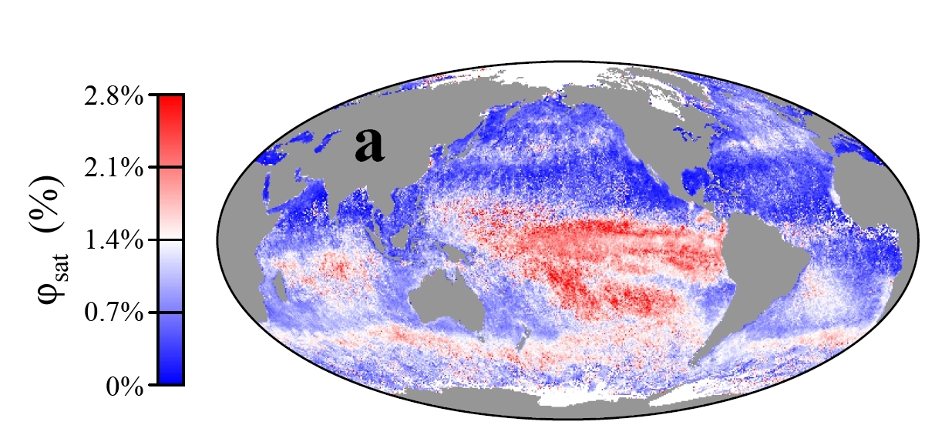
Fluorescence Quantum Yields (ϕ, or FQY)
A
B
C
D
E
F
Figure 3.Global climatological φ, calculated from 2004-2005 Aqua MODIS FLH. Some HNLC regions (C, E) exhibit elevated φ, while others do not, such as the subarctic NE Pacific (A) and high latitude Southern Ocean (F). Conversely, non-HNLC regions also exhibit elevated φ and are suggested to be driven by iron limitation (D) or other factors (B).

Slide 7
Main Proposed Tasks
1. Re-evaluate and compare alternative corrections for pigment packaging using results from semi-analytic inversion models
2. Determine appropriate NPQ correction from FLH, iPAR data
3. Develop an adequate correction for retrieved fluorescence yields from phytoplankton communities acclimated to different light environments
4. Examine mission time series of FLH-derived products for long term variations and correspondence with independent global environmental indices
Notes:
Also uncertainty analyses and data distribution w/ Measures

Slide 8
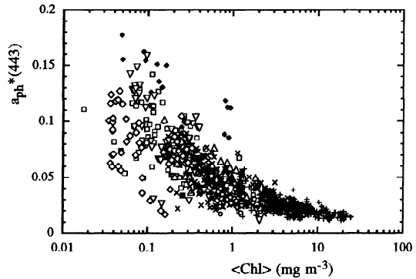
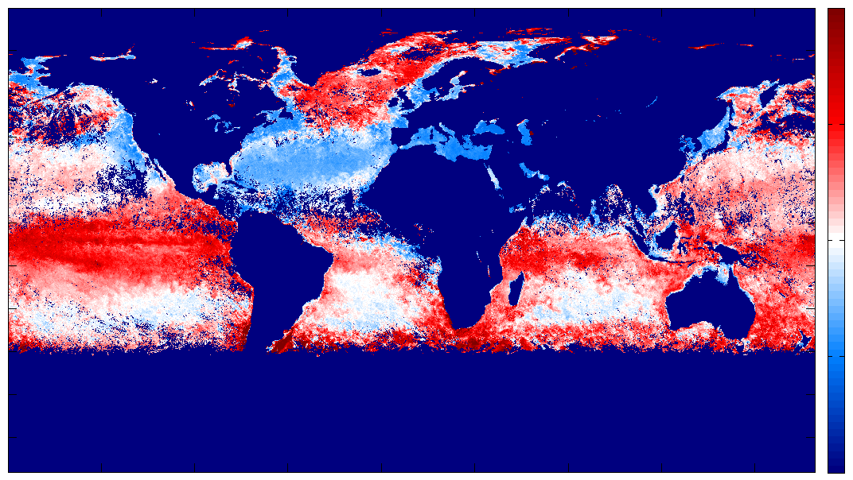
Pigment Packaging
We currently use Bricaud et al. (1998)
Differences have and “oceanographic” looking pattern
Ratio of a_{ph}(443) from QAA to a_{ph}(443) from B98
2.0
1.5
a_{ph}*(443)
1.0
0.5
0
Chlorophyll (mg m⁻³)
Notes:
8

Slide 9
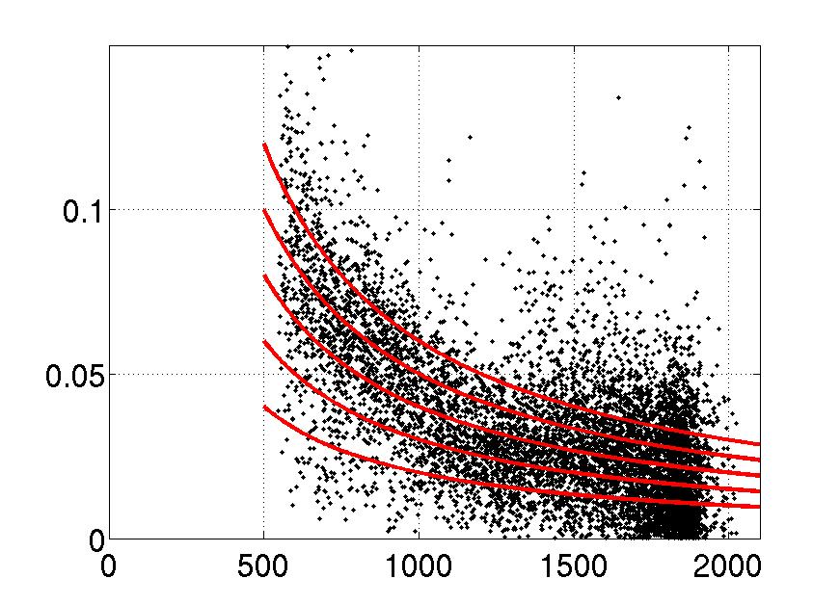
Non-photochemical quenching (NPQ)
1
iPAR
Package corrected FLH/Chl
Package corrected FLH/Chl
iPAR (μmol photon m⁻² s⁻¹)
iPAR (μmol photon m⁻² s⁻¹)

Slide 10
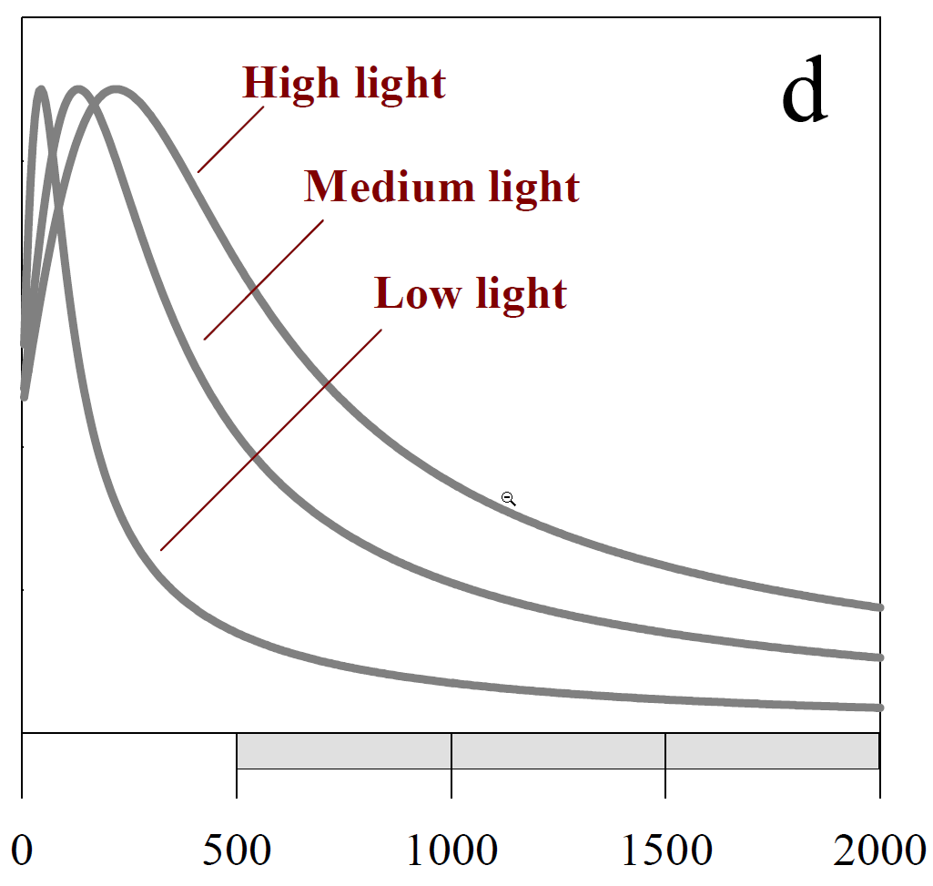
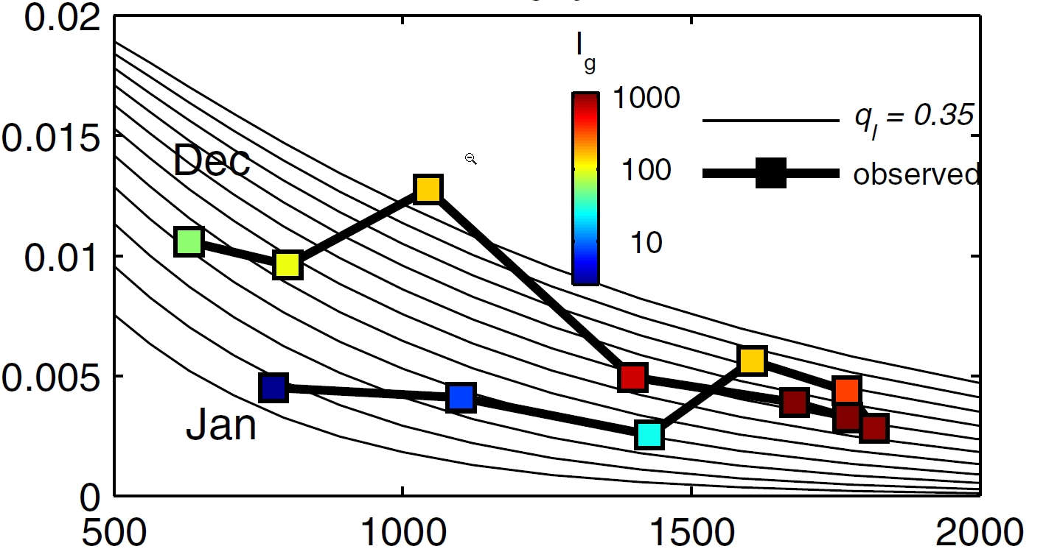
Photoacclimation
A
B
φ (relative)
φ
0 500 1000 1500 2000
iPAR (μEin m⁻² s⁻¹)

Slide 11
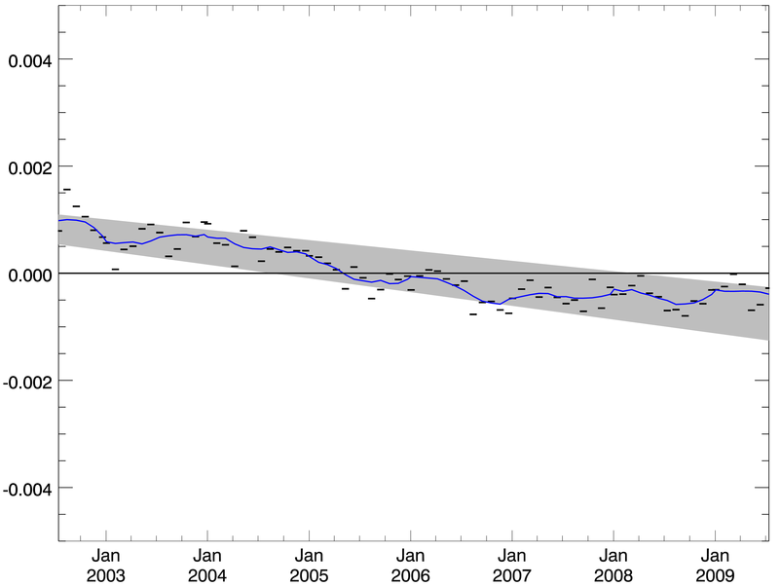
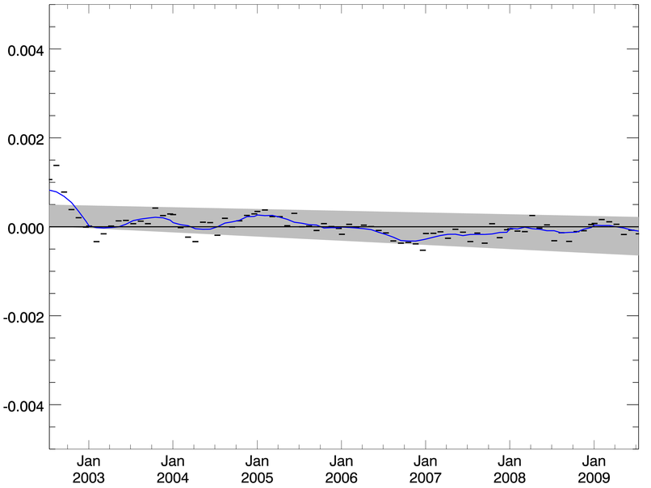
FLH trends
Before reprocessing
After reprocessing
FLH (dimensionless)
2003 2004 2005 2006 2007 2008 2009
2003 2004 2005 2006 2007 2008 2009
Removal of calibration related trends allows us to look for “real” climate signals

Slide 12
End

