Slide 1
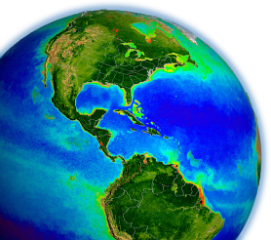
Achieving Consistency in the Multi-Mission Ocean Color Data Record
Bryan Franz
and the
NASA Ocean Biology
Processing Group
MODIS Science Team Meeting
19 May 2011 – College Park, MD
Notes:
here I'll focus on ocean color radiometry and the derived chlorophyll record
explain what we mean by cdr
how we achieve and assess the progess
show results and identify some remaining issues

Slide 2
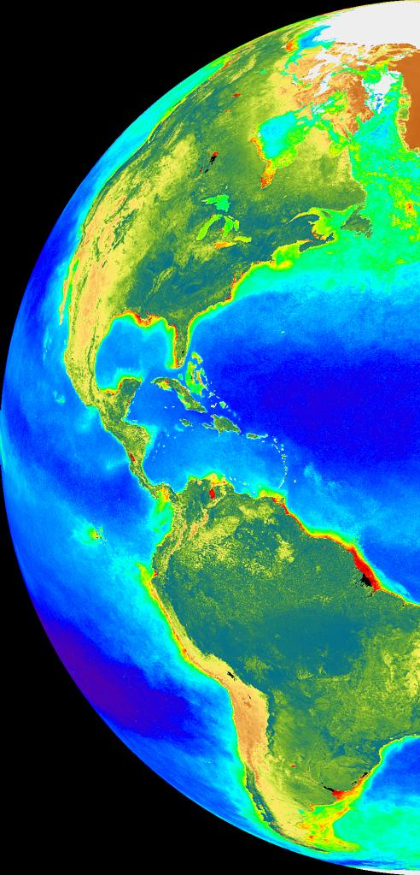
Outline
How we define a Climate Data Record
How we achieve CDR quality
Results of latest reprocessing effort
Future directions
Notes:
mostly from prospective of global change research

Slide 3
What is a Climate Data Record?
"A climate data record is a time series of measurements of sufficient length, consistency, and continuity to determine climate variability and change."
U.S. National Research Council, 2004
Notes:
US NRC defines a cdr as a time-series ...
multi-decadal scale

Slide 4
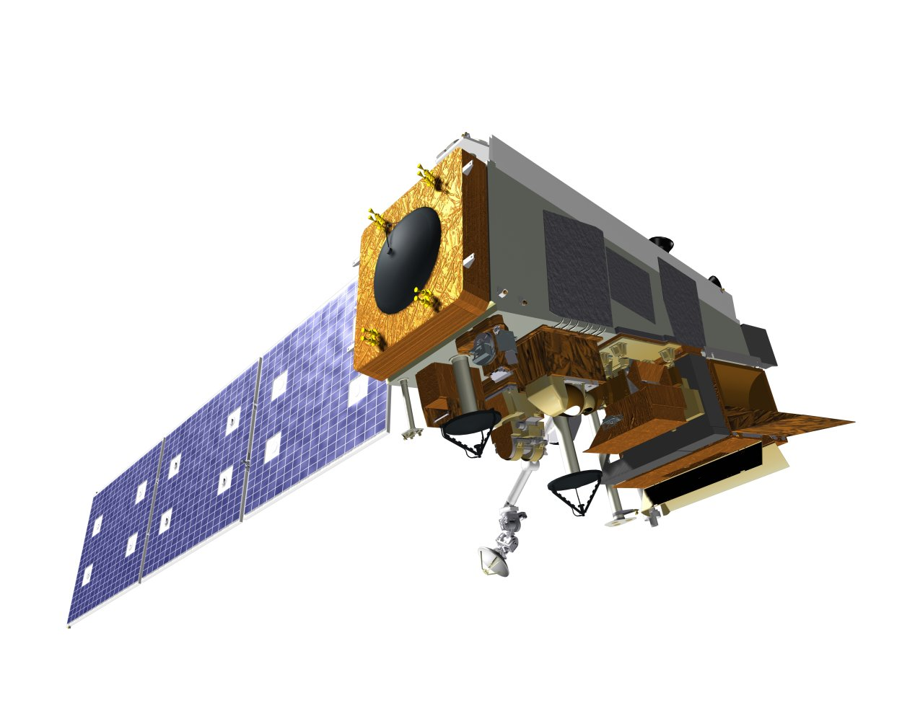
Length & continuity requires multiple missions
1980
1985
1990
1995
2000
2005
2010
CZCS (NASA)
OCTS
SeaWiFS (NASA)
MODIS-Terra (NASA)
NPP/VIIRS
Oct 2011 launch
MODIS-Aqua (NASA)
MERIS (ESA)
Notes:
missions in green are those that our group has responsibility for
i'll also show comparison with ESA 's MERIS mission
all sensors on the right have similar ocean color capabilities in terms of spectral range and global sampling
and the data is freely available
i'll focus here on the continuous data record since the launch of SeaWiFS in 1997
continuity of the data record requires consistent transitions between missions, as sensors reach end of life and new missions come online

Slide 5
How do we achieve consistency?
Notes:
pre-launch characterization and on-orbit calibration through lunar or solar observations
looking for evidence of residual instrument artifacts, and, where we have overlap, assessing mission-to-mission consistency
i'll be showing some of this trend analysis in the slides that follow

Slide 6
How do we achieve consistency?
Focus on instrument calibration
establishing temporal and spatial stability within each mission
Notes:
pre-launch characterization and on-orbit calibration through lunar or solar observations

Slide 7
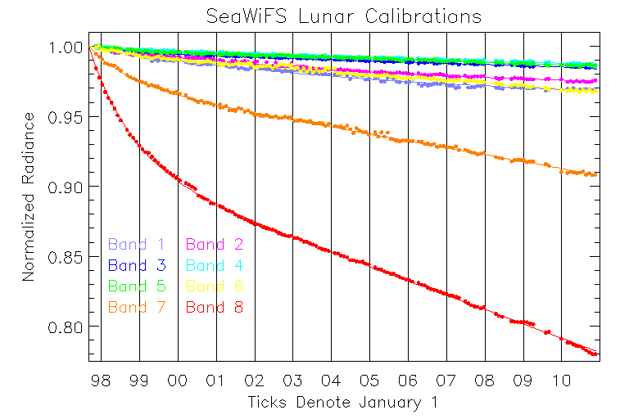
SeaWiFS Sensor Degradation
3%

Slide 8
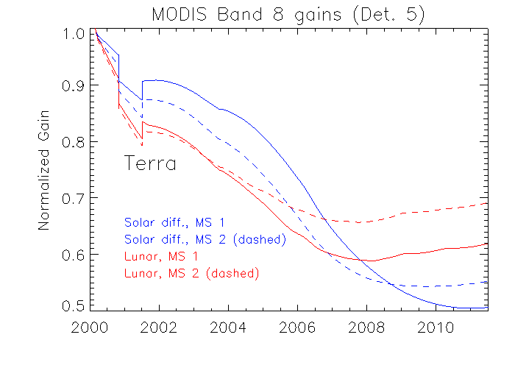
MODIS Lunar and Solar Calibration Trends
MODIS 412nm Responsivity Changes Since Launch
0%
10%
20%
Gain
Terra
50%
30%
40%
50%
Notes:
based on lunar and solar calibration data
50% change in 412 (similar in 443)
difference between dashed lines and solid lines is mirror-side
each mirror-side degrades differently leading to banding artifacts
difference between blue lines (solar) and red line (lunar) is assumed to be related to angle of incidence on scan mirror, since
lunar is measured near beginning of the scan, solar is measured near the end of scan
how mcst tracks change in response versus scan angle

Slide 9
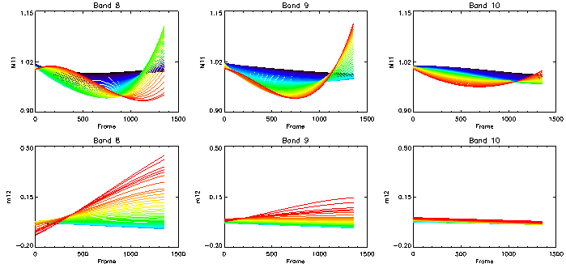
MODIS-Terra Vicarious On-orbit Characterization
relative to preliminary MCST collection 6 calibration
412
443
488
+15%
RVS
-10%
Polarization
Scan Pixel
Scan Pixel
Scan Pixel
Time
2000 2011

Slide 10
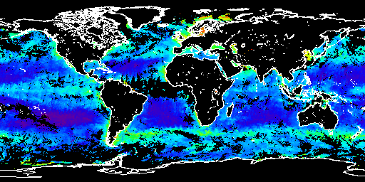
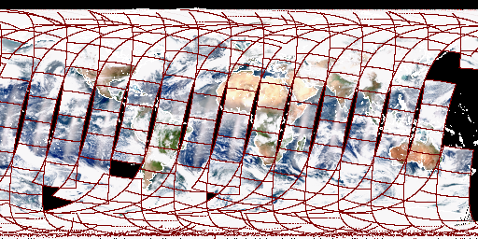
Vicarious Instrument Recharacterization to assess change in RVS shape and polarization sensitivity
L_{m}(λ) = M₁₁L_{t}(λ) + M₁₂Q_{t}(λ) + M₁₃U_{t}(λ)
SeaWiFS 15-Day Composite nLw(λ)
Vicarious calibration:
given L_{w}(λ) and MODIS geometry, we can predict L_{t}(λ)
Global optimization:
find best fit M₁₁, M₁₂, M₁₃ to relate L_{m}(λ) to L_{t}(λ)
where M_{xx} = fn(mirror aoi)
per band, detector, and m-side
MODIS Observed TOA Radiances

Slide 11
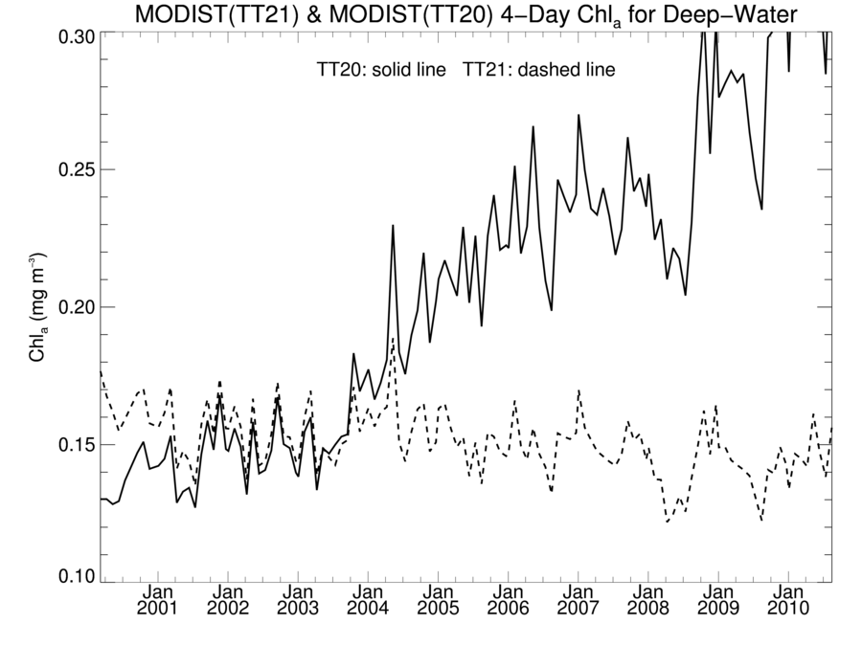
Effect of MODIST Recharacterization on Chlorophyll Global Deep-Water Trend
Before
100%
After
Notes:
w/o vicarious recharacterization, global marine biomass has doubled over 10 years

Slide 12
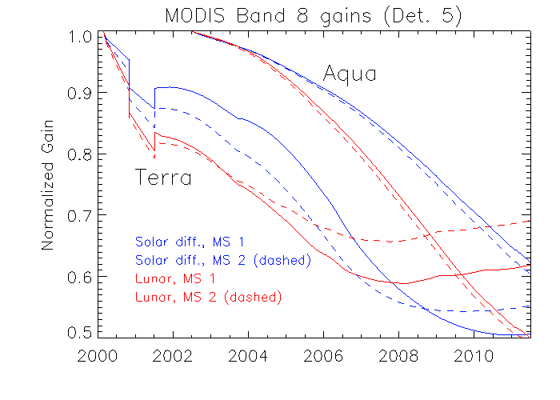
MODIS Lunar and Solar Calibration Trends
MODIS 412nm Responsivity Changes Since Launch
0%
Aqua
10%
20%
Terra
Terra
Gain
Terra
30%
40%
50%

Slide 13
How do we achieve consistency?
Focus on instrument calibration
establishing temporal and spatial stability within each mission
Notes:
pre-launch characterization and on-orbit calibration through lunar or solar observations
looking for evidence of residual instrument artifacts, and, where we have overlap, assessing mission-to-mission consistency
i'll be showing some of this trend analysis in the slides that follow

Slide 14
How do we achieve consistency?
Focus on instrument calibration
establishing temporal and spatial stability within each mission
Apply common algorithms
ensuring consistency of processing across missions
Notes:
pre-launch characterization and on-orbit calibration through lunar or solar observations
looking for evidence of residual instrument artifacts, and, where we have overlap, assessing mission-to-mission consistency
i'll be showing some of this trend analysis in the slides that follow

Slide 15
Sensor-Independent Approach
ancillary data
sensor-specific tables:
Rayleigh, aerosol, etc.
SeaWiFS L1A
MODISA L1B
MODIST L1B
OCTS L1A
MOS L1B
OSMI L1A
CZCS L1A
MERIS L1B
OCM-1 L1B
OCM-2 L1B
VIIRS-L1B
observed
radiances
Multi-Sensor
Level-1 to Level-2
(common algorithms)
water-leaving
radiances and
derived prods
Level-2 Scene
Level-3 Global
Product
Level-2 to Level-3
Notes:
MERIS
Vicarious cal, common source

Slide 16
How do we achieve consistency?
Focus on instrument calibration
establishing temporal stability within each mission
Apply common algorithms
ensuring consistency of processing across missions
Apply common vicarious calibration approach
ensuring spectral and absolute consistency of water-leaving radiance retrievals under idealized conditions
Notes:
pre-launch characterization and on-orbit calibration through lunar or solar observations
looking for evidence of residual instrument artifacts, and, where we have overlap, assessing mission-to-mission consistency
i'll be showing some of this trend analysis in the slides that follow

Slide 17
Sensor-Independent Approach
ancillary data
sensor-specific tables:
Rayleigh, aerosol, etc.
SeaWiFS L1A
MODISA L1B
MODIST L1B
OCTS L1A
MOS L1B
OSMI L1A
CZCS L1A
MERIS L1B
OCM-1 L1B
OCM-2 L1B
VIIRS-L1B
observed
radiances
Multi-Sensor
Level-1 to Level-2
(common algorithms)
in situ water-leaving
radiances (MOBY)
water-leaving
radiances and
derived prods
predicted
at-sensor
radiances
Level-2 Scene
vicarious calibration
gain factors
Level-3 Global
Product
Level-2 to Level-3
Notes:
well characterized, NIST traceable Marine Optical Buoy near Lanai, Hawaii

Slide 18
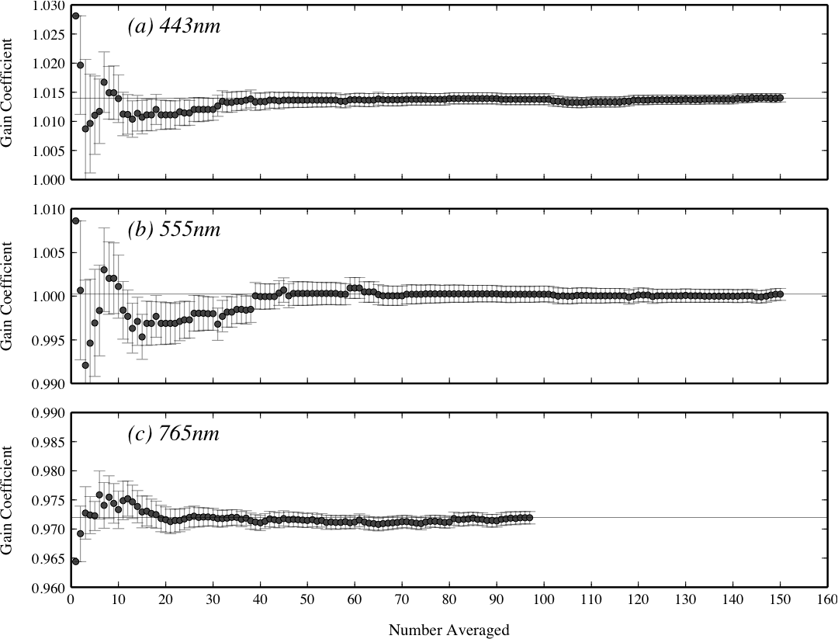
Cumulative mean vicarious gain
It requires many samples to reach a stable vicarious calibration, even in clear (homogeneous) water with a well maintained instrument (MOBY)
SeaWiFS to MOBY
Franz, B.A., S.W. Bailey, P.J. Werdell, and C.R. McClain, F.S. (2007). Sensor-Independent Approach to Vicarious Calibration of Satellite Ocean Color Radiometry, Appl. Opt., 46 (22).
Notes:
case of Terra, temporally adjusted using seawifs, absolutely calibrated using MOBY

Slide 19
How do we achieve consistency?
Focus on instrument calibration
establishing temporal stability within each mission
Apply common algorithms
ensuring consistency of processing across missions
Apply common vicarious calibration approach
ensuring spectral and absolute consistency of water-leaving radiance retrievals under idealized conditions
Perform detailed trend analyses (hypothesis testing)
assessing temporal stability & and mission-to-mission consistency
Notes:
looking for evidence of residual instrument artifacts, and, where we have overlap, assessing mission-to-mission consistency
i'll be showing some of this trend analysis in the slides that follow

Slide 20
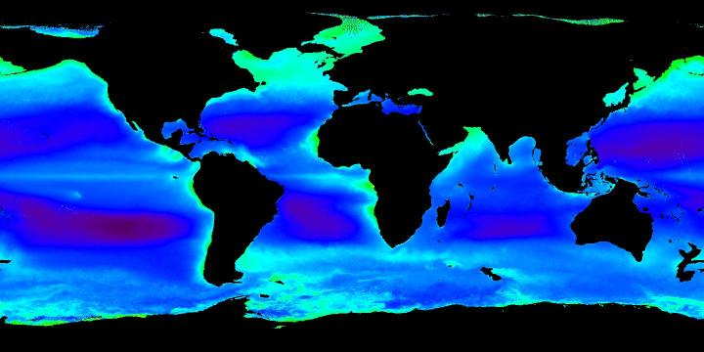
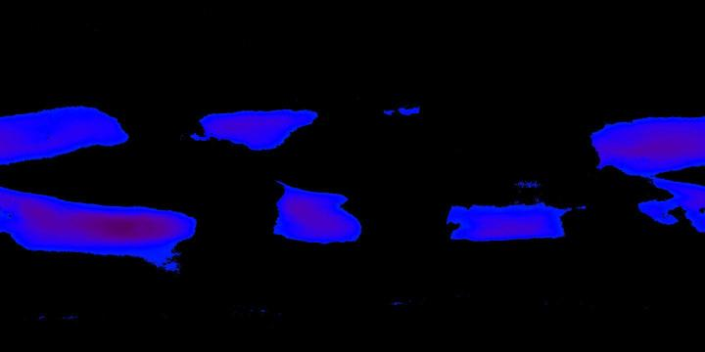
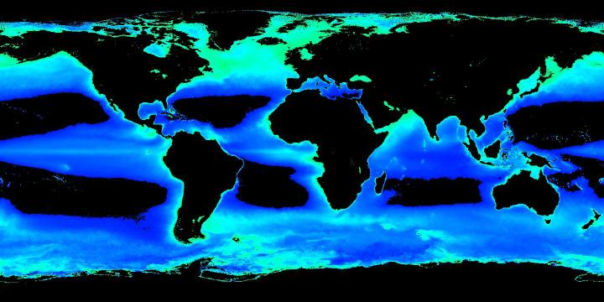
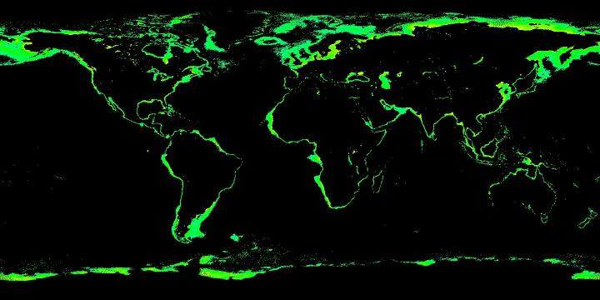
Trophic Subsets
Deep-Water (Depth > 1000m)
Oligotrophic (Chlorophyll < 0.1 mg m⁻³)
Mesotrophic (0.1 < Chlorophyll < 1)
Eutrophic (1 < Chlorophyll < 10)
Notes:
in doing so, we often stratify the data in geographic or trophic subsets
these are some that i'll be showing today
deep, olig, ...
these are areas that are typically low, medium, high chl
want to stress that these are fixed geographic regions

Slide 21
How do we achieve consistency?
Focus on instrument calibration
establishing temporal and spatial stability within each mission
Apply common algorithms
ensuring consistency of processing across missions
Apply common vicarious calibration approach
ensuring spectral and absolute consistency of water-leaving radiance retrievals under idealized conditions
Perform detailed trend analyses (hypothesis testing)
assessing temporal stability & and mission-to-mission consistency
Reprocess multi-mission timeseries
incorporating new instrument knowledge and algorithm advancements
Notes:
as instruments age, radiometric performance degrades, and more advanced algorithms are developed. so, we >> must << periodically reprocess.

Slide 22
Latest Multi-Mission Ocean Color Reprocessing
Scope: MODISA, MODIST, SeaWiFS, OCTS, CZCS
Status:
MODISA completed April 2010 (update in progress)
SeaWiFS completed September 2010
OCTS completed September 2010
MODIST completed January 2011
CZCS in progress
Highlights:
incorporated sensor calibration updates**
regenerated all sensor-specific tables and coefficients
improved aerosol models based on AERONET
additional correction for NO2
updated chlorophyll a and Kd algorithms based on NOMAD v2
http://oceancolor.gsfc.nasa.gov/WIKI/OCReproc.html
Notes:
recently completed a comprehensive reprocessing of all NASA's modern ocean color instruments, including SeaWIFS, MODIS on Terra and Aqua, and OCTS
first time ever to reprocess Terra for ocean color
-- working on CZCS now –
you can read the details of changes on the ocean color web
let me focus on results

Slide 23
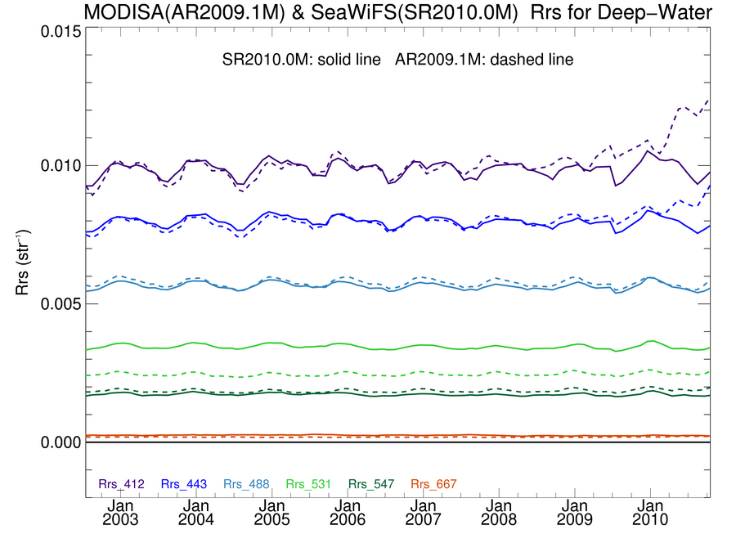
MODISA Rrs in good agreement with SeaWiFS
Deep-Water
solid line = SeaWiFS R2010.0
dashed = MODISA R2009.1
412
443
within 5%
at all times
Rrs (str⁻¹)
488 & 490
510
531
547 & 555
667 & 670
Notes:
overlapping time-series of SeaWIFS and MODIS/Aqua water-leaving reflectance
aqua is the dashed lines
these are monthly means over all deep water
see very good agreement in the common wavelengths
agreement about 2% on average, 5% over all time

Slide 24
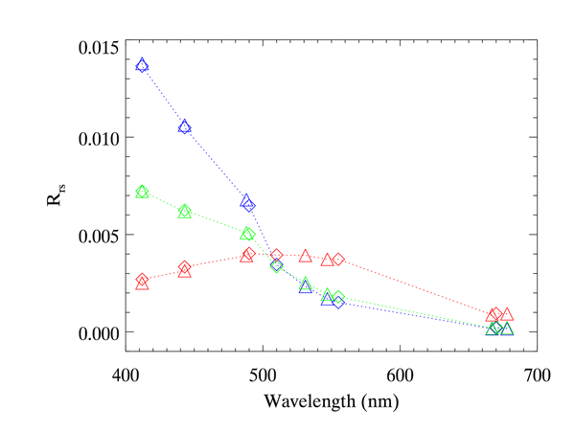
Mean spectral differences agree with expectations
SeaWiFS
MODISA
oligotrophic
mesotrophic
eutrophic
488
490
547 & 555
Notes:
uncharacterized out-of-band response, stray light (coastal)

Slide 25
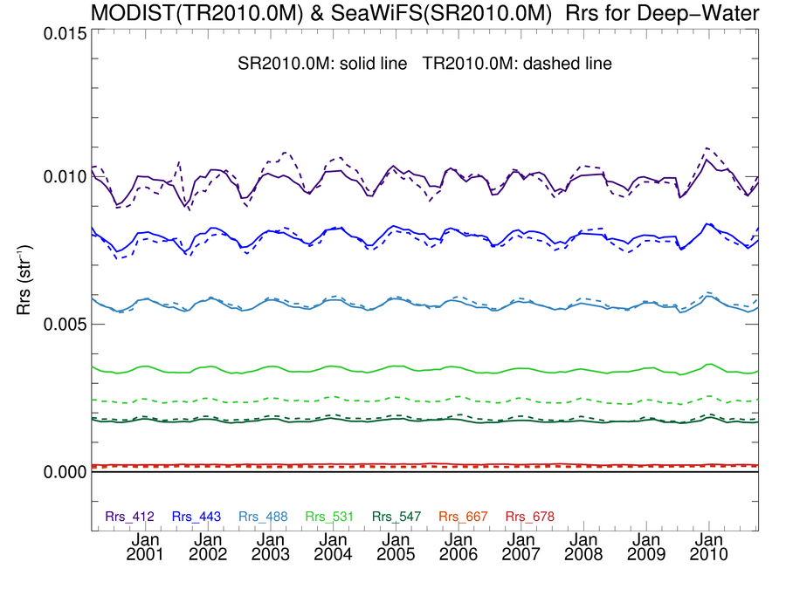
MODIST Rrs in good agreement with SeaWiFS
Deep-Water
solid line = SeaWiFS R2010.0
dashed = MODIST R2010.0
412
443
Rrs (str⁻¹)
488 & 490
510
531
547 & 555
667 & 670

Slide 26
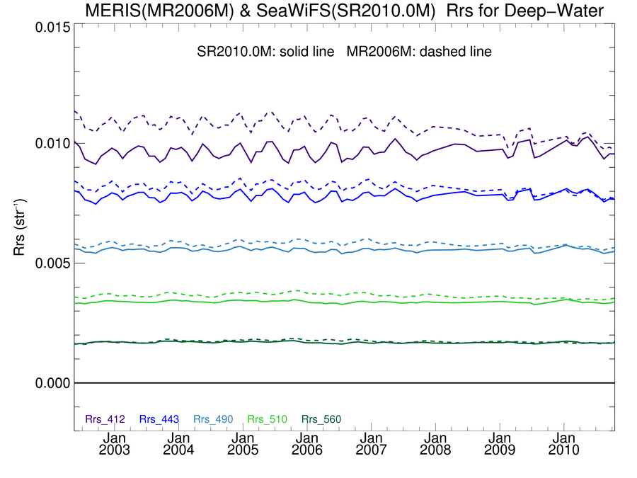
MERIS Rrs is biased relative to SeaWiFS
Deep-Water
solid line = SeaWiFS R2010.0
dashed = MERIS R2 (2006)
412
443
MERIS 3rd reprocessing underway. Updated instrument calibration and new vicarious adjustment should reduce biases and trends relative to SeaWiFS.
Notes:
similar but different processing algorithms, no vicarious calibration, and no instrument calibration updates since 2006.

Slide 27
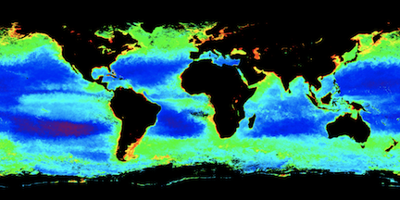
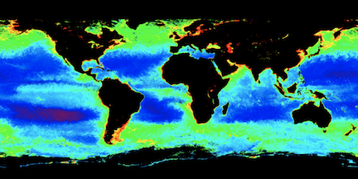
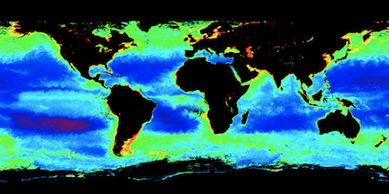
Chlorophyll spatial variation in good agreement
SeaWiFS
Fall 2002
MODIS/Aqua
MODIS/Terra
Notes:
2002-2003 el nino

Slide 28
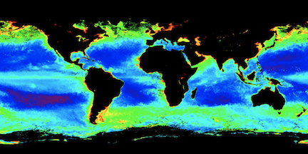
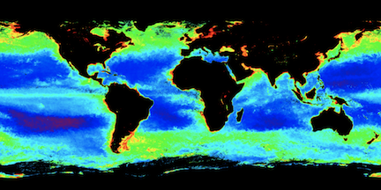
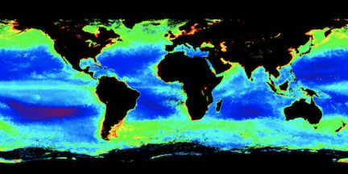
Chlorophyll spatial variation in good agreement
SeaWiFS
Fall 2008
MODIS/Aqua
MODIS/Terra
Notes:
202-203 el nino

Slide 29
Chl_{a} in Good Agreement with Global In situ
SeaWiFS
vs
in situ
MODISA
vs
in situ

Slide 30
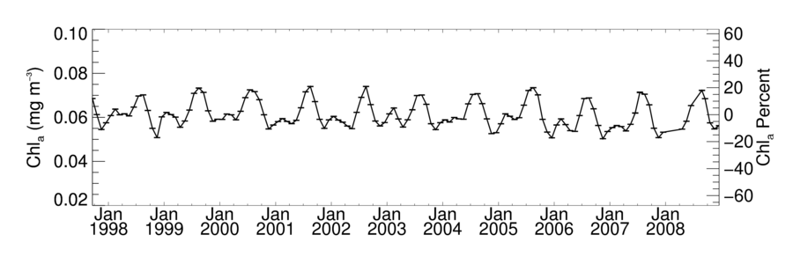
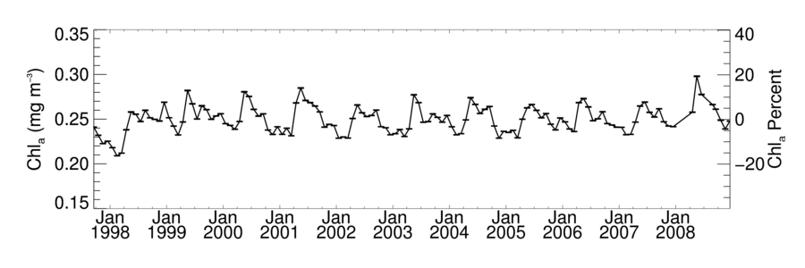
Global Chlorophyll Timeseries
Oligotrophic Subset
SeaWiFS
Mesotrophic Subset
SeaWiFS

Slide 31
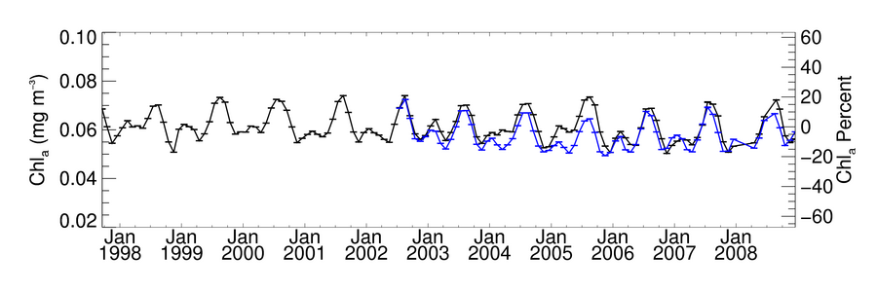
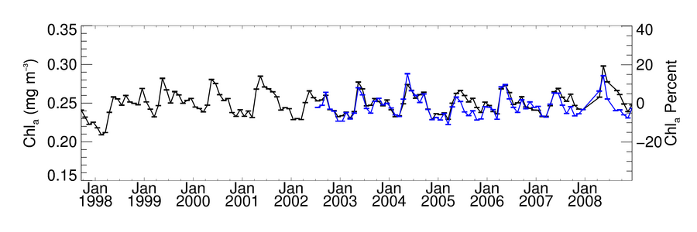
Global Chlorophyll Timeseries
Oligotrophic Subset
SeaWiFS MODISA
Mesotrophic Subset
SeaWiFS MODISA

Slide 32
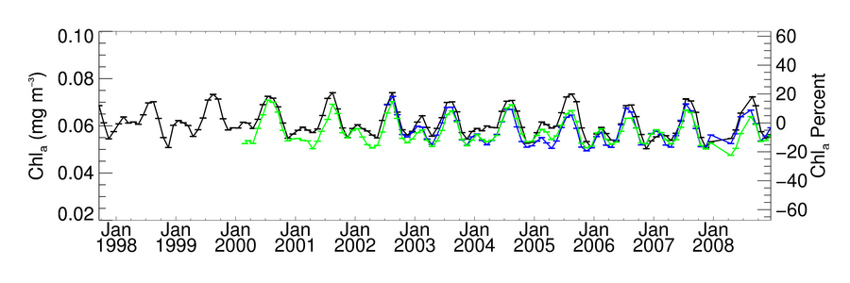
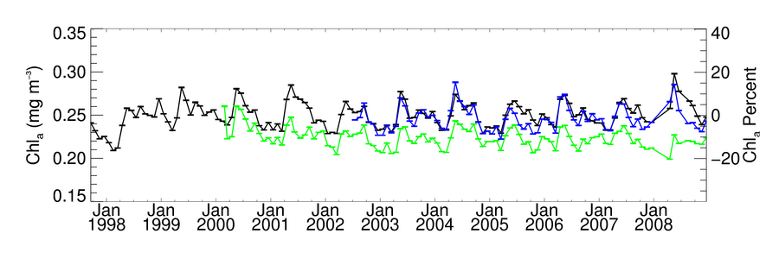
Global Chlorophyll Timeseries
Oligotrophic Subset
before reprocessing
SeaWiFS MODISA MODIST
Mesotrophic Subset
before reprocessing
SeaWiFS MODISA MODIST

Slide 33
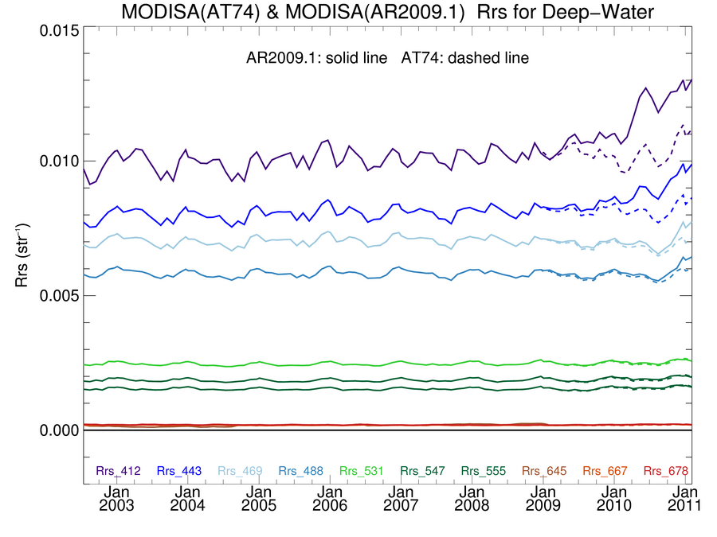
Coming Soon! Late Mission Reprocessing of MODISA
Notes:
Final SeaWiFS reprocessing
Final C6 calibration LUT
working on methods to maintain the calibration of Aqua and Terra without seawifs

Slide 34
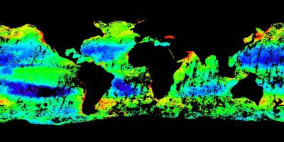
We will soon have the full MERIS Level-1B dataset enabling reprocessing with NASA algorithms
ESA-NASA bulk data exchange (lead Martha Maiden)
All MERIS L1B for all of MODIS and SeaWiFS (L1A on media)
MERIS FR data by June
MERIS RR data by September
redistribution rights
MERIS
Chlorophyll
Oct. 2003
ESA 2006
Reprocessing
Notes:
part of a larger NASA-ESA bilateral agreement

Slide 35
Summary
SeaWiFS has provided the first decadal-scale climate data record for ocean chlorophyll and, by proxy, phytoplankton biomass.
MODIS/Aqua open-ocean timeseries in very good agreement, suggesting the potential to extend the CDR into the future.
but biases remain that vary by bioregime (20% high in eutrophic waters)
revised calibration model / reprocessing needed to fix late mission trends
MODIS/Terra in much better agreement with SeaWiFS & MODIS/Aqua, but after extensive recharacterization using SeaWiFS.
not an independent climate data record beyond seasonal scale
MERIS needs reassesment after revised ESA calibration and reprocessing with common NASA algorithms.
Common algorithms is an essential first step to multi-mission CDR.

Slide 36
characterization of instrument degradation is the primary challenge to development of ocean color climate data records
as it was for MODIS, so it will be for VIIRS ...

Slide 37
