Slide 1
NASA’s Earth Science Division
Bureaucratic Overview for the MODIS Science Team
18 May 2011

Slide 2
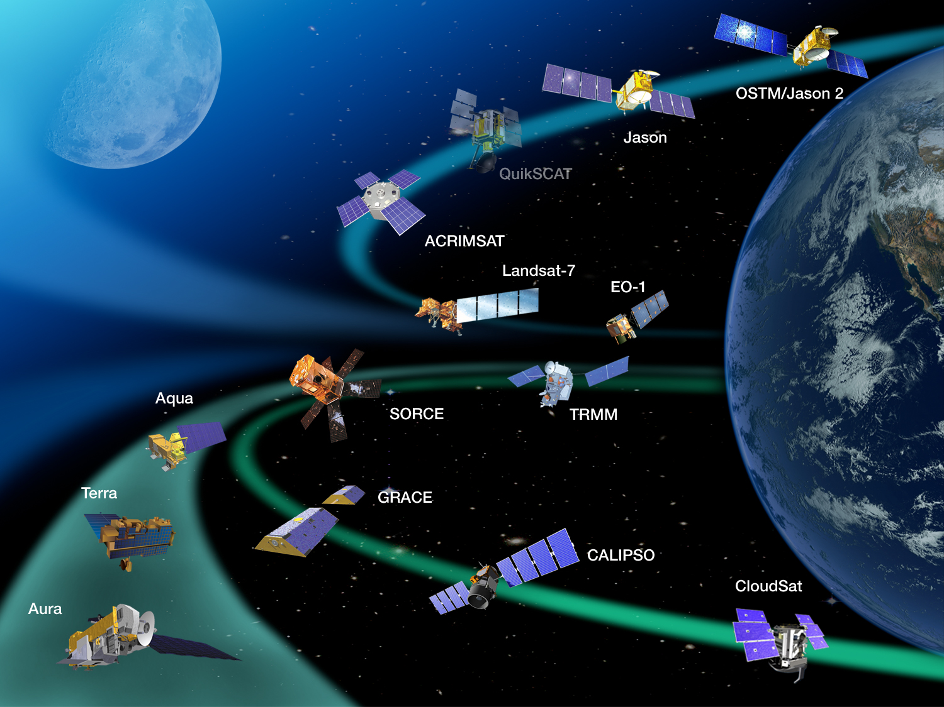
NASA Operating Missions (International Collaboration)
Senior Review during 2011
- Science
- National Needs
- Technical
- Recommendations 6/11
Batt !!
Batt !!
Batt !!

Slide 3
BUDGET OUTLOOK (incl. FY11 Appropriation)
FY11 PB
FY12 PB
FY10 PB
Previous Admin.

Slide 4
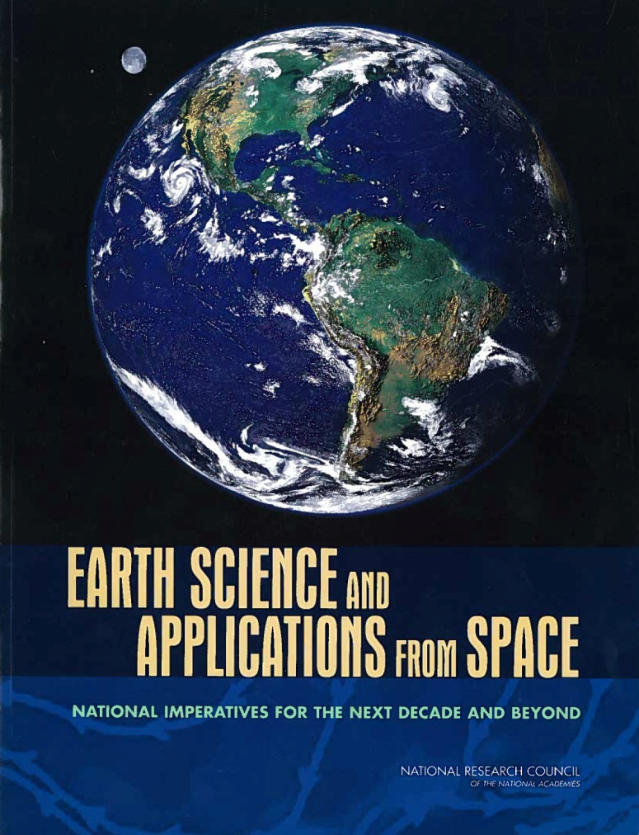
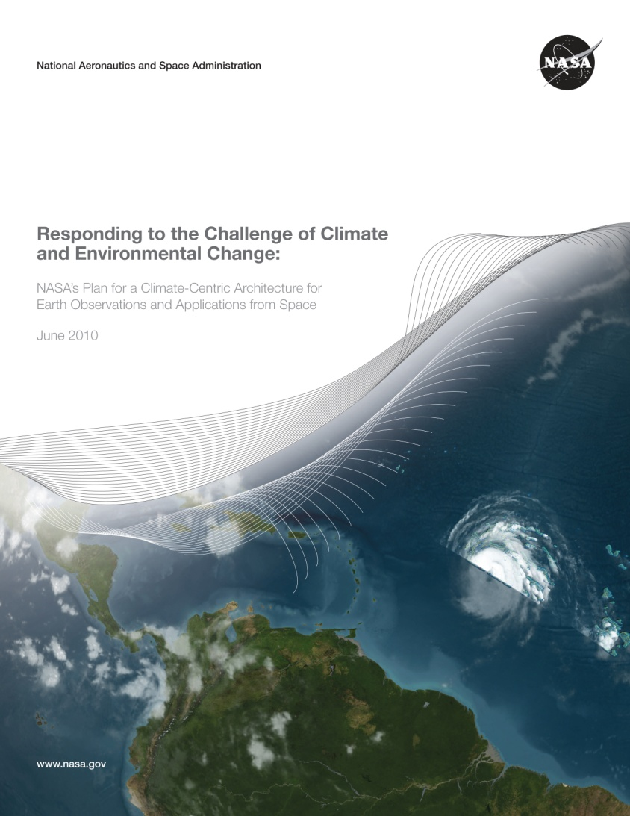
Guiding Recommendation Documents
Administration priorities
and constraints
Decadal survey,
OCO-2,
climate continuity
missions,
balanced program
Integrated Program
2007 Decadal Survey
  http://science.nasa.gov/media/
  medialibrary/2010/07/01/
  Climate_Architecture_Final.pdf
Research and Applications communities
priorities
No realistic budget constraint (calls for
$2B funding [FY06 constant $$
beginning in FY10)
Dec Surv + Administration priorities
Executable for FY11 Pres. Bud.
OSTP, USGCRP, OMB approval
Notes:
4

Slide 5
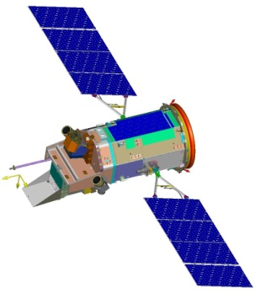
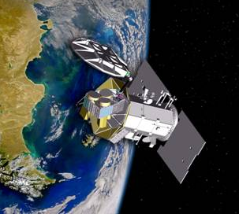
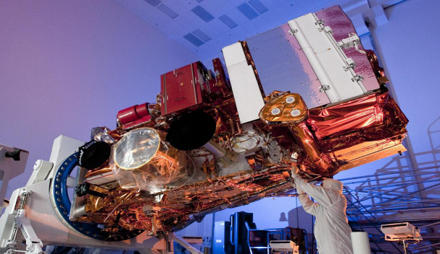
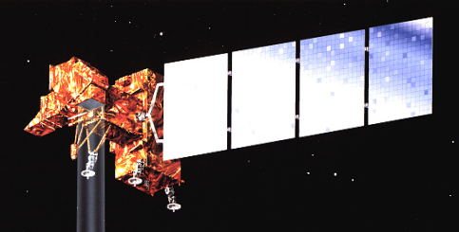
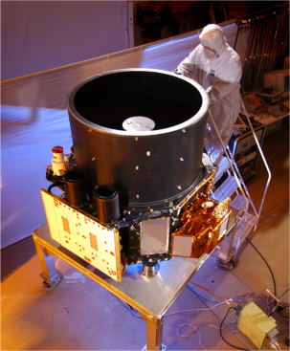

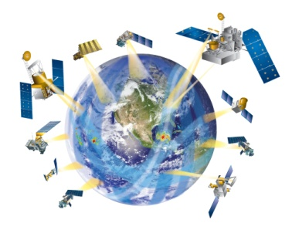
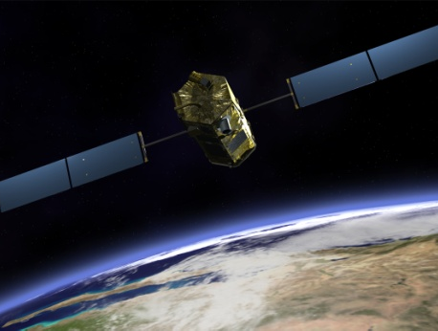
Missions in Formulation and Implementation – 4/2011
X
GLORY
3/4/2011
Aerosols, TSI
AQUARIUS
6/9/2011
w/CONAE; SSS
NPP
10/25/2011
w/NOAA
EOS cont., Op Met.
LDCM
12/2012
w/USGS; TIRS
ICESat-II
Likely 2016
Ice Dynamics
SMAP
Early CY2015
w/CSA
Soil Moist., Frz/Thaw
GPM
7/2013 ???
w/ JAXA; Precip
OCO-2
2013 ???
Global CO₂

Slide 6
Glory Aftermath/Status
  Glory mission was lost - LV failure (fairing non-sep) on 4 March
    Total Irradiance Monitor (TIM) and Aerosol Polarimetry Sensor (APS) + Cloud Cameras
    Refurbished Vegetation Canopy Lidar satellite bus
    Taurus-XL failure has similar manifestations to OCO loss (24 Feb 2009)
  Way forward: Glory
    Carbon-copy Glory recovery mission will not be developed – VCL bus obsolete
  Way forward: TIM
    SORCE, ACRIMSAT missions continuing through at least 2016
    TSIS instrument development passed KDP-C in 1/2011 (reimbursable, NOAA-funding to NASA SMD/JASD)
    Instrument delivery planned late CY2012; no s/c or LV yet identified
  Way forward: APS
    Science viability study – 90-days (due late June)
      Utility of flight of APS-capability sensor in 3-5 years
      Possible NRC (or ESS) review
    Implementation study for APS replacement mission – 120 days (late July)
      Cost, schedule, instrument approach, satellite approach, LV
    No recovery mission without top-line ESD budget augmentation
      Same programmatic approach as for OCO-2
Notes:
6

Slide 7
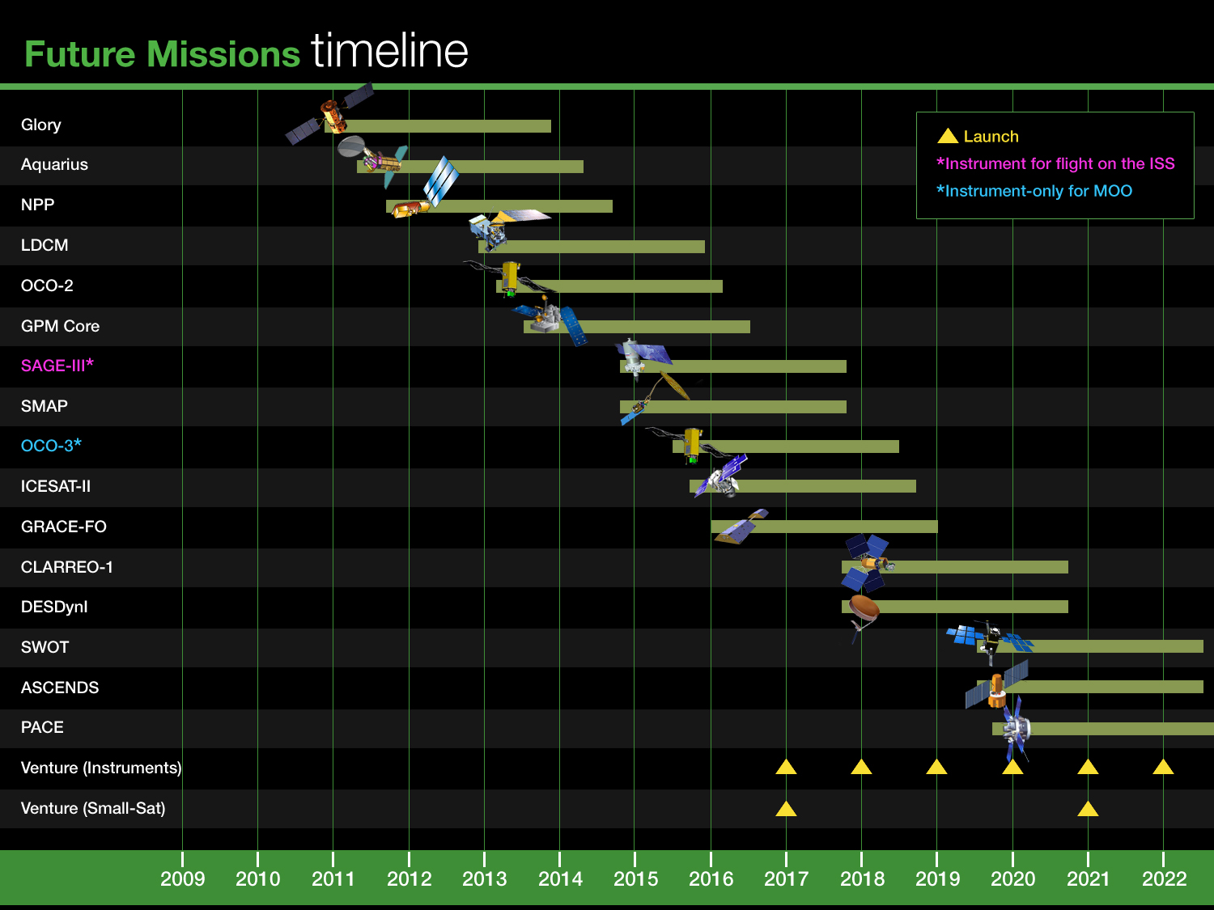
Future Orbital Flight Missions – 2011 – 2022
XX
XXXXXXXXXX
(International
contributions)
? - earthquake
Notes:
7

Slide 8
VENTURE-CLASS UPDATE/STATUS
  Venture-Class is a Tier-I Decadal Survey recommendation
    Science-driven, PI-led, competitively selected, cost- and schedule-constrained, regularly solicited, orbital and suborbital
    Venture-class investigations complement the systematic missions identified in the Decadal Survey, and provide flexibility to accommodate scientific advances and new implementation approaches
  Venture-Class is fully funded, with 3 “strands”
    EV-1: suborbital/airborne investigations (5 years duration)
      Solicited in FY09 (selections in FY10) and every 4 years
      5 investigations selected; flights beginning in FY11
    EV-2: small complete missions (5 years duration)
      Solicited in FY11 (selections in FY12) and every 4 years
      Small-sat or stand-alone payload for MoO; $150M total development cost
      Final AO release in May, 2011
    EV-Instrument: Spaceborne instruments for flight on MoO (5 years dev.)
      Solicited in FY11 (selections in FY12) and annually thereafter
      Final AO release in 2nd half of FY11
      ~$90M development costs, accommodation costs budgeted separately
      Common Instrument Interface specs being developed
Notes:
8

Slide 9












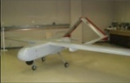
NASA Airborne Science Aircraft
80000
21km
(2) WB-57
(2) Global Hawk
70000
(2) ER-2
60000
15km
50000
(1) G-III
(1) DC-8
(1) Lear 23
Altitude (feet)
(1) Ikhana
40000
(3) B-200/UC12
9km
30000
(1) S-3B
(1) P-3B
20000
(1) Twin Otter
3km
10000
(1) SIERRA
0
0
5
10
15
20
25
30
Endurance (hours)

Slide 10
Airborne Science Program DS Missions
INTEX-B | 2006
CC-VEX | 2006
Arctic Sea Ice | 2006
INTEX-B | 2006
MILAGRO | 2006
WRAP | 2006-2009
Arctic Ice 2007 | 2007
CLASIC | 2007
TC-4 | 2007
ARCTAS | 2008
Calipso Caribean | 2008
CASIE | 2009
ASCENDS test flights | 2009
Racoro | 2009
GloPac | 2010
ABACATE | 2010
GLEAM | 2010
ASCENDS test flights | 2010
AID for ASCENDS | 2010
SIMPL | 2010
MACPEX | 2011
CAR | 2011
4Star | 2012
DC-3 | 2012
HEX | 2012
SEAC4RS | 2012
AVIRIS CONUS | 2006-2012
UAVSAR | 2006-2012
CLPX II | 2007-2008
SMAPVEX | 2008, 2010-11
OIB | 2009-2015
Earth Venture 1 | 2011-2014

Slide 11
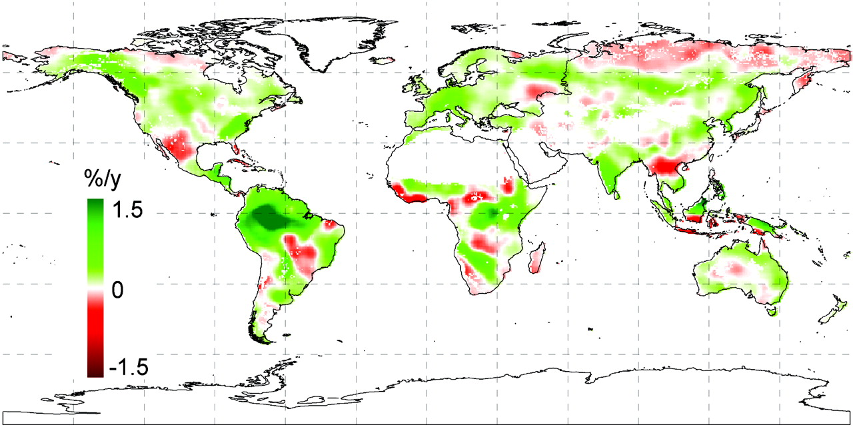
Climate change increased NPP from 1982 to 1999
AVHRR Data
Nemani et al., 2003, Science

Slide 12
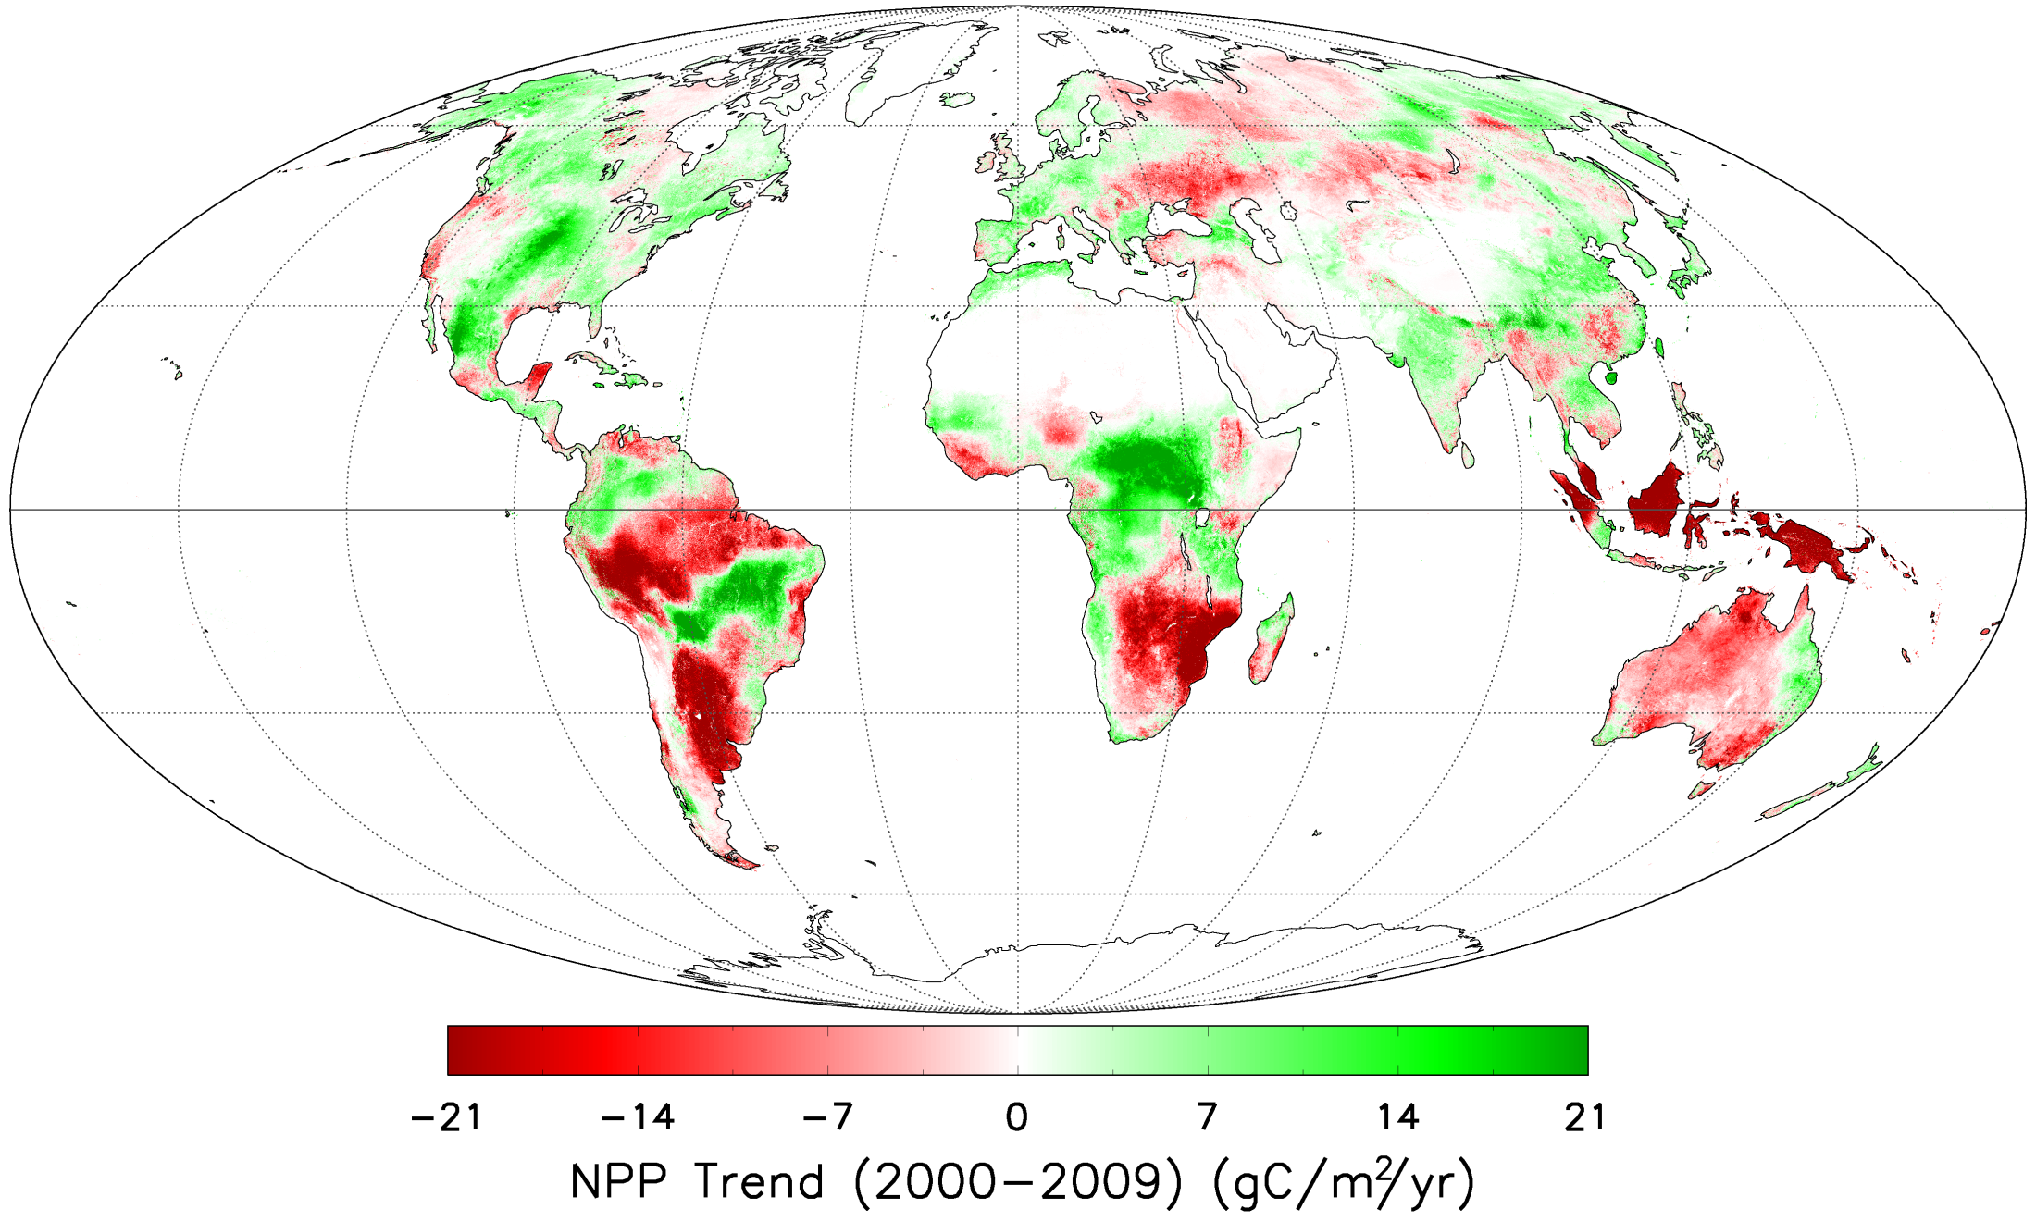
Drought Decreased NPP from 2000 - 2009
~0.1%/year decline
MODIS Data
Zhao & Running 2010, Science

Slide 13
KEY INTERAGENCY INTERACTIONS
  USGCRP (Global Change Research Program)
    Freilich is USGCRP Vice-Chair – Integrated Observations Lead
    Jack Kaye is ex-Acting USGCRP Chair, Integrated Strategic Planning Team member, NASA Principal
    NASA is a major contributor to the National Climate Assessment activity, the major contributor to USGCRP
  JPSS (Joint Polar Satellite System – ex-NPOESS)
    JASD Lead, coordinates with ESD
    ESD NPP mission will be used operationally after launch for JPSS
    Significant issues with NGST, NOAA
  USGS/DOI
    Landsat follow-on under discussion (reimbursable – will be JASD execution)
  Applied Science and R&A program investigations in collaboration with many Federal agencies (and non-Fed organizations)
    Field campaigns, joint solicitations, joint centers (e.g., JCSDA) support, collaborative multi-agency projects
Notes:
13

Slide 14
ESD Near-term Upcoming Launches
  Aquarius 6/2011 Delta-II
  NPP 10/2011 Delta-II
  LDCM 12/2012 Atlas-V (NLS-1 contract)
  OCO-2 2/2013 !! Taurus-XL !! (contract)
  GPM Core 7/2013 H-IIA (JAXA)
  [Jason-3 / NOAA 2014 ??] ?? (Taurus-XL was possible,
  LSTO in process)
  SMAP 3/2015 ?? (LSTO in process)
  SAGE-III 2015 SOMD – ATV, HTV to ISS
  ICESAT-2 2016 Atlas-V rideshare ??
  GRACE-FO 2016 Int’l Partnership
  [JPSS-1 / NOAA 2016/17 ??] ??
  OCO-3 (avail. 2015) is instrument for MoO, possibly ISS
Notes:
14

Slide 15
BACKUP

Slide 16
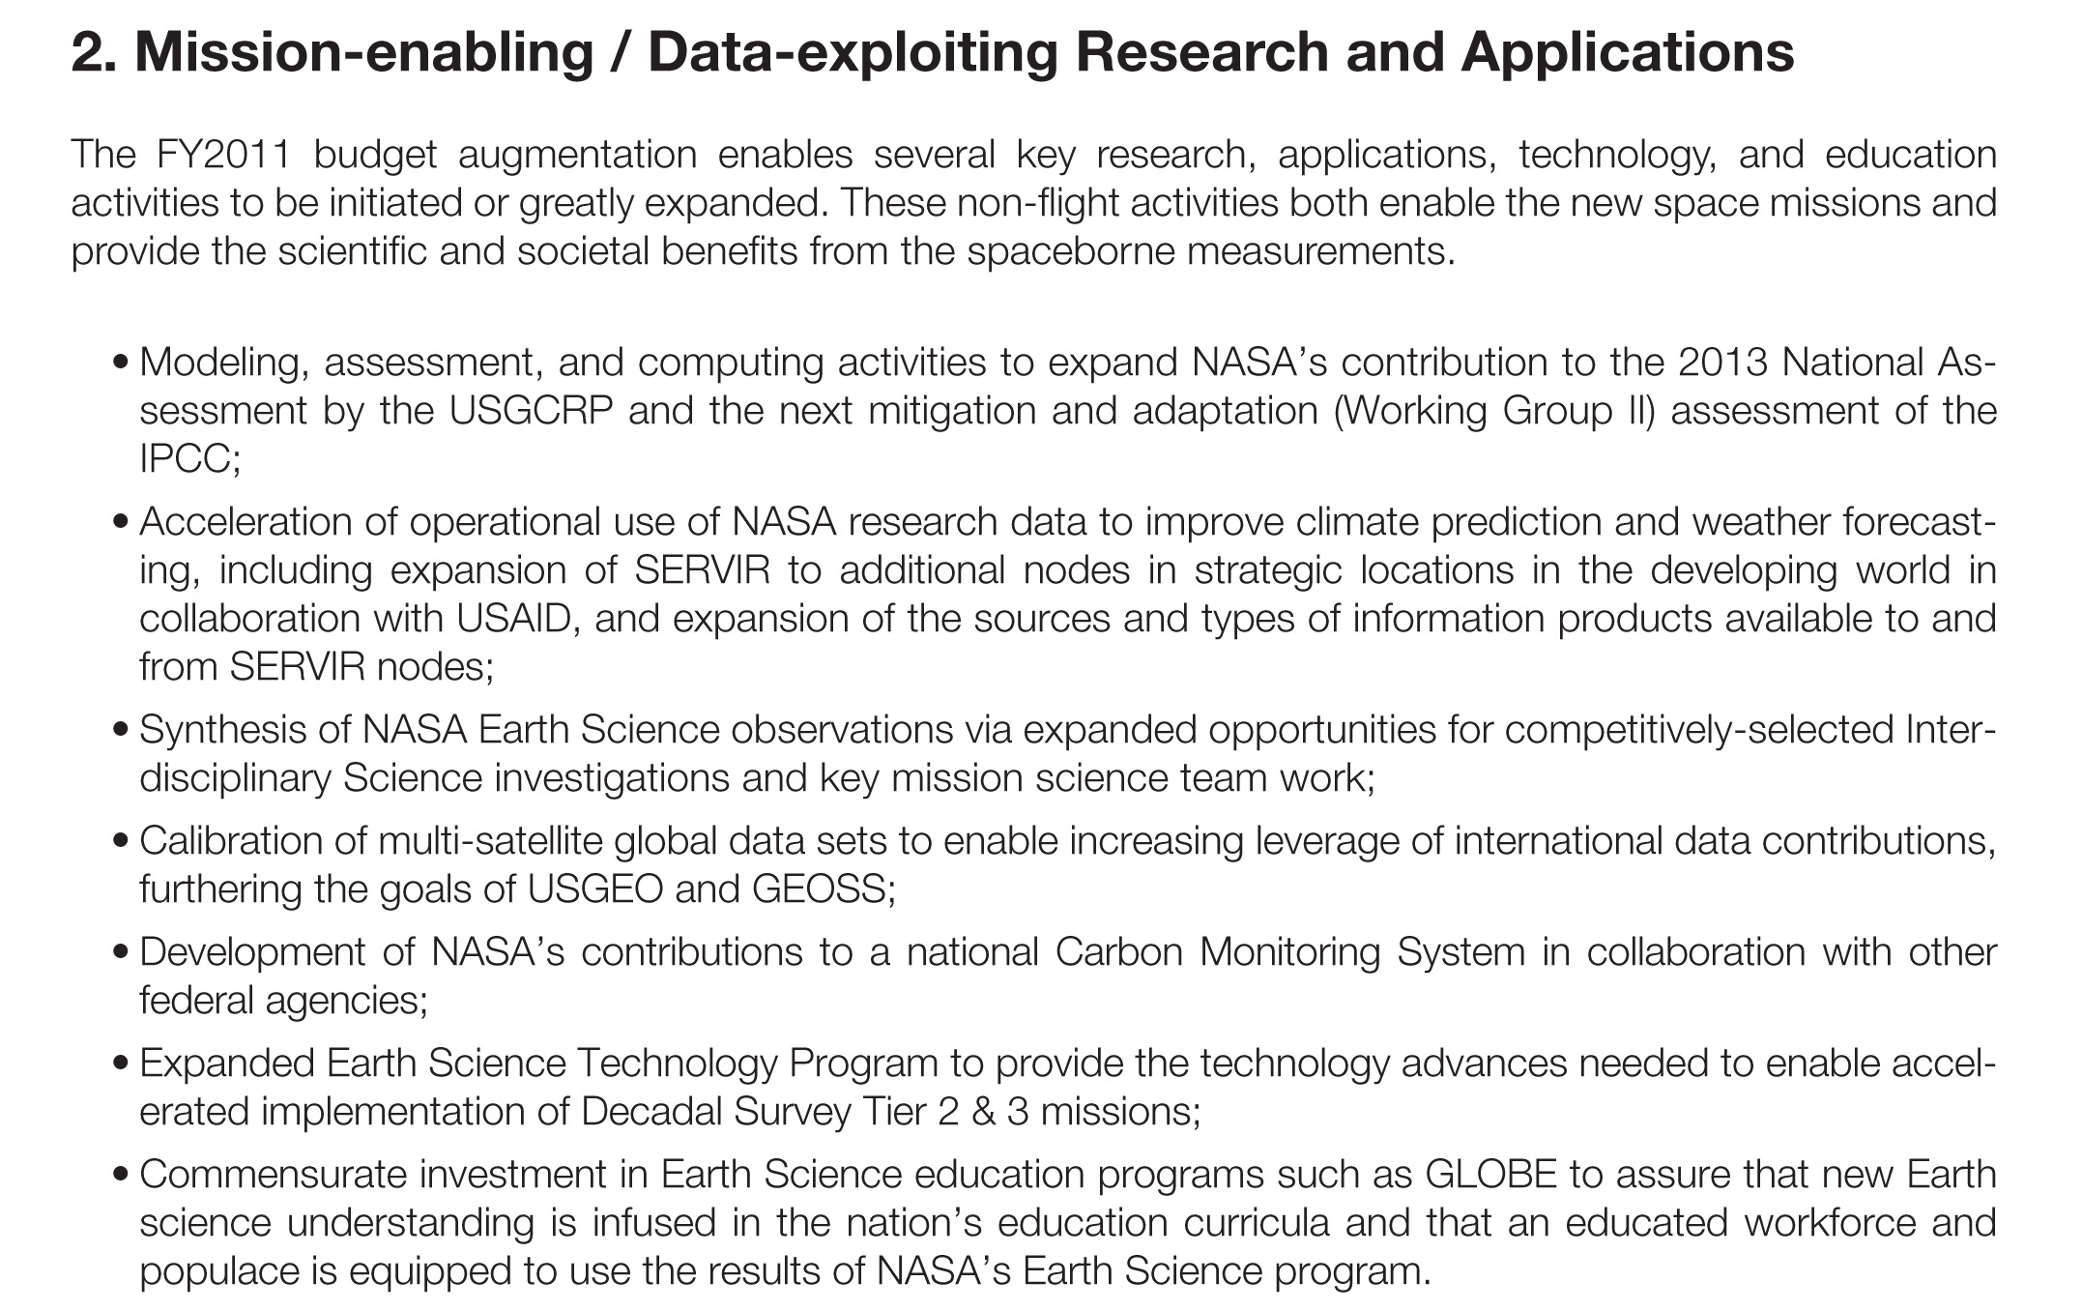
NON-FLIGHT RESEARCH AND APPLICATIONS
ACTIVITIES

Slide 17
Integrated Program for Water Availability/Quality
Precipitation
  TRMM (extended mission w/JAXA); Field Campaigns (e.g. GRIP,
  EV-1 Hurr. & Severe Storm Sentinel [HS3]); GPM (7/2013 w/ JAXA)
Soil Moisture and Freeze/Thaw State
  SMAP (5/2015 w/CSA)
Inland Waters
  SWOT (late 2019 w/CNES, CSA)
Subsurface Ground Water (Aquifer Volume Changes)
  GRACE (extended mission w/ Germany); GRACE-FO (2016 w/
  Germany)
Glacier and Ice Sheet Volume Changes and Dynamics
  ICEBRIDGE (ongoing); ICESAT-2 (2016); DESDynI (2017)
Coastal Water Quality
  PACE (2019/2020 w/ CNES [likely])
Northern Latitude Land, Lakes, Permafrost
  EV-1 CARVE, SMAP, SWOT, GRACE-FO, ICESAT-2, DESDynI
Accelerated Operational Use of Research Measurements, …
Notes:
17

Slide 18
Integrated Carbon Cycle Research, Monitoring, Products
Based on existing Carbon Cycle and Ecosystem R&A Focus Area
Global Measurements of Atmospheric CO2
  OCO-2 (2/2013)
  OCO-3 (2015; instrument for flight of opportunity)
  ASCENDS (2019-2020)
Global Measurements of Terrestrial Aboveground Biomass
  ICESAT-2 (2016; supporting lidar measurements)
  DESDynI radar/lidar (2017)
Global Measurements of Oceanic Productivity
  VIIRS(?) (2011/NPP, 2015??/JPSS)
  PACE (2019; ocean-optimized radiometry, polarimeter)
Development, Evaluation, and Evolution of Observationally-Based
Carbon Products
  Sustained Pilot Projects
Notes:
18

Slide 19
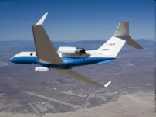
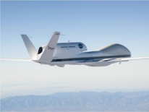
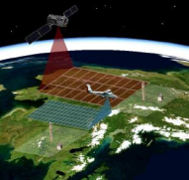
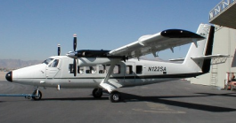
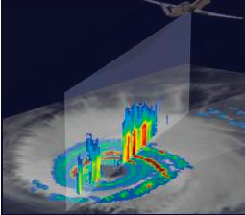

Earth Venture-1
Summaries
Airborne Microwave Observatory of Subcanopy and Subsurface (AirMOSS) - Univ Mich/JPL
North American ecosystems are critical components of the global exchange of the greenhouse gas carbon dioxide and other gases within the atmosphere. To better understand the size of this exchange on a continental scale, this investigation addresses the uncertainties in existing estimates by measuring soil moisture in the root zone of representative regions of major North American ecosystems. Investigators will use NASA's Gulfstream-III aircraft to fly synthetic aperture radar that can penetrate vegetation and soil to depths of several feet.
Airborne Tropical Tropopause Experiment (ATTREX) - ARC
Water vapor in the stratosphere has a large impact on Earth's climate, the ozone layer and how much solar energy the Earth retains. To improve our understanding of the processes that control the flow of atmospheric gases into this region, investigators will launch four airborne campaigns with NASA's Global Hawk remotely piloted aerial systems. The flights will study chemical and physical processes at different times of year from bases in California, Guam, Hawaii and Australia.
Carbon in Arctic Reservoirs Vulnerability Experiment (CARVE) - JPL
This investigation will collect an integrated set of data that will provide unprecedented experimental insights into Arctic carbon cycling, especially the release of the important greenhouse gases such as carbon dioxide and methane. Instruments will be flown on a Twin Otter aircraft to produce the first simultaneous measurements of surface characteristics that control carbon emissions and key atmospheric gases.
Deriving Information on Surface Conditions from COlumn and VERtically
Resolved Observations Relevant to Air Quality (DISCOVER-AQ) - LaRC
The overarching objective of the DISCOVER-AQ investigation is to improve the interpretation of satellite observations to diagnose near‐surface conditions relating to air quality. NASA's B-200 and P-3B research aircraft will fly together to sample a column of the atmosphere over instrumented ground stations.
Hurricane and Severe Storm Sentinel (HS3) – GSFC/ARC
The prediction of the intensity of hurricanes is not as reliable as predictions of the location of hurricane landfall, in large part because of our poor understanding of the processes involved in intensity change. This investigation focuses on studying hurricanes in the Atlantic Ocean basin using two NASA Global Hawks flying high above the storms for up to 30 hours. The Hawks will deploy from NASA's Wallops Flight Facility in Virginia during the 2012-14 Atlantic hurricane seasons.

Slide 20
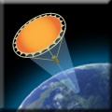
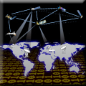
Earth Science Technology:
Program Elements
The Earth Science Technology Office (ESTO) is a targeted, science-driven, competed, actively managed, and dynamically communicated technology program and serves as a model for technology development.
Competitive, peer-reviewed proposals enable selection of best-of-class technology investments that retire risk before major dollars are invested: a cost-effective approach to technology development and validation.
ESTO investment elements include:
Observation Technologies:
Instrument Incubator Program (IIP)
provides robust new instruments and measurement techniques
Advanced Component Technologies (ACT)
provides development of critical component and subsystem technologies for instruments and platforms
Information Technologies:
Advanced Information Systems Technology (AIST)
provides innovative on-orbit and ground capabilities for communication, processing, and management of remotely sensed data and the efficient generation of data products and knowledge

Slide 21
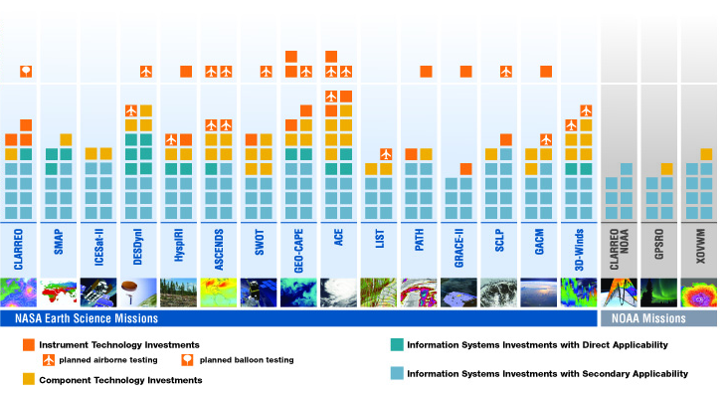
Earth Science Technology:
New Investments Enabling the Decadal Survey
Upon publication of the Earth Science Decadal Survey in 2007, ESTO investments already supported all 18 of the recommended mission concepts. Since then, ESTO has awarded 74 additional technology projects representing an investment of over $172M directly related to the Earth Science priorities outlined by the Decadal Survey.
2010
2007 - 2009
Tier I
Tier II
Tier III

Slide 22
INTERNATIONAL COLLABORATIONS (1 of 2)
  European Space Agency
    NASA-ESA Earth Science collaboration framework signed September 2010 (Weiler-Liebig)
      Field Campaigns/Cal-Val; Ground systems, data products, mission “interoperability”; Flight missions
  ISRO (India)
    Oceansat-2 scatterometer, ocean color instrument data exchange, validation
    QuikSCAT re-orientation to allow use as transfer standard
  CNES (France)
    SWOT (72%/28%$$ NASA/CNES work package agreed upon,
    Weiler/d’Escatha)
    Polder-FO (polarimeter) for PACE under discussion
  CSA (Canada)
    SMAP (Flight components, ground station under discussion; validation)
    SWOT (Flight components; science participation)
Notes:
22

Slide 23
INTERNATIONAL COLLABORATIONS (2 of 2)
  CONAE (Argentina)
    COSMIC real-time data provision (w/ NOAA)
    SAC-D/Aquarius full mission collaboration
  JAXA (Japan)
    TRMM, ASTER, AMSR-E extended missions
    ALOS-TDRSS operational data transmission until mission end (April 11)
    GOSAT/ACOS/OCO-2 (validation, OCO-2 algorithm refinement)
    GPM
  DLR/GFZ (Germany)
    GRACE extended mission
    GRACE-FO productive discussions, same workshare as GRACE
    DESDynI Radar unlikely but under discussion
  INPE (Brazil)
    GPM Low-Inclination Orbiter discussions increasing
Notes:
23

