Slide 1
NPP/VIIRS: Status
Jim Gleason, Jim Butler, N. Christina Hsu
Project Scientists
Contributions from:
Hassan Oudrari and
Government VIIRS Data Analysis Working Group
NASA, NOAA/IPO, Aerospace, MIT/Lincoln, Wisconsin
37 members, 20 NASA, 13 Aerospace, 4 MIT LL
(29 East Coast, 6 West Coast, 2 Wisconsin)
Launch Date: October 25, 2011

Slide 2
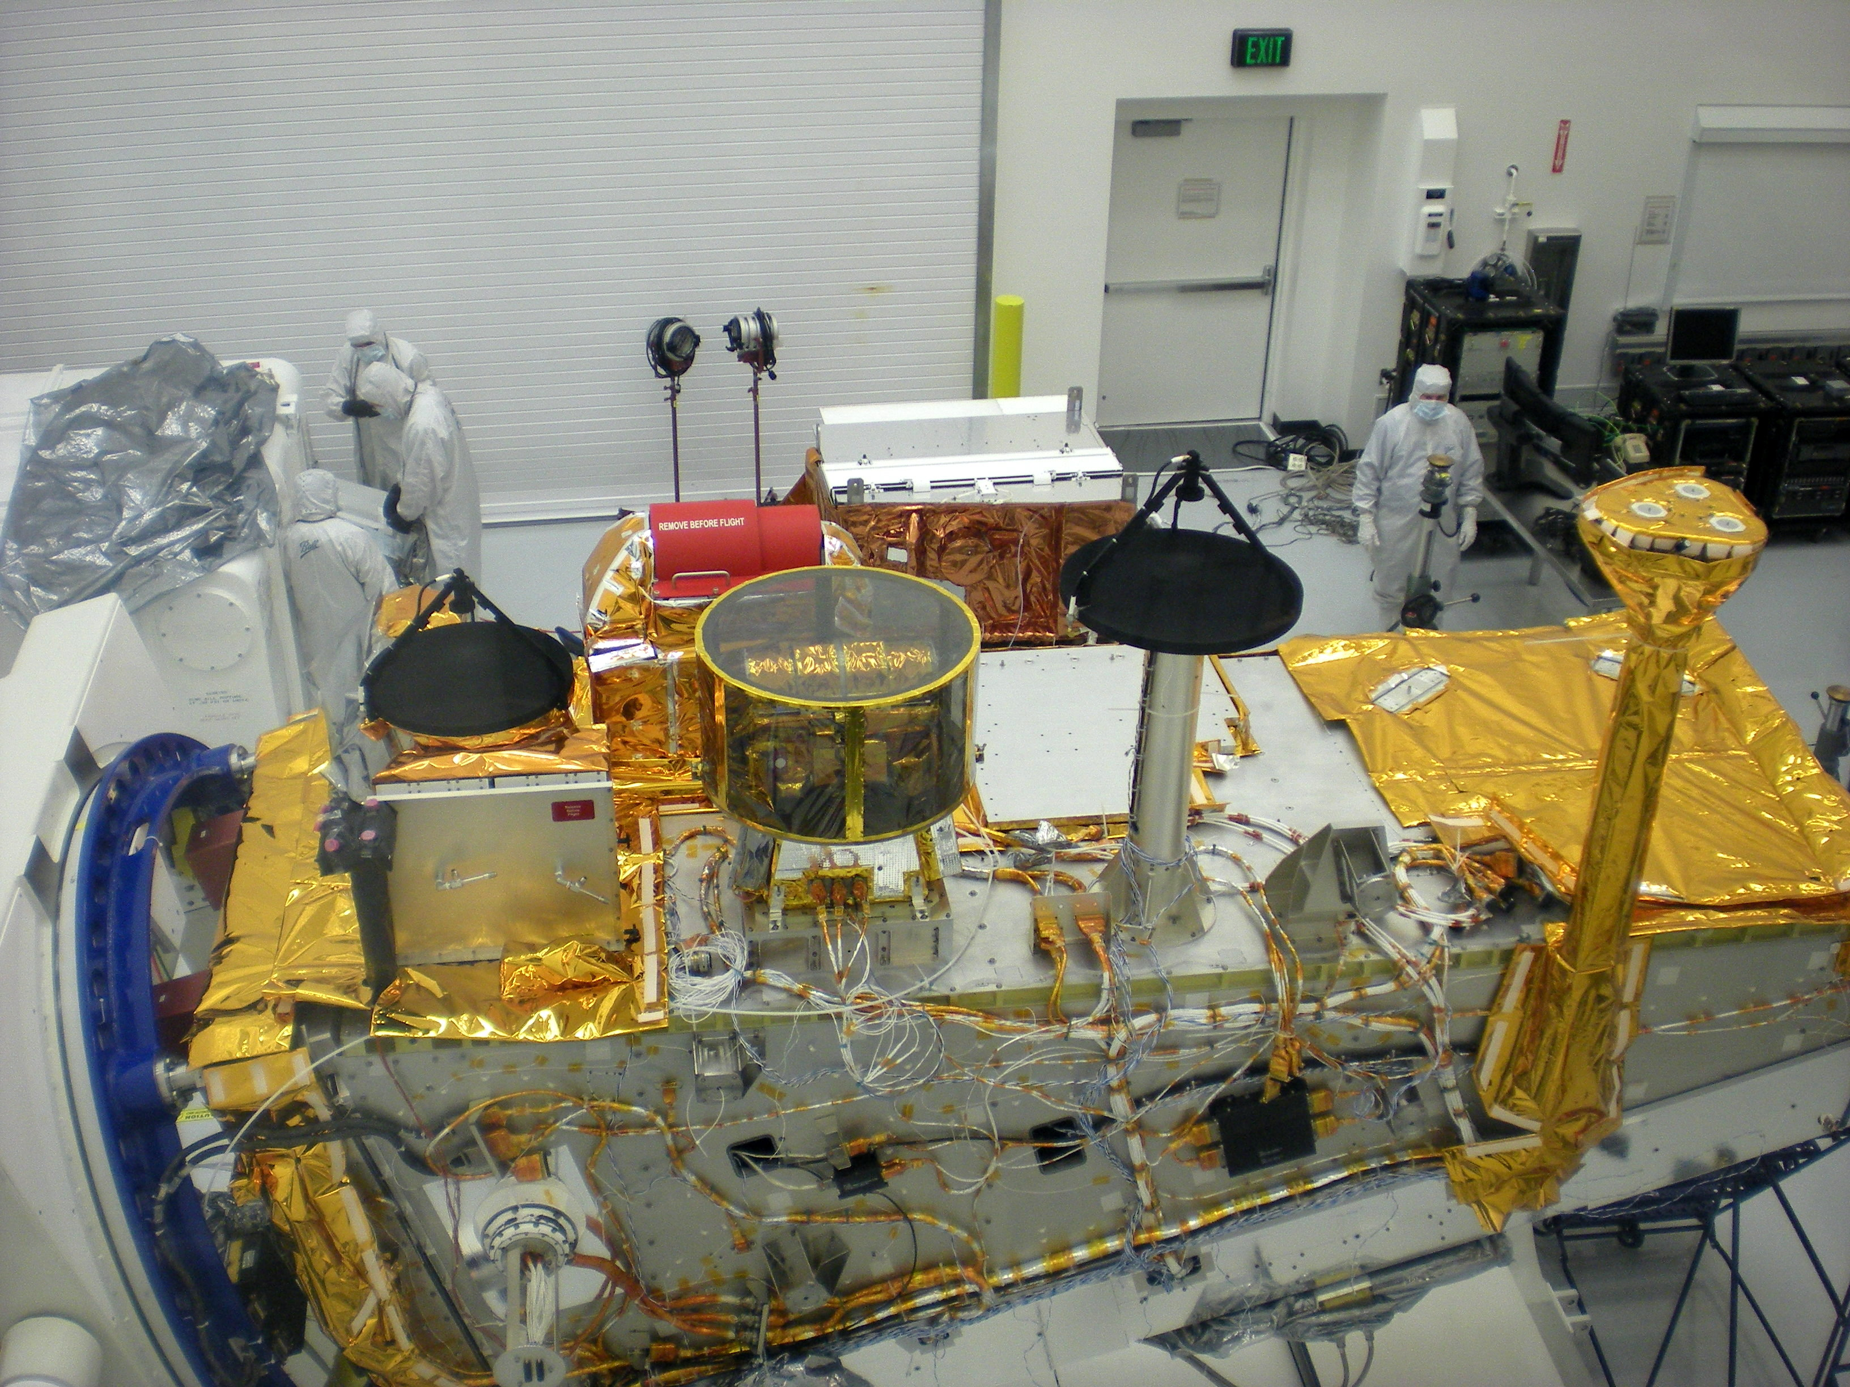
When we last met:
VIIRS in Clean Room with NPP
No CrIS
VIIRS

Slide 3
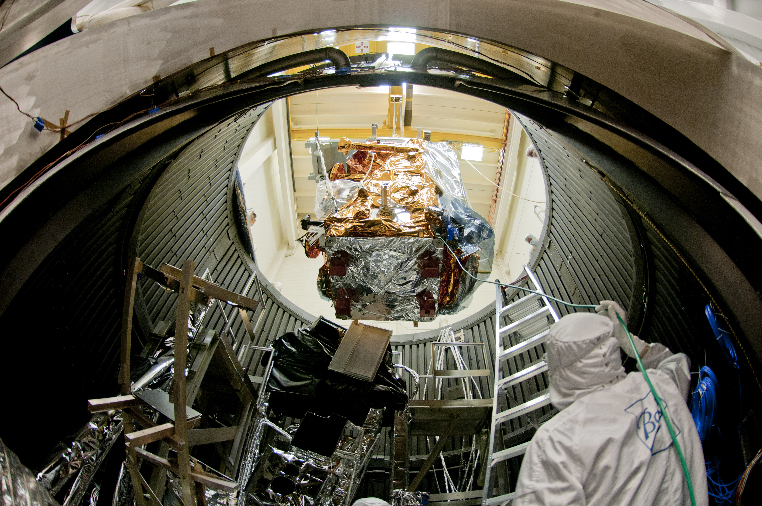
Current Status:
NPP Completed
Environmental Testing

Slide 4
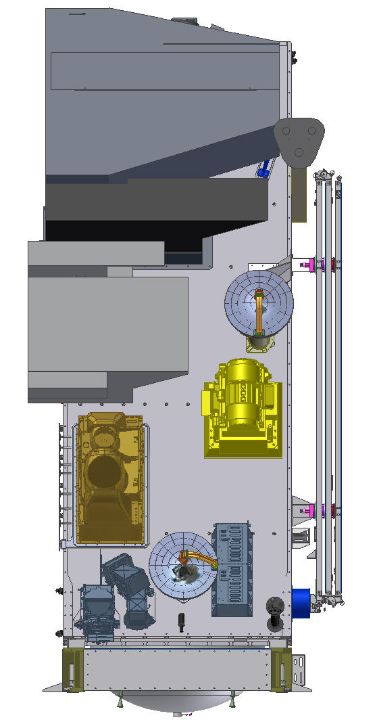
NPP Status:
VIIRS – Medium resolution Visible& Infra-red Imager
CrIS – Fourier Transform Spectrometer for IR Temperature and Moisture sounding
ATMS – Microwave sounding radiometer
OMPS – Total Ozone Mapping and
Ozone Profile measurements
CERES
Earth Radiation Budget measurements
Completed Environmental Testing; Shock, Acoustics, Vibration, EMI/EMC, Thermal Vacuum
VIIRS
CrIS
CERES
ATMS
OMPS Limb
OMPS Nadir

Slide 5
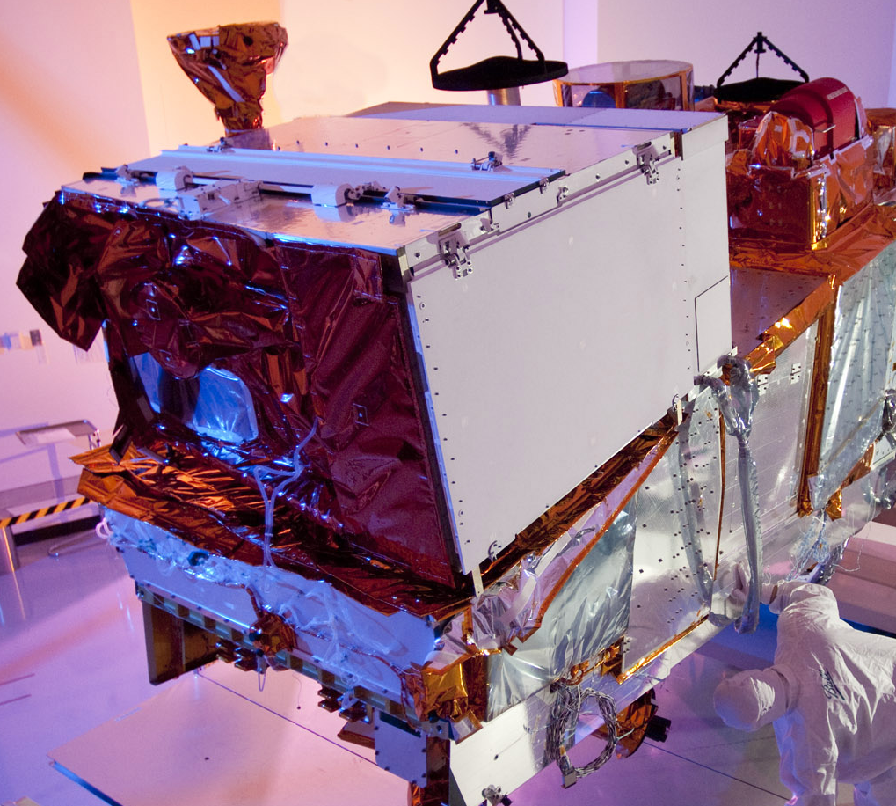
Visible Infrared Imaging Radiometer Suite
Description
Purpose: Global observations of land, ocean, & atmosphere parameters at high temporal resolution (~ daily)
Predecessor Instruments: AVHRR, OLS, MODIS, SeaWiFS
Approach: Multi-spectral scanning radiometer (22 bands between 0.4 µm and 12 µm) 12-bit quantization
Swath width: 3000 km
Status
Completed comprehensive performance monitoring testing during TV testing.
Performance is nominal
Preparing for Launch

Slide 6
Status of VIIRS F1 Performance Testing
VIIRS F1 testing program completed all planned testing phases, and has provided test data to support 141 sensor performance requirements:
NASA team has completed extensive test data analysis and VIIRS F1 performance requirement verification:
  VIIRS testing program was comprehensive and provided necessary test data to characterize VIIRS performance, and to establish a good baseline for on-orbit operations.
  .
All performance waivers have been evaluated by NGST and reviewed by NASA team
  Most waivers have small to negligible EDR performance impacts
  Algorithm revisions and/or changes to Cal/Val tasks were added to support waivers

Slide 7
VIIRS F1 Reflective Bands:
Radiometric Performance
Meets all Requirements for:
Signal to Noise Ratio, Dynamic Range,
Linearity, Uncertainty, Stability and Polarization
Minor Variances for:
Gain Transition: Gain transition points are well characterized
(VIIRS has dual gain bands)
Uniformity: Potential for striping, Plan for post-launch fix if needed

Slide 8
VIIRS F1 Emissive Bands:
Radiometric Performance
Meets all Requirements for:
NEdT, Dynamic Range, Gain Transition,
Linearity, Uniformity,
Absolute Radiometric Difference, and Stability

Slide 9
VIIRS F1 Spatial Performance
Meets Requirements for or only minor non-compliances:
Line Spread Function:
Scan and Track DFOV
Scan and Track MTF
Scan and Track HSR
Band-to-Band Registration
Pixel growth to “1.5 km x 1.5 km” at to the edge of scan

Slide 10
VIIRS F1 Spectral Performance
Largely Meets all Requirements for:
  Spectral Band Center, Spectral Bandwidth, Extended Bandwidth
  Minor non-compliances are well characterized. No impact expected.
Non-Compliances for Integrated Out-of-Band (OOB) Response
  Many bands did not meant the IOOB requirements, but low impact
  Multiple spectral testing provided a reliable F1 IOOB characterization
Spectral Band-to-Band Crosstalk
  VIIRS did not meet crosstalk requirements, which are much more strict than heritage values (e.g. MODIS)
  Optical cross-talk issue is well known (IFA defects), and intensively studied by both contractor and Government teams, using characterization data from testing performed at IFA and sensor levels.
  Impact analysis has shown Ocean and Aerosol EDRs products sensitive to this crosstalk effect. A mitigation plan was established for on-orbit operations in the case of these 2 EDRs.

Slide 11
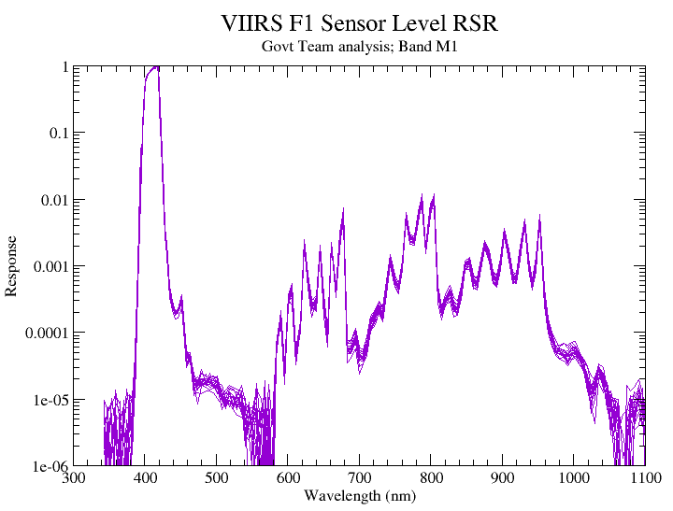
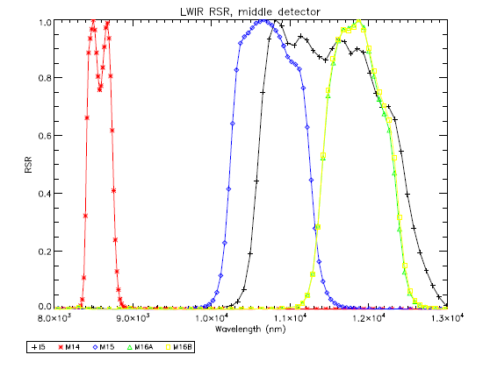
Government Team’s VIIRS RSRs
Reflective and Emissive Bands
VIIRS M1 Band
VIIRS LWIR Bands

Slide 12
Testing Summary
VIIRS F1 test program is complete and has provided good test data to assess sensor performance.
All F1 sensor performances has been verified, and non-compliances are expected to have minor effect on NASA science.
Effort by both Government and Contractor finalized sensor performance to generate VIIRS F1 on-orbit LUTs for SDR algorithm.
VIIRS measured performance, supported by planned calibration and validation activities is expected to meet NASA science objectives

Slide 13
Maneuvers
All VIIRS maneuvers have been approved by NPP Project
  Lunar Rolls and Pitch-up for deep space view and Yaws for diffuser characterization
  Maneuvers will be done during Intensive Cal/Val
  Working with NOAA and JPSS to ensure maneuvers part of regular operating baseline

Slide 14
JPSS
JPSS Transition is ongoing
  FY10 & FY11 (& FY12??) budgets are a challenge
Government taking responsibility for IDPS Data Product Performance
  NOAA NESDIS STAR providing leadership for VIIRS data products
    Changyong Cao for VIIRS SDR
    Ivan Csiszar for VIIRS EDRs
  Existing Gov’t funded cal/val activities are continuing.

Slide 15
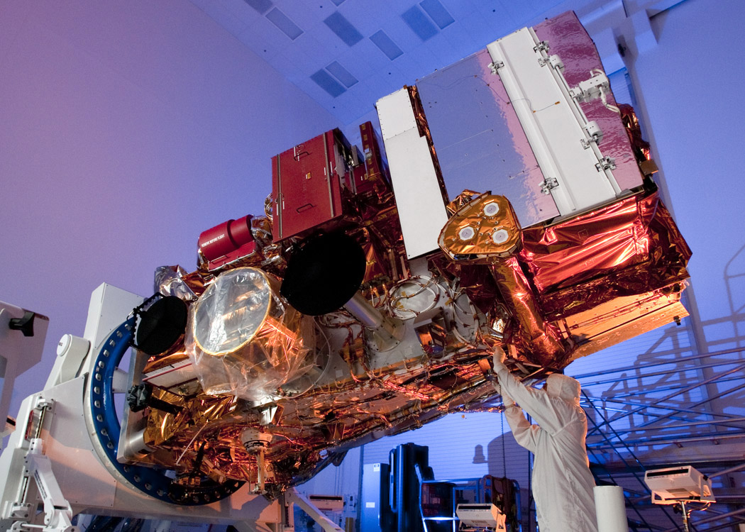
Questions
Launch Date: October 25, 2011

Slide 16
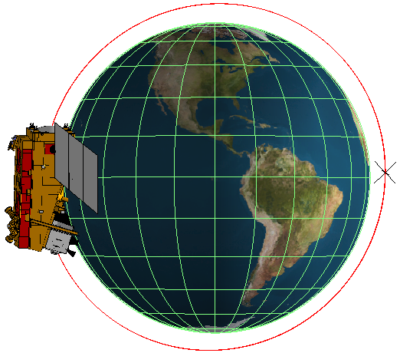
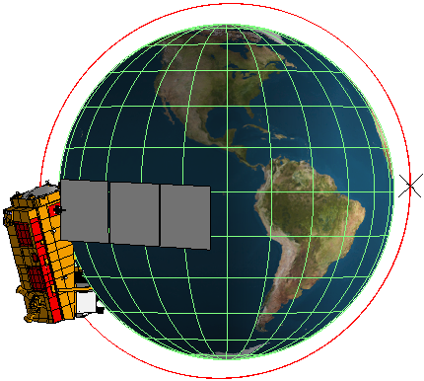
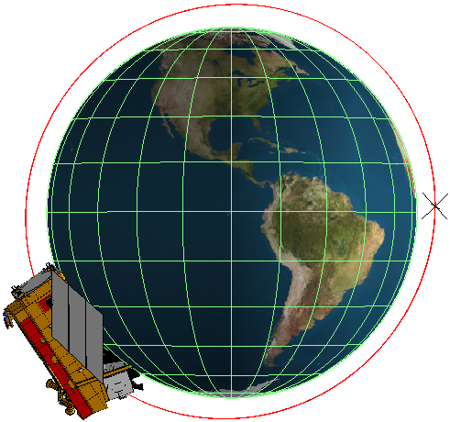
Maneuver #1 – Roll -25 degrees
Roll Maneuver (-X) - up to –25 degrees on the dark side of the orbit, and maintaining the offset for up to 5 minutes.
Spacecraft baseline requirement : YES
Science Rationale / Benefit
Meets needs of VIIRS Lunar Roll maneuver #8
ADCS / Thermal Assessment
Reference : SER 3257-THR248 (Thermal model V72)
SRS analysis accesses compliance to all thermal requirements of all spacecraft components and instrument interfaces throughout these maneuvers for Nominal Operation Science Mode (instruments powered on with doors open) as well as SRS Commissioning Maneuver Checkout (instruments powered off with doors closed). Eight individual hot and cold cases for bounding beta angles 12º and 34º were run; four in each mode.
Summary
As part of spacecraft ADCS commissioning, BATC will demonstrate this maneuver
SRS Compliance if performed in eclipse, S/C –Y side toward earth
Orientation modeled and all thermal parameters within allowable limits based on analysis
Nominal
Roll -25º
Nominal

Slide 17
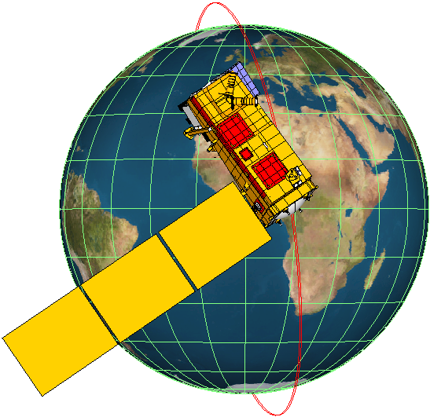
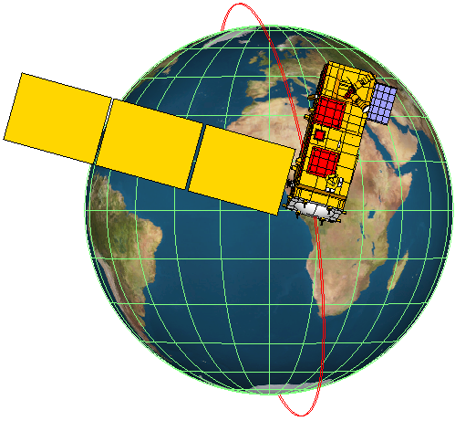
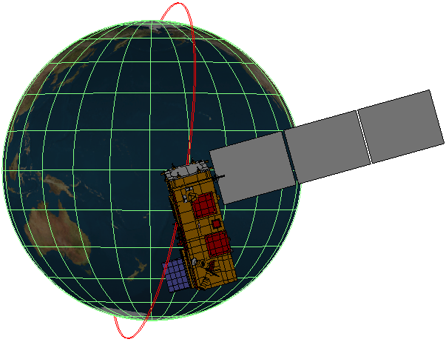
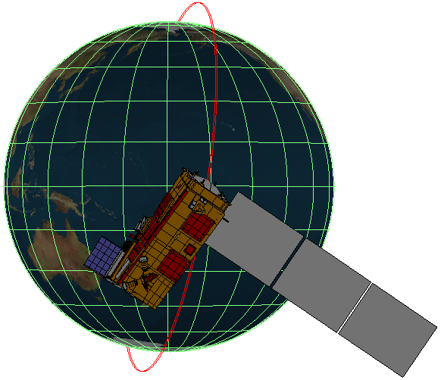
Maneuver #2 – Yaw +/-25 degrees
Yaw Maneuver (+/-Z) : yaw offset pointing up to 25 degrees, and maintaining the offset for up to 15 minutes at any point in the orbit.
Spacecraft baseline requirement : YES
-25º Yaw, Sun Side +25º Yaw, Sun Side
-25º Yaw, Eclipse Side +25º Yaw, Eclipse Side
Science Rationale / Benefit
Meets needs of VIIRS Solar Diffuser Cal maneuver #9
Meets needs of CERES Sunrise Solar Calibration maneuver #9 and Sunset Solar Calibration maneuver #10
ADCS / Thermal Assessment
Reference : SER 3257-THR248 (Thermal model V72)
SRS analysis accesses compliance to all thermal requirements of all spacecraft components and instrument interfaces throughout these maneuvers for Nominal Operation Science Mode (instruments powered on with doors open) as well as SRS Commissioning Maneuver Checkout (instruments powered off with doors closed). Thirty-two individual subsolar and eclipse, hot and cold cases for beta angles 12º & 34º, at +25º and -25º, were run. Sixteen cases for each mode
Summary
As part of spacecraft ADCS commissioning, BATC will demonstrate this maneuver
SRS Compliance to demonstrate yaw out to +25 deg, occurs in eclipse and daylight
SRS Compliance to demonstrate yaw out to -25 deg, occurs in eclipse and daylight
Orientation modeled and all thermal parameters within allowable limits based on analysis

Slide 18
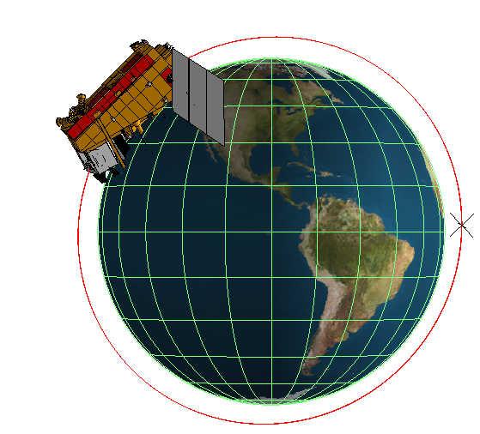
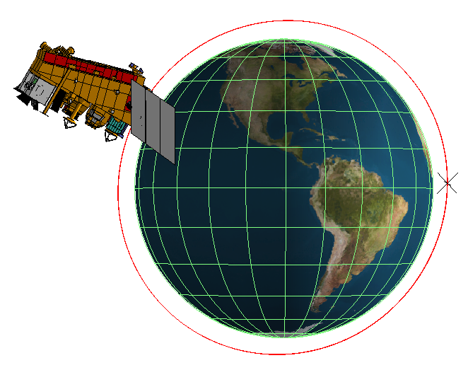
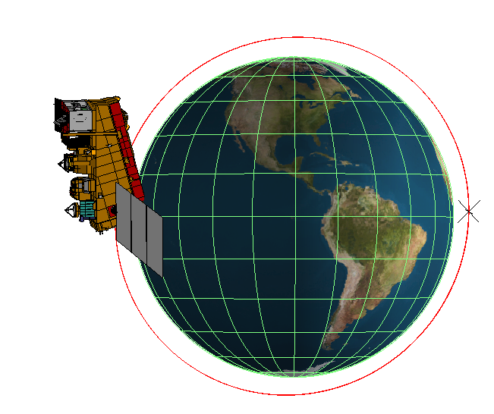
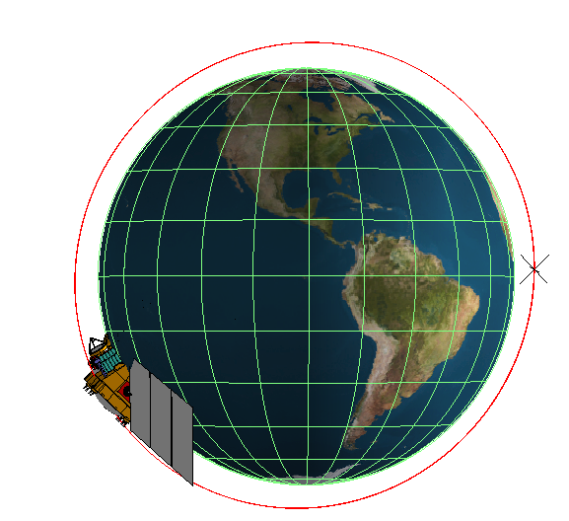
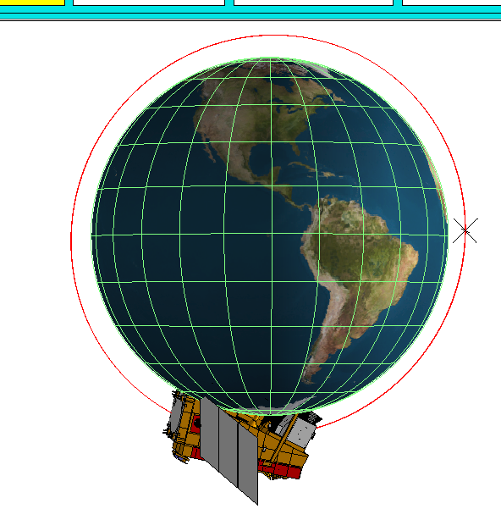
Maneuver #3 – Pitch Over Maneuver
Pitch Over - +Y slew in the opposite direction of the orbital pitch rate over 1/3 of the orbit, starting at terminator crossing from the Science Mode attitude, at the lowest constant rate that will return the Spacecraft to nominal pointing at the end of the slew
Spacecraft baseline requirement : YES
Science Rationale / Benefit
Meets VIIRS, ATMS and CERES needs for view of deep space maneuver #6
ADCS / Thermal Assessment
Reference : SER 3257-THR248 (Thermal model V72)
SRS analysis accesses compliance to all thermal requirements of all spacecraft components and instrument interfaces throughout these maneuvers for Nominal Operation Science Mode (instruments powered on with doors open) as well as SRS Commissioning Maneuver Checkout (instruments powered off with doors closed). Eight individual hot and cold cases for beta angles 12º & 34º were run. Four cases for each mode
Summary
As part of spacecraft ADCS commissioning, BATC will demonstrate this maneuver
SRS Compliance to demonstrate one back flip in eclipse,
Orientation modeled and all thermal parameters within allowable limits based on analysis
Nominal, Dusk Terminator Pitch 90º
Pitch 180º
Pitch 270º Nominal, Dawn Terminator

Slide 19
Maneuver #6 – Pitch Maneuver
VIIRS, CERES, ATMS Pitch Maneuver (+Y) : slew in the opposite direction of the orbital pitch rate over 1/3 of the orbit, starting at terminator crossing from the Science Mode attitude, at the lowest constant rate that will return the Spacecraft to nominal pointing at the end of the slew
Spacecraft baseline requirement : Yes
Science Rationale / Benefit
Frequency/Dwell : Twice separate by 1 orbit in the absence of the moon
Heritage : NOAA 14 at EOL; Terra after 2 years
Science Improvement :
VIIRS 0.5-1% Asymmetry correction
ATMS 1-3% Scan Bias Correction due to side lobe contributions based on both ATMS rolls (#4/#5) and the pitch over maneuver (#6)
CERES Reduces Offset uncertainty from 50 to 12 % (4:1)
ADCS / Thermal Assessment
ADCS Reference: SER 3257-ACS339
Thermal Reference : SER 3257-THR250
All bus components and instrument interfaces are compliant and within their flight allowable limits throughout each of calibration maneuvers with instruments powered on and doors open.
Prior to the pitch maneuver, the spacecraft remained in its nominal science mode orbit. Four individual hot and cold cases for beta angles 12º & 34º were run, where instruments are powered on with doors open.
Summary
This maneuver was accepted but will be limited to only one pitch maneuver. It will be performed between L+3 and L+6 months post launch. A revised thermal analysis is a prerequisite using on orbit thermal data.
Extended view of deep space for the calibration of potential scan asymmetry. Same as VIIRS and CERES Pitch maneuvers, hence only one consolidated maneuver is needed, but simulated twice, separated by one orbit (as required for ATMS).
Risk of VIIRS / CrIS cryo temperatures rise above set points or reverse bias on VIIRS cooler stages for low beta angles. Possible loss of emissive band
Nominal, Dusk Terminator Pitch 90º
Pitch 180º
Pitch 270º Nominal, Dawn Terminator

Slide 20
VIIRS Performance Evaluation based on Spacecraft TVAC Testing
NASA/NICST team provided an independent verification of the VIIRS performance measured during NPP TVAC testing.
NASA/NICST team received and processed all four VIIRS CPT test data, from Cold-1, Hot-1, Cold-4 and Hot-4 plateaus. CPT testing included:
NASA/NICST team released about seventeen (17) reports and summaries over 43 days of VIIRS TVAC testing, describing preliminary results of the test data analysis.
NASA/NICST verified that VIIRS data collected and analyzed are of good quality and sufficient to verify sensor performance.
NASA/NICST team summaries are in agreement with the contractor’s findings, that the sensor performance is as expected, and no specific concern or issue was identified
VIIRS Performance Evaluation based on Spacecraft TVAC Testing
Performance | Description | Risk
Gain and SNR | FPI source is used to illuminate VIIRS sensor inside the TVAC chamber at Ball. Gain values derived for VIIRS bands are within 10% of sensor level gains. SNR meet specification, but lower than sensor level testing (Source issue). | Low
OBC Warm-up/Cool-down | OBC operations meet spec for range and uniformity. Gain within 1.2% of sensor level testing | Low
Electronics Self-Test | In agreement with sensor level testing | Low
Noise | In agreement with sensor level testing | Low
SDSM Checkout | SDSM functionality verified (mirro rotating normally) | Low
Trending of gain and noise | No anomalies observed during the self compatibility testing | Low

Slide 21
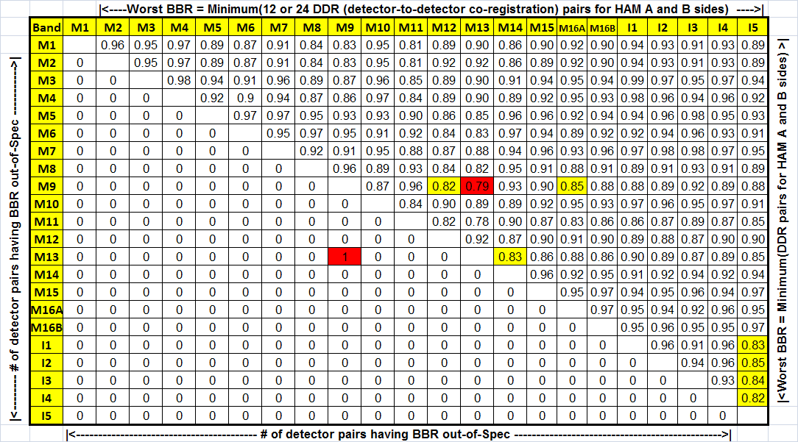
VIIRS F1 Band-to-Band Registration Performance
Worst BBR @ Nominal Perf Plateau
Lower-left = # of Det out of Spec, upper-right = test results.
Worst BBR meets Spec in Agg1 zone (+/-56.28,+/-44.86 deg) with bow-tie deletion, except 1 det pair M13 vs M9. BBR in Agg2 (+/-44.86, +/-31.72) and Agg3 (-31.72, +31.72 Deg) is better.
The root cause of the out of Spec BBR pair (M13 vs M9) is primarily due to effective focal length (EFL) to scan rate mismatch.
Yellow cells: BBR with <= 5% margin in the ground tests which may be out-of-Spec when in orbit with effects of S/C jitter etc.

Slide 22
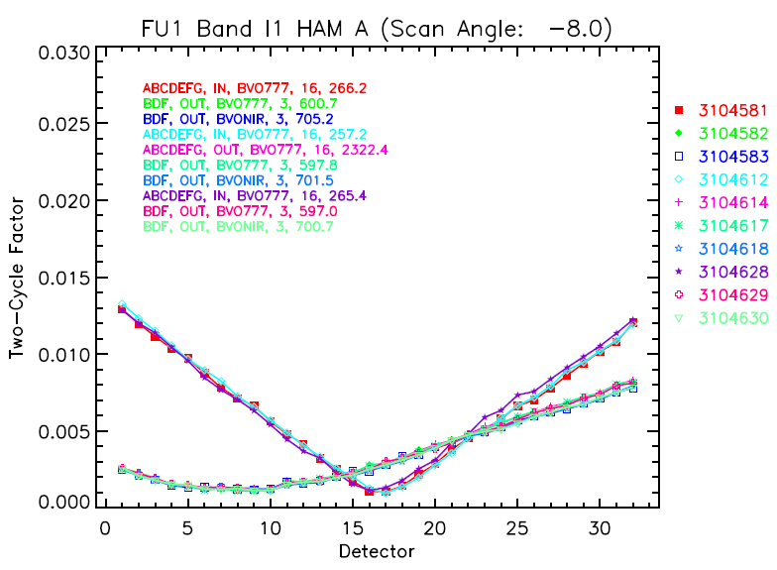
VIIRS F1 Polarization Performance
All Bands Meet Polarization Requirements

Slide 23
VIIRS Radiometric Requirements:
Emissive Bands
TABLE 17: Absolute radiometric calibration uncertainty of spectral radiance for moderate resolution emissive bands
All Reflective Bands Meet Radiometric Requirements With Margins

Slide 24
VIIRS F1 Performance Status
Based on sensor level TV testing
VIIRS F1 test program is complete and has provided good test data to assess sensor performance.
Sensor performance exceeds requirements in most cases, and non compliances were addressed in waiver packages and impact assessments
NASA performance assessments are beginning of life (BOL). Modeling of EOL performances are available in Raytheon Performance Verification Reports (PVRs).
Government team finalized VIIRS F1 Performance assessments to generate on-orbit LUTs for SDR algorithm

Slide 25
VIIRS F1 Bands and SNR/NEDT
All Bands Meet SNR Requirements With Margin

Slide 26
TABLE 5. VIIRS Spectral band optical requirements
[1] The values given under "OOB Integration Limits" are the specified limits on the 1% relative response points.
[2] The OOB integration limits will be the 1% response points determined during sensor characterization.

Slide 27
TABLE 12. Dynamic range requirements
for VIIRS Sensor reflective bands
Spectral radiance (Lmin and Lmax) has units of watt m-2 sr-1 μm-1.

Slide 28
TABLE 13. Dynamic range requirements
VIIRS Sensor emissive bands

Slide 29
TABLE 14: Sensitivity requirements for
VIIRS Sensor reflective bands
Notes:
The units of spectral radiance for Ltyp are watt m-2 sr-1 μm-1.
The SNR column shows the minimum required (worst-case) SNR that applies at the end-of-scan.

Slide 30
TABLE 15: Sensitivity requirements for VIIRS Sensor emissive bands

Slide 31
Table # 17/18: Emissive Bands Radiometric
Calibration Accuracy Requirements
Equivalent or Better Performance Was Achieved on MODIS

Slide 32
VIIRS F1 Spectral Performance
Meets all Requirements for:
Spectral Band Center, Spectral Bandwidth, Extended Bandwidth
Significant Non-Compliance for: Integrated Out-of-Band Response
Notes: Smaller non-compliances for emissive bands
Well characterized
Difficult to separate from Cross-talk effects
Band | Center Wavelength (nm) | Bandwidth (nm) | Requirement Maximum Integrated OOB Response (%) | Measured Maximum Integrated OOB Response (%)
M1 | 412 | 20 | 1.0 | 3.7
M3 | 488 | 20 | 0.7 | 1.1
M4 | 555 | 20 | 0.7 | 4.3
M5 | 672 | 20 | 0.7 | 3.2
M6 | 746 | 15 | 0.8 | 1.8

Slide 33
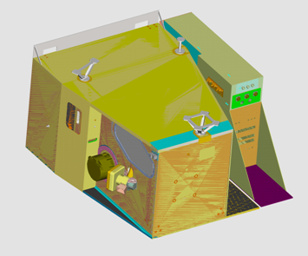
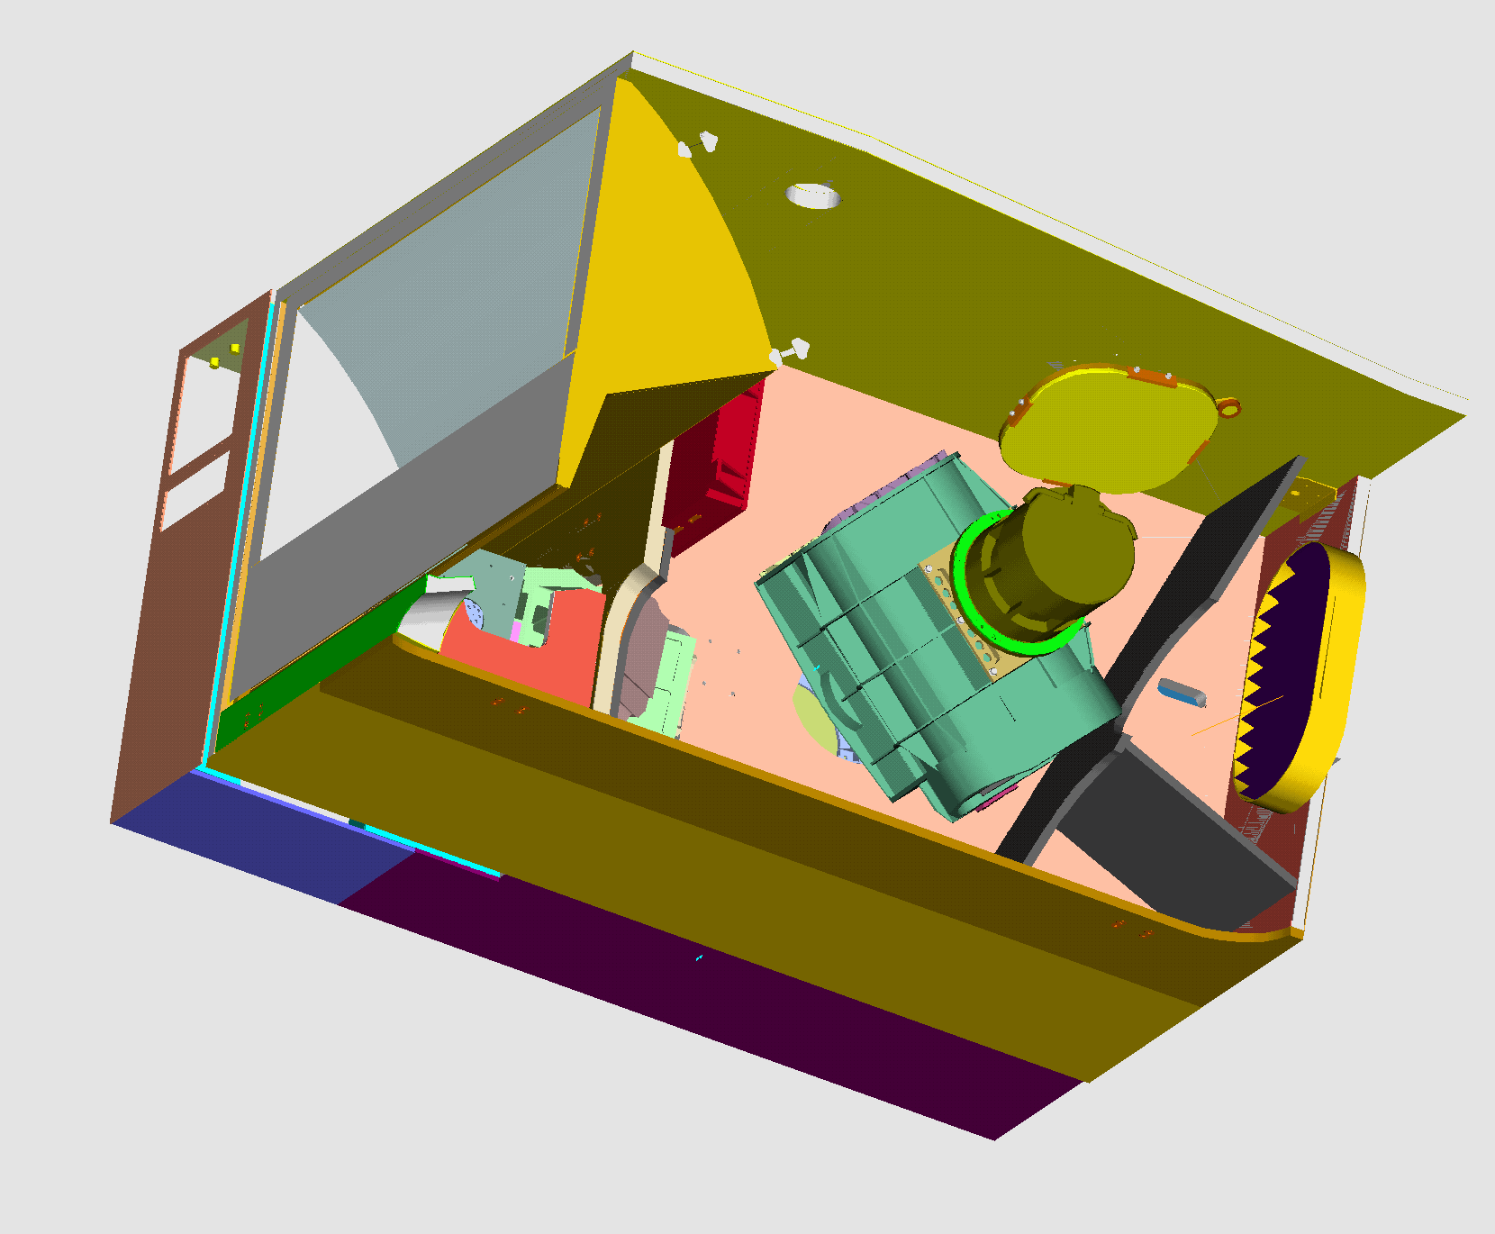
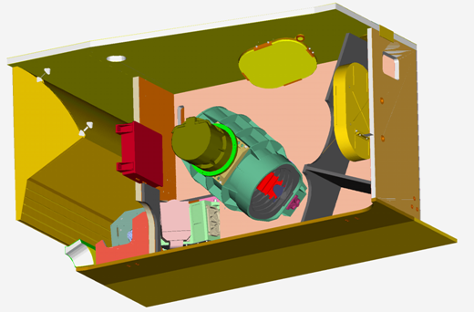
VIIRS Incorporates Modular
Sensor Approach
Separately Mounted Electronics Module
Solar Diffuser
Blackbody
RTMA
Solar Diffuser
Stability Monitor
3-Mirror Anastigmat
All reflective
Rotating telescope
FPIE
4-Mirror Anastigmat
All Reflective
Aft Optics Imager
Cryoradiator
Half-angle Mirror
Cold FPA
Dewar Assembly
OMM configuration

Slide 34

VIIRS F1 Sensor Block Diagram
SDSM
FPA
Dewar
Radiative Cooler/
Earth Shield
SWIR/
MWIR (8)
Solar
Diffuser
Sun
Beam-
splitter
LWIR (4)
Beam-
splitter
Blackbody
Rotating
Telescope
Assembly
Focal Plane
Electronics
Readout &
A/D
Conversion
HAM
Imager
Beam-
splitter
DNB/VNIR
(10 bands)
Space
View
Power, Command,
Control, Telemetry
Ground
Support
and
System Test
Equipment
Formatter
Buffer
Compression
Moon
DNB - Day/Night “Band”
VisNIR - Visible/Near IR
SWIR - Short Wave IR
MWIR - Mid Wave IR
LWIR - Long Wave IR
HAM - Half Angle Mirror
SDSM - Solar Diffuser Stability Monitor
Earth
CCSDS
1394 Data
Image provided courtesy of NASA GSFC

Slide 35
VIIRS Bands and Products
VIIRS 22 Bands:
16 M-Band, 5 I-Band and 1 DNB
VIIRS 24 EDRs
Land, Ocean, Cloud, Snow
* Product is a Key Performance Parameter (KPP)
Dual gain band
Similar MODIS bands are shown for comparison

Slide 36
VIIRS Spectral, Spatial, & Radiometric Attributes

Slide 37
VIIRS F1 Sensor Gov’t Activities
VIIRS F1 testing program is complete and has provided test data to support 141 performance requirements
NASA team has completed extensive analysis of VIIRS test data
  Support of sensor test data analysis, and requirement verification
    Release more than 130 reports and memos just Instrument TV phase
  Support to Waiver evaluation, including SDR/EDR impact assessment
NICST Data Analysis Satellite TV Summaries:
NICST team released five (5) Summaries on Friday April 22nd in support of the SC TVAC CTB meeting held on April 23rd. These VIIRS summaries represent NICST’s assessments of the overall VIIRS SC TVAC performance testing,
NICST is planning to develop detailed reports for VIIRS performance assessment based on SC TVAC testing.
NICST team summaries did not identify any specific concern or issue, and have shown that all VIIRS data collected and analyzed are of good quality and sufficient to verify that sensor performance is as expected.

Slide 38
Team Coordination

