Slide 1
NASA Earth Science Research
“With a Particular Tie to MODIS”
18 May 2011

Slide 2
Outline of Presentation
Research in the ESD Perspective
ESD Research Overview
  Some MODIS-related specifics
Airborne Instrument Development (esp. E-MAS)
Contributions of MODIS to
  data assimilation
  disaster analysis
  to EPO

Slide 3
Earth Science Division Overview
  Overarching goal: to advance Earth System science, including climate studies, through spaceborne data acquisition, research and analysis, and predictive modeling
  Six major activities:
    Building and operating Earth observing satellite missions, many with international and interagency partners
    Making high-quality data products available to the broad science community
    Conducting and sponsoring cutting-edge research
      Field campaigns to complement satellite measurements
      Analyses of non-NASA mission data
      Modeling
    Applied Science
    Developing technologies to improve Earth observation capabilities
    Education and Public Outreach

Slide 4
Summary of ESD ROSES Solicitations
Annual ROSES omnibus solicitation (SMD-wide) serves as mechanism for soliciting research – for ESD this includes research (including competed science teams), applied sciences, technology
Annual ROSES calls include
  More-or-less annual solicitations for some R&A, data, technology, and early career programs
    Earth System Data Record Uncertainty Analysis (10)
  Periodic solicitations for competed science teams
    Terra/Aqua (09)
    NPP Science Team for Climate Data Records (10)
  One-time solicitations for field campaigns
    Ocean Salinity Field Campaign (10)
    SEAC⁴RS (10)
  One-time solicitations for R&A-related activities and applied science programs (may become quasi-regular)
    Airborne Instrument Technology Transition (09)
    Remote Sensing Theory (09)
    Earth Venture-1 (09)
    Air Quality Applied Science Team (09)
    Satellite Calibration Interconsistency Studies (11)
    Impacts of Climate Variability and Change on NASA Centers and Facilities (11)
    Earth Science Applications: Fires and Wildfires (11)

Slide 5
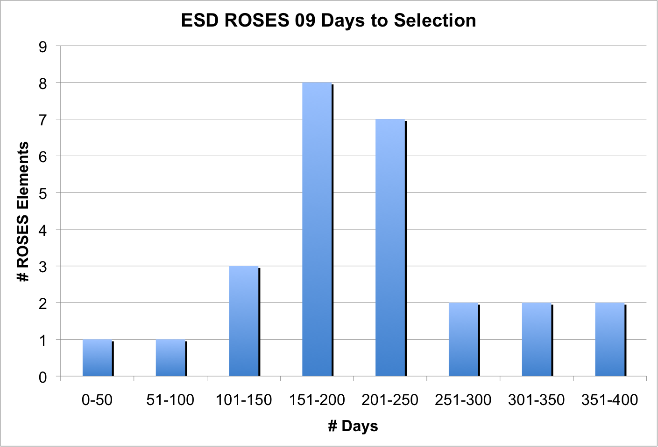
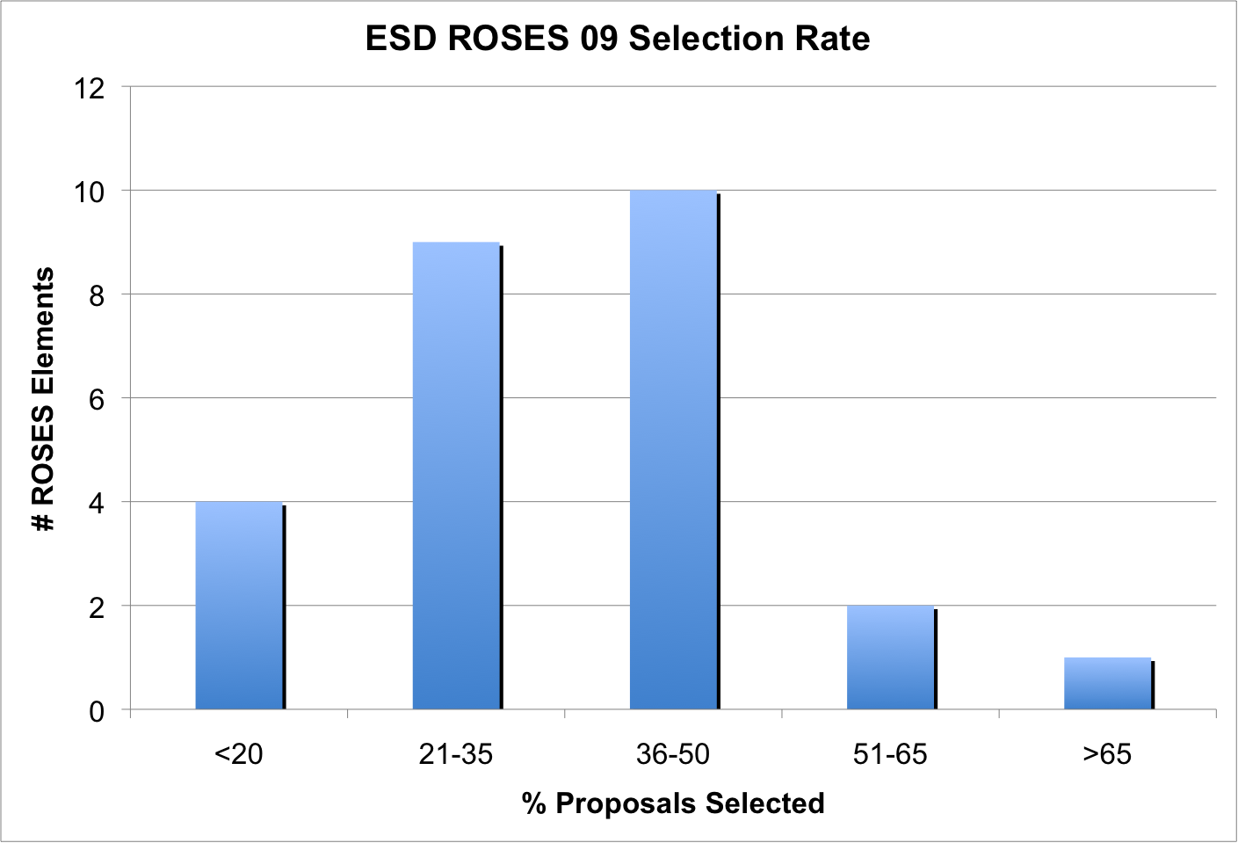
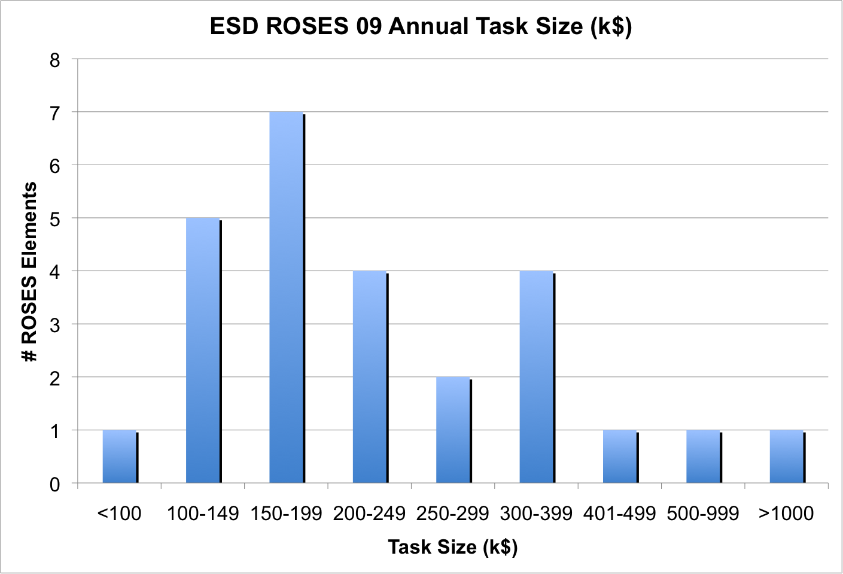
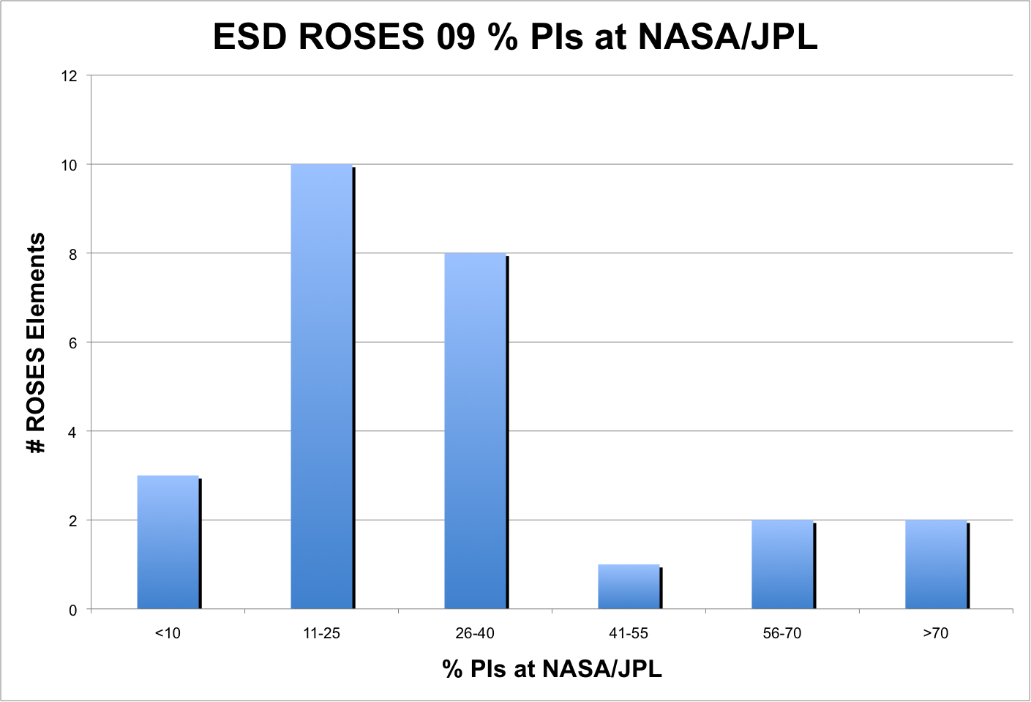
ESD ROSES 09 Summary Statistics
Overall: 1574 Submitted, 476 Selected (30%), 145 PIs at NASA/JPL (30%), Weighted time to selection – 227 days, Peak per year funding - $129.4M (average $272K - $213K w/o-EV-1)

Slide 6
Some MODIS Related Selections
ROSES 09 – A.41 –The Science of Terra and Aqua– of 87 selected, 60 specifically mention MODIS in their abstracts, 38 of which have MODIS in their title – ROSES element covered 5 types of proposals:
  Multi-Platform and Sensor Data Fusion
  Science Data Analysis
  Algorithms – New Data Products
  Algorithms – Existing Data Products
  Real- or Near-Real-Time Data Algorithms
ROSES 10 – A.22 – NPP Science Team for Climate Data Records – of 34 selected, 23 specifically mention MODIS in their abstracts, 4 of which have MODIS in their title

Slide 7
Some MODIS Related Selections, cont.
ROSES 10 – A.32 – Earth System Data Records Uncertainty Analysis – of 21 selected, 9 specifically mention MODIS in title and/or abstract
  Estimating Uncertainties in MODIS Cloud Data Records (S. Ackerman)
  Error Analysis of MODIS Fractional Snow-Covered Area and Snow Albedo in Mountain Regions (J. Dozier)
  Uncertainty Estimates in the A-Train Water Vapor Climate Data Record (E. Fetzer)
  Estimating, Validating and Conveying Measurement Differences in the Land Surface Temperature and Emissivity Products from ASTER, MODIS and AIRS (S. Hook)
  Using CALIPSO/CloudSat Observations for Assessing Uncertainties in Atmospheric Radiative Fluxes and their Vertical Distributions (Y. Hu)
  Uncertainty Analysis of the 13 year Time Series for the in situ Vicarious Calibration of Ocean Color Satellite Sensors (B. Johnson)
  Radio Occultation Climate Records (A. Mannucci)
  Optical Water Type-Based Uncertainties of Satellite Ocean Color Products (T. Moore)

Slide 8
Some MODIS Related Selections, cont.
ROSES 10 – A.5 –Carbon Cycle Science – of 34 selected,89 specifically mention MODIS in title and/or abstract
  Assessing the Impact of Ocean Acidification on Marine Planktonic Calcification Using Satellite Anlaysis and Earth System Modeling (D. Glover)
  A Global High-Resolution Fossil Fuel CO2 Inventory Built From Assimilation of In Situ and Remotely-Sensed Datasets to Advance Satellite Greenhouse Gas Decision Support Systems (K. Gurney)
  Assessment and Impact of Carbon Variability In The Nordic Seas (C. McClain)
  A Lidar-Radar-Optical Data Fusion Approach For Estimating The Aboveground Carbon Stocks of North American Forests: Means and Uncertainties At Regional To Continental Scales (R. Nelson)
  Global Carbon Emissions From Fires: Improving Our Understanding of Interactions Between Land Use, Fires, and Climate Change (J. Randerson)
  Synthesis and Integration of Recent Research Characterizing The Carbon Cycle of Northern Eurasia (M. Rawlins)
  Synthesis of Forest Growth, Response To Wildfires and Carbon Storage For Russian Forests Using A Distributed, Individual-Based Forest Model (H. Shugart)
  Influence of Disturbance and Seasonality on Regional Carbon Flux Upscaling (E. Smithwick)

Slide 9

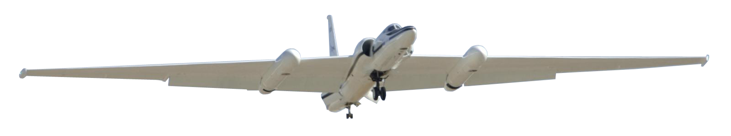
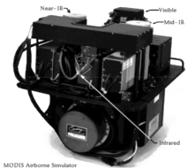
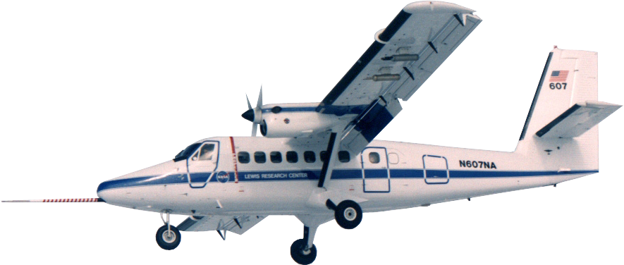
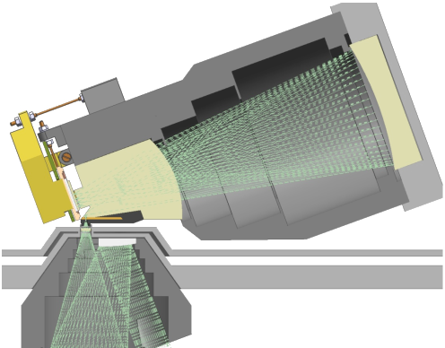
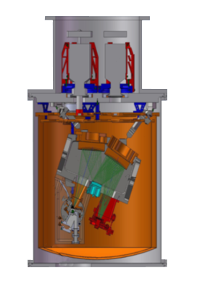
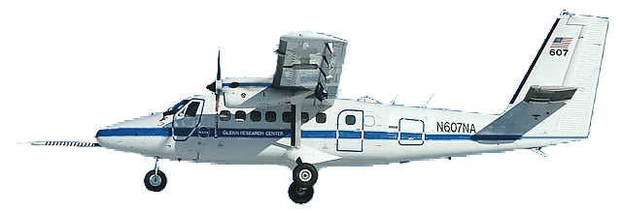
Stimulus-Funded Development:
Facility Class Instruments
Enhanced MODIS Airborne Simulator (eMAS)
This task will replace major subsystems on the MAS to extend its service life, increase reliability and improve data. The task will also increase spectral coverage, resolution, and calibration accuracy. The upgraded MAS will fly on the NASA ER-2.
$3.0M
Portable Remote Imaging Spectrometer (PRISM)
PRISM will be a UV-NIR (350 to 1050 nm) spectrometer capable of airborne measurements from a variety of platforms. PRISM will be particularly optimized
for coastal ocean measurements, with unprecedented sensitivity across the large range of coastal reflectance. PRISM will be test flown on the DHC-6 Twin Otter.
$2.5M
Next Generation Airborne Visible InfraRed Imaging Spectrometer (AVIRISng)
This next generation AVIRIS-class imaging spectrometer will help continue measurements of upwelling spectral radiance and support the HyspIRI Decadal Survey mission. Several new subsystems will help AVIRISng to achieve a factor of two improvement in SNR and spectral resolution relative to AVIRIS, as well as significant reductions in mass and
volume for future flights on the DHC-6 Twin Otter.
$5M
Earth Science Technology Office (ESTO)

Slide 10
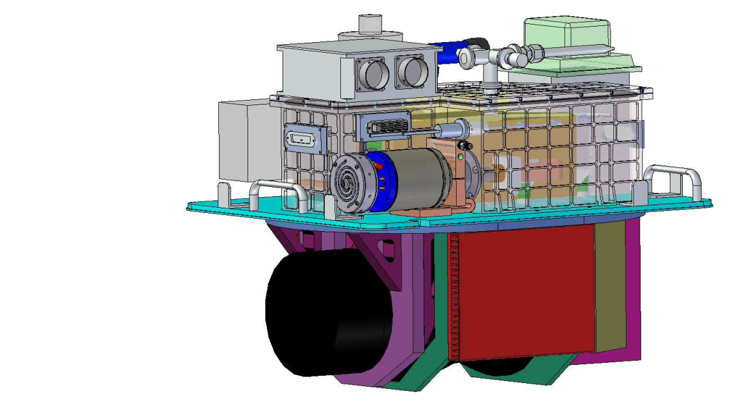
eMAS Project Overview
Purpose:
To provide a next generation airborne MODIS-like instrument with high spatial resolution and broad multi-spectral coverage (VNIR/SWIR-MWIR-LWIR)
Main Elements:
New IR spectrometer for the existing MAS line-scanner (“eMAS-Scanner”)
New stand-alone VNIR/SWIR Imaging Spectrometer (“eMAS-HSI”)
eMAS will be a suite of two bore-sighted, synchronized, instruments:
eMAS-HSI Imaging Spectrometer
eMAS Scanner
New Stirling-Cooled MW/LWIR Spectrometer
SWIR Spectrometer
VNIR Spectrometer
Telescope
(Dual-Offner V/SWIR Pushbroom)
Re-Built MAS Fore-Optics

Slide 11
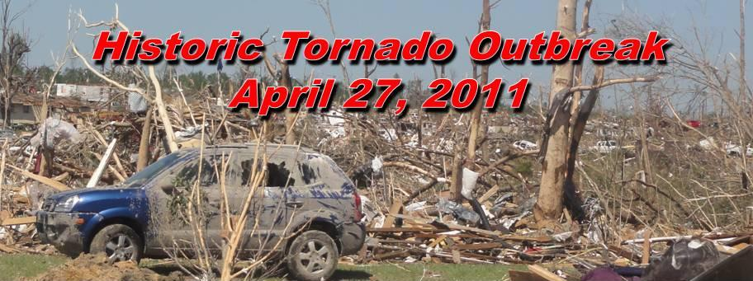
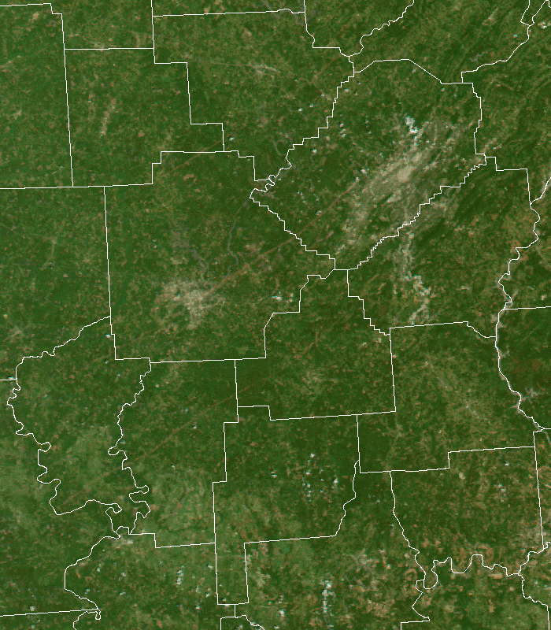
Birmingham
One of the most notable tornado outbreaks in history
Based on techniques of Jedlovec et al. (2006), NWS forecasters use MODIS color composites to evaluate tornado damage tracks
Guide forecasts to remote locations to conduct surveys
Correlate damage locations with Doppler radar rotational signatures
Used with high resolution 15m ASTER data for better assessment
Tuscaloosa
Jedlovec, Gary J., Udaysankar Nair, Stephanie L. Haines, 2006: Detection of Storm Damage Tracks with EOS Data. Wea. Forecasting, 21, 249–267. doi: 10.1175/WAF923.1

Slide 12
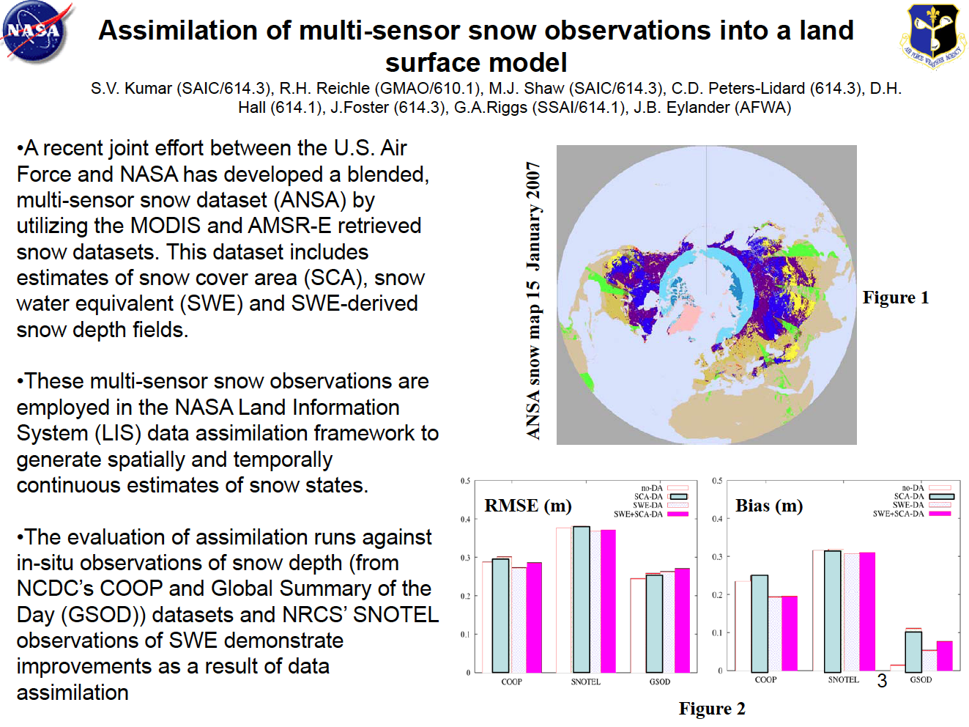
AFWA & NASA/GSFC joint effort to develop a blended multi-sensor snow data set from MODIS and AMSR-E snow retrievals
Data set includes snow cover area (SCA), snow water equivalent (SWE) and SWE-derived snow depth.
Multi-sensor snow products used in the NASA Land Information System to generate gridded estimates of snow states using data assimilation framework.
Assimilation improves snow state estimates in an evaluation against in situ observations (NCDC’s COOP and Global Summary of the Day data sets and NRCS’ SNOTEL observations of SWE).
Slide courtesy of L.-P. Riishjogaard

Slide 13
Contributions of MODIS to EPO
MODIS is responsible for more than half of the images used in Earth Observatory (approximate breakdown for 2010)*
  MODIS (both Terra & Aqua): 52%
  EO-1/ALI: 14%
  Landsats: 8%
  ISS: 6%
  all other sources: 20%
* Kevin Ward, 5/17/11

