Slide 1
Sea-Surface Temperature from MODIS
Peter J Minnett, Robert H Evans and Gui Podestá
Meteorology and Physical Oceanography
Rosenstiel School of Marine and Atmospheric Science
University of Miami

Slide 2
Overview
Sea-surface temperature (SST) as an Essential Climate Variable (ECV), and Climate Data Record (CDR)
MODIS SSTs
  Improvements in the atmospheric correction algorithms
Radiometric measurements of SSTs from ships
  Traceability to SI standards
Physical processes at the sea surface
  Diurnal heating and cooling
  Thermal skin effect

Slide 3
Sea-surface temperature
Temperature is a fundamental SI variable.
SST is an important variable, helps determine the coupling between ocean and atmosphere.
Has many applications in NWP, operational oceanography, climate studies.
Can be measured to good accuracy from space.
Can be validated to determine residual uncertainties.

Slide 4
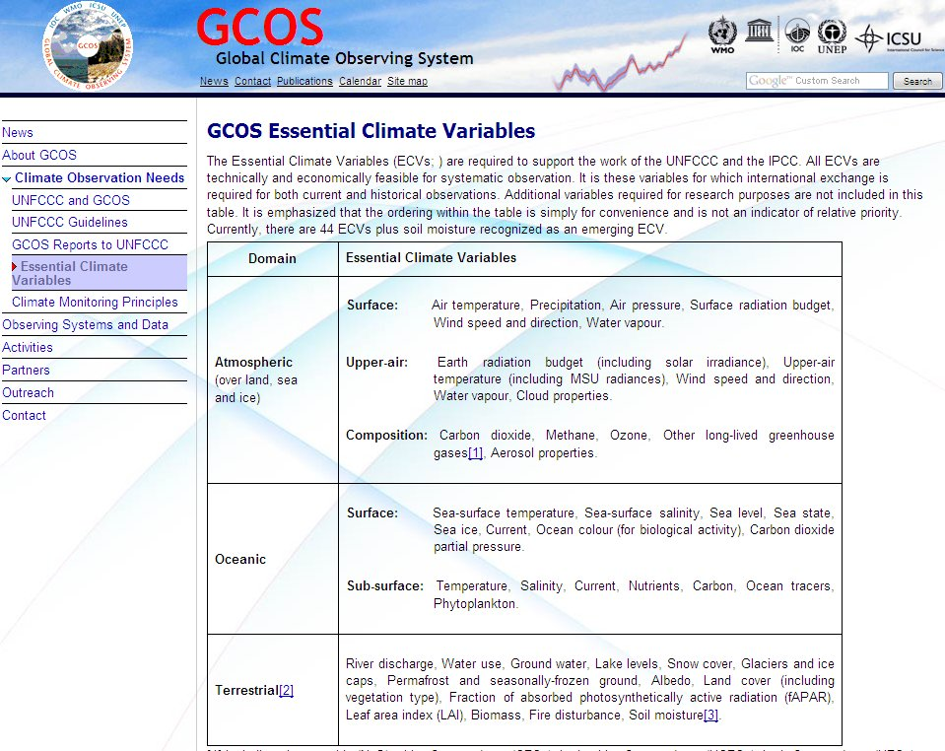
Essential Climate Variables

Slide 5
Essential Climate Variables

Slide 6
Satellite-derived CDRs
National Academy of Sciences Report (NRC, 2000): “a data set designed to enable study and assessment of long-term climate change, with ‘long-term’ meaning year-to-year and decade-to-decade change. Climate research often involves the detection of small changes against a background of intense, short-term variations.”
“Calibration and validation should be considered as a process that encompasses the entire system, from the sensor performance to the derivation of the data products. The process can be considered to consist of five steps:
  instrument characterization,
  sensor calibration,
  calibration verification,
  data quality assessment, and
  data product validation.”

Slide 7
Desired SST CDR uncertainties
The useful application of all satellite-derived variables depends on a confident determination of uncertainties.
CDRs of SSTs require most stringent knowledge of the uncertainties:
  Target accuracies: 0.1K over large areas, stability 0.04K/decade - Ohring et al. (2005) Satellite Instrument Calibration for Measuring Global Climate Change: Report of a Workshop. Bulletin of the American Meteorological Society 86:1303-1313

Slide 8
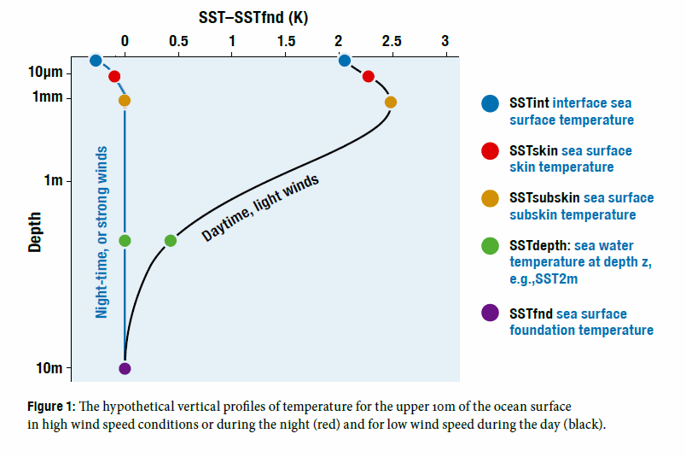
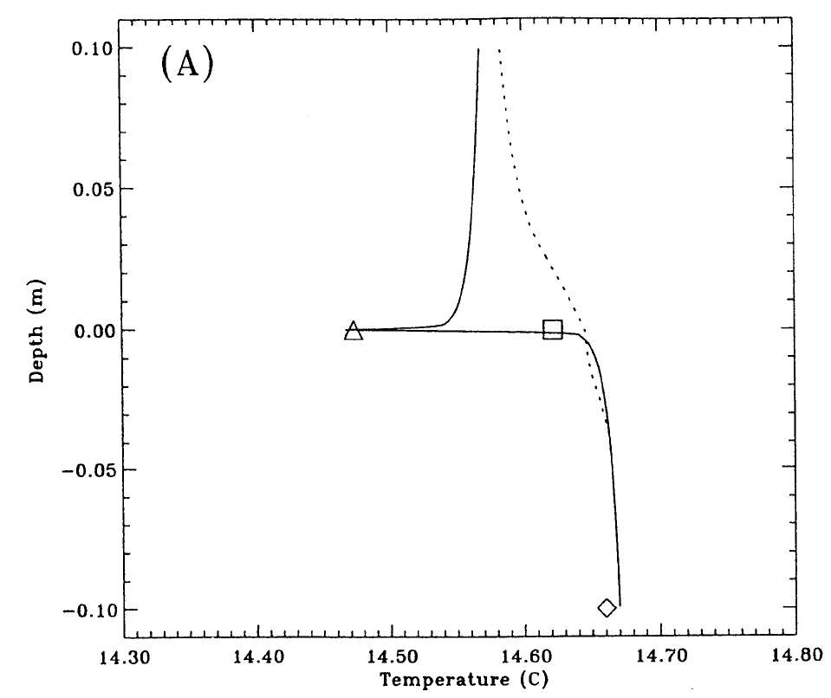
What is SST?
The infrared emission from the ocean originates from the uppermost <1mm of the ocean – the skin layer.
The atmosphere is in contact with the top of the skin layer.
Ocean-to-atmosphere heat flow through the skin layer is by molecular conduction: this causes, and results from, a temperature gradient through the skin layer.
Conventional measurements of SST are from submerged thermometers – a “bulk” temperature.
T_{depth} below the influence of diurnal heating is the “foundation” temperature.
From Eifler, W. and C. J. Donlon, 2001: Modeling the thermal surface signature of breaking waves. J. Geophys. Res., 106, 27,163-27,185.

Slide 9
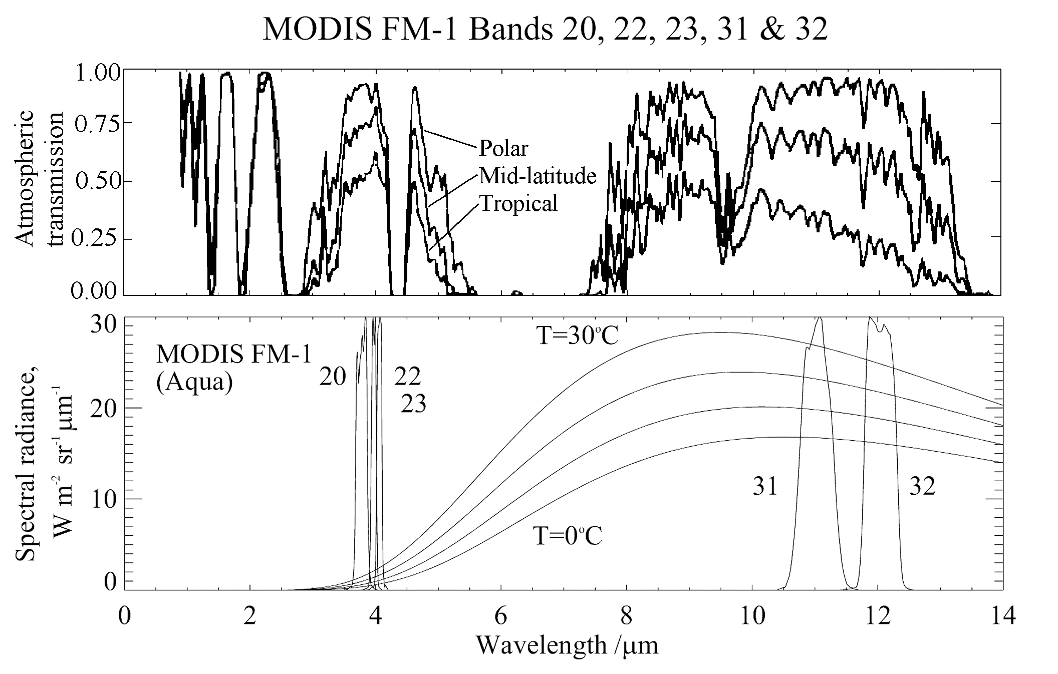
Infrared measurement of SST

Slide 10
The SST atmospheric correction algorithms
The form of the daytime and night-time algorithm for measurements in the long wave atmospheric window is:
SST = c₁ + c₂ * T₁₁ + c₃ * (T₁₁-T₁₂) * T_{sfc} + c₄ * (sec (θ) -1) * (T₁₁-T₁₂)
where T_{n} are brightness temperatures measured in the channels at n μm wavelength, T_{sfc} is a ‘climatological’ estimate of the SST in the area, and θ is the satellite zenith angle. This is based on the Non-Linear SST algorithm.
[Walton, C. C., W. G. Pichel, J. F. Sapper and D. A. May (1998). "The development and operational application of nonlinear algorithms for the measurement of sea surface temperatures with the NOAA polar-orbiting environmental satellites." Journal of Geophysical Research 103 27,999-28,012.]
The MODIS night-time algorithm, using two bands in the 4μm atmospheric window is:
SST4 = c₁ + c₂ * T_{3.9} + c₃ * (T_{3.9}-T_{4.0}) + c₄ * (sec (θ) - 1)
Note, the coefficients in each expression are different. They can be derived in three ways:
  empirically by regression against SST values derived from another validated satellite instrument
  empirically by regression against SST values derived surface measurements from ships and buoys
  theoretically by numerical simulations of the infrared radiative transfer through the atmosphere.

Slide 11
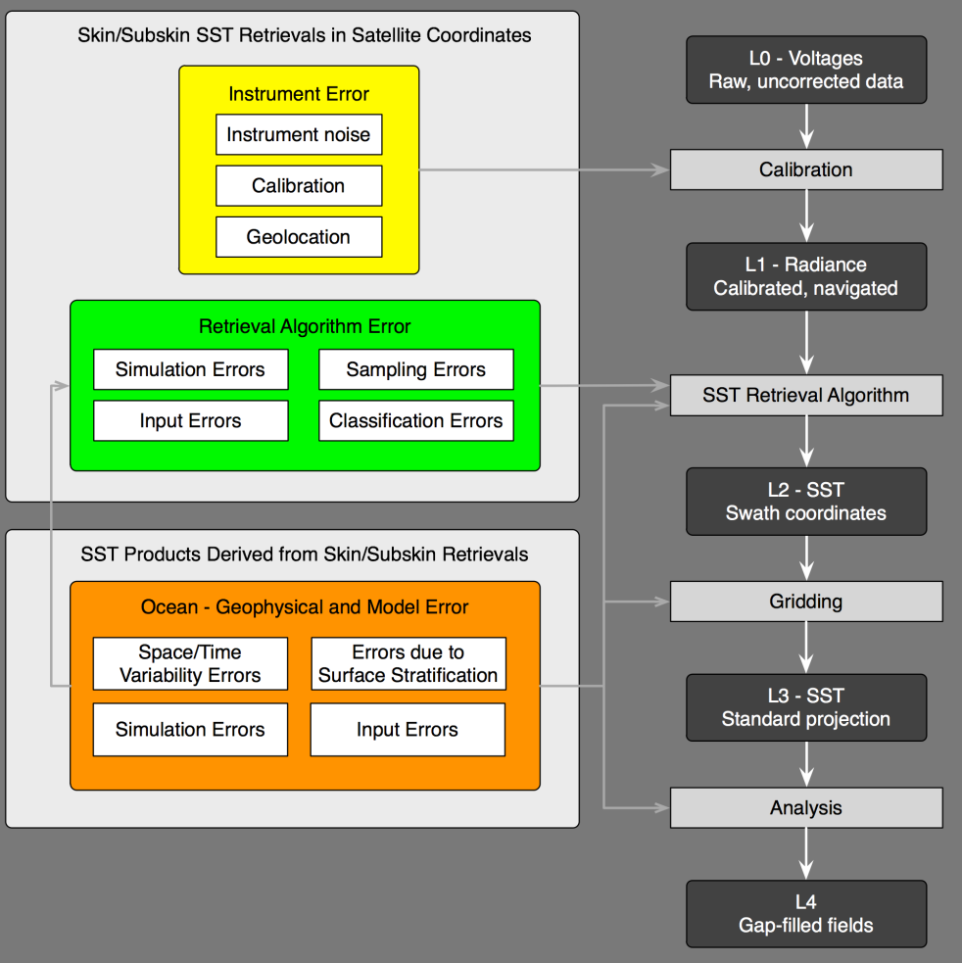
Uncertainty estimates
Each processing step is prone to additional error sources.
From Cornillon et al, 2010, Sea-Surface Temperature Error Budget White Paper. (http://www.ssterrorbudget.org/ISSTST/)

Slide 12
Uncertainty estimates
Each processing step is prone to additional error sources.
From Cornillon et al, 2010, Sea-Surface Temperature Error Budget White Paper. (http://www.ssterrorbudget.org/ISSTST/)

Slide 13
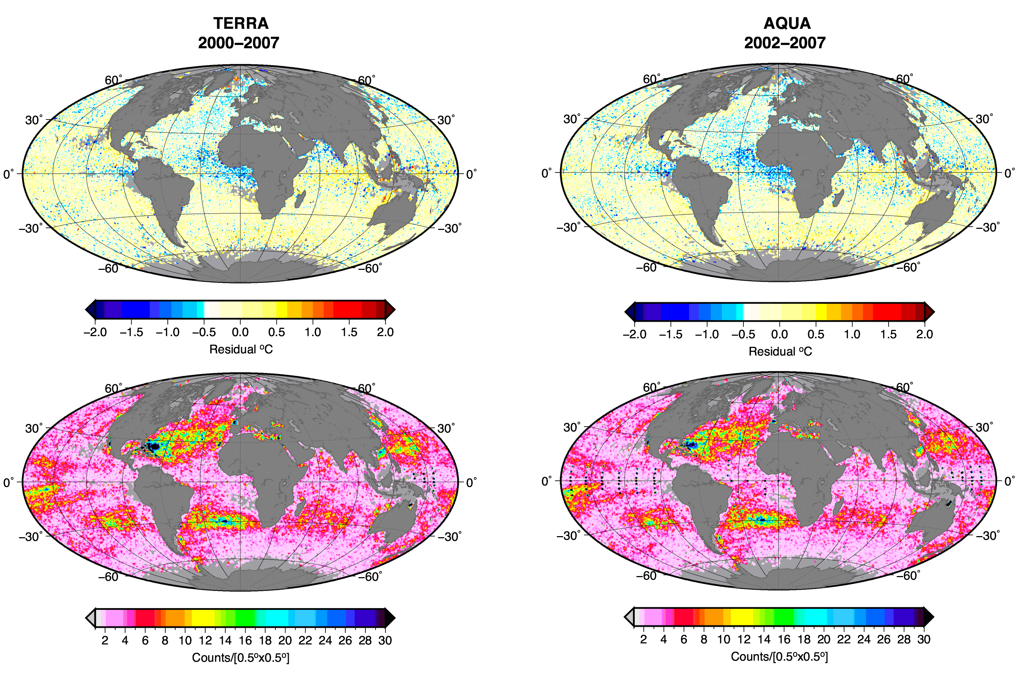
Spatial distribution of errors
Areas of high bias errors can be related to geophysical phenomena: aerosols, upwelling, diurnal heating, anomalous humidity distributions ….

Slide 14
Where next?
Refine NLSST with regionally as well as seasonally optimized coefficient sets – “Latband algorithm”
Use advanced computational techniques:
  Genetic Algorithm (GA)-based equation discovery
  to derive alternative forms of the correction algorithm
  Regression tree to identify geographic regions with related characteristics
  Support Vector Machines (SVM) to minimize error using state-of-the-art non-linear regression

Slide 15
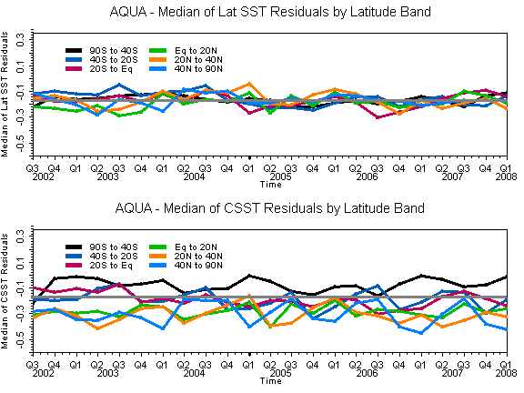
“Latband” improvements
Time series of mean SST residuals for MODIS-Aqua.
Algorithm coefficients estimated for six fixed latitudinal bands and for each month of the year.
V6 – with “LATBAND” approach.
V5 – without.
Version 6
Version 5

Slide 16
Equation Discovery using Genetic Algorithms
Darwinian principles are applied to algorithms that “mutate” between successive generations
The algorithms are applied to large data bases of related physical variables to find robust relationships between them. Only the “fittest” algorithms survive to influence the next generation of algorithms.
Here we apply the technique to the MODIS matchup-data bases.
The survival criterion is the size of the RMSE of the SST retrievals when compared to buoy data.

Slide 17
Genetic Mutation of Equations
The initial population of formulae is created by a generator of random algebraic expressions from a predefined set of variables and operators. For example, the following operators can be used: {+, -, /, ×, √, exp, cos, sin, log}. To the random formulae thus obtained, we can include “seeds” based on published formulae, such as those already in use.
In the recombination step, the system randomly selects two parent formulae, chooses a random subtree in each of them, and swaps these subtrees.
The mutation of variables introduces the opportunity to introduce different variables into the formula. In the tree that defines a formula, the variable in a randomly selected leaf is replaced with another variable.

Slide 18
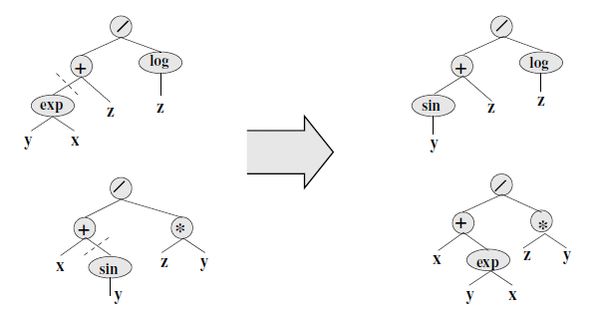
Successive generations of algorithms
The formulae are represented by tree structures; the “recombination” operator exchanges random subtrees in the parents. Here the parent formulae (y^{x}+z)/log(z) and (x+sin(y))/zy give rise to children formulae (sin(y)+z)/log(z) and (x+y^{x})/zy. The affected subtrees are indicated by dashed lines.
Subsets of the data set can be defined in any of the available parameter spaces.
(From Wickramaratna, K., M. Kubat, and P. Minnett, 2008: Discovering numeric laws, a case study: CO₂ fugacity in the ocean. Intelligent Data Analysis, 12, 379-391.)

Slide 19
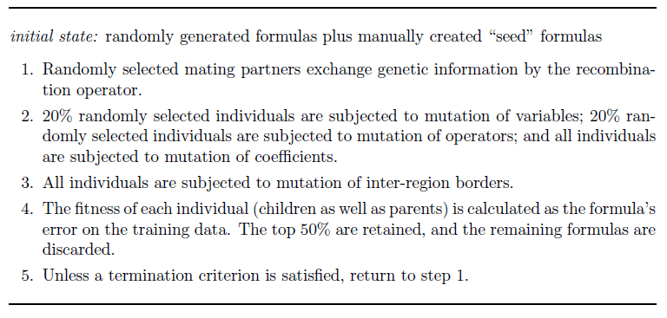
GA-based equation discovery

Slide 20

And the winner is….

Slide 21
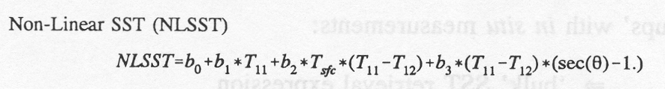
And the winner is….
The “fittest” algorithm takes the form:
where:
T_{i} is the brightness temperature at λ= i µm
θ_{s} is the satellite zenith angle
θ_{a} is the angle on the mirror (a feature of the MODIS paddle-wheel mirror design)
Which looks similar to the NLSST:

Slide 22
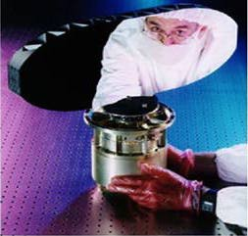
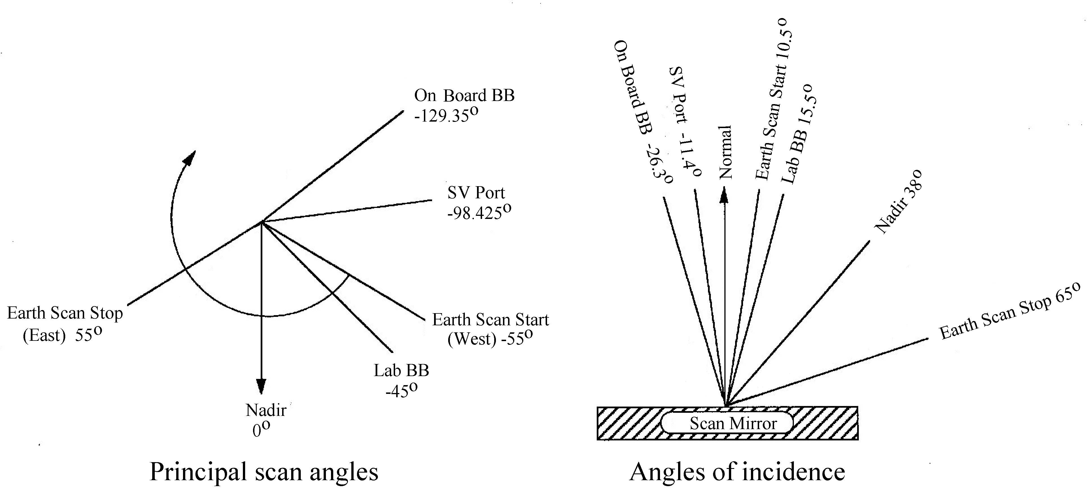
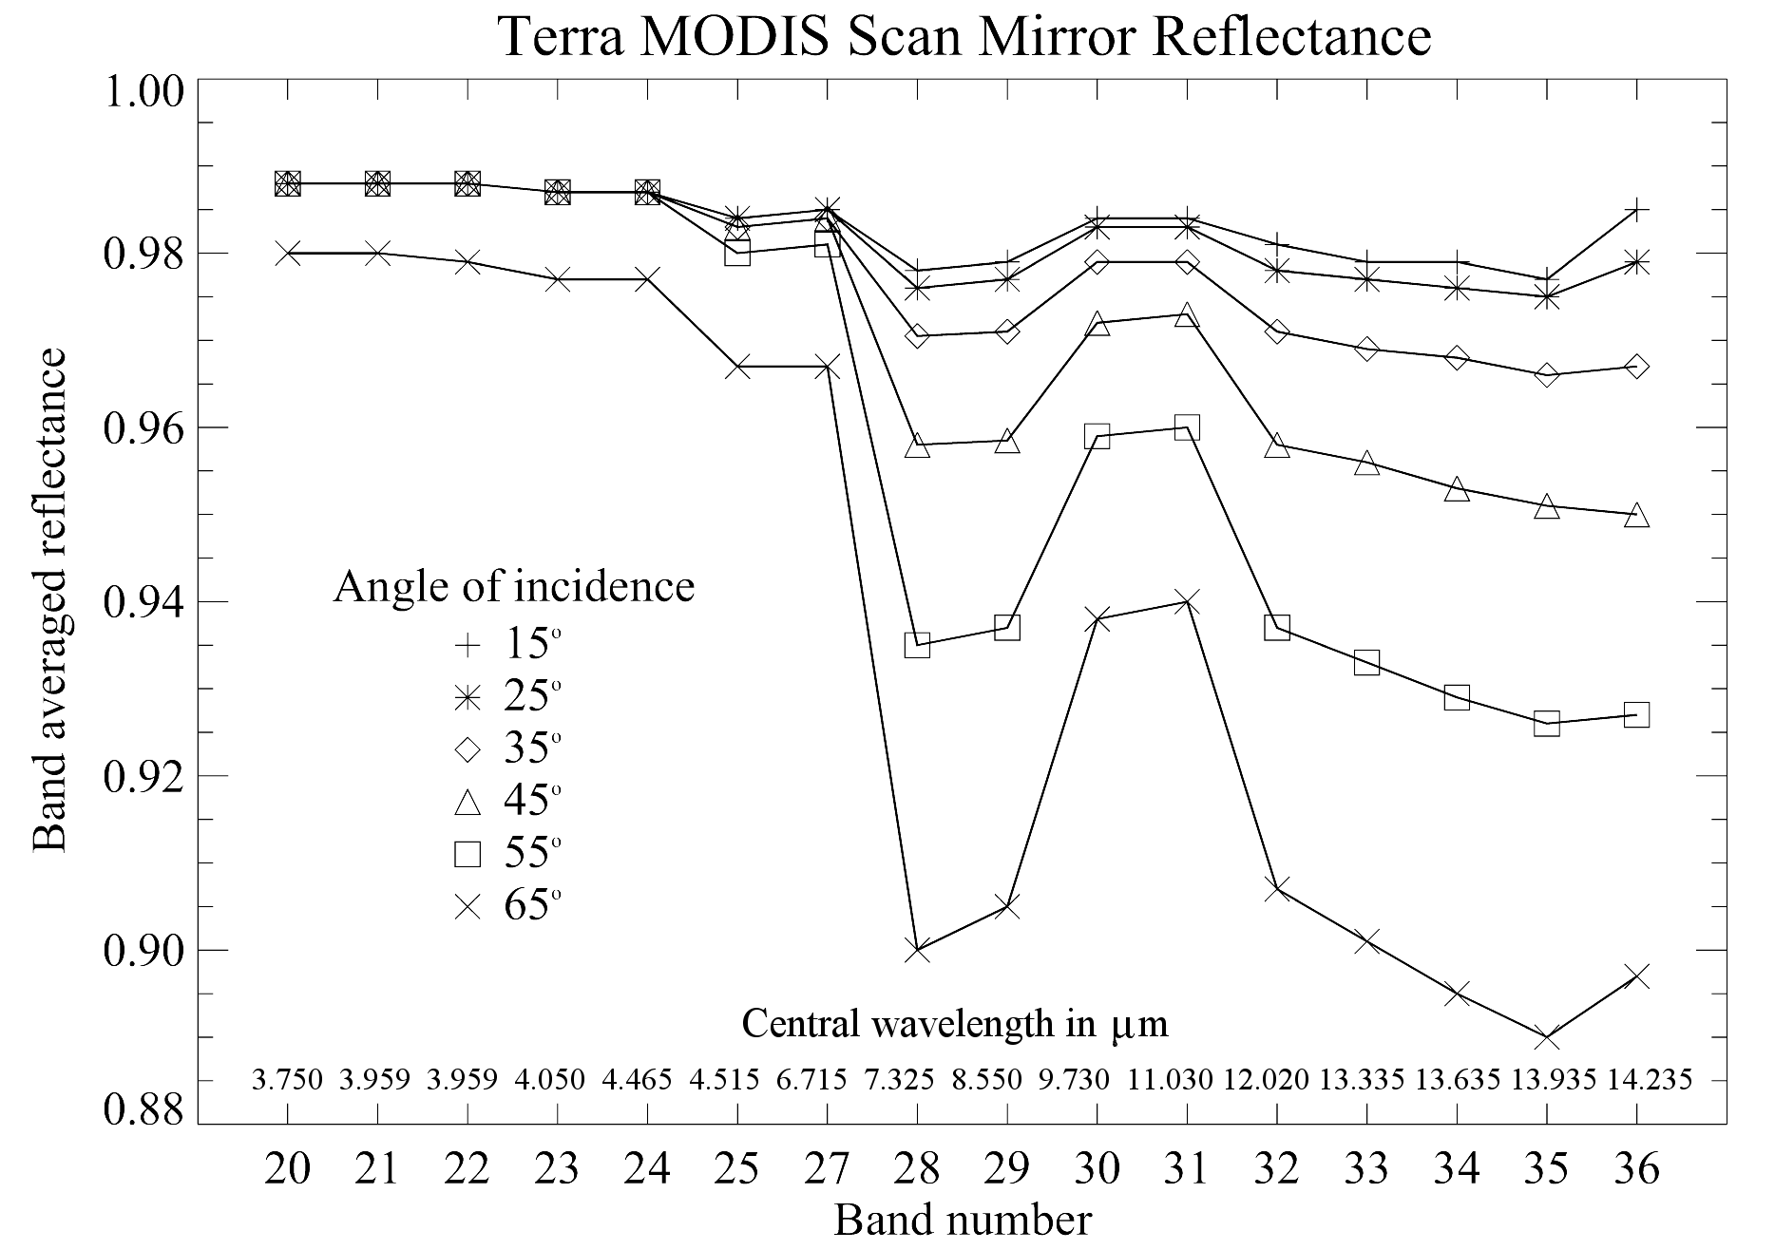
MODIS scan mirror effects
Mirror effects: two-sided paddle wheel has a multi-layer coating that renders the reflectivity in the infrared a function of wavelength, angle of incidence and mirror side.

Slide 23
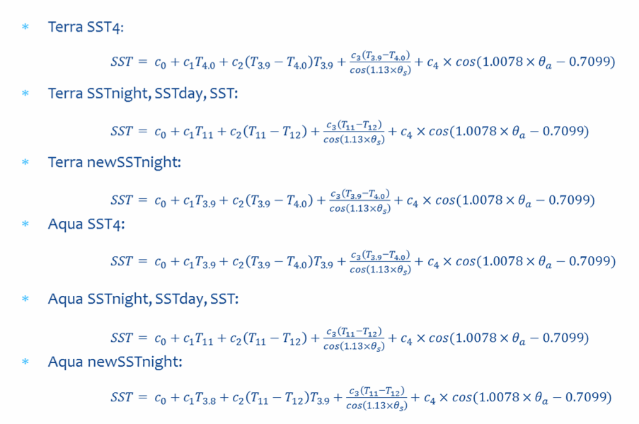
Variants of the new algorithms
Coefficients are different for each equation
Note: No T_{sfc}

Slide 24
Regression tree
Regions identified by the regression tree algorithm
The tree is constructed using
  input variables: latitude and longitude
  output variable: Error in retrieved SST
Algorithm recursively splits regions to minimize variance within them
The obtained tree is pruned to the smallest tree within one standard error of the minimum-cost subtree, provided a declared minimum number of points is exceeded in each region
Linear regression is applied separately to each resulting region (different coefficients result)

Slide 25
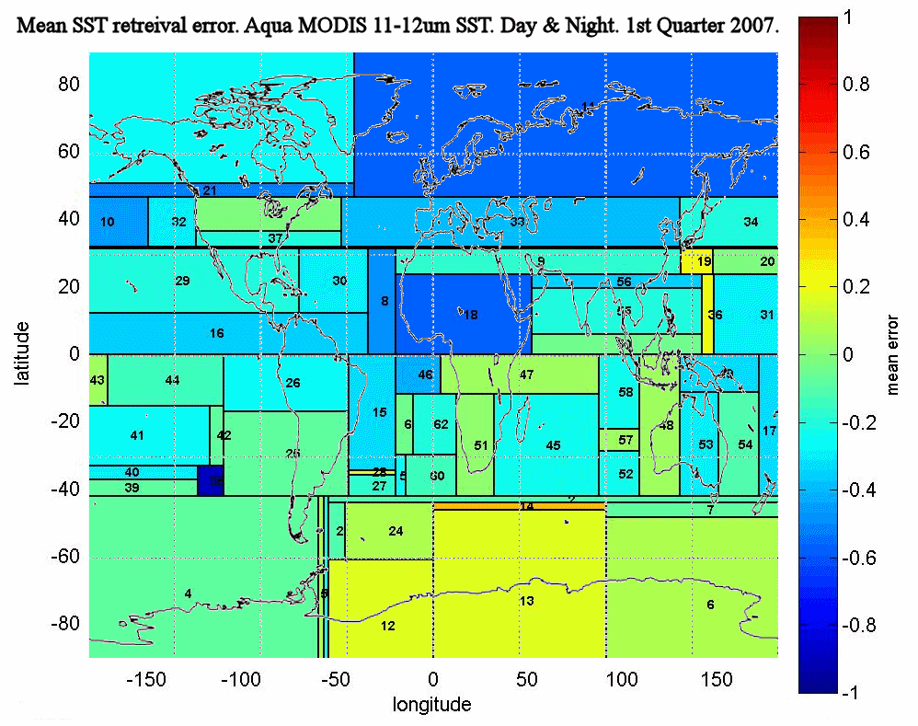

Slide 26
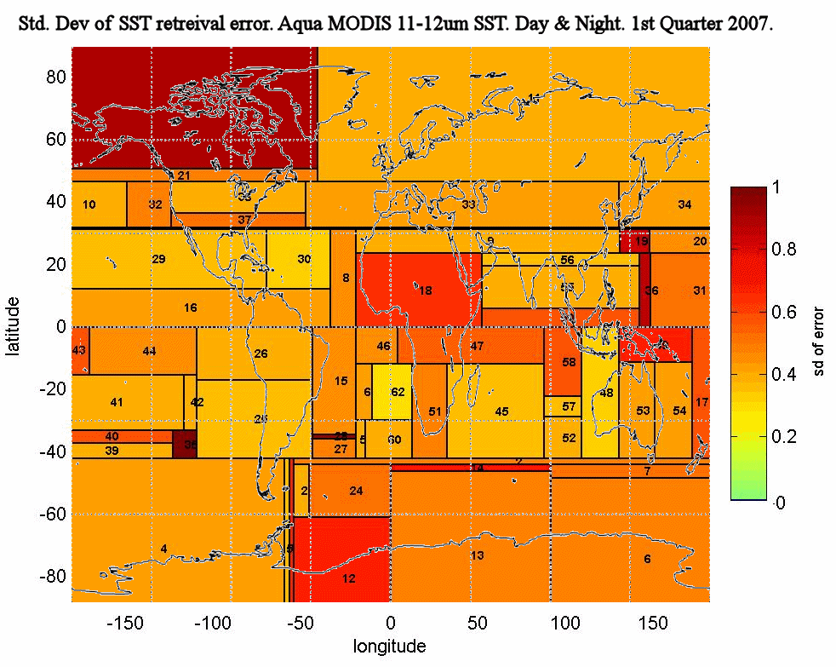

Slide 27
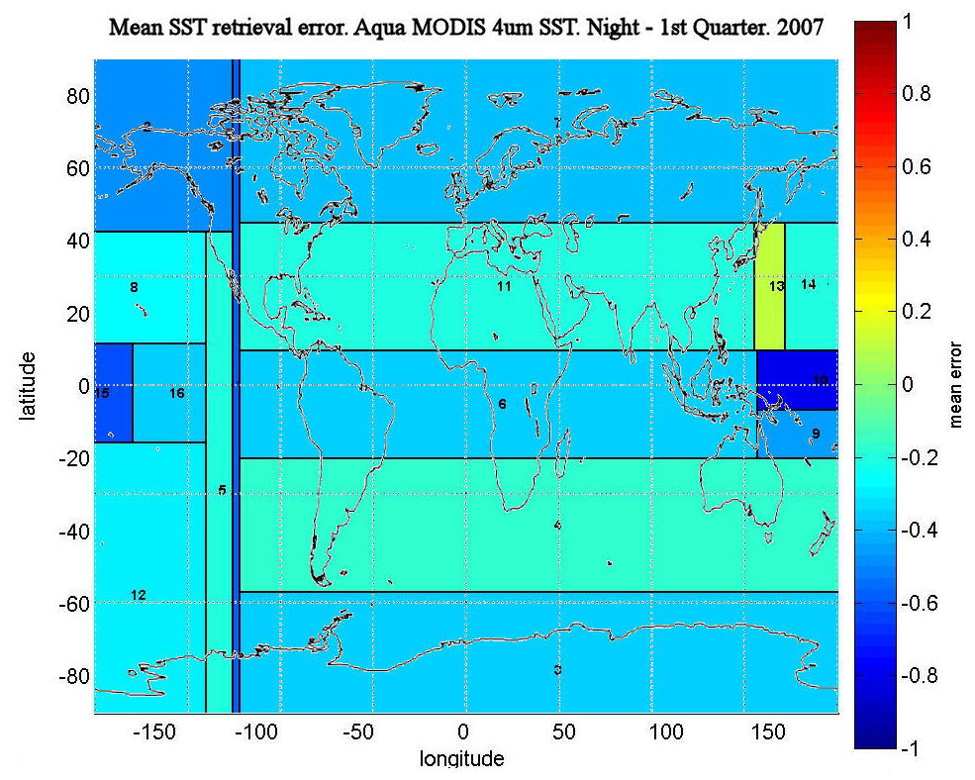

Slide 28
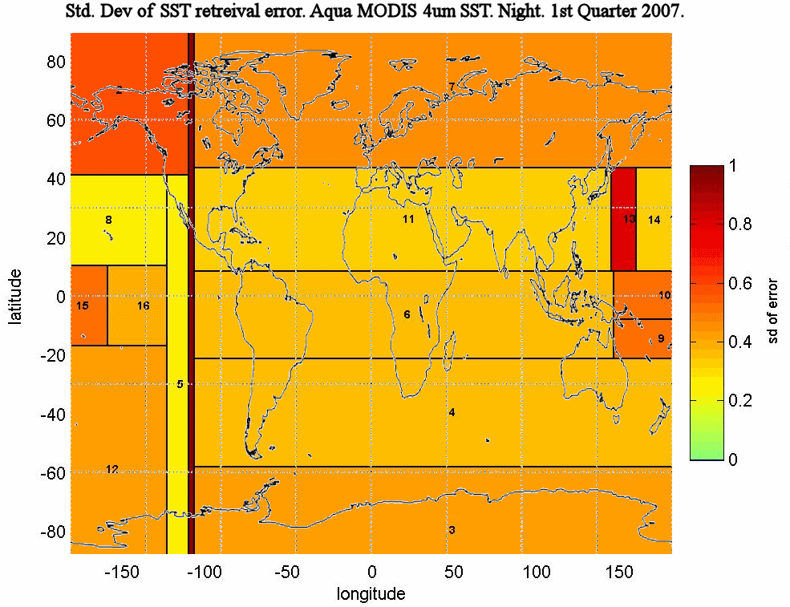

Slide 29
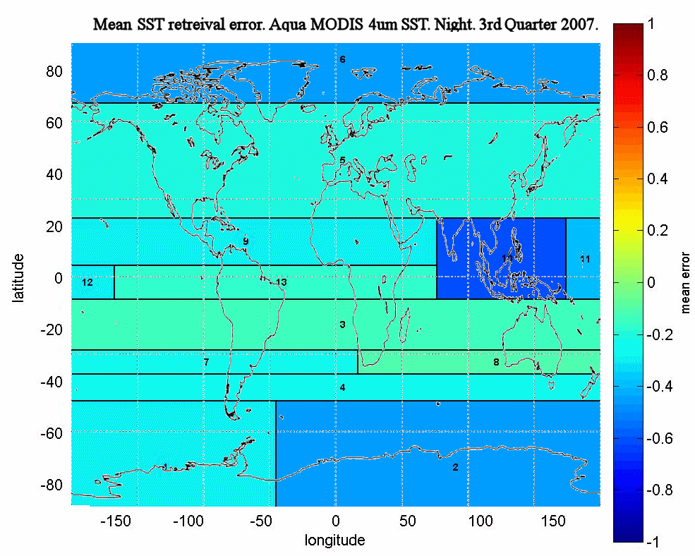

Slide 30
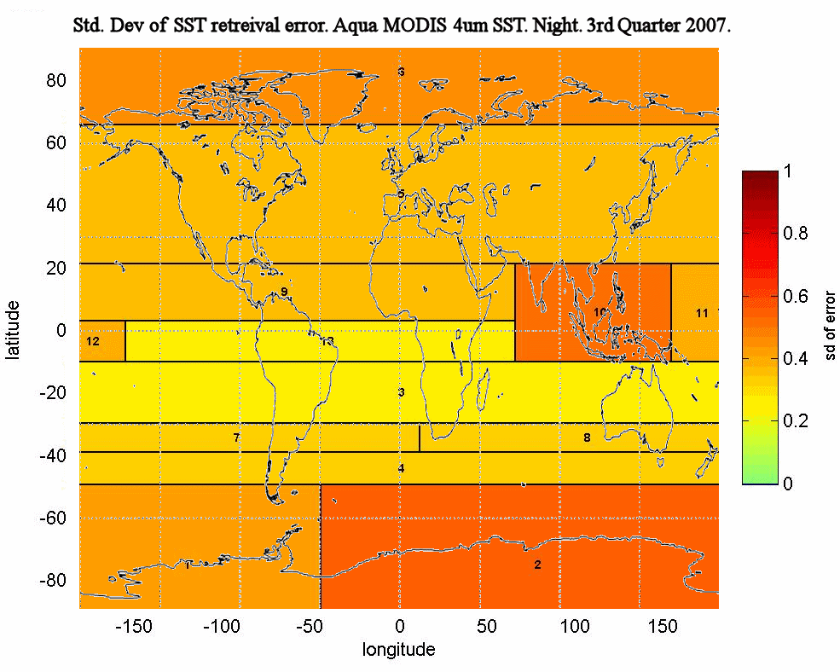

Slide 31
Regression tree performance
Terra 2004 SSTday
NLSST (no regions) – RMSE: 0.581
  New formula (no regions) – RMSE: 0.615
  New formula (with regions) – RMSE: 0.568
Terra 2004 SST4 (night)
SST4 (no regions) – RMSE: 0.528
  New formula (no regions) – RMSE: 0.480
  New formula (with regions) – RMSE: 0.456

Slide 32
Support Vector Machines (SVM)
Best accuracy observed when data set is large (lower accuracy when splitting into regions)
  Terra 2004 SSTday –
    RMSE (no region): 0.513, RMSE (with regions): 0.557
Problems:
  Computational costs
  Black-box approach

Slide 33
Preliminary Results
The new algorithms with regions give smaller errors than NLSST or SST₄
T_{sfc} term no longer required
Night-time 4µm SSTs give smallest errors
Aqua SSTs are more accurate than Terra SSTs
Regression-tree induced in one year can be applied to other years without major increase in uncertainties
SVM results do not out-perform GA+Regression Tree algorithms

Slide 34
Next steps
Can some regions be merged without unacceptable increase in uncertainties?
180ºW should not necessarily always be a boundary of all adjacent regions.
Iterate back to GA for regions – different formulations may be more appropriate in different regions.
Allow scan-angle term to vary with different channel sets.
Introduce “regions” that are not simply geographical.

Slide 35
Validation and CDR generation
Validation required over life-time of mission
Should encompass all atmospheric and oceanic variability.
Traceability to SI standards is needed.
→ ship-based radiometers

Slide 36
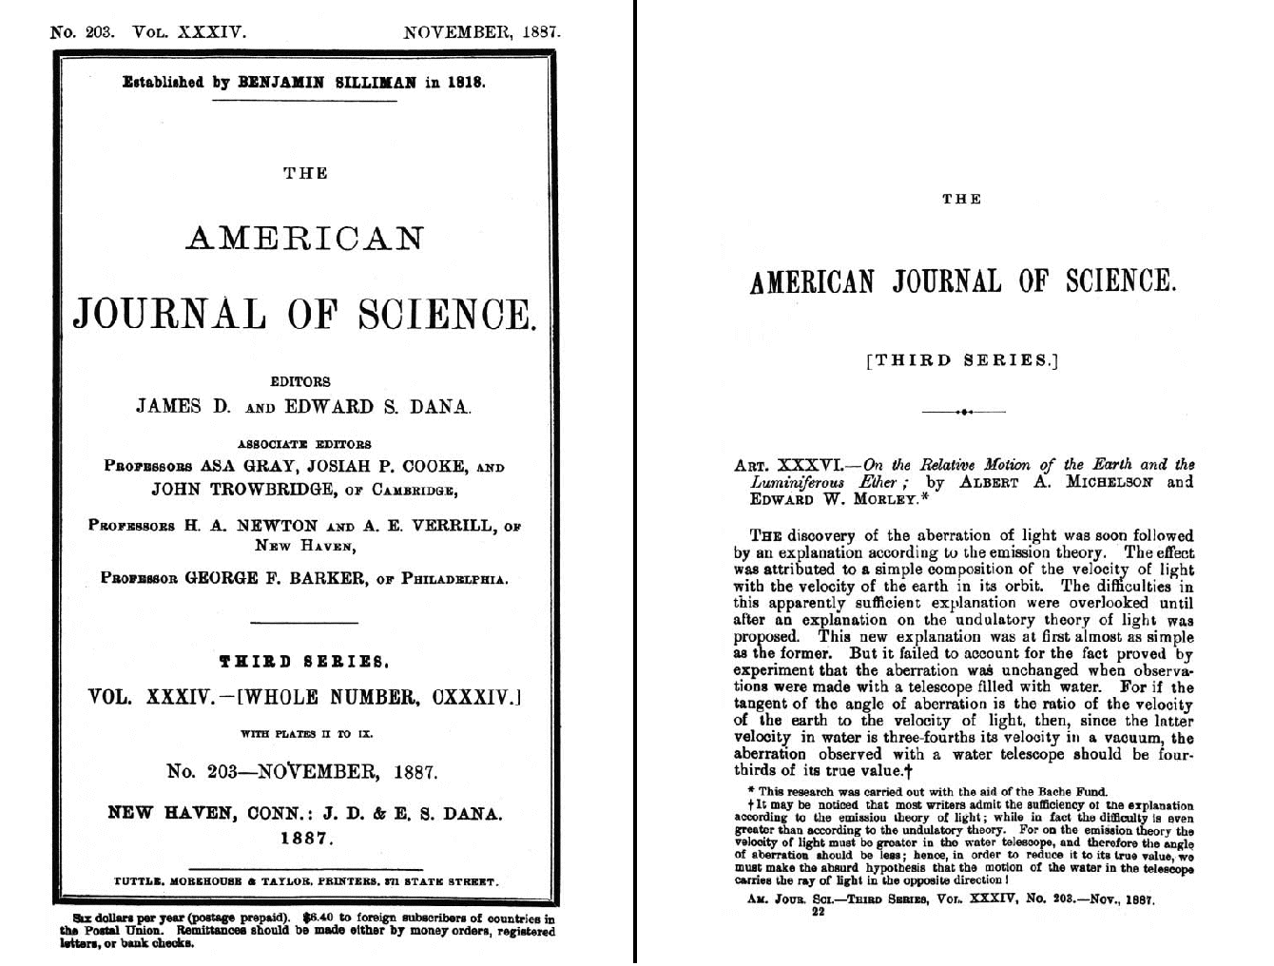
Marine-Atmospheric Emitted Radiance Interferometer
The M-AERI is a Michelson-Morley Fourier-transform infrared interferometric spectroradiometer. These were first developed in the 1880’s to make accurate measurements of the speed of light. Here we use it to make very accurate measurements of the sea-surface temperature, air temperature and profiles of atmospheric temperature and humidity. We also measure surface emissivity and the temperature profile through the skin layer, which is related to the flow of heat from the ocean to the atmosphere.

Slide 37
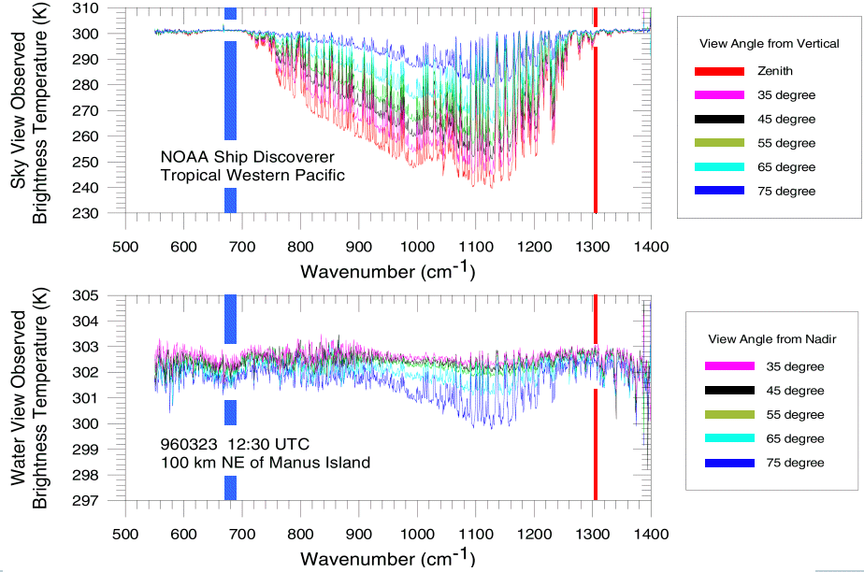
Ocean and atmosphere infrared spectra
NB: X10 change in temperature scale
Examples of parts of spectra measured by the M-AERI, represented as temperature, and those intervals where the sky temperatures are smallest indicate where the atmosphere is most transparent. The spikes in the atmospheric spectra are caused by emission lines. The blue bar shows which spectral region is used to measure air temperature, and the red bar skin sea-surface temperature. Note the change in temperature scales of the two panels. These data were taken in the Tropical Western Pacific during the Combined Sensor Program Cruise in 1996.
From Minnett, P. J., R. O. Knuteson, F. A. Best, B. J. Osborne, J. A. Hanafin and O. B. Brown (2001). "The Marine-Atmospheric Emitted Radiance Interferometer (M-AERI), a high-accuracy, sea-going infrared spectroradiometer." Journal of Atmospheric and Oceanic Technology. 18(6): 994-1013.

Slide 38
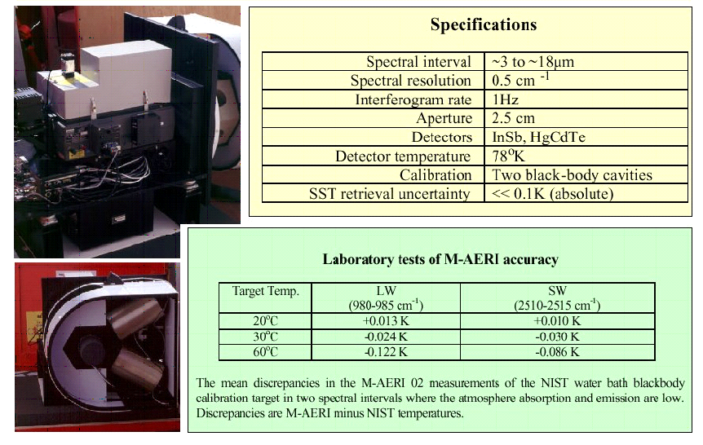
Marine-Atmospheric Emitted Radiance Interferometer (M-AERI)

Slide 39
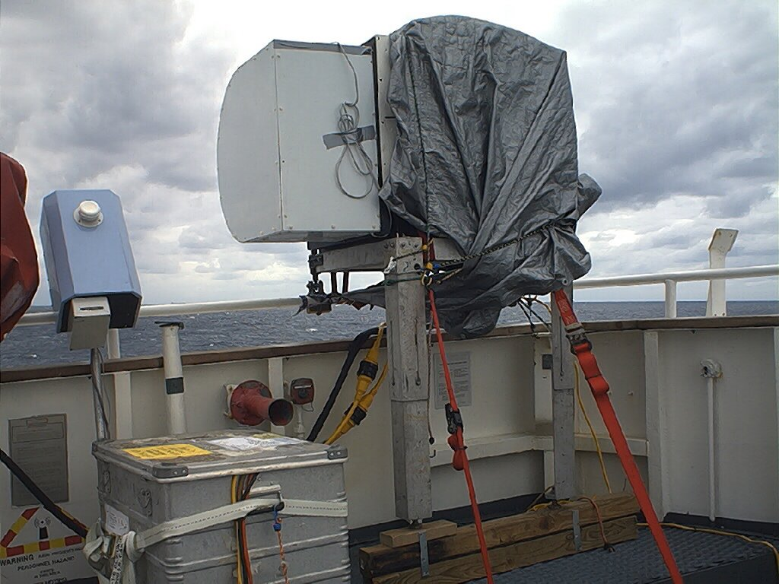
M-AERI on USCGC Polar Star, March 2000

Slide 40
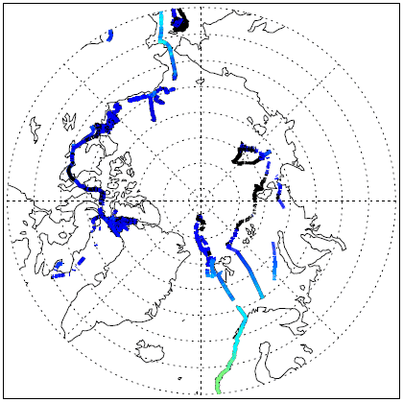

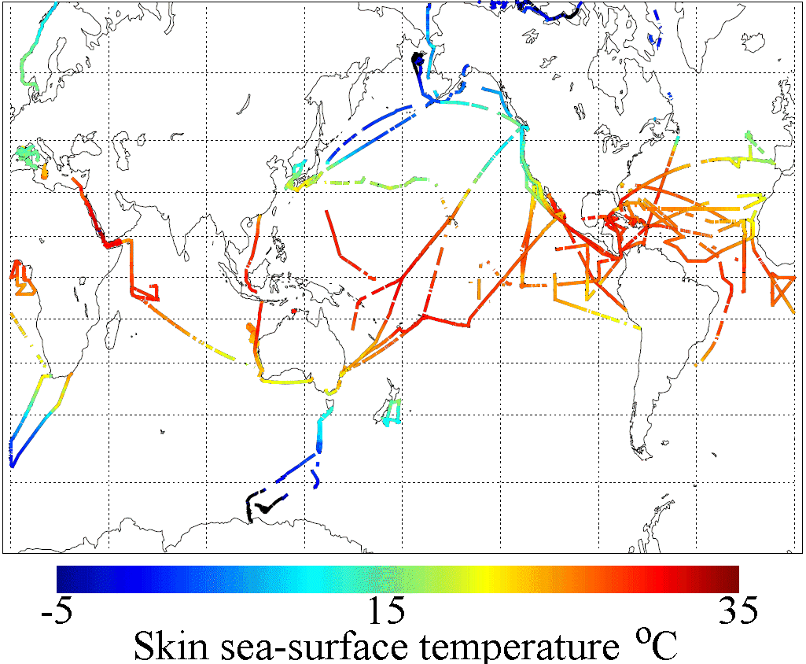
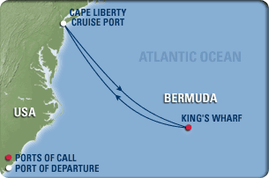
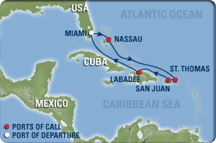


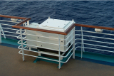
M-AERI cruises for MODIS, AATSR & AVHRR validation
Explorer of the Seas
Explorer of the Seas: near continuous operation December 2000 – December 2007. Restarted February 2010.

Slide 41
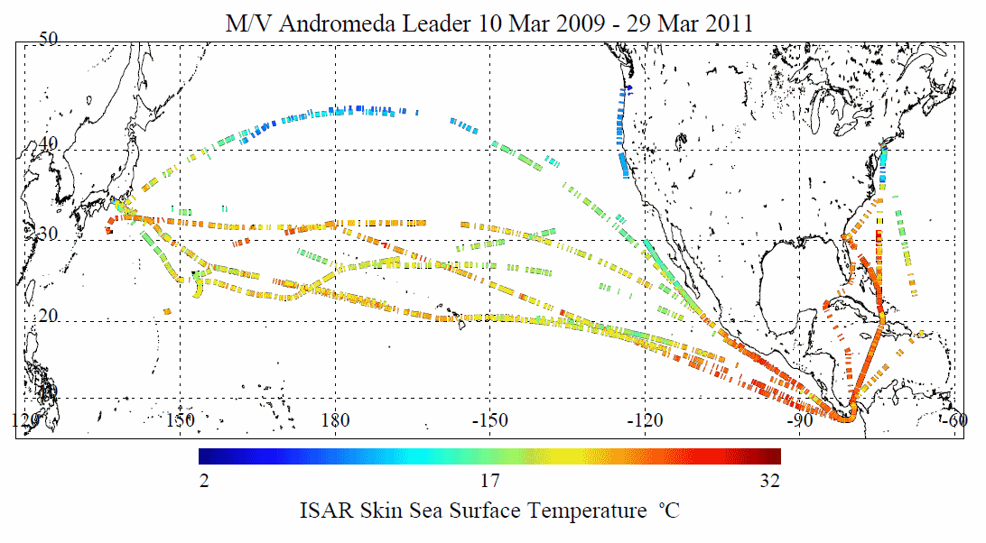
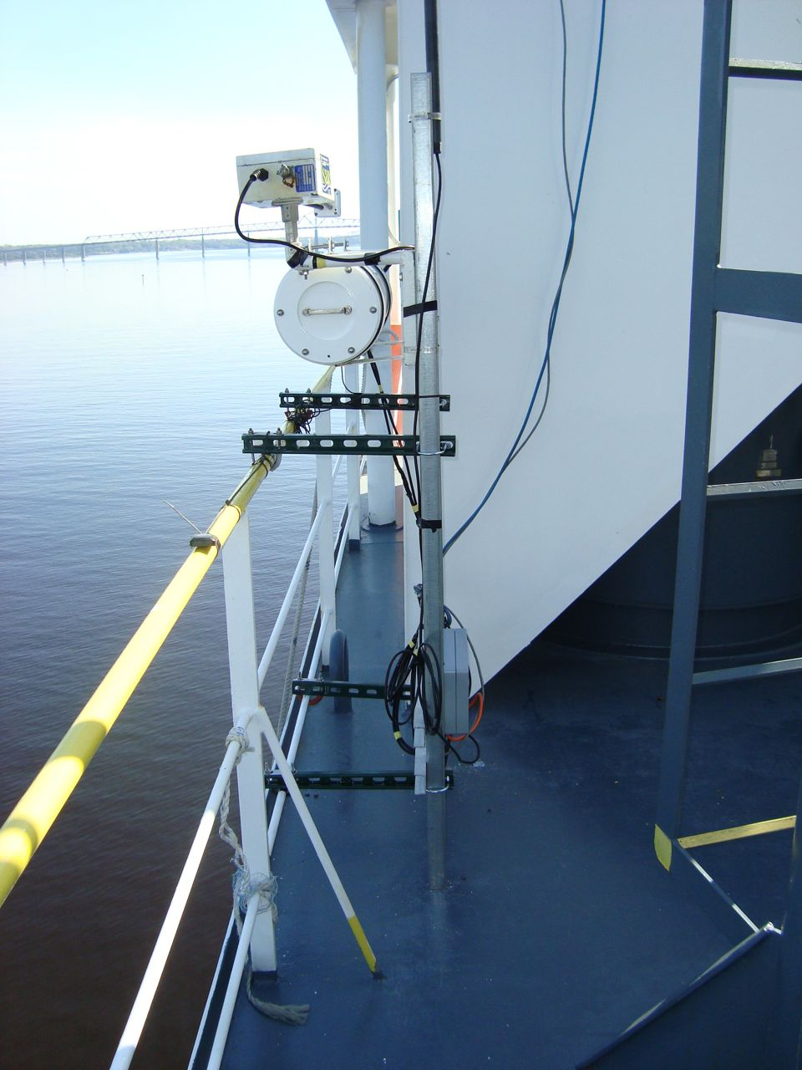
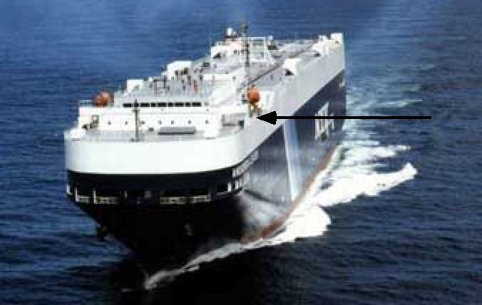
ISAR cruises for MODIS, AATSR & AVHRR validation

Slide 42
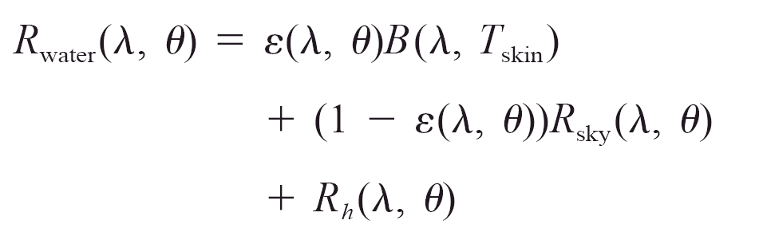
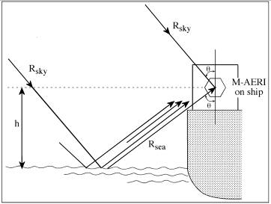
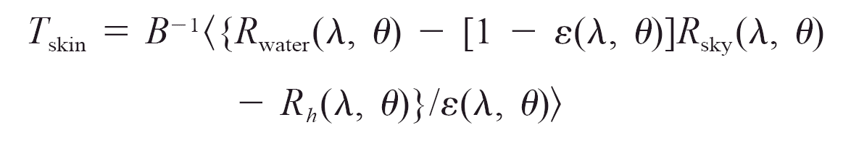
Measuring skin SST from ships
Scan-mirror mechanism for directing the field of view at complementary angles.
Excellent calibration for ambient temperature radiances.
Moderately good calibration at low radiances.

Slide 43
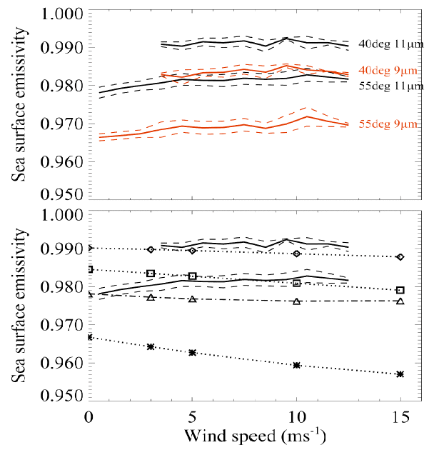
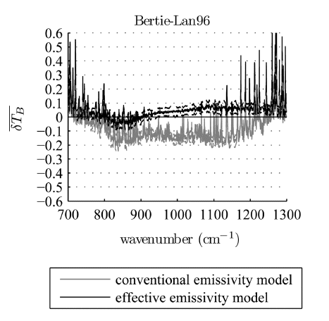
Sea surface emissivity (ɛ)
Conventional wisdom gave decreasing ε with increasing wind.
Not confirmed by at-sea hyperspectral measurements
Improved modeling confirms at-sea measurements.
Hanafin, J. A. and P. J. Minnett, 2005: Infrared-emissivity measurements of a wind-roughened sea surface. Applied Optics., 44, 398-411.
Nalli, N. R., P. J. Minnett, and P. van Delst, 2008: Emissivity and reflection model for calculating unpolarized isotropic water surface-leaving radiance in the infrared. I: Theoretical development and calculations. Applied Optics, 47, 3701-3721.
Nalli, N. R., P. J. Minnett, E. Maddy, W. W. McMillan, and M. D. Goldberg, 2008: Emissivity and reflection model for calculating unpolarized isotropic water surface-leaving radiance in the infrared. 2: Validation using Fourier transform spectrometers. Applied Optics, 47, 4649-4671.

Slide 44
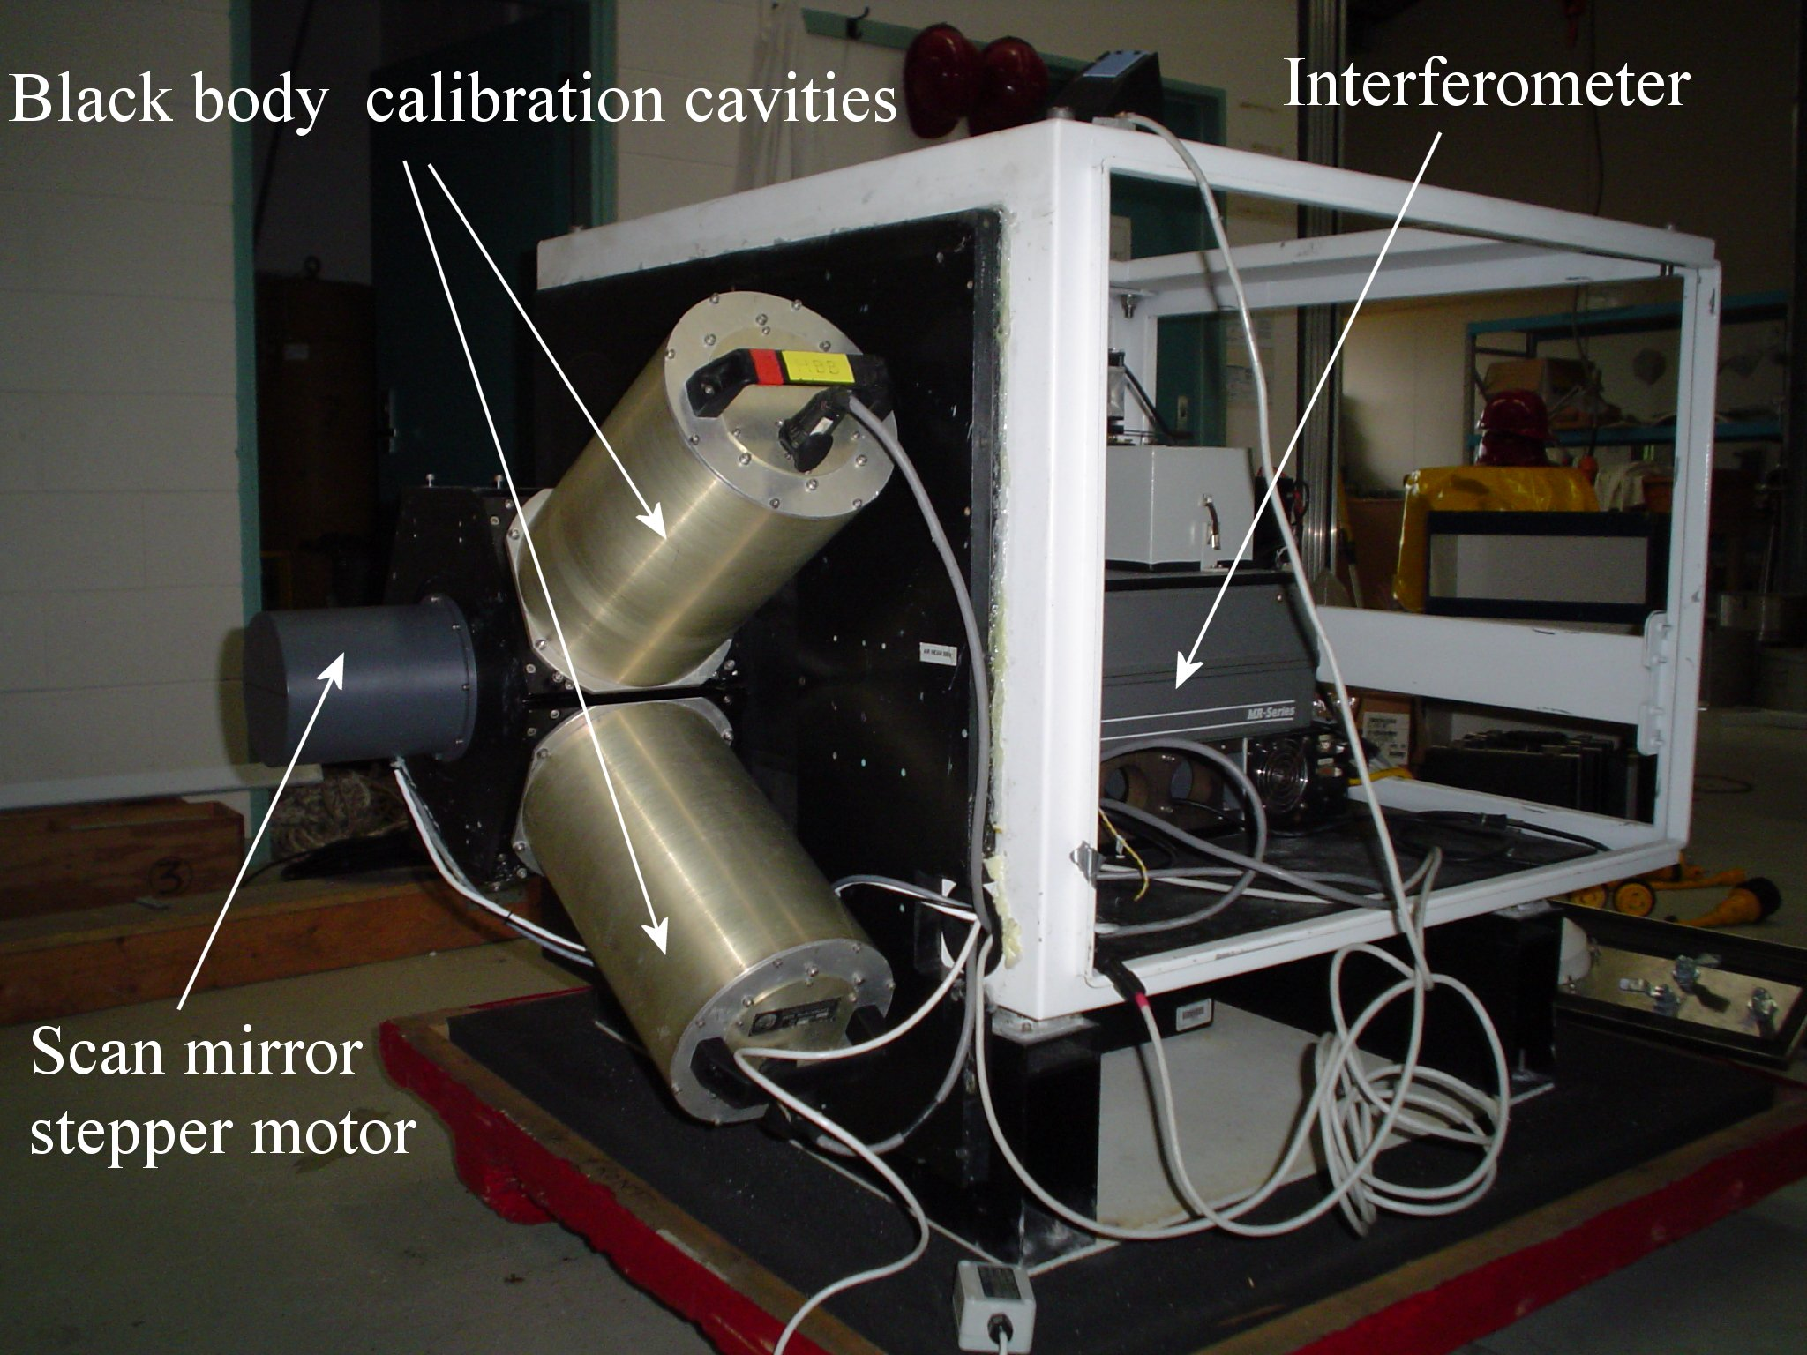
Internal Calibration

Slide 45
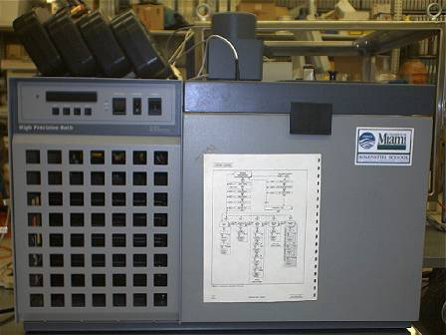
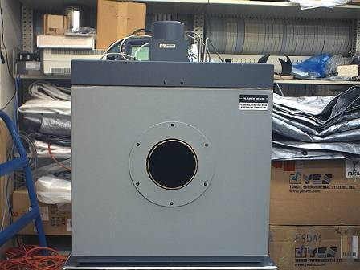
NIST water-bath black-body calibration target
See: Fowler, J. B., 1995. A third generation water bath based blackbody source, J. Res. Natl. Inst. Stand. Technol., 100, 591-599

Slide 46
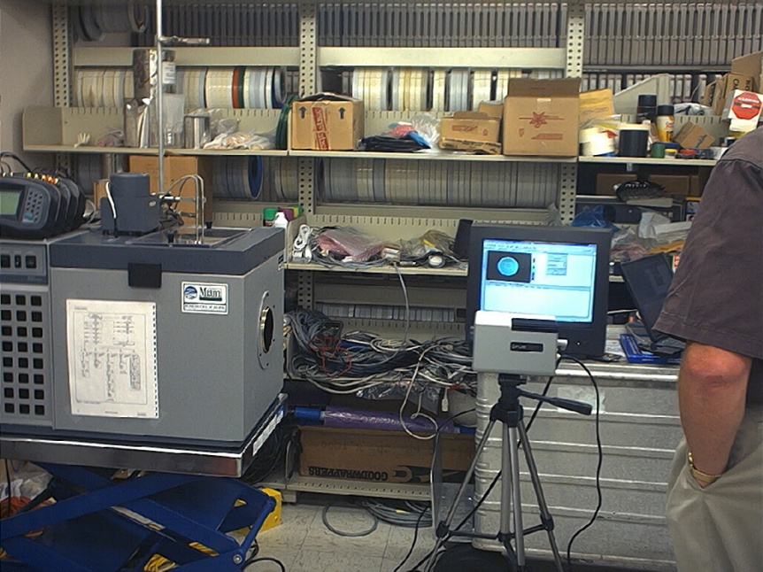
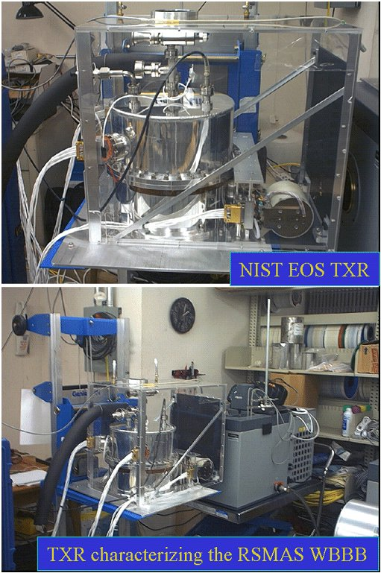
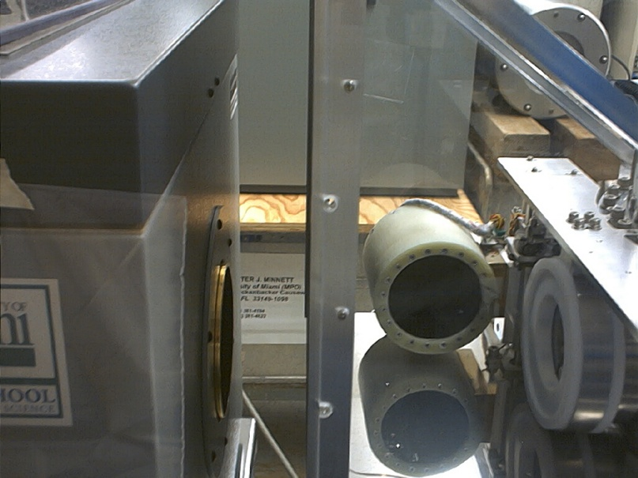
Traceability to NIST TXR

Slide 47
CDR of SST
Satellite-derived SSTs
NIST Traceable error statistics
M-AERI, ISAR…. measurements
Matchup analysis of collocated measurements
Laboratory calibration
NIST-designed water-bath blackbody calibrator
NIST-traceable thermometers
NIST TXR for radiometric characterization

Slide 48
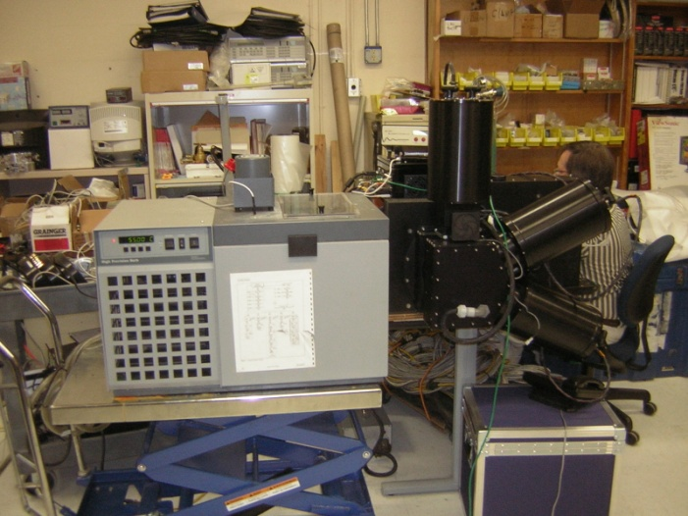
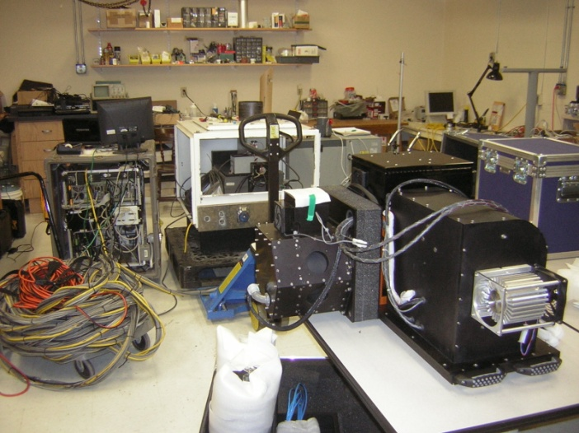
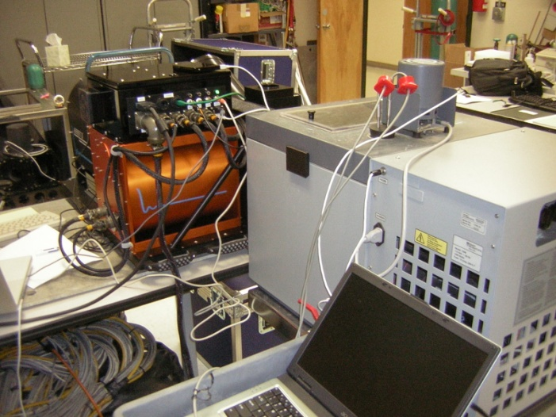
Next-generation ship-based FTIR spectroradiometer
M-AERI Mk-2 undergoing tests at RSMAS.

Slide 49
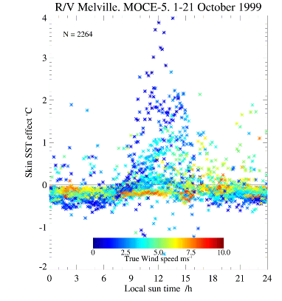
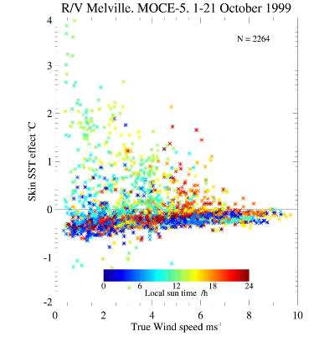
Skin – bulk SST differences
Example of wind speed dependence of diurnal & skin effects – off Baja California
From: Minnett, P. J., 2003: Radiometric measurements of the sea-surface skin temperature - the competing roles of the diurnal thermocline and the cool skin. International Journal of Remote Sensing, 24, 5033-5047.

Slide 50
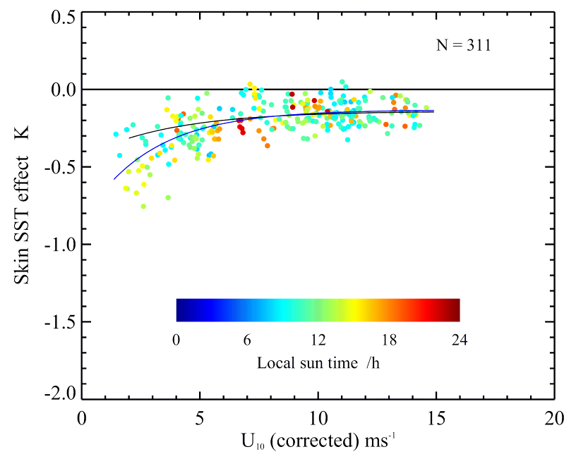
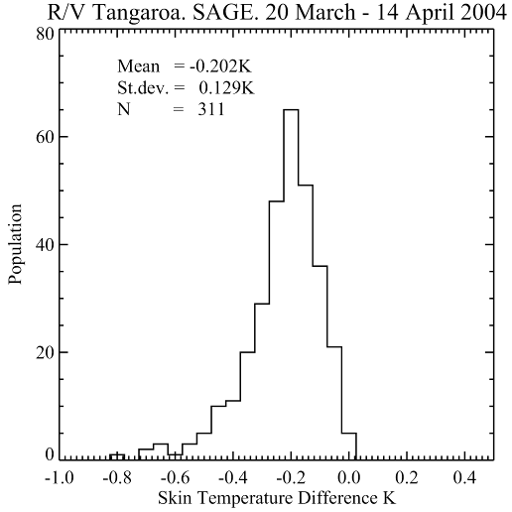


Skin effect
Caused by molecular conduction being the mechanism for heat flow from ocean to atmosphere.
First order correction:
  ΔT ≈ 0.2K
Better correction requires:
  accurate wind-speeds for U₁₀<7ms⁻¹,
  net infrared heat flux at the surface,
  incident solar radiation at the surface,
  SST.
σ = ±0.095K.
From: Minnett, P. J., M. Smith and B. Ward (2011). Measurements of the oceanic thermal skin effect. Deep Sea Research II. In the press.

Slide 51

Variability of Diurnal Heating
SST can change significantly in periods of an hour or less.
From Gentemann, C. L. and P. J. Minnett, 2008: Radiometric measurements of ocean surface thermal variability. Journal of Geophysical Research, 113, C08017. doi:10.1029/2007JC004540

Slide 52


Modeling Diurnal Warming and Cooling
Prior models generally failed to raise temperatures sufficiently quickly, were not sufficiently responsive to changes in the wind speed, and retained too much heat into the evening and the night.
New diurnal model that links the advantages of bulk models (speed) with the vertical resolution provided by turbulent closure models.
Profiles of Surface Heating (POSH) model:
NonDim Heat Content
Surface forcing: (NWP or in situ)
+
NonDim Depth (z)
See Gentemann, C. L., P. J. Minnett, and B. Ward (2009). Profiles of Ocean Surface Heating (POSH): a new model of upper ocean diurnal thermal variability. Journal of Geophysical Research 114: C07017.
Notes:
Bulk models run quickly but do not provide upper ocean vertical structure. Turbulence closure models (such as Kantha/Clayson and others) run more slowly but provide information on the vertical structure of the diurnal warm layer. POSH runs like a bulk but through a non-dimensional empirical fit to heat content and diurnal warm layer depth, provides vertical structure. Extensive validation of model to MAERI skin measurements of diurnal warm layer and comparisons to satellite data.

Slide 53
Related activities
  NASA SST Science Team
  NPP (VIIRS) Science Team
  GHRSST Science Team
  AVHRR Pathfinder Project
  AATSR Science Advisory Group
  HyspIRI Science Study Group
  EUMETSAT Mission Expert Team

Slide 54
Future
New ship-based spectroradiometers
  M-AERI Mk2
New spacecraft radiometers
  VIIRS
  SLSTR
Better buoy temperatures
  0.01K resolution
Use modified Argo profilers, gliders
  Measurements up to the surface
More (autonomous) radiometers, also on UAVs
  Ball Aerospace have built a miniature a/c radiometer
Improved atmospheric correction formulations
“Forward” solution for the atmospheric effect

Slide 55

Aqua MODIS SST
Thank you for your attention.
Questions?

