Slide 1
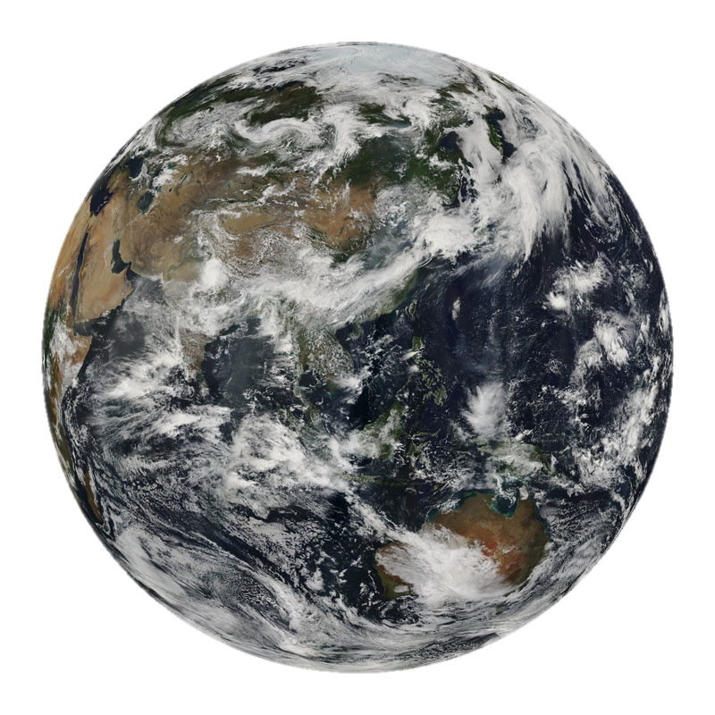
MODIS Atmosphere Products:
The Importance of Record Quality and Length in Quantifying Trends and Correlations
S. Platnick¹, N. Amarasinghe^{1,2}, P. Hubanks^{1,3}
and the entire MODIS Aerosol and Cloud Algorithm Team
¹ NASA GSFC, ² SSAI, ³ Wyle
MODIS STM, 19 May 2011

Slide 2
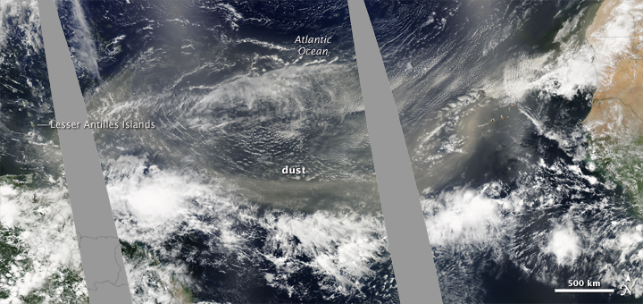
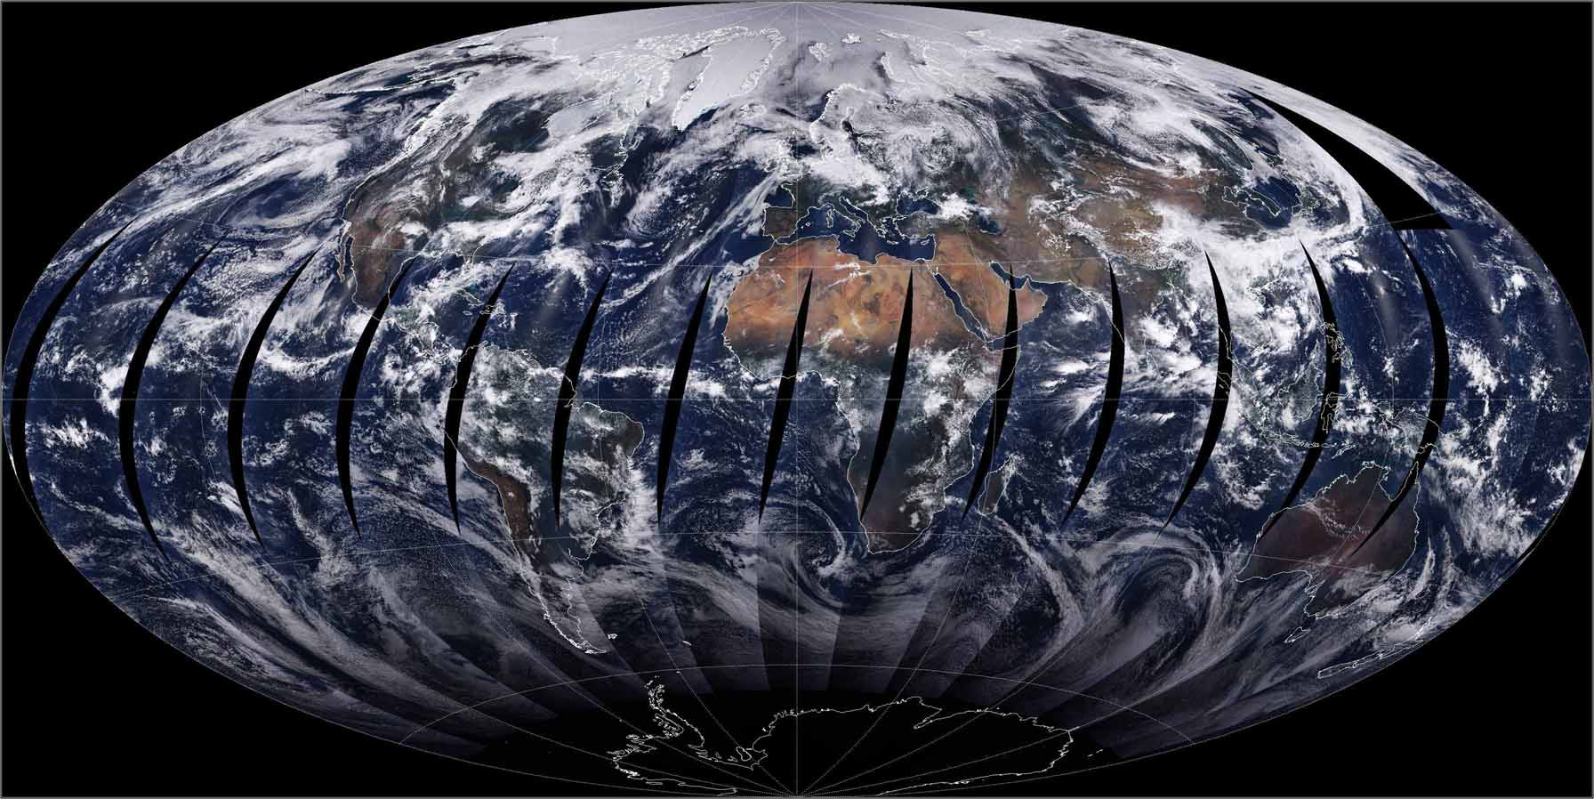
Outline:
Motivation
Trends and Time-to-Detection
ENSO Correlations
Platnick et al., MODIS STM, 19 May 2011

Slide 3
Motivation
Trends
  For observed temporal variability in a MODIS data set, what is the expected “time to detection” for a given trend? Can address even with “short” data records.
  Are statistically significant trends observed for the limited MODIS time record and what are their regional distributions? Consistency between Terra and Aqua MODIS? Lack of consistency traced to instrument differences?
Sensitivity of retrieved products to interannual (low frequency) climate variability, e.g., ENSO
  Correlation of atmosphere properties to ENSO phase useful for climate model evaluation (e.g., GFDL AM3 cloud fields)
  To what extent can ENSO responses alias into trend observations?
Challenges
  MODIS data records are only now beginning to be useful for such studies. Much longer time series are required for climate studies.
  Continuity into VIIRS time frame?
Platnick et al., MODIS STM, 19 May 2011

Slide 4
Data Set Used in Study
Atmosphere Team Level-3 Product
  Daily, Eight-day, Monthly
  1° × 1° equal angle grid
  Statistics: scalar (mean, standard deviation, …), 1D and 2D probability distributions
Trends and ENSO correlation analysis using monthly mean anomaly time series
Current production stream is Collection 5.1
Platnick et al., MODIS STM, 19 May 2011

Slide 5
Outline:
Motivation
Trends and Time-to-Detection
  The role of natural variability and the need for long time records
  Examples
  Instrumental artifacts?
ENSO Correlations
Platnick et al., MODIS STM, 19 May 2011

Slide 6
Evaluating Temporal Trends: Overview
natural variability
(+ retrieval + instrument uncertainty)
degrees of freedom (n =number of pts)
larger variability (uncertainty) => larger n*
larger the trend => smaller n*
Platnick et al., MODIS STM, 19 May 2011
Notes:
Note: details left out in the discussion of the n dependence. The (x-xbar)^2 term is a function of n, and Var(b1) can be approximated to have a sigma_yhat/n^3 dependence

Slide 7
Number of Years Required to Detect a Trend
(90% prob. of detecting a trend to a 0.05 statistical level, no autocorrelation)
~38 yrs
Trend/decade (%)
Variability in annual time series σ_{y}/⟨y⟩ (%)
^
Platnick et al., MODIS STM, 19 May 2011
Notes:
NOTE: SLIDE HAS NEW X-AXIS LABEL. In the presentation, the x-axis label didn’t explain that it was normalized variability in an annual time series (not monthly)! Contours for a monthly anomaly time series is shown in the next slide.
Note: contours for 3.3 approximation in N* (instead of 3.7), see Tiao et al. 1999, Weatherhead et al. 1998.

Slide 8
Number of Years Required to Detect a Trend
(90% prob. of detecting a trend to a 0.05 statistical level, no autocorrelation)
~17yrs
Trend/decade (%)
Variability in monthly anomaly time series σ_{y}/⟨y⟩ (%)
^
Platnick et al., MODIS STM, 19 May 2011

Slide 9
Time Required for Detection of 5%/decade Trend
(90% prob. of detecting a 0.05 statistical level,
based on yr-to-yr variability from July 2000 – June 2010, various binning)
0
10
20
30
40 yrs
Platnick et al., MODIS STM, 19 May 2011

Slide 10
Annual Mean Fraction (July 2000 – June 2001)
Cloud Fraction from
MODIS mask, Terra
(10° binning, daytime observations only)
0
0.5
1.0
Cloud Fraction Trends
(monthly anomalies, July 2000 – June 2010)
Trends Masked by Significance Level <0.05
%/decade
≤20
0
≥20
Platnick et al., MODIS STM, 19 May 2011

Slide 11
Annual Mean (July 2000 – June 2001)
Cloud Optical Thickness, water clouds, Terra
(10° binning, daytime observations only)
0
15
30
Optical Thickness Trends
(monthly anomalies, July 2000 – June 2010)
Trends Masked by Significance Level <0.05
%/decade
≤20
0
≥20
Platnick et al., MODIS STM, 19 May 2011

Slide 12
Annual Mean (July 2002 – June 2001)
Cloud Optical Thickness, water clouds, Aqua
(10° binning, daytime observations only)
0
15
30
Optical Thickness Trends
(monthly anomalies, July 2002 – June 2010)
Trends Masked by Significance Level <0.05
%/decade
≤20
0
≥20
Platnick et al., MODIS STM, 19 May 2011

Slide 13
Instrument Artifacts?
Trends (%/decade), ±60° latitude, areal averaging
Cloud Optical Thickness, Land (~ band 1)
 | Aqua (8 yrs) | Terra (8 yrs) | Terra (10 yrs)
τ_{liquid} | -3.44 | -15.62 | -14.56
τ_{ice} | -0.98 | -11.20 | -10.71
Cloud Optical Thickness, Ocean (~ band 2)
 | Aqua (8 yrs) | Terra (8 yrs) | Terra (10 yrs)
τ_{liquid} | -2.6 | -12.6 | -10.0
τ_{ice} | -1.4 | -13.1 | -10.5
Aerosol AOD, Land (~ band 3)
 | Aqua (8 yrs) | Terra (8 yrs) | Terra (10 yrs)
τ_{a} (pixel-weighing of grids) | -1.0 | -24.0 | -12.4
τ_{a} (no weighting) | -0.9 | -25.9 | -15.3
Platnick et al., MODIS STM, 19 May 2011

Slide 14
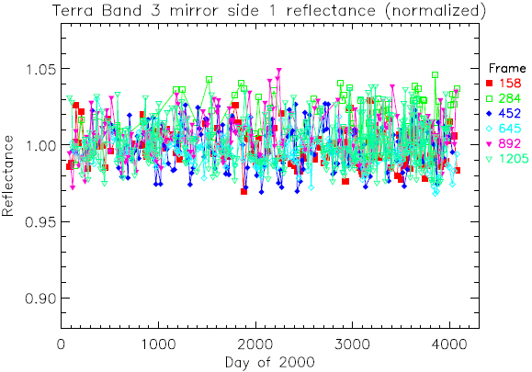
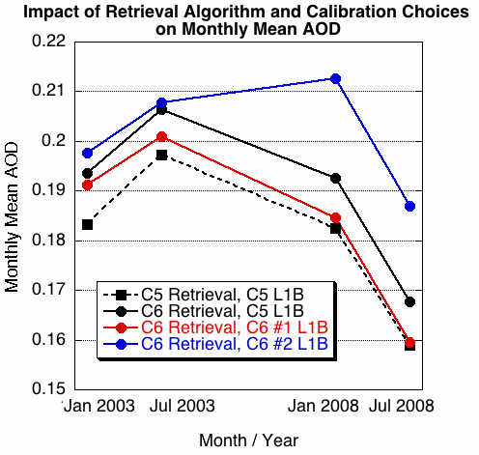
Instrument Artifacts? C5 Aqua & Terra Band 2 Trends vs. AOI (frame #)
MCST evaluation via desert ground targets (from Junqiang Sun)
Terra b3, ms1
5%
#2
C5
MCST Approach #2
(desert site correction)
C5
from R. Levy

Slide 15
Outline:
Motivation
Trends and Time-to-Detection
ENSO Correlations
  The role of natural variability and the need for long time records
  Examples
  Aliasing into trends?
Platnick et al., MODIS STM, 19 May 2011

Slide 16
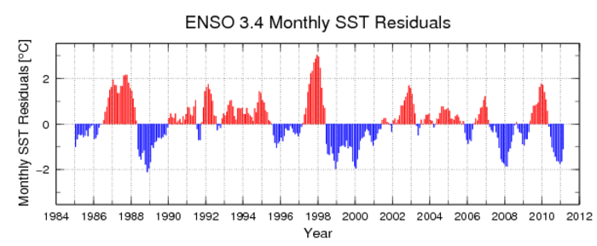
ENSO3.4 SST Anomaly Index
(avg. temperature in a box in east-central equatorial Pacific)
Aqua
Terra
Platnick et al., MODIS STM, 19 May 2011

Slide 17
Evaluating Correlations: Overview
degrees of freedom ≈ record length
natural variability decreases w/grid size,
covariance may also decreases w/grid size
(significance may increase or decrease)
Notes:
[used monthly anomaly time series]
Chen, Del Genio, Chen, J. Climate, 2007 (Tropical El Nino signla in satellite precip data and a global climate model): search for the closest local correlation maximum that has significance
Just as before: the longer the time record the better => the more significance you can assign the correlation
Dependence on grid size is a little tougher to generalize.
Caveats of such a study: (1) In regions that have a pronounced seasonal cycle, the current time record is not long enough to allow seasonal correlations. (2) Hidden variables: the danger in assigning causality for any correlation study.

Slide 18
Statistical Significance (p-value) vs. Correlation & DF
(90% prob. of detecting a trend to a 0.05 statistical level)
p-value ≈ 0.01
Correlation coefficient
Degrees of Freedom (DF)
(after autocorrelation correction)
Platnick et al., MODIS STM, 19 May 2011

Slide 19
Example ENSO3.4 vs. MODIS Anomalies
1° bins, masked by 1% statistical sig., July 2002–Jan 2011
High Cloud Amount
Degrees of Freedom
(max=108)
Lag (months)
[red => cloud response lags
E3.4 index; blue => cloud response precedes index]
Platnick et al., MODIS STM, 19 May 2011

Slide 20
Example ENSO3.4 vs. MODIS Anomalies
1° bins, masked by 1% statistical sig., July 2002–Jan 2011
High and Low Cloud Amount Correlations
Low Cloud
High Cloud
Platnick et al., MODIS STM, 19 May 2011

Slide 21
Example ENSO3.4 vs. MODIS Anomalies
1° bins, masked by 1% statistical sig., July 2002–Jan 2011
High Cloud Amount and Pressure Regression Slopes
High Cloud Amount
df_{c}/dT (K⁻¹)
Cloud-top Pressure
dp_{c}/dT (hPa-K⁻¹)
Platnick et al., MODIS STM, 19 May 2011

Slide 22
Example ENSO3.4 vs. MODIS Anomalies
1° bins, masked by 1% statistical sig., July 2002–Jan 2011
Upper Trop. Water Vapor and AOD Regression Slopes
Upper Trop. Water Vapor
(300-700 hPa)
dPW/dT (cm-K⁻¹)
5% statistical sig.
Aerosol Optical Depth
dτ_{a}/dT (K⁻¹)
Platnick et al., MODIS STM, 19 May 2011

Slide 23
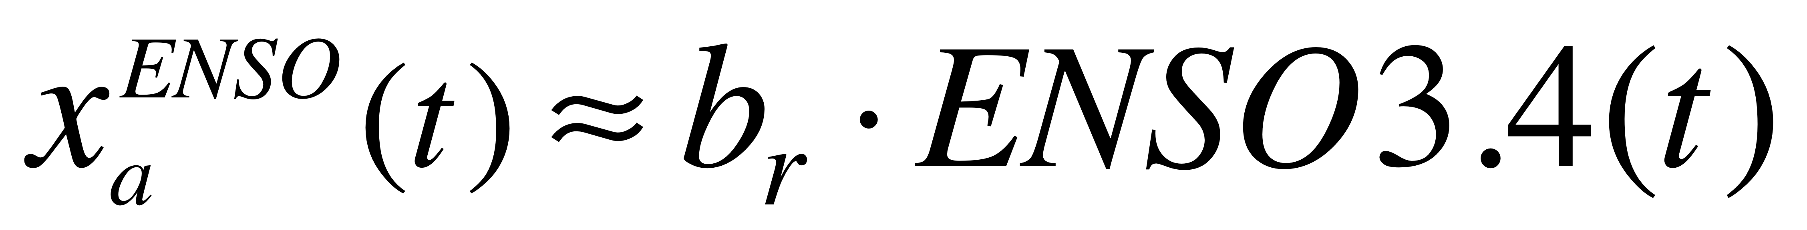
Example ENSO3.4 vs. MODIS Anomalies
If ENSO correlations imply a linear process (?), then the anomaly data record
x_{a} in a grid box due to ENSO can be approximated as:
≈ 0 for Terra
time record
≈ -1.2K/dec
for Aqua
time record
Platnick et al., MODIS STM, 19 May 2011

Slide 24
Example ENSO3.4 Component of MODIS Trend
Aqua, 1° bins, July 2002–Jan 2011
High Cloud Amount
High Cloud Trend
Masked by stat. sig. <0.05
High Cloud Trend
(%/Decade)
ENSO component of trend
derived from correlation
regression slope
(masked by trend & ENSO3.4
correlation sig. < 0.05)
ENSO component of trend (%)
derived from correlation
regression slope
Platnick et al., MODIS STM, 19 May 2011

Slide 25
Closing Thoughts
The ability to detect a trend to within some level of significance is a function of:
  Natural variability, spatial aggregation and temporal scale (e.g., monthly, seasonal, yearly)
  Record length (number of effective data points or degrees of freedom)
For anticipated atmospheric changes associated with global warming, trend detection and quantification is a multi-decadal problem.
  A decade long time series (Terra) is unlikely to have statistical significance at synoptic scales and smaller.
Other challenges
  Short term climate variability (e.g., ENSO) can alias into a time records complicating trend detection/interpretation.
  Instrument trends
  Retrieval biases that vary as the climate state changes
Platnick et al., MODIS STM, 19 May 2011

