Slide 1
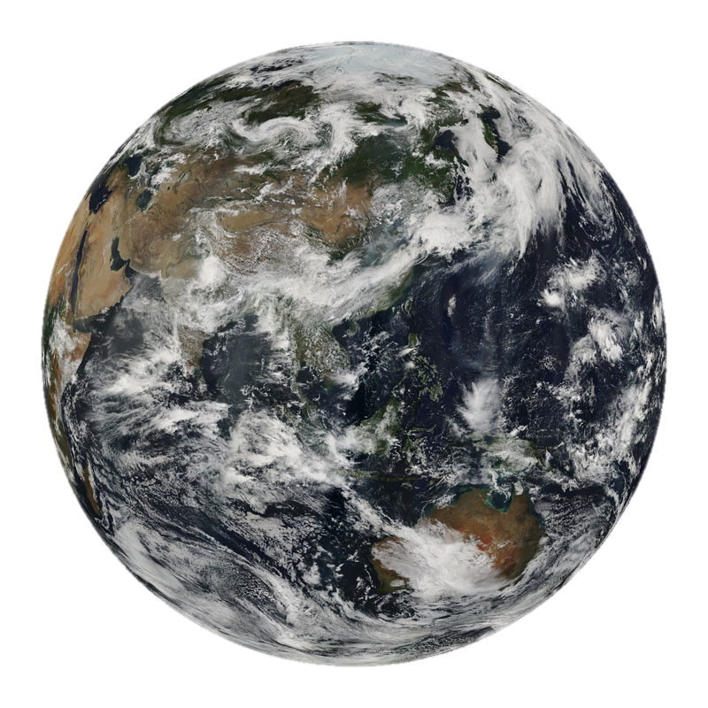
MODIS Atmosphere Team Summary Report
Steve Platnick and the atmosphere discipline team
MODIS Science Team Mtg.
College Park, MD
20 May 2011

Slide 2
Outline
The Atmosphere Discipline Team
  Who we are: overview of ROSES 2009 Terra/Aqua awards
Current status of Products, etc.
  Current Status of MODAPS Processing, Resources for Reprocessing
  “Special” products
Collection 6
  Status of MODAPS Processing, Resources for Reprocessing
  Nominal Schedule
Major Science Issues/Efforts
modis-atmos.gsfc.nasa.gov/team/
MODIS Atmosphere Team Overview, 18 May 2011

Slide 3
Overview from ROSES 2009 Terra/Aqua NRA:
20 funded investigations
Algorithm Refinement (proposal element 2.4)
  5 funded teams:
    Aerosol dark target: L. Remer, R. Levy
    Aerosol deep blue: C. Hsu, R. Hansell, J. Huang, S-C. Tsay
    Cloud-top, mask, profiles: S. Ackerman, P. Menzel, R. Frey, E. Borbas, B. Baum
    Cloud optical properties: S. Platnick, M. D. King, R. Pincus
    Ice cloud models: B. Baum, P. Yang, A. Heymsfield
  1 previous team not funded (cirrus reflectance, NIR water vapor)
New Algorithm Capability/Products (2.3)
  Cirrus retrievals w/1.38 µm band: K. Meyer, S. Platnick
NRT Capability (2.5)
  Direct broadcast/IMAPP: A. Huang
  Polar winds (MODIS & AIRS): D. Santek
S. Platnick, MODIS Atmosphere Team Summary Report, Plenary, 20 May 2011

Slide 4
Overview from ROSES 2009 Terra/Aqua NRA:
Science Data Analysis and Data Fusion (2.1, 2.2)
  Multi-spectral approach to evaluating the response of deep organized convection to aerosols: E. Wilcox, D. Posselt, T. Yuan
  MODIS aerosols in vicinity of clouds: R. Cahalan, A. Marshak, T. Varnai, G. Wen
  CO and aerosol retrievals, local radiative forcing: David Edwards
  Absorbing aerosol impacts on atmospheric heating and accelerated snowpack melting in Himalayas/Tibetan Plateau: W. Lau, Kyu-Myong, Ritesh, Hsu, Yasunari
  The dispersal and evolution of volcanic plumes: Vincent Realmuto
  Aerosol transport and climatic impacts: Hongbin Yu
  Trade wind cloud observations w/Terra, Aqua, and other satellites: L. Di Girolamo
  Terra/Aqua assessment of midlat ocean GCM cloud cover: C. Naud, Y. Chen
  Global constraints on radiative properties of ice clouds using MODIS & Polder: Bastiaan van Diedenhoven
  Global characteristics of marine Sc clouds and drizzle: Sandra Yuter
  MODIS marine BL clouds and LES models: Zhibo Zhang, S. Platnick, A. Ackerman
  CERES/MODIS to Improve energy balance snowmelt modeling: L. Hinkelman, R. Pinker, J. Lundquist [participates in Land team too]
MODIS, CERES, AMSR-E
MODIS, CALIOP, CERES
MODIS, MOPITT
MODIS, MISR, AMSR-E, CERES, AIRS
MODIS, MISR, AIRS, ASTER
MODIS, MISR, A-Train
MODIS, MISR, ASTER
MODIS, MISR, AMSR-E, AIRS
MODIS, POLDER, CALIOP
MODIS, AMSR-E
MODIS, AMSR-E, CloudSat
MODIS, CERES
S. Platnick, MODIS Atmosphere Team Summary Report, Plenary, 20 May 2011

Slide 5
Atmosphere Team Breakout Agenda
Day 1: Collection 6
  Status of “Testing” system, schedule, etc.
  L2 Algorithm Plans/Status
  L3 and ATML2 Plan/Status
  Ancillary:
    New BU gap-filled land and snow/ice spectral albedo
    Ice cloud models for retrievals and data analysis
Day 2: Science Data Analysis Presentations
  Science Talks (9)
Posters
  24 Posters
S. Platnick, MODIS Atmosphere Team Summary Report, Plenary, 20 May 2011

Slide 6
Collection Status
C5 L1B, cloud mask, profile products
C51 Atmosphere L2, L3 products
  Aqua C51 reprocessing completed early 2010
  Terra C51 reprocessing completed late 2010
Terra Deep Blue algorithm requires L1B polarization corrections (available only through 2007)
MODIS Atmosphere Team Overview, 18 May 2011
Notes:
6

Slide 7
Special Products (1)
MODIS Data for IPCC CMIP5 (Coupled Model Intercomparison Project)
  Previous IPCC assessments have not made good use of observational data for model assessment.
  Program for Climate Model Diagnosis and Intercomparison (PCMDI) at LLNL has reached out to make NASA products more effectively accessible for routine climate model evaluation.
  Two workshops were held (LLNL, Oct. 2010; GSFC, Nov 2010).
  Identified a small number (~12-14) of observational data sets that can be “directly” compared to model output.
  For MODIS: Cloud Fraction (MOD35)
    Monthly Terra cloud fraction data record from early 2000–Dec 2009
    netCDF Climate Forecast (CF) compliant naming conventions and metadata plus file structures that can be ingested into existing delivery infrastructure (Earth System Grid (ESG)).
    Currently working with Gary Fu (MODAPS) and many others (including JPL) trying to achieve CF compliance. Tedious/iterative!

Slide 8
Special Products (2)
MODIS Data for CFMIP5 (Cloud Feedback Model Intercomparison Project)
MODIS Cloud Simulator was developed for COSP (CFMIP Observational Simulation Package)
  Simulates core MODIS cloud products AND generates L3-like statistics for comparison with MOD08/MYD08.
Subsetted monthly L3 files corresponding to simulator output and converted to netCDF
  Full records (all years) for 35 data sets, Terra and Aqua C5.1 individually, and Terra+ Aqua combined (consistent w/other L3 temporal aggregations). Daytime only (most commensurate w/ simulator).
  ~0.5 GB/year (per Terra, Aqua, or combined data set)
  Includes netCDF metadata convention (CF compliant)
  Documentation file provided
  Archived at: ftp://ladsweb.nascom.nasa.gov/NetCDF/L3_Monthly/.

Slide 9
C6 Testing in MODAPS
C6 Approach
Algorithm development required a test system (not a production system)
  minimize delivery overhead, provide a baseline set of fixed input data files, fast turn-around of several months including L3 files. Provide on-line tracking of testing and visualization support (B. Ridgway)
Science Test Systems for Land / Atmosphere
  Run Atmosphere codes at 30x with online product archive

Slide 10
MOD_PR06OD Through the Ages
Product execution time for an average granule (70% cloudy)

Slide 11
MODIS Atmosphere Team Algorithm Dependencies
L1B MOD02,03
04 aerosol
(dark target)
Ancillary
04 aerosol
(deep blue)
MOD35
(cloud mask)
06
cloud top
06 cloud optical
Level-3
08_D, _E, _M
06 cirrus refl.
05
NIR PW
Land Team
07 profiles
05
IR PW

Slide 12
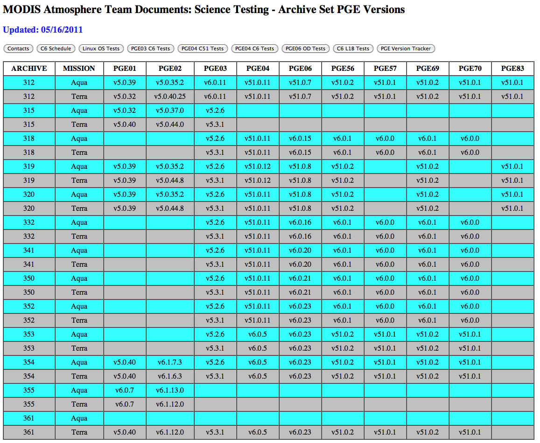
MODIS Atmosphere Team Overview, 18 May 2011
Notes:
12

Slide 13
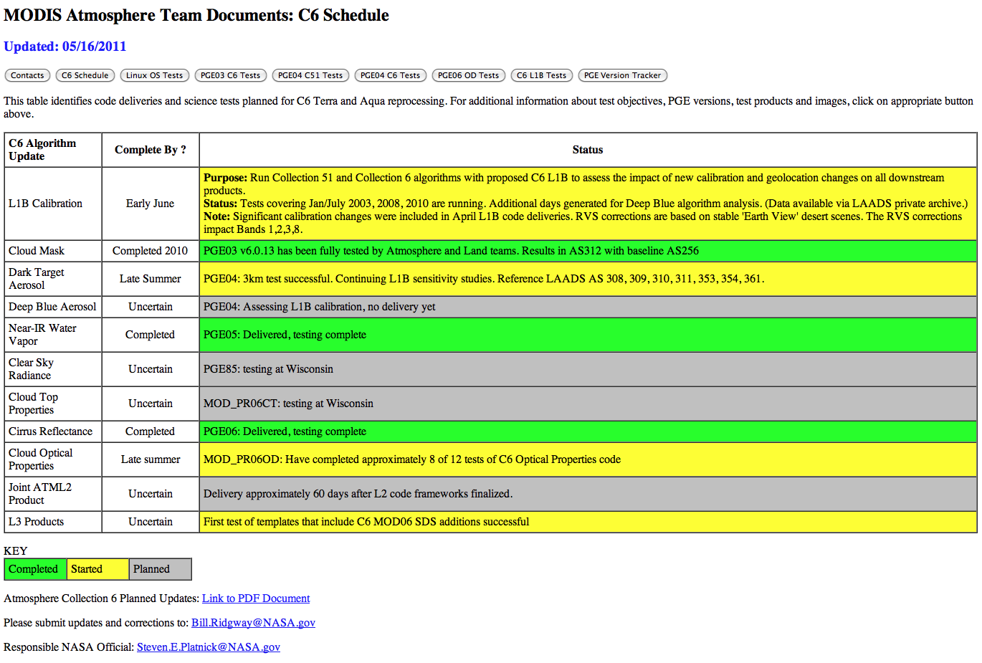
MODIS Atmosphere Team Overview, 18 May 2011
Notes:
13

Slide 14
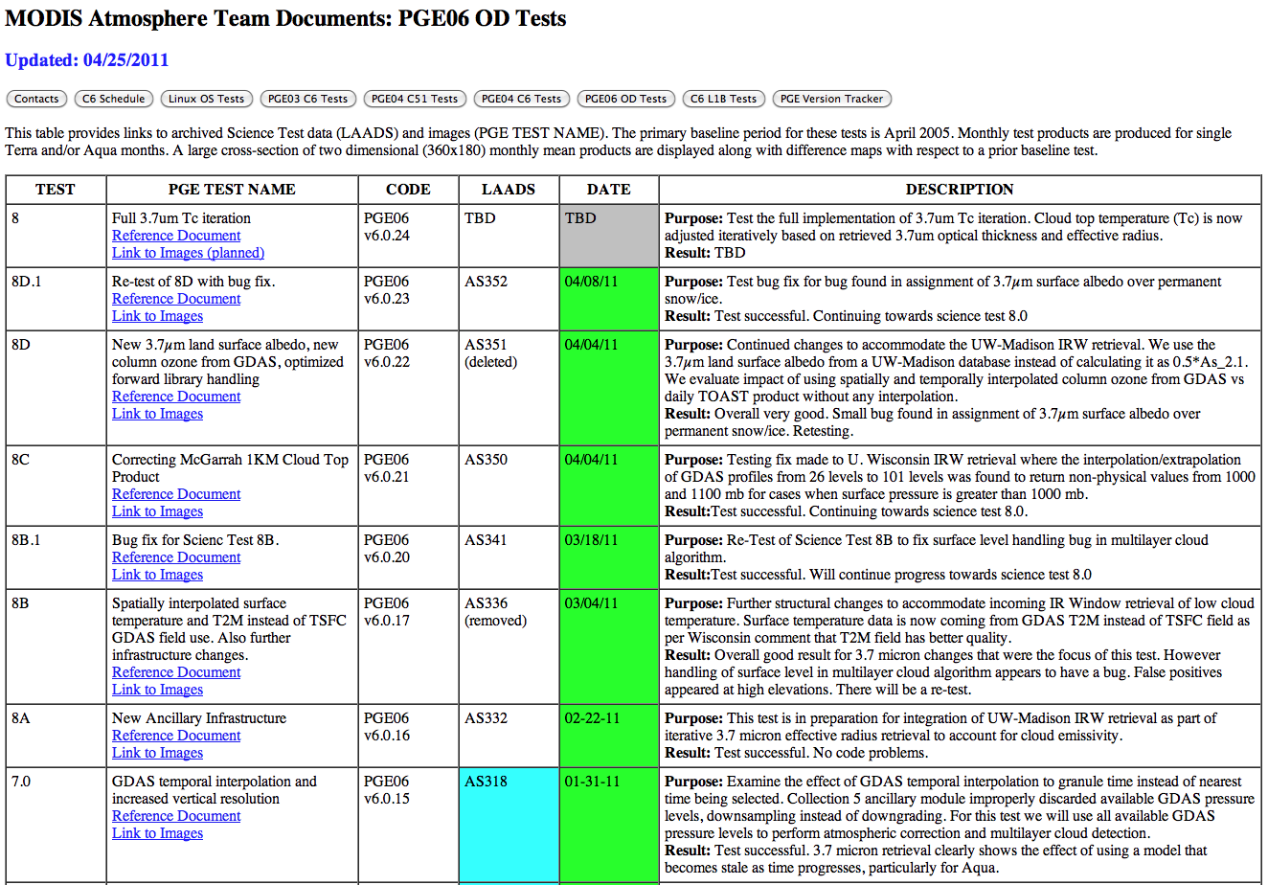
MODIS Atmosphere Team Overview, 18 May 2011
Notes:
14

Slide 15
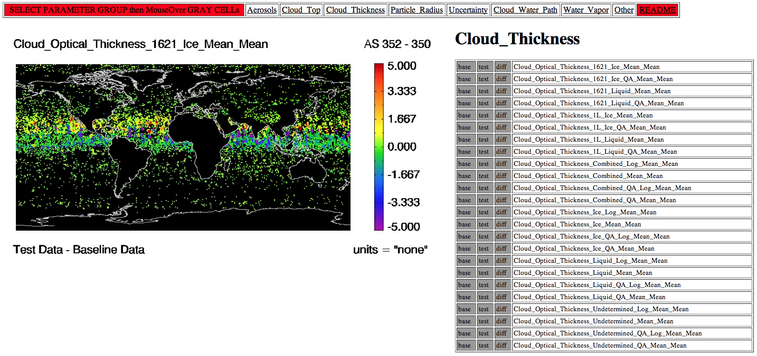
Science Test Image Archive
MODIS Atmosphere Team Overview, 18 May 2011
Notes:
15

Slide 16
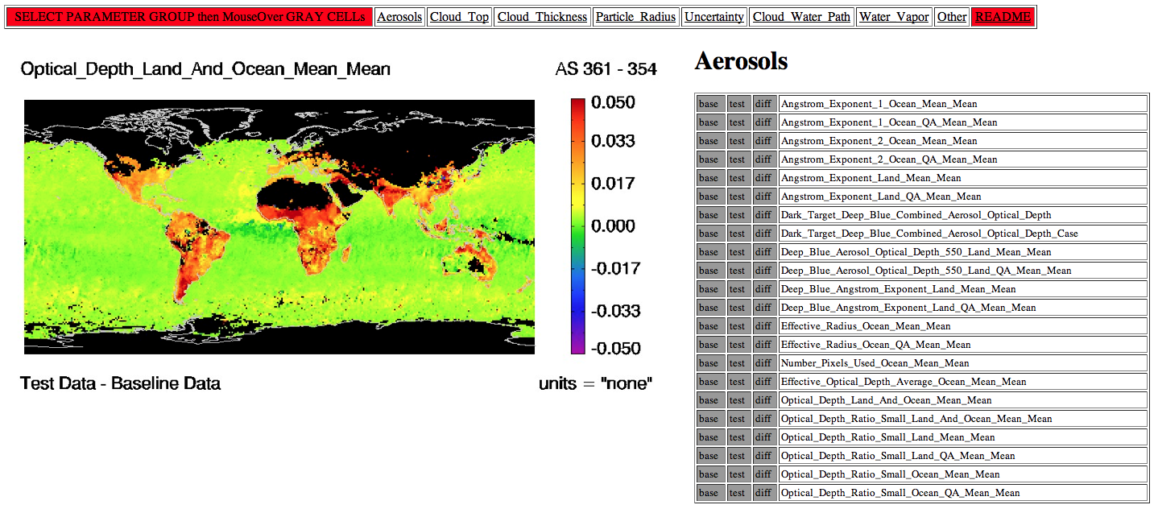
Science Test Image Archive
MODIS Atmosphere Team Overview, 18 May 2011
Notes:
16

Slide 17
Nominal Schedule for Atmosphere C6 Development, Testing and Reprocessing
June 2011 | L1B calibration assessments
June-Sept 2011 | L2 delivery and testing cycle continues
July-Sept 2011 | C6 L1B & Cloud Mask reprocessing
Sept 2011 | FileSpec for L2 products finalized
Oct-Nov 2011 | L3 delivery and testing
Nov-Dec 2011 | Final PGE science testing
Jan 2012 | C6 reprocessing ready to start ?
Apr 2012 | C6 reprocessing complete
MODIS Atmosphere Team Overview, 18 May 2011
Notes:
17

Slide 18
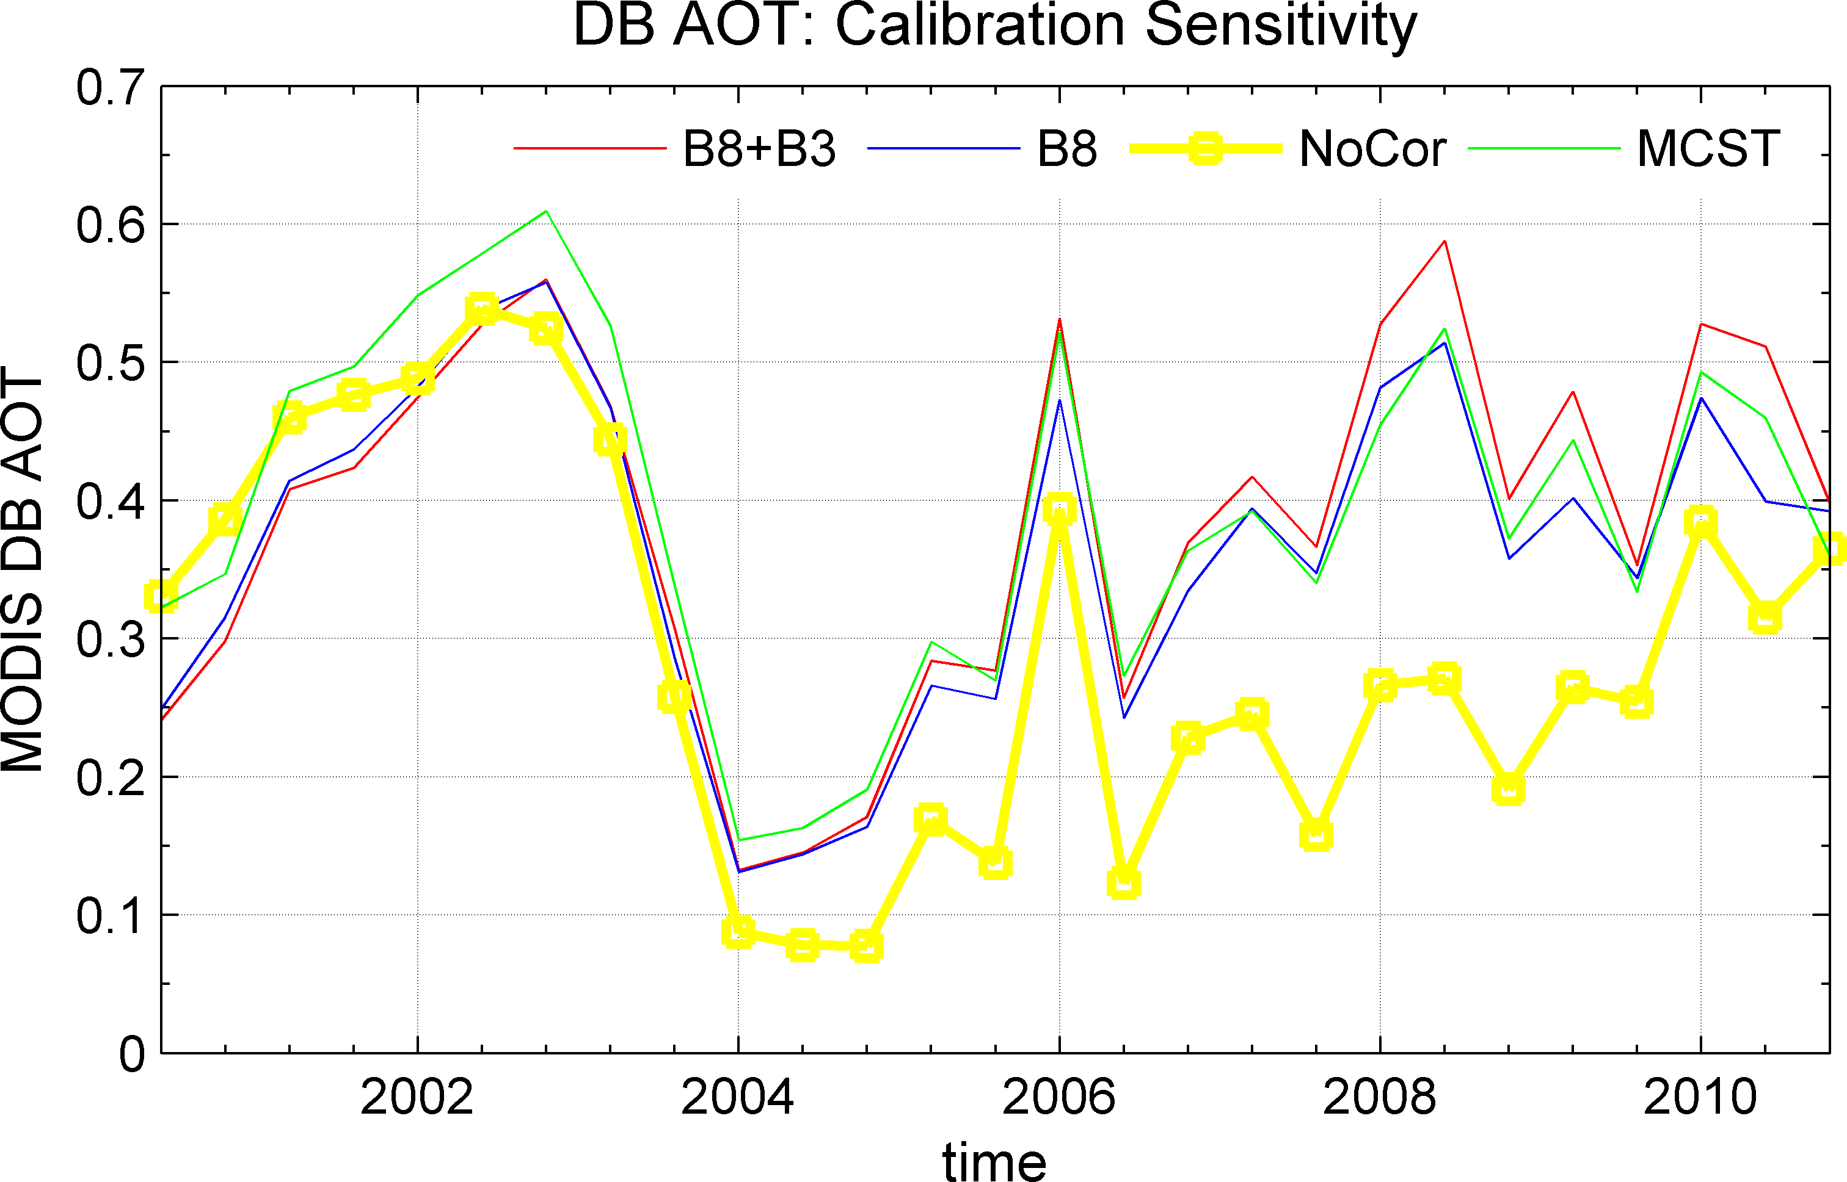
Key Issues/Efforts: Instrument
Instrument
Band 1, 2, 3 RVS trends.
  MCST “Approach 2” promising
Band 8 polarization
  “Differences between MCST and OBPG calibration methods for C6 are small in terms of DB retrieved parameters.” R. Hansell, C. Hsu
Characterization support more necessary than ever to ensure climate quality data records!

Slide 19
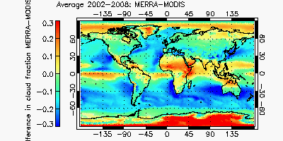
Key Issues/Efforts: Low Marine Clouds
Retrieval Issues
  Spectral effective radius discrepancies [Zhang]
  3D radiative transfer and role of drizzle [Zhang, Di Girolamo]
Science Questions
  Processes: drizzle frequency, cloud processes/evolution [Yuter]
  GCMs have difficulty in forming these clouds [Naud]
  Aerosol retrievals close to clouds [Marshak, Varnai, et al.]
Field work
  A balanced campaign portfolio needs to include these cloud types
Difference in average cloud fraction for 2002-2008 between MERRA and MODIS-Terra
(courtesy C. Naud)

Slide 20
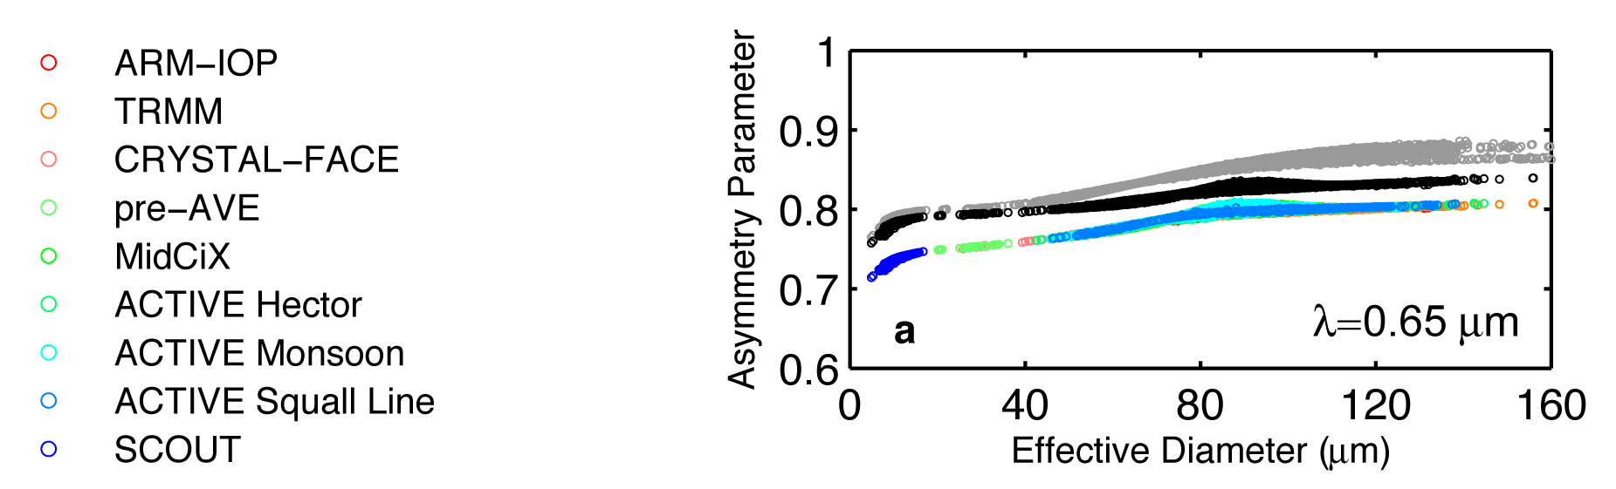
Key Issues/Efforts: Ice Clouds
Retrieval Issues
  Ice Cloud Radiative Models
  Tuesday workshop held at Goddard with CALIPSO and MODIS team members.
  Radiative Transfer: Improved scattering calculations [Ping Yang], habits and size distributions [Baum, A. Heymsfeld]
  IR closure: match TOA window radiance, consistency with IR thin cirrus retrievals (IR not sensitive to habit/roughness) [Heidinger, Yang, Jacques Pelon (CALIPSO IIR)]
  POLDER direction information [van Diedenhoven, Zhang]
Improved thin cirrus capability
  Quantitative use of 1.38 µm band w/uncertainties [Meyer]
Science Questions
  Sensitivity of deep convection to dynamic/thermodynamic history and aerosols [Wilcox]
MODIS C5
Gen. mixture
Mod. rough
Gen. habit mixture
Severely rough
(courtesy B. Baum)

Slide 21
Major Science Issues/Efforts: Aerosol Transport and Radiative Effects
  CO and aerosol retrievals, local radiative forcing: David Edwards
  Absorbing aerosol impacts on atmospheric heating and accelerated snowpack melting in Himalayas/Tibetan Plateau: W. Lau, Kyu-Myong, Ritesh, Hsu, Yasunari
  The dispersal and evolution of volcanic plumes: Vincent Realmuto
  Aerosol transport and climatic impacts: Hongbin Yu

