Slide 1

Phytoplankton physiology diagnosed from MODIS chlorophyll fluorescence
Toby K. Westberry, Michael J. Behrenfeld
With (lots of) help from
Emmanuel Boss, Allen Milligan, Dave Siegel, Chuck McClain, Bryan Franz, Gene Feldman, Scott Doney, Ivan Lima, Jerry Wiggert, Natalie Mahowald, others

Slide 2
What is Chlorophyll fluorescence?
Chlorophyll-a (Chl) is a ubiquitous plant pigment
It dissipates some of its absorbed energy as photons (i.e., fluorescence)
hν
¹O₂*
Chl
O₂
³Chl*
Photochemistry
Heat
Fluorescence
¹Chl*

Slide 3
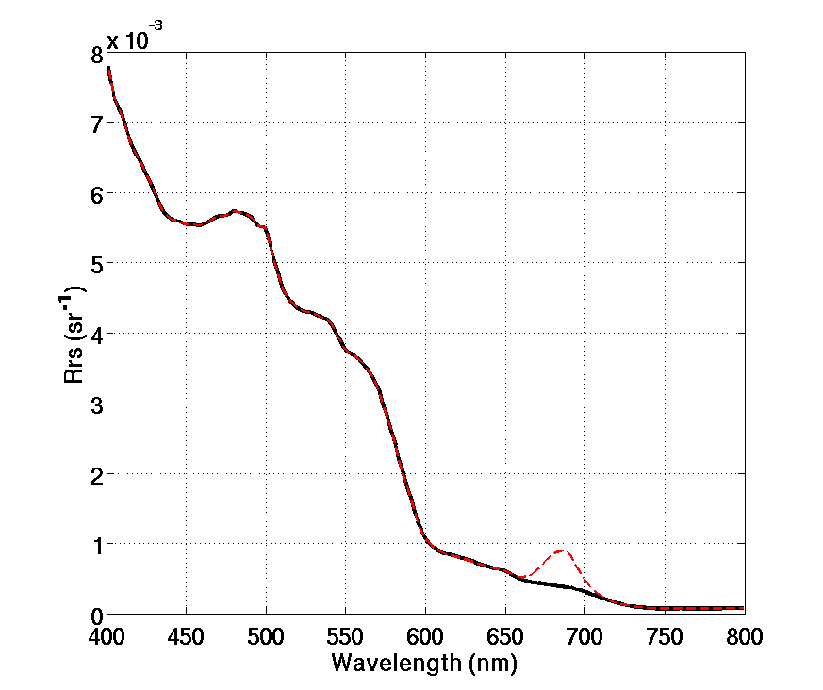
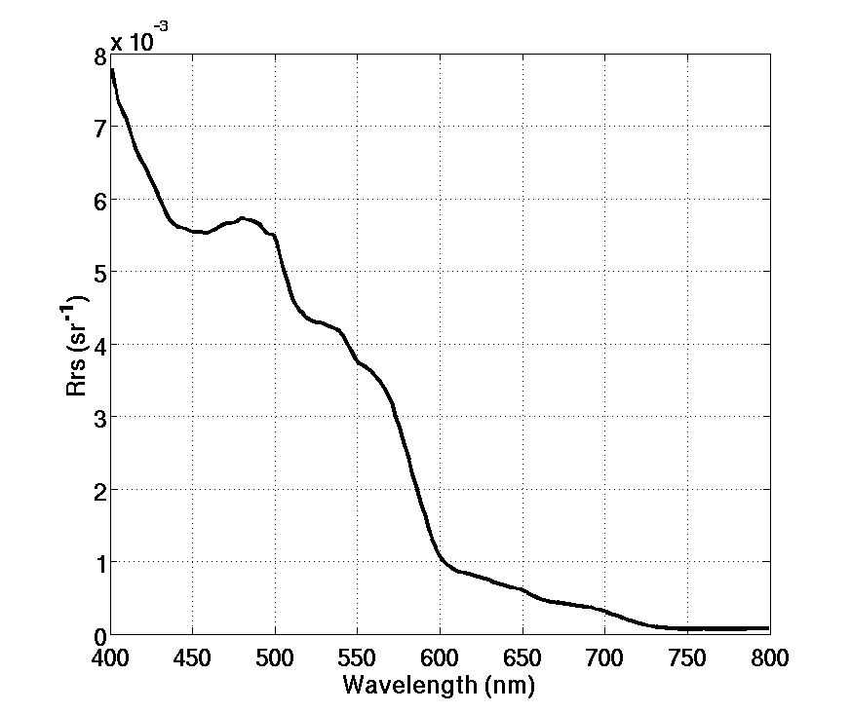
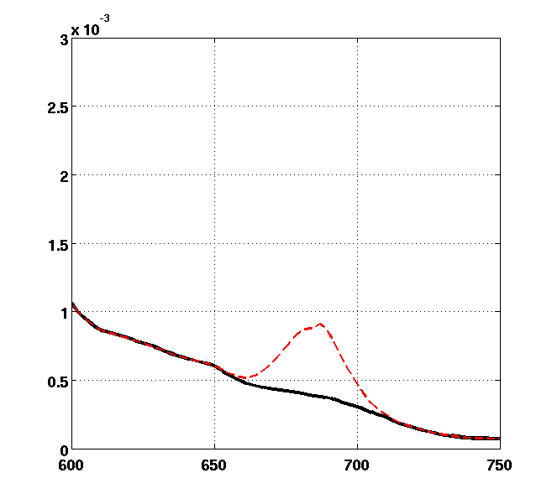
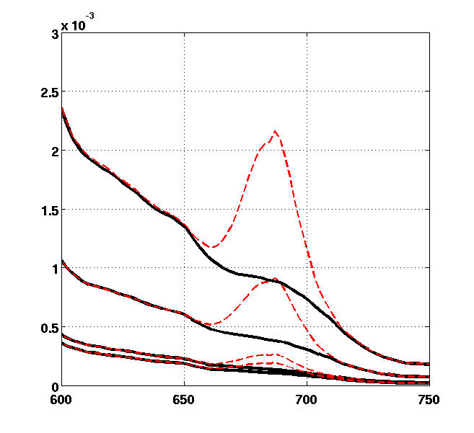
What is Chlorophyll fluorescence?
Chlorophyll-a (Chl) is a ubiquitous plant pigment
It dissipates some of its absorbed energy as photons (i.e., fluorescence)
Fluorescent even under natural sunlight
Fluoresced radiation is discernable in upwelled radiant flux
A typical ocean reflectance spectra
Chl

Slide 4
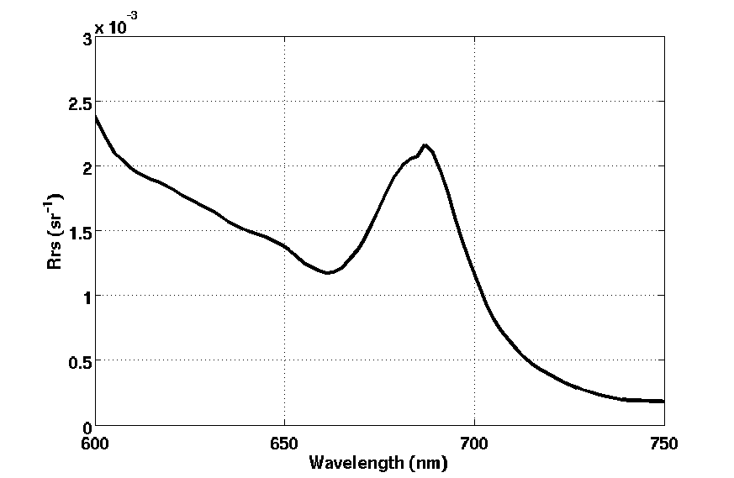
MODIS Fluorescence Line Height (FLH)
A geometric definition
Can be related to total fluoresced flux (e.g., Huot et al., 2005)
Band 13
Band 14
Band 15

Slide 5
Why MODIS FLH?
Alternative & independent measure of chlorophyll
(particularly in coastal environments)
Improved NPP estimates
Index of phytoplankton physiology
  Pigment Packaging
  Non-photochemical quenching
  Nutrient stress effects
  Photoacclimation
Notes:
Evaluation of existing chlorophyll algorithms

Slide 6
Fluorescence Basics
Three primary factors regulate global phytoplankton fluorescence distributions:
pigment concentrations
(2) “pigment packaging”, a self-shading phenomenon influencing light absorption efficiencies (Duysens 1956; Bricaud et al., 1995, 1998).
(3) a photoprotective response aimed at preventing high-light damage (i.e., “nonphotochemical quenching”, NPQ)

Slide 7
Derivation of φ (Fluorescence quantum yield)
Absorbed energy
ϕ
FLH = Chl_{sat} x <a_{ph}*> x PAR x x S
satellite
chlorophyll
chlorophyll-
specific
absorption
fluorescence
quantum
yield
subtract small FLH value of 0.001 mW cm⁻² μm⁻¹ sr⁻¹ to
satisfy requirement that FLH = 0 when Chl = 0
Notes:
radiometric uncertainty of MODIS fluorescence band is +/- 0.003 mW cm-2 um-1 sr-1

Slide 8
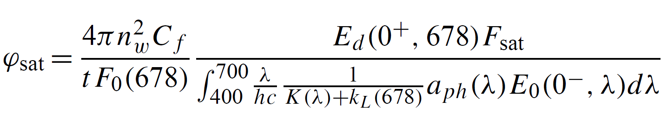
A little more complicated
full spectral fluorescence
emission relative to 683 nm
air-sea
interface
incident
scalar
PAR
Isotropic
emmission
FLH
TOA
irradiance
attenuation of
downwelling
radiation
attenuation of
upwelling
fluorescence
spectral
irradiance
phytoplankton
absorption

Slide 9
Results

Slide 10
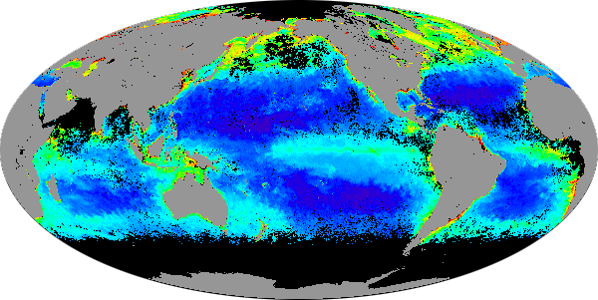
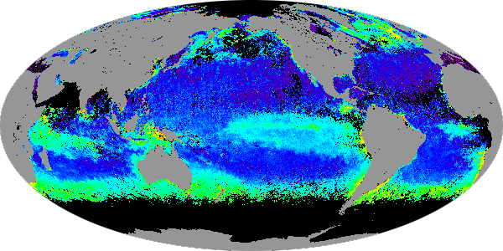
Global MODIS FLH
0.10
FLH
(mW cm⁻² um⁻¹ sr⁻¹)
0.01
0.001
10
Chlorophyll
(mg m⁻³)
1.0
0.1
0.01
Notes:
First order variability in FLH is due to chlorophyll concentration, but there are clear differences between the top
and bottom panels. For example, note hemispheric differences in the FLH field and the relatively high values for
FLH in the southern ocean compared to chlorophyll

Slide 11
Global MODIS FLH
Compute averages within bins of similar Chl σ²
2003 – 2009 Monthly MODIS OC3 Chl
43 regional bins
Notes:
coastal & arctic omitted

Slide 12
Global MODIS FLH
Compute averages within bins of similar Chl σ²
2003 – 2009 Monthly MODIS OC3 Chl
43 regional bins
FLH (mW cm⁻² um⁻¹ sr⁻¹)
Chlorophyll (mg m⁻³)
Notes:
Note that the Chl product is based on unpackaged estimates of Chl

Slide 13
Fluorescence Basics
Three primary factors regulate global phytoplankton fluorescence distributions:
pigment concentrations
(2) “pigment packaging”, a self-shading phenomenon influencing light absorption efficiencies (Duysens 1956; Bricaud et al., 1995, 1998).
(3) a photoprotective response aimed at preventing high-light damage (i.e., “nonphotochemical quenching”, NPQ)
Notes:
13

Slide 14
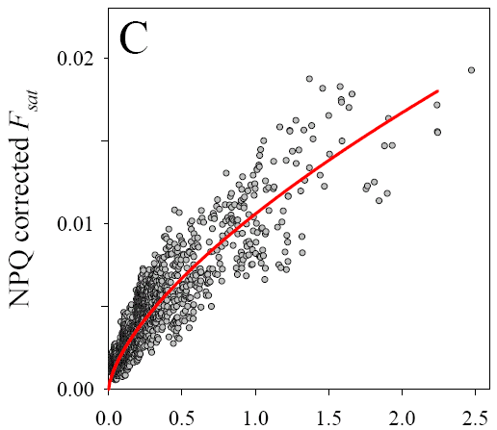
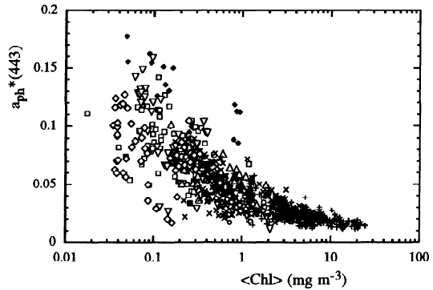
Pigment Packaging
Chlorophyll-specific
absorption @ 443 nm
NPQ-corrected FLH
Chlorophyll (mg m⁻³)
Bricaud et al. (1998), J. Geophys. Res.,
103, 31,033-31,044.
Chlorophyll (mg m⁻³)

Slide 15
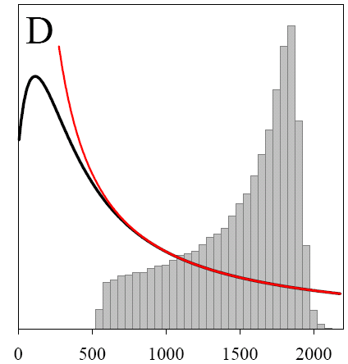


Non-photochemical quenching (NPQ)
MODIS
observations
1
iPAR
iPAR (μmol photon m⁻² s⁻¹)

Slide 16
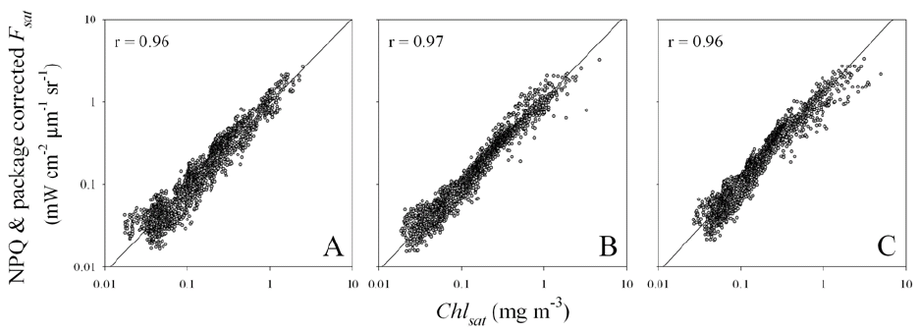
Remaining variability in FLH_{corrected}
Chlorophyll (mg m⁻³)
Chlorophyll (mg m⁻³)
OC-3
QAA
GSM
Notes:
…but can we go further?
If pigment concentration, packaging, and NPQ effects are accounted for,
does the residual signal (i.e., the fluorescence quantum yield) still retain
meaningful information on other environmental growth constraints?

Slide 17
What do we expect in remaining variability?
#1: Unique consequences of iron stress
- Over-expression of pigment complexes
- Increases in PSII:PSI ratio
1. Chlorophyll = PSII & PSI
2. Fluorescence = PSII
3. φ increases with PSII:PSI ratio
#2: Photoacclimation
- Low light = enhanced NPQ
at any given iPAR
→ lower φ
iPAR (μmol quanta m⁻² s⁻¹)
Notes:
- Focus spring/fall
& lower latitudes

Slide 18
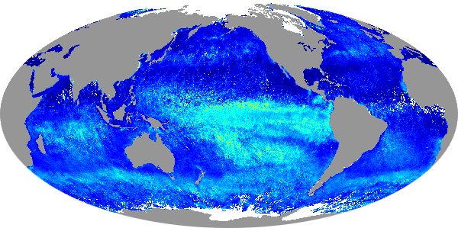
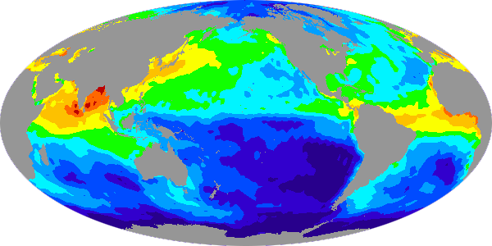
Fluorescence Quantum Yields (ϕ, or FQY)
Spring 2004
2.0%
1.5%
φ_{sat} (%)
1.0%
0.5%
0%
1
0.1
Soluble Fe deposition
( ng m⁻² s⁻¹ )
0.01
0.001

Slide 19
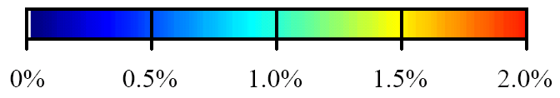
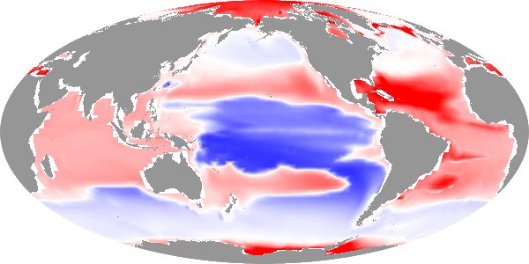
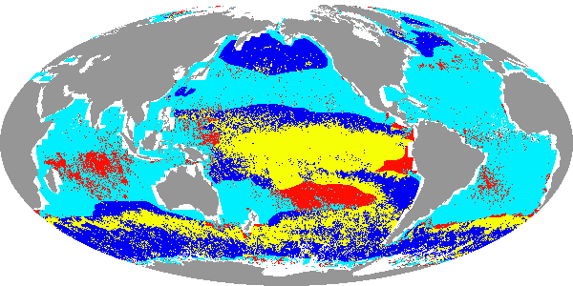
Fluorescence Quantum Yields (ϕ, or FQY)
Iron limited
N, P, light limited
-1.0
-0.5
0
0.5
1.0
φ_{sat} (%)
GCI (relative)
High φ_{sat} , model iron-limited
High φ_{sat} , model other-limited

Slide 20
Indian Ocean FQY

Slide 21
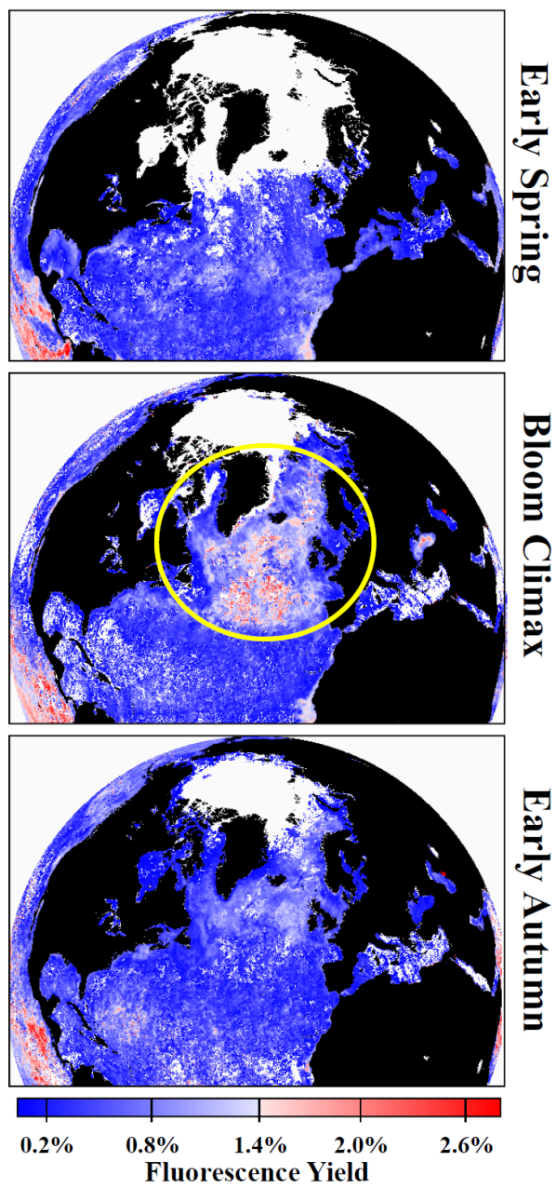
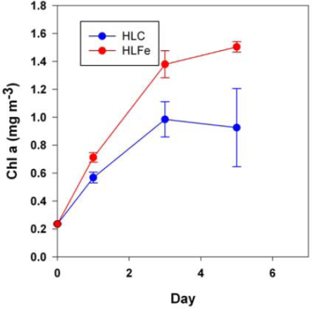
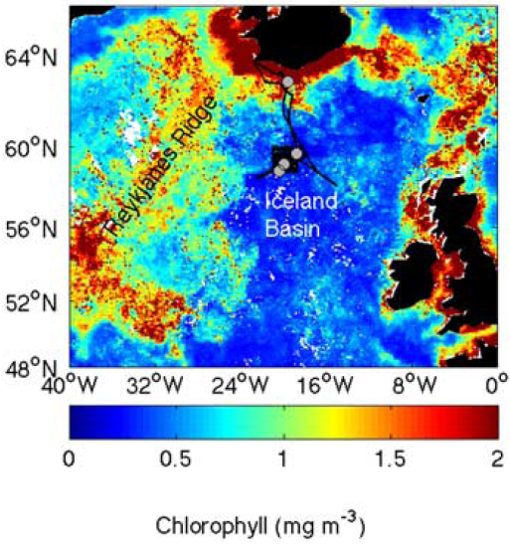
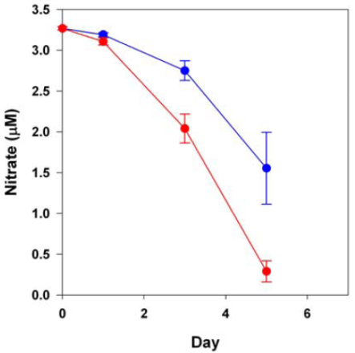
North Atlantic FQY
new satellite findings
new field results

Slide 22
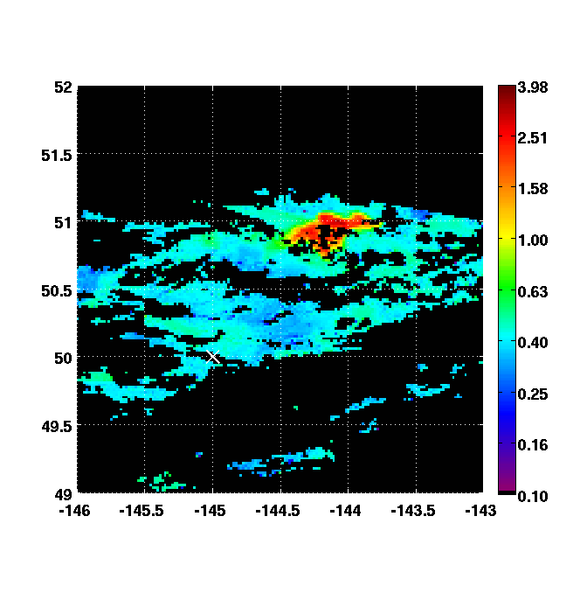
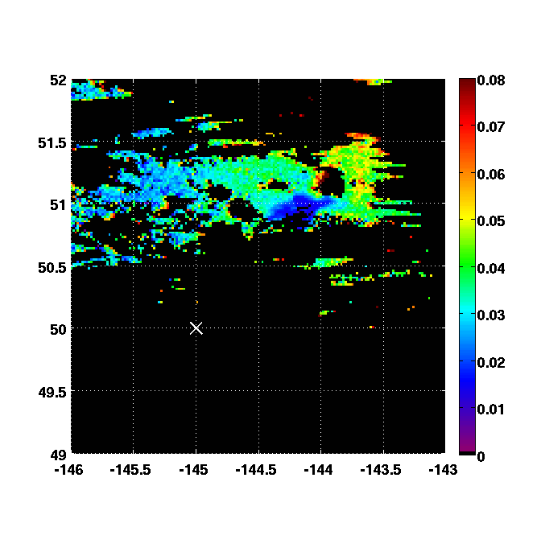
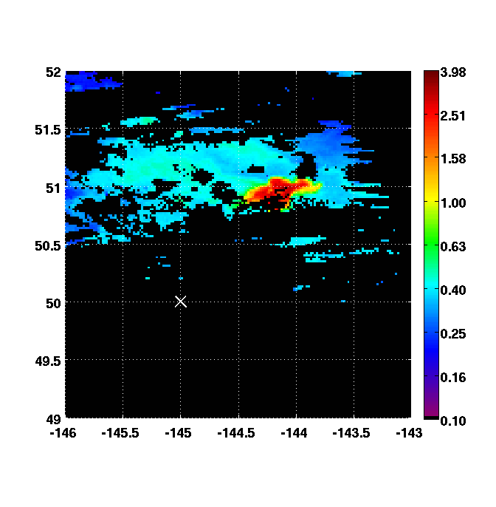
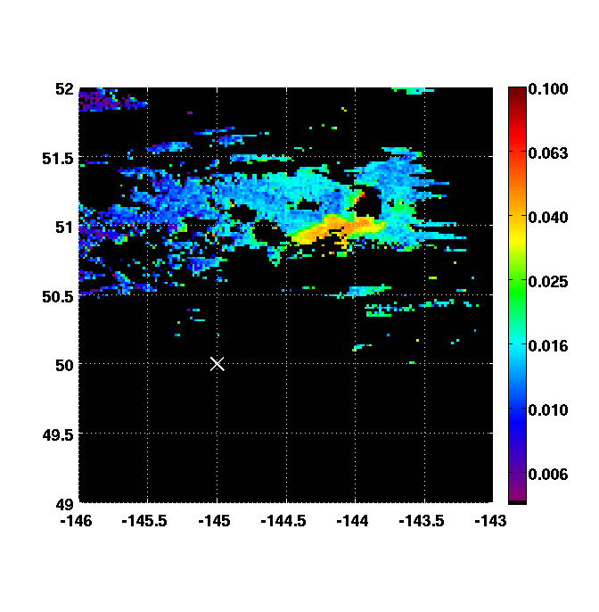
Fluorescence and Fe enrichment experiments
Example from SERIES
July 2002 at Station Papa (50°N, 145°W)
Terra Chl (mg m⁻³)
Terra FLH (mW cm⁻² μm⁻¹ sr⁻¹)
SeaWiFS Chl (mg m⁻³)
Terra FLH/Chl

Slide 23
Conclusions and Future Directions
Ironically, it is the global ocean that is easy, not productive waters
Hierarchy: [Chl] > ¹/iPAR_{NPQ} > packaging >
Solve E_{k} to expand iron diagnostic
Solve iron stress to derive Ek – then apply to Chl:C !
New tool for evaluating (i) Chl_{sat}, (ii) climate models, (iii) responses to natural and purposeful iron enrichments
Opportunity to view physiological changes over time
Fe stress
E_{k}

Slide 24
Thank you!
References:
Abbott, M. R. and Letelier, R.M.: Algorithm theoretical basis document chlorophyll fluorescence, MODIS product number 20, NASA, http://modis.gsfc.nasa.gov/data/atbd/atbdmod22.pdf, 1999.
Babin, M., Morel, A. and Gentili, B.: Remote sensing of sea surface sun-induced chlorophyll fluorescence: consequences of natural variations in the optical characteristics of phytoplankton and the quantum yield of chlorophyll a fluorescence, Int. J. Remote Sens., 17, 2417–2448, 1996.
Behrenfeld, M.J., T. K. Westberry, E. S. Boss, R. T. O'Malley, D. A. Siegel, J. D. Wiggert, B. A. Franz, C. R. McClain, G. C. Feldman, S. C. Doney, J. K. Moore, G. Dall'Olmo, A. J. Milligan, I. Lima, and N. Mahowald (2009), Satellite-detected fluorescence reveals global physiology of ocean phytoplankton, Biogeosciences v6, 779-794.
Boyd, P. W., et al. (2004), The decline and fate of an iron-induced subarctic phytoplankton bloom, Nature, 428, 549– 553.
Bricaud, A., Morel, A., Babin, M., Allalli, K. and Claustre, H. Variations of light absorption by suspended particles with chlorophyll a concentration in oceanic (case 1) waters: Analysis and implications for bio-optical models, J. Geophys. Res,103, 31,033–31,044, 1998.
Huot, Y., Brown, C. A. and Cullen, J. J.: New algorithms for MODIS sun-induced chlorophyll fluorescence and a comparison with present data products, Limnol. Oceanogr. Methods, 3, 108–130, 2005.
Mahowald, N., Luo, C., Corral, J. D., and Zender, C.: Interannual variability in atmospheric mineral aerosols from a 22-year model simulation and observational data, J. Geophys. Res., 108, 4352, doi:10.1029/2002JD002821, 2003.
Moore, J. K., Doney, S. C., Lindsay, K., Mahowald, N. and Michaels, A. F.: Nitrogen fixation amplifies the ocean biogeochemical response to decadal timescale variations in mineral dust deposition, Tellus, 58B, 560–572, 2006.
Morrison, J. R.: In situ determination of the quantum yield of phytoplankton chlorophyll fluorescence: A simple algorithm, observations, and model, Limnol. Oceanogr., 48, 618–631, 2003.
Westberry T. K. and Siegel, D.A.: Phytoplankton natural fluorescence in the Sargasso Sea: Prediction of primary production and eddy induced nutrient fluxes, Deep-Sea Research Pt. I, 50, 417–434, 2003.
Wiggert, J. D., Murtugudde, R. G., and Christian, J. R.: Annual ecosystem variability in the tropical Indian Ocean: Results from a coupled bio-physical ocean general circulation model, Deep-Sea Res. Pt. II, 53, 644–676, 2006.

