Slide 1
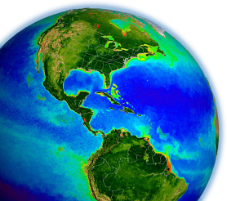
Ocean Break-out Summary
Bryan Franz
and the
MODIS Ocean
Science Team
MODIS Science Team Meeting
9 May 2012

Slide 2
R2010.0 Multi-Mission Ocean Color Reprocessing
Scope: MODISA, MODIST, SeaWiFS, OCTS, CZCS
Status:
SeaWiFS completed September 2010
OCTS completed September 2010
MODIST completed January 2011
MODISA completed June 2011
CZCS completed August 2011
Highlights:
consistent algorithms and methods for all sensors**
incorporated enhanced knowledge of sensor characterization**
regenerated all sensor-specific tables and coefficients
improved aerosol models based on AERONET
additional correction for NO2, improved turbid water atmos. corr.
http://oceancolor.gsfc.nasa.gov/WIKI/OCReproc.html

Slide 3
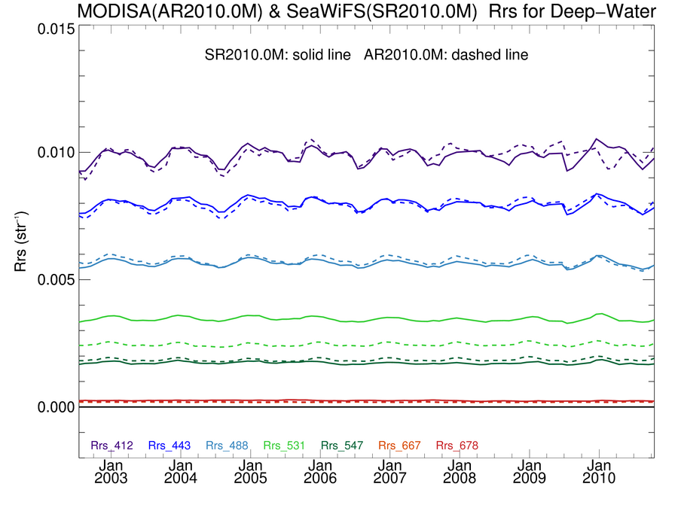
MODISA Rrs in good agreement with SeaWiFS
Deep-Water
solid line = SeaWiFS R2010.0
dashed = MODISA R2010.0
412
443
Rrs (str⁻¹)
488 & 490
510
531
547 & 555
667 & 670
Notes:
overlapping time-series of SeaWIFS and MODIS/Aqua water-leaving reflectance
aqua is the dashed lines
these are monthly means over all deep water
see very good agreement in the common wavelengths
agreement about 2% on average, 5% over all time
required cross-calibration for 412 and 443

Slide 4
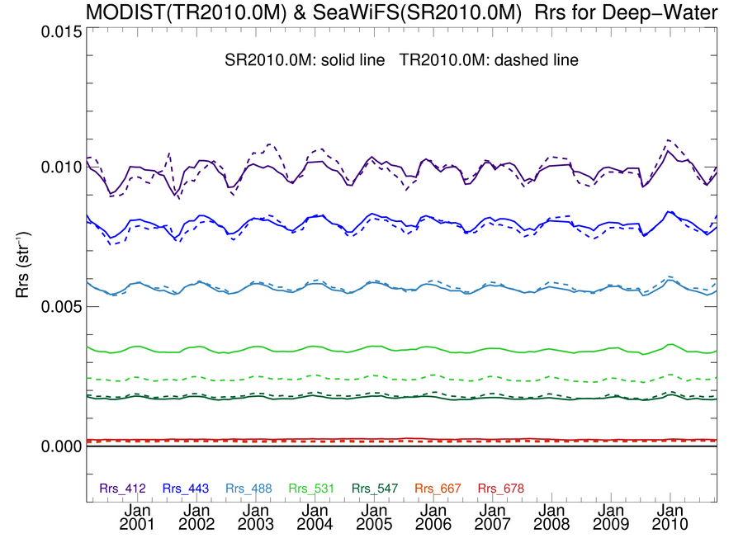
MODIST Rrs in good agreement with SeaWiFS
Deep-Water
solid line = SeaWiFS R2010.0
dashed = MODIST R2010.0
412
443
Rrs (str⁻¹)
488 & 490
510
531
547 & 555
667 & 670

Slide 5
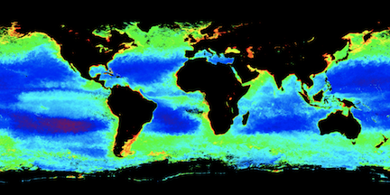
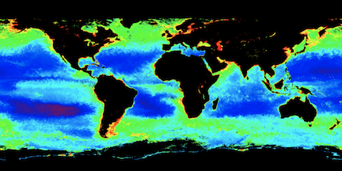
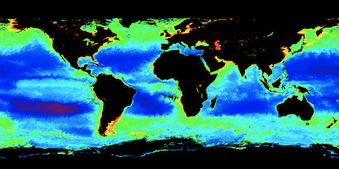
Chlorophyll spatial variation in good agreement
SeaWiFS
Fall 2002
MODIS/Aqua
MODIS/Terra
Notes:
2002-2003 el nino

Slide 6
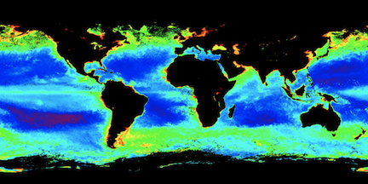
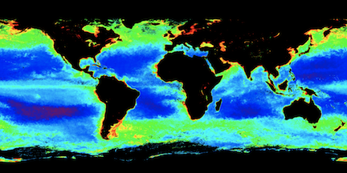
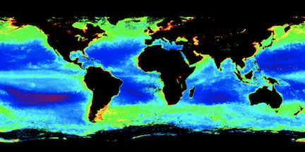
Chlorophyll spatial variation in good agreement
SeaWiFS
Fall 2008
MODIS/Aqua
MODIS/Terra

Slide 7
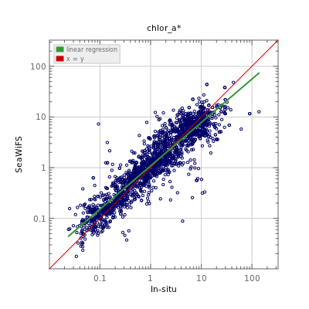
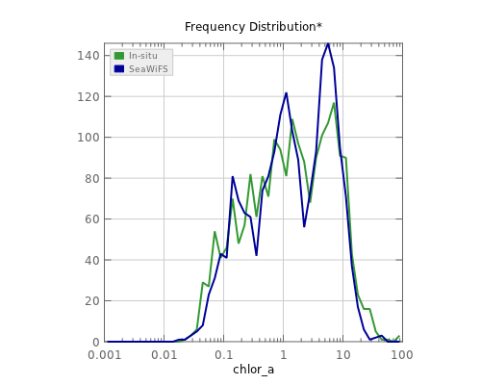
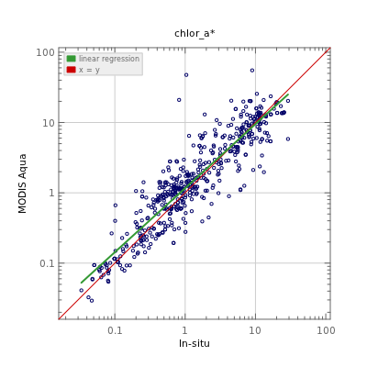
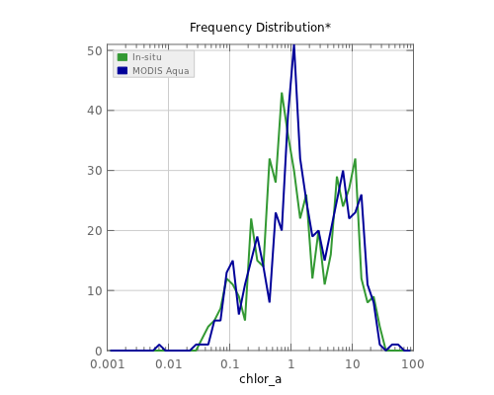
Chl_{a} in Good Agreement with Global In situ
SeaWiFS
vs
in situ
MODISA
vs
in situ

Slide 8
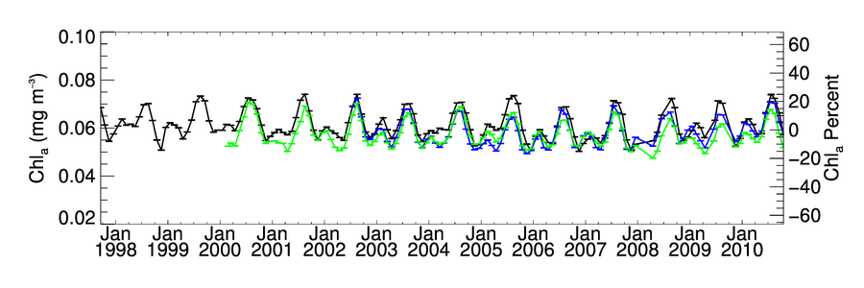
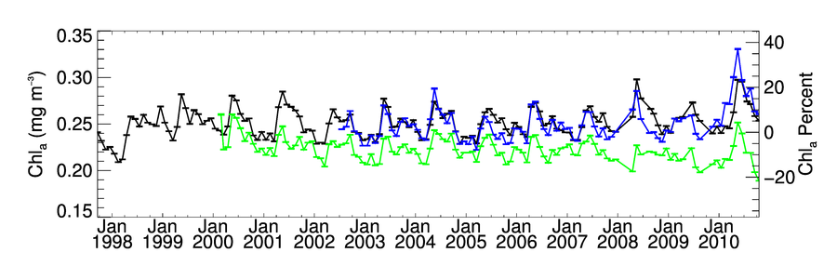
Global Chlorophyll Timeseries
Oligotrophic Subset
SeaWiFS MODISA MODIST
Mesotrophic Subset
SeaWiFS MODISA MODIST
Notes:
consistently processed timeseries
identify residual instrument problems
estimate uncertainties in the time-series and trends

Slide 9
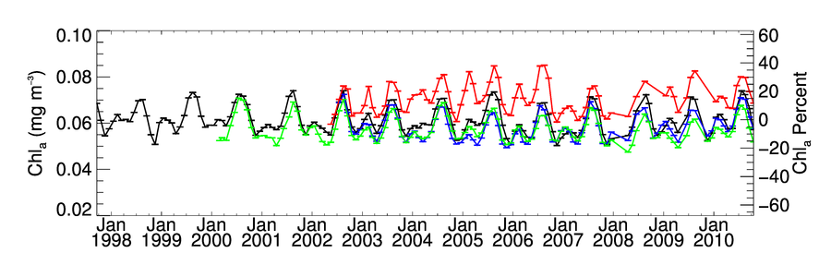
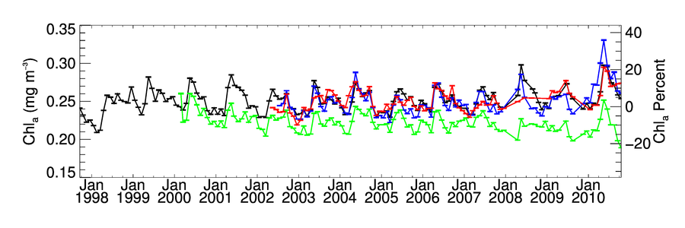
Global Chlorophyll Timeseries
Oligotrophic Subset
SeaWiFS MODISA MODIST MERIS
Mesotrophic Subset
SeaWiFS MODISA MODIST MERIS
Notes:
independently-processed time-series

Slide 10
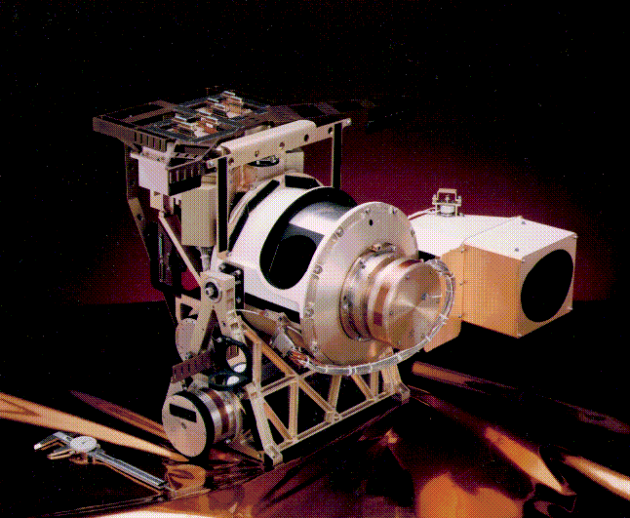
SeaWiFS
1997-2010
Notes:
everything changed
not a perfect instrument, but very good temporal calibration

Slide 11
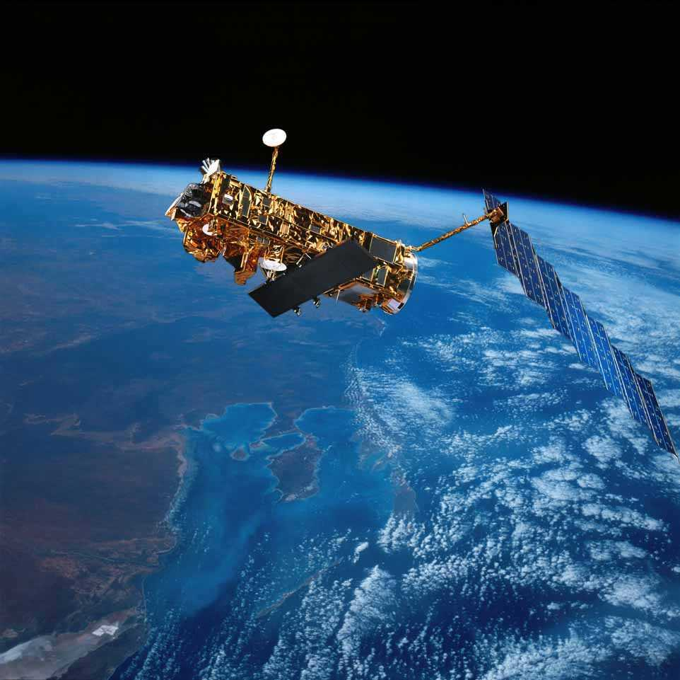
MERIS
2002-2012
Notes:
only other truly global ocean color capable sensor
instrument was performing well
also showed very good temporal stability over mission

Slide 12
MODISA Lunar and Solar Calibration Trends
More Erratic in 2011
MODIS 412nm Responsivity Changes Since Launch
0%
Solar
10%
20%
Lunar
Gain
30%
40%
50%
60%
Notes:
extrapolation of calibration was not valid

Slide 13
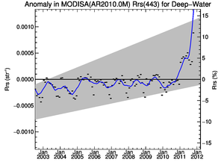
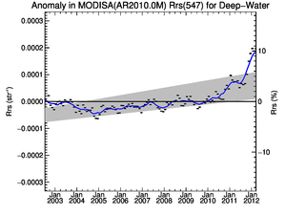
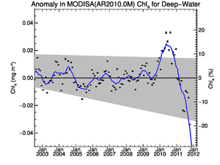
MODISA R2010.0 Temporal Anomalies (2002-2012)
Deep-Water
Rrs(443)
Rrs(547)
Chlorophyll
Big
Trending
Errors
in 2011
Notes:
good news, in a sense problem became large enough that other disciplines noticed (ocean color is the canary)

Slide 14
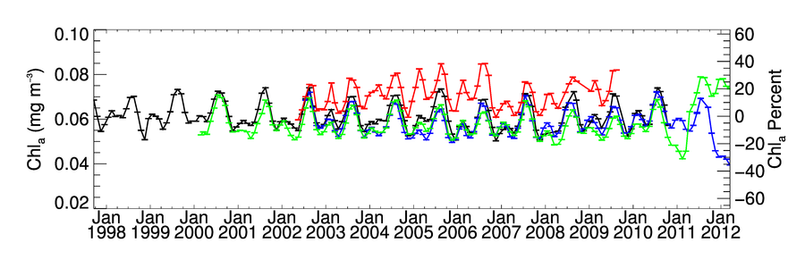
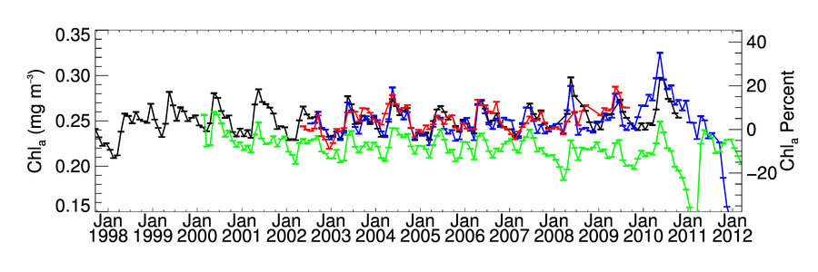
Degraded Timeseries Quality in 2011
Oligotrophic Subset
SeaWiFS MODISA MODIST MERIS
Mesotrophic Subset
SeaWiFS MODISA MODIST MERIS
Notes:
independently-processed time-series

Slide 15
New Temporal Calibration Approach
MCST final calibration for Collection 6 uses Earth view data
lunar calibration + desert observations for 412 and 443
largely reproduces previous SeaWiFS cross-cal results (validation!)
But still not quite good enough for ocean color
significant residual time-trend at 412 (due to scan-edge changes)
residual cross-scan and striping artifacts
Notes:
problem became large enough that other disciplines noticed (ocean color is the canary)
validation of OBPG calibration adjustments

Slide 16
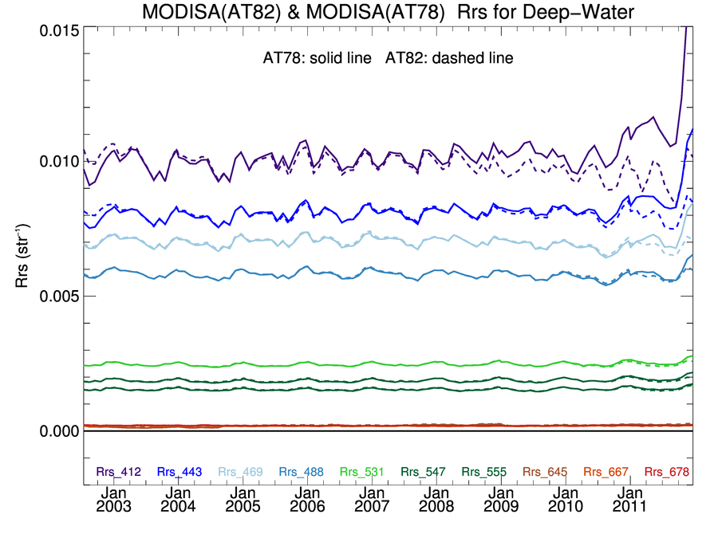
C6 Calibration introduced trend in 412
fixed 50%
increase
in Rrs at
412nm
induced downward trend
Notes:
traced to insufficient scan-edge corrections

Slide 17
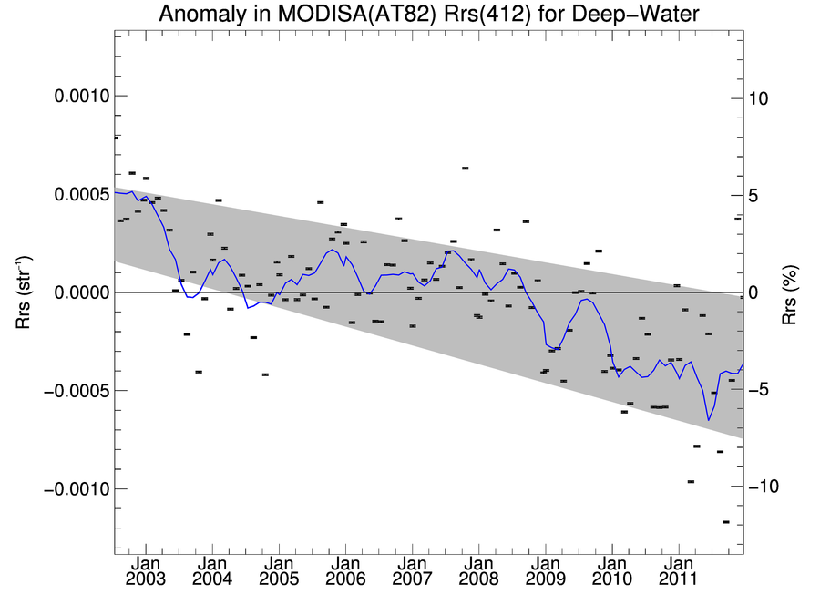
Significant Temporal Trend in Rrs(412) introduced after MCST C6 desert-based calibration
Notes:
significant impact to CDOM retrievals
traced to insufficient scan-edge corrections

Slide 18
New Temporal Calibration Approach
MCST final calibration for Collection 6 uses Earth view data
lunar calibration + desert observations for 412 and 443
largely reproduces previous SeaWiFS cross-cal results (validation!)
But still not quite good enough for ocean color
significant residual time-trend at 412 (due to scan-edge changes)
residual cross-scan and striping artifacts
Additional cross-scan correction developed by OBPG
relative to MCST C6 desert-based calibration
based on contemporaneous Aqua L3 15-day Rrs
derive time-varying RVS shape per detector & mirror-side
applied to all OC bands 412-678
See talk by Gerhard Meister this afternoon
Notes:
correct residual cross-scan variability relative to MSCT calibration

Slide 19
OBPG MODISA Cross-Scan Corrections at 412nm relative to MCST desert-based C6 calibration
412nm, Detector 5, Mirror-Side 1
Gain
2002
Mission Time
2012
Scan Pixel

Slide 20
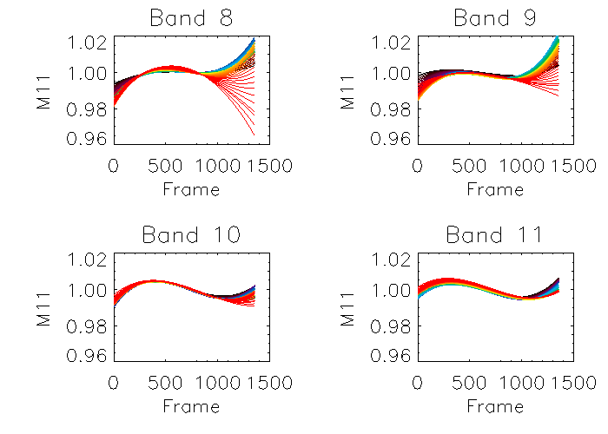
OBPG MODISA Cross-Scan Corrections relative to MCST desert-based C6 calibration
412nm
443nm
Gain
488nm
531nm
2002
Mission Time
2012

Slide 21
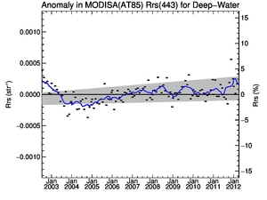
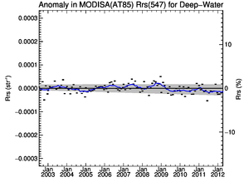
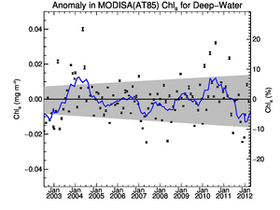
MODISA R2012.0 Temporal Anomalies (2002-2012)
Deep-Water
Rrs(443)
Rrs(547)
Chlorophyll
consistent with
expectation
Much Better!
Notes:
still some issues in 412 in 2012 (not shown), will always be a problem, limits quality of IOP retrievals

Slide 22
MODIS Reprocessing
New approach for temporal calibration of MODIS-Aqua
ocean color time-series is now fully independent of SeaWiFS
MODIS-Aqua Reprocessing 2012.0 starting this week
only change is to temporal calibration and vicarious adjustment
level-2 processing completed Sunday (10 years in 5 days, 700x!)
MODIS-Terra has similar issues
relies heavily on SeaWIFS for temporal RVS and polarization
waiting for "final" MCST C6 calibration
cross-calibrate Terra to Aqua to resolve polarization sensitivity
Both MODIS sensors are beyond design life
maintaining quality is an on-going challenge, user beware

Slide 23
Terra MODIS SST V6
Minnett & Evans
V6 Algorithm has coefficients derived for zonal intervals (Latband).
This removes regional and seasonally repeating bias errors
Following initial problems in first year of mission, instrument and SST retrievals are very stable.
Time series of median uncertainties of Terra MODIS 4 µm night-time SSTs, relative to drifting buoys, in six latitude bands.
Notes:
deviations versus time relative to drifting buoys, in different latitude zones
latitudinal algorithm tuning reduces regional and seasonal biases
also see higher residuals in early mission, become relatively stable in later mission

Slide 24
Uncertainties in MODIS SSTs
Best rms uncertainties in 4µm SST is <0.3K wrt drifting buoys. But buoy accuracies are ~0.25K, so MODIS is more accurate than can be demonstrated.
To improve this situation:
new generation of drifters being developed and deployed – target ~0.01K uncertainties
2nd generation ARGO profilers, uncertainties ~0.001K
2nd generation of M-AERIs, uncertainties <0.1K
Notes:
uncertainties in 4um SST of 0.3 kelvin, approaching uncertainties in the buoy measurements

Slide 25
Multi-year satellite radiometer measurements
Satellite-derived SSTs and uncertainties
CDR of SST
Significant differences between SI & non-SI uncertainties ?
N
Derivation of SST from satellite measurements
Y
SI Traceable uncertainty budget
Non – SI Traceable uncertainty budget
Matchup analysis of SI collocated measurements
Ship radiometer measurements
Matchup analysis of non-SI collocated measurements
Laboratory calibration
Laboratory
water-bath blackbody calibrator
Non-SI traceable in situ measurements
SI-traceable thermometers
Radiometric characterization
e.g. NIST TXR
SI-standard blackbody calibrator
Notes:
effort to establish the CDR for the long-term SST record (dating back to pathfinder)
drifting buoys not SI traceable
shipborne radiometers SI traceable

Slide 26
Balch: Many major cruises to study coccolithophores- both northern and southern hemisphere; sampled over >120,000 km…
Arctic’11
GNATS’98-’12
AMT 15-21
SW Pacific’11
Patagonian Shelf’08
SOGasEx’10
S. Ocean’11
S. Ocean’12
Notes:
with an eye toward the next ocean color reprocessing, B. Balch traveling the world collecting measurements of coccoliths to validate and refine the particulate inorganic carbon algorithm
Basically shows the large numbers of cruises that we’ve been doing in support of the PIC product.
coccoliths are calcifying organisms sensitive to ocean acidification

Slide 27
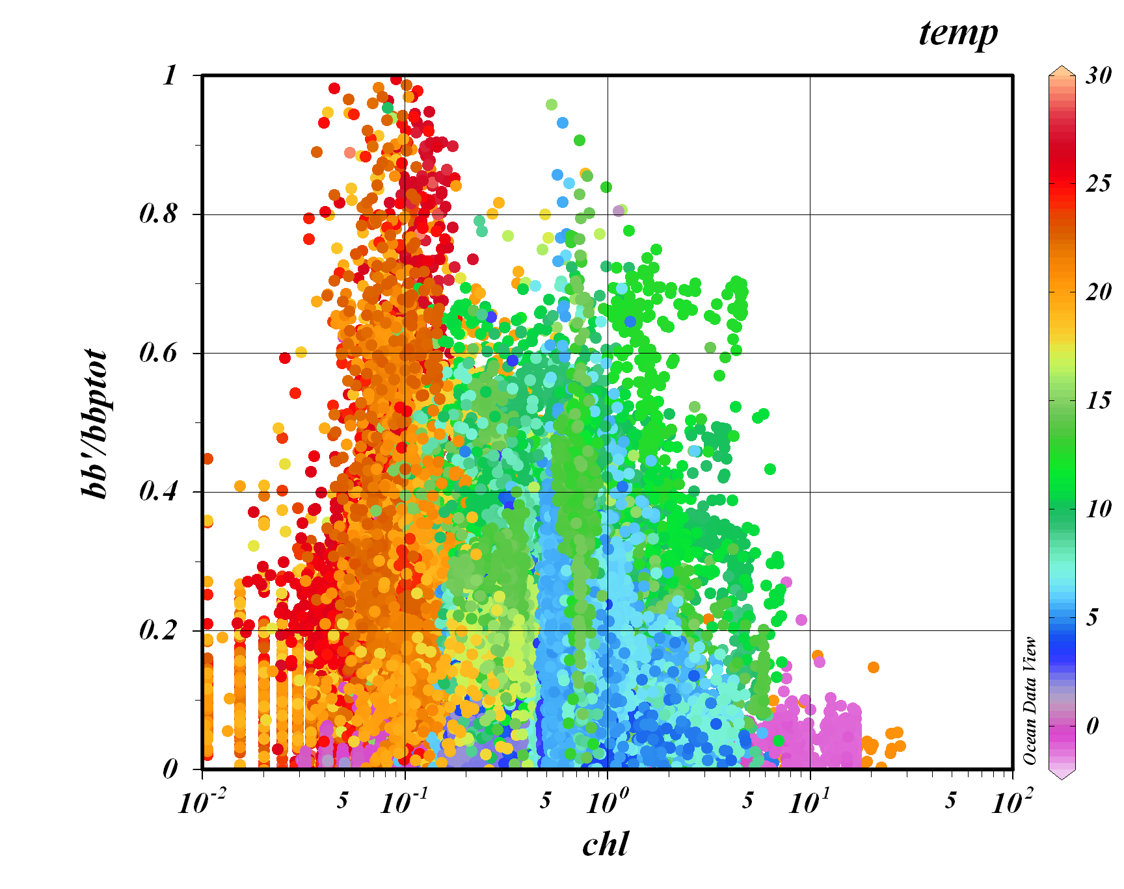
Shipboard PIC algorithm refinement continues (we have almost doubled the explained-variance globally). This plot illustrates the relative importance of PIC to total particle backscattering (b_{bp})…
Tropical
Sub-tropical gyres
PIC-dependent backscattering
total particle backscattering
Temperate
Sub-Polar
Polar
[Chlorophyll a] (mg m⁻³)
Notes:
illustrates importance of measurement to the optics, as PIC-dependent backscattering can dominate the total particle backscatter, even in very clear (low productivity) waters where no coccolith bloom is evident.
Color of data points represents temperature. Note high fractions of acid-labile backscattering (bb’; i.e. PIC backscatting) of total backscattering (>0.5) in tropical, sub-tropical gyres and temperate regions (basically all but polar). High values of bb’/bbtot do NOT mean a bloom. It only indicates a large relative contribution of PIC in huge regions of the global ocean, where the scattered light is NOT just due to chlorophyll. Indeed, one can see that in oligotrophic areas, PIC-dependent backscattering can actually can be the dominant source of backscattering.

Slide 28
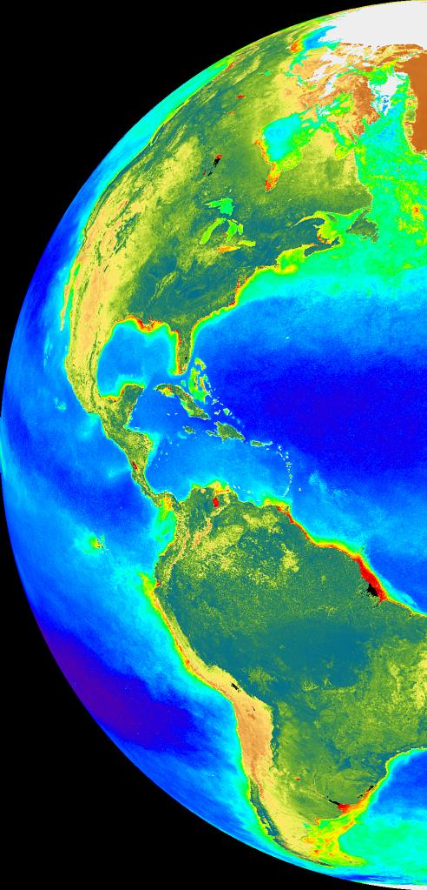
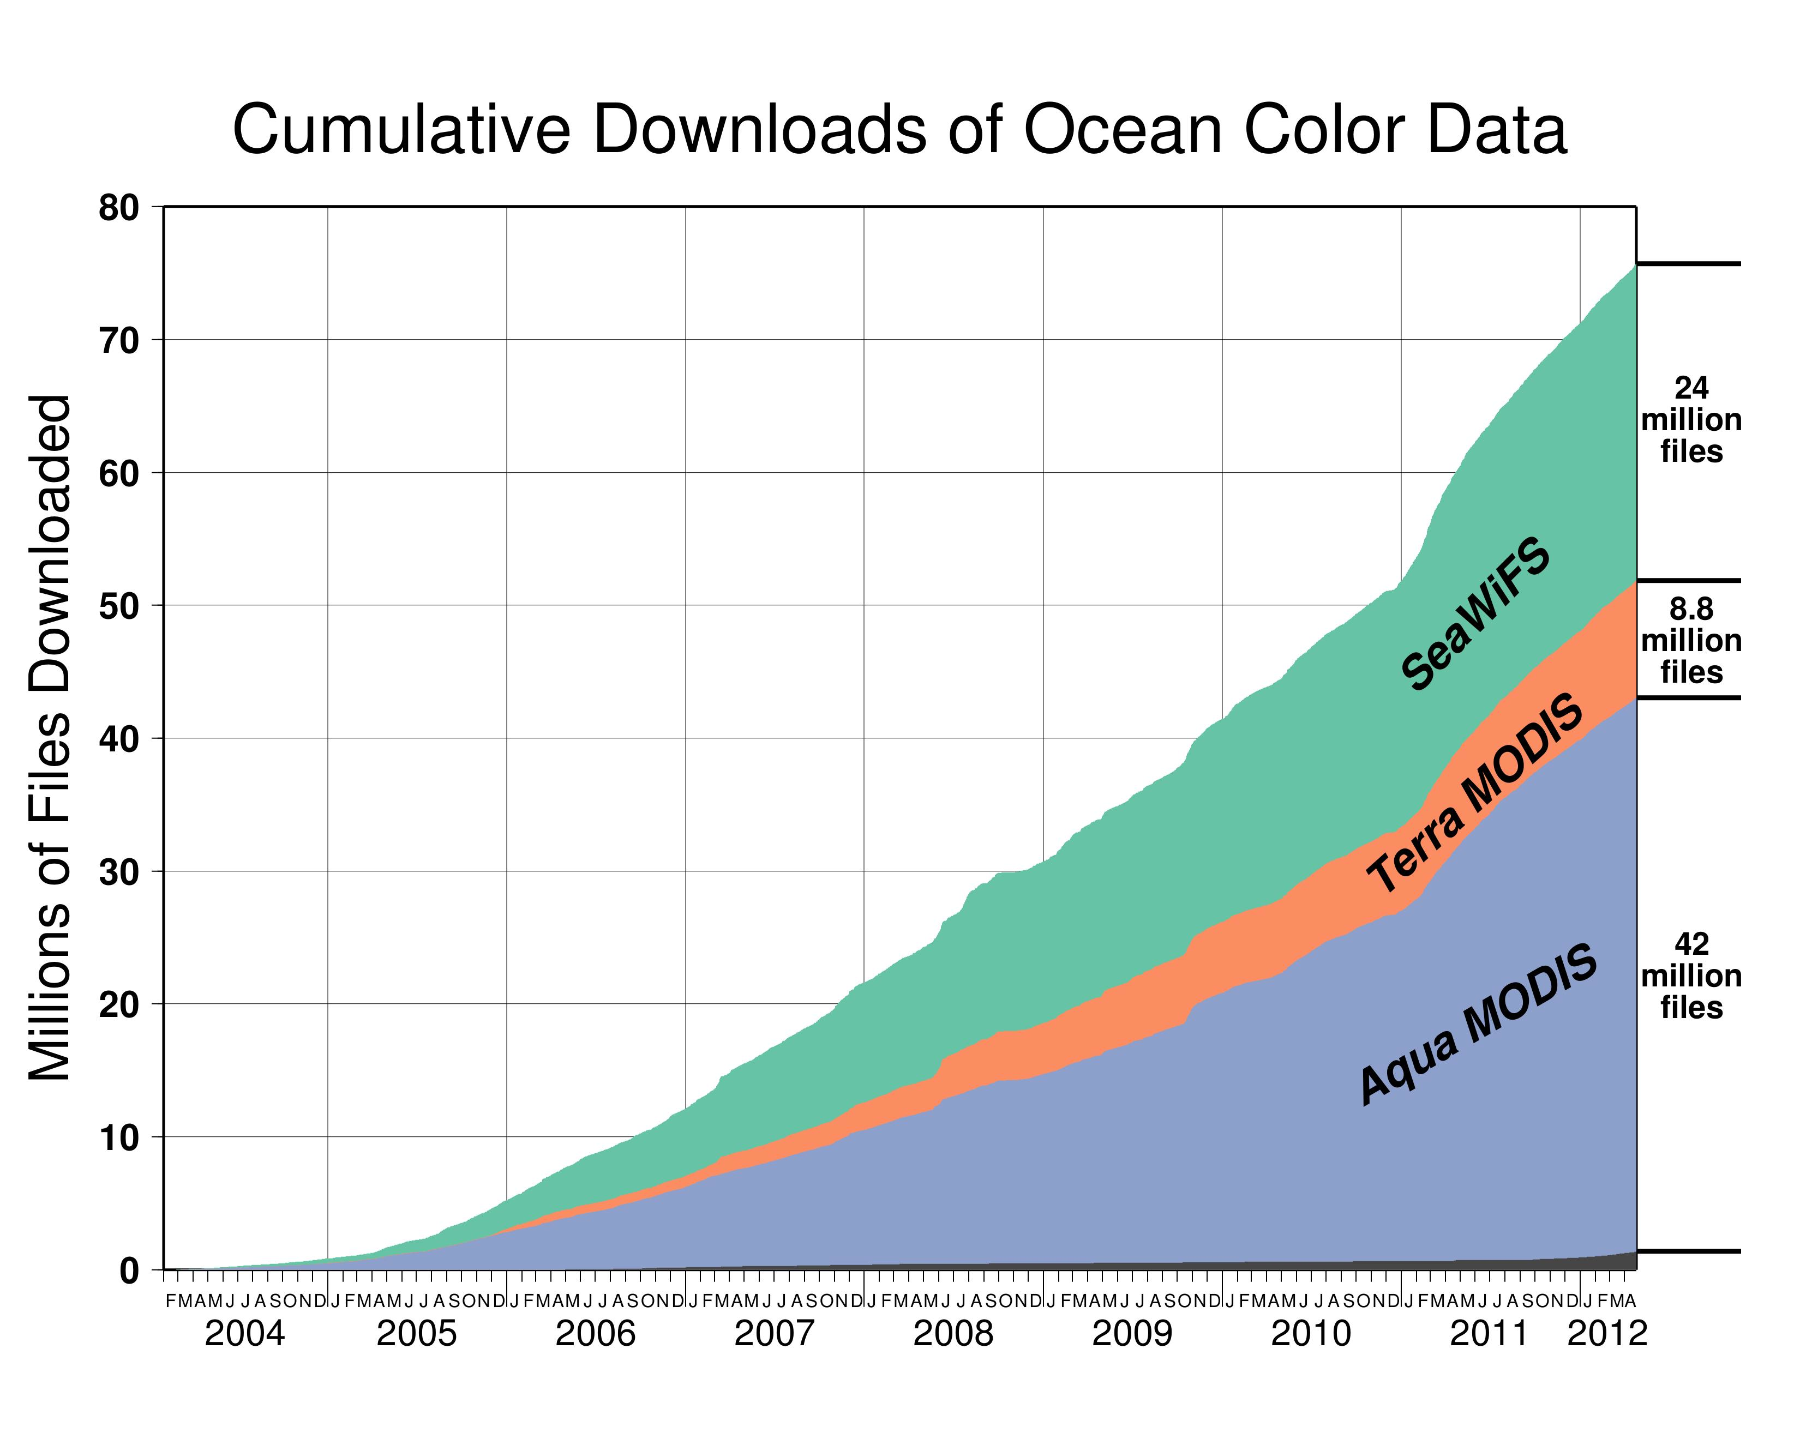
Question from Paula
Should we be organized around measurements or missions?
Notes:
all good news

Slide 29
Question from Paula
Should we be organized around measurements or missions?
MODISA
SeaWiFS
OCTS
MODIST
MOS
OSMI
OCM
OCM2
MERIS
CZCS
VIIRS
PACE
Notes:
integrating MERIS into the long-term record
still maintaining and distributing czcs and japanese OCTS mission
making limited use of other international missions, past and present
looking to viirs as best hope for contunity of existing products
and starting to develop the new science that will be possible from a PACE mission
not to mention the MERIS follow-on, OLCI, launching next year

Slide 30
Question from Paula
Should we be organized around measurements or missions?
Oligotrophic Subset
SeaWiFS MODISA MODIST MERIS VIIRS
Notes:
we have an ocean biology discipline meeting, where all missions are discussed, and this makes most sense for our community, moving toward an international science team

Slide 31
Question from Paula
Should we be organized around measurements or missions?
a mission meeting should focus on
instrument calibration, data quality,
and interdisciplinary algorithms
Notes:
need not be 3 days, need not be a physical meeting
folks at gsfc should talk more

Slide 32
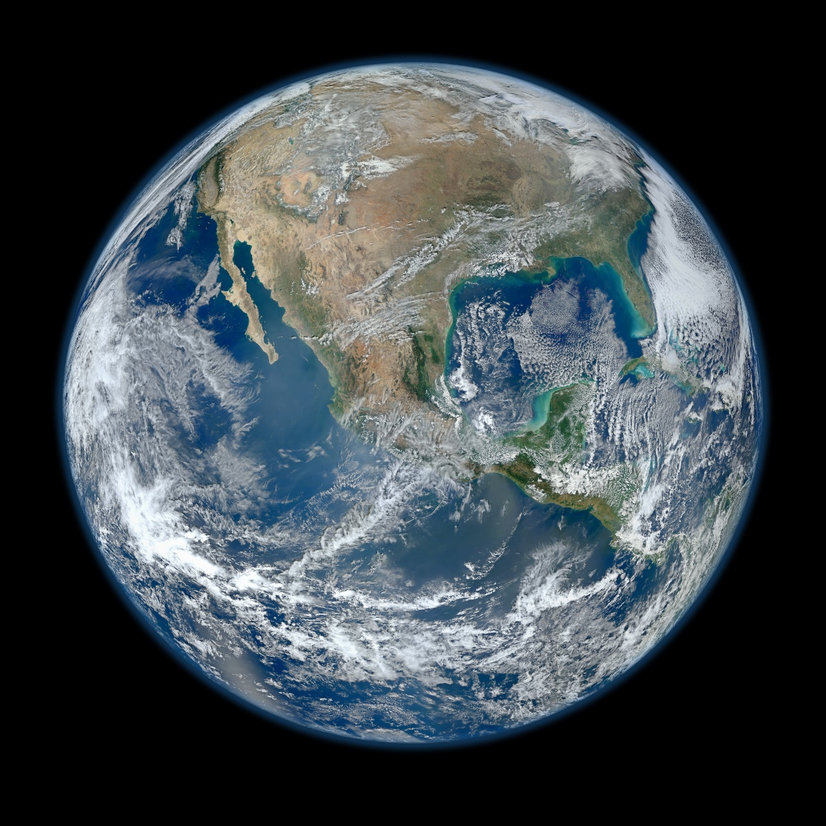
Notes:
lost two instruments, two instruments badly degrading, but viirs looks like it as the potential to provide measurements of sufficient quality to maintain the climate data record into the future.
*Updated February 2, 2012: According to Flickr, "The western hemisphere Blue Marble 2012 image has rocketed up to over 3.1 million views making it one of the all time most viewed images on the site after only one week."

Slide 33
Current MODIS OC Standard Product Suite
Level-2 OC Product
Algorithm Reference
R_{rs}(λ)
Ångstrom
AOT
Chlorophyll a
K_{d}(490)
POC
PIC
CDOM_index
PAR
iPAR
nFLH
R_{rs}(412)
R_{rs}(443)
R_{rs}(469)
R_{rs}(488)
R_{rs}(531)
R_{rs}(547)
R_{rs}(555)
R_{rs}(645)
R_{rs}(667)
R_{rs}(678)
Gordon and Wang 1994, Ahmad et al 2010, etc.
O'Reilly et al. 1998 (OC3) updated to NOMADv2
Werdell (KD2) algorithm (similar to OC3)
Stramski et al. 2008
Balch et al. 2005, Gordon et al. 2001
Morel and Gentili 2009
Frouin et al. 2003
Behrenfeld et al. 2009
Notes:
11 or 21

Slide 34
Current MODIS Evaluation Products
Euphotic Depth (Lee et al. and Morel et al.)
Zeu_lee, Zeu_morel
Spectral Diffuse Attenuation (Lee et al.)
Kd_412_lee, Kd_443_lee, Kd_490_lee (using QAA)
Diffuse Attenuation of PAR (Morel et al.)
Kd_PAR
Inherent Optical Properties (Maritorena et al. and Lee et al.)
adg_443_lee, bbp_443_lee, aph_443_lee, a_443_lee (QAA) **
adg_443_gsm, bbp_443_gsm, chl_gsm (GSM) **
** also in support of MEASURES (Maritorena)
Notes:
13 additional products
what products elevate to standard products

Slide 35
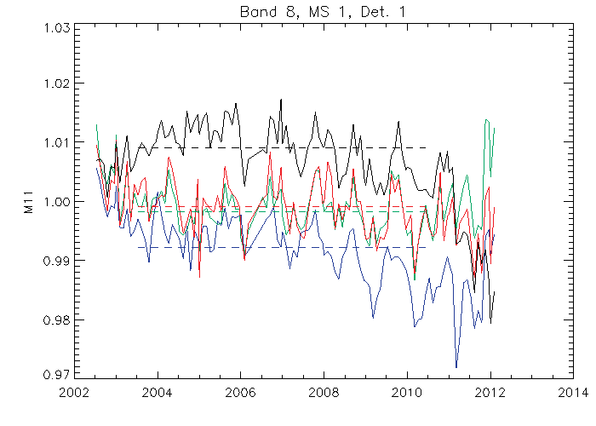
412 Trend Isolated to Scan Edges
Scan angles (frame): lunar (22), nadir (675),
Solar diffuser (989), end-of-scan (1250)

Slide 36
Generating SST Climate Data Records
Climate Data Records (CDRs) of SST require an unbroken chain from the derived SST fields to SI standards.
Drifting buoys are not traceable to SI calibration after deployment, but matchups between MODIS SSTs and drifters are numerous.
Ship-board radiometers are traceable to SI standards through the NIST TXR (transfer radiometer) at a series of workshops at RSMAS. Matchups between MODIS SSTs and radiometers are less numerous.
Following slides show how to generate SST CDRs using both buoys and radiometers (long version & short version).

Slide 37
Multi-year satellite radiometer measurements of SST
Non – SI Traceable uncertainty budget
SI Traceable uncertainty budget
Significant differences between SI & non-SI uncertainties ?
Y
N
CDR of SST

