Slide 1
NASA’s Earth Science Division
Bureaucratic Overview for the MODIS Science Team
7 May 2012

Slide 2
SMD Organization
Associate Administrator (AA) (John Grunsfeld)
Deputy AA (Chuck Gay)
JWST Program Office
Dir. (Rick Howard)*
Dep. (E. Smith)
Deputy AA for Programs
(Mike Luther)
Deputy AA for Mgt
(Roy Maizel)
Assistant AA
(Colleen Hartman)
Science Office for Mission Assessments
Chief Scientist
(Vacant/Colleen Hartman)
Strategic & Intl Planning Director (Marc Allen)
Embeds/POCs
Chief Engineer
(K. Ledbetter)
Safety & Msn Assurance
(P. Martin)
General Counsel
(R. McCarthy)
Legislative & Intergvtl Affairs
(D. Hollebeke)
Public Affairs
(D. Brown)
Intl & Interagency Relations
(K. Feldstein)
Research Lead
(M. Bernstein)
E/PO Lead
(S. Stockman)
Resource
Management Division
Dir. (C. Tupper)
Dep. (K. Wolf)
Strategic Integration &
Management Division
Dir. (D. Woods)
Dep. (G. Williams)
Earth Science
Division
Dir. (M. Freilich)
Dep. (M. Luce)
Joint Agency
Satellite Division
Dir. (M. Watkins)
Dep. (D. Schurr)
Heliophysics
Division
Dir. (B. Giles)
Dep. (V. Elsbernd)
Planetary Science
Division
Dir. (J. Green)
Dep. (Vacant)
Astrophysics
Division
Dir. (P. Hertz)
Act. Dep. (M. Moore)
Flight (S. Volz)
Solar System Exploration
(J. Adams - Act)
Applied Sciences
(L. Friedl )
Mars Exploration
(D. McCuistion)
Research (J. Kaye)
Planetary Research
(J.Rall)
Technology (GSFC)
(G. Komar)
Planetary Protection
Officer (C. Conley)**
* Direct report to NASA Associate Administrator
** Co-located from the Front Office
March 2012

Slide 3
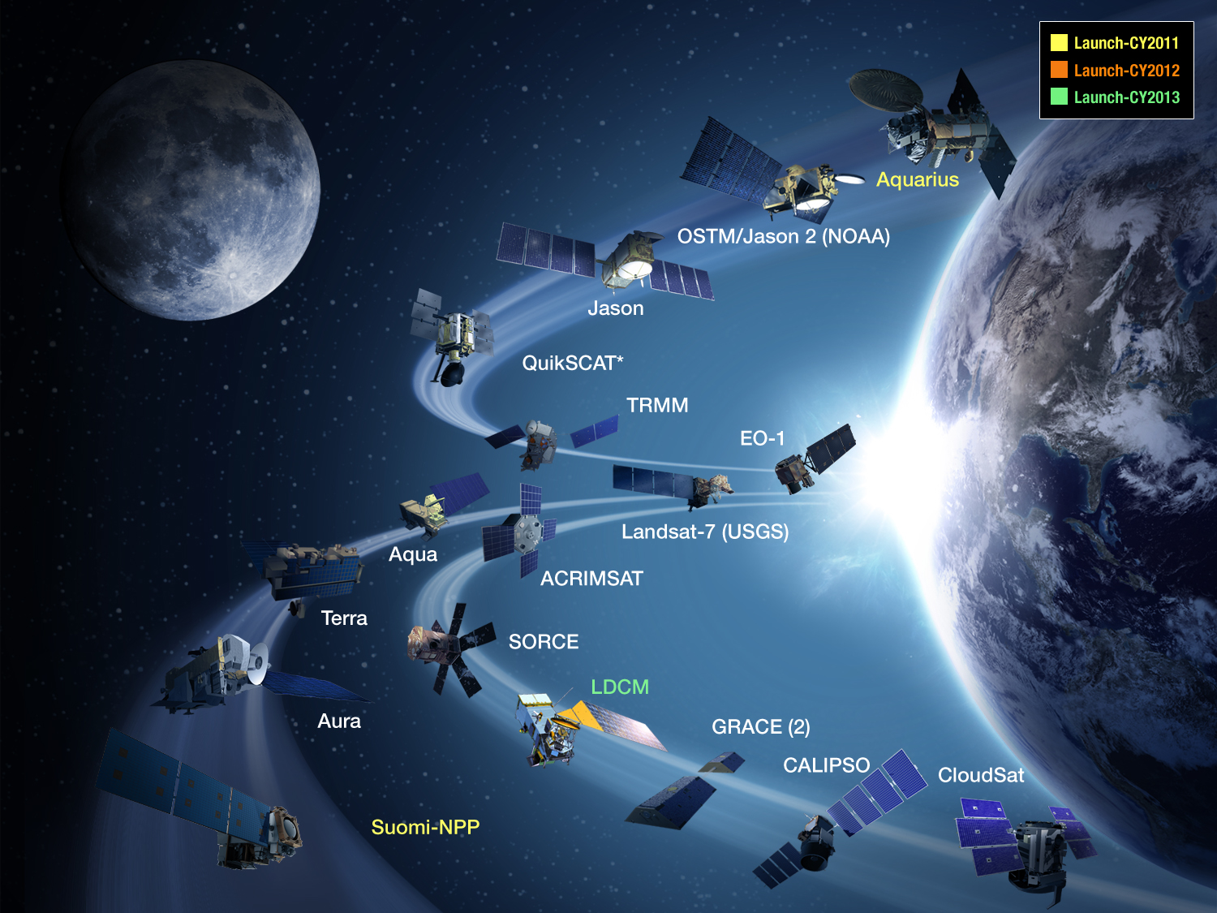

Slide 4
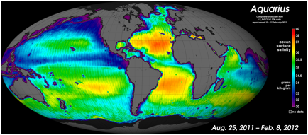
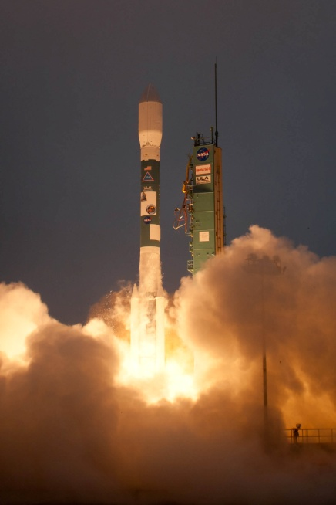
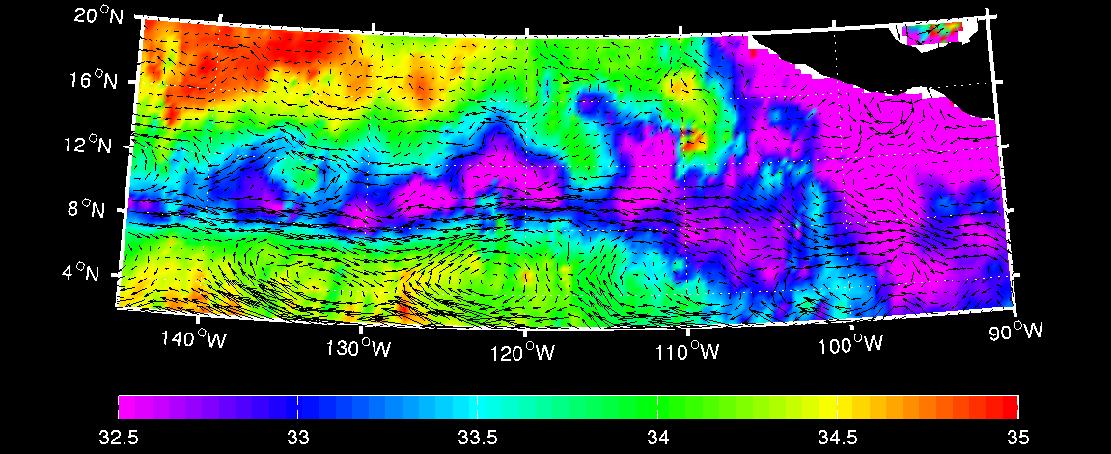
a
b
3–9 October 2011

Slide 5

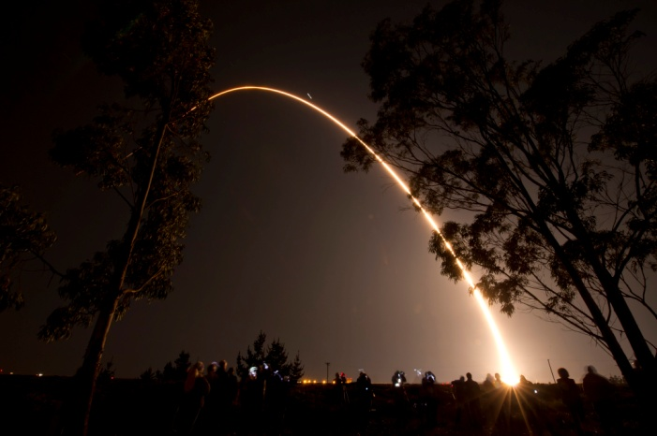
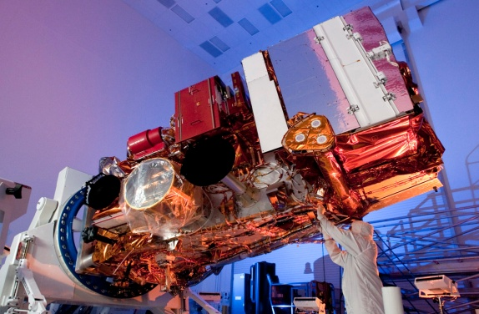
Suomi NPP Mission
Suomi NPP provides critical data continuity for Earth science research and risk reduction for JPSS instruments, algorithms, ground system, and archive.
NPP Instruments
Visible Infrared Imaging Radiometer Suite (VIIRS)
Cross-track Infrared Sounder (CrIS)
Advanced Technology Microwave Sounder (ATMS)
Ozone Mapping and Profiler Suite (OMPS)
Clouds and the Earth's Radiant Energy System (CERES)
→ Only CERES has flown in space before, the four other instruments are new designs.
Suomi NPP will continue essential climate, weather, and environmental data from polar orbit:
NASA
NOAA
  AIRS → CrIS
  AMSU → ATMS
  MODIS → VIIRS
  OMI → OMPS
  CERES → CERES
  HIRS → CrIS
  AMSU → ATMS
  AVHRR → VIIRS
  SBUV2 → OMPS
Anticipated Benefits
Tracking Climate Changes – measurements to understand climate and the health of our planet
A Vigilant Eye on Ozone – daily measurements to assess recovery of the ozone layer
A Sentinel When Disaster Strikes – wildfires, volcanic eruptions, snowstorms, droughts, floods, hurricanes
Watching the Weather – soundings of atmospheric temperature and moisture, cloud cover
Launched : October 28, 2011
Notes:
Notes:
- PI Masters Forum is something from Weiler for PI-led missions
- Hearing concerning LightSquared and its impact to GPS operations, NASA testifying (Badri Younes) among other agencies to the House Science Space, and Technology Committee – Investigations and Oversight Subcommittee
Acronyms:
iLEAPS – Integrated Land Ecosystem-Atmosphere Processes Study, project of the International Geosphere-Biosphere Programme (IGBP)
NYCRI – New York City Research Initiative
PEATE - Product Evaluation and Algorithm Test Elements
SCEC - Southern California Earthquake Center
SIPS - Science Investigator-led Processing Systems

Slide 6
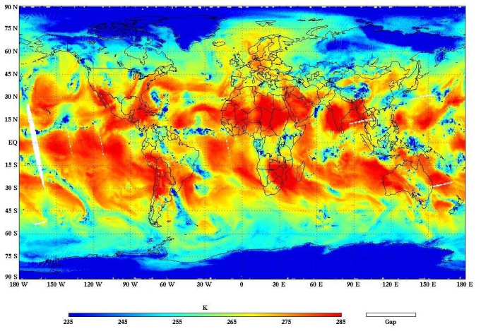
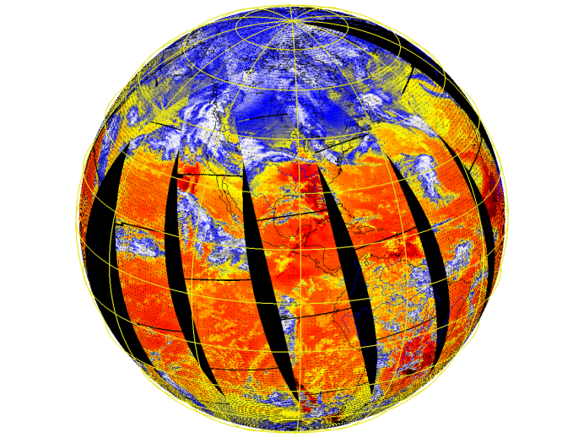
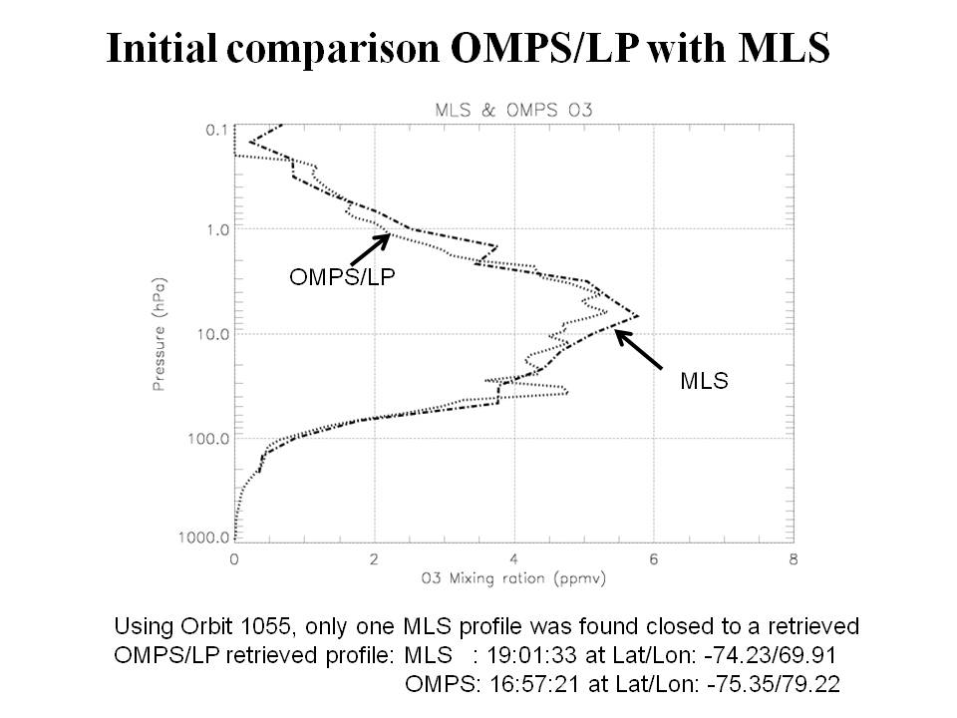

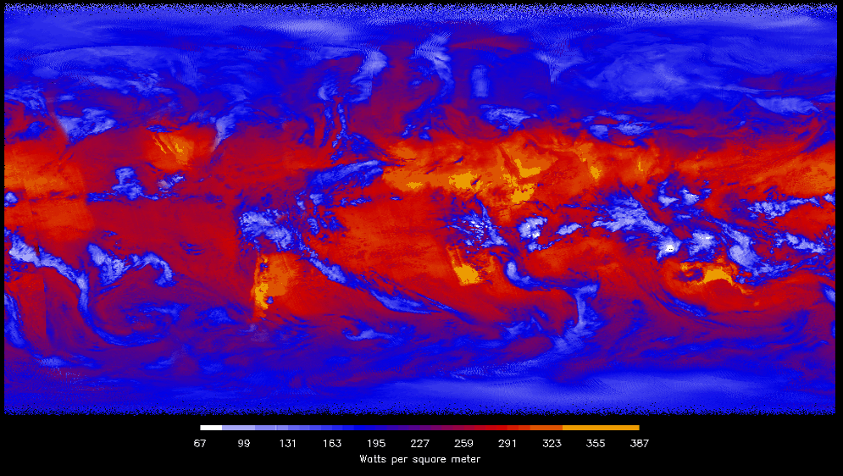
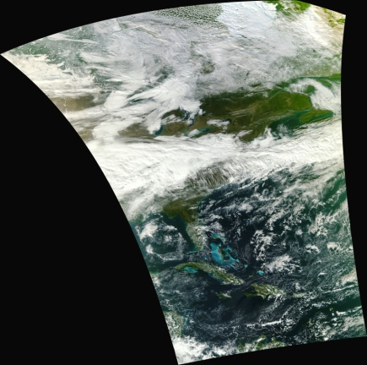
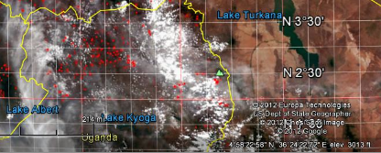
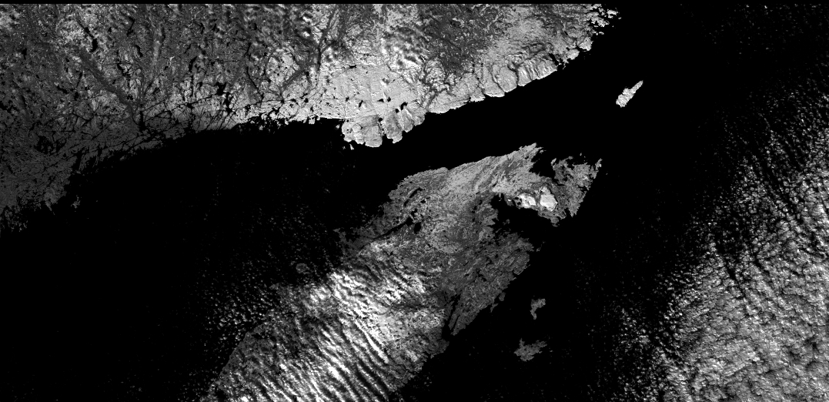
Suomi – NPP Products
ATMS
CrIS
OMPS
VIIRS 1st Image
CERES
VIIRS Night, Visible & Fires

Slide 7
An Assessment of NASA’s Earth Science Programs
Earth Decadal Survey Mid-Term Report
Dennis Hartmann, Committee Chair
University of Washington
Art Charo, Study Director
Lewis Groswald, Research Associate
National Research Council-Space Studies Board

Slide 8
Findings
Finding: NASA responded favorably and aggressively to the decadal survey, embracing its overall recommendations for Earth observations, missions, technology investments, and priorities for the underlying science. As a consequence, the scientific and applications communities have made significant progress over the past 5 years.

Slide 9
Findings (Cont’d)
Finding: The Earth Venture class program is being well implemented by NASA and is a crucial component of fulfilling the decadal survey’s objectives.
Finding: Alternative platforms and flight formations offer programmatic flexibility. In some cases, they may be employed to lower the cost of meeting science objectives and/or maturing remote sensing and in situ observing technologies.
Finding: NASA has made considerable efforts to secure international partnerships to meet its scientific goals and operational requirements.
Finding: Aligned with the intent of the decadal survey, NASA’s Applied Sciences Program has begun to engage applied researchers and governmental (federal and state) operational users on some survey mission science definition and applications teams and conduct research to better understand the value of these applications.

Slide 10
Findings (Cont’d)
Finding: The suborbital program
and, in particular, the Airborne
Science Program, is highly
synergistic with upcoming Earth
science satellite missions and is
being well implemented. NASA has
fulfilled the recommendation of the
decadal survey to enhance the program.
Finding: NASA has maintained a healthy investment in R&A activities and has protected the budgets of both mission-specific and non-mission-specific R&A programs against possible reallocation to cover cost growth in mission hardware.

Slide 11
Principal Impediment to Achieving Survey Recommendations
Finding: Funding for NASA’s Earth science program has not been restored to the approximate $2 billion per year (in FY 2006 dollars) level needed to execute the decadal survey’s recommended program. The failure to restore the Earth science budget to a $2 billion level is a major reason for the inability of NASA to realize the mission launch cadence recommended by the survey.

Slide 12
Other Impediments
Finding: The decadal survey’s recommendation that the Office of Science and Technology Policy develop an interagency framework for a sustained global Earth observing system has not been implemented. The committee concludes that the lack of such an implementable and funded strategy has become a key, but not sole, impediment to sustaining Earth science and applications from space.

Slide 13
Impediments (Cont’d)
Finding: NOAA’s capability to implement the assumed baseline and the recommended program of the decadal survey has been greatly diminished by budget shortfalls and cost overruns (especially those associated with the development of the NPOESS, now JPSS, program) and by sensor descopes and sensor eliminations on both JPSS/NPOESS and GOES-R.
Finding: Lack of reliable, affordable, and predictable access to space has become a key impediment to implementing NASA’s Earth science program. Furthermore, the lack of a medium-class launch vehicle threatens programmatic robustness.

Slide 14
Recommendations
Recommendation: ESD should interpret decadal survey estimates of mission costs as an expression of the relative level of investment that the survey’s authoring committee believed appropriate to advance the intended science and should apportion funds accordingly, even if all desired science objectives for the mission may not be achieved.
  Survey-derived cost estimates are by necessity very approximate and subsequent more detailed analysis may determine that all of the desired scientific objectives of a particular mission cannot be achieved at the estimated cost.
Recommendation: ESD should implement its missions via a cost-constrained approach, requiring that cost partially or fully constrain the scope of the mission such that realistic science and applications objectives can be achieved within a reasonable and achievable future budget scenario.

Slide 15
Recommendations (con’t)
Recommendation: NASA’s ESD should establish a cross-mission Earth system science and engineering team to advise NASA on execution of the broad suite of decadal survey missions within the interdisciplinary context advocated by the survey.
  The advisory team would assist NASA in coordinating decisions regarding mission technical capabilities, cost, and schedule in the context of overarching Earth system science and applications objectives.
  The team, similar to the Payload Advisory Panel established by NASA to assist in implementation of its Earth Observing System (EOS), would draw its membership from the scientists and engineers involved in the definition and execution of decadal survey missions as well as the nation’s scientific and engineering talent more broadly.

Slide 16
Recommendations (con’t)
Recommendation: NASA should seek to ensure the availability of a highly reliable, affordable medium-class launch capability.
Recommendation: Consistent with available budgets and a balanced Earth observation program from space based on the decadal survey recommendations, NASA should consider increasing the frequency of Earth Venture stand-alone/space-based missions.

Slide 17
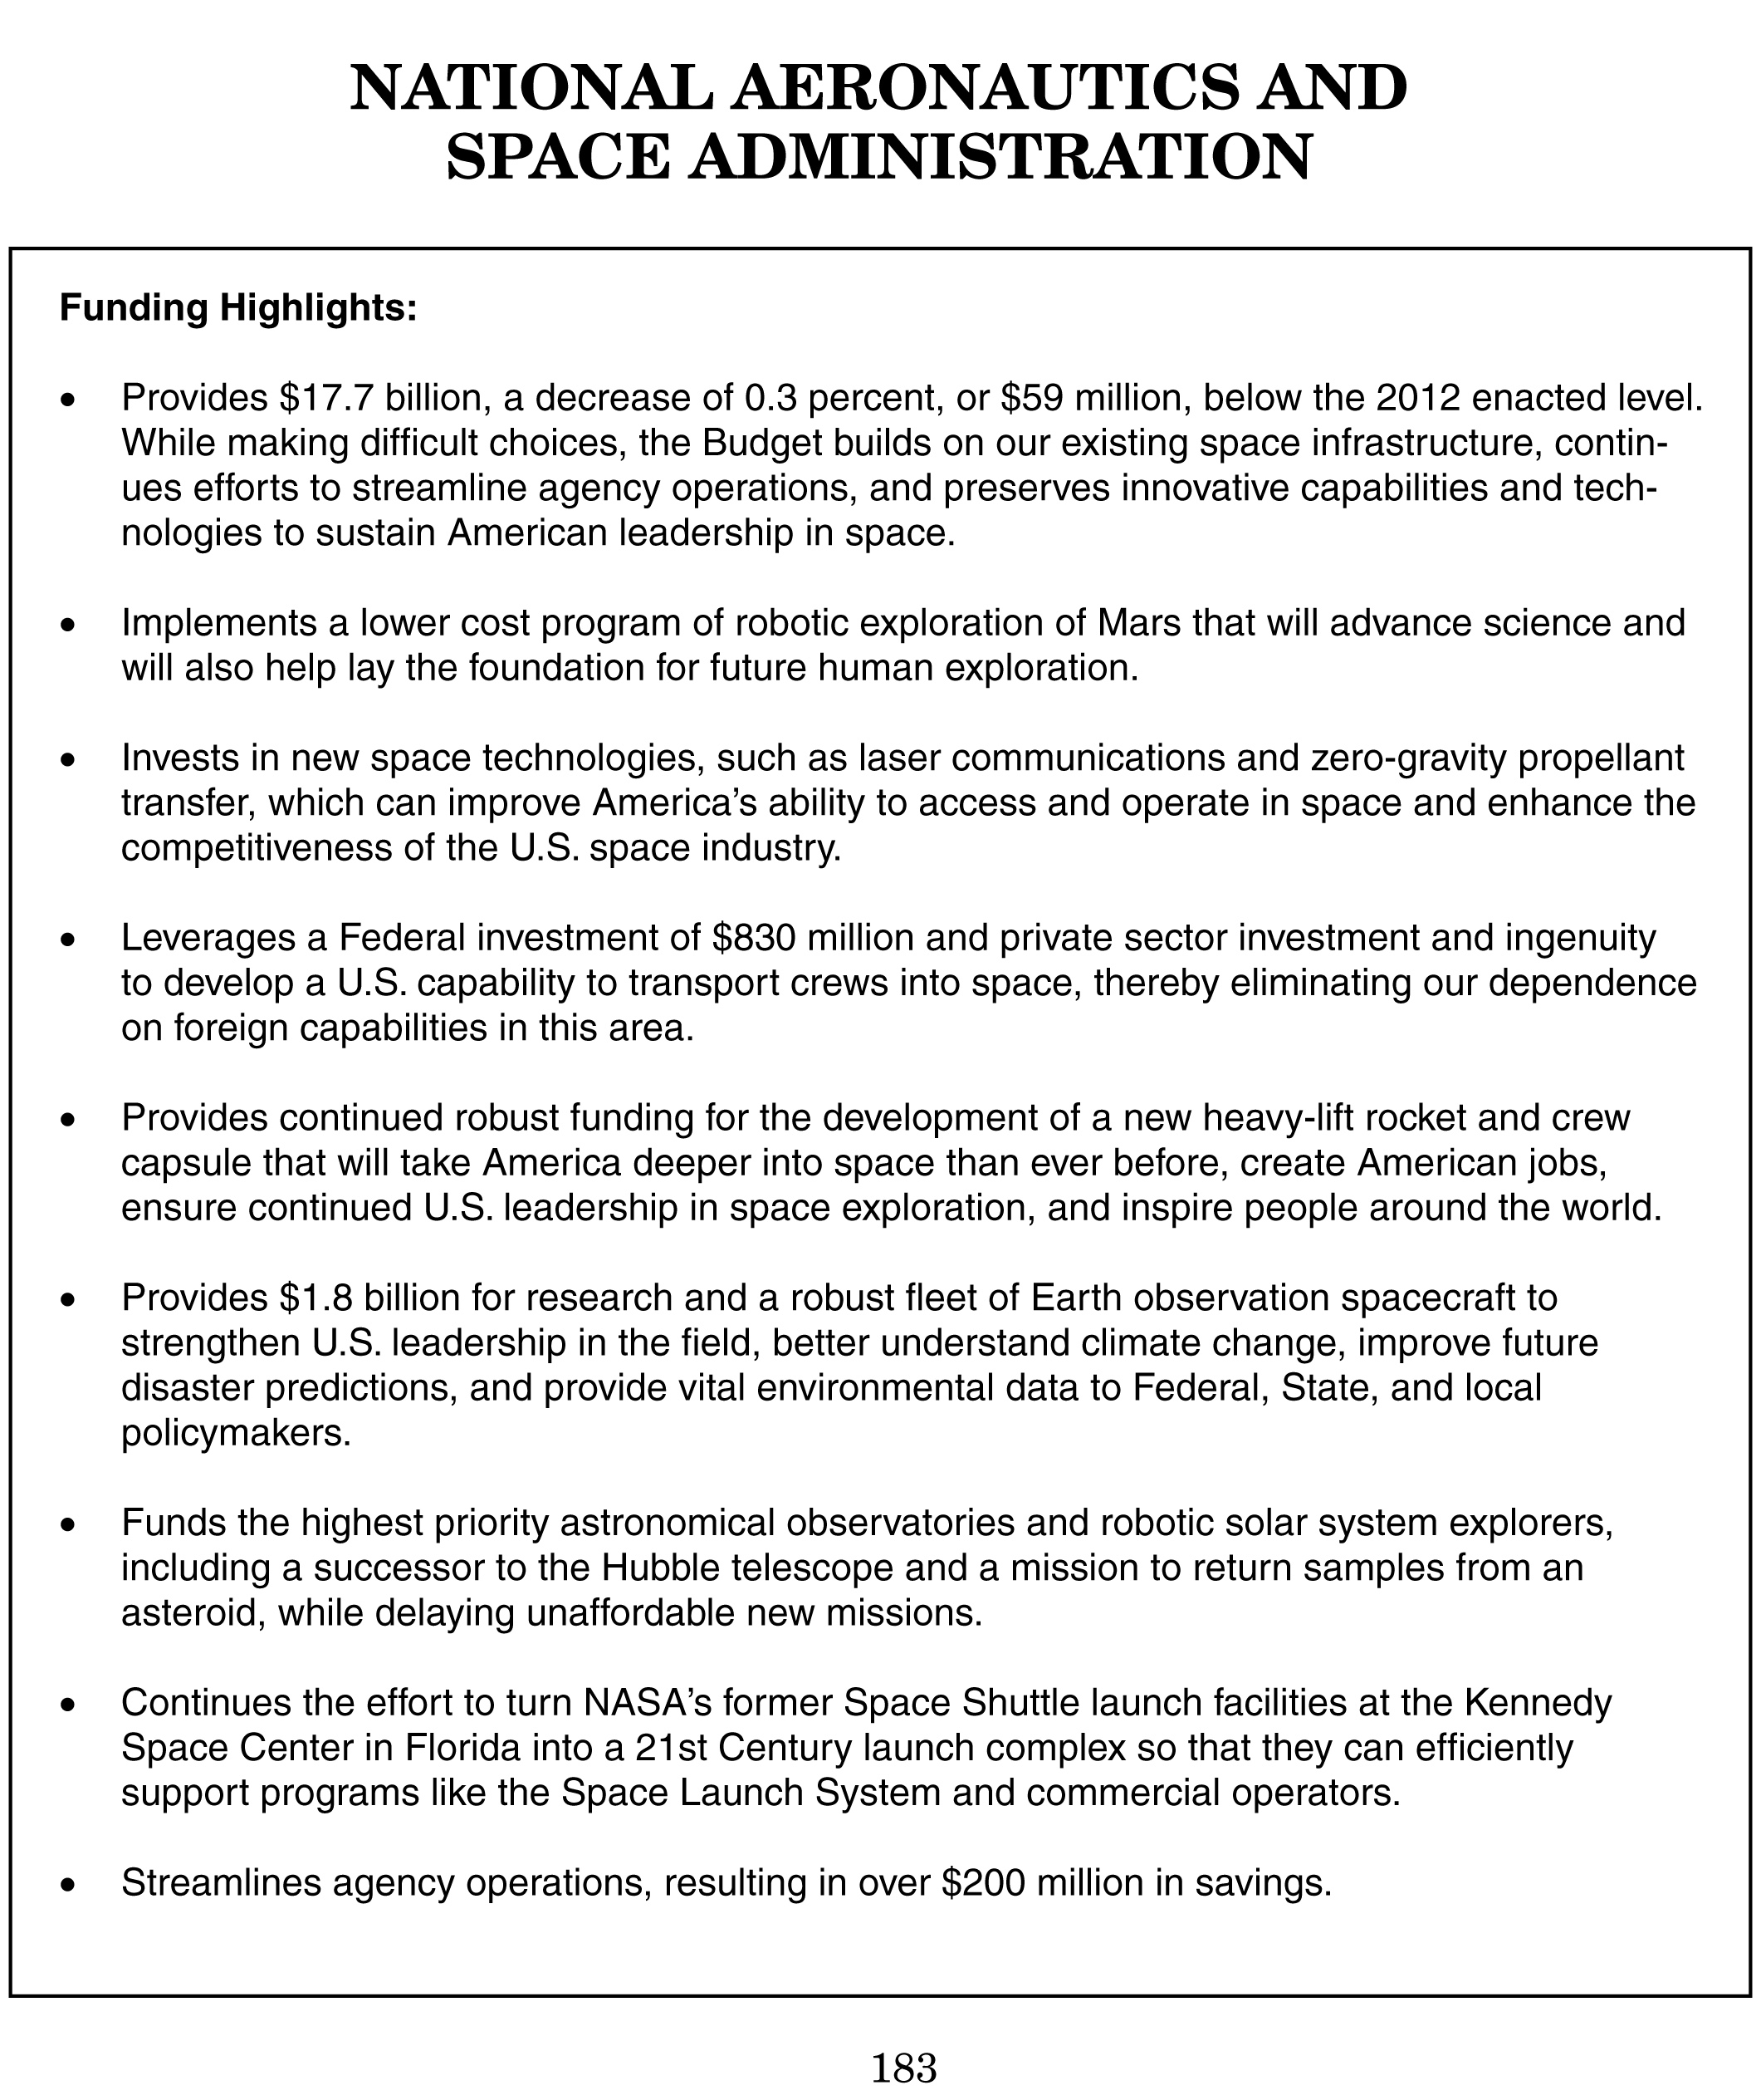
NASA “Highlights” Page from Budget Document

Slide 18
Earth Science Budget – FY13 Request
FY10 request
Prev Admin

Slide 19
Earth Science Budget Overview
The FY13 budget for Earth Science is consistent with the FY12 request – STABILITY!
  Congressional appropriation for FY12 was also consistent with the President’s budget request
  FY13 overall ESD funding level is ~$25M above FY12 appropriated level
  Overall NASA agency FY13 level represents 0.3% decrease from FY12; SMD overall budget decreased by ~3.3% from FY12
The March 2011 Glory launch failure has resulted in delays for OCO-2 and SMAP launches, and significantly higher budgeted cost levels for mid-range launch vehicles
  Solicitation for multiple launch services for OCO-2, SMAP (and JPSS-1) has been released – with higher evaluation emphasis on vehicle reliability
  SMAP launch date: 23 Oct 2014
  OCO-2 launch date: NET July 2014 (SMAP launch date has priority)
  FY13-vs-FY12 decreases in R&A (1.5%), Applied Science (5%), and Technology (3.3%) lines; however, all non-flight lines increase throughout 2013-2017
All 3 strands of Venture Class are fully funded throughout, with all AOs released

Slide 20
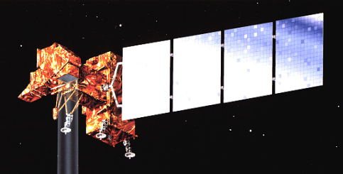
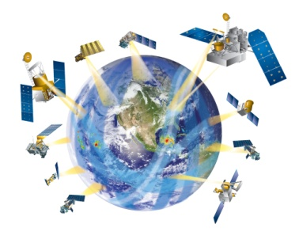
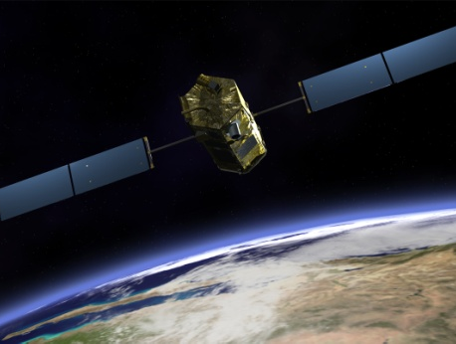
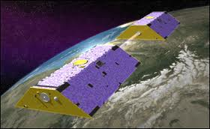
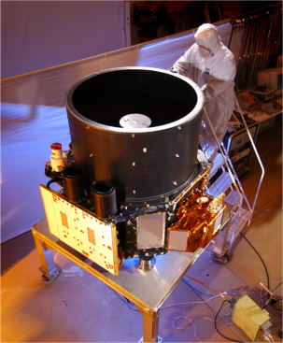
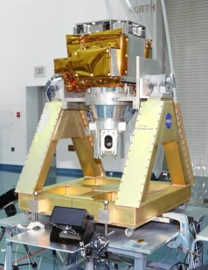

Near-Term Upcoming Systematic Missions – 3/2012
LDCM
1/2013
w/USGS; TIRS
GPM
2/2014
w/ JAXA; Precip
OCO-2
2014
Global CO₂
GRACE-FO
2017
w/DLR, GFZ (Germany)
Gravity, Ice, Grd. Water,
Climate
ICESat-II
January 2016
Ice Dynamics
SAGE-III on ISS
August 2014
w/HEOMD, ESA
Atmos. Profiles
SMAP
October 2014
w/CSA
Soil Moist., Frz/Thaw

Slide 21
VENTURE-CLASS UPDATE/STATUS
  Venture-Class is a Tier-I Decadal Survey recommendation
    Science-driven, PI-led, competitively selected, cost- and schedule-constrained, regularly solicited, orbital and suborbital
    Venture-class investigations complement the systematic missions identified in the Decadal Survey, and provide flexibility to accommodate scientific advances and new implementation approaches
  Venture-Class is fully funded, with 3 “strands”
    EV-1: suborbital/airborne investigations (5 years duration)
      Solicited in FY09 (selections in FY10) and every 4 years
      5 investigations selected; flights began in FY11
    EV-2: small complete missions (5 years duration)
      Solicited in FY11 (selections in FY12) and every 4 years
      Small-sat or stand-alone payload for MoO; $150M total development cost
      AO released 17 June, proposals received 29 Sept 2011, under review
    EV-Instrument: Spaceborne instruments for flight on MoO (5 years dev.)
      Solicited in FY11 (selections in CY12) and every 15-18 months thereafter
      Final AO release Feb 7; proposals due May 8, 2012 (Ken Jucks is POC)
      ~$90M development costs, accommodation costs budgeted separately
Notes:
21

Slide 22
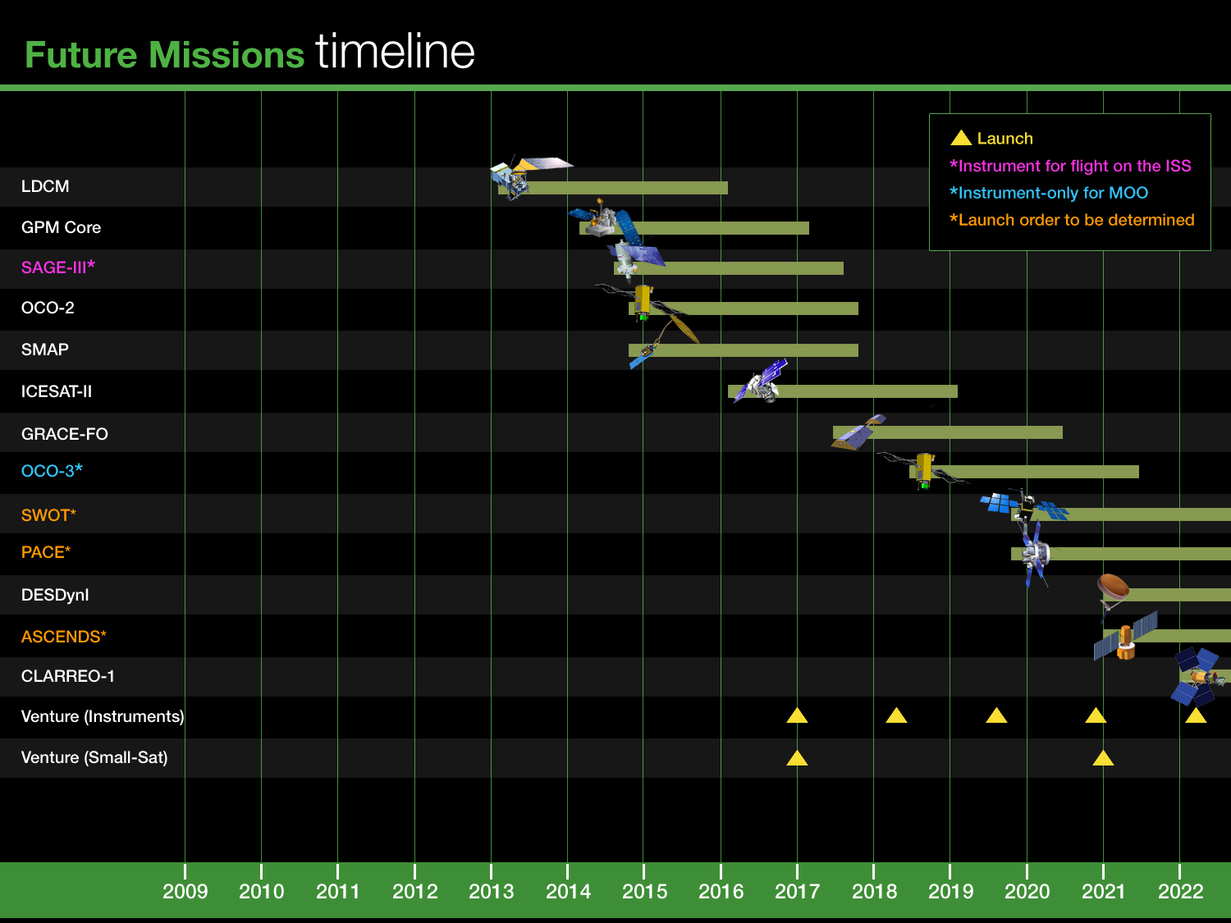

Slide 23
BACKUP

