Slide 1
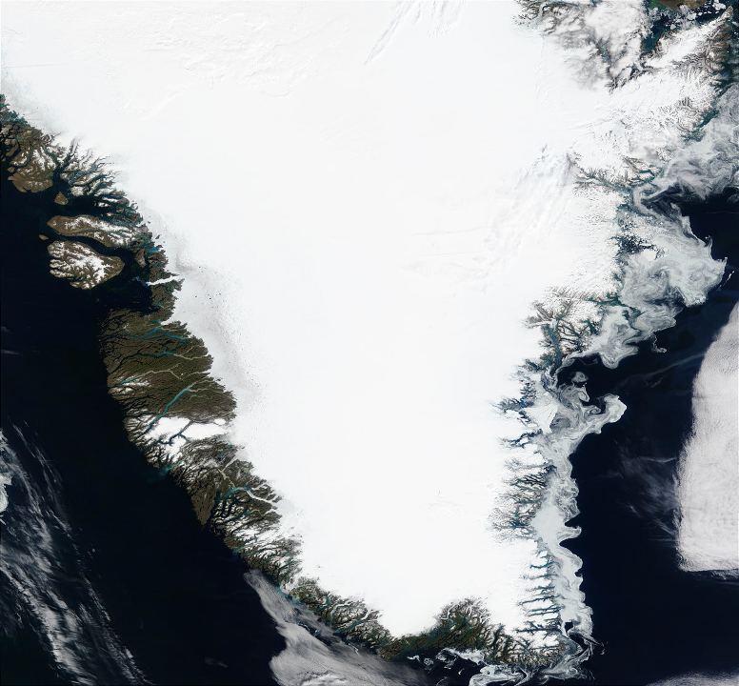
Surface Temperature and Melt on the Greenland Ice Sheet, 2000 – 2011
Dorothy K. Hall
Cryospheric Sciences Laboratory NASA / Goddard Space Flight Center Greenbelt, MD
Dorothy.K.Hall@ nasa.gov
MODIS Team Meeting
Silver Spring Civic Center, Silver Spring, Md.
8 May 2012

Slide 2
Collaborators
Josefino C. Comiso
Cryospheric Sciences Laboratory NASA / Goddard Space Flight Center, Greenbelt, Md.
Nicolo E. DiGirolamo
SSAI, Lanham, Md.
Christopher A. Shuman UMBC / JCET, Baltimore, Md.

Slide 3
Outline
Introduction to the Cryosphere
Climate warming at high latitudes
Greenland surface temperature and melt from MODIS

Slide 4
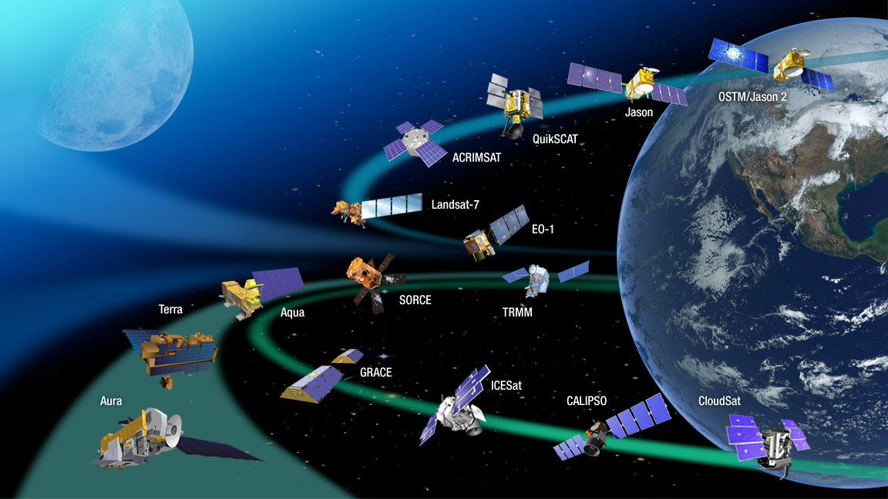
NASA’s Earth Observing System (EOS)
VIIRS
LDCM

Slide 5
The Cryosphere
Seasonal snow cover
Mountain glaciers
Ice sheets
Frozen lakes
Sea ice
Permafrost
North Pole
.
Greenland
United States
NASA Visible Earth

Slide 6
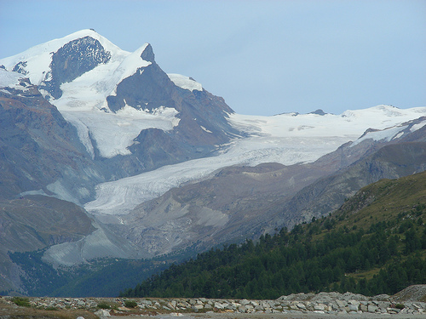
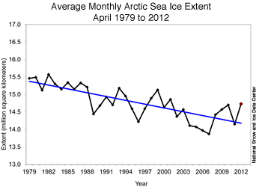
Evidence of Climate Warming has been Dramatic in the High Latitudes of the Northern Hemisphere
In the Northern Hemisphere there has been a decrease in:
Duration of lake ice over the last 150 years
Extent of sea ice since 1979
Extent of snow cover since 1966
Permafrost is warming and thawing in many areas
Small glaciers are shrinking (globally)
Melt on the Greenland Ice Sheet has been accelerating
Source: NSIDC
Klaus Thymann
Photo by Kimberly Casey/NASA

Slide 7
Seasonal Snow Cover

Slide 8
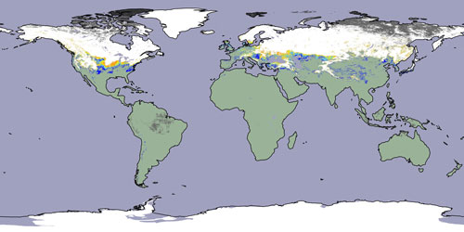
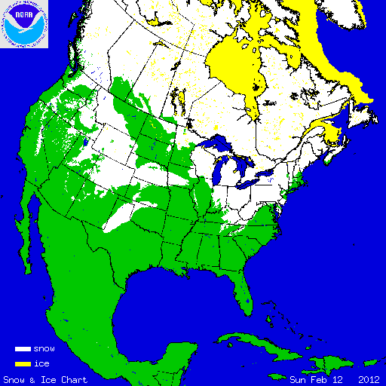
Satellite Snow-Cover Products
Feb. 2004
28 Dec. 2010
MODIS monthly snow-cover map
Northeastern U.S. MODIS swath fractional snow-cover map
National Ice Center (NIC) snow-cover map
IMS
12 Feb. 2012

Slide 9
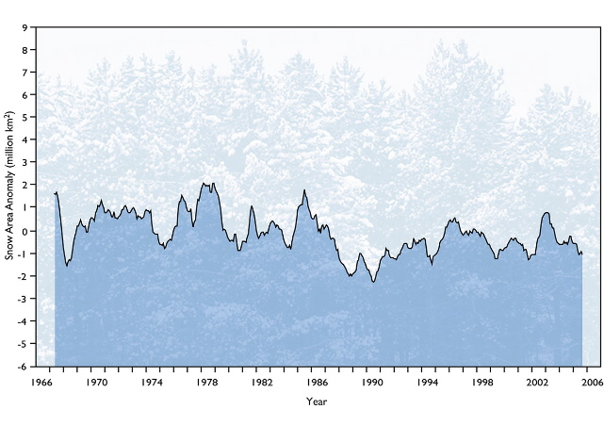
Northern Hemisphere Snow Cover Anomalies – Departure from 30-year Mean
Northern Hemisphere snow-cover record; snow cover extent has decreased by ~10% since the record began, mainly due to earlier melt of spring snow cover
Data courtesy Dave Robinson / Rutgers Univ.
Figure from Hall & Foster, 2007, Our Changing Planet, King et al. (eds.)

Slide 10
Snow-covered area derived from station data (before 1972) and NOAA satellite data (after 1972); the smooth curve shows decadal variations (updated from Brown, 2000)

Slide 11
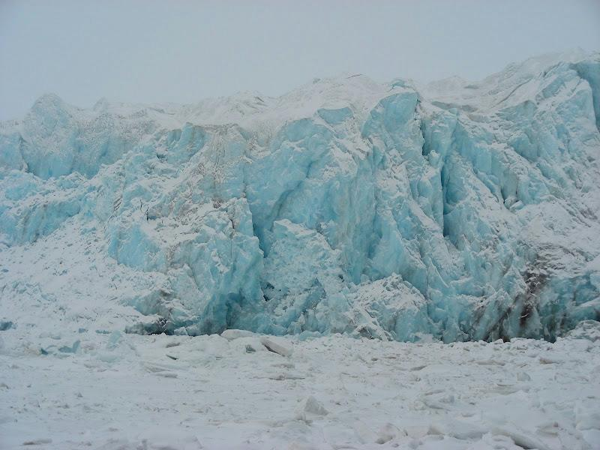
Small Glaciers and Ice Caps have been Shrinking
Globally, glaciers have been receding since ~1850; recession has accelerated in the last quarter century
Photo by Kimberly Casey/NASA

Slide 12
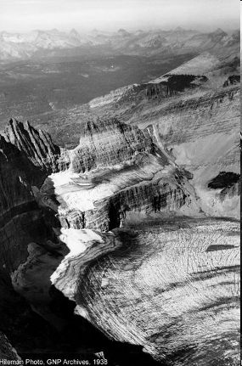
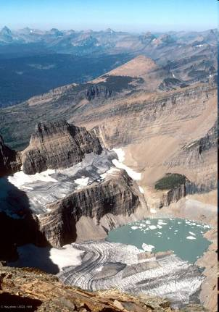
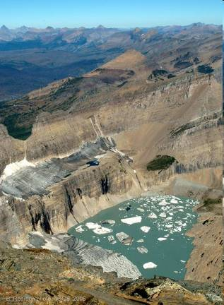
Glacier National Park, Montana Grinnell Glacier Recession*
1938 1981 2005
Salamander Glacier
T.J. Hileman Carl Key (USGS) Blase Reardon (USGS)
Since 1900 there has been an increase of ~1°C average summer temperature
*Not all of the glaciers in GNP are retreating at this high rate

Slide 13
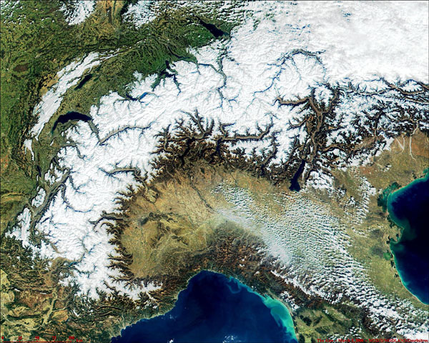
The European Alps
50% loss of glacier volume from ~1850 to 1975, another 25% between 1975 to 2000; an additional 10 – 15% from 2000 to 2005

Slide 14
Historical Length Variations of the Pasterze Glacier, Austria
Landsat era
From Zhuo and Oerlemans (1997)

Slide 15
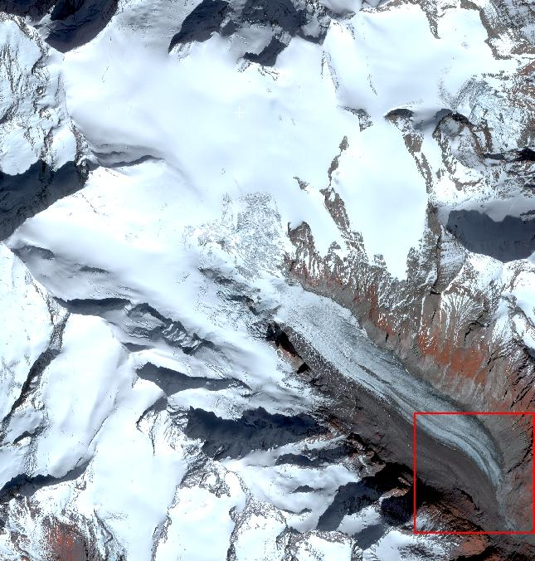
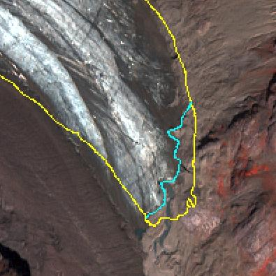
4-m resolution Ikonos image of the Pasterze Glacier in 2001
2000
2001
22,096±46m² decrease in area of the terminus
From Hall et al., 2003

Slide 16
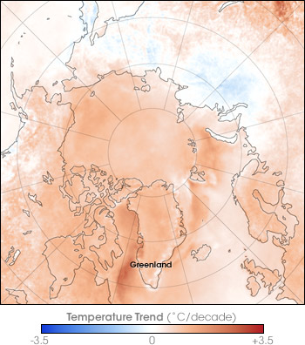
AVHRR IR satellite observations show Arctic warming
The surface temperature of the Arctic above 60°N has been increasing at an average of ~0.72 ± 0.20°C per decade, from 1981 to 2007
(updated from Comiso, 2006)
http://visibleearth.nasa.gov

Slide 17
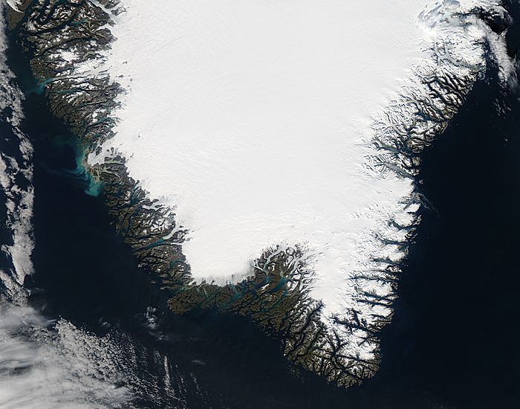
Greenland
Largest island on Earth (81% covered by ice)
Ice sheet is 1.7 million sq km
in area or 2.6 cubic km in volume
September 26, 2011 - Southern Greenland
MODIS Rapid Response Team – image of the day
Notes:
17

Slide 18
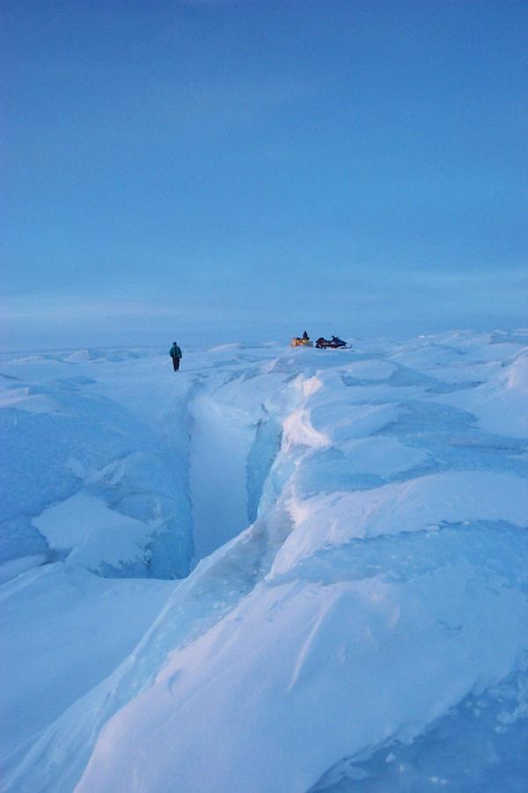
About 19 Washington Monuments would fit into the Greenland Ice Sheet at its thickest part
Contains ~8% of all of the Earth’s fresh water
The ice sheet has a maximum thickness of ~3.3 km (2 mi.)
Photograph by Jason Box / OSU

Slide 19
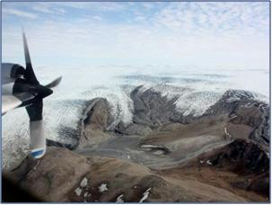
Photo credit: K. Hansen
Airborne Topographic Mapper (ATM) and ICESat laser altimetry data show greater thinning at the margins of the Greenland Ice Sheet (Krabill et al., 1999), below ~2000 m in elevation
Rate of thinning at margins has increased from increased melting and acceleration of outlet glaciers (Zwally et al., 2011)
ICESat satellite

Slide 20
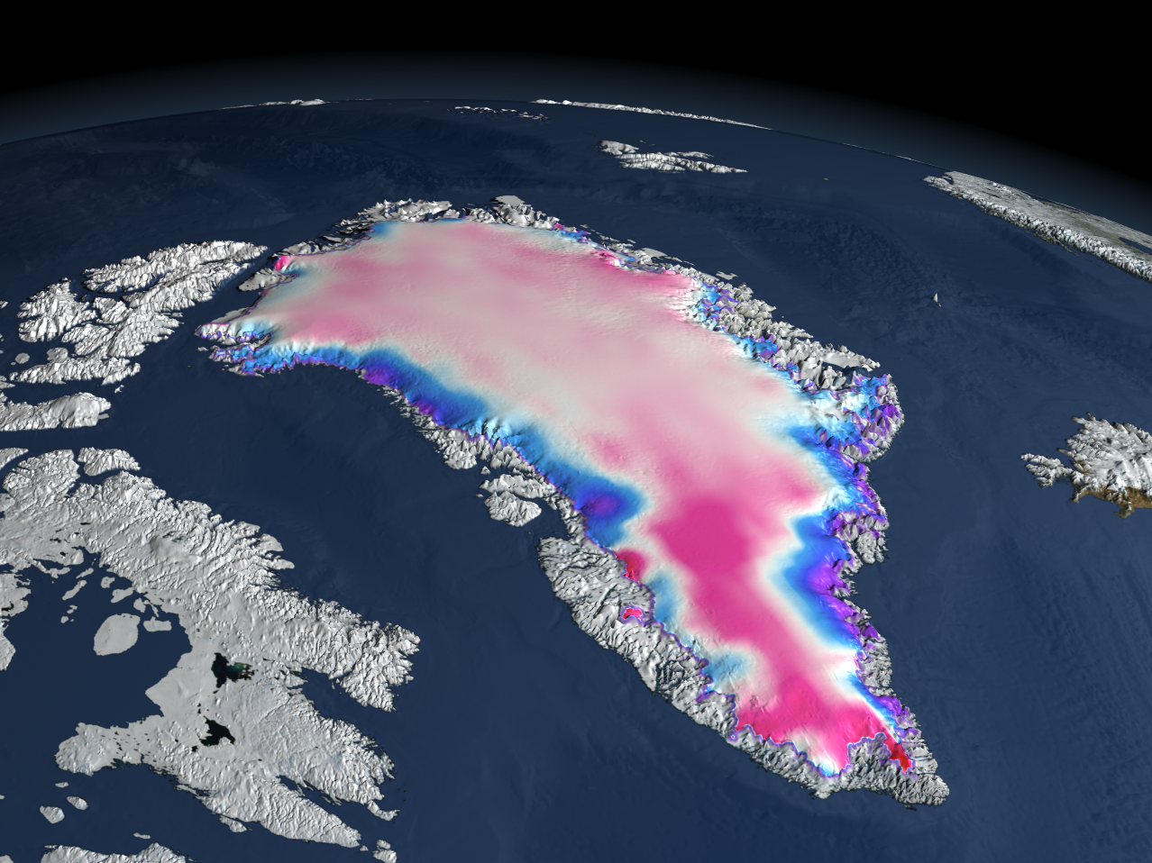
ICESat – Derived Changes in the Elevation of the Greenland Ice Sheet between 2003 and 2006
Increased melting and faster glacier flow lowered the surface along the margins of the ice sheet (blue), while increased snowfall thickened the ice in the interior of Greenland (pink)
http://icesat.gsfc.nasa.gov/

Slide 21
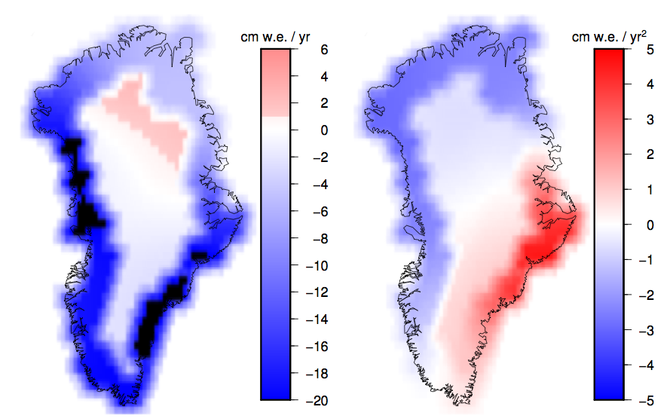
Increases in mass loss of the Greenland Ice Sheet have been documented in recent years using GRACE* satellite data
From 2002 to the present, GRACE gravimetry data show mass loss below 2000 m elevation, and no change (or slight gain in mass) above 2000 m
Figure courtesy of Scott Luthcke NASA/GSFC
No data
*Gravity Recovery & Climate Experiment

Slide 22
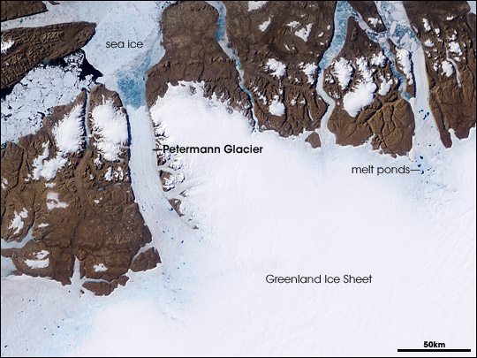
Glaciers, such as the Petermann Glacier along the island’s northern margin, drain the interior, returning this water to the sea as icebergs. Meltwater can accelerate the flow of a glacier by lubricating the underside as it scrapes over the rocky terrain. Despite Greenland’s remoteness, large-scale changes to the island’s ice sheet will have global influence. (NASA image by Jesse Allen and Robert Simmon.)
Emanating from the periphery of the ice sheet are many smaller ice streams and outlet glaciers that drain the main ice sheet and release icebergs into the ocean
MODIS image 5 July 2003
Earth Observatory

Slide 23
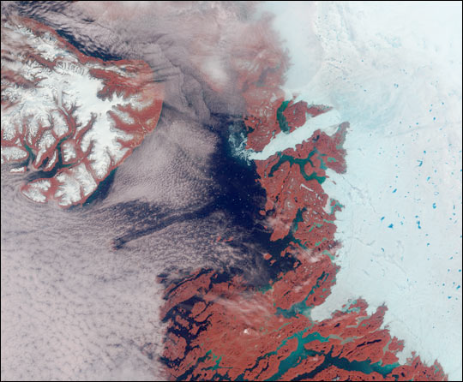
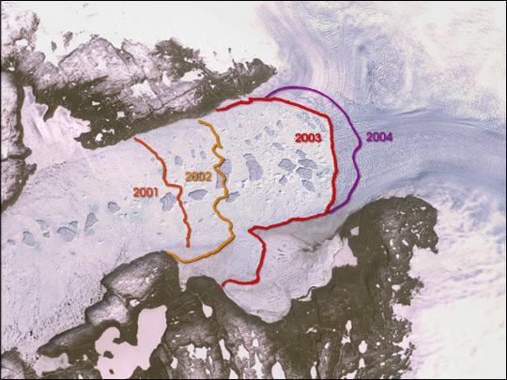
Retreat of Jakobshavn Glacier, SW Greenland
18 June 2003 MISR image from NASA/Earth Observatory
http://earthobservatory.nasa.gov/IOTD/view.php?id=5086
NASA/USGS image courtesy of the Science Visualization Studio, at GSFC

Slide 24
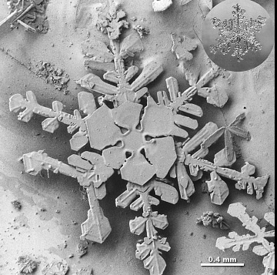
Surface Temperature and Melt
To monitor trends in surface temperature and melt extent on the Greenland Ice Sheet
To establish the uncertainties of mapping ice-surface temperature (IST) and surface melt extent from space

Slide 25
Ice Sheet Surface Temperature, or Ice-Surface Temperature (IST)
Surface temperatures are needed to
Estimate radiative fluxes;
For input to models to calculate the ice sheet contribution to sea-level rise;
Temperature is a physical quantity that can be compared directly with model results of skin temperature, conversely many different algorithms can be developed from the same passive- or active-MW data and they can provide different results;
Studies disagree on the amount and rate of warming, and increases in melt extent on the Greenland Ice Sheet – knowledge of IST can help reduce those uncertainties.

Slide 26
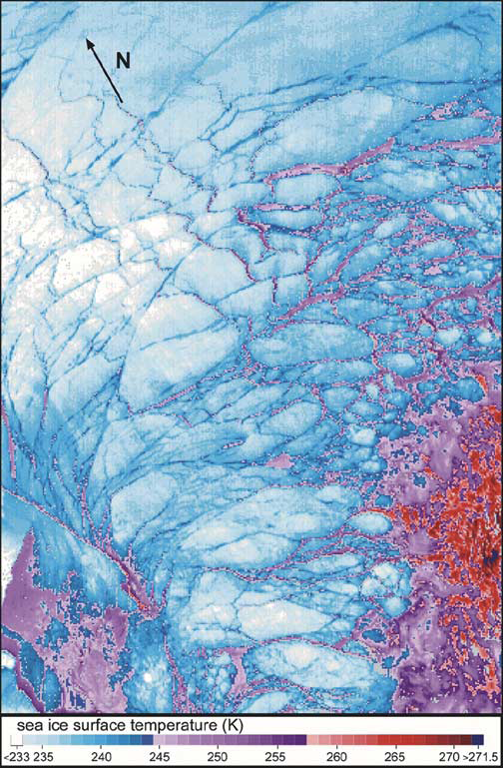
MOD29 Ice-Surface Temperature (IST)
MOD29 is the IST standard Terra MODIS data product
T_{s} = a + bT₁₁ + c(T₁₁ – T₁₂) + d [(T₁₁ – T₁₂) (sec θ – 1)]
Where T_{s} = surface temperature; T₁₁ and T₁₂ are satellite-measured surface temperatures in MODIS bands 31(11µm) and 32 (12 µm); θ is sensor scan angle and a, b, c & d are regression coefficients. Increased difference between bands 31 & 32 is related to atmospheric attenuation (Hall et al., 2004).
This “split-window” technique is based on the Key & Haefliger (1992) and Key et al. (1997) algorithm developed for the AVHRR, but uses different coefficients for MODIS
±1-4K accuracy (Hall et al., 2004 & Koenig and Hall, 2010)
MOD29 ice-surface temperature map of sea ice in the Arctic Ocean

Slide 27
MODIS:
Land-Surface Temperature (LST), MOD11 or MYD11 (Wan et al., 2002)
Ice-Surface Temperature (IST), MOD29 or MYD29 (based on Key et al., 1997 algorithm initially developed for use with AVHRR)
Algorithms are similar and results compare well under winter conditions, but can diverge during the summer over the ice sheet.

Slide 29
MODIS Ice-Surface Temperature (IST) Environmental Science Data Record (ESDR)
Developed an IST ESDR of the Greenland Ice Sheet using MODIS Terra and Aqua data,
Daily and monthly maps (downloadable online at: http://modis-snow-ice.gsfc.nasa.gov/)
6.25-km spatial resolution
Uncertainty information in each grid cell
Suitable for continuation using the Visible/Infrared Imager Radiometer Suite (VIIRS)
Studied 12-yr trends in surface temperature and melt extent, and compared with other data

Slide 30
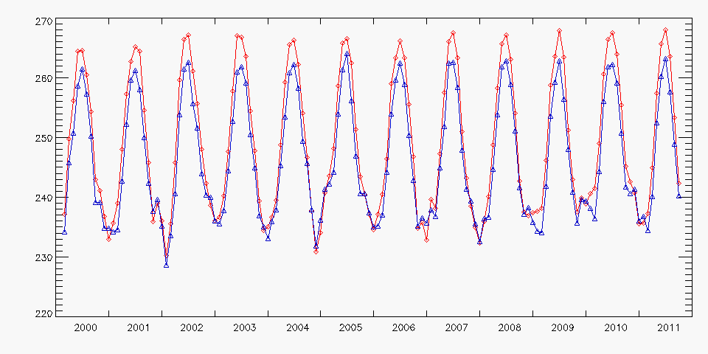
Can compare MODIS IST directly with model-derived ice sheet surface skin temperatures
Mean-Monthly Surface Temperature ( K)
MODIS IST
MERRA surface skin temperature
Used MERRA301.prod.assim.tavgM_2d_rad_Nx -- surface skin temperature

Slide 31
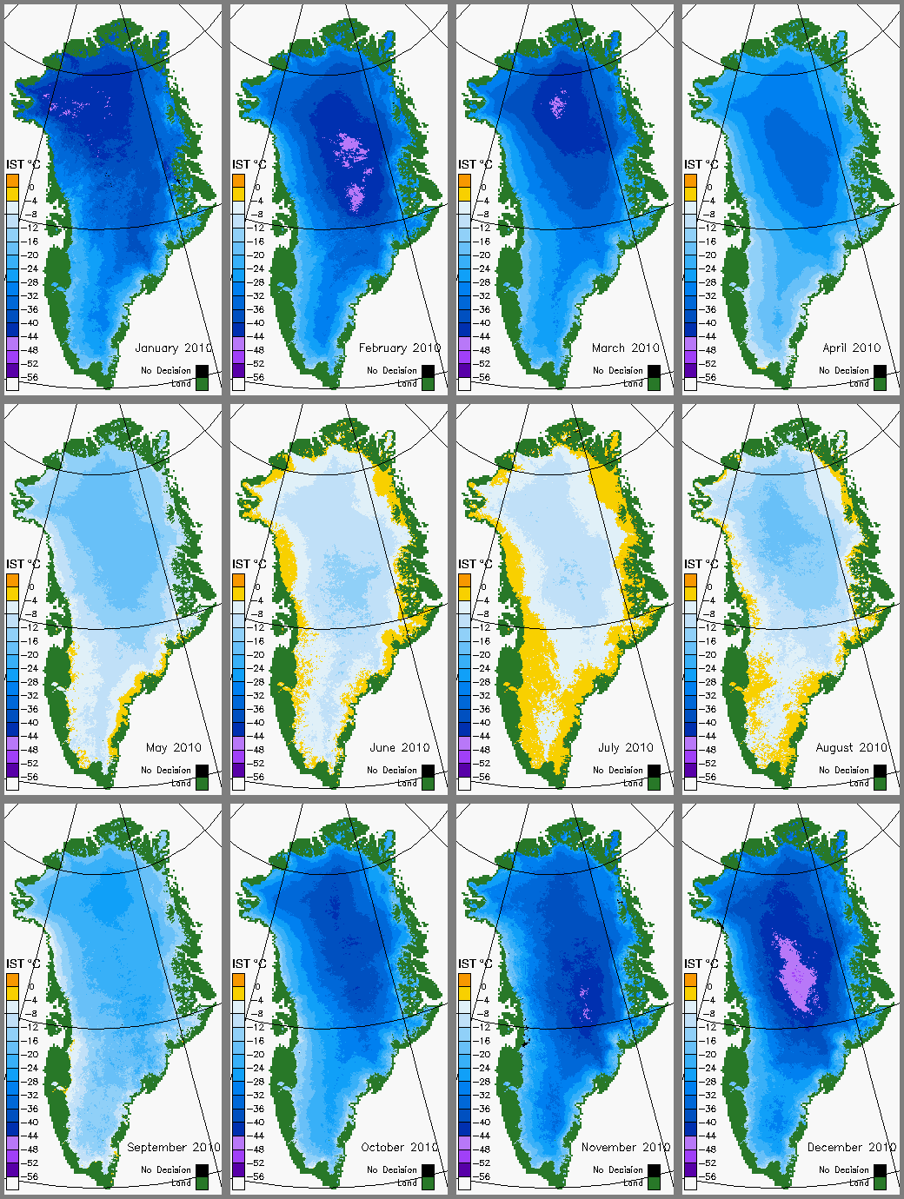
Monthly-mean MODIS ice-surface temperature (IST) color-coded maps for 2010
Jan
Feb
Mar
Apr
IST cannot be acquired through cloud cover
May
Jun
Jul
Aug
Hall, D.K., J.C. Comiso, N.E. DiGirolamo, C.A. Shuman, J.R. Key and L.S. Koenig, 2012: A Satellite-Derived Climate-Quality Data Record of the Clear-Sky Surface Temperature of the Greenland Ice Sheet, Journal of Climate.
Sep
Oct
Nov
Dec
http://modis-snow-ice.gsfc.nasa.gov

Slide 32
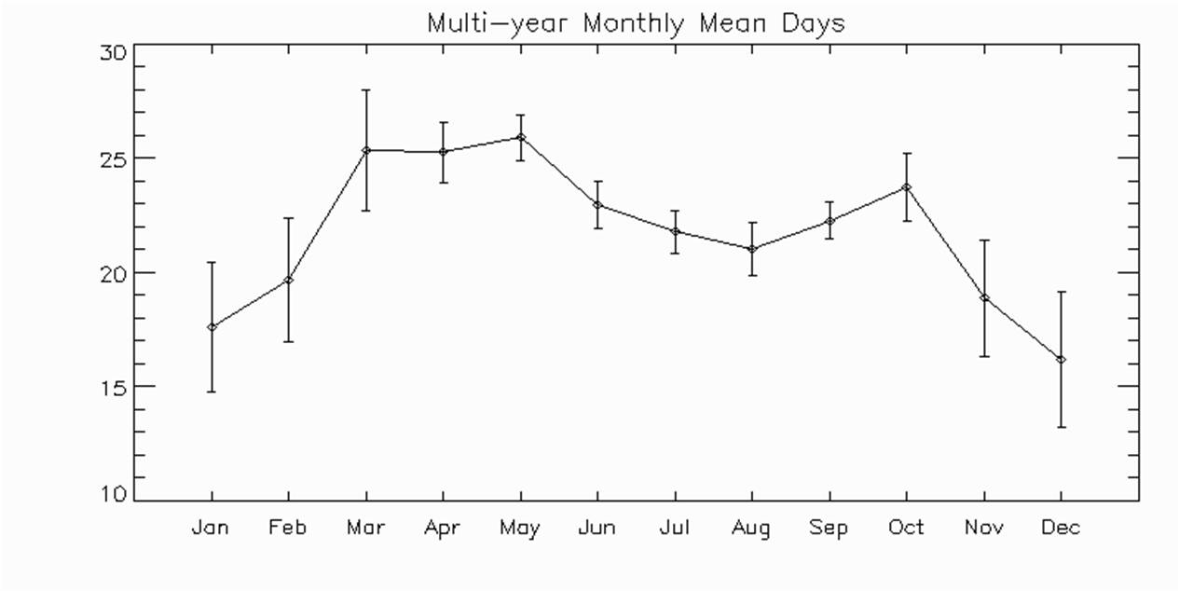
Coverage of Monthly-Mean IST Maps
January 2010 IST
Coverage
April 2010 IST
Coverage
Number of Days
Cloudcover is lowest in the spring (MAM)
Average number of days (2000 – 2010) available to create the monthly-mean IST maps by month
Hall et al., 2012, JCLIM

Slide 33
Comparison of MODIS IST and AWS near-surface air temperature
Summit Station 2003
AWS data supplied by J. Box/OSU
Air temperature is not the same as surface temperature, especially over ice

Slide 34
AWS data supplied by J. Box/OSU

Slide 35
Comparison of MODIS IST and AWS near-surface air temperature
NASA-SE Station – July 2003

Slide 36
12-Year Trends in Ice Surface Temperature and Melt
Because the record is short, the trends are not statistically significant and can change with each new data point

Slide 37
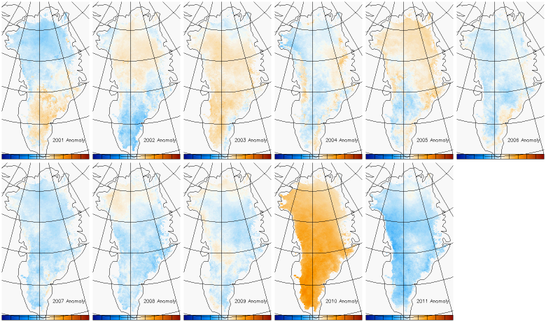
Annual MODIS IST Anomalies Based on 11-yr Record
2001
2002
2003
2004
2005
2006
Warmer (positive anomalies)
average
Cooler (negative anomalies)
2007
2008
2009
2010
2011

Slide 38
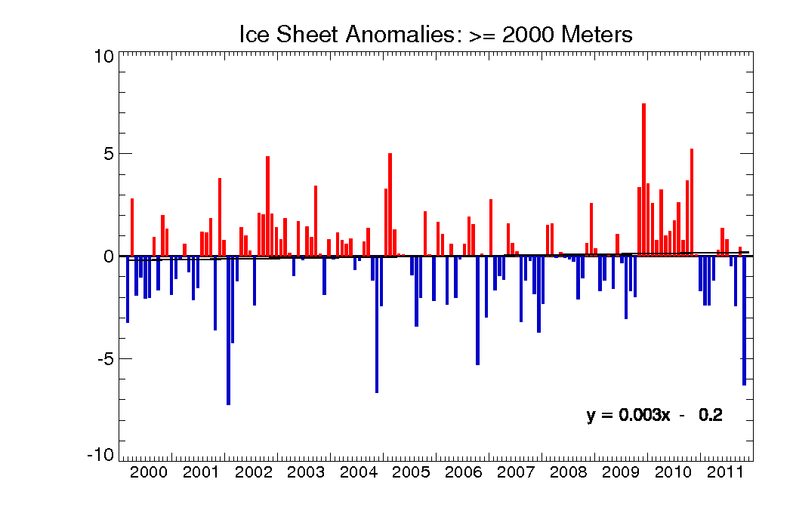
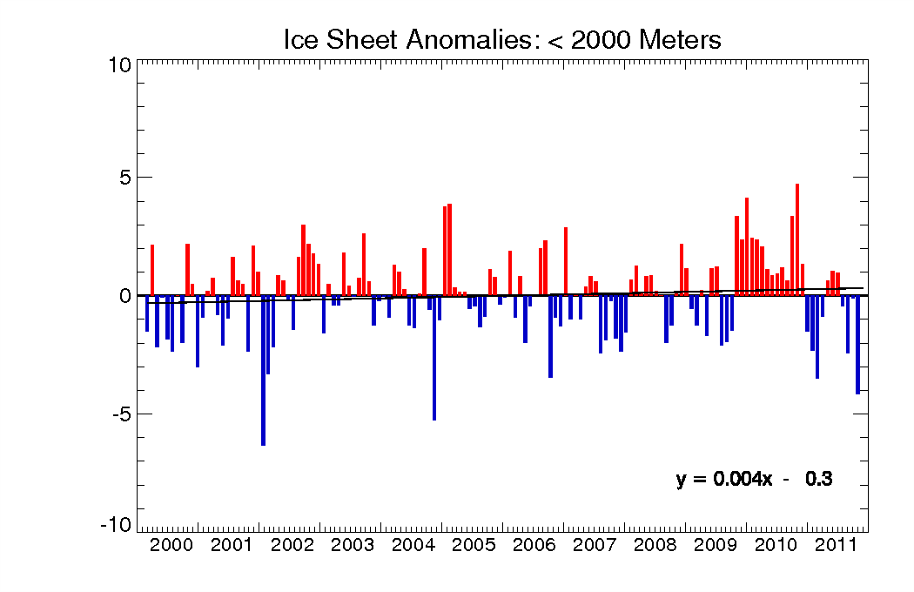
Above 2000 m
2010
IST Anomalies
IST Anomaly
°C
Trend = +0.36°C / decade
Below 2000 m
Greater IST increase below ~2000 m, consistent with ATM, ICESat and GRACE measurements showing greater mass loss below ~2000 m
Surface melt above ~1500 m is refrozen and retained (Humphrey et al., 2012), while melt below ~1500 m runs off, contributing to SLR
2010
IST Anomaly
°C
Trend = +0.48°C / decade

Slide 39
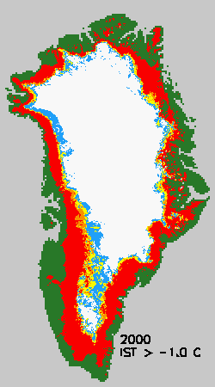
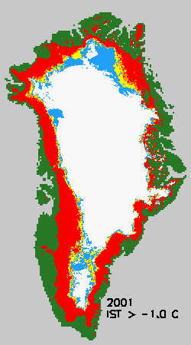
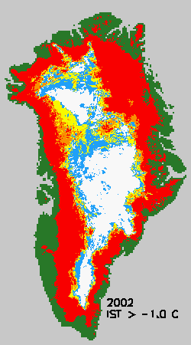
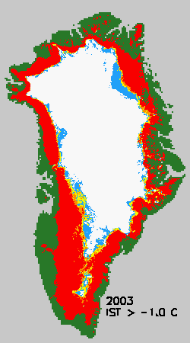
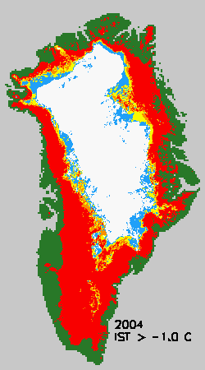
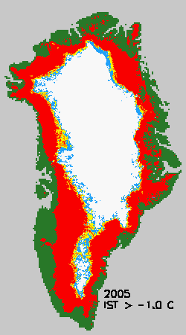
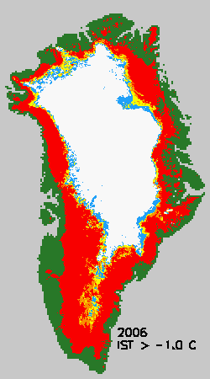
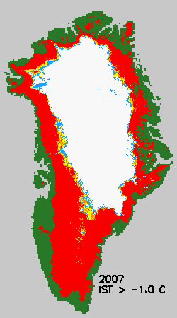
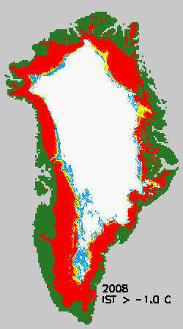
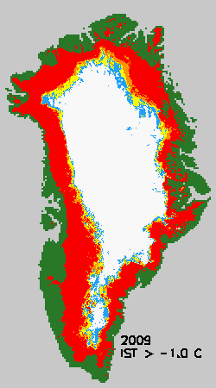
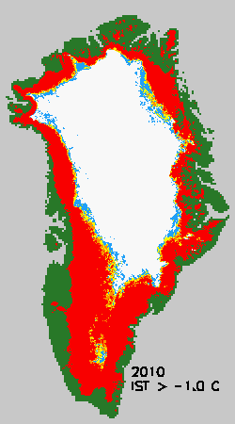
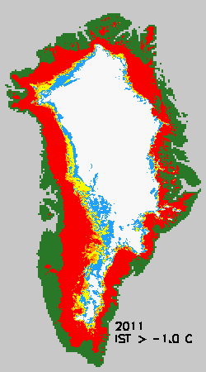
Maximum Melt Extent based on the MODIS IST ESDR, 2000 – 2011
Only 1 day of melt in the year
2 days of melt
3 days of melt in the year
4 or more days of melt

Slide 40
Maximum Melt Extent based on the MODIS IST ESDR, 2000 – 2011
Based on 4 or more days of melt (red on maps)
*Based on melt = IST>-1°C
Only 1 day of melt in the year
2 days of melt
3 days of melt in the year
4 or more days of melt

Slide 41
Satellite-Derived Melt Maps
Passive- and active-MW instruments detect surface and near-surface melt whereas IR instruments detect only surface melt;
Must resolve issues in measuring melt extent to provide ice sheet modelers with more accurate information.

Slide 42
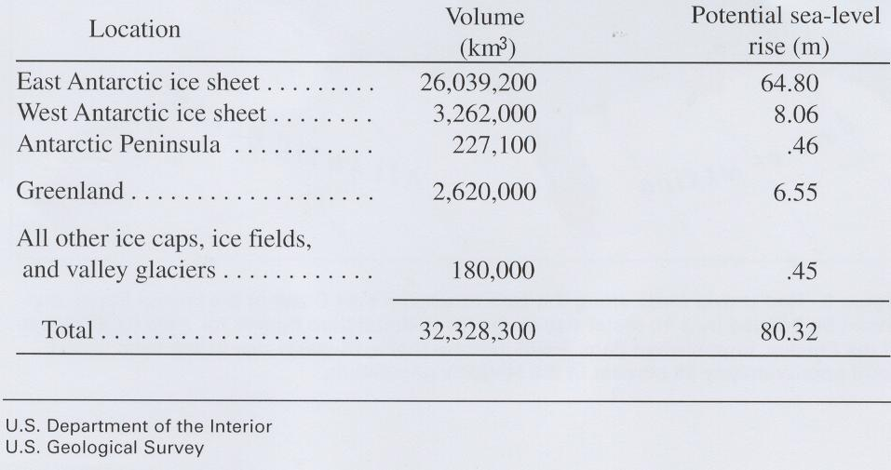
Estimated potential maximum sea level rise from the total melting of present-day glaciers
~7.2
After Williams and Hall, 1993
Notes:
42

Slide 43
Conclusions
Changes in Arctic sea ice, duration of ice cover on lakes, mountain glaciers, snow cover, permafrost and the Greenland Ice Sheet have been observed;
ATM, ICESat and GRACE measurements show mass loss of the Greenland Ice Sheet below ~2000 m in elevation;
A consistent pattern of ice sheet warming and increasing melt extent has been observed with different instruments, though the magnitude of changes differs;
IST can validate skin-temperature output of models, and as input to ice dynamics models, to improve accuracy of ice sheet mass balance and SLR estimates.

