Slide 1
MODIS global burned area product: Status and future developments
Luigi Boschetti, David Roy,
Chris Justice, Steve Stehman and Louis Giglio

Slide 2
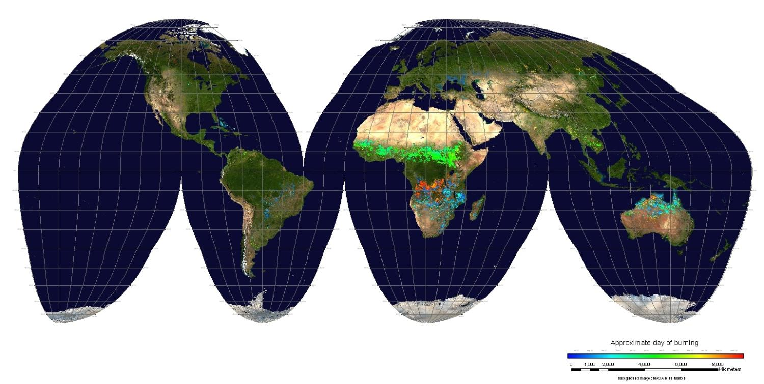
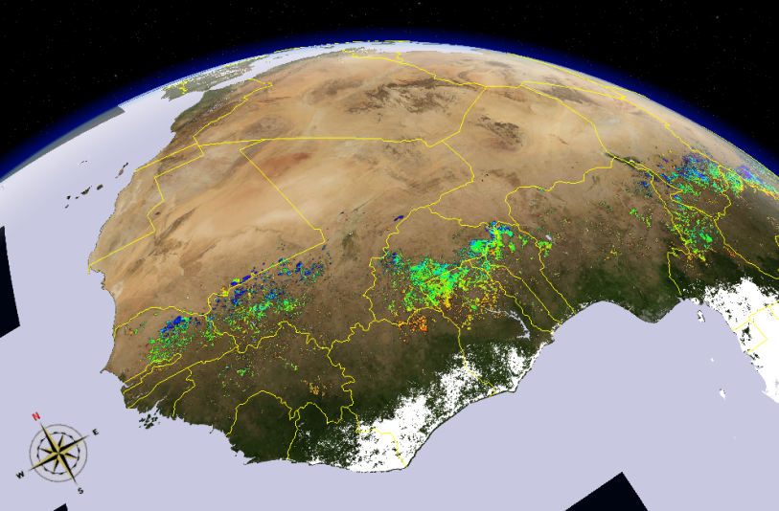
Current version is C5
first global run of the product
run on purpose with conservative thresholds

Slide 3
Collection 5.1
First reprocessing of the product, using C5 inputs
Reprocessing complete, planned to replace C5 as soon as QA is completed
Addresses know issues which caused omission errors in savannah and forest environment, through minor changes to the algorithm (mostly changes in thresholds and spectral tests):
Know issue solved in the handling of thermal data
Band 6 is no longer used
Makes use of the C5.1 500m MCD12Q1 (yearly product), instead of the static C4 1km MOD12Q1 used in C5. The use of MCD12Q1 is mostly limited to the identification of agricultural areas.
Burning in Agricultural areas remains unreliable, partially due to the lack of independent data for calibration and validation
Agricultural detections are assigned a special QA code (5), and users are advised about the unreliability
Change in output structure, replacing two bit-packed SDSs with four regular SDSs. The space savings due to the use of bit-packed SDSs are negligible after the introduction of internal compression, and they are far outweighed by the ease of access for the users.

Slide 4
Examples of Improvements
C5 – 2004275, h30v11
C51

Slide 5
Examples of Improvements
C5 – 2006152, h21v04
C51

Slide 6
Examples of Improvements
C5 – 2003182, h17v05
C51

Slide 7
Collection 6 plans
Significant changes to the algorithm, with a major redesign of the approach
Integration of the BRDF based product (MCD45) and the direct broadcast product (MCD64):
The two approaches have complementary characteristics, and the two outputs will be integrated
Expected reduction of the no-data areas
Use of active fire information (used for the generation of MCD64)
Prototype to be delivered by early summer
Production to start in early Fall

