Slide 1

MODIS Science Team Meeting
Silver Spring, MD - April 15-16, 2013
MODIS VI Product Suite Status
From C5 to C6
Kamel Didan & Armando Barreto
Work inherited from Alfredo Huete and Kamel Didan
The University of Arizona

Slide 2
Outline
VIs
C5 approach
C6 approach
C6 Tests Evaluation
PI SCF Work
  MODIS VI Error Analysis
Conclusions
MODIS Science Team Meeting - Silver Spring, MD. April 15-16, 2013

Slide 3
Background
Vegetation makes up most of the Earth land cover and plays a key role in the biosphere and atmosphere functioning
Vegetation Indices : Not a physical parameters, but can proxy a long list of physical/biophysical parameters (LAI, fPAR, GPP, LC, Biomass, etc…)
  NDVI : Strong history (Google : 70+K pubs, 100K+ of users, 1.1 M hits in Google). Plus historical value of AVHRR (30+ yrs)
  EVI an improved/enhanced version that with strong correlation with biomass/Carbon, structure, less background noise
  Requires backward compatibility - EVI2 (2 bands only)
The value of the Vegetation index data record (30+) to science and research is supported by:
  Science claims based on these data record, applications, Ease of access and use, and consistent reliability, no assumption about observations (TOC, TOA, etc…). Can derive Land Surface Phenology (or growing season characterization) from VI data. An excellent Integrator of climate impact and a barometer of change
MODIS Science Team Meeting - Silver Spring, MD. April 15-16, 2013

Slide 4
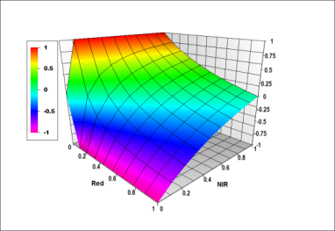
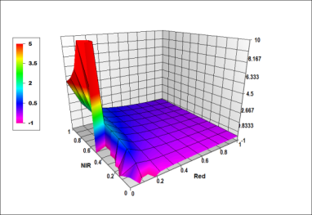
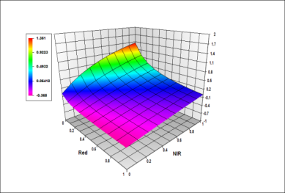
Vegetation Indices
NDVI – Widely used but has some issues
EVI – A complimentary Index that works better over dense canopies/vegetation and addresses background noise
  But requires the blue band (not available sometimes), and when available has a poor S/N ratio
  EVI has also some issues:
    Small dynamic range
    Poor performance over areas with residual cloud, sub-pixel snow, and due to blue band noise (prone to noise)
NDVI EVI (b~0.2) EVI (b~0.02)
MODIS Science Team Meeting - Silver Spring, MD. April 15-16, 2013

Slide 5
Our approach to generating consistent VI data records
C2, C3, C4, and currently C5 (Limit changes to necessary and consistency drives the change)
  Improved compositing: Not only simple MVC (prone to noise and disadvantageous to EVI). Introduced a simple and effective QA driven Compositing scheme:
    Eliminates poor quality data first (since most methods are blind to poor data)
    MVC is the last step
  From Collection to Collection we kept changes consistent and aimed at converging towards a stable product suite, irrespective of input related errors and uncertainty (consistency only). We learned many lessons:
    We learned that QA is key to compositing because MVC performs poorly when poor quality data is not filtered (show example of EVI over cloud and Snow/Ice/Thick Aerosols)
    We also learned that the MODIS observations are stored in a rather peculiar fashion making them not fully representative of the grid (percent cover that changes from orbit to orbit)
    Addressed this by reconstructing the pixel/grid value from all available observations (weighing scheme)
  Introduced a simpler user friendly approach to QA via the “Pixel reliability”, a simple measure of usefulness (No need for bit manipulation)
  VI Global Error and Uncertainty analysis shows a global input related error range of +/-5%
MODIS Science Team Meeting - Silver Spring, MD. April 15-16, 2013

Slide 6
C5 VI Algorithm
MODIS Science Team Meeting - Silver Spring, MD. April 15-16, 2013

Slide 7
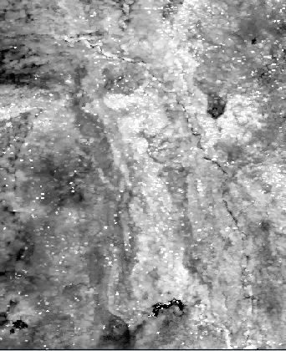
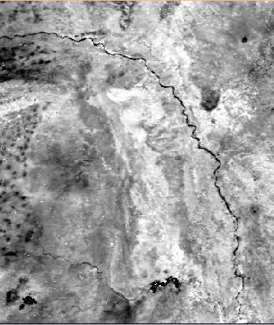
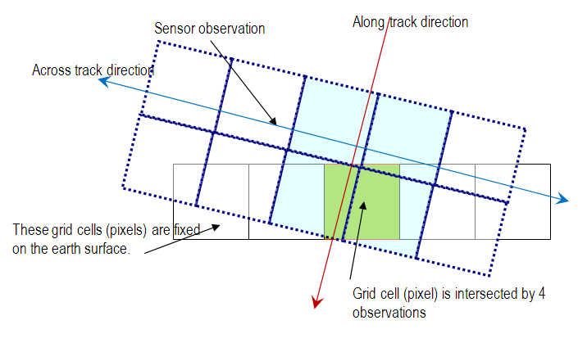
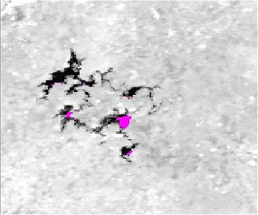
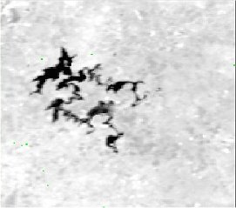
Observation coverage issue
Using only the observation
with highest overlap/cover
Reconstructing a new value
from all observations
MODIS Science Team Meeting - Silver Spring, MD. April 15-16, 2013

Slide 8
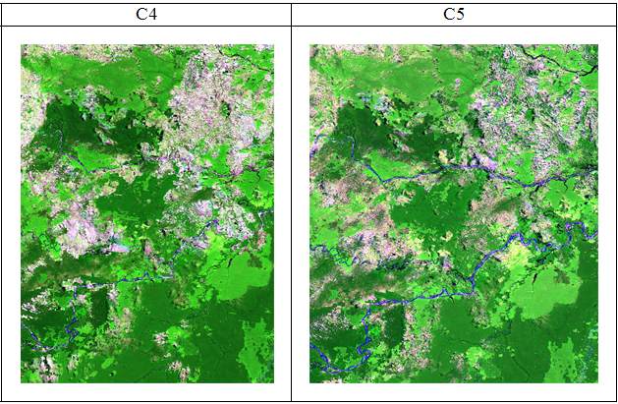
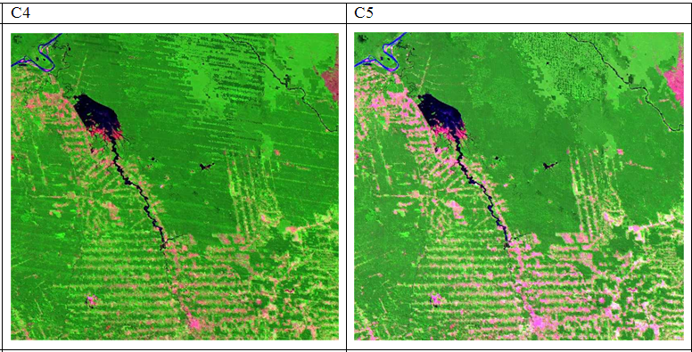
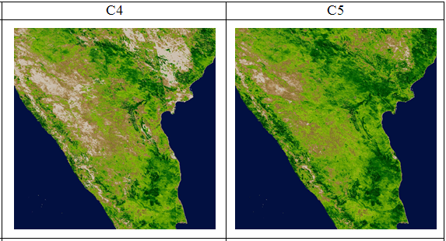
Convergence towards a consistent product suite
This is key to good science
MODIS Science Team Meeting - Silver Spring, MD. April 15-16, 2013

Slide 9
Starting C6
The Algorithm changed hands due to funding and resources
MODAPS maintains the Algorithm code
  Started using a new method for compositing
  No longer QA based compositing (hallmark of MODIS VI suite, as it was very effective at eliminating poor data)
  Used minimum blue compositing (aimed at minimizing aerosol)
  VI started using a pre-composited 8-day surface reflectance as input (2x 8-Day)
PI-SCF effort focused on
  Error Analysis
  Creation of Value added VI Data Records
MODIS Science Team Meeting - Silver Spring, MD. April 15-16, 2013

Slide 10
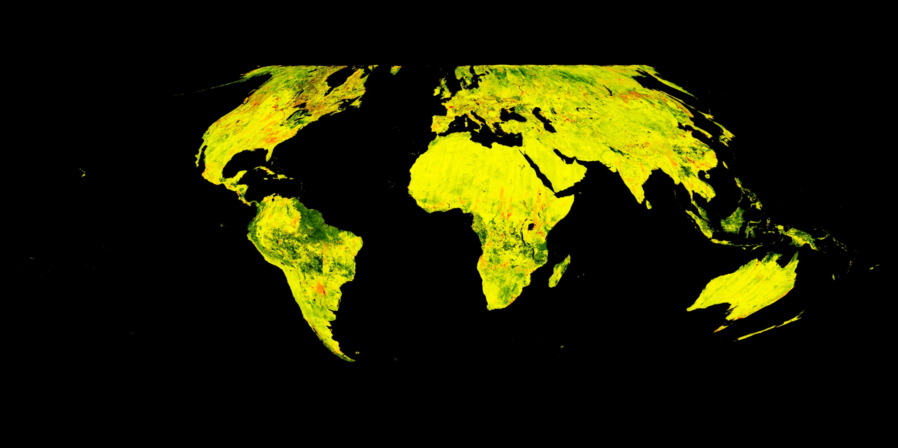
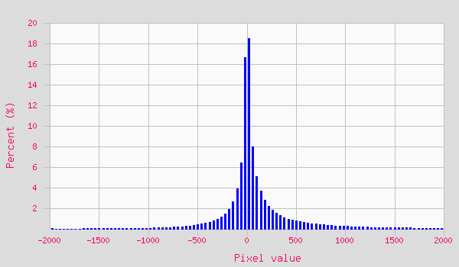

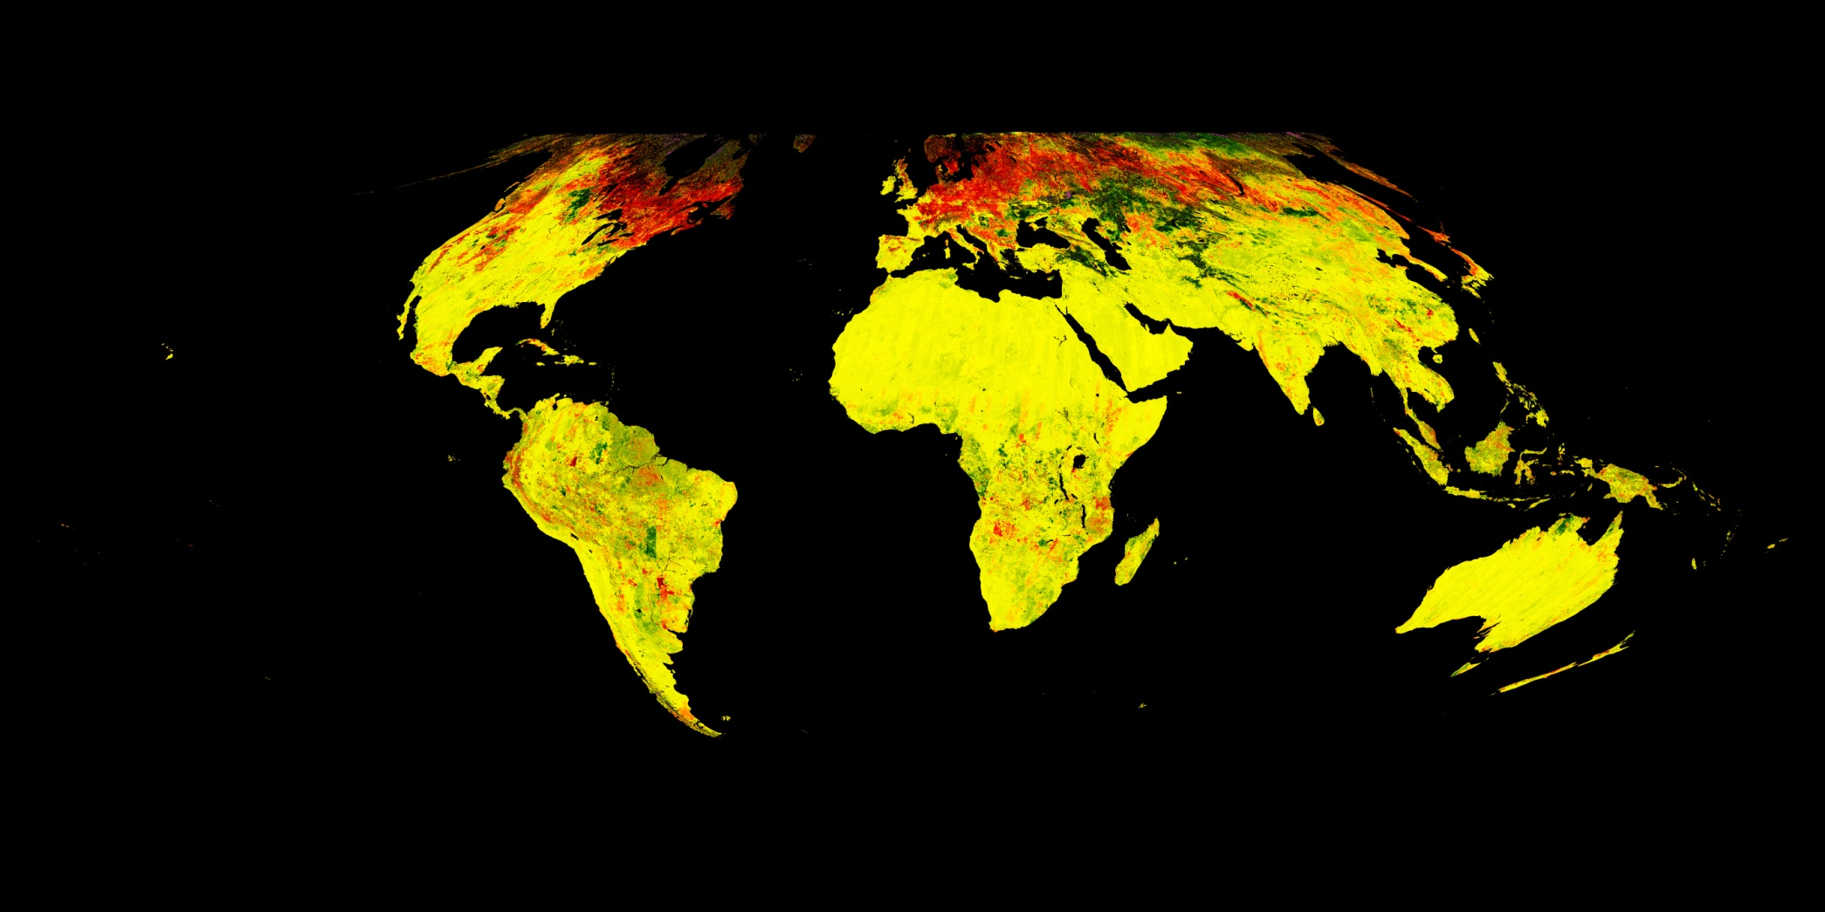
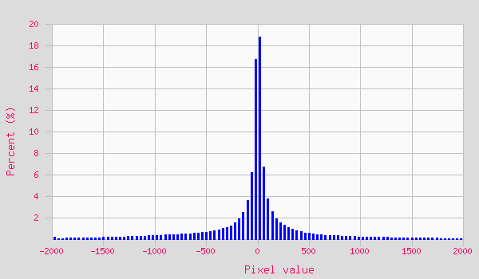
C6 Evaluation (Winter scene, 2003001)
Evaluation results based on [OLD-NEW]
Largest observed change (>+/-10%) over tropics and high latitude regions
NDVI and EVI changed differently
NDVI
Diff
EVI
Diff
MODIS Science Team Meeting - Silver Spring, MD. April 15-16, 2013

Slide 11
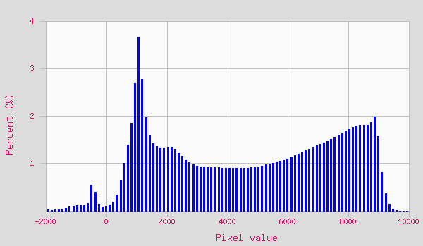
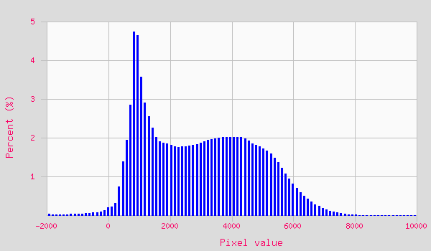
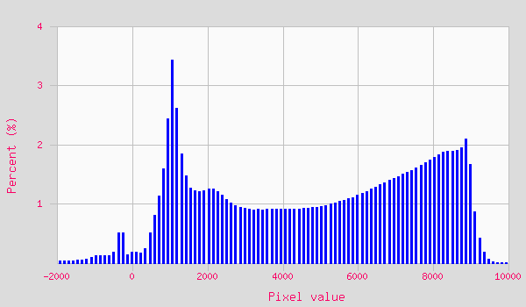
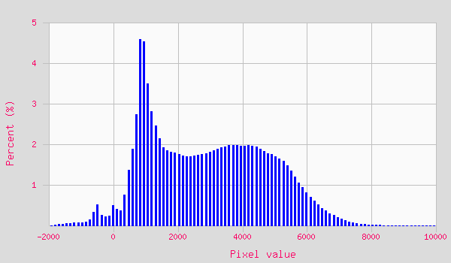
C6 VI Evaluation (Winter scene, 2003001)
VI Histogram distribution
NDVI EVI
New
Old
MODIS Science Team Meeting - Silver Spring, MD. April 15-16, 2013

Slide 12
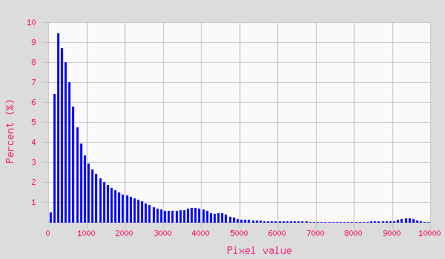
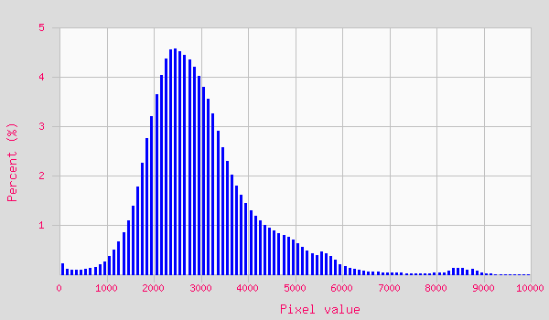
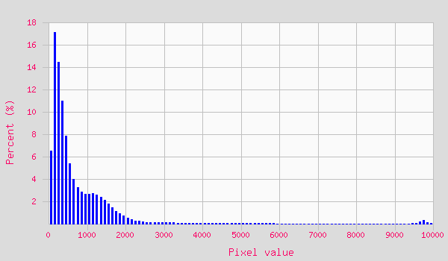
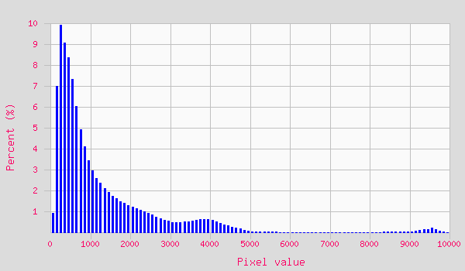
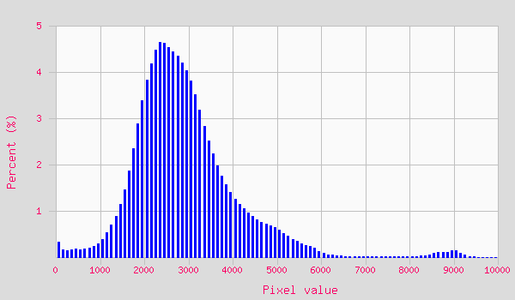
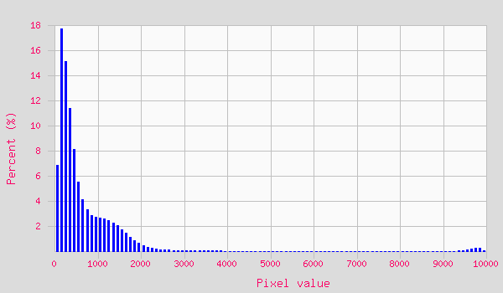
C6 LSR Evaluation (Winter scene, 2003001)
SR Histogram distribution
Red NIR Blue
New
Old
MODIS Science Team Meeting - Silver Spring, MD. April 15-16, 2013

Slide 13
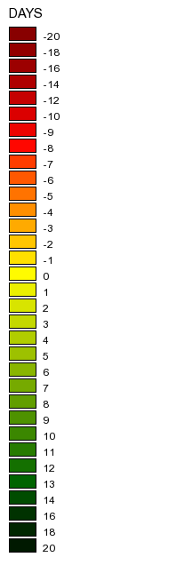
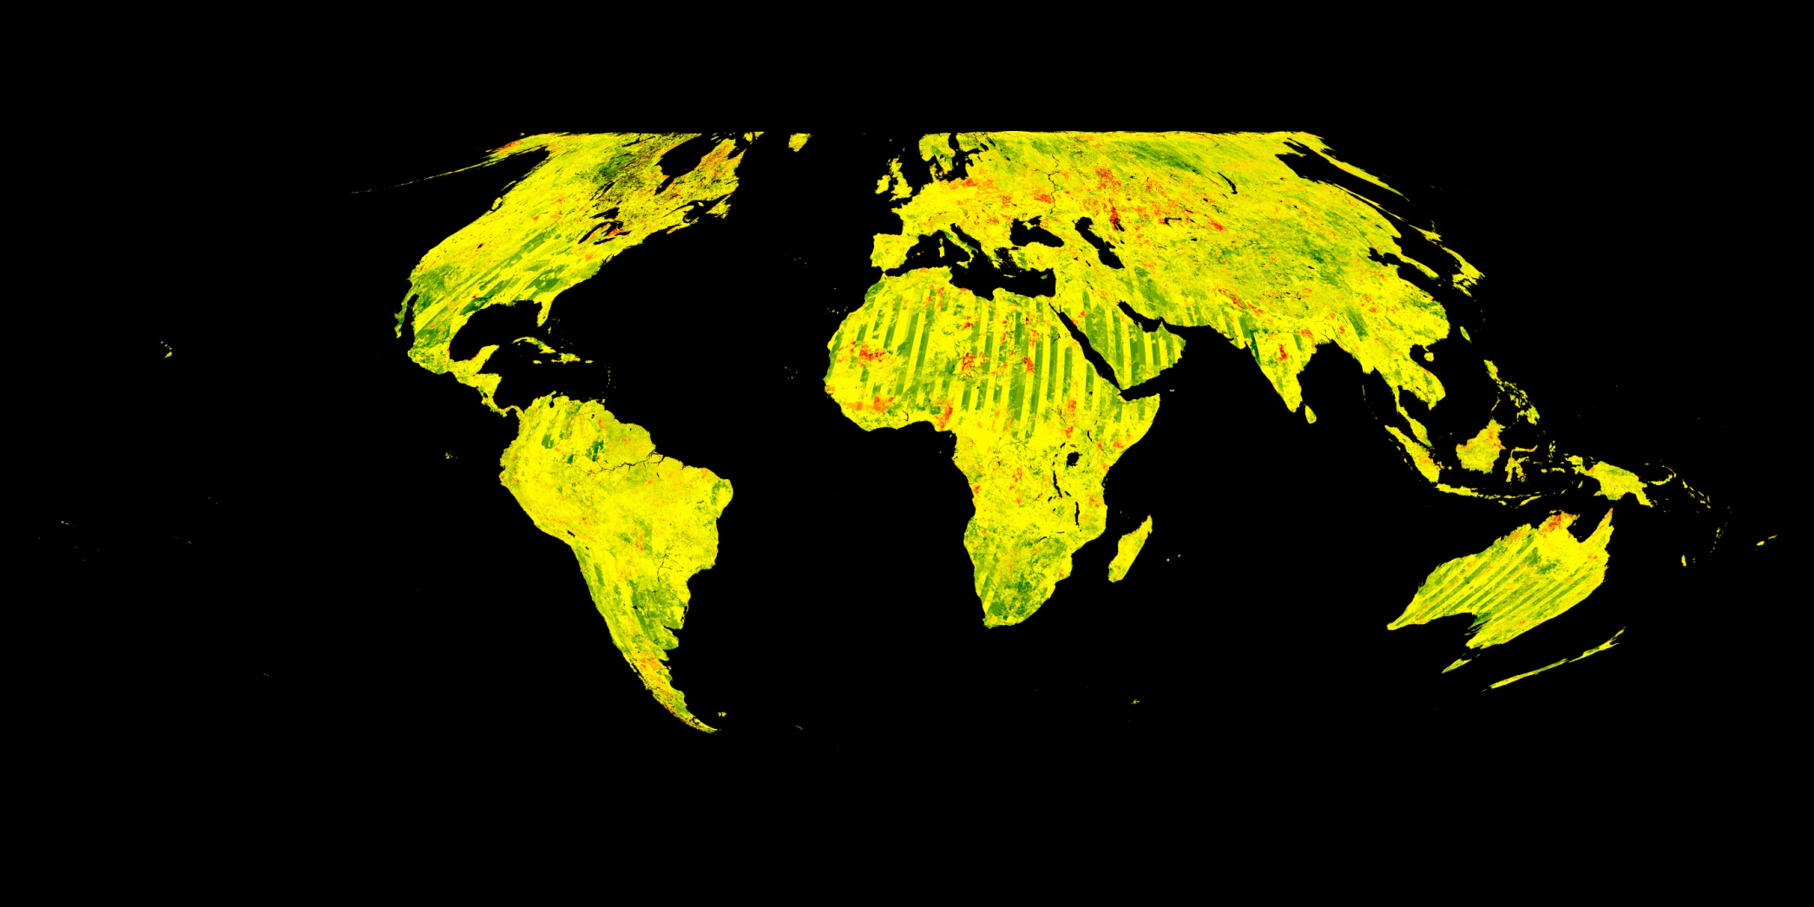
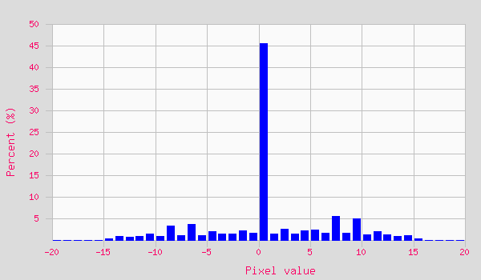
C6 Evaluation Composite DOY (Winter scene)
Slight shift to selection of earlier days
MODIS Science Team Meeting - Silver Spring, MD. April 15-16, 2013

Slide 14
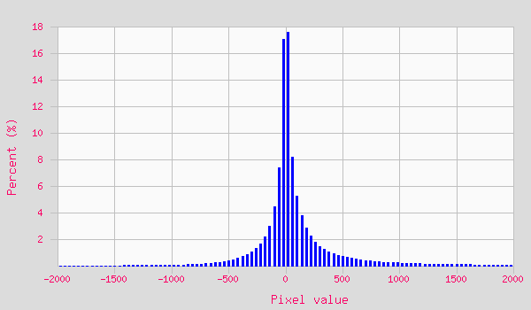
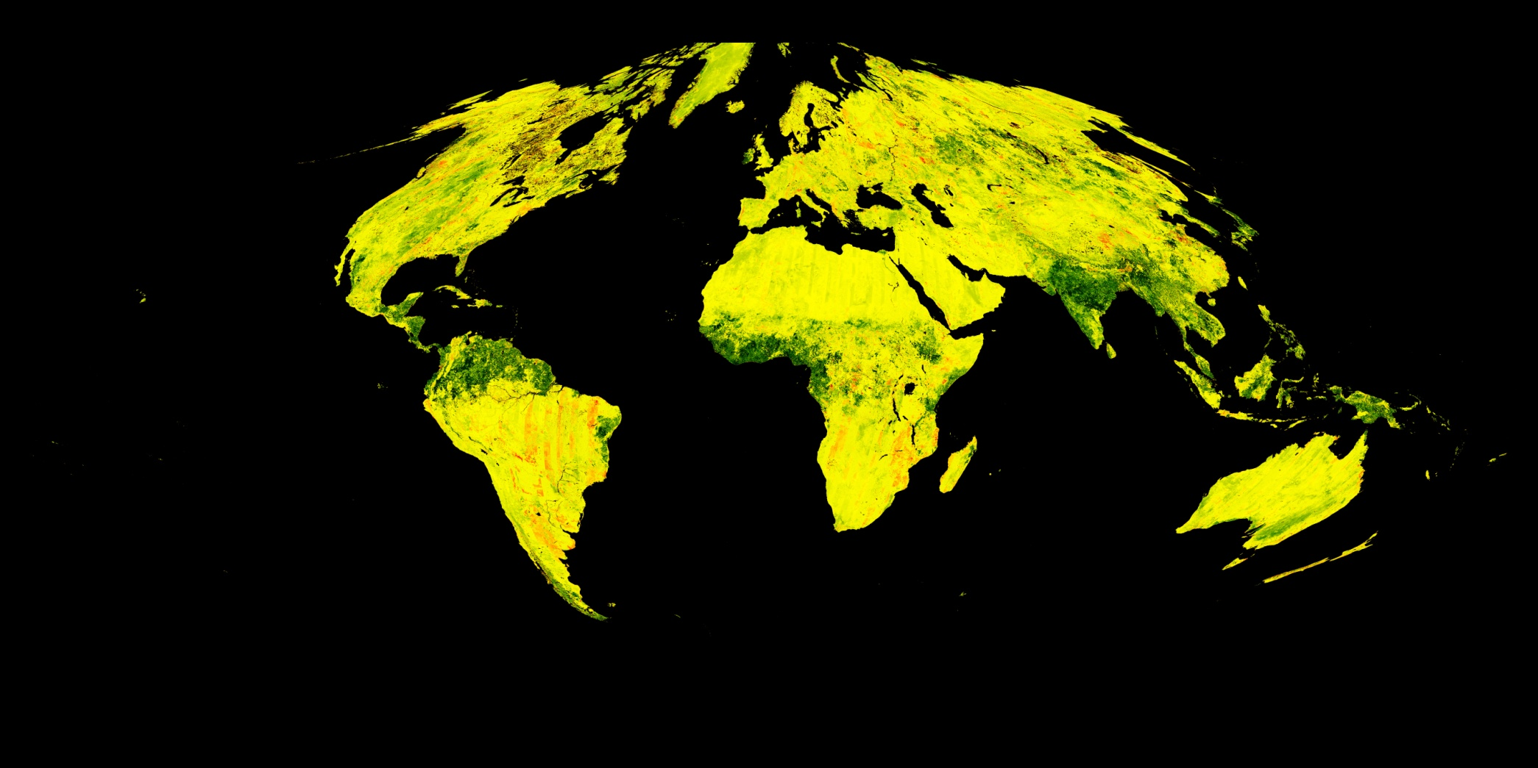

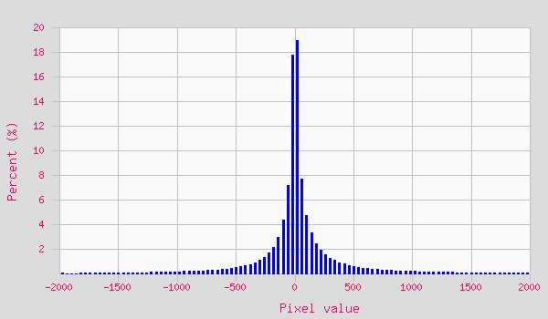
C6 Evaluation (Summer scene, 2003193)
Again OLD-NEW
Largest observed change over tropics
NDVI and EVI changed differently
NDVI
Diff
EVI
Diff
MODIS Science Team Meeting - Silver Spring, MD. April 15-16, 2013

Slide 15
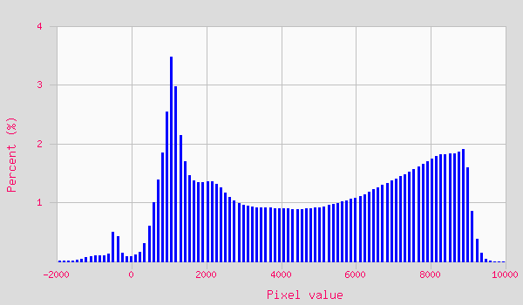

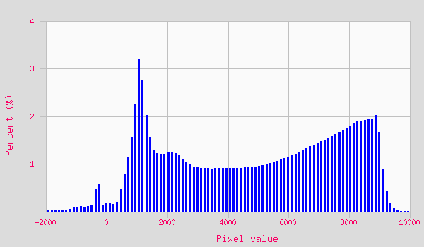
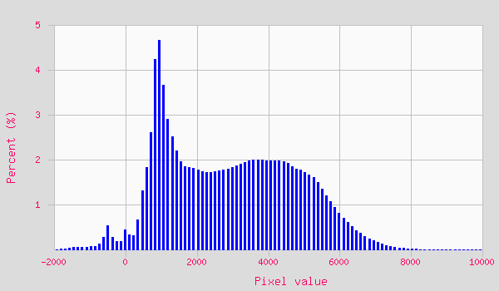
C6 VI Evaluation (Summer scene , 2003193)
NDVI EVI
New
Old
MODIS Science Team Meeting - Silver Spring, MD. April 15-16, 2013

Slide 16
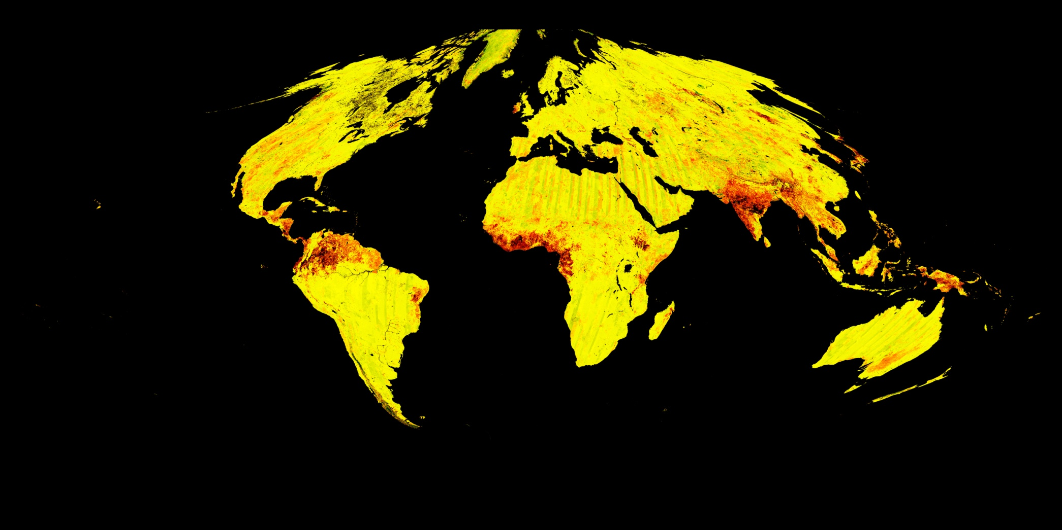


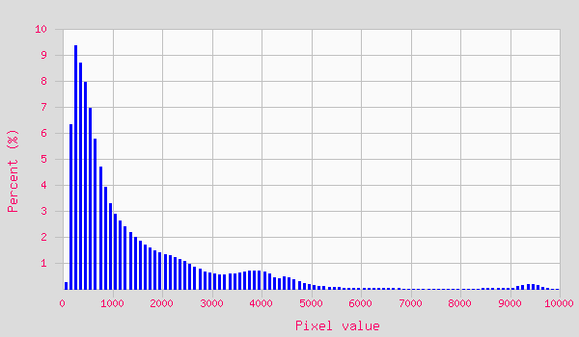





C6 LSR Evaluation (Summer scene , 2003193)
All SR values increased around the tropics (not proportionally)
Red NIR Blue
New
Old
MODIS Science Team Meeting - Silver Spring, MD. April 15-16, 2013

Slide 17
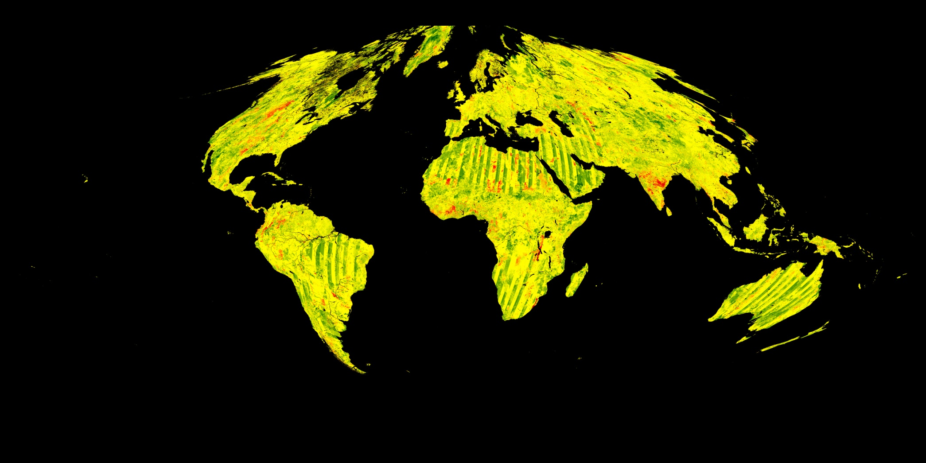
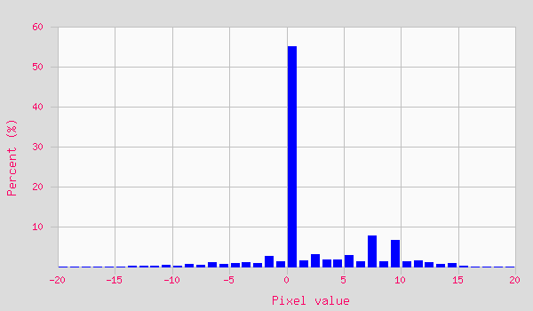
C6 Evaluation Composite DOY (Summer scene, 2003193)
C6 slight shift to earlier days
MODIS Science Team Meeting - Silver Spring, MD. April 15-16, 2013

Slide 18
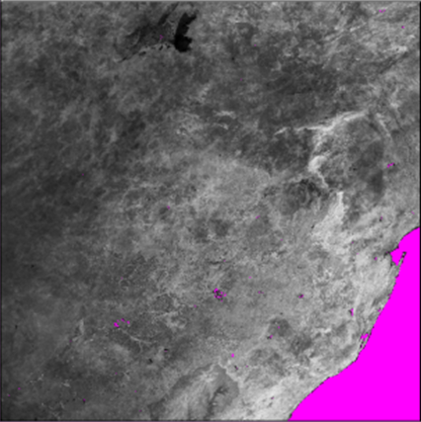
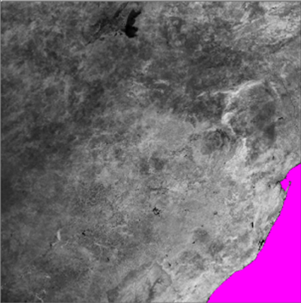
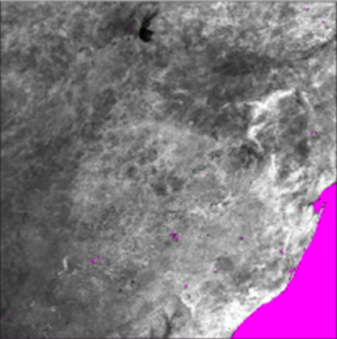
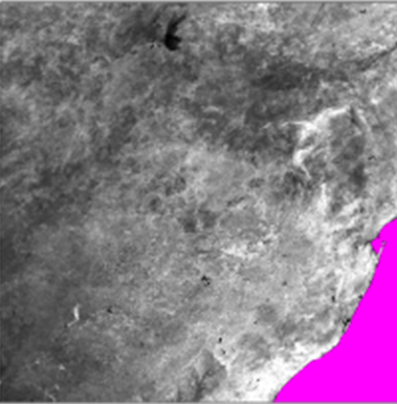
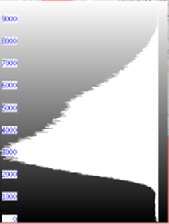
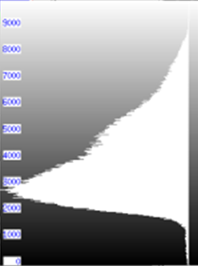
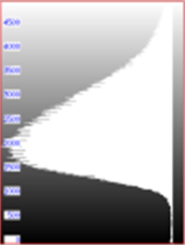
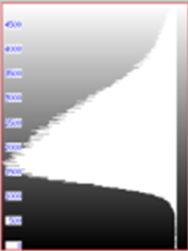
C6 Evaluation
OLD NEW OLD NEW
~10% shift
~10% shift
NDVI EVI
MODIS Science Team Meeting - Silver Spring, MD. April 15-16, 2013

Slide 19
PI SCF Work focused on
  “Error and Uncertainty” analysis of the full MODIS VI data record
  Improving the data Filtering
    Based on data ranking
    And long term confidence interval (to eliminate residual noise)
  Implemented EVI2 for forward and backward compatibility
    A full EVI2 MODIS record is now available (at CMG resolution)
    We’re producing a full 1km record
  Developed the “First good observation” compositing scheme to generate high temporal frequency Vegetation Index data in support of phenology and detection of fast change/disturbance
  Reanalyzed the full Terra and Aqua MODIS VI Data records to generate reference long term VI ESDRs
MODIS Science Team Meeting - Silver Spring, MD. April 15-16, 2013

Slide 20
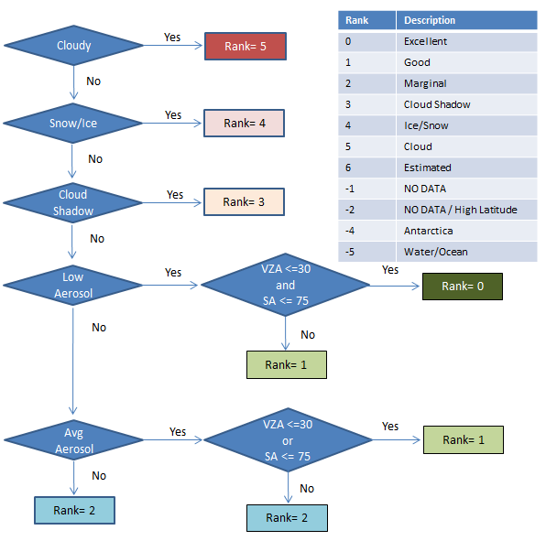
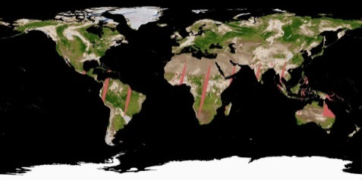
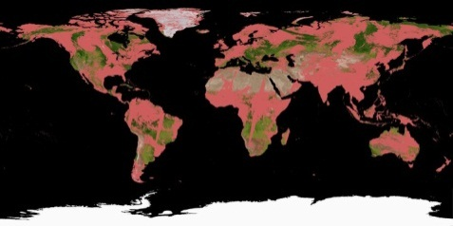
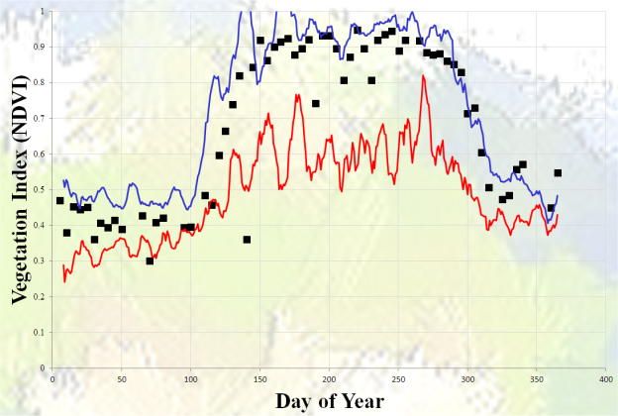

Improved Filtering
The objective is to help eliminate poor quality data and noise
  Based on Pixel QA ranking
    Simplify post-processing
    Categorize the data
    Automate data filtering
  Long term confidence interval
    Lots of QA error, especially with clouds, snow/ice
    Mislabeling
    Residual noise impact change analysis
Final
Filtered
Input
MODIS Science Team Meeting - Silver Spring, MD. April 15-16, 2013

Slide 21

Error Characterization Framework
Error related to input (1)
  Based on accurate field validation (sunphotometers)
Departure from normal/expected profile (2)
  Based on long term standard deviations
Temporal profile stability (3)
  Based on change about normal/mean
Change/Noise
Trend
Trend
2
1
3
MODIS Science Team Meeting - Silver Spring, MD. April 15-16, 2013

Slide 22

LSR Input related error
Land Surface Reflectance
NDVI = (N-R)/(N+R)
We’re not concerned with the VI formulation but the error in the input to this equation. In other words, how close we are to the TOC (Atm. Corr. Performance)
  Approach: Use Surface Reflectance validation results & Error analysis over sunphotometers sites (ex: EOS Core sites, LPV). Although, the reported average error is about 2-5% in Red & NIR, we will estimate the impact of a 10% error in Red/NIR on the VI estimation.
NDVI
Max Envelope
Max. VI input related Error
Vegetated = 0.04-0.05 VI Unit (~1-5-%)
Non-vegetated = 0.11 VI Unit (~100%)
Min Envelope
MODIS Science Team Meeting - Silver Spring, MD. April 15-16, 2013

Slide 23





LSR Input Error Global Propagation
Apply previous results to Long Term Avg. VI
Aug.
LTAVG
0.01
0.04
0.08
0.09
0.11
Input Error
Model
Absolute
1%
25%
50%
75%
100%
Relative
MODIS Science Team Meeting - Silver Spring, MD. April 15-16, 2013

Slide 24






Departure from Normal Related Error
Departure from normal/expected
profile (2)
Approach is to estimate error by long
term standard deviation analysis
  Error = 0.05 for vegetated and 0.005 for non-vegetated
  Largest over vegetated area and during winter (snow/ice cover)
JFM
AMJ
JAS
OND
JFM
AMJ
JAS
OND
MODIS Science Team Meeting - Silver Spring, MD. April 15-16, 2013

Slide 25






Stability of Time Series Profiles
Number of peaks and valleys (3)
  Assess the number of time the profile crosses
  the normal/expected profile
  Impact on cumulative VI (proxy of Carbon sequestration)
  Showing only Start of Growing Season (AMJ) and
  Start of Senescence (OND)
  Insets are standard deviation
  AMJ : Lowest over vegetated
  areas and highest over
  non-veg and high latitude.
  OND : Lowest over vegetated
  areas and highest over non-
  veg.
AMJ
OND
AMJ
OND
MODIS Science Team Meeting - Silver Spring, MD. April 15-16, 2013

Slide 26
Conclusions
C6 is different than all previous collections
  From a VI perspective it is hard to say which is better
  There was no clear convergence in C6. Differences cannot be attributed to a particular improvement
  They are simply slightly different data sets
  We will be able to answer this with a full time series record
Is C5 better?
  In some ways may be (consistency)
  C6 did not build on previous work
Error due to input is well constrained (absolute max ~0.05 or +/-5%). With Small impact on both NDVI and EVI. With EVI showing a slightly larger error
Largest error is due to noise (0.1 absolute , 100% over sparsely vegetated areas)
Impact on physical/biophysical parameters estimation
  8-10% on Sum-VI (proxy of GPP)
  The error is largest during winter (cloud/snow)
  Impact on estimating the exact day of event (10-40 days – analysis not shown here)
PI SCF is generate a high frequency (quasi-daily) data record
MODIS Science Team Meeting - Silver Spring, MD. April 15-16, 2013

Slide 27
Backup slides

Slide 28




LSR Input Error Global Propagation
EVI Seasonal Error
Largest error During winter and Over barren, sparsely, or snow/ice covered land
0.01
0.04
0.08
0.09
0.11
JFM
AMJ
JAS
OND
MODIS Science Team Meeting - Silver Spring, MD. April 15-16, 2013

