Slide 1
Vegetation Continuous Fields: C5/6 Updates
Charlene DiMiceli , John Townshend,
Matt Hansen, Rob Sohlberg,
University of Maryland
Mark Carroll, Sigma Space, NASA Goddard

Slide 2
Vegetation Continuous Fields—C5
Version 1 at LP-DAAC—percent tree cover
250m resolution, annual
New layers—percent bare, percent herbaceous
Code and models delivered/tested
Minor improvements to bare models ready for testing
Products available in 2-3 months
Notes:
We delivered version 1 with the percent tree cover layer last year. We have received good feedback from users.

Slide 3
VCF Bare Ground Layer Australia 2010
Percent
Vegetated
100
0
Notes:
The dark green represents fully vegetated pixels and the tan pixels with no green vegetation.

Slide 4
VCF Bare Ground Layer Australia 2010
Percent
Vegetated
100
0
Notes:
Zooming on Western Australia…

Slide 5
Notes:
The detail achieved by the 250m VCF is evident.

Slide 6
Vegetation Continuous Fields—C6
MOD44C compositing code—L2G lite version in place
VCF—no code changes
Testing requires 1 year of MOD09
Notes:
For collection 6, our code is done and delivered. Our intermediate compositing code was changed to run with the L2G lite. We expect the VCF code to run without change. We are looking forward to seeing test data.

Slide 7
VCF—Next steps
Evaluation of tree cover layer in progress
Tree cover layer improvements:
--update training for sparsely wooded
drylands
--improve persistently cloudy tropics
Evaluation of bare and herbaceous layers
Notes:
This year we hope to complete an evaluation of all the layers. We have begun evaluation of the tree cover layer. We would like to improve the sparsely wooded drylands by adding some additional training data for those areas. We are also working on improving areas of persistent clouds in the tropics.

Slide 8
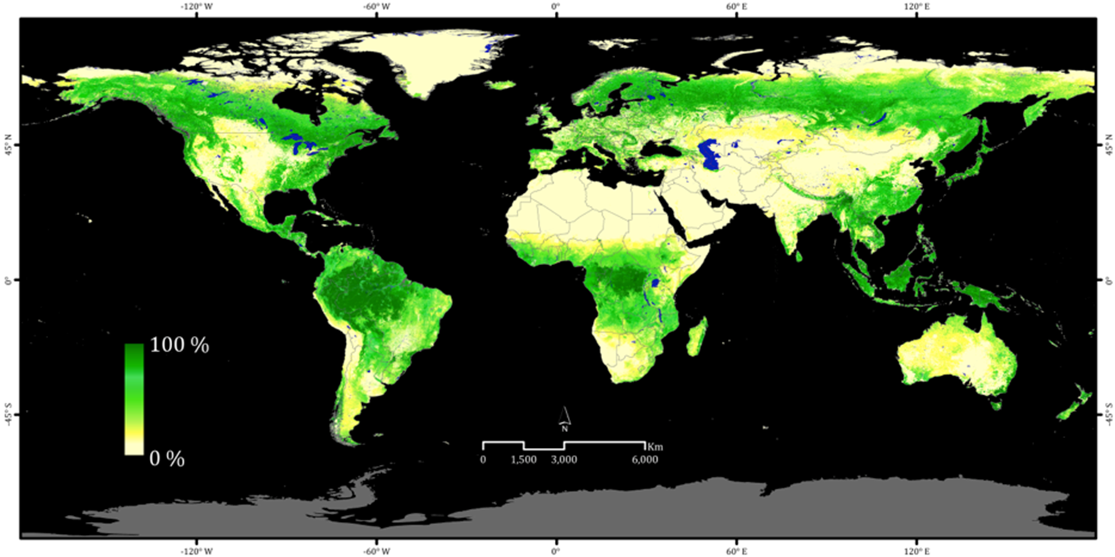
A global percent tree cover map at Landsat resolution by reflectance-based downscaling of MODIS continuous fields
J. O. Sexton, Xiao-Peng Song, M. Feng, P. Noojipady, A. Anand, D.H. Kim, D. Song, K.M. Collins, C. DiMiceli, C. Huang, S. Channan and J. R. Townshend
Global Land Cover Facility, University of Maryland
Notes:
A new vegetation continuous fields product has been developed by the Global Land Cover Facility at Maryland by downscaling MODIS VCF using Landsat reflectance data to map tree cover at 30-m resolution. This product should be available for download within 2 months. Two time periods: 2000 and 2005, planning to do 2010 if funded. There is a forthcoming paper in the International Journal of Digital Earth.

Slide 9
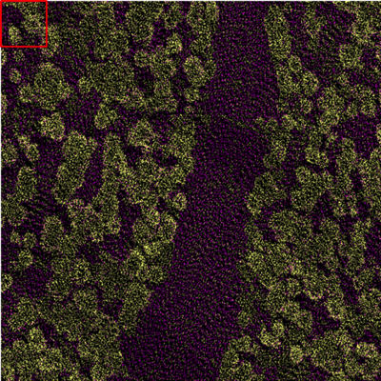
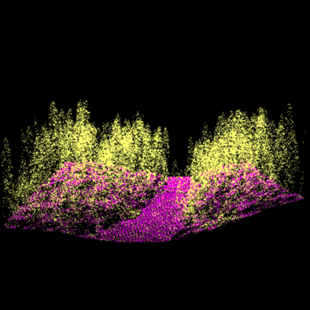
Error estimation based on lidar-measured tree cover
nadir
oblique
Three-dimensional distribution of lidar returns within one MODIS pixel (Sierra Nevada, CA test site).
Notes:
The GLCF has developed a method to use Lidar to validate and calibrate the MODIS and the Landsat VCFs and has tested it on four sites. We have hopes of expanding this project to more sites to allow a global VCF calibration dataset. Data points, which were sampled with intensity of approximately 13 points/m², are classified by height into tree (pink) and non-tree (yellow) classes. The red box in the upper-right corner shows the area of one 30-m Landsat pixel.

Slide 10
VCF—Long-term Data Records MEaSURES
Annual product, 0.05° resolution
Uses Land Long-term Data Record of Surface Reflectance (Eric Vermote, NASA Goddard)
AVHRR, MODIS
7 layers—including needleleaf, evergreen, broadleaf, deciduous
Annual regression tree models overcome instrument differences
Smoothing to remove noisy data for change detection

Slide 11
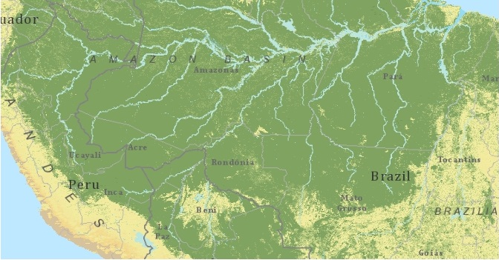
Percent tree cover, Amazon Basin, 1990--Land LTDR AVHRR data

Slide 12
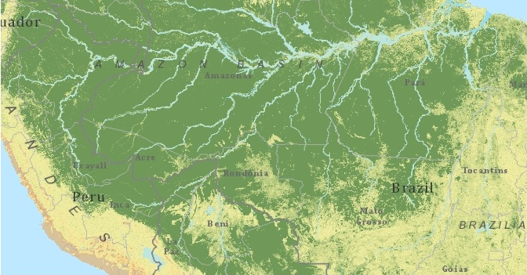
Percent tree cover, Amazon Basin, 2000—MODIS CMG data

Slide 13
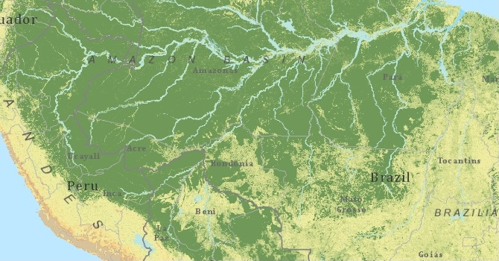
Percent tree cover, Amazon Basin, 2010--MODIS CMG data

