Slide 1

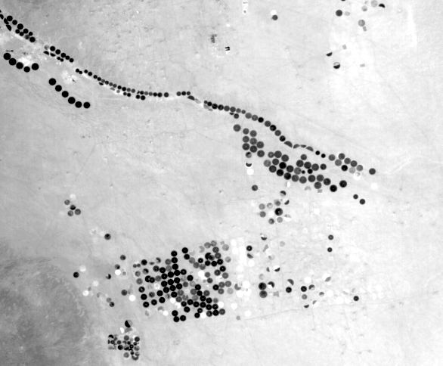
NASA
TIRS – Saudi Arabia
Overview of the
President’s
FY 2014 Budget Request
AMS Washington Forum
Federal Panel
Michael H. Freilich
4 April 2013
LDCM First-Light
OLI False-Color
Fort Collins area
Suomi NPP VIIRS
Visible Composite

Slide 2
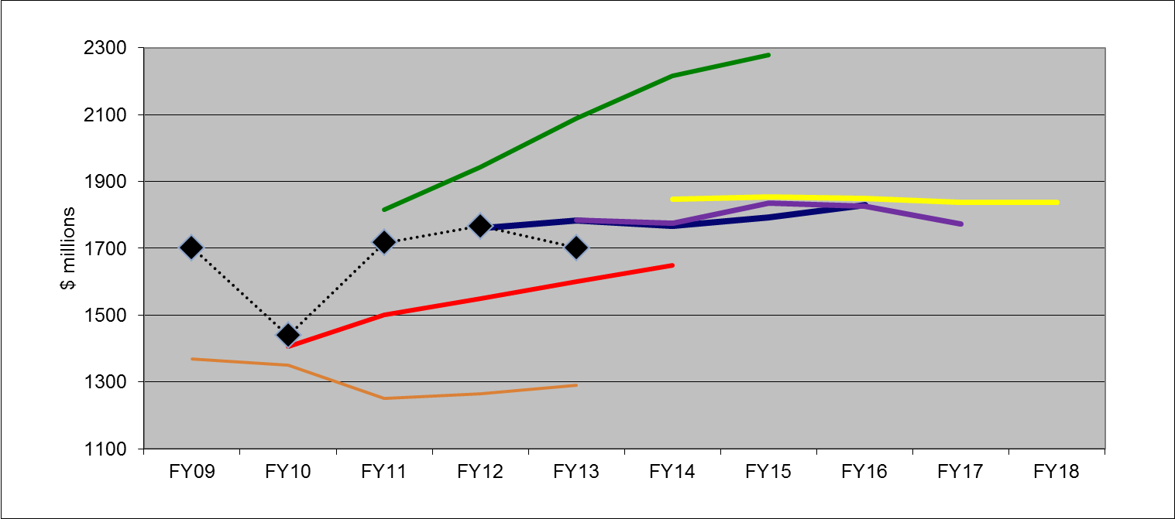
Earth Science Budget – FY14 Request
FY11 request
FY14 request
Appropriation
FY12 request
FY13 request
FY10 request
FY09 request
(previous Admin)

Slide 3
Science Budget Request Summary
FY 2015-FY 2018 estimates
are notional
FY13 numbers are not shown, and not fully determined at this time
Notes:
The final FY13 budget numbers are still pending. The CR included $5115.9M for Science, but this does not include the ~2% recission to comply with the Budget Control Act, nor does it include the ~5% reduction for sequester. The actual FY13 funding level for Science will be on the order of $4.8B.
The FY13 Budget Request included $4914.4M for Science in FY14. The FY14 Budget Request is over $100M higher.

Slide 4
Earth Science Budget Features
Initiates new Land Imaging project for development of a national sustained Land Imaging Satellite System (with USGS)
Expands Venture-Class competitive flight program
Initiates development of a program for TSIS, OMPS-Limb, and “CERES” measurements starting in the JPSS-2 time frame – ex-NOAA climate sensors
Completes integration of DSCOVR Earth observing instruments (EPIC and NISTAR) and initiates ground data system development in preparation for 2014 launch
Ops funding for QSCAT, Jason-1, CloudSat, GRACE, SORCE in FY14 – ends all by FY18
Advances development of SMAP, SAGE III/ISS, GRACE-FO, SWOT, CYGNSS, OCO-3, TEMPO, and ICESat-2 for launch before 2021
Pre-formulation studies will continue for PACE, L-band SAR, and other Decadal survey-recommended and climate architecture missions
Funds Carbon Monitoring System at $10M/year
E/PO funding removed – GLOBE “protected”
Space Geodesy acceleration for station final development/test
Notes:
May want to mention that the increased funding for Earth Science helps to cover the increased cost of the ICESat-2 launch vehicle.

Slide 5
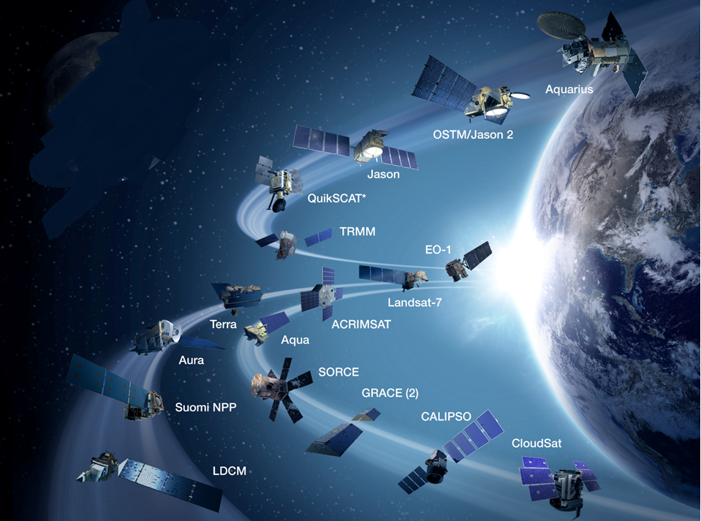
Bi-annual Senior Review
Ongoing in 2013

Slide 6

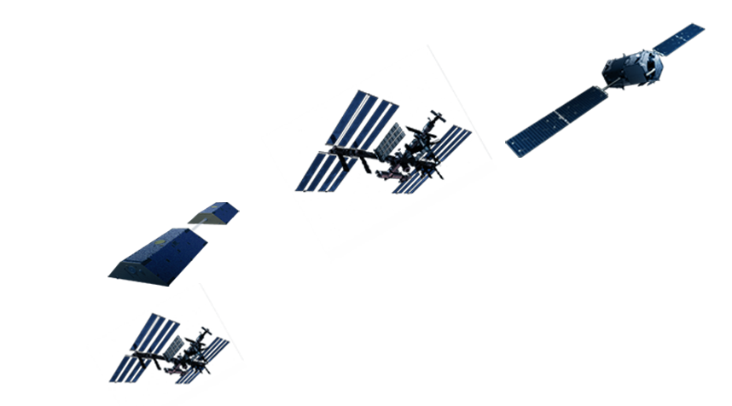
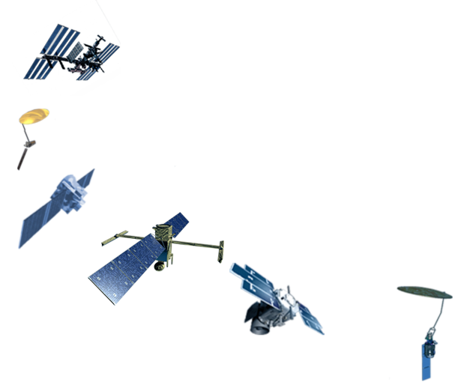

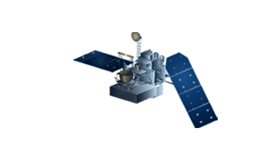
OCO-2
2014
SAGE-III
(on ISS) 2014
GRACE-FO
2017
OCO-3
(on ISS) 2017
CLARREO
(on ISS) NET 2023
L-Band SAR
NET 2021
EVI-3
2022
EVM-2
2021
GPM
2014
PACE
2020
EVI-2
2020
TEMPO
EVI-1, 2019
SWOT
2020
CYGNSS
EVM-1, 2016
ICESat-2
2016
SMAP
2014

Slide 7
VENTURE-CLASS UPDATE/STATUS
  EV-1 (“EV-S” - Suborbital, Airborne)
    All 5 investigations have completed at least 1 sustained field campaign
    All EV-1 investigations will fly during 2013
    Second EV-S solicitation funded, in preparation for release on schedule in mid-2013
  EV-2 (“EV-M” - Small-sat)
    CYGNSS PI team and NASA program office making good progress, under contract 7 Dec 2012 (planned 2016-2017 launch)
    ESD/SMD developing detailed “Class D” management approaches and processes
  EV-I (Instrument)
    TEMPO selected for GEO hosted payload opportunity (2017 launch)
    ESD initiating formal host selection/negotiation process
    Second “EV-I/2” solicitation funded, on schedule for release
Notes:
7

Slide 8
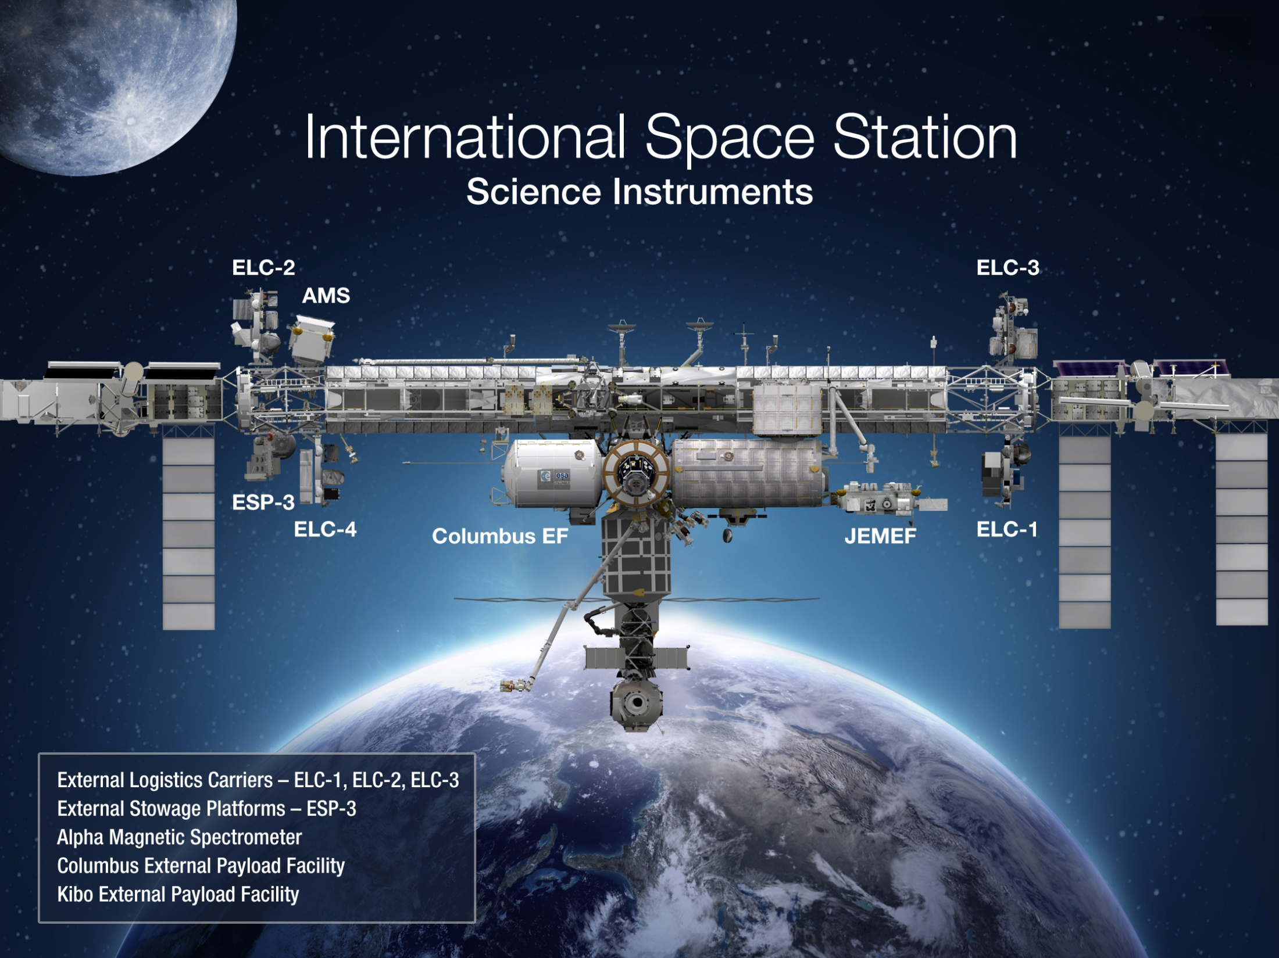
Earth
ESD/SAGE III (2014)
ISERV (2012)
ESD/OCO-3 (2017)
ISS/CATS (2014)
ISS/HICO (2009)
ISS/RapidSCAT (2014)

Slide 9
Non-Flight Budgets: 2007-2013
Non-Flight Fraction of ESD Budget
R & A
Applied Sciences
Technology
Competed Science Teams
Non-Flight Funding
Notes:
9

Slide 10
Earth Observations from the ISS:
NASA/ESD Status and Plans
On-orbit instruments funded by non-ESD sources, ESD funding for analysis
  HICO (Hyperspectral Imager for the Coastal Ocean)
    Launched September, 2009 on HTV; mounted on JEM-EF
  ISERV (Digital Camera and Telescope)
    Launched July, 2012 on HTV-3; mounted internally on WORF
Planned instruments funded by NASA/HEOMD, ESD funding for analysis
  CATS (Cloud-Aerosol Transport System for ISS)
    LIDAR, summer 2013, HTV, JEM-EF
  Rapid-Scat (Ku-band scatterometer)
    Launch early CY2014, Falcon/Dragon
  Lightning Imaging Sensor (under consideration)
  Hyperspectral Follow-on to HICO (under consideration)
Approved instruments funded by ESD
  SAGE-III (Stratospheric Aerosol and Gas Expt)
    In Phase-C; 12/2014 Launch on Falcon/Dragon; ESA provides hexapod pointing p’form
  OCO-3 (Orbiting Carbon Observatory-3 instrument only)
    Phase-A November 2012; Launch Fall, 2017

Slide 11
Reinvigorate On-Orbit Constellation (1 of 2)
  OSTM/Jason-2 Launched 6/2008
  OCO Launched 2/2009 (LV Failure)
  Glory Launched 3/2011 (LV Failure)
  Aquarius/SAC-D Launched 6/2011
  NPP Launched 11/2011
  LDCM Launched 2/2013
  GPM On Schedule for 2/15/2014 Launch
  OCO-2 On Schedule for 7/1-7/2014 Launch
  SMAP On Schedule for 10/31/2014 Launch
  SAGE-III/ISS On Schedule for 12/2014 Launch
Notes:
11

Slide 12
Reinvigorate On-Orbit Constellation (2 of 2)
  GRACE-FO Formulation for launch 8/2016
  ICESAT-2 Confirmed for launch 12/2016
  CYGNSS (EVM) Formulation for launch late 2016/17
  OCO-3/ISS Formulation for launch 2017
  TEMPO (EVI) Formulation for launch 2017
  PACE Acquisition Strategy under
  evaluation, launch 2020
  SWOT Formulation for launch 2020
Notes:
12

