Slide 1
MODIS Collection-6 Standard Snow-Cover Product Suite
Dorothy K. Hall¹
and
George A. Riggs^{1,2}
¹Cryospheric Sciences Laboratory, NASA / GSFC, Greenbelt, Md. USA ²SSAI, Lanham, Md. USA
MODIS Science Team Meeting Silver Spring Civic Building Silver Spring, Md. 15 April 2013

Slide 2
Collaborators
Nicolo E. DiGirolamo
SSAI, Lanham, Md. & NASA/GSFC Cryospheric Sciences Lab
Jody A. Hoon-Starr
UMCP & SSAI, Lanham, Md. & NASA/GSFC Cryospheric Sciences Lab
Jeffrey A. Miller Wyle Information Services & NASA/GSFC Cryospheric Sciences Lab

Slide 3
Outline
New C6 products
C6 improvements
Northern Hemisphere snow cover time series from MODIS

Slide 4
MODIS Collection-6 Standard Snow-Cover Products*
500-m resolution daily snow cover at the swath level, M*D10_L2
500-m daily snow-cover tile products – gridded to sinusoidal projection, M*D10A1
5-km daily climate-modeling grid (CMG) snow cover, M*D10C1
500-m 8-day composite snow-cover tile products – gridded to sinusoidal projection, M*D10A2
5-km 8-day composite climate-modeling grid (CMG) snow cover, M*D10C2
5-km monthly snow cover, M*D10CM
New!
500 m cloud-gap-filled (CGF) daily snow cover, M*D10A1F
5 km cloud-gap-filled (CGF) daily snow cover, M*D10C1F
500 m snow cover extent using surface reflectance input, MOD10A1S (Terra MODIS only for now)
*No significant changes to sea ice algorithms
Notes:
List the daily products then 8-day then monthly.

Slide 5
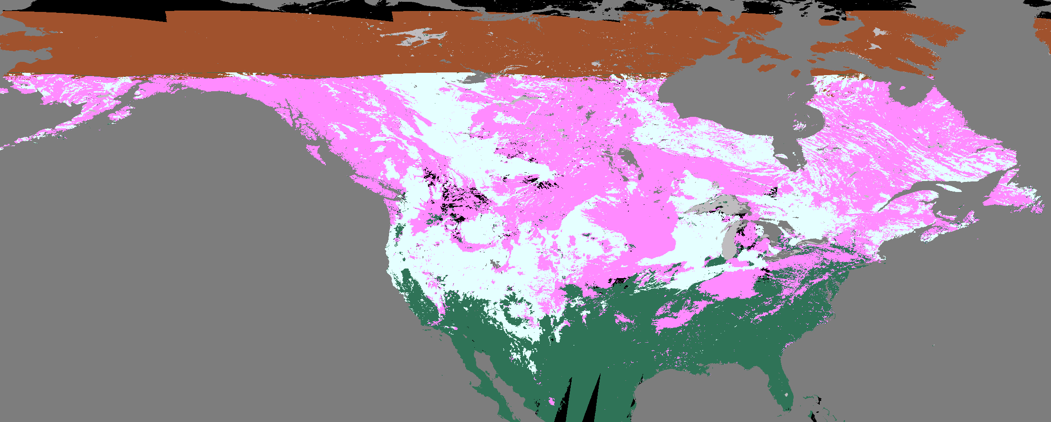
Sequence of MODIS Snow Maps (CGF) 1 – 6 January 2013
cloud
1 Jan 2013
1 Jan 2013
Notes:
Result is a “clear” view of snow cover extent on the current day.

Slide 6
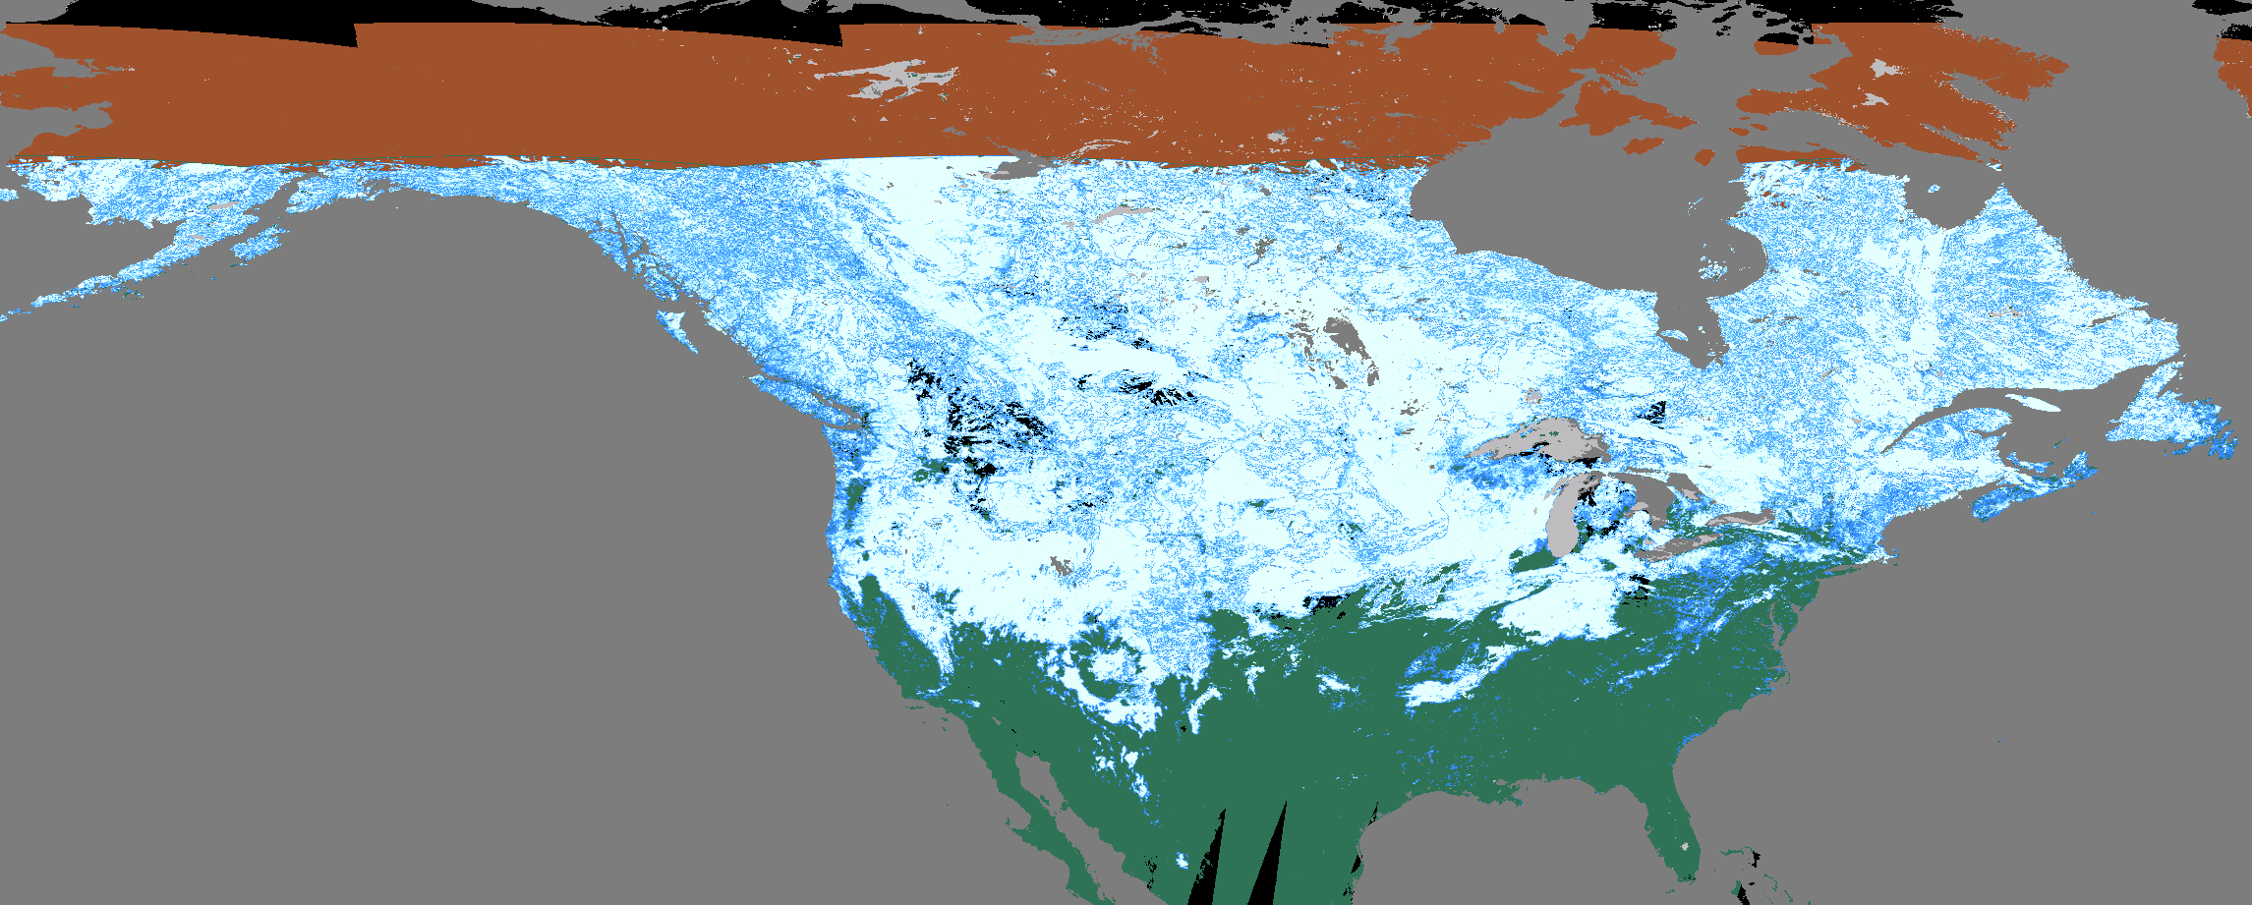
Sequence of MODIS Snow Maps (CGF) 1 – 6 January 2013
1 Jan 2013
Notes:
Result is a “clear” view of snow cover extent on the current day.

Slide 7
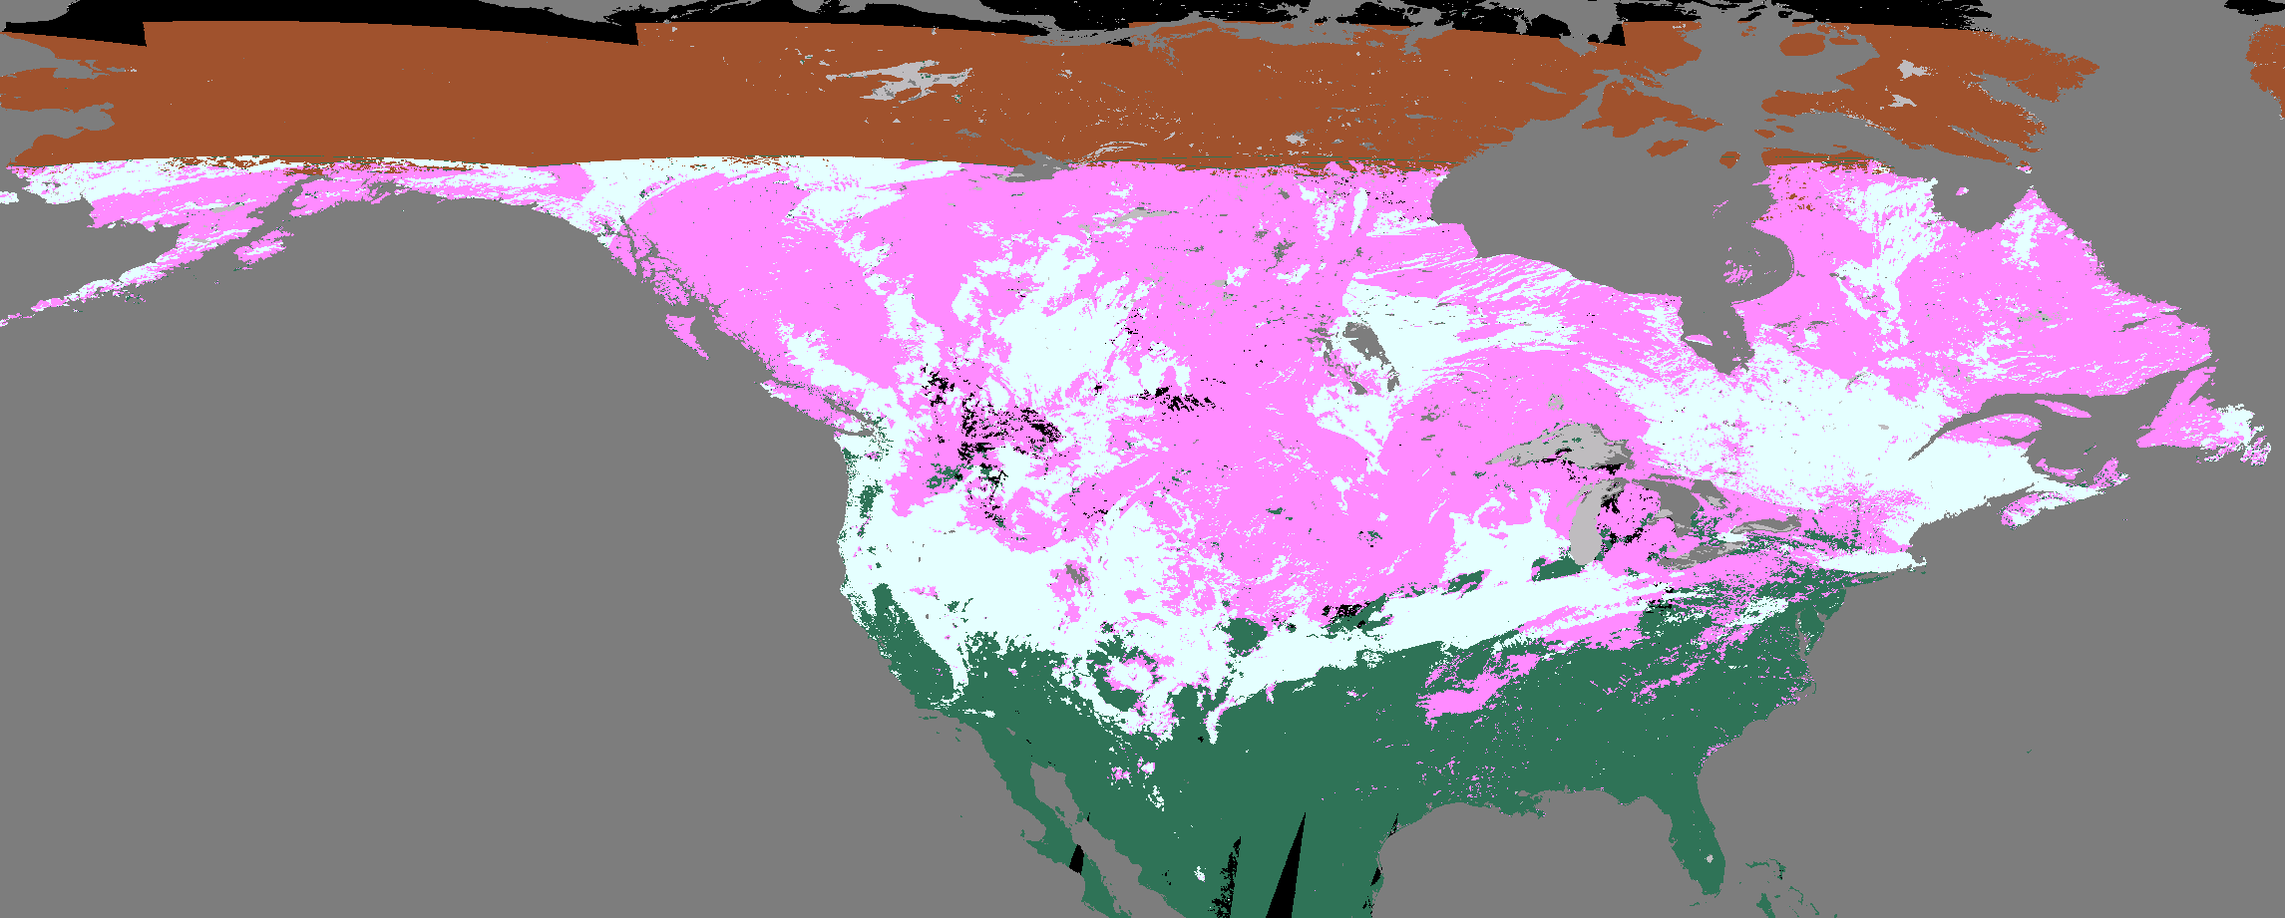
2 Jan 2013

Slide 8
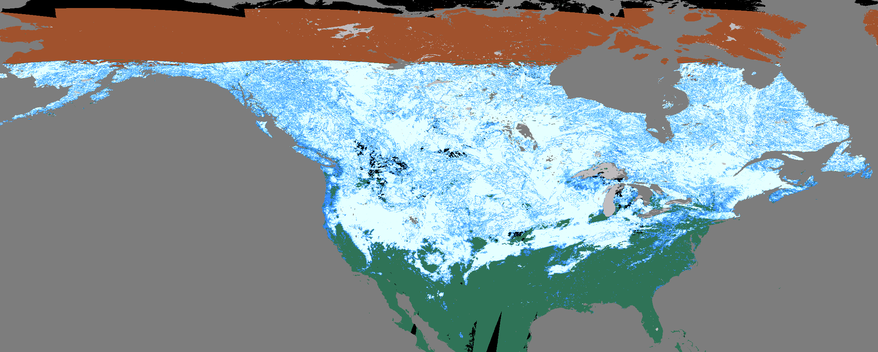
2 Jan 2013

Slide 9
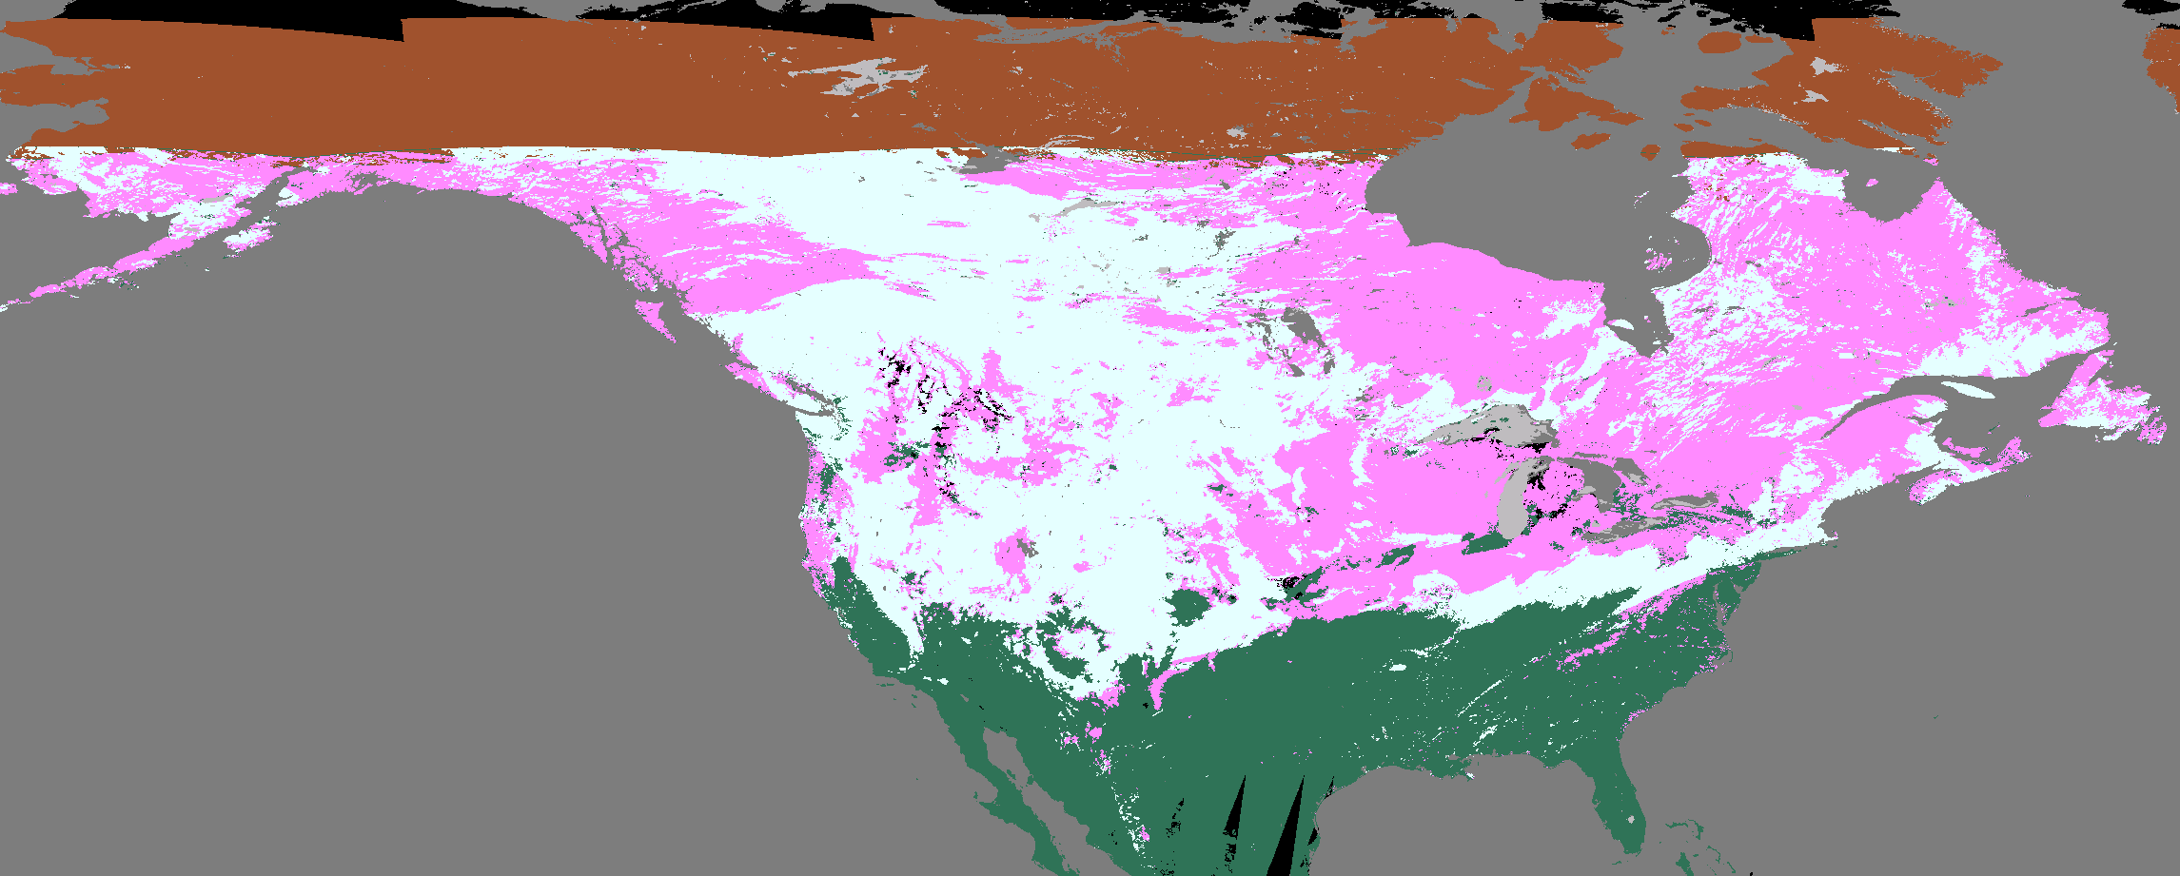
3 Jan 2013

Slide 10
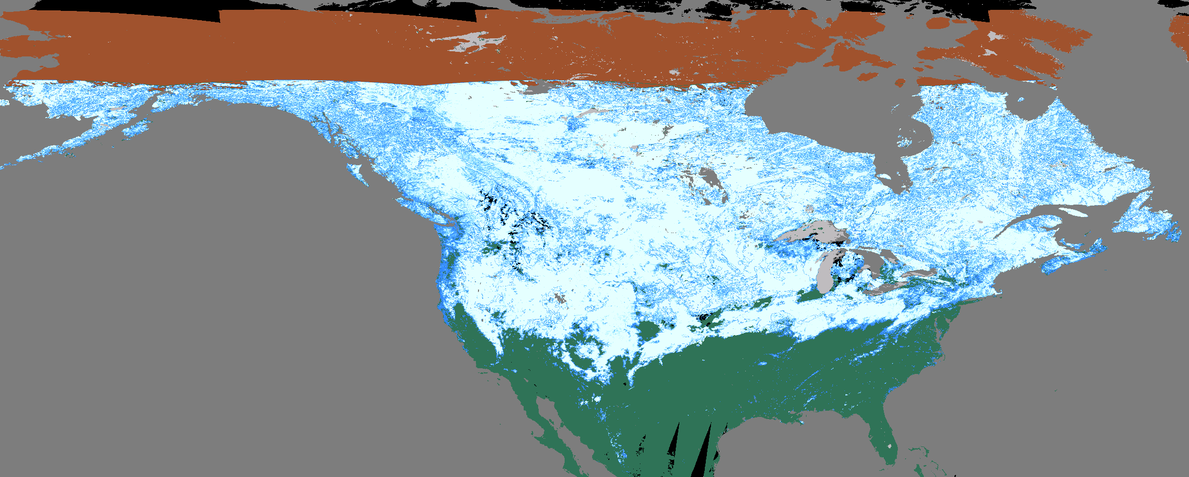
3 Jan 2013

Slide 11
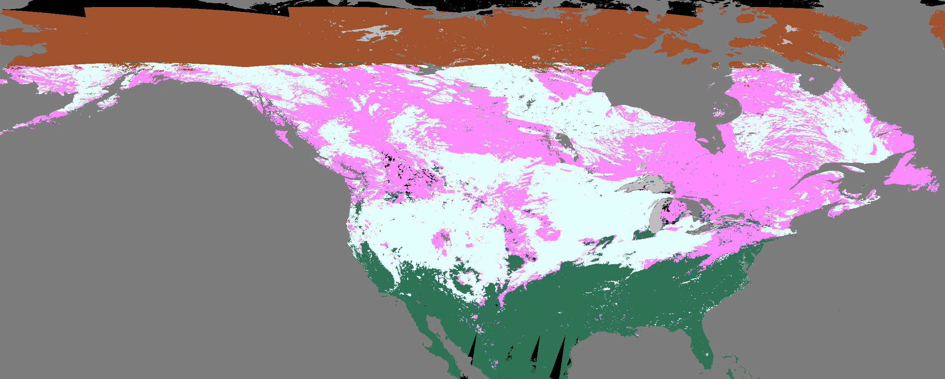
4 Jan 2013

Slide 12
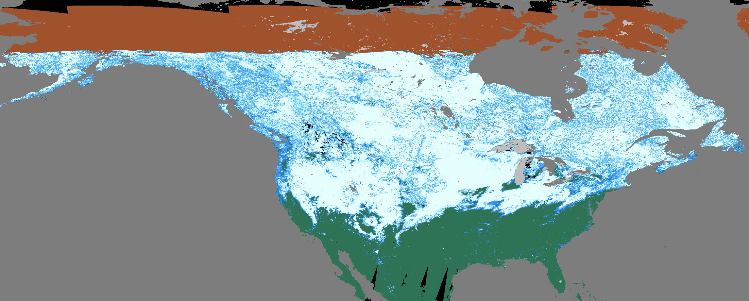
4 Jan 2013

Slide 13
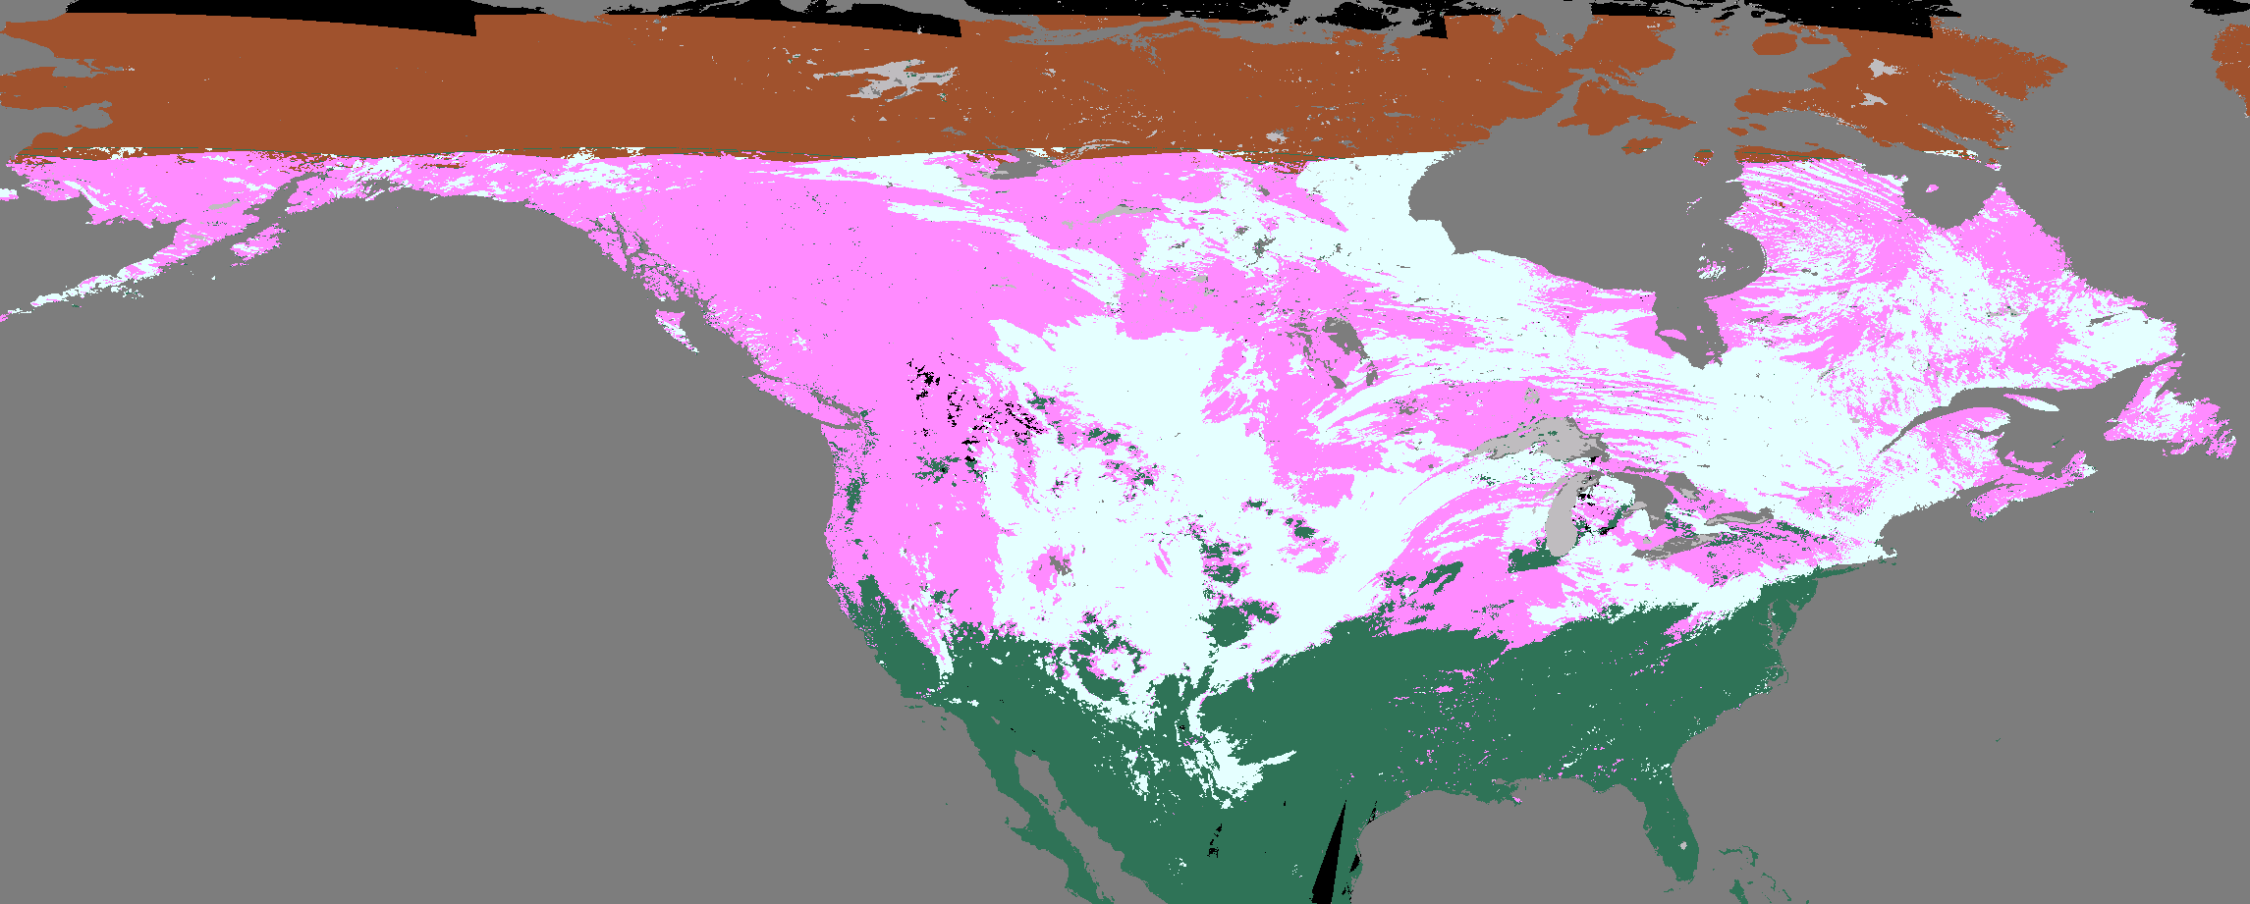
5 Jan 2013

Slide 14
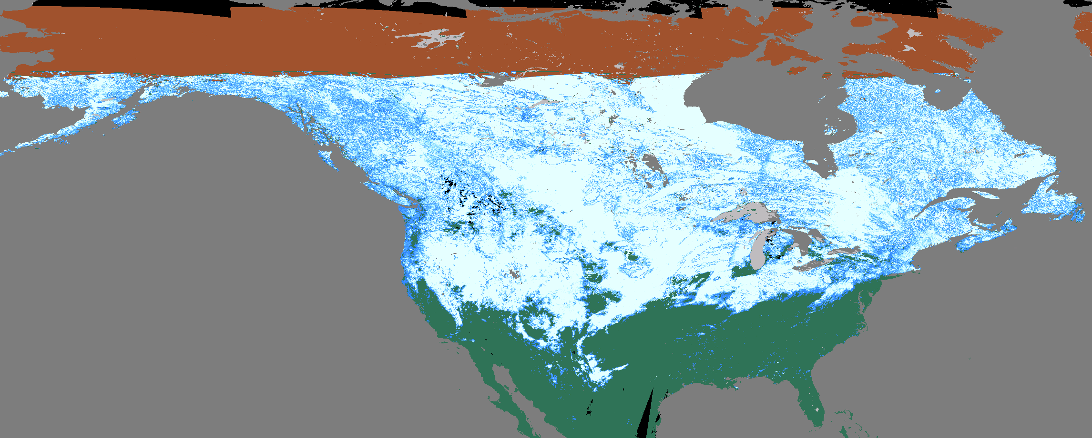
5 Jan 2013

Slide 15
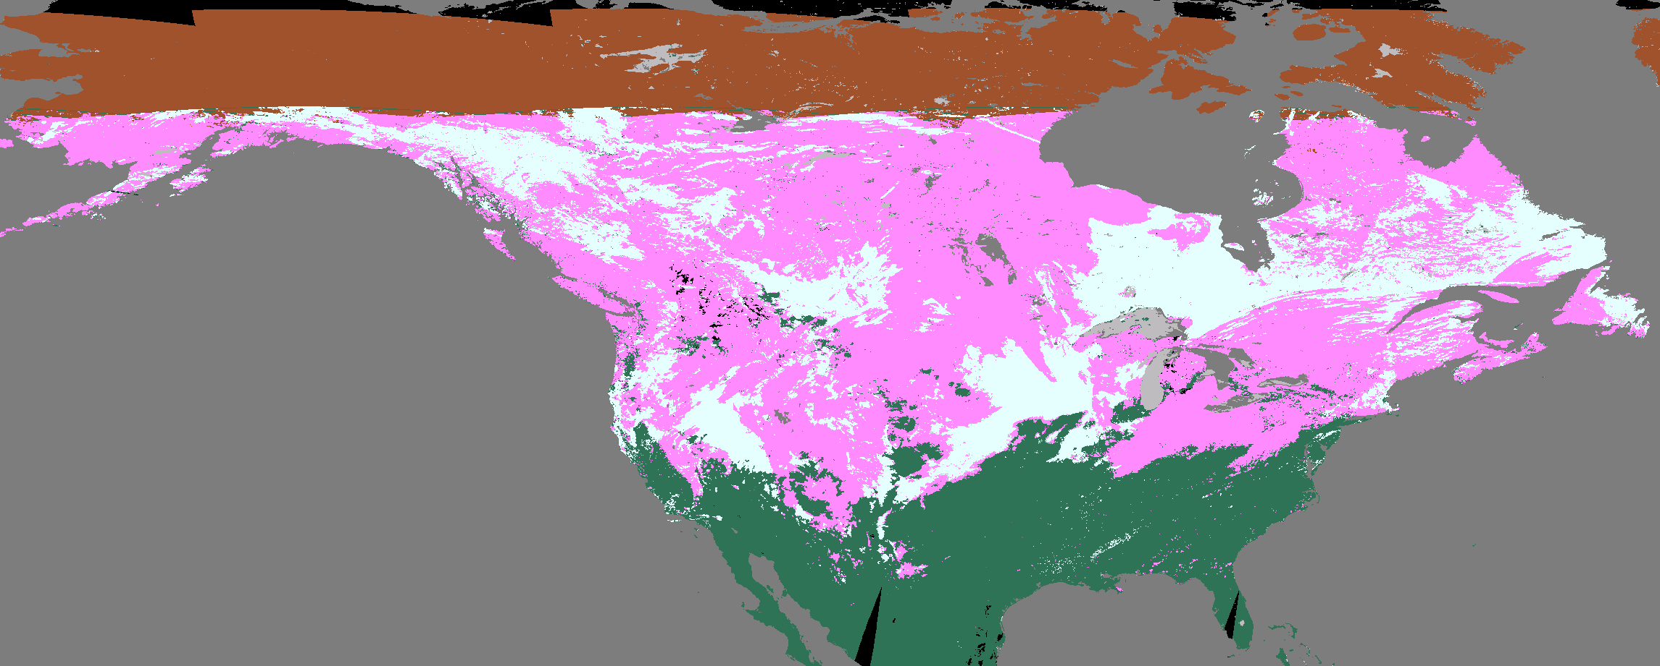
6 Jan 2013

Slide 16
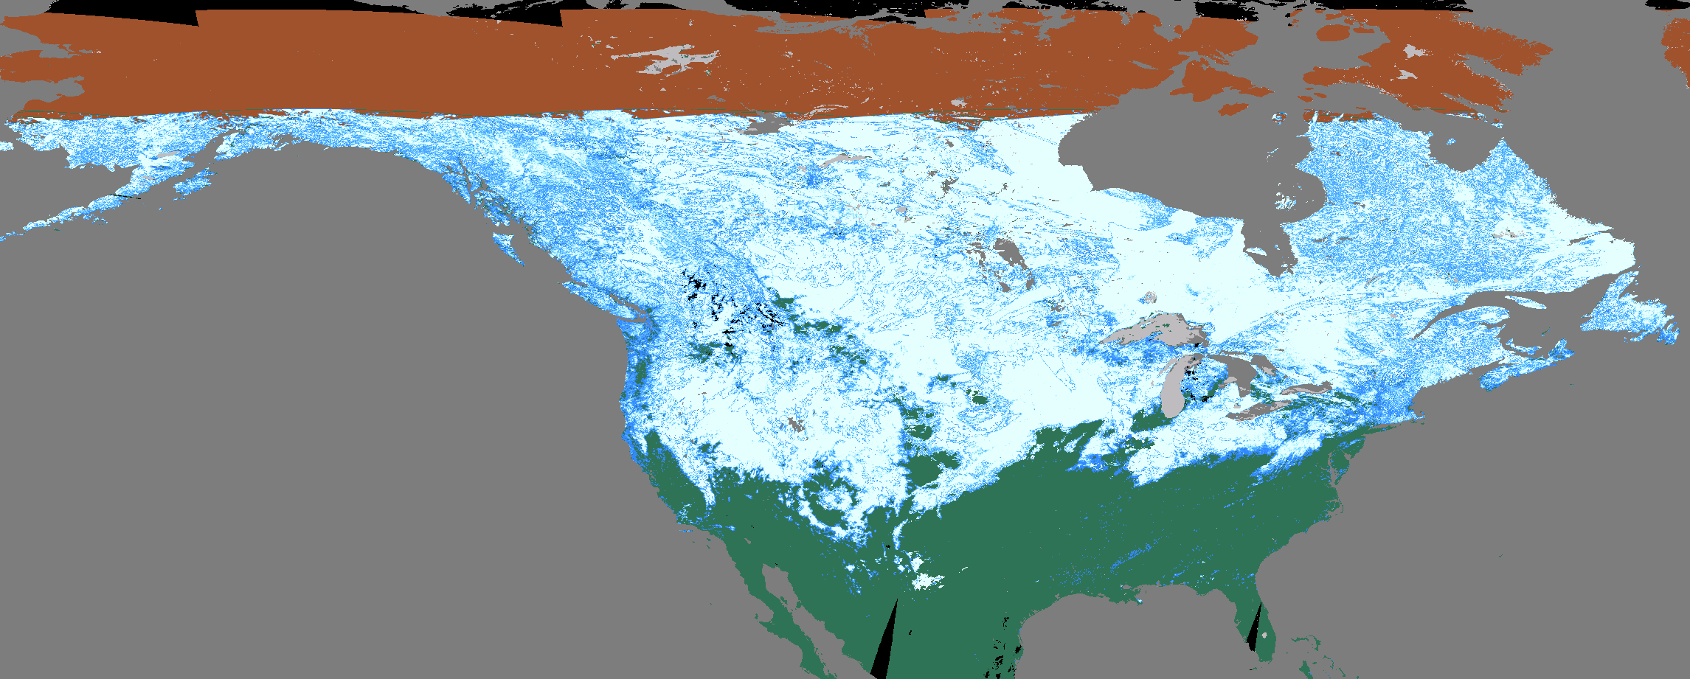
6 Jan 2013

Slide 17
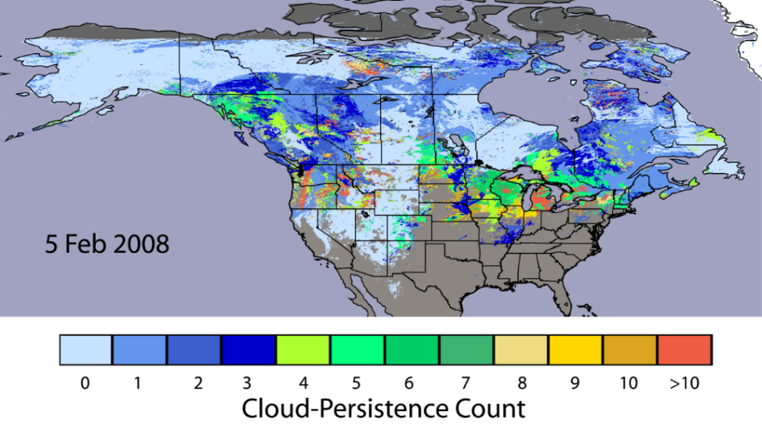
500 m cloud-gap-filled (CGF) daily snow cover
Cloud-gap filled (CGF) cloud-persistence count (CPC) snow-cover map. The CPC provides quality assurance (QA) information in each pixel or cell.
Notes:
Show the map of snow cover first, then this cloud persistence map to talk about how this info can help to assess the quality of the snow map. Maybe fade from snow map to this cloud map.

Slide 18
Surface Reflectance vs. TOA
New snow-cover products will use MOD09 surface reflectance instead of TOA reflectance as input;
  This change results in a small improvement in mapping snow cover in some areas, especially under less-than-ideal viewing conditions.

Slide 19
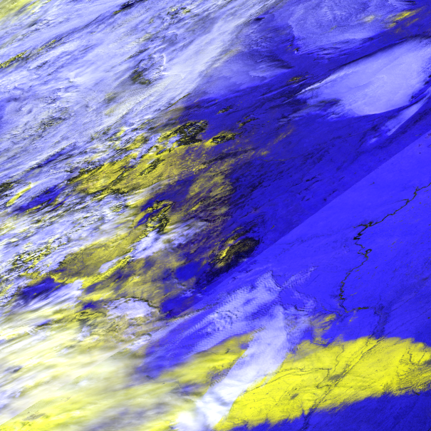
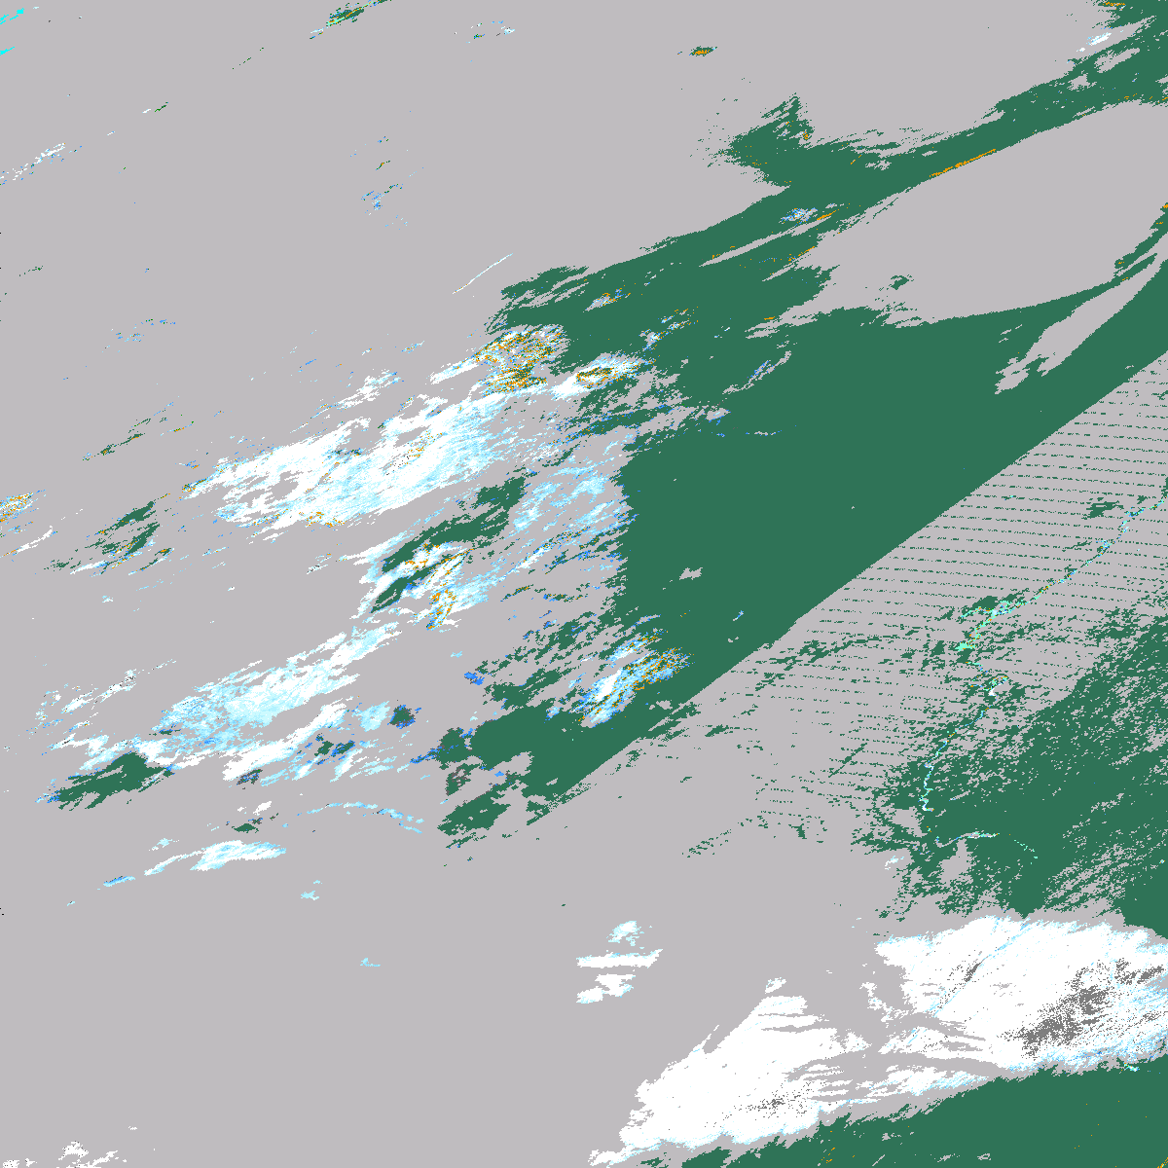
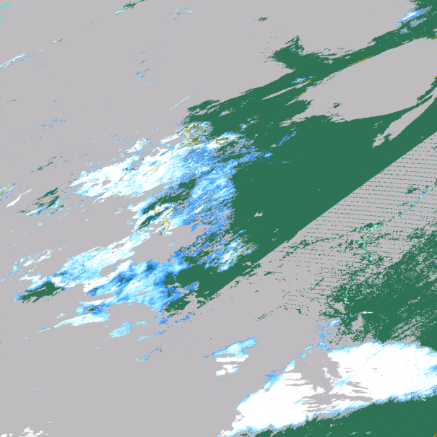
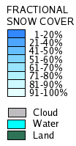
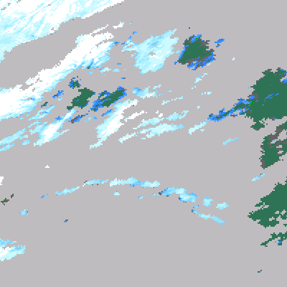
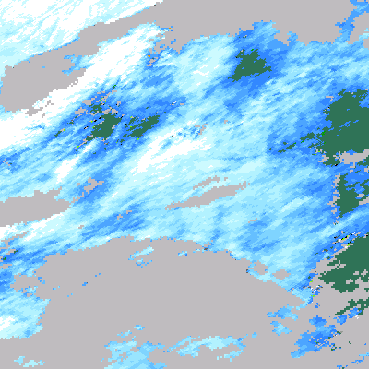
Combined use of the M*D09⁺ and M*D35 cloud masks can reduce cloud/snow confusion in some situations MOD09GA
MOD09GA.A2012043.h10v04.005.*.hdf,
MOD10A1S.A2012043.h10v04.v0.0
MOD10A1S.A2012043.h10v04.v1.1
MOD09GA -- RGB bands 1,4,6. Snow appears in hues of yellow.
Fractional snow map, using only MOD35_L2 cloud mask.
Fractional snow map, using combination of MOD35_L2 and MOD09GA land mask flags alleviate some snow/cloud confusion.
⁺ Based on M*D35
MOD10SR.2010187.h08v05
No low visible reflectance screen
Notes:
Shows that using two cloud masks reduces snow-cloud confusion – cloud if both masks say cloudy. MOD10A1S
MOD09GA is input, snow cover algorithm same as MOD10_L2, cloud/snow confusion reduced with use of both cloud masks in MOD09GA. Snow detection ability improved in some situations.
The QA data includes basic QA and flags specific to screens, and cloud detection in the algorithm.

Slide 20
Outline
New C6 products
C6 improvements
Northern Hemisphere snow cover time series from MODIS

Slide 21
Collection-6 (C6) Algorithm Improvements
Dropped the surface temperature screen that erroneously reversed snow detection on some mountains during spring and summer in C5;
For Aqua products, we are in the process of implementing the QIR (Gladkova et al.) to improve snow mapping using Aqua MODIS (with non-functional B6 detectors);
Dropped the binary snow product in C5 –only fractional snow algorithm will be provided using the full range of NDSI from 0.0 – 1.0; no binary product will be distributed;
Added new screens to alleviate snow commission errors;
Increased data information content in the QA data to enable better evaluation of the snow cover; QA flags set for screens applied.
Notes:
Some turbid water, clouds, can be confused & therefore new screens were needed.

Slide 22
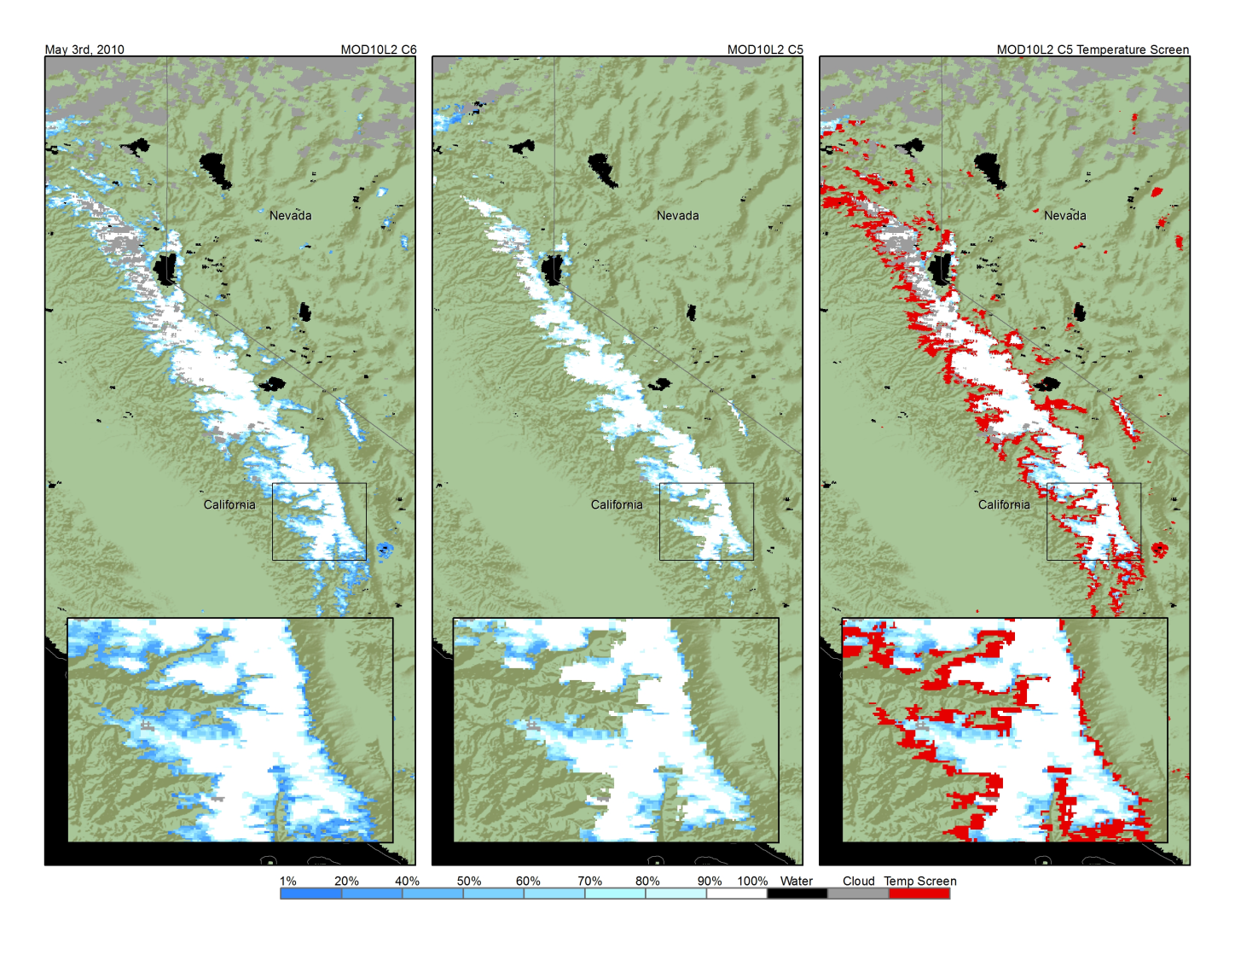
Deleterious Effect of the C5 Surface-Temperature Screen on Spring Snow-Cover Mapping in the Sierra Nevada Mts., USA
Collection 6 FSC Map
Collection 5 FSC Map
C5 / C6 difference
Red shows how much snow was “screened out “due to the tempera-ture screen in C5
Corrected in C6
3 May 2010

Slide 23
Collection-6 (C6) Algorithm Improvements
Dropped the surface temperature screen that erroneously reversed snow detection on some mountains during spring and summer in C5;
For Aqua products, we are in the process of implementing the Quantitative Image Restoration, QIR (Gladkova et al.), to improve snow mapping using Aqua MODIS data.
Dropped the binary snow product in C5 –only fractional snow algorithm will be provided using the full range of NDSI from 0.0 – 1.0; no binary product will be distributed;
Added new screens to alleviate snow commission errors;
Increased data information content in the QA data to enable better evaluation of the snow cover; QA flags set for screens applied.
Notes:
Some turbid water, clouds, can be confused & therefore new screens were needed.

Slide 24

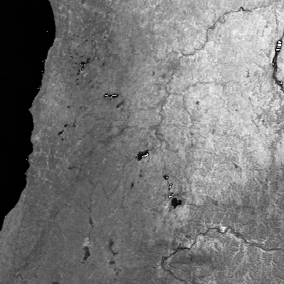
Quantitative Image Restoration (QIR) applied to Aqua Band 6
To enable the same snow algorithm to be used with both Terra and Aqua
Technique is based on multilinear regression over both spatial and spectral windows using Bands 1 – 5 and 7, to estimate value in Band 6
MYD02HKM C6 band6 has fill value for non-functional detectors. A sub image from MYD02HKM.A.2012043.1845.006*.hdf shown above.
MYD10_L2 with Quantitative Image Restoration (QIR) applied to MODIS Aqua band 6 data. QIR band6 restored shown above.
Gladkova, I., M. Grossberg, G. Bonev, P. Romanov, G. Riggs and D. Hall, 2012: A full snow season in Yellowstone: a database of restored Aqua Band 6, IEEE GSL, doi:10.1109/LGRS.2012.2213063.
Notes:
C6 : mcst decided not to fill missing data; in C5 we’ve been using Aqua band 7 and we adjusted the thresholds but quality wasn’t as good as with Terra; Lake superior ?? In C5 the Aqua snow algorithm uses band7 instead of band6 because of the non-functional band6 detectors. The QIR restores band6 image so that it can be used in the snow algorithm, and has the potential to be used by other algorithms or alone to make usable band 6 imagery.
The QIR algorithm has been successfully tested by MODAPS but there are technical implementation issues to be resolved to make it operational in MODAPS.

Slide 25
Collection-6 (C6) Algorithm Improvements
Dropped the surface temperature screen that erroneously reversed snow detection on some mountains during spring and summer in C5;
For Aqua products, we are in the process of implementing the QIR (Gladkova et al.) to improve snow mapping using MODIS band 6.
Dropped the binary snow product in C5 –only fractional snow algorithm will be provided using the full range of NDSI from 0.0 – 1.0; no binary product will be distributed;
Added new screens to alleviate snow commission errors;
Increased data information content in the QA data to enable better evaluation of the snow cover; QA flags set for screens applied.
Notes:
Some turbid water, clouds, can be confused & therefore new screens were needed.

Slide 26
Outline
New C6 products
C6 improvements
Northern Hemisphere snow cover time series from MODIS

Slide 27
Snow-Cover Trends in the Northern Hemisphere
13 winters of MODIS snow-cover maps are available to study short-term trends in snow-cover extent (SCE)
  Northern Hemisphere (North America & Eurasia separately)
  Regional studies
MODIS Terra maps of total SCE compare well with Rutgers University Climate Lab (RUCL) CDR maps, but MODIS maps have better spatial resolution (and other differences)

Slide 28
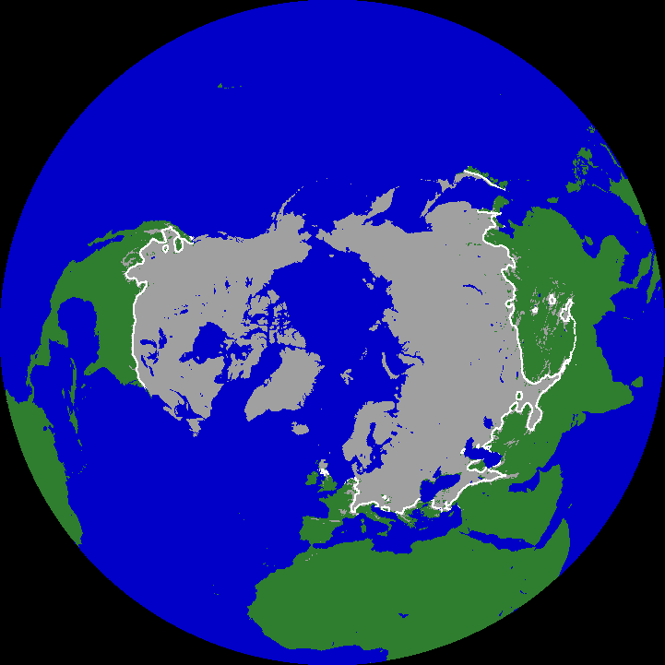
Average Maximum Snowline from MODIS, 2001 – 2012 Derived from MOD10CM standard data products
Derived from MOD10CM standard data products
Notes:
Average location of maximum annual snow cover extent in the Northern Hemisphere (NH) when a cell is reported to contain 40% or greater snow cover.

Slide 29
Snow Cover in Northern Hemisphere Declines in Springtime
June snow-cover reductions at a rate of -17.8% / decade between 1979 and 2011
(Derksen and Brown, 2012, GRL)
(a) snow-cover extent (SCE) anomaly time series from the NOAA snow chart CDR for (a) April, (b) May, and (c) June. Solid line denotes 5-yr running mean.

Slide 30
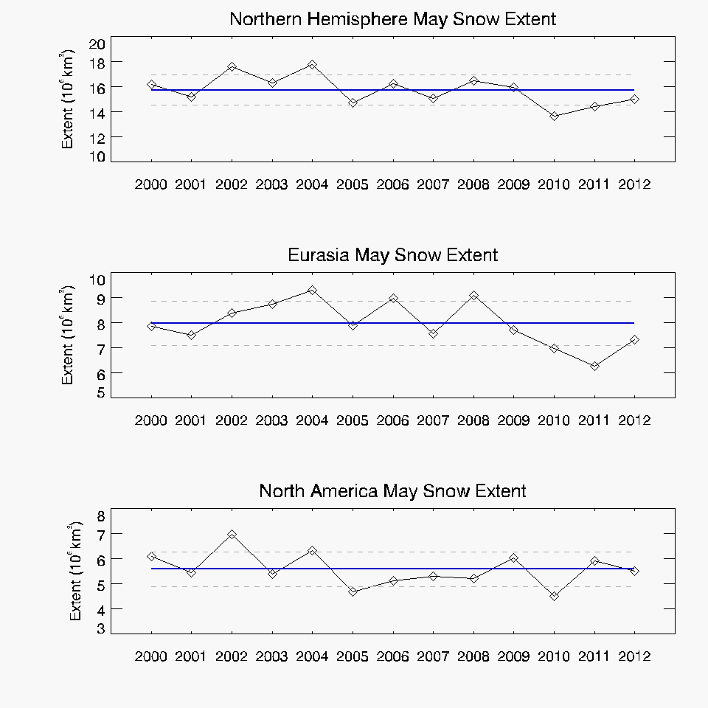
MODIS Monthly Data
Notes:
Trend numbers in 10⁶ km²
2000-2012:
-0.163710 NH
-0.103702 EA
-0.058545 NA
Just looking at 2004-2012:
-0.273574 NH
-0.275210 EA
0.000156 NA Derksen and Brown (2012) show increasingly negative SCE anomalies for the spring (Apr – Jun) in the NH

Slide 31
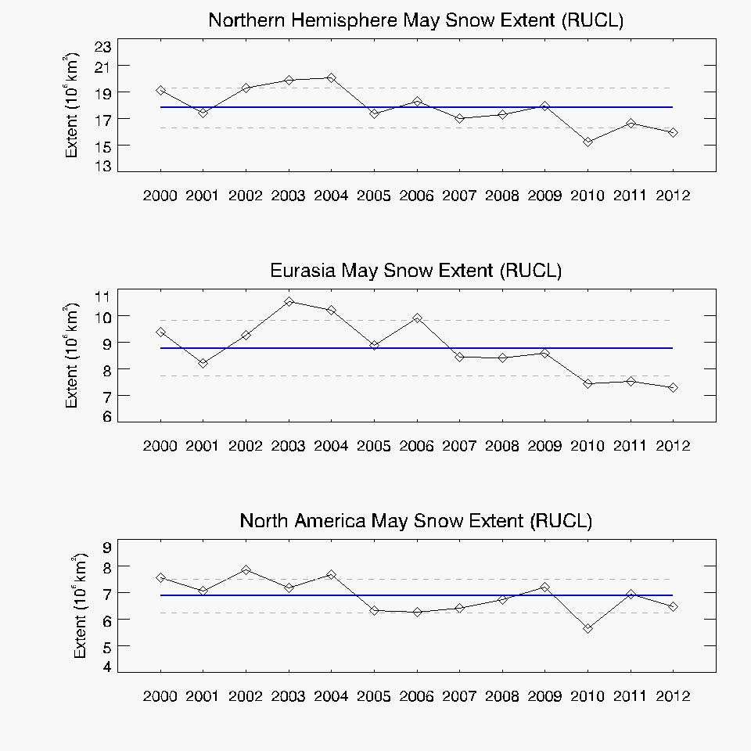
Rutgers (RUCL) Monthly Data
Notes:
Here are the RUCL data plots.
The trend values (in 10^6 km sq):
2000-2012
-0.280110 NH
-0.181923 EA
-0.098022 NA
2004-2012
-0.399833 NH
-0.341500 EA
-0.057833 NA

Slide 32
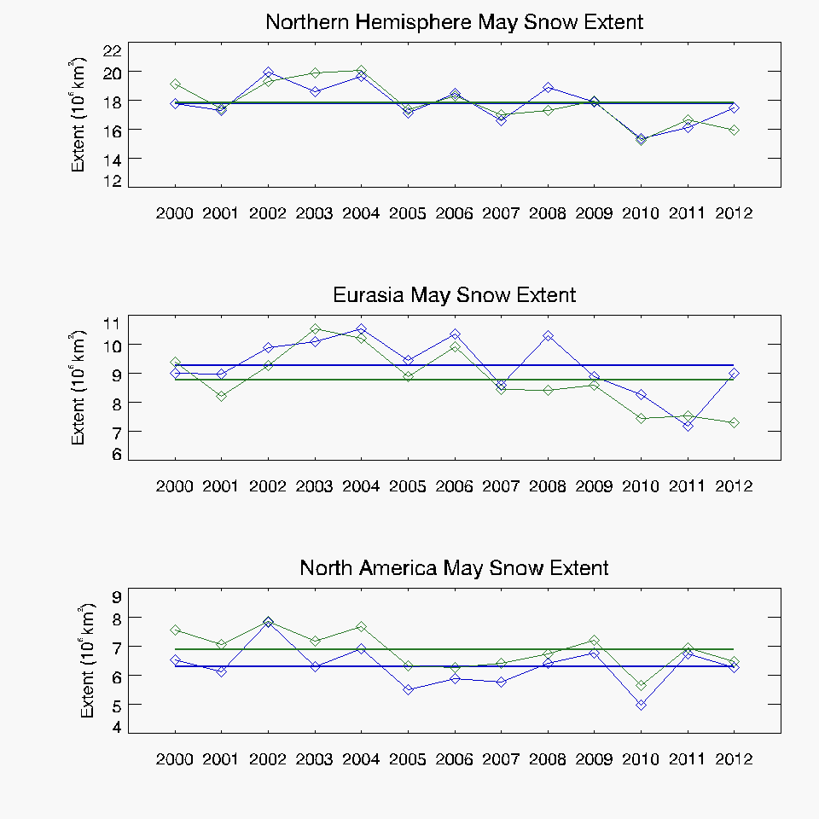
Comparison of MODIS & RUCL
Key:
Modis
RUCL
Notes:
25% or greater per pixel snow cover in modis

Slide 33
Conclusions
Snow cover and sea ice algorithms were mature in C5, but improvements have been made;
New products will be added to C6:
  Cloud-gap filled snow maps;
  Maps based on surface reflectance (instead of TOA).
Standard snow product improvements:
  Removed surface temperature screen;
  Added screens to reduce snow commission errors.
13-yr time series is especially useful for regional and snow-cover global studies and creation of a CDR which can be continued in the VIIRS era.

