Slide 1


MODIS Leaf Area Index (LAI) and Fraction of Vegetation Absorbed Photosynthetically
Active Radiation Products (FPAR) Products – An Update
Ranga B. Myneni
Department of Earth & Environment
Boston University

Slide 2
C6 Science Test Results (Credit: Drs. Sarkar and Devadiga)
Scientific Activities
Community Support
Concluding Remarks

Slide 3
C6 Science Test Results
Used L2G–lite surface reflectance at 500m resolution as (MOD09GA) input in place of
reflectance at 1km resolution (MODAGAGG).
An intermediate daily surface reflectance product (MOD15IP) at 500m resolution is
created from MOD09GA before being used by the LAI/FPAR PGE.
Uses the new multi-year land cover product at 500m resolution in place of the 1km
resolution land cover product used in the C5 operational processing. The new land cover
product is expected to be more accurate.
Uses the C5 science algorithm and LUT.

Slide 4
C6 Science Test Results
Test Data period
  Processed two 16-day periods starting with data day 2003-001 and 2003-193
  Processed Terra and Aqua
Baseline data (AS 825)
  Input is C5 MODAGAGG and Land Cover from C5 processing (Land Cover 3)
  Ran C5 operational version of PGE33/34/94
Test data (AS 827)
  Input is C5 L2G-lite MOD09GA and Land Cover Type 1
  Ran C6 version of PGE33/34/94

Slide 5
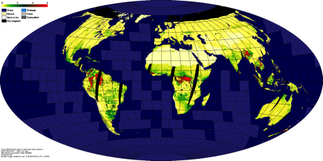
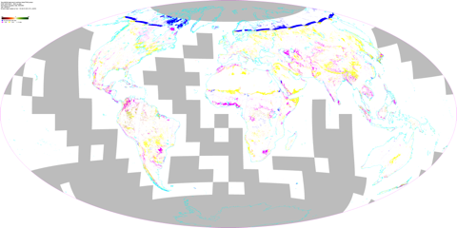
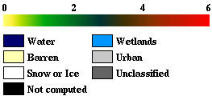
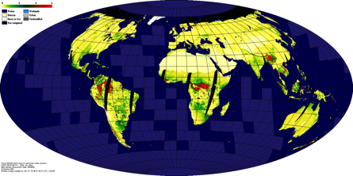
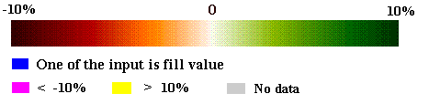
C6 Science Test Results
C5-LAI
Year 2013 Day 002
Relative Diff.
((C6-C5)/C5)*100
C6-LAI

Slide 6
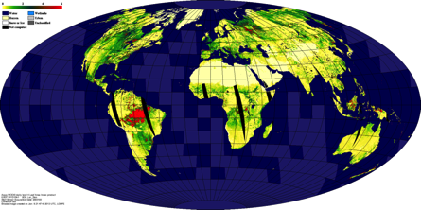
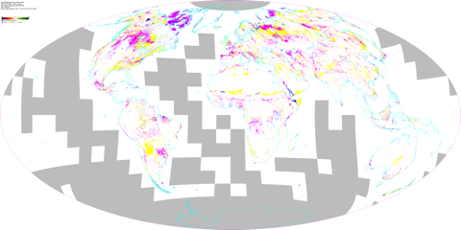
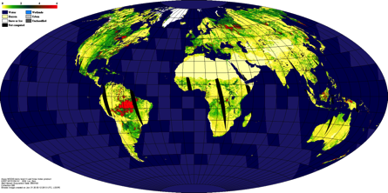
C6 Science Test Results
C5-LAI
Year 2013 Day 193
Relative Diff.
((C6-C5)/C5)*100
C6-LAI

Slide 7
C6 Science Test Results
Globally the C6 500M inputs seem to produce outputs comparable with C5 1KM version.
  The relative differences are mostly biased towards negative suggesting that the new C6 products are underestimating the LAI/FPAR values compared to C5.
  Over the entire global the absolute difference in FPAR is generally within C5 ± 0.04 and that for LAI is C5 ± 0.4
Noticed a few other issues:
  Extra coverage of ~5º in the north which is resulting from difference in threshold for solar zenith while using MODAGAGG or L2G-lite as input
  Large scale difference over areas near the Arctic circle, like Greenland mainly due to differences in the underlying land cover types used in C5 and C6.

Slide 8
C6 Science Test Results
Tile-based Analysis
Significant difference in both LAI and FPAR seen during summer in test tiles from central and mid-west region of US, Amazon and African Savannah.
In general C5 output shows higher values than C6
The bands (channel 1 and 2) for the two input data sets MODAGAGG (C5) and MOD15IP (C6) seem to be quite comparable.
The Red bands from the two datasets are more closely related than the NIR band.
The significant differences seen in LAI and FPAR values seems to come from the difference in Land Cover used in the baseline C5 and the new test C6.
The Project can do limited science testing and provide diagnostics, but only the science team member can perform comprehensive analysis and develop any needed algorithm refinements to maintain the integrity of the products.

Slide 9
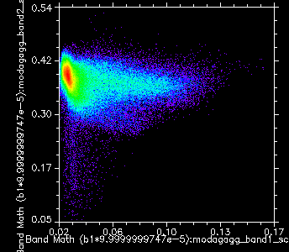
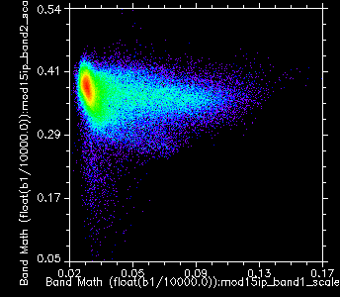
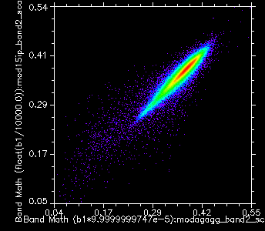
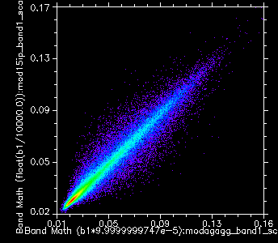
C6 Science Test Results
Scatter plot of Red vs NIR
H12v03 – Mid-West USA
MODAGAGG – C5
MOD15IP – C6
Scatter plot of NIR
Scatter plot of Red
MOD15IP – C6
MOD15IP – C6
MODAGAGG – C5
MODAGAGG – C5

Slide 10
2. Scientific Activities
Published Articles
Fang et al., 2013. Characterization and Intercomparison of Global Moderate Resolution Leaf Area Index (LAI) Products: Analysis of Climatologies and Theoretical Uncertainties, J. Geophys. Res. (Biogeosciences), doi: 10.1002/jgrg.20051
Mao et al., 2013. Global Latitudinal-Asymmetric Vegetation Growth Trends and Their Driving Mechanisms 1982-2009, Remote Sens. 2013, 5, 1484-1497; doi:10.3390/rs5031484
Zhu et al., 2013. Global Data Sets of Vegetation Leaf Area Index (LAI)3g and Fraction of Photosynthetically Active Radiation (FPAR)3g Derived from Global Inventory Modeling and Mapping Studies (GIMMS) Normalized Difference Vegetation Index (NDVI3g) for the Period 1981 to 2011, Remote Sens. 2013, 5, 927-948; doi:10.3390/rs5020927
Fang et al., 2013. The Impact of Potential Land Cover Misclassification on MODIS Leaf Area Index (LAI) Estimation: A Statistical Perspective, Remote Sens. 2013, 5, 830-844; doi:10.3390/rs5020830
Samanta et al. 2012. Seasonal changes in leaf area of Amazon forests from leaf flushing and abscission, J. Geophys. Res. VOL. 117, G01015, doi:10.1029/2011JG001818
Samanta et al., 2011. Comment on "Drought-Induced Reduction in Global Terrestrial Net Primary Production from 2000 Through 2009", Science, Vol. 333, p. 1093, DOI: 10.1126/science.1199048, 2011.

Slide 11
The average uncertainties and relative uncertainties are in the order: MODIS (0.17, 11.5%) <
GEOV1 (0.24, 26.6%) < Land-SAF (0.36, 37.8%) < JRC-TIP (0.43, 114.3%) - (Fang et al., 2013).

Slide 12
2. Scientific Activities
Accepted/Submitted Articles
Sitch et al., 2013. Trends and Drivers of Regional Sources and Sinks of Carbon Dioxide over the Past Two Decades, Global Change Biology (accepted).
Poulter et al., 2013. Recent Trends in Inner Asian Forest Dynamics to Temperature and Precipitation Indicate High Sensitivity to Climate Change, Agric. Forest. Meteorol. (accepted).
Wang et al. 2013. Evaluation of CLM4 Solar Radiation Partitioning Scheme Using Remote Sensing and Site-level FPAR Data Sets, Remote Sensing (submitted).
Anav et al., 2013. Evaluation of the Carbon Cycle Components of CMIP5 Earth System Models, Remote Sensing, (submitted).

Slide 13
3. Community Support
Generating higher quality, but downscaled, MODIS LAI and FPAR products from standard MODIS products and distribution via the PI web site.
Producing “custom” products for certain class of users (CMIP5, Carbon/Ag/Hydrology/Atmospheric Chemistry/etc. modelers).
Research on developing a LAI/FPAR CDR (AVHRR-MODIS fused product time series) and distribution to the community – currently distributing a 30 year LAI/FPAR data set.
The long-term data sets seem to be in much demand by the vast majority of users where the
focus is on climate change science needs.

Slide 14
4. Concluding Remarks
The Project can do limited science testing and provide diagnostics, but the science team member can perform comprehensive analysis and develop needed algorithm refinements to maintain the integrity of the products. This is clearly the case with C6 MODIS LAI/FPAR
MODIS LAI/FPAR products are the “best” of the current crop of LAI/FPAR products.
Product “quality” cannot be assured without the PI as the “gate keeper”
As the length of the time series is increasing, the scientific community is increasingly reaping the rewards from MODIS.
We need to continue the “tried and tested” model of a science team behind a live MODIS mission.

