Slide 1

Update on MOD17, GPP and NPP, and MOD16 ET
Steven W. Running
Numerical Terradynamic Simulation Group
College of Forestry and Conservation
University of Montana
MODIS Science Team Meeting
April 16, 2013

Slide 2
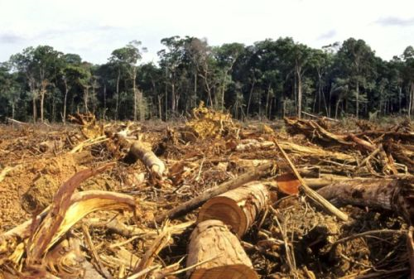
The Human Perturbation of the CO₂ Budget (2000-2009)
7.7±0.5 PgC y⁻¹
4.1±0.1 PgC y⁻¹
47%
+
2.4 PgC y⁻¹
27%
1.1±0.7 PgC y⁻¹
Calculated as the residual
26%
2.3±0.4 PgC y⁻¹
Global Carbon Project 2010; http://www.globalcarbonproject.org/carbonbudget/index.htm

Slide 3


Efficiency of Natural Sinks
Land Fraction
Ocean Fraction
Canadell et al. 2007, PNAS
Notes:
The global oceanic CO2 sink removed 25% of all CO2 emissions for the period 2000-2007, equivalent to an average of 2.3 PgC per year. The size of the CO2 sink in 2007 was similar to that in the previous year but lower by 0.1 PgC compared to its expected increase from atmospheric CO2 growth. This was due to the presence of a La Nina event in the equatorial Pacific. The Southern Ocean CO2 sink was higher in 2007 compared to 2006, consistent with the relatively weak winds and the low Southern Annular Mode. An analysis of the long term trend of the ocean sink shows a slower growth than expected of the CO2 sink over the last 20 years.
Terrestrial CO2 sinks removed 29% of all anthropogenic emissions for the period 2000-2007, equivalent to an average of 2.6 PgC per year. Terrestrial ecosystems removed 2.9 PgC in 2007, down from 3.6 Pg in 2006, largely showing the high year-to-year variability of the sink. An analysis of the long term trend of the terrestrial sink shows a growing size of the CO2 sink over the last 50 years.

Slide 4
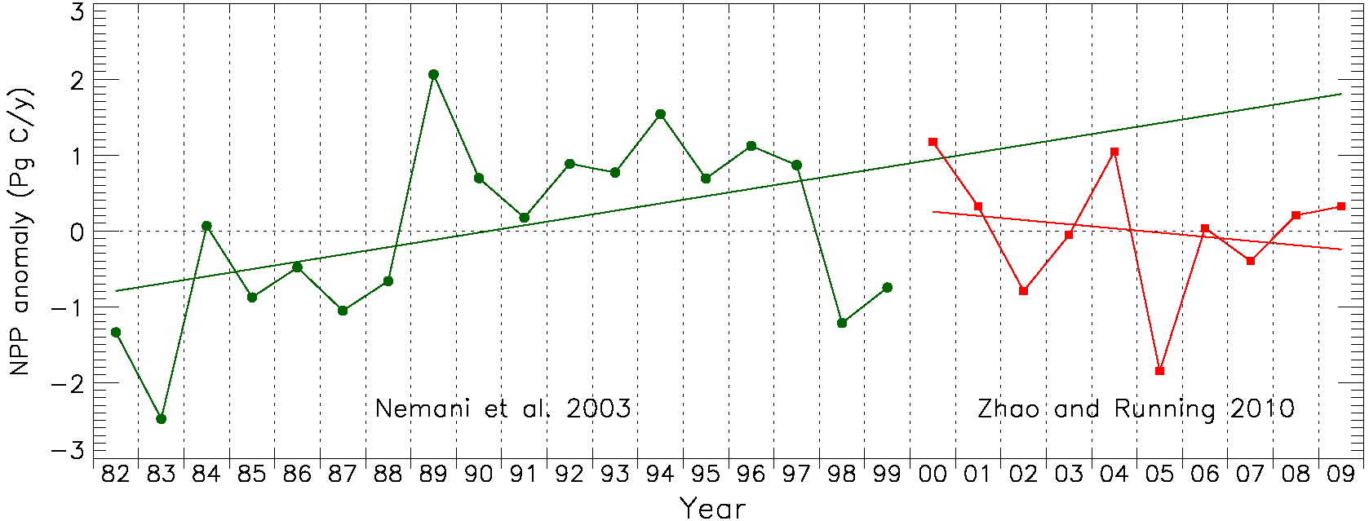
Global Trend in NPP (1982 – 2009)
AVHRR + MODIS with EOS algorithm

Slide 5
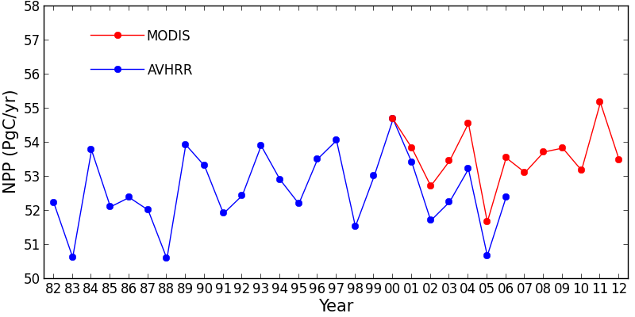
Global Terrestrial Net Primary Production (1982-2012)
+/- 1Pg or about 2%
Nemani et al 2003, Zhao and Running 2010

Slide 6
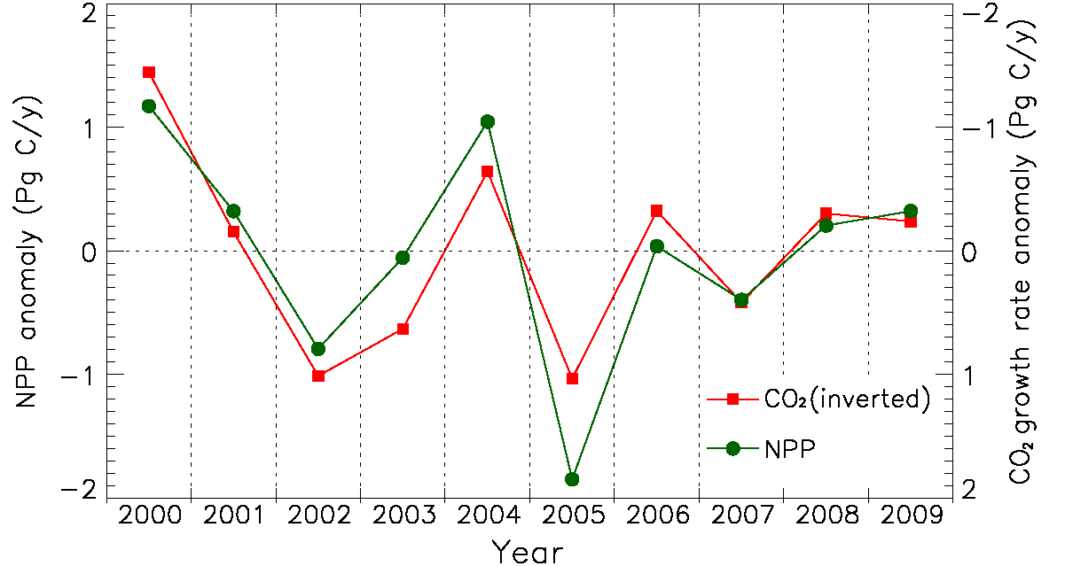
Global MODIS NPP Anomaly
R = -0.89, p < 0.0006
Zhao & Running 2010, Science
Notes:
The current financial crisis had a small but probably discernable impact on the emissions growth rate in 2008 (growth rate of 2.0% down from 3.4% per year average over the previous 7 years). Despite this slowdown, fossil fuel emissions continue to track the average of the most carbon-intensive scenario of the Intergovermental Panel on Climate Change. In 2009, we project emissions to decline to levels observed in 2007 with negative growth of -2.8%. Positive growth is expected return in 2011 as the change in global Gross Domestic Product goes positive.
We have estimated emissions for 2009 based on the projection of -1.1% GDP growth rate provided by the International Monetary Fund (October 2009) and assuming a continue global decline in the carbon intensity of the GDP as seen over the last 30 years (-1.7% per year).

Slide 7
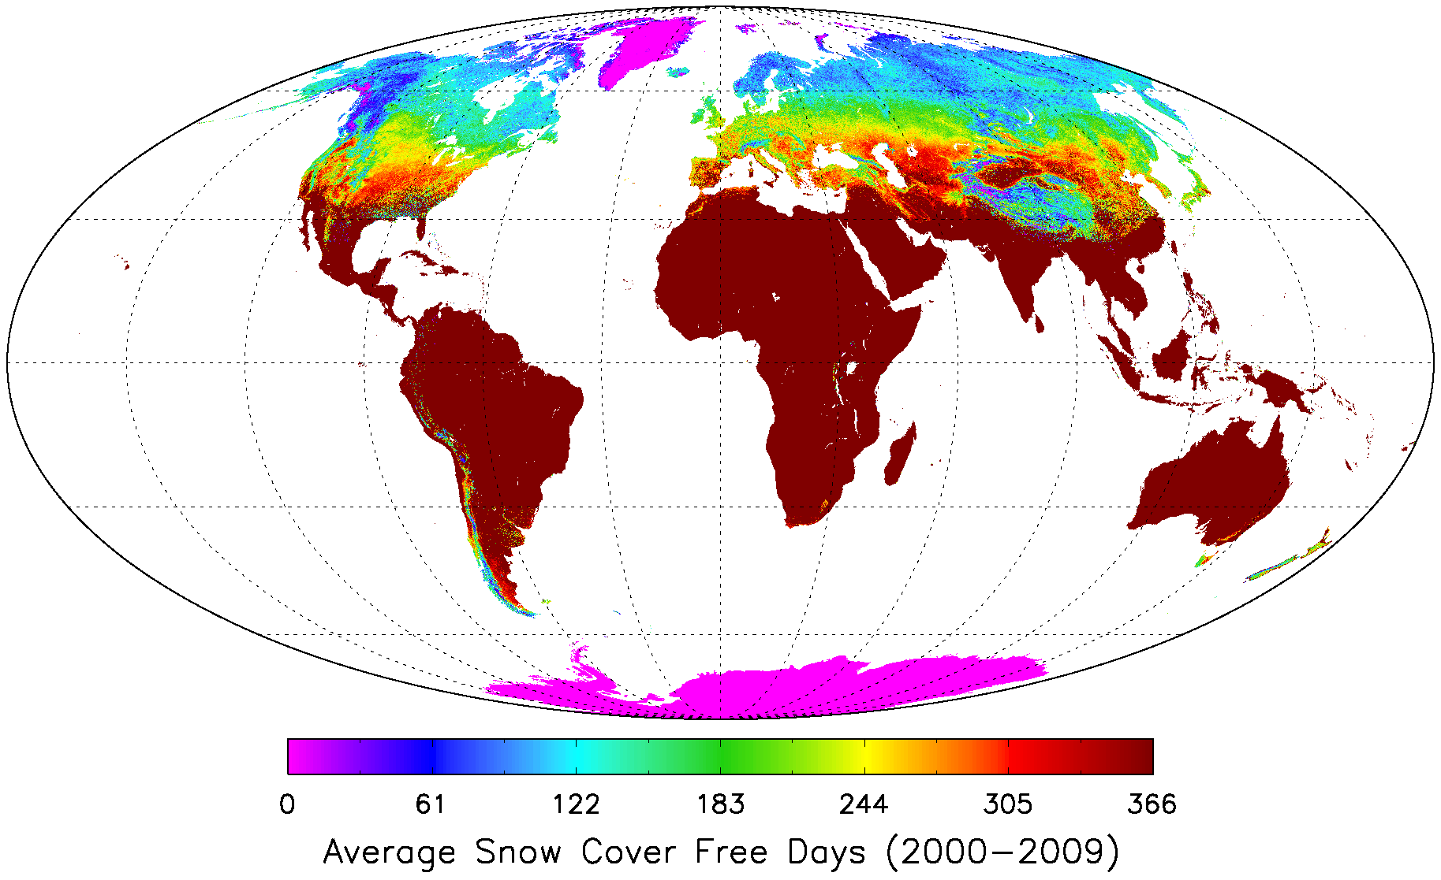
Temperature is a control factor of growing season for NH but not SH !
For NH, 125 days snow cover
For SH, 7.5 days snow cover
Zhao & Running 2010, Science
Notes:
This is derived from the Colleciton5 MODIS snow cover dataset.

Slide 8
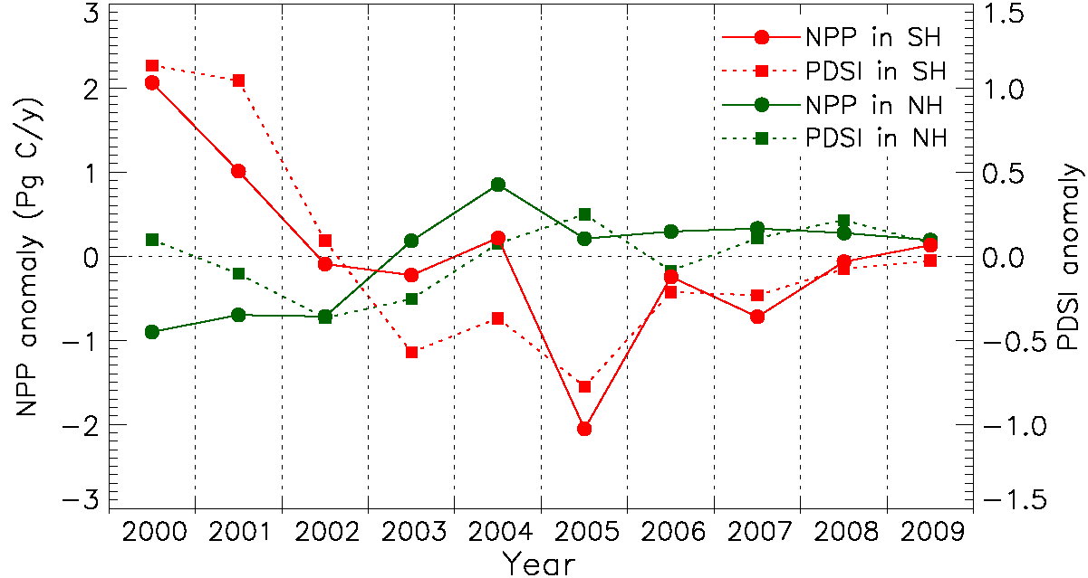
NPP over two hemisphere trend (2000-2009)
For NH, R = 0.39, p < 0.27
For SH, R = 0.87, p < 0.001
Zhao & Running 2010, Science
Notes:
PDSI is Palmer Drought Severity Index

Slide 9
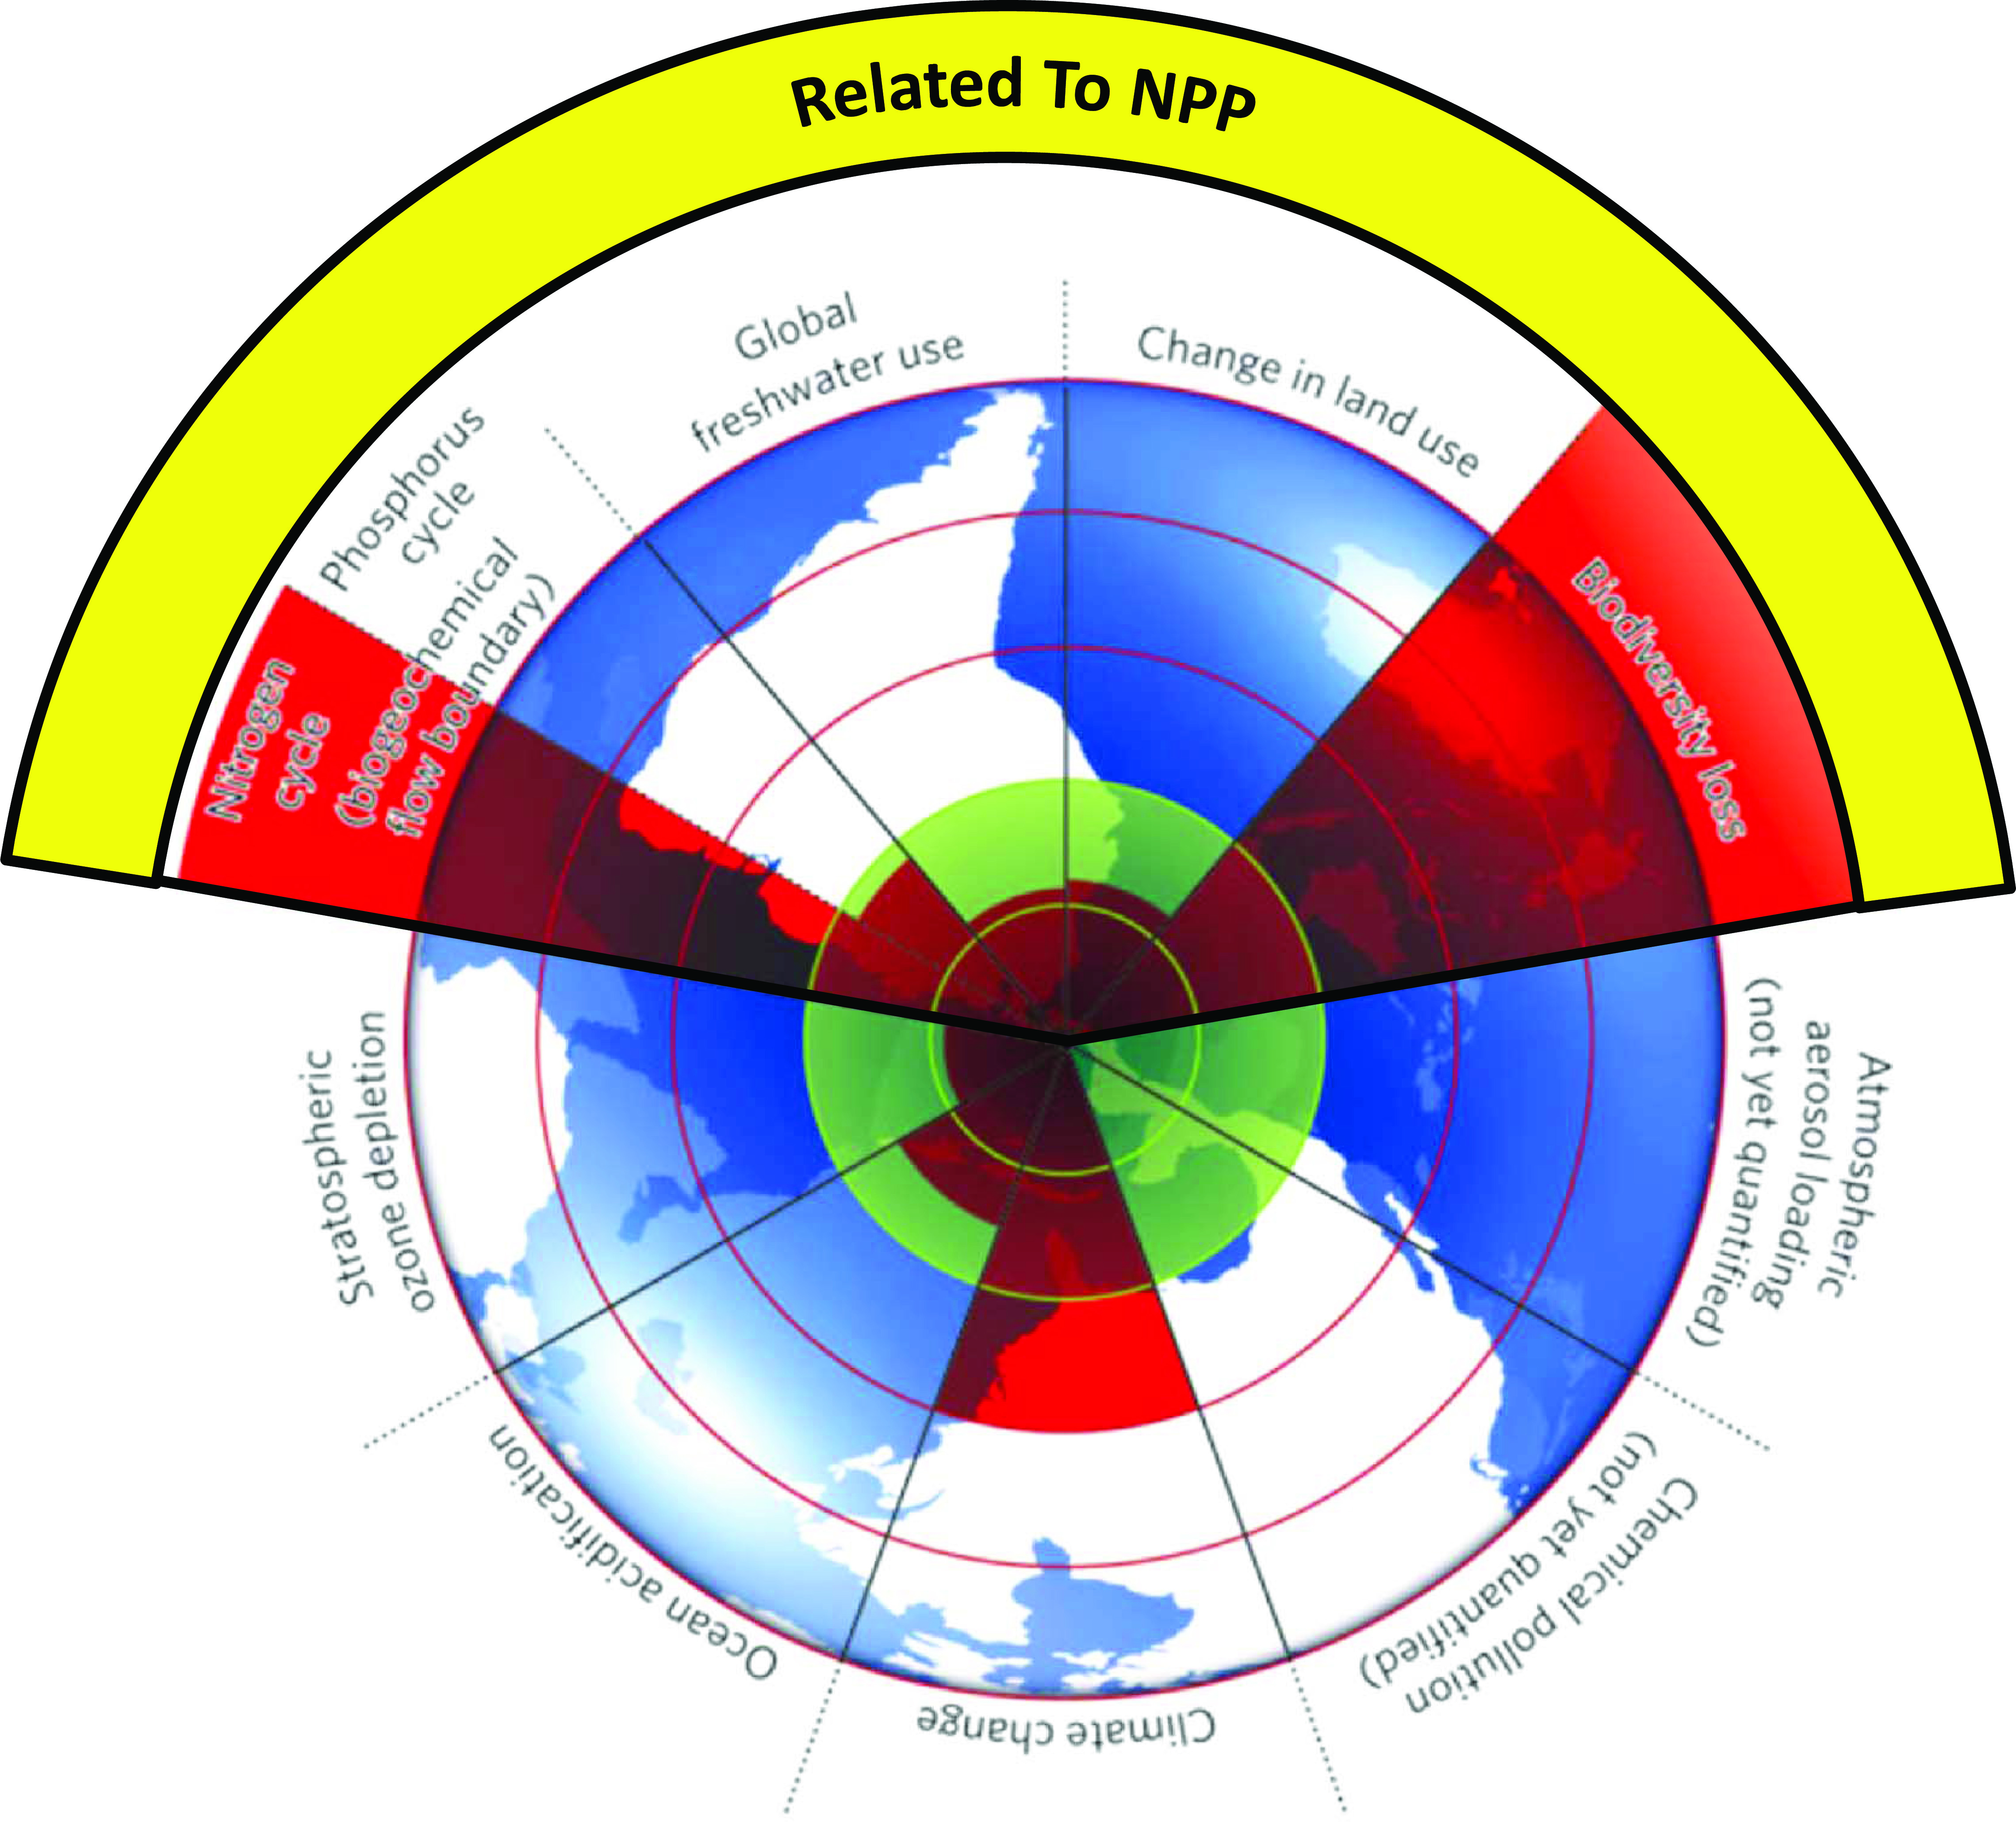

Slide 10
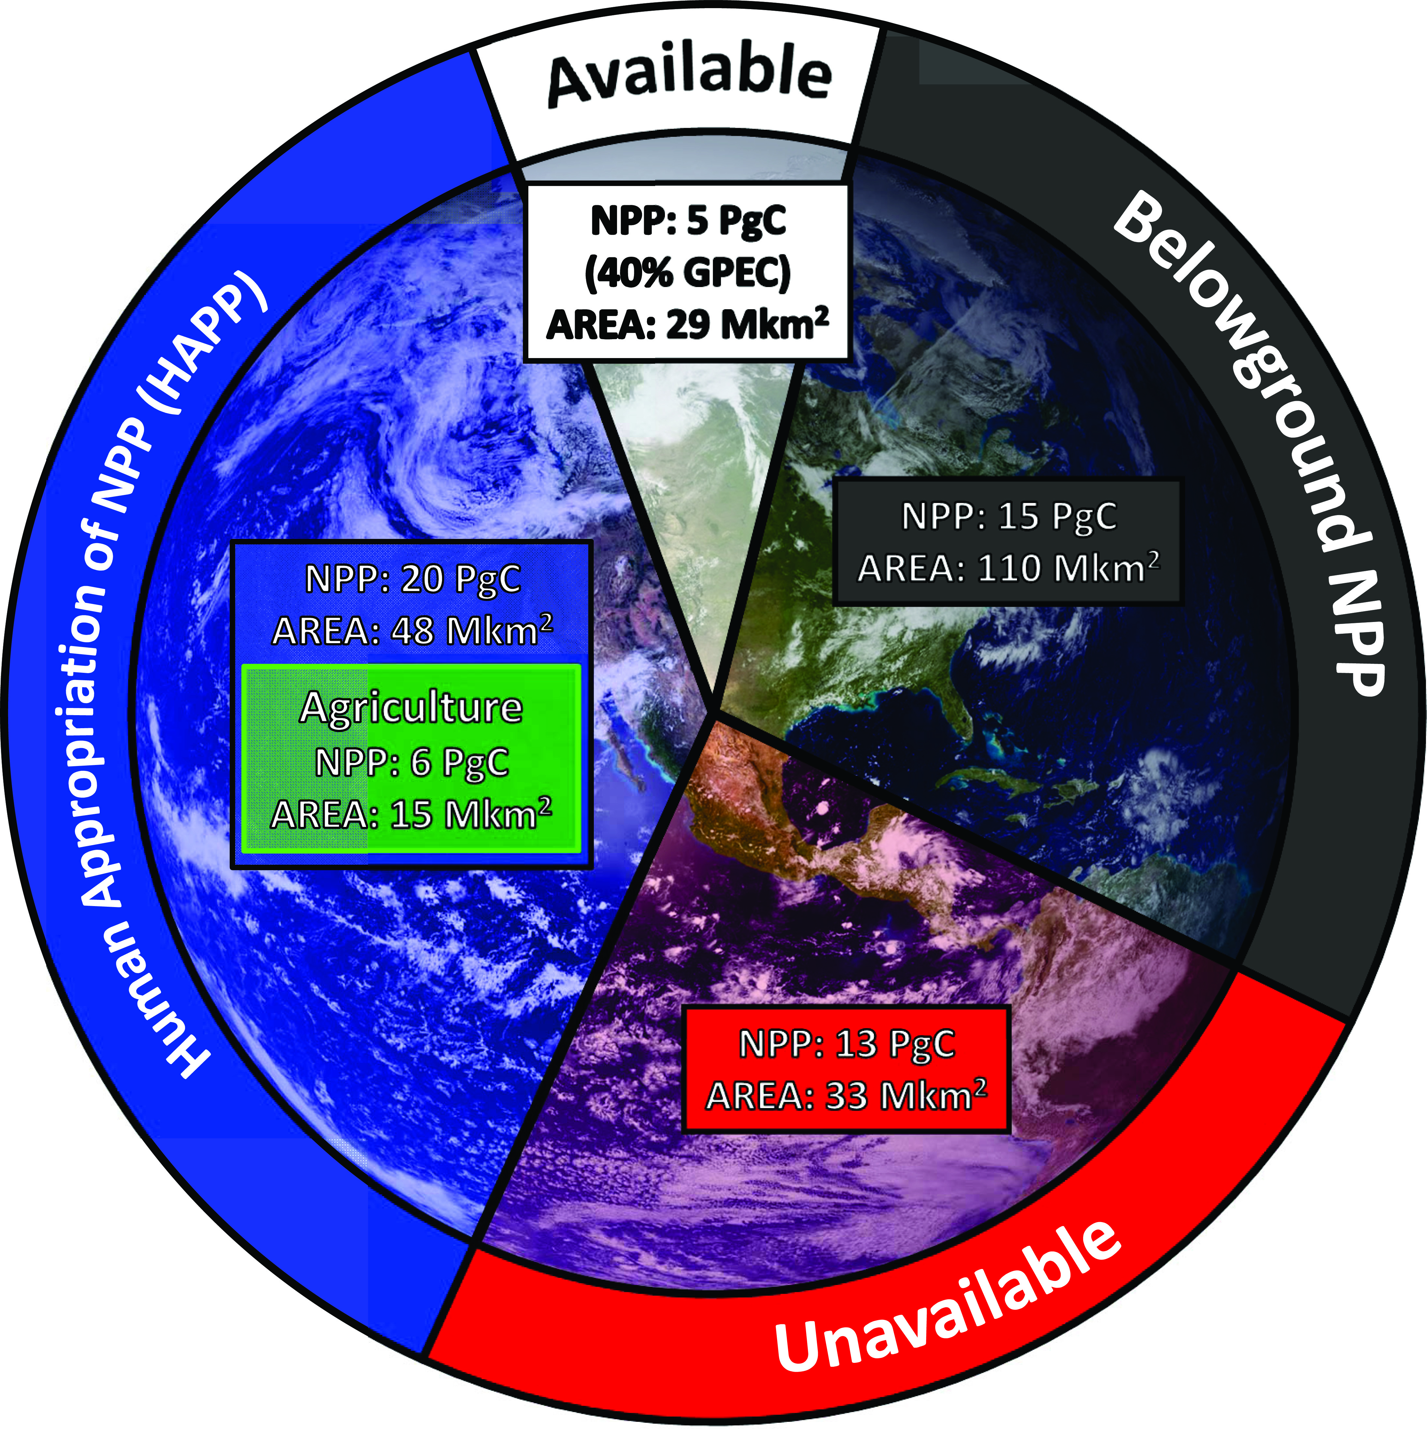
From Running, SW. Science 337 p1458-1459, 2012

Slide 11
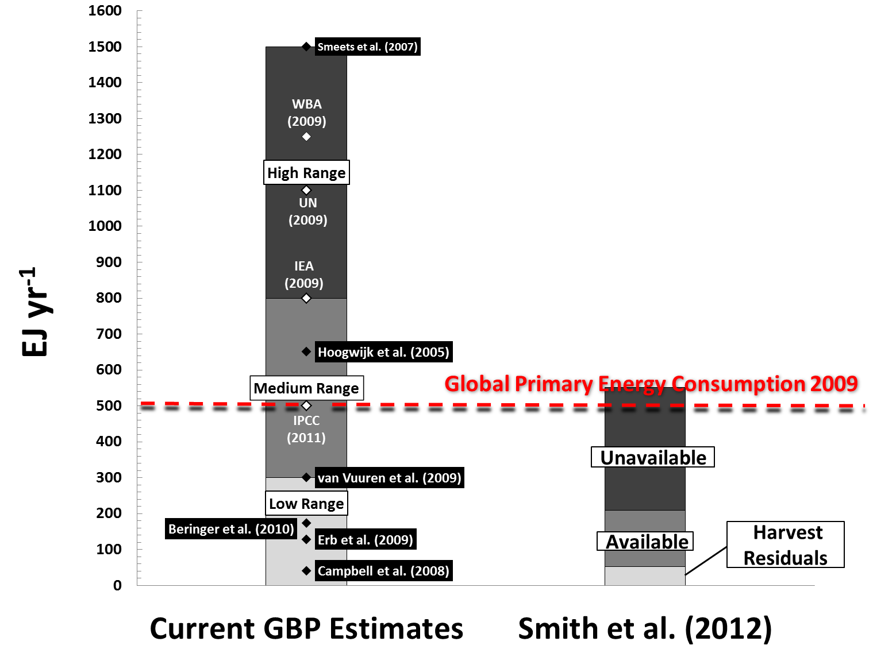
Capacity for Bioenergy Production
(estimated by ecologists)

Slide 12
PENMAN-MONTEITH equation for Evapotranspiration
THE PROBLEM
Temperature + Precipitation
does NOT show the landscape aridity
Land Water Balance = Precipitation – Evapotranspiration
Solar radiation
Air
Temperature
Humidity
Windspeed
Veg Leaf Area
Fairbanks and Tucson have nearly identical annual precipitation,
The difference is potential evaporation!

Slide 13
Spatial pattern of the 0.05°-resolution global MODIS ET anomalies during 2000-2005

Slide 14
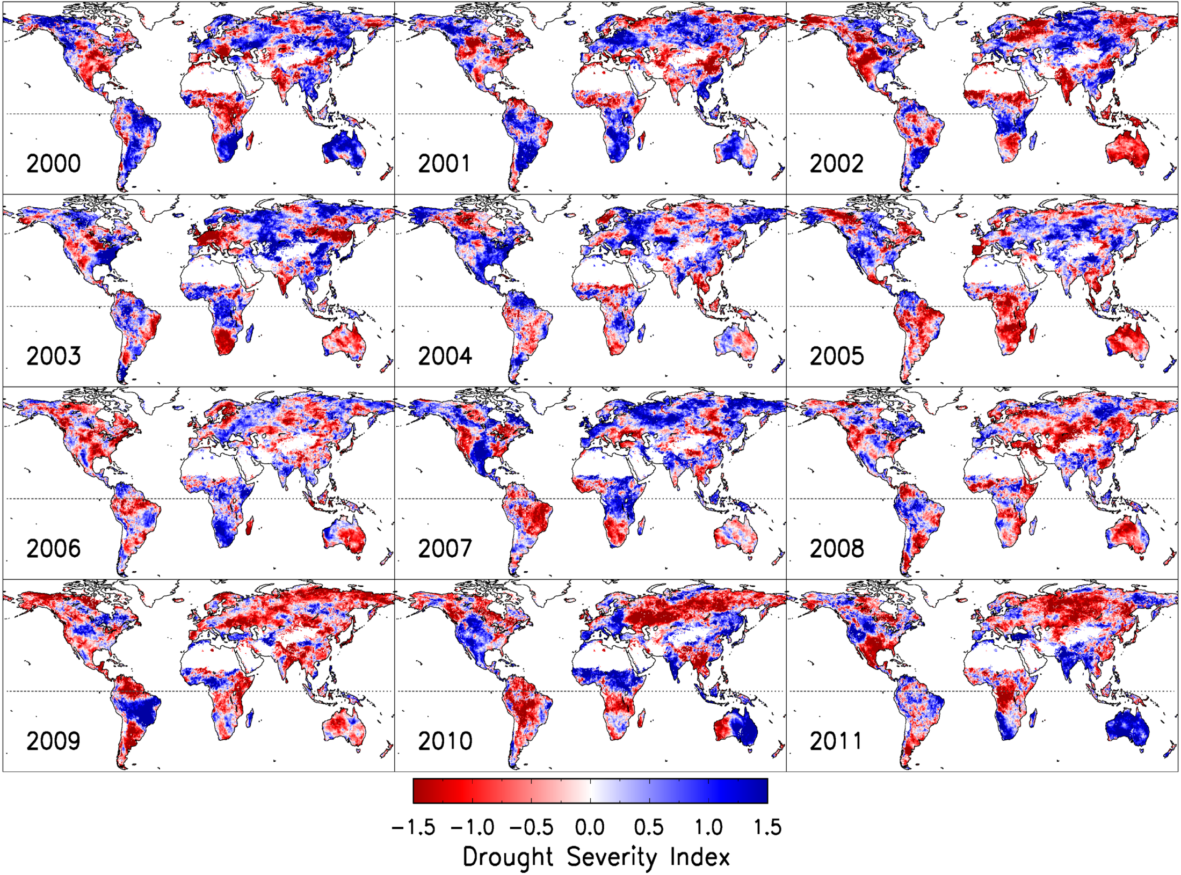

Slide 16
