Slide 1
Multi-Sensor Analysis of Global Daytime and Nighttime Urban Heat Islands
Steve Frolking¹, Annemarie Schneider², Jingfeng Xiao¹,
Tom Milliman¹, Leah Cheek³, Mark Friedl³
1. University of New Hampshire, Durham
2. University of Wisconsin, Madison
3. Boston University

Slide 2
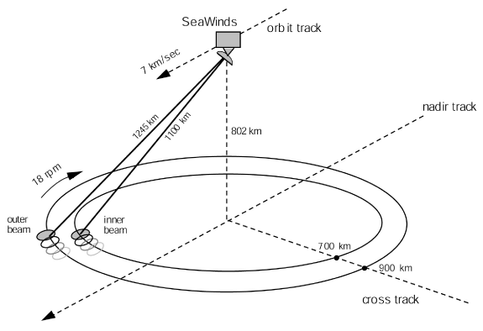
Ku-band
microwave
scatterometer
NASA Scatterometer Climate Pathfinder
D.Long, Brigham Young University

Slide 3
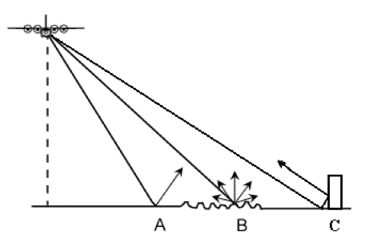
Ku-band
microwave
scatterometer
surface scattering
Seoul
A – specular reflection
B – diffuse scattering
C – corner reflector
Tokyo
Big cities have strong backscatter.

Slide 4
1.3 million new urban residents per week globally until 2050
Essentially all population growth in the coming 3.5 decades.
Where is growth occurring? With what effect on urban structure?

Slide 5
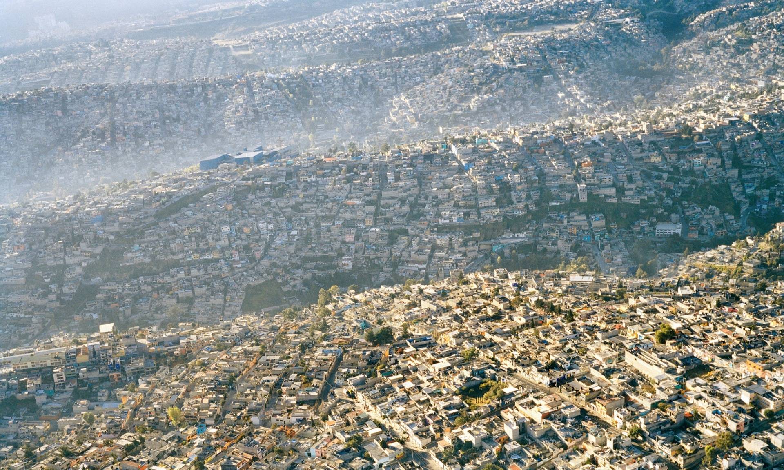
1.3 million new urban residents per week globally until 2050
Essentially all population growth in the coming 3.5 decades.
Where is growth occurring? With what effect on urban structure?
horizontal spread/sprawl
Mexico City; Photo: Pablo Lopez Luz

Slide 6
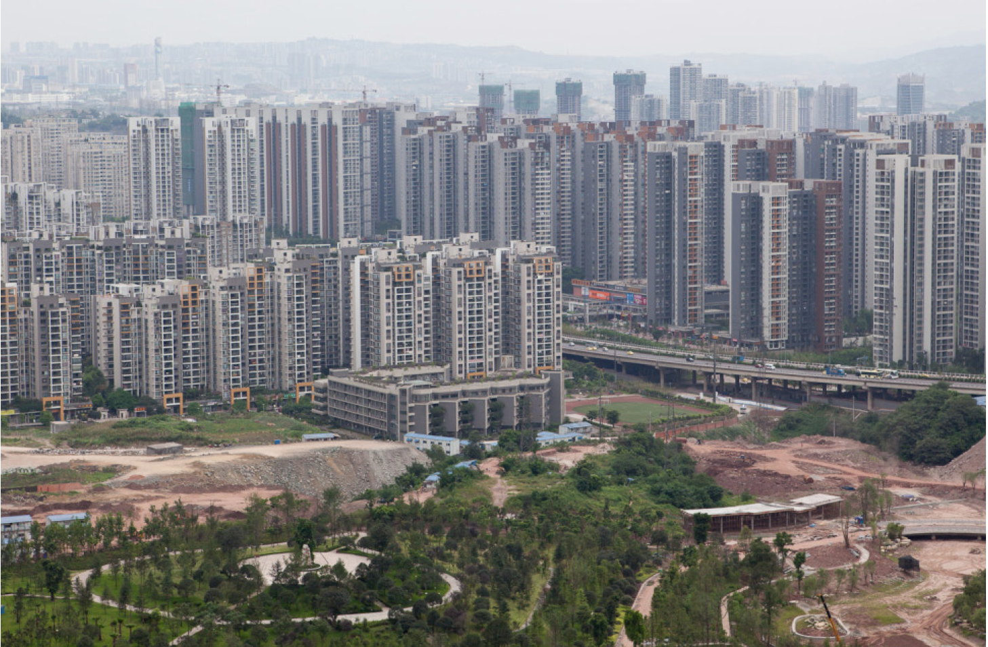
1.3 million new urban residents per week globally until 2050
Essentially all population growth in the coming 3.5 decades.
Where is growth occurring? With what effect on urban structure?
horizontal spread/sprawl -or- vertical rise/densification?
Mexico City; Photo: Pablo Lopez Luz Chongqing, China; Photo : Matthew Niederhauser

Slide 7
1.3 million new urban residents per week globally until 2050
Essentially all population growth in the coming 3.5 decades.
Where is growth occurring? With what effect on urban structure?
horizontal spread/sprawl -or- vertical rise/densification?
Mexico City; Photo: Pablo Lopez Luz Chongqing, China; Photo : Matthew Niederhauser
What are the consequences?
1. energy and resource use, etc.
2. urban heat islands.

Slide 8
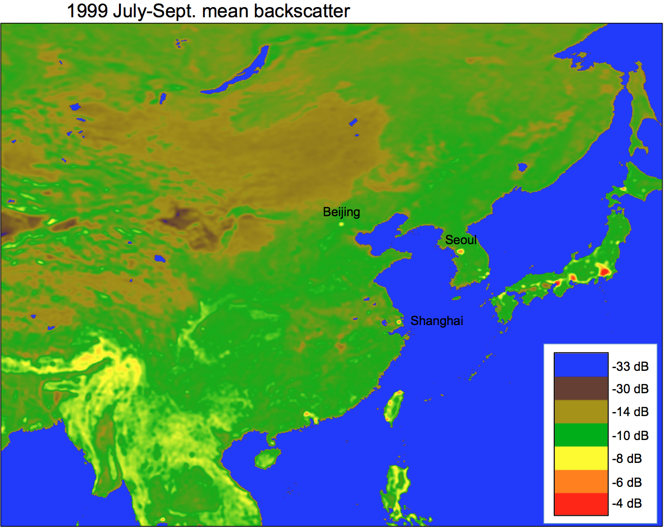
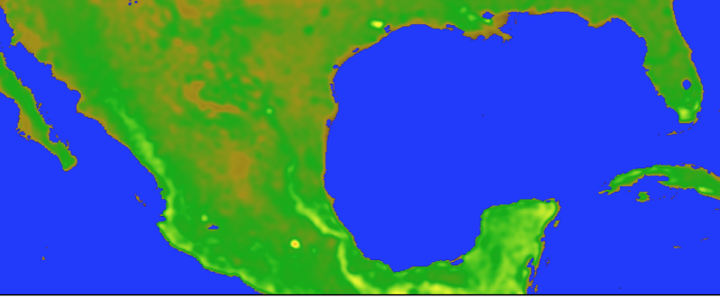

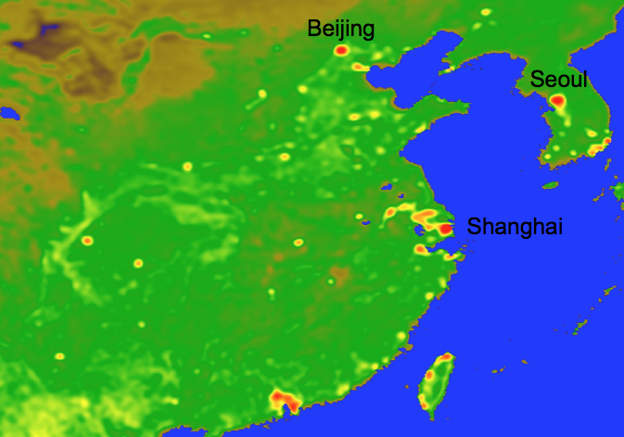
Mean July-Sept. SeaWinds Ku-band microwave backscatter in 1999 & 2009
1999
1999
Mexico City
Chongqing
2009
2009
quev data
http://scp.byu.edu

Slide 9
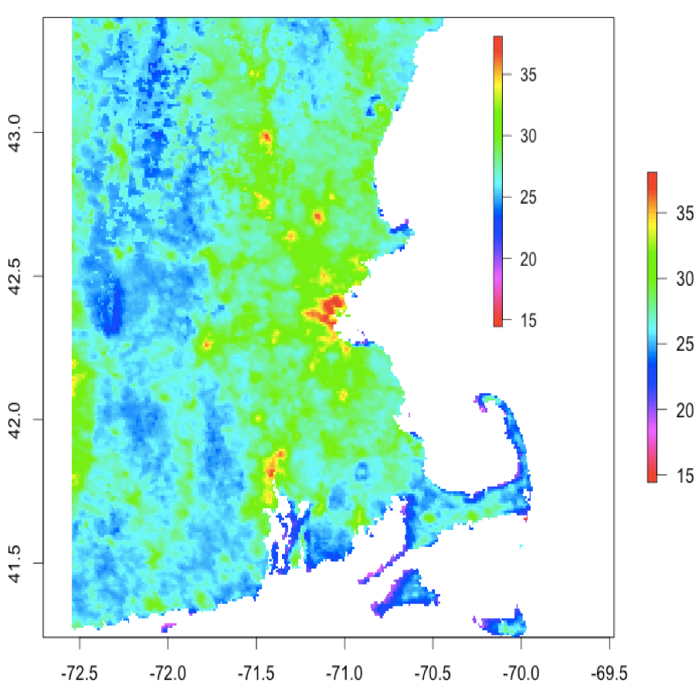
Urban heat islands
MODIS TERRA daytime LST (°C)
20 July 2001
Causes – Daytime:
energy balance driven by incoming
solar radiation; land surface
albedo and capacity to evaporate
water (land cover).
Causes – Nighttime:
cooling often inhibited by thermal
inertia of built environment and
waste heat exhaust from
energy use.
Mortality risk in US cities increased by ~2.5% per °F during prolonged periods of extreme heat (Anderson & Bell 2011).
Lack of nocturnal cooling can critically affect the amount of heat stress in large city core regions (Changnon et al. 1996).
Boston

Slide 10
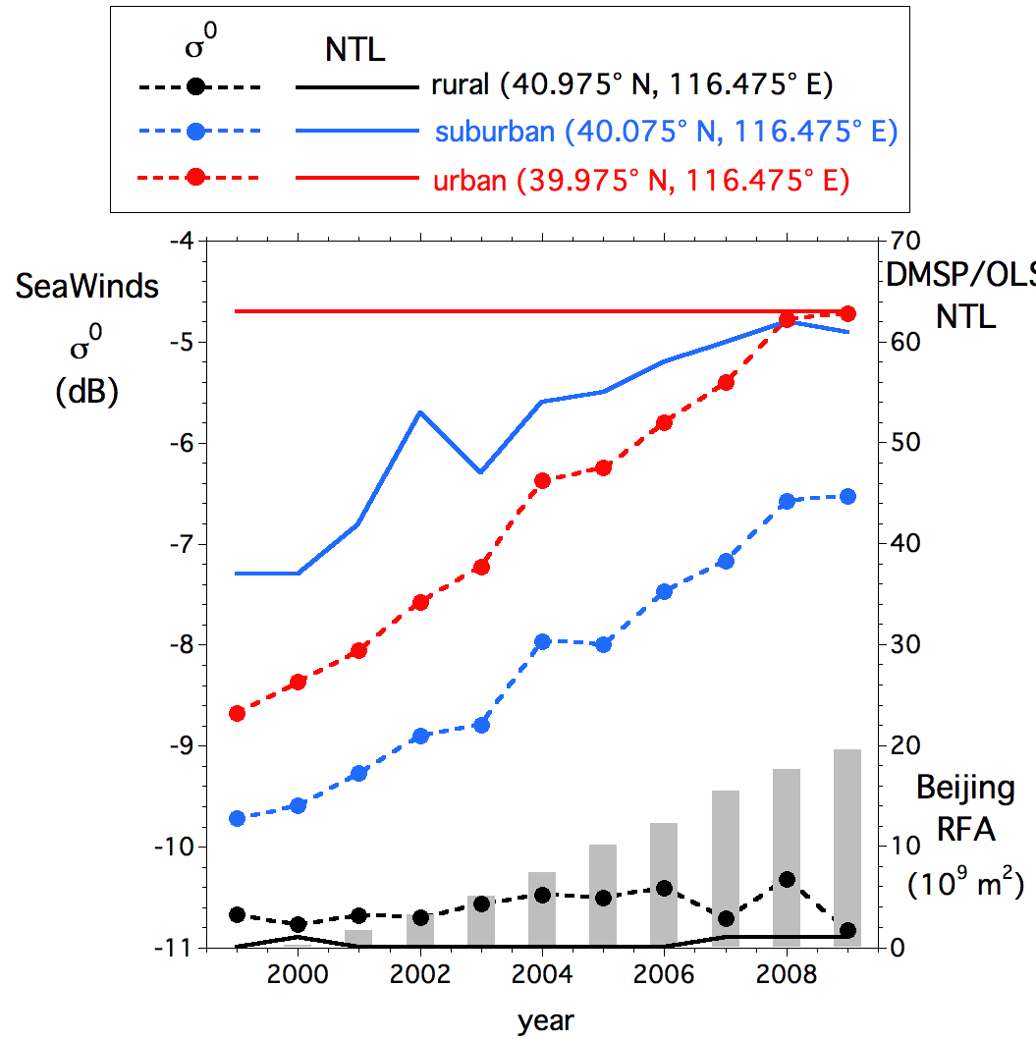
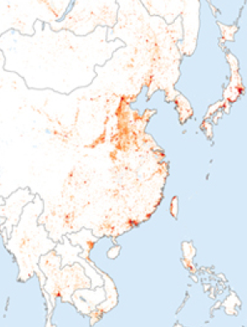
Project Overview
MODIS: map global urban expansion 2000-2010
Global Annual Urban Metrics
• MODIS: urban extent
• SeaWinds: urban backscatter
• DMSP/OLS: nighttime lights
• MODIS: % vegetation cover
• MODIS: EVI
• MODIS: rural landcover
MODIS: Land Surface Temperature
• Daytime and Nighttime LSTs
• Urban-Rural LST differences
Temporal trends
Empirical Analyses:
• stepwise multiple regression;
• classification & regression tree
Spatial patterns
Explanatory power for daytime and nighttime urban heat islands for each urban metric, with confidence intervals.

Slide 11
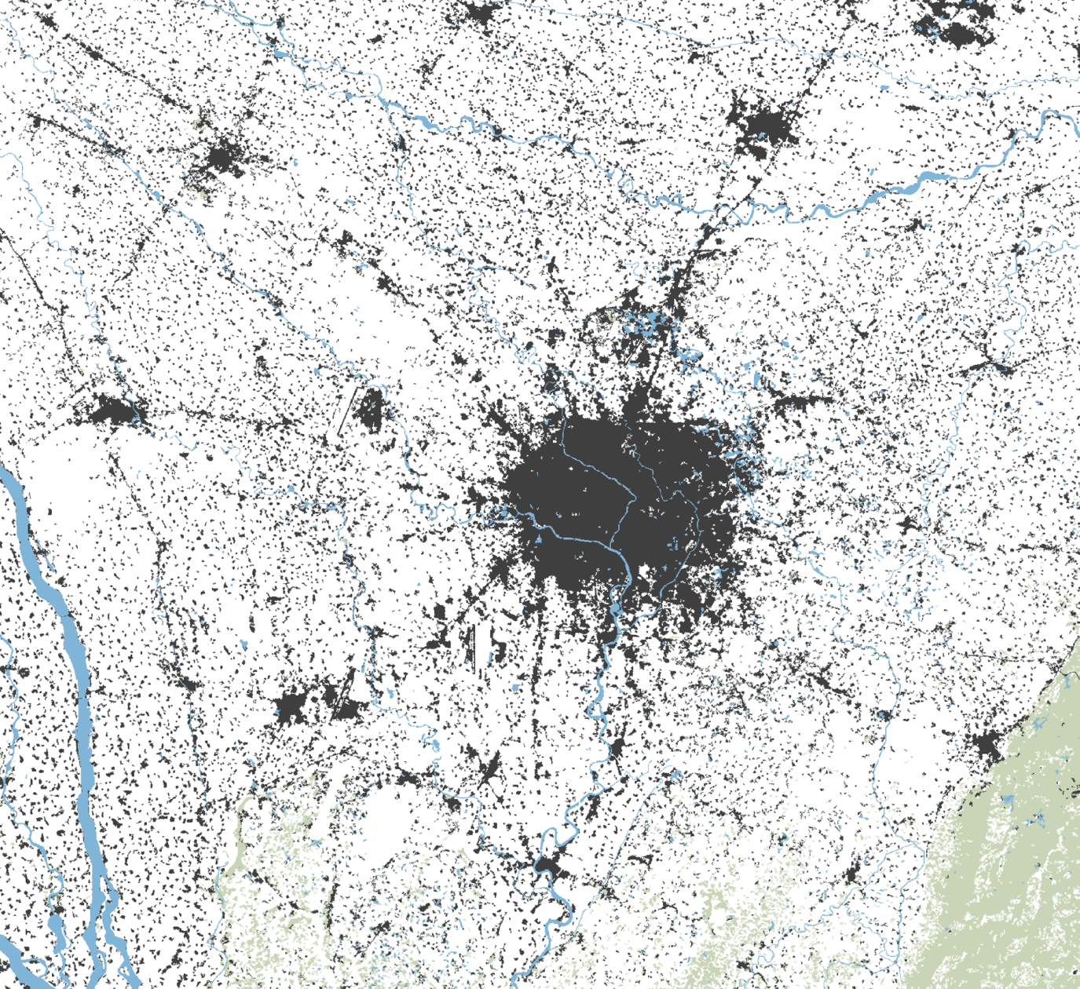
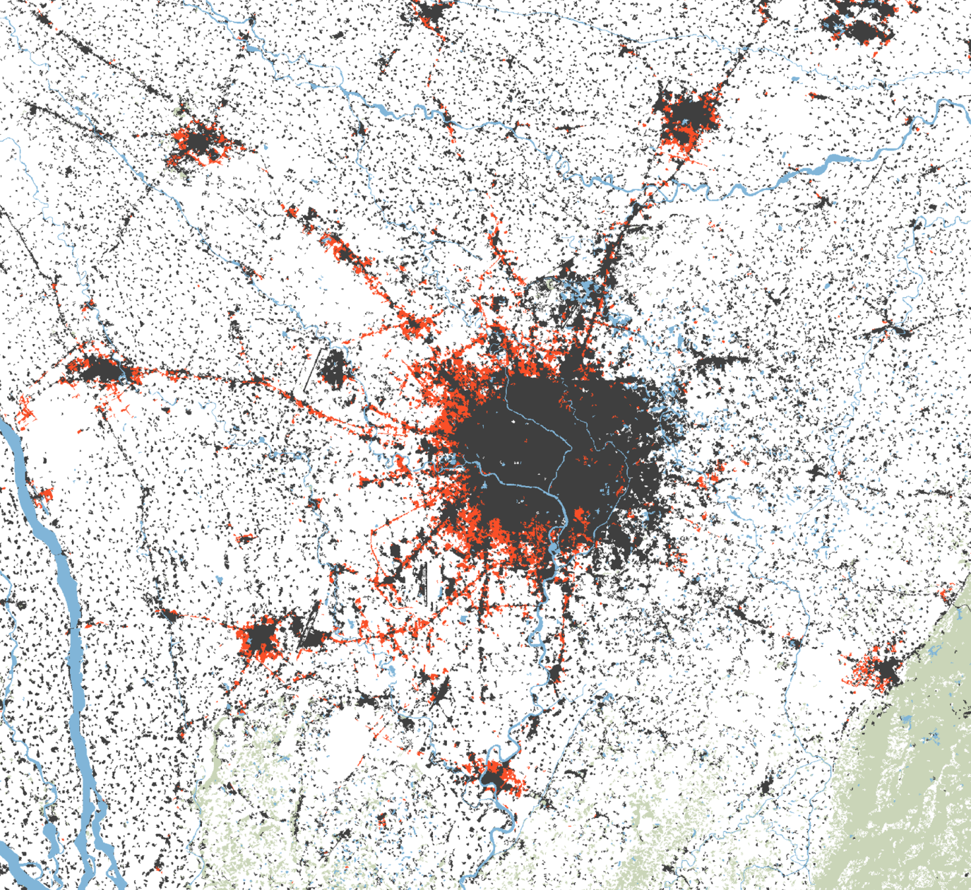
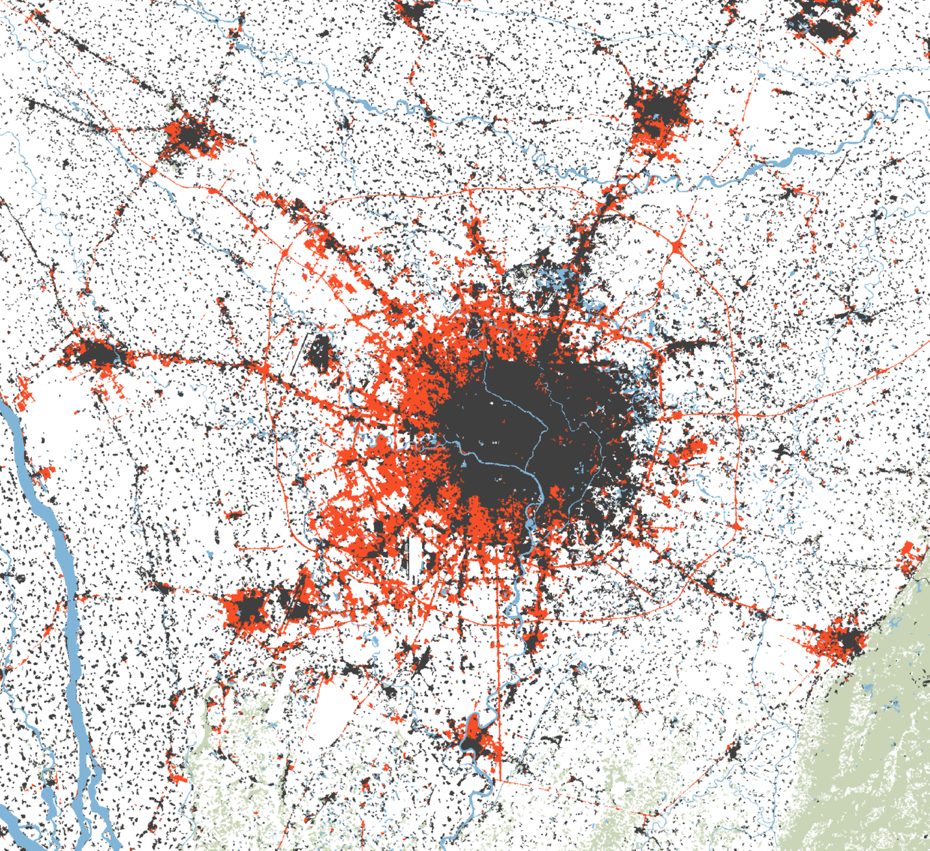
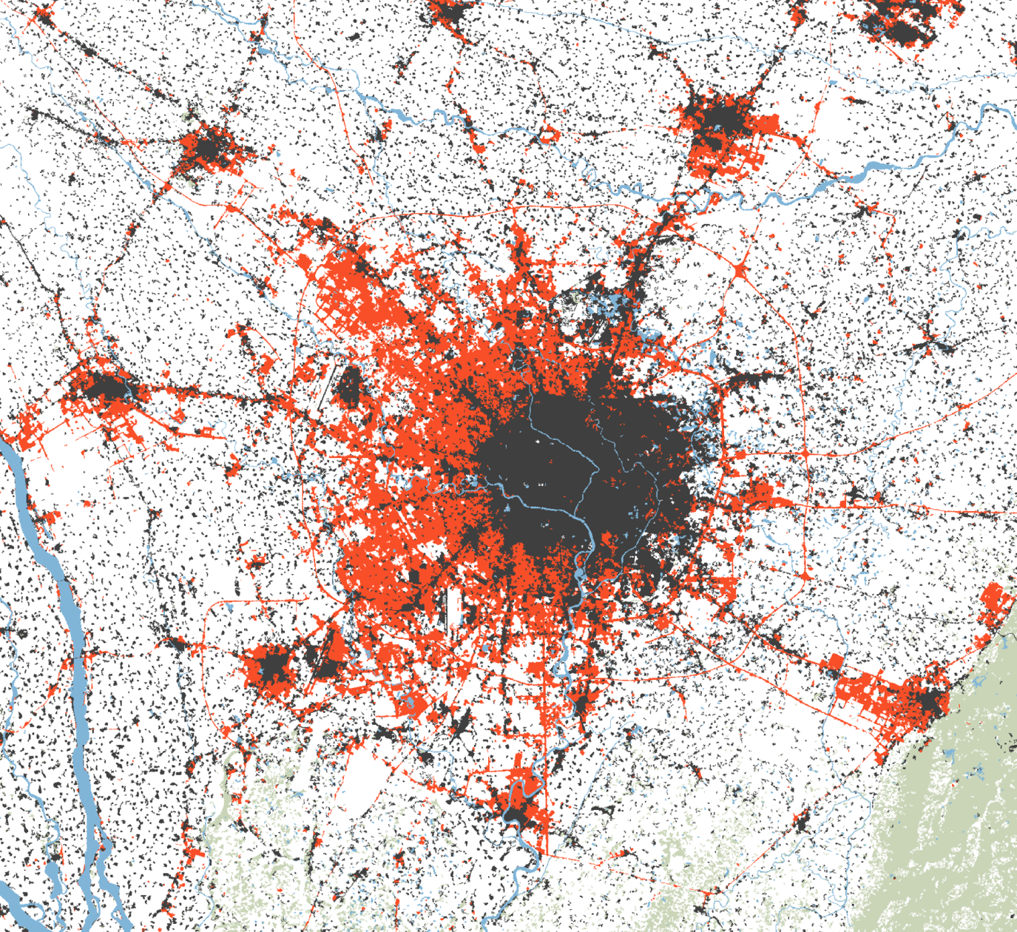
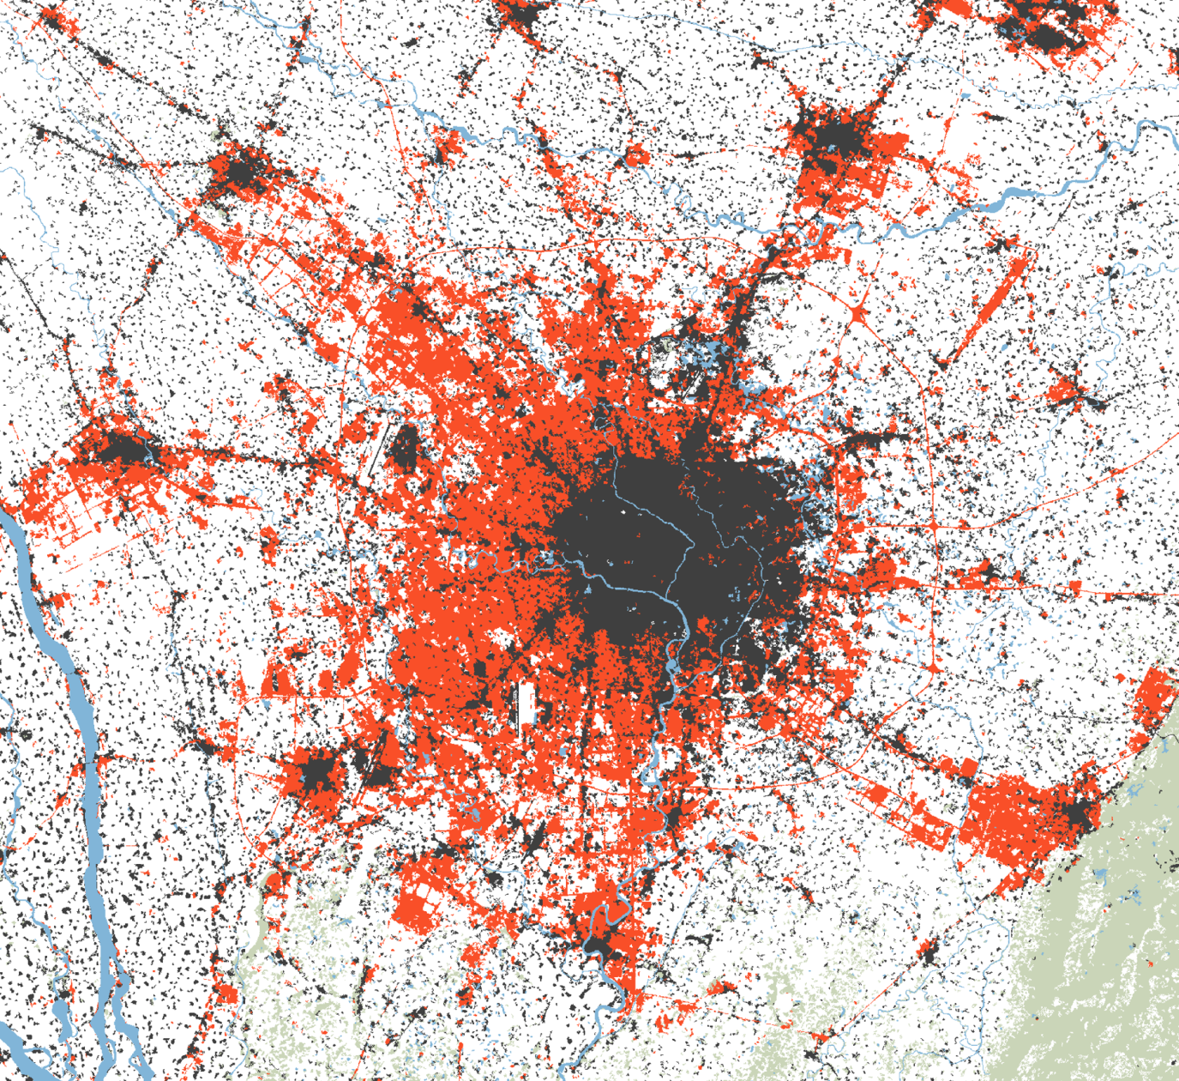
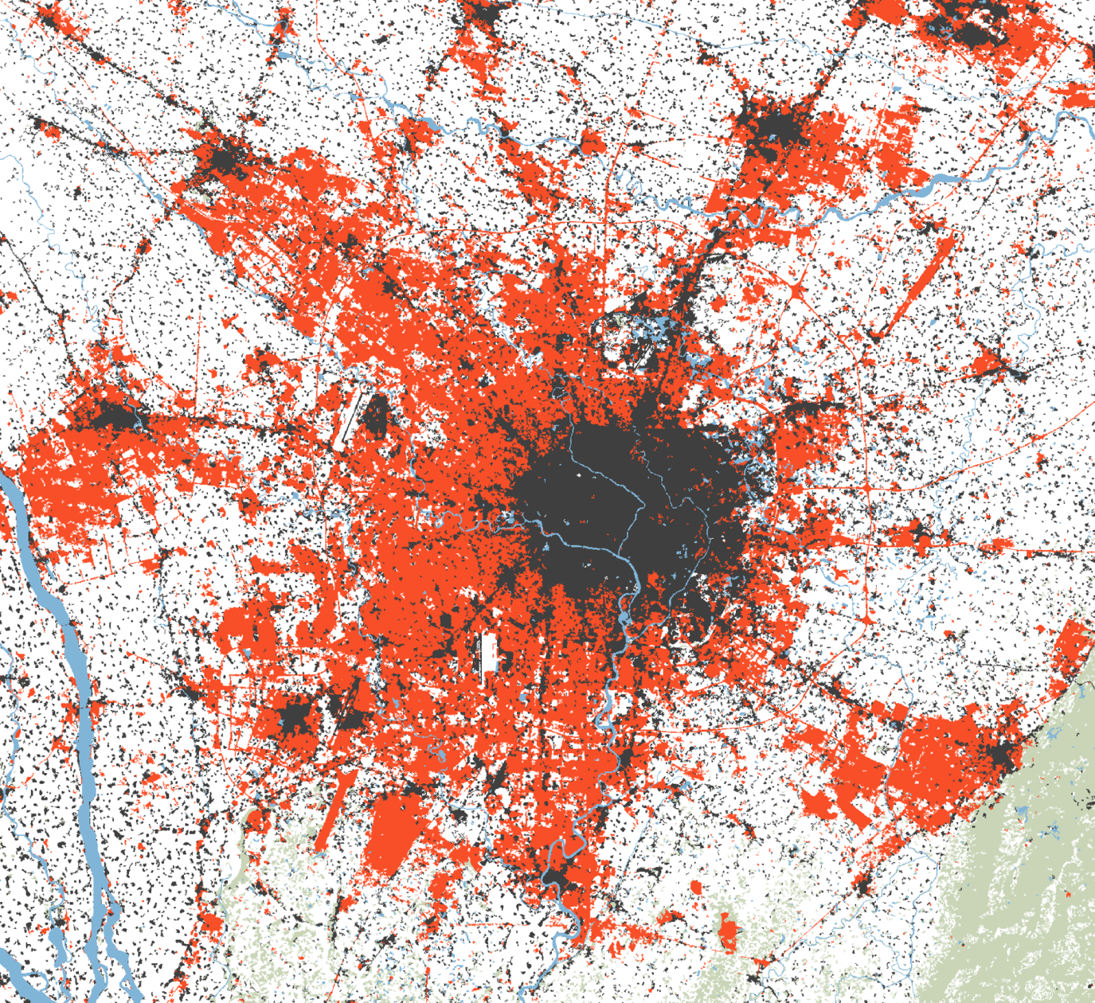
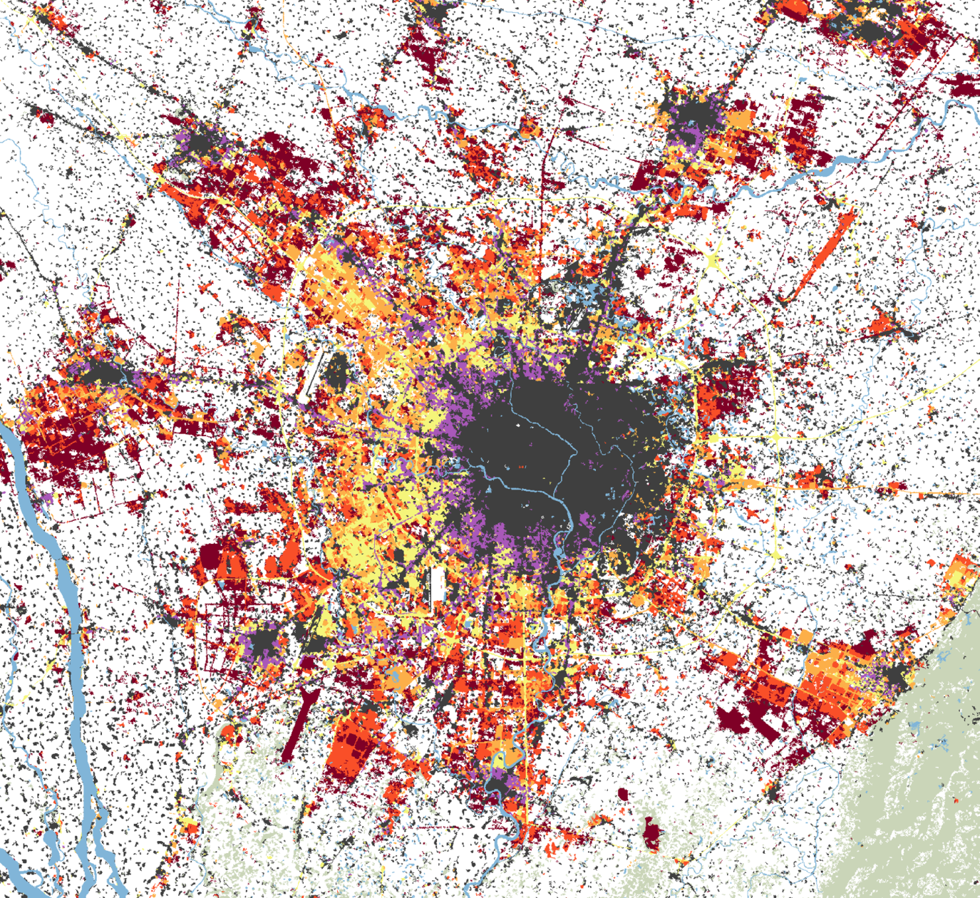
Mapping urban growth – an example for one city
from Annemarie Schneider
Previous work in China and Southeast Asia
Change detection using
Landsat satellite data
Assess trajectory of
multiple time points
Multitemporal data is key, but requires large amount of data processing
Rely instead on coarse resolution datasets (250m–1km)
stable urban
1988 - 1995
Chengdu, Western China:
400% increase
in urban land, 1988-2009
1995 - 2000
2000 - 2003
2003 - 2006
2006 - 2009
1988-2009
1988
1995
2000
2003
2006
2009
~40 km
Notes:
1500 landsat scenes to cover East Asia
30-50 landsat footprints
problem with cloud cover, etc.
add ERL citation?

Slide 12
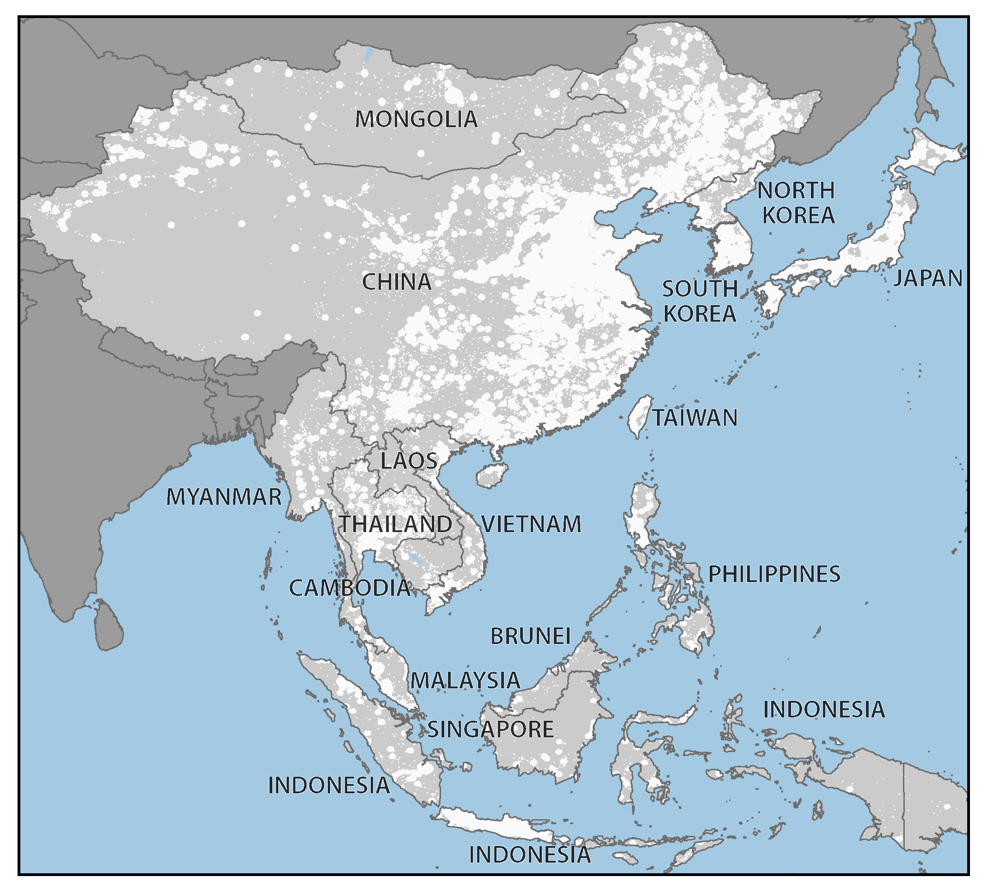
Methods for mapping global urban expansion
Step 1: Delineate study area extent
    Merge 2001 MODIS map of urban extent with all point datasets on cities (GRUMP, UN, etc.).
    \
    Categorize urban patches into three classes based on areal extent and population.
    Buffer by small, medium, and large urban areas by 5, 25, and 100 km, respectively.
    Study extent (white) represents 30% of total land area in the region
Schneider et al. 2015 ERL
Mertes et al. 2015 RSE
Notes:
Map of the East Asia region illustrating the study area extent defined by known locations of urban land
Merge c 2001 MODIS map of global urban extent with all available global- and country-level point datasets on cities and metropolitan areas (GRUMP, UN, etc.)

Slide 13
Methods for mapping global urban expansion
Step 1: Delineate study area extent
    Merge 2001 MODIS map of urban extent with all point datasets on cities (GRUMP, UN, etc.).
    \
    Categorize urban patches into three classes based on areal extent and population.
    Buffer by small, medium, and large urban areas by 5, 25, and 100 km, respectively.
Step 2: Map c. 2010 urban extent
    Supervised decision tree classification of 500-m multispectral data –– probability of urban extent.
    Prior probability surface of urban land –– 250-m vegetation index data.
    Combine probabilities using data fusion (Bayes’ Rule).
    Study extent (white) represents 30% of total land area in the region
Schneider et al. 2015 ERL
Mertes et al. 2015 RSE
Notes:
Map of the East Asia region illustrating the study area extent defined by known locations of urban land
Merge c 2001 MODIS map of global urban extent with all available global- and country-level point datasets on cities and metropolitan areas (GRUMP, UN, etc.)

Slide 14
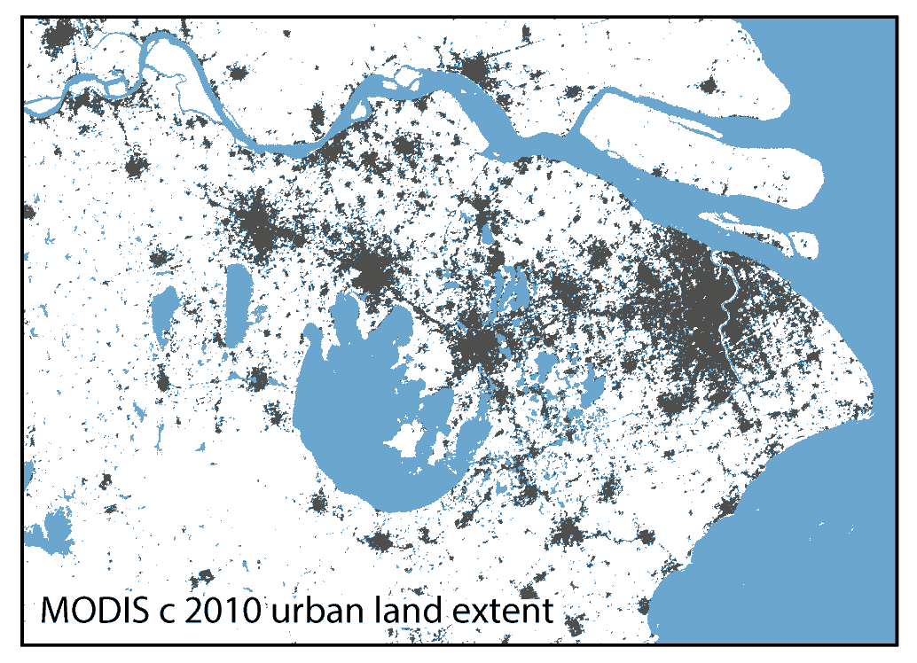
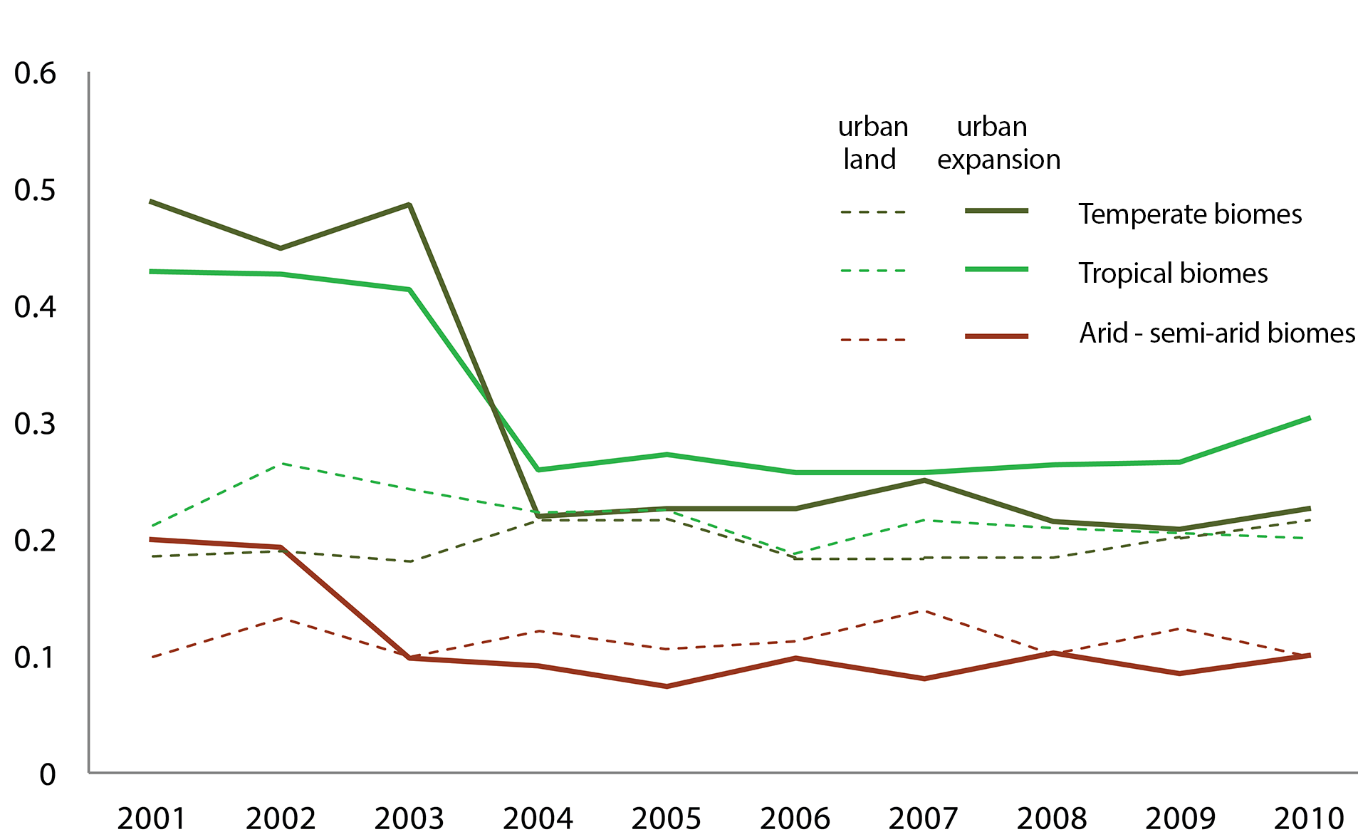
Step 3: urban expansion
Change detection
• Work backwards: were 2010 urban areas urban in 2000, or did they urbanize between 2000 and 2010?
• Use 2010 urban map to constrain change detection.
• 10-y growing season max EVI data; stacked, multi-date composite.
Shanghai
region
Maximum EVI trajectories over time
Schneider et al. 2015 ERL
Mertes et al. 2015 RSE
Notes:
to choose breakpoints for urban change and stable urban classes
Capitalizing on our assumption that urban land does not become ‘undeveloped’, the 2010 urban extent map was used to spatially constrain the change detection process. The change detection method used ten years of growing season maximum EVI data (2001-2010) as input to a boosted decision tree algorithm (C4.5) to classify circa 2010 urban extent as: (1) urban areas built up in 2000 that remained built‐up throughout the period; and (2) areas that belonged to a non-urban land cover class in 2000 (e.g., agriculture, grassland, forest) that became urbanized during the 2000‐2010 period. The pixel-based training data collected for the logistic regression (Figure 3c) were revisited, and all urban sites were labeled as existent urban land, or newly developed urban land, 2000-2010 (Figure 3d).
This approach relies on the observed relationship between maximum EVI and urban areas described above: any conversion from a non-urban land cover to developed land is detectable through changes in vegetation content. The premise is similar to that of EVI trajectory analysis that has been widely employed for change detection (Kennedy et al., 2007; Verbesslt et al., 2010, Clark et al., 2013). Here, the use of growing season metrics and supervised multi-date composite classification of changed areas help address the challenges associated with the large amount of cloud-contaminated data in East Asia. Similar to the procedure used for the 2010 urban extent map, the decision tree output probabilities for the urban expansion class were iteratively thresholded and compared to c 2010 Google Earth VHR imagery on a regional basis to choose breakpoints for the urban change and stable urban classes.
(Figure 5).

Slide 15
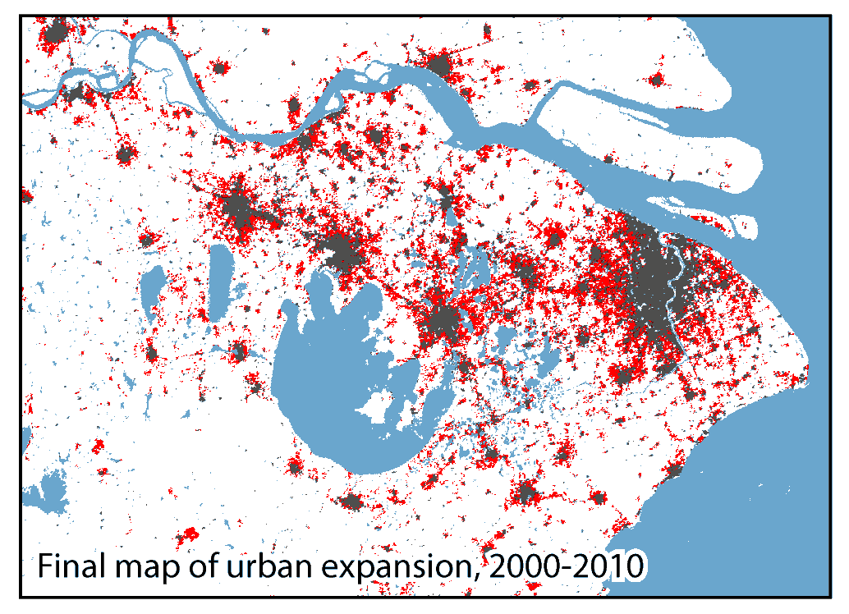
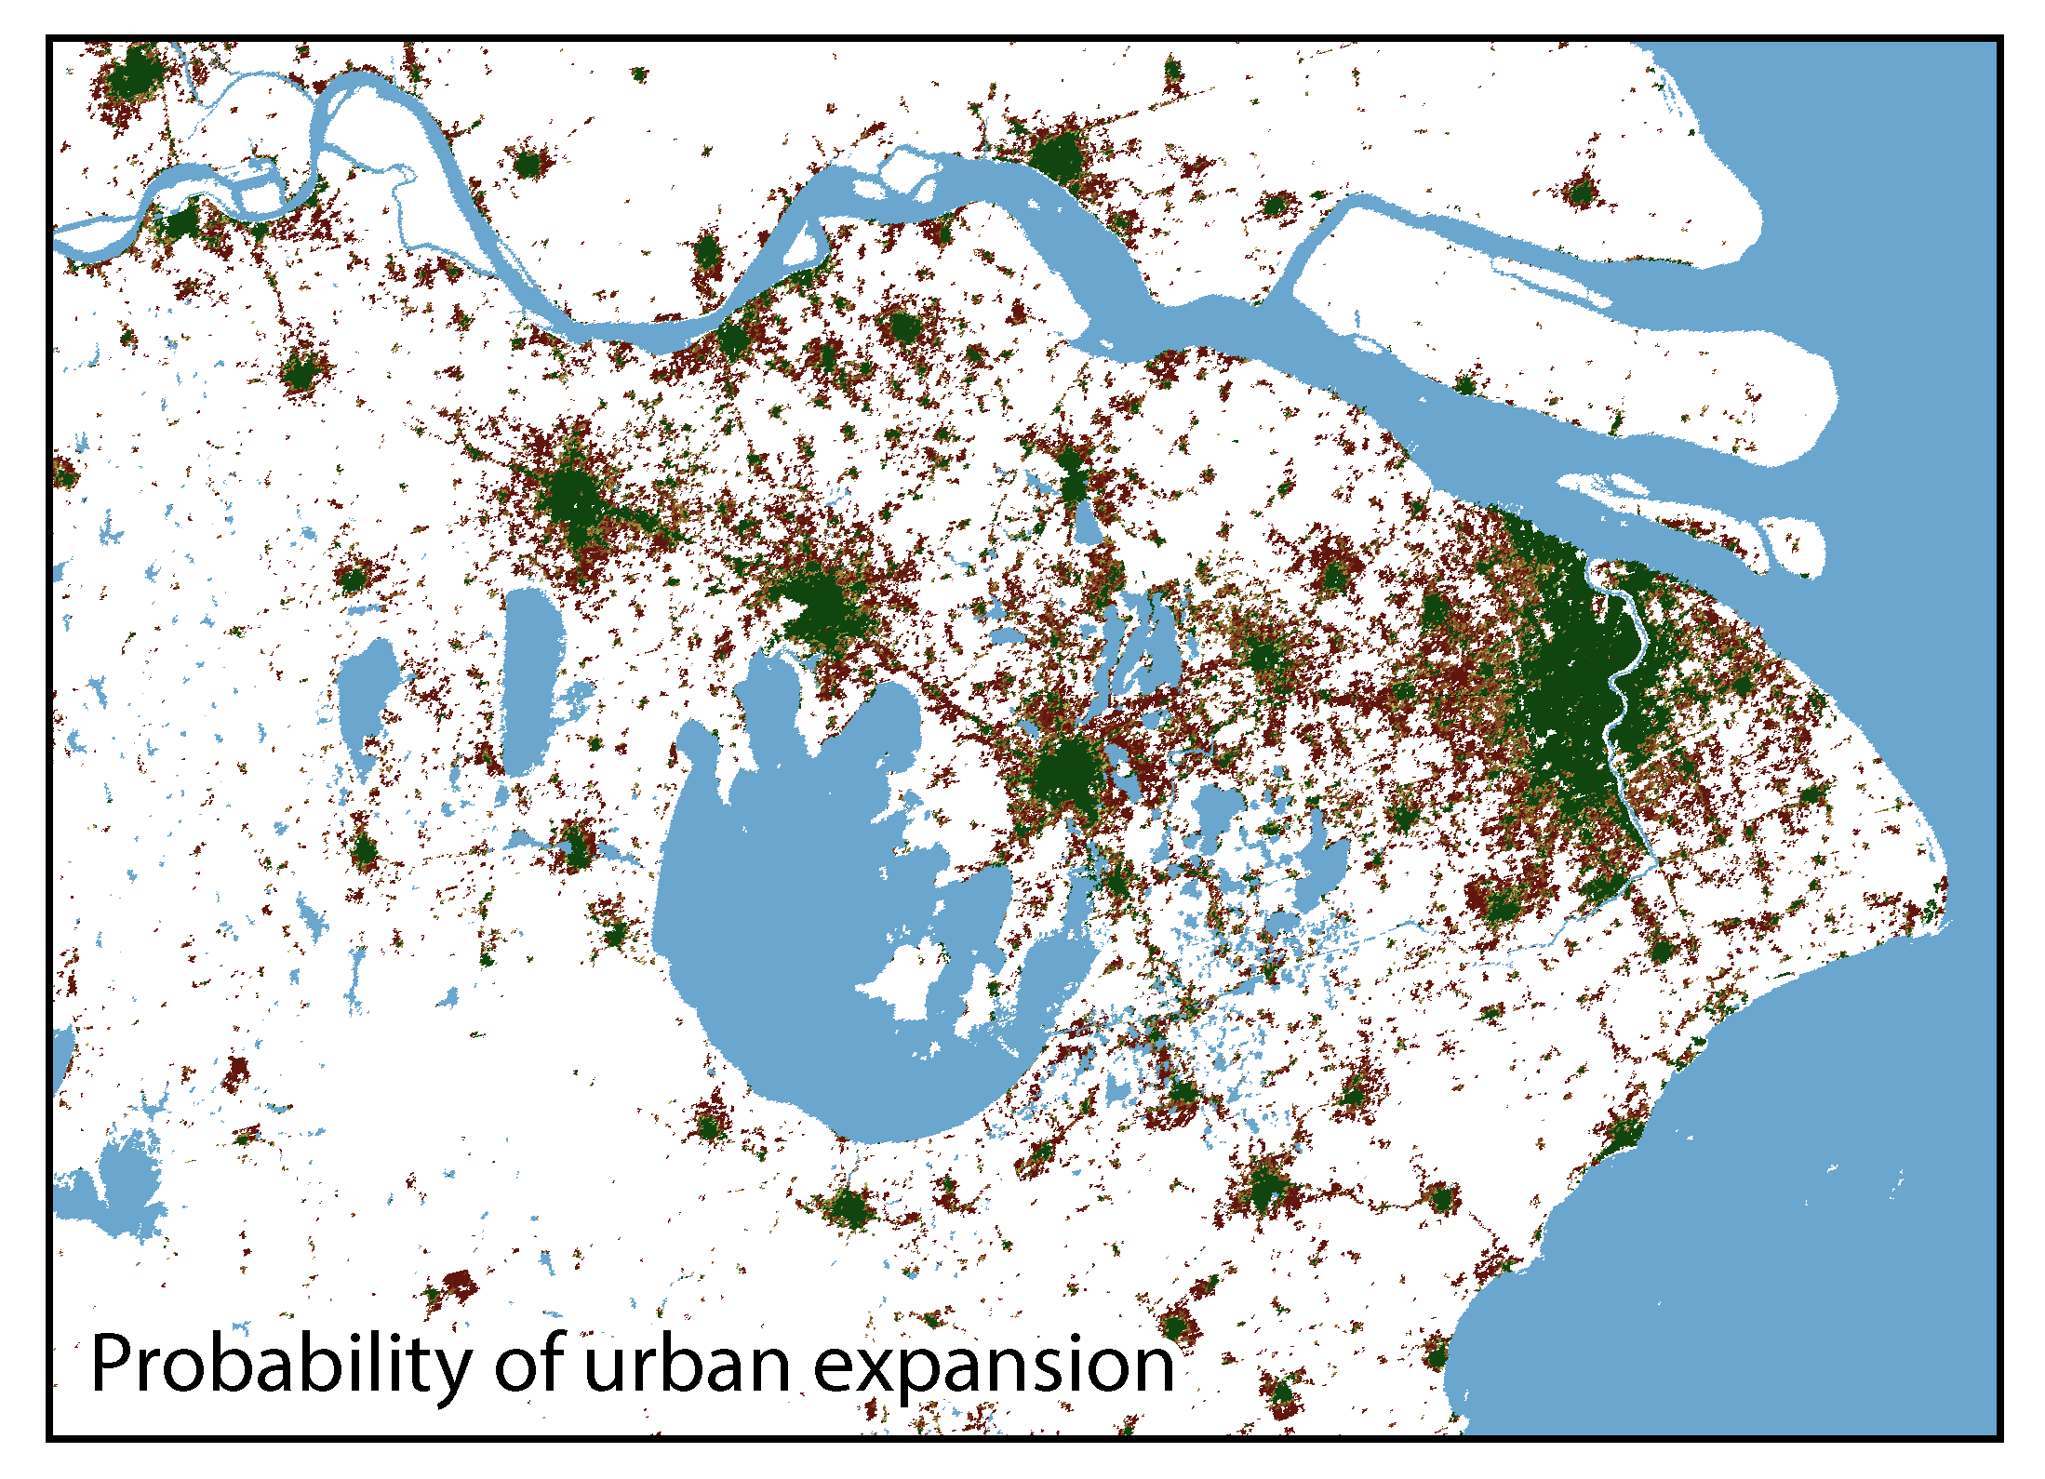
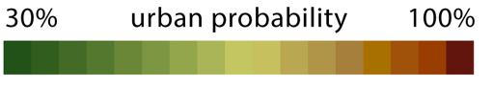
Step 3: urban expansion
Change detection
• Work backwards: were 2010 urban areas urban in 2000, or did they urbanize between 2000 and 2010?
• Use 2010 urban map to constrain change detection.
• 10-y growing season max EVI data; stacked, multi-date composite.
• Supervised boosted decision tree algorithm (C4.5).
• Local training data revisited, urban sites labeled as (1) stable urban areas, or
(2) areas urbanized, 2000-2010.
• Output probabilities iteratively thresholded, compared to c2010 Google Earth imagery.
Shanghai
region
Schneider et al. 2015 ERL
Mertes et al. 2015 RSE
Notes:
to choose breakpoints for urban change and stable urban classes
Capitalizing on our assumption that urban land does not become ‘undeveloped’, the 2010 urban extent map was used to spatially constrain the change detection process. The change detection method used ten years of growing season maximum EVI data (2001-2010) as input to a boosted decision tree algorithm (C4.5) to classify circa 2010 urban extent as: (1) urban areas built up in 2000 that remained built‐up throughout the period; and (2) areas that belonged to a non-urban land cover class in 2000 (e.g., agriculture, grassland, forest) that became urbanized during the 2000‐2010 period. The pixel-based training data collected for the logistic regression (Figure 3c) were revisited, and all urban sites were labeled as existent urban land, or newly developed urban land, 2000-2010 (Figure 3d).
This approach relies on the observed relationship between maximum EVI and urban areas described above: any conversion from a non-urban land cover to developed land is detectable through changes in vegetation content. The premise is similar to that of EVI trajectory analysis that has been widely employed for change detection (Kennedy et al., 2007; Verbesslt et al., 2010, Clark et al., 2013). Here, the use of growing season metrics and supervised multi-date composite classification of changed areas help address the challenges associated with the large amount of cloud-contaminated data in East Asia. Similar to the procedure used for the 2010 urban extent map, the decision tree output probabilities for the urban expansion class were iteratively thresholded and compared to c 2010 Google Earth VHR imagery on a regional basis to choose breakpoints for the urban change and stable urban classes.
(Figure 5).

Slide 16
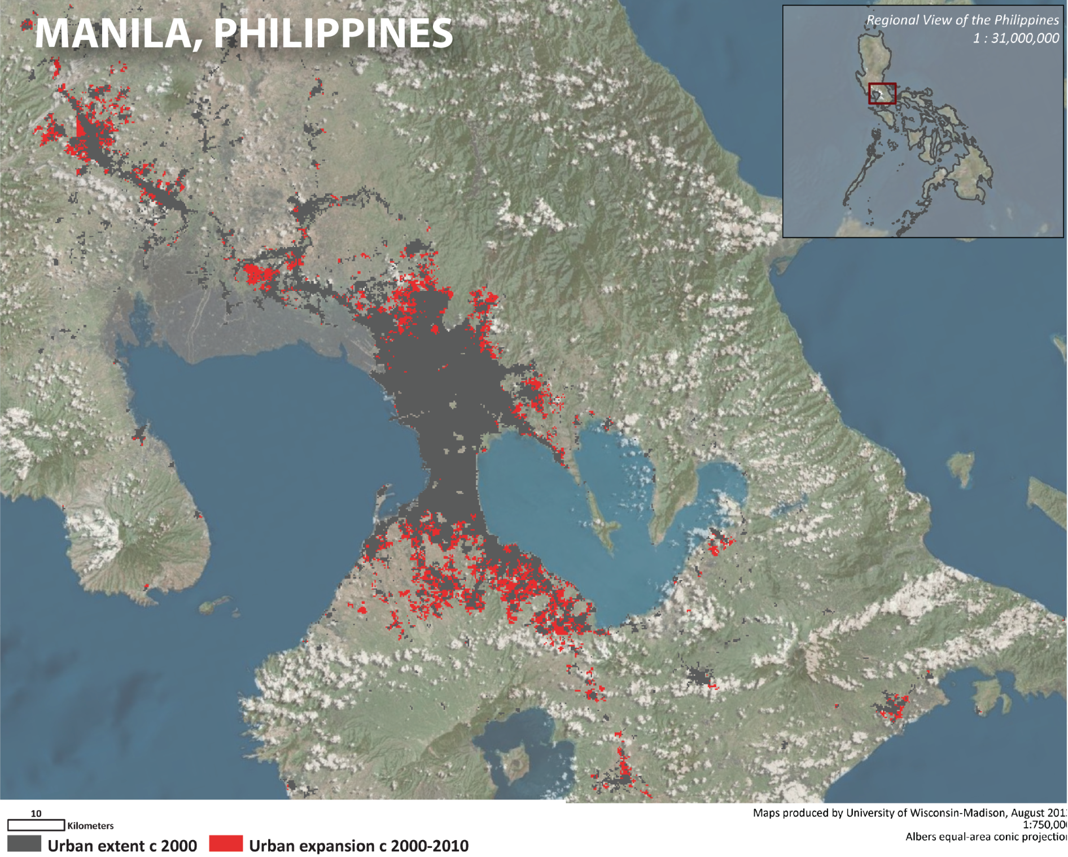
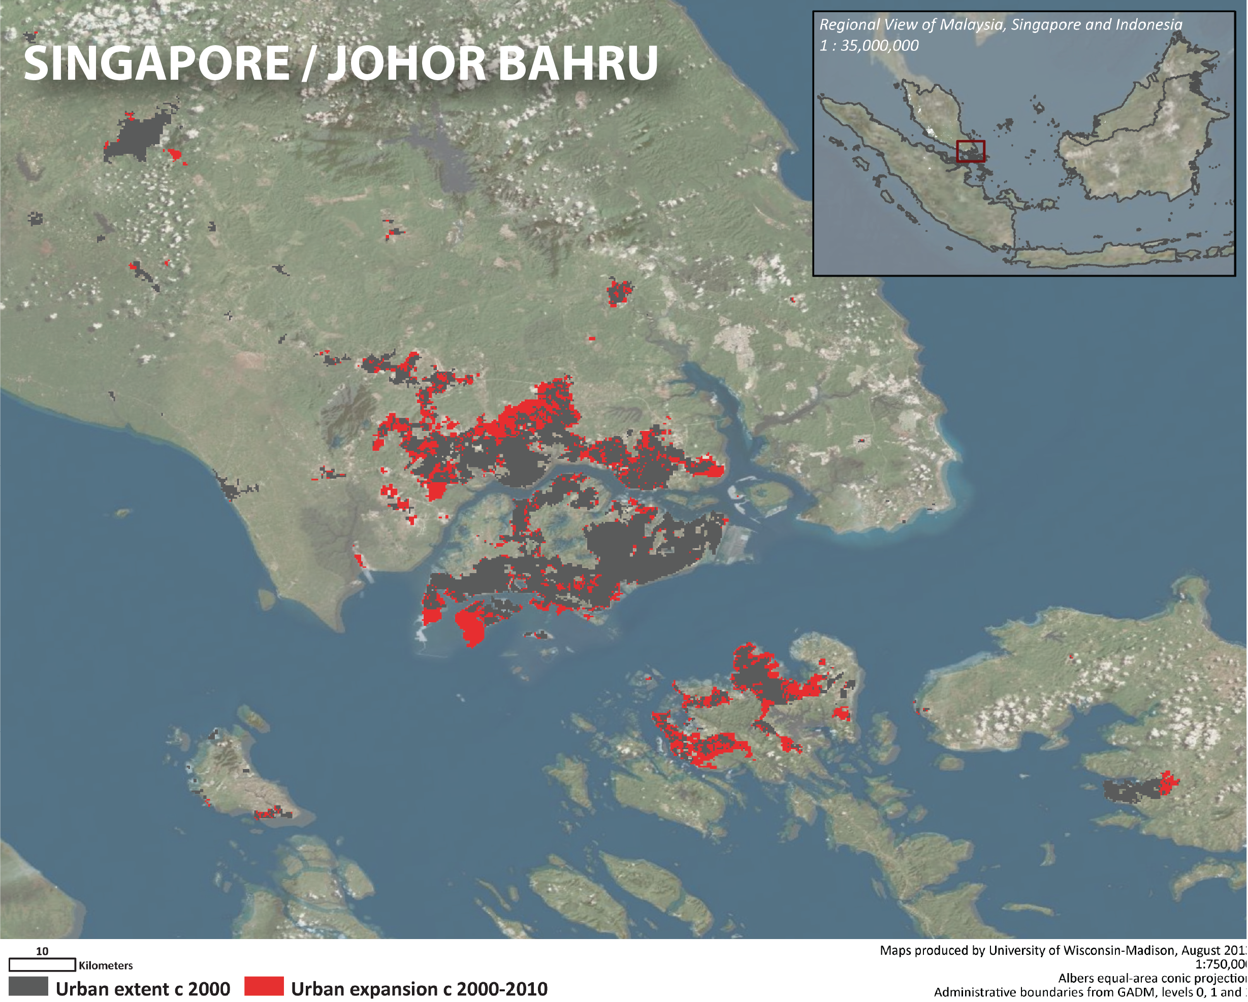
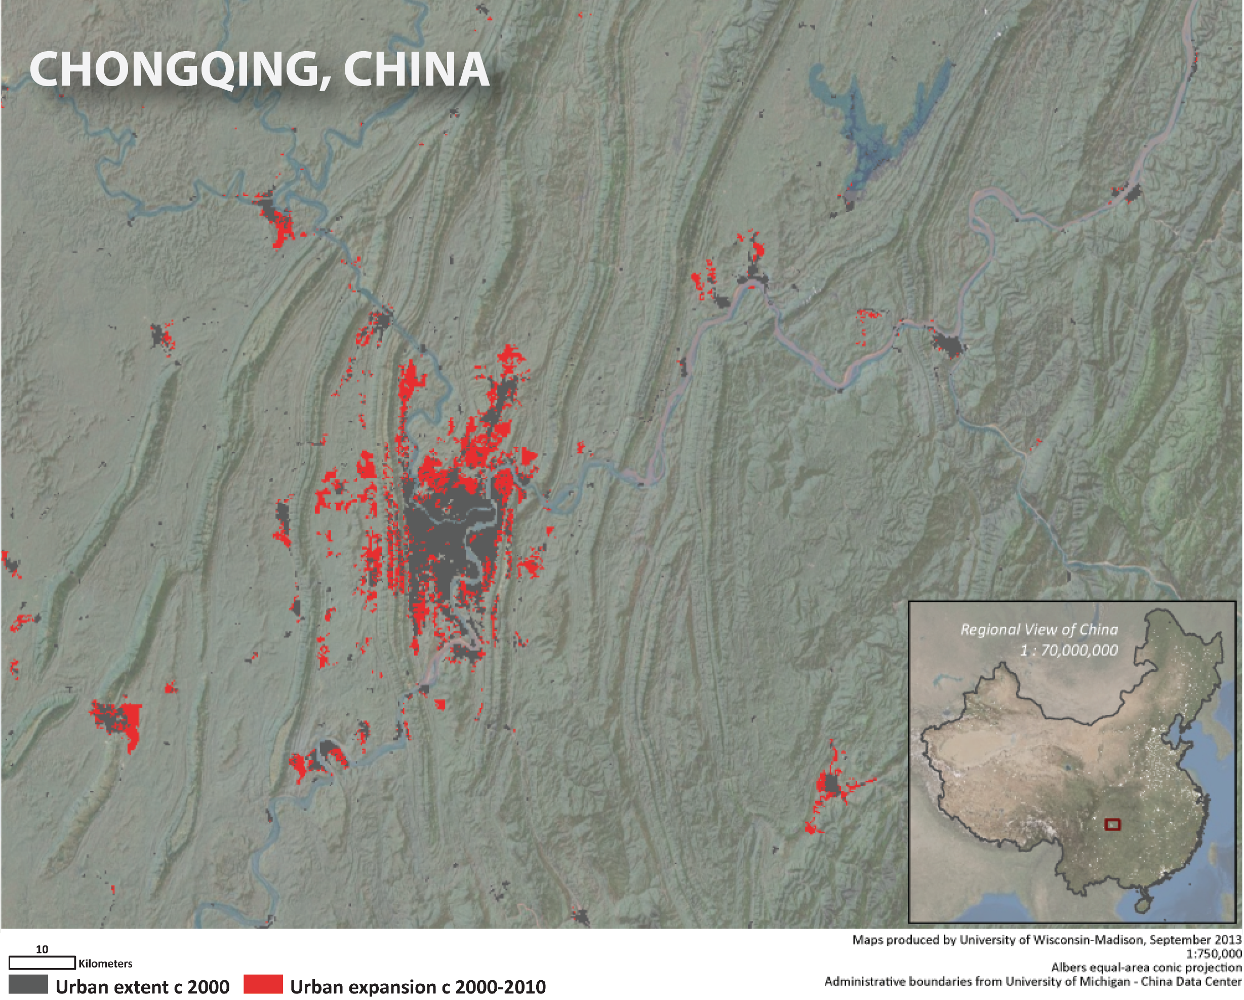
Schneider et al. 2015 ERL
Mertes et al. 2015 RSE

Slide 17
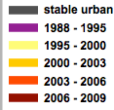
Chengdu –was the urban core ‘stable urban’?
~40 km

Slide 18
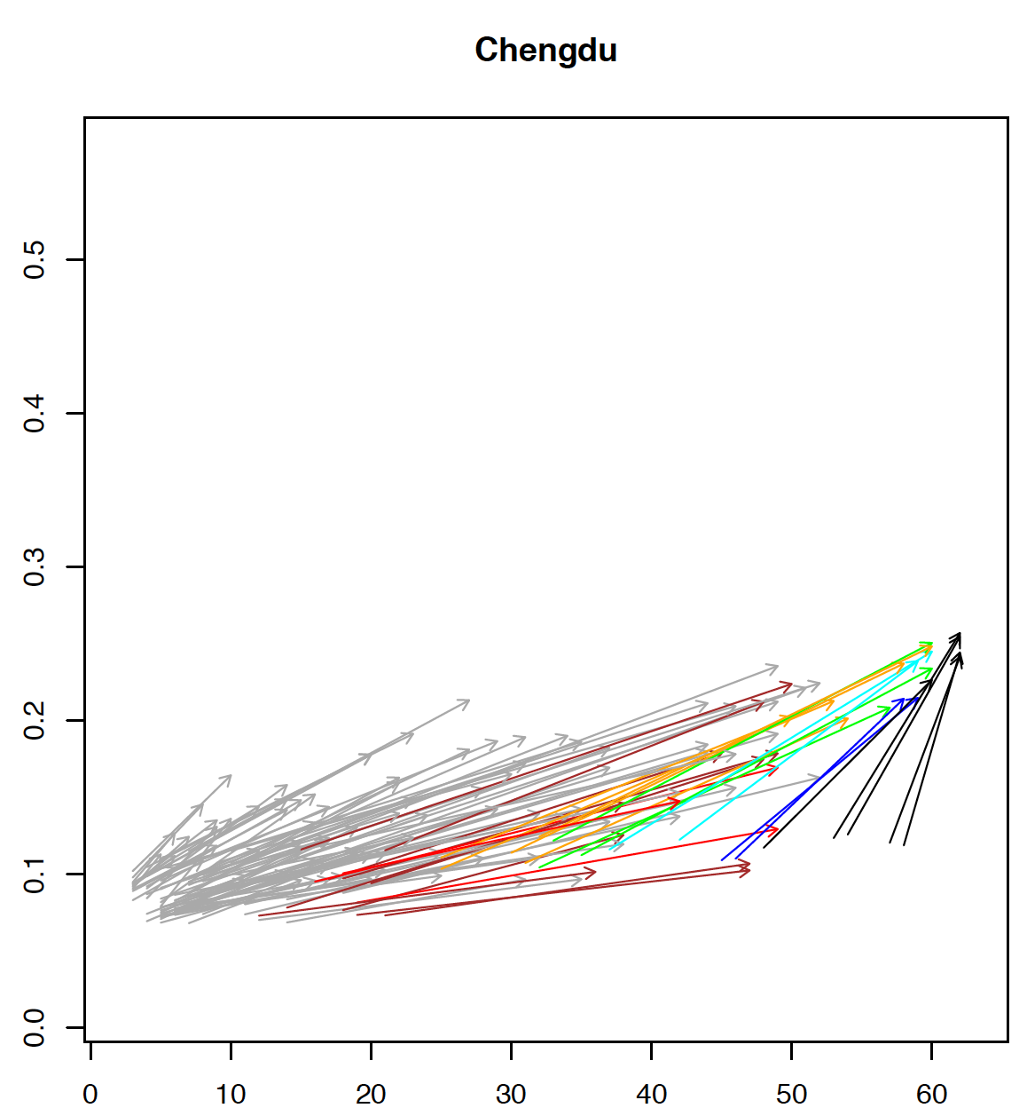
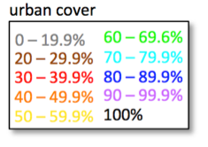
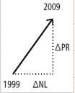
Chengdu – the urban core got ‘brighter’, both nighttime lights and backscatter
SeaWinds power return (PR = 10^(σ⁰/10)
~40 km
DMSP/OLS night time lights (NL; max. = 63)
• 11 x 11 grid (0.05°) centered on Chengdu (approx. 40x50 km)
• summer mean backscatter; annual mean night time lights.
• arrows point from NL and PR in 1999 to NL and PR in 2009.
• urban fraction (arrow color) from MODIS land cover product.
Frolking et al. 2013 ERL

Slide 19
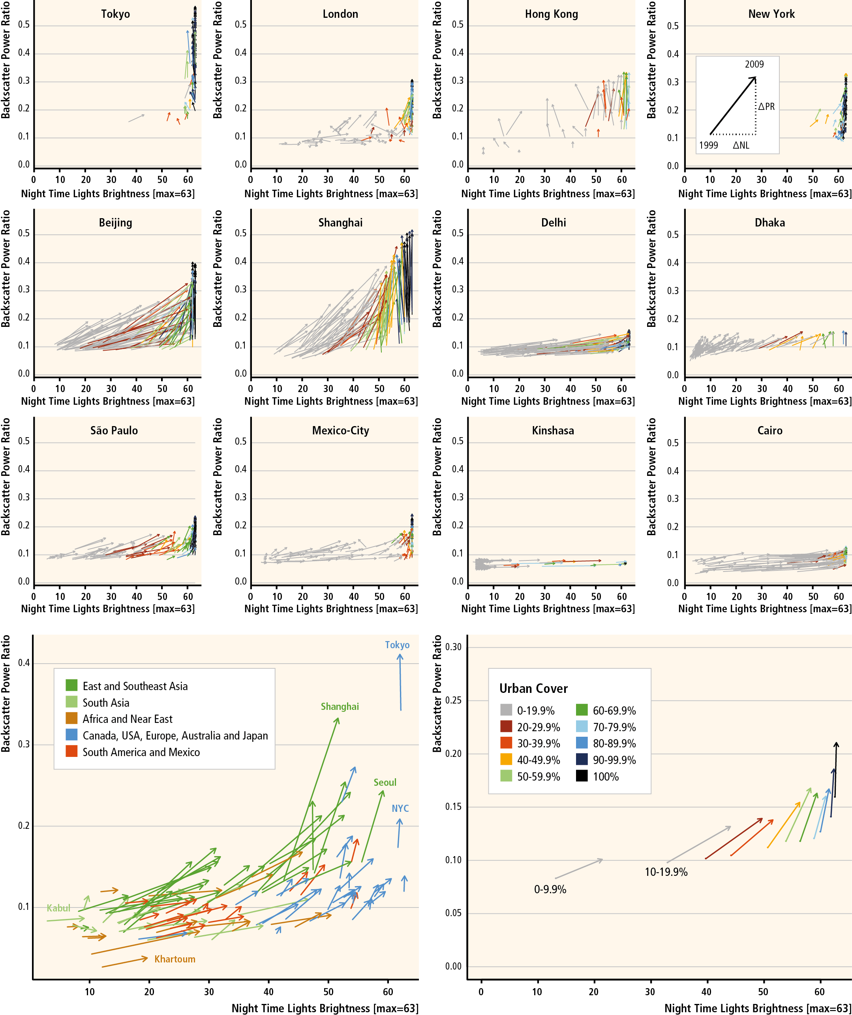
1999-2009 change in night time lights and microwave backscatter
SeaWinds power return (PR = 10^(σ⁰/10)
DMSP/OLS night time lights (NL; max. = 63)
• 11 x 11 grid (0.05°) centered on each city (approx. 50x50 km)
• summer mean backscatter; annual mean night time lights.
• arrows point from NL and PR in 1999 to NL and PR in 2009.
• urban fraction (arrow color) from MODIS land cover product.
• water grid cells masked out.
Frolking et al. 2013 ERL

Slide 20
1999-2009 change in night time lights and microwave backscatter
SeaWinds power return (PR = 10^(σ⁰/10)
DMSP/OLS night time lights (NL; max. = 63)
• 11 x 11 grid (0.05°) centered on each city.
• summer mean backscatter; annual mean night time lights.
• arrows point from NL and PR in 1999 to NL and PR in 2009.
• urban fraction (arrow color) from MODIS land cover product.
• water grid cells masked out.
Frolking et al. 2013 ERL

Slide 21
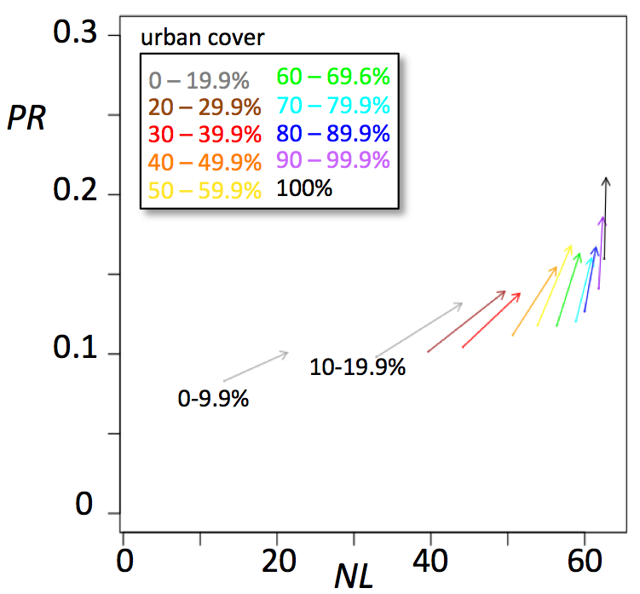
Mean change in NL and PR as function of urban cover for 100 large cities.
1999-2009 change in night time lights and microwave backscatter
Mean of 121 grid cells (0.05°) for 100 large cities, disaggregated by percent urban cover.
Frolking et al. 2013 ERL

Slide 22
Night lights & backscatter – different urban characteristics.
2009
Night lights
Backscatter power
40.4°N
Beijing
39.6°N
116.8°E
116.0°E
29.0°N
Delhi
28.2°N
76.8°E
77.6°E
0
NTL
63
0
PR
0.6
Plan view: 21x21 grid cells (0.05°)

Slide 23
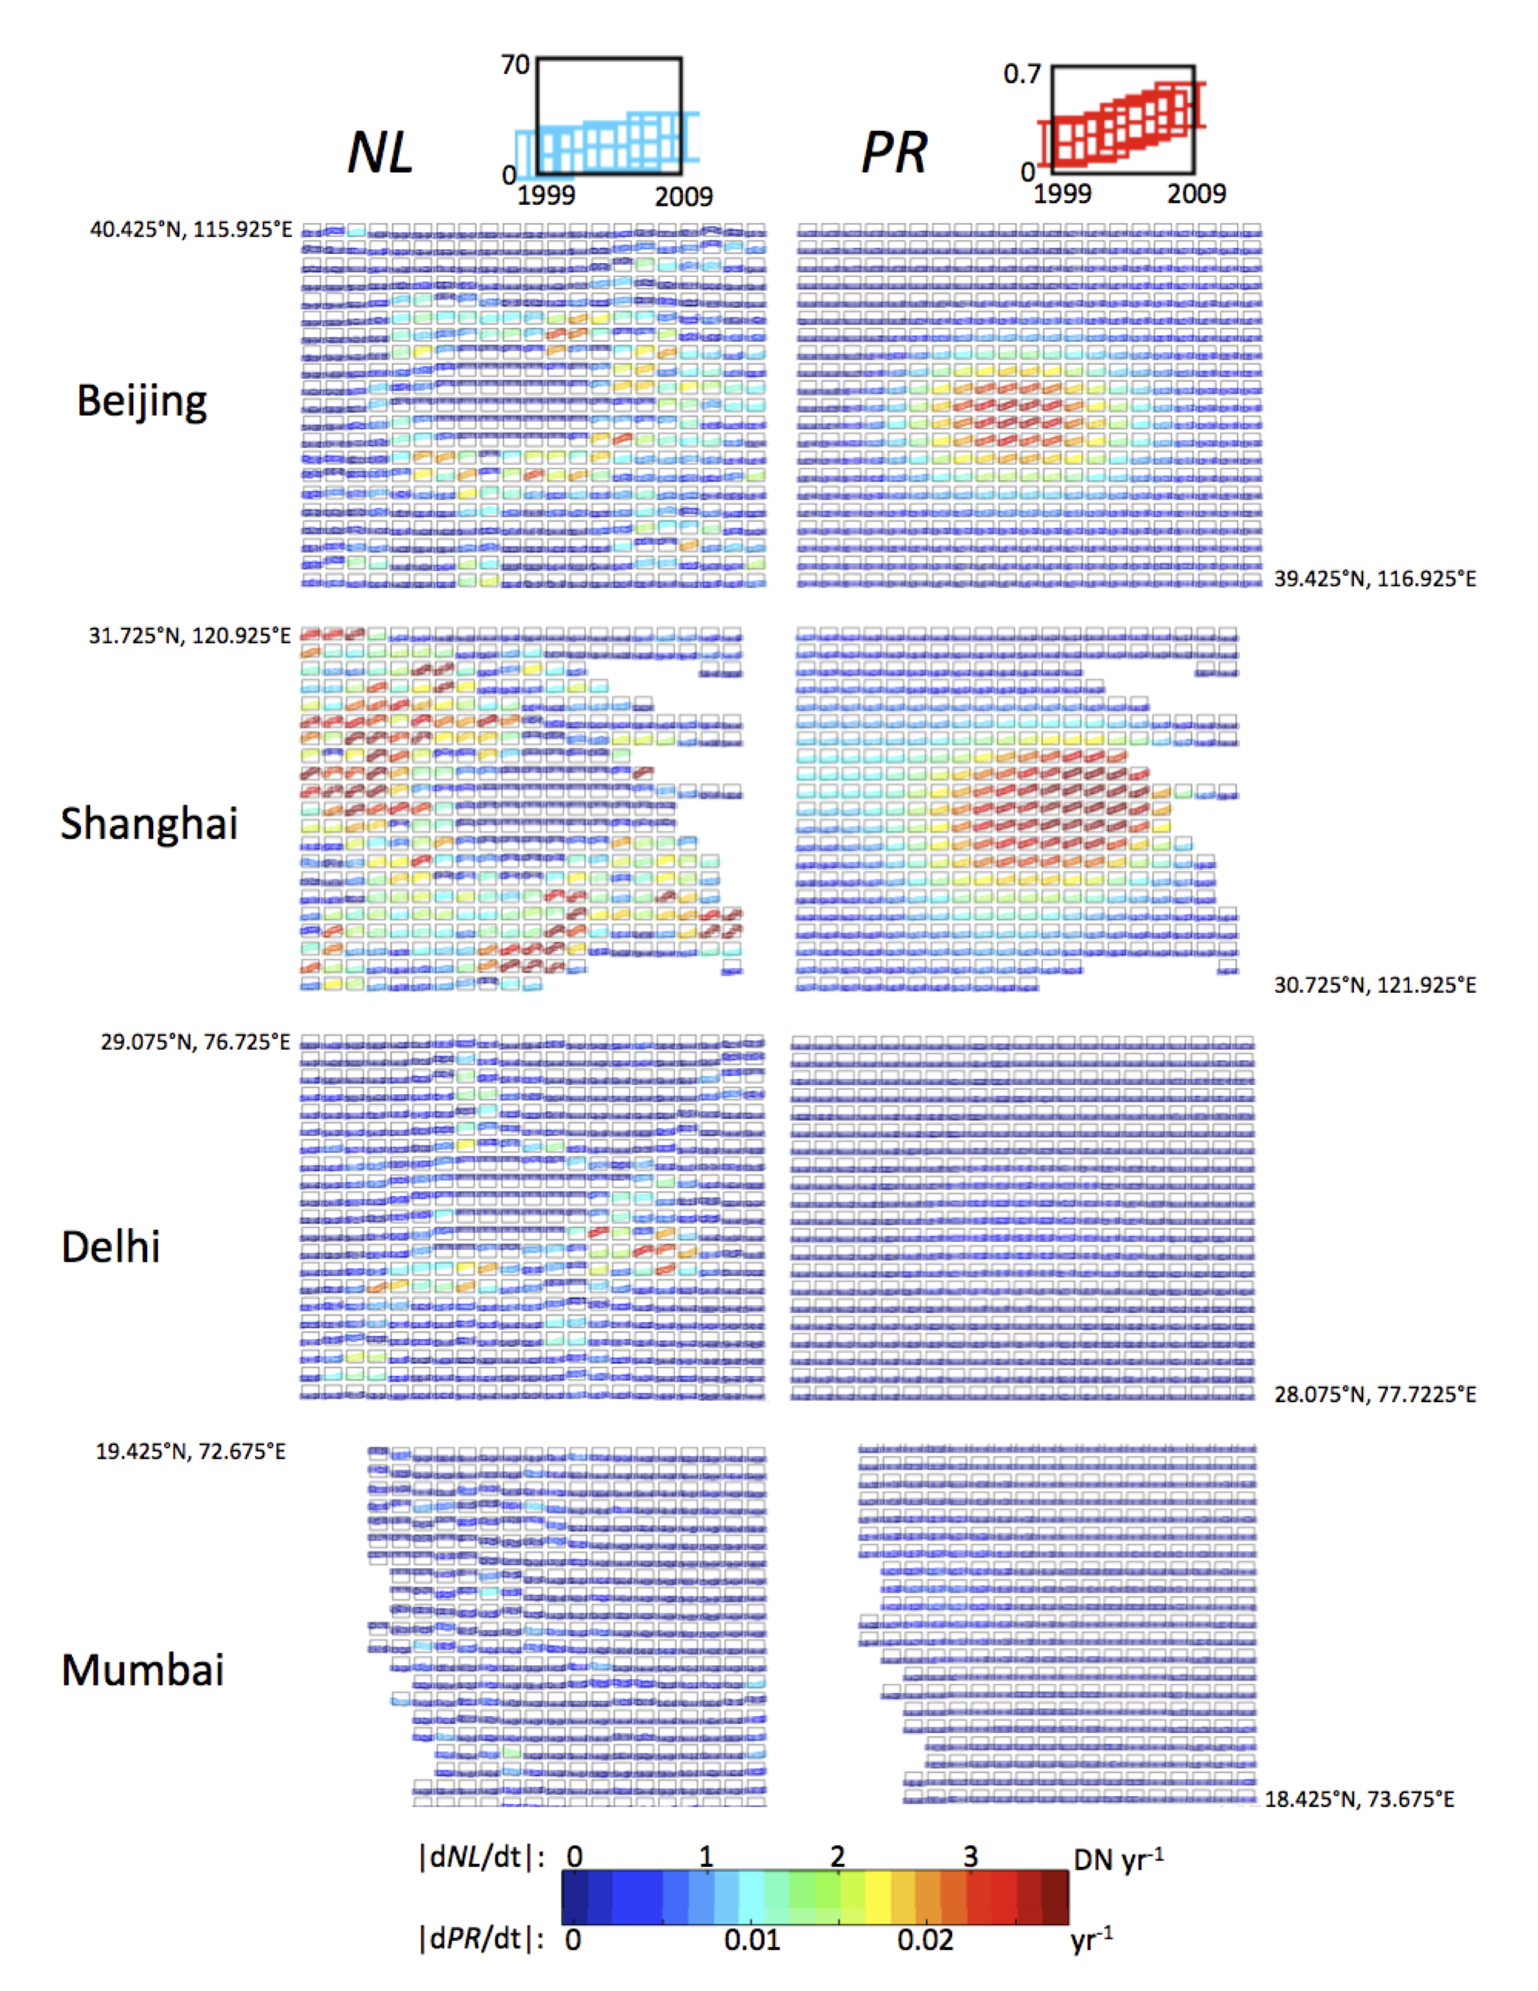
Night lights & backscatter – different urban characteristics & modes of change.
Change 1999 – 2009
2009
Night lights
Backscatter power
40.4°N
Beijing
39.6°N
116.8°E
116.0°E
29.0°N
Delhi
28.2°N
76.8°E
77.6°E
0
NTL
63
0
PR
0.6
Plan view: 21x21 grid cells (0.05°)

Slide 24
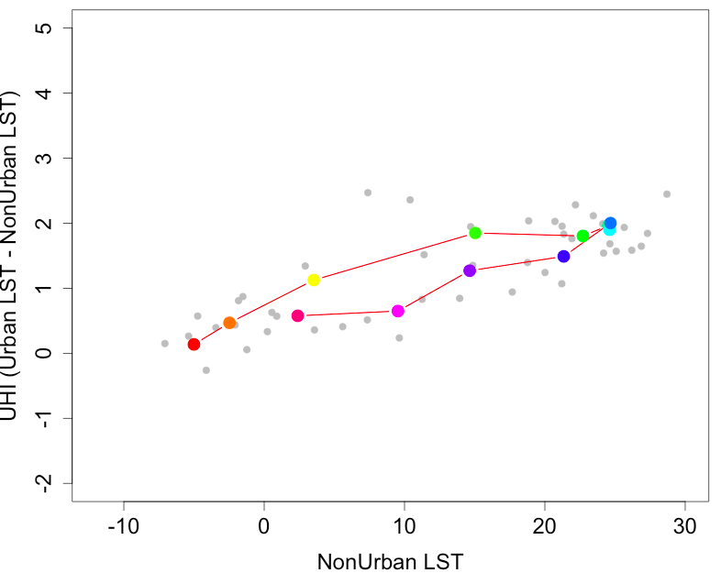
Still to do:
The proposed urban heat island analyses. Specific questions we plan to address:
Comparing eastern Asia with eastern North America, are there differing trends in UHI that can be associated with different rates and types of 2000-2010 urban growth – lateral expansion, night lights, and/or backscatter?
What does UHI seasonal hysteresis
spatial variability, as reported by Zhou
et al. (2013, GRL), correlate with?
Do we see a relationship between UHI and urban ‘roughness’, as simulated by Zhao et al. (2014, Nature),
using backscatter as remote sensing metric of ‘roughness’?
weak UHI hysteresis in Boston
(preliminary)
A
UHI (°C)
F
S
J
N
non-urban LST (°C)

Slide 25
Thank you

Slide 26
EXTRA SLIDES

Slide 27
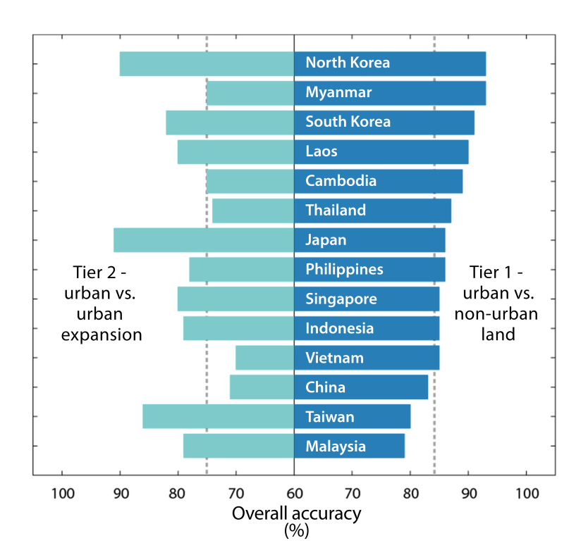
Step 4: accuracy assessment
Overall accuracy by country, two-tier assessment
Assessing map accuracy
  • Maps assessed using two-tier approach
    Tier 1: assess c2010 urban extent
    Tier 2: assess maps of urban expansion
  • Approach: stratified random sample of
  sites labeled by multiple analysts,
  double-blind procedure.
  • Results for overall accuracy, country-level:
  Tier 1 (extent): 79-93% (mostly commission errors – overestimating urban)
  Tier 2 (expansion): 70-91% (mostly commission errors – overestimating expansion)
  • errors propagate – start with a good classification!

Slide 28
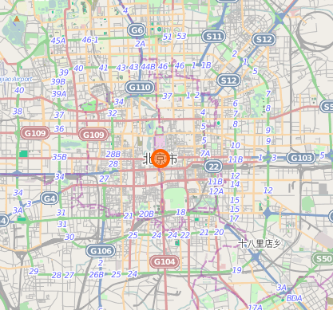
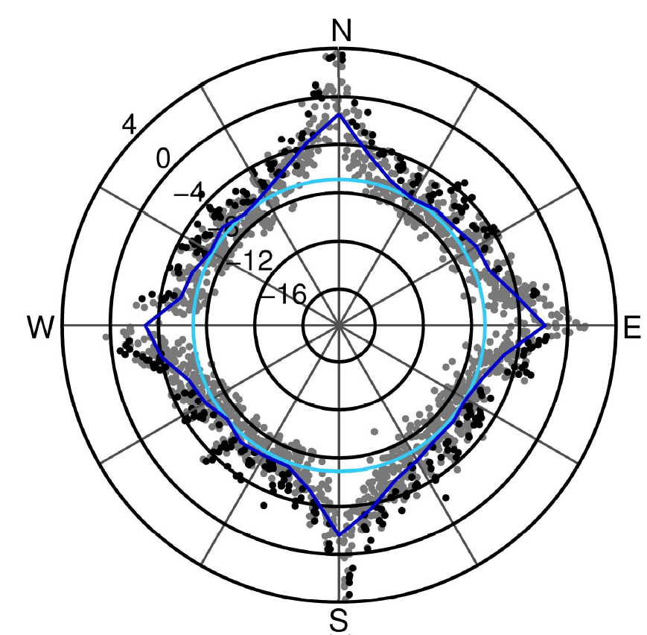
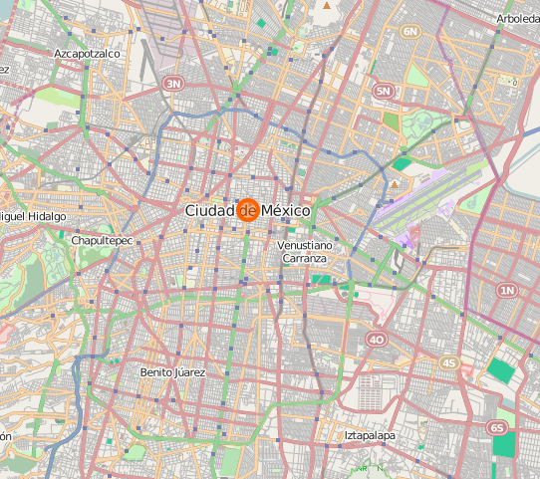
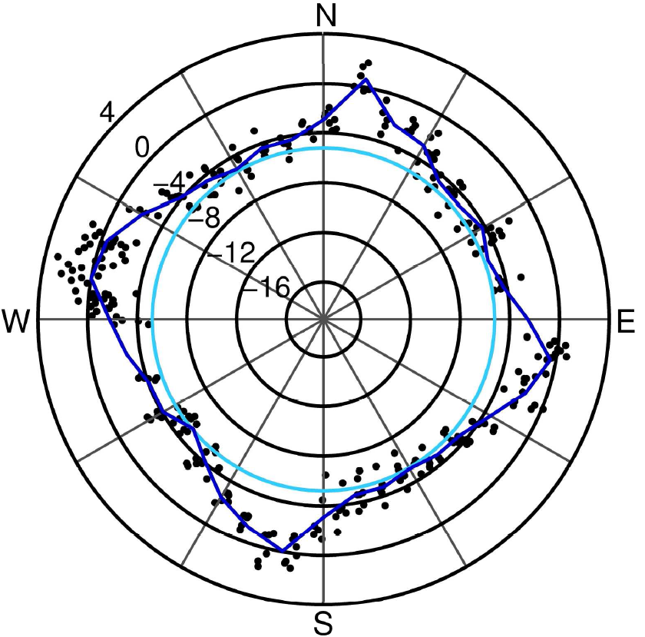

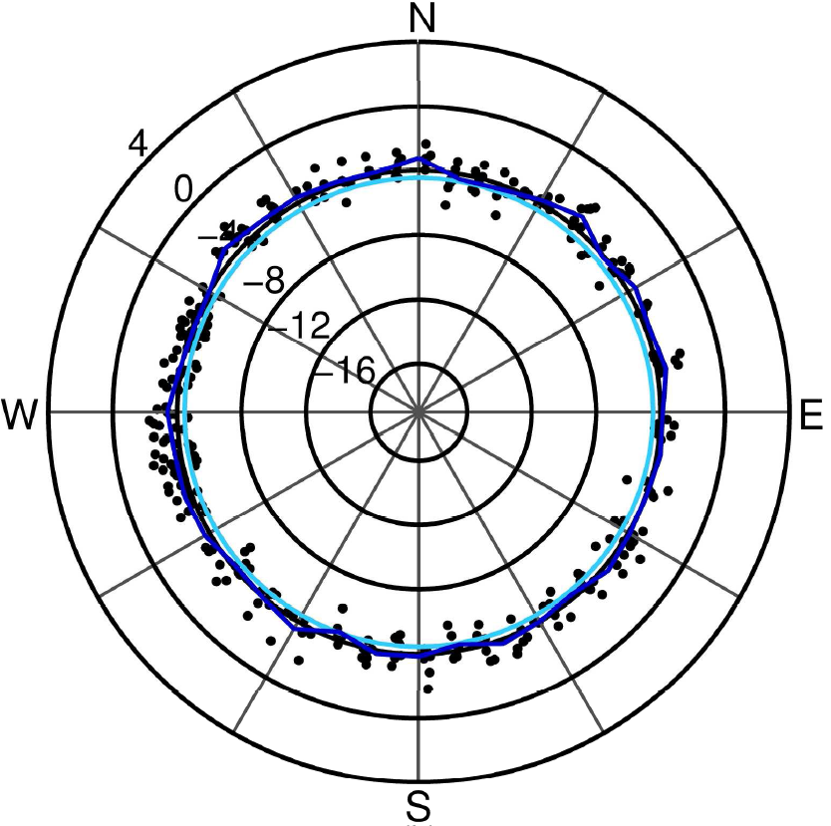
Beijing
Quikscat level 1b backscatter
Azimuthal dependence of individual backscatter returns vary by city (high to none). Averaging over one or more months fully samples azimuthal range.
Although urban backscatter magnitude changed over 1999-2009, there was no trend in azimuthal dependence for several large cities we sampled.
Mexico
City
www.OpenStreetMap.org
São
Paulo
floor
mean by angle
Paget et al. (2015)

Slide 29
1999-2009 change in night time lights and microwave backscatter
Quikscat power return (PR = 10^(σ⁰/10)
DMSP/OLS night time lights (NL; max. = 63)
• 11 x 11 grid (0.05°) centered on each city.
• summer mean backscatter; annual mean night time lights.
• arrows point from NL and PR in 1999 to NL and PR in 2009.
• urban fraction (arrow color) from MODIS land cover product.
• water grid cells masked out.

