Slide 1
Fusing MODIS, Landsat and Geostationary
Data for Daily Monitoring of Crop
Condition and Water Use at Field Scales
MODIS Science Team Meeting, May 18-22, 2015, Silver Spring, MD
PIs: Feng Gao and Martha Anderson
USDA-Agricultural Research Service (ARS), Hydrology and Remote Sensing Laboratory, Beltsville, MD 20705
Co-Is: Christopher Hain (University of Maryland and NOAA NESDIS); Bill Kustas (USDA ARS;) Joe Alfieri (USDA ARS); Iliana Mladenova (USDA ARS)
Collaborators: Rick Mueller, Zhengwei Yang, Dave Johnson, Noemi Guindin (USDA National Agricultural Statistics Service)
USDA is an equal opportunity provider and employer

Slide 2
Background
Crop Condition and Water Use Monitoring
Droughts cause reductions in crop yields and impact livestock production
The impacts from drought can vary widely depending on many factors (e.g., crop type, soil, water management, and crop growth stage)
Variability in drought resilience across agricultural landscapes is most appropriately investigated at field scales
In addition, crop phenology has been changed in last several decades. Accurately documenting shifts and variability in phenology require better temporal sampling than can currently be provided by a single high-resolution satellite platform.
Notes:
Global climate change is increasing the occurrence of extreme weather events. As the climate continues to evolve, droughts are expected to become more frequent and more severe in some regions, as evidenced by both observations and model simulations.
such as crop type, soil texture, water management approach (rain-fed or irrigated cropping system, tile drainage) and crop growth stage

Slide 3
Project Objectives
Crop Condition and Water Use Monitoring
Map crop progress, water use, and drought impacts at 30-m spatial resolution by fusing MODIS, Landsat and geostationary satellites
Specifically, we will
  improve the Spatial and Temporal Adaptive Reflectance Fusion Model (STARFM) algorithm for the complex regions;
  extend our thermal imagery Data Mining Sharpening (DMS) approach for sharpening Landsat and MODIS thermal imagery using shortwave reflectance bands;
  improve and evaluate our MODIS reference-based Landsat Leaf Area Index (LAI) retrieval approach over multiple biome types and regions;
  use dense time-series of fused MODIS-Landsat data, actual Landsat data and Landsat-like resolution data to derive crop phenological metrics at Landsat spatial resolution;
  fuse retrievals based on Landsat, MODIS and geostationary surface temperature data to map daily evapotranspiration (ET) and an associated Evaporative Stress Index (ESI) at 30-m resolution.
  study drought impacts on crop yield
An end-to-end mapping system will be developed, integrating and refining several models/tools developed by the team.

Slide 4
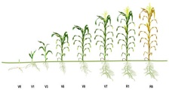
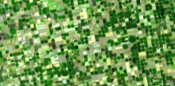


Approach
TOOLS
STARFM
Multi-sensor data
fusion
DMS
Thermal image
sharpening
APPLICATIONS
(daily/30 m)
ALEXI
Multi-scale ET
modeling
Crop phenology
metrics
Crop water use
(Evapotranspiration)
ASSETS
SW/TIR
GEO
Hourly 5km/5km
Crop stress
(drought early warning)
MODIS
Daily 250m/1km
Landsat
16 day 30m/100m
Impact on yield
Lsat-like
~20-60m/ --

Slide 5
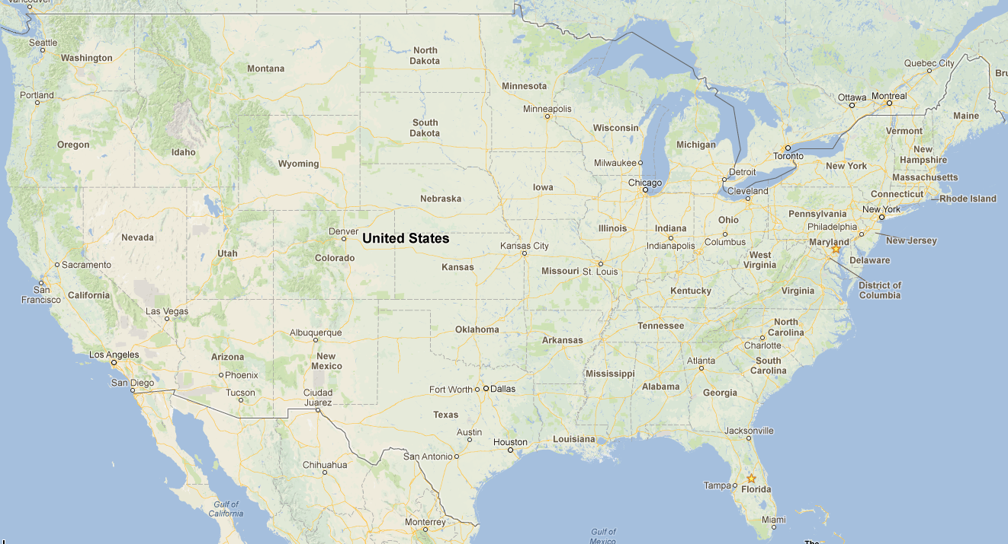
Study Area

Slide 6
Task I. Mapping Crop Phenology at Field Scale
Crop Condition and Water Use Monitoring

Slide 7
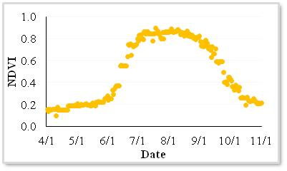
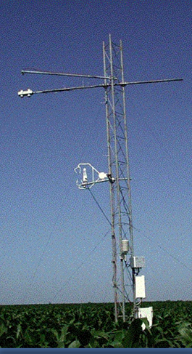
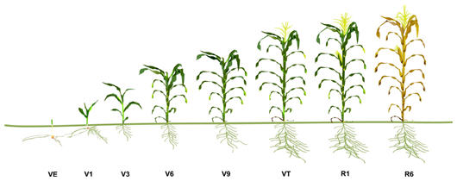

Crop Condition and Water Use Monitoring
Approach: extract crop phenology and growth stages at field-scale
MODIS
STARFM
Landsat
Normalization
Lsat-like
Phenology
start of season
end of season
emerged
silked
… …

Slide 8
Crop Condition and Water Use Monitoring
Method 1: Image Normalization using MODIS
Gao, F., J. Masek, R. Wolfe, C. Huang, Building consistent medium resolution satellite data set using MODIS products as reference, Journal of Applied Remote Sensing, Vol. 4, 043526, doi: 10.1117/1.3430002, 2010
Notes:
Consistent data set should be processed in surface reflectance. However, even with perfect calibration and atmospheric correction, direct comparison of surface reflectance from different sensors are still limited by viewing and illumination geometries, spectral band response function and geolocation accuracy and resampling approaches.

Slide 9
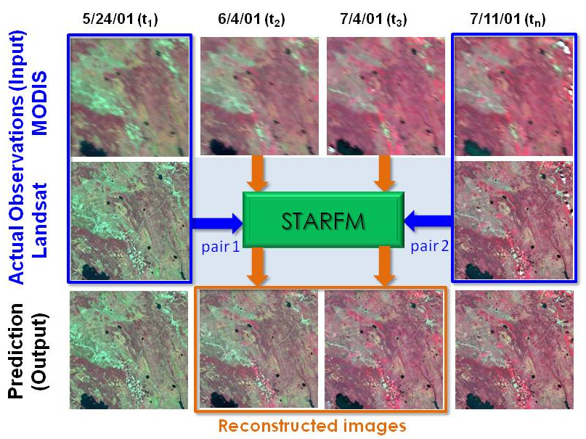
Crop Condition and Water Use Monitoring
Method 2: STARFM - Fusing MODIS and Landsat
Gao, F., J. Masek, M. Schwaller and F. Hall, On the Blending of the Landsat and MODIS Surface Reflectance: Predict Daily Landsat Surface Reflectance, IEEE Transactions on Geoscience and Remote Sensing, vol. 44, no. 8, pp. 2207-2218, 2006

Slide 10
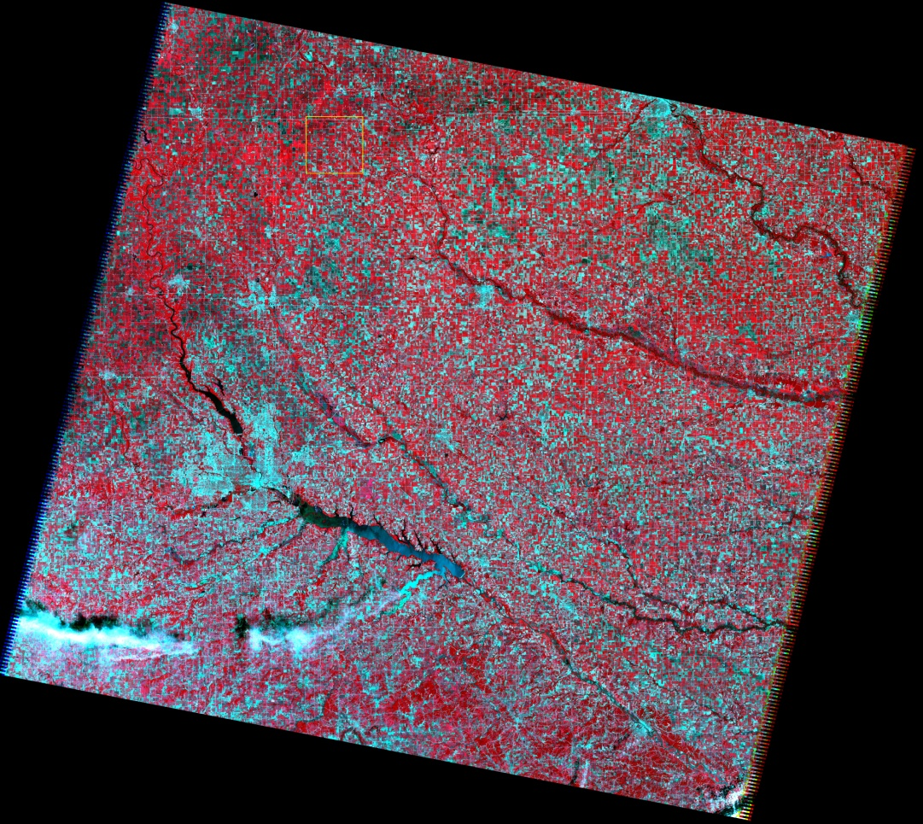
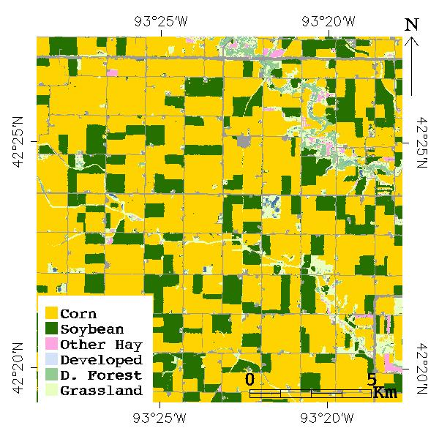
An Example: South Fork, Iowa
WRS-2 Path 26 Row 31 Cropland Data Layer (2011)
(six pairs of Landsat and MODIS images from July 2 to Nov. 7, 2011)

Slide 11
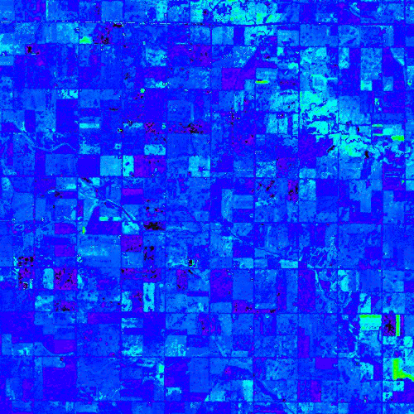
Crop Condition and Water Use Monitoring
0.0 0.5 1.0
Smoothed Daily NDVI, Apr. 1 – Nov. 1, 2011

Slide 12
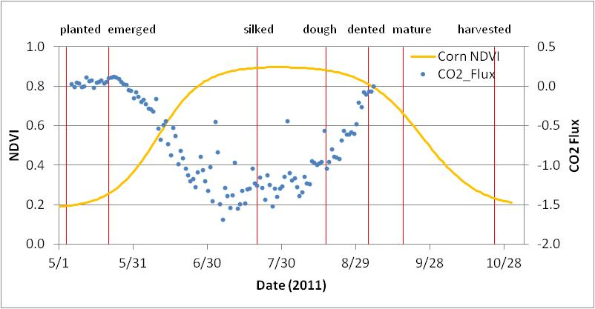
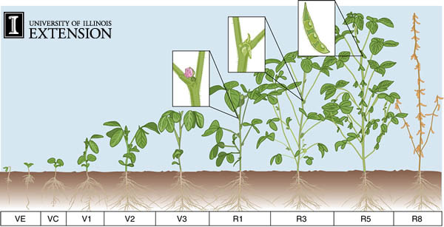
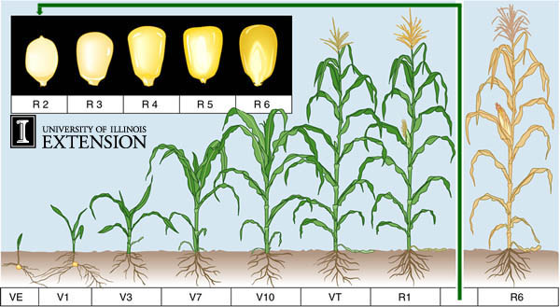
Crop Growth Stages & Remote Sensing Phenology
Crop Growth Stages and Conditions Monitoring

Slide 13
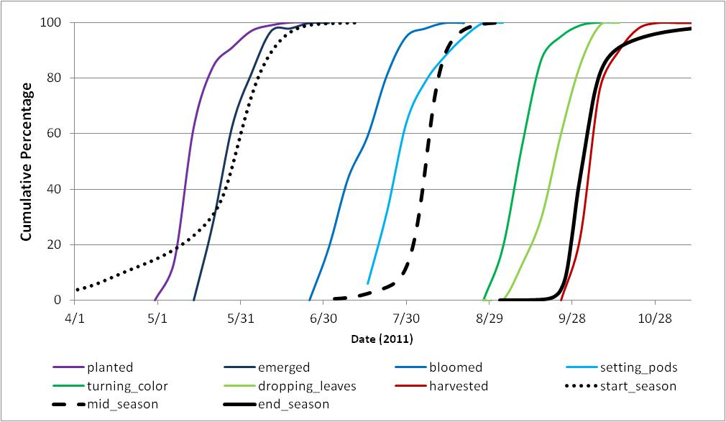
Remote Sensing Phenology vs.
NASS Crop Progress Report
(Landsat p026r031, central Iowa, soybean)
Crop Condition and Water Use Monitoring

Slide 14
Task II. Mapping Daily Evapotranspiration and Stress at Field Scale
Crop Condition and Water Use Monitoring

Slide 15


Water Use Estimation from Space
Using Energy Balance Model
T_{SATELLITE}
Transpiration
Energy balance modeling
Net radiation
Evaporation
T_{VEG}
T_{SOIL}
Two-Source Energy Balance (TSEB) and Atmosphere-Land EXchange Inverse (ALEXI) model

Slide 16
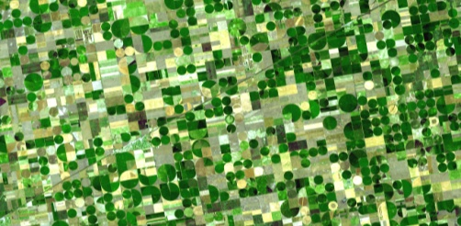
Crop Condition and Water Use Monitoring
FIELD-SCALE
DAILY EVAPOTRANSPIRATION
SW/TIR
STARFM
Daily 30 m ET maps
GEO
DMS
MODIS
LAI
Landsat
ALEXI

Slide 17
Monitoring Evapotranspiration (ET) and Drought
Using Thermal Remote Sensing
Comparison of monthly USDM drought classifications with maps of ESI, anomalies in NASS topsoil moisture data, and with the VegDRI index, primarily reflecting anomalies in NDVI. Also shown are monthly changes in USDM drought class and standardized ESI change anomalies (Anderson et al., 2013). The core of the drought impacted area is clearly delineated in the ESI change indicator in May.

Slide 18
Crop Condition and Water Use Monitoring
Rainfed soybean – SMEX02 (Iowa)
RAIN
Reference ET
Observed ET
Landsat retrievals
Landsat-only
Landsat-MODIS fusion
Results of Landsat-MODIS ET data fusion (red solid line) compared to observations in a rainfed soybean field in Ames, Iowa (blue dots/line) and to a Landsat-only interpolation scheme (red dotted line). The fused MODIS data capture ET enhancements in response to a rainfall event that occurred between Landsat overpasses (red squares)

Slide 19
Task III. Evaluating Drought Impacts on Yield
Crop Condition and Water Use Monitoring

Slide 20
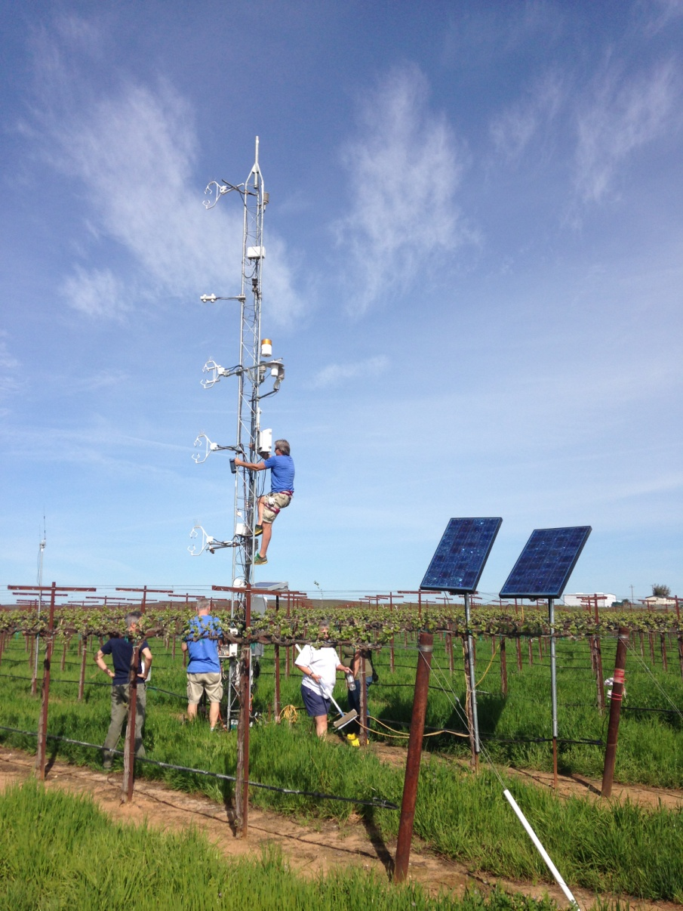
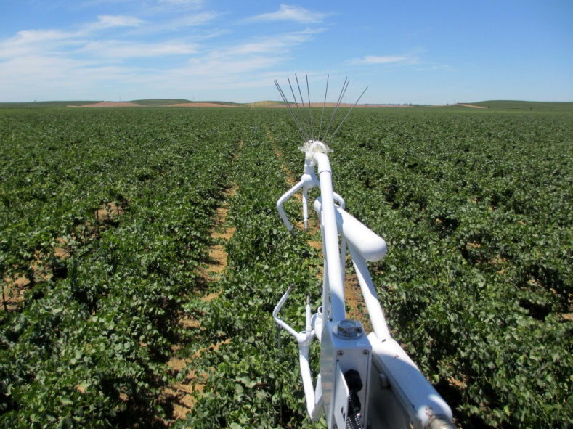
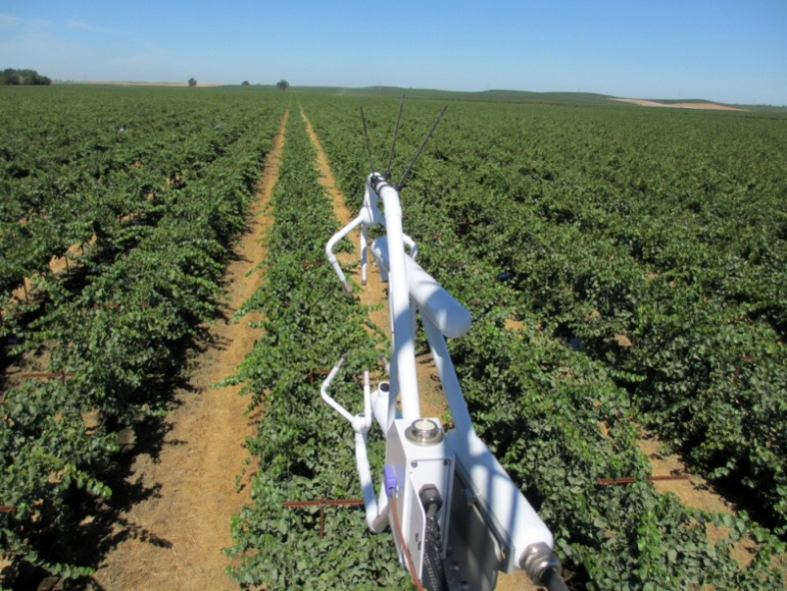
Crop Condition and Water Use Monitoring
Gallo Vineyards, Lodi CA
Site 1: 8-year Pinot Noir
1
2
Site 2: 5-year Pinot Noir

Slide 21
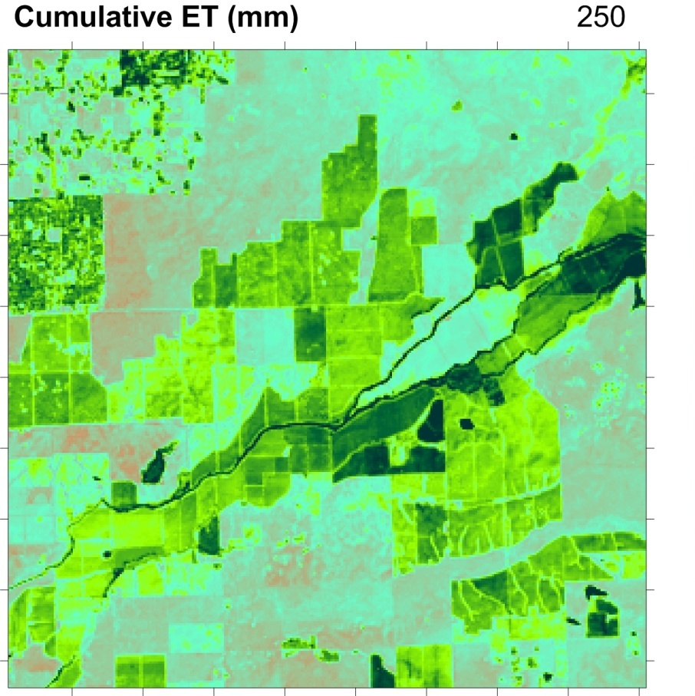
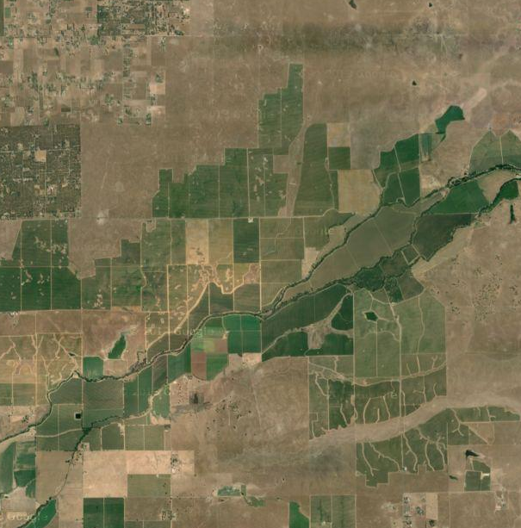
Crop Condition and Water Use Monitoring
Gallo Vineyards, Lodi CA
1
2
Landsat 8 - 2013
GRAPEX 2013, 2014, 2015

Slide 22
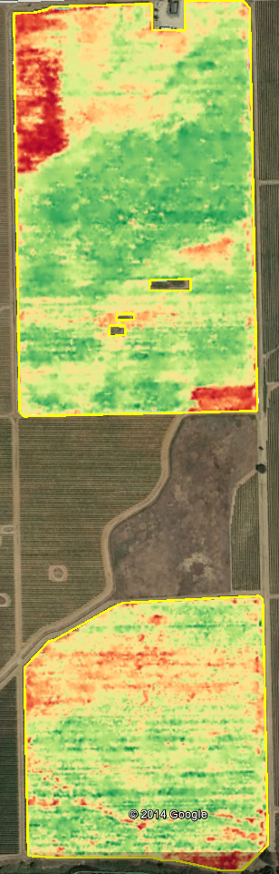
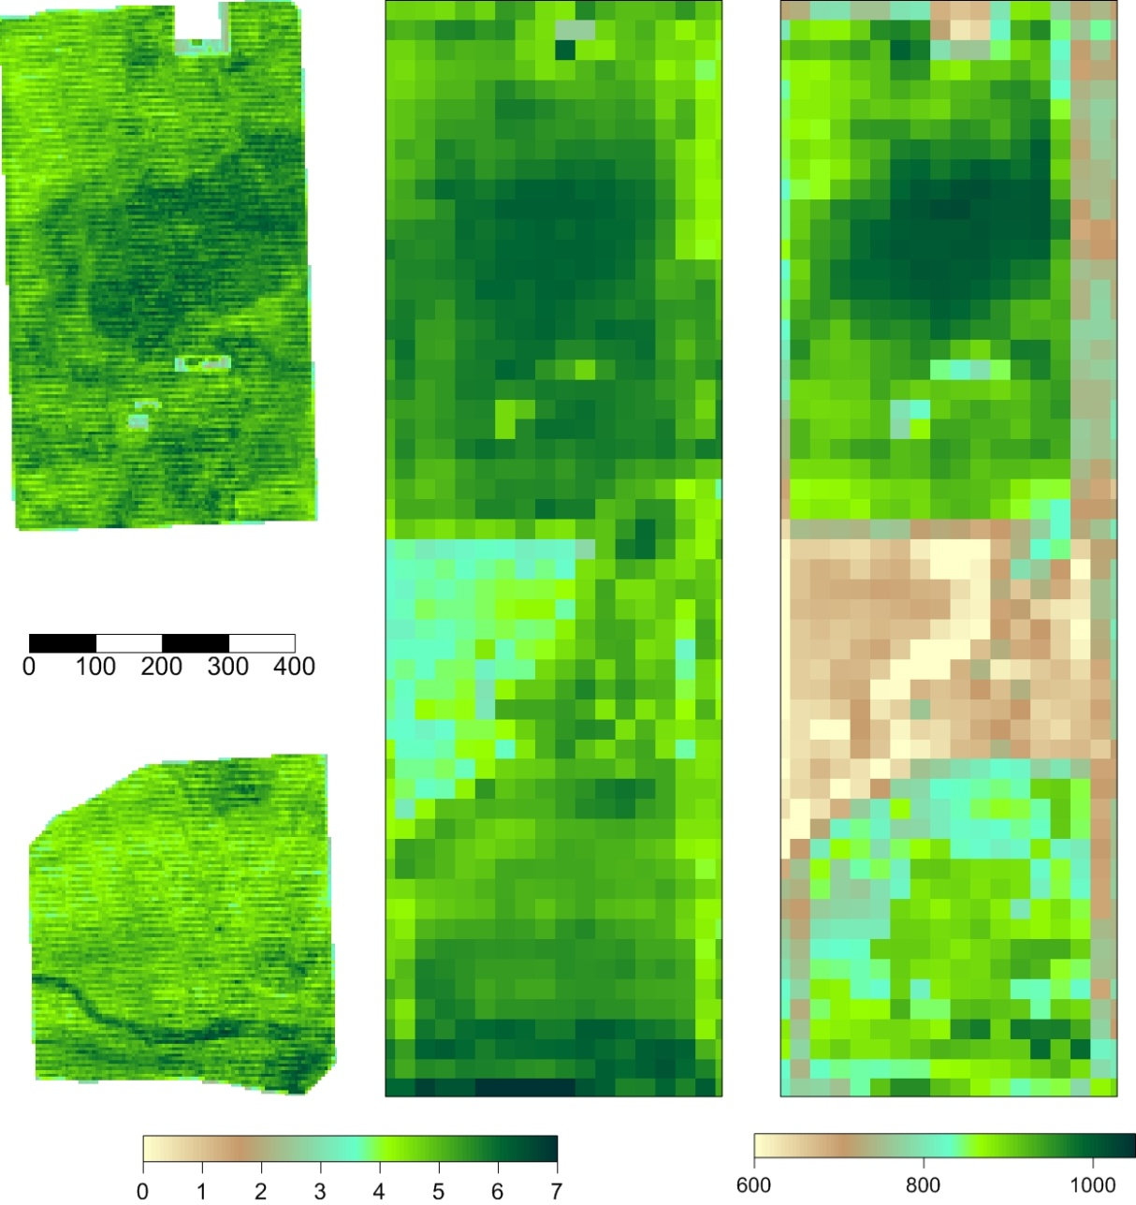
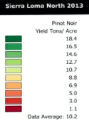

Yield Comparisons
2013 Yield
Aircraft ET (5m)
Landsat 8 ET (30m)
June 12, 2013
Cumulative

Slide 23
Summary
Crop Condition and Water Use Monitoring
TOOLS
STARFM data fusion
DMS TIR image sharpener
ALEXI/DisALEXI ET modeling
LAI, Phenology …
FIELD-SCALE APPLICATIONS
Crop phenology
Daily crop water use and stress
Drought Impact and early warning
USDA is an equal opportunity provider and employer.

