Slide 1
Applications of MODIS and VIIRS Products for Disaster Response at SPoRT
1
Andrew Molthan
(andrew.molthan@nasa.gov)
Research Meteorologist
NASA Marshall Space Flight Center / Earth Science Office / SPoRT
MODIS-VIIRS Science Team Meeting 2015

Slide 2
Background
2
SPoRT has a well-established presence in supporting the NASA Applied Sciences: Disasters emphasis area, incorporating observations from Aqua/Terra MODIS and S-NPP / VIIRS.
Selected Examples:
Early applications of the VIIRS DNB in response to Superstorm Sandy – data used by Department of Defense in civil response, acknowledged in 2012 annual report
Recent applications of DNB outage detection for the Nepal Earthquake
Integration of MODIS and VIIRS observations for severe storm damage within the NOAA/NWS Damage Assessment Toolkit, as part of ongoing “Decisions” award from ROSES 2011: Disasters solicitation
Storm damage detection identified through short-term changes in vegetation index and increases in land surface temperature.
In 2014, our successes were acknowledged by an agency-wide Group Achievement Award to the SPoRT Disaster Response Team

Slide 3
Use of the VIIRS DNB
3
Since the VIIRS DNB observes light emitted from human activities, we focus on the loss or change in pre-event light in order to identify affected areas and recovery
Two concepts have been explored to date:
False color RGB compositing to highlight changes in light
Using a composite where R and G are pre-event, and B as post-event, missing lights are highlighted in shades of yellow.
Differencing pre- and post-event to produce a “percent of normal light”
In a more quantitative approach, dividing current emissions by a reasonable pre-event baseline allows for monitoring current light conditions and trends toward normal during recovery efforts
Disaster response can be further supported by identifying populations and infrastructure located within outage areas.

Slide 4
Concepts Applied to Superstorm Sandy
4
False color composite of pre- and post-storm VIIRS DNB imagery over New York and New Jersey following Superstorm Sandy (reproduced from Molthan et al. 2013)
SPoRT provided U.S. Northern Command with daily VIIRS DNB and guidance on deriving “percent of baseline” light emissions used by DoD in recovery efforts.

Slide 5
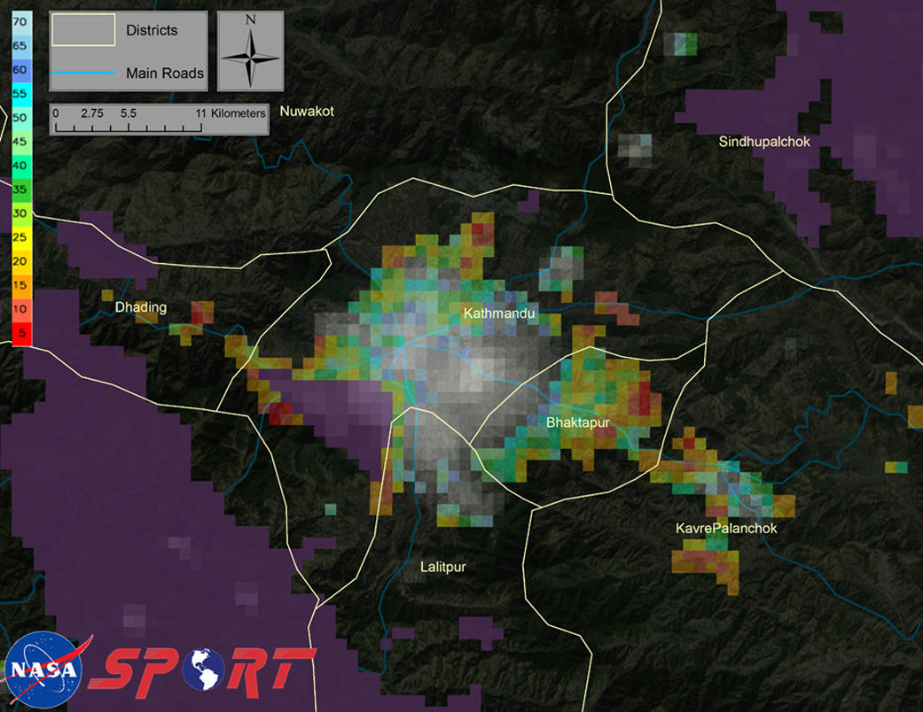
Outages from Nepal Earthquake
5
SPoRT currently uses the NOAA DNB SDRs and terrain-corrected geolocation to difference pre- and post-event imagery. The team would greatly appreciate gridded, daily products that are cloud-free and with lunar contribution removed.

Slide 6
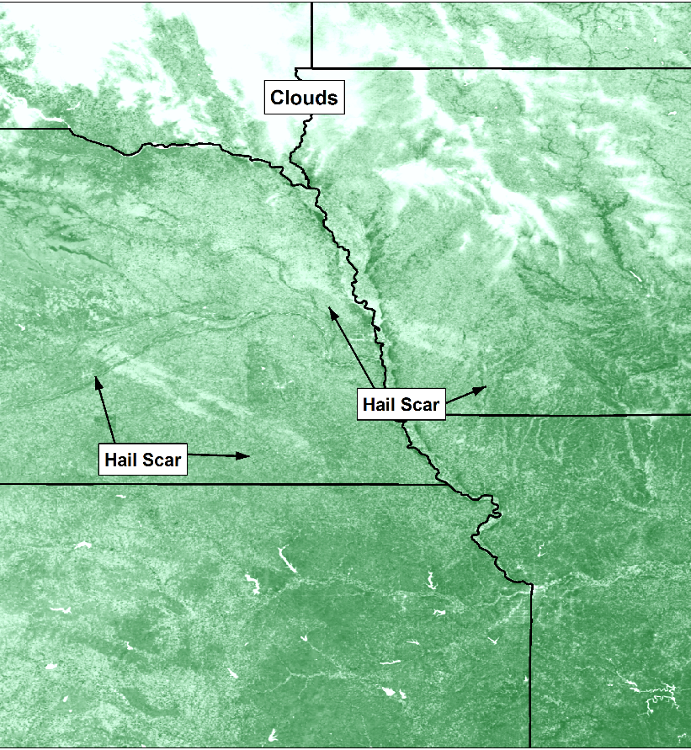
Use of Vegetation Information
6
As with tornado track detection, hail causes significant damage to vegetation
Damage can be identified as changes in vegetation index (e.g. NDVI) and land surface temperature, but manual analysis is too time consuming
Develop algorithm to identify damage areas
Incorporate NDVI and land surface temperature to objectively identify scars
Extract as geospatial features
Hail damage scars across Nebraska and Iowa from a mid-June severe weather event in 2014

Slide 7
End-User Decision Support
7
Products generated by the SPoRT Disasters Team are integrated into a web mapping service and provided to the NOAA/NWS Damage Assessment Toolkit (DAT)
The DAT is a handheld smartphone, tablet, and web-based application that NWS meteorologists use to identify and catalog damage from severe storms

Slide 8
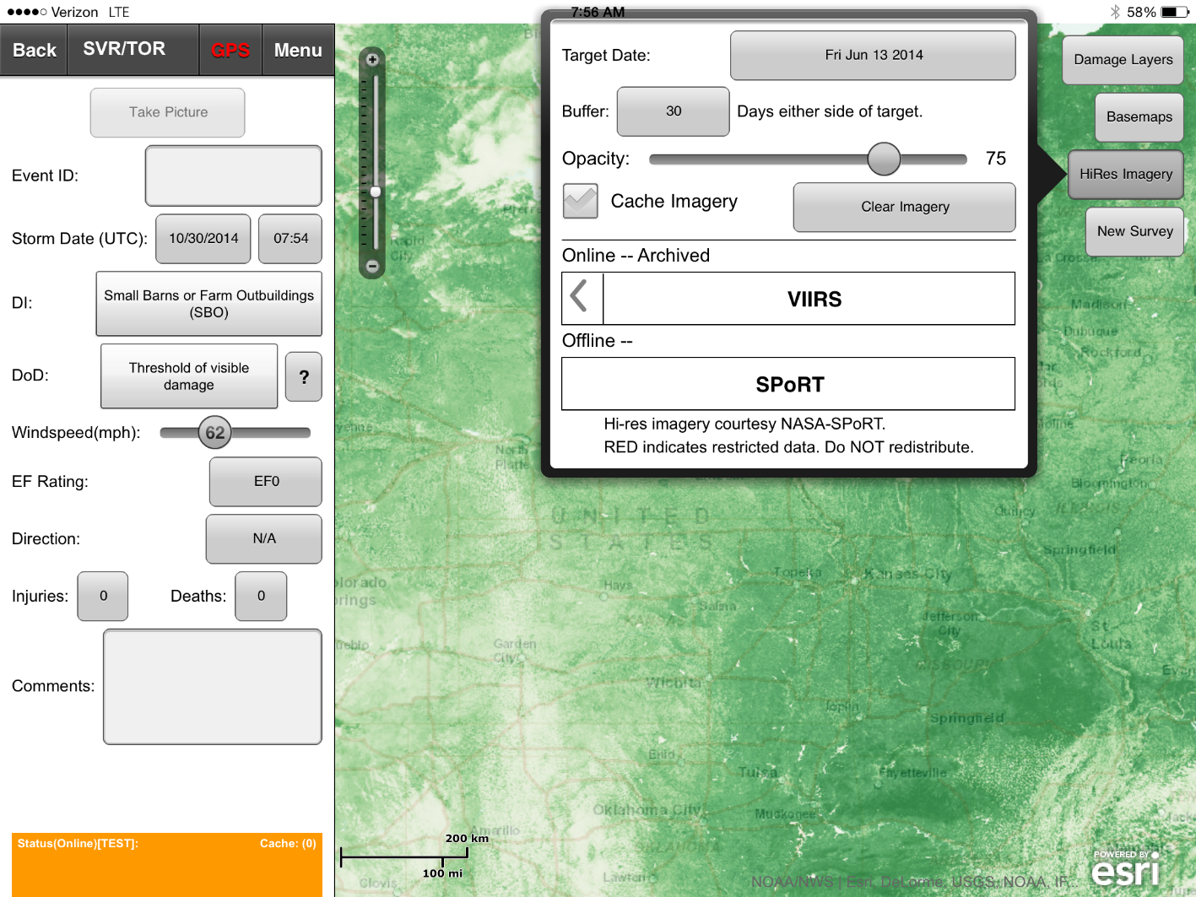
Integration with NOAA/NWS Damage Assessment Toolkit
8
Integration of imagery via WMS allows for search and query within the Damage Assessment Toolkit:
MODIS, VIIRS, Landsat-7, Landsat-8, ASTER, ISERV, Commercial Imagery, and derived products…

Slide 9
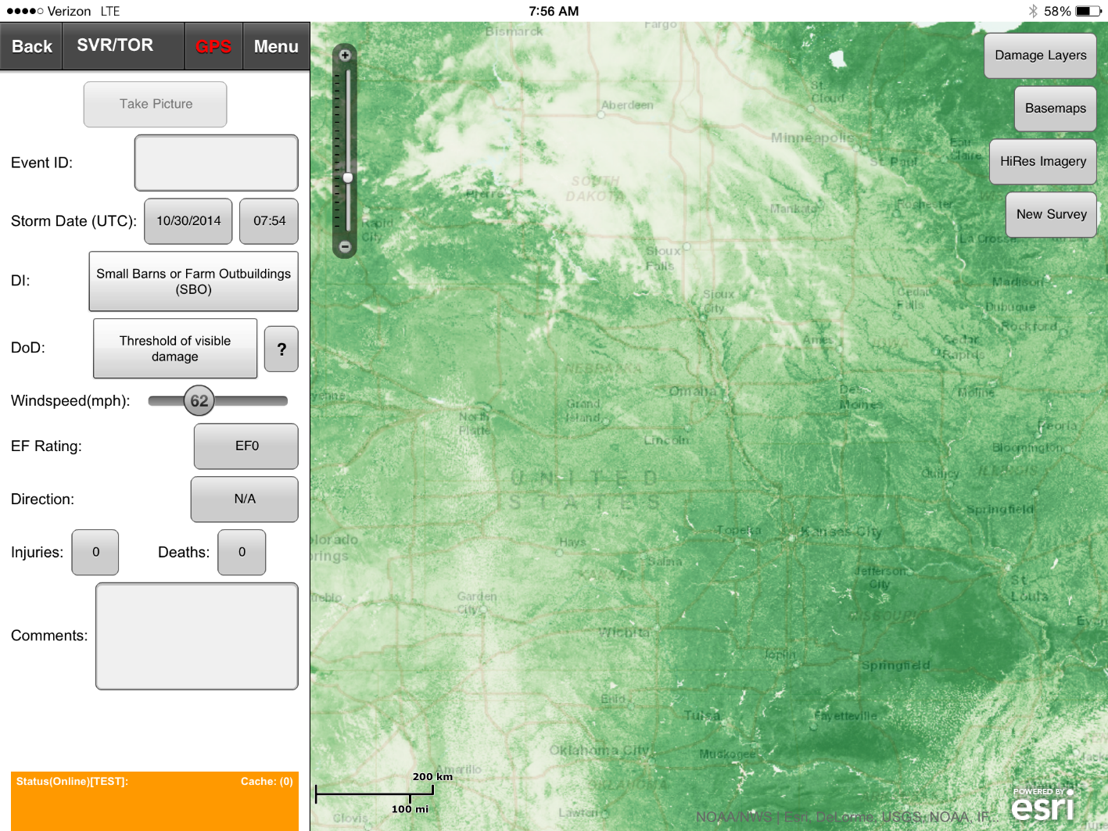
Integration with NOAA/NWS Damage Assessment Toolkit
9
Imagery is tiled to various resolutions for pan and zoom (like Google Earth), and DAT allows for pinch-zoom capability.

Slide 10
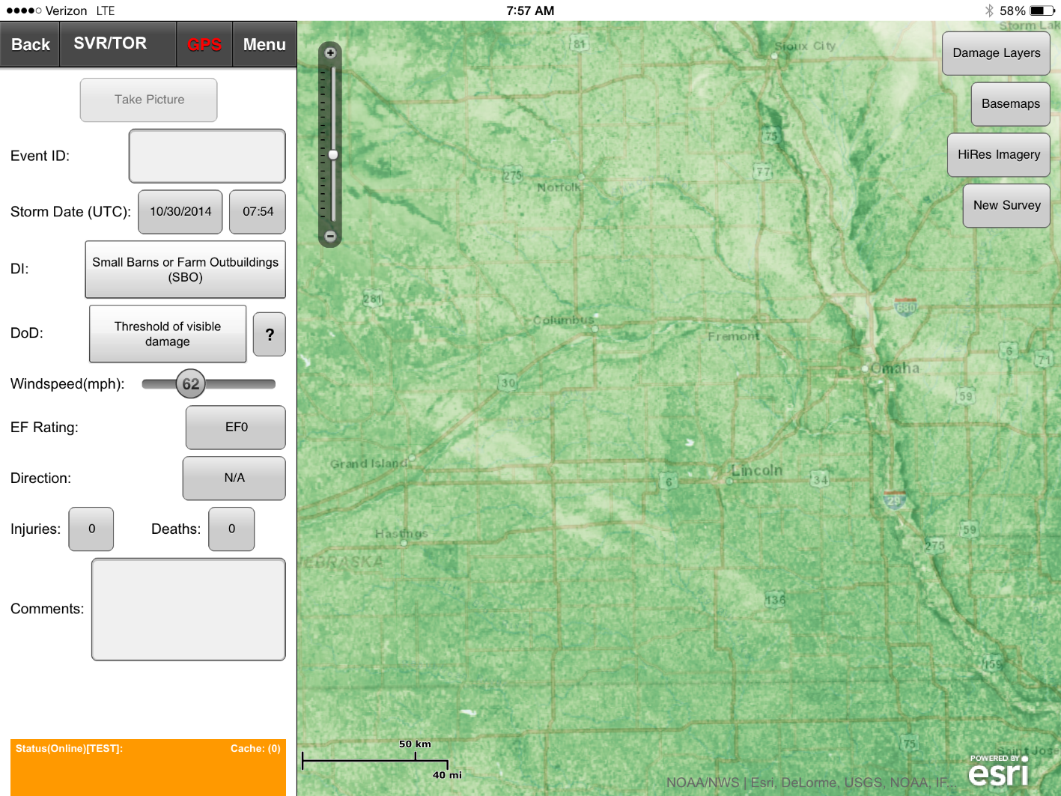
Integration with NOAA/NWS Damage Assessment Toolkit
10
Imagery within the DAT can be viewed and corroborated with other storm reports and surveys.
Goal: Use imagery and algorithms to identify damage areas (J. Bell, UAH)

Slide 11
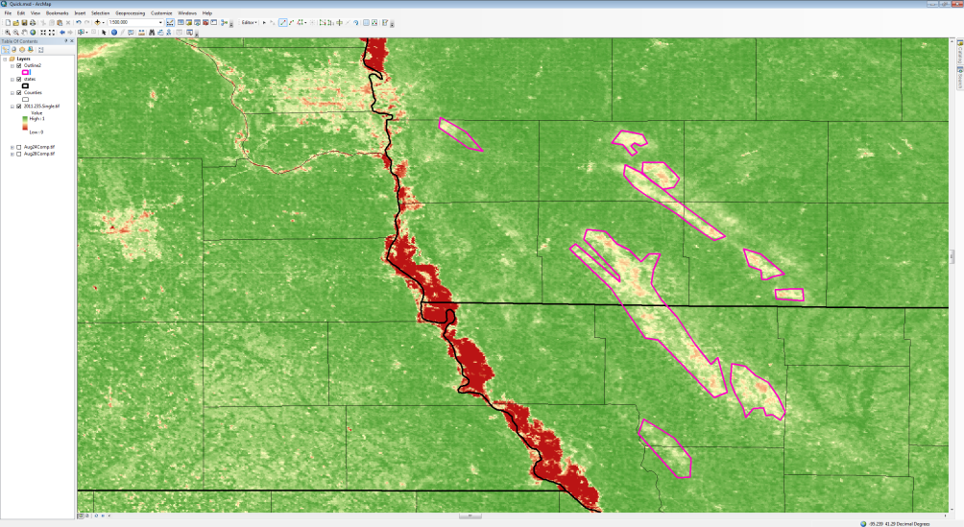
Hail Detection Algorithm
11
As with tornado track detection, hail causes significant damage to vegetation
Damage can be identified as changes in vegetation index (e.g. NDVI) and land surface temperature, but manual analysis is too time consuming
Develop algorithm to identify damage areas
Currently focused on using NDVI & LST to develop algorithm from case study analysis
An example of short-term NDVI change with hail streaks evident in Iowa and Missouri, with possible manual analysis via GIS and hand-drawn shapefiles.

Slide 12
Hail Detection Algorithm
12
As with tornado track detection, hail causes significant damage to vegetation
Damage can be identified as changes in vegetation index (e.g. NDVI) and land surface temperature, but manual analysis is too time consuming
Develop algorithm to identify damage areas
Currently focused on using NDVI & LST to develop algorithm from case study analysis
MODIS/VIIRS ΔNDVI
MODIS/VIIRS ΔLST
Identify Possible Damage
Confirm Hail
w/Radar and SPC
Constrain to Likely Hail-Damaged Pixels
Output to WMS/DAT
Conceptual algorithm envisioned for the identification of hail-damage pixels using near real-time MODIS imagery.

Slide 13
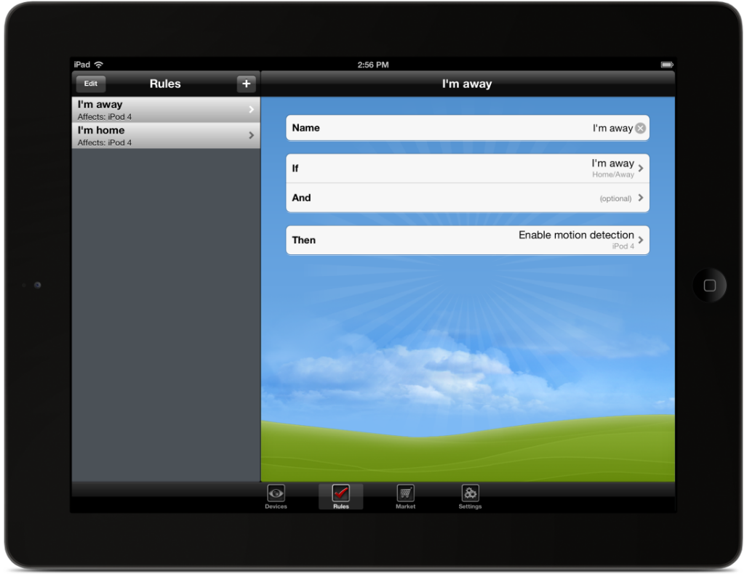
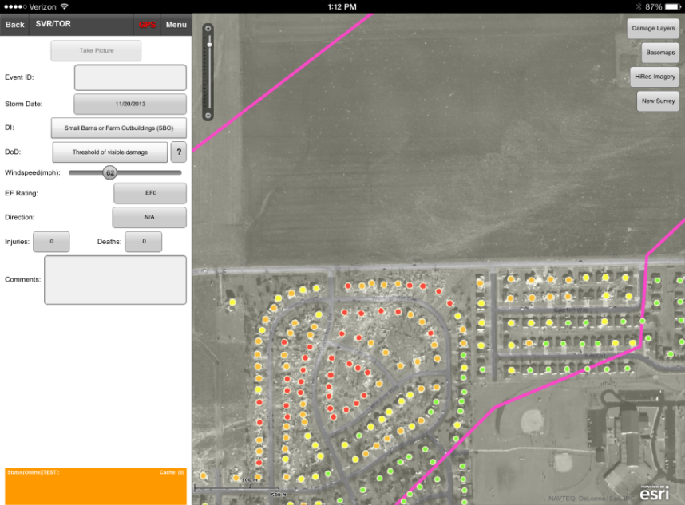
Hail Detection Algorithm
13
Longer-term goal is to establish a viable algorithm to aid in damage detection, for inclusion in the DAT.
NWS meteorologists do not routinely perform hail damage surveys, some offices do keep detailed
Additional info can be provided to
End users (NWS, USDA, USGS)
Emergency managers
Interested parties to aid in damage assessments.
When completed, the hail detection algorithm can be incorporated as an additional near real-time product for inclusion in the DAT, supplementing radar-based products that identify hail fall regions.

Slide 14
Training
14
To support the use of imagery within the DAT, the proposal team has developed multiple forms of training:
Teletraining completed with partnering Southern Region WFOs during the Fall 2014 season, rollout to Central Region planned for Spring 2015
Quick Guides, or one-page highlights of products available and examples of their usage
Narrated slide presentations (e.g. Articulate) will eventually be developed for viewing within the mobile client or web viewer

Slide 15
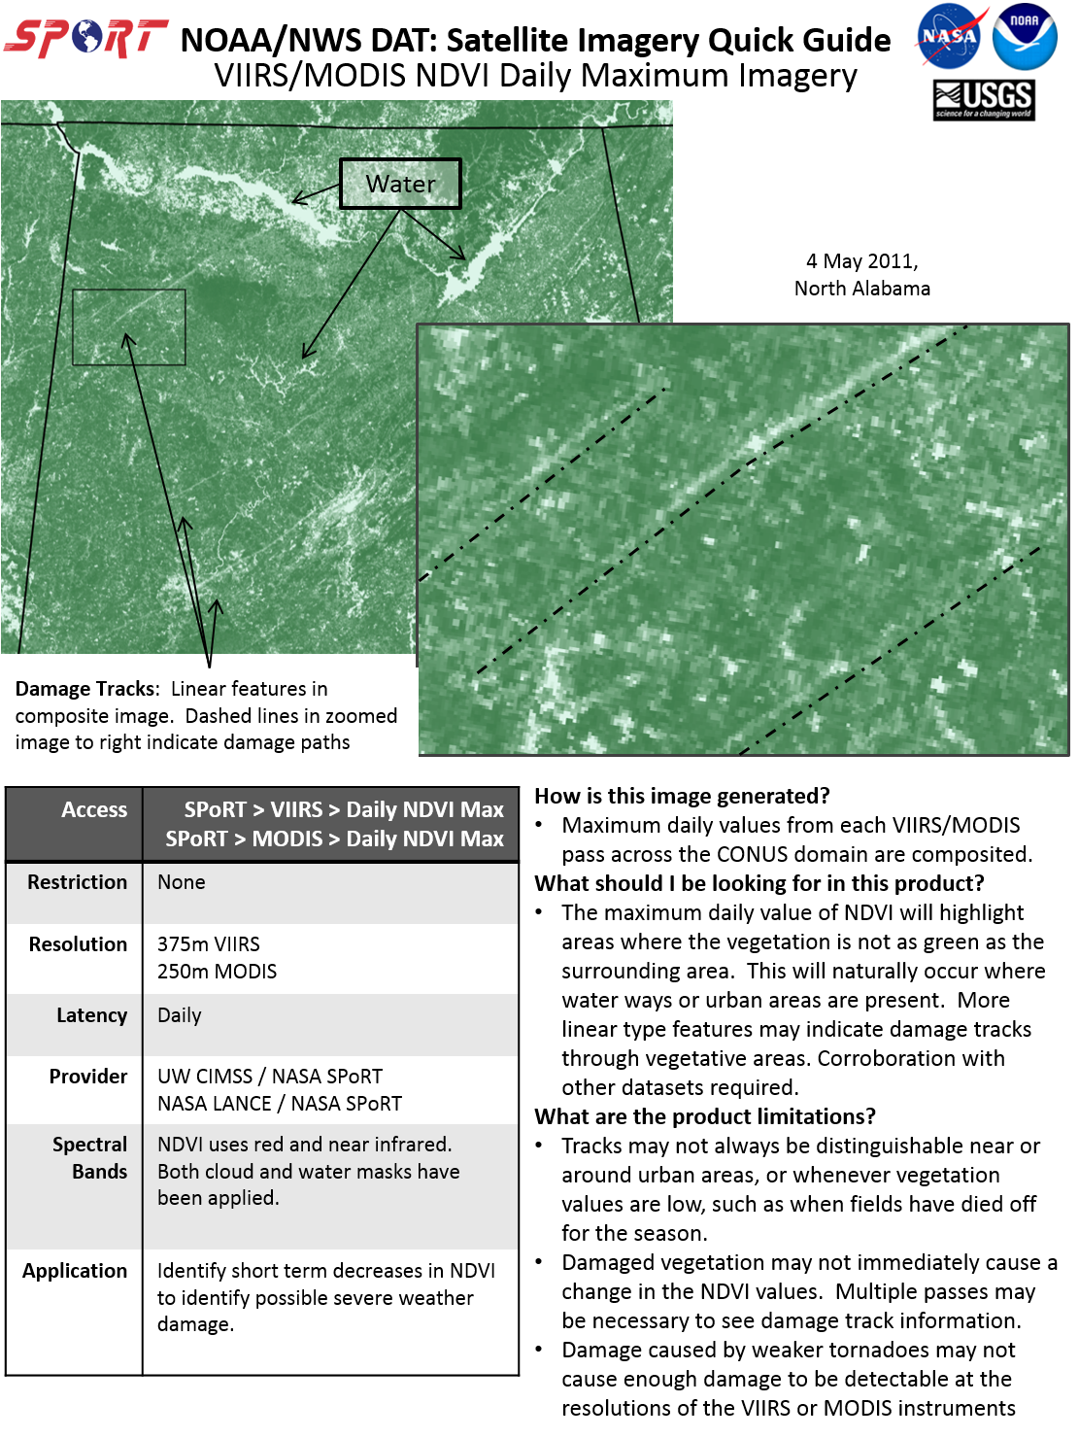
15
Quick Guide Example
Quick guides have been provided for each product disseminated in near real-time to the DAT.
Short-term goal to work with NWS developer to integrated training directly within the DAT.
Other future opportunities for derived products (NDVI change) or automated techniques (damage detection)

Slide 16
Wish List!
16
Gridded products are quite helpful, as they allow a user to download information from a known area without concern about stitching of granules.
Products in GeoTIFF format, including raster (byte, uint, etc.) with conversion to a physical value, are helpful for data processing.
Alternatively, tools to convert from granule or grid to GeoTIFF.
Include ancillary information that assist with product generation: for example, a cloud mask to accompany a DNB product or land surface information.
Quantitative, long-term information from the DNB is helpful to establish a “climatology” and separate variability from signal when detecting outage areas.
Reduced latency (e.g LANCE) is key for near real-time applications, especially for timely disaster information.

Slide 17
Questions?
17
andrew.molthan@nasa.gov

