Slide 1
2015 MODIS/VIIRS Science Team Meeting:
Data Production and Archiving Session (Wednesday May 18th, 2015)
VIIRS Land SIPS,
JPSS Land Product,
and CEOS/WGCV/LPV Status
Miguel O. Román (GSFC), C. Justice (UMCP), E. Masuoka (GSFC)
with contributions from: J. Nickeson, C. Davidson, S. Devadiga,
E. Vermote, J-C. Roger, N. Pahlevan, I. Csiszar, M. Vargas,
Y. Yu, D. Wang, X. Zhan, W. Schroeder, and others…

Slide 2

VIIRS Land Web Site (http://viirsland.gsfc.nasa.gov/)
Public as of 2014
Home Page includes -> News, Meetings, Sensor and Land Data information
Navigation includes -> Products - Validation - People - Tools - Publications – Links
Please keep us informed of publications, particularly those that are peer-reviewed
Input is welcome, please send us news or validation plans.
Recently Updated – NASA/NOAA
The Products navigation button was separated into NOAA EDR products and NASA ESDR products. Main product page for each agency describes their general approach (SIPS vs. IDPS). Each NASA product page includes a Validation Plan section. The NOAA page includes a section for NOAA-unique products.
People page includes navigation at left to pages for both the NASA Science Team and NOAA Product Team members
Additional updates as SIPS get rolling and products advance

Slide 3
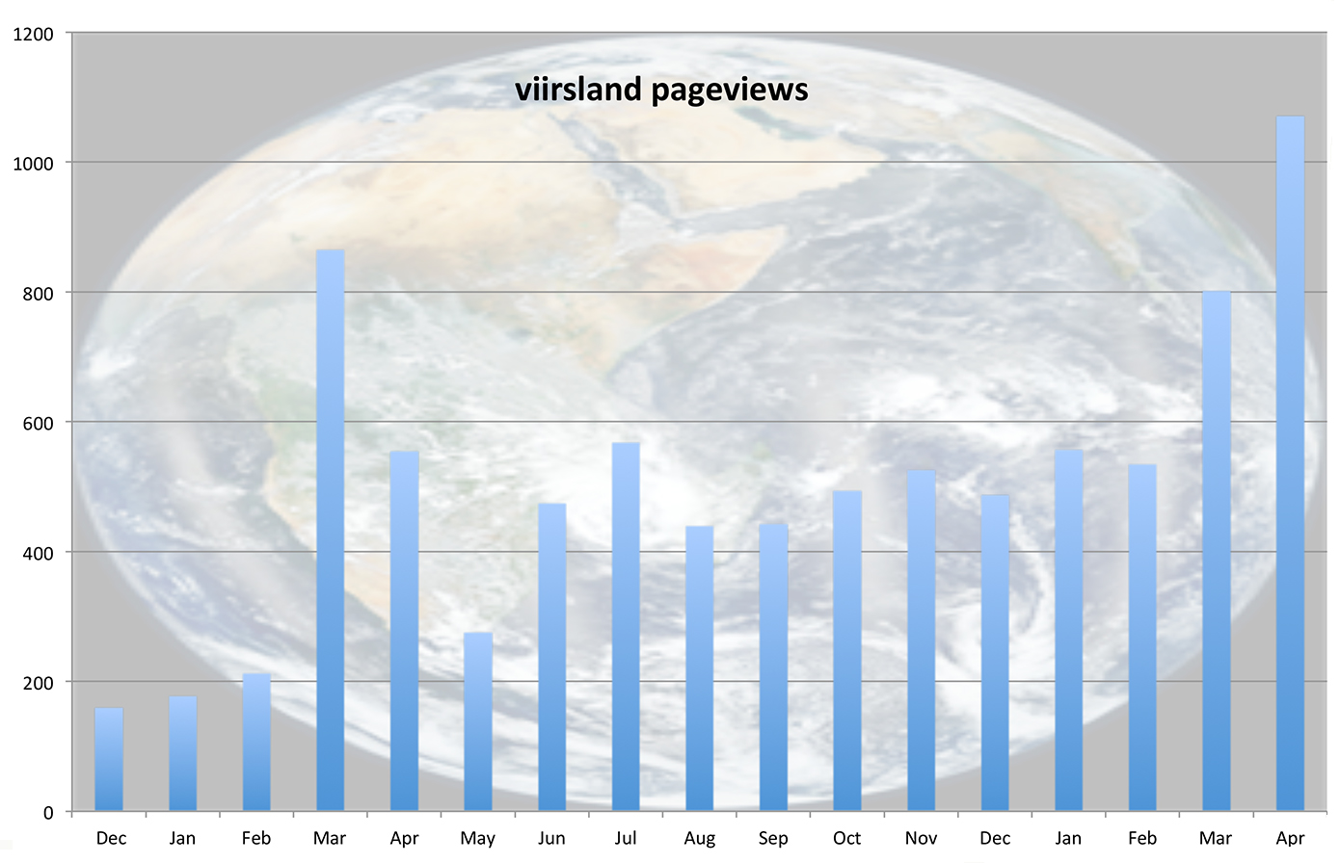
VIIRS Land Monthly Web site visits
Site announced to science team
2014
http://viirsland.gsfc.nasa.gov/
2015

Slide 4
VIIRS Land SIPS Tasks
Assist the SNPP Science Team with integrating and testing the product generation software in the SIPS environment,
Implement the product generation software in MODAPS,
Create VIIRS Level 1-3 products in multiple processing streams (next slide)
Reprocess VIIRS products when directed by the SNPP Land Science Team,
Provide assessment capabilities for VIIRS land products (LDOPE),
Deliver VIIRS land products, software, browse imagery, and associated ancillary data and metadata to LP and NSIDC DAACs for archive and distribution.
Produce and deliver VIIRS products required as inputs in CERES processing

Slide 5
Product Generation by Land SIPS
Land SIPS processing will be separated into four separate modes, all operating simultaneously:
Forward Stream Processing Mode: create the best possible global VIIRS L1B and Land L2/L3 products using the highest fidelity input data sources (requires 24-48 hour delay). Land L2/L3 products are delivered to LP and NSIDC DAACs.
Near Real-Time Processing Mode: create low latency global VIIRS products (< 3 hours) in LANCE (nrt3 and nrt4 strings).
Historical Reprocessing Mode: create the best possible VIIRS L1B and Atmosphere L2/L3 products for the entire SNPP mission record. Land L2/L3 products are delivered to LP and NSIDC DAACs.
Experimental Reprocessing and Evaluation Mode: create global VIIRS Level 1B and Land L2/L3 test for review and evaluation by the SNPP Science Team. Products are available to Land Science Team only.

Slide 6
Items Delivered to DAAC
Data products along with scientific algorithm software source code, coefficients, and ancillary data used to generate these products to the NASA-assigned Distributed Active Archive Center (DAAC) with no period of exclusive access.
Algorithm Theoretical Basis Document (ATBD) documentation as well as the accompanying spatial, temporal, and product metadata associated with the standard products.
Browse products associated with standard products.

Slide 7
Land SIPS (Current Processing Status)
AS 3000
AS 3001
AS 3002
C1.1 Reprocessing
  Mx7.2 based codes with Land PEATE improvements for Aerosols, LSR, and Geolocation
  Snow Ice initiates from Daily NISE (Near real time Ice and Snow Extent) that is gridded, not IDPS Snow Ice GIP files.
  VI initiates from 4-year mean of MODIS Aqua 16-day tiled product, MYD13A2, not IDPS 17-Day Rolling NDVI.
  Uses “Best Of” LUTs for SDR/Geo codes as provided by VCST
  1/19/2012 through 3/31/2015 complete
  Reprocessing of April 2015 underway

Slide 8
Land SIPS Reprocessing – Transition C1.1 to C1.2
C1.2 Reprocessing/Operational Forward Processing
  Will start after the NASA L1 becomes available (June 2015)
  Will use Mx8.6 based SDR and Geolocation (or NASA VCST and GEO code if becomes available)
  Will use new Mx8.6 based LUTs from VCST for Geolocation & SDR. (Could also use NASA VCST LUTs in compliant with the NASA VCST delivered calibration code)
  Implement scaling for DNB products
  C12 will be continuation to C11. Reprocessing from beginning of mission (1/19/2012) will be done with mandate from NASA science team.
  Will use same PGEs as in C11 for all other products, unless new algorithms are provided by the NASA science teams for the product
  NASA science team delivered algorithms will replace the operational PGEs as algorithms become available.
  Operational processing streams in AS 3001 and 3002 will cease.
  A science test processing system in place to support science testing of NASA ST delivered algorithms.
2

Slide 9
Land SIPS VIIRS NRT and Science PGEs
NASA VIIRS Science PGEs
  Will use EDOS L0 PDS as starting point, not RDRs
  NASA VIIRS L1A->Geolocation->L1B will be first level of processing
  Ancillary files, such as NCEP, NAAPS, TLE and PolarWander will be from GDAAC in their native format rather than the hdf5 wrapped versions from IDPS
  L1A, L1B and Geolocation products will be netCDF/HDF5 format
    Will have option for users to obtain data in hdf4 format
  Swath products will be 6-minute granules
  Plan to port existing Land PEATE Science DDRs to Land SIPS PGEs. Will try to match MODIS numbers.
    New numbering scheme (e.g. Surface reflectance – PGE11 in MODIS Land, PGE511 in Land SIPS)
    New ESDTs (e.g. Surface Reflectance – MOD09 in MODIS Land, VIIRSNP09 in Land SIPS)
    New Archive Sets to be used in processing – Inherit Collection Version Number
  Will use IDPS PGE code where necessary or desired, and science team delivered code if already available
    CloudMask will be IDPS code initially
    Fire algorithm provided by the science team
NRT PGEs
  Production Plans:
    Active Fire (Louis Giglio’s code)
    Corrected Reflectance (as obtained from Direct Readout Laboratory)
    Chain of PGEs for Land Surface Reflectance, to determine latency only
    Daily Gridded Day/Night Band Products (Virginia Kalb and Zhuosen Wang’s code)
  Using IDPS SDR/Geo codes, Mx8.6 version
  Processing with NCEP, NAAPS, TLE and PolarWander data from GDAAC

Slide 10
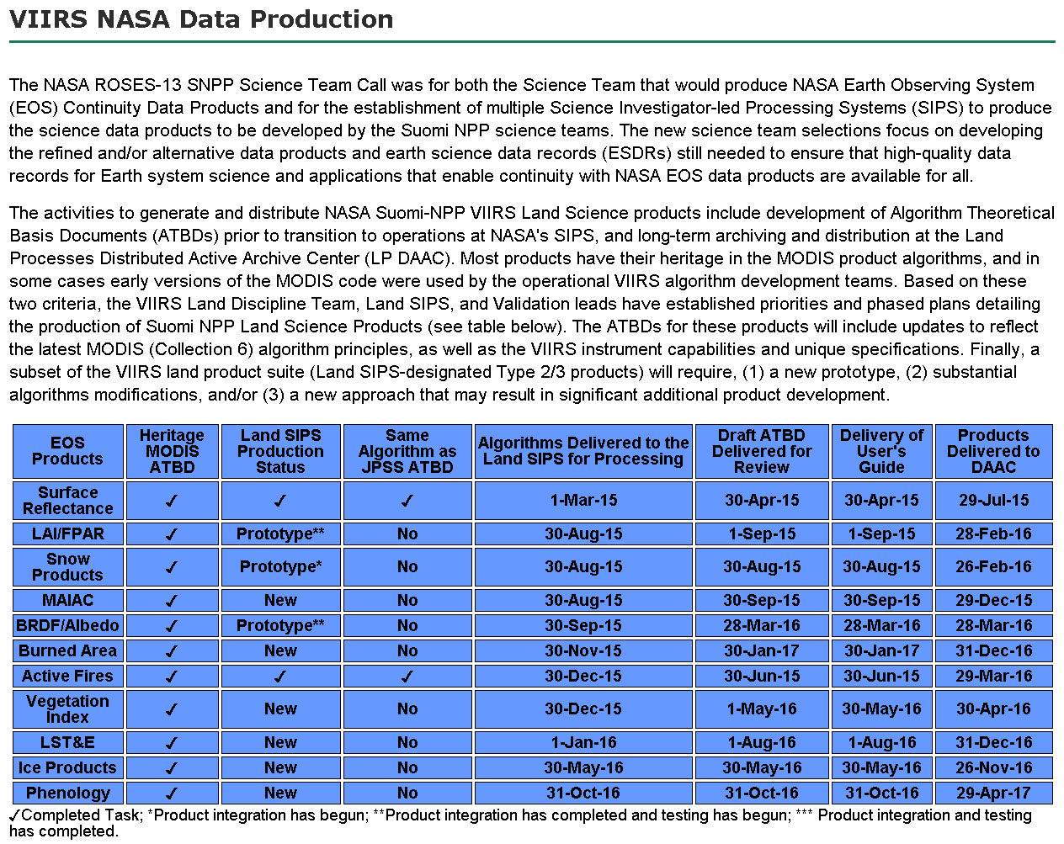

Slide 11

JPSS Land EDR Product Status

Slide 12
JPSS/GOES-R Data Product Validation Maturity Stages – DEFINITIONS (Nominal Mission)
Beta Product is minimally validated, and may still contain significant identified and unidentified errors. Information/data from validation efforts can be used to make initial qualitative or very limited quantitative assessments regarding product fitness-for-purpose. Documentation of product performance and identified product performance anomalies, including recommended remediation strategies, exists.
Provisional Product performance has been demonstrated through analysis of a large, but still limited (i.e., not necessarily globally or seasonally representative) number of independent measurements obtained from selected locations, time periods, or field campaign efforts. Product analyses are sufficient for qualitative, and limited quantitative, determination of product fitness-for-purpose. Documentation of product performance, testing involving product fixes, identified product performance anomalies, including recommended remediation strategies, exists. Product is recommended for operational use (user decision) and in scientific publications.
Validated Product performance has been demonstrated over a large and wide range of representative conditions (i.e., global, seasonal). Comprehensive documentation of product performance exists that includes all known product anomalies and their recommended remediation strategies for a full range of retrieval conditions and severity level. Product analyses are sufficient for full qualitative and quantitative determination of product fitness-for-purpose. Product is ready for operational use based on documented validation findings and user feedback. Product validation, quality assurance, and algorithm stewardship continue through the lifetime of the instrument.
JPSS accuracy requirements: http://viirsland.gsfc.nasa.gov/NOAAprod.html

Slide 13
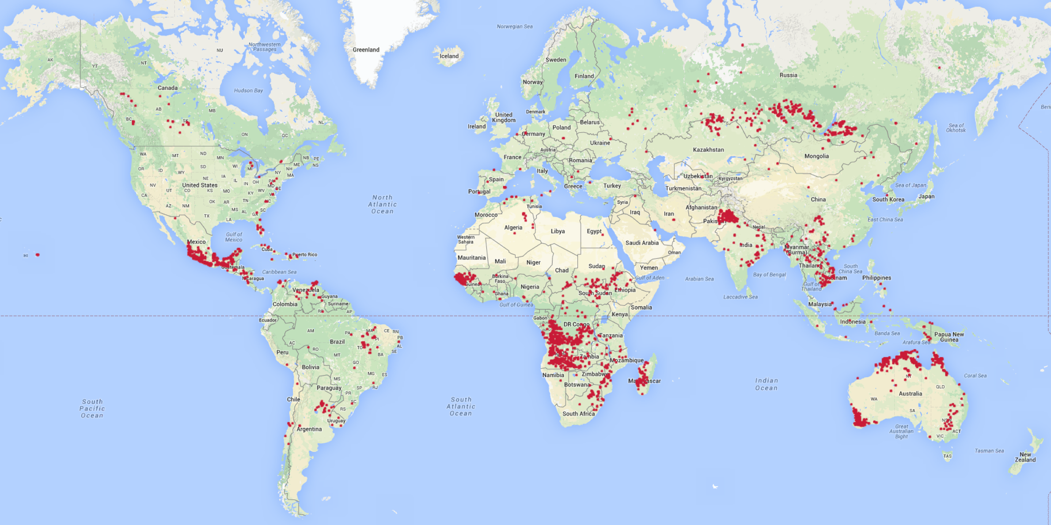
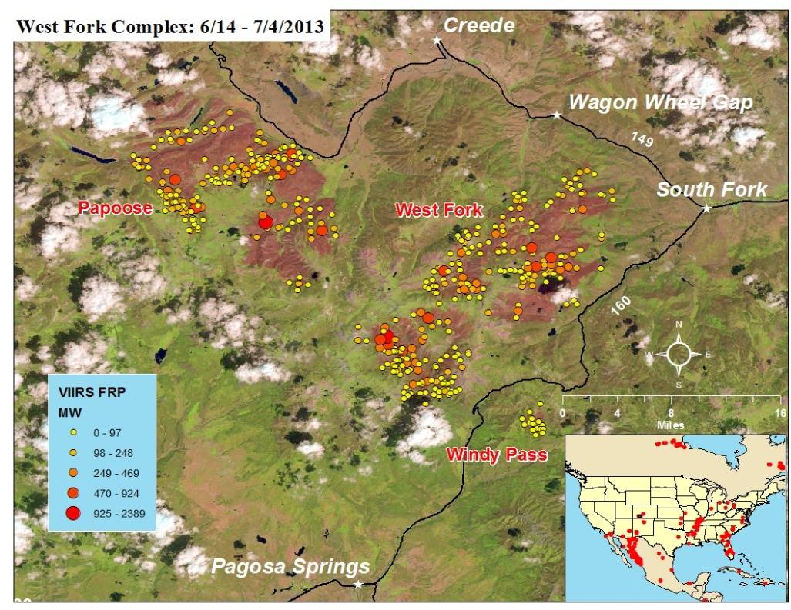
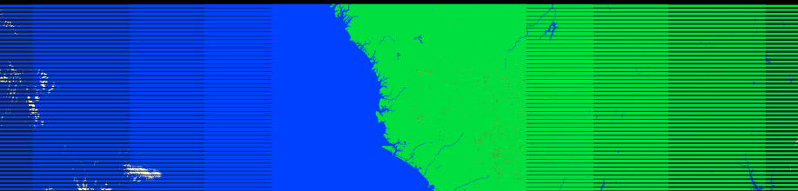
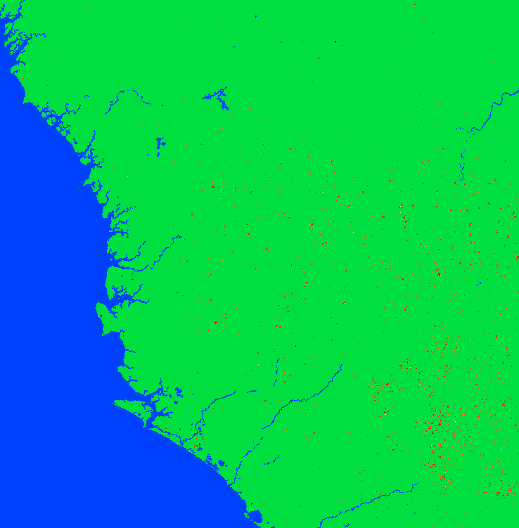
VIIRS Active Fire
  Current Operational IDPS Product
  Contextual-thresholding detection algorithm based on MODIS Collection 4 algorithm
  List of detections over cloud-free land
  File format: HDF5
  Cal/Val Maturity Status:
  Validated 09/04/2014 Science Review; S-NPP Active Fire ARP was declared Operational by SPSRB in Aug-2014
  J1 Updates/Improvements:
  Collection 6-equivalent algorithm
  Include additional output: fire radiative power (FRP)
  Global coverage (including water)
  Full fire mask
  File format: netCFD4
  Schedules/Timeline:
  Tailored version of the NASA science code for NOAA real-time applications
  To be implemented in NOAA’s Suomi NPP Data Exploitation (NDE) system by late Summer 2015
  To become the operational NOAA product for Suomi NPP after verification
Current IDPS product over a global map
viirsfire.geog.umd.edu
Fire Radiative Power
clouds
fires
cloud
water
land
water
NASA science code output
NOAA NDE test code output
CRITICAL INFORMATION AIR QUALITY, ECOSYSTEM, AND DISASTER MANAGEMENT
Ivan Csiszar, NOAA/NESDIS/STAR; Wilfrid Schroeder, Louis Giglio et al. UMD

Slide 14
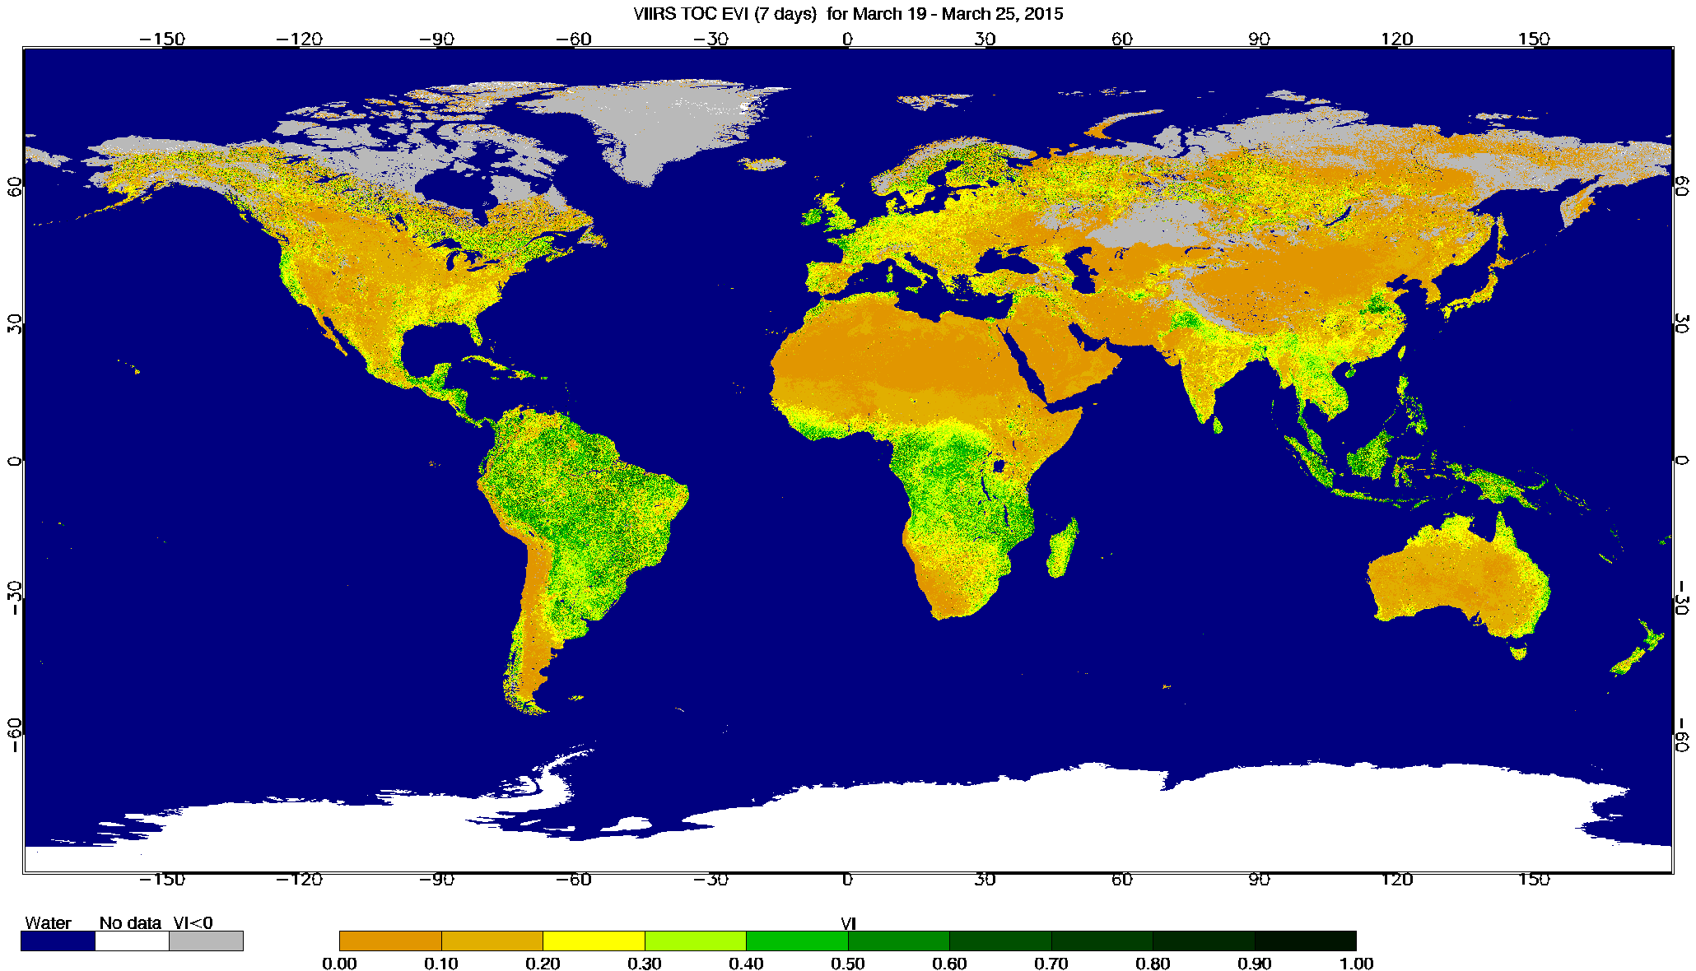
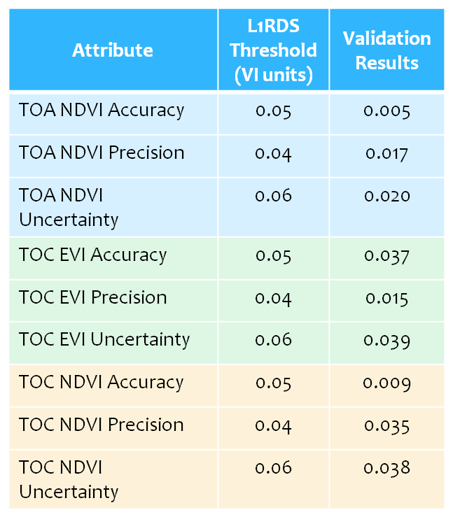
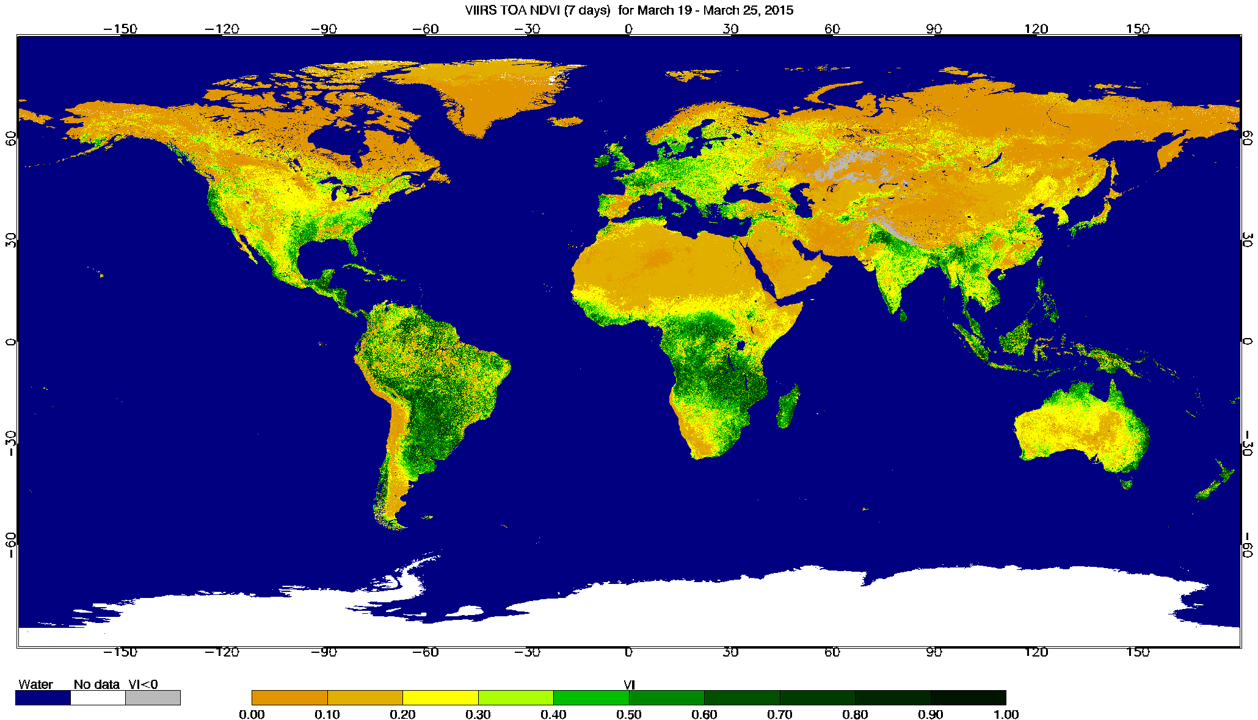
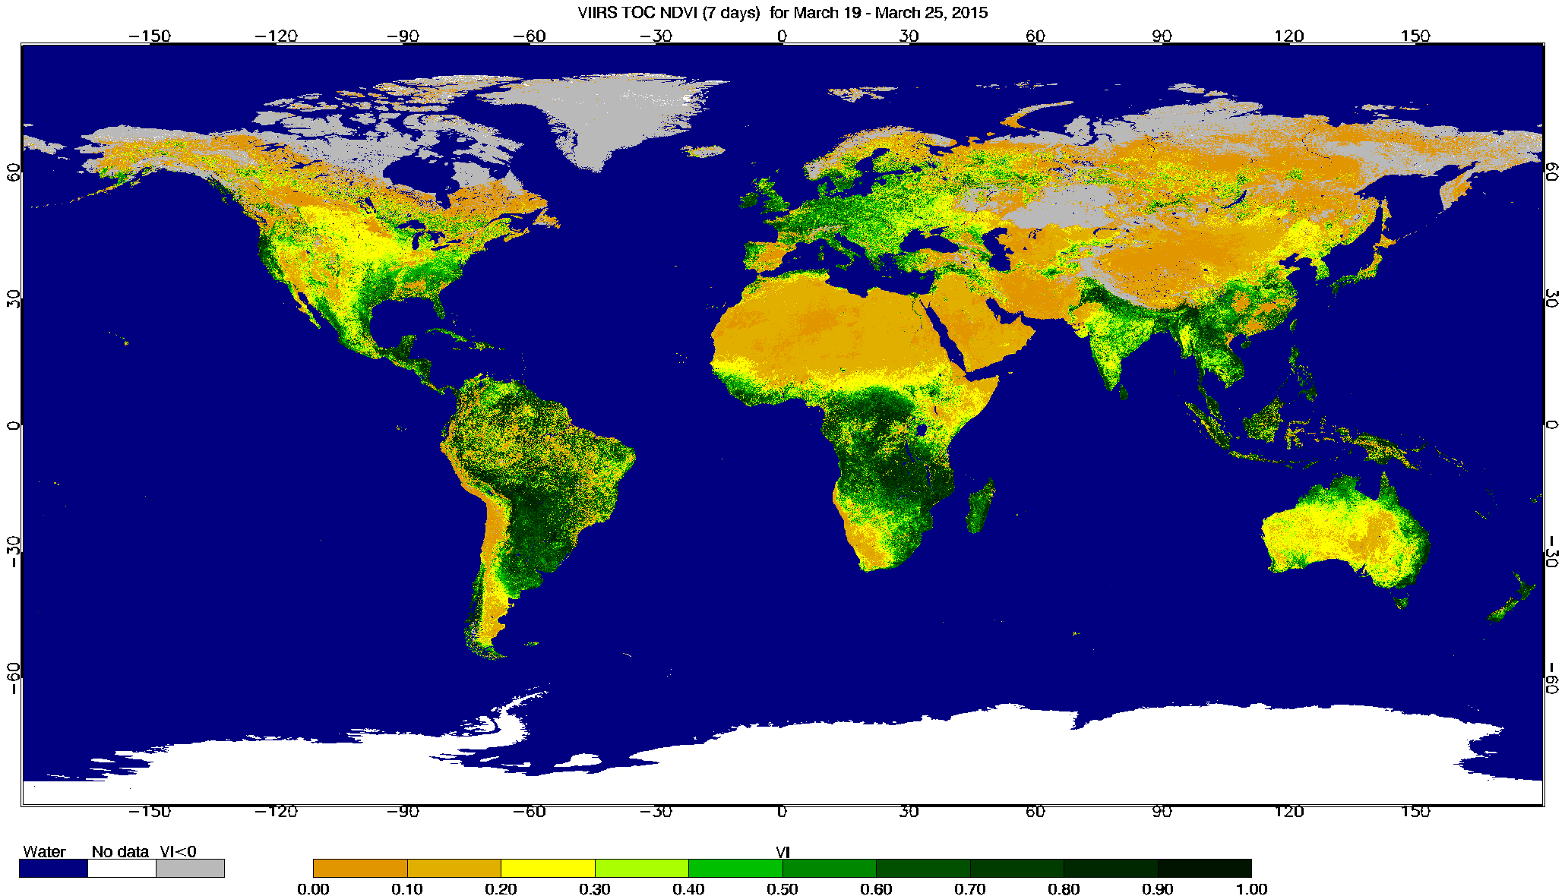
VIIRS Vegetation Index EDR
  Products
  Normalized Difference Vegetation Index (NDVI) from top-of-atmosphere (TOA) reflectances
  Enhanced Vegetation Index (EVI) from top of canopy (TOC) reflectances
  Normalized Difference Vegetation Index (NDVI) from top of canopy (TOC) reflectances (New Product for JPSS-1)
  File format: HDF5
  Cal/Val Maturity Status:
Validated 04/01/15 AERB Approved
TOC – EVI March 19-25, 2015
APU Estimates (2013 – 2014)
TOA – NDVI March 19-25, 2015
  J1 VI EDR Updates/Improvements:
  Addition of a new dataset (TOC NDVI)
  Addition of a new Quality Flag byte (QF4)
  Improved definition of high quality of the product
  Implementation of an EVI alternate (EVI2) algorithm
  Generation of Level 3 products (spatial and temporal composites)
TOC – NDVI March 19-25, 2015
  J1 VI EDR Updates Implementation Schedule:
  CDR - May 2014
  TRR – November 2014
  ARR – March 2015
  IDPS Block 2.0 – Late 2015
JSTAR VI Lead: Marco Vargas UH VI EDR Cal/Val Lead Tomoaki Miura

Slide 15
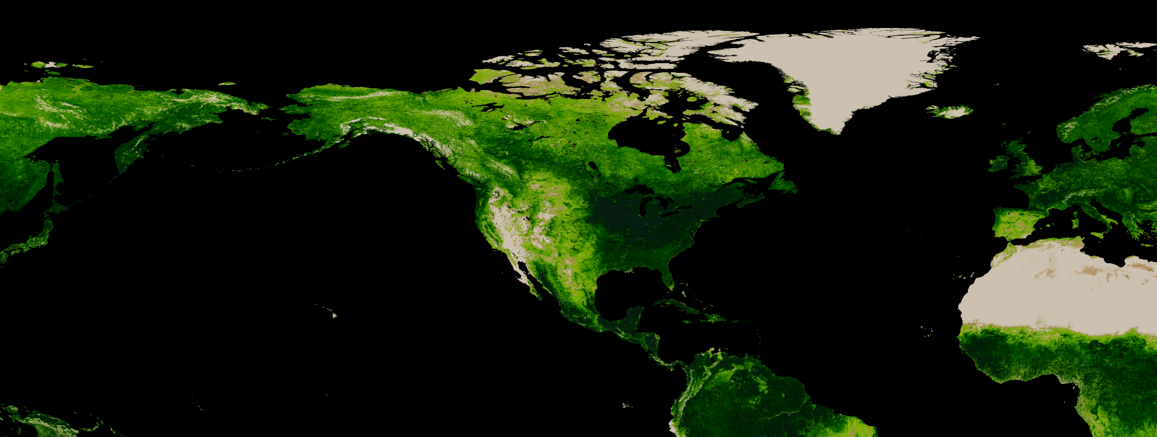
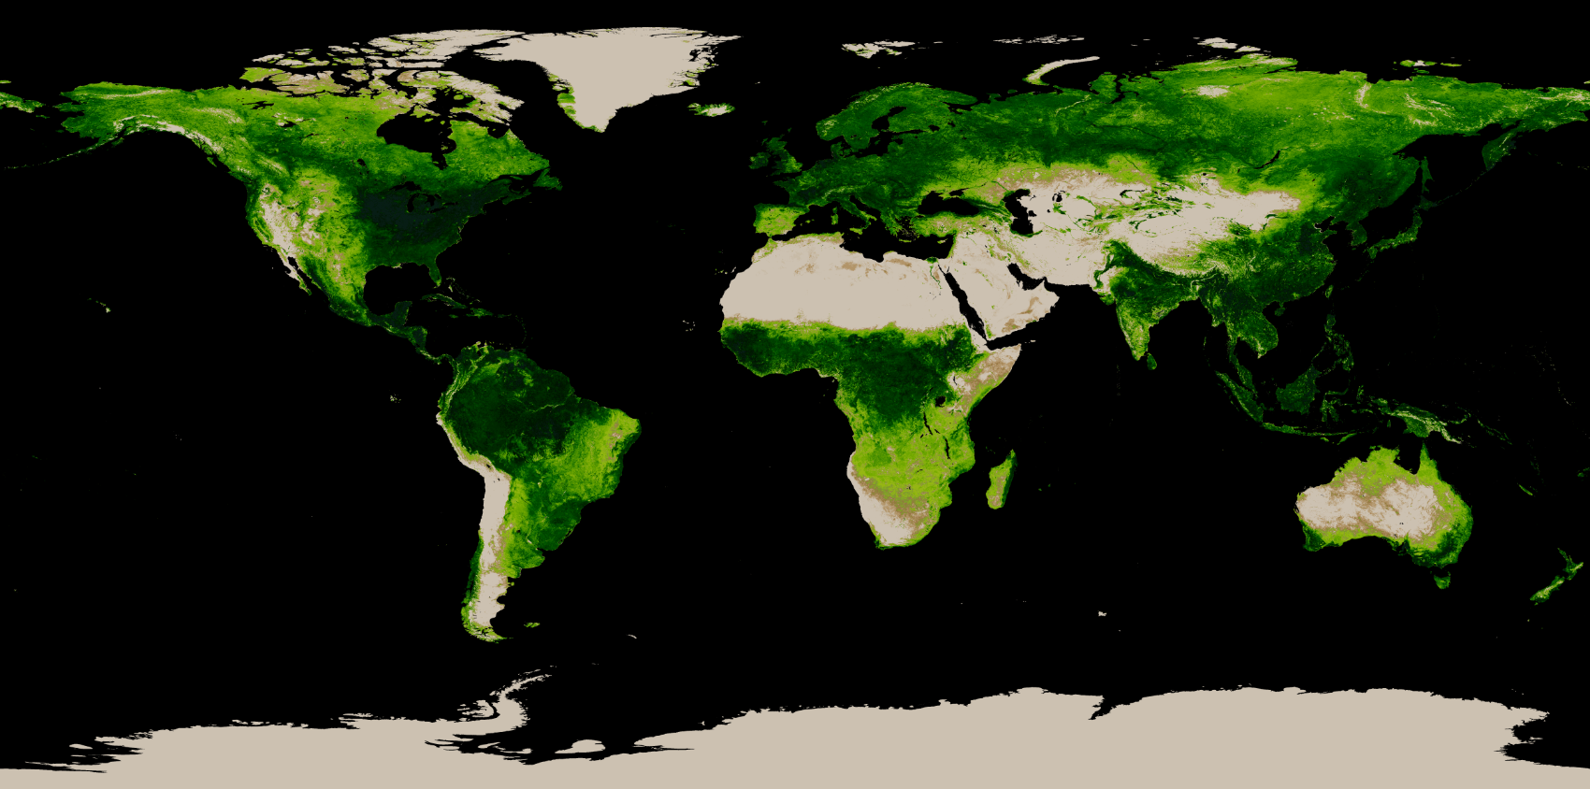
SNPP VIIRS Green Vegetation Fraction (GVF)
NOAA Unique Product (NUP)
  Products
The SNPP VIIRS Green Vegetation Fraction (GVF) consists of two products:
  Weekly global GVF at 4 km resolution
  Weekly regional GVF (Lat 7.5°S to 90°N, Lon 130°E to 30°E) at 1 km resolution
Sliding weekly composites are produced daily in Plate Carrée projection in NetCDF4 format
The file size is 80MB for the regional product and 15MB for the global product.
The 4km product is available, starting on Feb. 13, 2015, from CLASS: www.class.noaa.gov
Declared operational on 02/12/2015
1km regional
Attribute Analyzed | L1RD Threshold | VIIRS GVF
Measurement accuracy
1. Global | 12% | 7.9%
2. Regional | 12% | 6.5%
Measurement precision
1. Global | 15% | 10.9%
2. Regional | 15% | 12.6%
Measurement uncertainty
1. Global | 17% | 13.4%
2. Regional | 17% | 14.2%
4km global
Sep 1-7, 2014
JSTAR GVF Lead: Marco Vargas

Slide 16
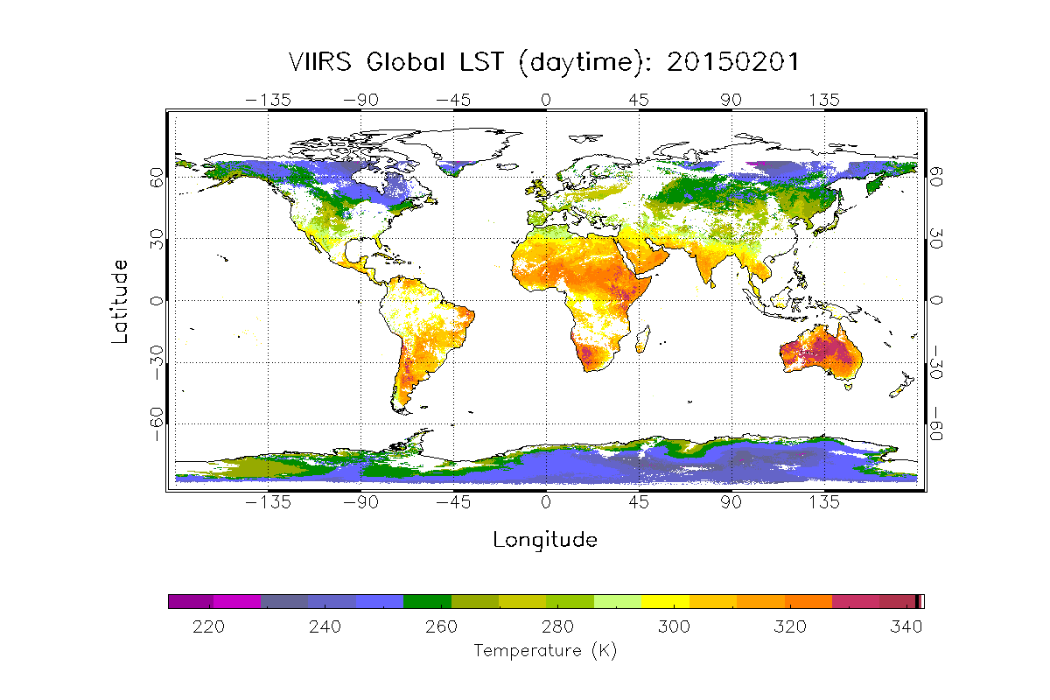
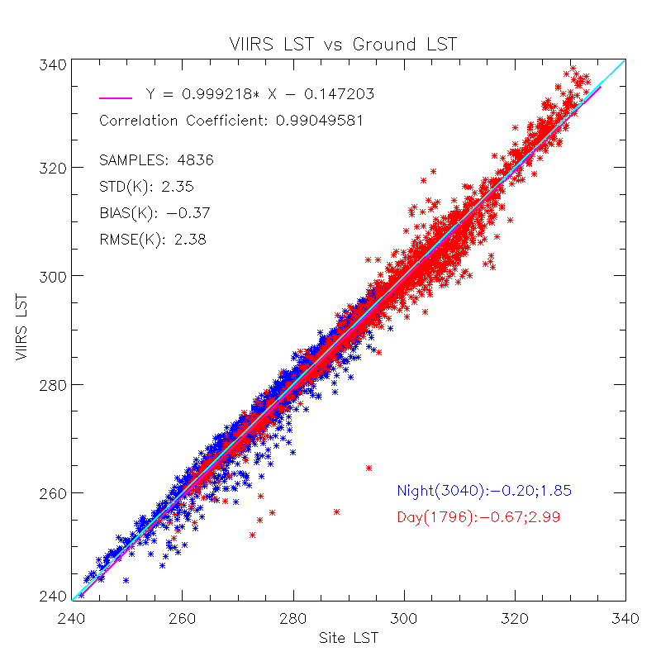
VIIRS Land Surface Temperature (LST)
  Products
  Land Surface Temperature
  File format: HDF5
  Cal/Val Maturity Status:
  Validated 03/25/2015 AERB Approved
  J1 Updates/Improvements:
  Water Vapor correction
  Angular correction
  Emissivity explicit algorithm
Attribute Analyzed | L1RD Threshold | Validation Result | Description
In-situ Validation | 1.4K (2.5K) | -0.37 (2.35) | Results are based on the VIIRS data over SURFRAD sites for over 2.5 years . The error budget estimation is limited by ground data quality control, cloud filtering procedure and upstream data error.
R-based Validation | 1.4K (2.5K) | 0.47(1.12) | A forward radiative transfer model is used, over 9 regions in globe, representing all 17-IGBP types over the seasons. The error budget estimation is limited by profile quality, cloud screening procedure and sampling procedure.
Cross satellite Comparison |  | 0.59(1.93): daytime 0.99(2.02): nighttime | The results are based on comparisons to MODIS LST, over 100 scenes, over low latitude, polar area and CONUSThe error budget estimation is limited by the spatial and temporal difference, sensor difference, angle difference etc.
JSTAR LST Lead: Bob Yu

Slide 17
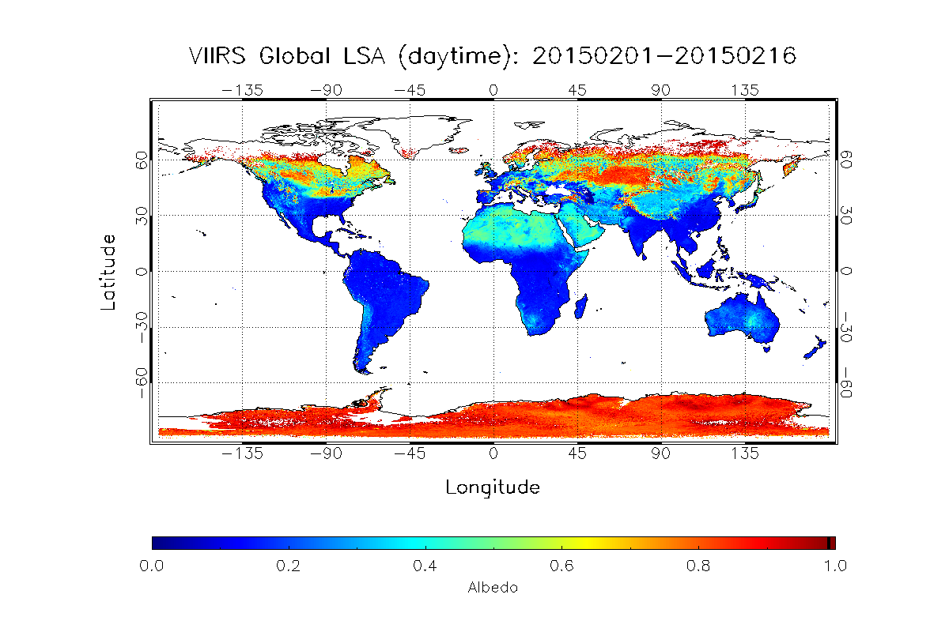
VIIRS Surface Albedo
  Products
  Land Surface Albedo (LSA)
  Ocean Surface Albedo (OSA)
  Sea-Ice Surface Albedo (SSA)
  Only LSA and SSA are validated and maintained in the current VIIRS Albedo release
  File format: HDF5
  Cal/Val Maturity Status:
  LSA Validated 03/25/2015 AERB Approved
  J1 Updates/Improvements:
  Update LUT of regression coefficients for estimating sea ice Albedo
  Develop a separate LUT for snow pixels and other major land surface types
  Implement a temporal filtering to improve both quality and continuity
  Work with NWP users to develop a framework to generate gridded data set of LSA that fit users’ needs
JSTAR LSA Lead: Bob Yu

Slide 18
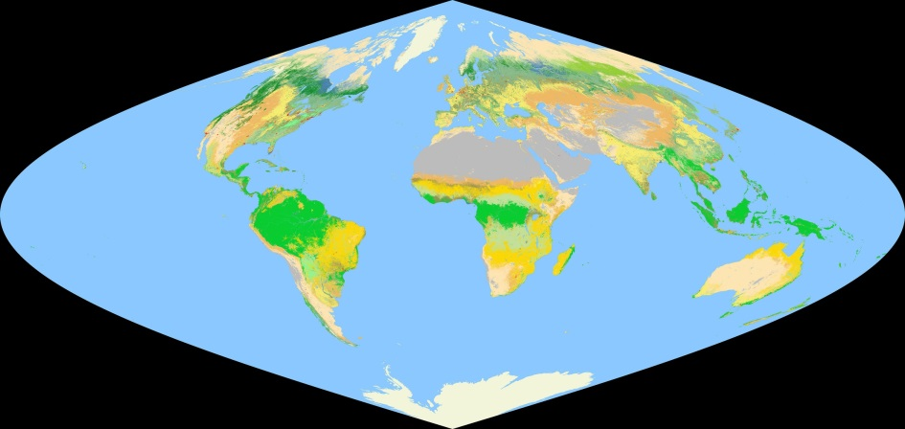
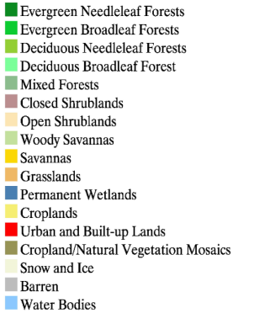
VIIRS Surface Type
  Products
  VIIRS Surface Type (granule level)
  VIIRS Quality Surface Type IP (QST IP, Global Gridded Surface Type Map)
  File format: HDF5
  Cal/Val Maturity Status:
  Validated 04/01/2015 AERB Approved
  Users:
  Modeling studies
    Land surface parameterization for GCMs (e.g. NCEP Noah LSM)
    Biogeochemical cycles
    Hydrological processes
  Carbon and ecosystem studies
    Carbon stock, fluxes
    Biodiversity
  Downstream products
    Land surface temperature, cloud mask, aerosol products, other products require global land/water location information
S-NPP VIIRS Surface Type IP: Global Surface Type Map
  J1 Updates/Improvements:
  Support vector machines (SVM) may replace the decision tree (DT) algorithm for higher reliability/stability
  Multiple year classification metrics are expected to produce more stable Surface Type map
  Schedules/Timeline:
  SVM product evaluated Dec-2015
  New global surface type IP (QST IP) delivered to IDPS Dec-2015
JSTAR Surface Type Lead: Jerry Zhan

Slide 19
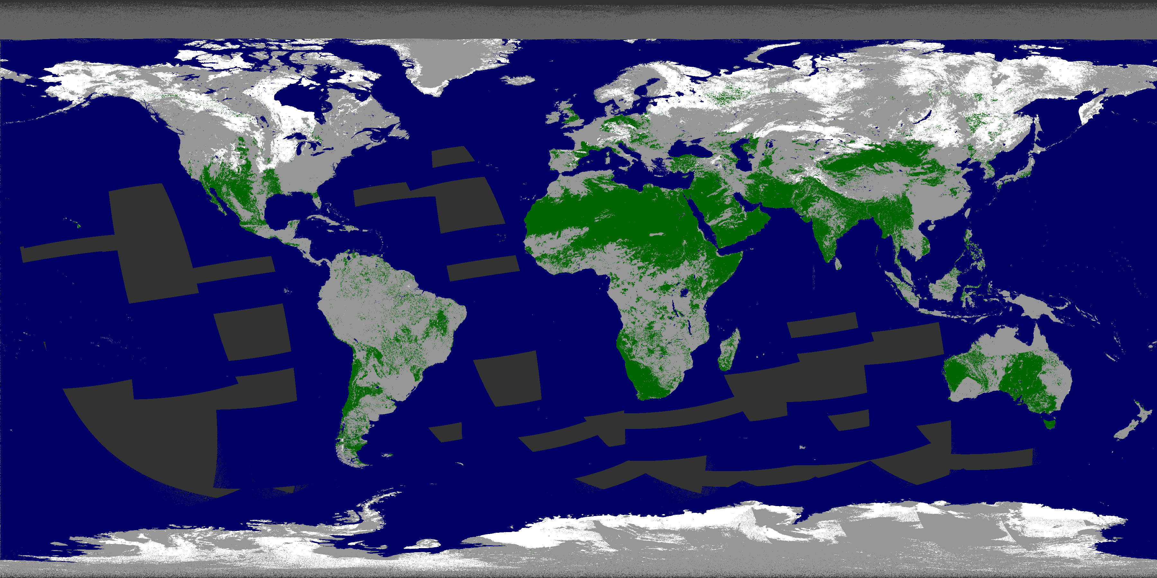
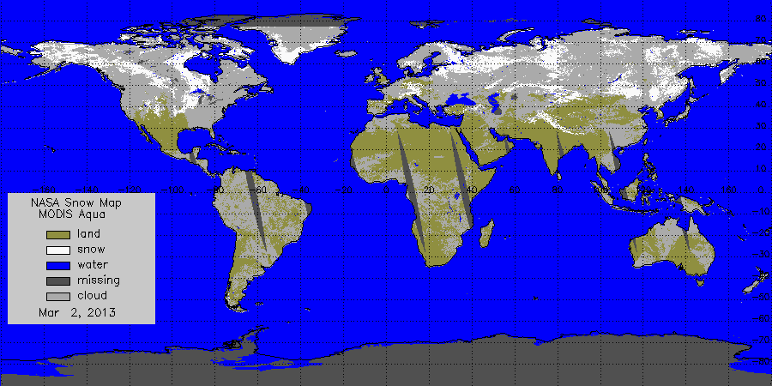
VIIRS Snow and Ice
  Products &Cal/Val Maturity Status:
  Snow Cover: Binary Map
    Validated 01/08/2014
  Snow Cover: Fractional Snow Cover
    Provisional 12/20/2013
  Ice Surface Temperature
    Validated 01/08/2014
  Sea ice characterization
    Provisional 12/20/2013
  File format: HDF5
S-NPP VIIRS
snow
land
cloud
No data
  J1 Updates/Improvements:
  Two new VIIRS snow fraction products will be generated by NOAA, both at 375 m, one providing MODIS heritage and one providing GOES heritage.
  A new VIIRS ice thickness product will be generated by NOAA.
  The fate of the current operational snow fraction and ice characterization products is unclear.
MODIS Aqua
March 2, 2013 (day 2013061)
JSTAR Cryosphere Lead: Jeff Key
Notes:
Information on ice and snow cover is needed by other EDRs.
AMSR2 on GCOM-W1 will have other snow and ice products: Ice Characterization, Snow Cover, Snow Depth, and Snow Water Equivalent (SWE). These will be operational later this year (2015) or in 2016.

Slide 20


CEOS/WGCV/LPV Status

Slide 21
CEOS > WGCV > LPV
CEOS - Committee on Earth Observation Satellites
  31 CEOS Members
  24 Associate Members (eg UNEP, GTOS, IGBP, WMO, GCOS)
CEOS coordinates civil space-based observations of the Earth
This is achieved through its working groups and virtual constellations. The Working Group on Calibration and Validation (WGCV) is one of 5 CEOS working groups.
  Land Product Validation (LPV) is one of 6 WGCV subgroups
Current LPV Officers
Chair Gabriela Schaepman-Strub University of Zurich
Vice-Chair Miguel Román NASA/GSFC
LPV Support Jaime Nickeson SSAI/GSFC
9 Focus Areas with 2 co-leads each
Notes:
International associates include intergovernmental groups like GCOS, GEO, UN systems
WGCV subgroups Terrain Mapping, IR Visible Optical Sensors, SAR, Microwave, Atmospheric Composition

Slide 22
This Year: Focus-area Strategy
Aims
Review validation stage and activities (focus area co-leads)
Define next validation steps (focus area co-leads and LPV officers)
Define goals and action items for 2015/2016 (i.e., GCOS interaction, specific workshops, protocol writing and processing of fiducial reference data.)
Review organization and contributions to focus area (i.e., update LPV terms of reference)
Participants
Focus area co-leads
LPV Officers
Guests (proposed by co-leads and chair)

Slide 23
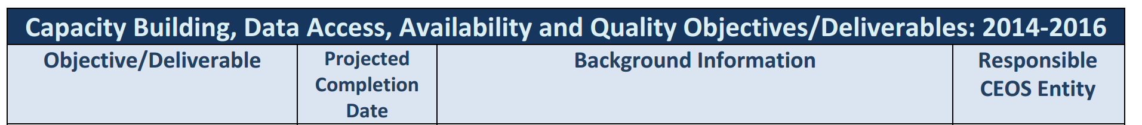
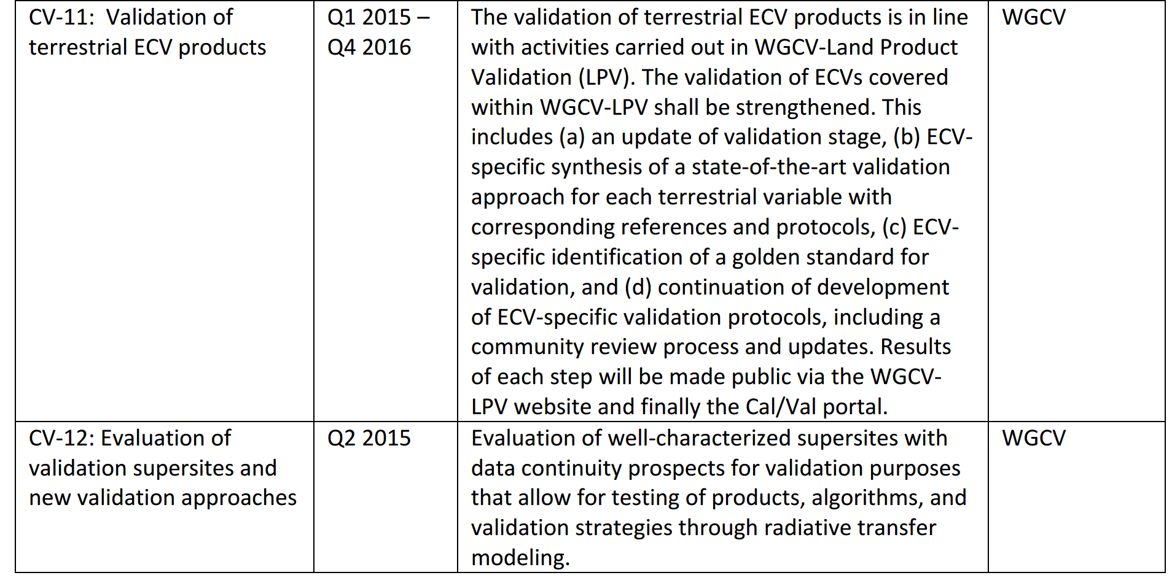

LPV 2014-2016 Deliverables

Slide 24

LPV Web Site
Established in 2003.
Subscribed member list has grown to nearly 700 members over the years.
Each focus area (ECV) has pull down menu of links to
Home page
References
- Collaboration
- Products
http://lpvs.gsfc.nasa.gov

Slide 25
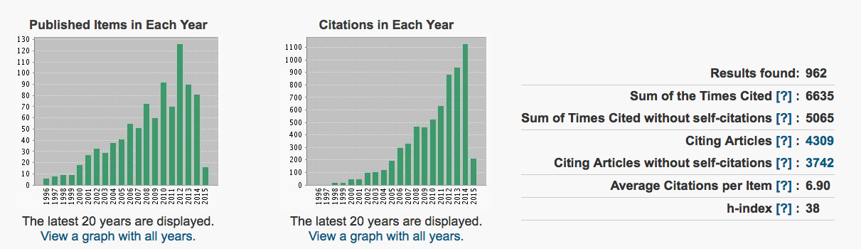
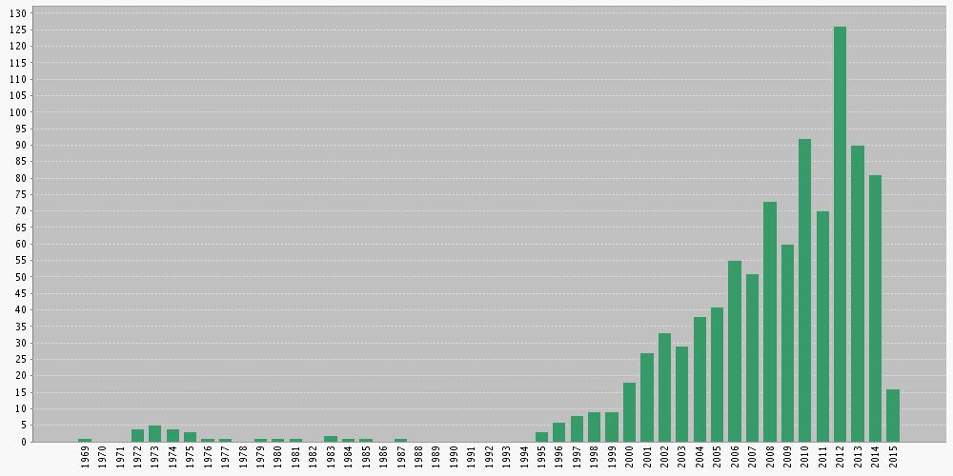
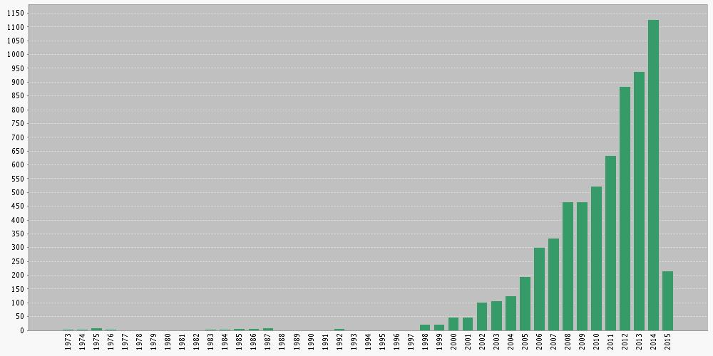
LPV Web of Science Metrics
Searched word: “Land Product Validation” OR “LPV”
  962 items are searched; ~80 items published in 2014; ~1100 citations
Published items in Each year (All years)
Citations in Each year (All years)
From: Taejin Park (BU)

Slide 26
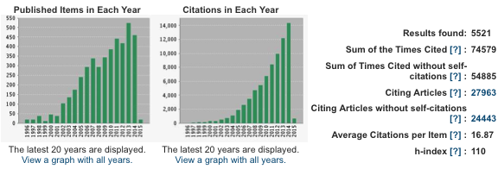
NASA/MODIS Web of Science Metrics
Searched word: “MODIS” or “Moderate Resolution Imaging Spectroradiometer”
  5,521 items are searched
Published items in Each year (All years)
Citations in Each year (All years)
From: Taejin Park (BU)

Slide 27
from 2015 Aqua Senior Review Panel:
Q.14: Could there be further classification of the errors associated with the MODIS data/observations and products?

Slide 28
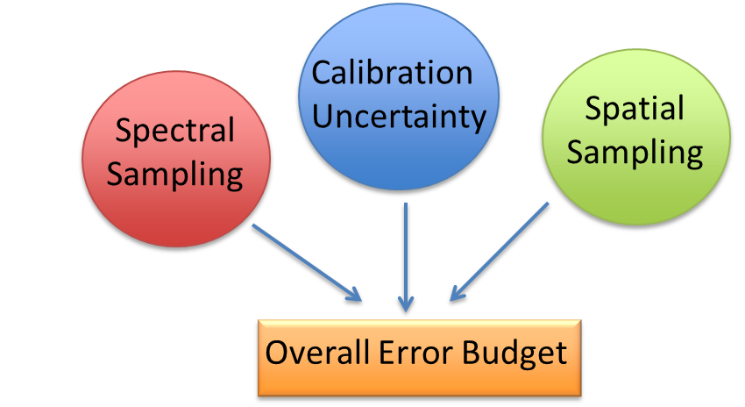
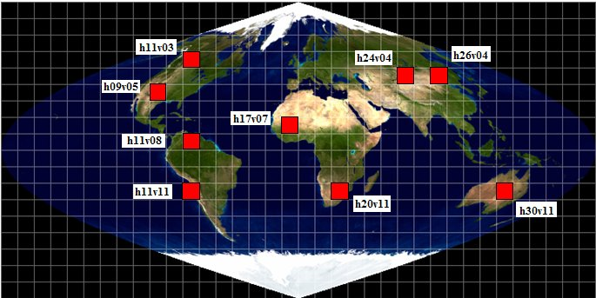
Senior Review panel's question 14: Could there be further classification of the errors associated with the MODIS data/observations and products?
Mapping Aqua-MODIS Sensor Per-pixel Uncertainty (N. Pahlevan, SSAI / NASA GSFC)
Objective: To establish a comprehensive error budget model for Aqua MODIS instrument data records (Level 1b/2) by decomposing measurement errors into its major constituents.
Approach: Simulations and sensitivity analyses using existing moderate-to-high spatial-spectral measurements (e.g., Landsat-8 and EO-1 Hyperion) are performed over all MODIS Land Golden Tiles – i.e., 9 regions that are representative of the variability of the majority of the MODIS Land products (shown in red squares) .
Team Response: At the Aqua-MODIS sensor level (Level 1b/2), further classification of errors is possible by: (1) considering all constituents within an overall error budget and (2) providing a representative global sample of land surface and retrieval conditions.

Slide 29
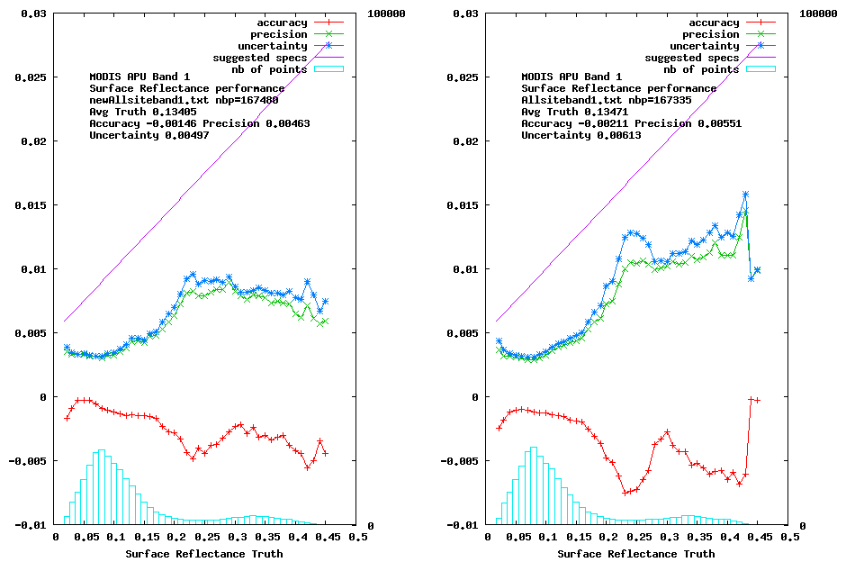
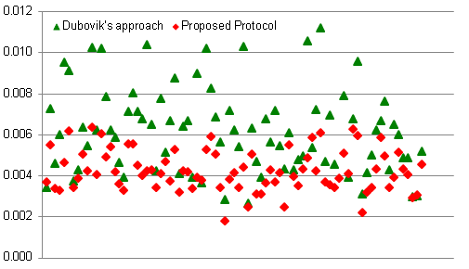
Senior Review panel's question 14: Could there be further classification of the errors associated with the MODIS data/observations and products?
Protocol for Validation of the Aqua-MODIS Land Surface reflectance using AERONET (J.C. Roger, E. Vermote and B. Holben)
Validation of Land Surface Reflectance
The Problem: A standard land surface reflectance protocol for using reference AERONET products needs to be agreed on by the MODIS science team.
The Solution: A validation protocol for MODIS Land surface reflectance that requires the aerosol model to be readily available.
Description of Surface Reflectance Validation Protocol
Aerosol models for each AERONET site can be defined using new regressions with optical properties (i.e., τ₄₄₀ and α) as standardized parameters. For the aerosol models, the aerosol microphysical properties provisioned by AERONET, including size-distribution (%C_{f}, %C_{c}, r_{f}, r_{c}, σ_{r}, σ_{c}), complex refractive indices and sphericity, can also be used as standardized protocol measures.
Comparisons with AERONET indicate that parameter standardization produces Accuracy-Precision-Uncertainty (APU) metrics up to 20% lower than the current baseline (Dubovik et al., 2002).
Uncertainties on the retrieved surface reflectance for 40 AERONET sites
MODIS band 1 (red) – synthetic input surface reflectance = 0.05
Example of APU for MODIS band 1 (red) for the whole 2003 year data set
Proposed protocol
Dubovik’s protocol
Team Response: Further classification of errors requires the adoption of consistent and agreeable protocols across MODIS land surface reflectance products. This is also crucial to enable objective assessment and characterization of downstream product impacts (e.g., NDVI/EVI, LAI/FPAR, BRDF/Albedo/NBAR).

Slide 30
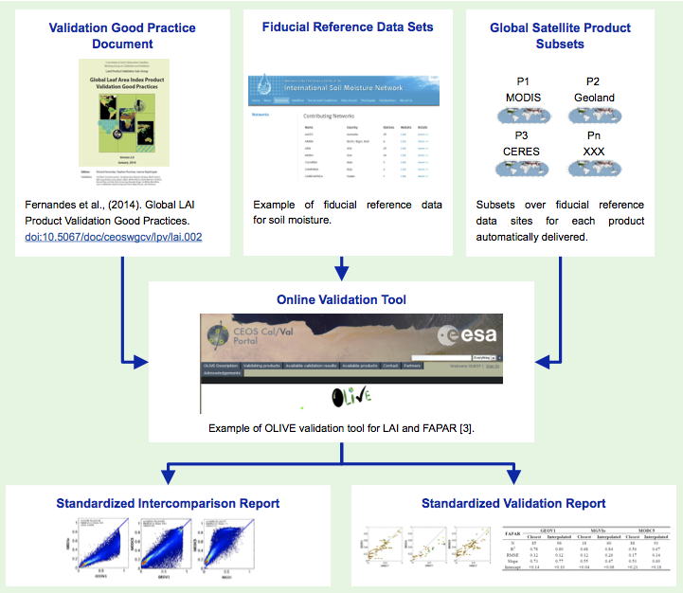
Senior Review panel's question 14: Could there be further classification of the errors associated with the MODIS data/observations and products?
A Global Framework for Land Product Intercomparison and Validation (Miguel Román, NASA/GSFC)
A. B. C.
D.
E. F.
The MODIS Land Science team has adopted the global framework for product intercomparison and validation developed by the Land Product Validation (LPV) subgroup of the CEOS Working Group on Calibration and Validation (WGCV).
This framework is based on a peer-reviewed protocol (A.), collection of fiducial reference data (B.), and development of automated subsetting capabilities (C.) Each of these parts are then integrated into an online platform (D.) where quantitative tests are run, and standardized intercomparisons (E.) and validation results (F.) reported.
Team Response: At the final (Level 3+) product level, further classification of errors is possible when products are characterized in a statistically rigorous way (i.e., over multiple locations and time periods representing global conditions). Establishing a global framework for land product validation is key to this effort, and of high priority for Aqua-MODIS and future sensors.

