Slide 1
Producing Incident Shortwave Radiation and Photosynthetically Active Radiation Products Over Land Surfaces from MODIS and Multiple Geostationary Satellite Data
Drs. Dongdong Wang, Tao He
Yi Zhang, Meredith Brown
Prof. Shunlin Liang
University of Maryland
May 21 2015

Slide 2
Outline
Importance of insolation and PAR
Objective and major tasks
Progress and current status
Summary of recent researches
  Use of hyperspectral data
  New optimization method
  Temporal scaling of daily shortwave radiation
Timetable and future work
Summary

Slide 3
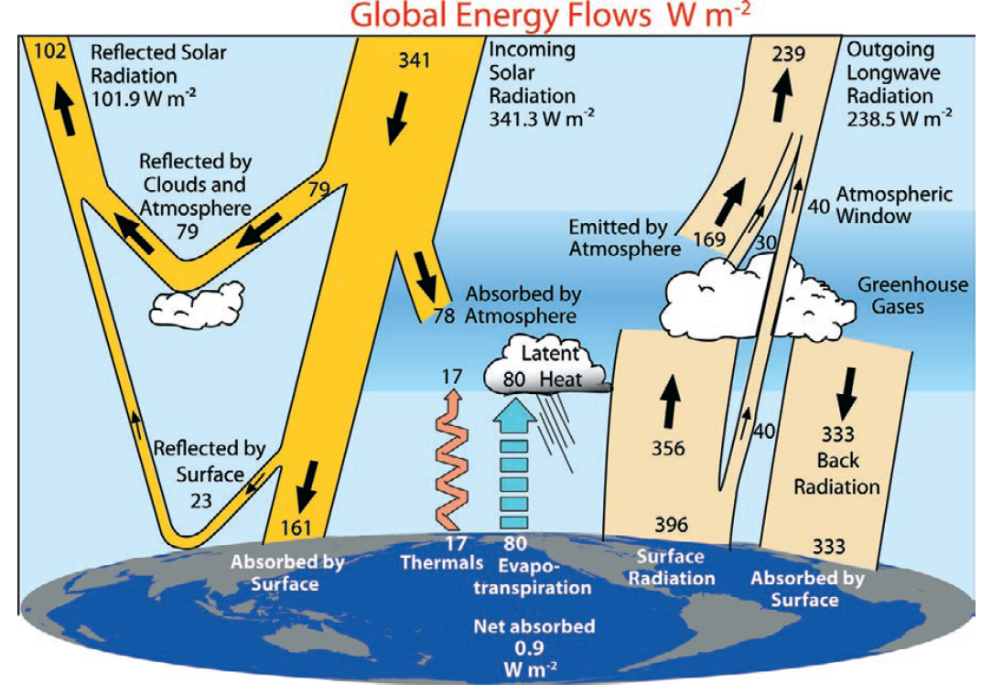
Trenberth et al. (2009)

Slide 4
Need for high spatial resolution products
Current global radiation products have coarse spatial resolution (>1°) primarily for atmospheric modeling, and do not account for many local features, such as urbanization.
Land applications require the high spatial resolution (~1km) but the reasonable temporal resolution (e.g., daily):
  Ecosystem modeling (say, MOD17 NPP product) requires high-resolution products of PAR(1km);
  Hydrological modeling (ET, MOD16) at 1km;
  Other applications (e.g., drought monitoring, clean renewable solar energy).

Slide 5
Incident shortwave radiation and PAR products
Current global incident shortwave radiation satellite products
Insolation products | Spatial resolution | Temporal resolution | Temporal range
ISCCP | 280km | 3-hour | 1983-2008
GEWEX-SRB | 1° | 3-hour | 1983-2007
CERES | 140km | 3-hour | 1997-present
WMO requirements for surface downward shortwave irradiance
 | Uncertainty goal (Wm⁻²) | Uncertainty threshold (Wm⁻²) | Horizontal resolution goal (km) | Horizontal resolution Threshold (km)
Global NWP | 1 | 20 | 10 | 100
Agricultural Meteorology | N/A | N/A | 1 | 20
Climate-AOPC | 5 | 10 | 25 | 100

Slide 6
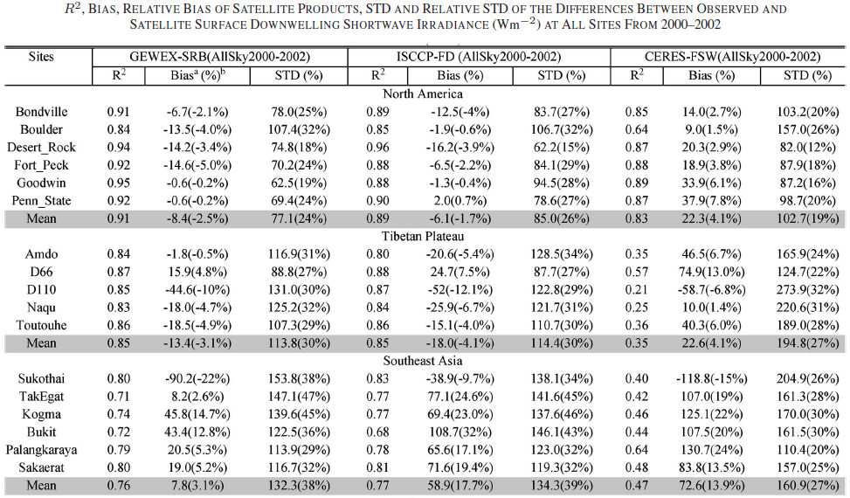
Accuracy of current data sets of incident shortwave radiation
Gui, S., S. Liang, K. Wang, and L. Li, (2010), Validation of Three Satellite-Estimated Land Surface Downward Shortwave Radiation Datasets, IEEE Geoscience and Remote Sensing Letters,7(4):776-780

Slide 7
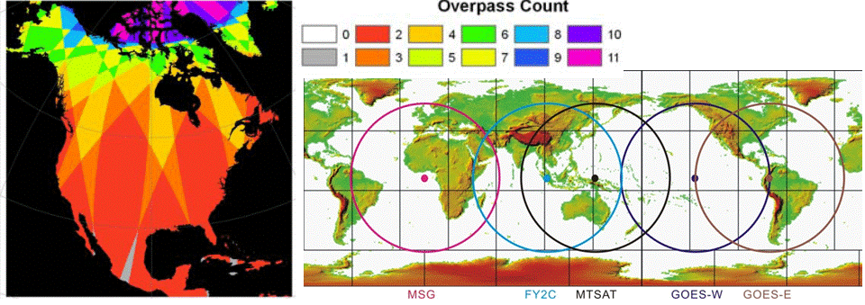
Objective and major tasks
Objective: to produce global high-resolution (5km, 3-hours) incident shortwave radiation and PAR over land surfaces from Terra/Aqua MODIS and a series of geostationary satellite data.
Figure. Daytime MODIS overpass counts from both Terra and Aqua and coverage of the current geostationary satellites.
Major tasks:
1.ATBD improvement and code delivery
2.Evaluation of sensor radiometric calibration
3.Algorithm validation
4.Product quality assessment
5.Product validation
6.Outreach and product advertisement

Slide 8
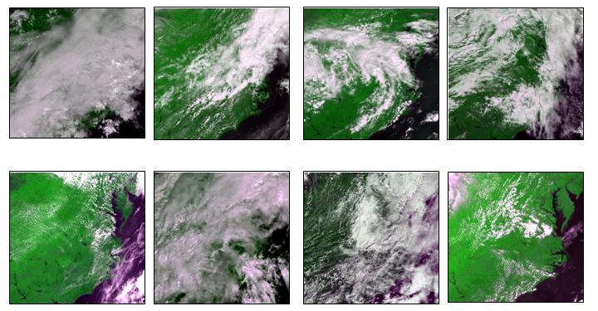
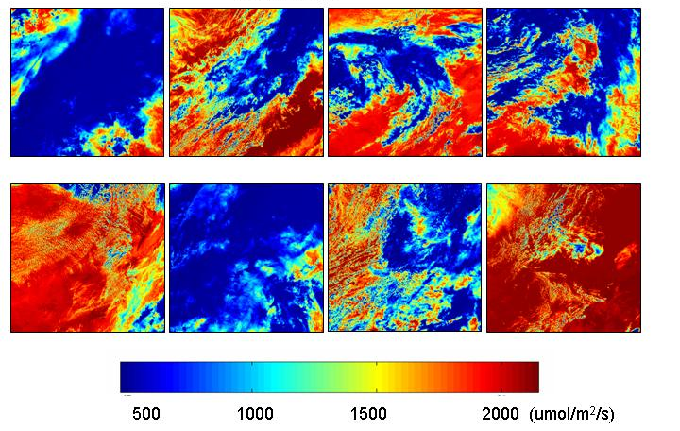
Algorithms for retrieving PAR and insolation
The basic procedure is composed of two steps:
determination of the surface reflectance from observations under the “clearest” atmospheric conditions in a temporal window;
calculation of incident PAR from the determined surface reflectance and TOA radiance/reflectance using the LUT approach.

Slide 9
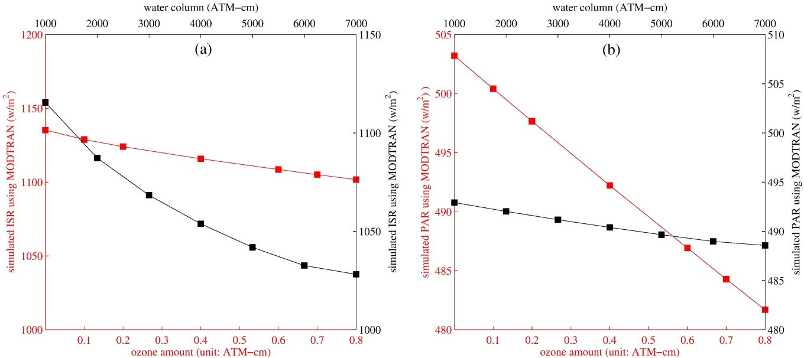
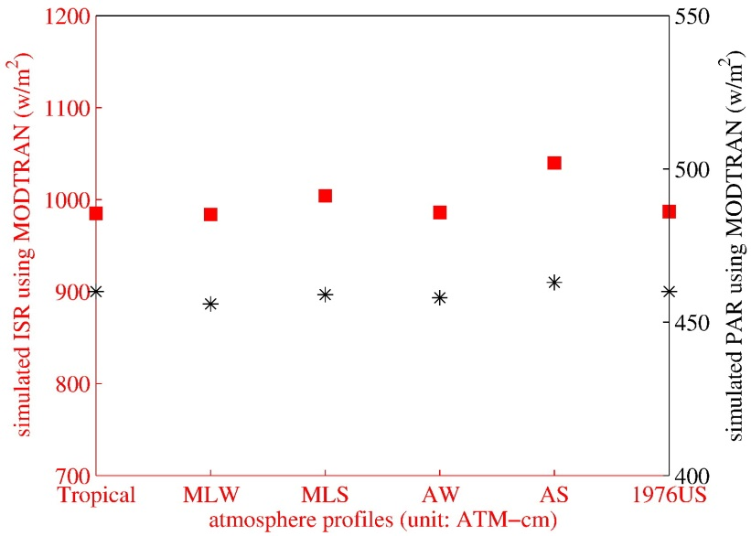
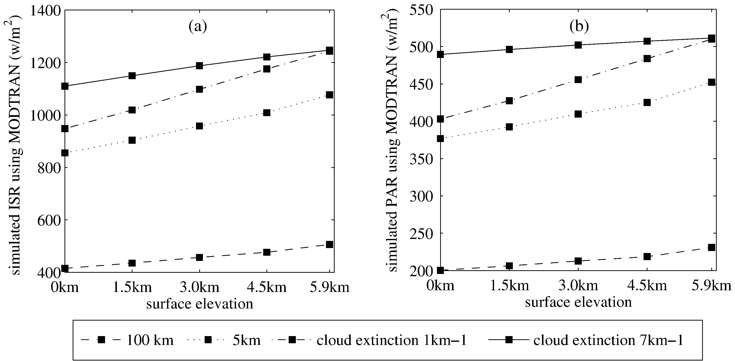
Sensitivity study of the algorithms
Water vapor and ozone concentration
Atmosphere profile
Tropical, MLW, MLS, AW, AS, and 1976US represent the tropical, mid-latitude winter, mid-latitude summer, Arctic winter, Arctic summer, and 1976 US standard atmosphere profiles, respectively.
Zhang et al., RSE, 2014
Elevation

Slide 10
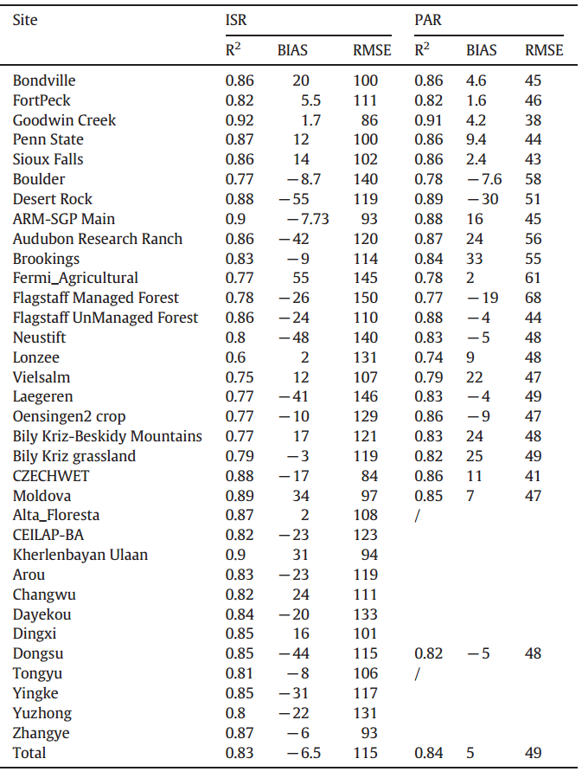
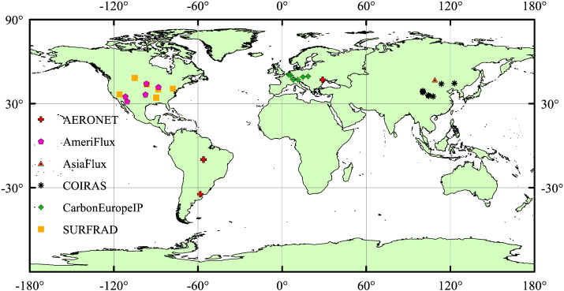
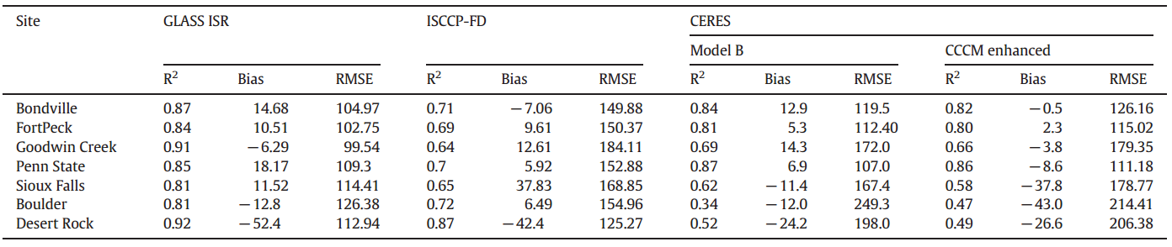
Validation of the proposed algorithms
34 field stations of radiative fluxes
24 of them have PAR measurements
Comparison with existing products

Slide 11
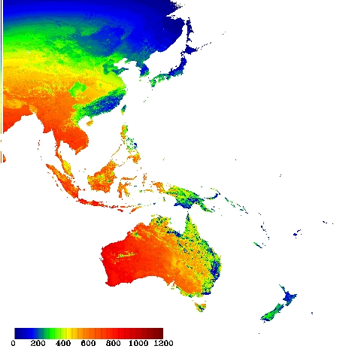
Current status of surface downward radiation product development
Software package:
Data preprocessing
  I/O, re-projection, radiometric calibration
Main algorithm
  Liang et al. 2006; Zhang et al. 2014
Data post-processing
  Data fusion, mosaic
Ancillary data
  Water vapor, DEM
  ATBD preparation
Total land surface shortwave downward radiation (W/m²) of part of Asia and Oceania on GMT 0530, Jan 2nd, 2010, derived from MODIS and MTSAT data.

Slide 12
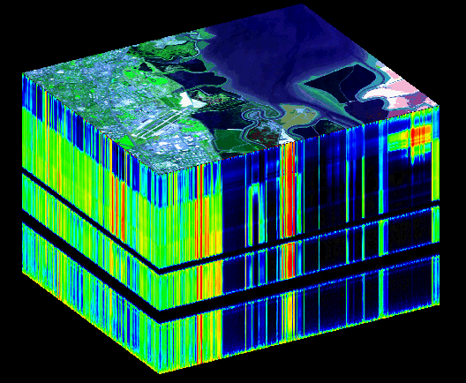
Estimating surface radiation from hyperspectral data: AVIRIS
Airborne Visible InfraRed Imaging Spectrometer (AVIRIS) is a airborne hyperspectral sensor.
It has 224 spectral channels with wavelengths from 400 to 2500 nm.
AVIRIS is used in NASA HyspIRI Preparatory Airborne Campaign.
We are funded by NASA to estimate quantities surface radiation budget (including land surface albedo) from HyspIRI-like data.
http://aviris.jpl.nasa.gov/data/image_cube.html

Slide 13
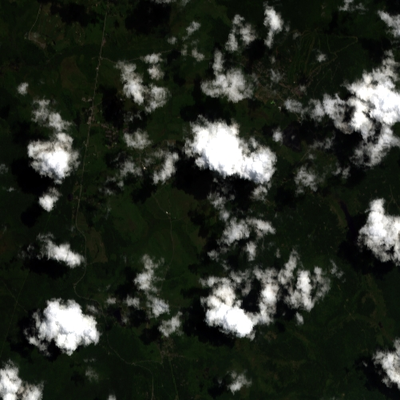
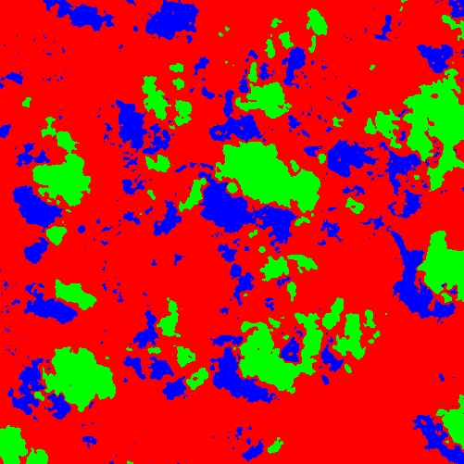
Fine-resolution AVIRIS data helps understand uncertainties in validation with scattered clouds in the coarse resolution data
Detection of cloud/shadow from AVIRIS data: (a) True color composite of AVIRIS data at site US-CaV on DOY 187, 2009; (b) detection results of the AVIRIS data (land: red; cloud: green; shadow: blue).

Slide 14
Advantages of hyperspectral information in net shortwave radiation estimation
Method A
Statistics of NSR direct estimation based on simulation data
Conversion of cumulated radiation from AVIRIS bands to shortwave radiation (W/m²)
Method B

Slide 15
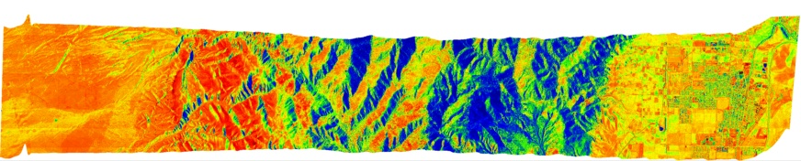
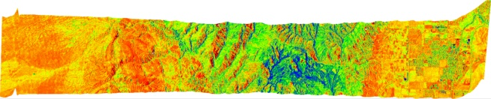
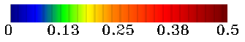
Estimation surface downward radiation and surface albedo from AVIRIS (Method A): topographic correction
Surface downward radiation
Before correction
After correction
Shortwave albedo before correction
Shortwave albedo after correction

Slide 16
Shortwave downward and net radiation estimation: AVIRIS
(He et al. 2015, RSE)
(a)
(b)
(c)
Comparison of ground measurements AVIRIS downward radiation (a) and net radiation from Method A (b) and Method B (c) estimates (W/m²) at AmeriFlux sites.
Two methods had similar estimation accuracies. N is smaller in (b) than that in (c) because surface albedo estimates were not available under cloud/shadow conditions.

Slide 17
An optimization method for estimating surface downward shortwave radiation
Assumption
  Surface BRDF and AOD stay relative stable for a short period of time window.
Algorithm
  Simulating atmospheric radiative transfer with Qin’s (2001) non-Lambertian parameterization method
  Using climatology of BRDF and surface albedo as first guess in optimization
  Estimating surface downward radiation using the optimized BRDF and AOD as inputs
Validation
  One year data of 2005 for 7 SURFRAD sites

Slide 18
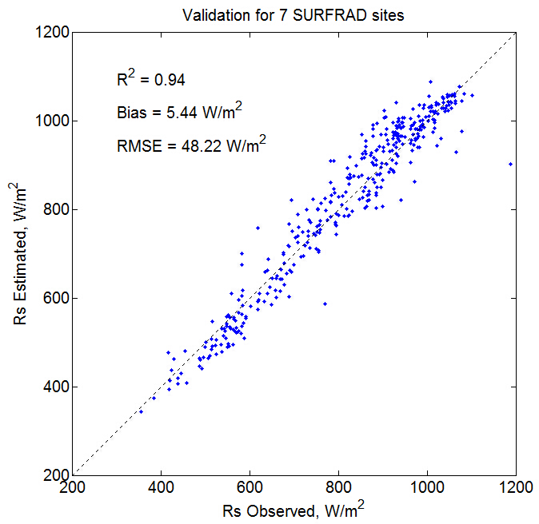
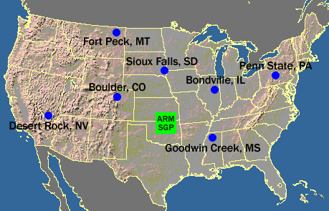
Flowchart and Validation
TOA Reflectance
Prior AOD
Radiative Transfer Model
Prior BRDF
LUT
Estimate Surface
Downward Radiation
Optimization
Optimal BRDF
and AOD
Surface Elevation
Water vapor
Solar Zenith Angle

Slide 19
Estimation of daily surface shortwave net radiation (SSNR)
Shortwave net radiation is equivalent to incident solar radiation, given land surface albedo.
To develop a more robust high-resolution solar radiation product, we investigated an alternative algorithm for estimating daily shortwave net radiation from MODIS data.
The morning Terra MODIS data were combined with the afternoon Aqua MODIS data to improve the mapping of intra-daily variations in atmospheric conditions.
The synergy of the two MODIS sensors reduced the errors in daily SSNR estimates by 6-7 W/m2.

Slide 20
Scale effects in validating SSNR
The impacts of window size on the validation results of satellite radiation quantities: a) daily SSNR, b) monthly SSNR and c) surface albedo.
Wang et al. TGRS, in press

Slide 21
Validation results
Figure. Comparing field measurements of daily surface shortwave net radiation at seven SURFRAD sites with four data sets: a) MODIS, b) CERES, c) ERA-Interim and d) NARR. MODIS data are averaged from a 71km by 71km window centered at the sites.

Slide 22
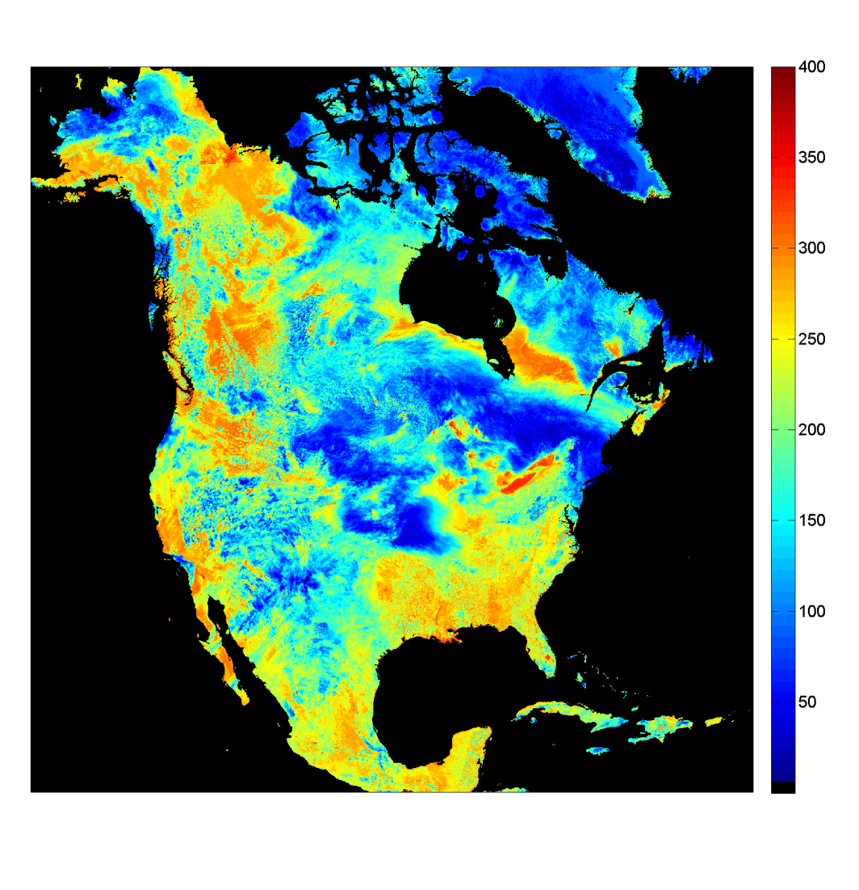
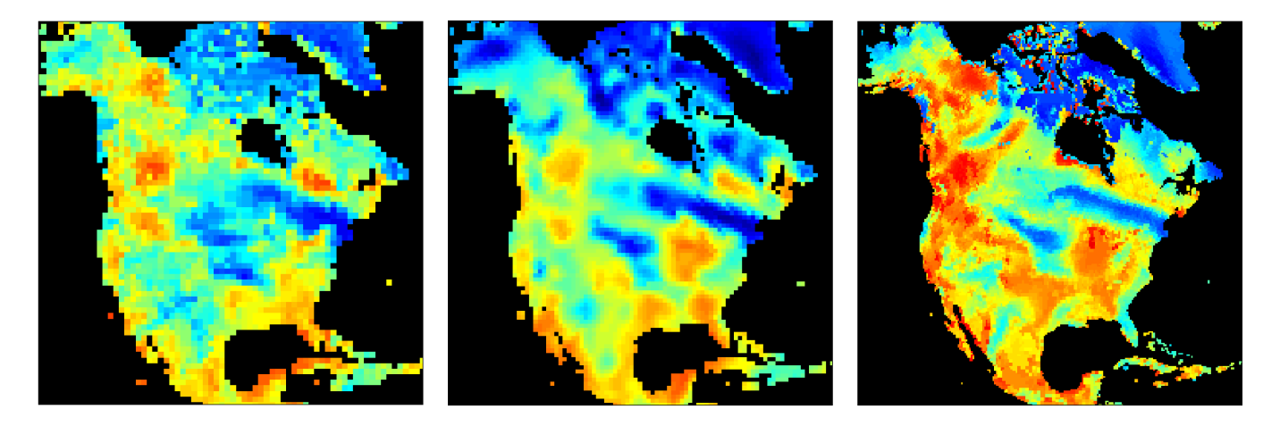
North American maps of daily surface shortwave net radiation on June 9 2009 from a) MODIS, b) CERES) c) ERA-Interim and d) NARR.

Slide 23
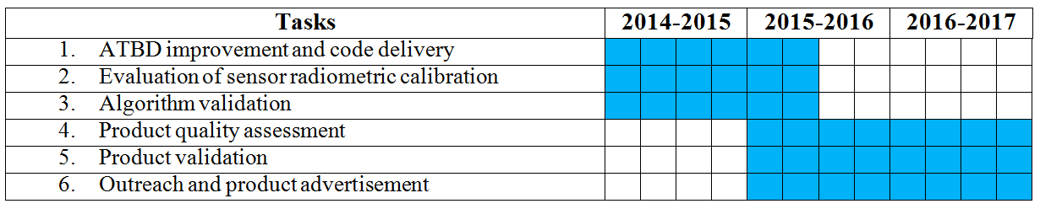
Timetable and future work
  ATBD and software delivery
  Continuing algorithm improvement
  Extensive algorithm/product validation

Slide 24
Reference
Wang, D., Liang, S., He, T., & Shi, Q. (2015). Estimation of daily surface shortwave net radiation from the combined MODIS data. IEEE Transactions on Geoscience and Remote Sensing. In press.
Wang, D., Liang, S., He, T., & Shi, Q. (2015). Estimating clear-sky all-wave net radiation from combined visible and shortwave infrared (VSWIR) and thermal infrared (TIR) remote sensing data. Remote Sensing of Environment. In press.
He, T., Liang, S.L., Wang, D., Shi, Q., & Goulden, M.L. (2015). Estimation of high-resolution land surface net shortwave radiation from AVIRIS data: algorithm development and preliminary results. Remote Sensing of Environment. In press.
Wang, D., Liang, S., He, T., Cao, Y., & Jiang, B. (2015). Daily surface shortwave net radiation estimation from FengYun-3 MERSI data. Remote Sensing, 7, 6224-6239, doi:10.3390/rs70506224.
Wang, D. and S. Liang (2014). Mapping High-Resolution Surface Shortwave Net Radiation From Landsat Data. IEEE Geoscience and Remote Sensing Letters 11(2): 459-463.
Liang, S.L., Zheng, T., Liu, R.G., Fang, H.L., Tsay, S.C., & Running, S. (2006). Estimation of incident photosynthetically active radiation from Moderate Resolution Imaging Spectrometer data. Journal of Geophysical Research-Atmospheres, 111
Zhang, X.T., Liang, S.L., Zhou, G.Q., Wu, H.R., & Zhao, X. (2014). Generating Global LAnd Surface Satellite incident shortwave radiation and photosynthetically active radiation products from multiple satellite data. Remote Sensing of Environment, 152, 318-332

Slide 25
Summary
The major tasks have been performed as scheduled.
We expect to deliver the codes and ATBD by the end of this year.
We have investigated several related issues and explored new methods for further improvement:
  Scaling issues in validation;
  New optimization method;
  Application of hyperspectral data;
  Temporal scaling of daily SSNR.

