Slide 1
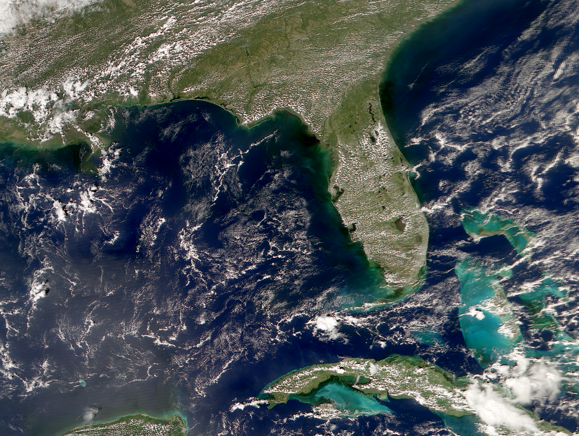

Dependence of satellite ocean color data products on viewing angles: A comparison between SeaWiFS, MODIS, and VIIRS
Brian Barnes
Chuanmin Hu
20 May 2015
MODIS Aqua true color RGB 11 Oct 2014

Slide 2
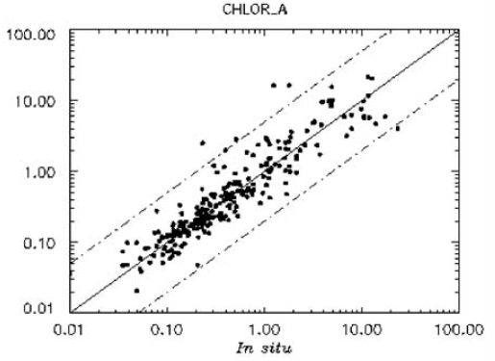
Motivation: Understanding Uncertainties in Products
McClain et al. (2004, DSR-II), Gregg and Casey (2004, RSE)
Antoine et al. (2010, JGR), Moore et al. (2015, RSE)

Slide 3
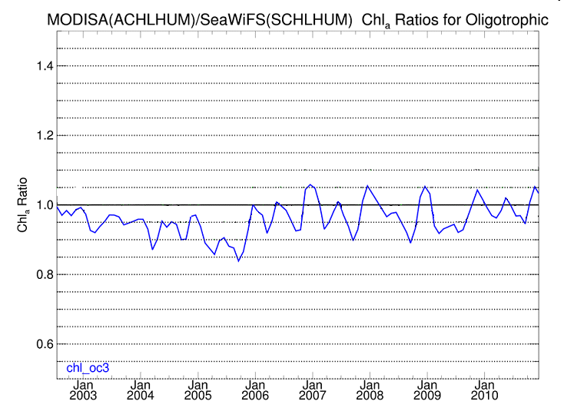
Time series, global ocean
Oilgotrophic MODISA/SeaWiFS ratio, 2003 - 2010
Blue: OCx (current algorithm)

Slide 4
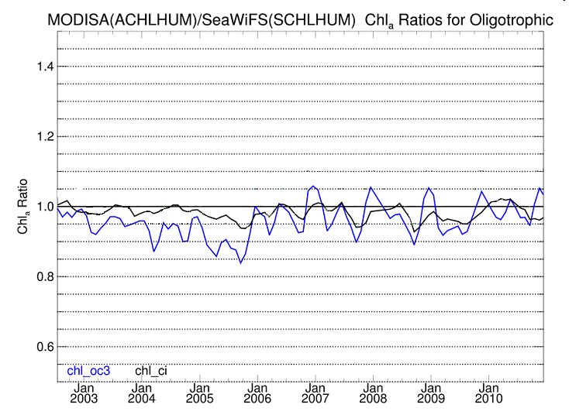
Time series, global ocean
Oilgotrophic MODISA/SeaWiFS ratio, 2003 - 2010
Blue: OCx (current algorithm)
Black: CI (new algorithm)

Slide 5
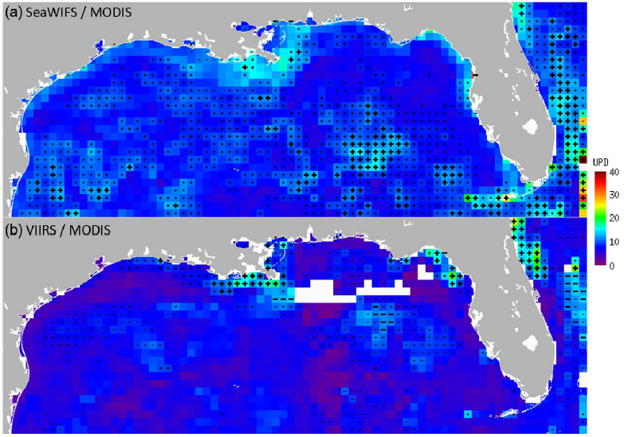
Comparison of simultaneous (+- 5 minutes) measurements
UPD for a) SeaWiFS / MODIS and b) VIIRS / MODIS simultaneous K_{d}_lee matchup
at 0.25 degree resolution. Regions with positive or negative MRD greater than 5%
are marked with ‘+’ or ‘-’, respectively. For MRD greater than 10%, symbols are bold.

Slide 6
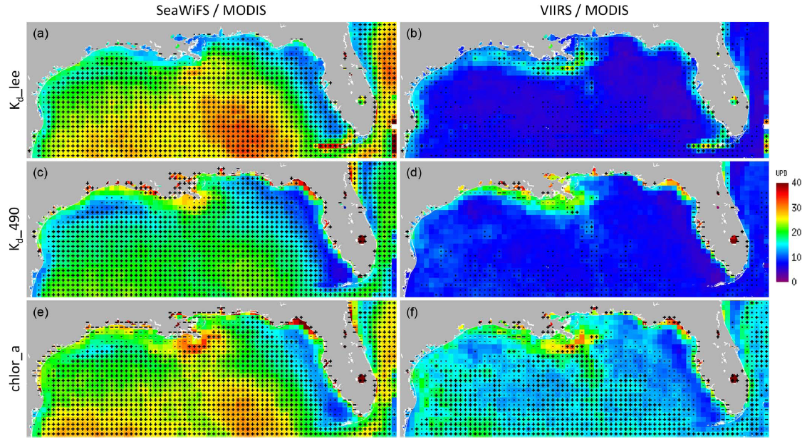
Comparison of monthly mean products
UPD for a) SeaWiFS / MODIS and b) VIIRS / MODIS monthly mean products

Slide 7
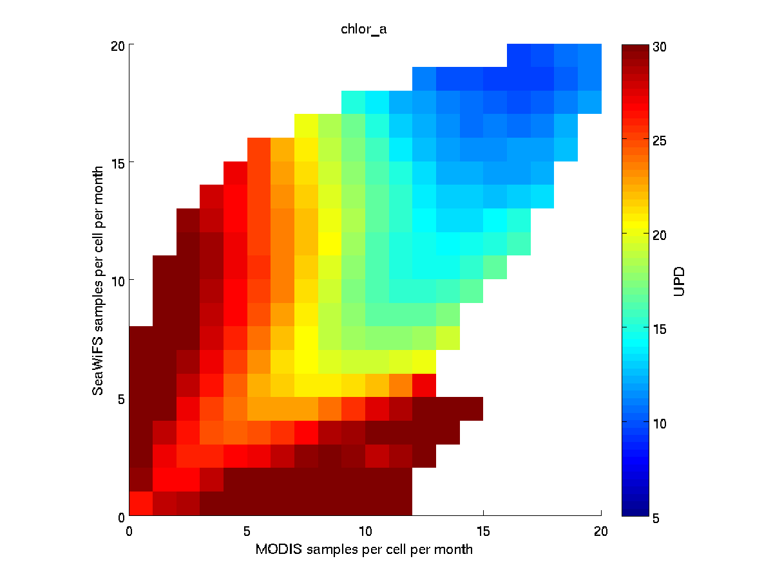
Differences in monthly mean products for clear waters of the Gulf of Mexico
Notes:
Chl Ocx comparison. Mean UPD (%) for monthly matchups as a function of the number of measurements from the two satellites per grid cell (0.25 by 0.25 degree) per month.

Slide 8
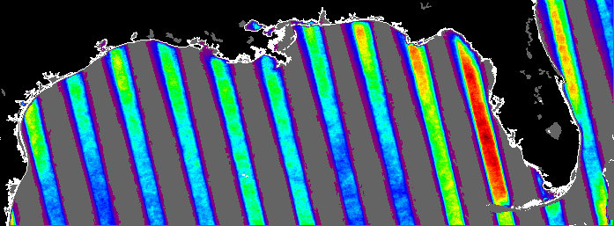
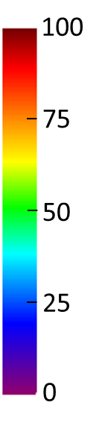
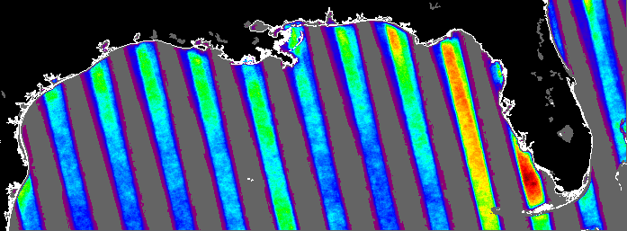
Why does viewing angle matter?
Satellite data may degrade at high SZA
Geostationary sensor design
Any (non polar) location is viewed from only ~6 SZAs for MODIS & VIIRS
18 – 22°
# of pixels
180
135
24 – 28°
90
45
1
Notes:
Figure shows number of valid MODIS measurements partitioned by 6 degree SZA bins. Figure demonstrates that angular dependence has a spatial component, and thus will affect different pixels differently. This is due to the fixed orbit.

Slide 9
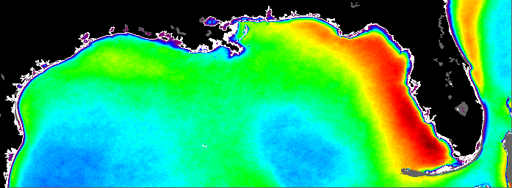
Study area & data distribution
SeaWiFS, MODIS, & VIIRS (1997 – 2014)
3 km resolution
# of pixels
SeaWiFS, 0 – 60°
1500
1125
750
375
1
Notes:
This is SeaWiFS data, but looks exactly the same for MODIS, VIIRS, and matchup datasets.

Slide 10
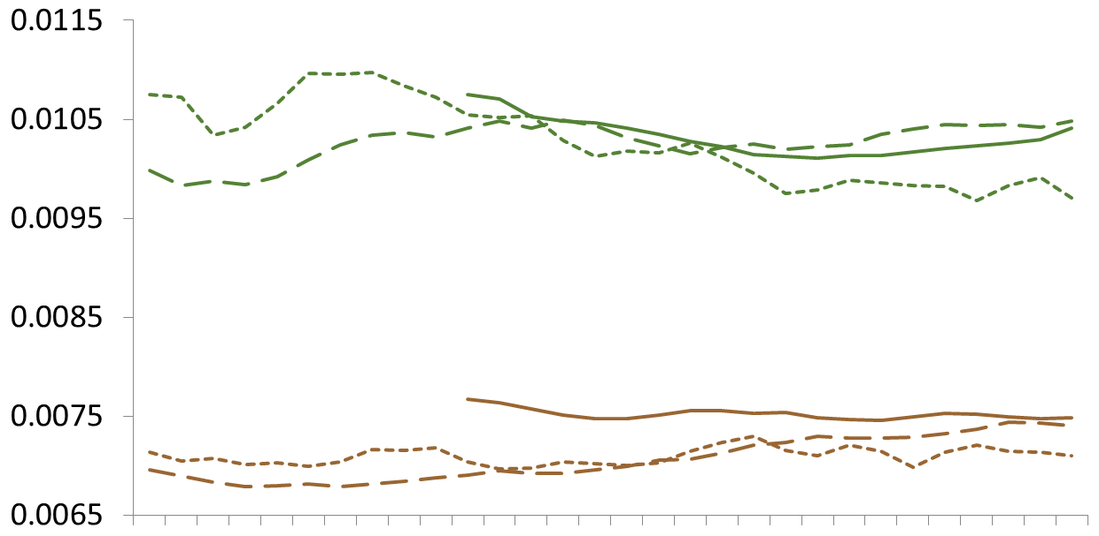
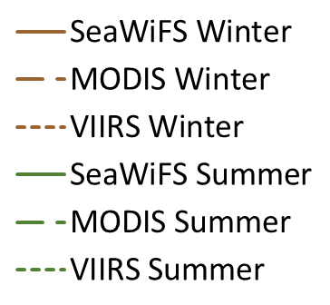
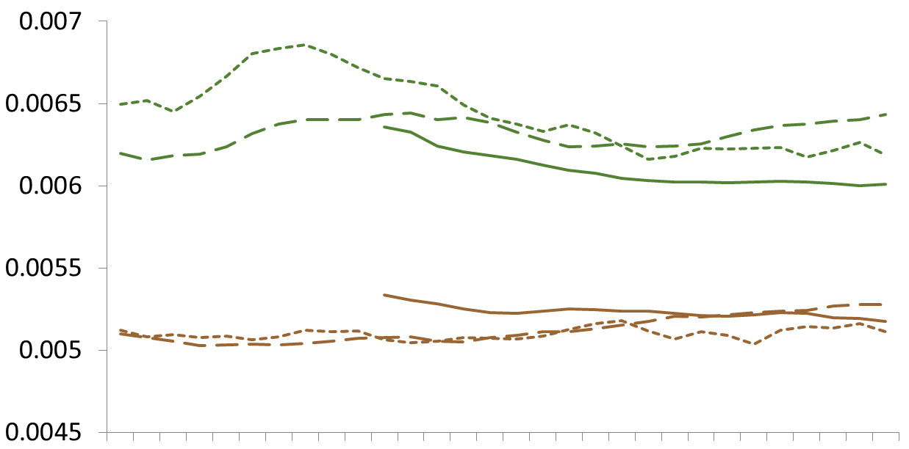
Single sensor SZA trends – R_{rs}
R_{rs}(412)
Mean R_{rs} (sr⁻¹)
0
10
20
30
40
50
60
R_{rs}(488)
0
10
20
30
40
50
60
SZA (°)
Offshore waters, CHL_{OCI} ≤ 0.25 mg m⁻³
Notes:
Pretty good. No major trends with SZA, and satellites generally agree

Slide 11
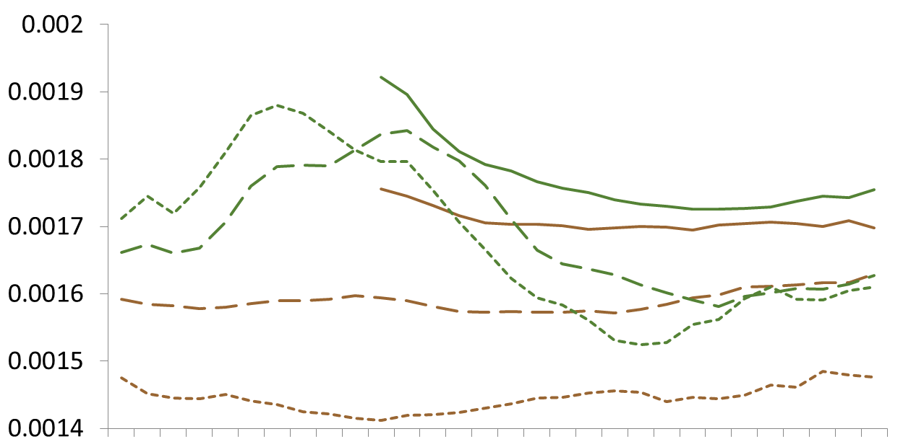
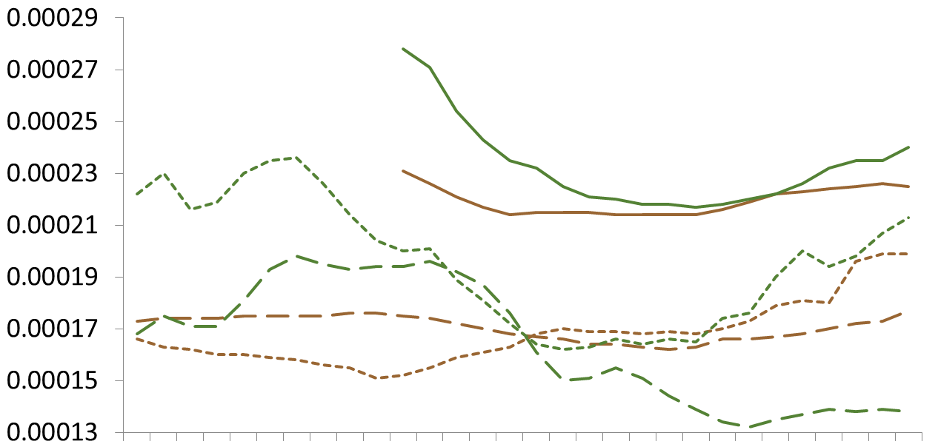
Single sensor SZA trends – R_{rs}
R_{rs}(555)
Mean R_{rs} (sr⁻¹)
0
10
20
30
40
50
60
R_{rs}(667)
0
10
20
30
40
50
60
SZA (°)
Offshore waters, CHL_{OCI} ≤ 0.25 mg m⁻³
Notes:
Evidence of residual sun glint (circled) for MODIS and VIIRS.

Slide 12
Single sensor SZA trends – R_{rs}
R_{rs}(555)
Mean R_{rs} (sr⁻¹)
0
10
20
30
40
50
60
R_{rs}(667)
0
10
20
30
40
50
60
SZA (°)
Offshore waters, CHL_{OCI} ≤ 0.25 mg m⁻³
Notes:
Evidence of residual BRDF issues (circled) for SeaWiFS

Slide 13
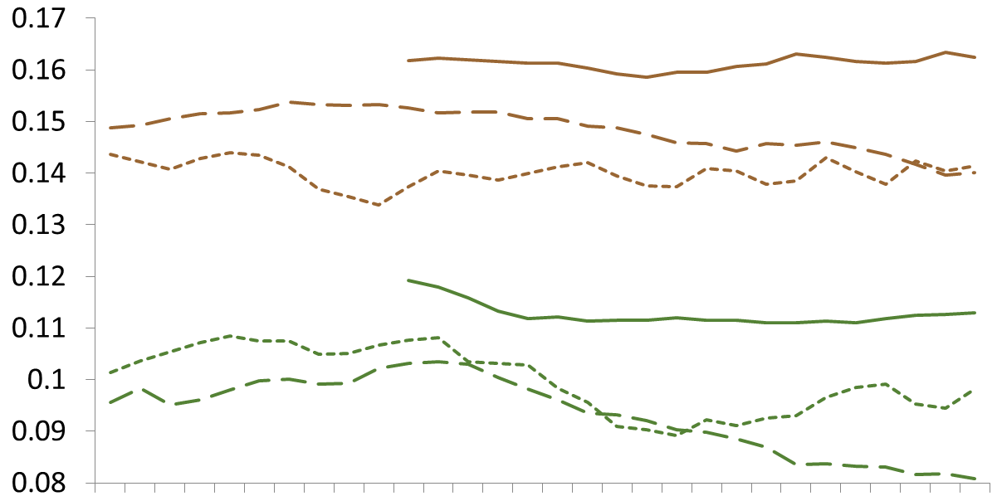

Single sensor SZA trends – Chla
CHL_{OCx}
Mean Chla (mg m⁻³)
0
10
20
30
40
50
60
CHL_{OCI}
0
10
20
30
40
50
60
SZA (°)
Offshore waters, CHL_{OCI} ≤ 0.25 mg m⁻³
Notes:
Much better agreement between a 3 satellites with OCI. OCx also shows potential sun glint and BRDF issues from previous slides. MODIS OCI declines after ~40⁰ SZA

Slide 14
Single sensor SZA trends – Chla
CHL_{OCx}
Mean Chla (mg m⁻³)
0
10
20
30
40
50
60
CHL_{OCI}
0
10
20
30
40
50
60
SZA (°)
Offshore waters, CHL_{OCI} ≤ 0.25 mg m⁻³
Notes:
Much better agreement between a 3 satellites with OCI. OCx also shows potential sun glint and BRDF issues from previous slides. MODIS OCI shows pronounced declines after ~40⁰ SZA

Slide 15
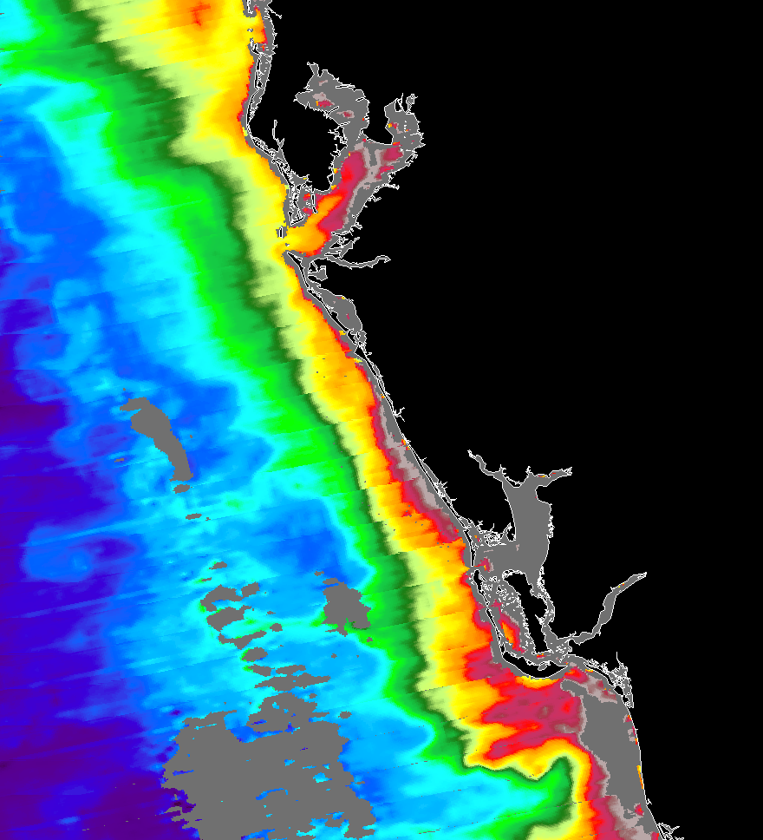
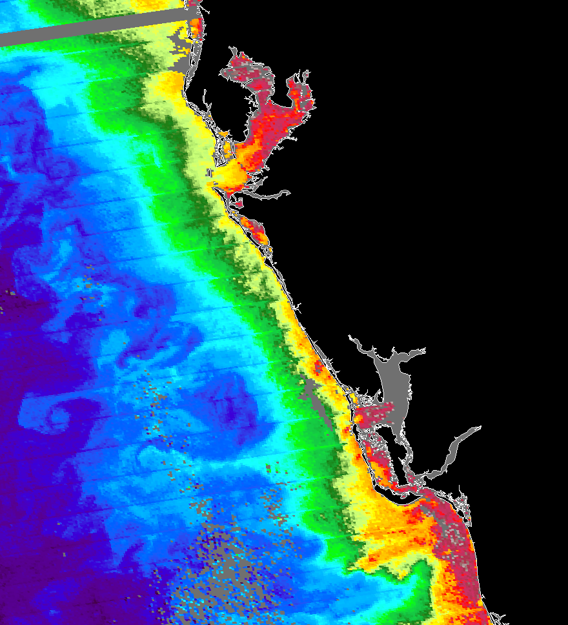
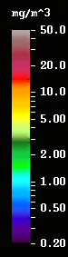
Cross-sensor SZA assessment
Collocated, < 1 hour temporal overlap
MODIS
VIIRS
MODIS Aqua and VIIRS NPP data from 11 November 2014

Slide 16
Assessment terms
UPD = Percent difference
MRD = Bias
Notes:
MODIS is x, y is either SeaWiFS or VIIRS

Slide 17
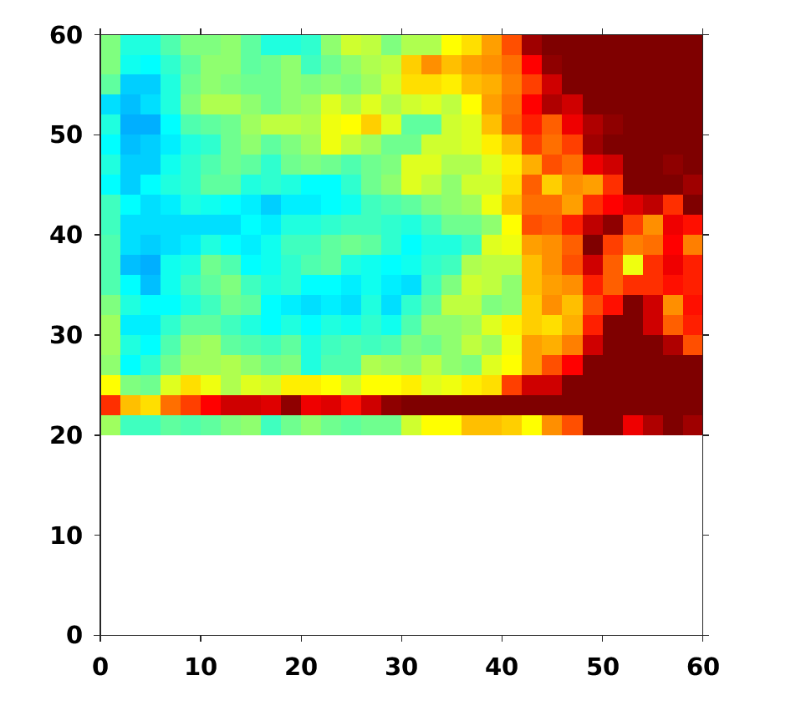
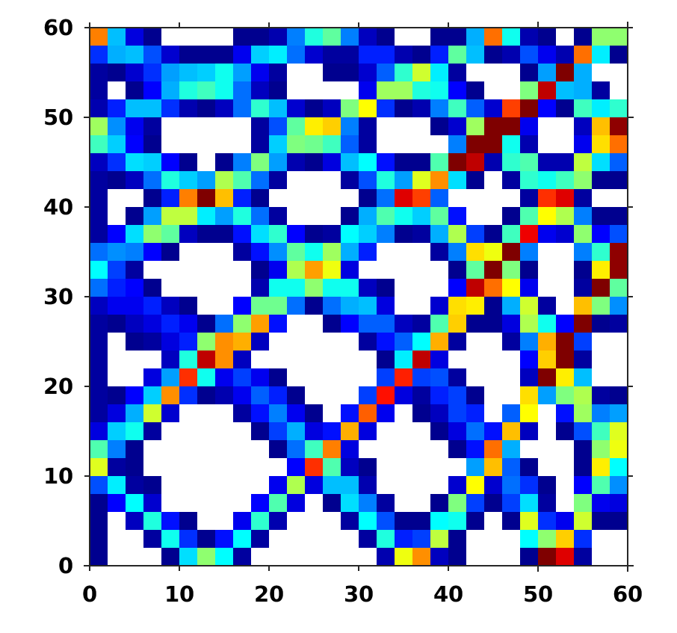
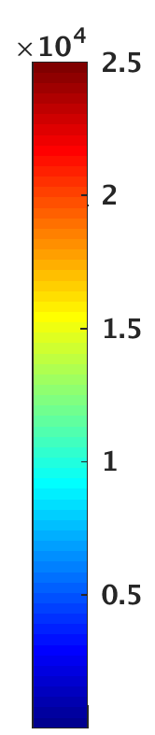
Data distribution by SZA
Number of Matchups
SeaWiFS SZA (°)
VIIRS SZA (°)
MODIS SZA (°)
MODIS SZA (°)
Notes:
This is the distribution of data for the matchups. Also can use this slide to familiarize audience with format for subsequent images…

Slide 18
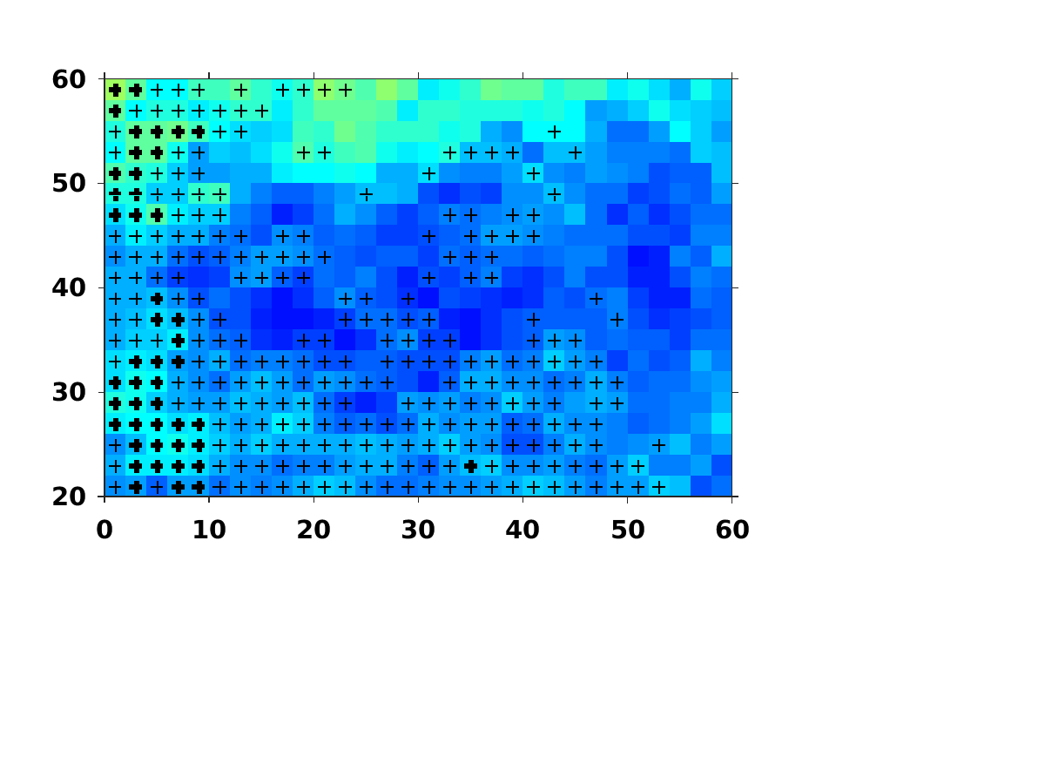
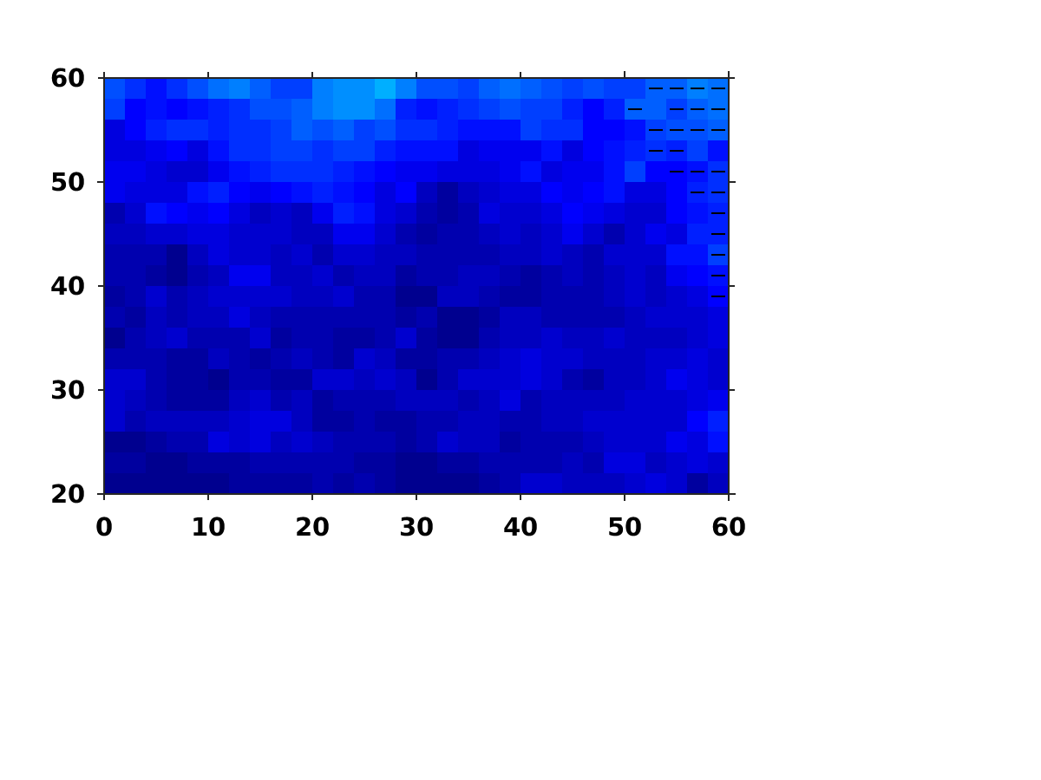
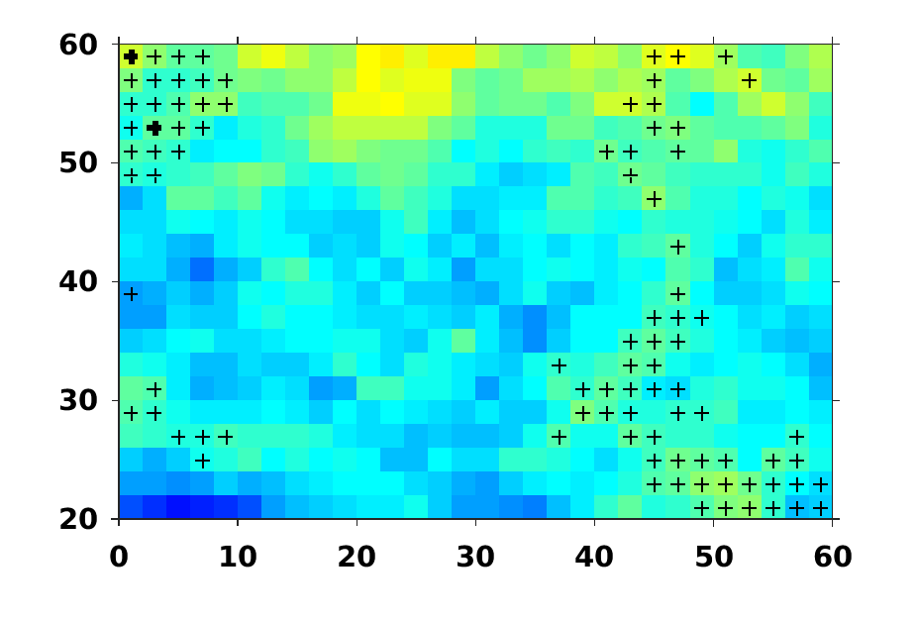
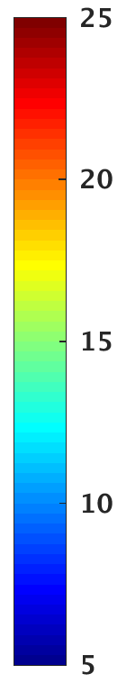
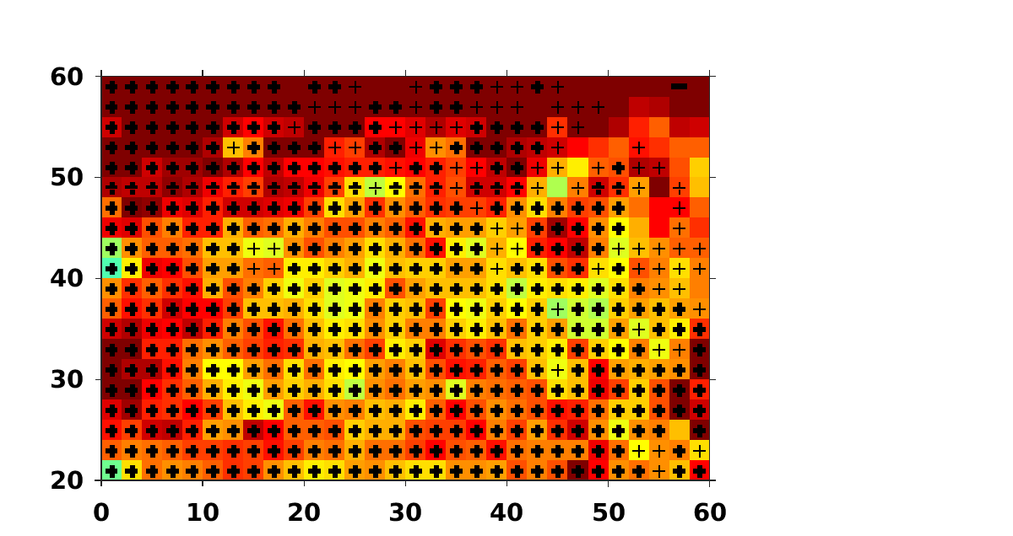
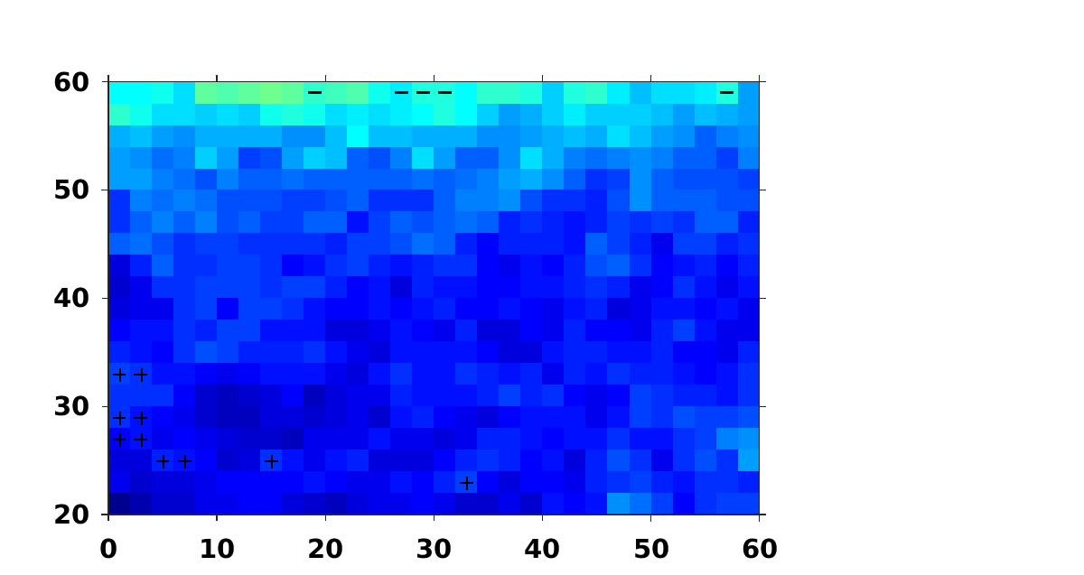
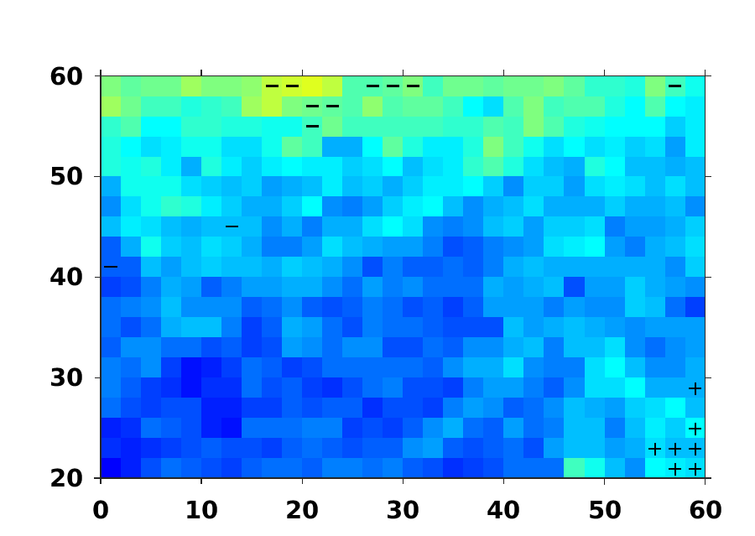
SeaWiFS vs MODIS – R_{rs}
Low Chla (CHL_{OCI} ≤ 0.25)
R_{rs}(412)
R_{rs}(488)
R_{rs}(555)
UPD
SeaWiFS SZA (°)
High Chla (CHL_{OCI} > 0.25)
MODIS SZA (°)
+ / - = MRD > 5%
+ / - = MRD > 10%
Notes:
General increase in UPD with SeaWiFS SZA. No change with MODIS SZA. Blue band agreement better in low CHLA conditions, but red & green better in high Chla conditions

Slide 19
SeaWiFS vs MODIS – R_{rs}
Low Chla (CHL_{OCI} ≤ 0.25)
R_{rs}(412)
R_{rs}(488)
R_{rs}(555)
UPD
SeaWiFS SZA (°)
High Chla (CHL_{OCI} > 0.25)
MODIS SZA (°)
+ / - = MRD > 5%
+ / - = MRD > 10%
Notes:
General increase in UPD with SeaWiFS SZA. No change with MODIS SZA. Blue band agreement better in low CHLA conditions, but red & green better in high Chla conditions

Slide 20
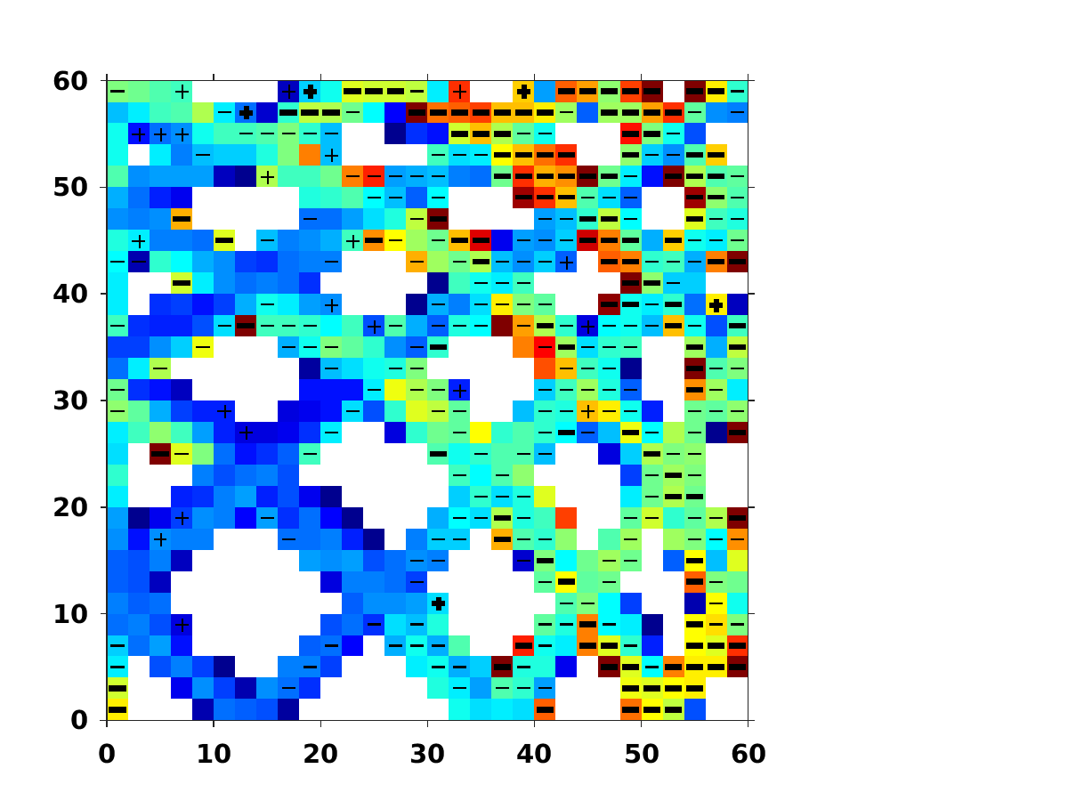
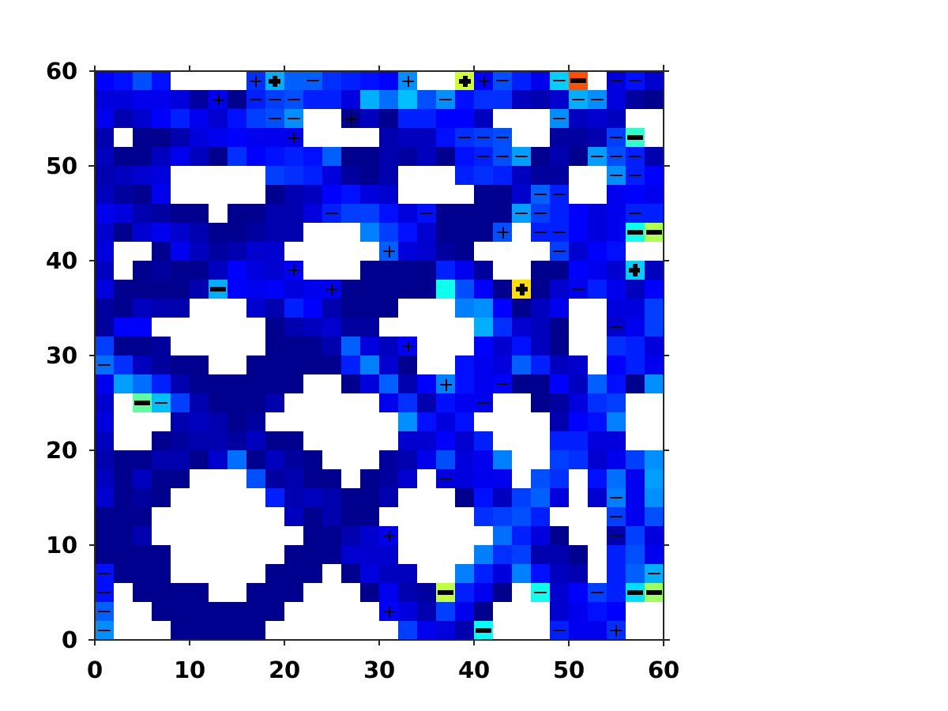
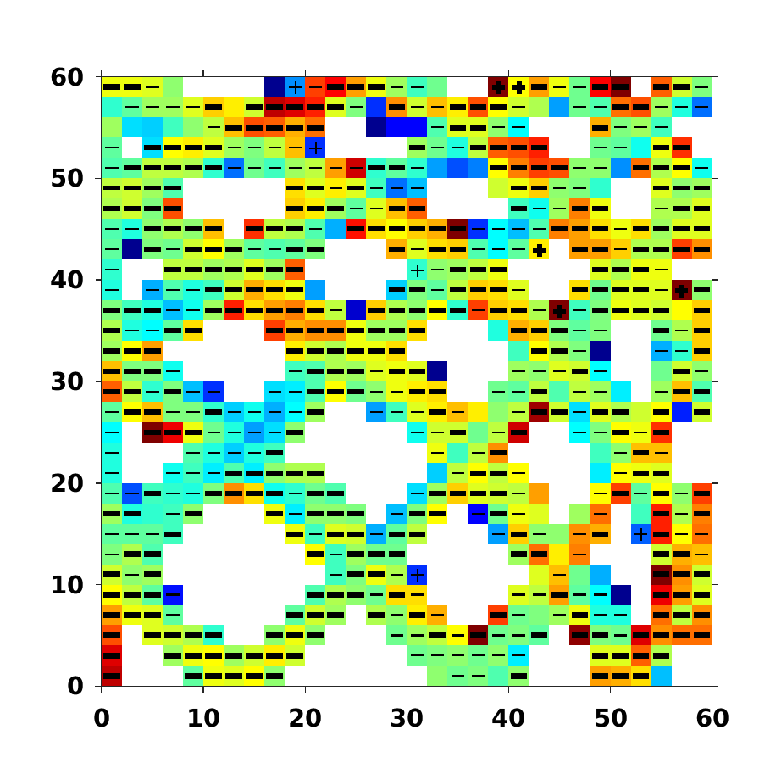
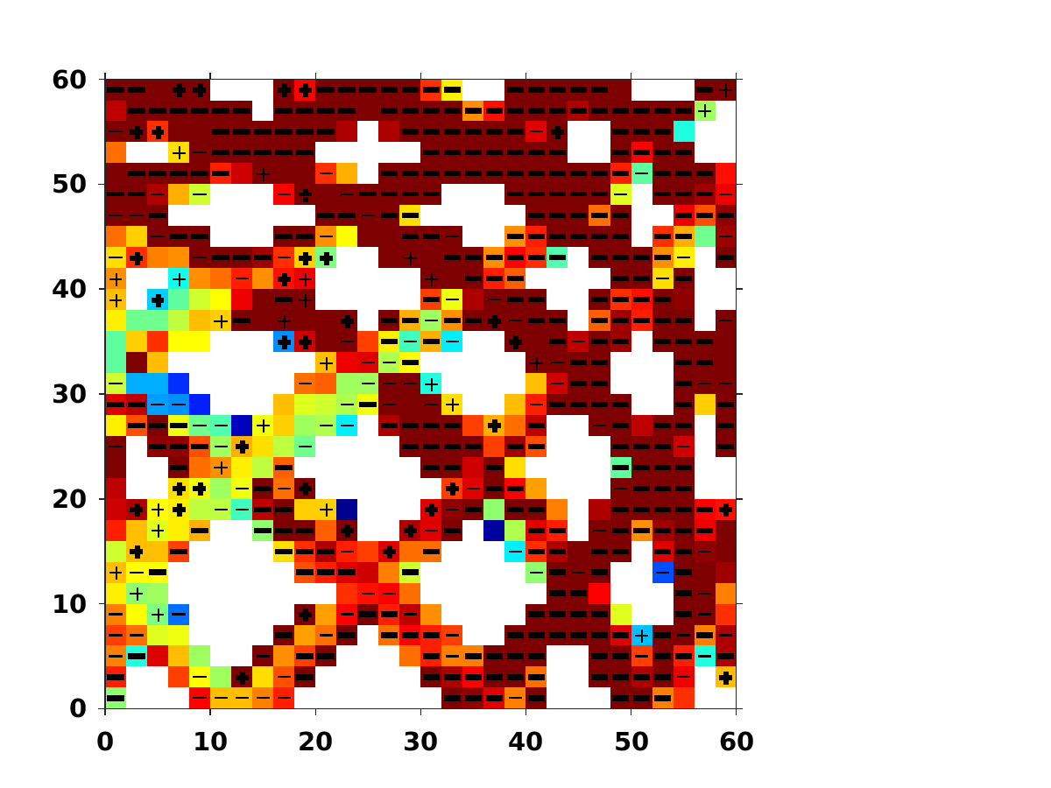
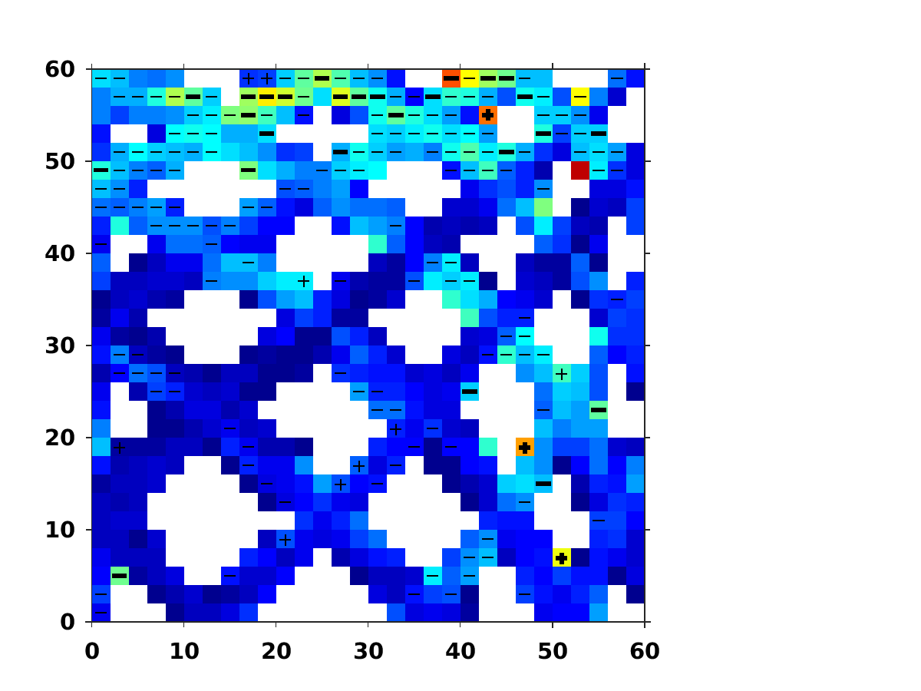
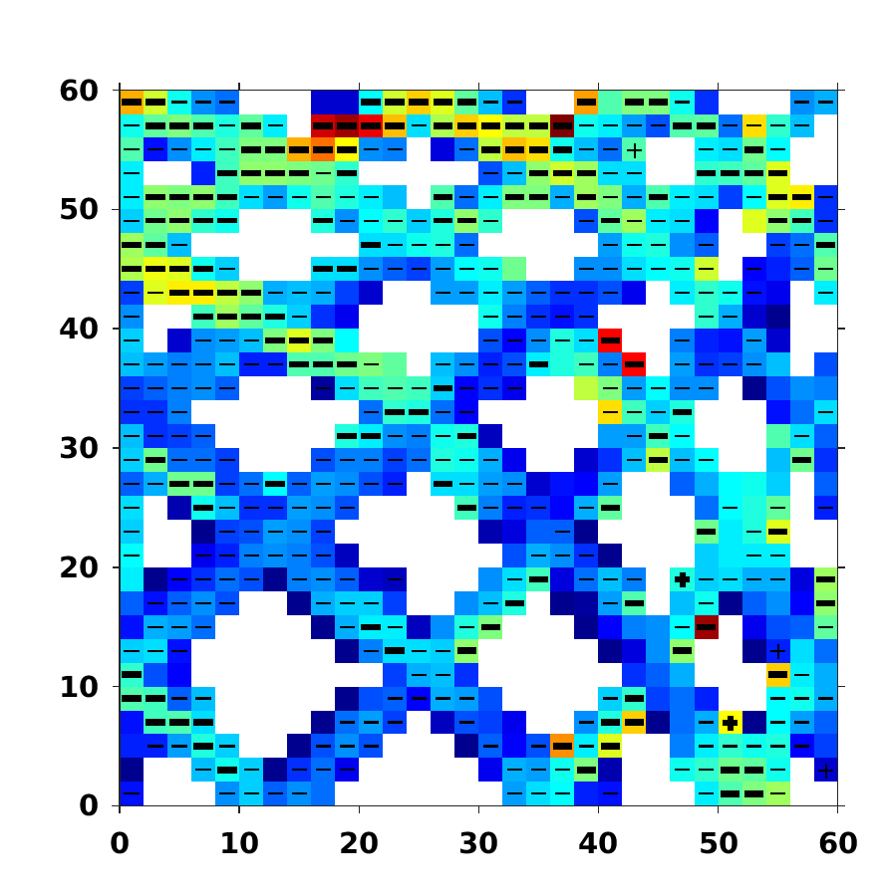
VIIRS vs MODIS – R_{rs}
Low Chla (CHL_{OCI} ≤ 0.25)
R_{rs}(412)
R_{rs}(488)
R_{rs}(555)
UPD
VIIRS SZA (°)
High Chla (CHL_{OCI} > 0.25)
MODIS SZA (°)
Notes:
General increases in

Slide 21
VIIRS vs MODIS – R_{rs}
Low Chla (CHL_{OCI} ≤ 0.25)
R_{rs}(412)
R_{rs}(488)
R_{rs}(555)
UPD
VIIRS SZA (°)
High Chla (CHL_{OCI} > 0.25)
MODIS SZA (°)
Notes:
General increases in UPD with higher VIIRS SZA. For blue bands, see UPD increase with MODIS SZA

Slide 22
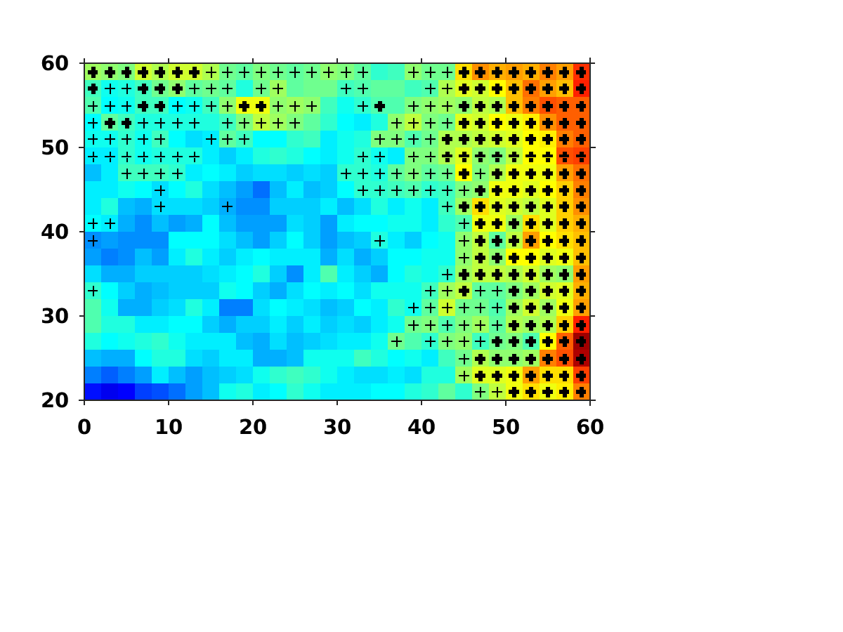
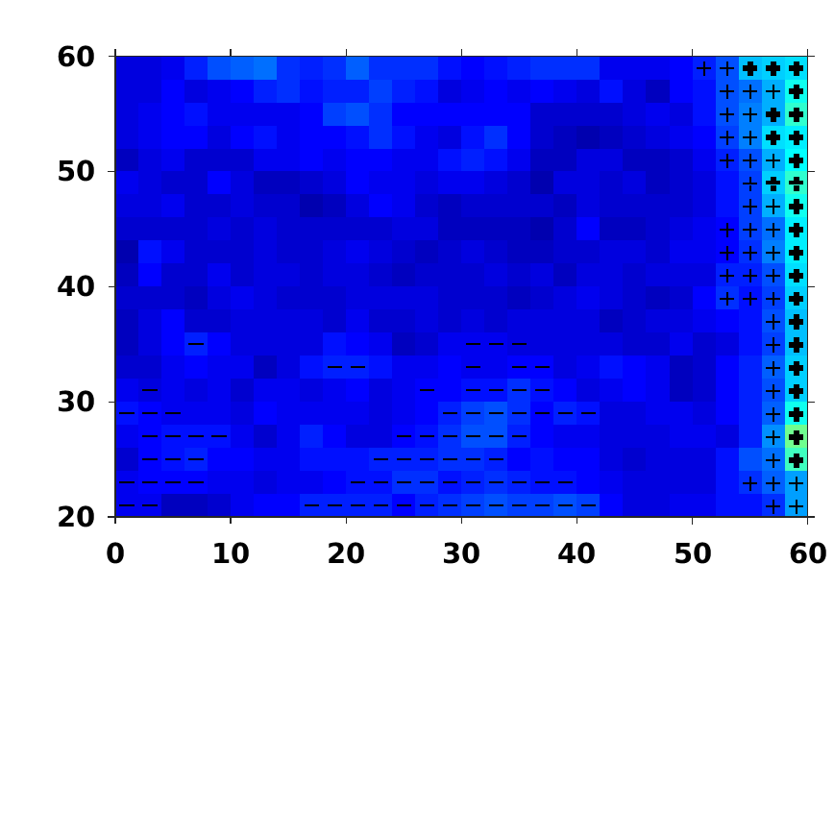
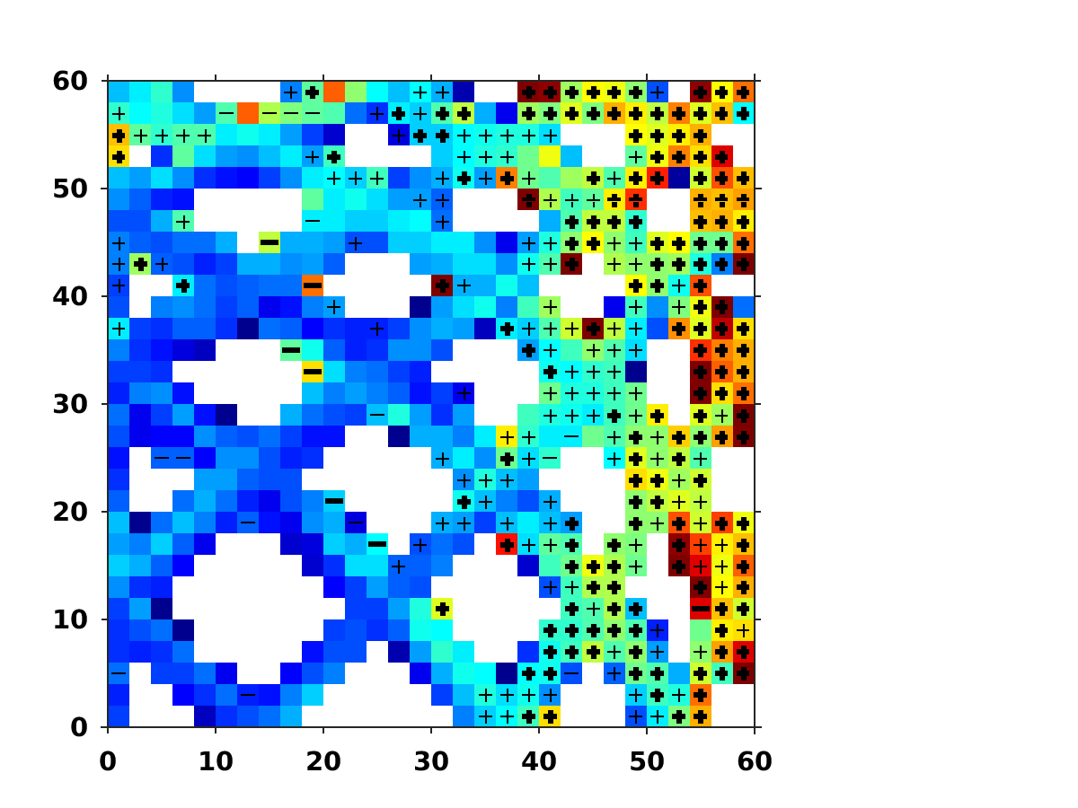
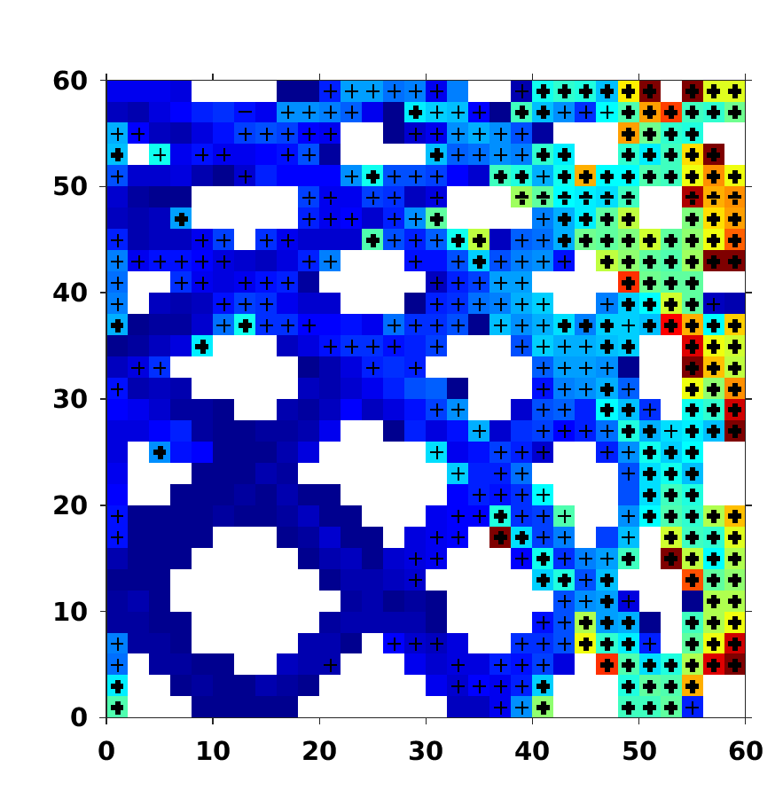
Angular dependence in Chla
CHL_{OCx}
CHL_{OCI}
SeaWiFS SZA (°)
UPD
VIIRS SZA (°)
MODIS SZA (°)
+ / - = MRD > 5%
+ / - = MRD > 10%
Notes:
Pretty severe angular dependence for OCx, but OCI is resilient to across-the-board increases in Rrs uncertainty. Circled area is potentially due to MODIS degradation after SeaWiFS ended.

Slide 23
Angular dependence in Chla
CHL_{OCx}
CHL_{OCI}
SeaWiFS SZA (°)
UPD
VIIRS SZA (°)
MODIS SZA (°)
+ / - = MRD > 5%
+ / - = MRD > 10%
Notes:
Pretty severe angular dependence for OCx, but OCI is resilient to across-the-board increases in Rrs uncertainty. Circled area is strange, as if MODIS and SeaWiFS agree, then MODIS and VIIRS issues should present with increases in VIIRS UPD. Potentially due to MODIS degradation after SeaWiFS ended.

Slide 24
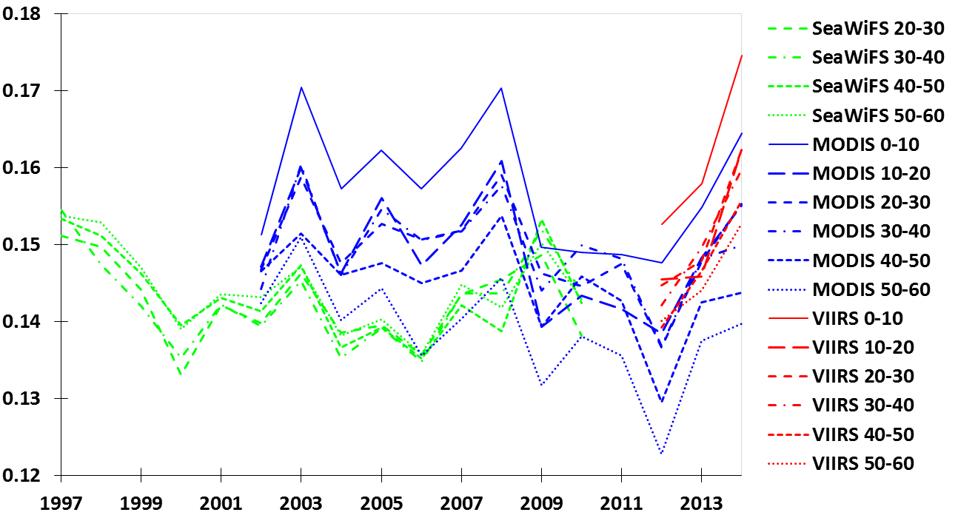
SZA dependence - time series
Mean CHL_{OCI} (mg m⁻³)
Year
All GoM, CHL_{OCI} ≤ 0.25 mg m⁻³
Notes:
Time series of OCI, separated by 10 degree SZA increments. MODIS SZA issues may be getting worse, explaining the circled area in previous graph

Slide 25
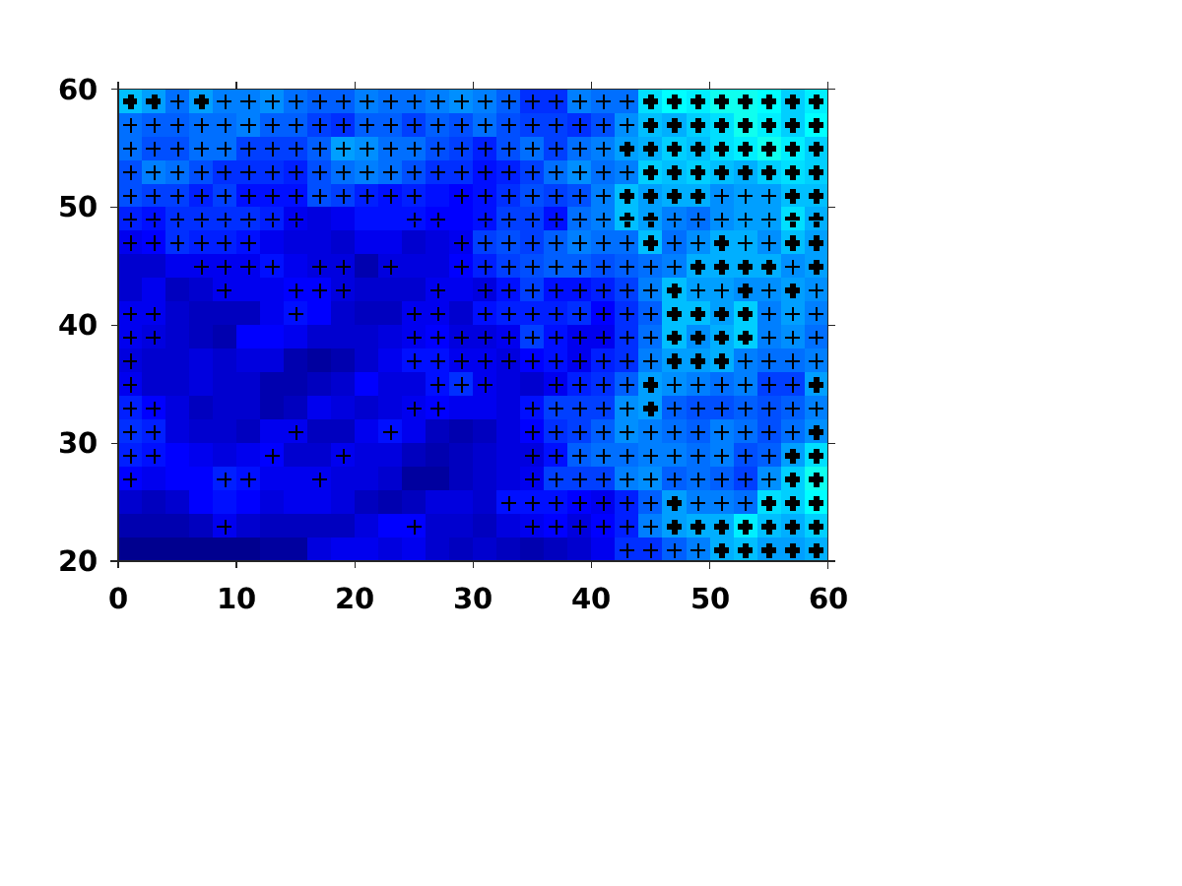
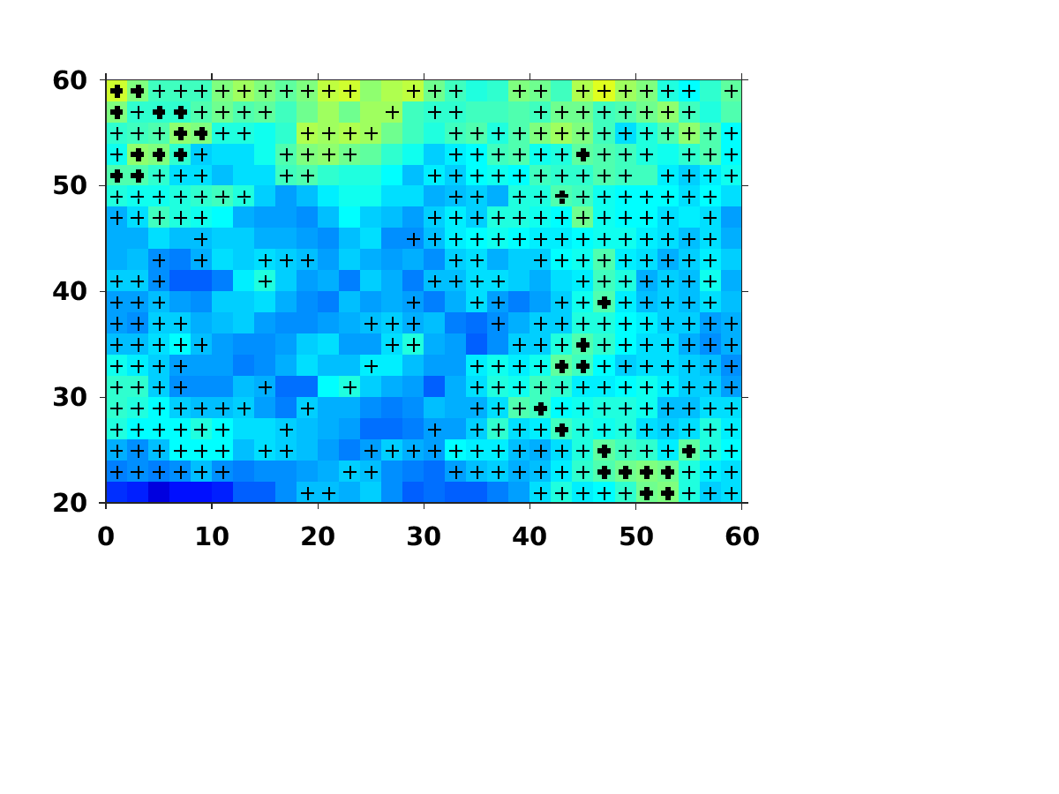

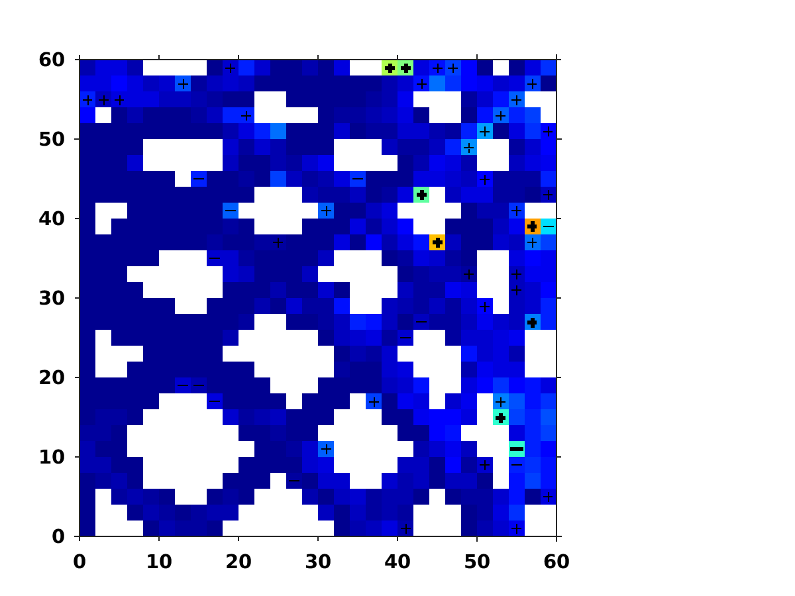
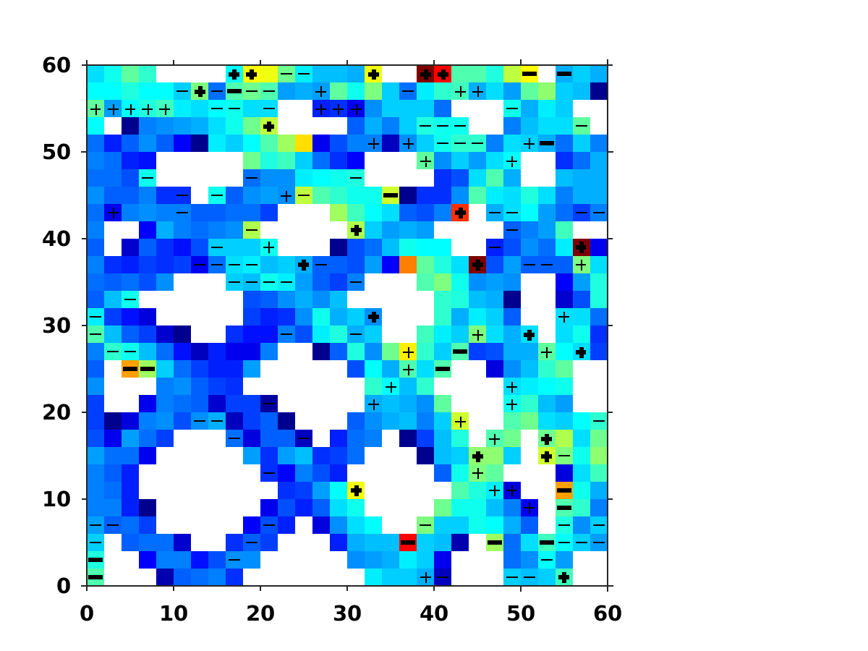
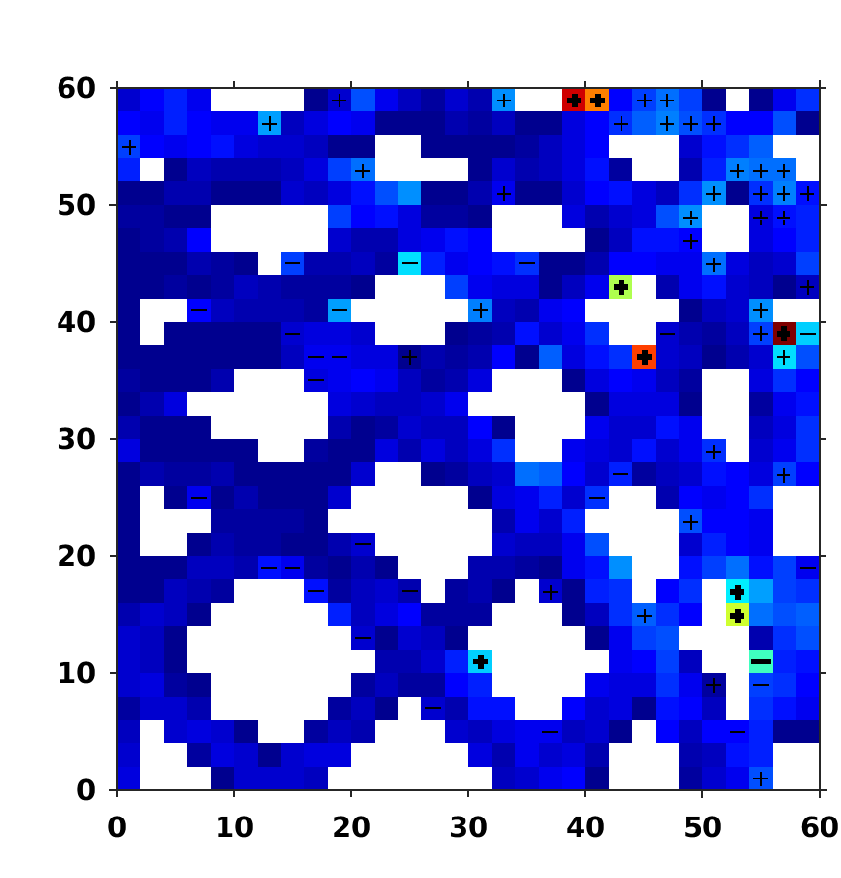
Angular dependence in QAA
a_{t}(488)
b_{b}(488)
K_{d}(488)_lee
SeaWiFS SZA (°)
UPD
VIIRS SZA (°)
MODIS SZA (°)
Low Chla (CHL_{OCI} ≤ 0.25)
+ / - = MRD > 5%
+ / - = MRD > 10%
Notes:
at and kd_lee generally show less angular dependence than corresponding Rrs bands (exception is 488, which is about equal). bb is higher, but not propagated to Kd_lee

Slide 26
Conclusions
Apparent SZA dependence for all instruments
  Potential MODIS and VIIRS insufficient sun glint masking
  Potential SeaWiFS BRDF correction uncertainties
Impressive overall continuity for R_{rs}
  Generally, UPD < 10%, except for red bands
  MRD < 5%, but SeaWiFS > MODIS > VIIRS
  Most angular dependence for SZA > 40°
OCI much more resilient to angular dependence than OCx
SZA dependence muted in QAA & K_{d}_lee products

