Slide 1
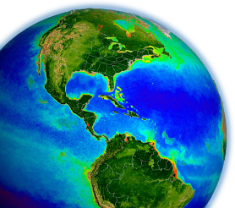
SNPP VIIRS
On-Orbit Calibration for
Ocean Color Applications
Gene Eplee, Kevin Turpie,
Gerhard Meister, and Fred Patt
NASA Ocean Biology
Processing Group
MODIS / VIIRS Science Team Meeting
May 2015
Notes:
1
On-Orbit calibration group for the OBPG

Slide 2
OBPG VIIRS On-Orbit Calibration Methodology
Applied Optics 54, 1984-2006 (2015)
Notes:
OBPG on-orbit calibration methodology has recently been published in Applied Optics.
Approach is still valid with an additional year of data.

Slide 3
OBPG On-Orbit Calibration Updates
An additional year of solar/lunar observations (Jan 2012–May 2015).
Empirical libration angle corrections extended to sub-solar point:
Scatter in lunar data small enough for residual sub-solar libration effects to be observed in addition to sub-spacecraft libration effects.
Corrections result in a further reduction of scatter in lunar observations.
First substantive derivation of SWIR band calibration:
Sun Pointing Anomaly in March 2012.
Residual libration effects also observed in SWIR band lunar data.
Absolute calibration of solar observations using diffuser measurements:
Vicarious calibration will mitigate gain adjustments for bands M1-M6.
2% gain adjustment for band M7.
Absolute calibration sets response for SWIR band solar time series.
Notes:
Petulant mode event for SWIR bands: lunar time series starts after event.

Slide 4
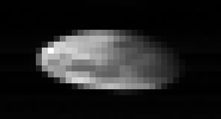
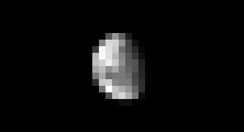
Lunar Calibrations
Band 4
Unaggregated
Band 6
Aggregated

Slide 5
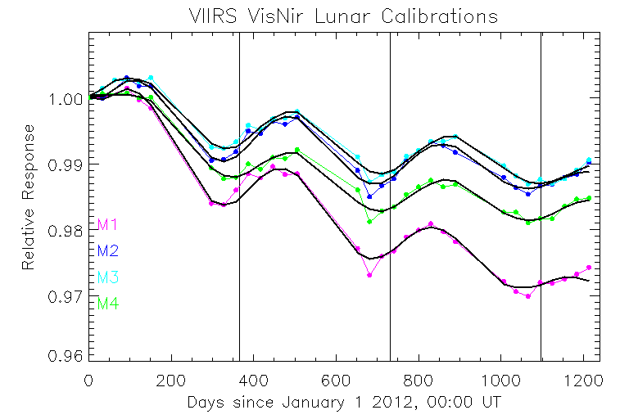
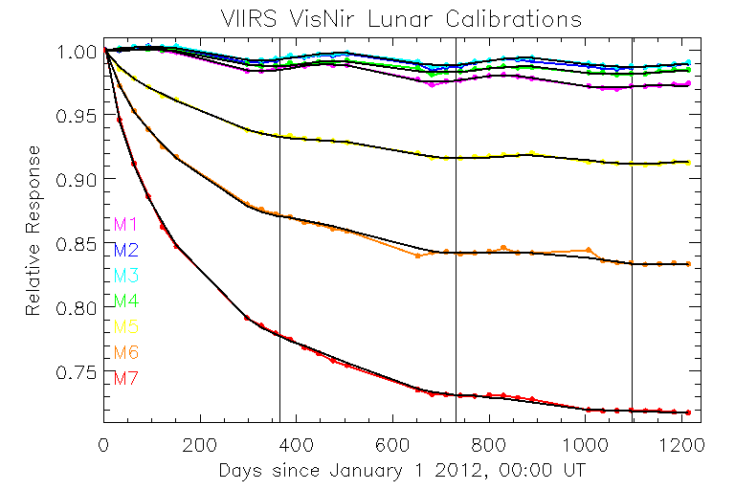
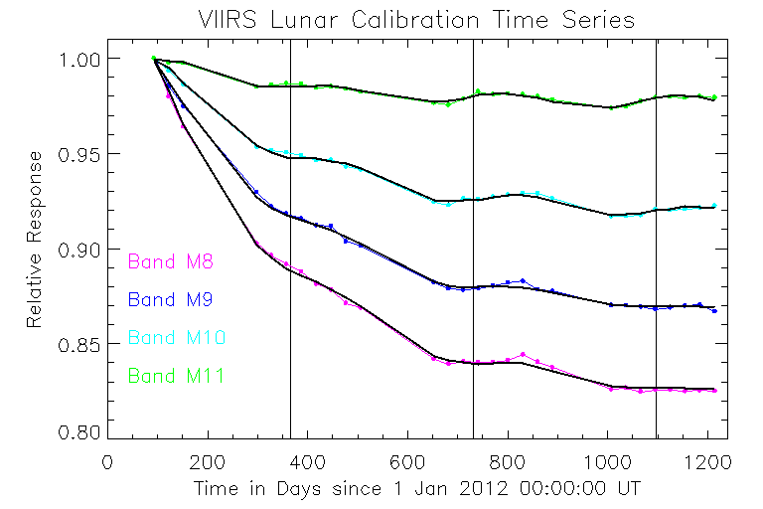
Lunar Calibration Time Series
Lunar time series are ratios of VIIRS observations to USGS ROLO model predictions made using modulated VIIRS spectral response functions.
Fits are exponentials of time plus linear functions of sub-spacecraft and sub-solar libration angles.
5
Notes:
For bands M1-M4, the fits incorporate an exponential plus linear function of time, linear functions of the longitude and latitude of the sub-spacecraft libration point, and linear functions of the longitude and latitude of the sub-solar point. For bands M5-M11, the fits are simultaneous functions of time and linear functions of the sub-spacecraft and sub-solar libration points.
This is the first OBPG effort at a SWIR band lunar calibration.

Slide 6
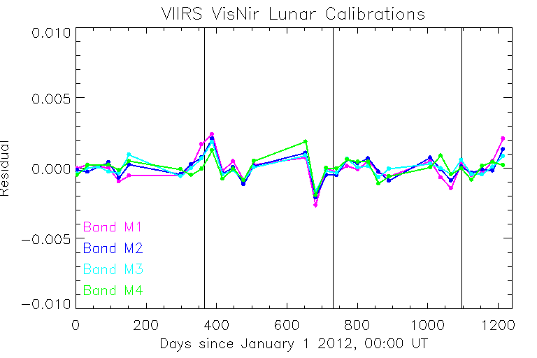
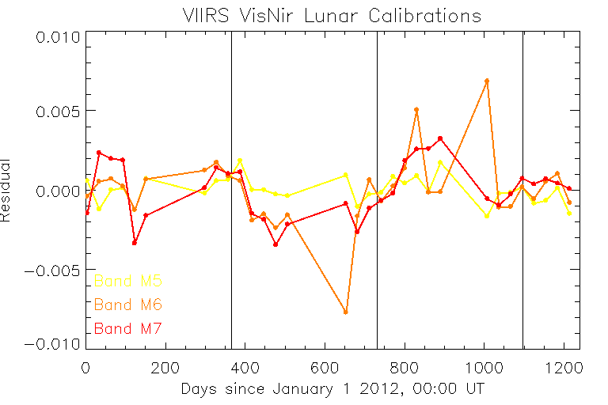
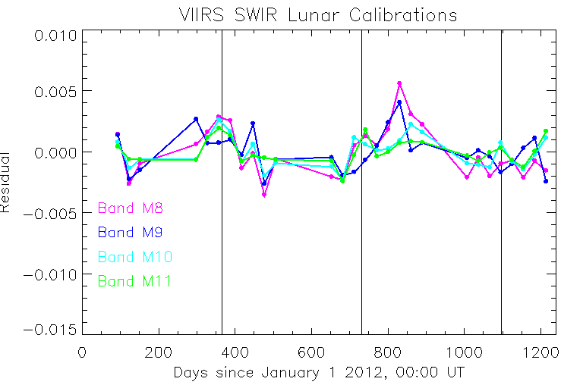
Lunar Calibration Fit Residuals
The sub-spacecraft and sub-solar libration corrections capture
the periodic signals
in the lunar time series.
6
Notes:
Band M6 is an outlier.

Slide 7
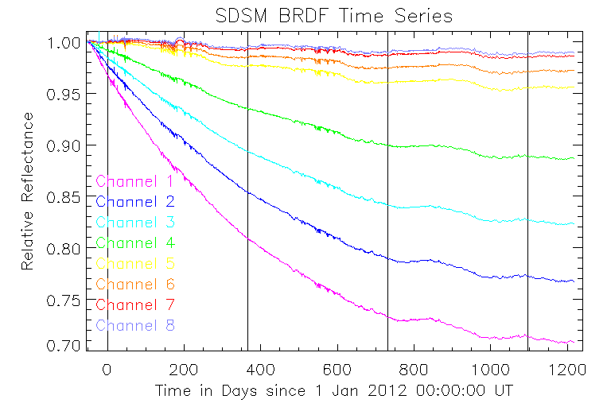
SDSM Calibrations
Channels 1-7 correspond to bands M1-M7.
Channel 8 (935 nm) tracks SDSM performance.

Slide 8
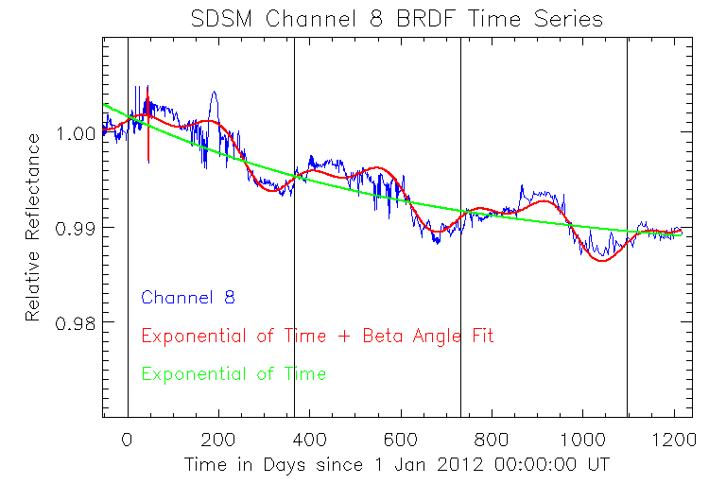
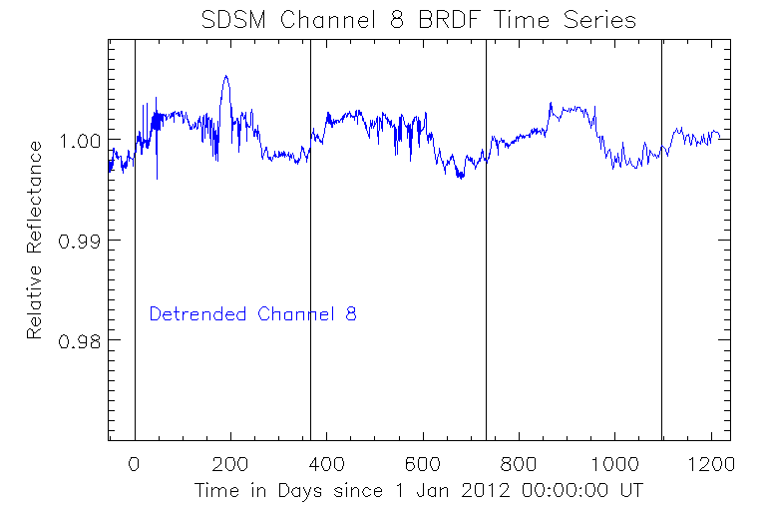
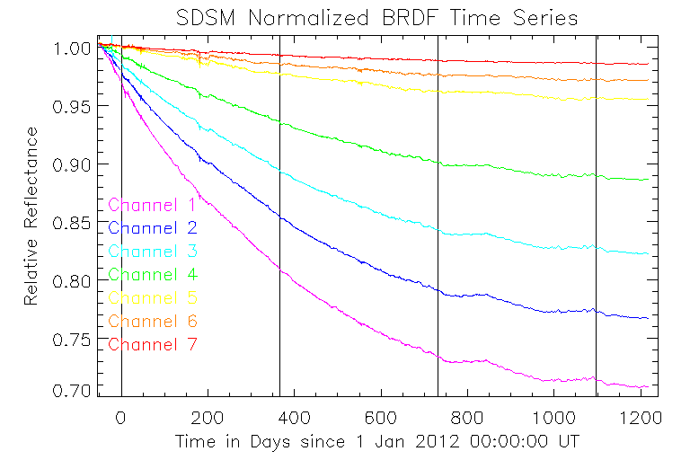
SDSM Calibration Time Series
SDSM channel 8 is fit with an exponential function of time plus a linear function of solar beta angle.
Normalization of channels 1-7 by detrended channel 8 reduces noise and beta angle dependence without changing temporal dependence.
8
Notes:
Detrended channel 8 normalization reduces noise in channels 1-7 without changing temporal dependence in those channels.
The H-factors are interpolated to time basis of solar observations so that direct corrections to the solar data can be made.

Slide 9
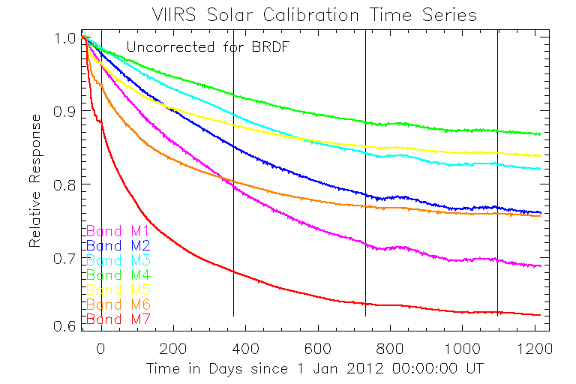
Solar Calibrations
Solar calibration time series for band M1-M7,
uncorrected for diffuser BRDF degradation.

Slide 10
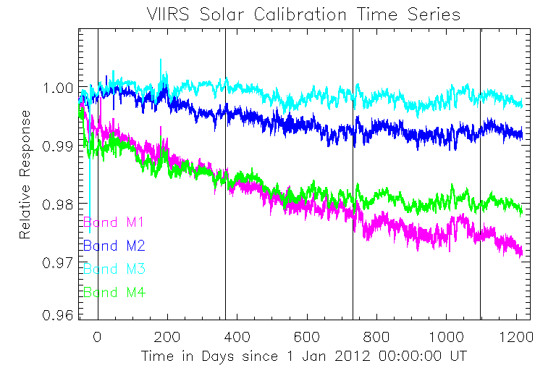
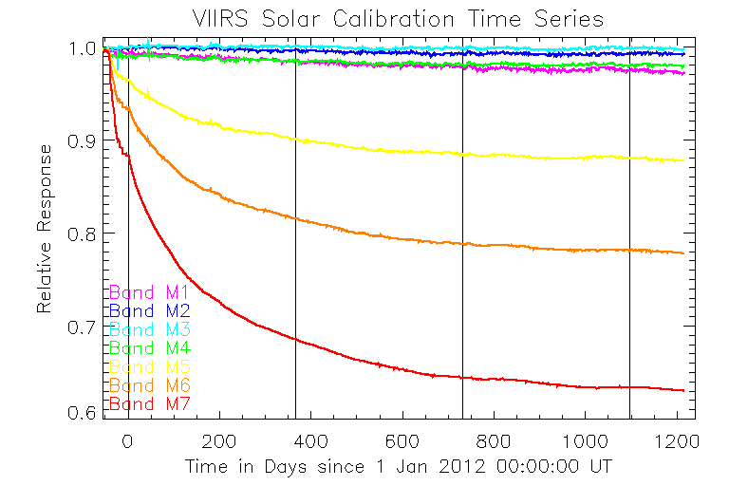
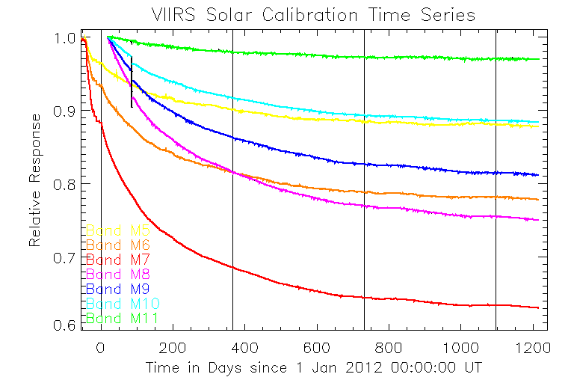
Solar Calibration Time Series
Bands M1-M7 are corrected for
diffuser BRDF degradation by
SDSM-derived H-factors.
SWIR band radiometric responses changed discontinuously during March 2012 Sun Pointing Anomaly.
10
Notes:
The fits for bands M1-M4 are exponential plus linear functions of time. The fits for bands M5-M7 are simultaneous exponential functions of time. For the SWIR bands (M8-M11), the time series prior to the petulant mode event are fit with exponential functions of time. The time series after the petulant mode event are fit with simultaneous exponential functions of time.
This is the first OBPG effort at SWIR band solar calibration.

Slide 11
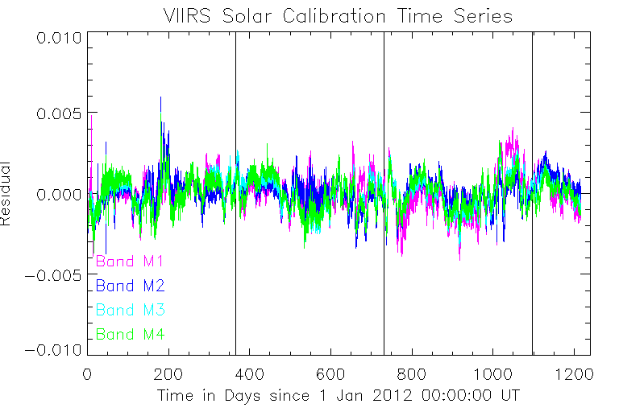
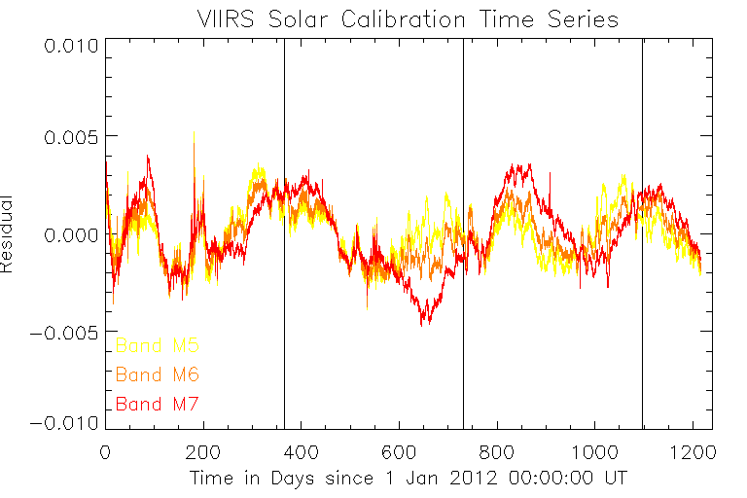
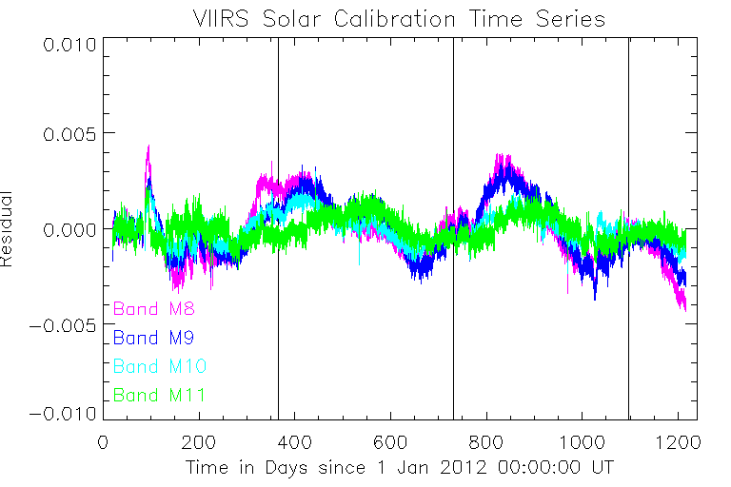
Solar Calibration Fit Residuals
The detrended SDSM channel 8 normalization and the latest
screen transmission / diffuser BRDF functions derived by VCST minimize periodic signals in the solar time series.
11

Slide 12
Solar / Lunar
Calibration Comparisons
Concern over how effectively
SDSM observations track
solar diffuser BRDF degradation.
VIIRS observes the solar diffuser and the space view (Moon)
at the same angle of incidence (60.2°)
on the half-angle mirror.
12
Notes:
The primary concern with the solar calibration is how effectively the SDSM tracks the solar diffuser BRDF degradation. Likely sources of error are inhomogeneous degradation of the diffuser or changes in the center wavelength of the SDSM channels.
Since the Moon is a more stable calibration reference than the diffuser, the solar / lunar comparison allows identification of extraneous trends in the solar data. The shortcoming of the lunar data set is that it does not readily provide a per-detector calibration for both high and low gains.
The lunar-adjusted solar calibration time series are the primary calibration reference, since this approach makes use of the stability of the lunar calibrations and the per-detector, per gain calibration of the solar calibrations.

Slide 13
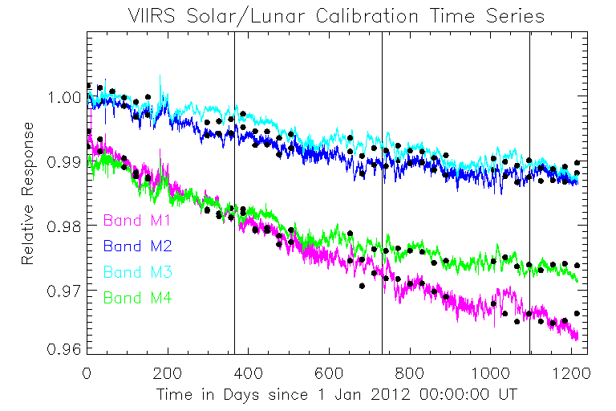
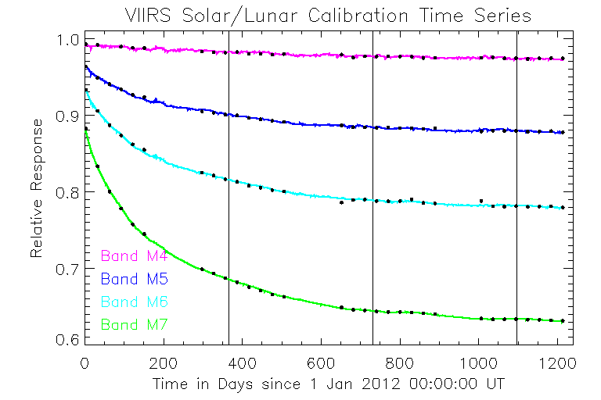
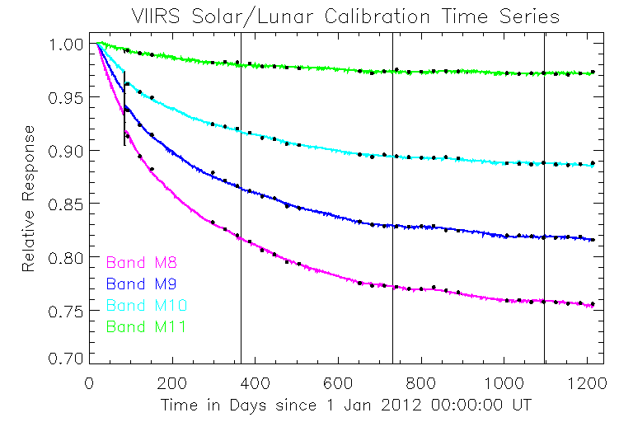
Solar / Lunar Calibration Comparisons
Single normalizations are applied to each band of the lunar time series
to account for calibration biases.
13
Notes:
Single point normalizations are applied to the lunar time series to account for calibration biases between the lunar and solar time series without altering any differences in temporal response.

Slide 14
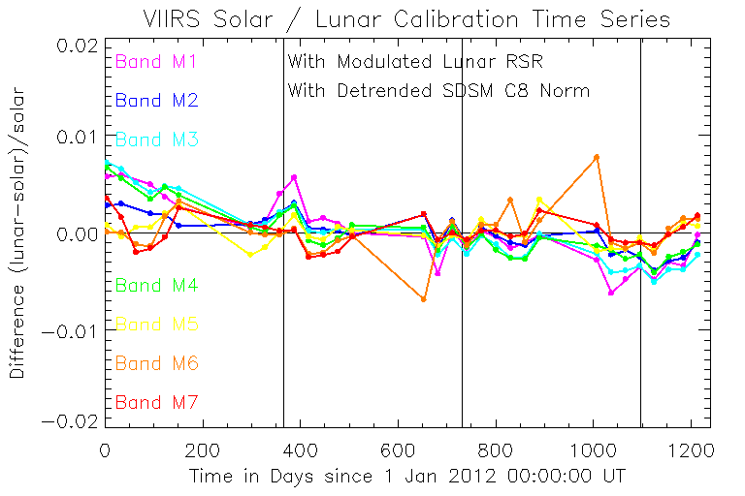
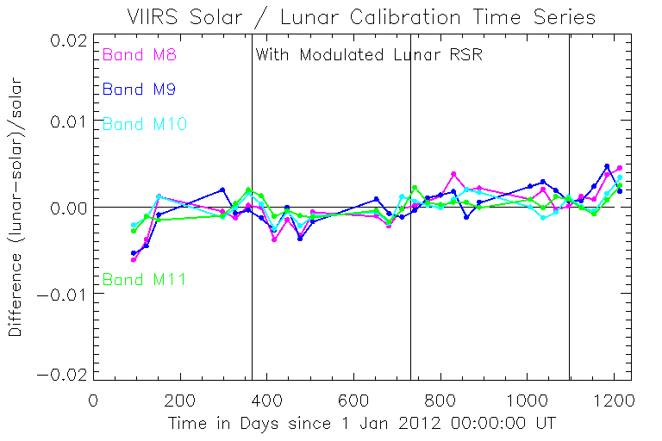
Initial Solar / Lunar Calibration Comparisons
Point-by-point calibration comparisons are made using closest solar observation to each lunar observation.
Slopes of the comparisons provide lunar-derived adjustments
for the solar calibration time series.
Notes:
Point-by-point calibration comparisons are made using the closest solar observation to each lunar observation.
The slides show the initial comparisons for bands M1-M7 and M8-M11. The slopes of the comparisons provide the lunar-derived adjustments for the solar time series.
.

Slide 15
Solar / Lunar Calibration Comparisons
Band | λ (nm) | Initial Slope | Revised Slope
M1 | 412 | -7.578E-06 | 4.012E-08
M2 | 445 | -4.138E-06 | 1.0644E-08
M3 | 488 | -8.048E-06 | 4.0553E-08
M4 | 555 | -6.115E-06 | 2.898E-08
M5 | 672 | -9.108E-07 | 6.347E-10
M6 | 746 | 6.485E-07 | 4.370E-11
M7 | 865 | -2.767E-07 | 1.325E-10
M8 | 1240 | 4.836E-06 | 1.633E-08
M9 | 1378 | 4.900E-06 | 1.672E-08
M10 | 1610 | 1.740E-06 | 1.880E-09
M11 | 2250 | 1.805E-06 | 2.506E-09
Units for the slopes are fractional change per day.
Notes:
The slopes for bands M1, M3, and M4 are statistically significant.

Slide 16
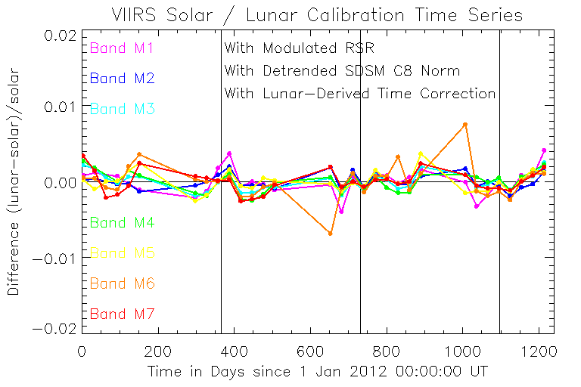
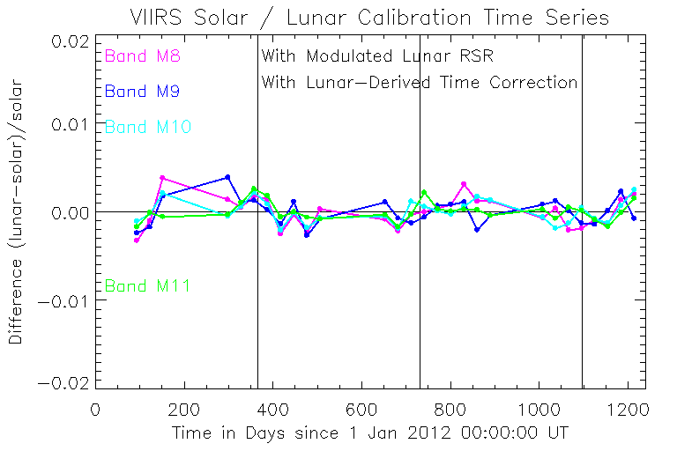
Final Solar / Lunar Calibration Comparisons
Comparisons with the lunar-derived adjustments applied
to the solar calibration time series.
Lunar time series provides long-term stability reference for each band
while solar time series provides per-detector, per-gain calibration.
Notes:
The slides show the comparisons with the lunar-derived adjustments applied.

Slide 17
Final Solar / Lunar Calibration Comparisons
Band | Solar Residuals | Lunar Residuals | Solar / Lunar Differences
M1 | 0.115 | 0.0955 | 0.166
M2 | 0.0941 | 0.0788 | 0.0973
M3 | 0.103 | 0.0645 | 0.116
M4 | 0.0989 | 0.0719 | 0.136
M5 | 0.130 | 0.0830 | 0.129
M6 | 0.131 | 0.230 | 0.230
M7 | 0.182 | 0.175 | 0.142
M8 | 0.160 | 0.208 | 0.170
M9 | 0.137 | 0.161 | 0.150
M10 | 0.0745 | 0.127 | 0.127
M11 | 0.0661 | 0.0988 | 0.105
RMS residuals and RMS differences are in percent.
VIIRS calibration stability is comparable to that achieved for heritage instruments (SeaWiFS, Aqua MODIS).

Slide 18
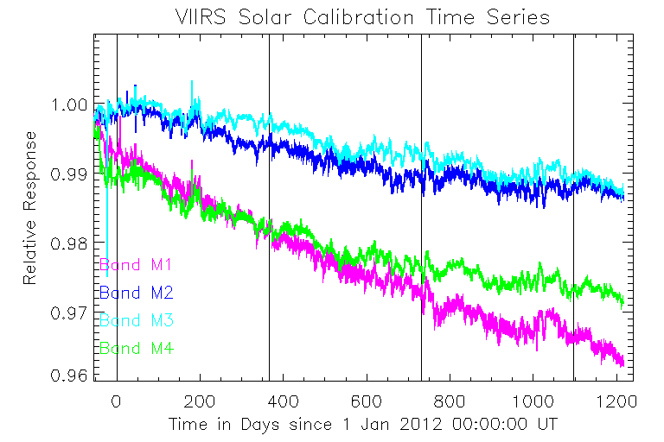
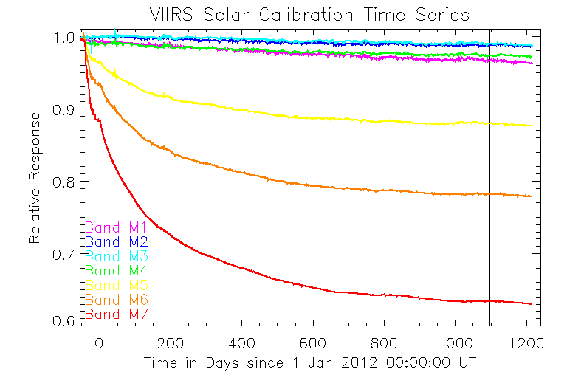
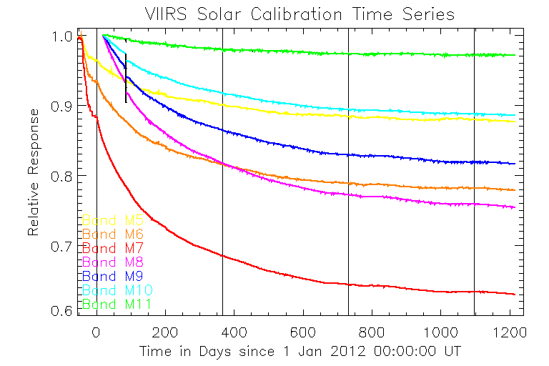
Lunar-Adjusted Solar Calibration Time Series
Vicarious calibration is applied to bands M1-M6.
Fits to lunar-adjusted solar calibration
time series for bands M1-M7 provided the calibration used for Reprocessing 2014.0.
18

Slide 19
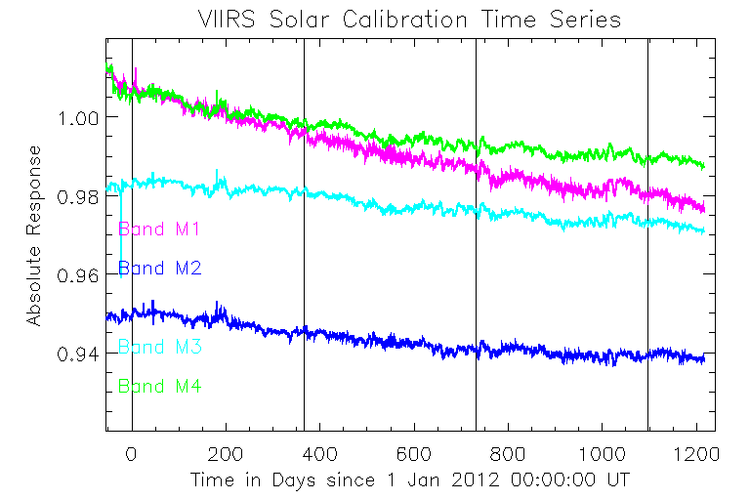
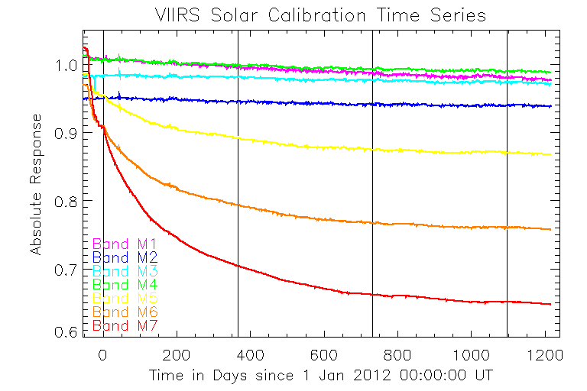
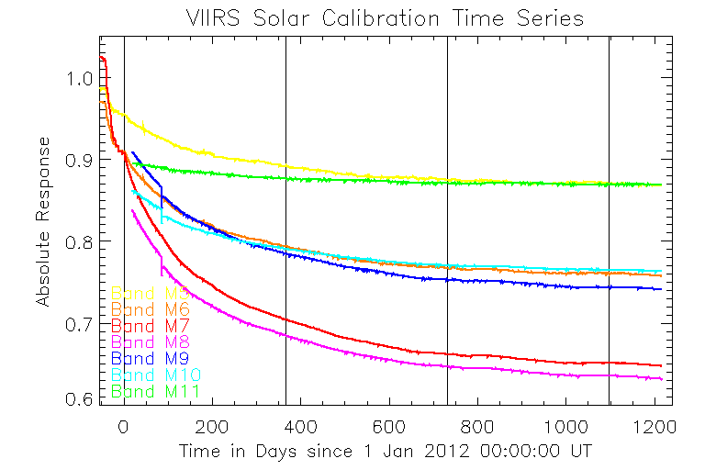
Absolute Solar Calibration Time Series
Responses for bands M8-M11 are consistent with
NIR Degradation Anomaly.
Fits to lunar-adjusted SWIR band solar calibration time series are under evaluation by OBPG for alternate atmospheric correction.
19
Notes:
This is the first OBPG effort at absolutely calibrating the solar time series. The resulting F-factor lookup table is now being evaluated for producing the standard ocean color data products and for implementation of a SWIR-band atmospheric correction.
Band M8 has a lower response than band M7. The responses of bands M9 and M10 are comparable to the response of band M6. The response of band M11 is comparable to the response of band M5. These SWIR band absolutely calibrated responses are consistent with the VIIRS Near-Infrared Degradation Anomaly.

Slide 20
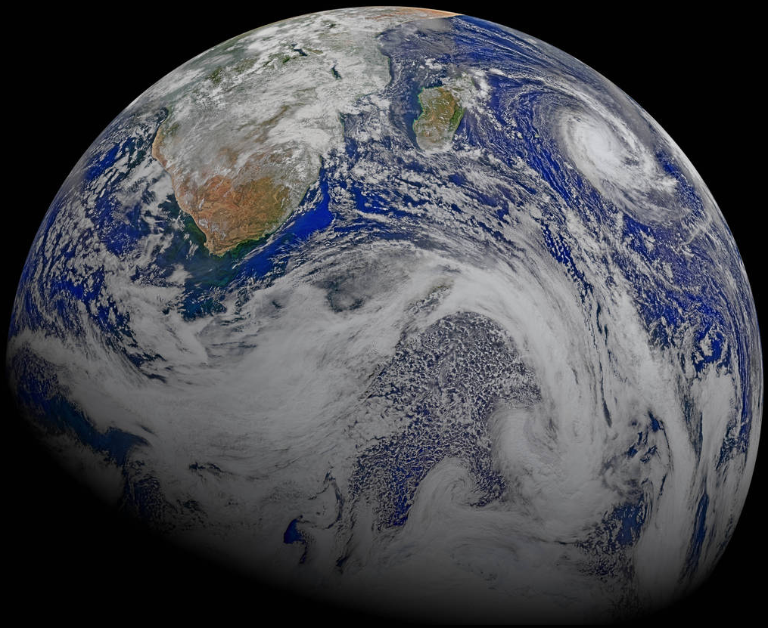
Calibration Validation:
Ocean Color Data Reprocessing 2014.0
Earth Day 2015
Image courtesy of
Norman Kuring,
NASA OBPG

Slide 21
Improved Calibration Yields
Improved Chlorophyll Retrievals
Reprocessing 2013.1
Reprocessing 2014.0
Calibration includes detector relative corrections
to reduce image striping artifacts.
Notes:
Reprocessing 2014.0 yields better chlorophyll retrievals due to the improved calibration of the VNIR bands and yields scenes with reduced striping artifacts.

Slide 22
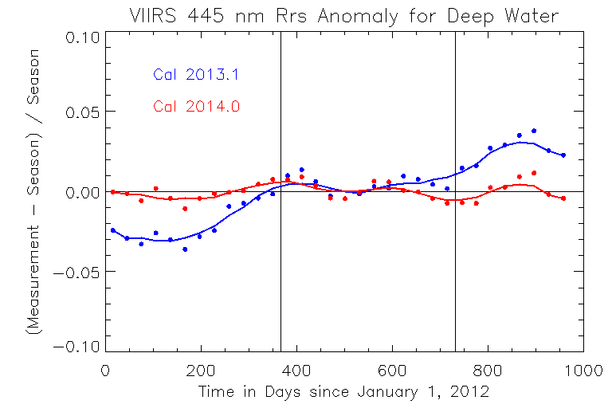
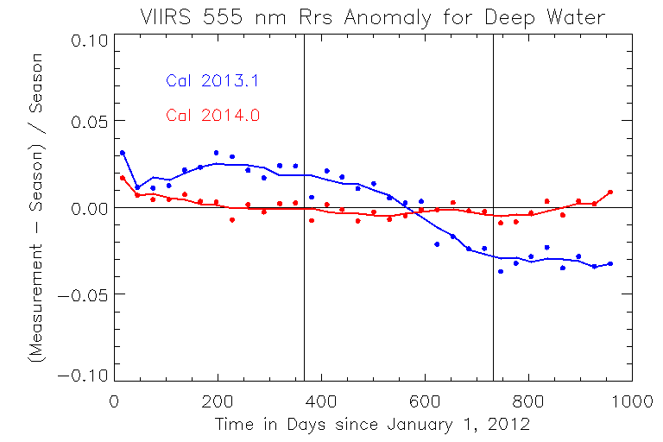
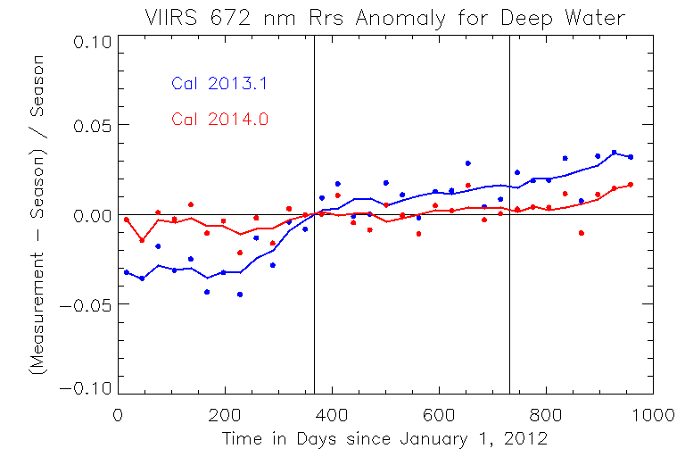
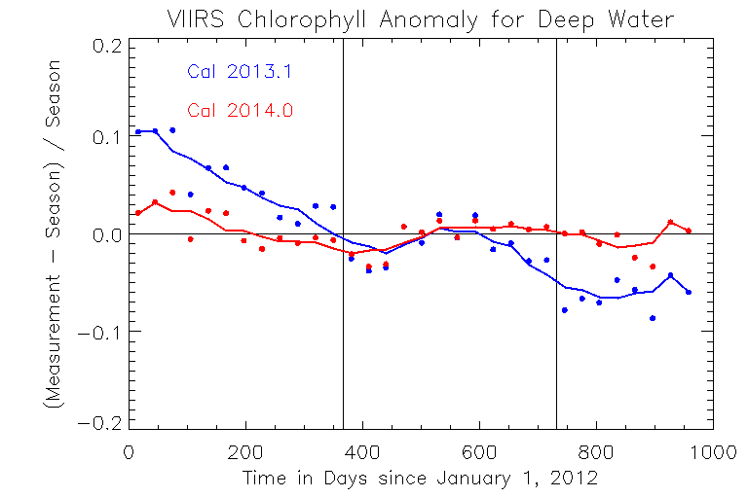
Improved VIIRS Ocean Product Temporal Stability
Global Mean Deep-Water Anomaly Trends
Rrs(443)
Rrs(555)
R2013.1 (old)
R2014.0 (new)
Monthly - Seasonal
Monthly - Seasonal
R2014.0 (new)
R2013.1 (old)
Rrs(671)
Chlorophyll
R2013.1 (old)
R2014.0 (new)
Monthly - Seasonal
Monthly - Seasonal
R2014.0 (new)
R2013.1 (old)
22
Days Since 1 January 2012
Days Since 1 January 2012

Slide 23
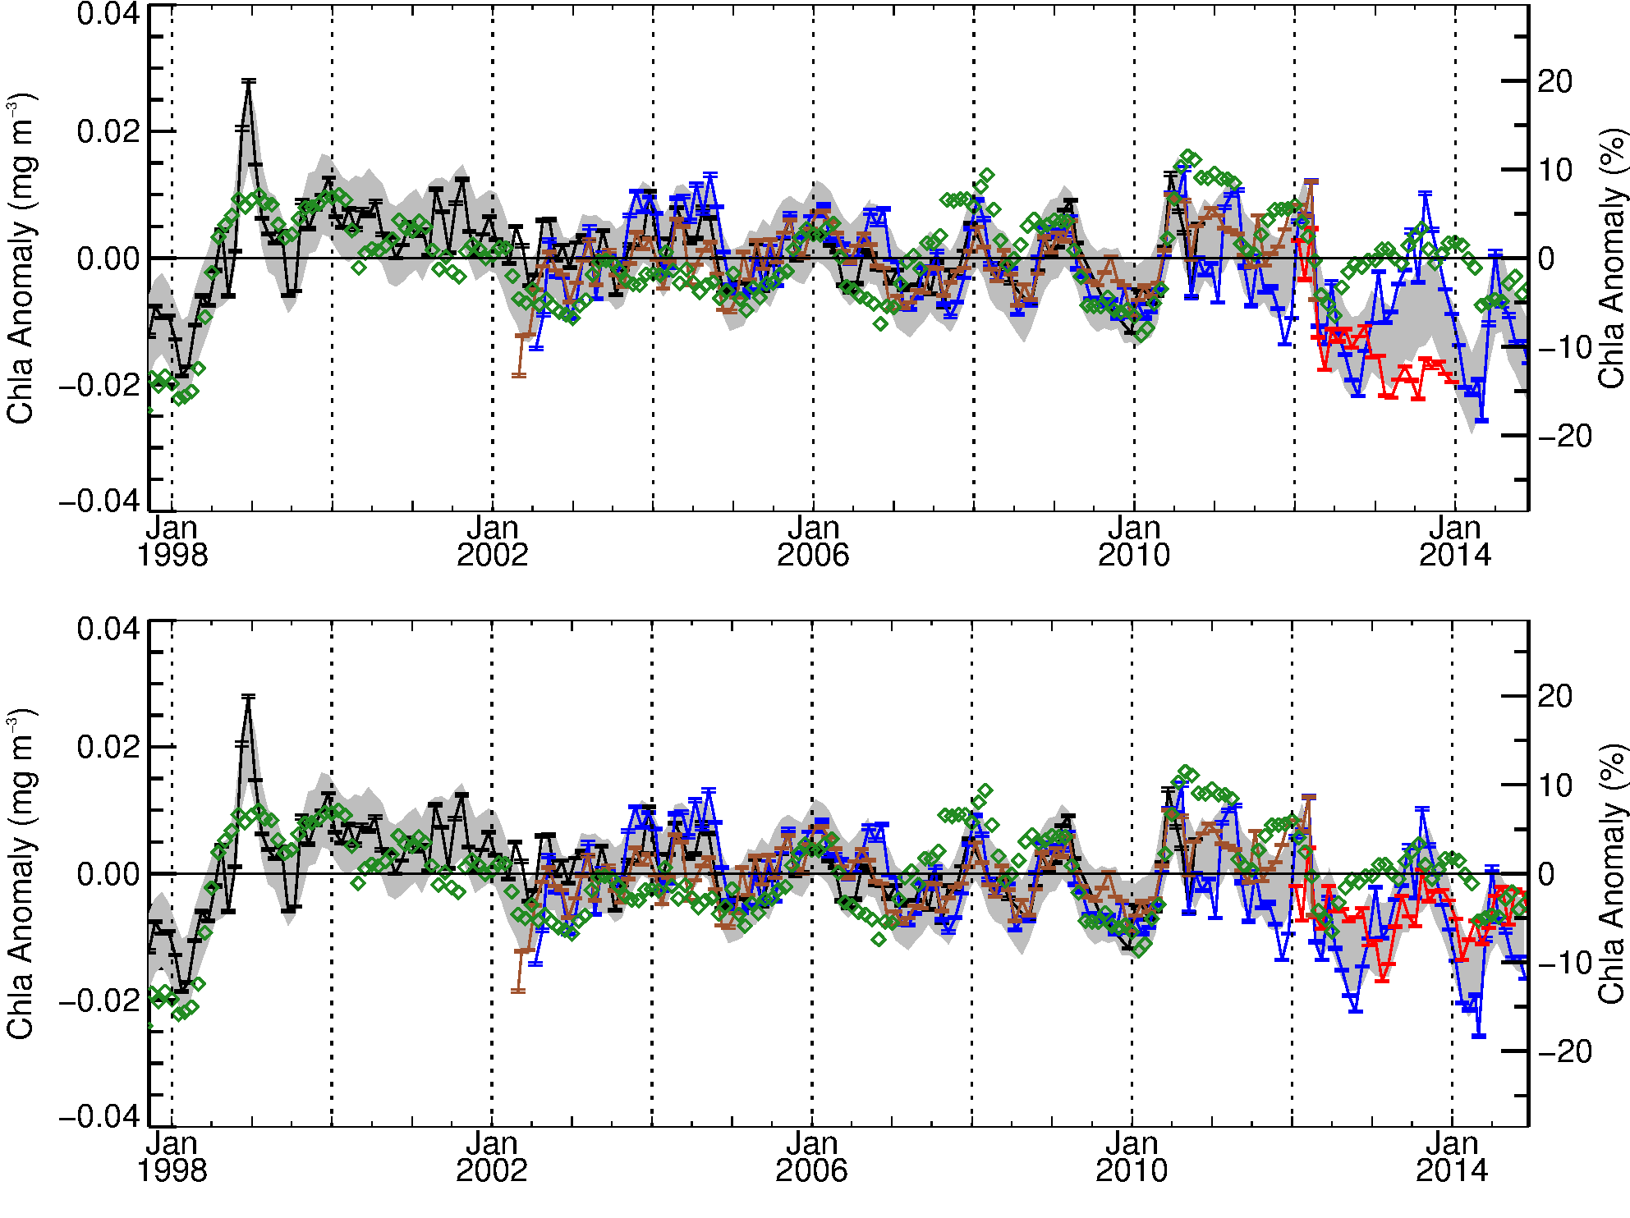
Global Mid-Latitude (+/- 40°) Chlorophyll Anomaly showing improved agreement of VIIRS with MODISA, MEI, and historical norms after R2014.0 reprocessing
Multivariate Enso Index (MEI)
VIIRS R2013.1
SeaWiFS
MERIS
MODISA
NASA VIIRS
calibration issue
resolved
Multivariate Enso Index (MEI)
VIIRS R2014.0
SeaWiFS
MERIS
MODISA
NASA VIIRS
Following Franz, B.A., D.A. Siegel, M.J. Behrenfeld, P.J. Werdell (2015). Global ocean phytoplankton [in State of the Climate in 2014]. Bulletin of the American Meteorological Society, submitted.
Notes:
As of Reprocessing 2014.0, NASA VIIRS ocean color products have sufficient stability and quality to be incorporated into global trend studies.

Slide 24
OBPG VIIRS On-Orbit Calibration Summary
Significant elements of lunar calibration methodology include:
Use of modulated RSRs in ROLO model for lunar geometry corrections.
Application of empirical sub-spacecraft and sub-solar point libration corrections to VIIRS/ROLO model comparisons.
Significant elements of solar calibration methodology include:
Use of detrended SDSM channel 8 time series to normalize H-factors.
Interpolation of H-factors to time basis of F-factors, allowing point-by-point correction of F-factors for diffuser BRDF degradation.
Derivation of absolute calibration of F-factors from the solar diffuser measurements, making SWIR bands useable for ocean color retrievals.
Solar / lunar calibration comparisons results:
Slopes provide lunar-derived adjustments to the solar calibration time series and resulting F-factor LUTs.
VIIRS calibration stability comparable to that achieved for heritage instruments (SeaWiFS, Aqua MODIS).
VIIRS ocean color data quality is sufficient for global trend studies.
Notes:
The radiometric stability of the VIIRS on-orbit calibration is commensurate with the stability achieved for SeaWiFS and Aqua MODIS.

Slide 25
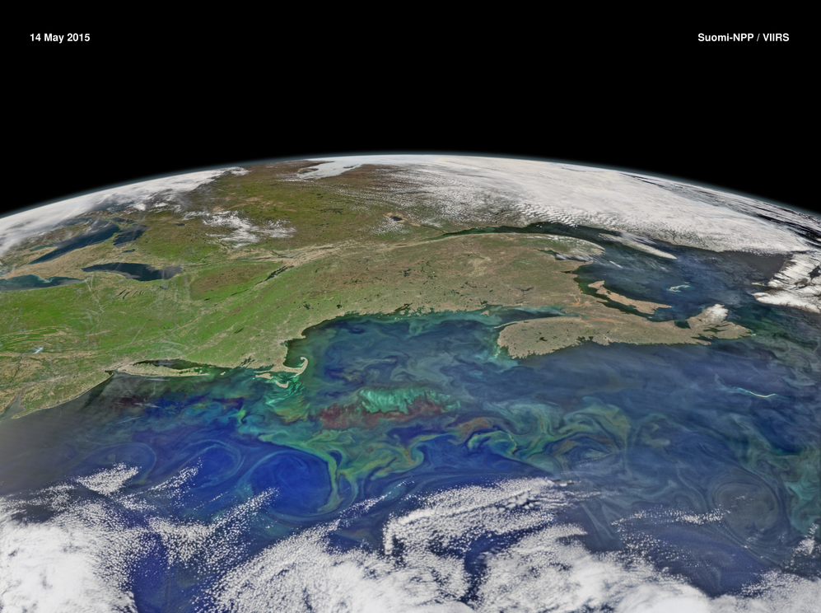
Thank You

Slide 26
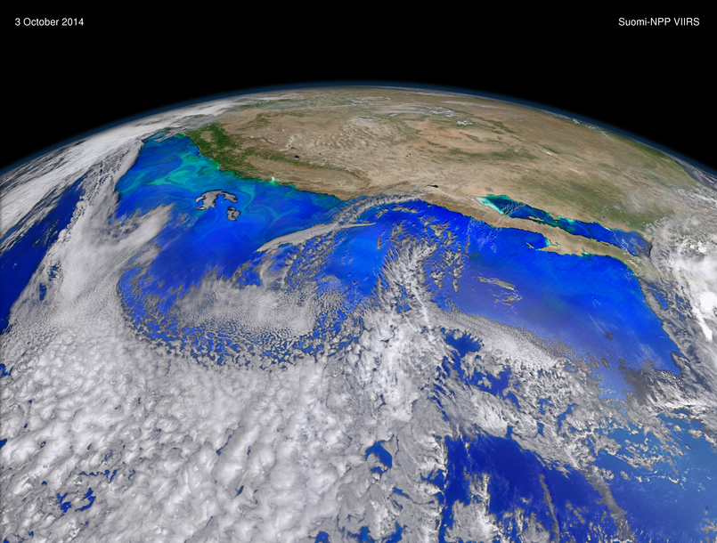
Thank You

Slide 27
Backup Slides

Slide 28
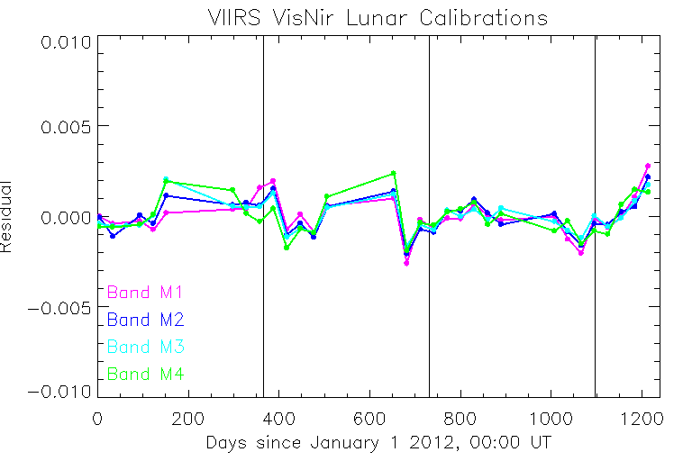
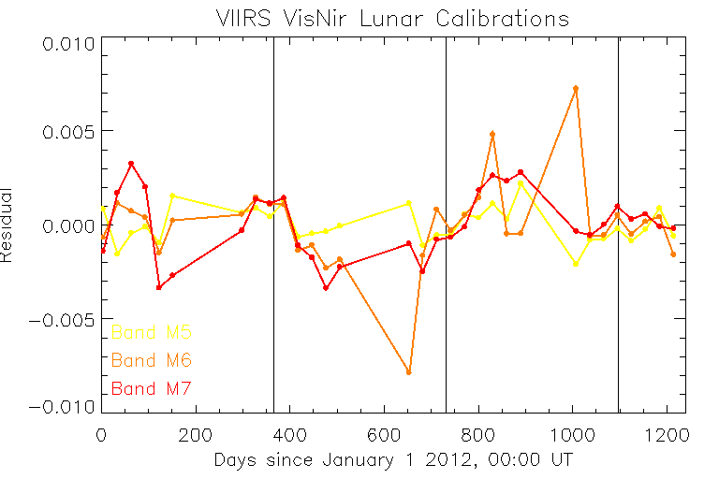
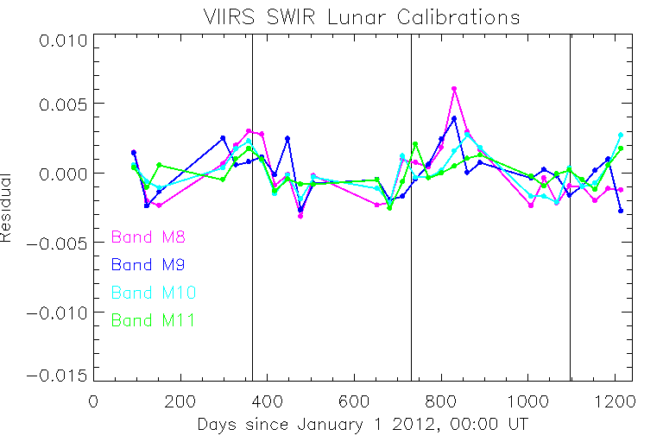
Lunar Calibration Fit Residuals
Linear
Sub-Spacecraft Libration Angle
Fits
Notes:
Residuals of fits to the lunar data which incorporate sub-spacecraft libration point effects alone are large in magnitude than residuals for fits which incorporate both sub-spacecraft and sub-solar libration effects. The su

