Slide 1
Effects of cloud adjacency on TOA radiance and ocean color products: A statistical assessment
Lian Feng and Chuanmin Hu
University of South Florida
NASA MODIS/VIIRS Science Team Meeting
May 18 – 22, 2015, Silver Spring, MD

Slide 2
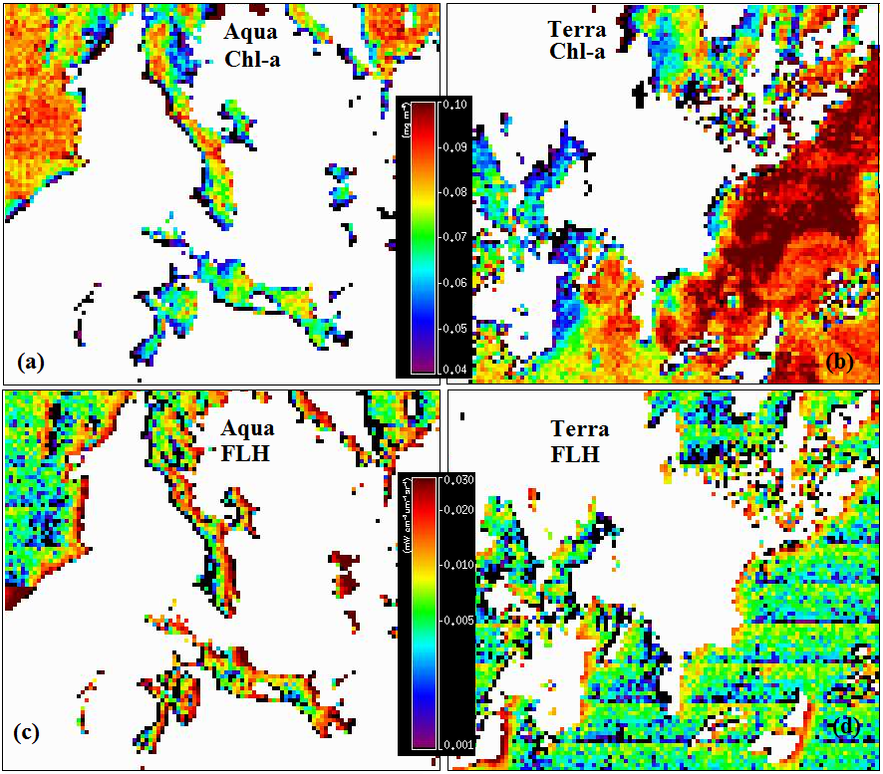
Problem and Motivation
Cloud effects on Chl-a and FLH
Notes:
While Chl-a show relatively low values around the cloud edge for both sensors (a and c), considerably higher normalized Florescence Line Height (nFLH) are observed in western of cloud for MODISA and eastern of cloud for MODIST respectively

Slide 3
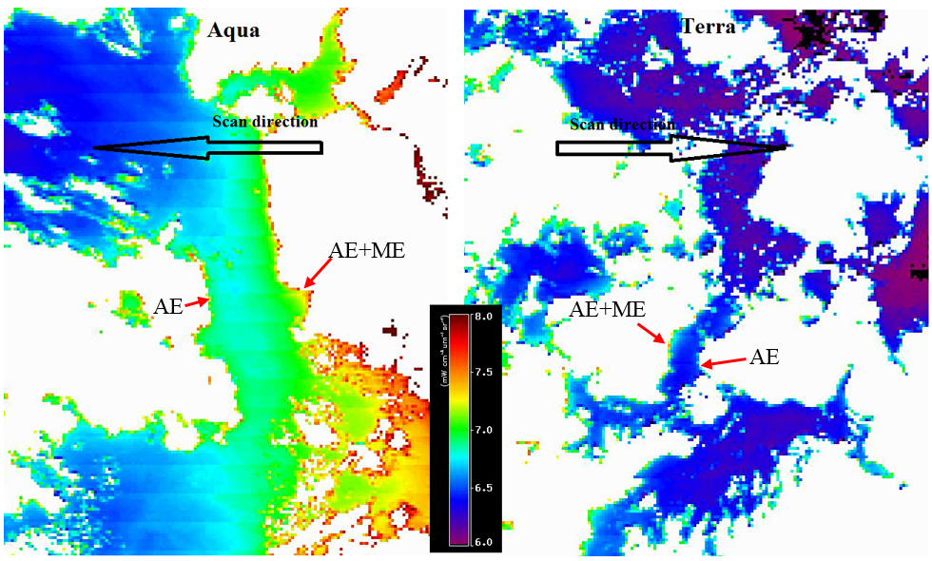
Problem and Motivation
AE and ME in L_{t,443}
Notes:
An example to show the combined effects of AE and ME in L_{t,443} in the up scan discretion of MODISA and MODIST (west of cloud for MODISA and east of cloud for MODIST), where the AE are also shown in the down scan direction.

Slide 4
Objectives
Understand the spatial scale of cloud adjacency effects in a statistical meaningful approach and evaluate the impacts on the TOA radiance and ocean color products;
Determine how to minimize such effects on the ocean color products and recover some of the data

Slide 5
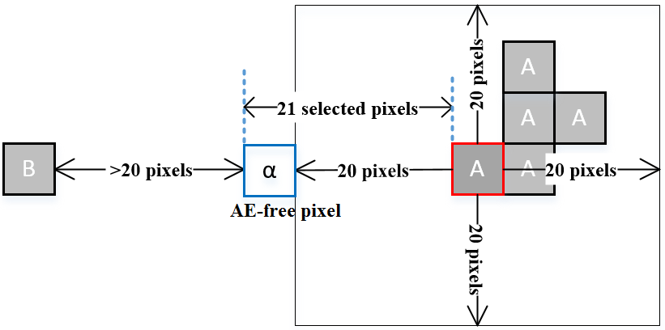
Methodology
Γ_{α} and Γ_{i} are the values of TOA or ocean color products for pixel “α” and the other 20 selected. pixels“α” is the AE-free pixel, and “A” and “B” represent different cloud patches.

Slide 6
Results ME-free direction
MODISA
MODIST

Slide 7
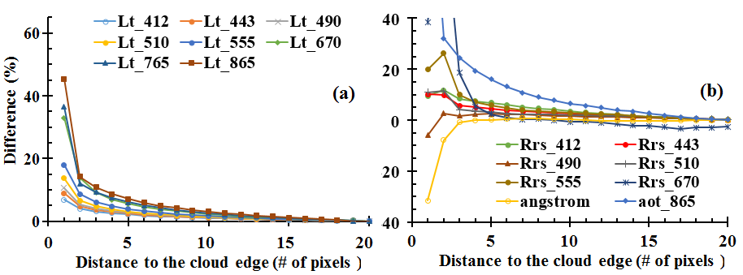
Results ME-free direction
SeaWiFS

Slide 8
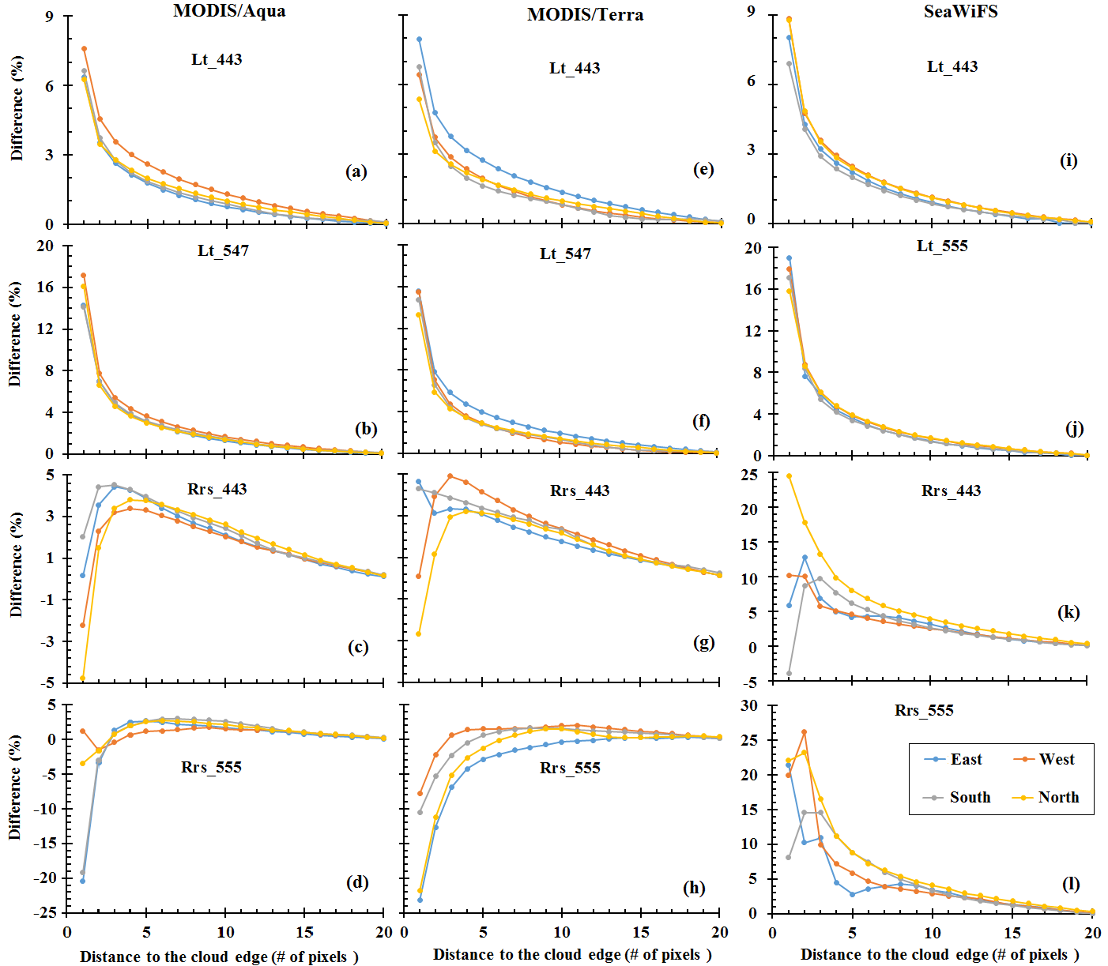
Results: different directions
Notes:
ME effects are clearly revealed in the up scan directions in two MODIS sensors

Slide 9
Results: Cloud effects in Chl-a

Slide 10
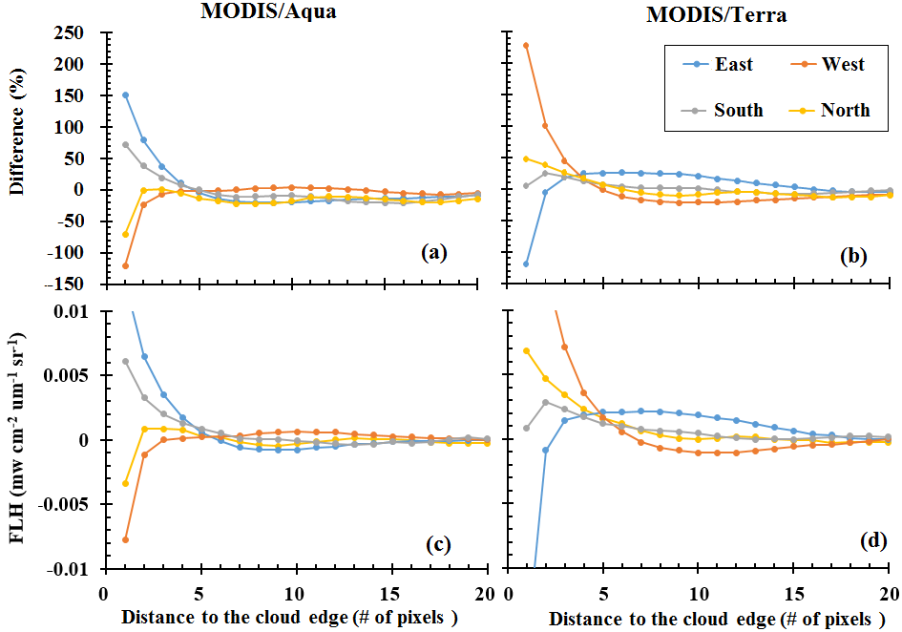
Results: Cloud effects in FLH

Slide 11
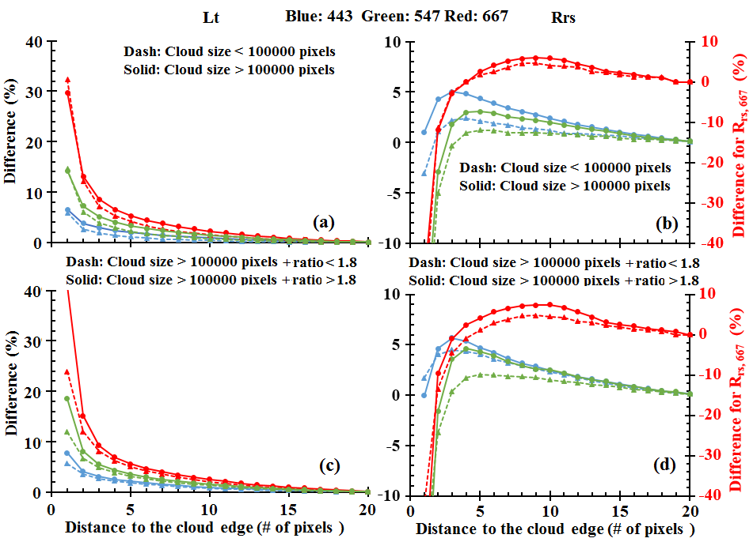
Results: influence of cloud size and albedo
Notes:
The data for different size groups (>100000 and <100000 pixels) are shown in a & b. The albedo ratio is calculated as the Lt, 645 at the cloud edge pixel divided by that of the AE-free pixel, a threshold of 1.8 was used as the to separate the two groups (c & d), while the cloud size of these two groups were of the same level (>100000).

Slide 12
Uncertainties and limitations
Changes of up to 2-3% for Chl-a within 20 pixels (or 20 km at nadir).
The spatial variability of nFLH cloud reach to ~15% in relative difference or 0.0006 mw⁻² µm⁻¹ sr⁻¹ in absolute value
Notes:
Chl-a, (b) nFLH in relative differences and, (c) nFLH in absolute differences.
The results based on real clouds are also plotted for comparison (solid line)
results from clear water show changes of up to 2-3% for Chl-a within 20 pixels (or 20 km at nadir). And the spatial variability of nFLH cloud reach to ~15% in relative difference or 0.0006 mw⁻² µm⁻¹ sr⁻¹ in absolute value. The background changes may have two sources: 1) real changes of the ocean and 2) speckle noise of the satellite products.

Slide 13
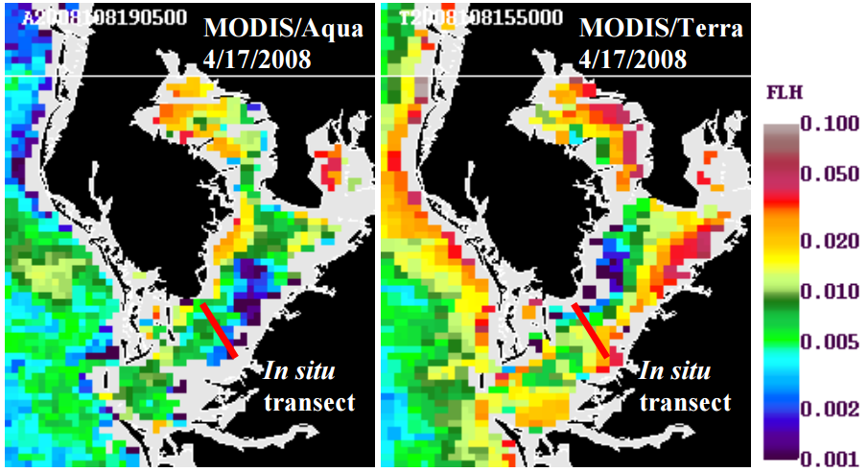
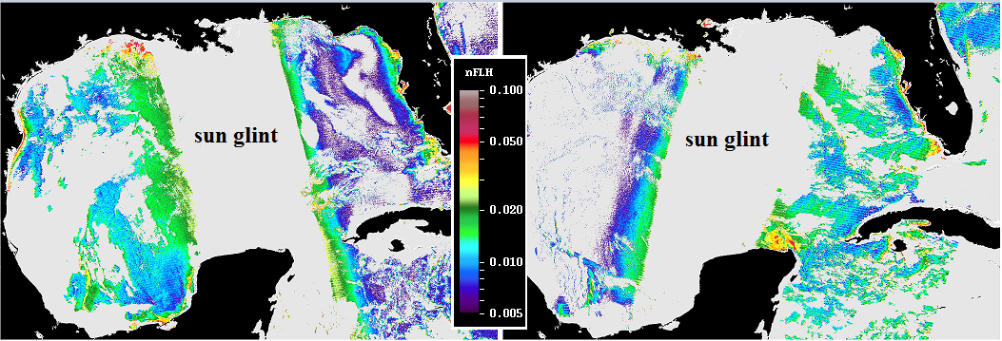
Effects from land and sun-glint

Slide 14
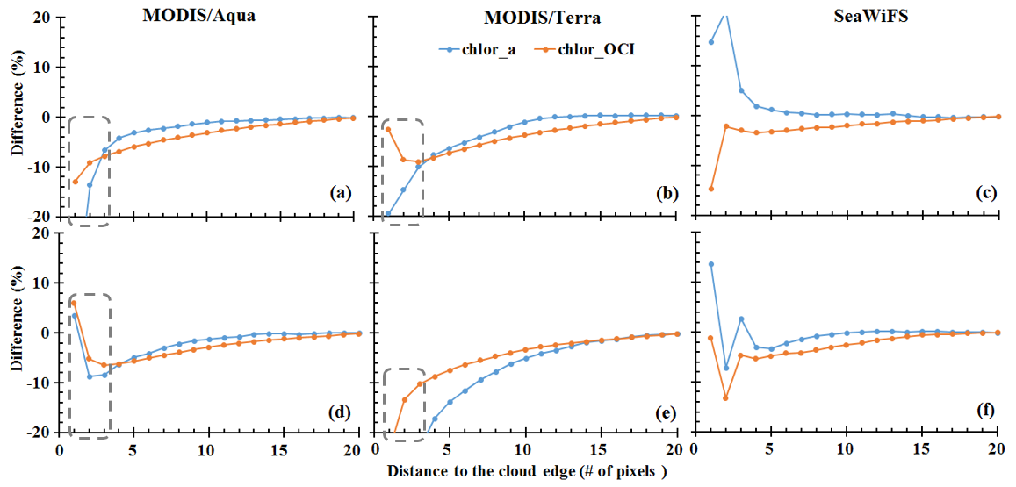
Implications for Chl-a data recovery
Comparison of the cloud AE between Chl_{ocx} and Chl_{OCI} in the ME-free (a, b and c) and ME-affected (d, e and f) directions
Notes:
The AE of Chl_{OCI} are much lower than Chl_{OCX} for the 2-3 near cloud edge pixels for the two MODIS sensors, and the effects for the second pixel decreases to less than 10%. The pixels within the gray box are flagged as low quality data with the default masking scheme and band-ratio Chl-a algorithm.

Slide 15
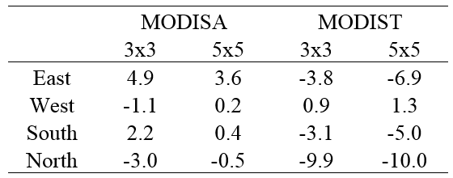
Implications for Chl-a data recovery
?
The SeaDAS operational masking window (7x5) could be changed to 3x3 with the new Chl-a algorithm, without losing confidence for the remaining data
Notes:
Table lists the differences (in %) of AE between using two smaller window sizes (3x3 and 5x5) with Chl_{OCI} and the current operational mask method (eg. 5x7 window size) with Chl_{OCX}
The values are estimated between the Chl_{OCI} AE and Chl_{OCX} AE (both in absolute values) of the pixels just outside of their own masks. Specifically, the AE of Chl_{OCX} in the calculations are fixed at the fourth pixel of along scan direction and the third pixel of along track direction respectively. In contrast, the AE of Chl_{OCI} selected the second (third) pixel for all the directions when window size of 3x3 (5x5) was used.

Slide 16
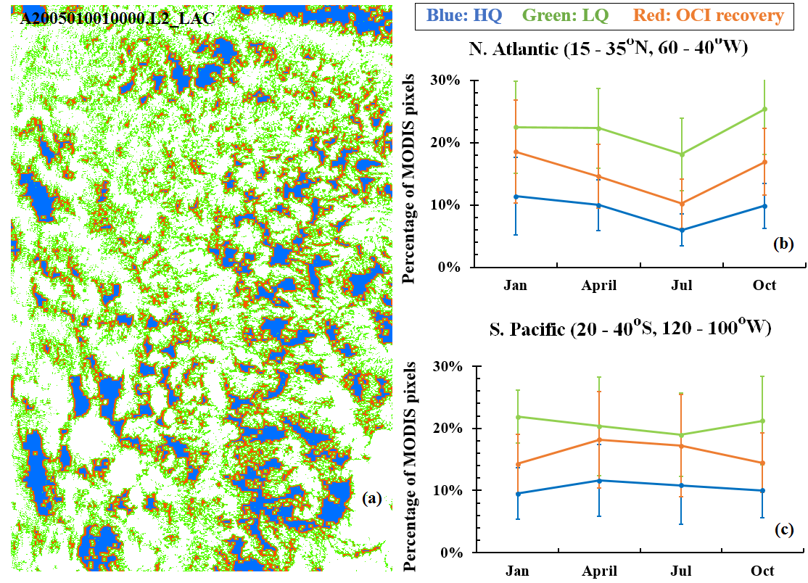
Implications for Chl-a data recovery
Notes:
a large amount of data (>40%) have been recovered for any given months of the two regions.

Slide 17
Data recovery around cloud edges?
Notes:
17

Slide 18
Conclusions
Cloud-adjacent AEs and MEs of two MODIS instruments and SeaWiFS have been estimated using satellite measurements;
A smaller masking window size (3x3) together with the OCI Chl-a algorithm can result in an increase of > 40% in Chl-a data coverage without losing data quality
Further validations of the above data recovering approach using field observations are required

