Slide 1
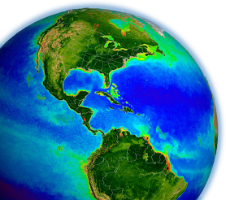
MODIS & VIIRS
Ocean Science Team Break-out
MODIS Science Team Meeting
19-22 May 2015, Silver Spring, MD

Slide 2
Ocean Break-out Agenda
May 20

Slide 3
Ocean Break-out Agenda
May 21

Slide 4
A.28 The Science of Terra and Aqua
A.46 Terra and Aqua – Algorithms – Existing Data Products
A.29 Suomi National Polar-orbiting Partnership Science Team
MODIS and VIIRS Ocean Science Team
26 Selected Proposals
16 Unique PIs
Notes:
6 of 9 VIIRS PIs also MODIS PIs

Slide 5
Organization
Program Scientist (S-NPP & MODIS, etc., etc.)
Paula Bontempi
Science Team Leaders
Michael King (MODIS)
Jim Gleason (VIIRS, S-NPP Project Scientist)
Science Team Ocean Discipline Leaders
Bryan Franz (MODIS)
Carlos Del Castillo (VIIRS)
Ocean SIPS (MODIS & VIIRS, Implementation and Processing)
Gene Feldman & Bryan Franz
DAAC (MODIS & VIIRS, Archive and Distribution)
OB.DAAC (Gene Feldman & Sean Bailey, Ocean Color)
PO.DAAC (Robert Toaz & Ed Armstrong, SST)

Slide 6
Product Development and Documentation

Slide 7
Standard, Evaluation, and Test Products
a standard product is one that the SIPS is committed to maintain, and the DAAC is committed to archive and distribute, at the ultimate discretion of Program Management
an evaluation product is one that the SIPS/DAAC may produce and distribute, if resources allow, to support community assessment of a new product or alternative product algorithm
a test product is one that the SIPS may produce to support the algorithm PI in implementation verification and product testing
in practice, OC standard products are made at Level-2 and Level-3, while
eval products are made only at Level-3 (usually from Level-3 Rrs dailies).

Slide 8
OC Implementation
NASA Standard Processing Code
ancillary data
sensor-specific tables:
Rayleigh, aerosol, etc.
SeaWiFS L1A
MODISA L1B
MODIST L1B
OCTS L1A
MOS L1B
OSMI L1A
CZCS L1A
MERIS L1B
OCM-1 L1B
OCM-2 L1B
VIIRS L1A
GOCI L1B
OLI L1T
observed
radiances
L2GEN
Level-1 to Level-2
(common algorithms)
Δ
in situ water-leaving
radiances (MOBY)
water-leaving
reflectances &
derived prods
predicted
at-sensor
radiances
Level-2 Scene
vicarious calibration
gain factors
Level-3 Global
Product
Level-2 to Level-3
Notes:
we do not typically run independent code, we integrate algorithms into a standard code

Slide 9
SST Implementation
NASA Standard Processing Code
ancillary data
sensor-specific tables:
radiance/temperature
MODISA L1B
MODIST L1B
VIIRS L1A
observed
radiances
L2GEN
Level-1 to Level-2
(common algorithms)
Δ
brightness temps &
derived SST prods
Level-2 Scene
Level-3 Global
Product
Level-2 to Level-3
Notes:
we do not typically run independent code, we integrate algorithms into a standard code

Slide 10
Product Documentation
MODIS has historically required that every standard product have associated with it an Algorithm Theoretical Basis Document (ATBD)
The original MODIS ATBDs are extremely out of date and in many cases they are not relevant to current standard products
This is largely due to the fact that the MODIS processing was awarded to the NASA OBPG in 2004 with the mandate to adopt the SeaWiFS heritage processing, as documented in SeaWiFS TMs
It is also the case that the ocean algorithms are predominantly sensor-independent, evolved from broad community contributions
To satisfy NASA Program Management and better serve the research community, we need to establish a new set of product documentation for the current standard product suite of MODIS & VIIRS, and maintain that level of documentation going forward
To that end, Ocean SIPS is developing a set of online documents that can be easily updated and will include dynamic links to ensure that implementation and validation information remains current

Slide 11
Product and Algorithm Description Document standardized elements
Product Summary
defines what it is and what it’s for
Algorithm Description
as detailed as necessary to ensure full traceability to algorithm basis and heritage (e.g., links to published literature)
if applicable to multiple sensors, include any sensor-specific modifications required (e.g., adjustments for band passes)
algorithm failure conditions and associated product flags
Implementation
how is the product distributed (product suite, file-types, encoding)
direct links to source code and/or software flow charts

Slide 12
Product and Algorithm Description Document standardized elements
Assessment
validation analyses (e.g., direct link to dynamic match-ups)
uncertainties
References
links to previous ATBD(s) or TM(s), if relevant
links to published literature (DOIs)
Product History
document version (date)
product change log

Slide 13
Product Description Documents

Slide 14
Algorithm Description

Slide 15
Implementation Details

Slide 16
Assessment

Slide 17
Product Lifecycle from concept to standard product
PI develops new algorithm or modification, demonstrates feasibility, perhaps publishes results.
If PI and Ocean Team Leader agree, PI works with SIPS to implement in NASA processing code and to develop a test plan for verification and large-scale testing.
If PI is satisfied with implementation tests, and SIPS confirms that required computing resources are available, evaluation products and documentation will be produced and distributed, and the algorithm will be incorporated into SeaDAS.
PI works with SIPS to develop or update the Product Description Document (to be hosted under “evaluation products”).
SIPS/DAAC begins production and distribution of product
PI performs assessment of results (validation, global dist., trends)
Before the next mission reprocessing opportunity, PI/SIPS/DAAC and Program Management review the performance evaluation, documentation, and appropriateness for standard production.

Slide 18
MODIS & VIIRS Ocean Processing Status

Slide 19
2014.0 Multi-Mission Ocean Reprocessing
Scope
OC from CZCS, OCTS, SeaWiFS, MERIS, MODIS(A/T), and VIIRS
SST from MODIS
Motivation
improve interoperability and sustainability of the product suite by adopting modern data formats, standards, and conventions
incorporate algorithm updates and advances from community and last MODIS Science Team developed since 2010 (last alg. update).
incorporate knowledge gained in instrument-specific radiometric calibration and updates to vicarious calibration
Status
OC from OCTS & VIIRS done, MODISA in progress
SST from MODISA and MODIST done (not yet released)
Notes:
tied to MODIS science team, new algorithm development
7 instruments

Slide 20
R2014.0 Changes to OC Standard Product Suite
Level-2 OC Product
Algorithm Changes
R_{rs}(λ)
Ångstrom
AOT
Chlorophyll a
K_{d}(490)
POC
PIC
CDOM_index
PAR
iPAR
nFLH
calibration updates, ancillary data updates, improved land/water masking, terrain height, other minor fixes
λ = 412, 443, 469, 488, 531, 547, 555, 645, 667, 678
new algorithm (Hu et al. 2012)
coefficient update
no change
updated algorithm and LUT
remove product (redundant with new IOP suite)
consolidated algorithm, minor fixes
MODIS-only, no change
MODIS-only, flagging changes (allow negatives)
12. IOPs
added suite of inherent optical property products (Werdell et al. 2013)

Slide 21
R2014.0 VIIRS OC Standard Product Suite
Level-2 OC Product
Algorithm Reference
R_{rs}(λ)
Ångstrom
AOT
Chlorophyll a
K_{d}(490)
POC
PIC
PAR
Spectral water-leaving reflectance and derived aerosol optical properties
λ = 410, 443, 486, 551, 671
Phytoplankton chlorophyll concentration
Marine diffuse attenuation at 490nm
Particulate organic carbon concentration
Particulate inorganic carbon concentration
Daily mean photosynthetically available radiation
12. IOPs
Suite of inherent optical property products (Werdell et al. 2013)

Slide 22
Expanded Product Suite - IOPs
proposed IOP product suite
a(λ) total absorption at all visible wavelengths
bb(λ) total backscatter at all visible wavelengths
adg(443) absorption due to phytoplankton at 443nm
Sdg exponential spectral slope for adg
bbp(443) particle backscattering at 443nm
Sbp power-law spectral slope for bbp
uncertainties uncertainties in adg, aph, bbp at 443nm
VIIRS λ = 410, 443, 486, 551, 671
MODIS λ = 412, 443, 469, 488, 531, 547, 555, 645, 667, 678

Slide 23
General Status of MODIS & VIIRS Ocean Color
MODISA
last full mission OC reprocessing in 2012 (current version 2013.1)
there are issues with the calibration stability in the VIS-NIR, especially after Jan 2014 (will be “improved” in 2014.0 reprocessing)

Slide 24
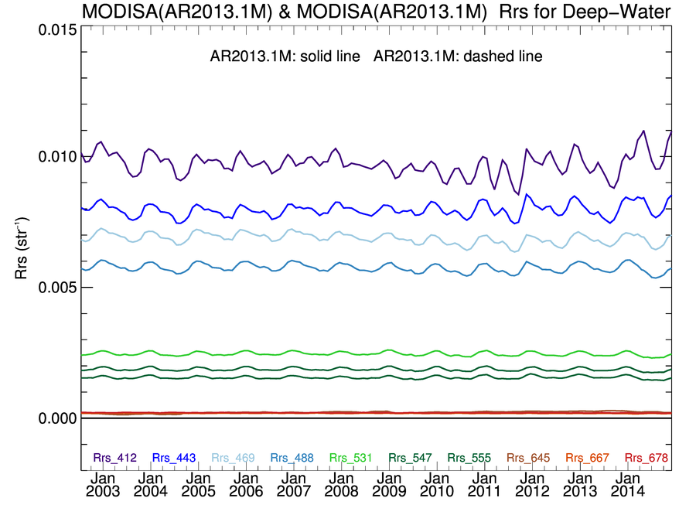
MODISA Rrs(λ) Deep-Water Time-Series
Processing Version R2013.1
increasing variability
412
443

Slide 25
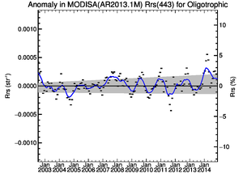
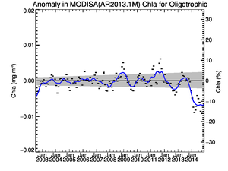
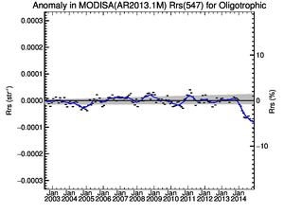
MODISA Clear-Water Rrs Anomaly Trends
Current Operational
R2013.1
Rrs(443)
Chlorophyll
Rrs(547)
2014 anomaly
“calibration issue”

Slide 26
General Status of MODIS & VIIRS Ocean Color
MODISA
last full mission OC reprocessing in 2012 (current version 2013.1)
there are issues with the calibration stability in the VIS-NIR, especially after Jan 2014 (will be “improved” in 2014.0 reprocessing)
MODIST
last full mission OC reprocessing in 2011 (current version 2010.0)
calibration of MODIST requires stable MODISA/SeaWiFS for cross-cal
effort pending finalization of MODISA and SeaWiFS reprocessing
VIIRS
2014.0 OC reprocessing completed (previous version 2013.1)
calibration stability and data quality looks very good, following extensive calibration efforts
redesign of VIIRS Level-1A/B and geolocation process and format in progress, with anticipated regeneration of all VIIRS granules late 2015

Slide 27
General Status of MODIS & VIIRS SST
MODISA & MODIST
full mission SST reprocessing recently completed (not yet released)
incorporates latest algorithm coefficient updates and quality flag updates from algorithm PI, and Collection 6 calibration
VIIRS
SST processing capability using MODIS heritage algorithms implemented, but pending final refinement of algorithm coefficients
algorithm refinement is pending operational launch of Level-1A redesign, which is needed to support efficient regional extraction and specialized processing for in situ buoy match-ups

Slide 28
Instruments and Calibration
SeaWiFS | Fred Patt
MODIS | Gerhard Meister
VIIRS | Gene Eplee

Slide 29
Product Quality

Slide 30
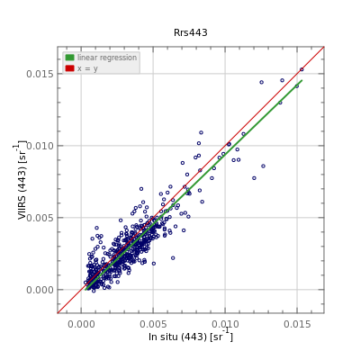
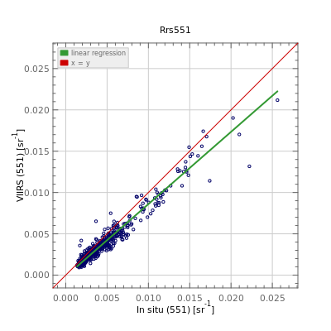
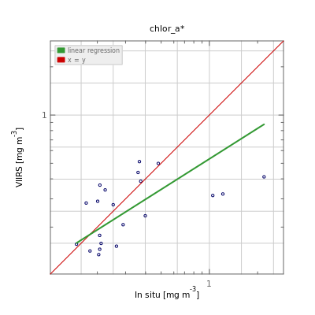
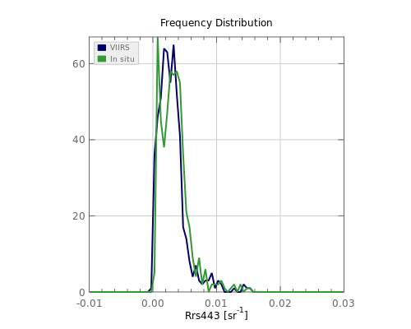
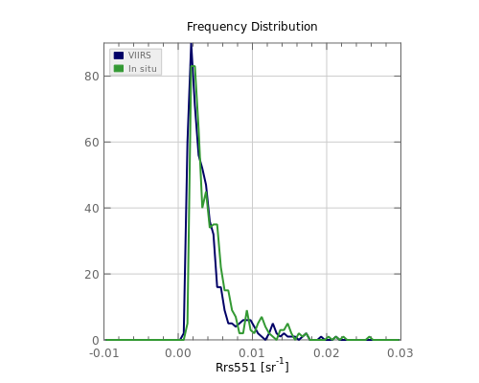
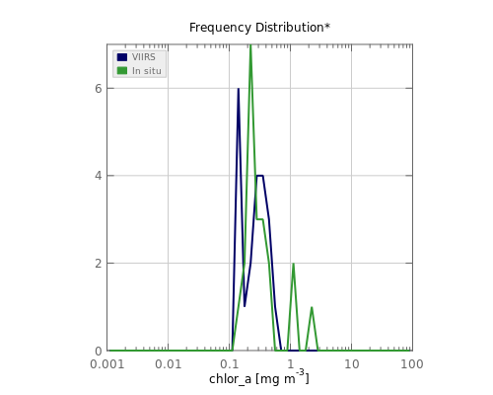
VIIRS R2014.0 In Situ Validation
Rrs(443)
Rrs(547)
Chl_{a}

Slide 31
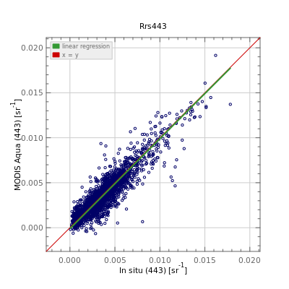
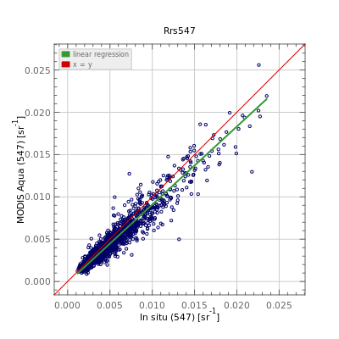
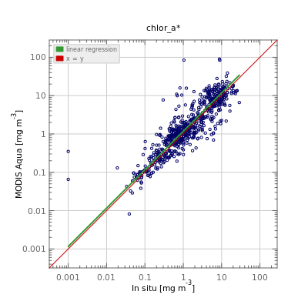
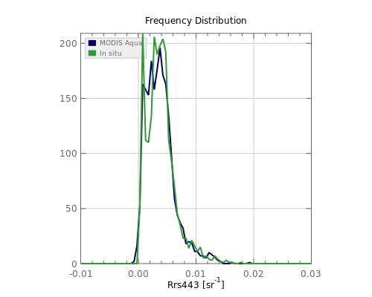
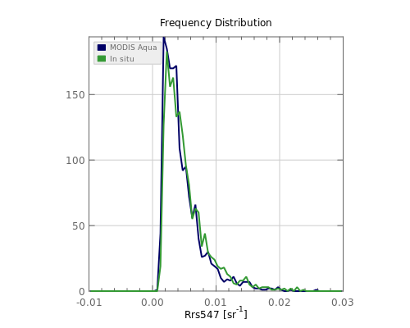
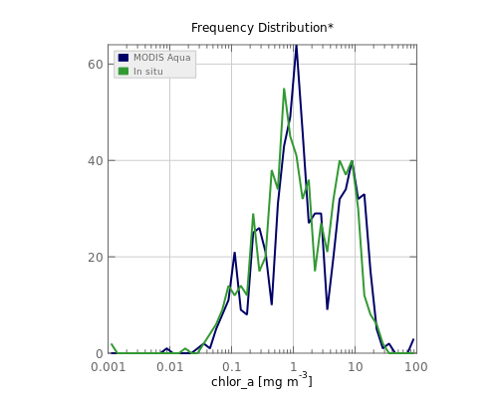
MODISA R2013.1 In Situ Validation
Rrs(443)
Rrs(547)
Chl_{a}

Slide 32
MODISA Rrs(λ) Deep-Water Time-Series
monthly mean deep-water Rrs
Processing Version R2013.1
increasing variability
412
443

Slide 33
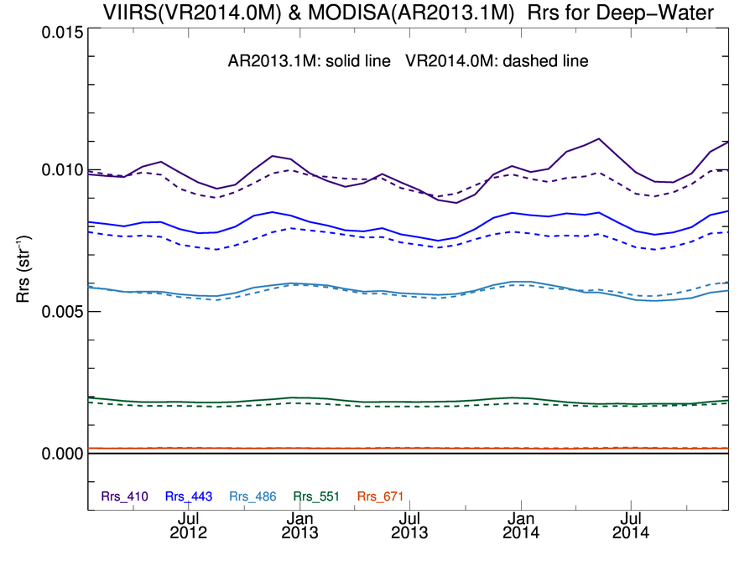
VIIRS R2014.0 & MODISA R2013.1 monthly mean deep-water Rrs
VIIRS
MODISA

Slide 34
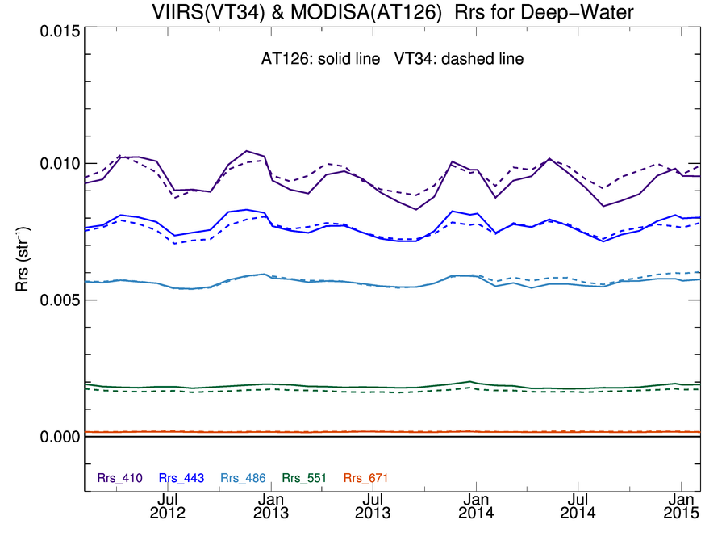
MODISA showing agreement with R2014.0 VIIRS Rrs(λ) Deep-Water Time-Series
MODISA & VIIRS R2014.0 Test Results
4-day means (not monthly)
VIIRS
412
443
MODISA
MODIS
VIIRS
Ratio

Slide 35
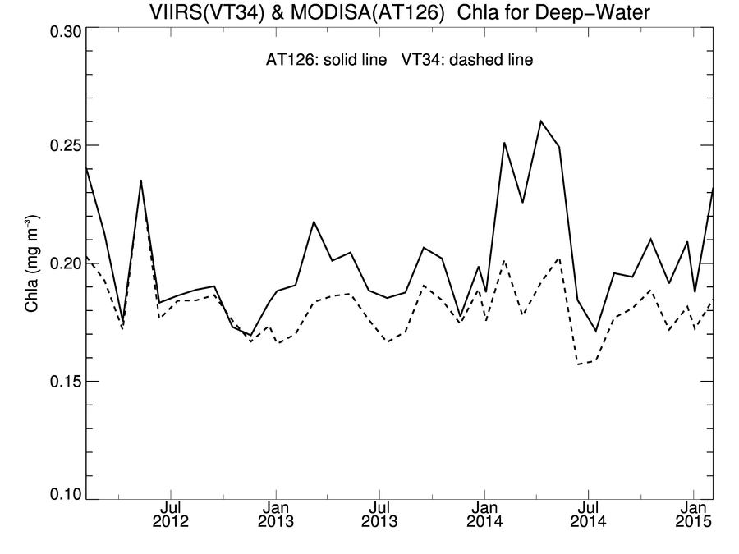
MODISA showing agreement with R2014.0 VIIRS Chlorophyll (OCI) Deep-Water Time-Series
MODISA & VIIRS R2014.0 Test Results
4-day means (not monthly)
VIIRS
MODISA
 | Mean | Stdv
MODISA | 0.20 | 0.023 | mg m⁻³
VIIRS | 0.18 | 0.018 | mg m⁻³
VIIRS/MODISA | 0.91 | 0.07

Slide 36
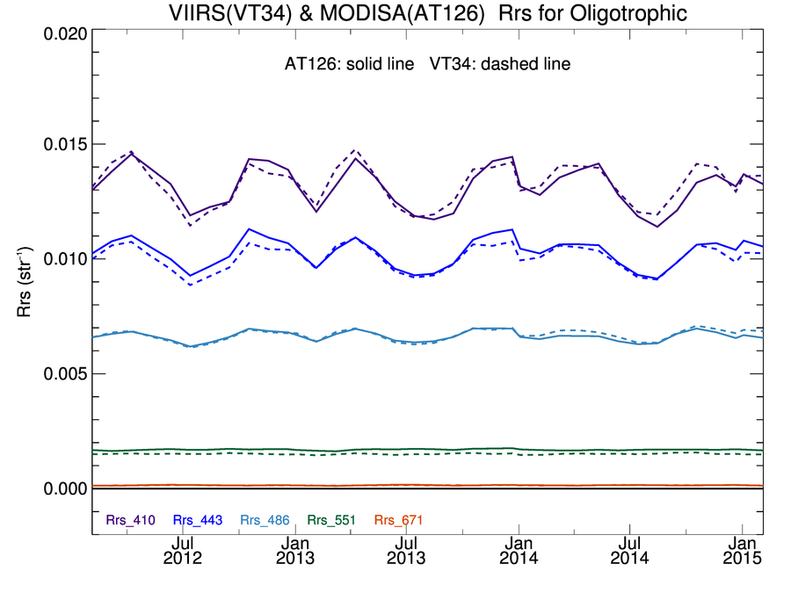
MODISA & VIIRS Rrs(λ) Clear-Water Time-Series showing “good” agreement
MODISA Processing Test Results
412
443
486-488
547-551

Slide 37
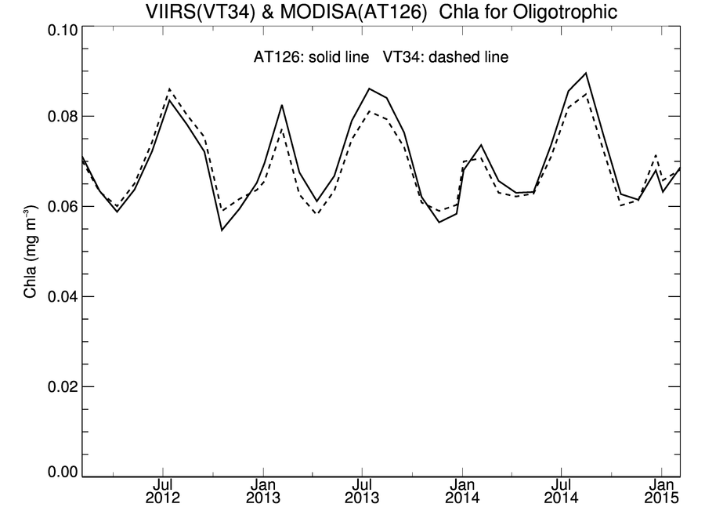
MODISA showing agreement with R2014.0 VIIRS Chlorophyll (OCI) Deep-Water Time-Series
MODISA & VIIRS R2014.0 Test Results
4-day means (not monthly)
VIIRS
 | Mean | Stdv
MODISA | 0.069 | 0.009 | mg m⁻³
VIIRS | 0.068 | 0.008 | mg m⁻³
VIIRS/MODISA | 0.99 | 0.04
MODISA

Slide 38
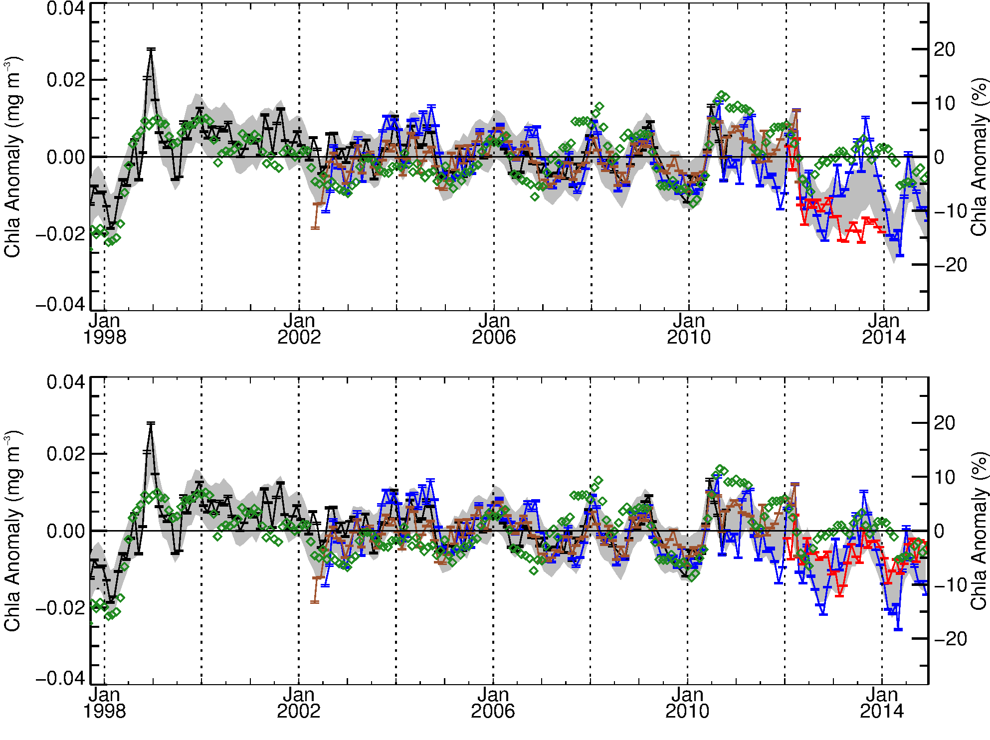
Global Mid-Latitude (+/- 40°) Chlorophyll Anomaly showing improved agreement of VIIRS with MODISA, MEI, and historical norms after R2014.0 reprocessing
Multivariate Enso Index (MEI)
VIIRS R2013.1
SeaWiFS
MERIS
MODISA
NASA VIIRS
calibration issue
resolved
Multivariate Enso Index (MEI)
VIIRS R2014.0
SeaWiFS
MERIS
MODISA
NASA VIIRS
Following Franz, B.A., D.A. Siegel, M.J. Behrenfeld, P.J. Werdell (2015). Global ocean phytoplankton [in State of the Climate in 2014]. Bulletin of the American Meteorological Society, submitted.

Slide 39
Possible Discussion Topics
questions about anything presented?
is VIIRS better than MODIS?
VIIRS Level-1A/B/GEO redesign
SeaDAS status
SeaBASS status
MERIS/GOCI/OLCI/SGLI/OLI status

