Slide 1


Combining Data Assimilation with an Algorithm to Improve the Consistency of VIIRS Chlorophyll:
Toward a Multidecadal, Multisensor Global Record
NASA ROSES 2013 NNH13ZDA001N-SNPP
2.1.3 Other New NASA Data Products from Suomi NPP Measurements
Watson W. Gregg, Principal Investigator
NASA Global Modeling and Assimilation Office
Cécile S. Rousseaux, Co-Investigator
NASA Global Modeling and Assimilation Office
Universities Space Research Association

Slide 2
Objective:
Use data assimilation and bias correction to produce
enhanced representations of VIIRS global ocean chlorophyll
A proposed Level 4 product

Slide 3
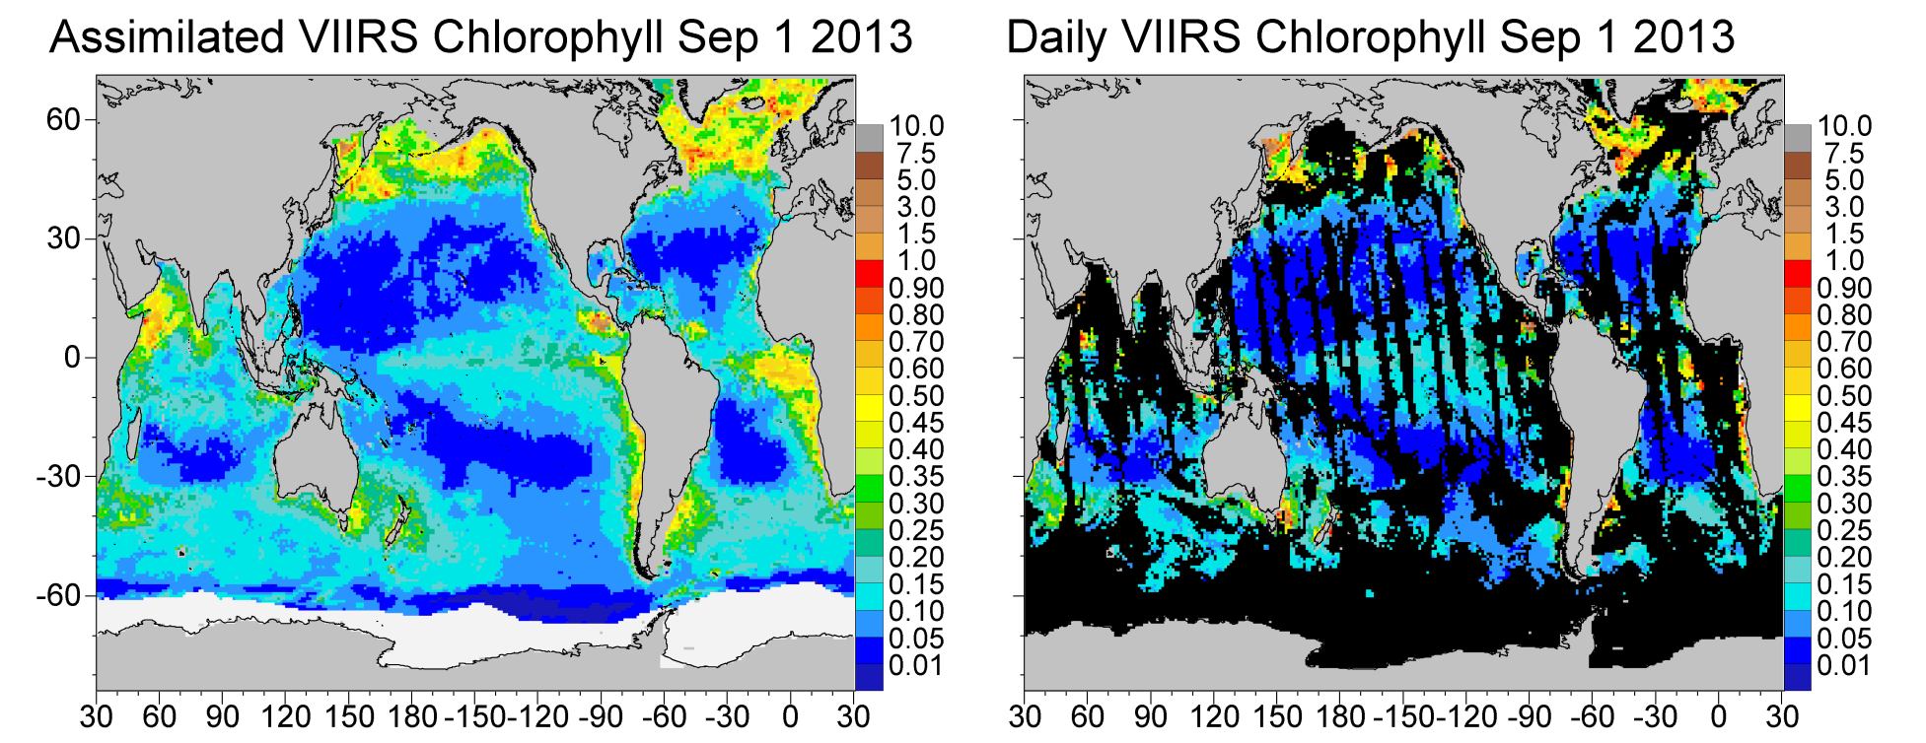
Daily Chlorophyll
Chlorophyll mg m⁻³
Ice fields are shown in white. Missing data in black.

Slide 4
VIIRS: v2015
Aqua: v2013
Chlorophyll mg m⁻³

Slide 5
Chlorophyll mg m⁻³

Slide 6
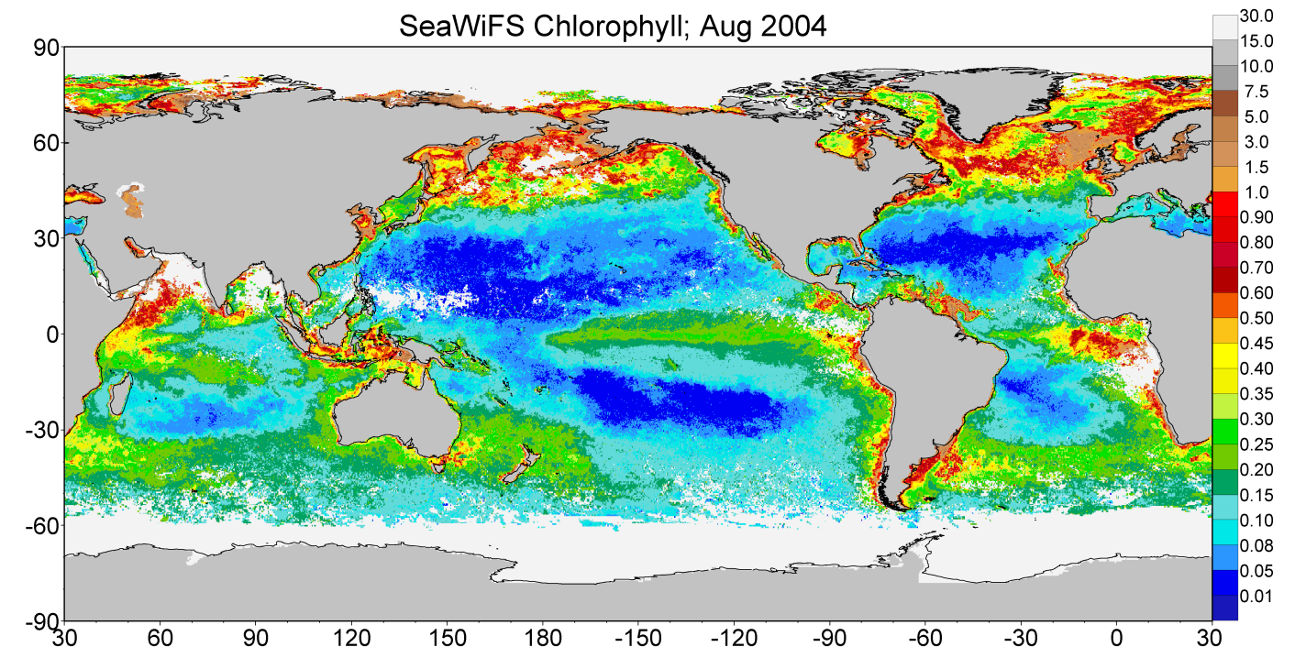
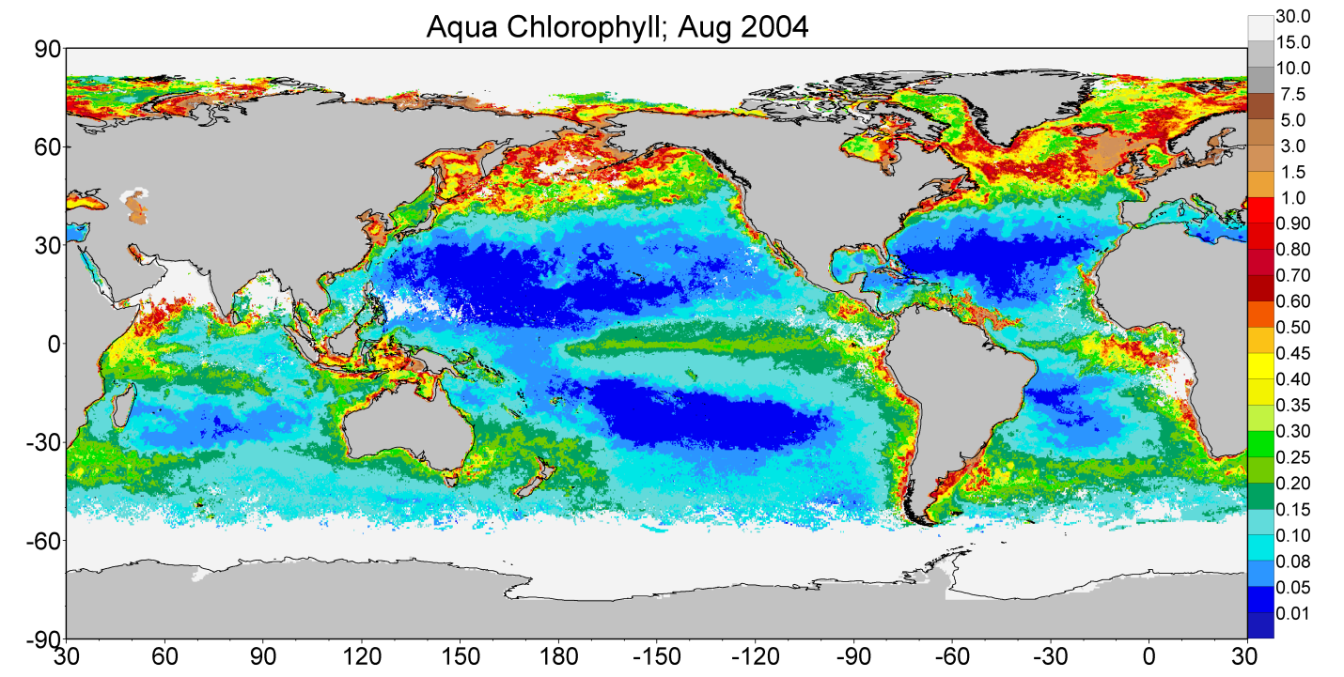
Chlorophyll mg m⁻³
Equatorial
Atlantic
North Indian
Antarctic
Differences in sampling between SeaWiFS (top) and MODIS (bottom) due to 1) aerosol masking in the North Indian and Equatorial Atlantic and 2) the Antarctic.

Slide 7
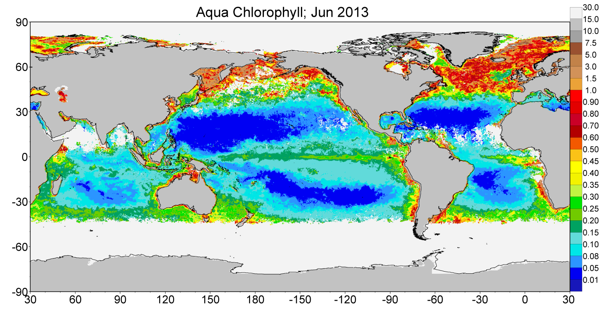
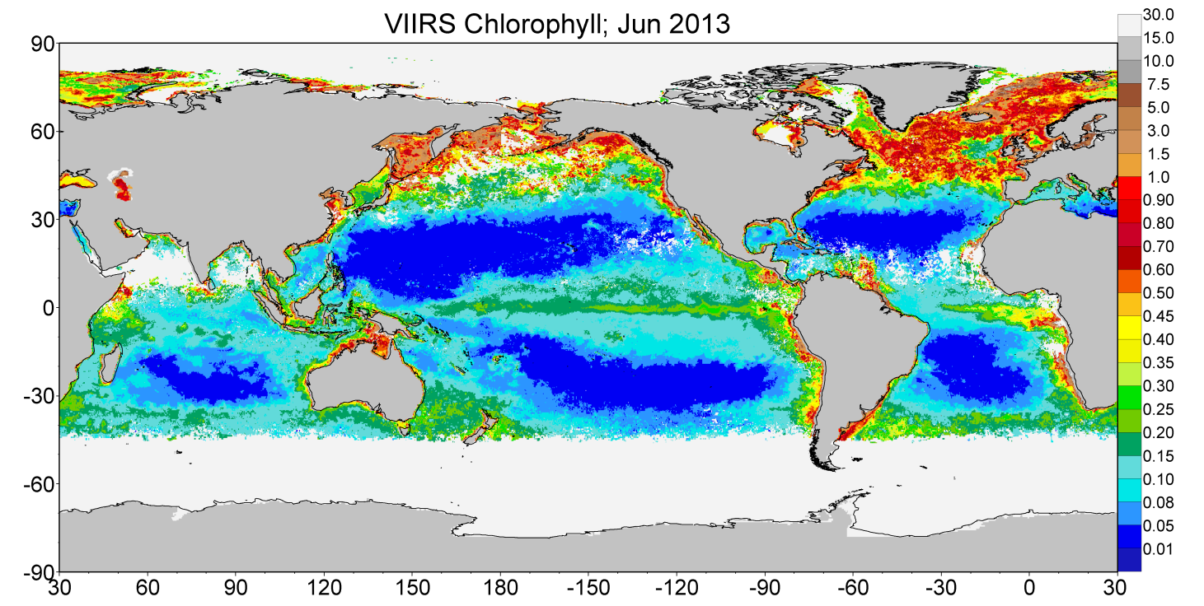
Chlorophyll mg m⁻³
North Central
Atlantic
North Indian
Antarctic
Differences in sampling between MODIS-Aqua (top) and VIIRS (bottom). The differences are smaller than between MODIS and SeaWiFS. Notice increased coverage by VIIRS in Southern Ocean.

Slide 8
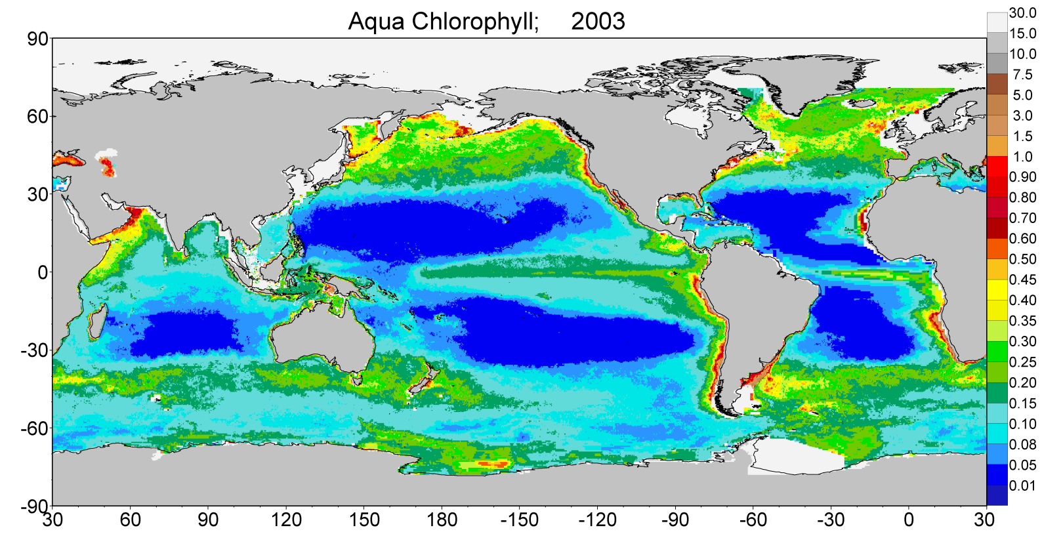
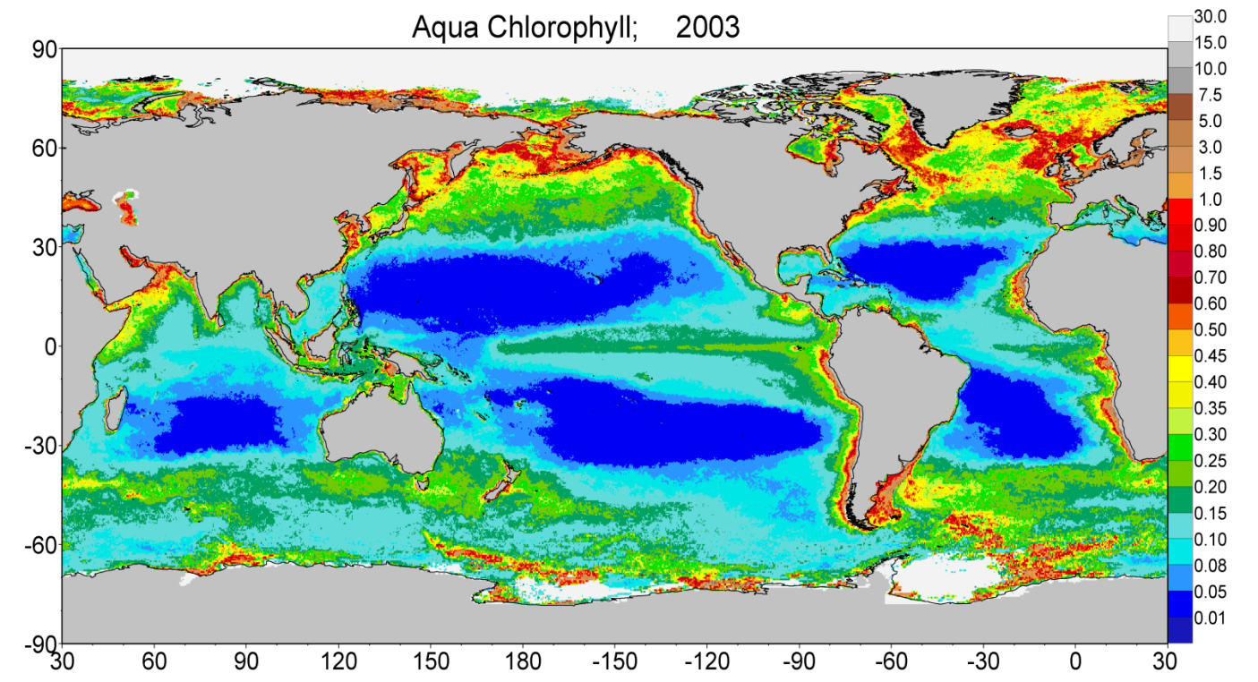
Assimilated
Global Annual
Median Chlorophyll
for MODIS-Aqua
Chlorophyll mg m⁻³
Global Annual
Median Chlorophyll
for MODIS-Aqua
Note the plumes of high chlorophyll in the Southern Ocean that are artifacts of sampling. Missing data along some continental shelves, which is due to the underlying model domain.

Slide 9
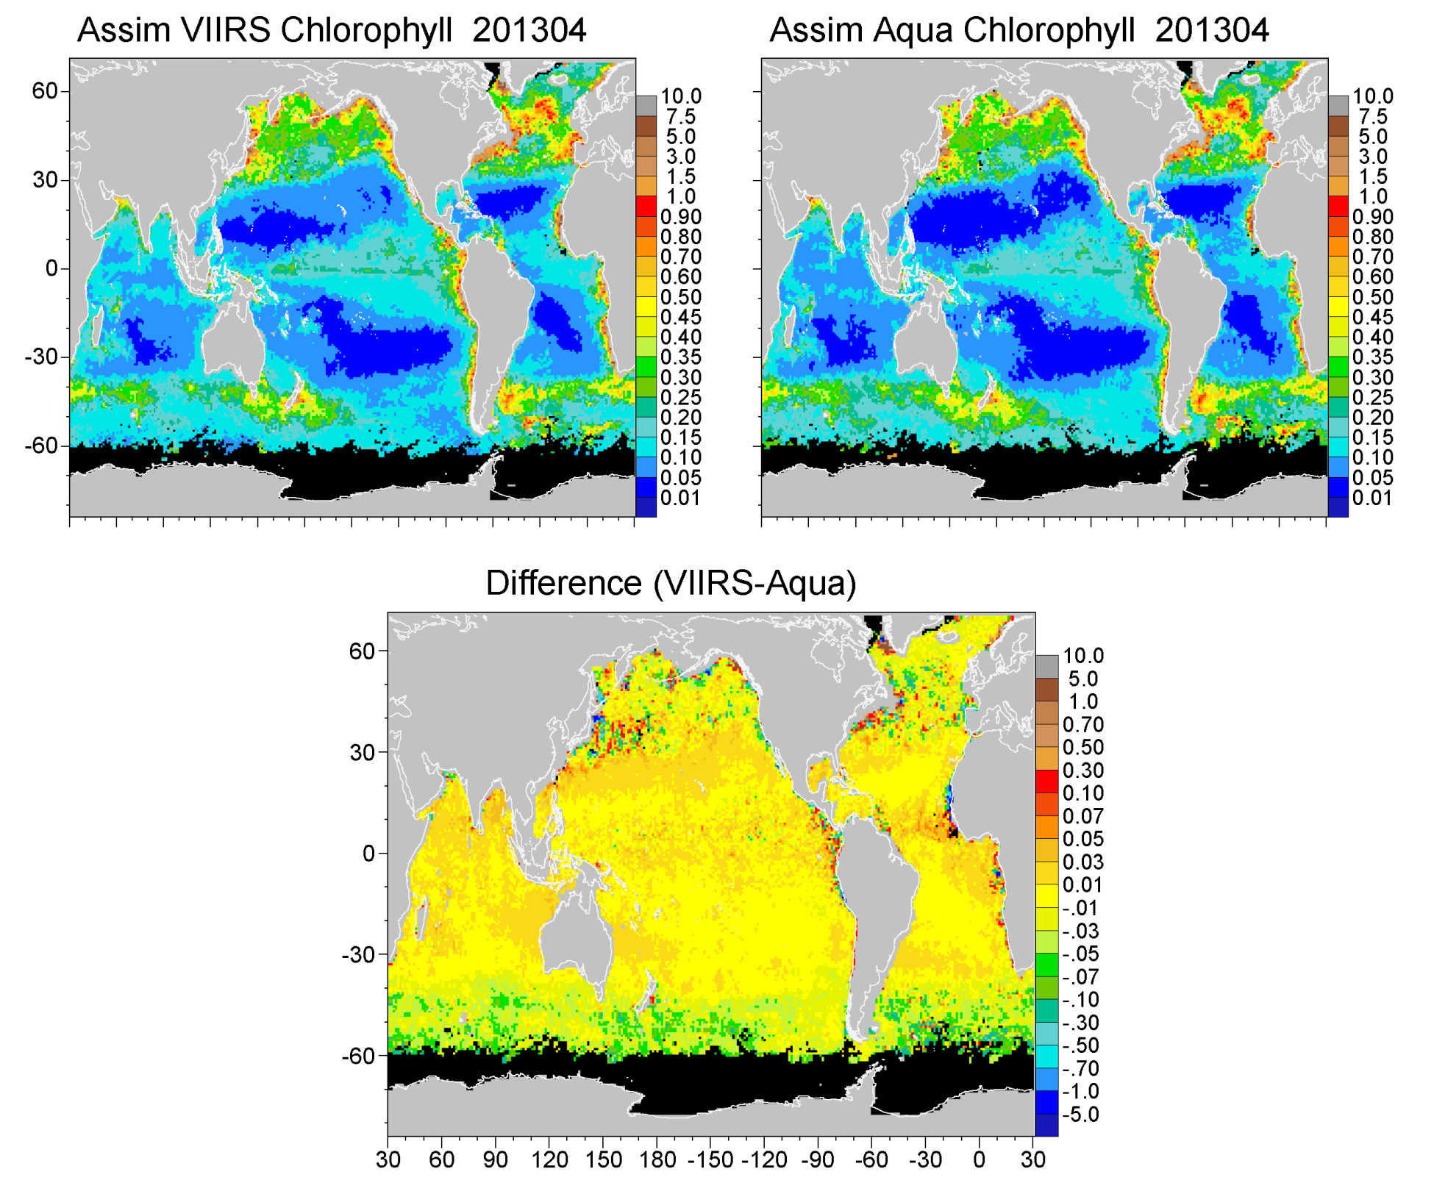
VIIRS April 2013 v2015 MODIS April 2013 v2013
Chlorophyll mg m⁻³
Chlorophyll mg m⁻³
Chlorophyll mg m⁻³

Slide 10
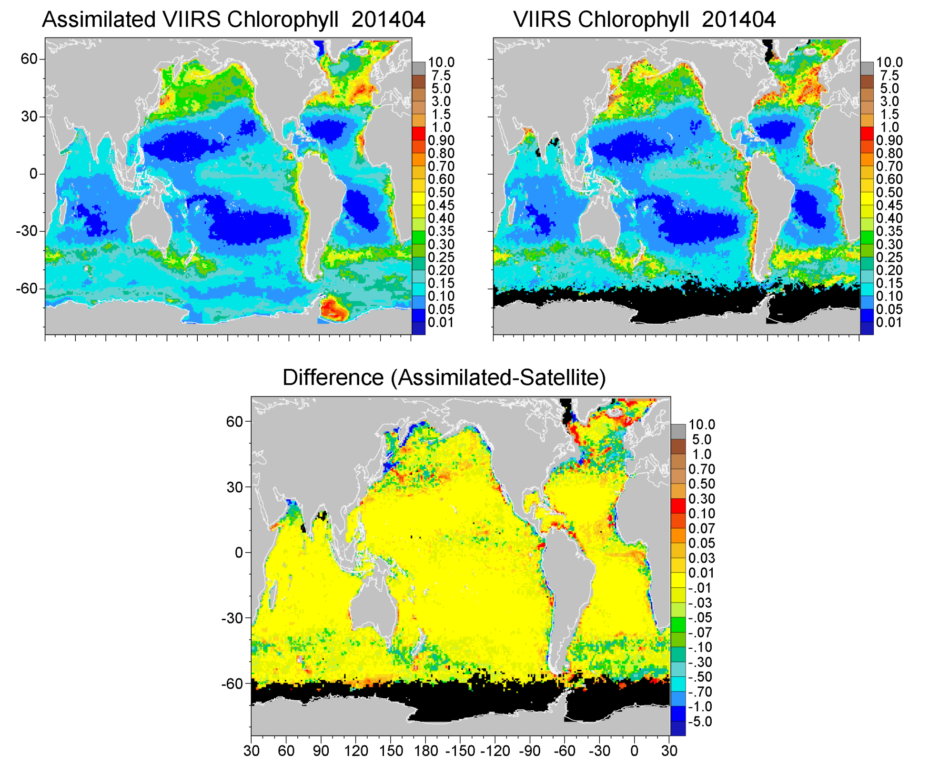
Chlorophyll mg m⁻³
v2015

Slide 11
Bias-Correction Using In Situ Chlorophyll Data
We use 3 archives:
NODC
SeaBASS
AMT
Quality checked using blended analysis (used for bias correction of
SST by the Reynolds methodology) for the period 2012-2014

Slide 12
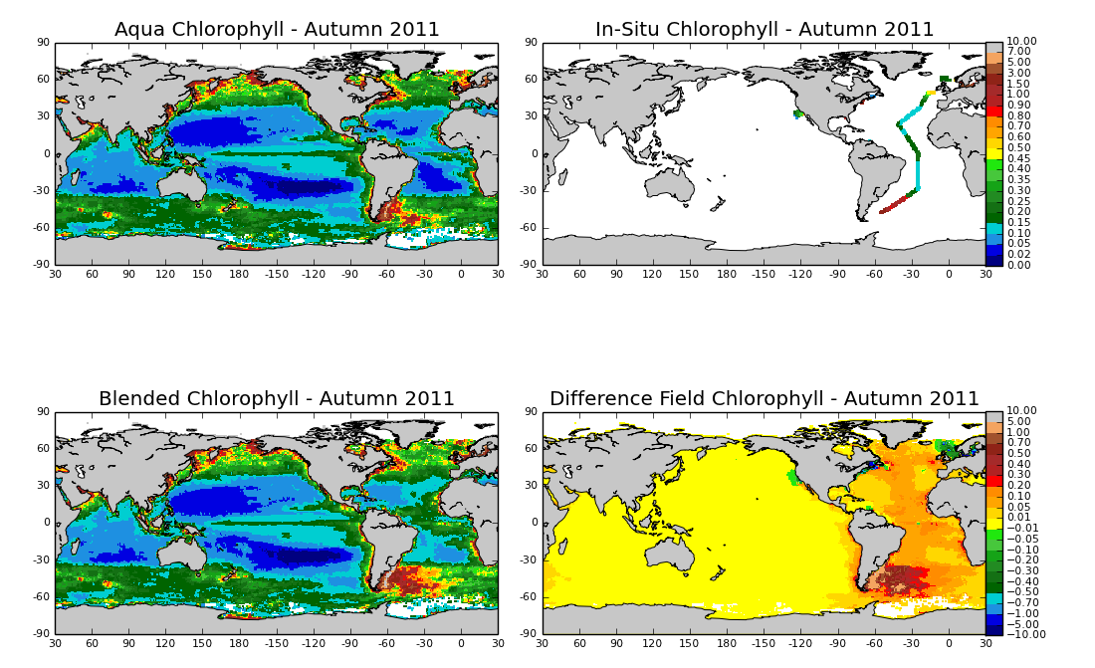
Chlorophyll mg m⁻³
After QC, we have 611 data points of chlorophyll for 2012-2014

Slide 13
Statistics for 2012-2014
Comparison with In situ Data
(Satellite-weighted; open ocean only)
Bias (Median% diff) Uncertainty (SIQR) N
MODIS-Aqua v2013: 5.0% 23.3% 140
VIIRS v2015: 23.8% 27.6% 158
(for 2002-2009 we had 1757 data points matchups for MODIS)

Slide 14
Gregg and Rousseaux, JGR-Oceans 2014

Slide 15
Plans
Obtain more in situ data
Obtain new MODIS-Aqua 2015 re-processing
Develop statistics; assess the need for bias correction
Begin discussions on how to implement Level-4
assimilated data products

