Slide 1
Analysis and Mitigation of Atmospheric Crosstalk
Kyle Hilburn
Remote Sensing Systems
May 21, 2015

Slide 2
Introduction
What is crosstalk?
When a retrieval algorithm aliases unrelated geophysical signals into the retrieval
Why is understanding crosstalk important?
Can mask important modes of variability (e.g., El Nino)
Can produce spurious trends on decadal time scales
What are primary crosstalk sources for IR SST retrievals?
Clouds, water vapor, aerosols
Why is quantifying IR SST crosstalk difficult?
Vapor is correlated with SST, and this correlation is a function of time scale
Vapor and cloud are correlated
Clouds have significant horizontal, vertical, and microphysical variability
Aerosols have a variety of radiative properties and lack unique spectral signature

Slide 3
Objectives
Develop a better understanding the effects of water vapor, aerosols, and clouds on VIIRS SST retrievals
Develop and implement two VIIRS SST algorithms
Physically parameterized statistical algorithm (PPSA)
Weighted least-squares algorithm, parameterized in terms of physical quantities
Tunable, like a statistical algorithm, by adjusting the a priori values and uncertainties
Combined VIIRS and AMSR2 algorithm
Uses AMSR2 in specifying a priori values and uncertainties
Additional cloud clearing based on AMSR2
Identifying and mitigating aerosol effects by comparing AMSR2 and VIIRS
Provide a characterization of uncertainties in SST retrievals

Slide 4
Preliminary Results
Downloaded SDR data from VIIRS SIPS FTP at University of Wisconsin Space Science and Engineering Center
SVM12, SVM13, SVM15, SVM16, GMTCO
Does cloud clearing require other channels?
One granule = 52 MB
One day = 52 GB
One year = 19 TB
Our project will be delivering software to VIIRS Ocean SIPS to run the SST algorithms
Is this the dataset I should be using for algorithm development?
Also using RSS AMSR2 retrievals of SST, wind, vapor, cloud, and rain
Data available at www.remss.com
Resolution: twice daily, 0.25-deg grid
Validation of AMSR2 SST: Gentemann and Hilburn, 2015, JGR-O, accepted
Intercomparison of RSS and JAXA calibrations: Hilburn and Gentemann, 2015, JGR-O, submitted
Note: VIIRS starts October 2011, AMSR2 starts July 2012

Slide 5
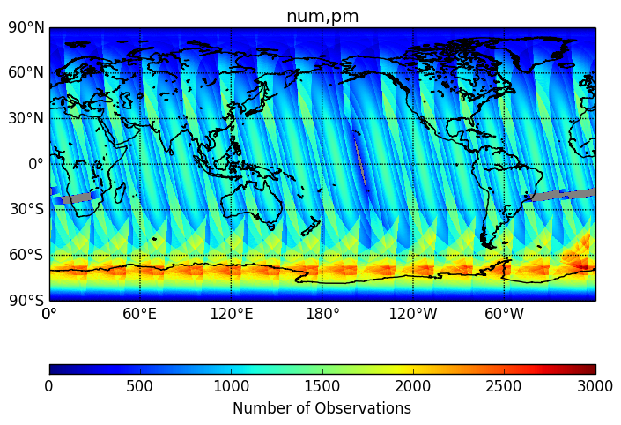
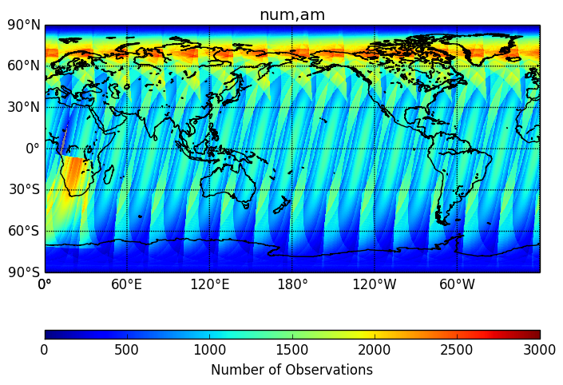
Sampling Patterns
Maps show the number of observations falling in 0.25-deg Earth grid, for one day, separated local AM/PM
VIIRS resolution = 0.7 km
Thus, in the swath center the typical number of observations is
25 km (1440 x 720) gives 1225 obs
12.5 km (2880 x 1440) gives 289 obs
9 km (4096 x 2048) gives 144 obs
5 km (7200 x 3600) gives 49 obs
Sampling patterns are complicated along swath edges because
Adjacent passes overlap (increases number of observations)
Mitigation of bow-tie effect (decreases number of observations, for two distinct scan angle ranges)
To handle the TB-scale data volume, our project is to use VIIRS files that are pre-processed onto Earth grids
Is there compelling reason to chose particular grid resolution?
Since Earth zenith angle increases with scan angle, is there a maximum scan angle beyond which retrieval is not advisable?
Avoid high latitude overlap by making each map one orbit?

Slide 6
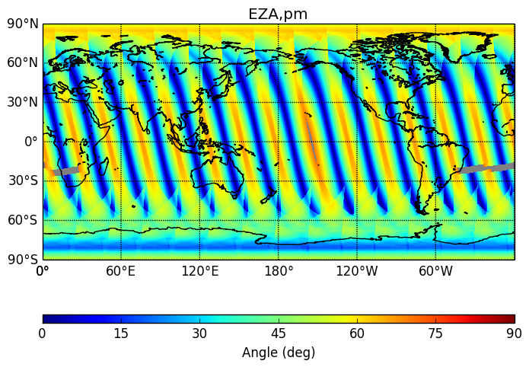
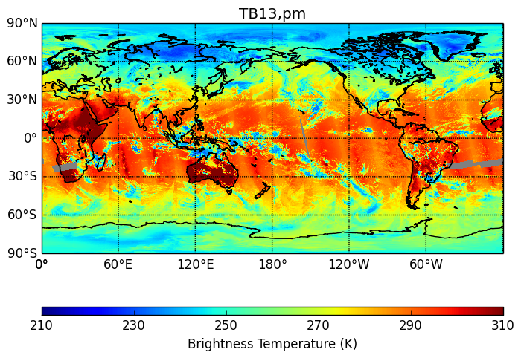
Viewing Geometry
The Earth zenith angle varies from 0 deg at swath center to 70 deg at swath edges
At swath edge, path through atmosphere is 2.9 x longer than swath center
At 4.05 micron there is clear zenith angle dependence
Warmer at zenith angles of 0 deg
Cooler at zenith angles of 70 deg
4.05 micron

Slide 7
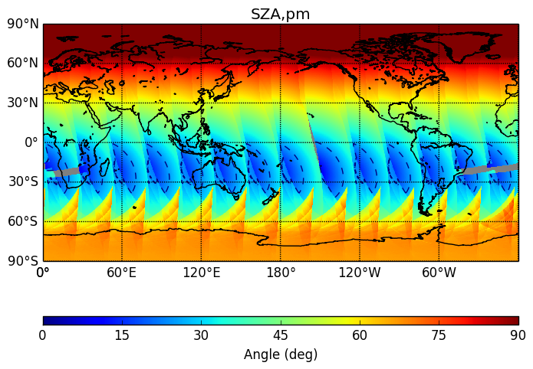
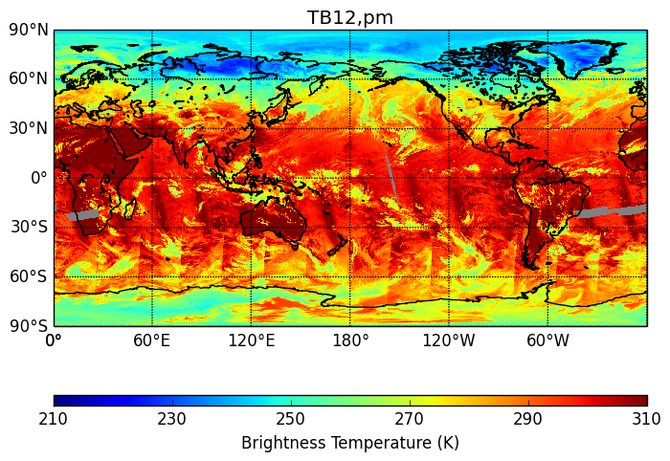
Solar Geometry
Areas with solar zenith angle less than 25 deg are highlighted with dashed contours
These correspond to hot areas in the 3.70 micron TB
Would be preferable to examine sun-glint angle, which is angle between sun reflection vector and boresight vector
3.70 micron

Slide 8
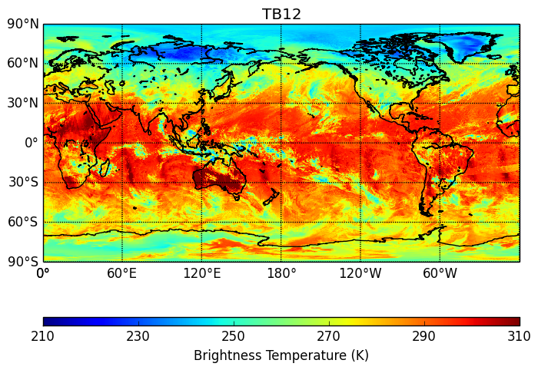
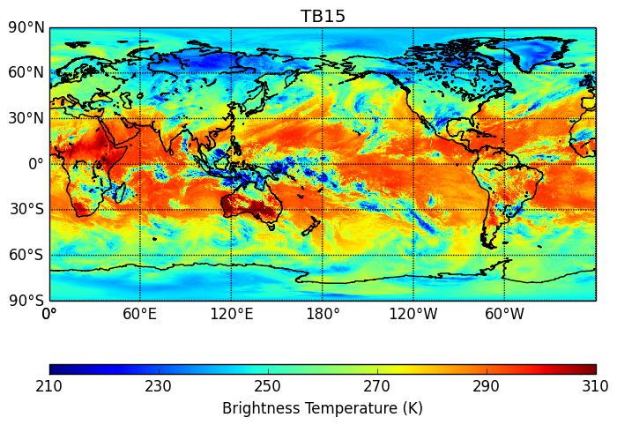
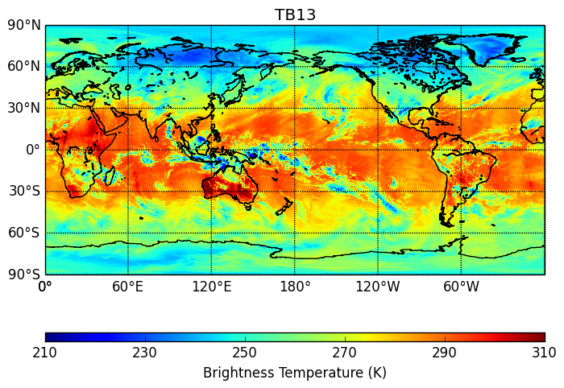
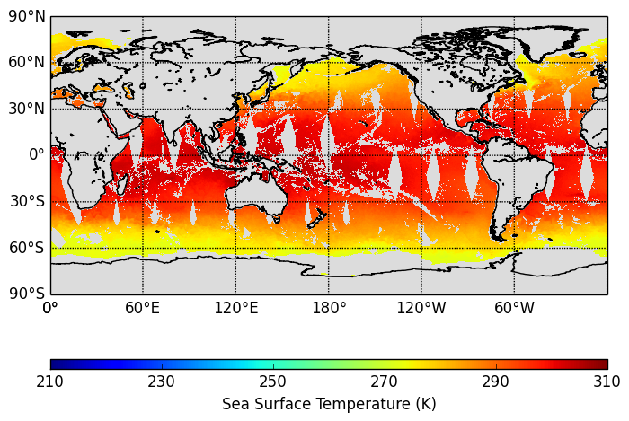
Daily Average TB
3.70 micron
10.76 micron
Temperatures range from about 260 K over high-latitude ocean to 300 K over tropical ocean
Areas with TB below 250 K are tall clouds with cold cloud tops, and are most prominent in longer wavelengths
The 3.70 micron channel most closely resembles SST
4.05 micron
12.01 micron
AMSR2 SST
Daily average VIIRS TB from 2015/01/01

Slide 9
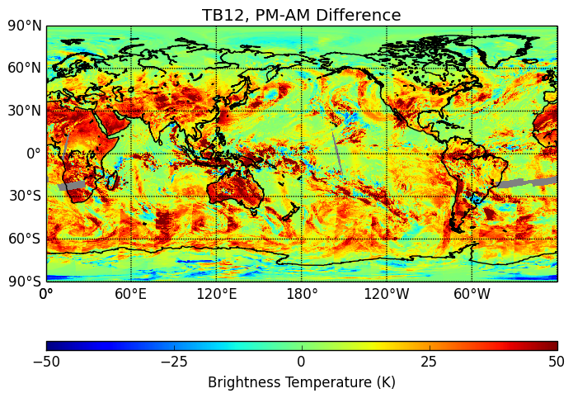
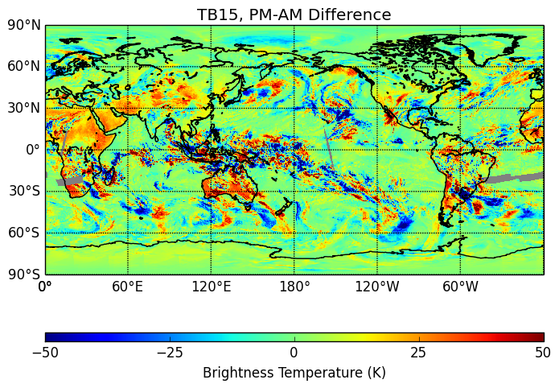
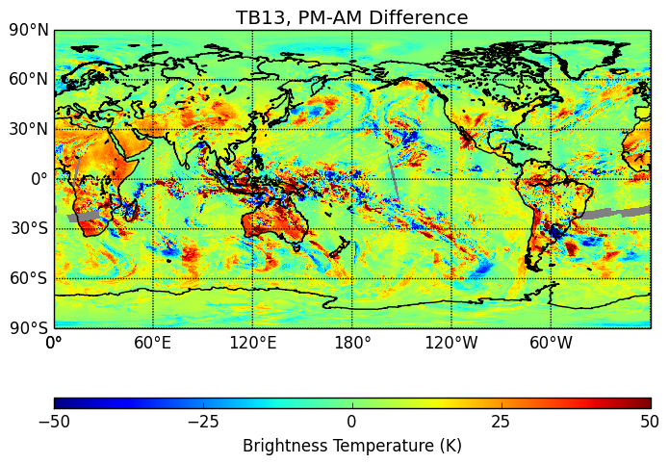
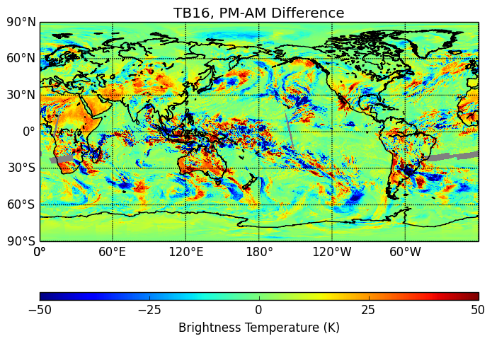
PM-AM TB Difference
3.70 micron
10.76 micron
VIIRS on Suomi NPP satellite has ascending node time of 1:30 PM
Over land, the increase in temperature from morning to afternoon is strongest at 3.70 micron, indicating the largest surface contribution
3.70 micron also has large (20-30 K) positive PM-AM differences over Southern Ocean – this example is from January: sun reflection
Diurnal differences are on the order 10-20 K at 4.05 micron and are 10 K or less for 10.76 and 12.01 micron
4.05 micron
12.01 micron
PM-AM (LT) VIIRS TB from 2015/01/01

Slide 10
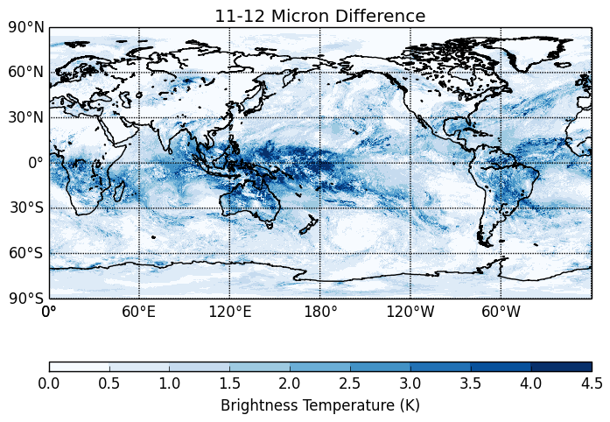
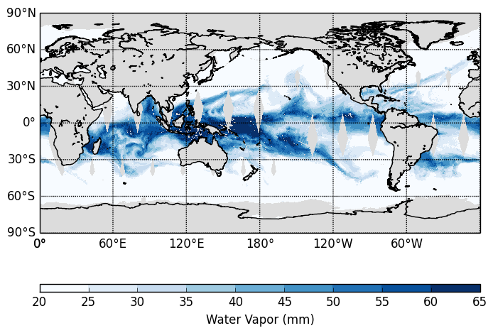
11-12 Micron TB Difference and Vapor
Overall, there is a positive correlation between the VIIRS TB difference (top) and AMSR2 total columnar water vapor (bottom)
This is most evident in the western tropical Pacific
Other areas with abundant water vapor, like the eastern tropical Pacific and Indian Oceans have a smaller TB differences
In some areas, like the tropical Atlantic, larger TB differences can be found outside of high vapor areas
Plumes of vapor that extend into mid-latitudes are sometimes evident in TB difference (north Atlantic), and other times not (northwestern Pacific)

Slide 11
Summary and Conclusions
Performed initial exploration of VIIRS data and comparison with AMSR2
There is a clear SST signal in VIIRS TBs
There is also a clear signal from clouds
Large TB-SST differences occur where water vapor is abundant
Large differences also can occur where vapor is low
Suggests that effective air temperature also plays important role
The relationship between 11-12 micron TB diff and vapor varies by region
First order of business: to produce gridded VIIRS TB with clouds cleared
Q/C: sun glint, TB bounds check, scan angle threshold, number of obs threshold
Maps should also include time and Earth zenith angle

